Slide 1
New service board
The LHCb muon I2c long-line protocol using GBT-SCA and IGLOO2
LHCb Upgrade Electronics
P. Fresch, V. Bocci

Slide 2
Index:
Introduction to the muon ECS
The Front-End boards control link
The GBT link implementation in the ECS upgrade
The I2C protocol converter
Microsemi® IGLOO2® HW description and features
Test on the LHCb apparatus
Quick check test with miniDAQ
Status of the prototypes and IGLOO2 HDL-code
Conclusions

Slide 3
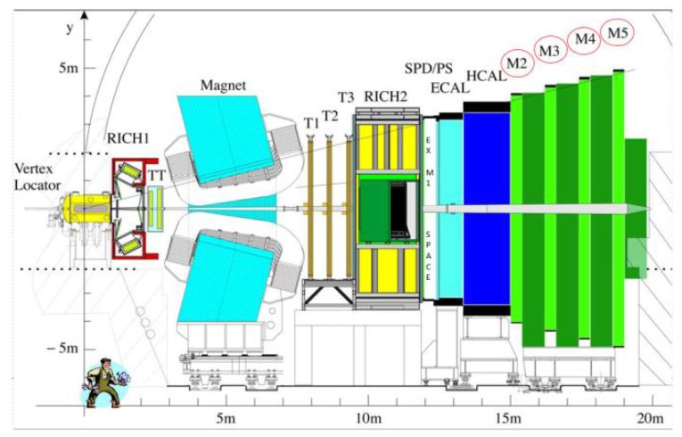
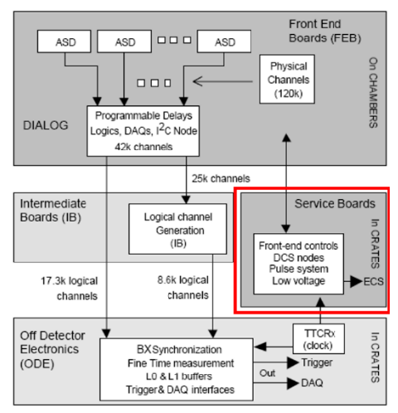
Introduction to the muon ECS
1000 chambers
100’000 physical channel
7000 Front-End boards
The front-end boards have control registers that can be set for tuning and monitoring purposes. A Service Boards System is in charge of proving to the ECS the access of these configuration map.
V. Bocci - Architecture of the LHCb muon Frontend control system upgrade

Slide 4
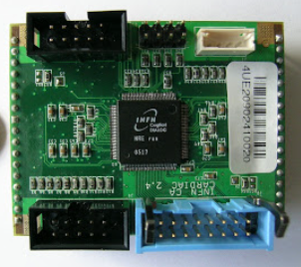
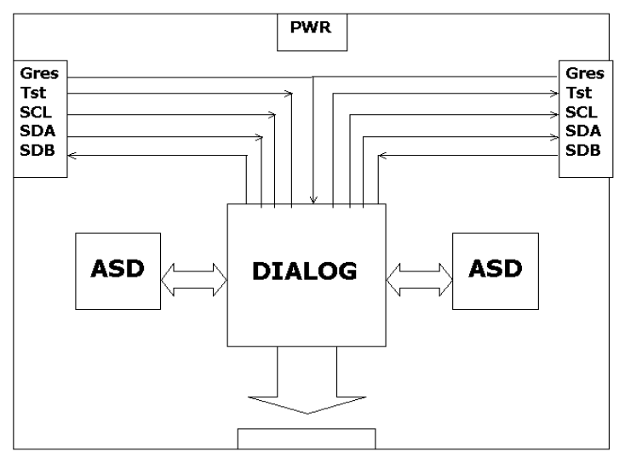
The Front-End boards control link
The tuning and debugging operations are carried out by the DIALOG chip
93 memory-mapped registers are used to set the operation mode of this chip
The registers are accessed following the protocol of standard I2C RAM device (e.g. writing frame below)
The Front-End boards are positioned at >10m away from the Service Boards system crates, a standard I2C bus is not the best solution
To overcome signal degradation commercial I2C bus-extender were available but not possible to use in a radiation environment
On other hands LVDS rad-tolerant chips and IP were present
It has been chose to split the bidirectional Serial Data wire in two LVDS-based unidirectional lanes
V. Bocci, G. Chiodi, F. Iacoangeli, F. Messi, and R. A. Nobrega - The Muon Front-End Control Electronics of the LHCb Experiment
S. Cadeddu, V. De Leo, C. Deplano and A. Lai - Dialog 1.0 Datasheet

Slide 5
The Front-End boards control link
+VDD
Rp
The standard I2C requires the bus wires to be in a wired-or configuration. Thus an interface write and read on the same wire and all the slaves share and senses the same physical wire.
WiredOR
Sxy
Splitting the single wire (Sxy) on two different lanes (Txy and Rxy) allowed the use of the LVDS standard. It requires an end-to-end connection (avoiding Multipoint LVDS). The serial clock line requires one lane only because is a single master configuration
I/O
Thus the slaves are connected in a daisy chain fashion and do not share and sense the same physical lane. This requires a particular management (at the moment carried out by a dedicated uP-based rad-tol board)
Rxy_p
Txy_p
Rx LANE
Rxy_n
Txy_n
Tx LANE
Txy_p
Rxy_p
Tx LANE
Txy_n
Rxy_n
Rx LANE
previous
DIALOG INTERFACE
next

Slide 6
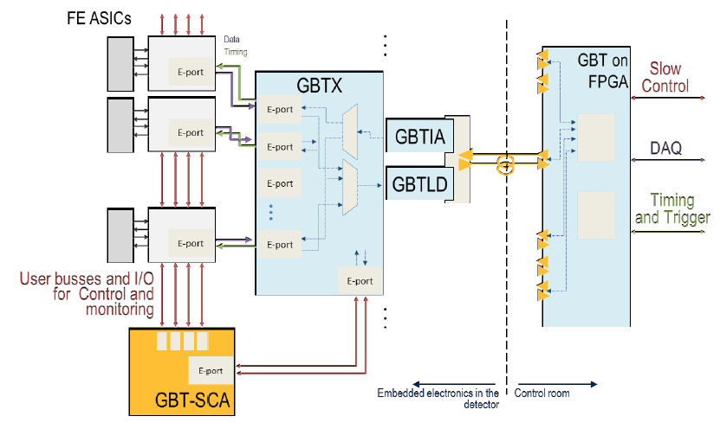
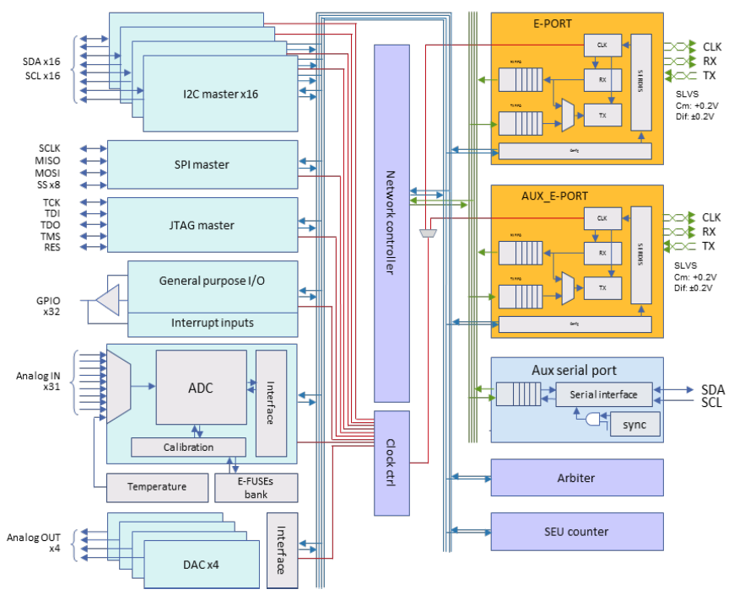
The GBT link implementation in the ECS upgrade
The GBT link project provide 16 I2C master in the Slow Control Chip whose aim is exactly providing an interface between the custom Front-End of the experiments and the custom GigaBit Transmission link for monitoring and debug purposes.
Muon control Room
(online PC)
Front-End
(DIALOG)
At logical level, the LVDS-based link is exactly equal to the I2C. A standard I2C master might be able to drive the bus. The idea is to provide to the GBT-SCA I2C interface the possibility to communicate on the custom bus and provide the access to the DIALOG chip on Front-End boards by the means of the GBT link.
A. Caratelli, C. Paillard, K. Kloukinas, S. Bonacini, A. Marchioro, P. Moreira, R.De Oliveira – The Slow Control Adapter for the GBT system USER MANUAL

Slide 7
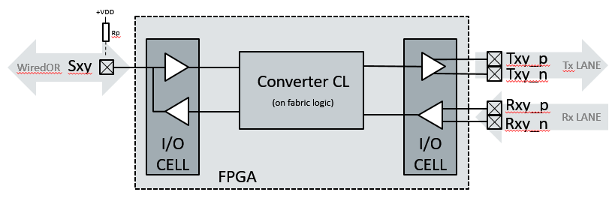
The I2C Protocol Converter
Considering this property of the bus, an FSM is required for a partial parsing of the messages on the I2C bus that acts on the hardware and permit the communication in both directions:
When the master has the control of the bus, the data flow is from the master to the slave(s) (from left to right in the picture above). After the 8th bit it release the bus and wait for the slave to acknowledge the transaction
Serial Clock Line
When the slave as the control the data are flowing from the slave(s) to the master (from right to left in the picture above). After the 8th bit it release the bus and wait for the master to acknowledge the transaction
Serial Clock Line
If the sense of the data flow is not correctly managed the communication fails. The Converter Combinatory Logic senses the actual frame and acts correspondingly. It is synchronized with the I2C Serial Clock Line that is then buffered on the dedicated LVDS lane to reach the slaves.

Slide 8
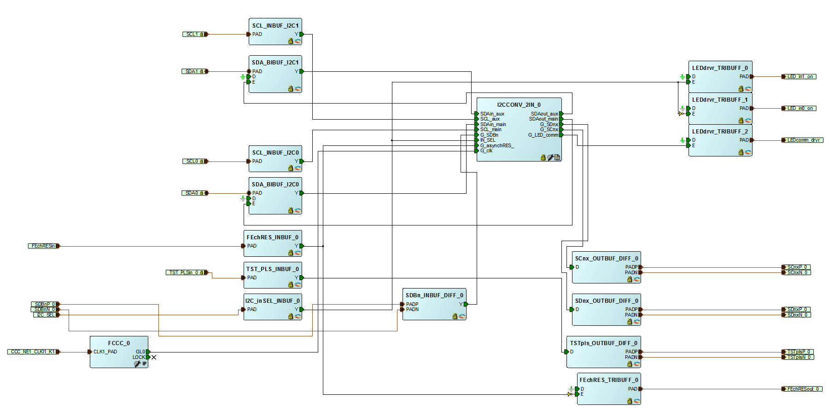
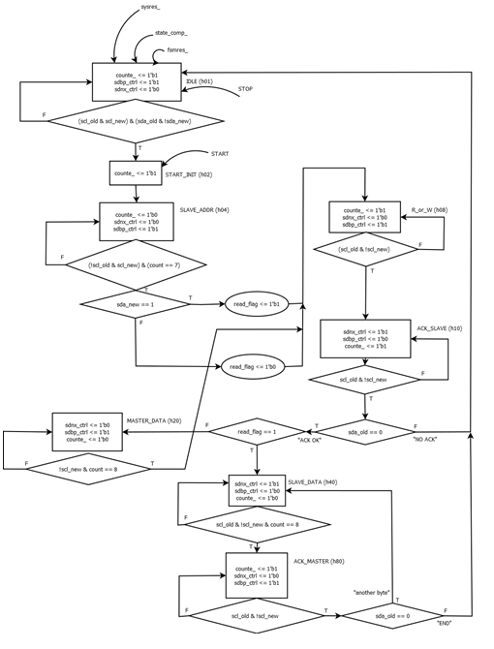
The I2C Protocol Converter
One I2C protocol converter is employed for each Front-End channel
The converter has two input source for debugging purposes

Slide 9
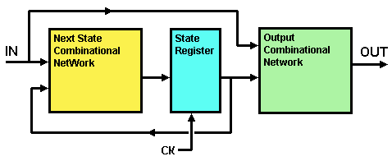
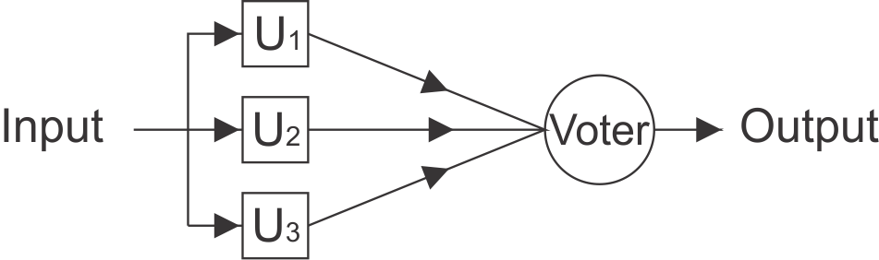
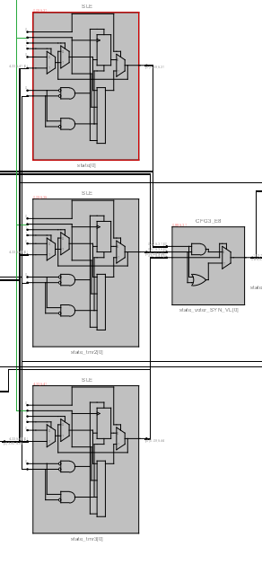
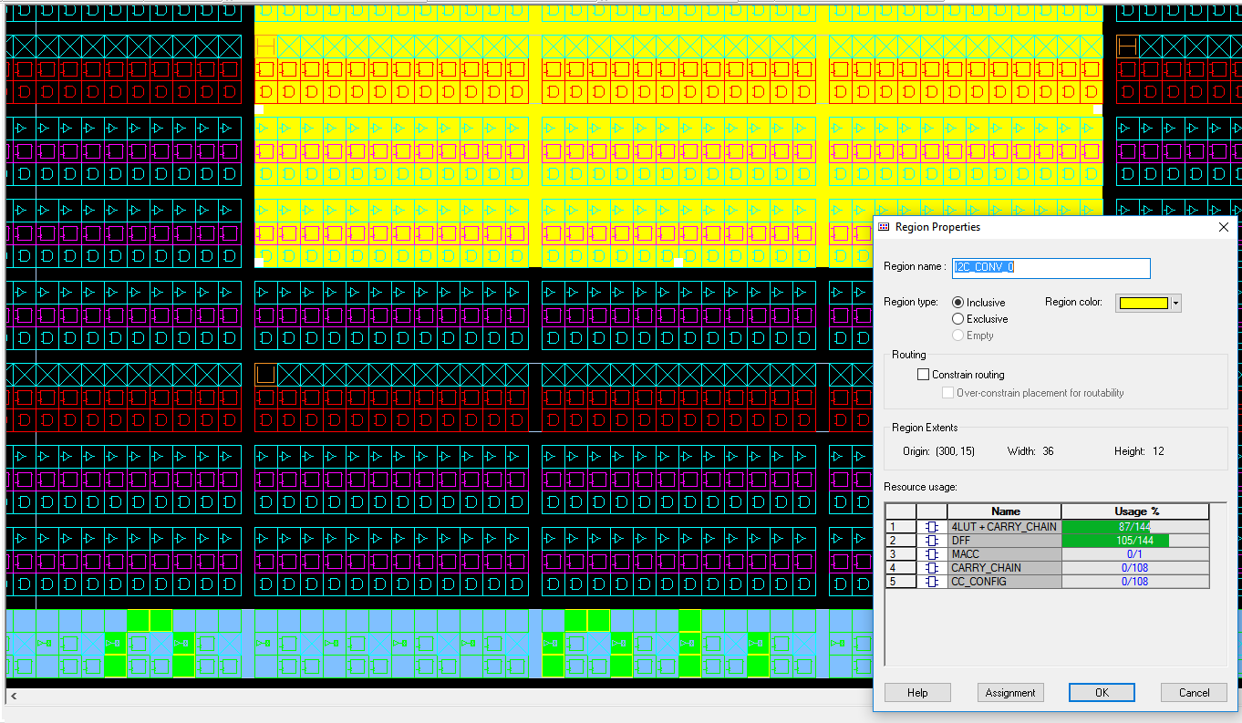
The I2C Protocol Converter
The FSM has a Mealy architecture
The state register (and all te other register of the FSM) are TMR protected
The TMR is implemented by a synthesis directive
The total usage is <140 cells (4 input LUT + 1 FF)
We expect to fit all the 12 FSM required in 10% of the chip

Slide 10
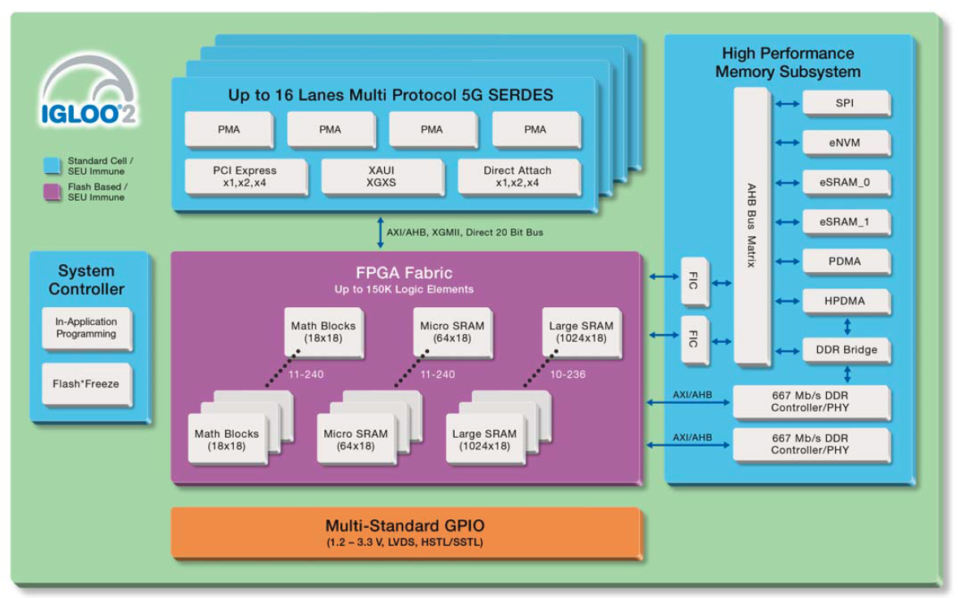
Microsemi® IGLOO2® HW description and features
4 input Look-Up Table (LUT) Single Event Upset (SEU) Immune implemented with Zero FIT FPGA Configuration Cells
High Performance Memory Subsystem on AHB with SECDEC enable/disable feature to protect eSRAM and eNVM data
Multi-Standard GPIO with native LVDS
The FSM registers are protected by Triple Mode Redundancy automatically implemented using Symplify compiling directives
Versatile and reliable platform for further logic development
Microsemi® - IGLOO2 FPGAs Product Brief

Slide 11
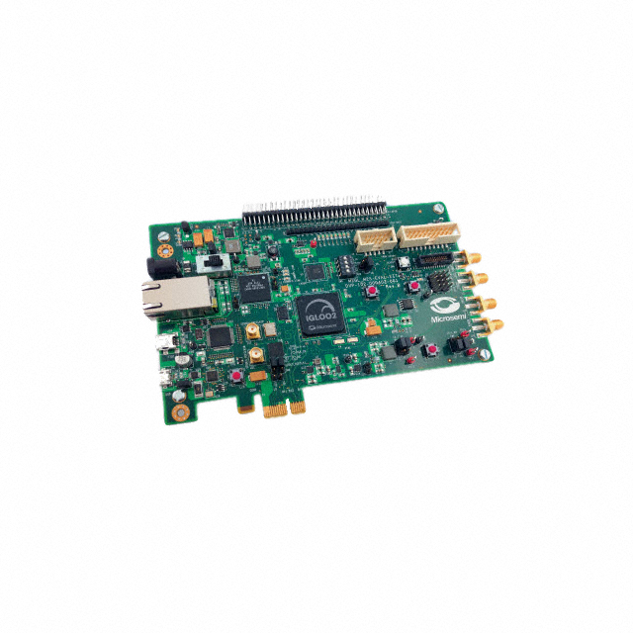
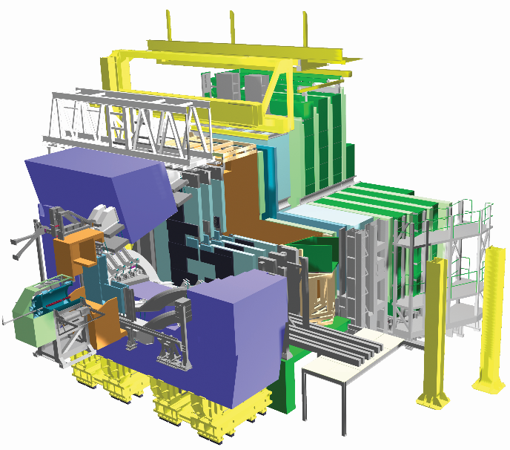
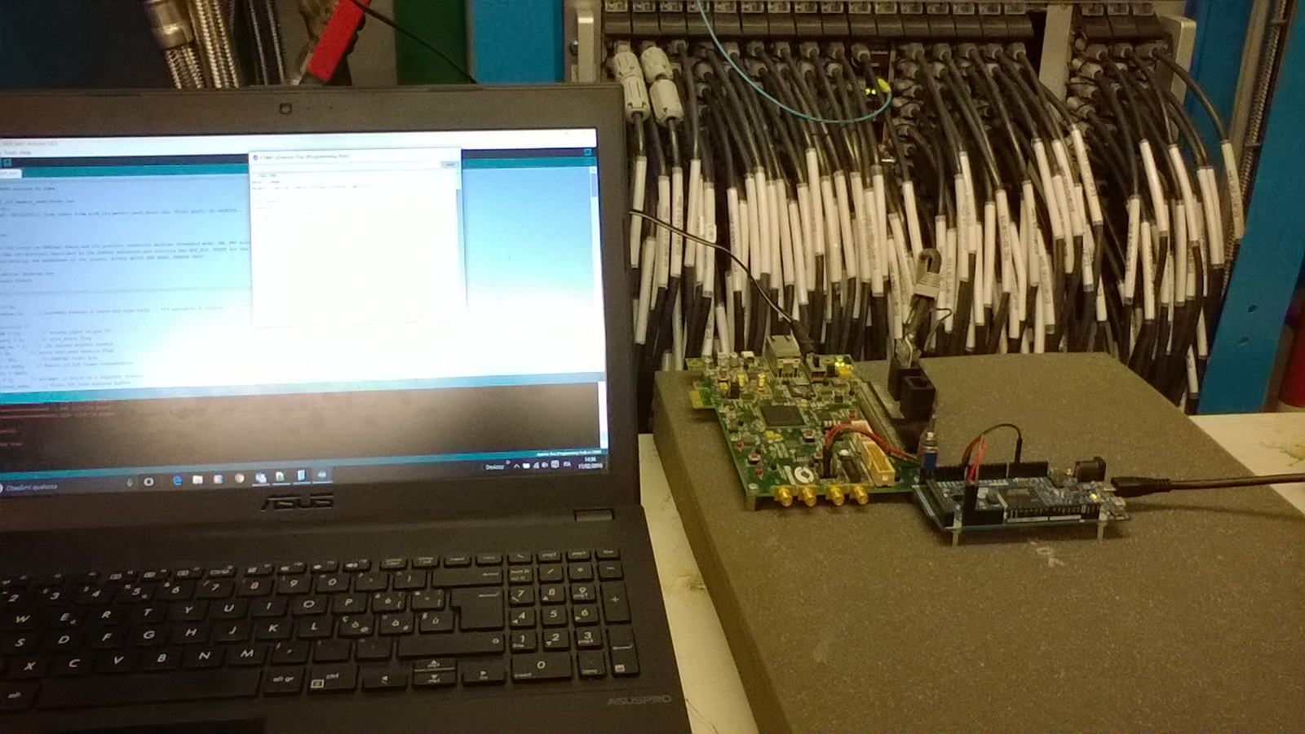
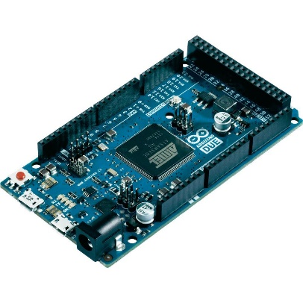
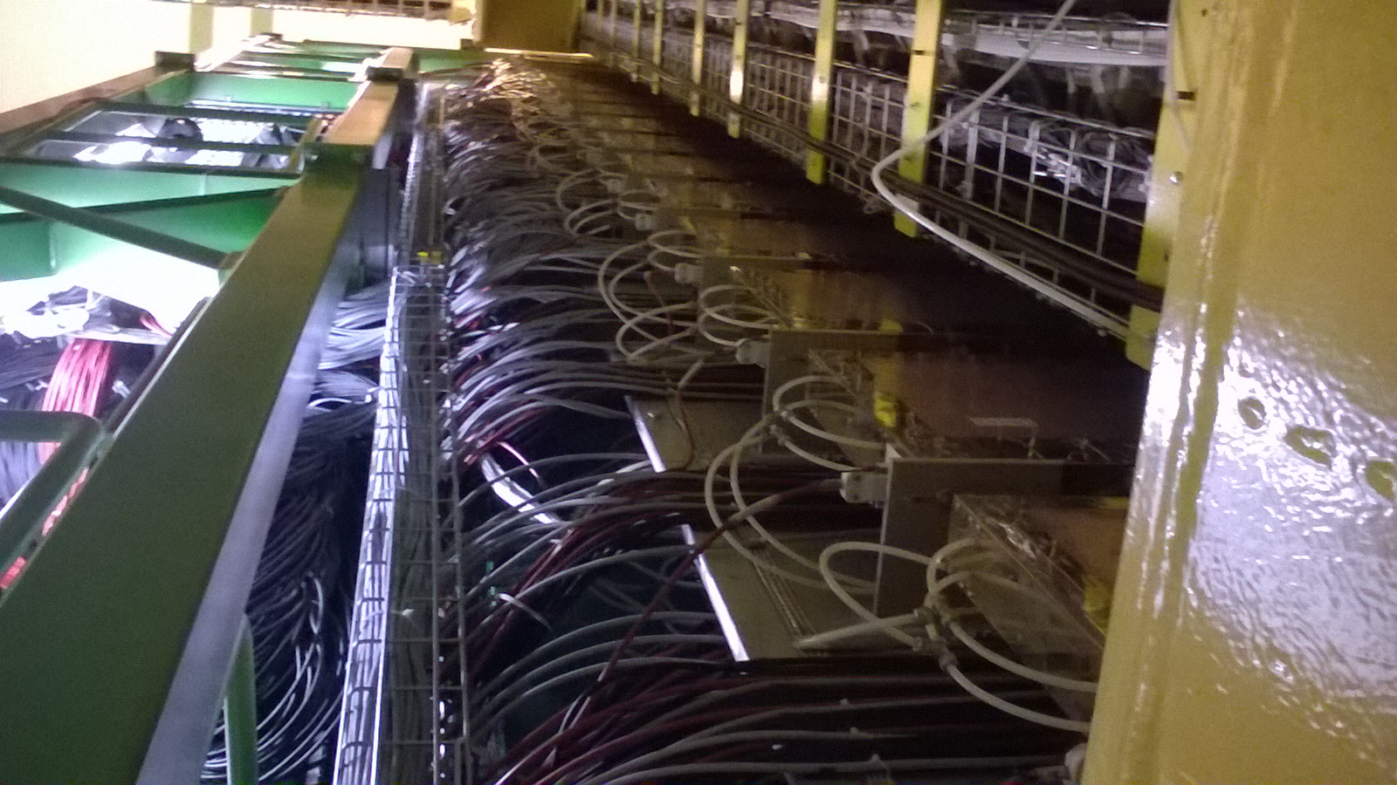
Test on the LHCb muon detector
I2C
Protocol Converter
IGLOO2 FPGA
SCnx
…
SDnx
SDBp
FE daisy chain
BUS
SCL
SDA
Standard I2C Master
Arduino Due
IT IS WORKING!!

Slide 12
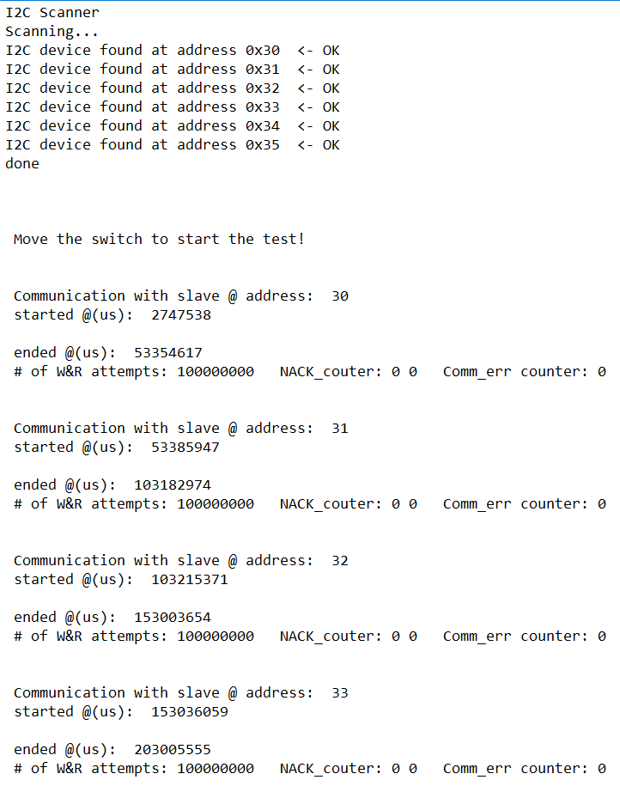
Test on the LHCb muon detector
Communication test have been done on a bus of FE connected through a 26m-long cable (the longest, worst condition)
The same register has been written and read at full speed (1 Mbps) for 100’000’000 times. Two known sample byte have been used alternatively and checked at each iteration, looking for errors on communication/elaboration on each FE (DIALOG chip) belonging to the bus (6 devices)
In the end a total amount of about 1,2GB of data have been exchanged (>13 hours) without any error (do not refer to the @(us) time stamp!). To completely reconfigure and check the entire system less than 2.5 MB are required

Slide 13
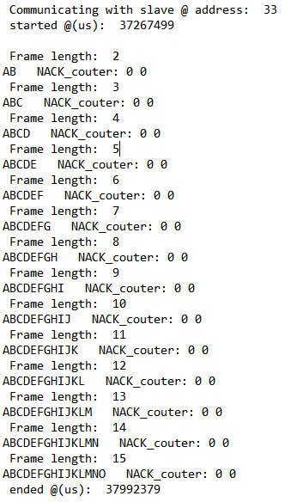
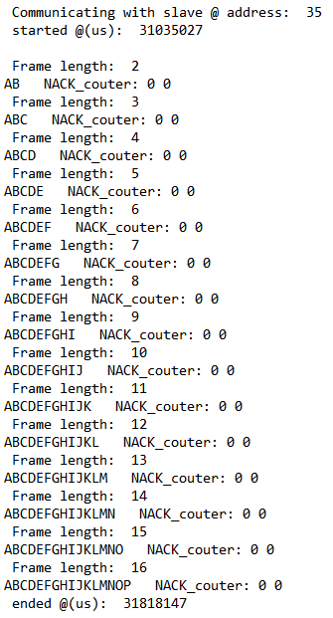
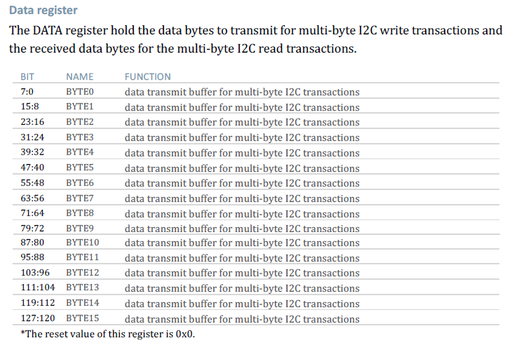
Test on the LHCb muon detector
The SCA I2C transmission buffer max size is 16 Byte:
Let’s test if the DIALOG can do that:
W&R from add 0x00 to 0x0E
W&R from add 0x14 to 0x23
[*] “GBT-SCA: THE SLOW CONTROL ADAPTER ASIC FOR THE GBT SYSTEM - User Manual” v.7
A maximum of 16 byte can be exchanged in a single write or read I2C frame
All the DIALOG on the I2C LVDS bus were tested with success. All the possible frame size have been used. Data varied from 0x41 to 0x50 (ASCII “A”to”P”)

Slide 14
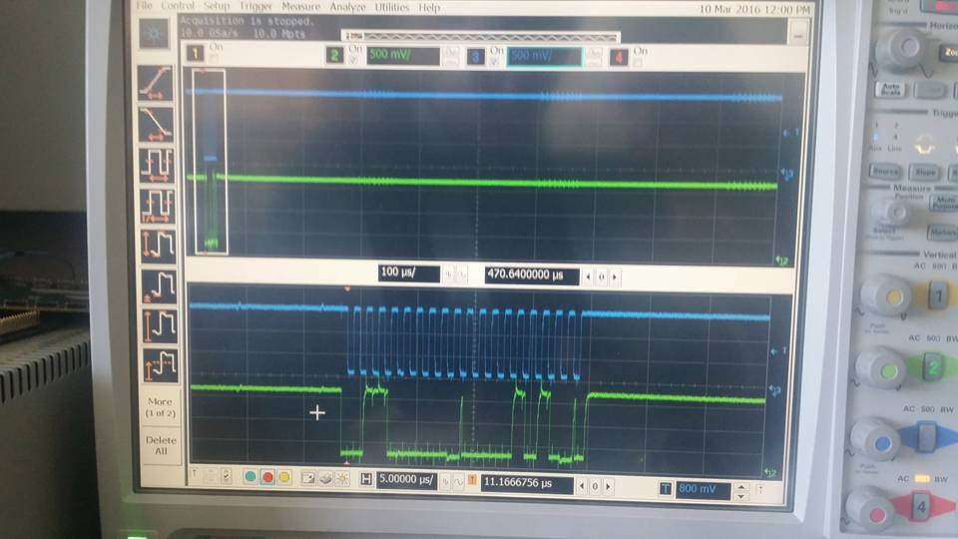
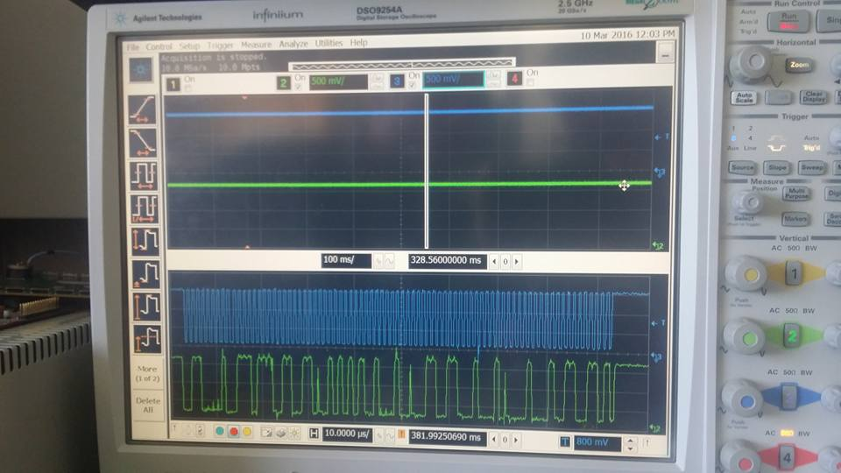
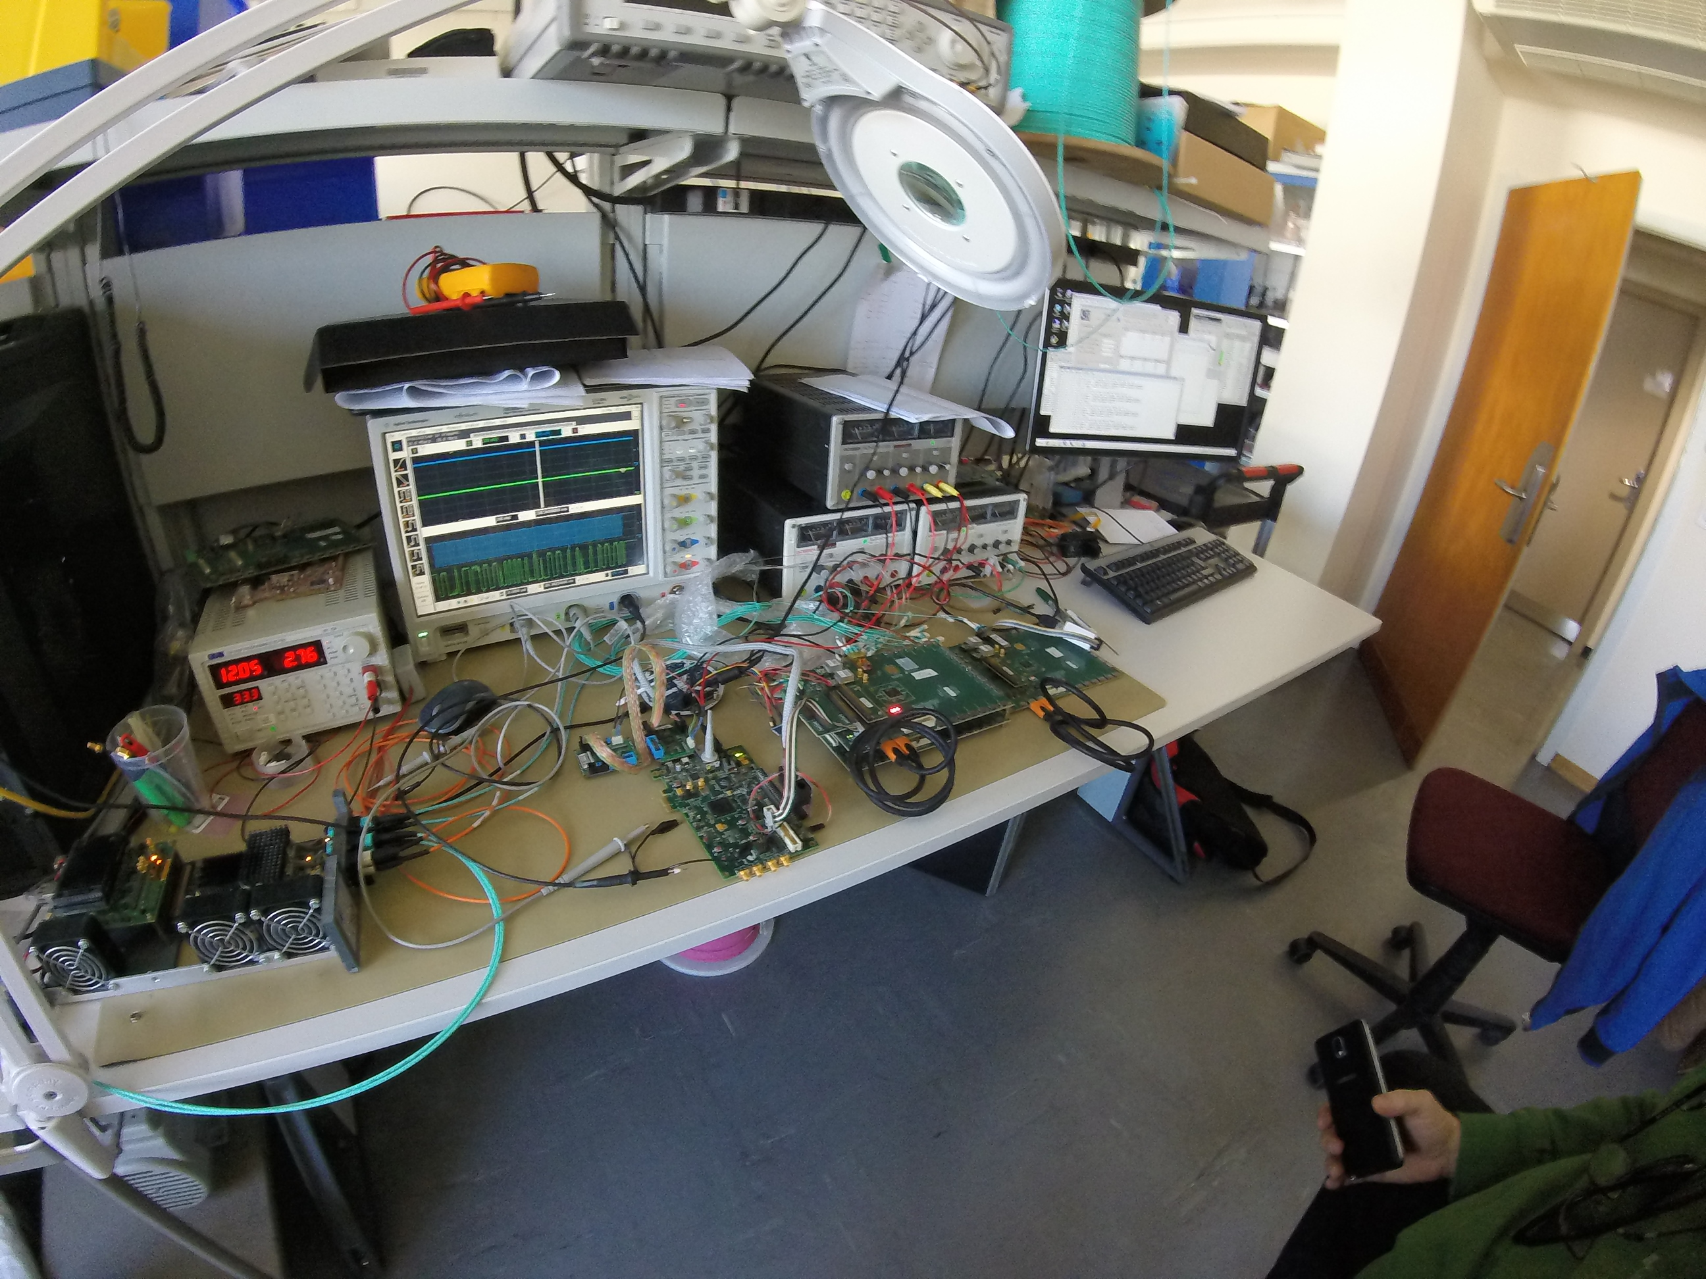
Quick check test with the MiniDAQ
VLDB
GBTx-SCA
Evaluation
board
MiniDAQ
I2C
Protocol Converter
IGLOO2 FPGA
SCnx
FE
BUS
FE
(DIALOG)
FE
(DIALOG)
…
FE
(DIALOG)
SDnx
SDBp
The logic showed to work correctly since the first test but because of analogic signal misalignments due to a different power source module used on the CERN VLDB we initially had poor performances in terms of BER
Fixing the issue with a small modification of the IGLOO2 Evaluation Kit we solve the problem and the test bench started working correctly

Slide 15
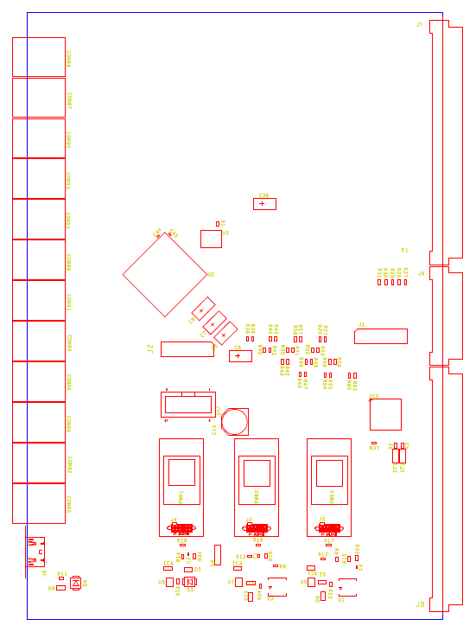
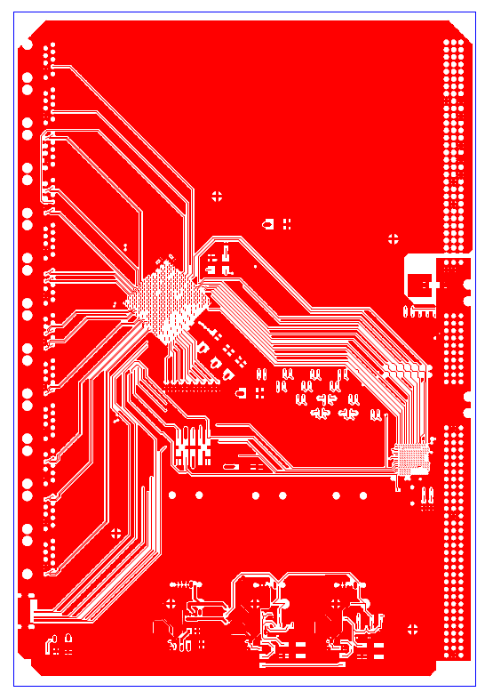
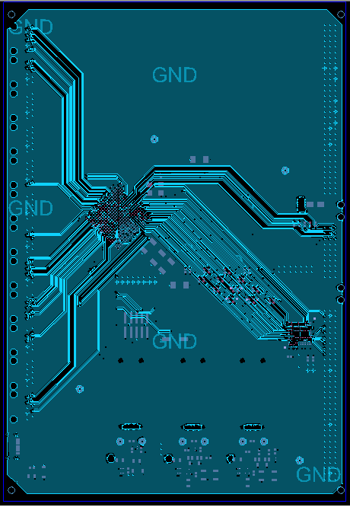
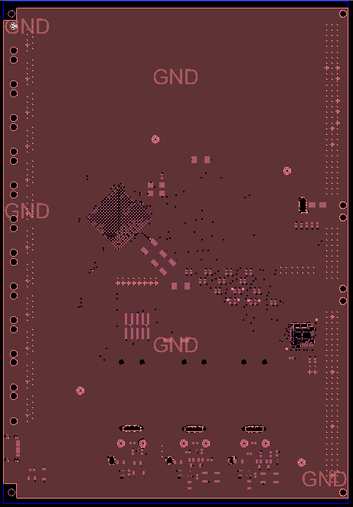
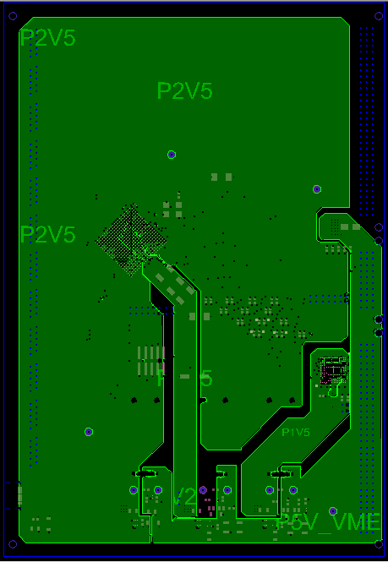
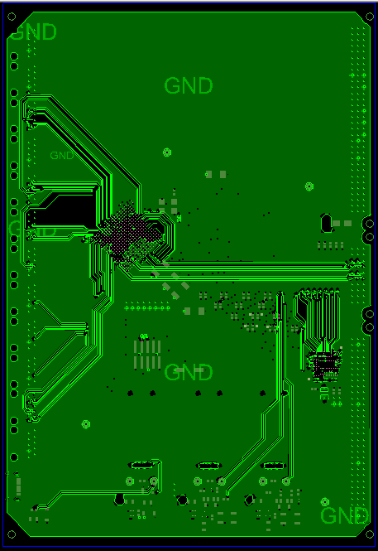
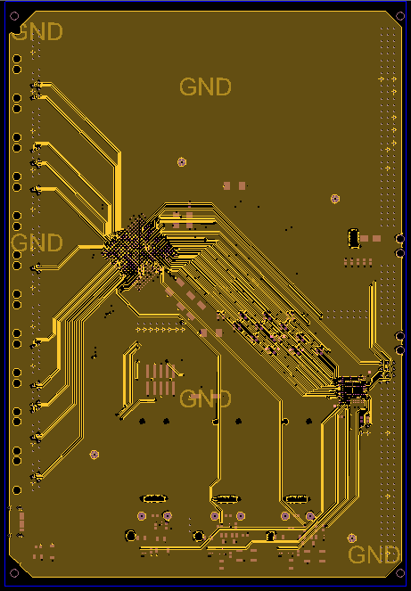
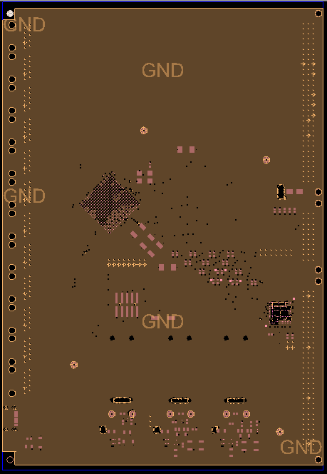
Final version of the nSB prototypes
TOP
In1
GND1
Alim
In2
Bottom
GND2
We are waiting for the production of the prototypes of the nSB
The manufacturing request order has been submitted
Credit to: Giacomo Chiodi

Slide 16
Conclusions
The protocol converter combined with the LVDS-based I2C bus forms a long-line link that can be driven by the GBT-SCA chip, suitable for environment with presence of radiations
Each configuration/debug register is seen by the GBT system as a standard I2C RAM memory register
Moreover the link developed for this special application can be extended to any application where a long-line I2C link is needed
The logic of the converter showed to be robust during the first test session on the apparatus but more test will be done (probably directly on the nSB prototypes)

Slide 17

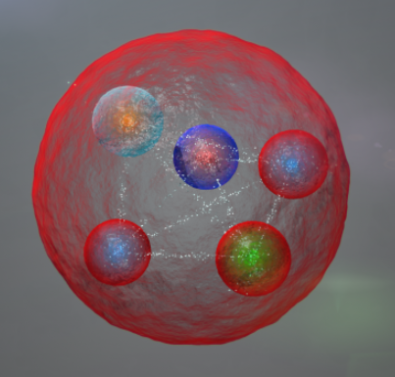
Thank you
For your attention!

