Slide 1

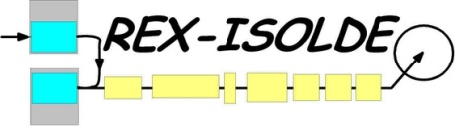
First results from IS468
and further investigation of in-trap decay of ⁶²Mn
First results from 2008 ;
Problems and questions ;
Further investigations ;

Slide 2
1/ First results from 2008
9 shifts : beam time overview
08h00
setup time
(REX, MINIBALL, tuning of radioactive beam)
mass resolving tests
TOF gates
A=61 (“proton triggered” – in-trap decay)
16h00
debugging
A=61 (“proton triggered” – in-trap decay)
A=61 (“proton triggered” – in-trap decay)
A=61
(“standard” coulex)
setup A=62 beam
24h00
A=61
(“standard” coulex)
A=61 (“proton triggered” – in-trap decay)
A=62 (“proton triggered” – in-trap decay)
08h00

Slide 3
1/ First results from 2008
9 shifts : beam time overview
08h00
setup time
(REX, MINIBALL, tuning of radioactive beam)
mass resolving tests
TOF gates
A=61 (“proton triggered” – in-trap decay)
16h00
debugging
A=61 (“proton triggered” – in-trap decay)
A=61 (“proton triggered” – in-trap decay)
A=61
(“standard” coulex)
setup A=62 beam
24h00
A=61
(“standard” coulex)
A=61 (“proton triggered” – in-trap decay)
A=62 (“proton triggered” – in-trap decay)
08h00

Slide 4
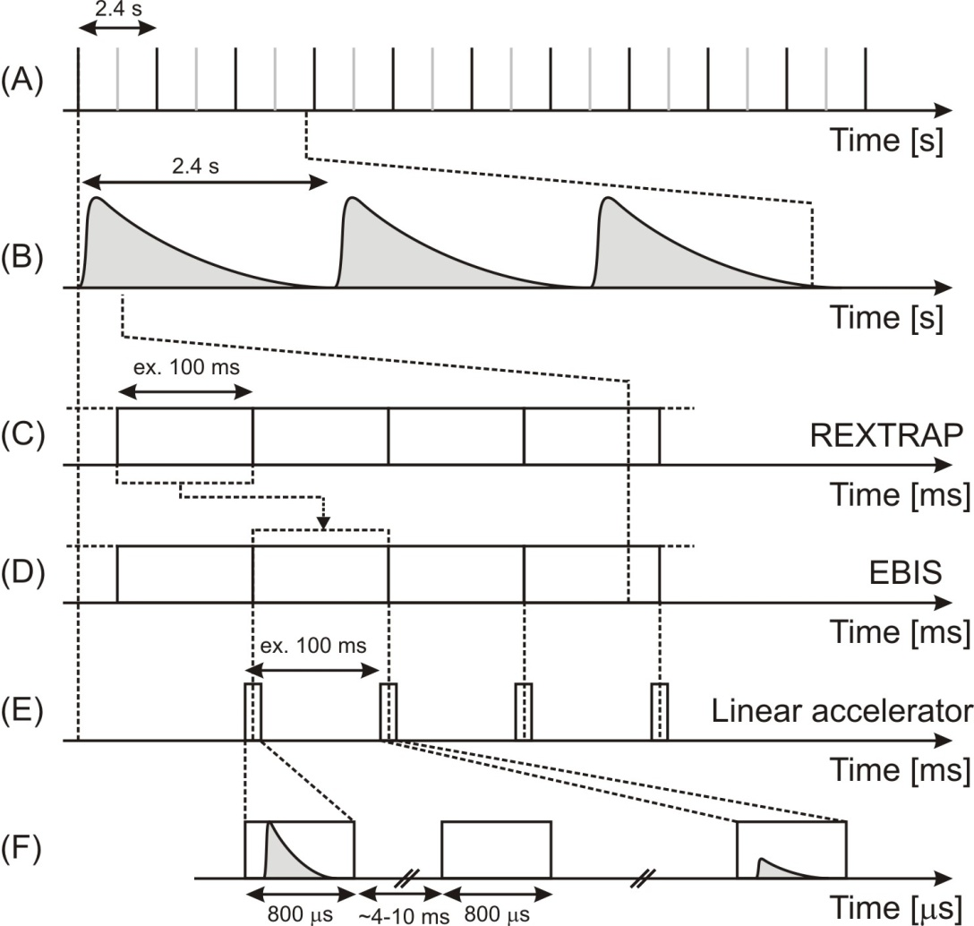
1/ First results from 2008
No Beamgate
Trapping time 30 ms
Breeding time 28 ms
1.3x10⁵ pps post-accelerated beam intensity
T_{1/2} = 670(40) ms : 96 % ⁶¹Mn
30 ms
28 ms
30 ms
Notes:
4

Slide 5
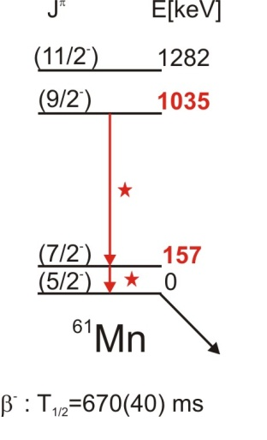
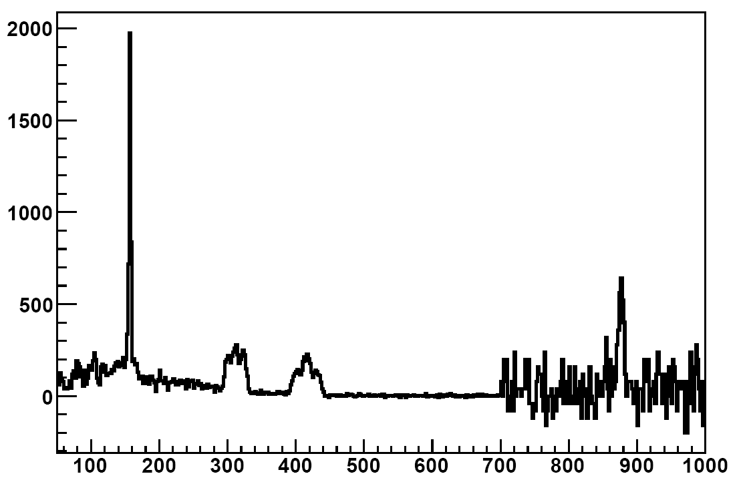
1/ First results from 2008
7/2⁻→5/2⁻ (157 keV) : 38(4) W.u.
Shell Model : 20 W.u.
(S. Lenzi, e_{π}=1.5, e_{ν}=0.5, GXPF1A interaction)
J.J. Valiente-Dobon et al.,
PRC 78, 024302 (2008)
30 ms
28 ms
30 ms
Counts
Measuring time ≈ 8 h
⁶¹Mn
X 40
⁶¹Mn
¹⁰⁹Ag
312 keV 415 keV
J. Van de Walle et al., EPJA, ENAM08 conference proceedings, submitted (2009)
Energy [keV]
Notes:
5

Slide 6
1/ First results from 2008
9 shifts : beam time overview
08h00
setup time
(REX, MINIBALL, tuning of radioactive beam)
mass resolving tests
TOF gates
A=61 (in-trap decay)
16h00
debugging
A=61 (in-trap decay)
A=61 (in-trap decay)
A=61
(“standard” coulex)
setup A=62 beam
24h00
A=61
(“standard” coulex)
A=61 (in-trap decay)
A=62 (“proton triggered” – in-trap decay)
08h00

Slide 7
1/ First results from 2008
“standard” setup
No Beamgate
Trapping time 30 ms
Breeding time 28 ms
1.3x10⁵ pps post-accelerated beam intensity
T_{1/2} = 670(40) ms : 96 % ⁶¹Mn
Notes:
7

Slide 8
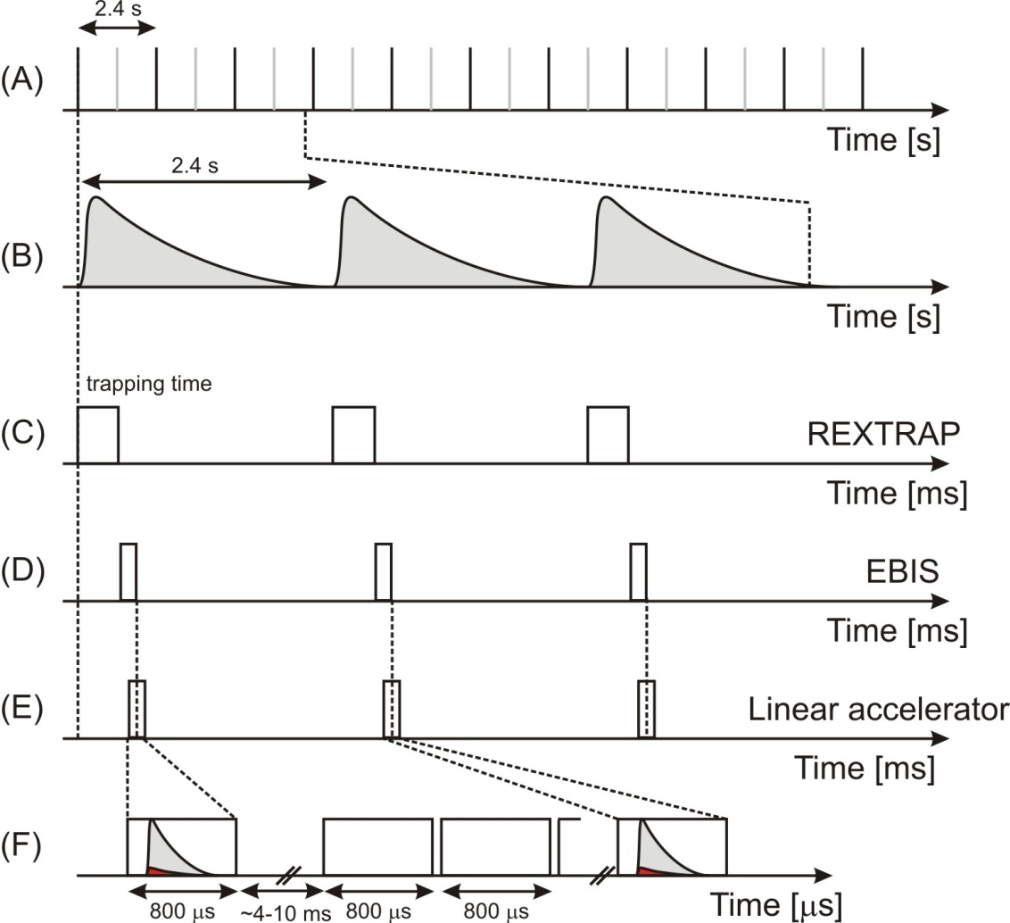
1/ First results from 2008
“proton triggered” in-trap decay setup
Beamgate 200 ms
Trapping time 200 ms
Breeding time 28 ms
5x10³ pps post-accelerated beam intensity
T_{1/2} ⁶¹Mn= 670(40) ms : 12 % ⁶¹Fe
Notes:
8

Slide 9
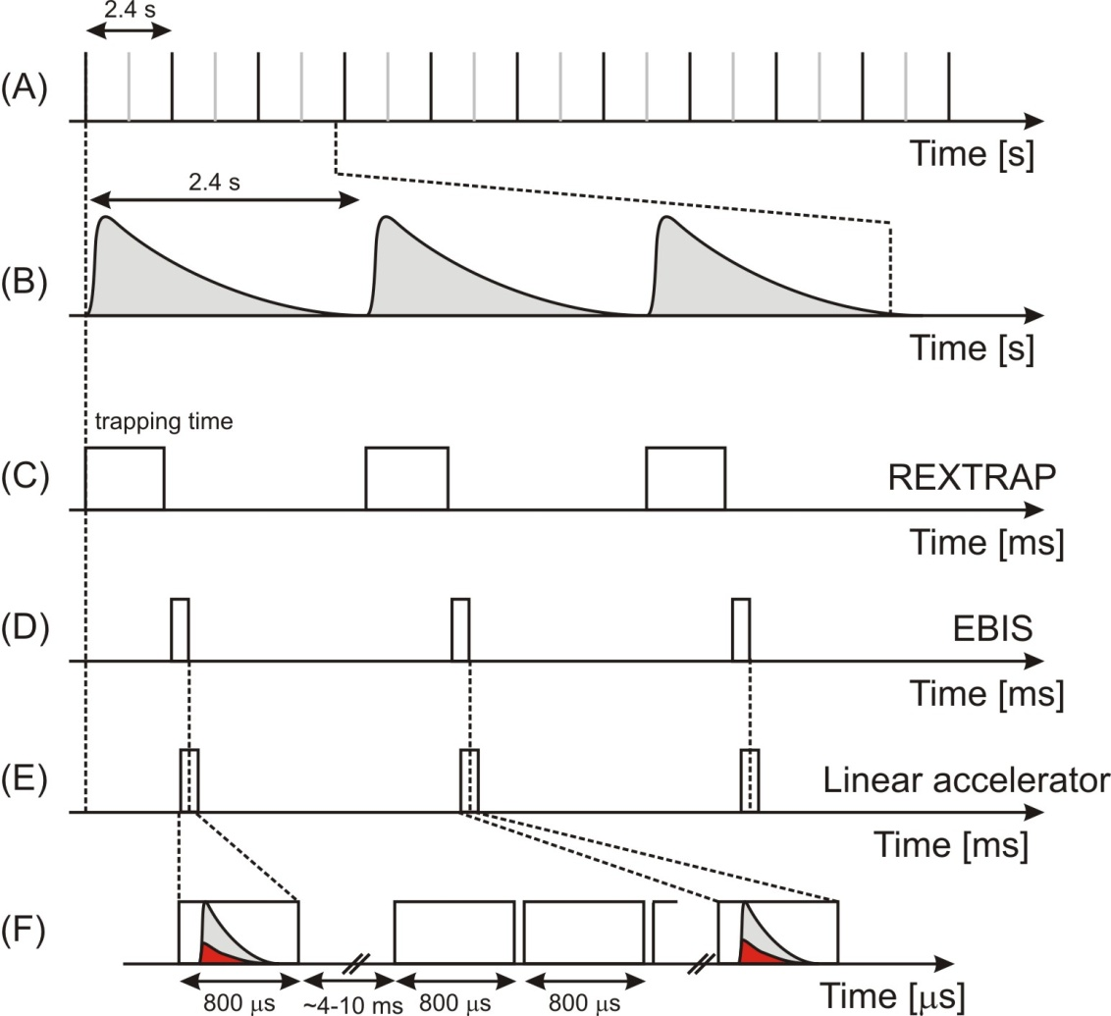
1/ First results from 2008
“proton triggered” in-trap decay setup
Beamgate 200 ms
Trapping time 400 ms
Breeding time 28 ms
5x10³ pps post-accelerated beam intensity
T_{1/2} ⁶¹Mn= 670(40) ms : 29 % ⁶¹Fe
Notes:
9

Slide 10
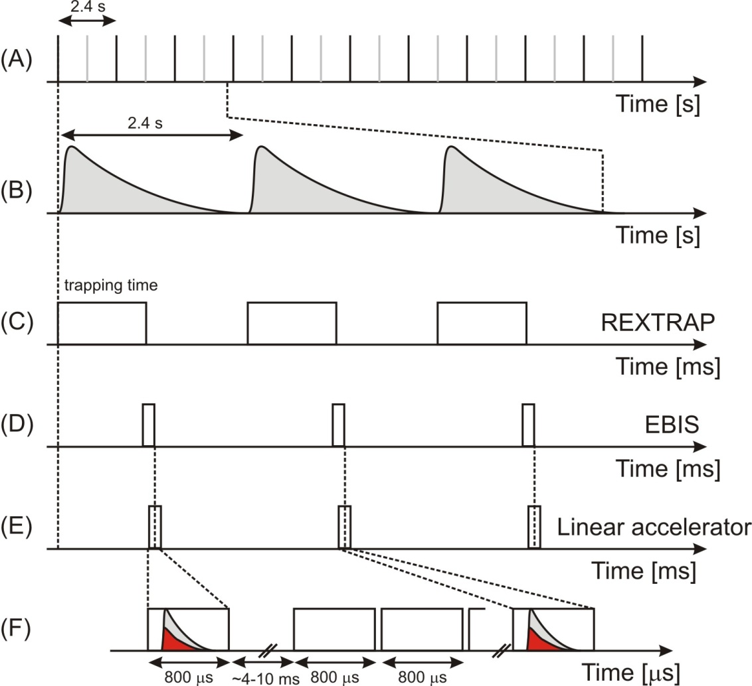
1/ First results from 2008
“proton triggered” in-trap decay setup
Beamgate 200 ms
Trapping time 600 ms
Breeding time 28 ms
5x10³ pps post-accelerated beam intensity
T_{1/2} ⁶¹Mn= 670(40) ms : 42 % ⁶¹Fe
Notes:
10

Slide 11
1/ First results from 2008
“proton triggered” in-trap decay setup
Beamgate 200 ms
Trapping times 200-1100 ms
Breeding time 28 ms
5x10³ pps post-accelerated beam intensity
On average : 39 % ⁶¹Fe expected
Notes:
11

Slide 12

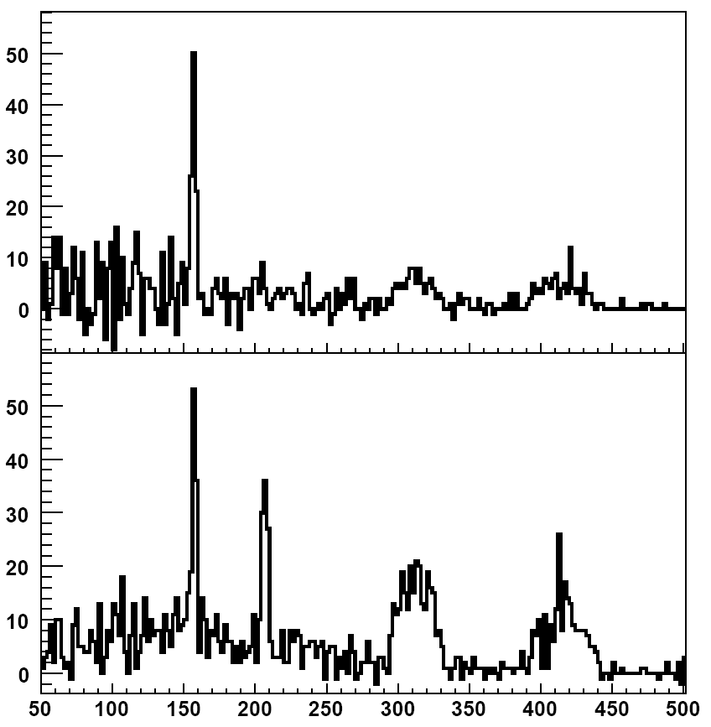
1/ First results from 2008
⁶¹Mn
≈ 5 hours
Counts
No ⁶¹Fe coulex …
Energy [keV]
On average : 39 % ⁶¹Fe expected
≈ 100% Mn (from ratio 157 keV - target excitation)
Notes:
12

Slide 13
1/ First results from 2008
Beamgate 200 ms
Trapping time 200 ms
Breeding time 28 ms
5x10³ pps post-accelerated beam intensity
T_{1/2} ⁶¹Mn= 670(40) ms : 12 % ⁶¹Fe
Notes:
13

Slide 14
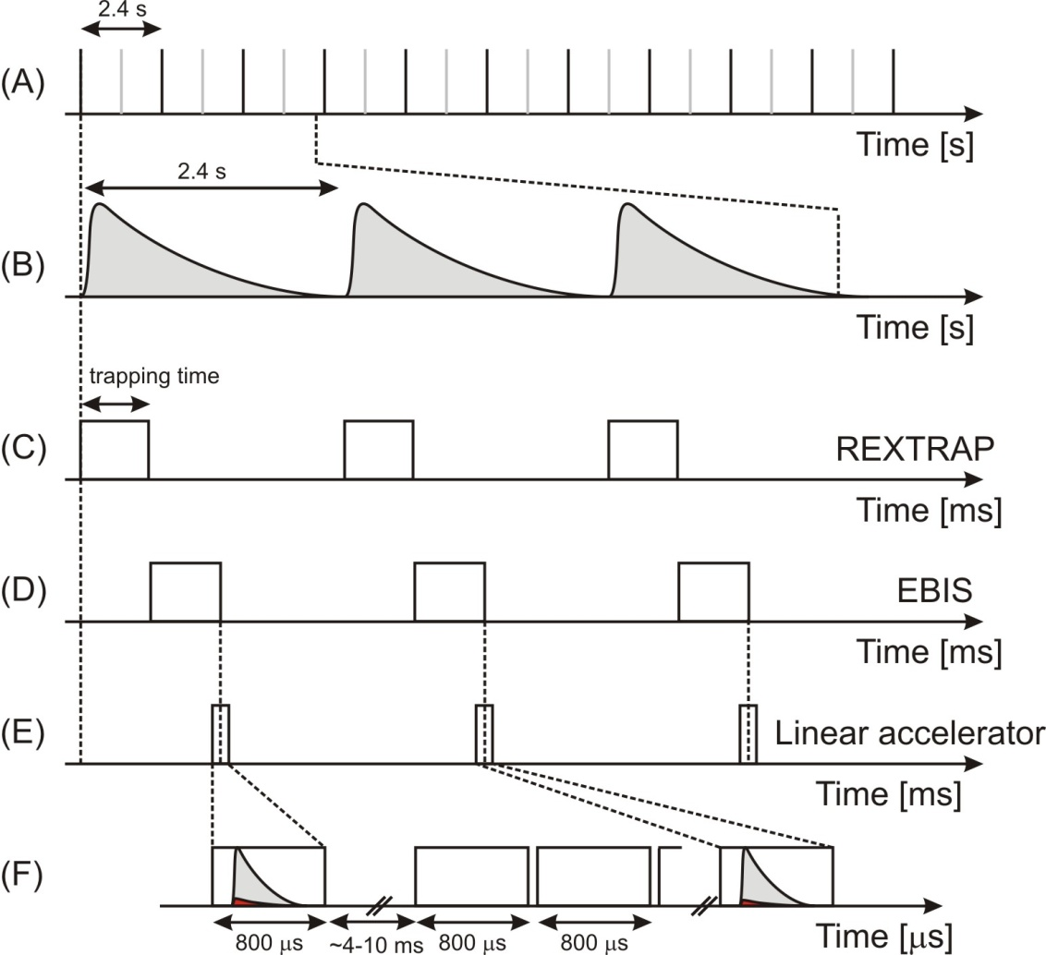
1/ First results from 2008
Beamgate 300 ms
Trapping time 300 ms
Breeding time 298 ms
1x10⁴ pps post-accelerated beam intensity
T_{1/2} ⁶¹Mn= 670(40) ms : 37 % ⁶¹Fe
Notes:
14

Slide 15
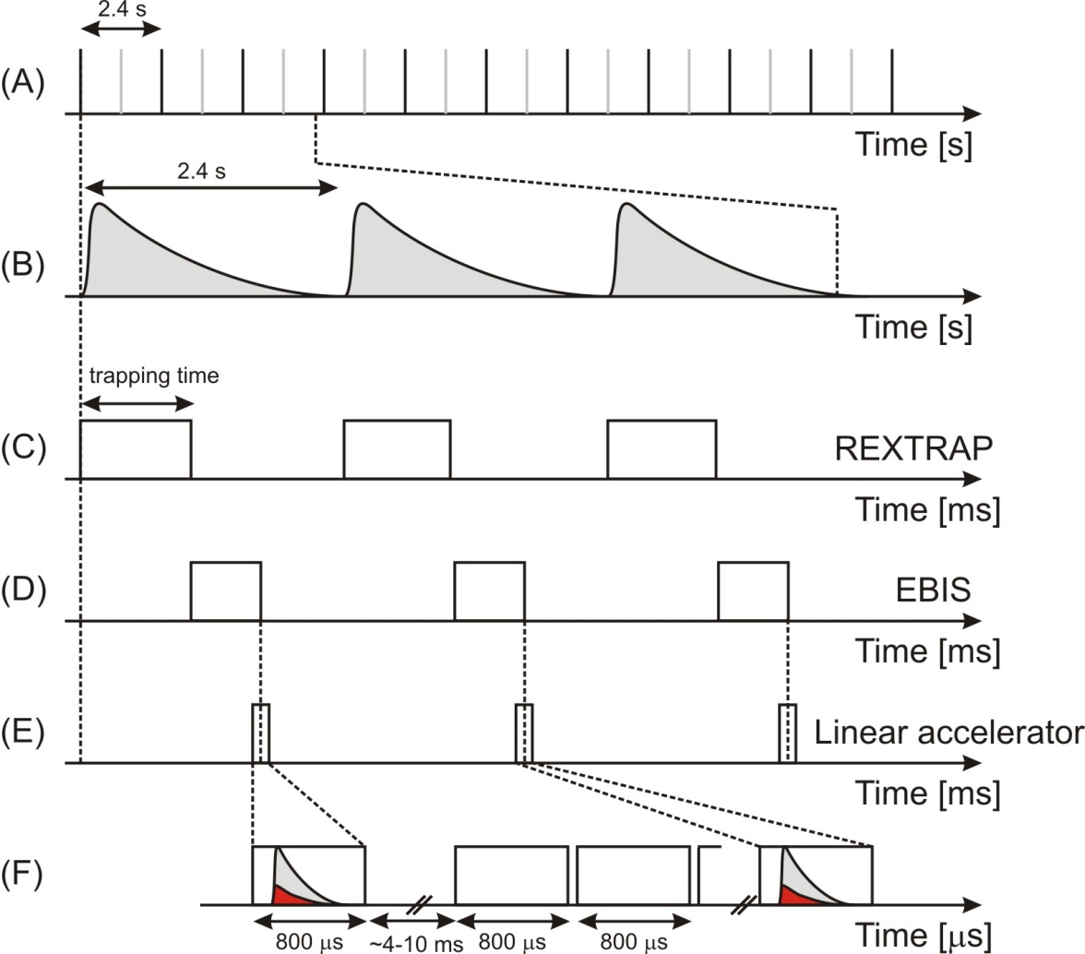
1/ First results from 2008
Beamgate 300 ms
Trapping time 500 ms
Breeding time 298 ms
1x10⁴ pps post-accelerated beam intensity
T_{1/2} ⁶¹Mn= 670(40) ms : 51 % ⁶¹Fe
Notes:
15

Slide 16
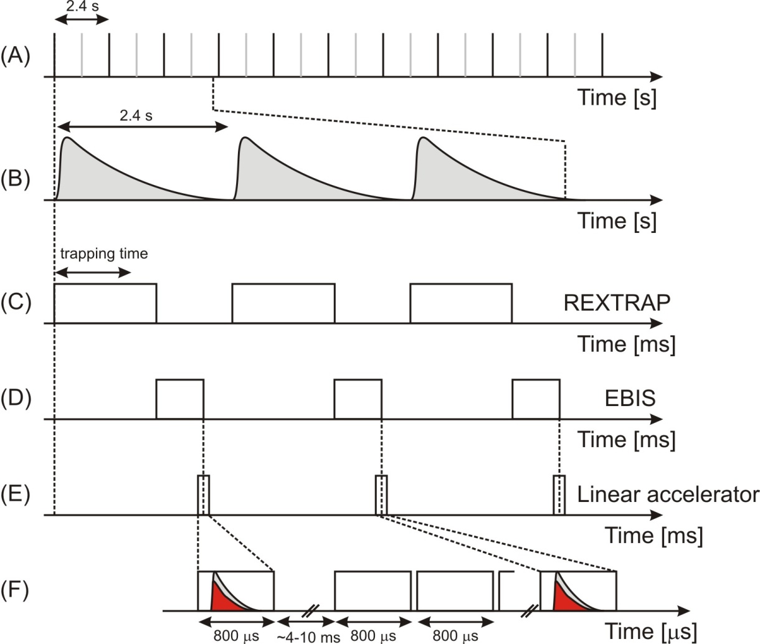
1/ First results from 2008
Beamgate 300 ms
Trapping time 700 ms
Breeding time 298 ms
1x10⁴ pps post-accelerated beam intensity
T_{1/2} ⁶¹Mn= 670(40) ms : 42 % ⁶¹Fe
Notes:
16

Slide 17
1/ First results from 2008
Beamgate 300 ms
Trapping times 300-900 ms
Breeding time 298 ms
1x10⁴ pps post-accelerated beam intensity
On average : 51 % ⁶¹Fe expected
Notes:
17

Slide 18
1/ First results from 2008
Breeding time 28 ms, Trapping times 200-1100 ms
On average : 39 % ⁶¹Fe expected
100% Mn (from ratio 157 keV - target excitation)
Counts
⁶¹Mn
≈ 5 hours
No ⁶¹Fe coulex …
Energy [keV]
Notes:
18

Slide 19
1/ First results from 2008
Breeding time 28 ms, Trapping times 200-1100 ms
On average : 39 % ⁶¹Fe expected
100% Mn (from ratio 157 keV - target excitation)
⁶¹Mn
≈ 5 hours
Counts
≈ 7 hours
5/2⁻→3/2⁻ (207 keV) : 17(6) W.u.
Energy [keV]
On average : 51 % ⁶¹Fe expected
61(6) % Fe (from ratio 157 keV - target excitation) !
Breeding time 298 ms, Trapping times 300-900 ms
Notes:
19

Slide 20
1/ First results from 2008
9 shifts : beam time overview
08h00
setup time
(REX, MINIBALL, tuning of radioactive beam)
mass resolving tests
TOF gates
A=61 (“proton triggered” – in-trap decay)
16h00
debugging
A=61 (“proton triggered” – in-trap decay)
A=61 (“proton triggered” – in-trap decay)
A=61
(“standard” coulex)
setup A=62 beam
24h00
A=61
(“standard” coulex)
A=61 (“proton triggered” – in-trap decay)
A=62 (in-trap decay)
08h00

Slide 21
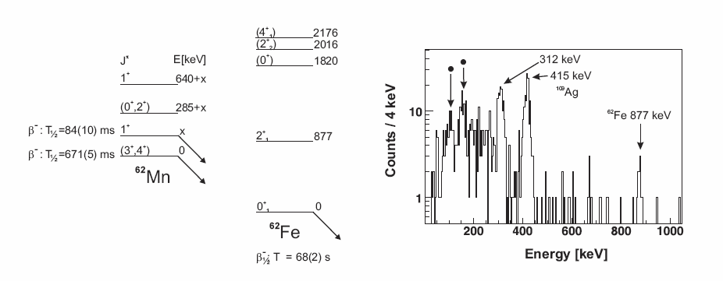
1/ First results from 2008
- B(E2) ⁶²Fe = 8(2) W.u.
[preliminary Legnaro value 21% error bar, Gadea et al, presentation in Zakopane, 4-10 September 2006]
- 1.6x103 pps
- Breeding time 298 ms, Trapping times 300-900 ms (same trick as A=61)
≈ 8 hours
On average : 55 % ⁶²Fe expected
≈ 30 % Fe
Notes:
21

Slide 22
1/ First results from 2008
Comparison with A=61
On average : 51 % ⁶¹Fe expected
61(6) % Fe (from ratio 157 keV - target excitation) !
Breeding time 298 ms, Trapping times 300-900 ms
≈ 8 hours
On average : 55 % ⁶²Fe expected
≈ 30 % Fe
Does the recoil energy play a crucial role ?
⁶¹Fe (298 ms breeding time) on average 61(6)% Q_{β-}^{max} = 475 eV
⁶²Fe (298 ms breeding time) on average ≈ 30% Q_{β} ^{max} = 1020 eV
Notes:
22

Slide 23
2/ Problems and questions
Main question
Inconsistency 28 ms ↔ 298 ms breeding time + varying trapping times

Slide 24
2/ Problems and questions
Main question
Inconsistency 28 ms ↔ 298 ms breeding time + varying trapping times
Possible causes
- Maximum recoil energy ⁶¹Fe = 475 eV (distribution !)
  REXTRAP voltage barriers :
    165 V at entrance
    230 V at extraction
  EBIS barriers :
    500 V

Slide 25
2/ Problems and questions
Main question
Inconsistency 28 ms ↔ 298 ms breeding time + varying trapping times
Possible causes
- Maximum recoil energy ⁶¹Fe = 475 eV (distribution !)
  REXTRAP voltage barriers :
    165 V at entrance
    230 V at extraction
  EBIS barriers :
    500 V
Recall :
⁶¹Fe (298 ms breeding time) on average 61(6)% Q_{β-}^{max} = 475 eV
⁶²Fe (298 ms breeding time) on average ≈ 30% Q_{β} ^{max} = 1020 eV

Slide 26
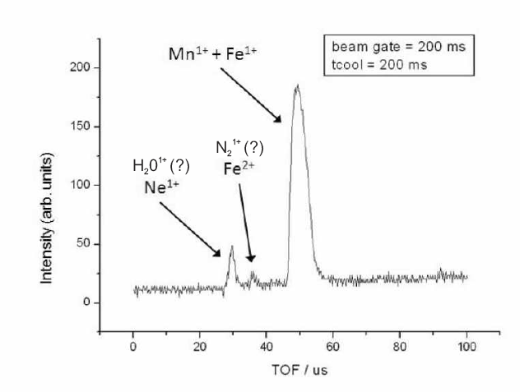
2/ Problems and questions
Main question
Inconsistency 28 ms ↔ 298 ms breeding time + varying trapping times
Possible causes
- Maximum recoil energy ⁶¹Fe = 475 eV (distribution !)
  REXTRAP voltage barriers :
    165 V at entrance
    230 V at extraction
  EBIS barriers :
    500 V
- Insufficient cooling of Fe ?
- Recombination time of Fe²⁺ ?
- Charge exchange with buffer gas ?
- Molecule formation ?

Slide 27
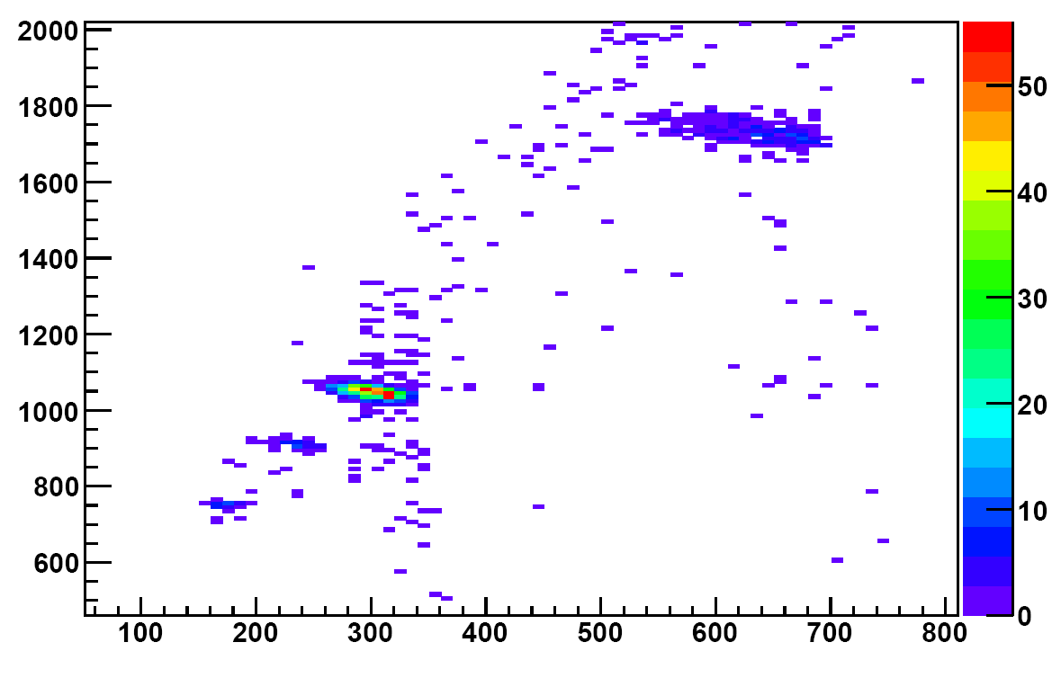
2/ Problems and questions
Problem
Beam diagnostics.
Undetected leak in gas supply to ΔE detector during the beamtime
NO resolution anymore …
Spectrum A/q = 4 beam before IS468
Gas (ΔE)
Si (E_{rest})

Slide 28
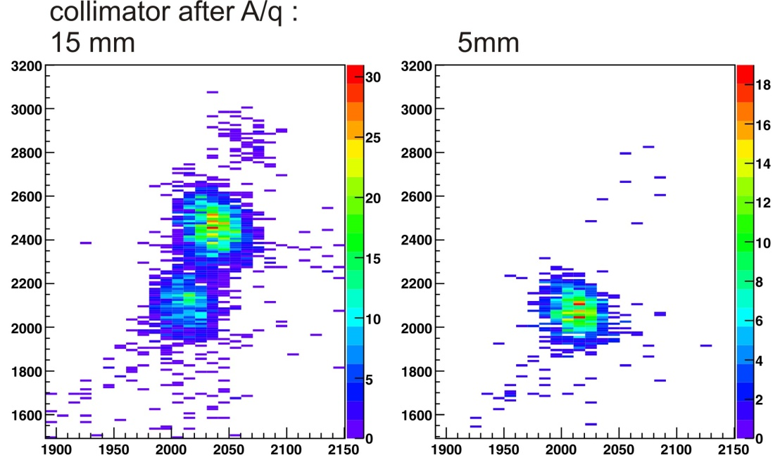
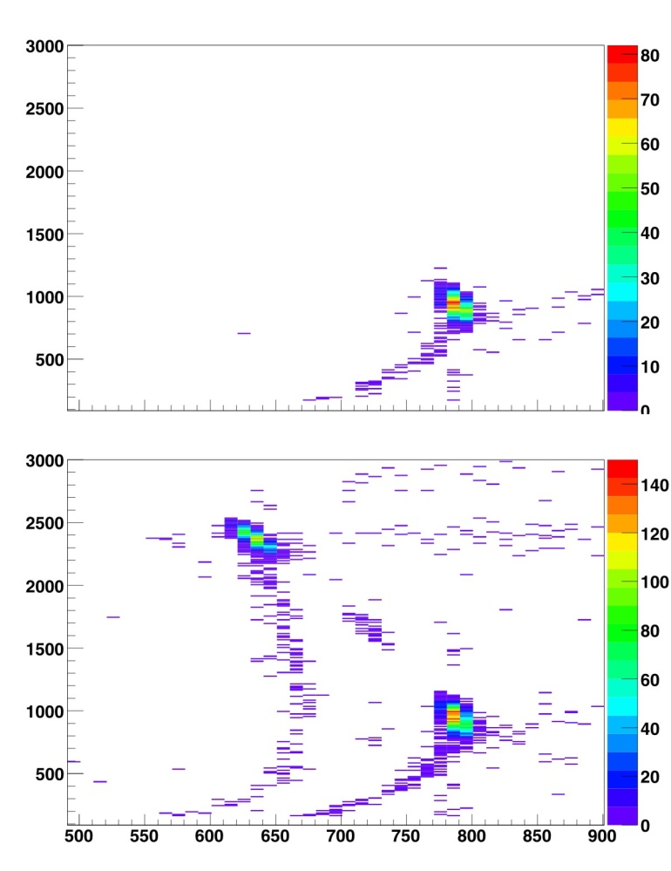
2/ Problems and questions
Problem
Beam diagnostics.
Solved and tested
during the summer
with different beams
A/q = 3.391 from EBIS with stable Kr isotopes
No protons - Beamgate open
With protons - Beamgate open
²⁷Na
A=27 beam from HRS
E_{residual} (Si)
E_{residual} (Si)
²⁷Mg
²⁷Al
²⁷Al
ΔE (gas)
ΔE (gas)

Slide 29
2/ Problems and questions
Problem
Beam diagnostics.
Advantage
We do have a reference beam for 300 ms breeding and trapping :
⁶¹Mn and ⁶¹Fe ⇒ resolution and calibration can be tested !

Slide 30
3/ Further investigations
Why do we ask for an additional 9 shifts for IS468 ?
It IS possible to post-accelerate decay products ⇒ ⁶²Fe within reach
  More accurate B(E2) measurement with low energy coulex (≈10% error bar);
  Quadrupole moment in combination with lifetime measurements ;

Slide 31
3/ Further investigations
Why do we ask for an additional 9 shifts for IS468 ?
It IS possible to post-accelerate decay products ⇒ ⁶²Fe within reach
  More accurate B(E2) measurement with low energy coulex (≈10% error bar);
  Quadrupole moment in combination with lifetime measurements ;
Possible (future) applications (Mother – Daughter) :
  neutron rich K-Ca ; ⁹⁶Rb – ⁹⁶Sr ; ¹²Be – ¹²B ; ⁹⁸⁻¹⁰³Y – ⁹⁸⁻¹⁰³Zr ;
  ^{33,34,35}Al – ^{33,34,35}Si ; …

Slide 32
3/ Further investigations
Why do we ask for an additional 9 shifts for IS468 ?
It IS possible to post-accelerate decay products ⇒ ⁶²Fe within reach
  More accurate B(E2) measurement with low energy coulex (≈10% error bar);
  Quadrupole moment in combination with lifetime measurements ;
Possible (future) applications (Mother – Daughter) :
  neutron rich K-Ca ; ⁹⁶Rb – ⁹⁶Sr ; ¹²Be – ¹²B ; ⁹⁸⁻¹⁰³Y – ⁹⁸⁻¹⁰³Zr ;
  ^{33,34,35}Al – ^{33,34,35}Si ; …
Need to understand the apparent losses in REXTRAP and/or EBIS ;
Relevant for ALL experiments at REX needing long trapping
and breeding times with short lived isotopes (also HIE-ISOLDE !) ;

Slide 33
3/ Further investigations
Why do we ask for an additional 9 shifts for IS468 ?
It IS possible to post-accelerate decay products ⇒ ⁶²Fe within reach
  More accurate B(E2) measurement with low energy coulex (≈10% error bar);
  Quadrupole moment in combination with lifetime measurements ;
Possible (future) applications (Mother – Daughter) :
  neutron rich K-Ca ; ⁹⁶Rb – ⁹⁶Sr ; ¹²Be – ¹²B ; ⁹⁸⁻¹⁰³Y – ⁹⁸⁻¹⁰³Zr ;
  ^{33,34,35}Al – ^{33,34,35}Si ; …
Need to understand the apparent losses in REXTRAP and/or EBIS ;
Relevant for ALL experiments at REX needing long trapping
and breeding times with short lived isotopes (also HIE-ISOLDE !) ;
Radioactive beam is needed for in-trap decay studies ;
  ^{61,62}Mn is clean, short lived, intense, feasibility proven (2008),
  two Q-values for reference (A=61 and A=62) ⇒ ideal candidates !

Slide 34
3/ Further investigations
9 shifts : proposed beam time
08h00
- Transmission tests with radioactive beam ;
- Test of beam diagnostics and resolution ;
Systematic scan of trapping and breeding times ;
Investigation of TOF spectrum ;
Systematic scan of trapping and breeding times ;
16h00
Systematic scan of trapping and breeding times (**) ;
(*)
A=62 – in-trap decay
(target ¹⁰⁹Ag)
(*)
A=62 – in-trap decay
(target ⁵⁸Ni)
24h00
A=62
(“standard” coulex)
(*)
A=62 – in-trap decay
(target ¹⁰⁹Ag)
(*)
A=62 – in-trap decay
(target ⁵⁸Ni)
08h00
(*) depending on the outcome of the tests with REXTRAP and EBIS
(**) - changing breeding time ⇒ linac scaling (A/q) !
- includes as well : second cooling frequency (Fe²⁺),
change buffer gas pressure, …
- difference between A=61 and A=62 (influence recoil energy Fe daughter)
- time consuming and expertise required !

Slide 35
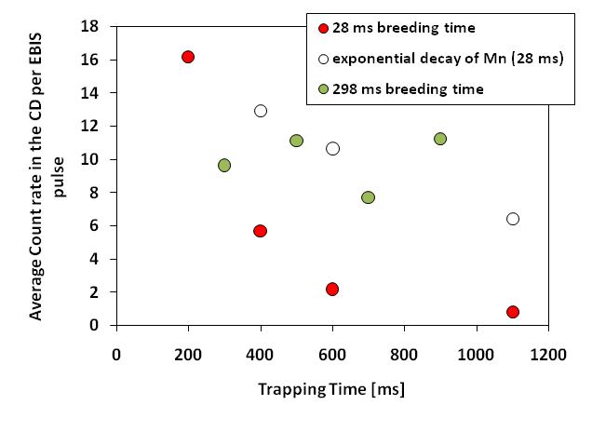
Backup Slides
Careful !
Absolute scale and comparison does NOT take into account possible
fluctuations in laser ionization efficiency … !!!!

Slide 36
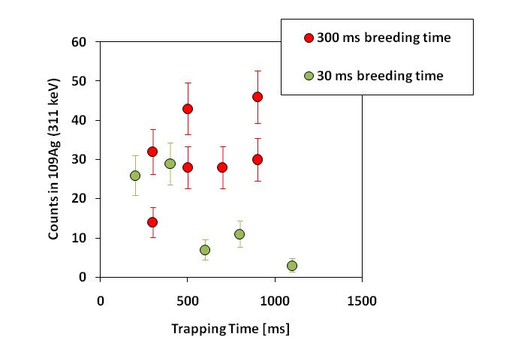
Backup Slides
Careful !
Absolute scale and comparison does NOT take into account possible
fluctuations in laser ionization efficiency … !!!!

Slide 37
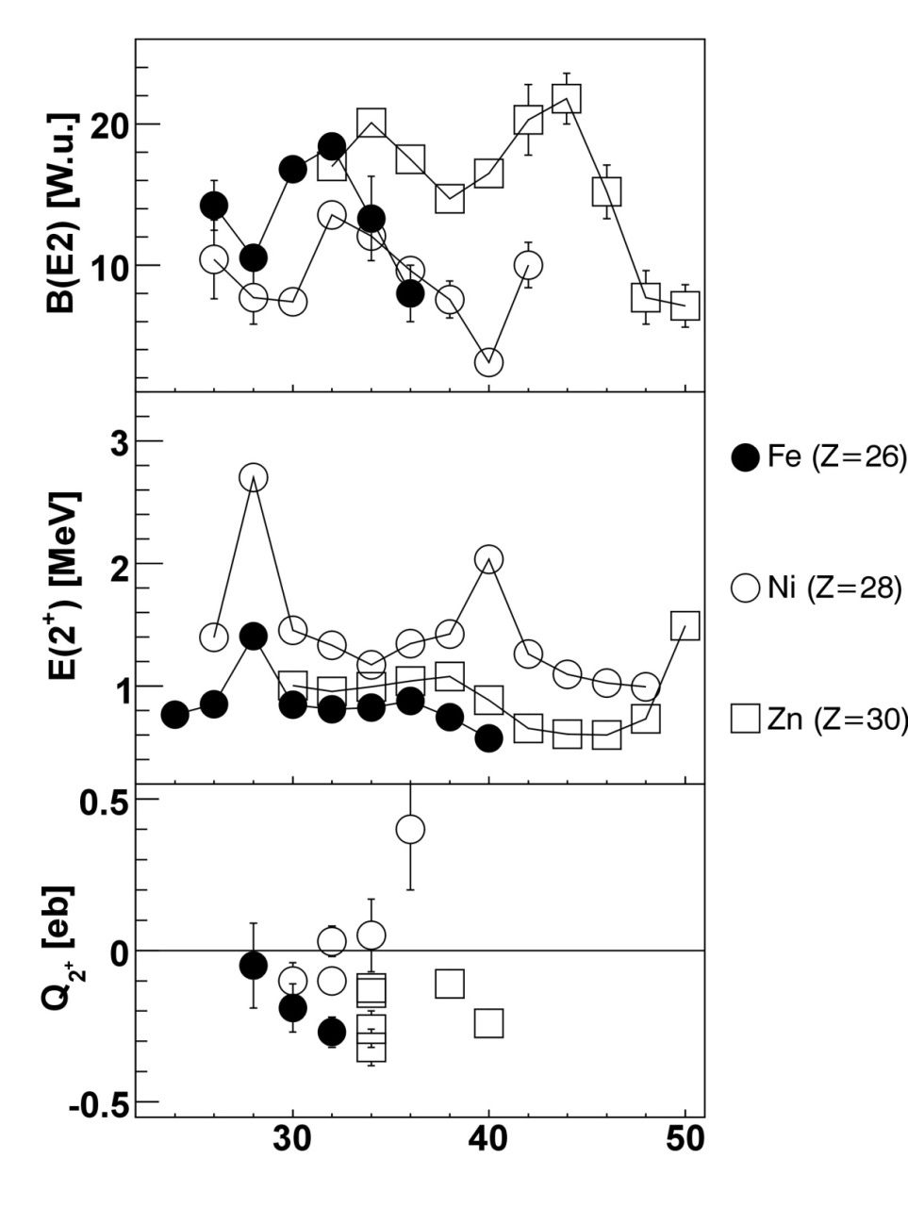
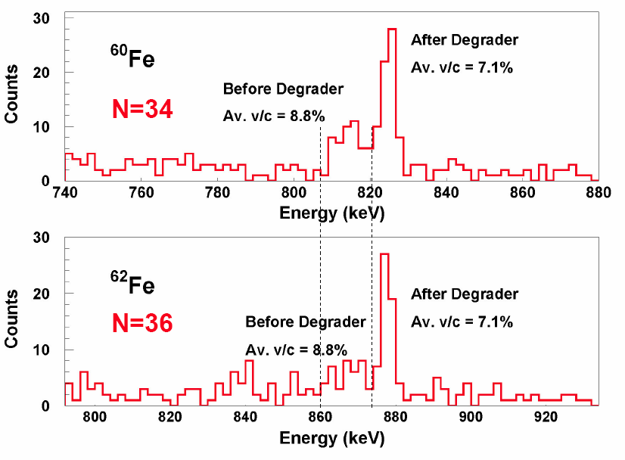
Backup Slides
2⁺ T_{1/2}=9.5(20)ps
B(E2)=8(2) W.u.
Lifetime measurements at Legnaro,
Picture from presentation by
A. Gadea, Conference on Trends in Nuclear Structure,
Zakopane 4-10 sept. 2006
Neutron Number

Slide 38
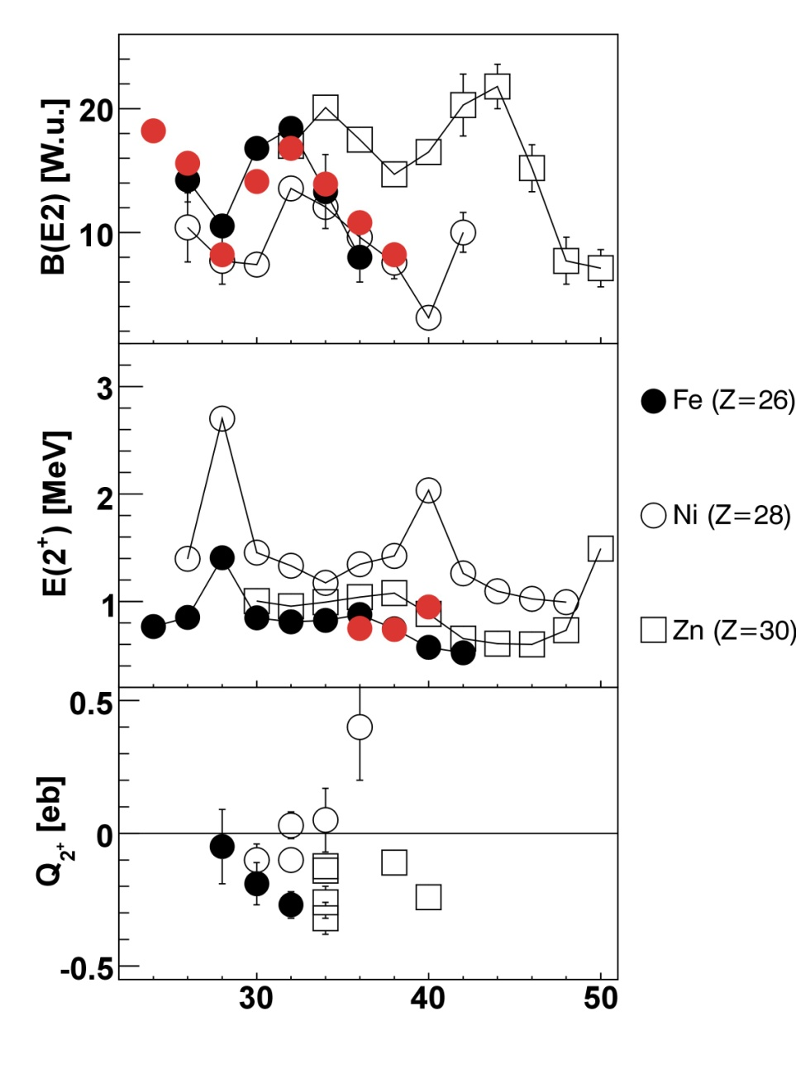
Backup Slides
Calculations from Caurier et al.
EPJA, 15, 145-150 (2002)
pf-shell (KB3G interaction )
Neutron Number

Slide 39
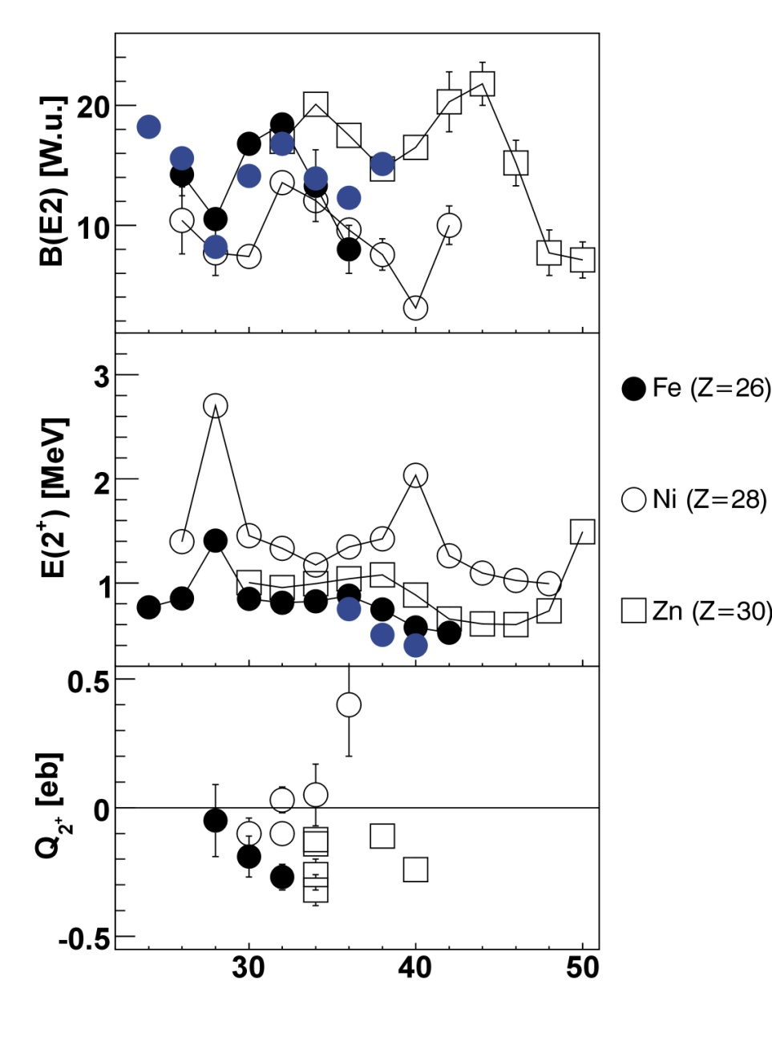
Backup Slides
Calculations from Caurier et al.
EPJA, 15, 145-150 (2002)
pf-shell (KB3G interaction )
pfgd (⁵²Ca core)
How do the 1g_{9/2} and possibly 2d_{5/2} neutron orbitals influence the quadrupole collectivity below Z=28 ?
Neutron Number

Slide 40
Backup Slides
Calculations from Caurier et al.
EPJA, 15, 145-150 (2002)
pf-shell (KB3G interaction )
pfgd (⁵²Ca core)
How do the 1g_{9/2} and possibly 2d_{5/2} neutron orbitals influence the quadrupole collectivity below Z=28 ?
(Re-)measure the (unpublished) B(E2) value in ⁶²Fe
Neutron Number

Slide 41
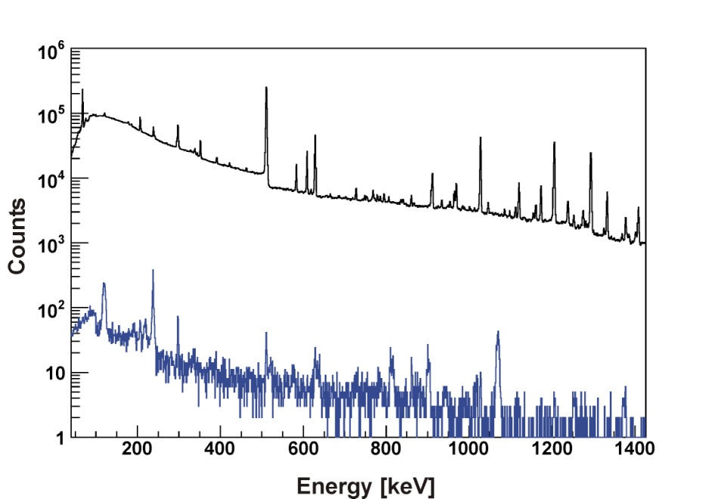
Backup Slides
β-decay spectrum from singles and γ-γ coincidences
singles (in+off beam)
Runte et al. NPA 441 (1985) 237
Notes:
41

Slide 42
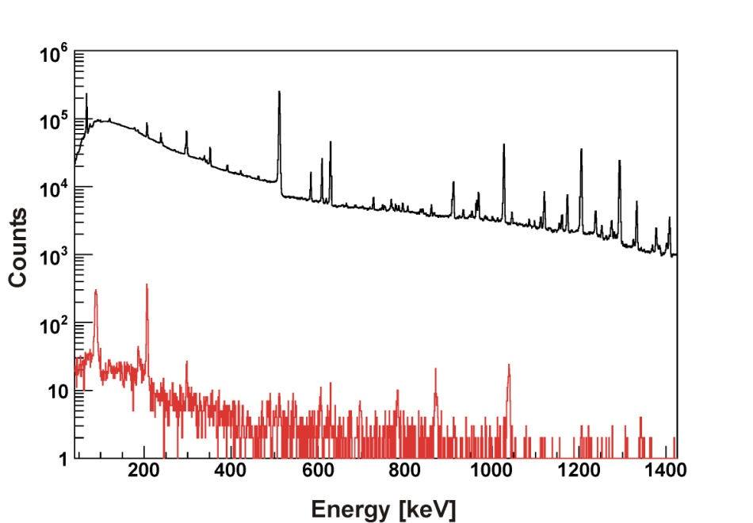
Backup Slides
β-decay spectrum from singles and γ-γ coincidences
singles (in+off beam)
Runte et al. NPA 441 (1985) 237
Notes:
42

