Slide 1
Status and plans of WA104/ICARUS
Carlo Rubbia
GSSI, L’Aquila, Italy
CERN
(on behalf of the WA104/ICARUS Collaboration)

Slide 2
The ICARUS/WA104 Collaboration
Argonne National Laboratory (ANL), USA
Brookhaven National Laboratory (BNL), USA
CERN, Geneva, Switzerland
Colorado State University, USA
Fermi National Laboratory (FNAL), USA
INFN Sez. di Catania and University, Catania, Italy
INFN GSSI, L’Aquila, Italy
INFN LNGS, Assergi (AQ), Italy
INFN Sez. di Milano Bicocca, Milano, Italy
INFN Sez. di Napoli, Napoli, Italy
INFN Sez. di Padova and University, Padova, Italy
INFN Sez. di Pavia and University, Pavia, Italy
H. Niewodniczanski Inst. of Nucl. Phys., Polish Academy of Science, Krakow, Poland
Institute for Nuclear Research (INR),
Institute of Physics, University of Silesia, Katowice, Poland
Inst. for Radio-Electronics, Warsaw University of Technology, Warsaw, Poland
Los Alamos National Laboratory (LANL), USA
National Centre for Nuclear Research, Warsaw, Poland
Pittsburgh University, USA
Russian Academy of Science, Moscow, Russia
SLAC, Stanford, CA, USA
Texas University, Arlington, USA

Slide 3
What are “sterile” neutrinos ?
Sterile neutrinos are a hypothetical type of neutrinos that do not interact with any of the fundamental interactions of the Standard Model except gravity.
The name was coined in 1957 by Bruno Pontecorvo, who hypothesized their existence in a seminal paper.
Since per se they would not interact electromagnetically, weakly, or strongly, they are extremely difficult to detect.
If they are heavy enough, they may also contribute to cold dark matter or warm dark matter.
Bruno Pontecorvo
Sterile neutrinos may mix with ordinary neutrinos via a mass term. Evidence may be building up from several experiments.

Slide 4
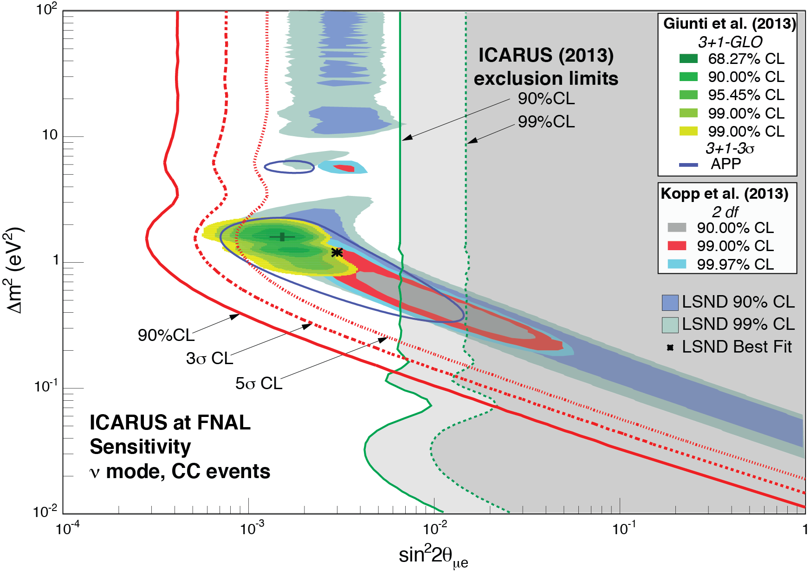
The LSND anomaly at Los Alamos (30 years ago)
The experiment LSND at the LAMPF Neutrino Source collected data from 1993 to 1998. Cherenkov light emitted by particle interactions was detected by an array of 1220 photomultipliers.
The more recent 2012 ICARUS experiment from CERN to LNGS and other data (KARMEN+MiniBooNE) have strongly reduced the region of LSND experimental window to a narrow region at Δm_{s}² ≈ 1 eV². (see f.i. Giunti et al.)

Slide 5
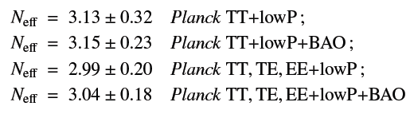
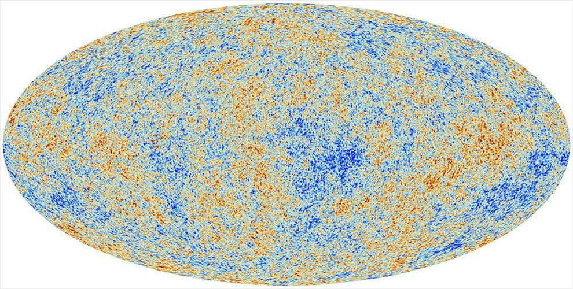
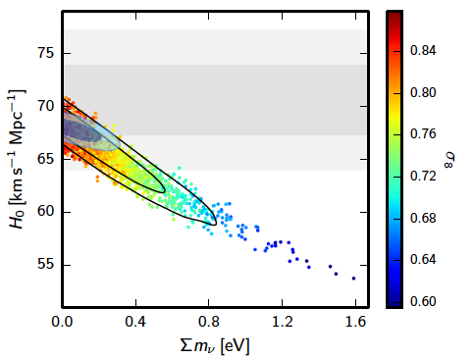

Number of neutrino families from Big Bang cosmology
N = 3
Hubble
Neff

Slide 6
Comparing the LSND anomaly with cosmology
Thirty years after its first observation, the LSND anomaly still requires a definitive experimental clarification.
However cosmological data combining data from cosmic microwave background (CMB) experiments, large scale structure (LSS) and Lyman-α forest observations naively bind the mass limit for a 3 massless + 1 massive sterile neutrino to m_{s} < 0.26 eV (0.44 eV) at 95% (99.9%) c.l.
This result, which implies Δm_{s}² ≤ (0.26 eV)² = 0.067 eV² should effectively exclude the sterile neutrino hypothesis as an explanation of the LSND anomaly.
If the LSND anomaly is notwithstanding finally confirmed experimentally, cosmological data will have been proven wrong and we will need to re-examine the entire framework on which rest these very tight constraints.

Slide 7
Persisting other anomalies in the neutrino sector
In addition to the observation of presumed excess signals of ν_{e} electrons from muon neutrinos from particle accelerators (the LSND effect) additional classes of anomalies have been reported, namely the apparent disappearance signal in the anti-ν_{e} events:
    (1) missing fraction from near-by nuclear reactors and
    (2) from Mega-Curie k-capture calibration sources in the experiments to detect solar ν_{e},
The most popular direction is the one of of ”sterile neutrinos” although also other alternatives are possible
These independent signals may all point out to the possible existence of at least a fourth non standard and heavier neutrino state driving oscillations at near distances, with Δm²_{new} of the order of ≈ 1 eV² and relatively small sin²(2θ_{new}) mixing angles.

Slide 8
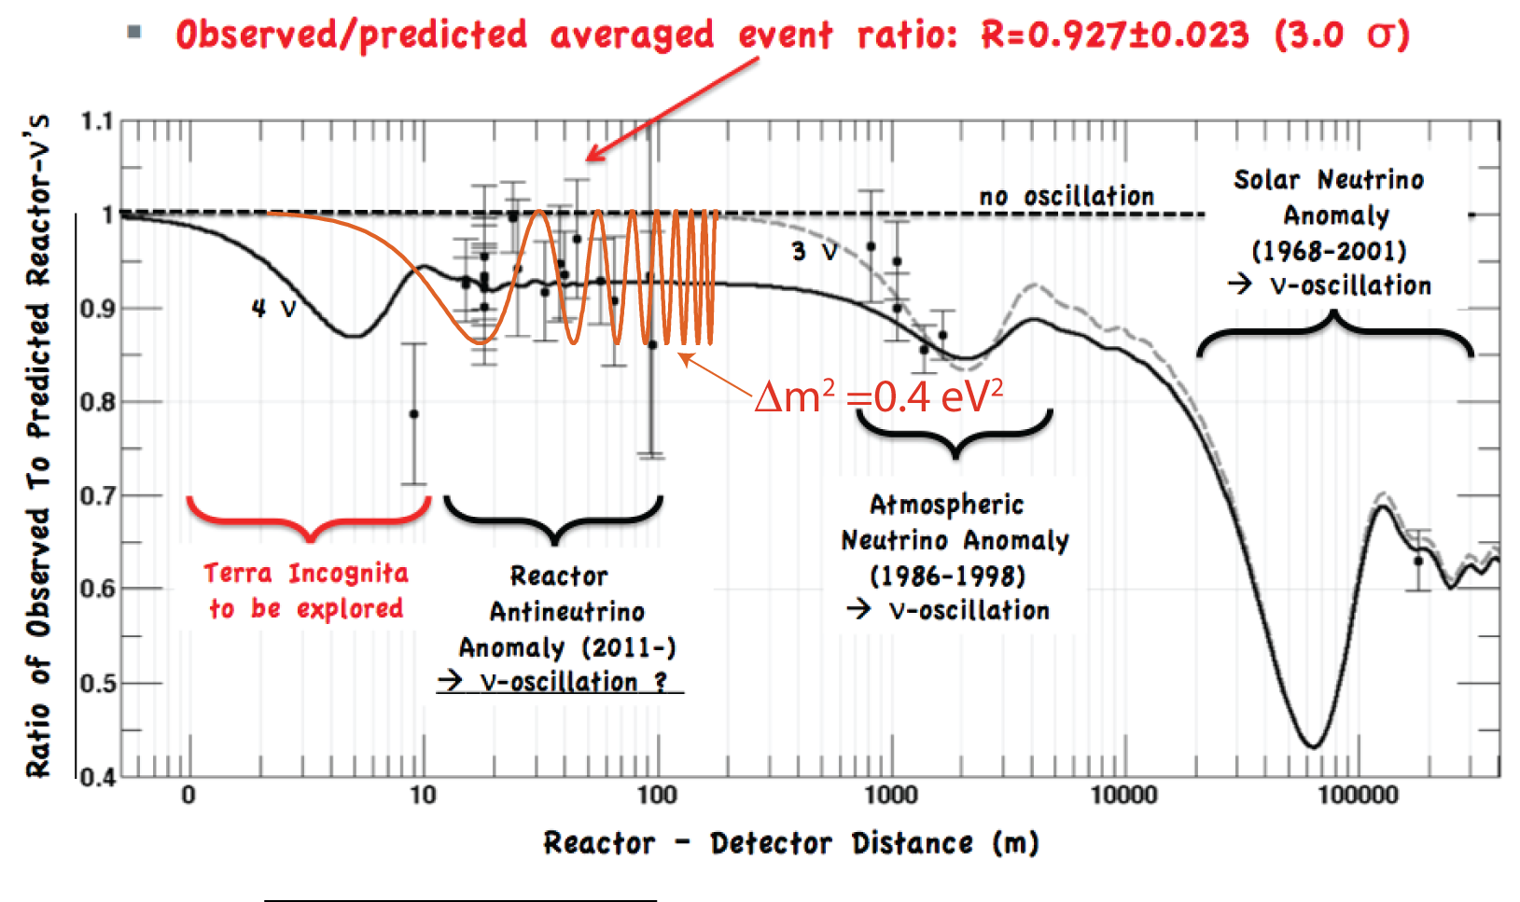
1.-The reactor (anti)-neutrino disappearance anomaly
A recent re-evaluation of the reactor antineutrino spectra has introduced changes in the expected flux. With such new evaluation, the ratio R between the observed and predicted rates of experiments is significantly less than 1.
However all reactor experiments rely on a common prediction on fission cross-sections and R = 0.938 ± 0.023, leading to a deviation of 2.7 σ from unity
Δm² ≈ 1 eV²
Sterile
neutrinos ?
Δm²21 ≈ 8 x 10⁻⁵ eV²
Δm²31 ≈ 2.4 x 10⁻³ eV²

Slide 9
Experimental data from reactors are not in perfect agreement
A rate excess is observed over Montecarlo flux predictions at about 5 MeV

Slide 10
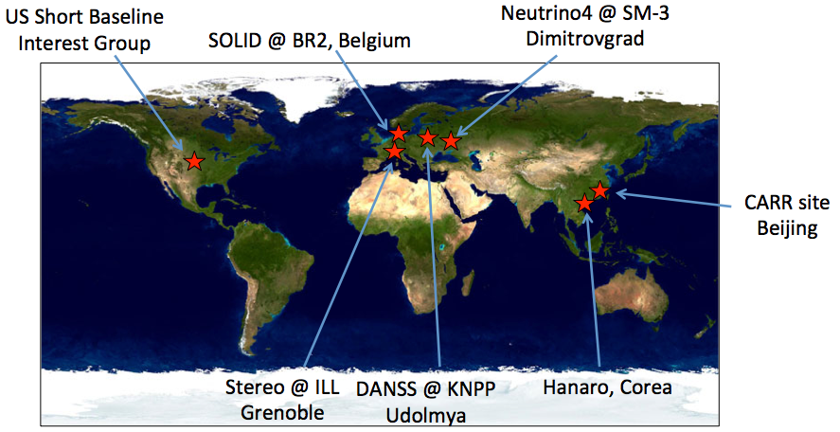
Several future, very short baseline reactor experiments
Compact, intense sources and very short baselines are used in order to determine oscillation patterns within the detector
High statistics ~100 evts/day/t
Challenging reactor-induced backgrounds (γ and n)
NUCIFER @ OSIRIS

Slide 11

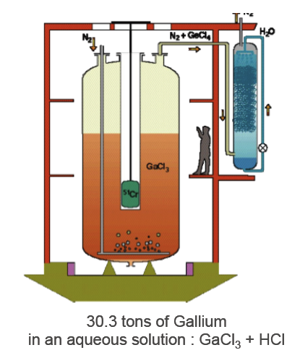
2.-The Gallium disappearance anomaly
SAGE and GALLEX experiments recorded the calibration signal produced by intense artificial k-capture sources of ⁵¹Cr and ³⁷Ar.
The averaged result of the ratio R between the source detected and predicted neutrino rates are consistent with each other, giving R=(0.86 ± 0.05), about 2.7σ from unity
These best fitted values may favour the existence of an undetected sterile neutrino with an evidence of 2.3σ and a broad range of values centred around Δm²new ≈ 2 eV² and sin²(2θnew) ≈ 0.3.
Notes:
11

Slide 12
Future experiments
Aiming at recording the L/E oscillation pattern within the detector using an intense ν source:
  Existing (Borexino, KamLAND, Daya-Bay) or future (SNO+, LENS, JUNO ) liquid scintillator detectors;
  Future experiments based on other techniques (RICOCHET, BEST)
First data available by 2016 ?

Slide 13
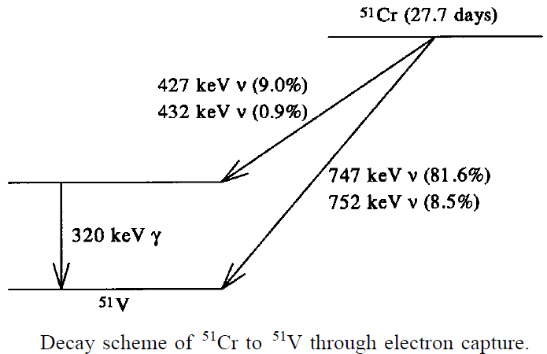
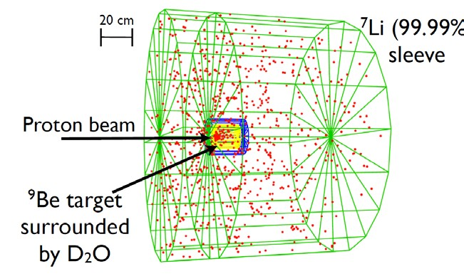
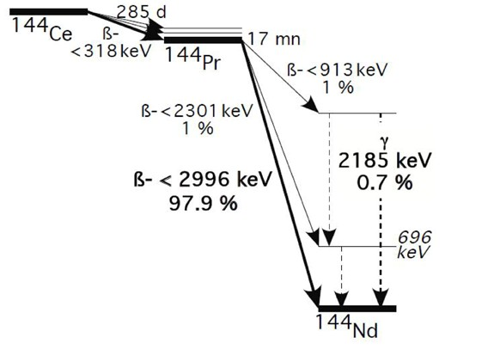
Many processes have been studied
⁵¹Cr: 750 KeV ν; 40 d
¹⁴⁴Ce: <2.99 MeV ν; 411 d
⁸Li: <13 MeV ν; 868 ms
3.7 10¹⁷ ν/s
3.7 10¹⁵ n/s
8.2 10¹⁴ n/s
Production: thermal neutrons on ⁵⁰Cr; n-capture x-sect ~17 b
Advantages: 320 KeV γ emitted by the source not difficult to handle; Enriched Cr still available from Gallex.
Disadvantages: radioctivity is a serious bkg for ν+e→ν+e- detection.
Production: extracted from exhausted nuclear fuel (Russia)
Advantages: detecting reaction anti-+p->n+e+ has very little bkg; long source lifetime.
Disadvantages: s (E=2.2 MeV) emitted by the source are difficult to handle.
Production: IsoDAR, Isotropic Decay At Rest (prototype by 2016): 60 MeV p on ⁹Be tgt -> n moderated and multiplied by D20 shield -> ⁸Li produced in surrounding sleeve of ⁷Li
Advantages: long data taking possible; high Eν.
Disadvantages: flux known at ~5%; Prod. of ⁸Li not point-like (~150 cm).

Slide 14
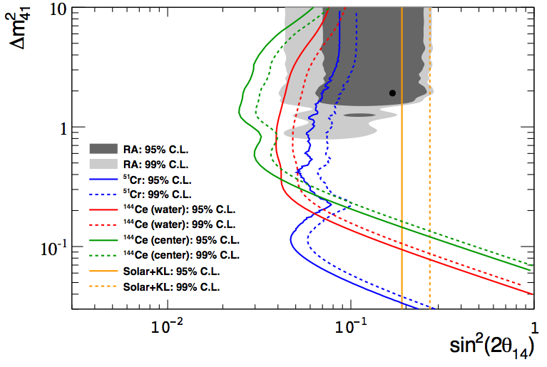
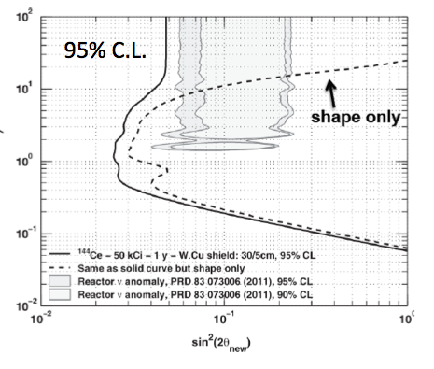
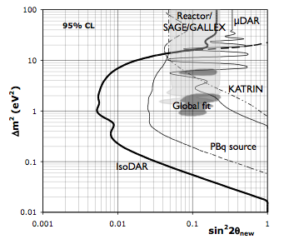
Some examples of different detectors
Borexino detector:
SOX
75 kCi ¹⁴⁴Ce and
10MCi ⁵¹Cr placed
outside/
in water tank/
in inner Scintill.:
Kamland:
CeLAND
Phase 1 (2015): 75 kCi ¹⁴⁴Ce in outer detector
Phase 2 (2016, if feasible): 50 kCi ¹⁴⁴Ce at center of LS
IsoDAR:
R&D proposal to place high-power low-energy cyclotron (DAEdALUS project) in the Kamioka mine to search for an oscillation pattern in Kamland
5 years

Slide 15
An example:Borexino experiment at LNGS
¹⁴⁴Ce source
3 eV²
0.5 eV²

Slide 16
Transport of the ¹⁴⁴Ce source from Russia to LNGS

Slide 17
A definitve clarification of these “anomalies” at FNAL
A single experiment capable to clarify all these anomalies at the appropriate > 5 sigma level is therefore highly desirable.
Our experiment at FNAL is based on two main, innovative concepts and a low energy ν and anti-ν from a proton accelerator.
  The first new concept is the comparison for spectral differences of two (or more) identical detectors located at two different distances. In the case of absence of “anomalies”, the two distributions will be a precise copy of each other, without any Monte Carlo comparison.
  The second new concept is the novel, now fully operational large mass (0.7 k ton) Liquid LAr-TPC detector developed by the ICARUS collaboration. The detector offers a “bubble chamber like” continuous sampling, homogeneous calorimeter with excellent accuracies and the total energy reconstruction of the event from charge integration.

Slide 18
The ICARUS LAr-TPC invention by INFN
  The ICARUS T600 detector, ~500 ton of sensitive mass, has already concluded in 2013 a long duration experiment with LNGS underground lab taking data both of CNGS ν beam and c-rays.
  The detector demonstrated the performance as tracking device (~1 mm³ spatial resolution) and as homogenous calorimeter measuring the total energy with excellent accuracy for contained events. Remarkable particle identification capabilities have been determined exploiting the measurement of dE/dx vs. range.
  Reconstruction of the neutrino interaction vertex, measurements of e.m. showers generated by primary electrons and invariant mass of photon pairs allow to reject to unprecedented level backgrounds in the study of νμ→νe f.i. in LSND like transitions.
  Momentum of non-contained muons can be determined via multiple Coulomb scattering with Δp/p ~15% in the 0.4-4 GeV/c range.

Slide 19
ICARUS physics at FNAL
  The ICARUS Collaboration at FNAL has been enlarged by a number of US teams: Arlington University, ANL, BNL, Colorado State University, FNAL, LANL, Pittsburg University and SLAC) .
  ICARUS detector will be soon moved to the US and exposed to the ≈ 0.8 GeV ν beam from the Booster at 600 m from target, in the framework of the SBN program. The neutrino oscillations are searched comparing the measured spectra with the un-oscillated ones at the nearer sites of MicroBooNE(400 m) and SBND(130 m).
  At shallow depths, a large background of uncorrelated cosmic rays will occur during the 1 ms long the LAr-TPC readout and each triggering event: ~ 11 muon uncorrelated tracks per drift in were measured on surface in Pavia 2001.
  ICARUS will also collect simultaneously a large sample of ve events with the NUMI Off-Axis beam at ~ 2 GeV in preparation to the future DUNE project.

Slide 20
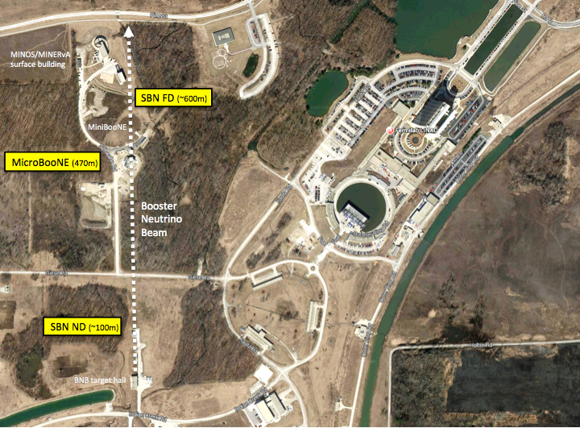
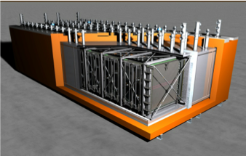


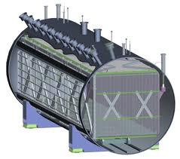
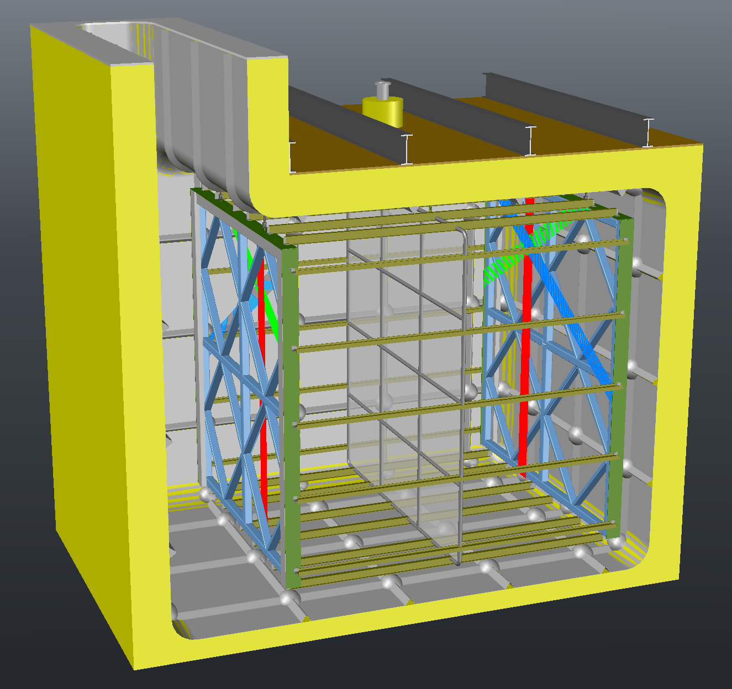

SBN@BNB
ICARUS T600
MicroBooNE
SBND

Slide 21
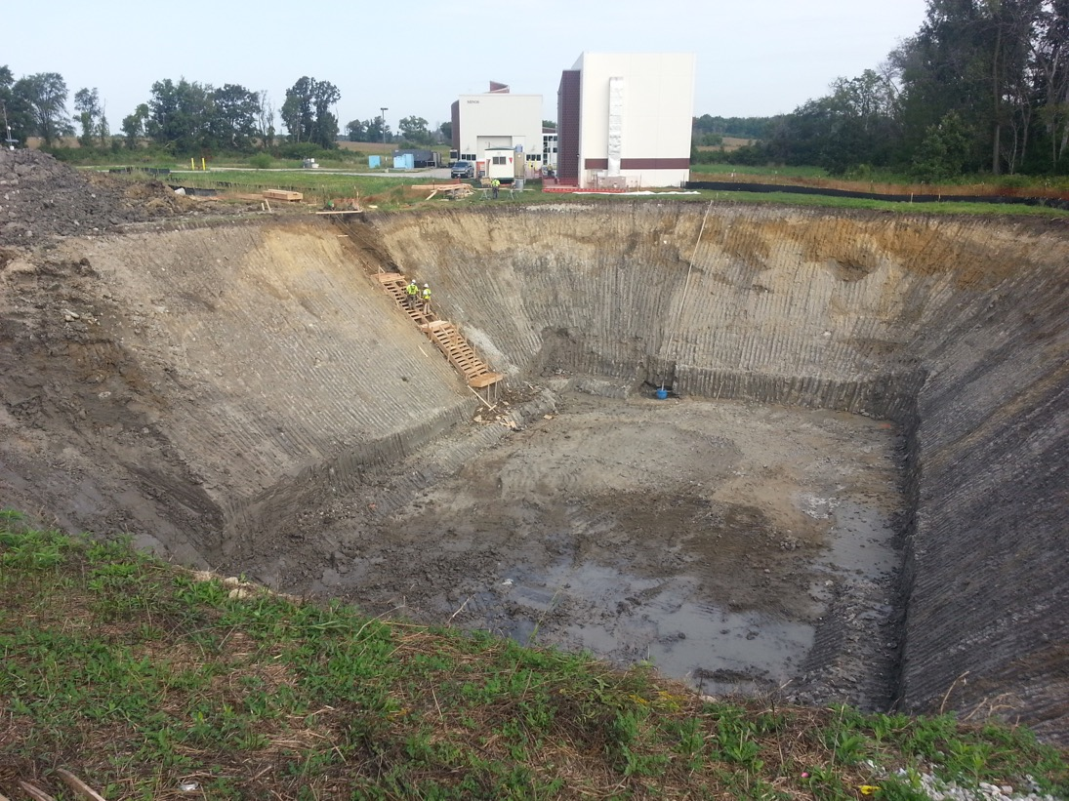
Far Detector building at FNAL
Engineering design of the infrastructures (Far Detector building and services) to host the T600 plant at FNAL has been completed in July 2015. Groundbreaking has started in August 2015.
End of excavation September 4, 2015

Slide 22
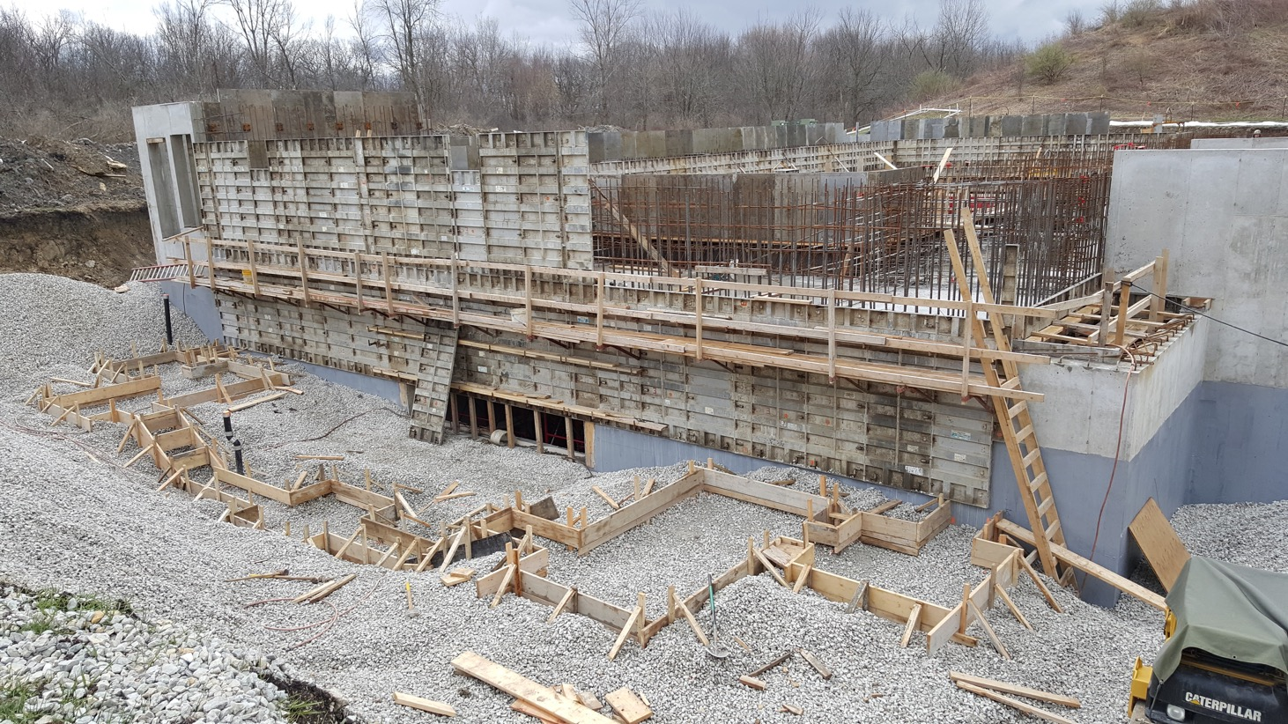
T600 transport and Far Detector building
According to schedule, the two T300 modules will be ready for shipment to the US by the end of 2016, which is compatible with the foreseen beneficial occupancy of the Far Detector building in beginning 2017.
Ground level walls under construction and
preparatory work for the loading dock (front)
April 7, 2016

Slide 23
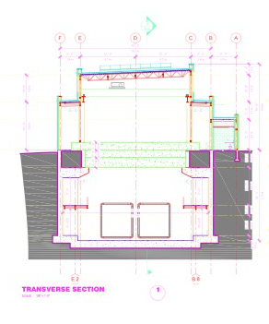
A new building
Transverse section of the FNAL building for T600
3 m overburden
T600
LAr volumes

Slide 24
A “naïve expectation” for the short baseline FNAL program
Let us combine the appearance (LSND) and the disappearances (neglecting oscillations into ν_{τ} and direct νμ↔νe) as coming from an unique sterile neutrino signature with a 4 x 4 matrix U_{ik}.
The general formula in the (3+1) model is then:
where Δm₄₁² is the squared mass difference with respect to the fourth heavier neutrino
Let us take LSND with sin²(2θ_{eμ})= 4|U_{e4}|²|U_{μ4}|² ≈ 1.5 10⁻³
This implies disappearances of both νe and νμ, since sin²(2_{ee})= 4|U_{e4}|² (1-|U_{e4}|²) and sin²(2_{μμ})= 4|U_{μ4}|² (1-|U_{μ4}|²).
Reactors may claim sin²(2_{ee})≈ 0.12,hence |U_{e4}|² = 0.03.
Let us assume in addition also muon-electron Universality, such that νe and νμ disappearances are identical.
Then we expect sin²(2_{ee)}= sin²(2_{μμ})≈ 0.08, still in reasonable agreement within present observations.

Slide 25
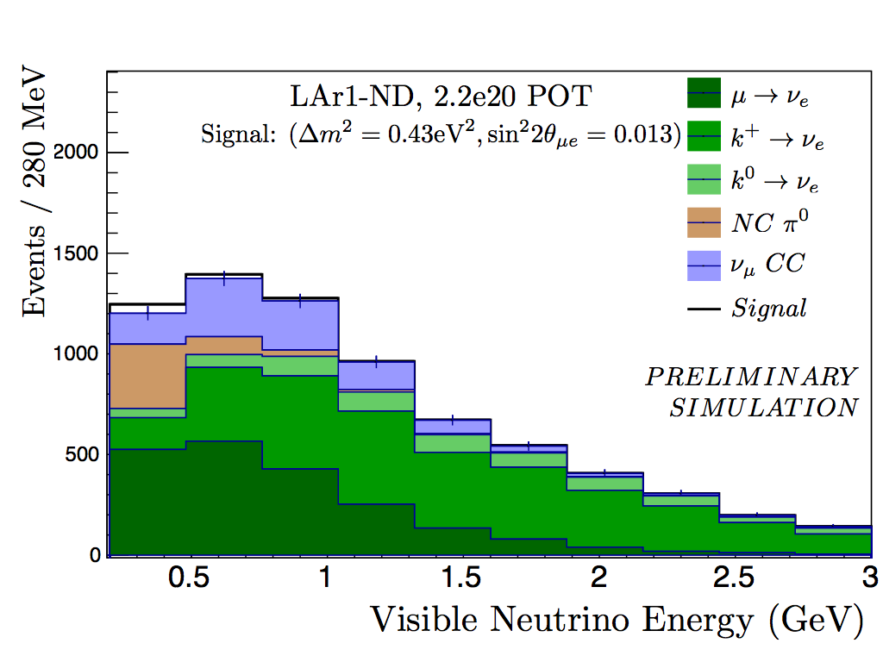
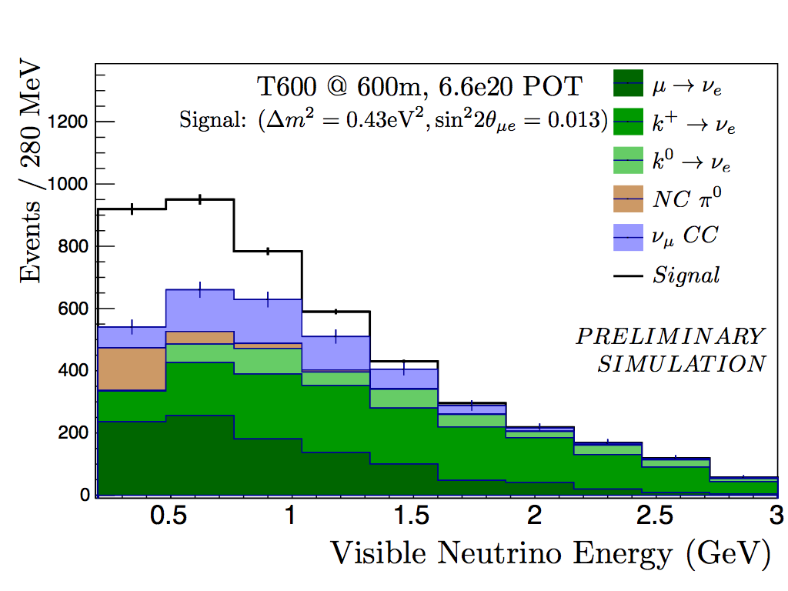

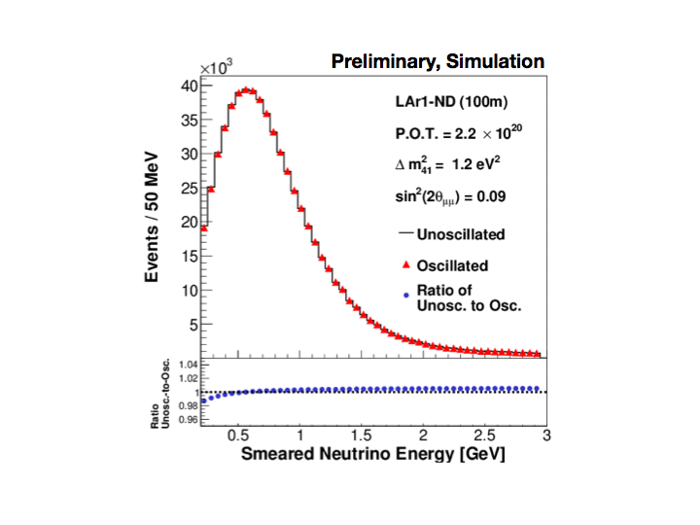
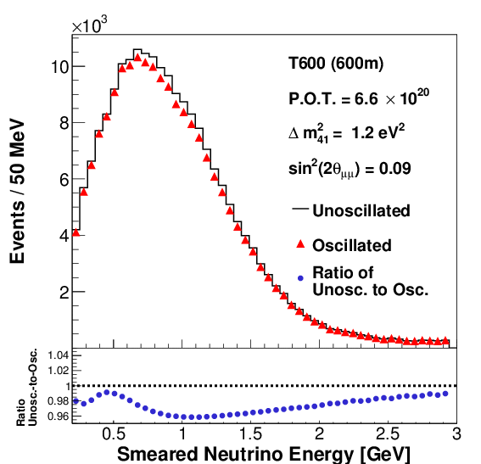

Appearances and disappearances
ND @ 120 m
ICARUS T600 @ 600 m
Δm² = 0.4 eV²
νe Appearance
Δm² = 1.2 eV²
νμ Disappearance
25

Slide 26
Cancellations between disappearance and appearance
There is an important difference between the original LSND and the future FermiLab programs.
This is due to the fact that νe events are now produced both from R_{νe}(E), the “intrinsic” νe source at about 0.5% of the muon rate and R_{νμ}(E) and from a potential LSND νμ-> νe effect.
Therefore cancellation between these two contributions is expected in the detected νe signal S_{νe}:
S_{νe} = [R_{νμ}(E)sin²(2θ_{eμ}) - R_{νe}(E) sin²(2θ_{ee})] sin²(1.27 Δm₄₁² L/E)
Δm₄₁² ,the squared mass difference with respect to the fourth heavier neutrino is a common factor as a function of mass difference and L/E.

Slide 27
Examples of electron neutrino spectra
Giunti Laveder best fit:
Δm² ~ 1.5 eV² ;
sin²(2θμμ) = 0.05 ;
sin²(2θee) = 0.1 ;
sin²(2θμe) = 1.25 x 10⁻³
Extreme case of full cancellation
Δm² ~ 1.5 eV² ;
sin²(2θμμ) = 0.016 ;
sin²(2θee) = 0.1 ;
sin²(2θμe) = 0.4 x 10⁻³

Slide 28
A brief description of the activities of WA104/ICARUS
The WA104/ICARUS program is devoted to "Improving the ICARUS T600 Liquid Argon Time Projection Chamber (LAr TPC) in order to prepare for its operation at shallow depths",
The overhauling activities on the T600 at CERN are progressing, to be completed by end of 2016 and include amongst others:
  new purely passive insulation (1a) and new cold vessels (1b)
  a renovated purification systems (2a) and cryogenics (2b) ,
  inner detectors with better planarity (3)
  an improved scintillation system(4a) and its electronics(4b)
  A faster, higher-performance wire read-out electronics (5)
  Experimental observation of cosmic ray shower events (6)
At FNAL’s shallow depth, the T600 will require two additions:
  3 m concrete overburden to mitigate the c. rays background,
  Particles entering the detector must be removed with a Cosmic Rays Tagging (CRT) around the full LAr volume

Slide 29
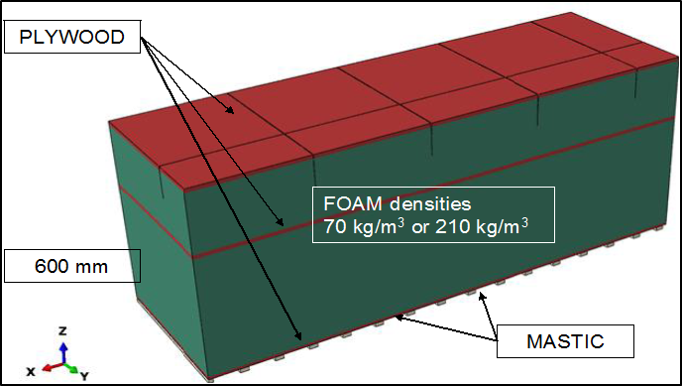
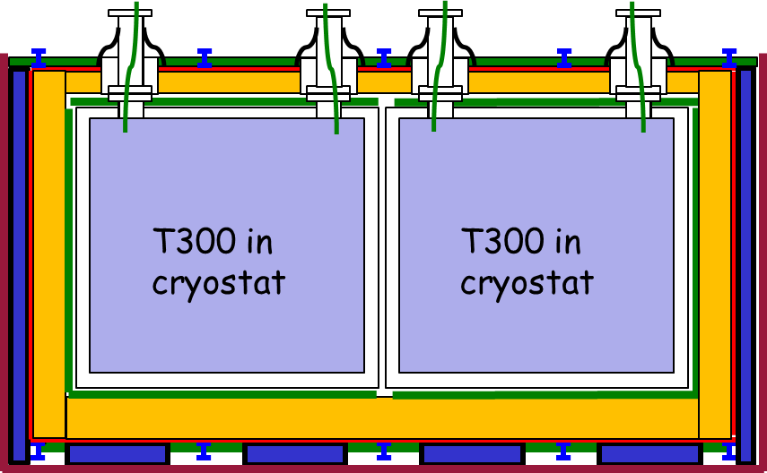
1a.- New purely passive insulation
Purely passive insulation (right), and two-phase N2 cooling shield.
Insulation technique developed with membrane for LNG transport ships. Expected heat loss through insulation: ≈ 6.6 kW (10-15 W/m²).
Preliminary design of the insulation 2 years ago by GTT: to be refined and integrated in the next two months.
Simplified front view in the installed ICARUS detector:
N2 cooling shield;
thermal insulation;
external warm vessel (see next slide).

Slide 30
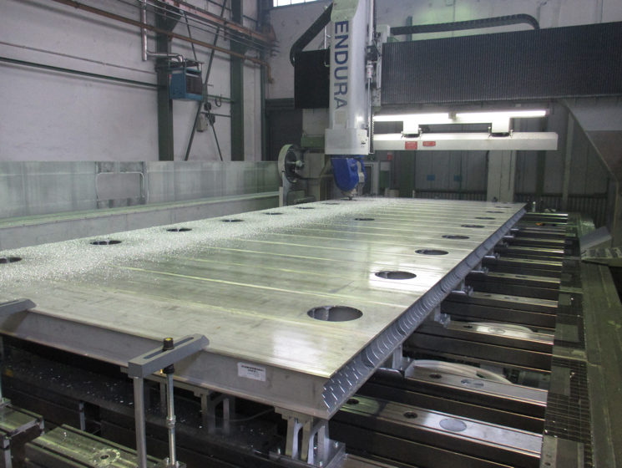
1b.- New cold vessels
The new cold vessels are being assembled at CERN. The production and delivery of the pre-assembled aluminum profiles (orders sent out in 2015) is on schedule.
CERN Main Workshop is proceeding with the stiffening frames, special profiles that will stand the LAr mass. All the pieces (angular and “I” profiles) have been delivered at CERN.
The 1st module is being assembled in bdg. 156 and will be completed in June 2016.
The 2nd will be ready in October 2016: it will be built in bdg. 185, to allow operation in parallel
Roof pre-assembly

Slide 31
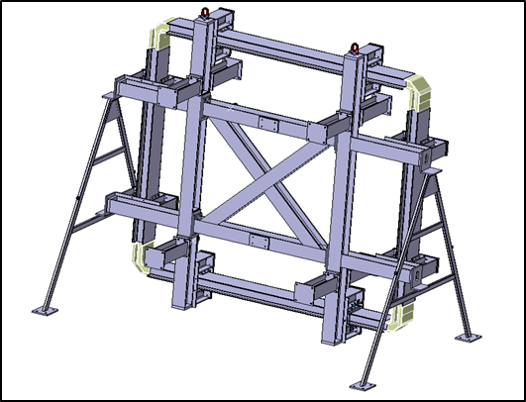
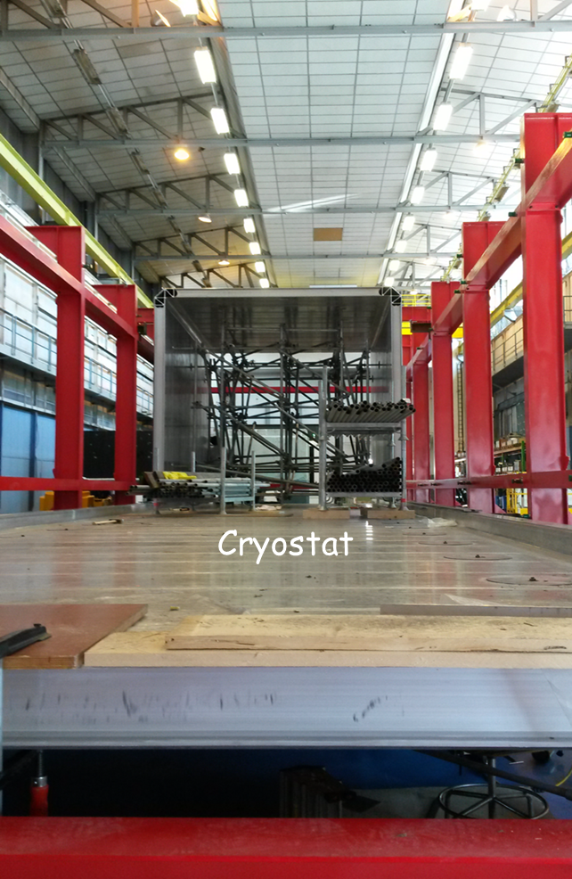
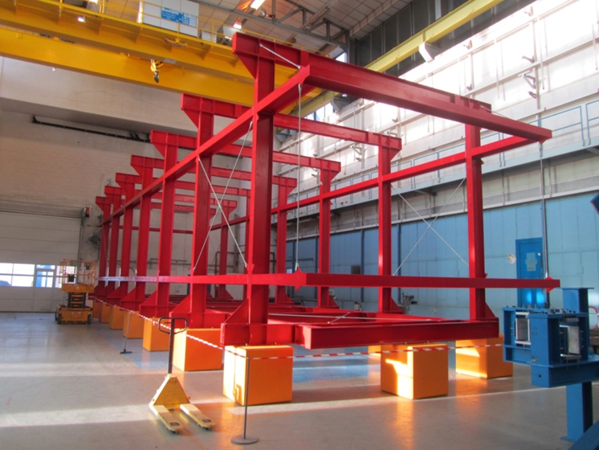
New cold vessels (cont)
A dedicated tool has been built for the assembly of stiffening of frames at CERN.
Main
assembly
structure

Slide 32
Cold Vessels Time Schedule

Slide 33
2a.- Purification systems
Selection of parts to be recovered for operations at FNAL is underway, with the help of CERN Cryolab group.
Tests of the new, dual-phase N2 cold shield have been done in 2015. Lab. measurements confirm the numerical model, and technical drawings now are being prepared.
Oxysorb/Hydrosorb filters used in the previous ICARUS experience allowed reaching extremely high purity results (electron lifetime τe > 16 ms), but their content of hexavalent Chromium has raised safety issues for use in US laboratories.
A search for chemical residuals of Chromium was performed at CERN on the T600 detector in 2015, yielding negative results.
Filters based on Copper, have been proposed by FNAL. Such purifiers were developed by the lab. personnel, carrying out regeneration in house. The filters are made of alumina pellets with Copper deposited on them (10% mass of Cu). Copper surface is rough, in order to increase active adsorption area

Slide 34
Characterization of copper filters
A small, 50 liters TPC at CERN is presently used to characterize these Copper filters.
Results with gas circulation show that purification capability is compatible with ICARUS needs: easily reached τe > 10 ms, above the sensitivity of the 50 l chamber.
Measured adsorption capacity in gas is of 5 g of O2 per kg of filtering material. Further tests for purification in liquid phase are being prepared.
According to experience from US colleagues, a factor 5-10 decrease in adsorption capacity is expected at cryogenic temperatures.
The final choice is still under discussion between the Oxysorb commercial solution widely used in Europe (ICARUS, ATLAS), and copper purifiers.

Slide 35
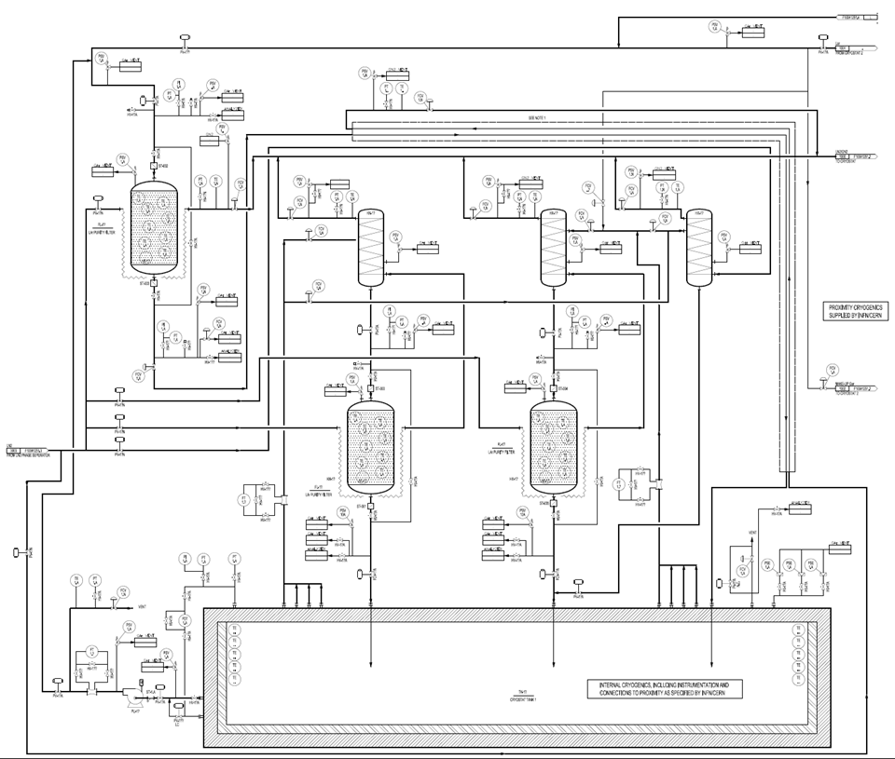
2b.- Cryogenics specifications
Example of Process and Instrumentation diagram (P&ID) for the T600 @ FNAL, developed in collaboration between ICARUS and CERN Cryolab group.
Drawings and technical specs for the ICARUS detector are being finalized, and a tendering document is in preparation.
Tender opening is foreseen for June 2016.
The tender concerns the proximity cryogenics of all the Argon detectors included in the Neutrino Platform.

Slide 36
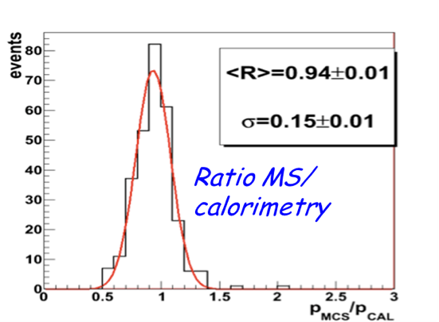
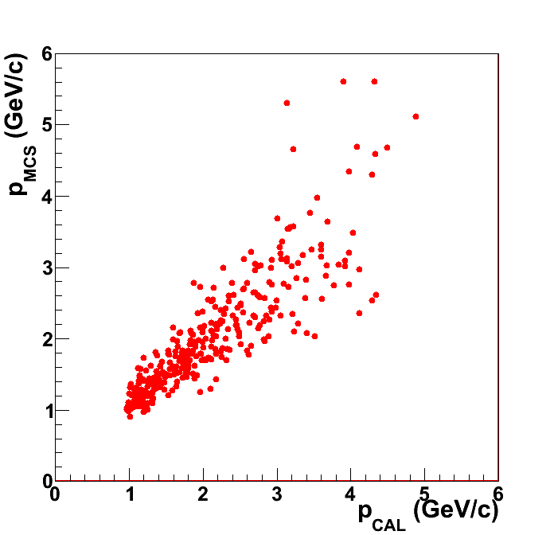
3a.-Inner detectors with better planarity
  Muon momentum measurements by Multiple Coulomb Scattering (MCS) has been demonstrated at the CNGS experiment with Δp/p ~ 15% in the few-GeV region and Lμ ≈ 4 m.
Unexpected deviations for p > 3 GeV/c have been observed for tracks travelling at d < 50 cm from the cathode, caused to a non-perfect planarity of TPC cathode panels.
The consequent apparent deviations of tracks would mimic a larger MCS, resulting in an underestimation of the momentum.
Lμ = 4 m
Initial p from MS ->
Initial p from calorimetry ->

Slide 37
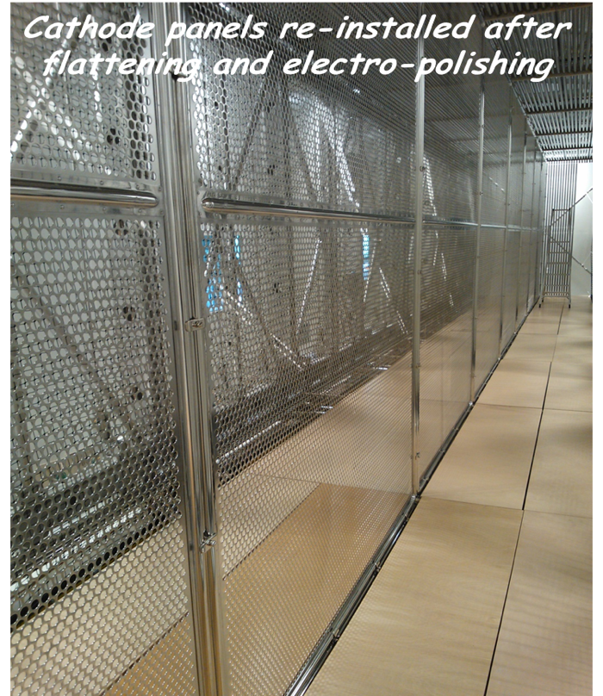
3b.-Refurbishing of the cathode panels at CERN
  A thermal treatment, including local heating and pressing was applied to the panels of the first T300 module in September 2015. The intervention, performed by CERN Main Workshop, was successful in reducing the non-planarity to within few mm.
  Panels have been reinstalled in the detector after cleaning and electro-polishing.
  The TPC cathode of the second T300 module will be treated during this summer.
These interventions will improve the event imaging and track reconstruction for the future of ICARUS T600.
Slide: 37

Slide 38
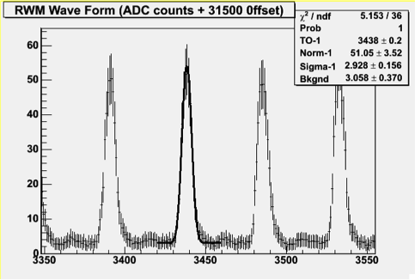
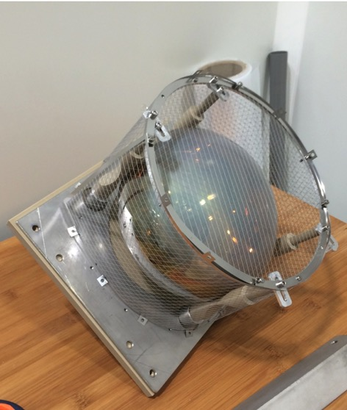
4a.-The new T600 light detection system
The improved light detection system has been designed to ensure:
  The generation of a more sophisticated light based trigger signal;
  The identification of the time of occurrence (t0) with high temporal precision of ≈ 1 ns, to exploit the available 2ns/19ns bunched beam structure of the FNAL Booster.
  An initial identification of the various event topologies.
  New shielded mechanical supports which prevent the induction of PMT signals to the collection planes.
19 ns
FWHM 2 ns

Slide 39
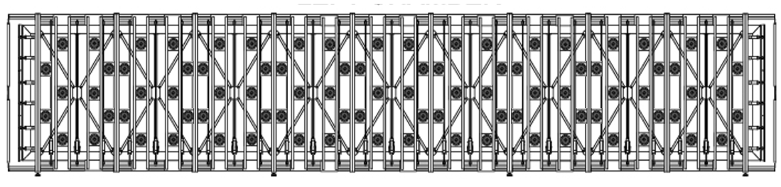
The new T600 light detection system
X axis
(vertical direction)
Z axis (beam direction)
The new light collection system consists of 90 PMTs 8‘’ HAMAMATSU R5912-MOD for TPC, installed behind each wire chamber (360 PMTs in the whole T600). About 200 μg/cm² of wavelength shifter is deposited on each PMT window. The photo-cathode coverage corresponds to 5% of the wire plane area.
The number of photo-electrons collected per MeV of deposited energy in a single TPC is ~ 15 phe/MeV (9 phe/MeV for events close to the cathode) allowing the possibility to trigger low energy (100 MeV) events with fairly high threshold and multiplicity.

Slide 40
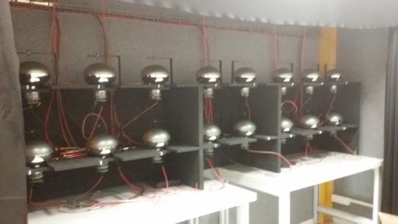
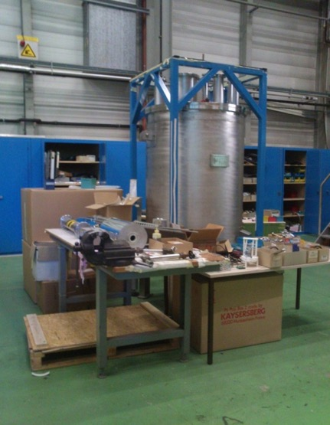
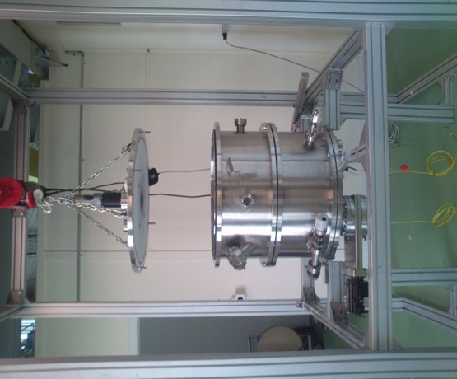
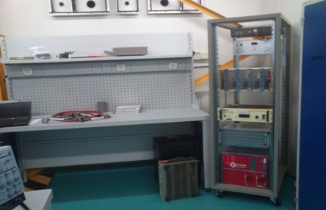
Present PMT activities at CERN
Activities on the PMTs are organized at CERN in three different areas:
Room temperature tests
IdeaSquare building 3179
Tests can be carried out in consecutive bunches of 16 samples.
Cold tests
building 182
A cryogenic facility allows the simultaneous measurement of 10 PMTs in a LAr bath.
TPB deposition
TE-Laboratory hall (B169)
The facility allows the production of ~5 coatings per day.
Dark Room
Test laboratory
Cryogenic laboratory
Evaporator
Slide: 40

Slide 41
4b.- PMT electronics and calibration system
The electronics for PMT signals must offer recording of the fast component of the scintillation light and, at the same time recording of the photons of the slow LAr component (1.6 µs).
The ADC sampling frequency should be sufficiently high, in order to allow a time resolution of 1 ns, with a buffer size sufficient to collect all events occurring during the 1 ms LAr-TPC acquisition windows. Possible acquisition boards will be tested in the next months.
To obtain a 1 ns timing, equalization of all the channels will be performed with the help of a signal of a fast LASER.
The system will be made by fused fiber splitters, optical switches and optical patch-cords. The fibers to be inserted in the detector have been selected for LAr temperature endurance and have been commissioned. Each element of the system will be tested for installation and functionality.

Slide 42
5.-A new, higher-performance read-out electronics
ICARUS-T600 electronics was organized in sets of 32 low noise amplifiers, a tree of 8 analog multiplexers, of 4 10-bit ADCs, of 2 digital multiplexers, that result in a 2.5 MHz AD conversion (400 ns sampling). A digital VME module provides storage, data compression & trigger information.
Some limitations, due to the technology when electronics was first conceived, can be now overcome. Improvements concern:
  adoption of serial synchronous ADCs, one per channel;
  housing and integration of electronics on detector flanges;
  adoption of a modern serial bus architecture (instead of VME) with optical links for faster transmission rate (Gbit/s).
The imaging “quality” of a LAr TPC is fully based on mechanical accuracy, LAr purity, and electronics that treat the signal.
In the following we show that we don’t need to change our basic architecture, but only adopt more modern components.

Slide 43
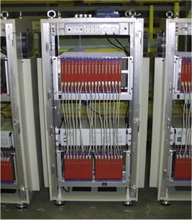
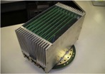
A new simplified/compact design
Adoption of single ADCs (12 bits, one per channel) in place of the multiplexed arrangement used in T600 al LNGS.
Sampling of channels (400 ns/s) of the whole detector are now synchronous, improving for instance the μ momentum of MCS with < 4 GeV/c and 4 m length to Δp/p to 12%.
The digital part is contained in a single high performance FPGA in each board, handling signal filtering and the information of ADCs.
The new compact design allows the hosting of both analogue and digital electronics directly on the flanges.
Prototype boards are under test at INFN-LNL and CERN.
From 595
to 10 liters

Slide 44
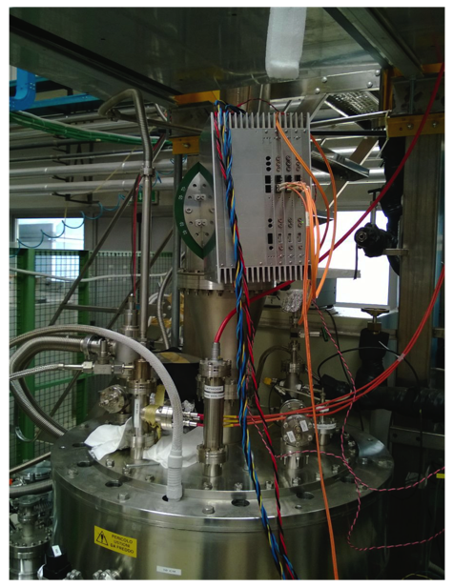
Electronics optimization
The new electronics response is designed to be faster without undershoot with optimized shaping. So far the approach is:
  signal integration by pre-amplifier (long shaping time) followed by zero-pole cancellation circuit;
  short shaping time preserves bipolar signals in induction planes allowing for numerical integration of the digitized output.
Ongoing tests at Lar TPC facility in CERN and LNL facilities.
Significant improvement on the Induction wire planes is obtained.
New cables have been selected. First delivery is expected in April.
Test set-up on ICARINO at LNL

Slide 45
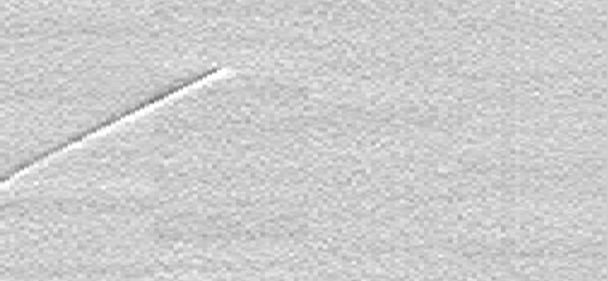
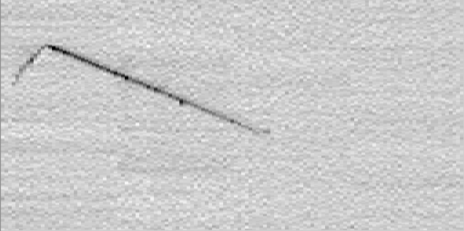
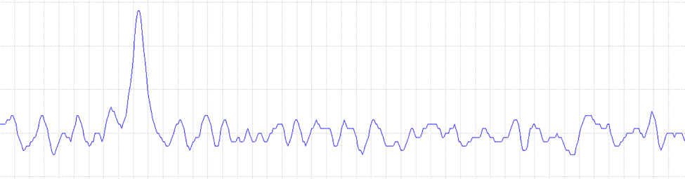
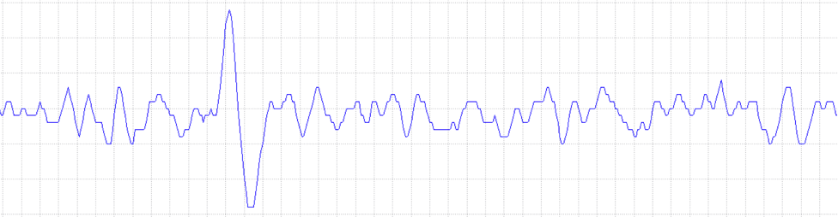
Cosmics test @ CERN LAr TPC facility
dd
180 µs (280 mm)
Drift velocity 1.5mm/µs
128 collection wires (325 mm)
128 induction wires (325 mm)
40
Collection signal (on a single wires)
0
Pulse height in units of~400 el/count
Drift time (180 µs, 4µs/div)
25
Induction signal (on a single wire)
-5

Slide 46
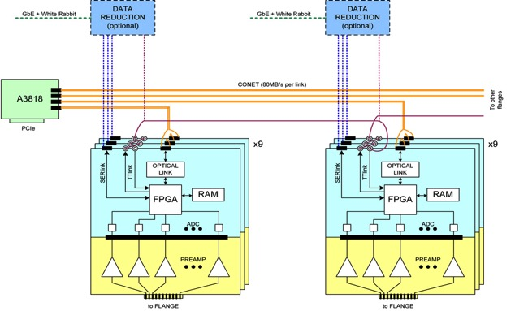
DAQ architecture
Prototypes under development use CONET-2 (by CAEN) transfer protocol (80 MB/s) and a A3818 controller. The system will guarantee the full TPC drift data recording even in case of a Booster repetition rate of 15 Hz (47 MB/s).
A DAQ demonstrator of the basic functionality has been setup at LNL and CERN for integrating the synchronization and readout of multiple TPC front-end units with the PMT system.

Slide 47
6.- Simulation of cosmic ray (νe) events
Primary cosmic rays electrons and hadrons are are strongly attenuated by an heavy concrete shield. However, secondary interactions may enter the T600 and be confused with νe events.
The propagation of the cosmic primary flux, predicted by CRY through the overburden with GEANT4 and FLUKA codes shows comparable and substantial differences especially in the rates of hadrons passing through the concrete shielding (up to a factor 4).
Therefore, an experimental verification in comparison with the simulation is required and it will be performed at CERN with the much smaller WARP detector, already operated extensively at LNGS, which offers the opportunity to provide experimentally crucial information on cosmic ray induced background events.
  the apparatus is also configured to ensure convincing proof on a relatively smaller verification of several technologies required for the T600 upgrade at CERN before going to FNAL.

Slide 48
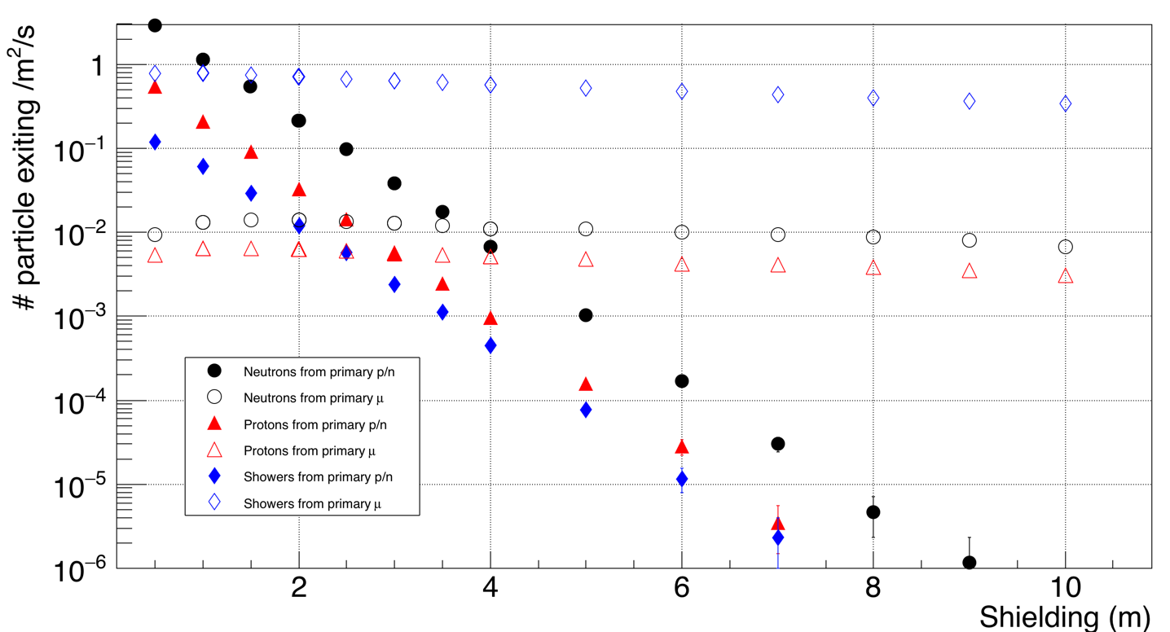
Comparison in T600 of penetrated particles from n+p and μ
1/100
showers
neutrons
Secondary from muons
protons
neutrons
Secondary
from hadrons
protons
showers
Kinetic energy threshold for the particles exiting: T > 200 MeV.
While only ≈ 1% of muon induced showers may show no presence of the visible µ, showers from hadrons remain mostly unaccompanied.

Slide 49


The ICARUS – WARP cosmic ray facility
  The apparatus consists of a LAr-TPC - 1.8 m width x 1.8 m length x 3.2 m height - inserted in the existing WARP cryostat, a cylinder of 3 m diameter and 6 m of height and ~15 t active LAr mass, surrounded by a 4π CRT.
  The chamber is composed of 3500 wires organized in 3 planes, with 3 mm pitch/plane spacing oriented at 0⁰,+/- 60⁰ w.r.t. horizontal direction. A 500 V/cm electric field is applied over 1.8 m drift distance.
  Scintillation light will be collected by 10 PMT 8’’ Hamamatsu coated with TPB wave-shifting, located behind the TPC wire planes.

Slide 50
Cosmic Rays induced background measurement
The proposed facility will be exposed, below a 3 m overburden, at an estimated rate of ~ 460 ev/s with mostly cosmic μ’s giving a LAr signal E >100 MeV in the TPC.
A first mandatory reduction is provided by the 4π CRT with an estimated anti-coincidence rate of 98%, leading to a ~9.2 ev/s rate.
The integrated c-ray active time of the ICARUS-T600 has been estimated to be 211 s during the 3 years of beam exposure with FNAL neutrino beam.
The equivalent c-ray dose can be collected with WARP in ~ 55 hours of active time (200’000 triggers), at the limited rate of 1 ev/s. Therefore it should be possible to record in a reasonable time several relevant data samples with different conditions.
The first step of data reduction would consist of selecting events requiring the presence of an e.m. shower, expected in ~1% of the cases, leading to a more reasonable number of events to be studied with the LAr-TPC.

Slide 51
Conclusions and moving to FNAL
We expect that the two T300 modules will be ready for transportation at the end of 2016, in correspondence with the beneficial occupancy of the Far Detector building at FNAL.
The transport of the equipment to the US will require about 2 months, funded by CERN for an estimated amount of 1 Million SF.

Slide 52





Thank you !
LNGS_May2011
Slide 52

