Slide 1

Experience adding computing static information in GOCDB
Information System Task Force
12th May 2016

Slide 2
Current dependency on the BDII
LHC VOs rely on the BDII to discover CE queues and related information
  But only a few attributes!
  There is no need to provide more information and run the BDII only for this!
Attribute generic name | GLUE 1 | GLUE 2 | Example
CE endpoint | Included in GlueCEUniqueID | GLUE2EndpointID | ce503.cern.ch:9619
Queue name | Included in GlueCEUniqueID | GLUE2ComputingShareMappingQueue | grid_2nh_atlas
CE type | GlueCEImplementationName | GLUE2EndpointImplementationName | HTCondorCE
CE LRMS type | GlueCEInfoLRMSType | GLUE2ManagerProductName | Condor
Max CPU time | GlueCEPolicyMaxCPUTime | GLUE2ComputingShareMaxCPUTime | 2880
Max Wallclock time | GlueCEPolicyMaxWallClockTime | GLUE2ComputingShareMaxWallTime | 2880

Slide 3
Proposal
Provide static computing attributes through the GOCDB/OIM extension properties
  Stop dependency on the BDII service for computing information
  Agree on a naming convention for the attributes
    Using GLUE 2 seems the best option
  Agree on the possible values for the type names
    We could be aligned with GLUE Enumerated types
      https://github.com/OGF-GLUE/Enumerations/blob/master/ServiceType_t.csv
  All the details:
    https://twiki.cern.ch/twiki/bin/view/EGEE/StopBDII#Computing

Slide 4
Experience from Glasgow (I)
Thanks to Gareth Roy for this
Manually added the relevant attributes:
  https://goc.egi.eu/portal/index.php?Page_Type=Service&id=2712
  https://goc.egi.eu/portal/index.php?Page_Type=Service&id=2711
  https://goc.egi.eu/portal/index.php?Page_Type=Service&id=2710
  https://goc.egi.eu/portal/index.php?Page_Type=Service&id=5541
Very simple to do, takes a few minutes
  Implies editing key/value pairs
    But it could be done using bulk add editing feature! (See next slide)
    And we are also requesting a writeable API (see next presentation)

Slide 5
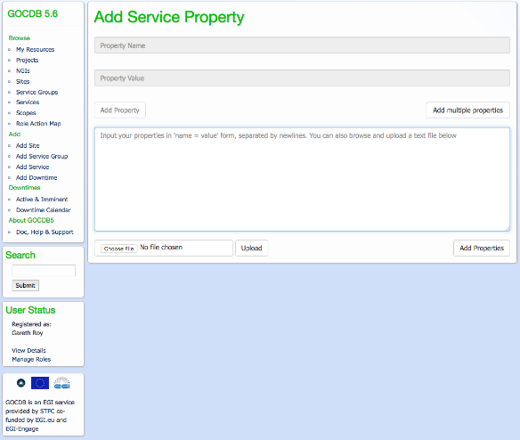
Experience from Glasgow (II)
GOCDB allows to bulk add several attributes
Even uploading them from a file
The site can maintain this file through version control

Slide 6
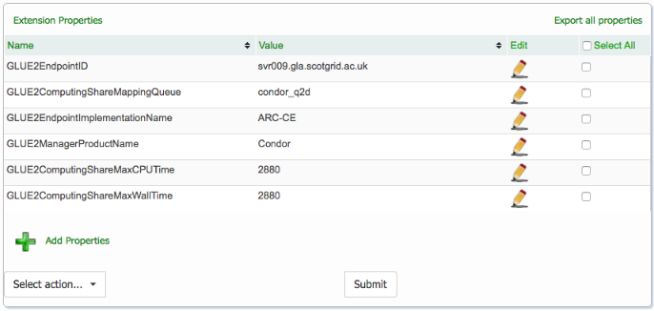
Experience from Glasgow (III)
All extension properties can be exported from GOCDB in the correct format for modifications and re-uploading as well

Slide 7
What about OIM?
It is also possible to add key/value pairs
For instance, Max Wall Time was added in this resource as an example
  https://oim-itb.grid.iu.edu/oim/resourceedit?id=3
To be tested in practice but in principle no problems from a technical point of view

Slide 8
Next steps
Use AGIS to consume this information from GOCDB/OIM instead of BDII
  If OK, evaluate whether this could be done also for other experiments
    Understand what changes are needed in their frameworks/tools
Ask remaining sites to provide this information in GOCDB/OIM
When all sites provide this information in GOCDB/OIM AND experiments consume it from there, stop publishing on BDII
    Provide a recipe similar to dedicated WLCG storage

