Slide 1



Searches for other new phenomena in final states with leptons and photons in ATLAS and CMS
W. Fedorko

Slide 2
Introduction
In this talk:
  Contact interactions / compositeness
    Non-resonant interpretation of dilepton search
    Excited quarks and leptons
    tttt contact interaction
  Multilepton searches
    H⁺⁺ Σ
    Seesaw type II and III
  Photon as a ‘tag’ – light resonances
NOT in this talk
  Dark matter
  High mass resonances
  Vector-like quarks
  Leptoquarks
  Heavy neutrino
  Displaced vertices, hidden valleys
  Heavy charged particles.
  …

Slide 3

Quark and lepton compositness: Why and how?
‘Family’ structure of leptons and quarks
Free parameters of SM
Excited quarks and leptons
Contact interaction signatures
2
q
?
q
+
q
Z / γ*
q

Slide 4
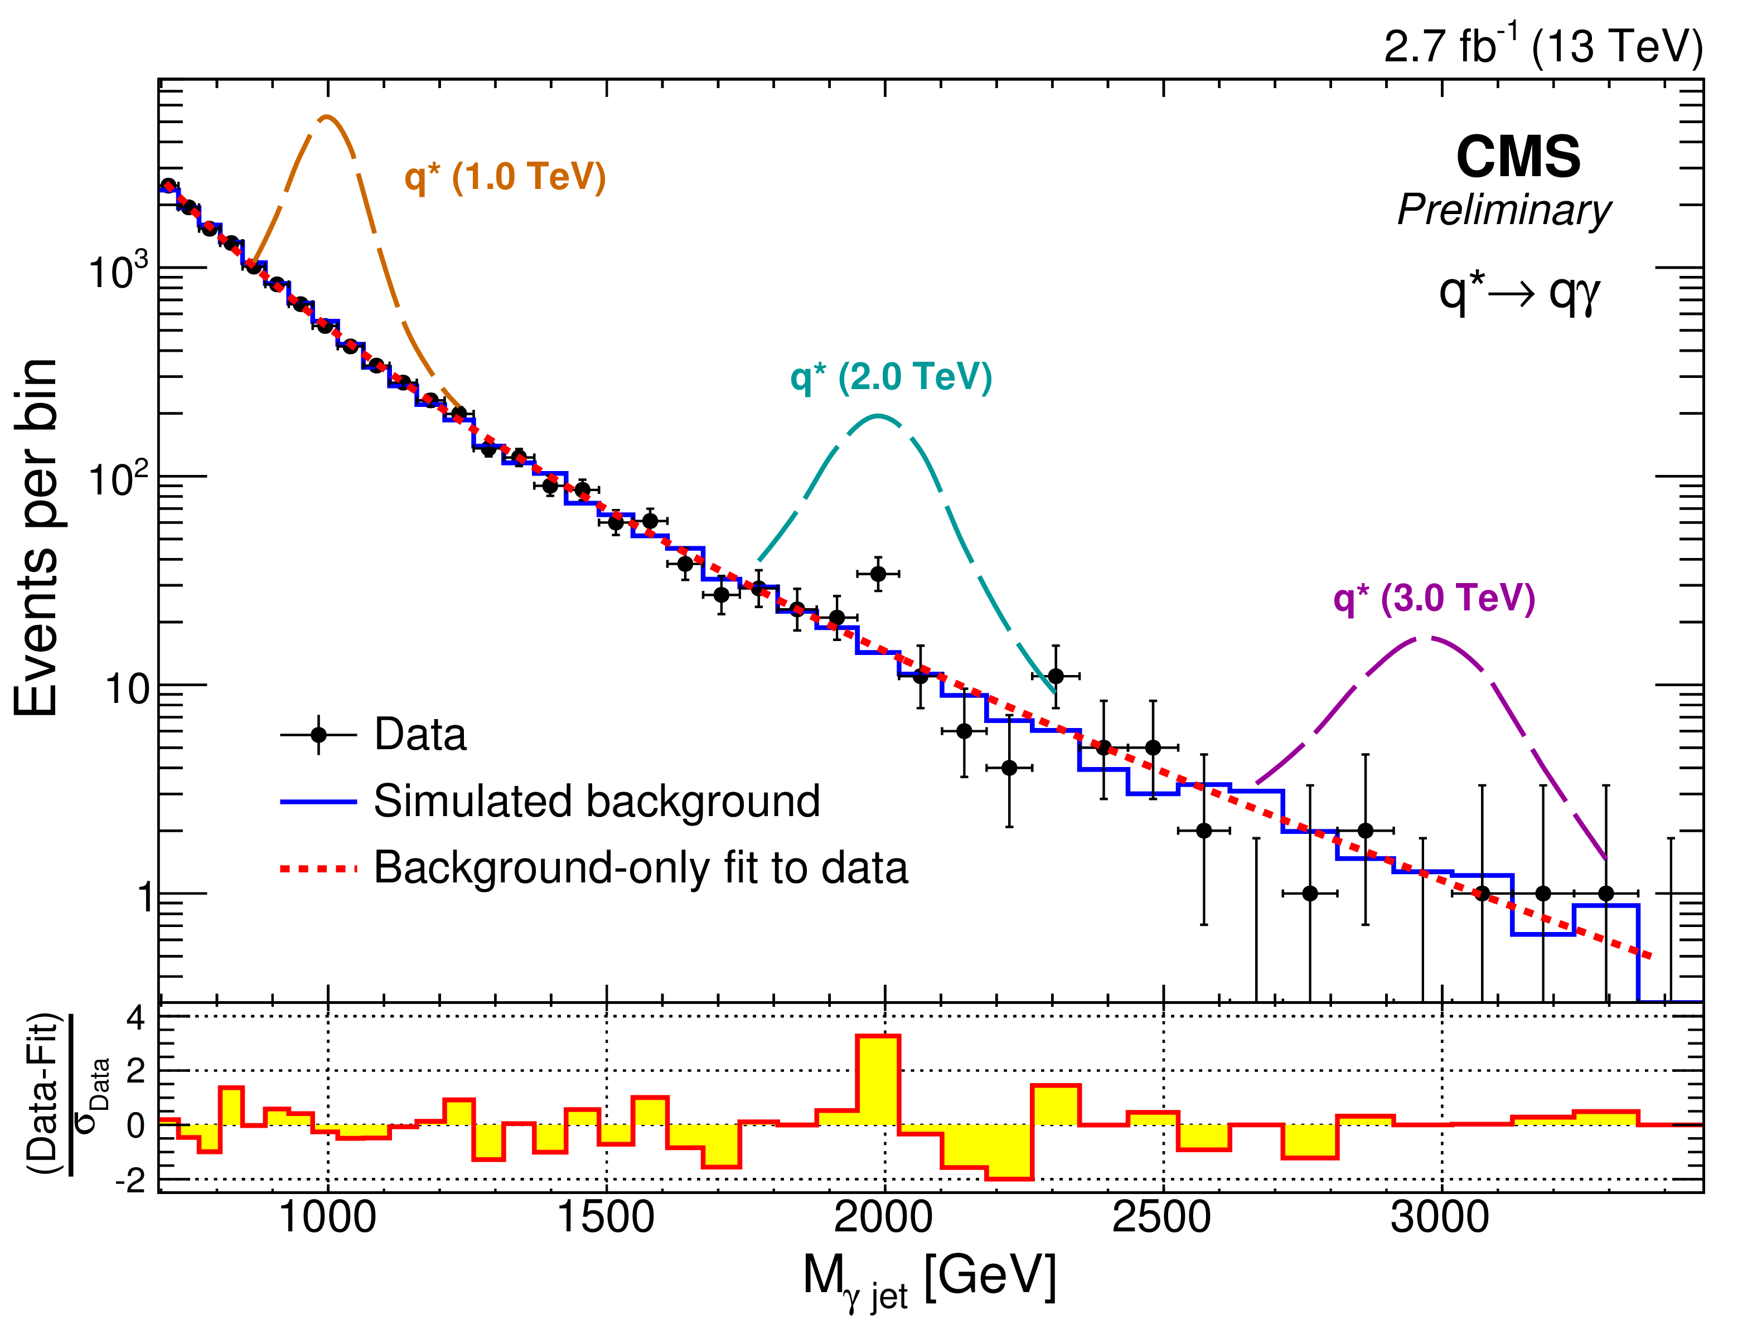
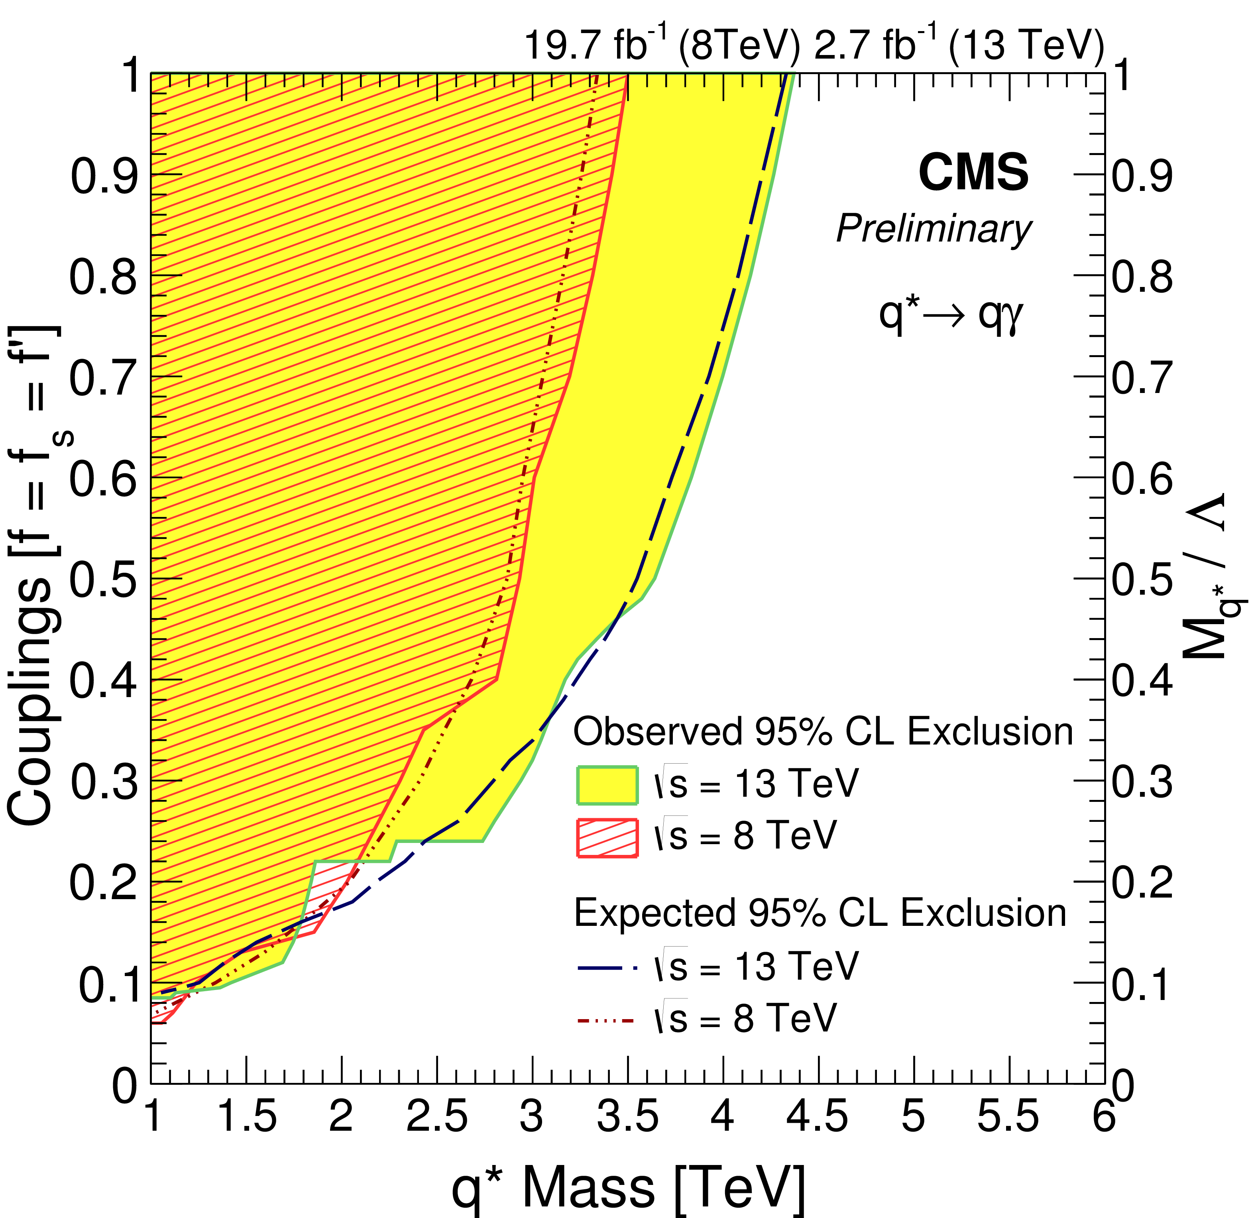
Excited quark search
CMS-PAS-EXO-16-015
ATLAS 3.2/fb M_{q*} > 4.4 TeV
ATLAS CMS dijet M_{q*} > 6.0 TeV
High p_{T} (>190 GeV) barrel photon
High p_{T} jet (>190 GeV)
  Back-to-back to photon (Δϕ < 1.5)
  Close in pseudorapidity to the photon (Δη < 1.8)
M_{γ,jet} > 695 GeV
Background from fit
q
γ
q*
f_{s}
q
f,f’
14 exp 34 obs
f=0.1 3.7 σ local 2.8 global
4.4 TeV
Notes:
JER PER 5% on signal shape width. 4% photon id > 1TeV 2.7% lumi; width 3% x f^2 x Mq*

Slide 5
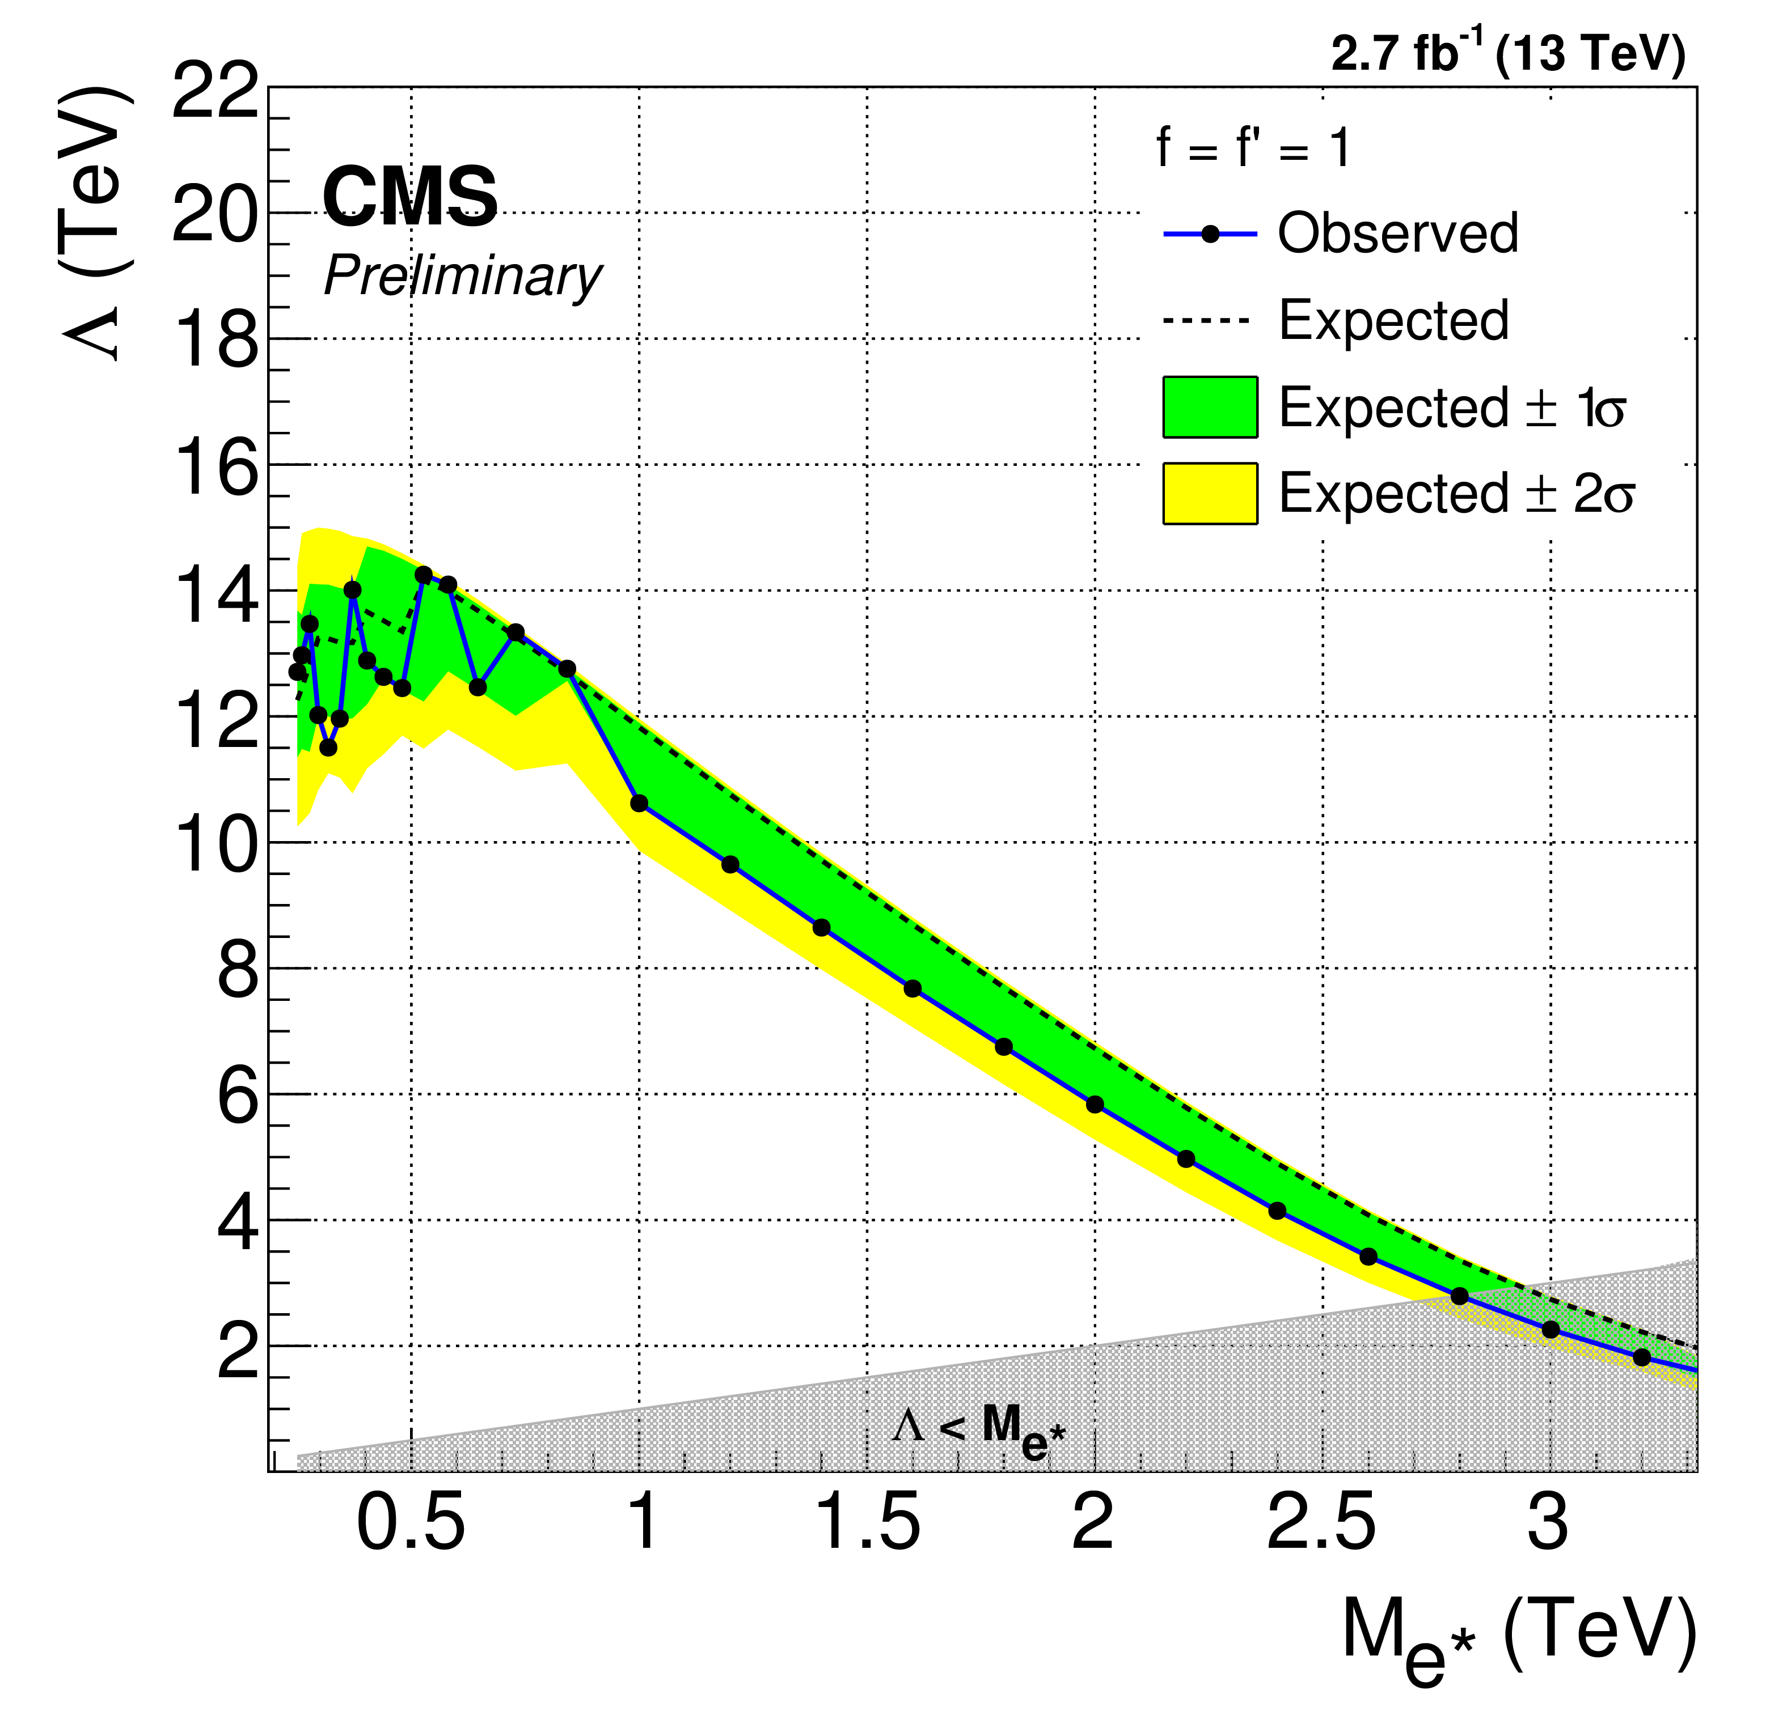
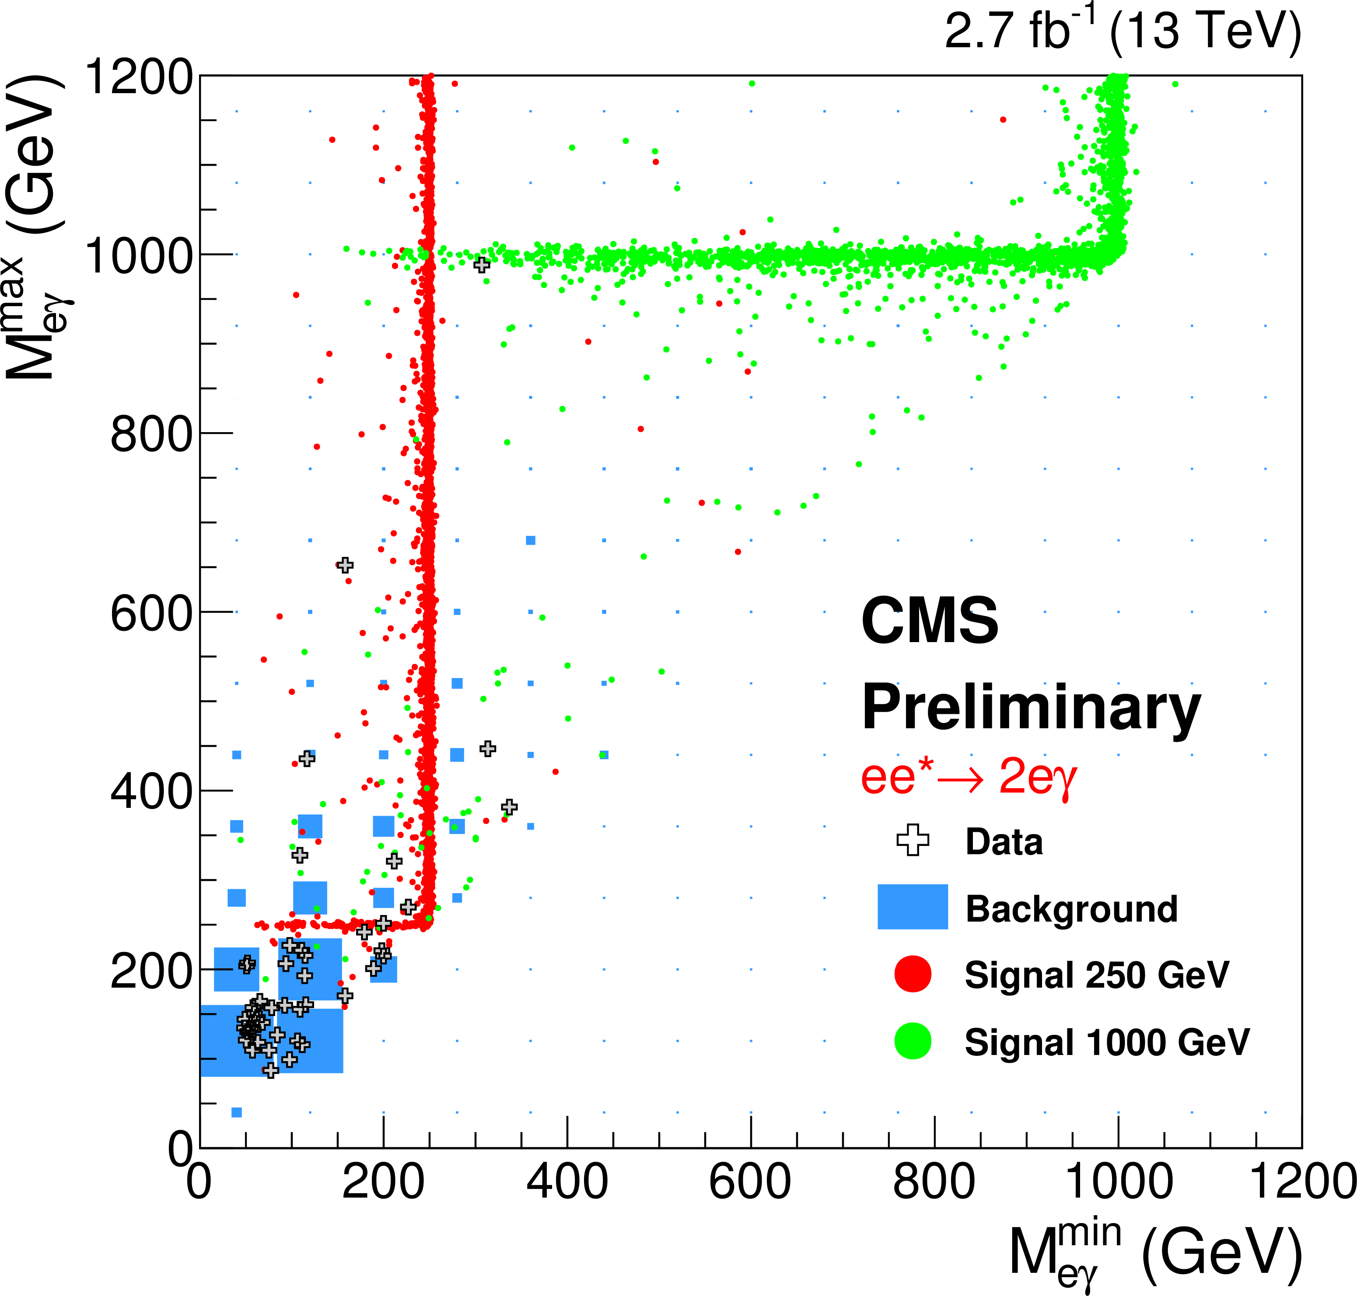
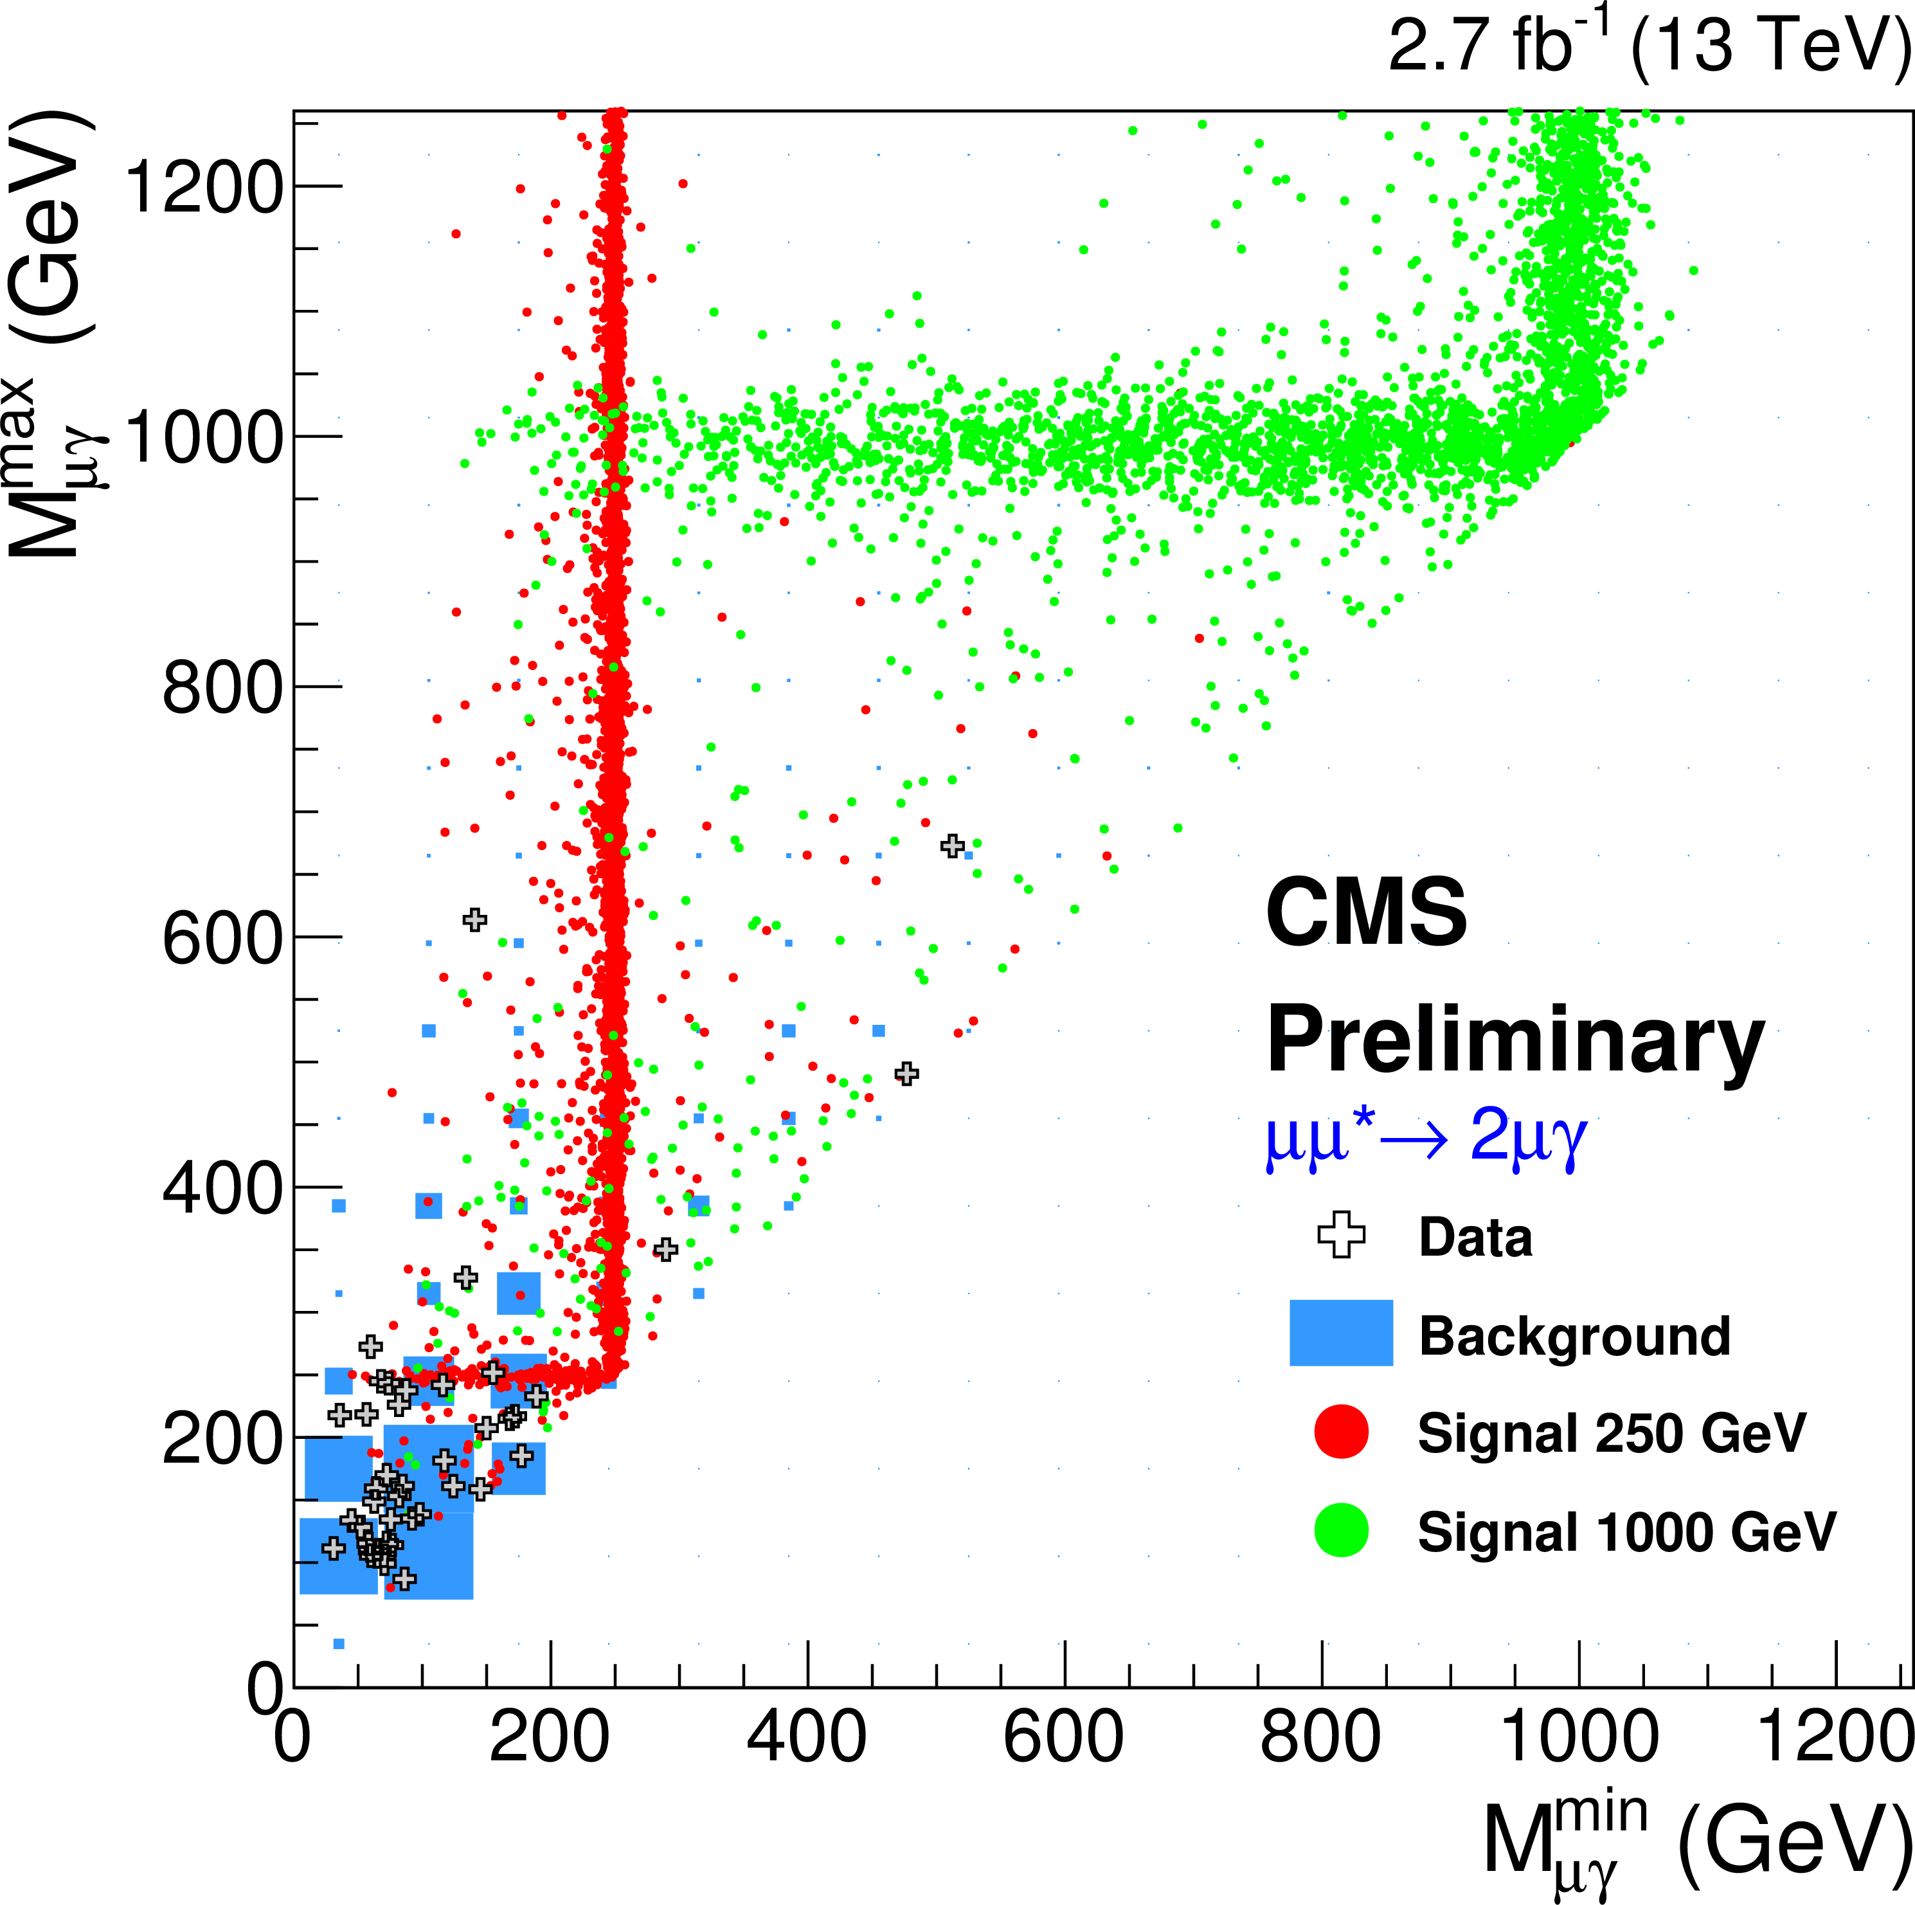
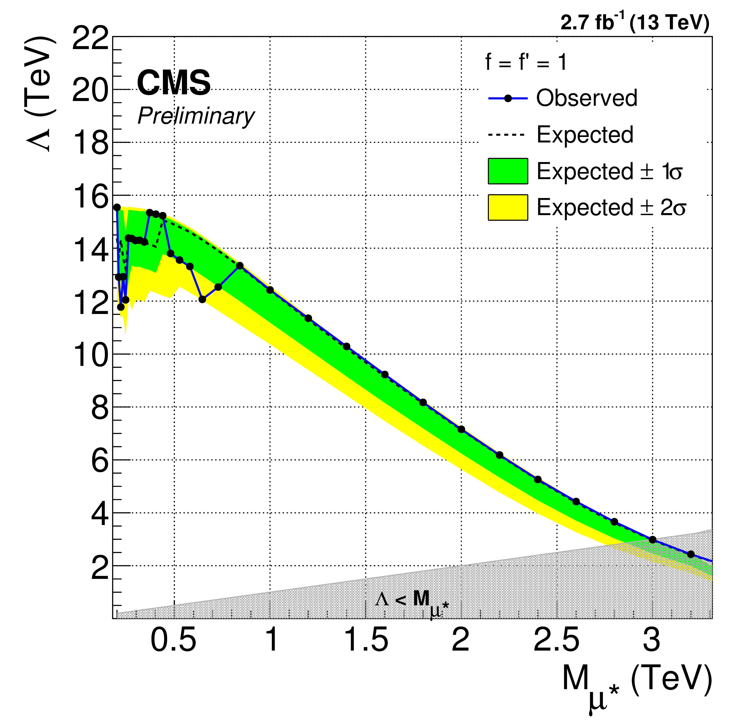
Excited leptons search
CMS-PAS-EXO-16-009
ATLAS μ* CI mediated 8 TeV
ATLAS l* 8TeV
γ
Two same flavour leptons
Barrel γ (|η|<1.44)
ΔR(γ,l)>0.7, Z-veto (m_{ll} > 116 GeV)
MC Background estimate for all prompt leptons and prompt γ
Data driven for fake γ and fake e
Form M_{lγ}^{min} and M_{lγ}^{max} – define ‘L’ shaped window depending on l* mass → counting experiment
q
l*
l
q
l
2.8 TeV
3.0 TeV
Notes:
Dilepton trigger DY+gamma NLO fpr p_T_gamma<130 GeV

Slide 6
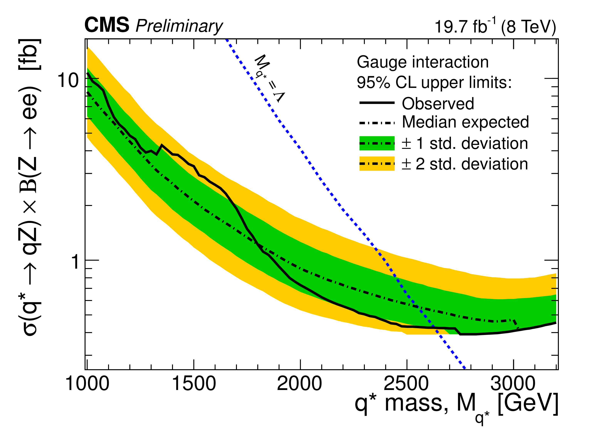
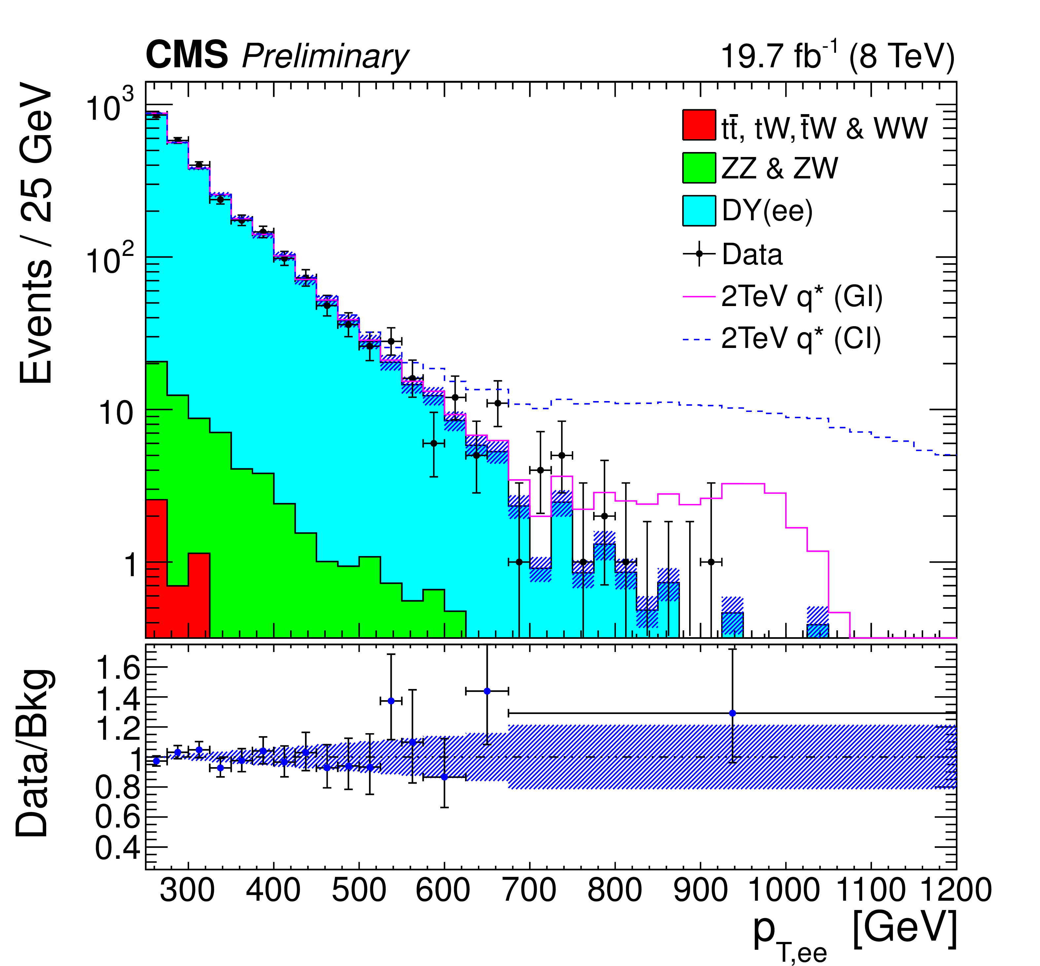
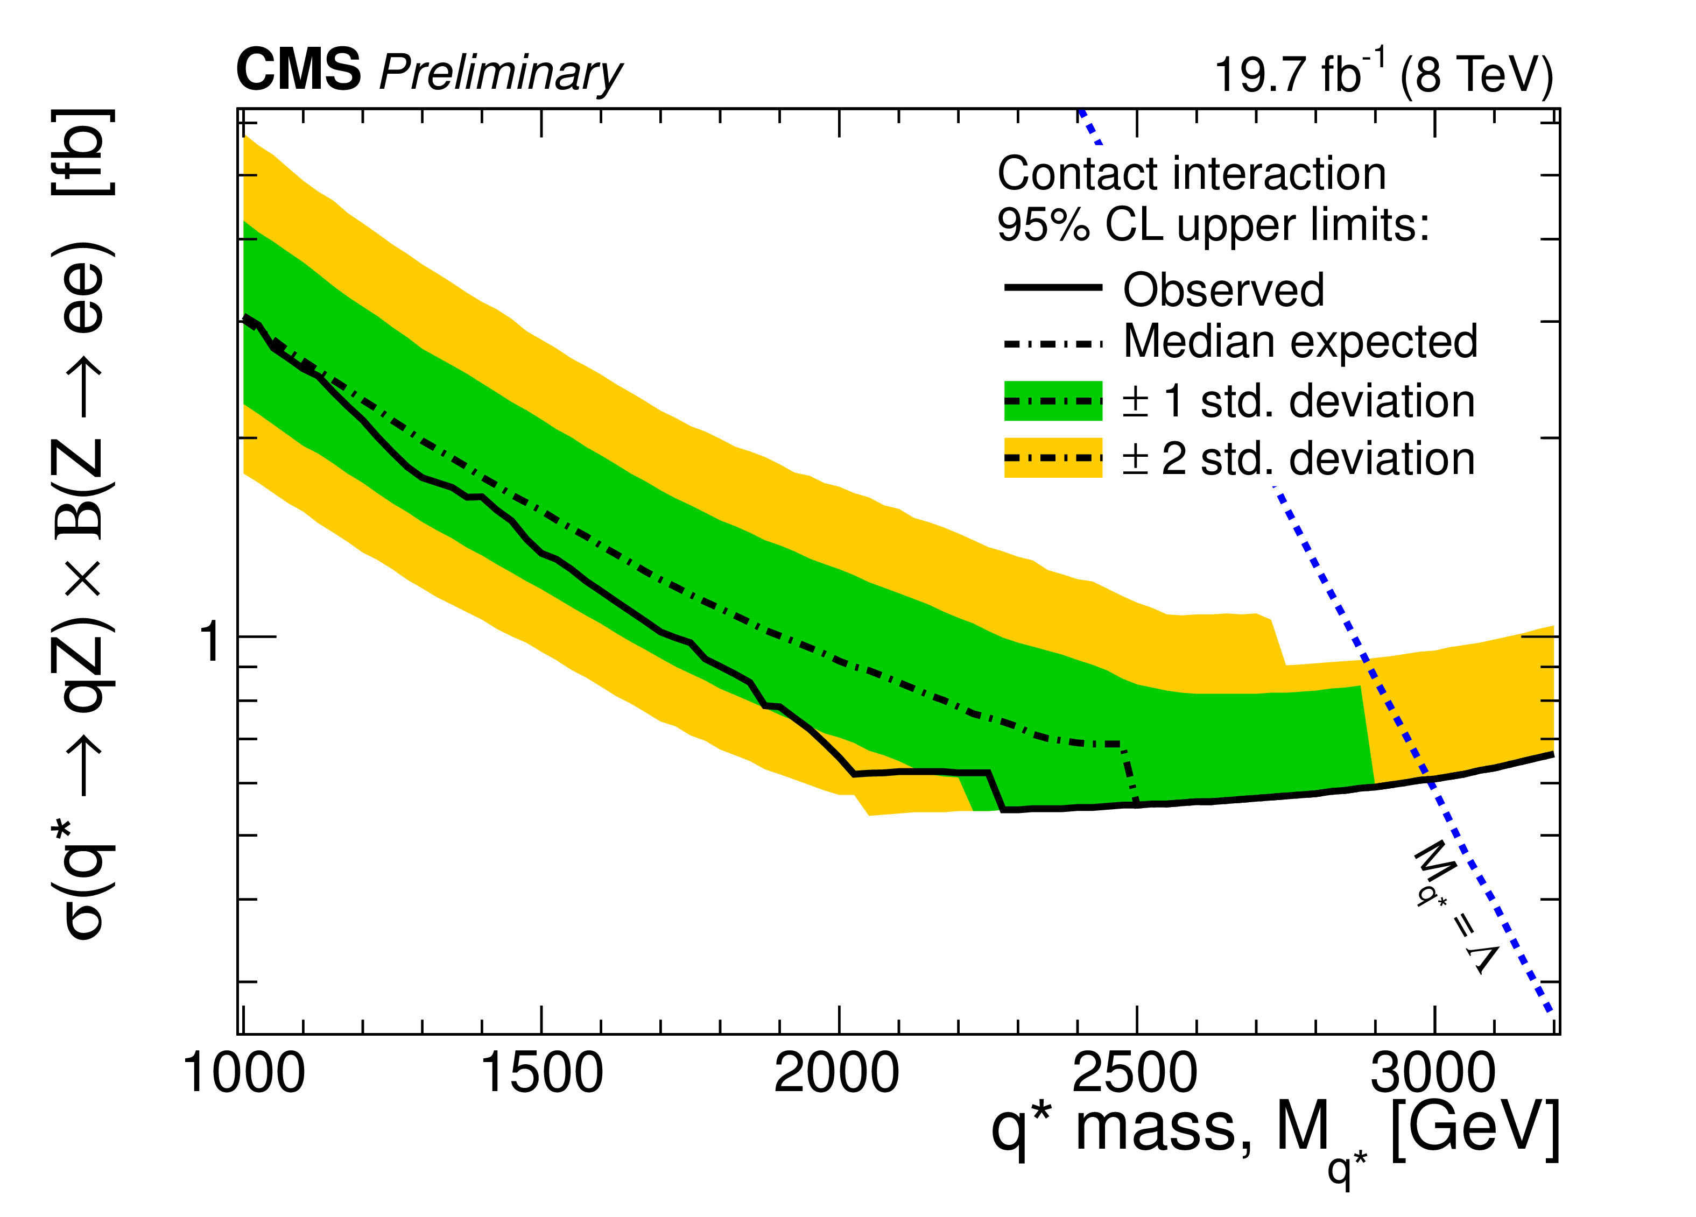
Boosted Z → ee
CMS-PAS-EXO-12-033
CMS Z(W)(→qq) q; 13 TeV M_{q*} > 4.8 (5.0) TeV
Two barrel electrons m_{ee} consistent with Z
  Modified isolation excludes tracks and calo deposits from the other e
  Veto if Δη_{ee}<0.07 and Δφ_{ee}<0.3 (modelling)
MC for prompt l: DY (MadGraph x k_{QCD,NLO}(p_{T}), normalized) , eμ validation for tt, tW, VV
Data-driven misidentified estimate
Bayesian limit: binned extended max L in p_{T,ee}
Z
q
q*
q
q*
q
Z
q
q
q
g
Gauge interaction
2.6 TeV
f_{s}=f=f’=1
Contact interaction
3.0 TeV
Notes:
2e trigger
Bayesian limit setting
Bg uncertainty 2% at 300 GeV to 40% at 1250 GeV Blackhat VS POWHEG NLO QCD VS NLO (QCD +EW) Dittmaier et al.
Signal pdf: Gaussian + asymmetric exp

Slide 7
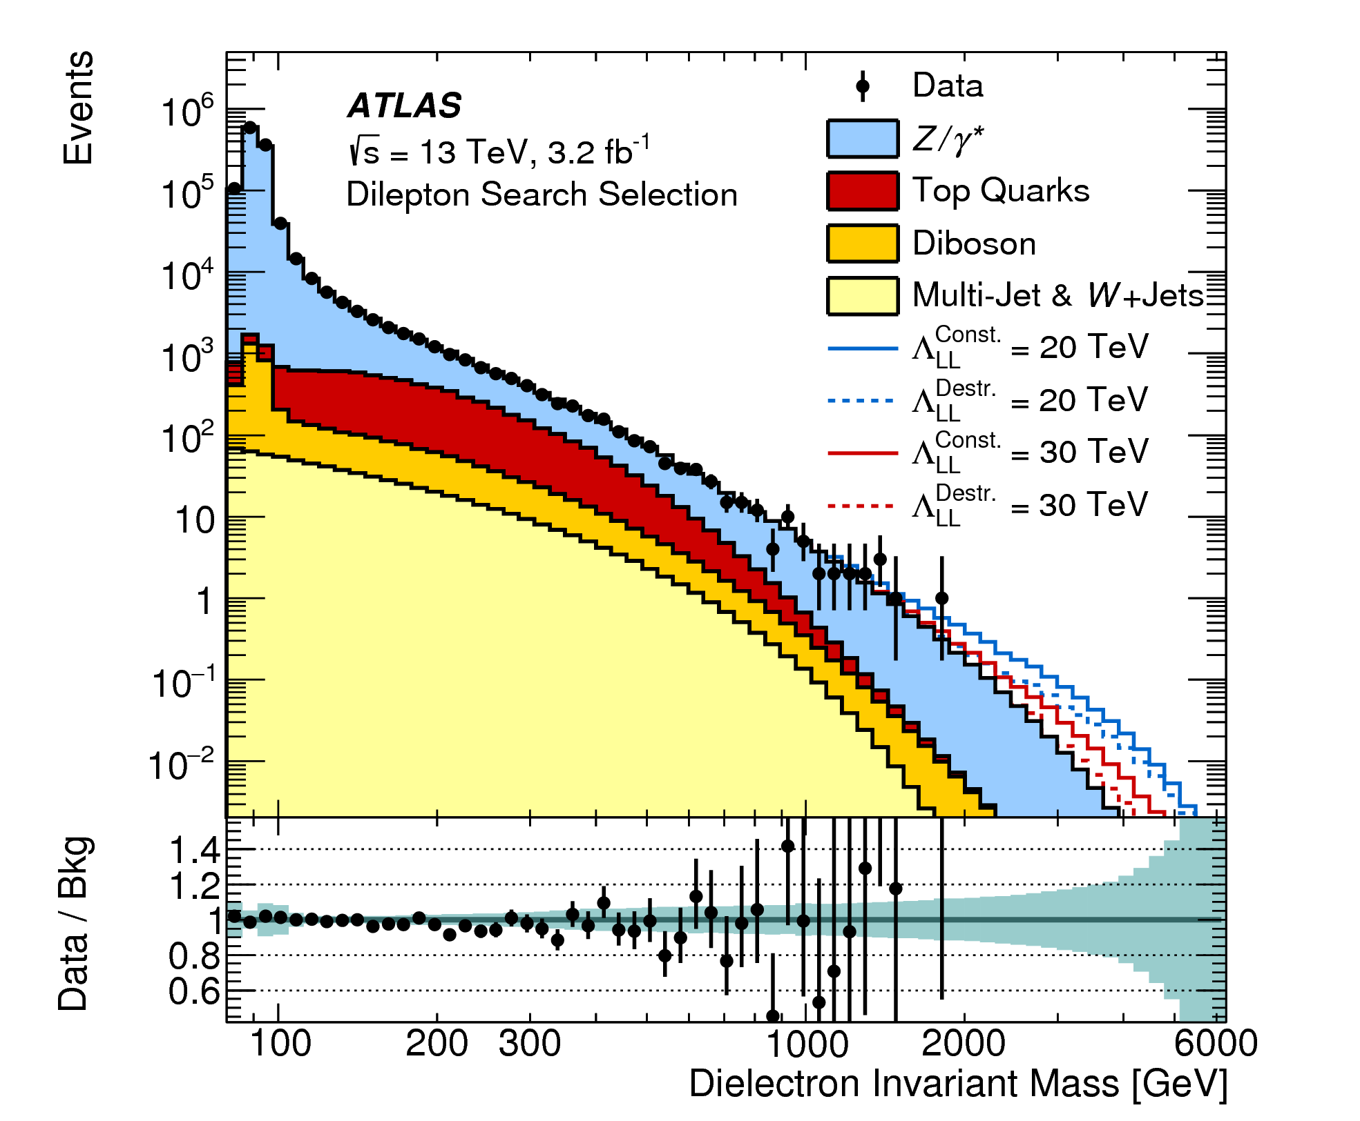
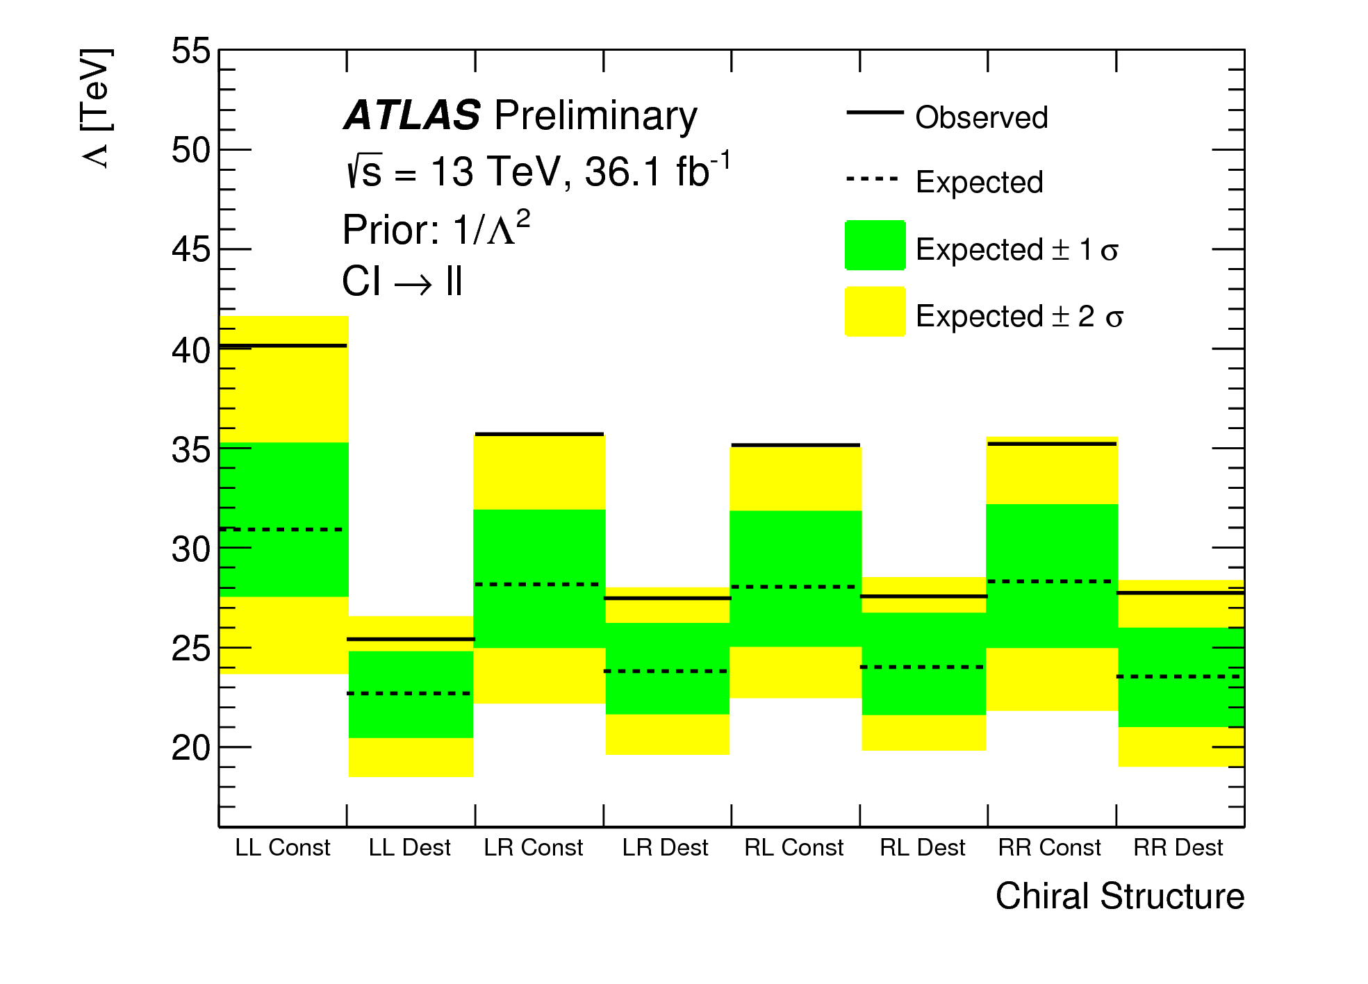
Dilepton final state: non-resonant interpretation
ATLAS-CONF-2017-027
q
CMS 8 TeV
l⁻
q
l⁺
Bayesian limit setting; assume pure CI term or pure interference term
Depending on the chiral structure Λ > 19 -40 TeV

Slide 8
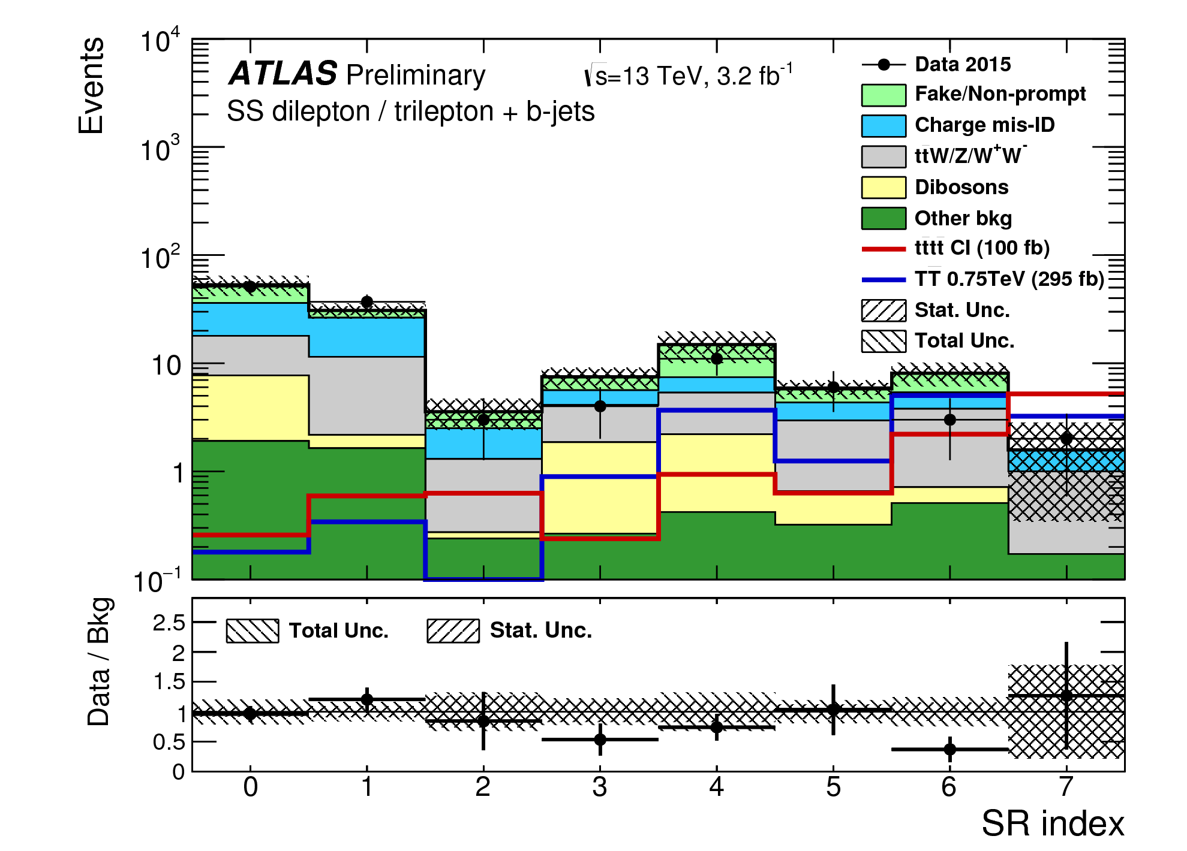
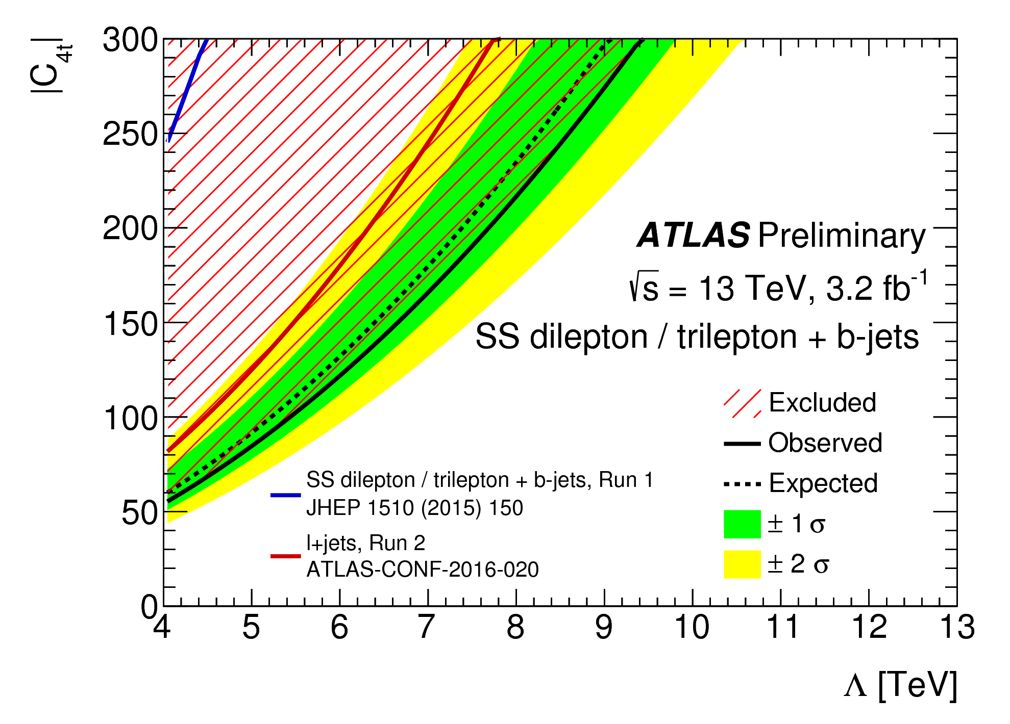
b jets + same charge leptons
ATLAS-CONF-2016-032
t
t
Two same sign leptons or >2 leptons
  m_{ee}>15 GeV, not on Z-peak
Two jets, at least one b-tagged
High E_{T}^{miss} H_{T}
8 signal regions optimized for different types of signal:
  N_{b} (1,2,3), H_{T}(>400 GeV < 700 GeV, > 700 GeV), E_{T}^{miss}(>40 GeV <100 GeV, > 100 GeV)
t
t
+VLQ (TT,BB) + UED
Notes:
CI: Madgraph (LO)
Single lepton trigger

Slide 9
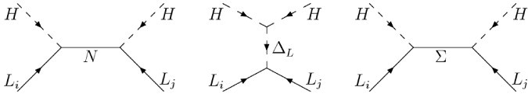
Seesaw: ingredients
Type I: add right handed singlet
Type II: add scalar triplet
Type III: add fermion triplet
Seesaw: m_{ν} ~ 1/M_{N} , 1/M_{Δ}², 1/M_{Σ}

Slide 10
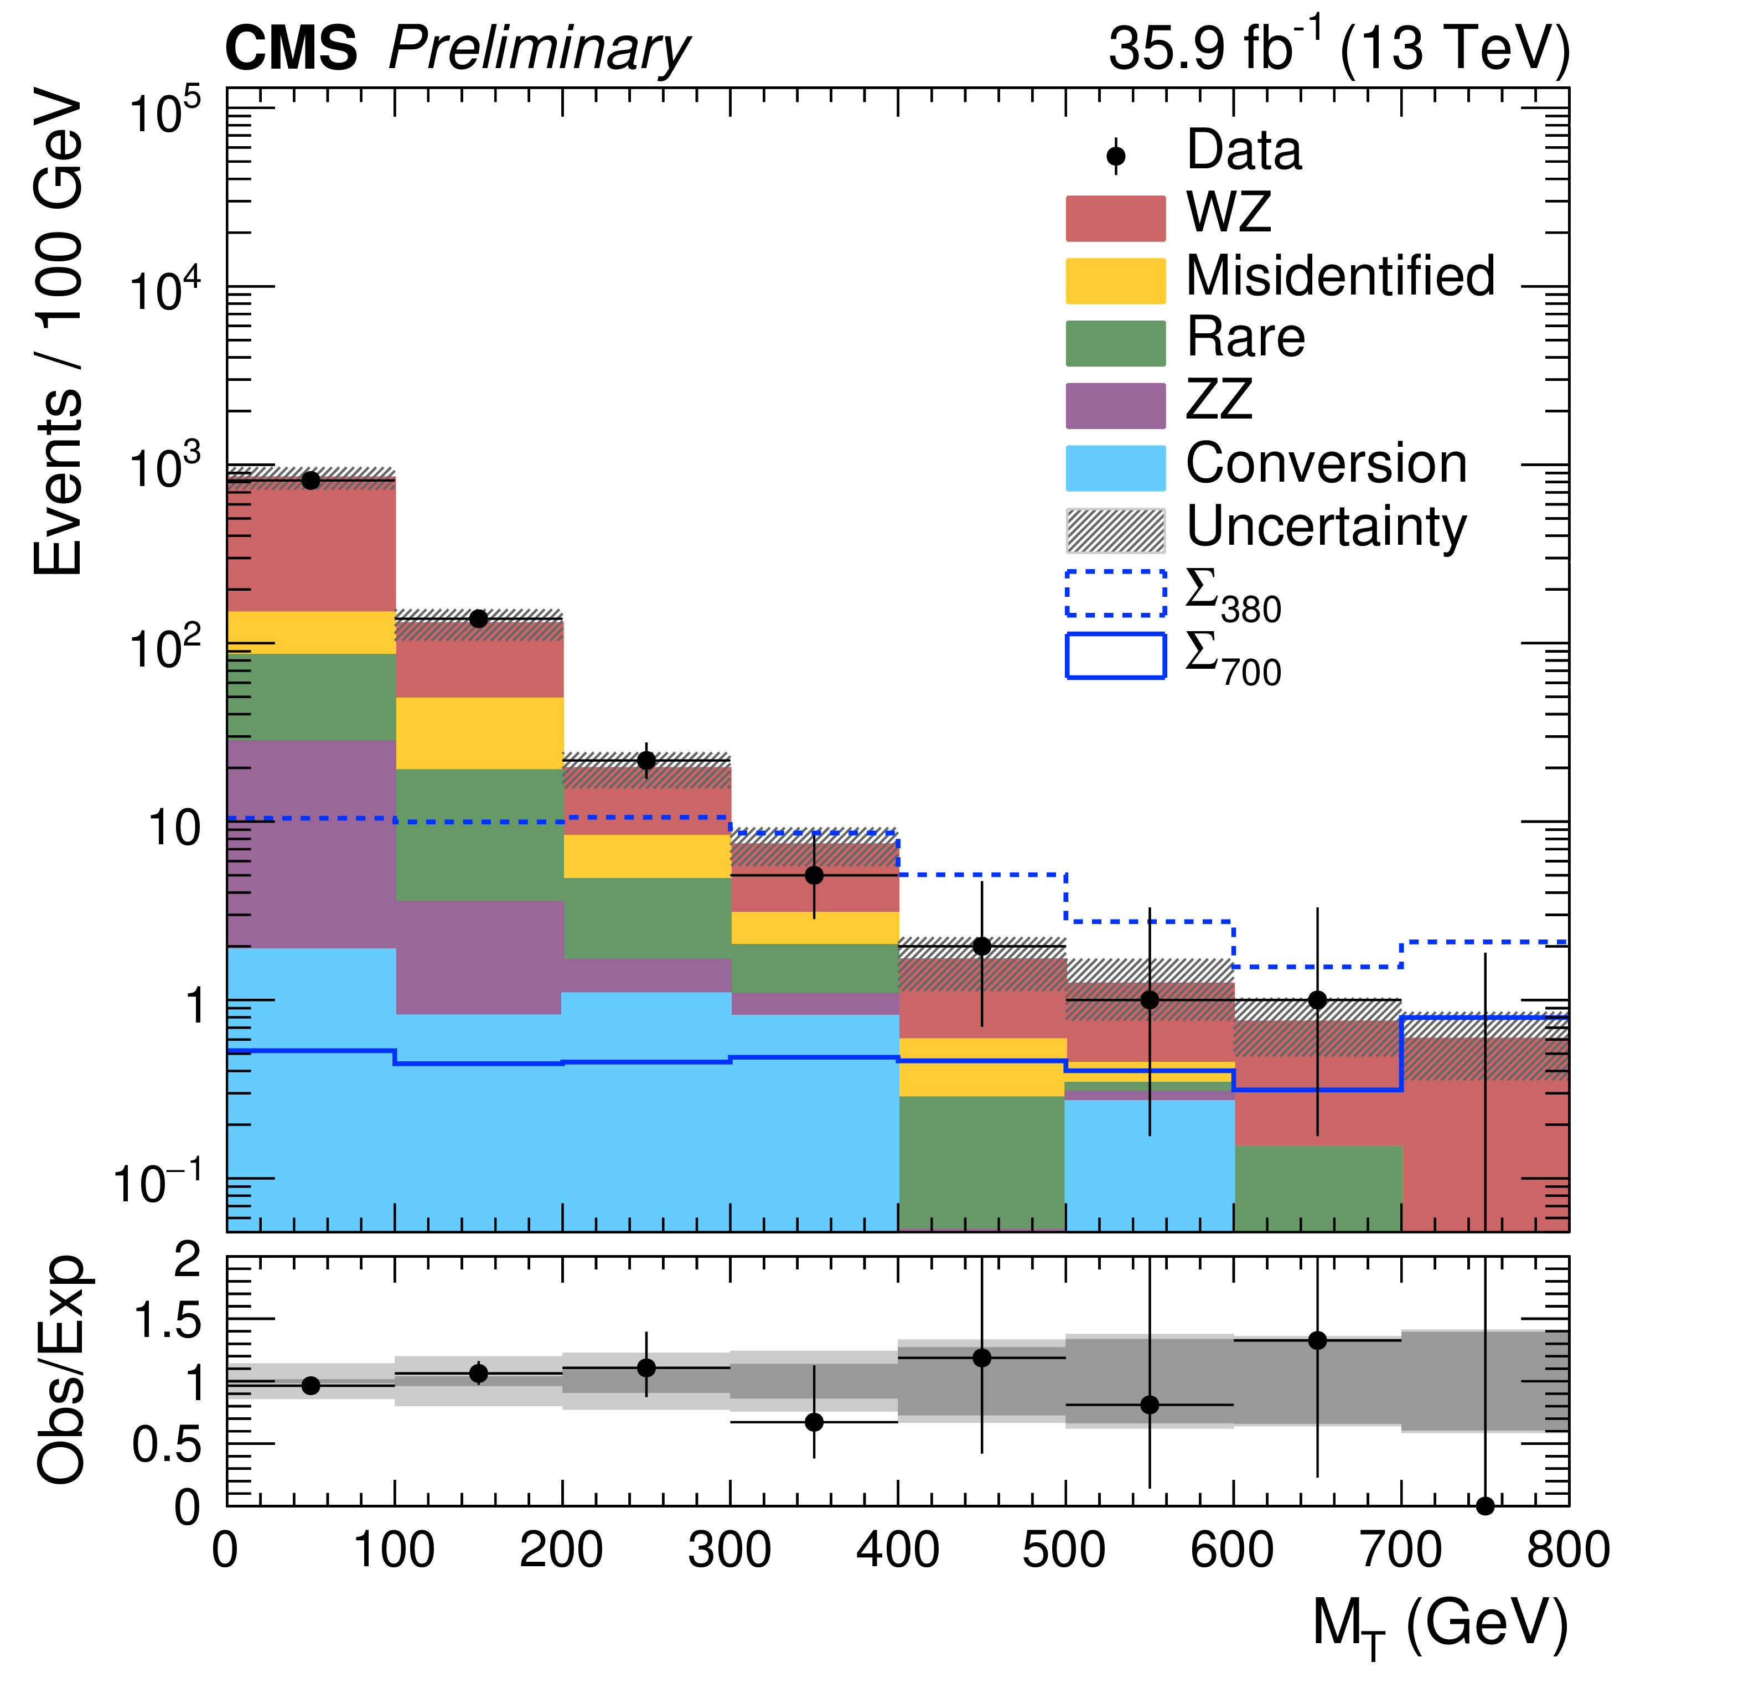
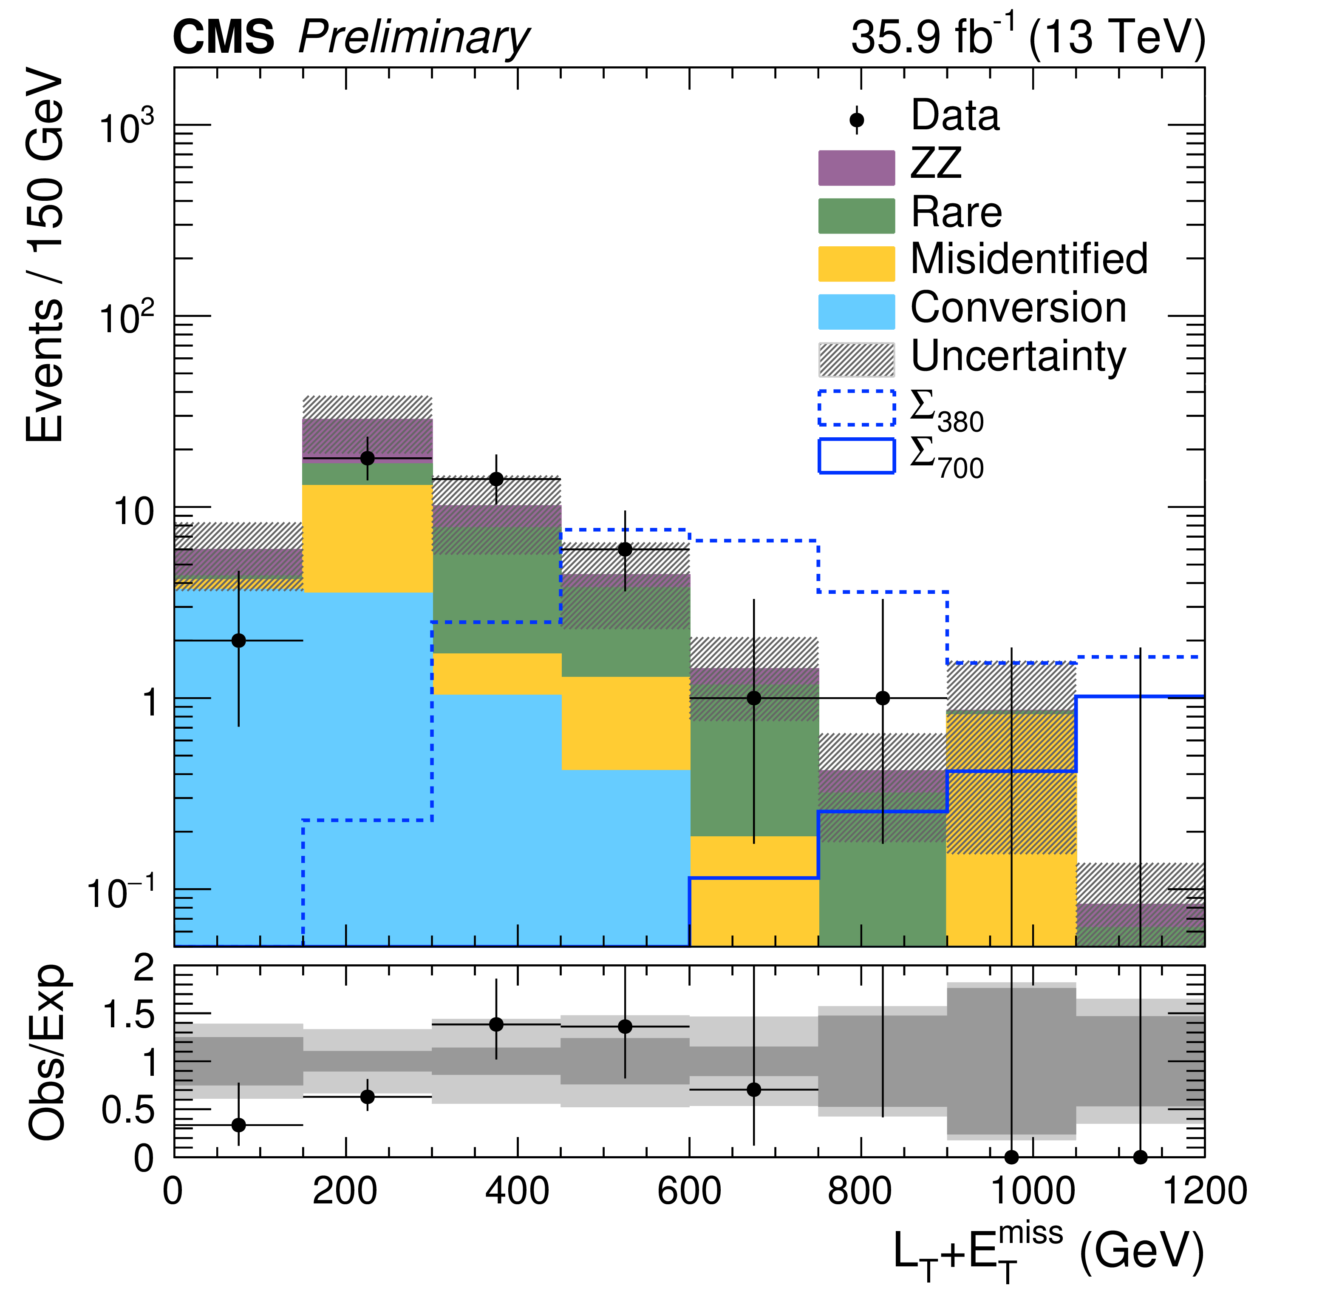
Type III seesaw in multileptons
CMX-PAS-EXO-17-006
ATLAS 8 TeV
Σ
At least 3 leptons
Veto OSSF m_{ll} < 12 GeV
Categorise:
  number of leptons (3, >=4)
  number of OSSF pairs (0,1,2)
    1 OSSF pair below-, on-, above Z-peak
  CR vetos
CRs for WZ ZZ
Misidentified and conversion background data-driven
In each category 8 bins in L_{T}+p_{T}^{miss} or M_{T} (l not in OS + E_{T}^{miss})
Σ
Σ⁺⁻→H l⁺⁻, Z l⁺⁻, W⁺⁻ν
Σ⁰→H ν, Z ν, W⁺⁻l⁻⁺
Lepton flavor democratic,
Mass degenerate
M_{Σ}> 850 GeV
4 l, 1 OSSF
3 l, 1 OSSF on-Z
Notes:
Dilepton triggers;
Signal madgraph 5
Lepton threshold 25 15 10 GeV
Matrix method
Conversions from trileptons on-Z
Systematics mainly due to WZ/ZZ

Slide 11
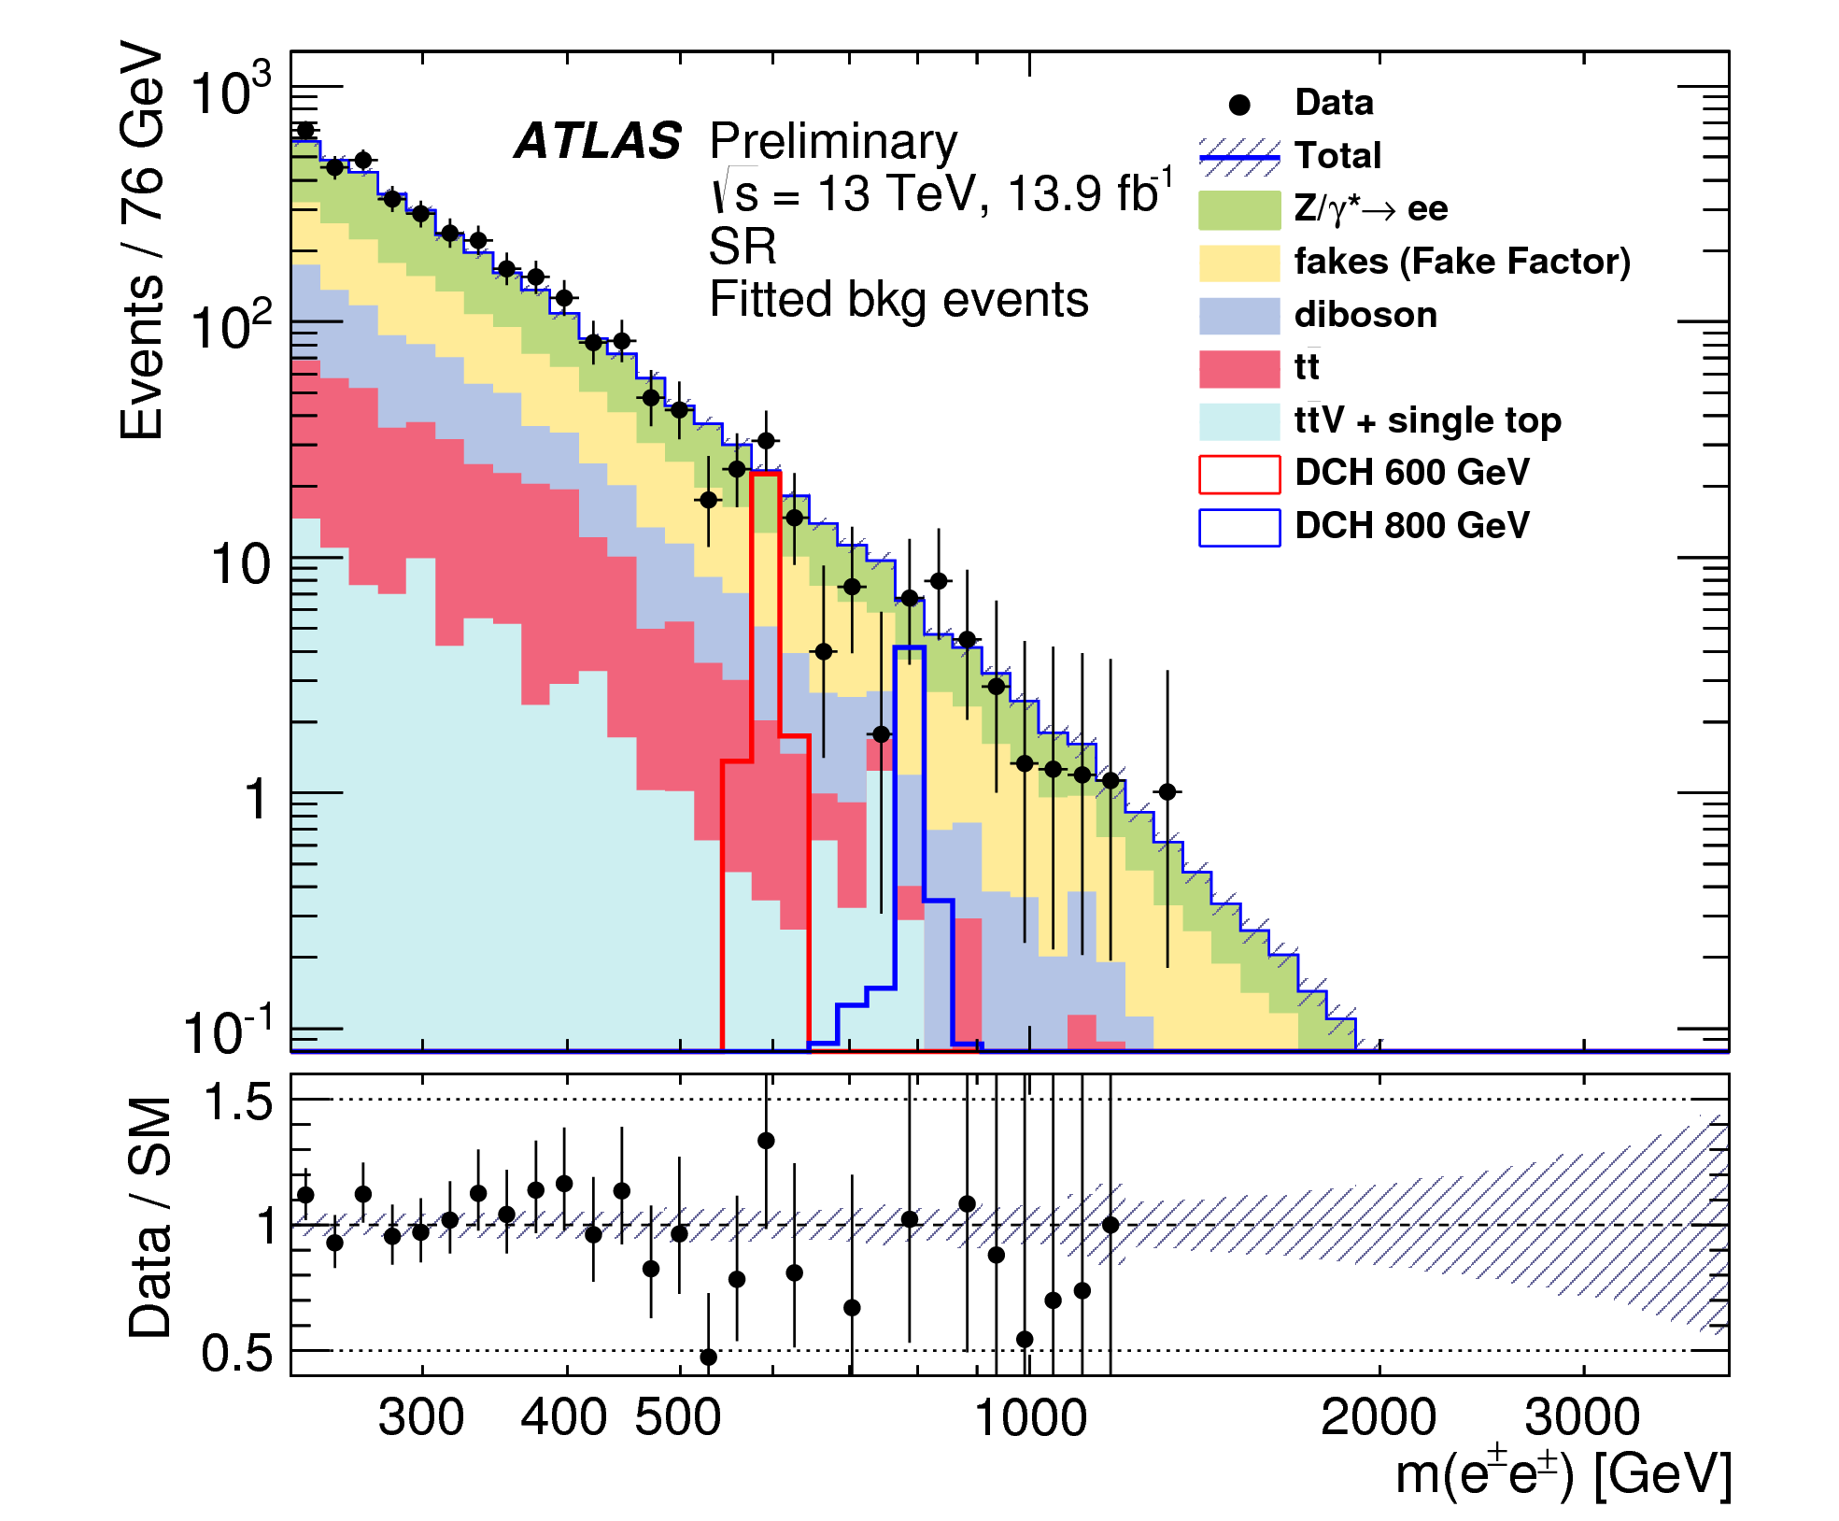
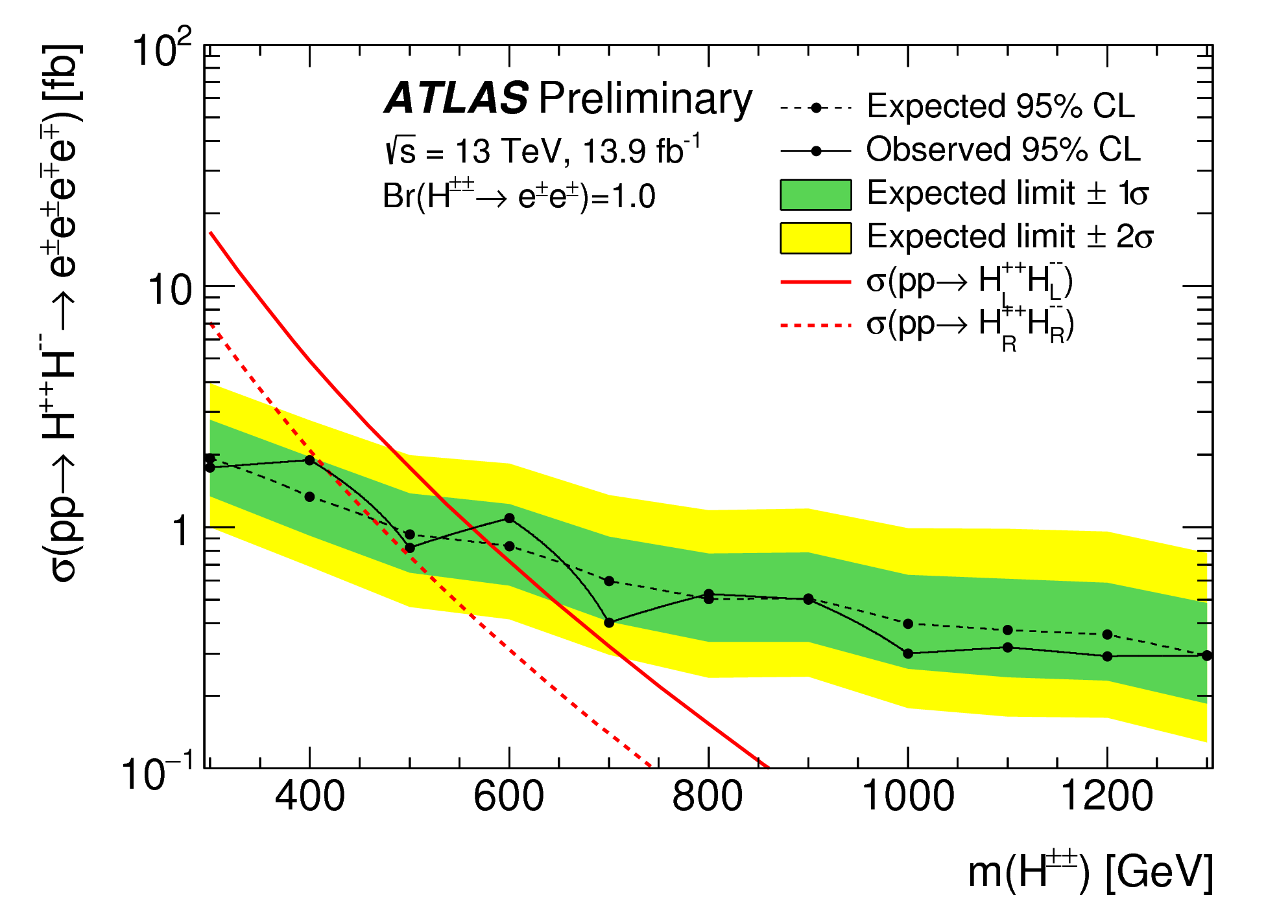
Doubly charged Higgs
ATLAS-CONF-2016-051
e⁺
H⁺⁺
e⁺
Signal region: at least one SS ee pair with m(ee) > 300 GeV
  Control region:
    OSCR exactly one opposite sign ee pair
    DBCR one OS pair near Z peak + SS, pair SS partner with the e from the window m(ee)<200 GeV
Backgrounds:
  Charge mis-id: MC, reweighted using Z→ee
  Fakes (data-driven)
Combined fit in m(ee) + CL_{S}
H⁻⁻
e⁻
e⁻
LRSM:
BR→ee=1:
M(H_{R})>420 GeV
M(H_{L})>570 GeV
BR→ee=0.5:
M(H_{R})>380 GeV
M(H_{L})>530 GeV
Notes:
Dielectron + single e trigger

Slide 12
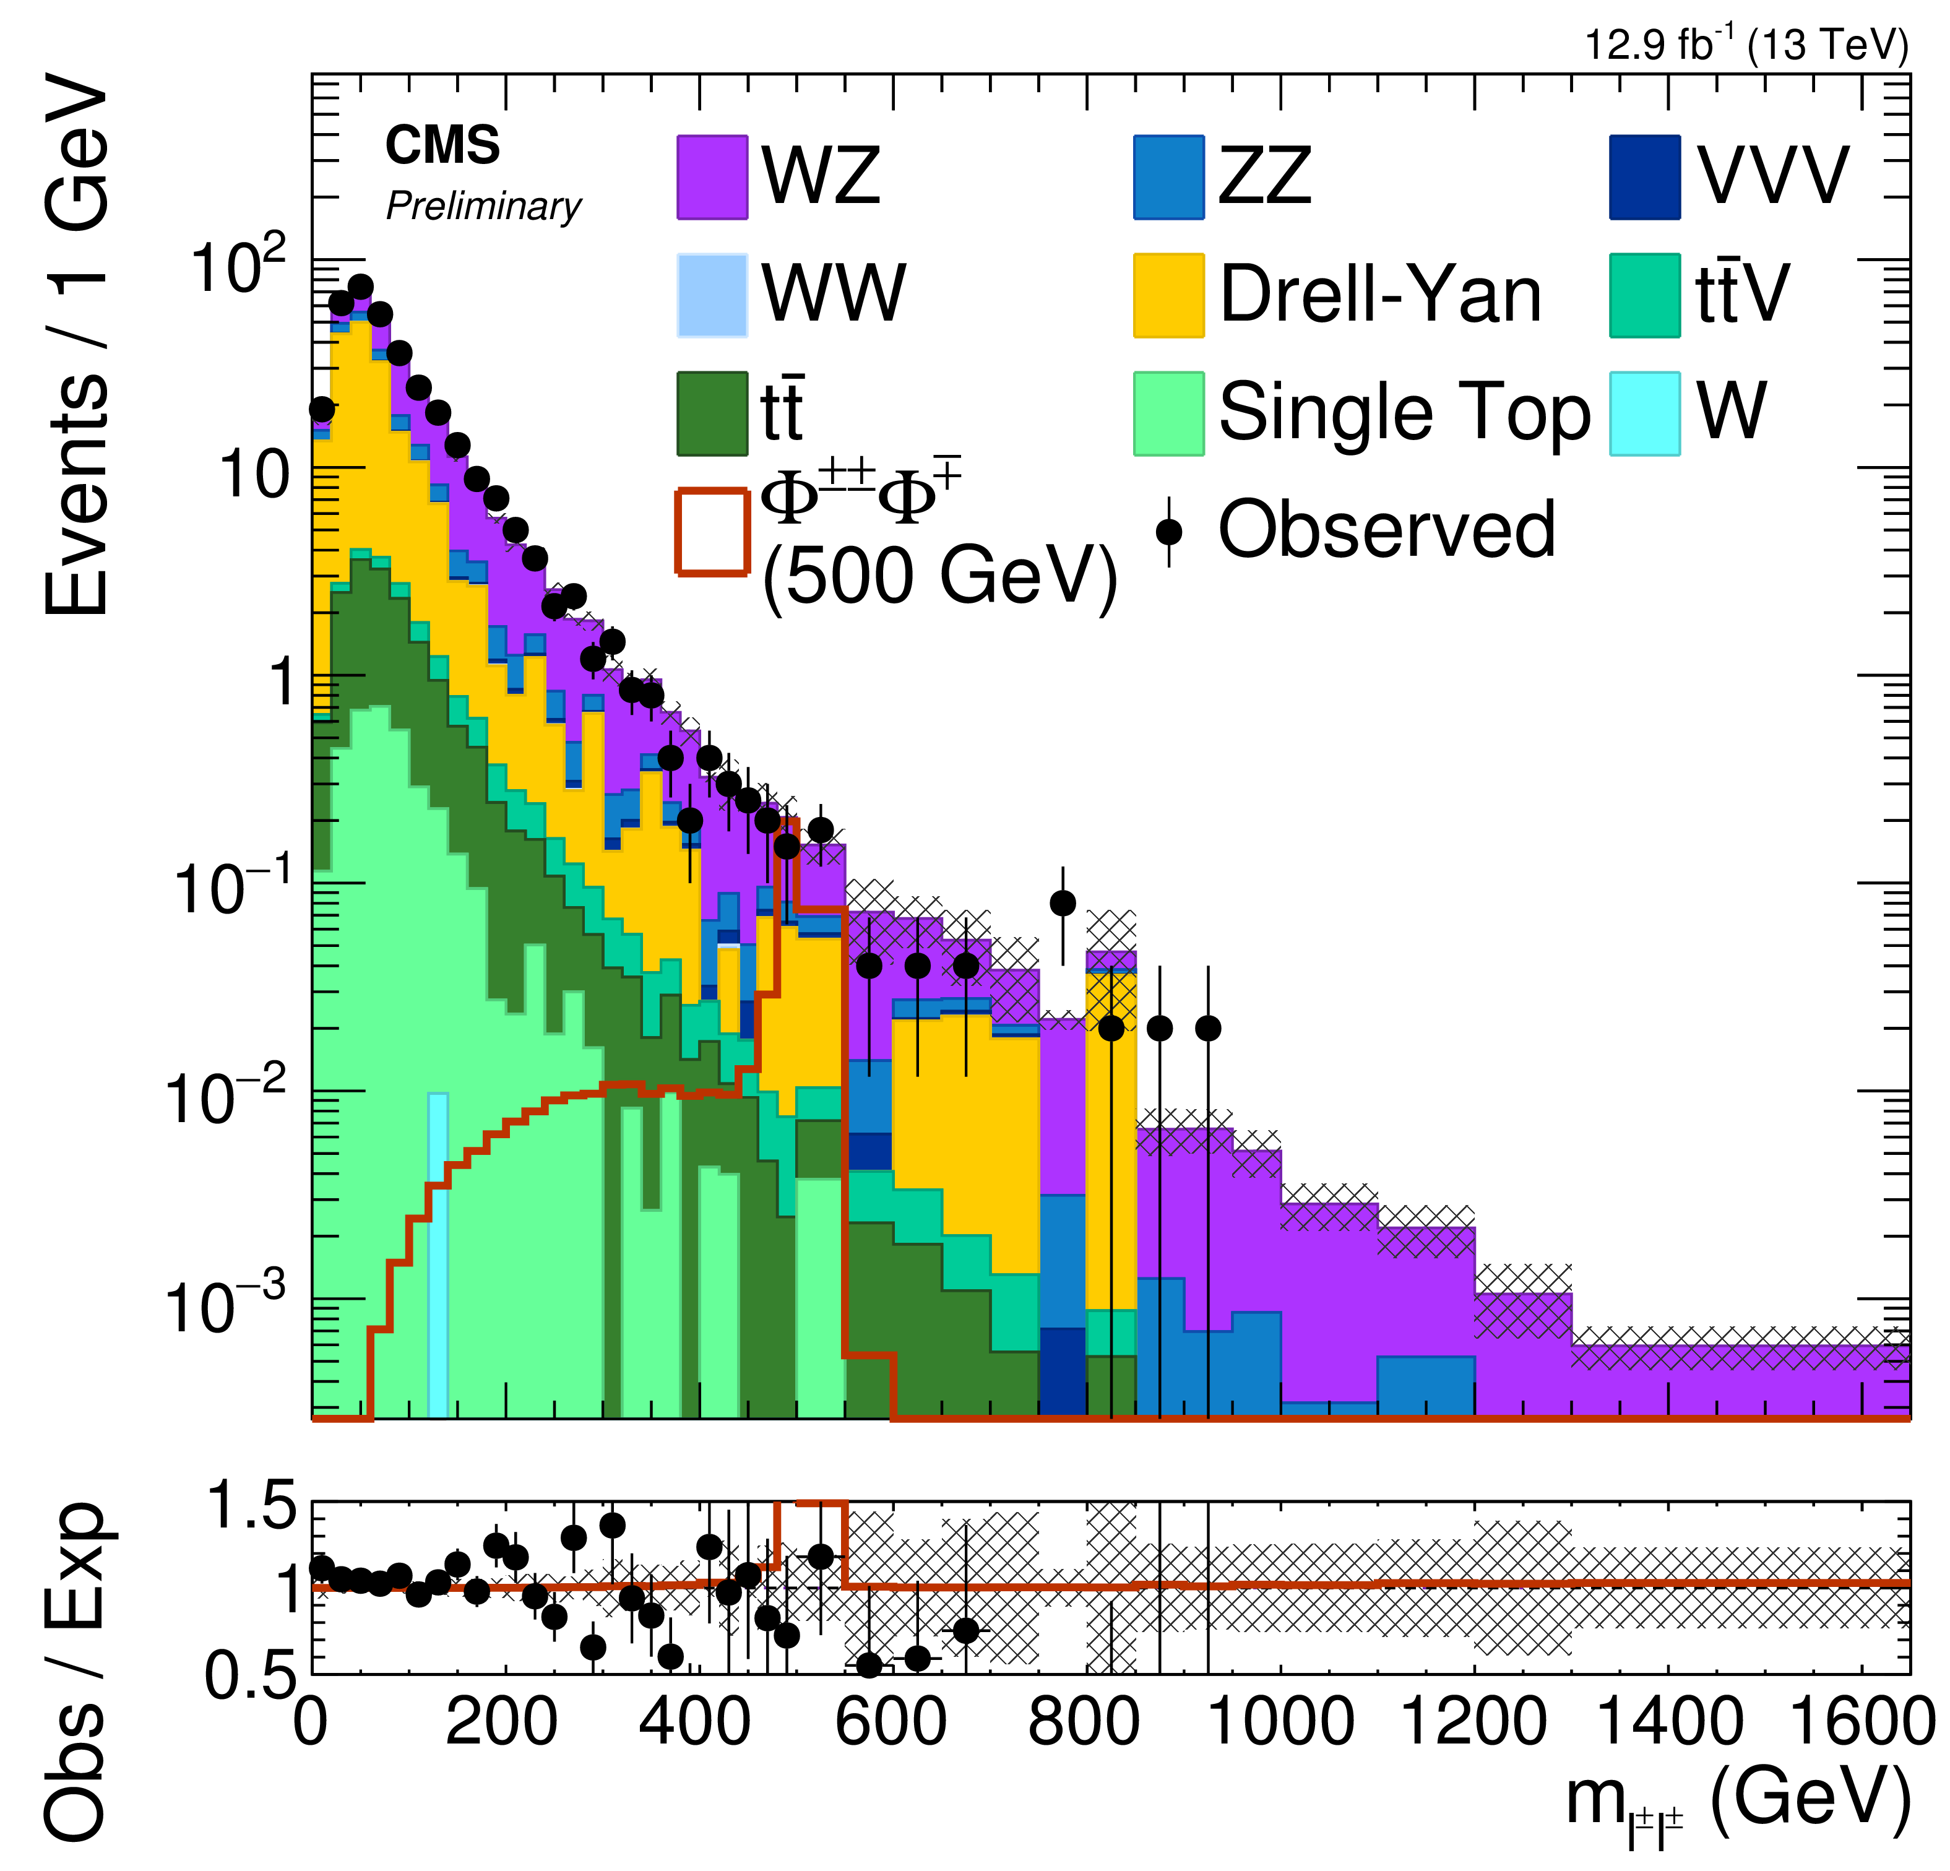
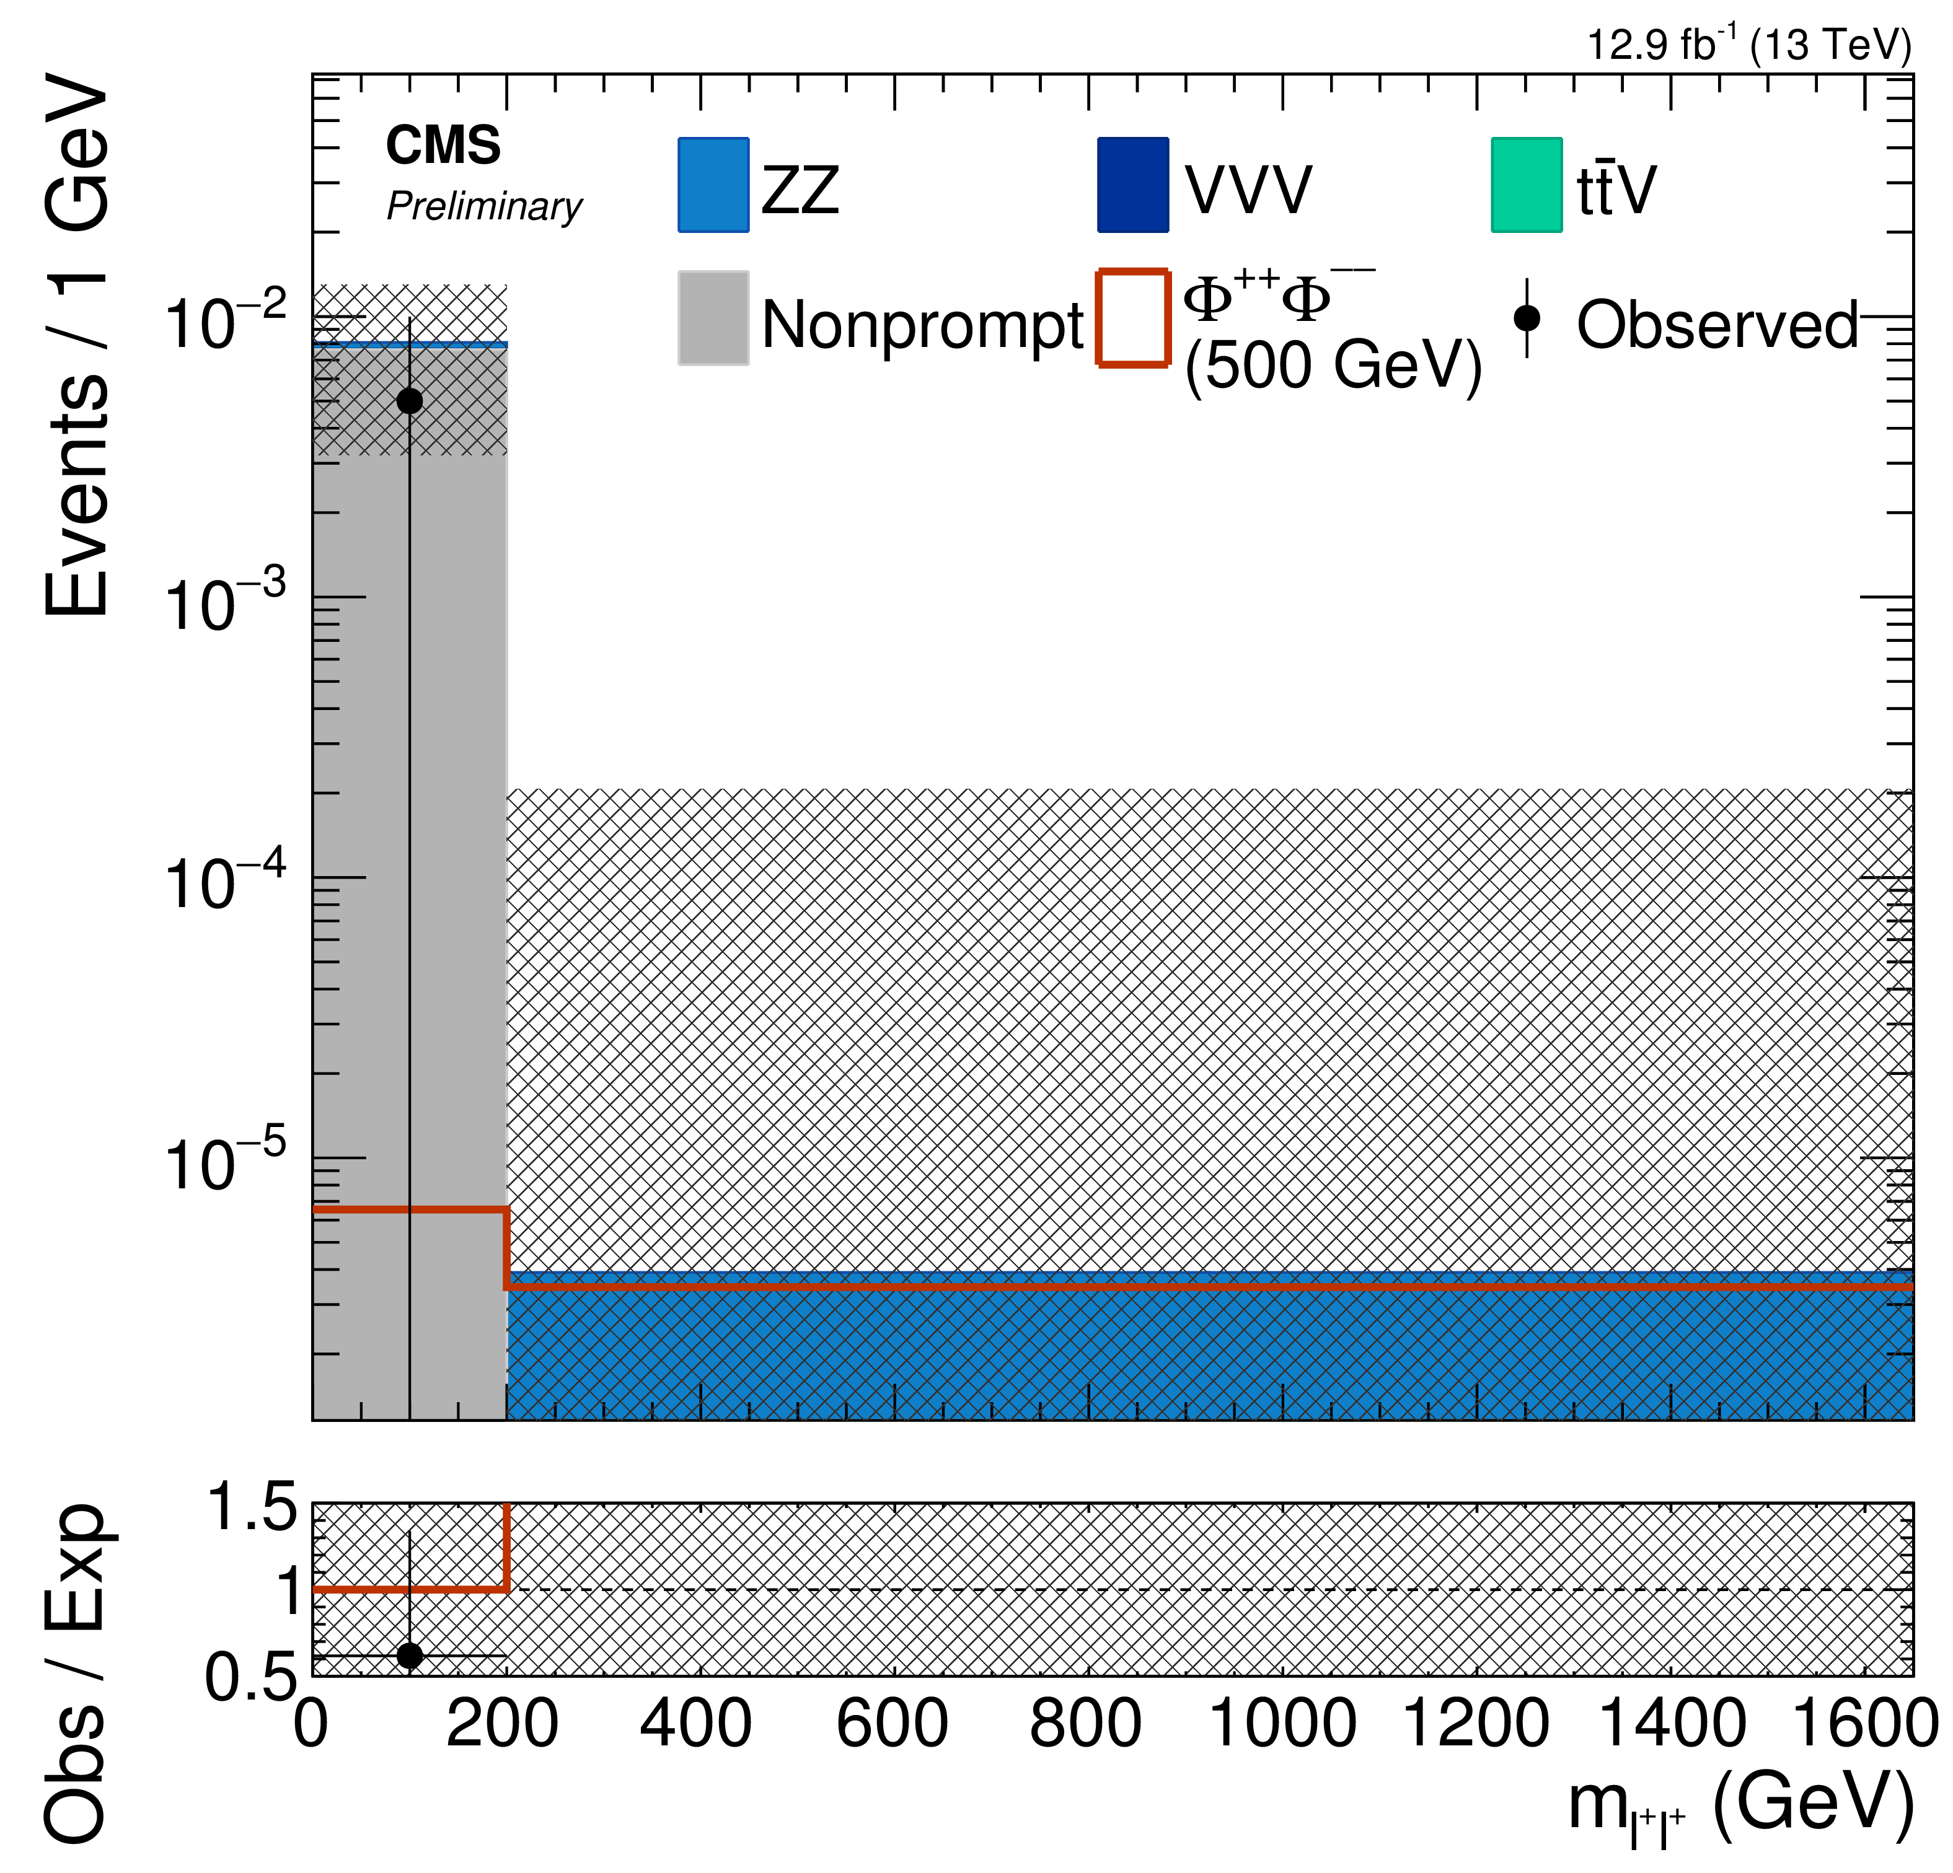
Doubly charged Higgs
CMS-PAS-HIG-16-036
l⁺
φ⁺⁺
l⁺
W
100% BR to ee, eμ, μμ, eτ, μτ, ττ
Also 4 benchmark points
3 ++- --+ or 4 ++-- leptons, m_{ll}>12 GeV
Selections in S_{T}, Δm_{OSSF} to Z, E_{T}^{miss}, ΔR(l^{+/-},l^{+/-})
Same sign mass window up to 0.3-1.1 m_{φ}
Sideband + tight to loose (for non-prompt)
CL_{S} Sideband + mass window combined
φ⁻
l⁻
ν
Limits: m_{φ} > 535-820 GeV
lll
ττττ
Notes:
1 or 2 e or mu OR 2 had taus
Hadron + strips hadronic tau
pT 20-40 depending on the config

Slide 13
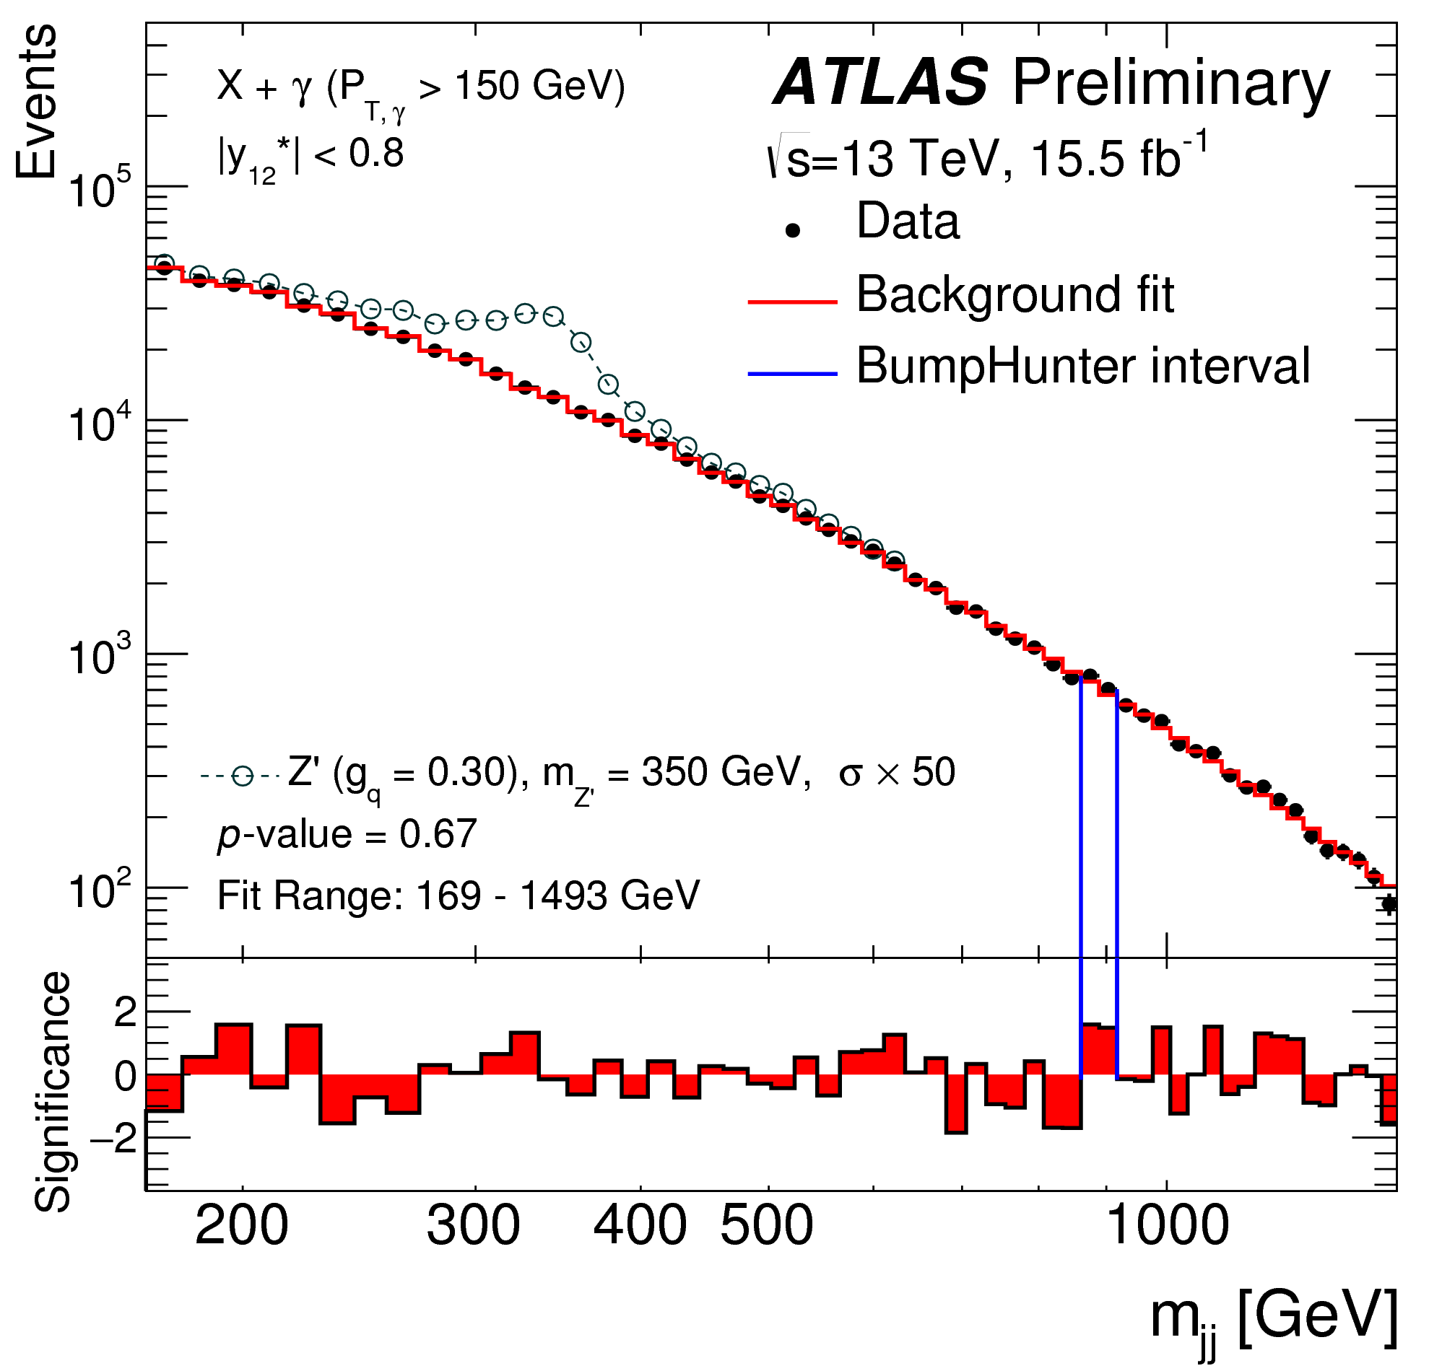
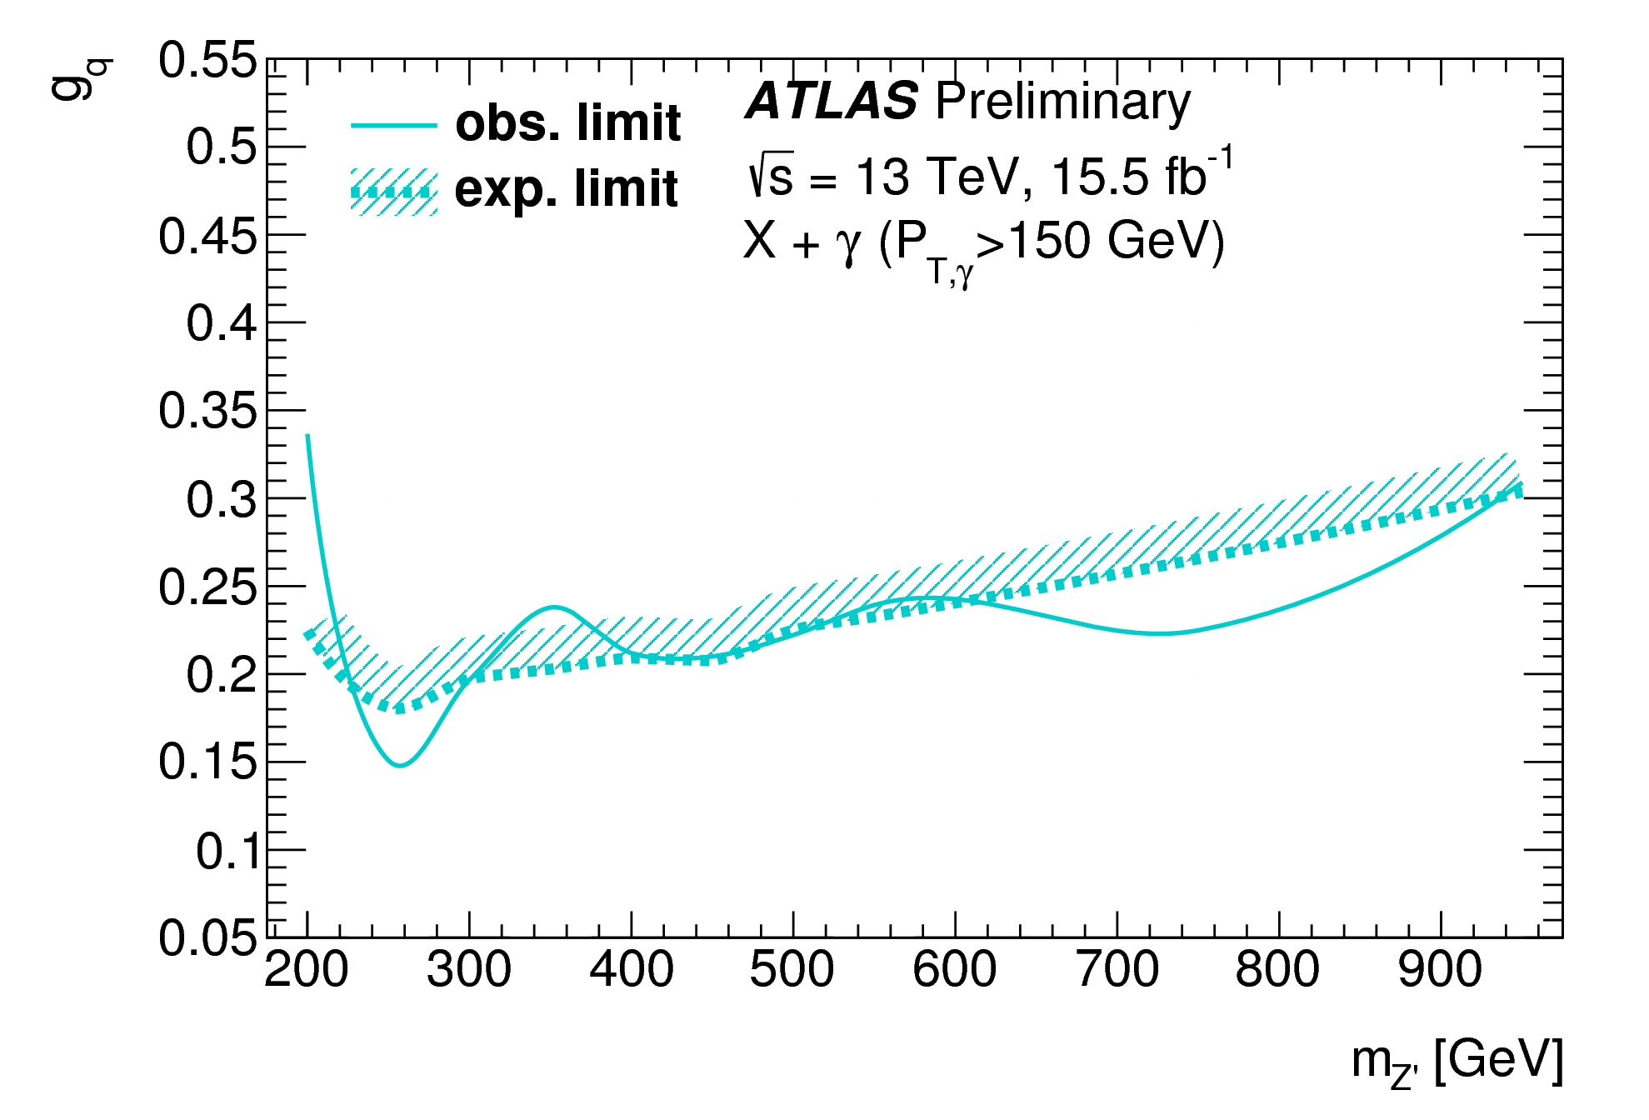
Light resonance decaying to a pair of jets produced in association with a photon or a jet
ATLAS-CONF-2016-070
Photon p_{T}>150 GeV
Two R=0.4 jets y₁₂*<0.8 ΔR_{γ,j}>0.8
Fit m_{jj} to a continuous model
BumpHunter search and Bayesian limit setting: leptophobic Z’ and generic Gaussian
q
X
q
q
q

Slide 14
Conclusions
“The more he looked inside the more Piglet wasn't there.” A. A. Milne
Some results with 2015+2016 data still coming
A lot more data coming!
  Let’s stay creative

Slide 15
extras

Slide 16


q* Lagrangian

Slide 17
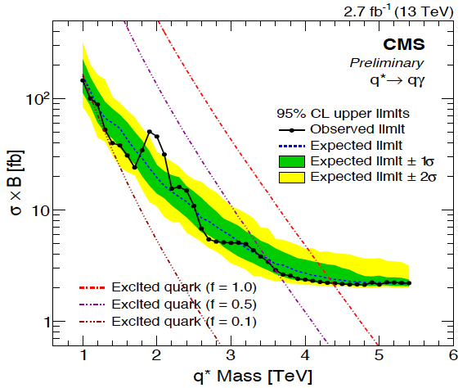
q* cross section limit
CMS-PAS-EXO-16-015

Slide 18
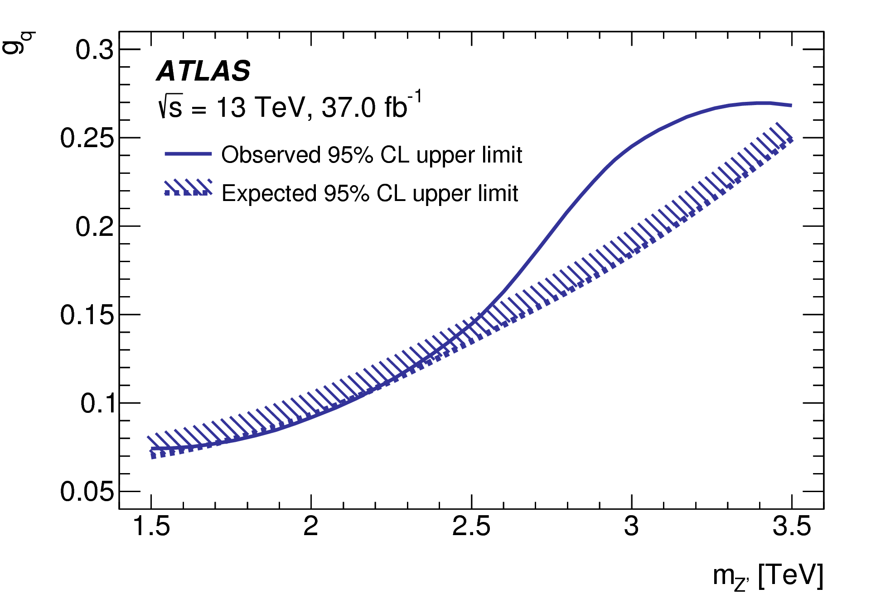
ATLAS dijet g_{q} limit

Slide 19
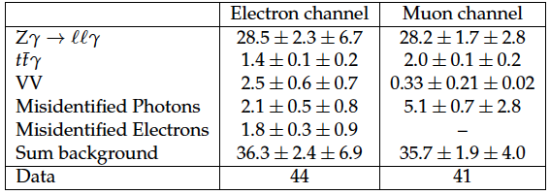
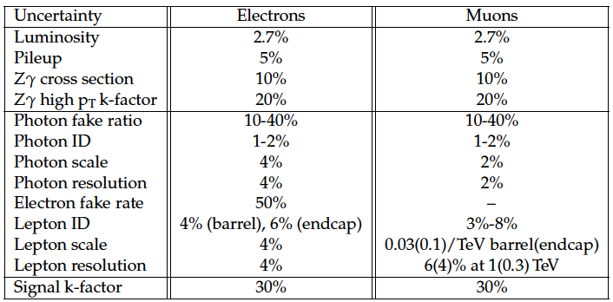
l* yields and systematics
(No ‘inverted L’ cut)

Slide 20
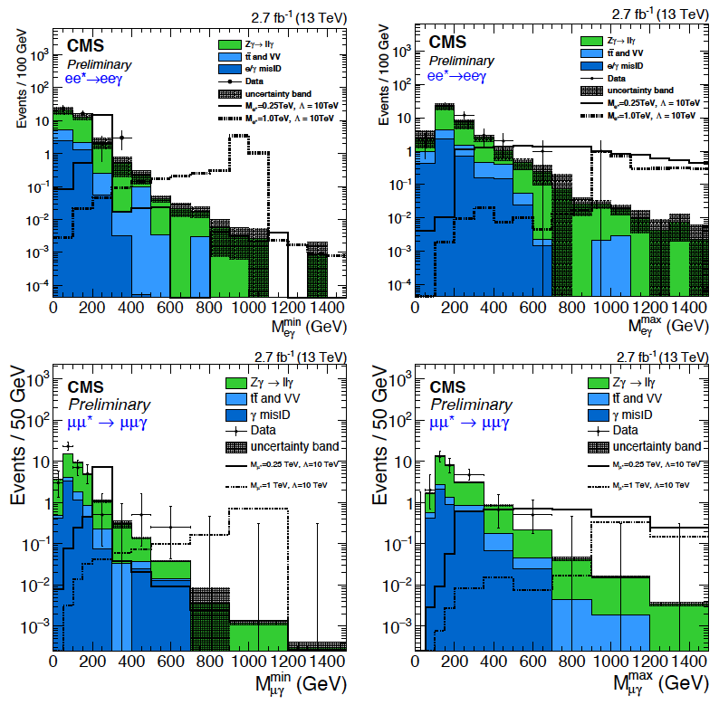
l* 1D distributions

Slide 21

4-t Lagrangian

Slide 22
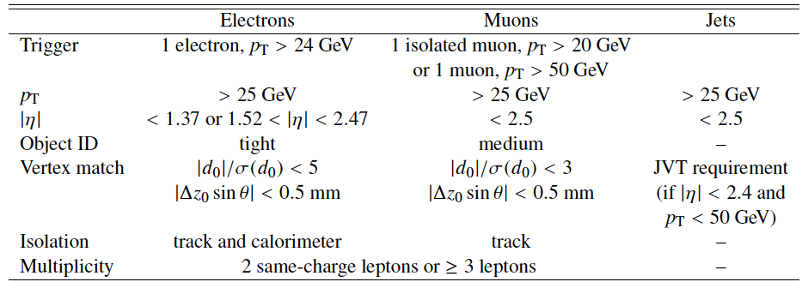
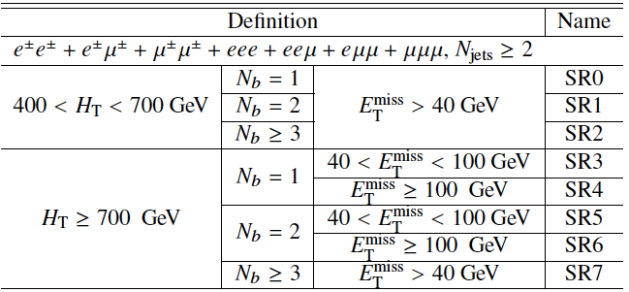
tttt preselection and SR definition

Slide 23
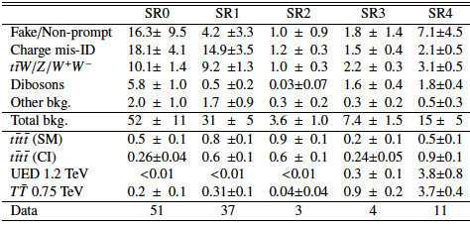
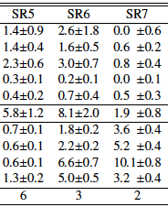
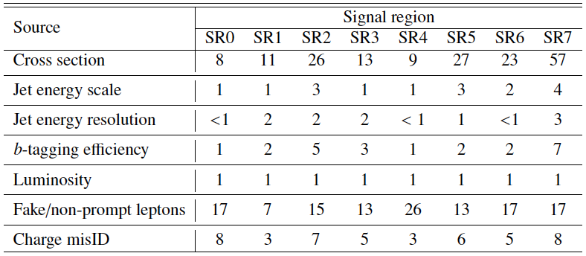
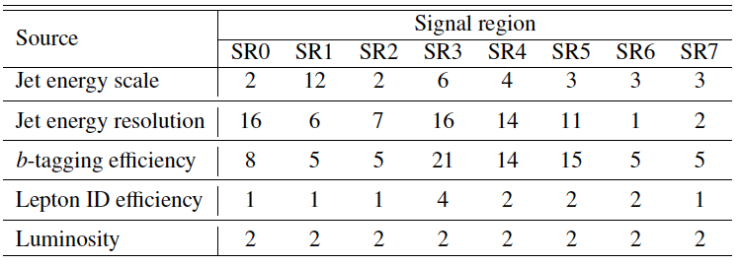
tttt yields and systematics
background
%
signal

Slide 24
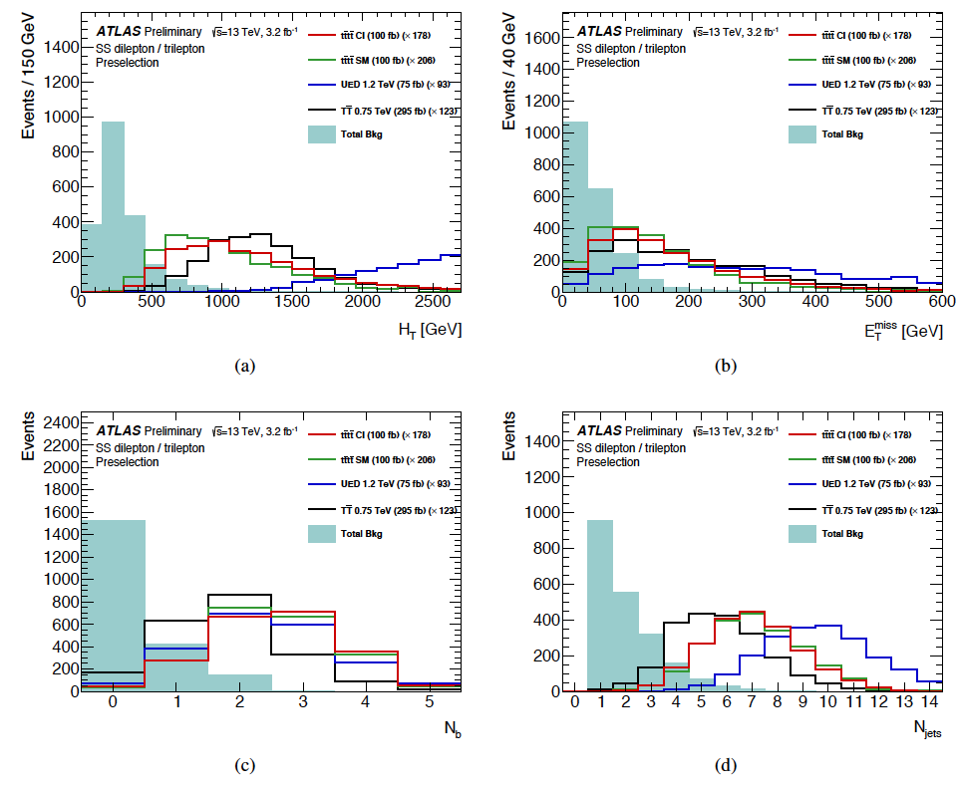
tttt distribution after pre-selection

Slide 25
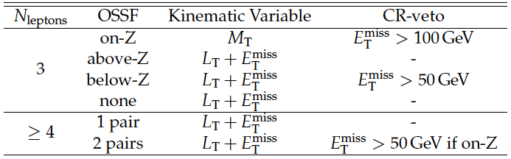
Type III Seesaw SRs

Slide 26
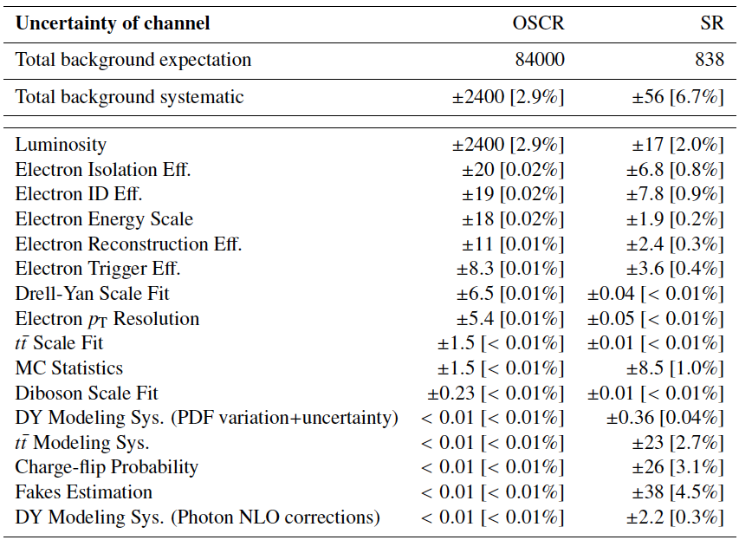
H++ (ATLAS) systematics (post fit)

Slide 27
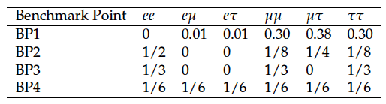
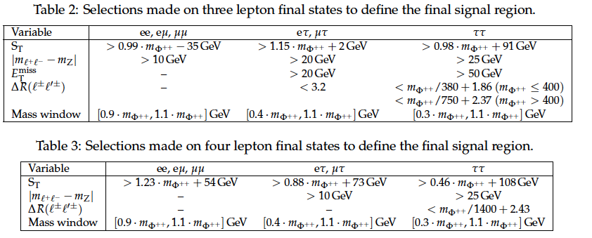
H++ CMS BPs and SRs

Slide 28
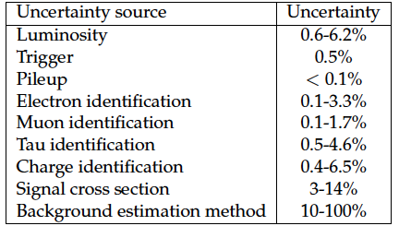
H++ CMS systematics

Slide 29
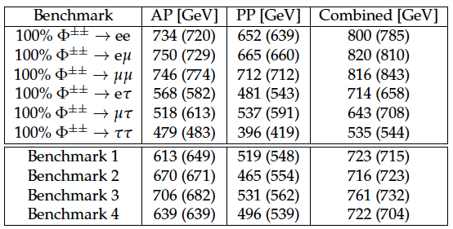
H++ CMS limits

