Slide 1
Calorimeter Calibration Issues and ECal Optimization with DD4hep
Nikiforos Nikiforou
CERN/EP-LCD

Slide 2
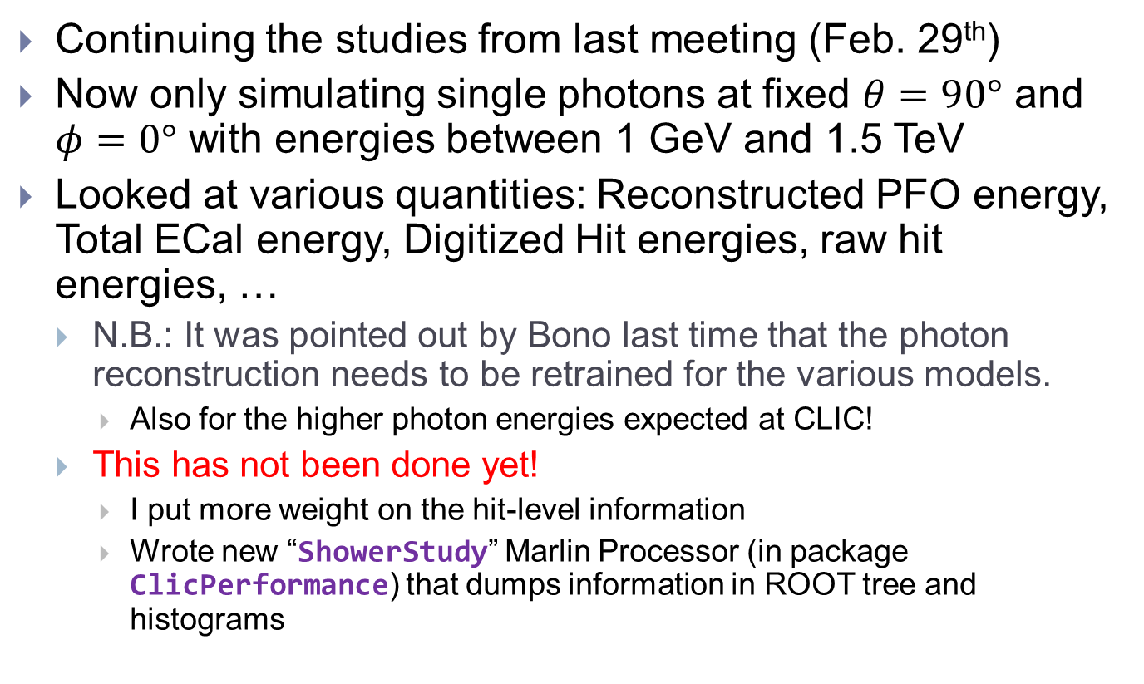
Introduction
Continuing the studies from last meeting (Feb. 29th)
Now only simulating single photons at fixed $θ=90°$ and $φ=0°$ with energies between 1 GeV and 1.5 TeV
Looked at various quantities: Reconstructed PFO energy, Total ECal energy, Digitized Hit energies, raw hit energies, …
  N.B.: It was pointed out by Bono last time that the photon reconstruction needs to be retrained for the various models.
    Also for the higher photon energies expected at CLIC!
  This has not been done yet!
    I put more weight on the hit-level information
    Wrote new “ShowerStudy” Marlin Processor (in package ClicPerformance) that dumps information in ROOT tree and histograms

Slide 3
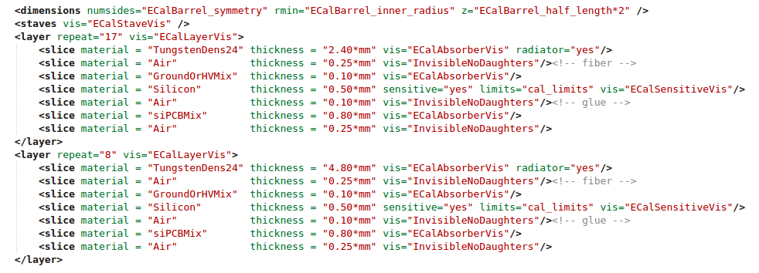
Modify geometry and simulate
Use simple “GenericCalBarrel” driver (no need to compile anything)
  Polyhedral layered calorimeter
Specify makeup and number of layers in xml for every model
Simulate single photons with ddsim to get lcio files with SimCalorimeterHits

Slide 4
Possible Models (only Si active layer)
Calculations from geometry xml file using excel
 | # Layers | Absorber Thickness [mm] | Si [mm] | Other (gaps, etc) [mm] | Absorber Thickness [X0] | Si+Other Thickness [mm] | Si+Other Thickness [X0] | Total Thickness [mm] | Total Thickness [X0] | Calorimeter Thickness [mm] | Calorimeter Depth [X0]
CLIC_o2_v04 (current) | 17 | 2.4 | 0.5 | 1.5 | 0.65 | 2 | 0.06 | 74.8 | 12.01 | 129.2 | 22.85
 | 8 | 4.8 | 0.5 | 1.5 | 1.30 | 2 | 0.06 | 54.4 | 10.84
CLICdet_20_10 (original CLIC_ILD) | 20 | 2 | 0.5 | 1.5 | 0.54 | 2 | 0.06 | 80 | 11.96 | 140 | 23.35
 | 10 | 4 | 0.5 | 1.5 | 1.08 | 2 | 0.06 | 60 | 11.39
CLICdet_30_10 (possible high granularity option) | 30 | 1.5 | 0.5 | 1.5 | 0.41 | 2 | 0.06 | 105 | 13.89 | 155 | 22.58
 | 10 | 3 | 0.5 | 1.5 | 0.81 | 2 | 0.06 | 50 | 8.68
CLICdet_40 (possible high granularity option) | 40 | 1.9 | 0.5 | 1.5 | 0.51 | 2 | 0.06 | 156 | 22.85 | 156 | 22.85
 | 0 | 0 | 0 | 0 | 0.00 | 0 | 0.00 | 0 | 0.00
Note: we can “easily” accommodate an ECal thickness up to 159 mm (thickness of envelope) in our models without increasing detector size

Slide 5
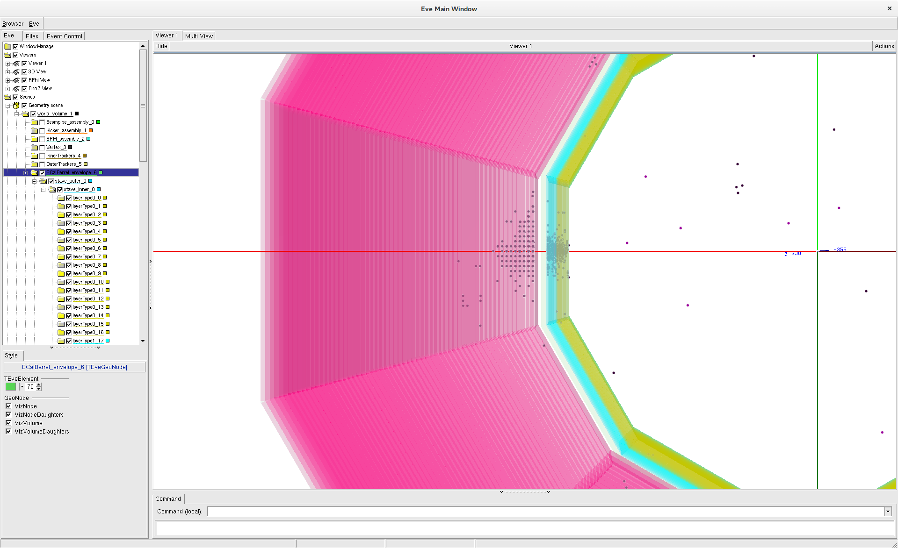
200 GeV γ in CLIC_o2_v04 with teveLCIO in DD4hep

Slide 6
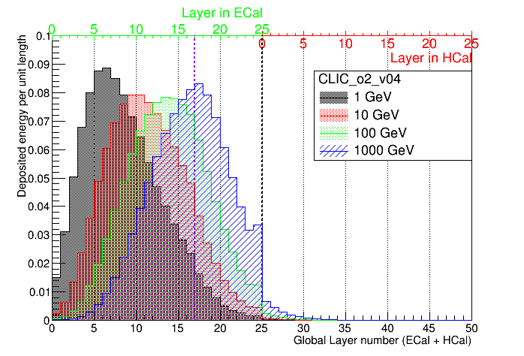

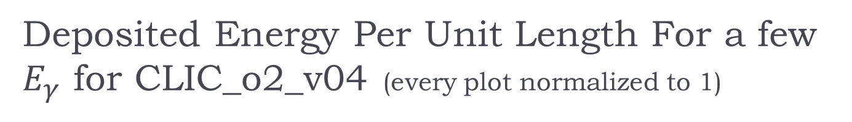
Deposited Energy Per Unit Length For a few $E_{γ}$ for CLIC_o2_v04 (every plot normalized to 1)
Raw energy deposited in sensitive volume as reported by Geant4, divided by sensitive volume thickness. Normalization starts to fail for high energies due to loss of energy in dead material between ECal and HCal
2.4 mm/layer
4.8 mm
22.85$X_{0}$
Already at 100 GeV we are sampling with the “bad” layers
Notes:
Root files with shower data obtained by running ./submitMarlinJob.sh -b eos-CLICdet_40_PROPER_SEED-gamma-1to1500.txt -t /home/nikiforo/CLICdet_40Calib/output/showerShapes.xml -G /home/nikiforo/CLICdet_40Calib/GearOutput.xml -x /afs/cern.ch/eng/clic/work/ilcsoft/HEAD-2016-02-19/lcgeo/HEAD/CLIC/compact/CLICdet_ECalStudy/CLICdet_40.xml -m -1 -d ShowerData_CLICdet_40_gamma_1to1500GeV -X
For each point. ShowerData processor from ClicPerformance is needed.
Then /afs/cern.ch/user/n/nikiforo/scripts/drawShowerDepthPlot.C is used on each model

Slide 7
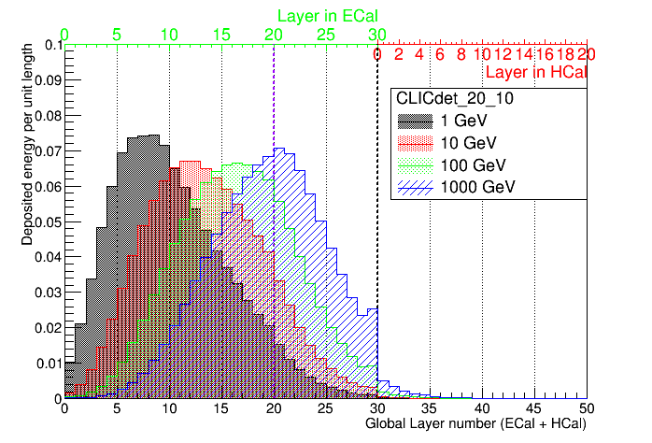
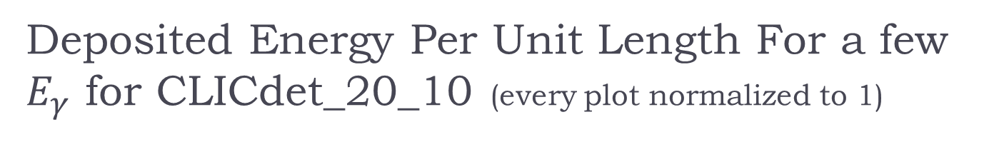

Deposited Energy Per Unit Length For a few $E_{γ}$ for CLICdet_20_10 (every plot normalized to 1)
Raw energy deposited in sensitive volume as reported by Geant4, divided by sensitive volume thickness. Normalization starts to fail for high energies due to loss of energy in dead material between ECal and HCal
2 mm/layer
4 mm
23.35$X_{0}$
A bit better, but still not optimal

Slide 8
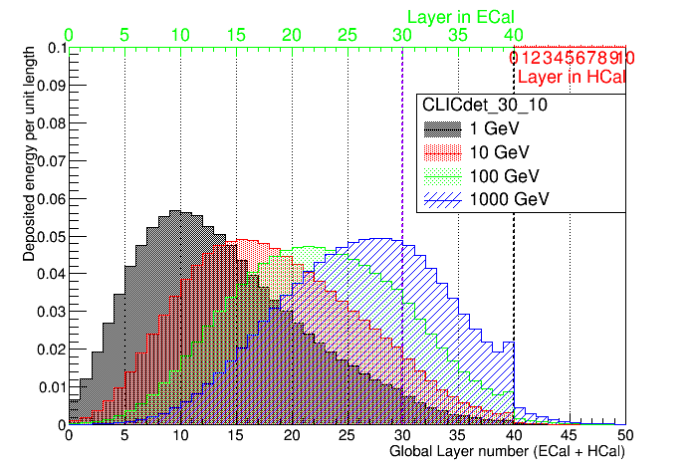


Deposited Energy Per Unit Length For a few $E_{γ}$ for CLICdet_30_10 (every plot normalized to 1)
Raw energy deposited in sensitive volume as reported by Geant4, divided by sensitive volume thickness. Normalization starts to fail for high energies due to loss of energy in dead material between ECal and HCal
1.5 mm/layer
3 mm
22.58$X_{0}$
An expensive option with reasonable sampling throughout the energy range

Slide 9
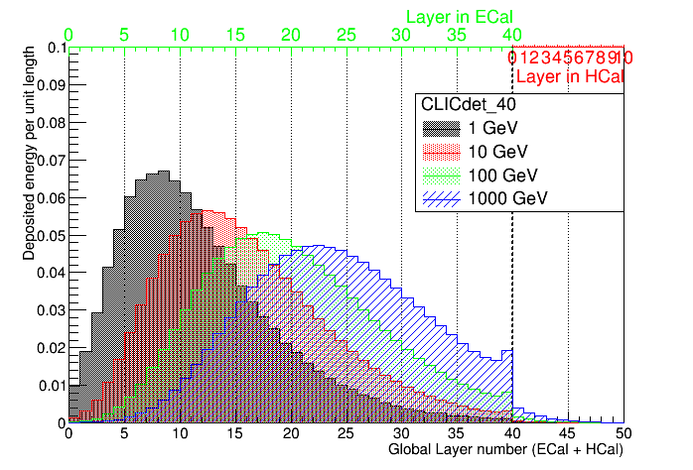
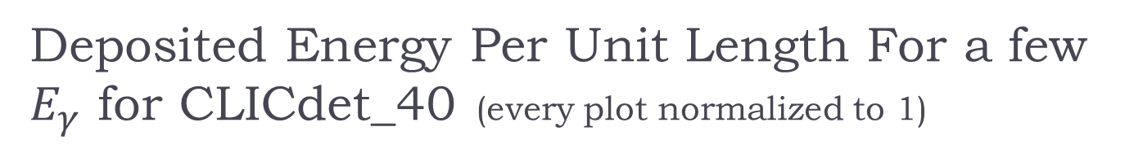

Deposited Energy Per Unit Length For a few $E_{γ}$ for CLICdet_40 (every plot normalized to 1)
Raw energy deposited in sensitive volume as reported by Geant4, divided by sensitive volume thickness. Normalization starts to fail for high energies due to loss of energy in dead material between ECal and HCal
1.9 mm/layer
22.85$X_{0}$
An expensive option with constant sampling

Slide 10
Calibration Issues
To compare model performance (resolution, leakage) one has to calibrate first (Geant4 GeV -> particle GeV)
  I only look at digitized calorimeter hits, so no Pandora calibration constants used
Start by using the digitization part of the Calibration procedure by Steve
  Use single particles (10 GeV γ, 50 GeV K0L), fit gaussians, get CalibrECAL, CalibrHCAL: these are constants of the order 40-50
  Puzzle: Say in the ECal, 2.4 mm W + other dead material = 0.7 X0 and 0.5 mm Si is 0.0053 X0. Therefore I would have expected CalibrECAL=0.7/0.0053=132 (:s ?)
    The ratio works if absorber/sensitive slices are the same (or have similar X0). Verified by simulating ECal with W absorber and W slices marked as “sensitive”
  Anyway, we use what we get and we also assume an additional factor of 2 for the layers in the back which have 4.8 mm W (though it probably should be 1.925, taking into account the other dead material X0, even more different for other combinations of layers)

Slide 11
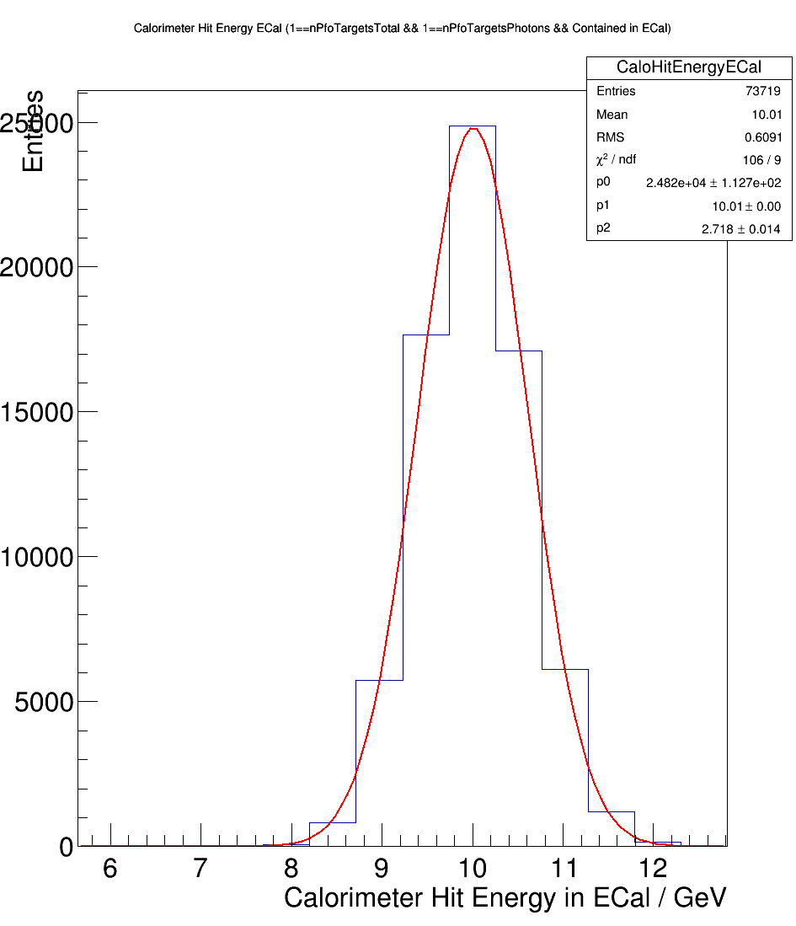
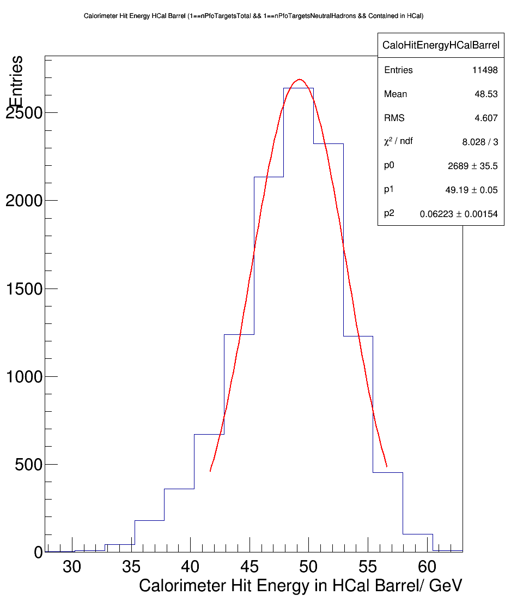
Initial Calibration of a model (CLIC_o2_v04)
10 GeV γ
50 GeV Κ0L
Obtain CalibrECal = 40.34 and 80.68
Obtain CalibrHCalBarrel = 46.62
We can now digitize our hits and use them to make sums of energies and determine resolutions (or not?)
N.B.: later in the Pandora calibration (not needed today) you obtain additional parameters like
ECalToEMGeVCalibration=HCalToEMGeVCalibration=~1
ECalToHadGeVCalibrationBarrel=~0.975 and HCalToHadGeVCalibration=1.05
-> Essentially we kind of digitize at the EM scale (?)
Notes:
From the output of Steve’s calibration procedure

Slide 12
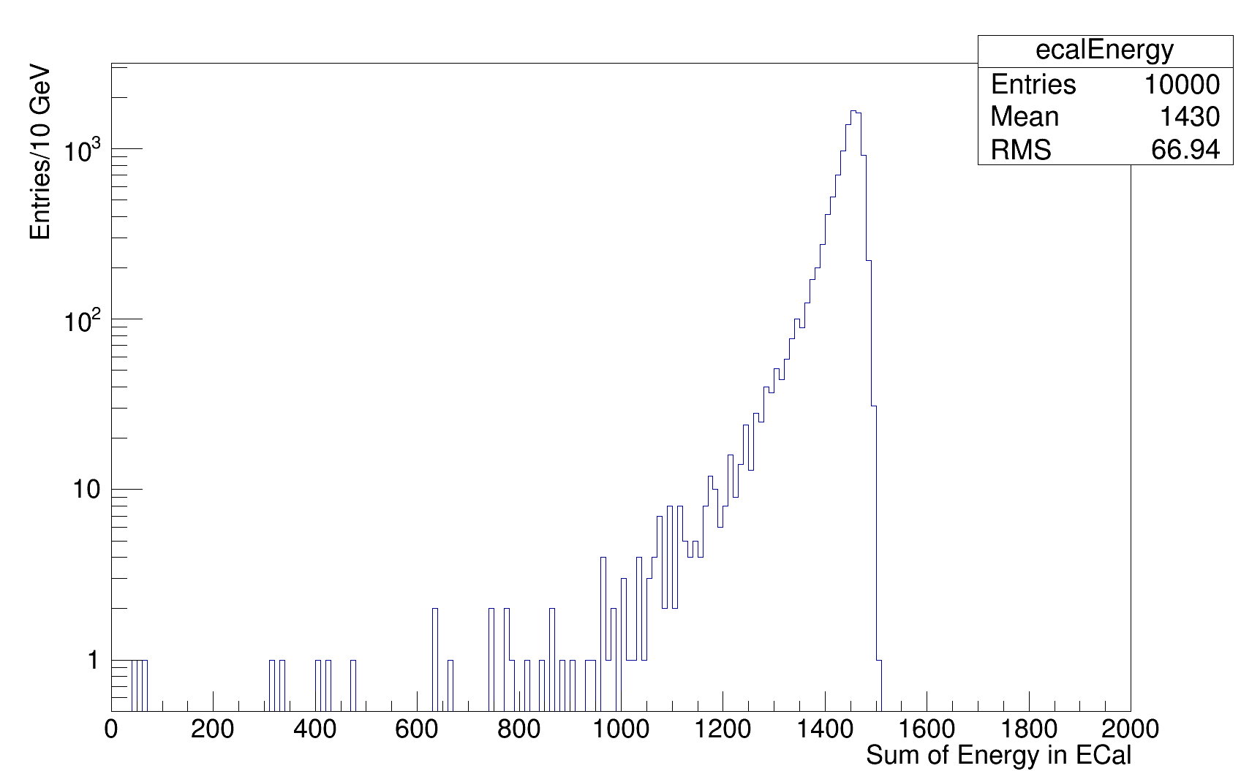
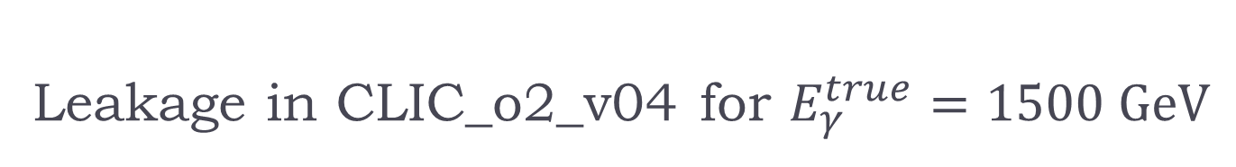
Leakage in CLIC_o2_v04 for $E_{γ}^{true}=1500 GeV$
Clearly we are losing energy in the HCal and recovery is needed
Add HCal energy

Slide 13
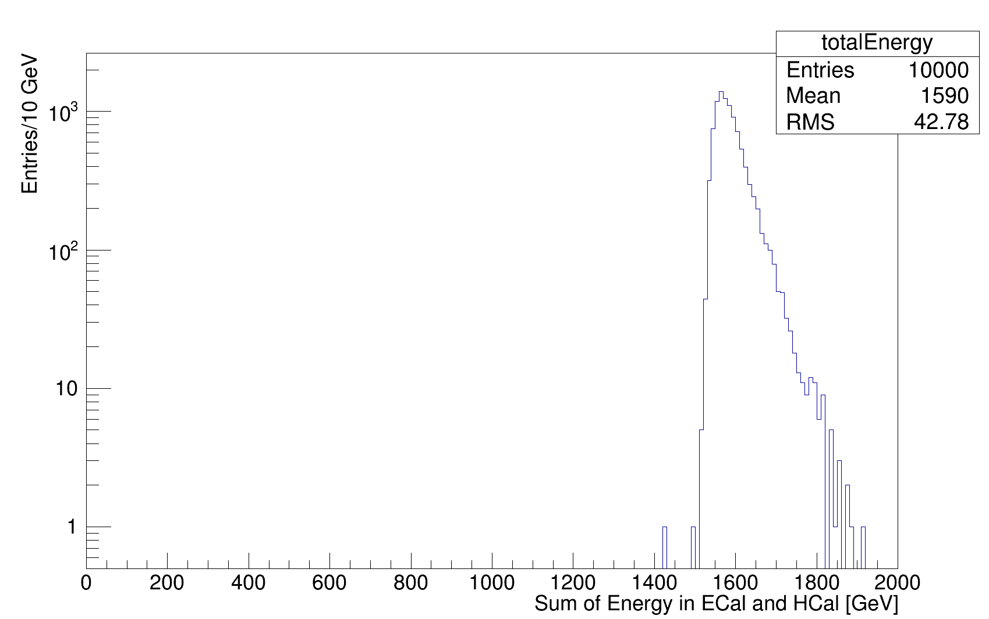


Leakage Recovery in CLIC_o2_v04 for $E_{γ}^{true}=1500 GeV$
Again clearly we are doing something wrong in simply adding the HCal hits as digitized with CalibrHCAL (hadronic scale)
Need to recalibrate HCal for EM scale!
  Not clear that this is to blame
Simply removing the ECal and firing photons on the HCal (which is the same for all models) does not really work
  Calibrate at 1500 GeV constraining ${αE}_{ECal}+{βE}_{HCal}=1500 GeV$

Slide 14
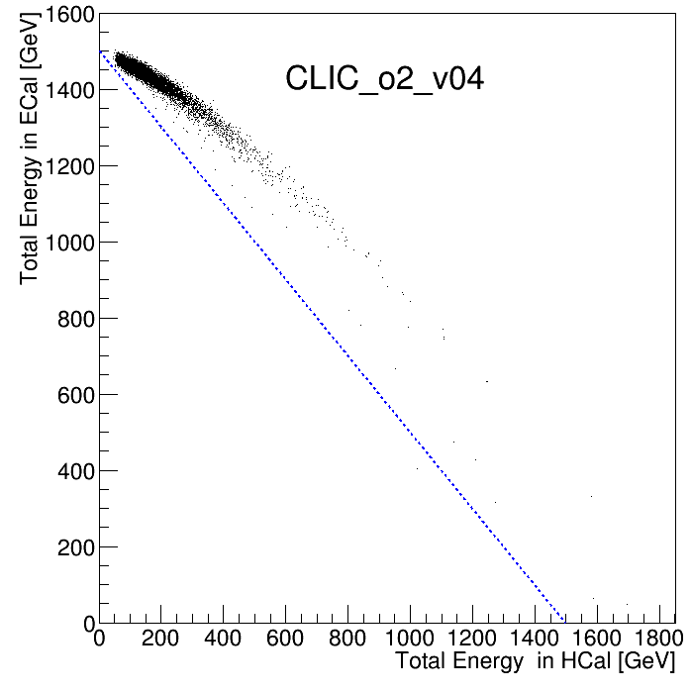
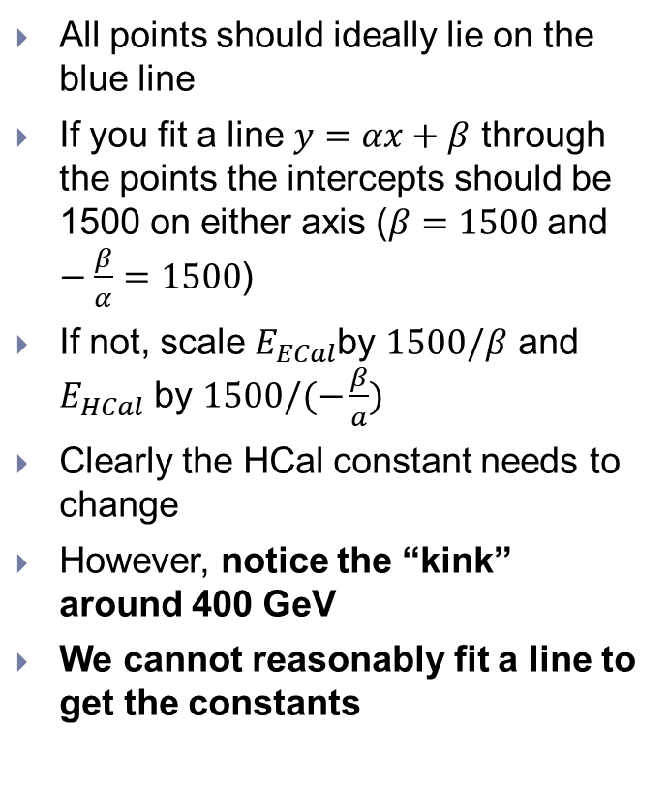
Leakage Recovery in CLIC_o2_v04 for $E_{γ}^{true}=1500 GeV$
All points should ideally lie on the blue line
If you fit a line $y=αx+β$ through the points the intercepts should be 1500 on either axis ($β=1500$and $−\frac{β}{α}=1500$)
If not, scale $E_{ECal}$by $1500/β$ and $E_{HCal}$ by $1500/(−\frac{β}{a})$
Clearly the HCal constant needs to change
However, notice the “kink” around 400 GeV
We cannot reasonably fit a line to get the constants

Slide 15
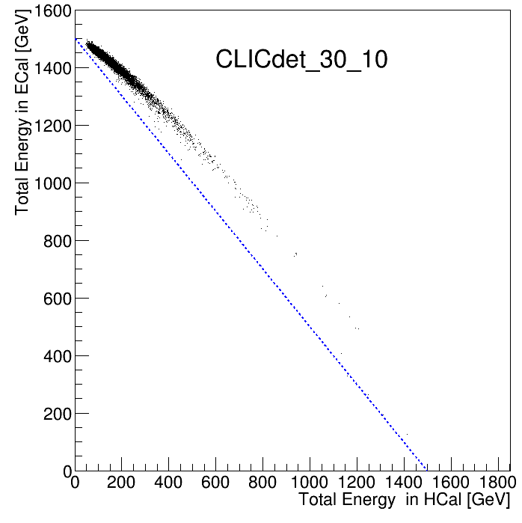
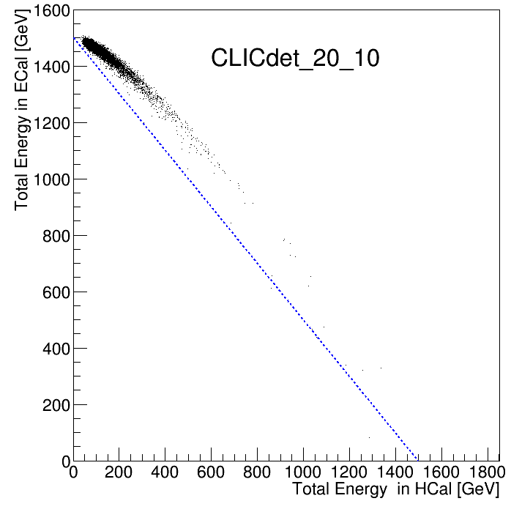
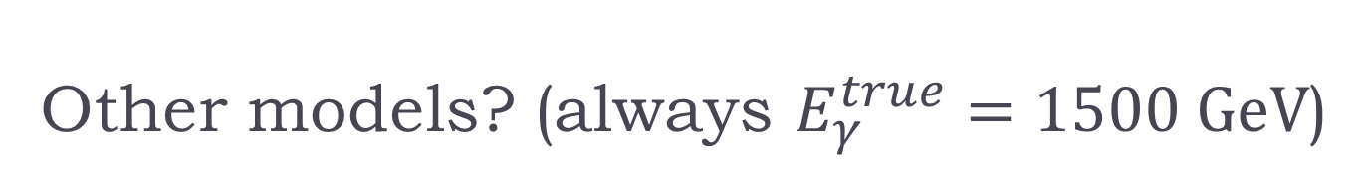
Other models? (always $E_{γ}^{true}=1500 GeV$)
Other models also show kink

Slide 16
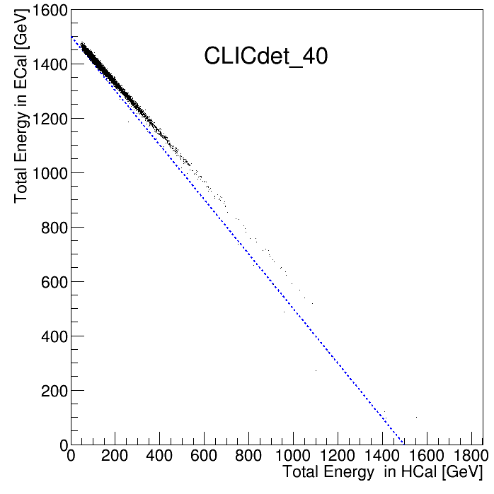
CLICdet_40 is OK
The uniform model (40 layers of constant thickness) doesn’t exhibit this pathology

Slide 17
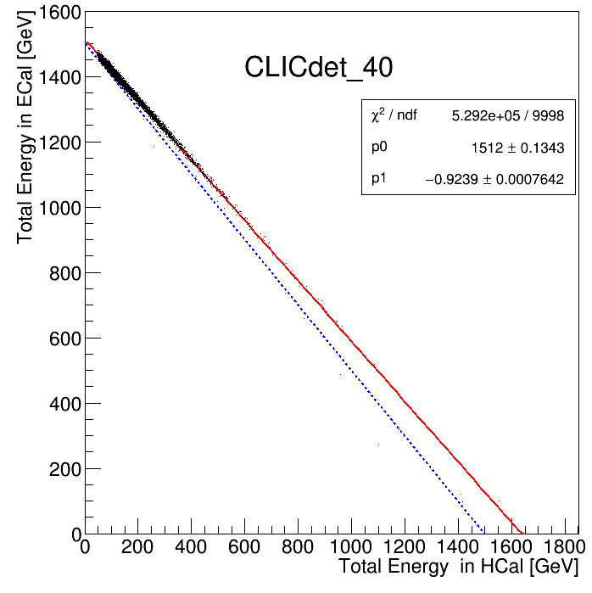
CLICdet_40 is OK
The uniform model (40 layers of constant thickness) doesn’t exhibit this pathology
We can easily fit and obtain the constants

Slide 18
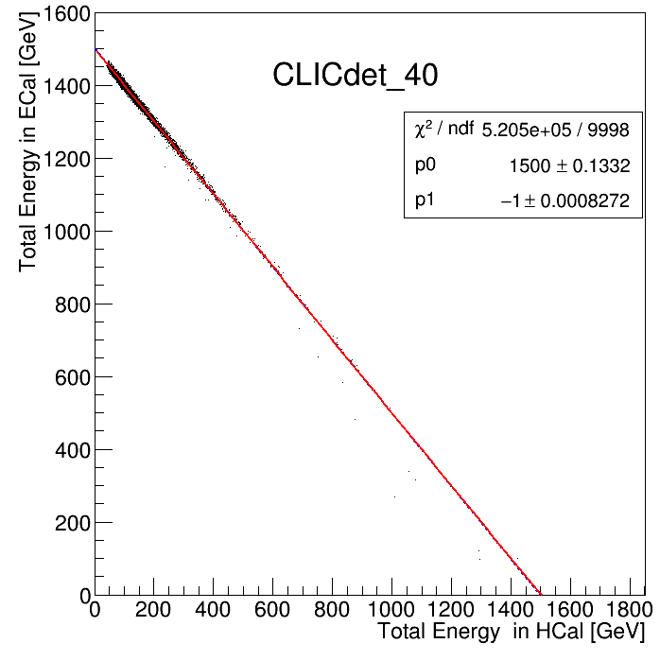
CLICdet_40 is OK
The uniform model (40 layers of constant thickness) doesn’t exhibit this pathology
We can easily fit and obtain the constants and rescale. We could then apply the constants to the rest (lower) of the energy points
This would suggest that the factor of two between the front and back layer calibration is wrong
Remember, hits are already digitized with CalibrECAL, 2xCalibrECal and CalibrHCALBarrel
For the ECal models with two layer compartments one needs to simultaneously calibrate the two ECal compartments and the HCal

Slide 19
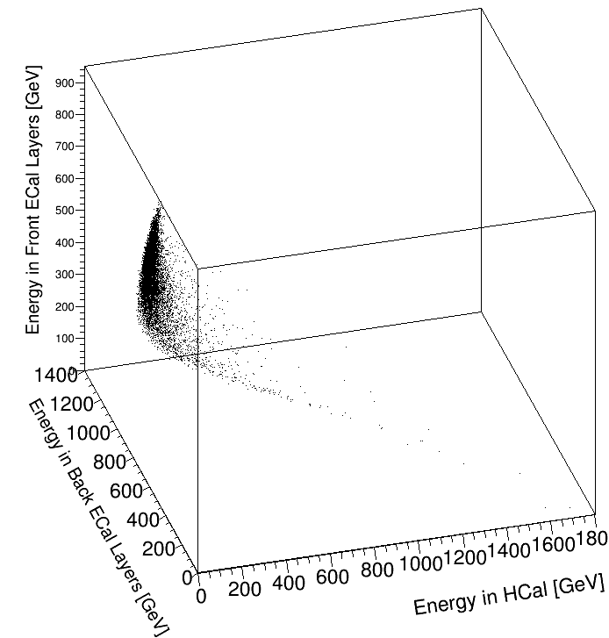
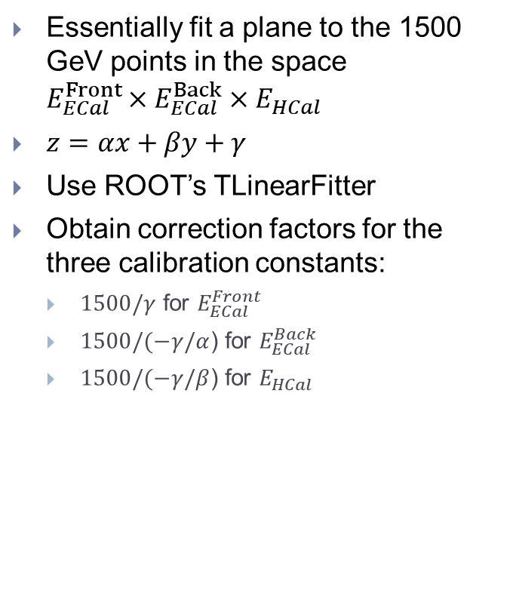
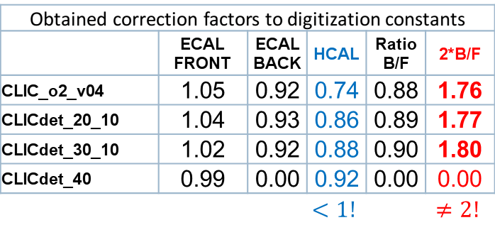
Generalized Line Fit
Essentially fit a plane to the 1500 GeV points in the space $E_{ECal}^{Front}×E_{ECal}^{Back}×E_{HCal}$
$z=αx+βy+γ$
Use ROOT’s TLinearFitter
Obtain correction factors for the three calibration constants:
  $1500/γ$ for $E_{ECal}^{Front}$
  $1500/(−γ/α$) for $E_{ECal}^{Back}$
  $1500/(−γ/β$) for $E_{HCal}$
Obtained correction factors to digitization constants
 | ECAL FRONT | ECAL BACK | HCAL | Ratio B/F | 2*B/F
CLIC_o2_v04 | 1.05 | 0.92 | 0.74 | 0.88 | 1.76
CLICdet_20_10 | 1.04 | 0.93 | 0.86 | 0.89 | 1.77
CLICdet_30_10 | 1.02 | 0.92 | 0.88 | 0.90 | 1.80
CLICdet_40 | 0.99 | 0.00 | 0.92 | 0.00 | 0.00
 |  |  | $$<1!$$ |  | $$≠2!$$
1.5 TeV γ, CLIC_o2_v04
Only for illustration
Notes:
/afs/cern.ch/user/n/nikiforo/scripts/linearFit.C will be used to fit. Here, just a simple visualization using showerData->Draw("total_layerGroup_energy[0]:total_layerGroup_energy[1]:totalLeakEnergy","trueEnergy==1500","")
For CLIC_o2_v04

Slide 20
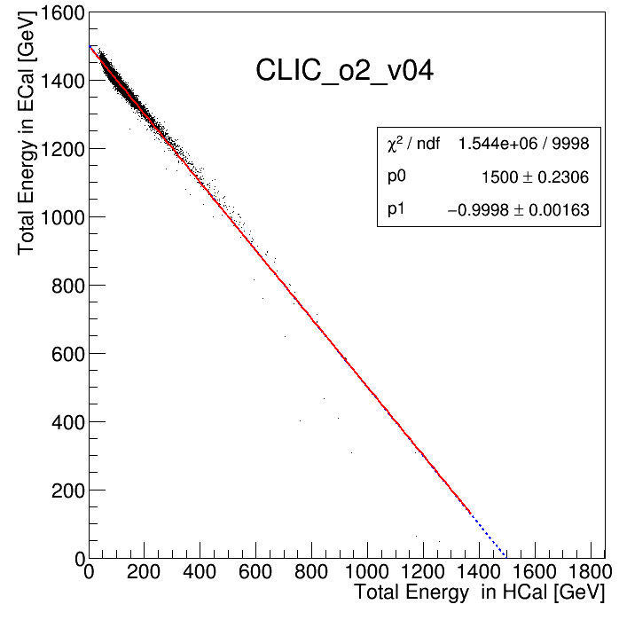
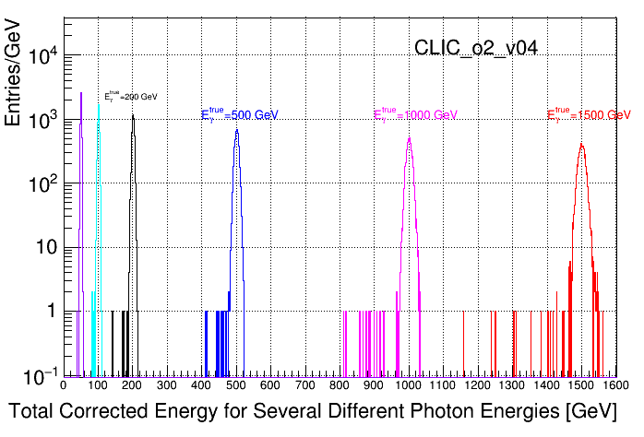
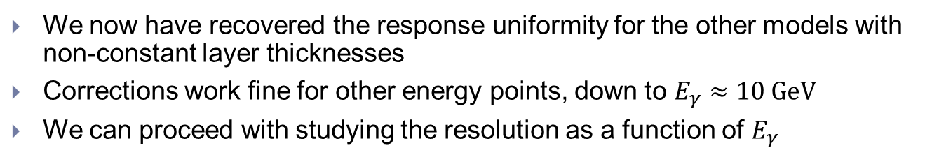
CLIC_o2_v04 (others similar) are now OK
This fit only for illustration
We now have recovered the response uniformity for the other models with non-constant layer thicknesses
Corrections work fine for other energy points, down to $E_{γ}≈10 GeV$
We can proceed with studying the resolution as a function of $E_{γ}$

Slide 21
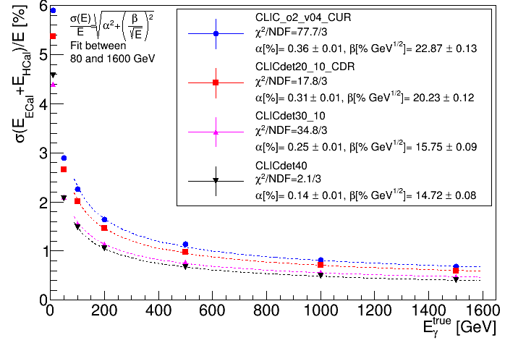
Resolution using total ECal and HCal Energy
REMINDER: Only single photons at fixed $θ=90°$ and $φ=0°$
Fits not perfect, but constant term <1% shown and agreeing with the trend of the points.
Thicker back layers detrimental to high energy γ’s
The uniformly thin option is the best behaving at high energy since it has the thinnest layers at the back (1.9 mm)
Perhaps should have also investigated a uniform 30 layer option (if 40 layers is prohibitive) though I am afraid it will need at least 2.6 mm thick plates ( for 22.8 X0)
Notes:
Obtained using /afs/cern.ch/user/n/nikiforo/scripts/makeSDPlots1to1500.C which creates all the total energy distribution plots for every energy point and every model and fits iteratively gaussians within 3 sigma. The script uses calibration parameters obtained using ~/scripts/linearFit.C which fits a plane to the set of 3d points in the space of totalEnergyECalFront x totalEnergyECalBack x totalEnergyHCal

Slide 22
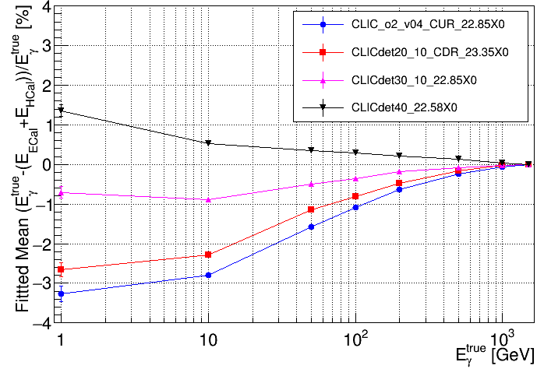
Residuals
Since we are optimized for high energy, we observe the calibration breaking down at lower energy
Could perhaps calibrate at an intermediate value
Non linearity corrections probably needed.
Should also look at effect on Jet Energy Resolution
Notes:
Obtained using /afs/cern.ch/user/n/nikiforo/scripts/makeSDPlots1to1500.C which creates all the total energy distribution plots for every energy point and every model and fits iteratively gaussians within 3 sigma. The script uses calibration parameters obtained using ~/scripts/linearFit.C which fits a plane to the set of 3d points in the space of totalEnergyECalFront x totalEnergyECalBack x totalEnergyHCal

Slide 23
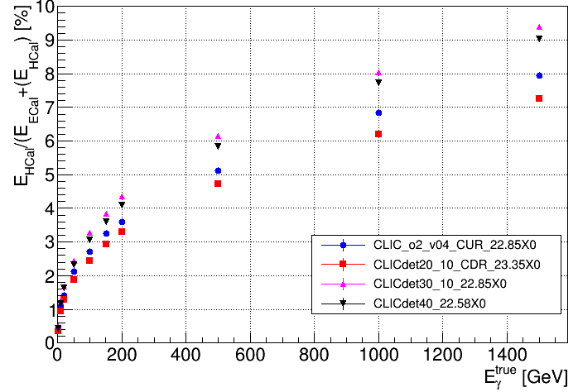
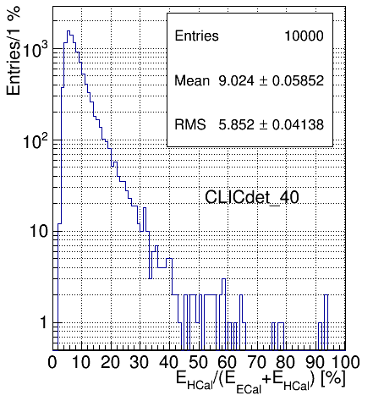
Leakage
Example at 1500 GeV
Mean
More X0’s is generally better, of course
Do not completely understand the splitting (thinner plates leak more), or why 22.58X0 leaks less than 22.85X0
A next iteration of the study should keep #X0 constant!
  probably at the deeper option (23.35X0 +)
Notes:
Obtained using /afs/cern.ch/user/n/nikiforo/scripts/makeSDPlots1to1500.C which creates all the total energy distribution plots for every energy point and every model and fits iteratively gaussians within 3 sigma. The script uses calibration parameters obtained using ~/scripts/linearFit.C which fits a plane to the set of 3d points in the space of totalEnergyECalFront x totalEnergyECalBack x totalEnergyHCal

Slide 24
More exotic tests: A full steel block HCal
Would have liked to quantify leakage better
I also tried simulating the ECal models with a fully homogenous Steel block HCal at their back
Collected the energy in the steel (no sampling – hoping to have a perfect response at the back of the ECal). Results more confusing than helpful
  Somehow getting more energy in the HCal than needed (still calib factor <1)
    Non linearity to blame rather than the Scale?
I still believe such a test with a perfect “tail catcher” could be instructive, if we understand what’s going on
Could be done, perhaps more easily, by using all the MC Particles after the ECal

Slide 25
Summary, open issues and conclusions
Need to revisit calibration procedure for obtaining Digitization/Pandora constants for physics reconstruction
  Calibrate two ECal compartments simultaneously, rather than applying factor of 2 in digitization constants?
    HCal calibration: Consider issues with EM/Had scale. Maybe calibrate together with ECal with high energy photons first?
  Consider non-linearity corrections? Maybe at least higher photon energy for calibration rather than just 10 GeV?
Hit-level performance should be studied with more realistic events
  At least with isotropically distributed single photons
Photon Training: still needs to be done at least for eventual model to be used. Should do for all models under investigation to compare final photon performance
Leakage: will we really be able to recover the energy in the HCal in real events?

Slide 26
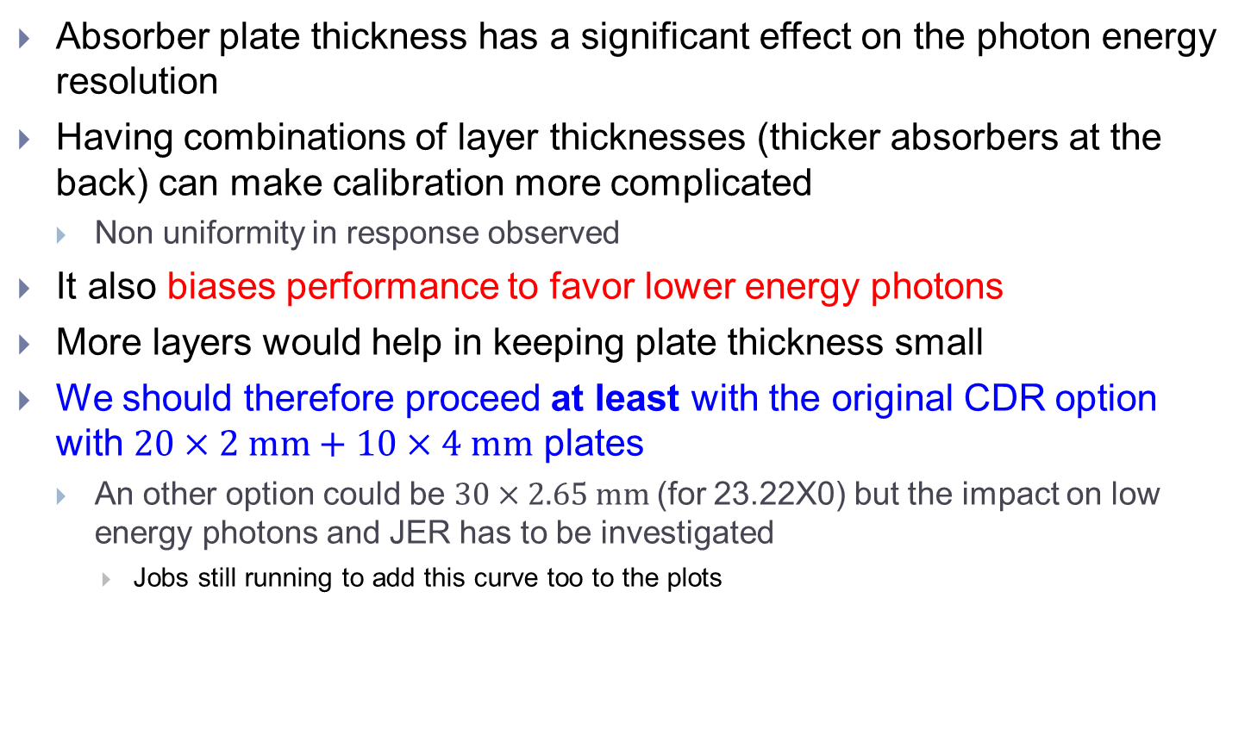
Summary, open issues and conclusions II
Absorber plate thickness has a significant effect on the photon energy resolution
Having combinations of layer thicknesses (thicker absorbers at the back) can make calibration more complicated
  Non uniformity in response observed
It also biases performance to favor lower energy photons
More layers would help in keeping plate thickness small
We should therefore proceed at least with the original CDR option with $20×2 mm+10×4 mm$ plates
  An other option could be $30×2.65 mm$(for 23.22X0) but the impact on low energy photons and JER has to be investigated
    Jobs still running to add this curve too to the plots

Slide 27
Backup Material

Slide 28
More models

Slide 29
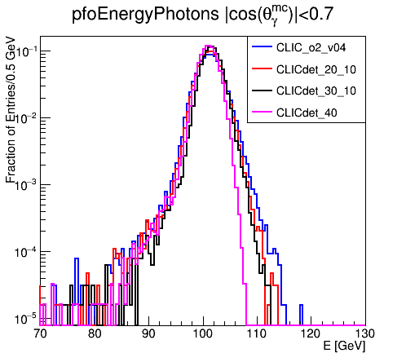
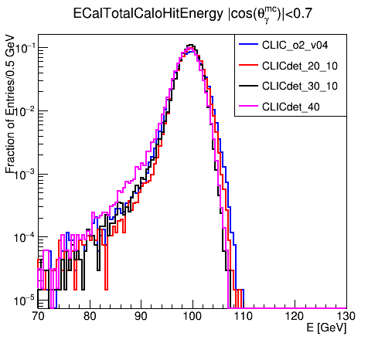
100 GeV Photons (old study)
Notice that this has significant underflows! ~6-7% -> Implicitly “bad” events where photons are badly reconstructed are ignored
Underflows <0.1%
Model/ Energy | Total γ PFO Energy |  | Total ECal Energy (no γ reco)
 | Mean [GeV] | Sigma [GeV] | Mean [GeV] | Sigma [GeV]
CLIC_o2_v04_100GeV | 101.33 | 2.25 | 99.55 | 2.33
CLICdet20_10_100GeV | 101.32 | 2.04 | 99.72 | 2.05
CLICdet30_10_100GeV | 101.67 | 1.74 | 99.49 | 1.82
CLICdet40_100GeV | 101.07 | 1.65 | 99.17 | 2.04

Slide 30
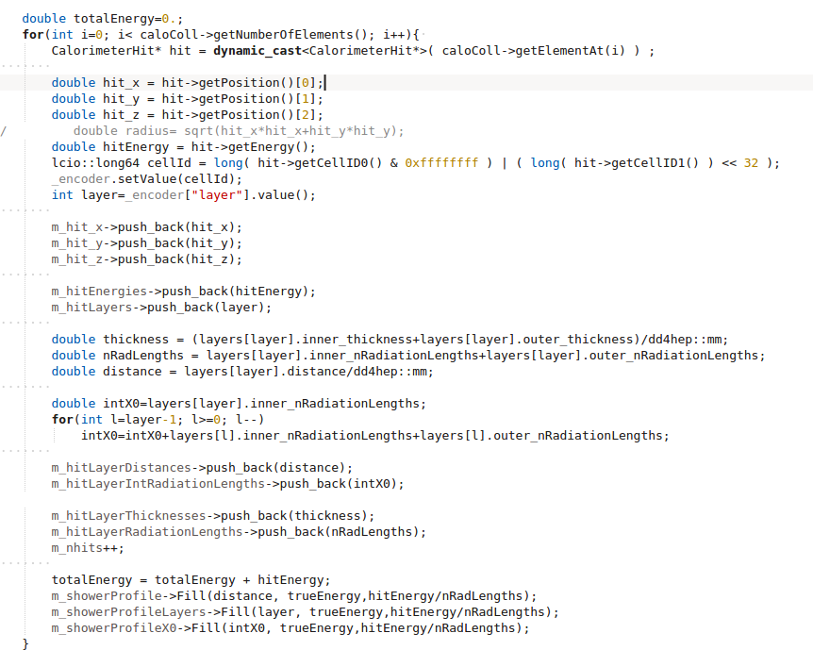
Simple analysis of digitized Calorimeter LCIO hits
Can equivalently easily run simple python scripts on lcio files (no need to run the full ILCSOFT framework)

