Slide 1
Updated ECal Optimization Plots
Nikiforos Nikiforou
CERN/EP-LCD

Slide 2
More models
 | Number of Layers | Absorber Thickness [mm] | Si Thicknes [mm] | Other (gaps, etc) [mm] | Absorber Thickness [X0] | Si+Other Thickness [mm] | Si+Other Thickness [X0] | Total Thickness [mm] | Total Thickness [X0] | Calorimeter Thickness [mm] | Calorimeter Depth [X0]
CLIC_o2_v04 | 17 | 2.4 | 0.5 | 1.5 | 0.648 | 2 | 0.058 | 74.8 | 12.007 | 129.2 | 22.846
 | 8 | 4.8 | 0.5 | 1.5 | 1.297 | 2 | 0.058 | 54.4 | 10.838
CLICdet_20_10 | 20 | 2 | 0.5 | 1.5 | 0.540 | 2 | 0.058 | 80 | 11.965 | 140 | 23.351
 | 10 | 4 | 0.5 | 1.5 | 1.081 | 2 | 0.058 | 60 | 11.386
CLICdet_30_10 | 30 | 1.5 | 0.5 | 1.5 | 0.405 | 2 | 0.058 | 105 | 13.894 | 155 | 22.578
 | 10 | 3 | 0.5 | 1.5 | 0.811 | 2 | 0.058 | 50 | 8.684
CLICdet_40 | 40 | 1.9 | 0.5 | 1.5 | 0.513 | 2 | 0.058 | 156 | 22.848 | 156 | 22.848
 | 0 | 0 | 0 | 0 | 0.000 | 0 | 0.000 | 0 | 0.000
CLICdet_40x195 | 40 | 1.95 | 0.5 | 1.5 | 0.527 | 2 | 0.058 | 158 | 23.389 | 158 | 23.389
 | 0 | 0 | 0 | 0 | 0.000 | 0 | 0.000 | 0 | 0.000
CLICdet_30 | 30 | 2.65 | 0.5 | 1.5 | 0.716 | 2 | 0.058 | 139.5 | 23.216 | 139.5 | 23.216
 | 0 | 0 | 0 | 0 | 0.000 | 0 | 0.000 | 0 | 0.000
CLICdet_30_10b | 20 | 2.6 | 0.5 | 1.5 | 0.703 | 2 | 0.058 | 92 | 15.207 | 141 | 23.043
 | 10 | 2.9 | 0.5 | 1.5 | 0.784 | 2 | 0.000 | 49 | 7.836
Added lines in red

Slide 3
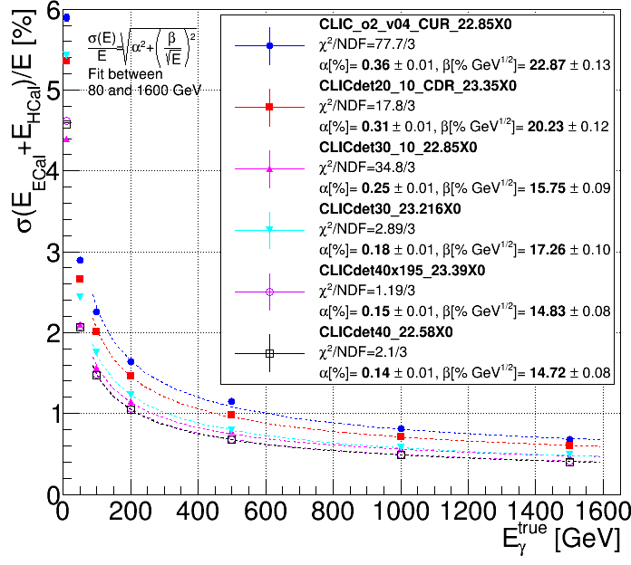
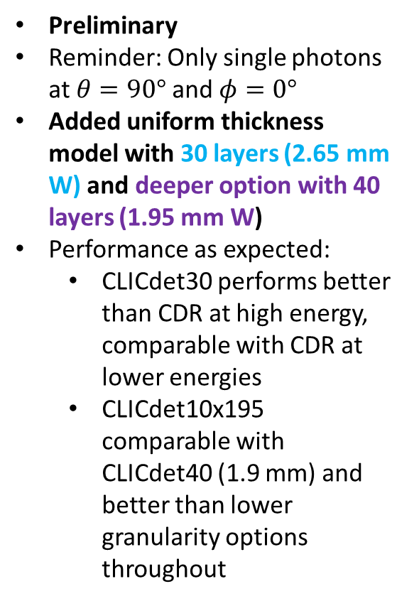
Resolution as a function of Photon Energy
Preliminary
Reminder: Only single photons at $θ=90°$and $φ=0°$
Added uniform thickness model with 30 layers (2.65 mm W) and deeper option with 40 layers (1.95 mm W)
Performance as expected:
  CLICdet30 performs better than CDR at high energy, comparable with CDR at lower energies
  CLICdet10x195 comparable with CLICdet40 (1.9 mm) and better than lower granularity options throughout
Note: CLICdet30 has 9700 events compared to 10000 for the rest

Slide 4
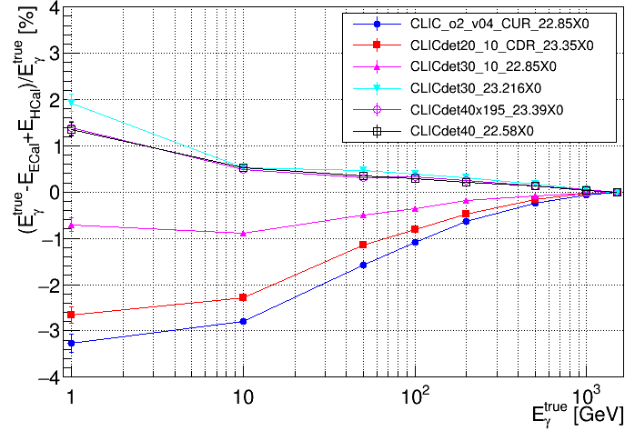
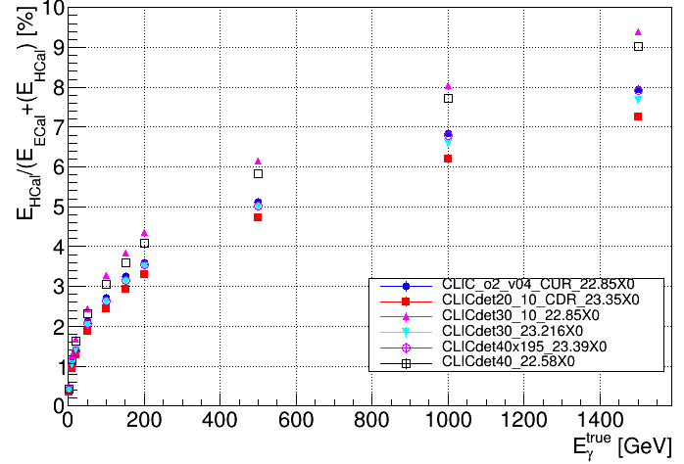
Residuals and leakage
Residuals as expected
Leakage is improved for CLICdet_40x195

