Slide 1
Highlights from MAX IV commissioning and operation
Pedro F. Tavares on behalf of the MAX IV team
ELETTRA – September 2016

Slide 2
Summary
The MAX IV Facility
The MAX IV 3 GeV Ring
Commissioning Highlights
Next Steps
Future Perspectives

Slide 3
Conceptual Basis of the MAX IV Design
Scientific Case calls for high brightness radiation over a wide spectral and time range: IR to Hard R-rays, Short X-Ray Pulses.
Need for high brightness: low emittance and optimized insertion devices.
This is hard to achieve in a single machine:
higher electron beam energy → harder photons
lower electron beam energy → softer photons
One size does not fit all !

Slide 4
The MAX IV Approach
Different machines for different uses:
  A high energy ring with ultra-low emittance for hard X-ray users.
  A low emittance low energy ring for soft radiation users
  A LINAC based source for generating short pulses and allowing for future development of an FEL source.

Slide 5
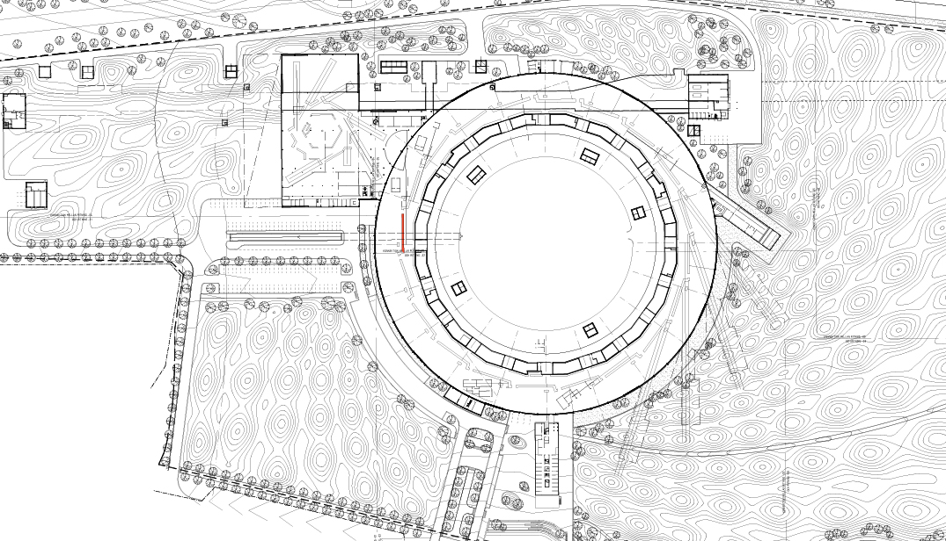
MAX IV – an overview
Short Pulse Facility
Linear Accelerator
1.5 GeV SR
3 GeV Storage Ring
Annika Nyberg, MAX IV-laboratoriet, 2012
Notes:
MAX-lab – a national research facility jointly financed by the Research Council and Lund University. Synchrotron radiation is produced and used for experiments.
Three storage rings and an injector.
MAX I: 550 MeV, 32.4 m circumference, commissioned 1986
MAX II: 1.5 GeV, 90 m circumference, commissioned 1996
MAX III: 700 MeV, 36 m circumference, commissioned 2007

Slide 6
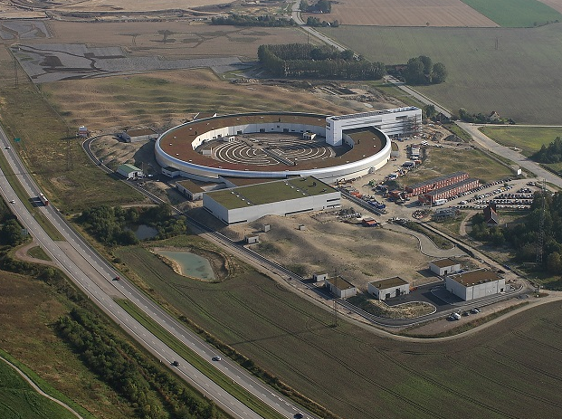
© Photo: Perry Nordeng
18-Sept-2014

Slide 7
MAX IV - An integrated Solution
Compact Magnet Design. High precision, High vibration frequencies
Full Energy Injector LINAC: Short Pulses
Multi-purpose Strong Magnets
Low RF frequency
Large Number of Magnets
MBA Lattice
Ultra-low emittance
robust, high stability. large momentum aperture
Small Magnet Apertures
IBS
Narrow vacuum Chambers
Wake-Fields
Long Bunches
Landau Cavities
100 % NEG Coating
Low Vacuum Conductance
Copper Chambers
High Heat Load Density

Slide 8
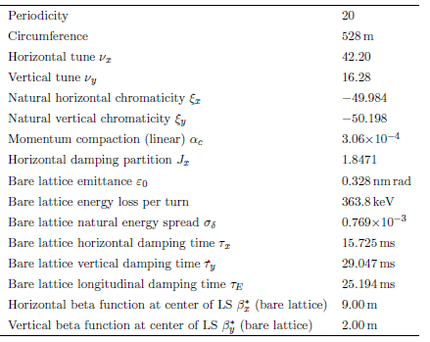
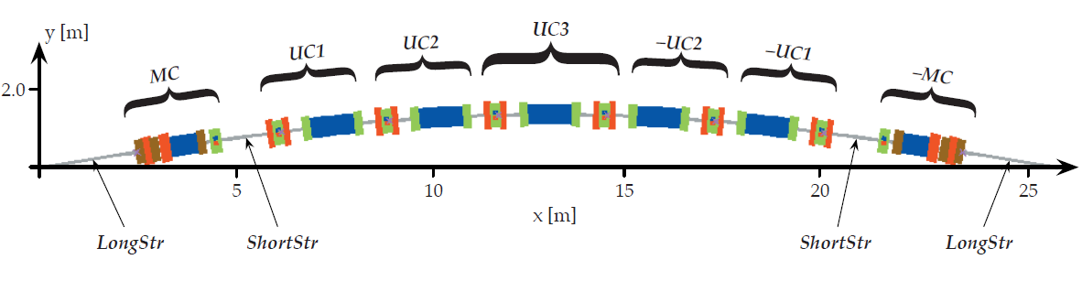
The MAX IV 3 GeV ring Lattice
7-bend achromat
20 periods
Unit Cells
Picture MAX IV DDR
Matching Cells

Slide 9













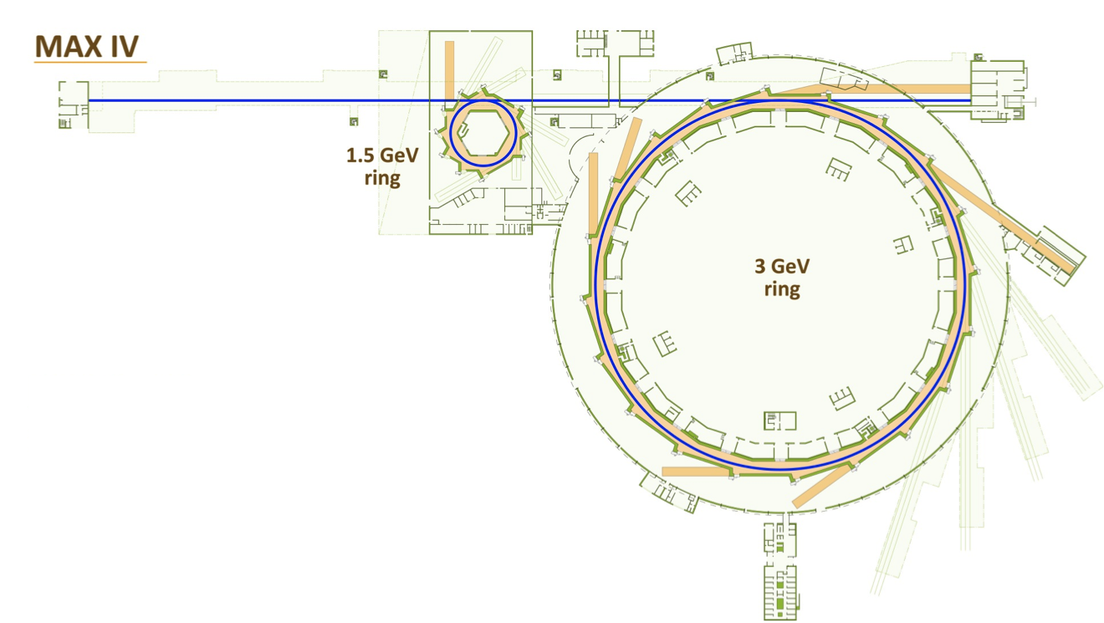

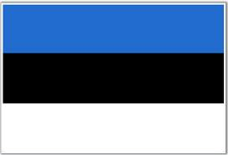


7
11
1
6
10
5
FemtoMAX
fs dynamics in solid
NanoMAX
Nano-imaging & - spectroscopy
BALDER
Chemical spectroscopy: operando
BioMAX
Protein crystallography
Veritas
Electronic & magnetic excitations: solids
Hippie
Photoemission: near ambient pressure
ARPES
Electronic structure: solids
FinEstBeaMS
Electronic structure: gases, aerosols
SPECIES
Electronic & magnetic excitations: surfaces
Transfer_PEEM
Microscopy: surfaces
Transfer_XPS
Electronic structure: surfaces & gases
CoSAXS
Geometric structure & correlation: (bio) liquids
SoftiMAX
Microscopy & method development
8
9
2
14
13
12
Slide by C. Quitmann
4
15
3
DanMAX
Powder diffraction & imaging: materials science
ForMAX
Wood & paper: structure & processing
MicroMAX
Most relevant (difficult) protein structures
DiffMAX
Crystal structure of bulk & surface
iMAX
Imaging of engineering materials

Slide 10
Project Timeline – MAX IV 3 GeV Ring

Slide 11
3 GeV Ring Commissioning Timeline
Beam in TR3
Aug 11
2015
First Turn
Aug 25
2015
Stored Beam
0.1 mA
Sep 15
2015
Stacking
4 mA
Oct 08
2015
First Light
Nov 2
2015
198 mA
July 9, 2016
Feb&March 2016
First IVUs

Slide 12
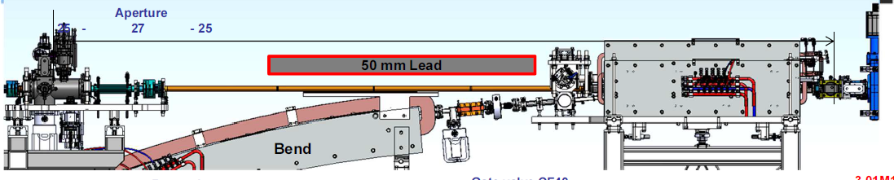
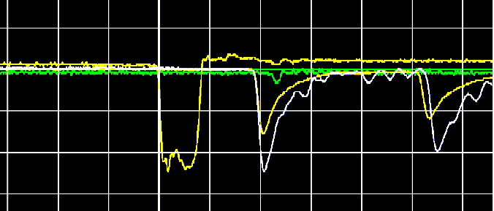
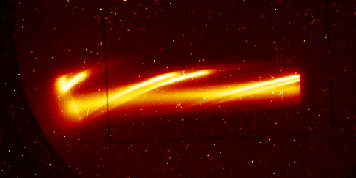
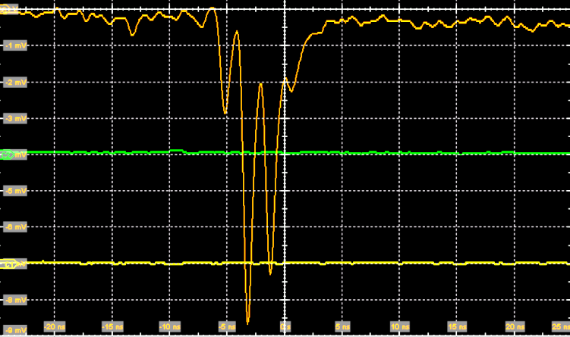
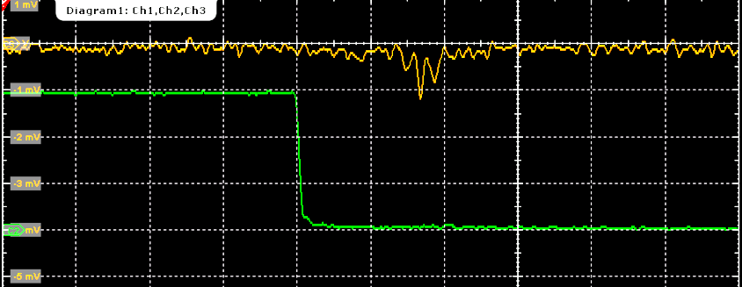
Early Commissioning Results
Picture J.Alhbäck
M1
Beam observed at the end of TR3 and into the ring.
2015/08/11

Slide 13
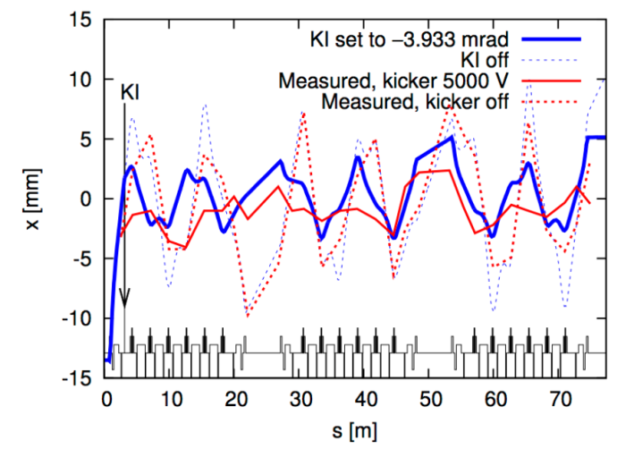
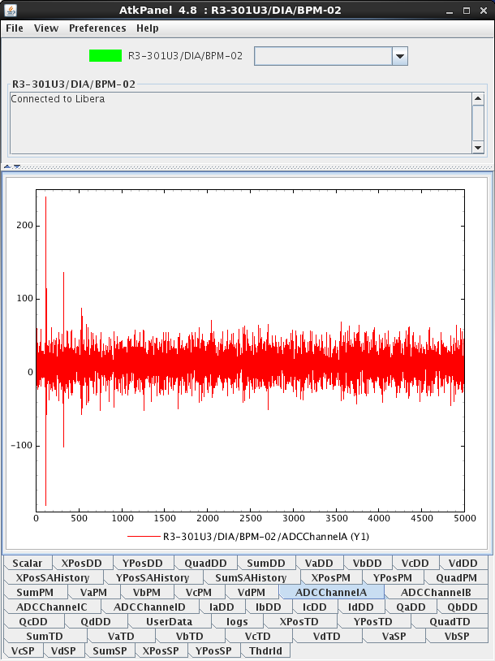
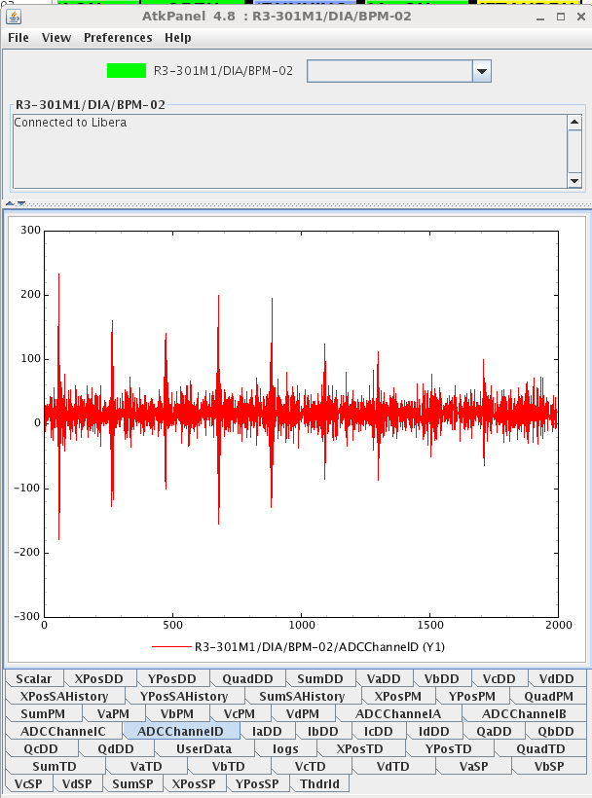
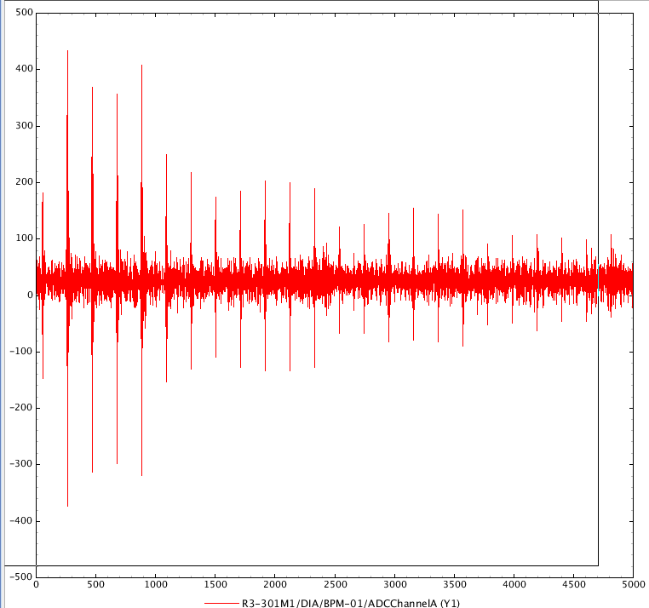
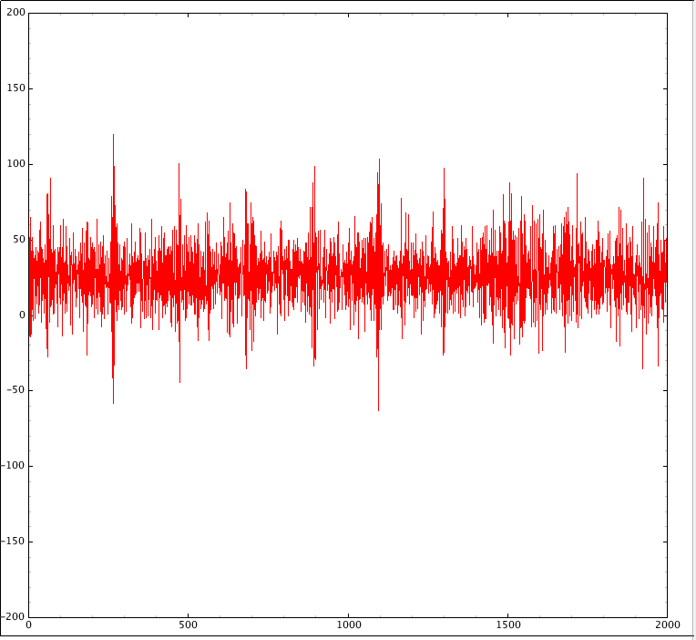
Threading the beam – first turn – many turns
2015/08/25
3 passes
All correctors OFF
Picture S.Leemann
35 passes
2015/08/26
2015/08/27

Slide 14
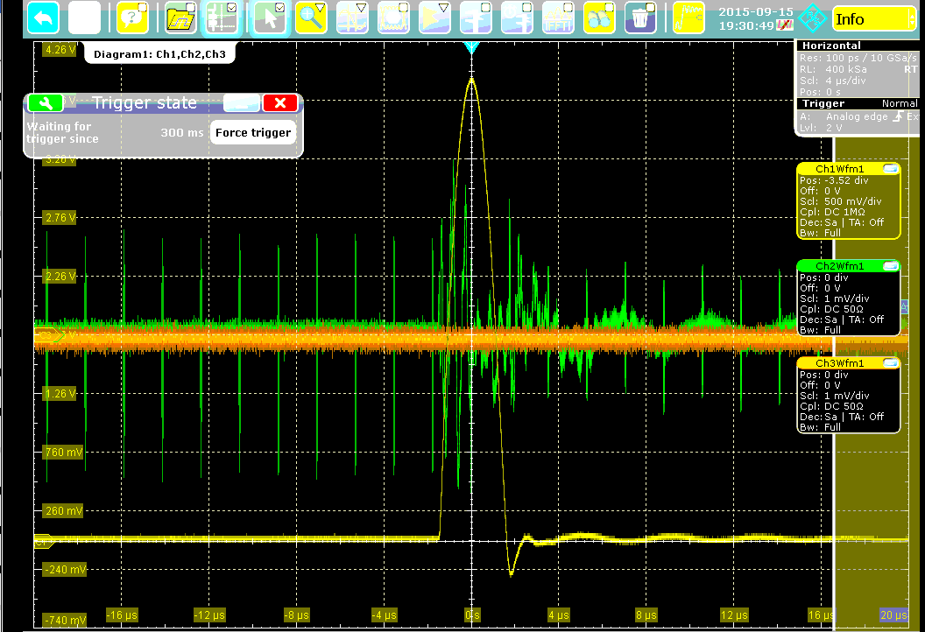
First Stored Beam
Injected beam
Revolution period
Stored beam 2 seconds after previous injection pulse
Kicker Current
Injection
2015/09/15

Slide 15
Linear Optics Characterization: Integer Tunes
Fractional tunes: 0.2087/0.2676

Slide 16
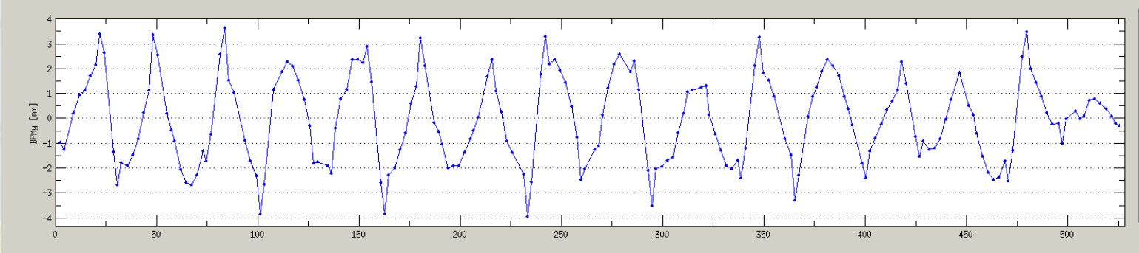
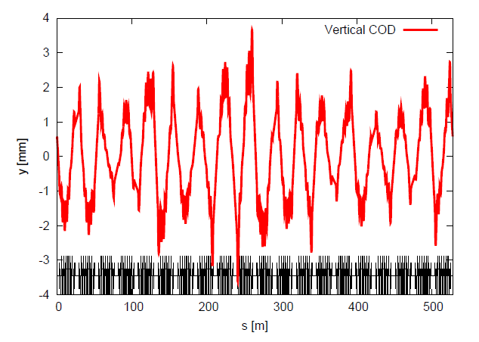
Bare Vertical Orbit
Plot by M.Sjöström
Example calculation for one random seed
MAX-lab Internal Note 201211071 by S.Leemann

Slide 17
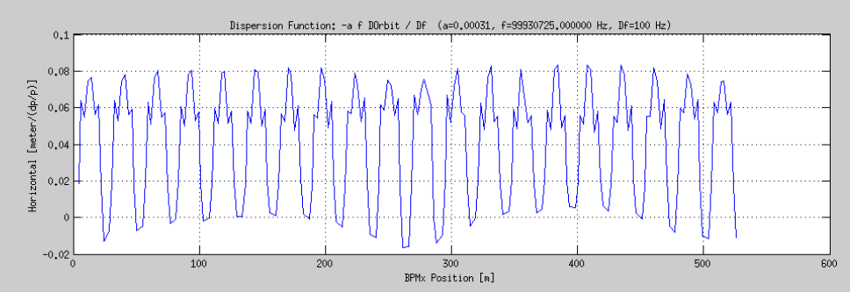
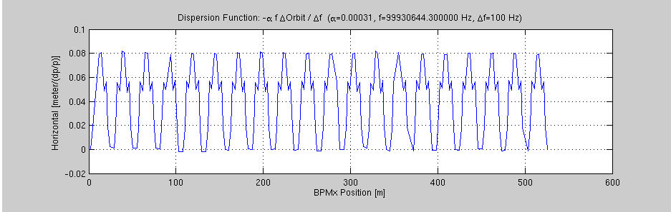
LOCO: reduction in dispersion beating
Before LOCO
Before LOCO
After LOCO: July 2016

Slide 18
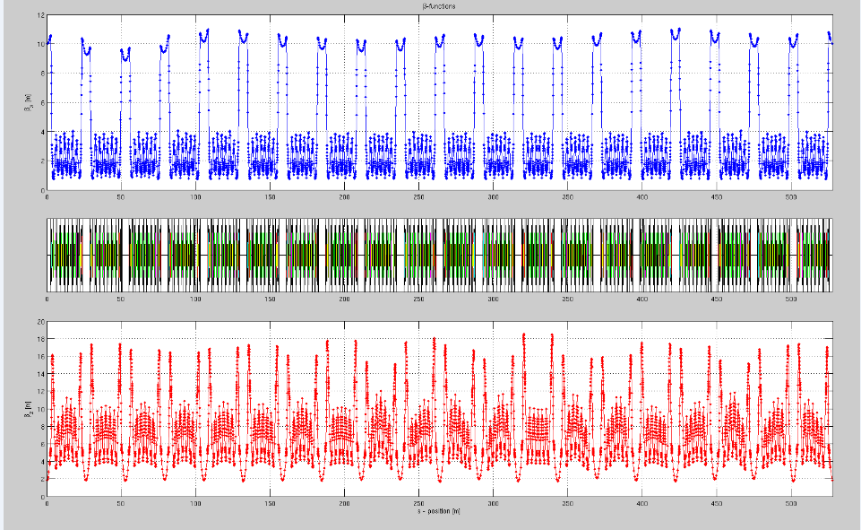
Beta-beat Reconstructed from LOCO

Slide 19
BPM Offsets
Measured by BBC using trim coils in sextupole magnets
RMS: 144 µm H / 138 µm V

Slide 20
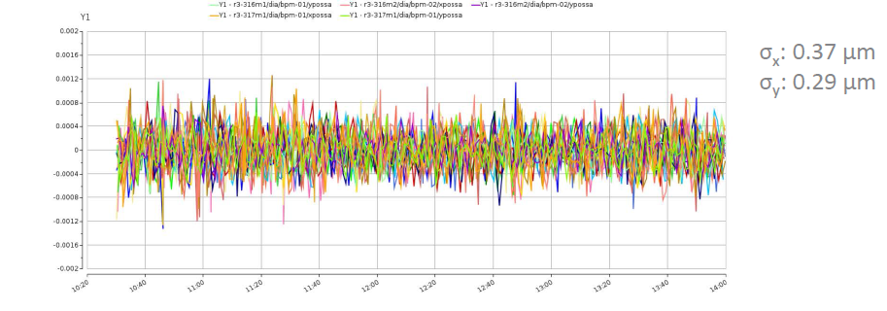
Orbit Stability / Slow Acquisition
Plot by M. Sjöström

Slide 21
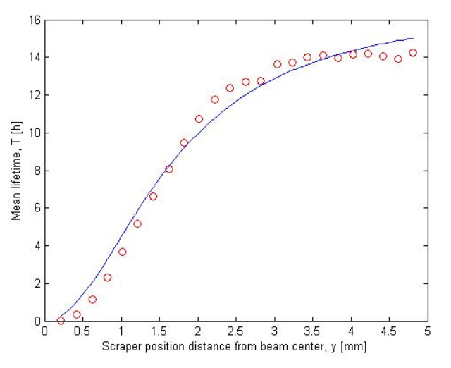
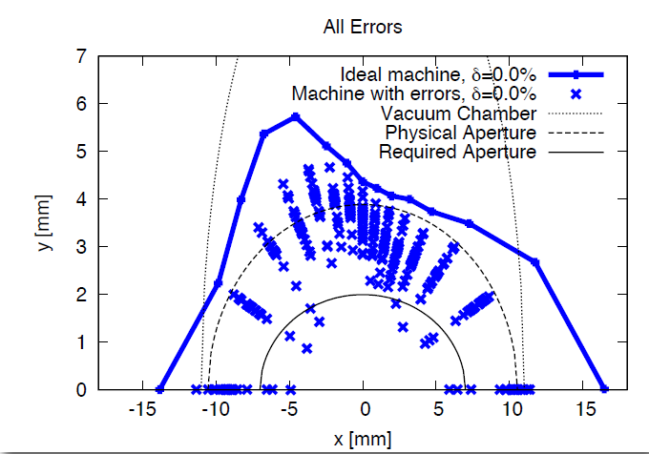
Aperture scans, scraper measurements
2016-02-03 measurement by J. Sundberg
2011 simulations by S.Leemann
Vertical aperture scaled to center of LS 2.3 mm

Slide 22
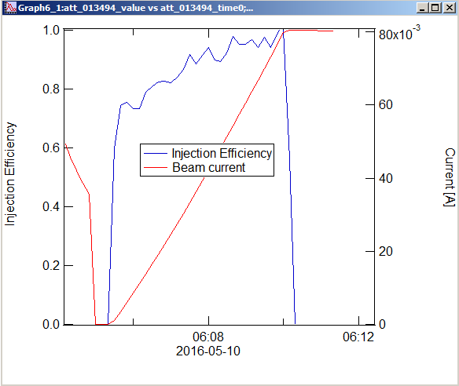
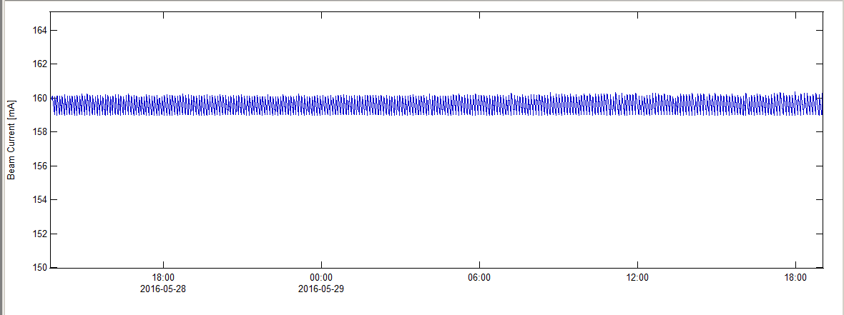
Injection Efficiency&Top-up (closed shutters)
>95 %
>24 hr top-up at 160 mA

Slide 23
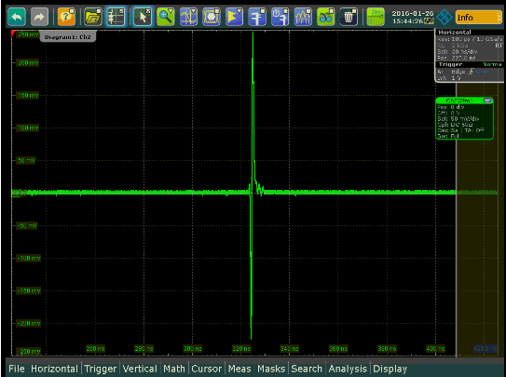
Collective Effects – Single Bunch
No signs of TMCI up to 8.55 mA (nominal 2.8 mA/bunch).
Significant bunch lengthening even without harmonic cavities
Data by J.Breunlin, A.Andersson, G.Skripka, R.Nagaoka

Slide 24
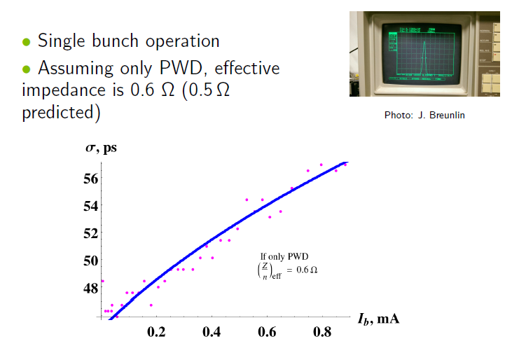
Bunch Lengthening
Slide by G. Skripka

Slide 25
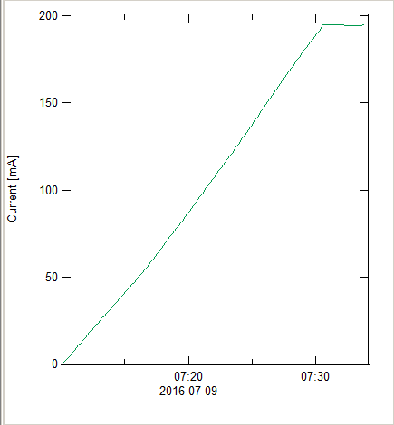
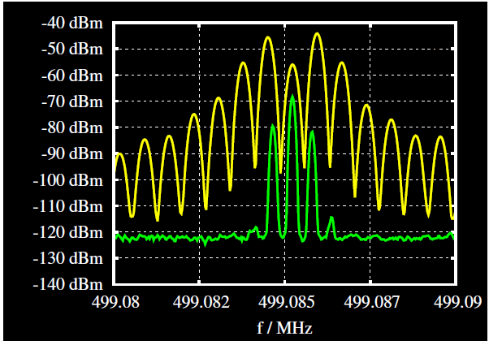
Collective Effects - Multibunch
Possible to store >170 mA without feedback and without harmonic cavities. Predicted RW threshold was only ~ 40 mA !
HOM driven longitudinal motion is evident at a few mA in uniform fill.
Temperature tuning has proved effective in fighting longitudinal CBI.
Up to 198 mA in multibunch mode
HC stabilization of CBMs at 120 mA
Picure by G.Skripka

Slide 26
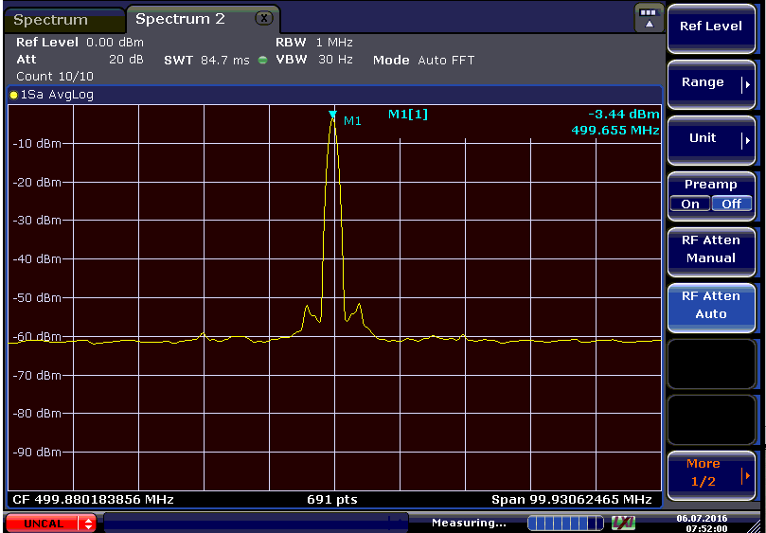
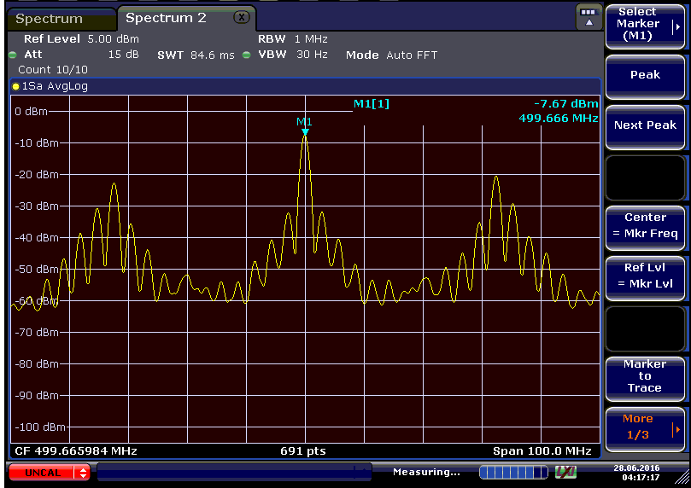
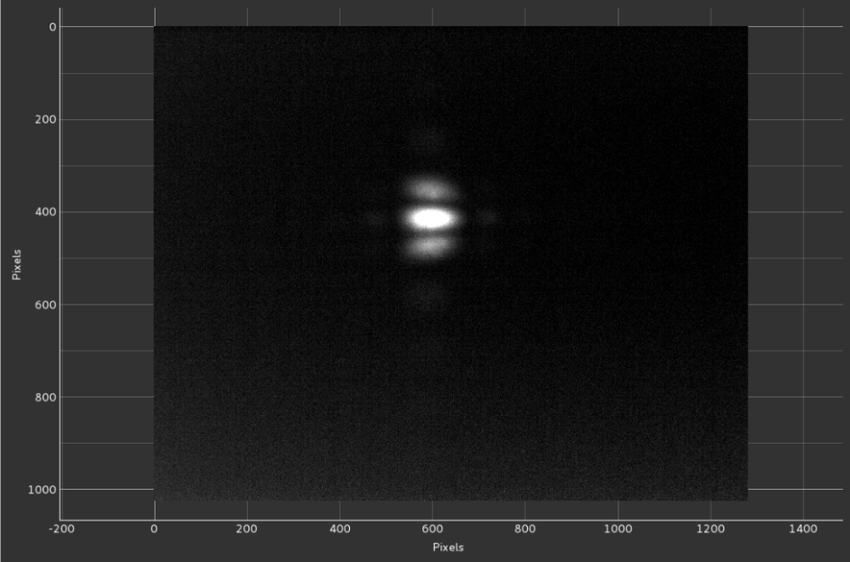
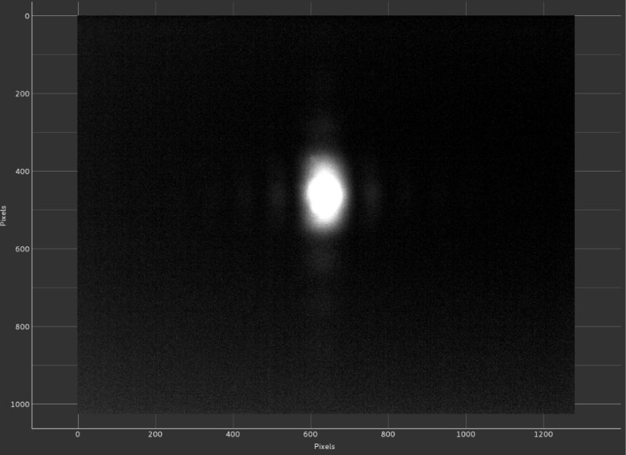
Bunch-By-Bunch feedback
Stable beam with feedback on at 90 mA
Unstable beam with feedback off at 100 mA
Longitudinal
Spectrum
Transverse
Profile

Slide 27
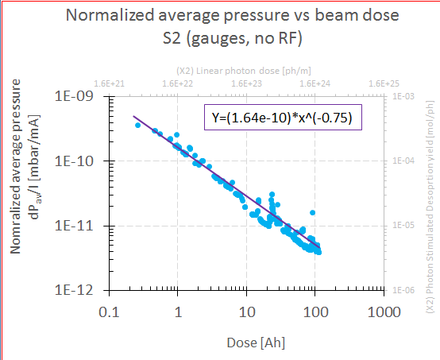
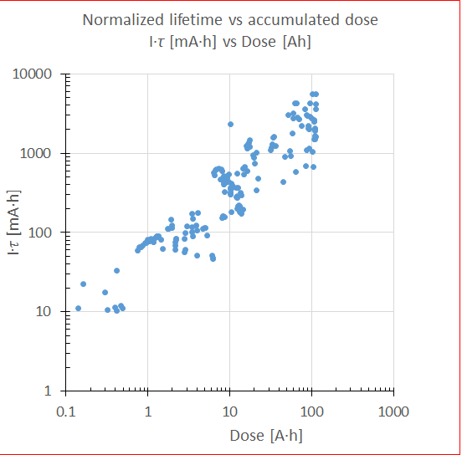
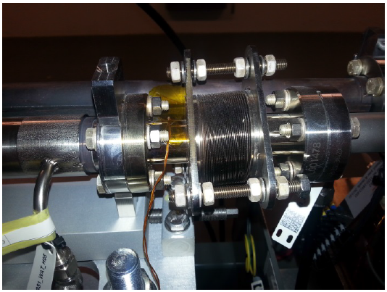
Vacuum System
> 100 A.h Accumulated Dose
>6 A.h product lifetime*Current
Plots by M.Grabski
Chamber Heating downstream of absorber
Photo by M. Sjöström

Slide 28
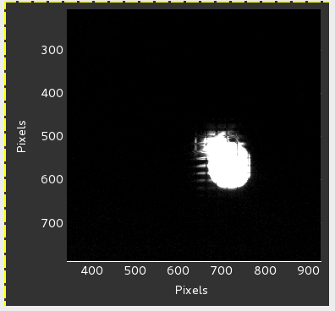
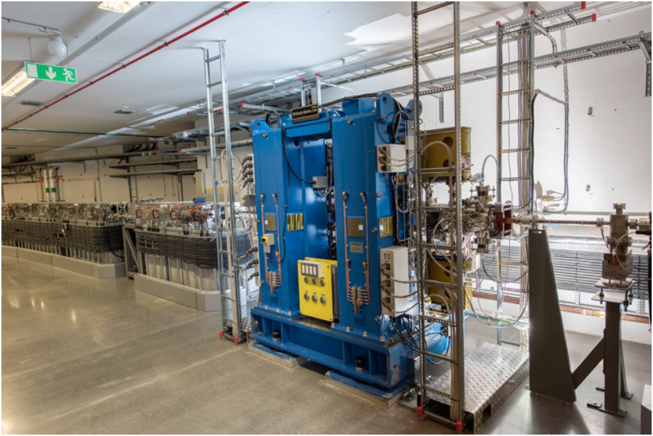
Insertion Devices 3 GeV ring
2 In vacuum undulators in spring 2016
1 in vacuum wiggler + 2 EPUs (Autumn 2016)
Biomax undulator in the 3 GeV ring tunnel
First light from IVU in Biomax
2016/04/29 0.5 mA, 14 mm gap

Slide 29
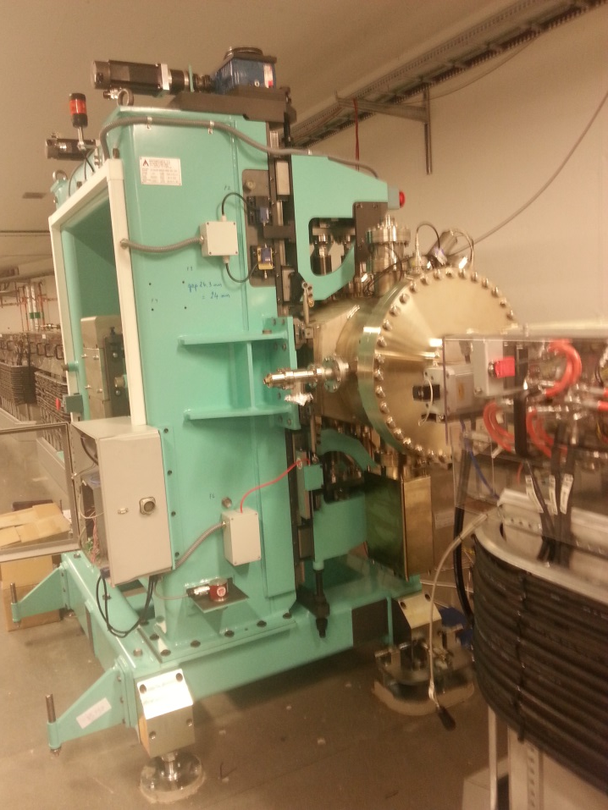
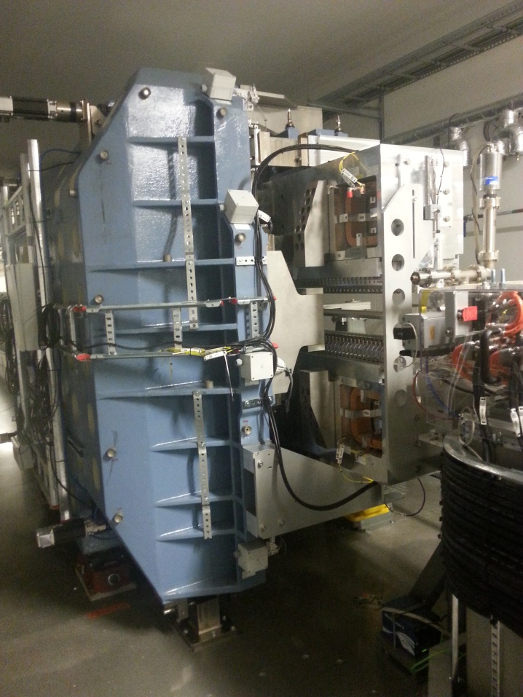
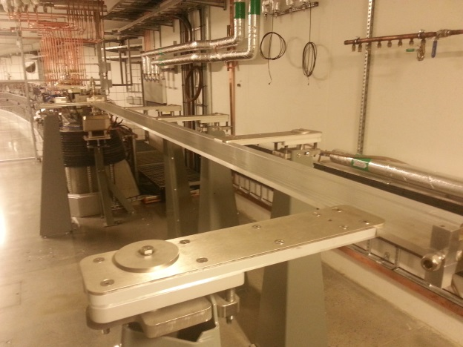
Insertion Devices in the 3 GeV Ring
Balder In-vacuuum wiggler
Hippier EPU
Veritas EPU chamber

Slide 30
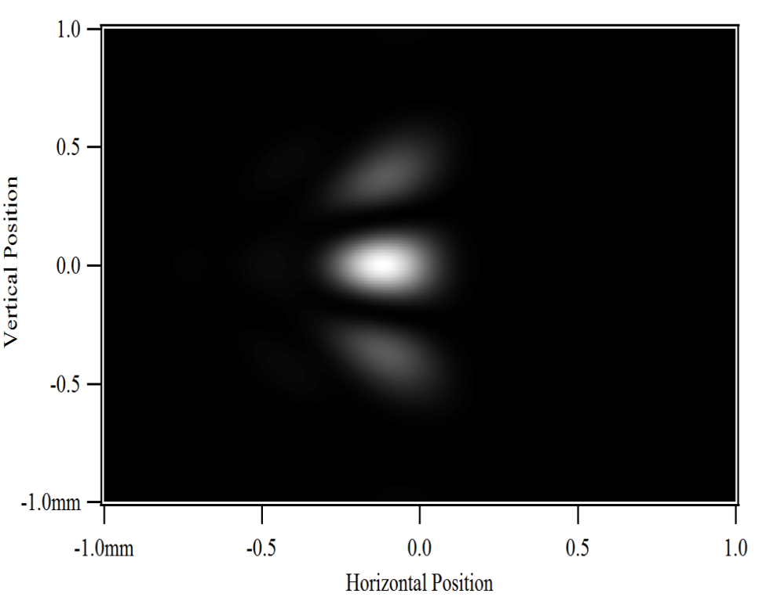
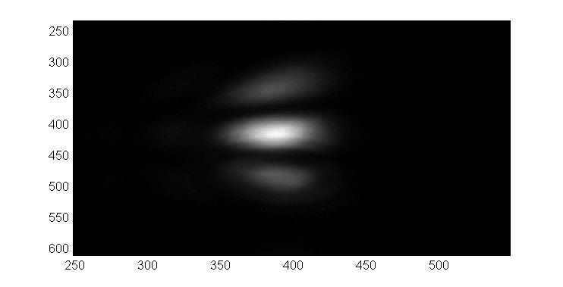
Sigma polarized SR, 632.8 nm, SRW calculation (left) and measured image (right). The simulation is done for ε_{x} = 320 pm rad, β_{y} = 1.5 m.
Both figures show a 2 x 2 mm^2 area of the image plane.
The fringe pattern is too weak to be visible.
Optical magnification of m=-2.28 is taken into account in the SRW model
Horizontal opening angle: 6 mrad
Vertical opening angle: 8 mrad
Exposure time: 2.9 ms
Emittance Measurement
Slide by J.Breulin

Slide 31
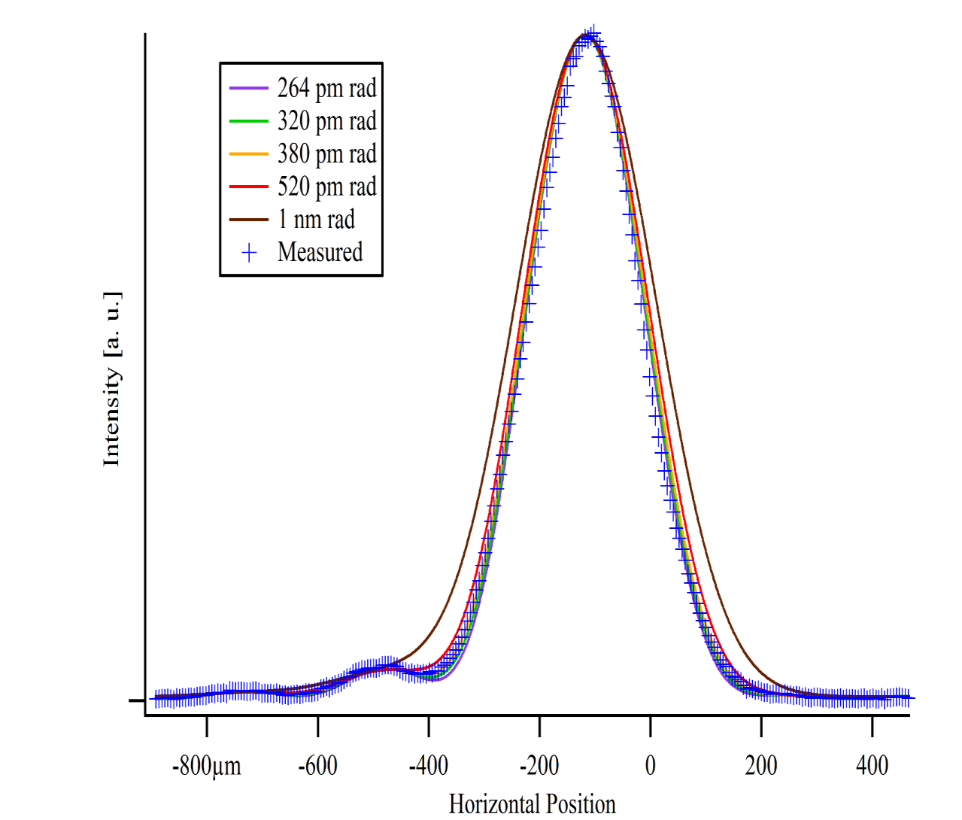
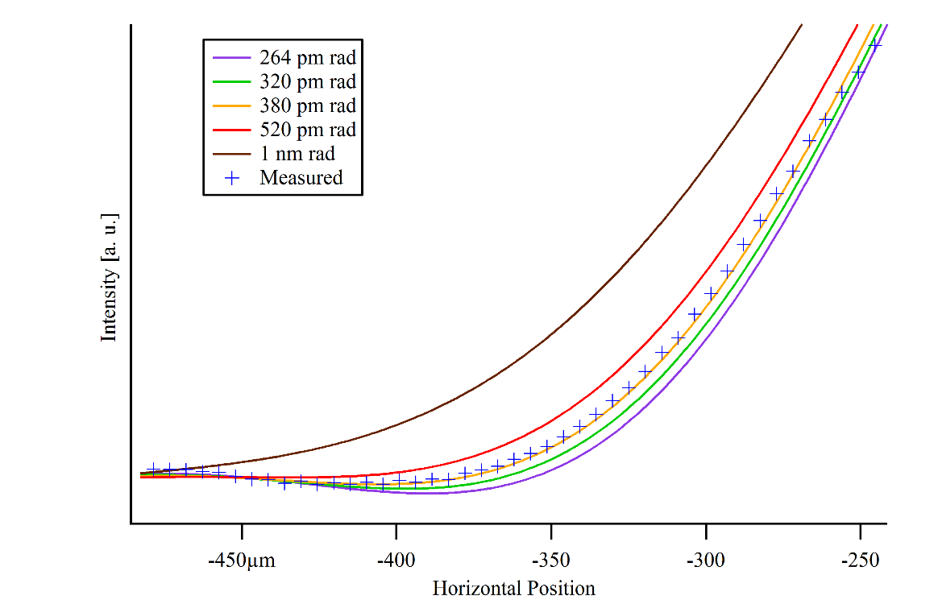
Horizontal intensity profile of imaged sigma polarized SR. Due to the reduced horizontal opening angle the fringe pattern is not as pronounced as it could be, but easier to understand and to calculate.
Present setup is limited by optical aberations (from misalignments) and surface quality from optical components (some are inherited from MAX II, MAX III). Steady improvements during the next weeks are planned. Camera linearity might also be an issue!
Challenges on the SRW model side are to include for example: variation of dipole field, variation of beta_x, variation of vertical opening angle, along the observed electron beam path.
Slide by J.Breulin

Slide 32
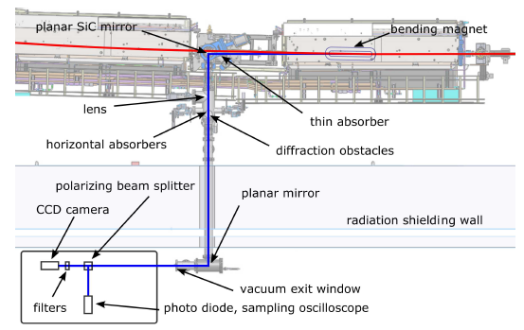
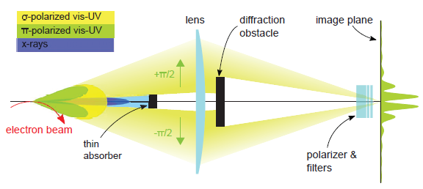
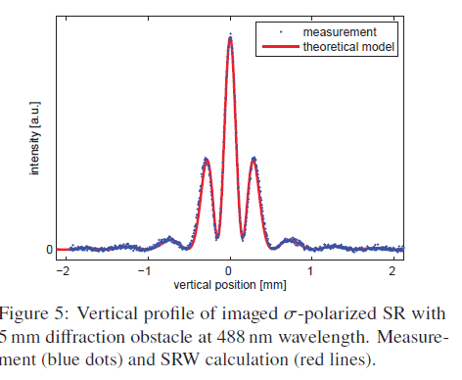
Vertical Emittance Measurement
εy=6.94 ± 0.9 pm.rad
Figs by J.Breunlin and Å.Andersson

Slide 33
Beam parameters Thermionic Gun
Extraction
3 GeV
Thermionic RF gun
L9B
Kicker & septum
L19B
L0
L1B
Photo cathode RF gun
MS2
Energy | 270 MeV
Energy spread | 0.5 % (fwhm)
Norm emittance x | 12 mm mrad
Norm emittance y | 4.7 mm mrad
Charge | ~ 280 pC
MS3/TR3
Slide by S.Thorin
MS1
Energy | 3 GeV
Energy spread | 0.6 % (fwhm)
Norm emittance x | 15 mm mrad
Charge | ~ 220 pC
Energy | 270 MeV
Energy spread | 0.5 % (fwhm)
Norm emittance x | 5.5 mm mrad
Charge | ~ 280 pC

Slide 34



LINAC Mode Switching and Feedback

Slide 35


Installation and Start of Commissioning 1.5 GeV Ring

Slide 36
Main Problems/Difficulties
RF Cavity Conditioning
Diagnostic System Commissioning
  BPMs
Kicker Magnet PS failure
Gun Klystron Failures
Long Radiation Surveys
Cooling System Failures
PS Failures
Heating of chambers (in photon beam pipe)

Slide 37
Next Steps
  3 GeV Ring
    Further conditioning of RF cavities
    Further linear optics trimming/Non-linear optics trimming
    Collective Effects studies (Harmonic cavity tuning)
    Fast Orbit feedback
    Multipole Kicker (SOLEIL&BESSY collaboration)
1.5 GeV ring Commissioning
November 2016: Commissioning users (3 GeV ring)
Spring 2017: First open call users (3 GeV ring)
Spring 2017: First Ids in the 1.5 GeV ring
May-June 2017: LINAC RF upgrade

Slide 38
Future Perspectives
Full Delivery of the DDR Parameters – User operations
LINAC
Soft X Ray FEL (proposal User Community)
Hard X Ray FEL
3 GeV Ring
Brightness Improvements: current lattice and Ids (150 pm rad)
Brightness Improvements: additional focussing (100 pm rad)
1.5 GeV Ring
Timing modes (requested by User Community)
Completely new lattice (diffraction limit at 10 keV)

Slide 39




Thank You !
Photo:H.Tarawneh
Photo:S.Thorin
Photo:L. Isaksson

Slide 40
Backup slides

Slide 41

Alignment error model S.Leemann October 2011

Slide 42



Pulsed Magnets – Dipole Kickers
Kickers and Pingers (4 units) delivered to MAX IV in October 2014.
Site Acceptance tests done December 2014.
Kicker and Pinger chamber installed in the 3 GeV ring
Pulsed Magnet Cabinets
Assembled Pinger Magnet on 3 GeV Ring
Kicker Magnet Chamber on 3 GeV Ring

Slide 43

MAX IV 3 GeV Ring DC Magnets
• Each cell is realized as one mechanical unit containing all magnet elements.
•Each unit consists of a bottom and a top yoke half, machined out of one solid iron block, 2.3-3.4 m long.
Slide by Martin Johansson

Slide 44
DC Magnet Production History

Slide 45

MAX IV 3 GeV ring vacuum system layout
Slide by E.Al-dmour
BPM
Ion pump location
VC9
Absorber location
Sector valve location
VC8
One achromat
VC7
VC6
VC5
VC4
VC3
VC2
Beam direction
VC1
VC10

Slide 46
Chamber Production History
“standard “ chambers

Slide 47




MAX IV 3 GeV ring RF System
Passive Harmonic Cavities
100 MHz Main Cavities
SS UHF Transmitters

Slide 48





Capture and Bunching
First pass
100 turns
150 turns
500 MHz from Chopper
175 turns
200 turns
Plots S.Leeman
2015/09/23

Slide 49
Orbit Stability – Fast Acquisition
Plot by Brian Jensen

Slide 50
Beam parameters Thermionic Gun
Extraction
3 GeV
Thermionic RF gun
L9B
Kicker & septum
L19B
L0
L1B
Photo cathode RF gun
MS2
Energy | 270 MeV
Energy spread | 0.5 % (fwhm)
Norm emittance x | 12 mm mrad
Norm emittance y | 4.7 mm mrad
Charge | ~ 350 pC
MS3/TR3
Slide by S.Thorin
MS1
Energy | 3 GeV
Energy spread | 0.6 % (fwhm)
Norm emittance x | 15 mm mrad
Charge | ~ 300 pC
Energy | 270 MeV
Energy spread | 0.5 % (fwhm)
Norm emittance x | 5.5 mm mrad
Charge | ~ 350 pC

Slide 51

Compactedness is the key !
Picture by E. Aldmour

Slide 52
Beyond MAX IV – exploring future possibilities
Can the MBA concept be used to design a storage ring that provides a bare lattice natural emittance ̴ 10 pm rad within the MAX IV 3 GeV ring circumference (528 m) ?
If we take the present trend to smaller gaps to a new level, and consider that “…when it is necessary that a magnetically significant dimension of a magnet is very small, a permanent magnet will always produce higher fields than an electromagnet”, K. Halbach J.App.Phys (1985), Vol. 57, N. 1.
Large scale use of permanent magnet technology could play a key role in this development.

Slide 53





Slide 54
Current SR Projects using PM Technology (for dipole magnets)
Sirius
ESRF-II
Spring 8-II

Slide 55
Diffraction Limited @ 10 keV within ~ 500 m
Compact Design – Small Aperture
Enabling Technologies
Novel Injection Schemes
High Gradient Permanent Magnets
NEG coating very small apertures
Long(er) Bunches

Slide 56


Beyond MAX IV – an exercise
Existing 7 BA
Future Lattice Candidate – 19 BA

Slide 57



Beyond MAX IV – an exercise
Lattice design: OPA (A.Streun)
Elegant (M.Borland)
19-BA lattice in the MAX IV 3 GeV ring tunnel
QF
QF
SD
SF
SD
BH
BH
Unit cell phase advances: $∆μ_{x}=2\frac{2π}{16}$ , $∆μ_{y}=\frac{π}{16}$

Slide 58

Beyond MAX IV – an exercise
19-BA lattice in the MAX IV 3 GeV ring tunnel

Slide 59


19-BA lattice in the MAX IV 3 GeV ring tunnel - Dynamic and momentum aperture
No errors !

Slide 60
19-BA lattice in the MAX IV 3 GeV ring tunnel – Magnet Parameters
Magnet bore radius = 5.5 mm

