Slide 1
KT @ CERN
G. Anelli, KT Group Leader, IPT Department
30.05.2016

Slide 2
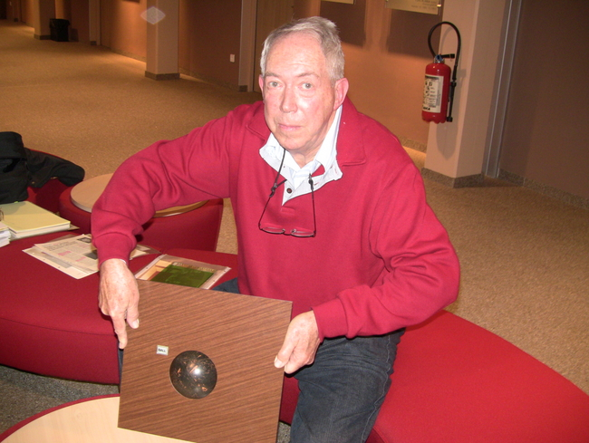

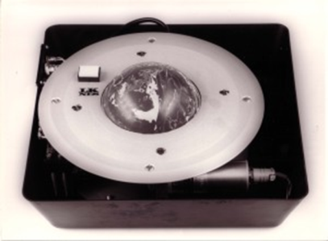
Did you know?

Slide 3
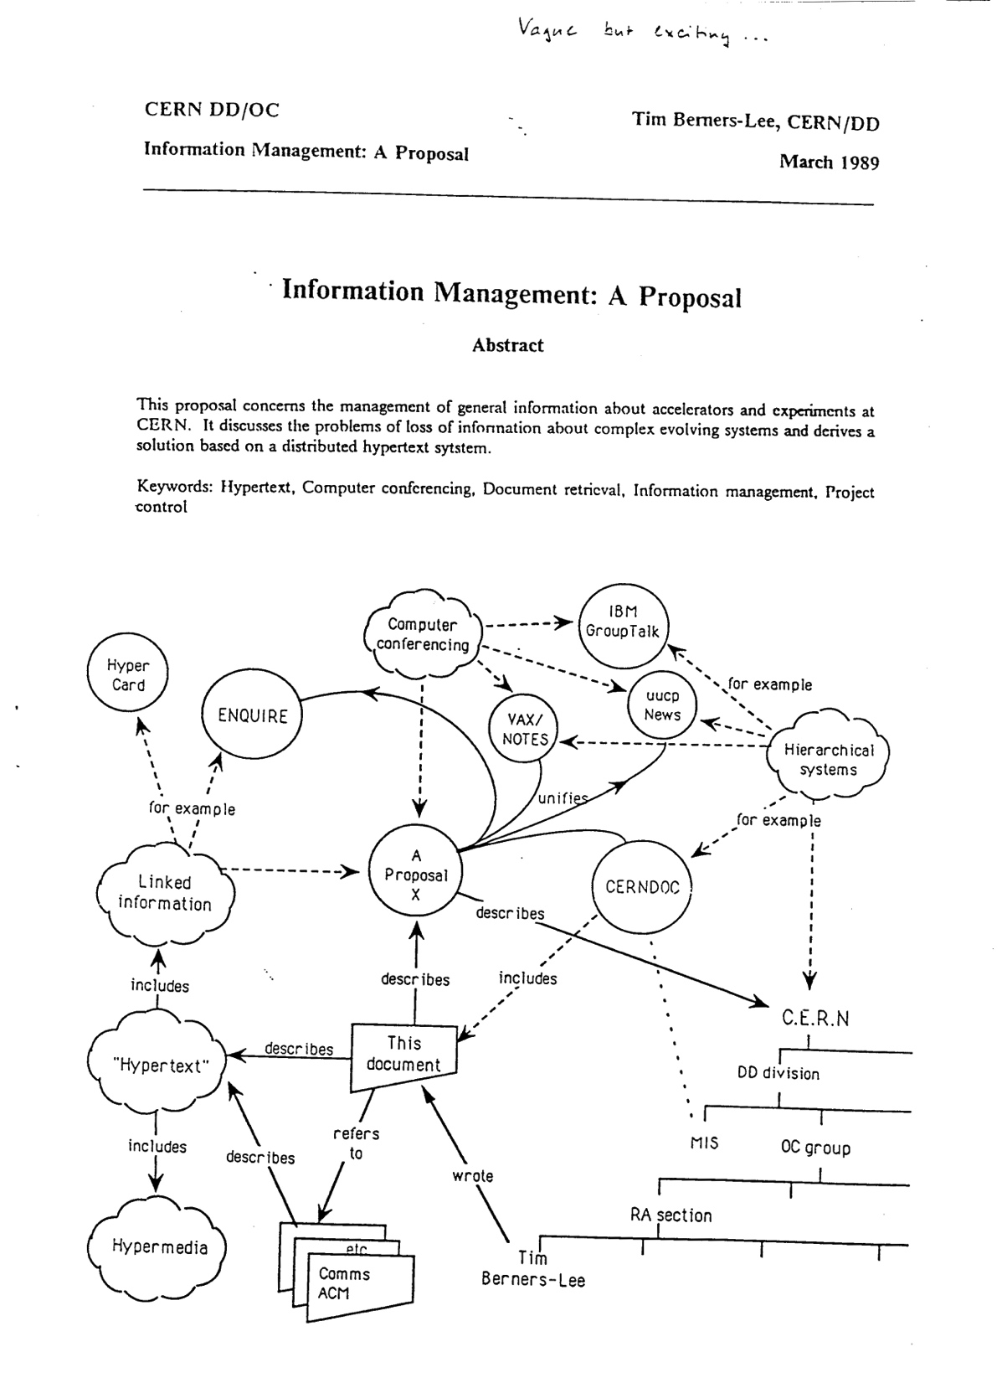
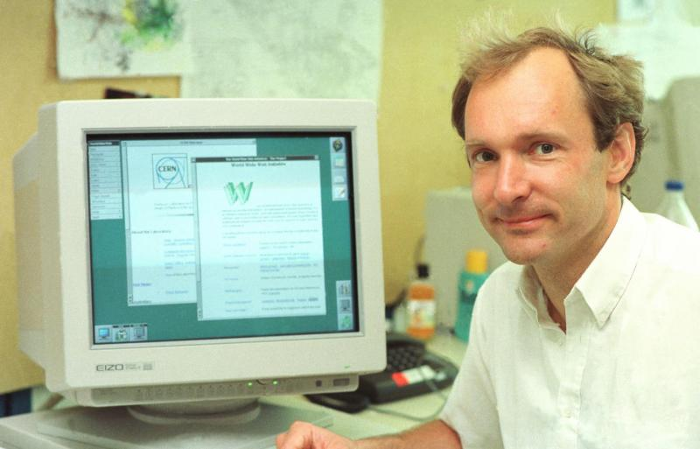
The WWW

Slide 4
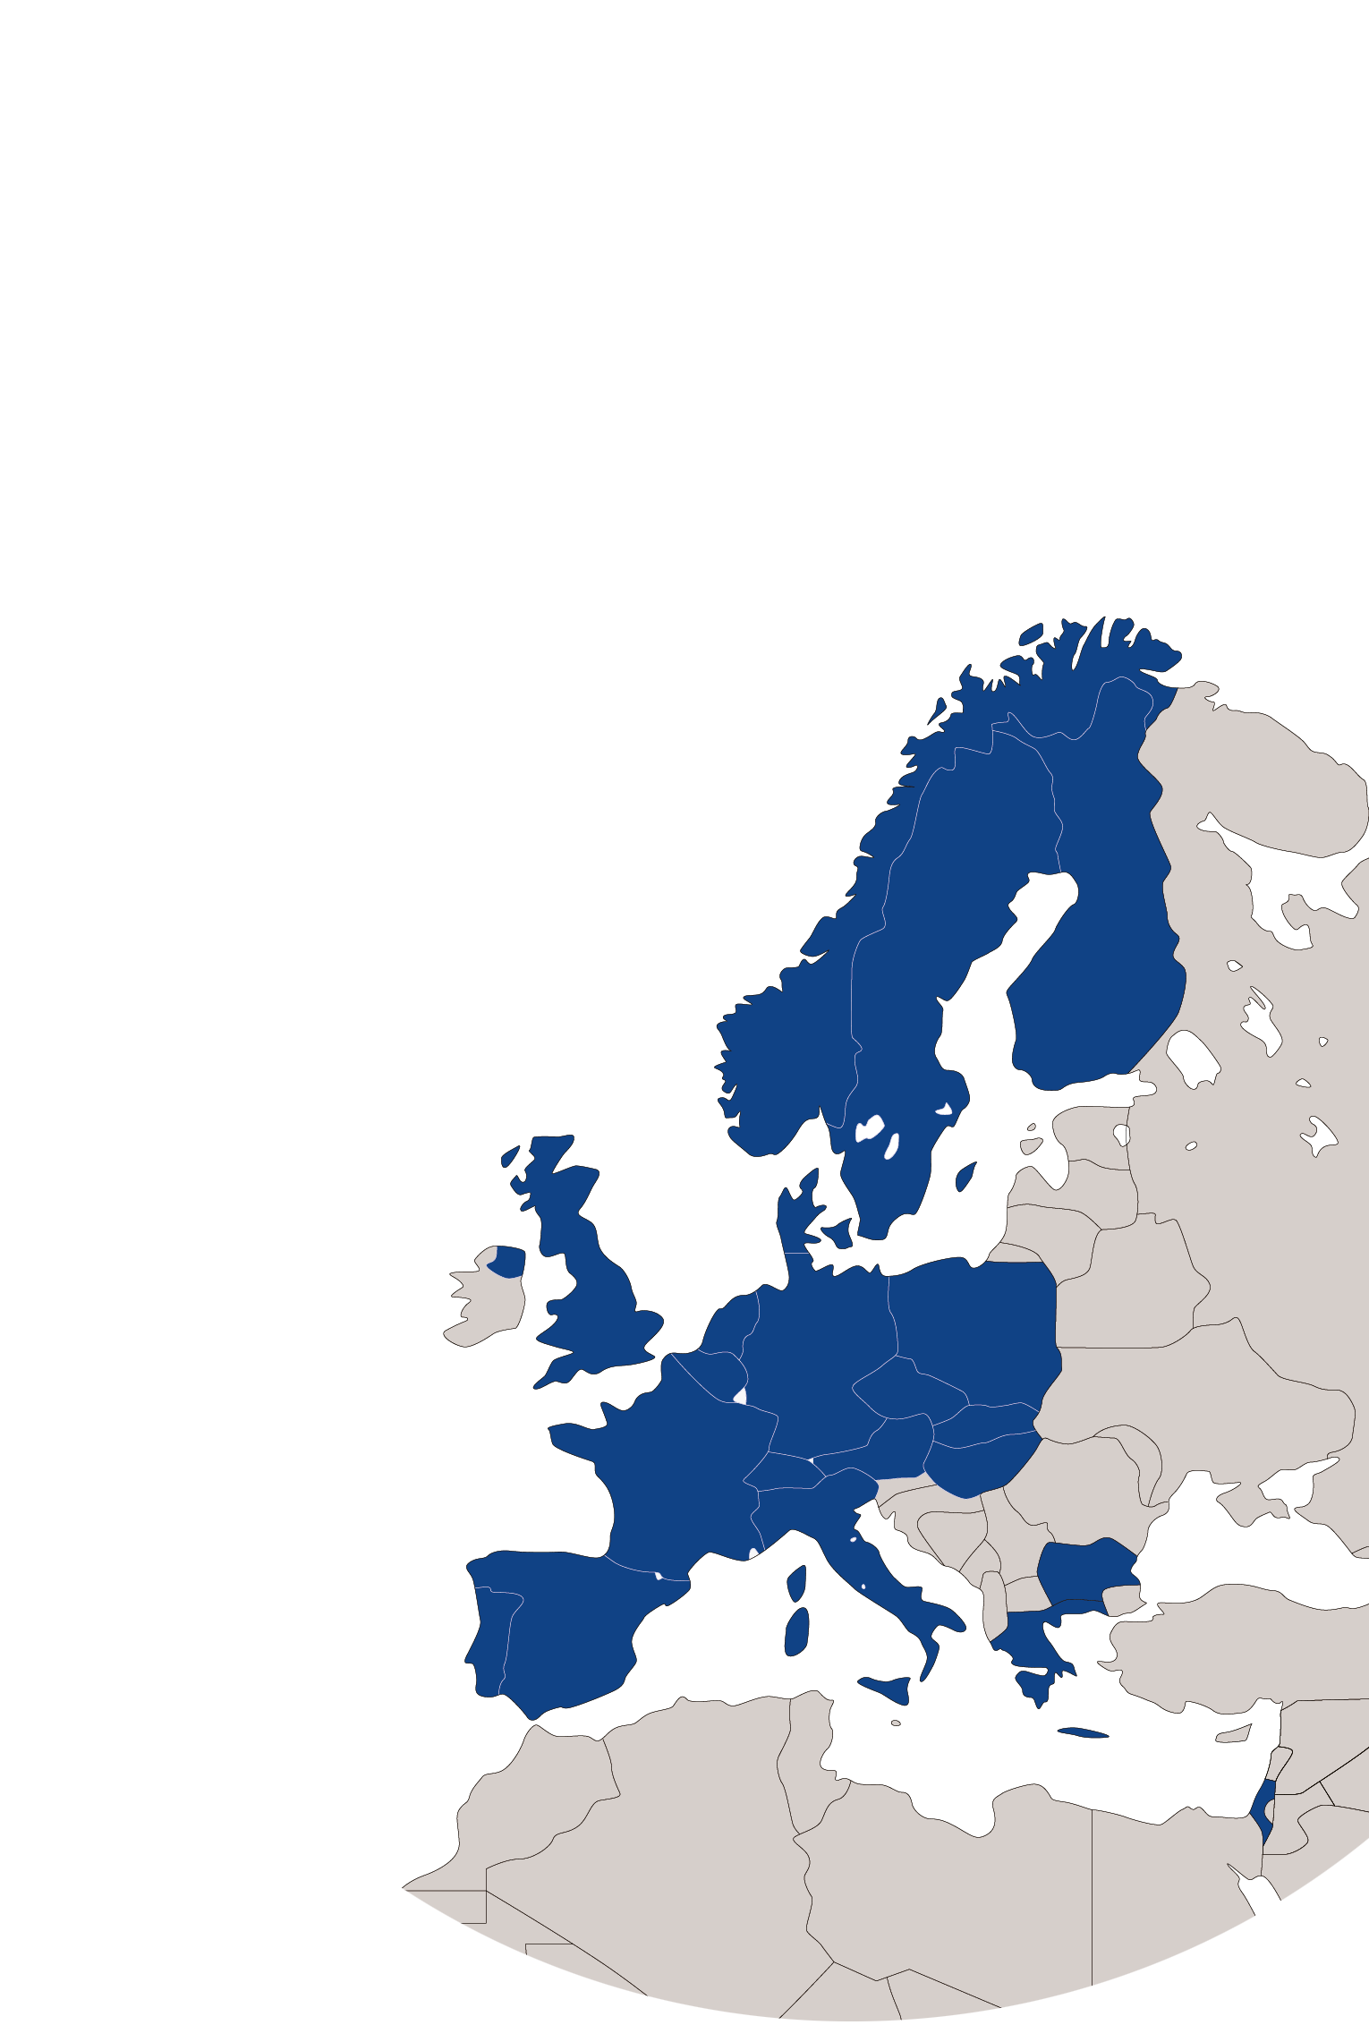
KT Mission
Maximize the technological and knowledge return to society, in particular through Member States industry
Promote CERN’s image as a center of excellence for technology and innovation
Demonstrate the importance and impact of fundamental research investments
Key words are dissemination and impact

Slide 5

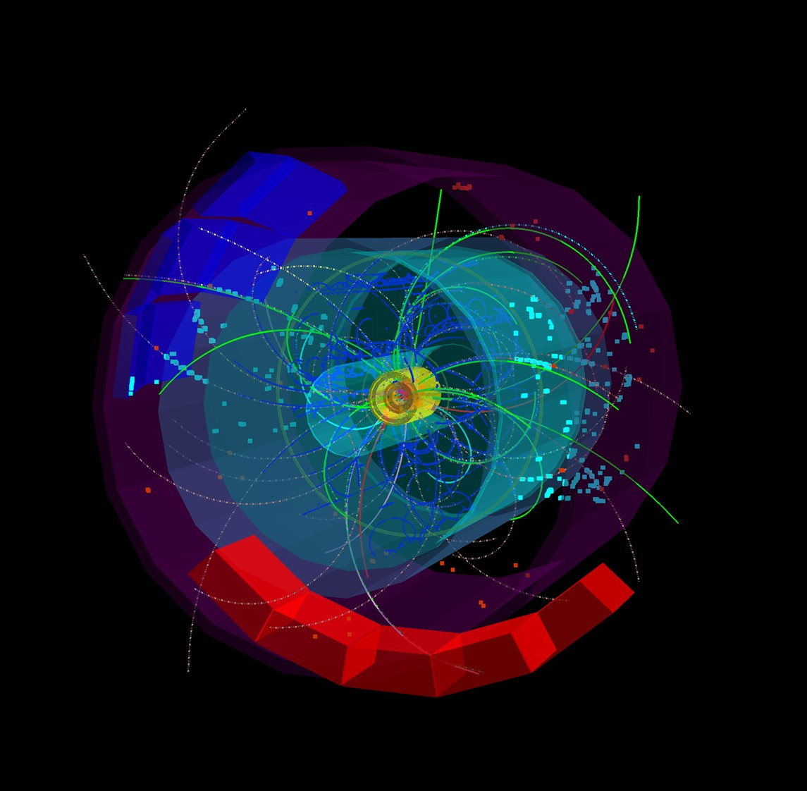
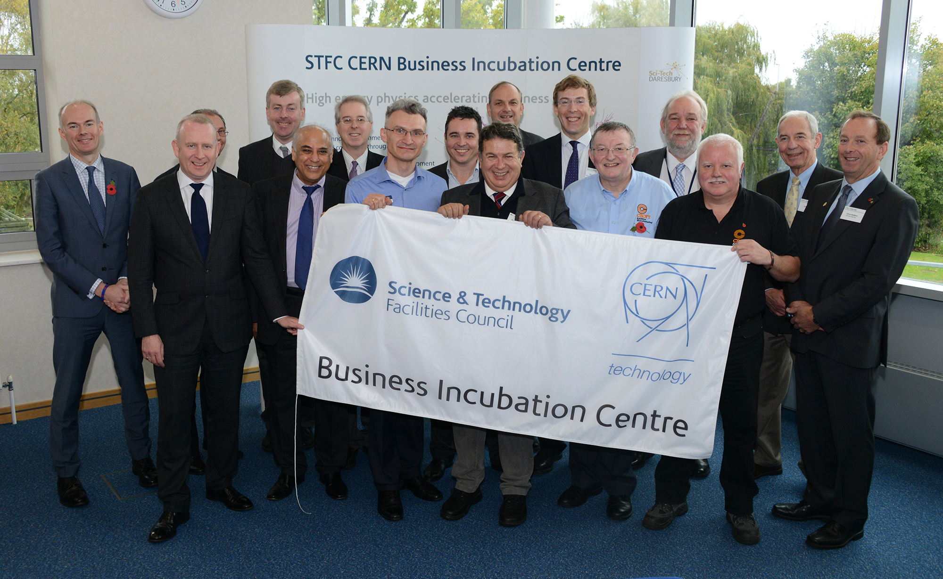
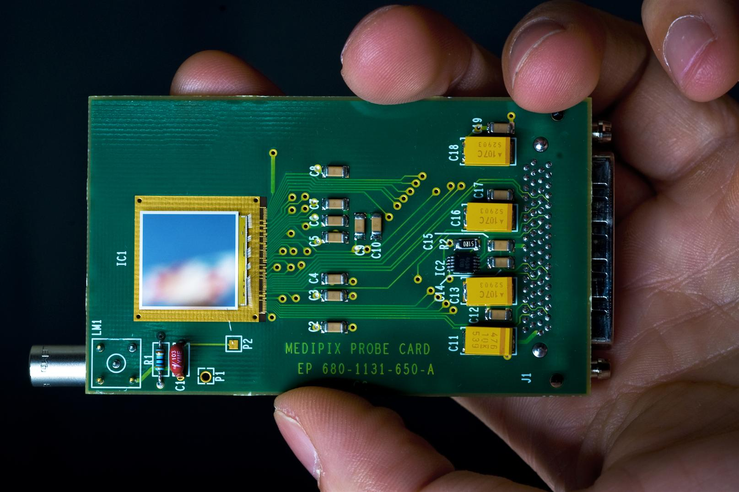
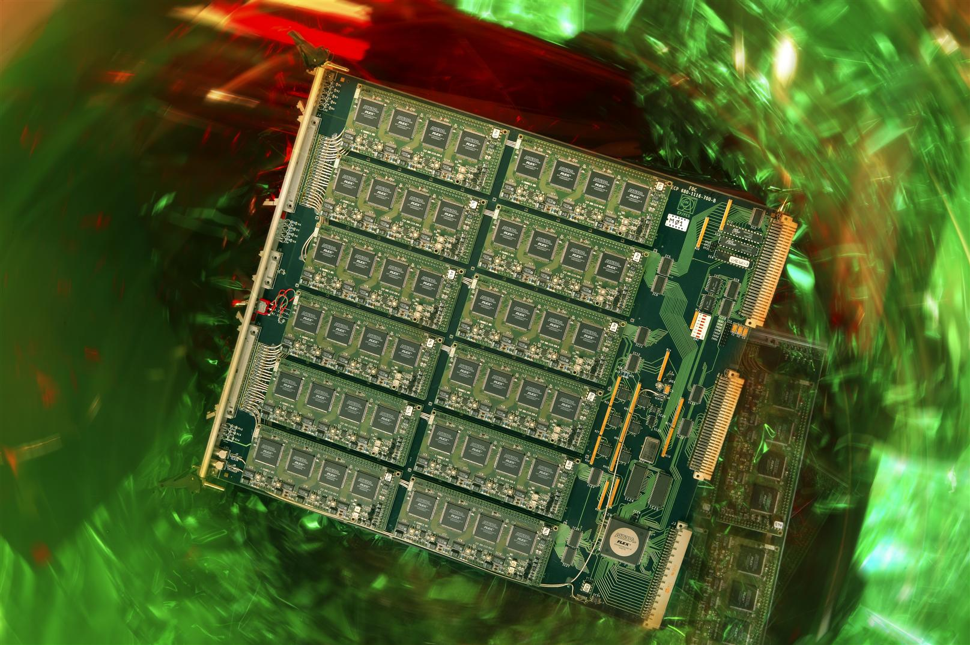

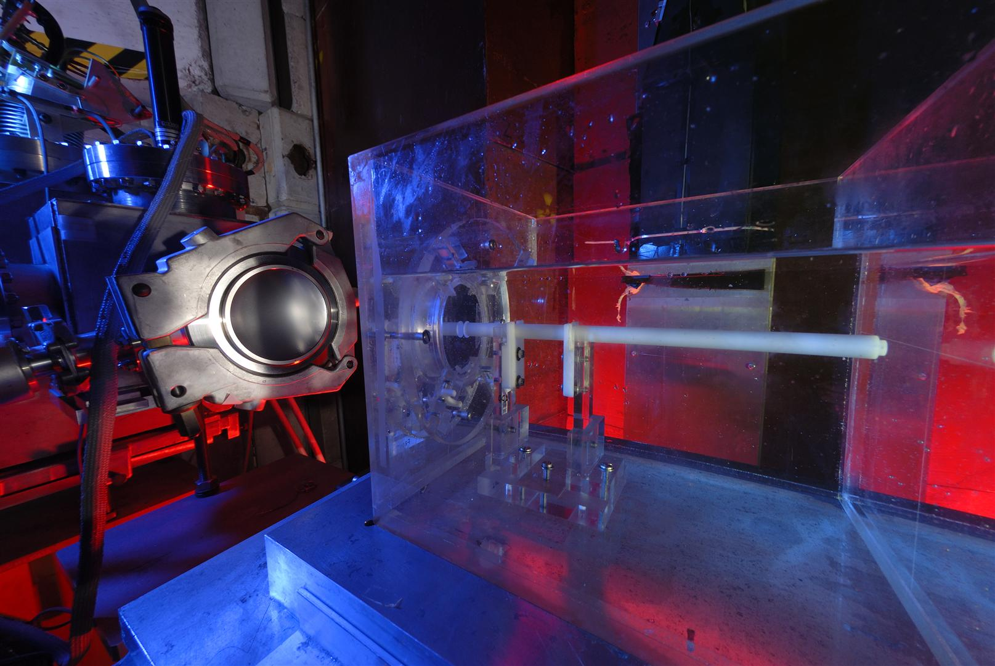
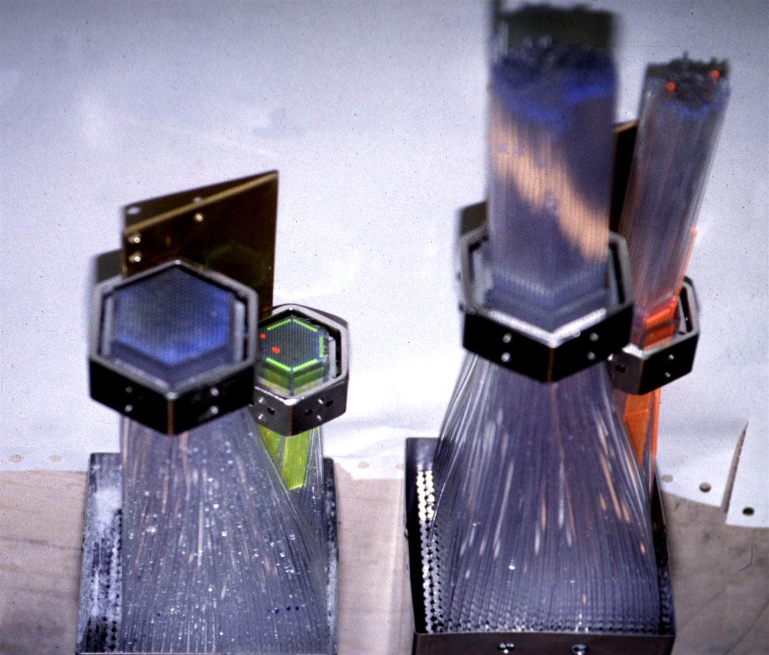
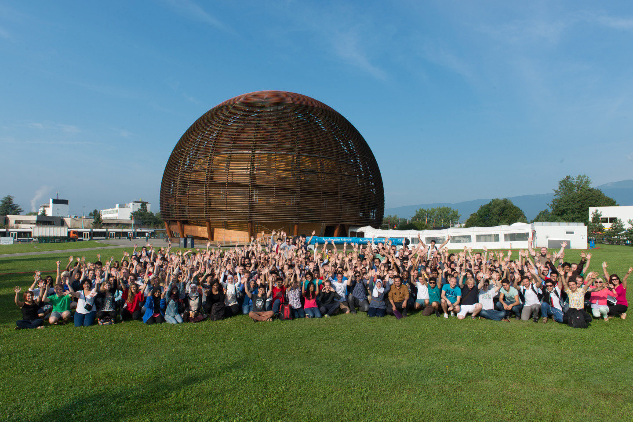

KT Modes
Easy Access IP
Licensing
Open Source Software
Open Hardware
Business Incubation
Procurement
Service and Consultancy
EU Projects
Training
R&D Collaborations
Notes:
I often use this slide as it gives a good overview of what we do.
Licensing, Service and Consultancy and R&D Collaborations are the contracts we do.
Business Incubation → introduces the network of Incubators
Easy Access IP, Open Hardware and Open Source Software: alternative ways (some created by us) to disseminate our technos.
EU Projects: a good vehicle to disseminate our Know how to industry.

Slide 6
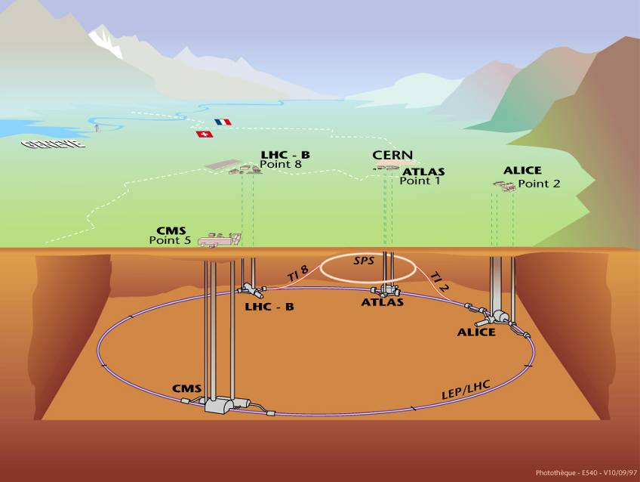




CERN’s areas of excellence
Accelerating
particle beams
Detecting
particles
IT technologies

Slide 7
Accelerator Technologies
Base Technologies: LHC
Superconductivity
(12kA)
Cryogenics
(1.9 K)
Vacuum
(10⁻¹³ atm)
Magnets
(8 T)

Slide 8
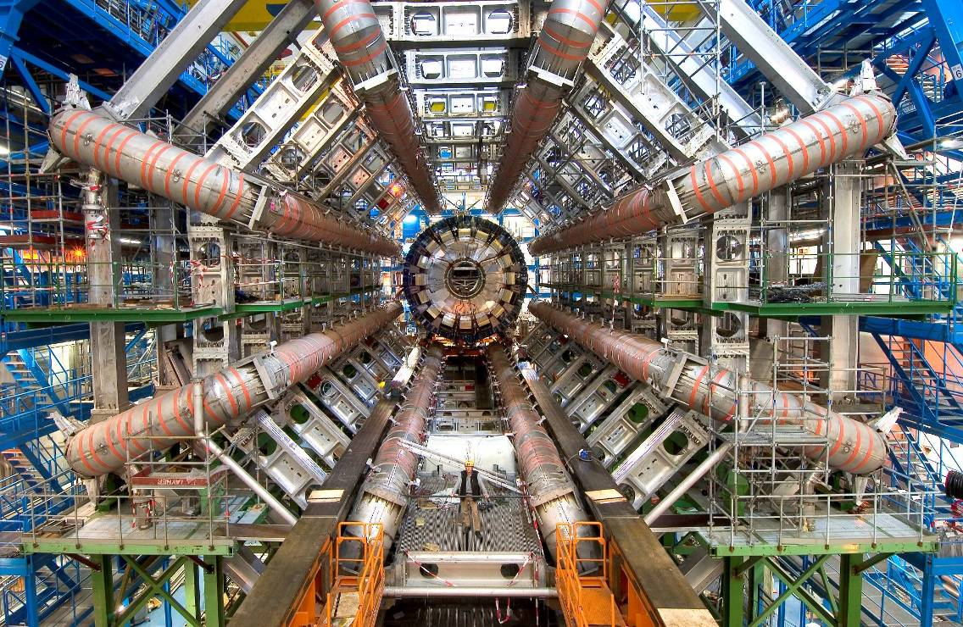
Detector Technologies
Challenge: sample the results of up to 600
million proton-proton collisions per second!
LHC detectors have sophisticated electronic trigger systems that precisely measure the passage time of a particle to accuracies in the region of a few billionths of a second. The trigger system also registers the location of the particles to millionths of a metre. This is essential for ensuring that the particle recorded in successive layers of a detector is one and the same.

Slide 9
Computing Technologies: the Grid
After filtering, CERN detectors select ~200 interesting
collisions per second.
Several MBs of data to be stored for each collision...
more than 25 Petabytes/year of data!
8 Megabyte (8MB)
A digital photo
1 Gigabyte (1GB)
= 1000MB
A DVD movie
1 Terabyte (1TB)
= 1000GB
World annual
book production
> 25 Petabytes (25PB)
= 25000TB
Annual LHC data output
CERN, home of the World Wide Web, is a driving force
in Grid Computing

Slide 10
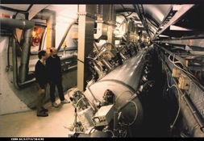
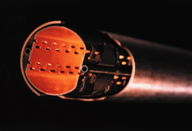

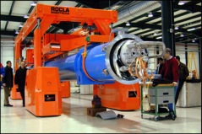
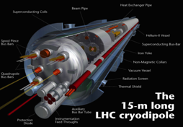
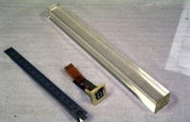
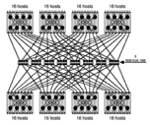
CERN Core Competences
Super-conductivity
(13kA, 7MJoules)
Vacuum
(10⁻¹² Torr)
Cryogenics (1.9 K)
Very high performance
detectors and electronics
Magnets
(10 T)
Data processing

Slide 11
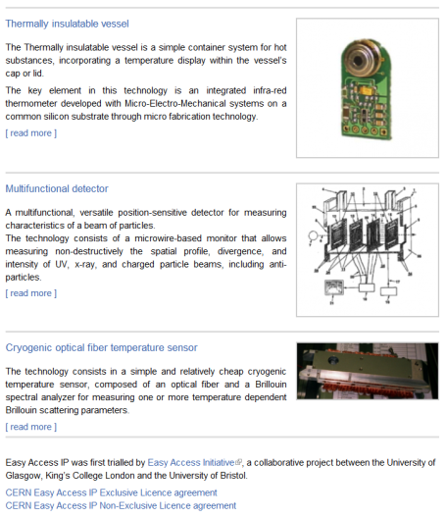
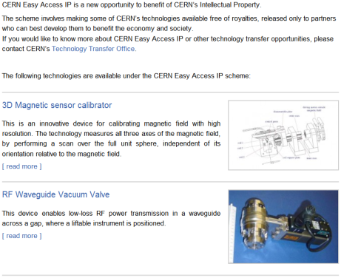
CERN Easy Access IP
Notes:
This is a screenshot of our website.
We have implemented the scheme pioneered by the University of Glasgow. We are ready to give a free license (for some of our technologies) to companies who will demonstrate that they can turn it into a product.

Slide 12

CERN Open Hardware Licence
A legal framework to facilitate knowledge exchange across the electronic design community.
In the spirit of knowledge and technology dissemination, the CERN OHL was created to govern the use, copying, modification and distribution of hardware design documentation, and the manufacture and distribution of products.

Slide 13
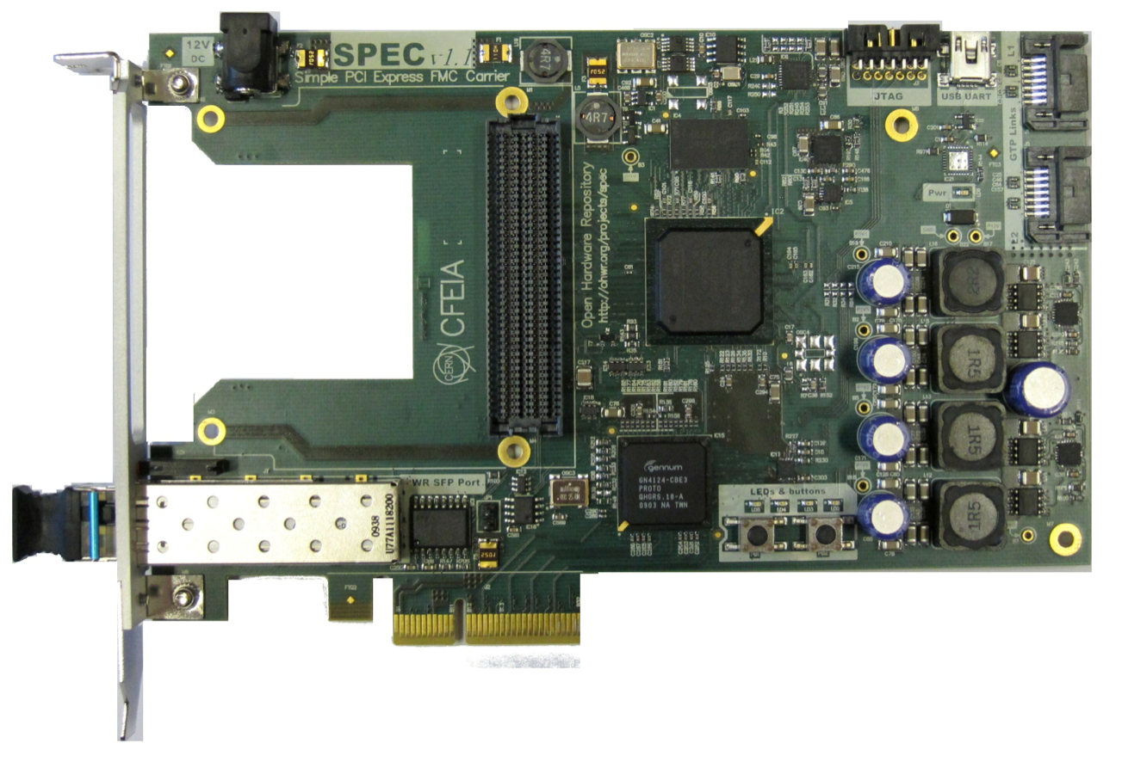
CERN OHL: it is making an impact!
CERN OHL v1.1 Launched in 2011, great interest from the worldwide community
More than 100 hardware designs licensed under CERN OHL
More than 20 companies are using it
The license is being used by people outside our community as well (and for any kind of hardware)
Thanks to the interactions with the community, we improved the license and launched v1.2 in 2013

Slide 14
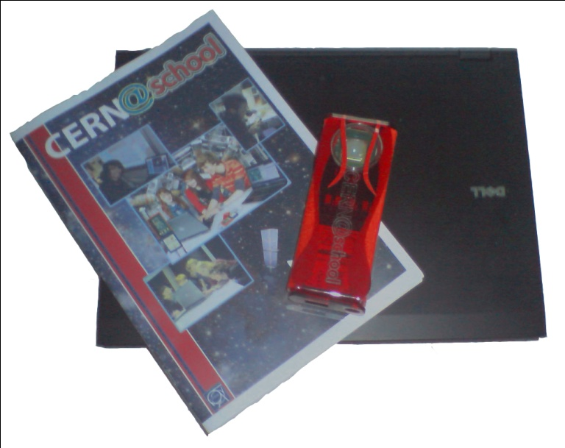
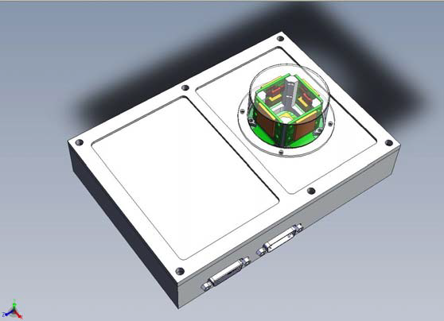

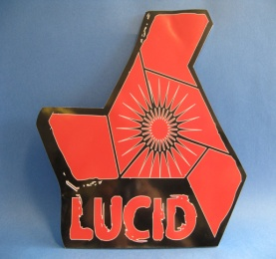
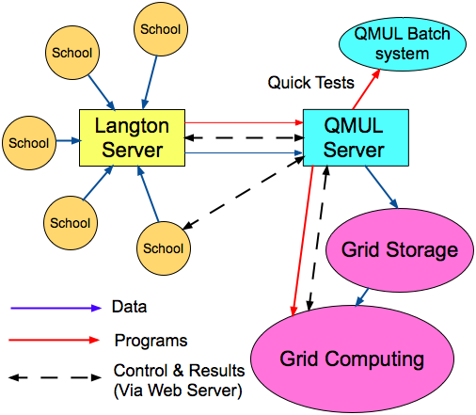
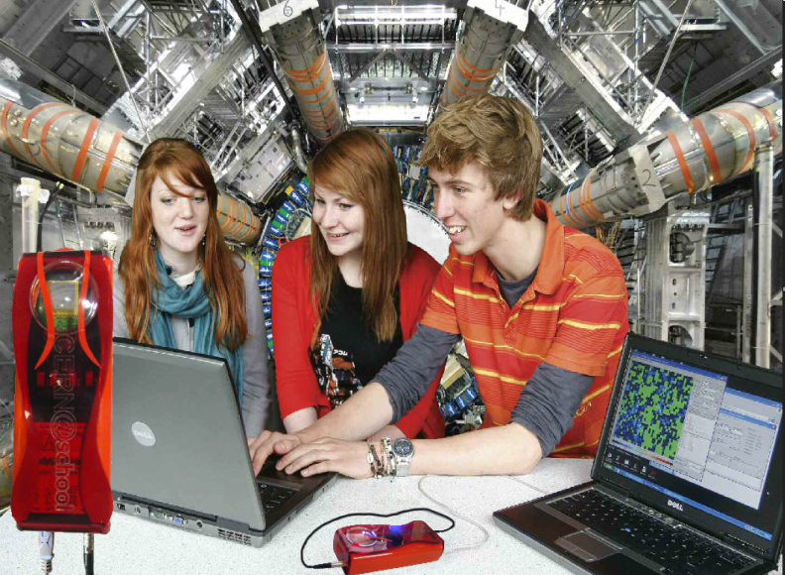
Langton Ultimate Cosmic ray Intensity Detector uses 5 Timepix chips to monitor the radiation environment in Space
CERN@school allows students to use a Timepix chip in the lab to visualise radiation
Data from LUCID and CERN@school detectors will be uploaded to the Grid and made available for students to analyse

Slide 15
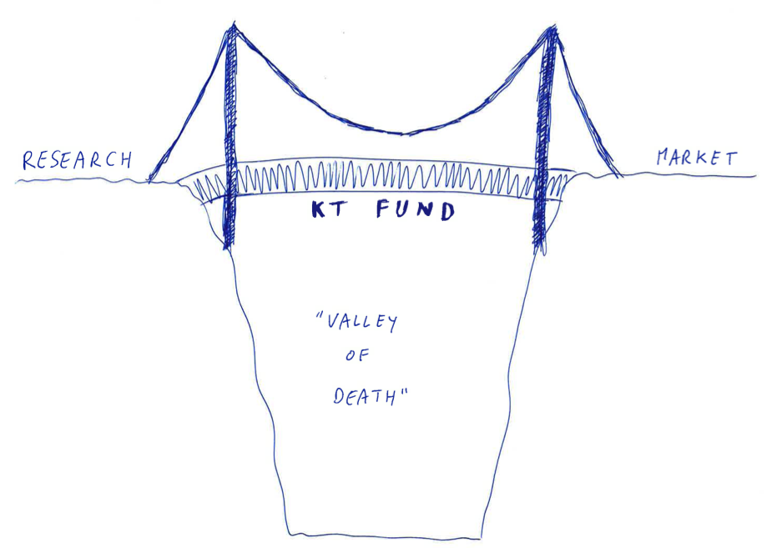
The KT Fund: bridging the « valley of death »

Slide 16

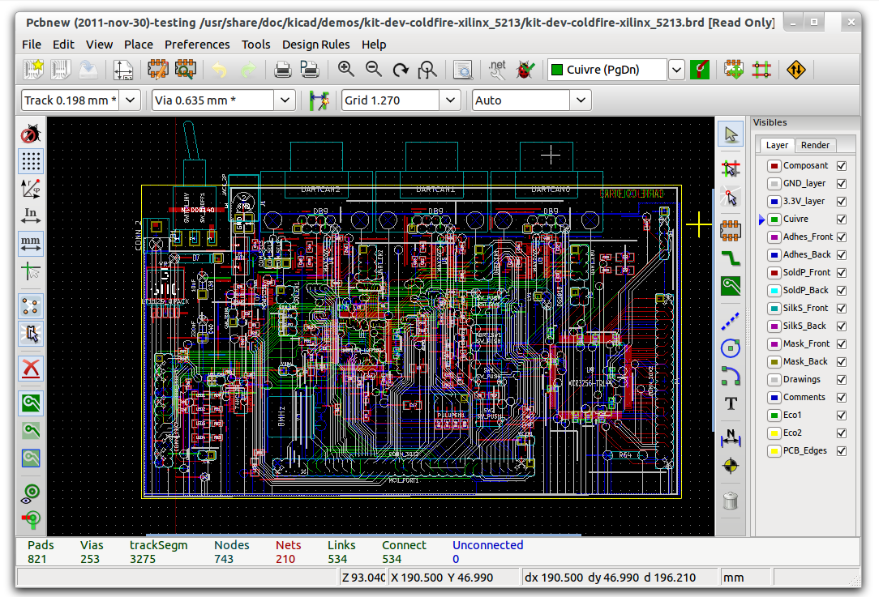
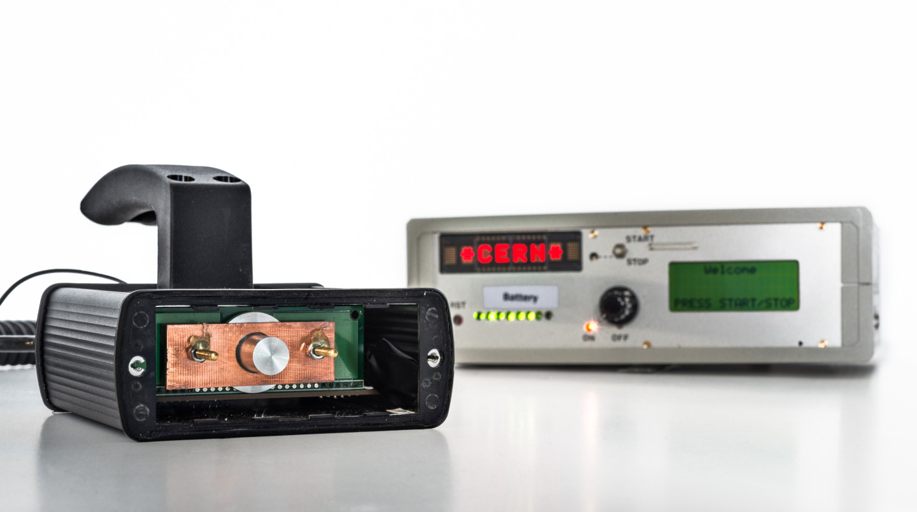
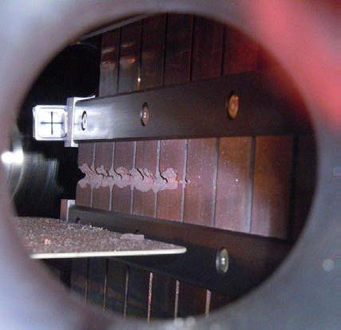
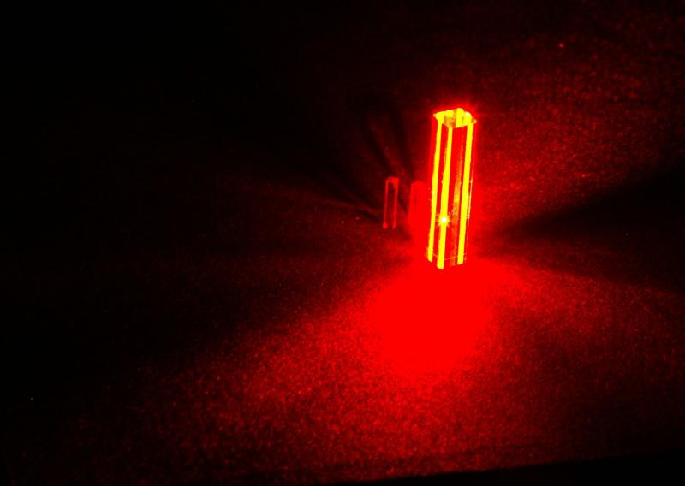
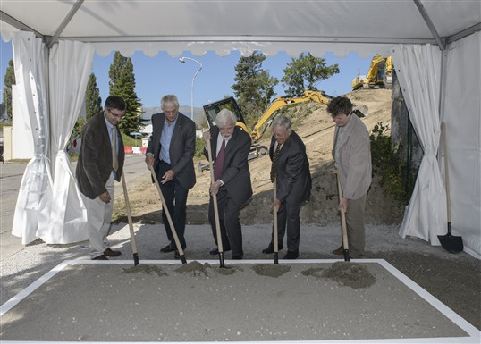
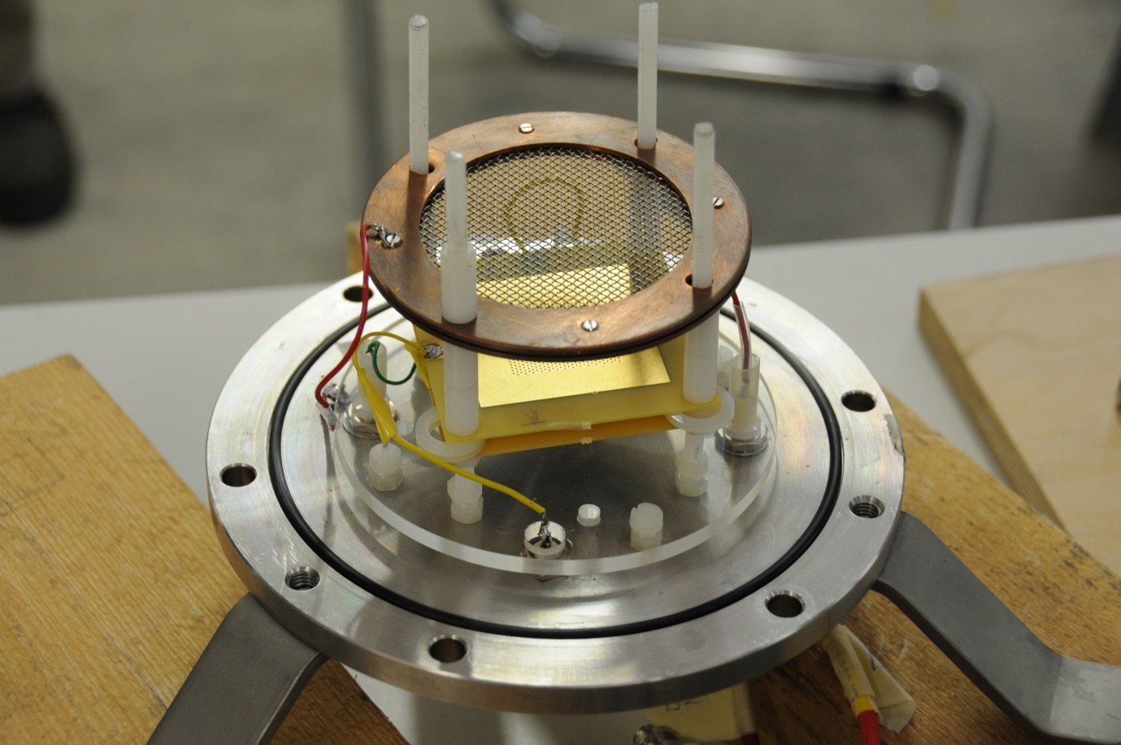
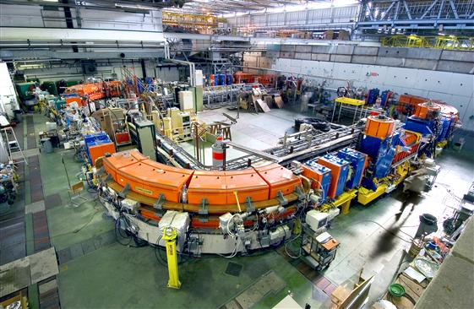
The KT fund
CERN’s incentive scheme to help transferring our Knowledge and Technologies
Projects selected by a committee composed by the Heads of Department and KT

Slide 17
Knowledge Transfer through Procurement
Results from a survey of companies involved in technology-intensive
procurement contracts with CERN.
178 questionnaires analyzed, related to 503 MCHF procurement
budget.
Results:
44% indicated technological learning
42% increased their international exposure
38% developed new products
36% indicated market learning
13% started new R&D teams
52% would have had poorer sales performance without CERN
41% would have had poorer technological performance

Slide 18
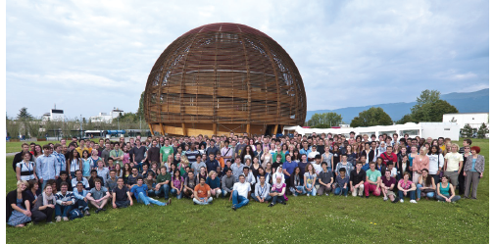
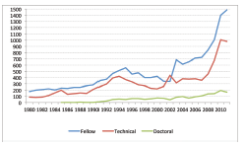
Knowledge Transfer through People
Every year, hundreds of students come to CERN to contribute to our research programs
An opportunity for young people to learn in a multicultural environment
Not only for physicists! Also engineers, computer scientists, administrative students…

