Slide 1
The basic ideas of the DKB development
To represent all stages of data processing and analysis by the ATLAS Collaboration in unified information space we need to formalize the data analysis life-cycle. So, now we are working on the development of the Data Analysis OWL Ontology for ATLAS
To “feed” this ontology with the information we will use the following methods:
  Data acquisition from ATLAS metadata sources: AMI, GLANCE, Rucio, JIRA, Indico, CDR, CERN Twiki
    Data findings: energy, luminosity, Run Number, generators, papers, conf Notes, managers, JIRA-tickets
  Mining full texts of ATLAS Internal Notes (PDF documents)
    Data findings: dataset names, and other data required by ontology and absent in other metadata sources
    METHODS:
      Preparing PDFs for the analysis, parse PDF to TXT
      Linguistic analysis & Machine Learning algorithms for the automatic text markup
  Mining ProdSys2
    Data findings: aggregated detailed information about tasks, input/output datasets
DKB storage backend: Hadoop clusters in NRC KI and TPU
  Currently ProdSys1 & ProdSys2 have been exported to NRC KI Cluster in AVRO files
  ProdSys data aggregation will be tested with Impala (NRC KI) & Spark (TPU)
Ontology storage Virtuoso in TPU (in progress…)
Test the GATE (https://gate.ac.uk/) - a full-lifecycle open source solution for text processing – for the Internal Notes processing.

Slide 2
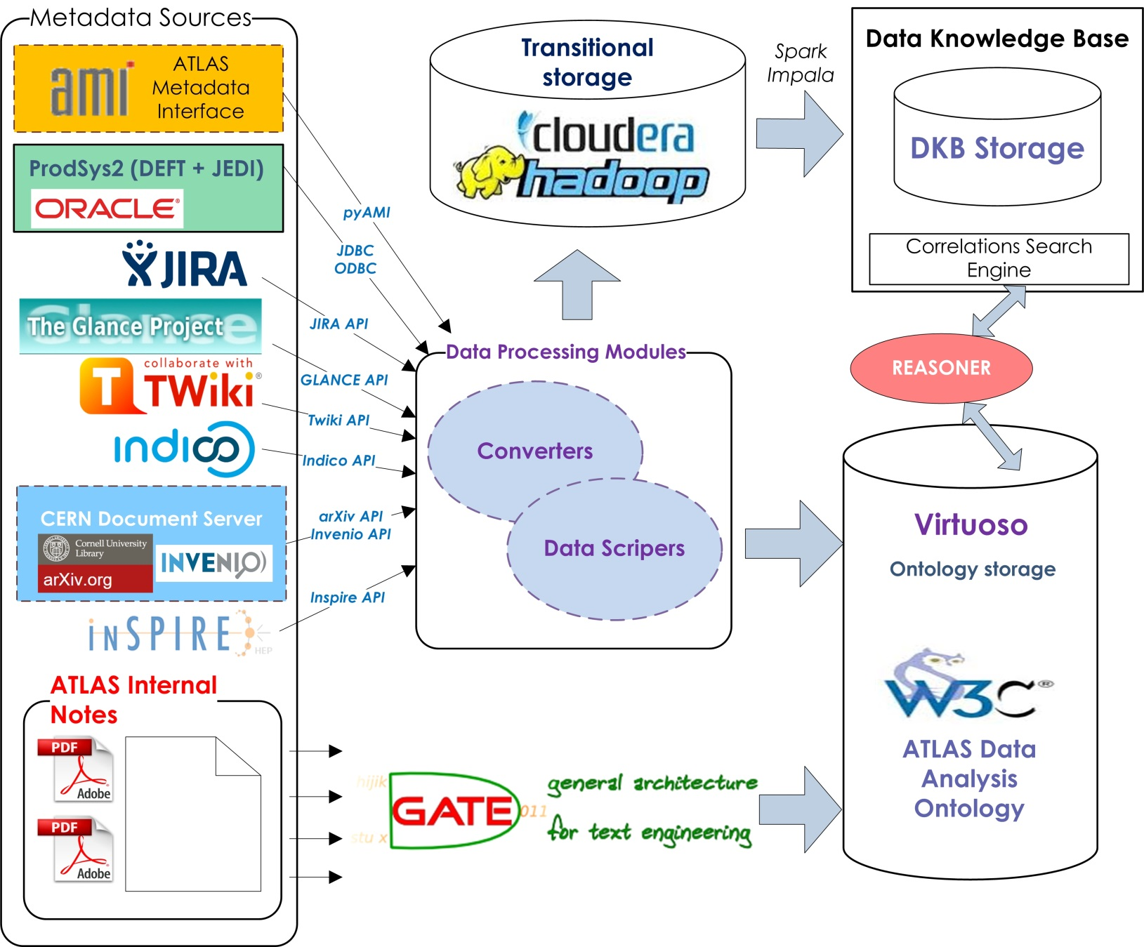
DKB Architecture Prototype

Slide 3
Anomaly detection
First step: simple “cold” task completion time predictions.
Second step: machine learning-based models for both “cold” and “hot” predictions.

Slide 4
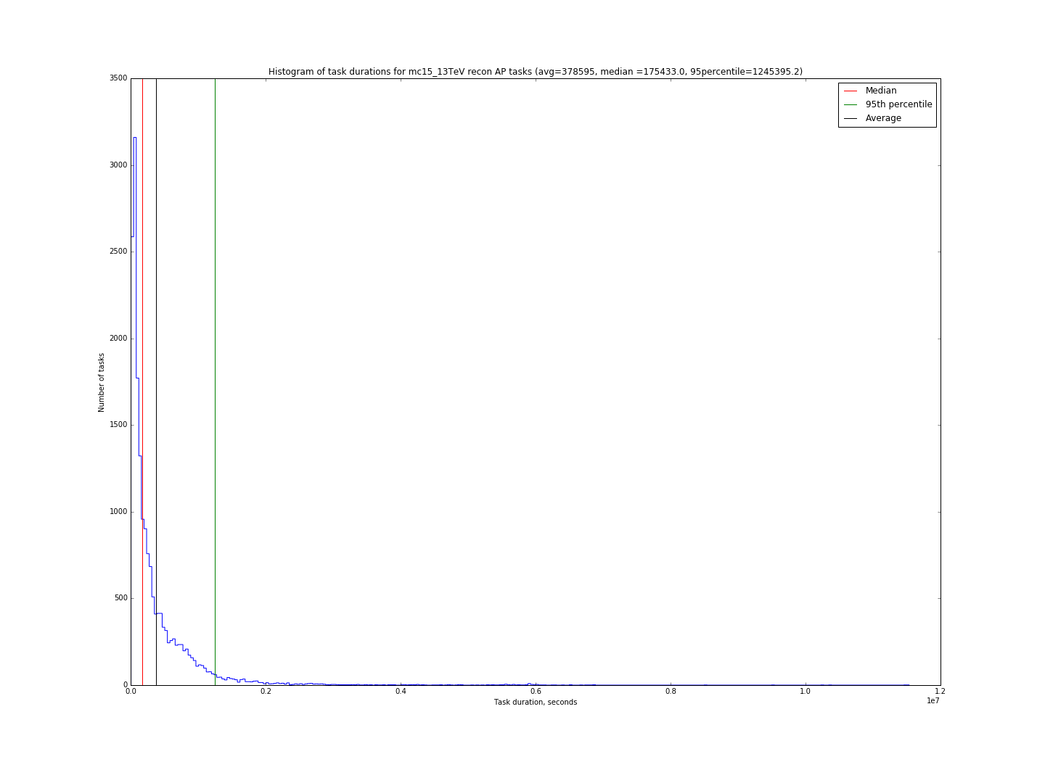
Task duration distribution
Project | Type | Provenance | TTC (days)
data15_13TeV | merge | GP | 50.8
data15_13TeV | recon | GP | 2.2
data15_13TeV | recon | AP | 8.9
data15_13TeV | merge | AP | 4.9
data15_5TeV | merge | GP | 10.1
data15_5TeV | merge | AP | 2.2
data15_5TeV | recon | AP | 2

