Slide 1
LVR – SLVR overview
CMS ECAL VFE phase II upgrade workshop
CEA-Saclay INSTN
11-13 May 2016
B. Betev, L. Djambazov, W. Lustermann, ETH Zurich

Slide 2
Present front electronics
Fiber Patch Panel
Fiber Patch Panel
Control
Token Ring Board
Trigger Fiber(s)
Data Fiber
Front End Electronics
Digital Voltage
Distribution (DCU)
Power in
LVR
VFE
VFE
VFE
VFE
VFE
‘Analog’ Voltage
Distribution:
MGPA + ADC
Mother Board
HV in
Flexible Connection to APD’s / VPT’s

Slide 3
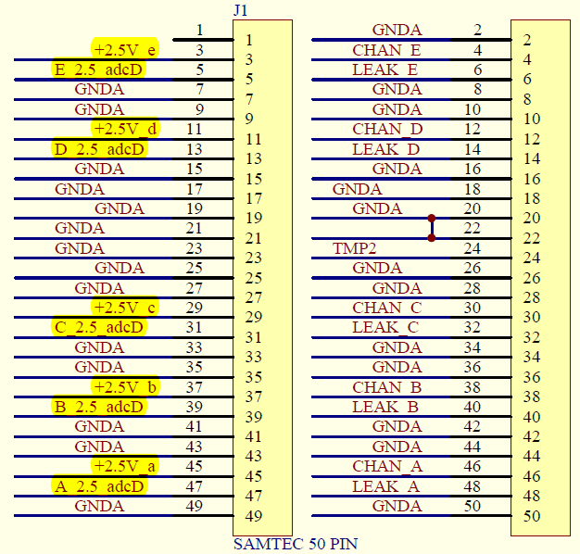
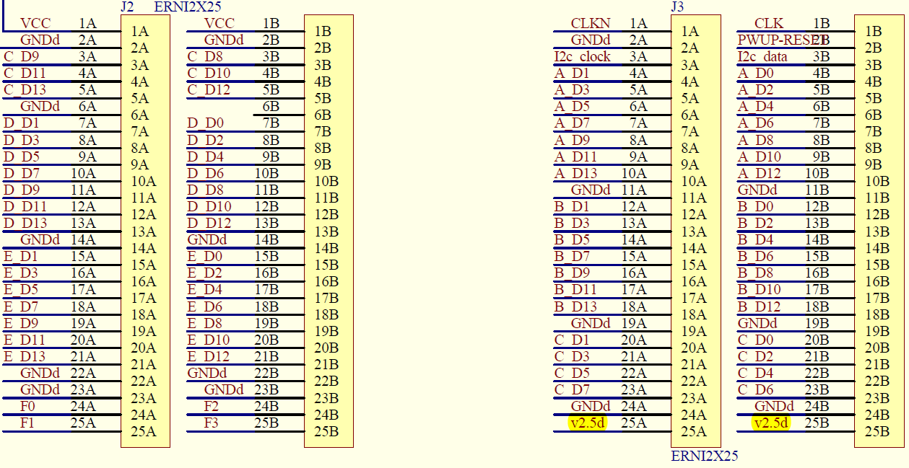
VFE power nets
VFE has 11 power nets:
5 x 2.5 V analog (MGPA)
5 x 2.5 V digital (ADC)
1 x 2.5 V digital (DCU)
10 of the power nets arrive via the MB
1 is connected to the FE card

Slide 4
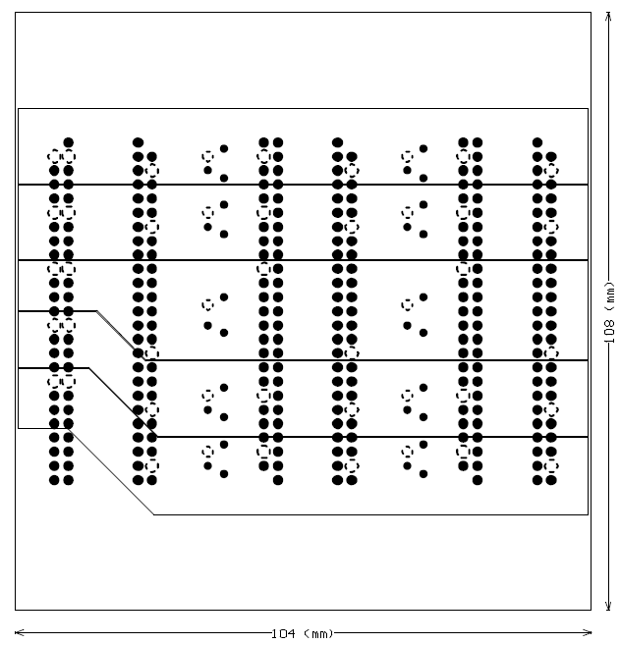
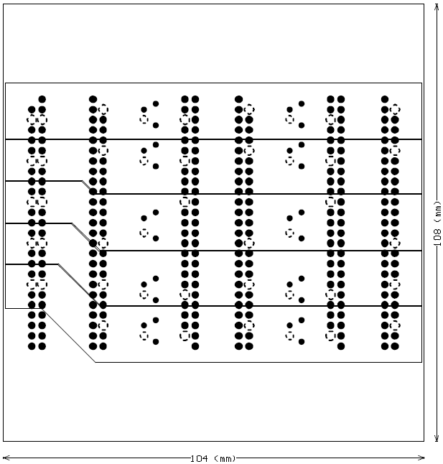
Power nets in the motherboard
Motherboard internal power planes
2.5 V digital
2.5 V analog

Slide 5
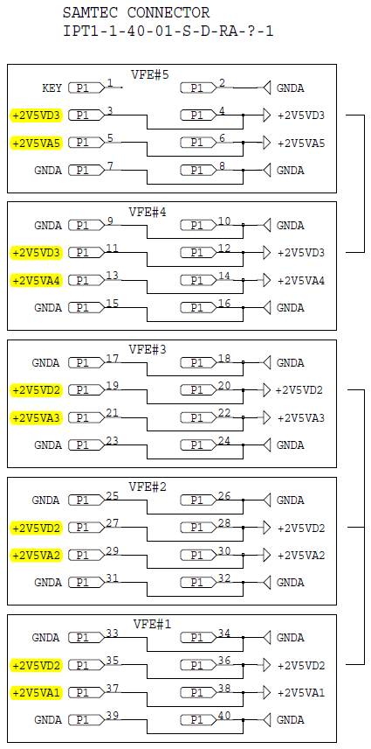
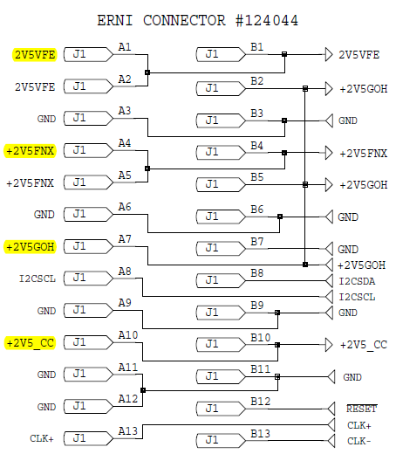
Power nets in the LVR
LVR hosts 11 linear regulators providing:
4 digital voltages to the FE:
  3 voltages for the FE
  1 voltage for the DCUs on the VFE
7 voltages to the mother VFE:
  5 x 2.5 V for the MGPAs
  2 x 2.5 V for the ADCs

Slide 6
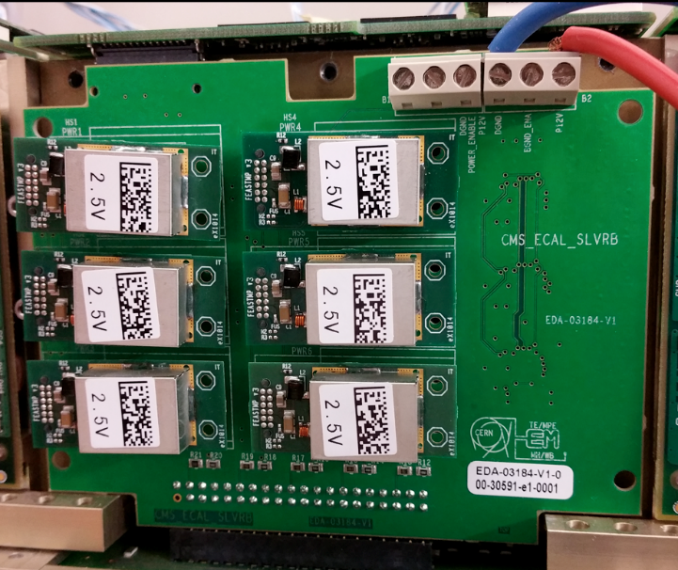
SLVR with FEASTMP_CLP
First version designed by Magnus
6 power nets == FEASTMP_CLP:
  5 x 2.5 V for the VFE
  1 x 2.5 V for the FE
- Tested in TT setup: B. Betev
- Tested at Virginia University
Design and layout iteration: make it fit into super-modules:
- Prototypes are in production

Slide 7
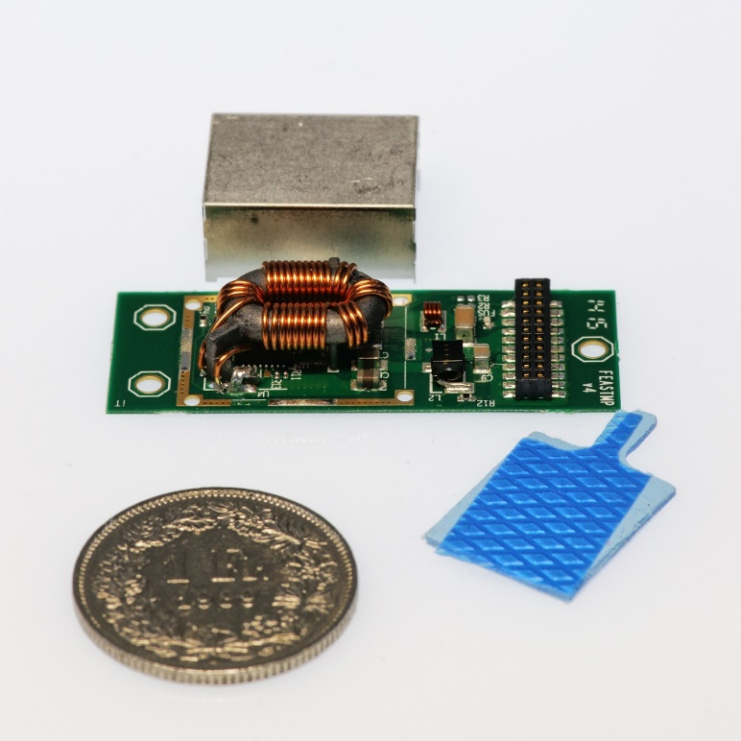
SLVR with FEASTMP_CLP
The SLVR becomes an almost passive board, hosting connectors for the FEASTMP_CLP modules and 3 DCU chips for voltage, current and temperature monitoring
➔ Properties and performance are (almost exclusively) determined by the FEASTMP modules
Developed and fabricated by CERN
radiation tolerant
over current protection
over temperature protection
under voltage protection
Output voltage variation:
Load and line regulation
Spread of output voltages
Radiation effects
Temperature effects

Slide 8
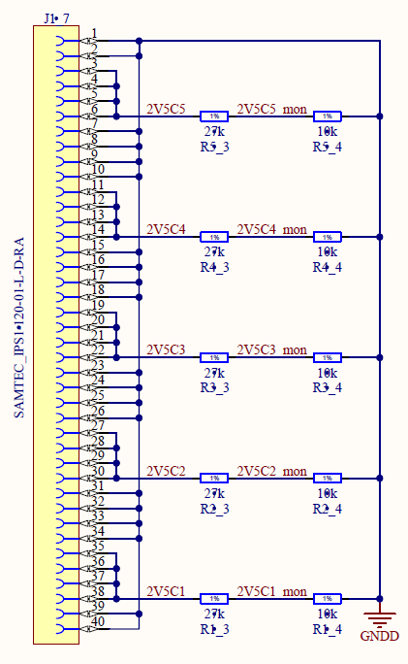
SLVR power interface
Interface to the MB unchanged
VFE analog and digital power grouped
original
new

Slide 9
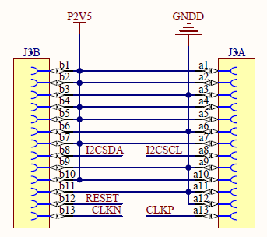
SLVR power interface
Interface to the FE unchanged
All voltages on a single net

Slide 10
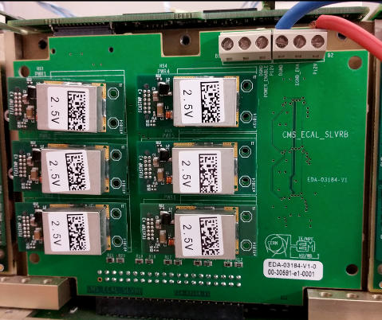
SLVR 3D view
TOP view: will be covered by the housing and coupled to the cooling bar
BOTTOM view
FEASTMP modules plug through the SLVR card

Slide 11
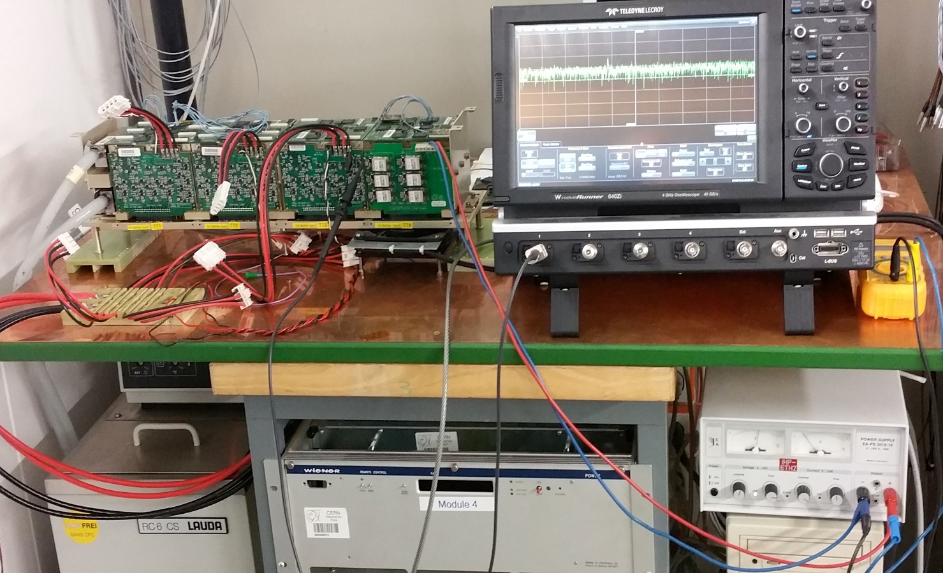

TT testsetup
SLVRB
Linear LV Power Supply
for input voltage of SLVRB
(Input voltage = 10 Volts)
Trigger Tower Test Setup in
B.892. The SLVR Board integrated in TT4 (CCU=6)
Wiener LV power supply for input voltage of TT 1, 2 and 3

Slide 12
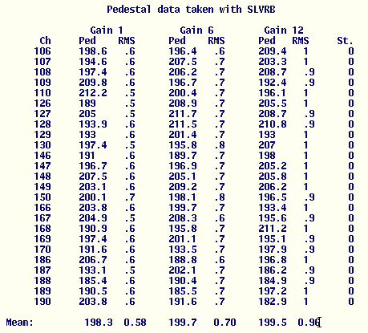
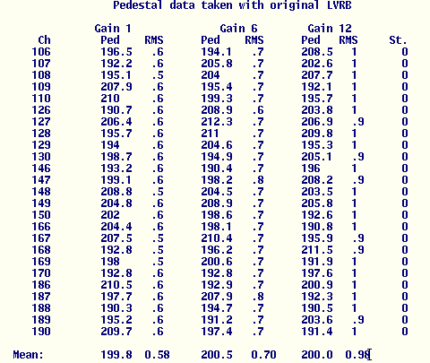
TT noise measurements
LVR → SLVR: Performance remains unchanged

Slide 13
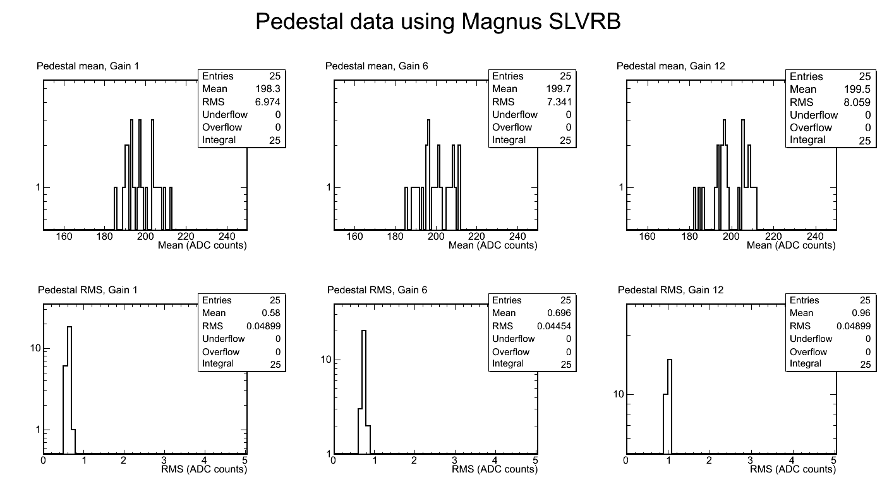
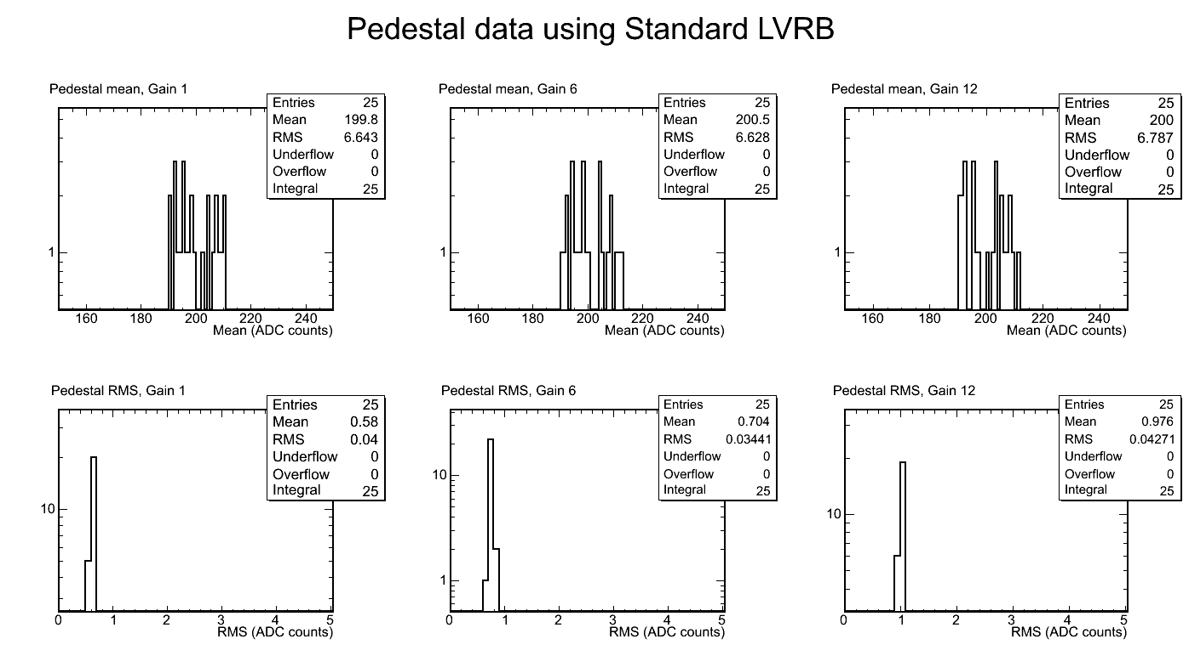
TT testsetup
new SLVR
old LVR
LVR → SLVR: no significant difference

