Slide 1
Critical Point and
Event-by-Event Fluctuations
Mark Gorenstein
Bogolyubov Institute for Theoretical Physics, Kiev
Introduction: QCD Critical Point
Van der Waals Equation of State: Nuclear Matter
Critical Point for the Liquid-Gas Transition: Critical Indexes
IV. Long Range Correlations at the Critical Point
V. Fluctuations at the Critical Point: Scaled Variance,
Skewness, and Kurtosis at the Critical Point
Strongly Intensive Measures of Fluctuations
Summary

Slide 2
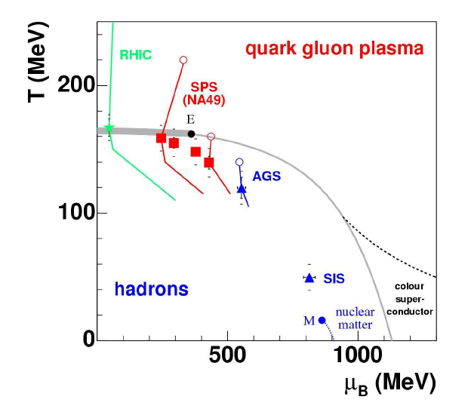
QCD
Critical
Point
Critical Point of Nuclear Matter

Slide 3
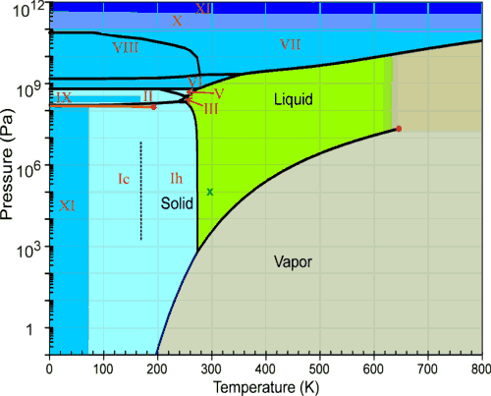
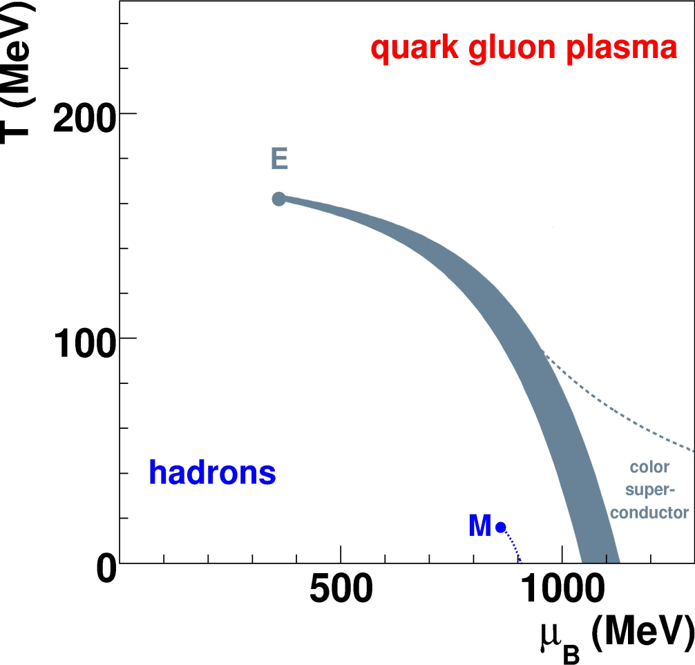
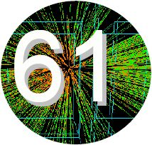
Critical Point
Water Strongly Interacting Matter
Temperature (MeV)
QCD Critical Point
1st Order Phase Transition

Slide 4
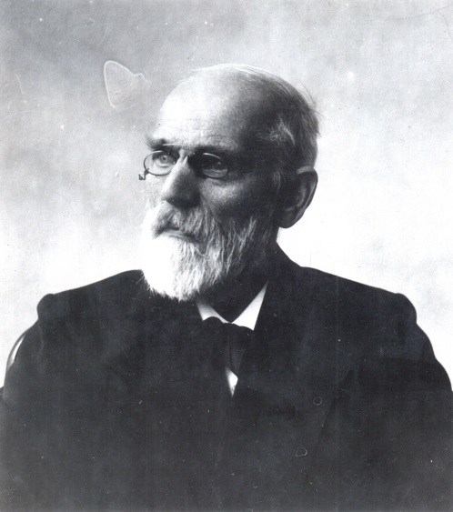
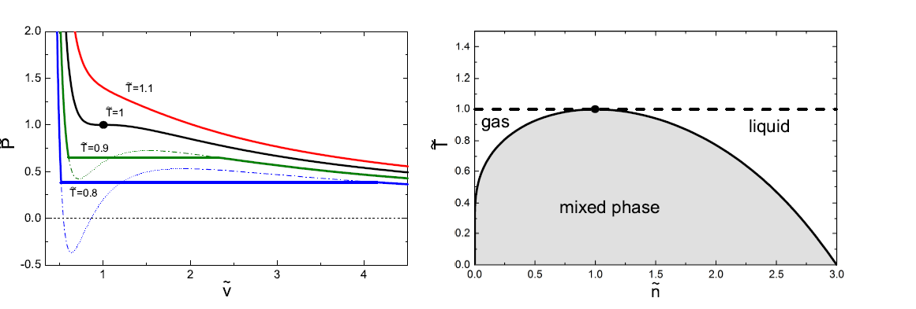
II. Van der Waals Equation of State
1873, Ph. D. Thesis 1910, Nobel Prize in Physics

Slide 5
CE GCE
Rischke, M.I.G.,Stocker,
W.Greiner,
Z. Phys. C (1991)
Vovchenko, Anchishkin,
M.I.G.
J.Phys. A (2015)

Slide 6
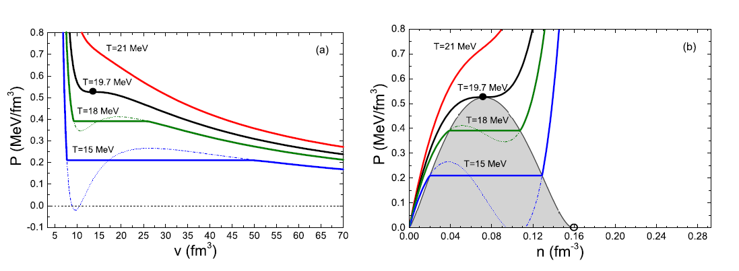
Nuclear Matter = nucleons with van der Waals EoS
Fermi Statistics,
Vovchenko, Anchishkin, M.I.G., Phys. Rev. C (2015)

Slide 7
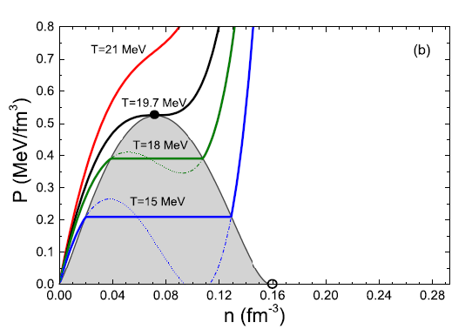
liquid gas

Slide 14
V. Fluctuations at the Critical point
Scaled Variance
Vovchenko, Anchishkin, M.I.G.
J.Phys. A (2015)

Slide 15
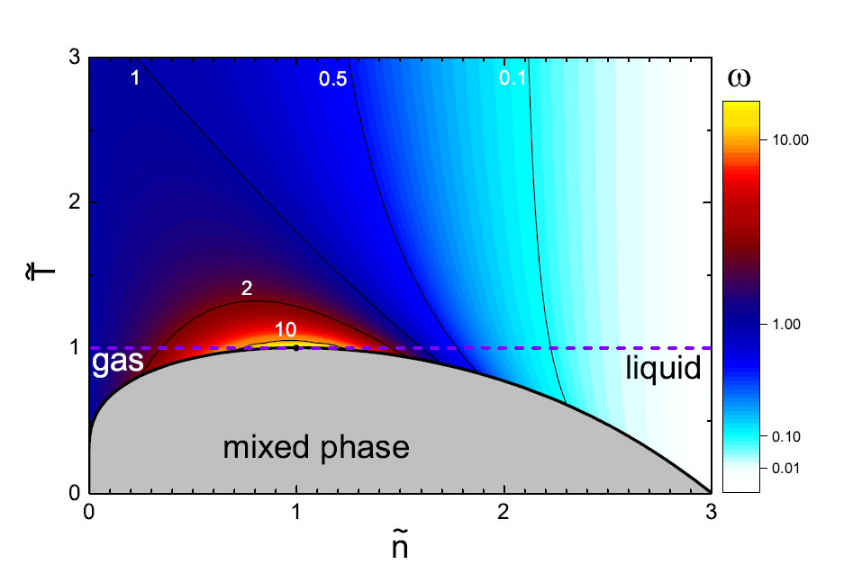

Slide 16
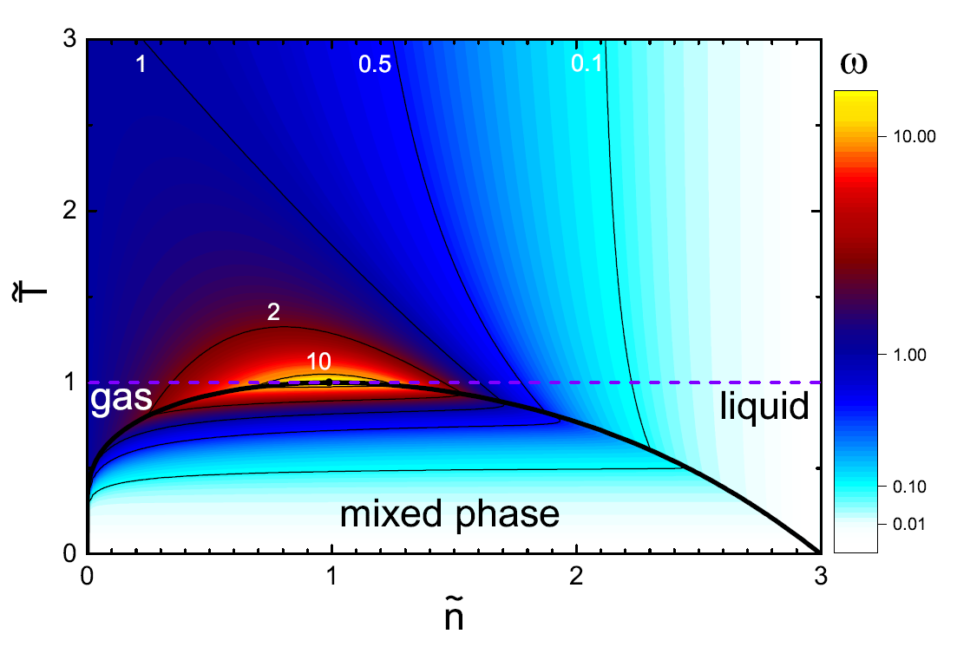

Slide 17
Vovchenko, Anchishkin,
M.I.G., Poberezhnjuk,
Phys. Rev. C (2015)

Slide 18
Particle Number Density
crossover

Slide 19
Scaled Variance

Slide 20
Skewness

Slide 21
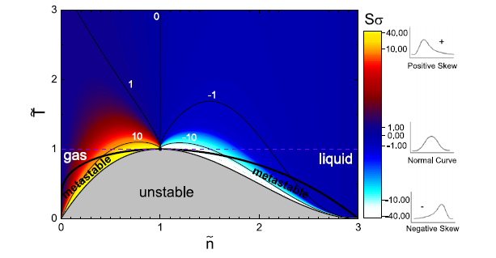
Skewness

Slide 22
Kurtosis

Slide 23
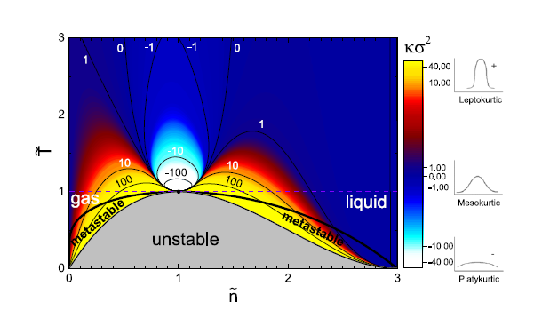
Kurtosis

Slide 24
VI. Strongly Intensive Measures of Fluctuations
These combinations of second moments
are independent of
M.I.G., Gazdzicki, Phys. Rev. C (2011)

Slide 25
Normalization:
For the Independent Particle Model:
IB-GCE ; Mixed Event Model
Gazdzicki, M.I.G., Mackowiak-Pawlowska, Phys. Rev. C (2013)

Slide 28
Summary
Van der Waals Equation of State for Nuclear Matter
Provides an analytical example of the systems with 1st order liquid-gas phase
transition and critical point.
Particle Number Fluctuations:
Scaled Variance increases at a vicinity of the critical point
(goes to infinity at the CP)
For Skewness and Kurtosis the CP is a point of essential singularity:
i.e., the limiting singular values of skewness and kurtosis depend on the
path of approach to the CP
3. Strongly Intensive Measures and
i.e., in the excluded volume model

