Slide 1
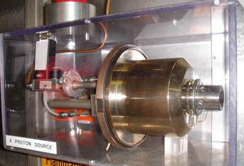
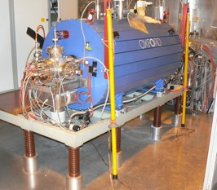
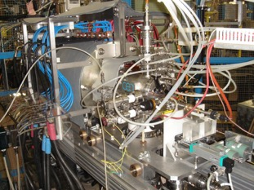
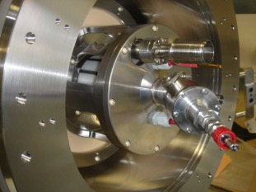
Ion source physics and technology
Detlef Küchler
CERN/BE/ABP/HSL

Slide 2
INtroduction

Slide 3
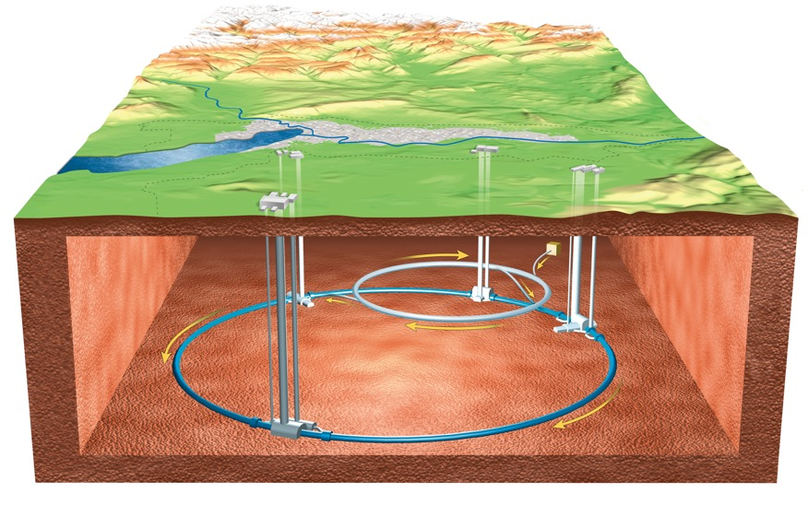
What is an ion source?
For an accelerator physicist an ion source is somewhere far away.
It is a black box with three buttons:
On/Off
Particle type
Intensity

Slide 4
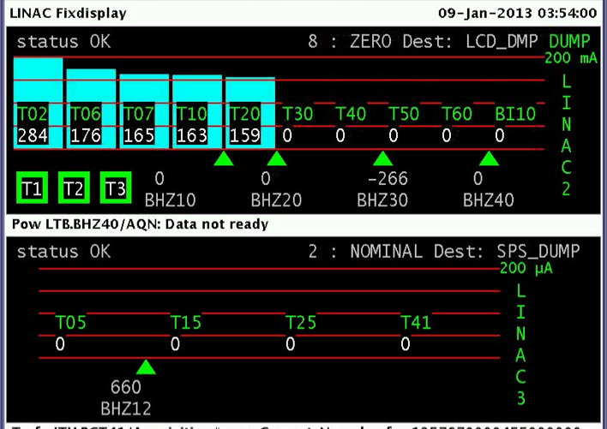
What is an ion source?
For an operator, if there is a problem, it must be the ion source!

Slide 5
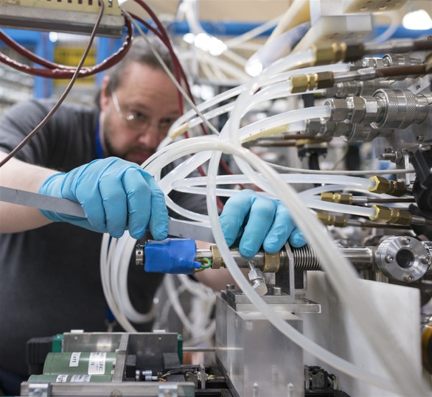
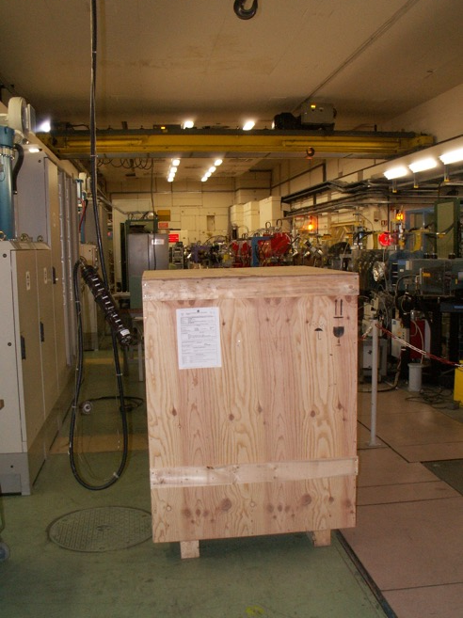
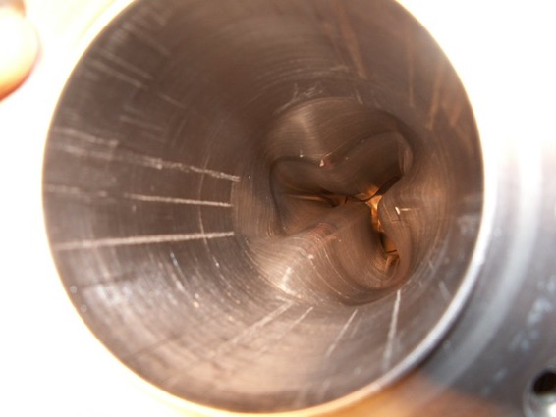
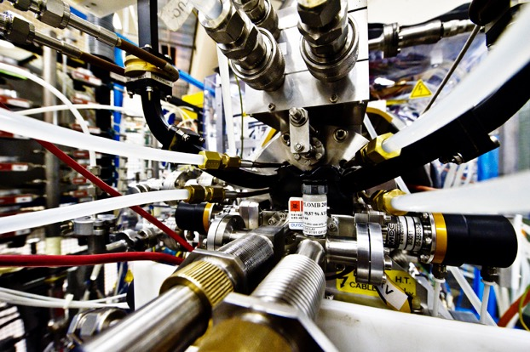
What is an ion source?
For an ion source physicist an ion source is
… a Christmas present
… a piece of art
… the source of trouble
… his daily work

Slide 6
What is an ion source?
Definition (for primary beams)
An ion source is a device to create a charged particle beam.
An ion source is a device to create a charged particle beam.
An ion source is a device to create a charged particle beam.
An ion source is a device to create a charged particle beam.
An ion source is a device to create a charged particle beam.
This definition is not perfect, but covers most of the cases.
Particles in this context are ions, molecules and clusters.

Slide 7
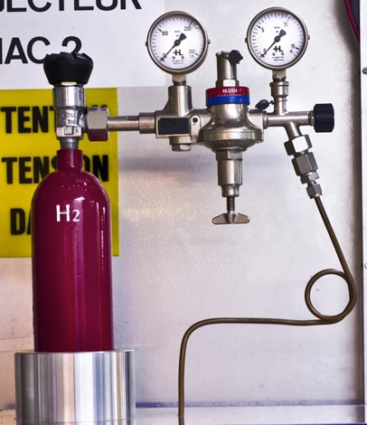
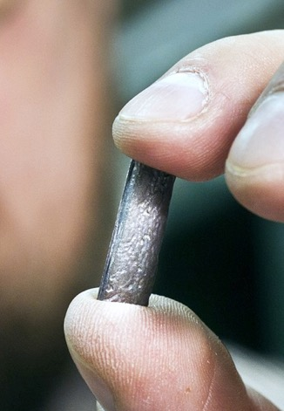
Why we have to create a charged particle beam?
Ordinary matter is neutral.
In an accelerator electric and magnetic fields are used to manipulate the beam (acceleration and transport).

Slide 8
What does it mean
“to create a particle beam”?
The ion source
ionizes the particles
shapes a beam
The main beam properties are defined at the source
charge state
beam intensity
beam energy
beam shape and emittance
time structure (continuous or pulsed)
+
+
+
+

Slide 9
Classification of ion sources
Ion sources can be classified by
the mechanism of ion generation
the particle type
their application

Slide 10
Classification by ion generation mechanism
The ionization takes place
in a plasma
by electron bombardment
due to field ionization
on a surface
due to laser irradiation
due to charge transfer
The list is not complete.

Slide 11
Classification by particle type
Ion sources for
positive ions
molecular ions
polarized ions
negative ions
cluster
The list is not complete.

Slide 12
Classification by application
Primary beam
Secondary beam
Accelerators (scientific, medical)
Neutral beam injector for fusion devices
Target ion sources of ISOL facilities
Ion beam lithography for nanostructures
Implanter for semiconductor production
Charge breeders
The list is not complete.

Slide 13
Some ion source types
Electron cyclotron resonance ion source (ECRIS)
Electron beam ion source (EBIS)
Laser ion source (LIS)
Duoplasmatron
Penning ion source
RF ion sources
Metal vapor vacuum arc ion source (MEVVA)
Liquid metal ion sources

Slide 14
Why do we have to speak about ion sources?
The ion source is an essential part of an accelerator.
It is important to understand the limitations of the source
(beam properties, reliability, life time).
Accelerator experts tend to forget these limitations and try to shift their problems towards the source.
A basic knowledge of the source can help during the operation and is essential for designing an accelerator
(to find compromises between wishes and reality).
It is always good to know where the source is located and who the specialists are.

Slide 15
What will this lecture provide?
some basic principles of ion production and beam extraction
some examples of ion sources
only a limited number of formulas and values, because this could be easily found in any text book

Slide 16
What can this lecture not provide?
the complete theory of plasmas,
ion production and beam extraction
the complete overview of all types of ion sources and their technical background
in-depth explanations
For more information see the books listed in the bibliography.

Slide 17
Structure of this lecture
Engineering
  Technical infrastruc-ture to operate an ion source
Source physics
  Source principle
  Source operation
  Beam extraction
Plasma physics
  Plasma parameters
  Particle processes
Atomic physics
  Rate equation
  Atomic processes

Slide 18
Atomic physics

Slide 19
Basic differential equation concerning the ion production process - Rate equation
– ion density of the charge state i
– cross section going from the charge state i to the charge state i-1
– electron current density ( )
– ion confinement time

Slide 20
Basic differential equation concerning the ion production process - Rate equation
The equation is simplified. Some source and loss terms are missing.
The creation of higher charge states is a stepwise process.
A similar equation describes the evolution of the energy density.
Terms of ion
production
Terms of ion
losses

Slide 21
More precise example
… but this is still only one equation of the complete differential equation system!

Slide 22
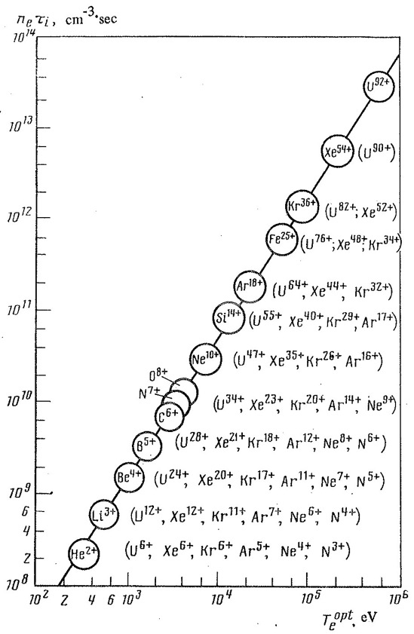
Golovanivskii plot
The ion confinement time τ_{c} and the electron density n_{e} are influencing the maximum charge state that could be reached.
The confinement time influences the losses from the plasma and in this way the ion current that can be extracted (high confinement time => low ion current).
K.S. Golovanivskii, Magnetic mirror trap with electron-cyclotron plasma heating as a source of multiply charged ions, Instrum Exp Tech; (1986) p. 989.

Slide 23
Main atomic processes
Charge state
increasing reactions
Charge state lowering reactions
Electron impact ionization
Charge exchange
Radiative recombination
Surface ionization
Photoionization
Dielectronic recombination
Field ionization
Charge exchange

Slide 24
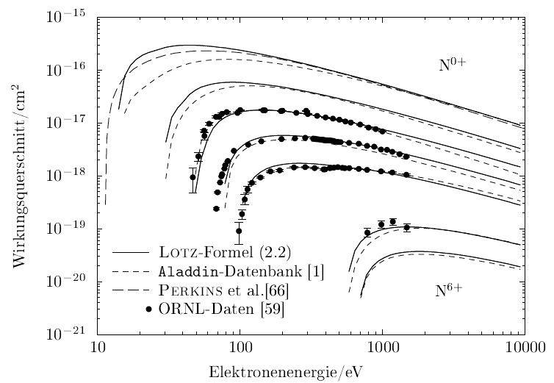
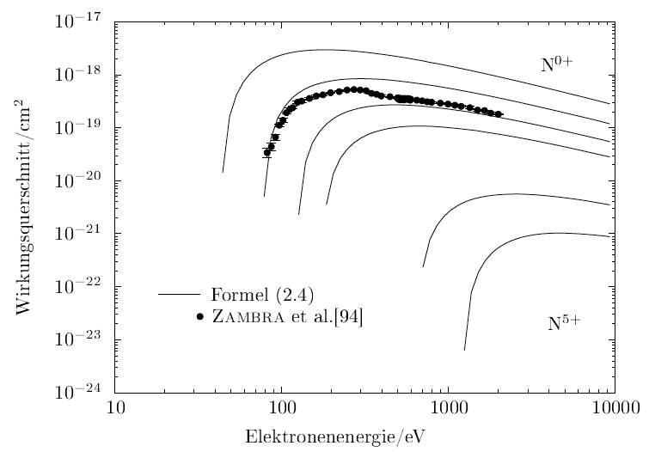
Electron impact ionization
dominant ionization process in plasmas
single ionization
double ionization
energy threshold (ionization energy)
=> the production of higher charge states needs a higher electron energy
the cross section has its maximum at around two to three times the ionization energy
the ionization rate has its maximum at around five times the ionization energy
single ionization
cross section/cm²
formula
database
electron energy/eV
double ionization
cross section/cm²
formula
electron energy/eV

Slide 25
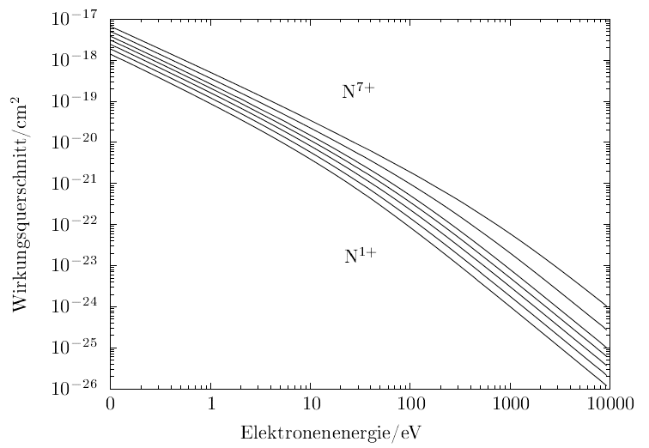
Radiative recombination
Limiting process towards higher charge states
The cross sections are bigger for lower electron temperatures and higher charge states
cross section/cm²
electron energy/eV

Slide 26
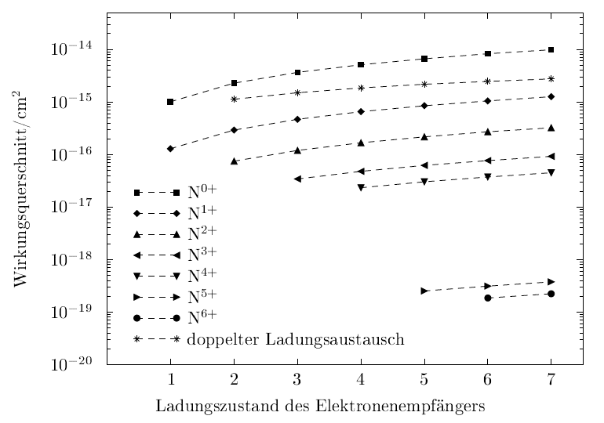
Charge exchange
the charge exchange acts in both directions
  increases the charge state for low q
  lower the charge state for high q
  it is also possible between different ion charge states
depends on the neutral particle density (rest gas)
cross sections are bigger for higher charge states
also possible with
cross section/cm²
double charge exchange
charge state of the ion receiving the electron

Slide 27
Other processes I
Surface ionization
  positive ionization of atoms with low ionization potential on heated metal surfaces with a high work function (e.g. tungsten)
  the surface has to be heated to increase the desorption
  works only for a limited number of elements (alkalines)
  negative ions can be created for elements with high electron affinity

Slide 28
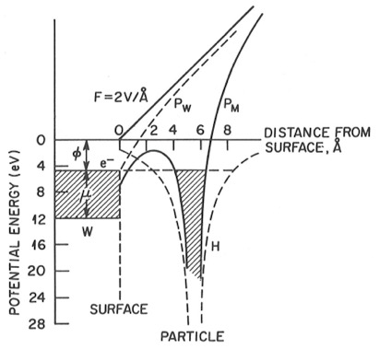
Other processes II
Field ionization
  high electric field gradient modifies atom potential so that an electron can tunnel into the metal surface
  dominant process in liquid metal ion sources

Slide 29
Other processes III
Photoionization
  the photon energy has to exceed the ionization energy
  dominant process in resonant laser ion sources
  (combined steps of excitation and ionization, chemically selective)
Dielectronic recombination
  resonant process
  could play a role for higher charge states depending on electron energy and density

Slide 30
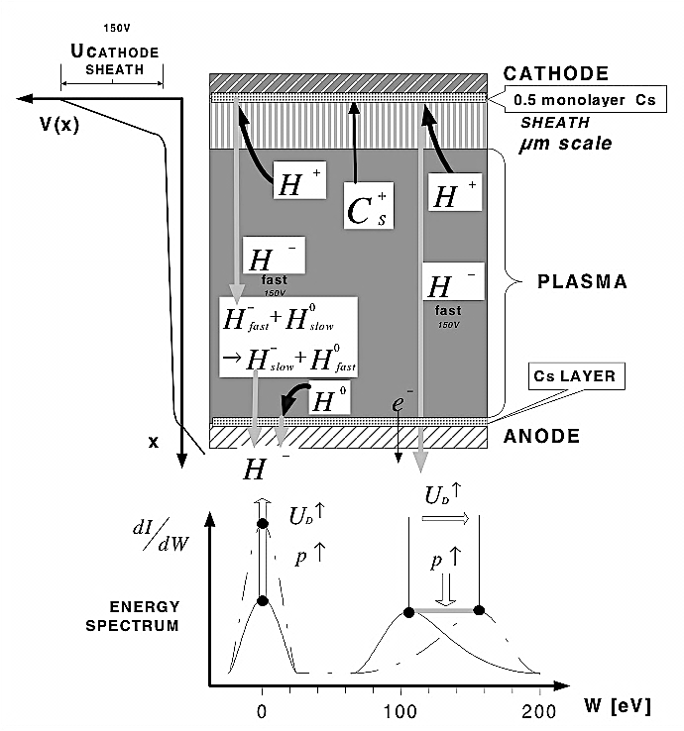
H⁻ production I
charge transfer
  the simplest method is the conversion of a primary proton beam in a converter target
  (e.g. a cesiated surface, cesium vapor or hydrogen gas)
  used e.g. for polarized beams
surface effect
  protons from a plasma hitting the wall can pick up electrons, the walls are covered with low work function material
  (e.g. cesium)

Slide 31
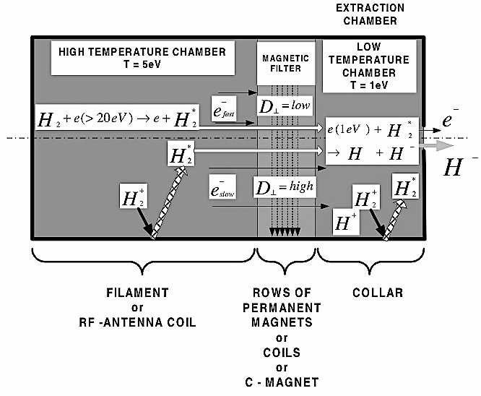
H⁻ production II
volume effect
  H⁻ is created from vibrational excited hydrogen molecules through dissociative electron attachment
H⁻ ions are very sensitive to particle collisions and strong fields (Lorentz stripping)
=> only H⁻ ions created near to the extraction hole can be extracted

Slide 32
Plasma physics

Slide 33
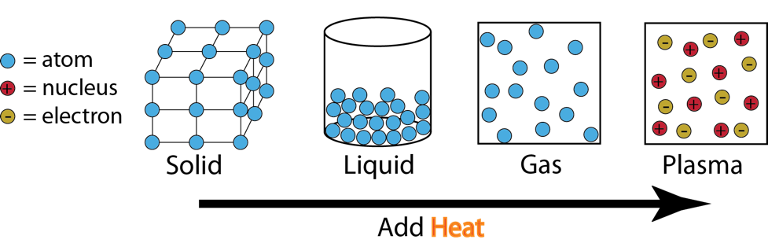
What is a plasma?
A plasma is a quasi neutral gas of charged and neutral particles which exhibits collective behavior. (F.F. Chen “Plasma physics”)
It is often also called the 4th state of matter.

Slide 34
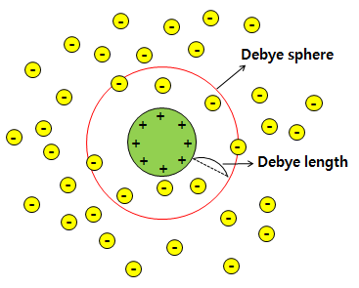
What is quasi neutrality?
overall charge neutrality is preserved
due to the electron movement local deviations are possible
departure from neutrality gives rise to electric fields limiting the charge build-up
the system is quasi neutral if the dimensions are much larger than the Debye length λ_{D}

Slide 35
What is collective behavior?
the plasma consists of charged particles
the moving charges can create local concentrations of charges
-> electric fields
the moving charges can generate currents
-> magnetic fields
the fields affect motion of other charged particles far away
coupling of local conditions with remote plasma regions -> collective behavior

Slide 36
“Because of collective behaviour,
a plasma does not tend to conform to external influences; rather, it often behaves as if it had a mind of its own.”
F.F. Chen

Slide 37
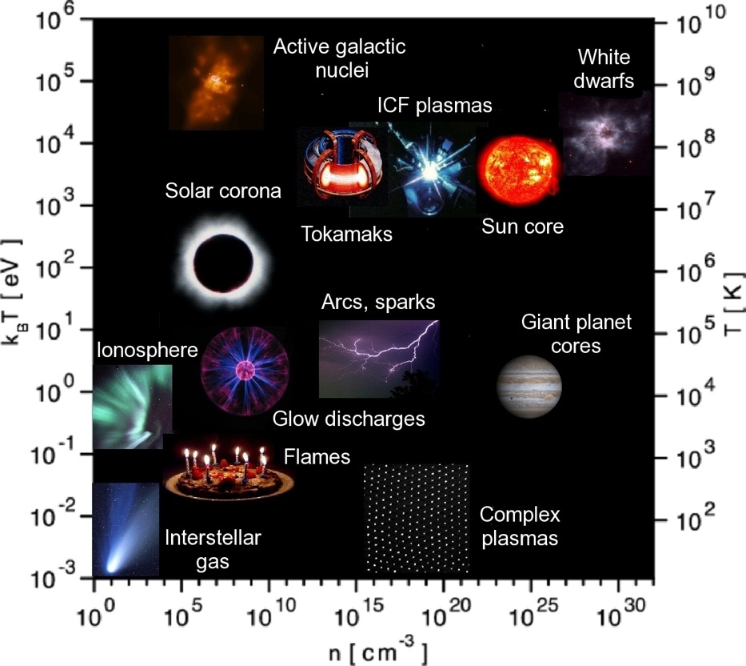
Plasma map
plasmas exist in a wide range of densities and temperatures
most laboratory plasmas

Slide 38
Basic plasma parameters
particle density
  electron density n_{e}, ion density n_{i},
  neutral density n₀
  units: cm⁻³ or m⁻³
  in ion sources in the vicinity of n_{e}~10¹² cm⁻³
  Attention! the term “plasma density” is not very well defined

Slide 39
Basic plasma parameters II
particle temperature
  electron temperature T_{e}, ion temperature T_{i},
  neutral temperature T₀
  units: eV or K (1 eV ≅ 11600 K)
  in the presence of a magnetic field the temperatures can be anisotropic (parallel and perpendicular to the field: T∥ and T⟂)
  the term “temperature” is defined only for a Maxwellian energy distribution (thermal equilibrium)
  Attention! the term “plasma temperature” makes only sense if all temperatures are the same

Slide 40
Basic plasma parameters III
ionization fraction
  ratio of the ion density to the total density of ions and neutrals
  if there are no neutrals left the plasma is fully ionized
  Attention! the term “highly ionized” is used for plasma with high ionization fraction or for ions with a high charge state

Slide 41
Basic plasma parameters IV
plasma frequency
  small deviations from charge neutrality causing a restoring force -> plasma oscillation
  for electrons for ions
  n – density, m – mass, q – charge state

Slide 42
Single particle motion
the Lorentz force is determining the motion of charged particles in electrical and magnetic fields
due to the orientation of the fields to each other, the field structures (field inhomogeneities) and temporal variations different kinds of particle motion are possible
(ExB drift, gradient drift, …)

Slide 43
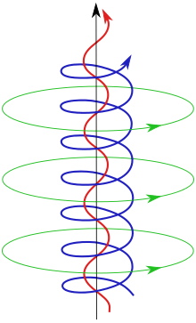
Single particle motion II
charged particles in a magnetic field are gyrating around the field lines
cyclotron frequency
Larmor radius

Slide 44
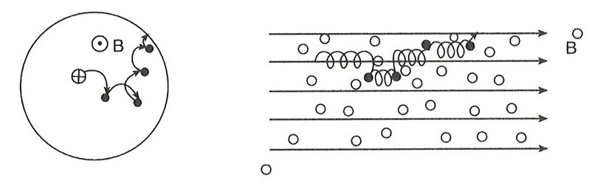
Diffusion
particle transport due to density gradient
in neutral gases the diffusion is reduced due to collisions
in magnetized plasmas collisions cause diffusion (restore particle freedom to cross the magnetic field)

Slide 45
Diffusion II
diffusive motion in a neutral gas (flux Φ)
-> definition of the diffusion coefficient D_{i}
D_{i} is not a constant, depends on densities, temperatures, …
diffusion is ambipolar, particles of each sign diffuse with same velocity (role of the slow particles)
many different approaches to describe the diffusion coefficient for the different plasma types

Slide 46
Multi particle model
for a self-consistent description with varying time one can describe a plasma as a fluid (Magnetohydrodynamics MHD)
periodic motions can be described with waves
in a fully ionized plasma the collisions are Coulomb collisions
there are elastic (energy transfer) and inelastic collisions (atomic processes)
collisions are described by collision frequency (typical time scale) and mean free path (typical length scale)

Slide 47
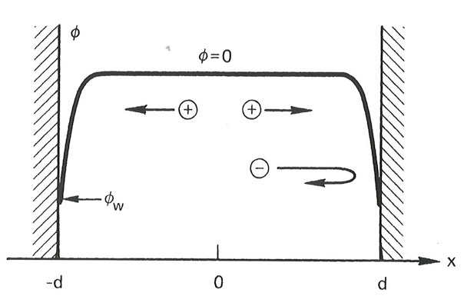
Plasma-wall interaction
between a plasma and a wall a boundary layer is formed -> the plasma sheath
the sheath has in the undisturbed case a thickness of around one Debye length
due to the different mobility of ions and electrons a plasma potential builds up
it decelerates the electrons and accelerates the ions to balance the flows and to keep the plasma neutrality
the sheath screens external fields

Slide 48
Plasma heating
to trigger and sustain atomic and plasma physical processes one has to introduce energy into the plasma
this can be done in may different ways
  Electrical discharges (filament sustained)
    Duoplasmatron, MEVVA
  Radio frequency (internal or external antenna)
    RF driven ion sources, H⁻ sources, Multicusp sources
  Laser
    Laser Ion Sources
  Microwave
    ECRIS

Slide 49
Microwave plasma heating
the plasma is heated resonantly if the injected microwave has the same frequency as the electron cyclotron frequency
stochastical process
only frequencies higher than the electron plasma frequency can penetrate the plasma, the others are reflected
-> critical density for the energy transfer
due to mode conversion, non-linear and other effects overdense plasmas are possible

Slide 50
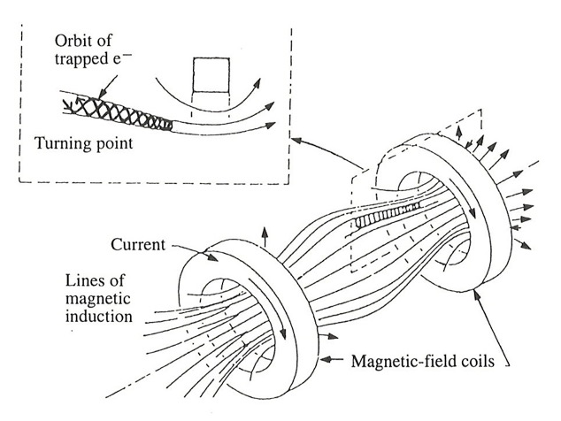
Plasma confinement
magnetic fields are used to confine the plasma
many different types: multicusp, magnetic mirror, magnetic bottle (minimum-B mirror)
the magnetic moment is an invariant
-> magnetic mirror effect
if B goes up, v⟂ goes up and v∥ goes down (conservation of total energy), reflection where v∥ becomes zero

Slide 51
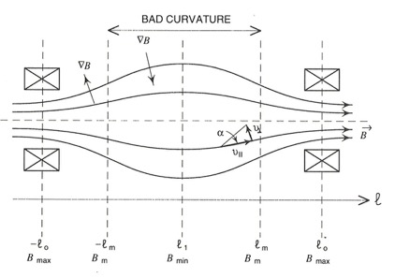
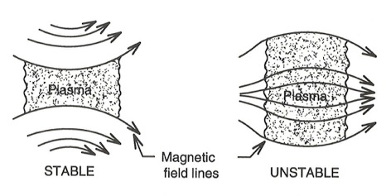
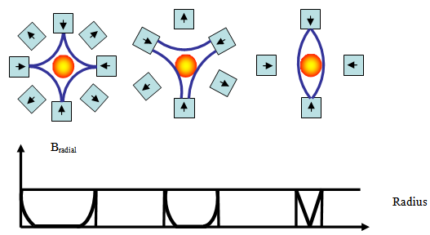
Plasma confinement II
the simple magnetic mirror is MHD unstable
due to the curvature of the field lines there is a gravitational-like force outwards driving the plasma radially
adding a magnetic multipole creates a field with convex field lines -> MHD stable (minimum-B mirror)
disadvantage: the multipole forces a non-rotational symmetric plasma distribution

Slide 52
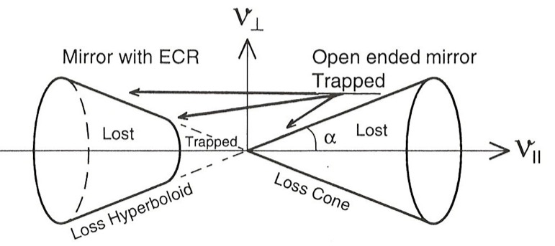
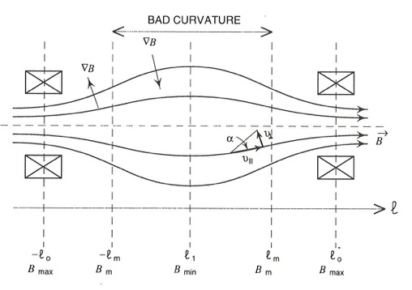
Plasma losses
for the magnetic mirror a trapping condition in the velocity space can be formulated -> mirror ratio
the volume defined by the mirror ratio is called the loss cone
particles inside the loss cone are lost from the plasma (and can be extracted)
B_{max}
B_{min}

Slide 53
Ion source physics and technology
part II
Detlef Küchler
CERN/BE/ABP/HSL

Slide 54
Structure of this lecture
Engineering
  Technical infrastruc-ture to operate an ion source
Source physics
  Source principle
  Source operation
  Beam extraction
✔
Plasma physics
  Plasma parameters
  Particle processes
Atomic physics
✔
  Rate equation
  Atomic processes

Slide 55
Source physics

Slide 56
Generalized source model
Power
Extractor
Material input
Ion beam
Ion container
Ion production region

Slide 57
Generalized source model
Ion container and production region
The container is the main body of the source
It has an interfaces to the whole source infrastructure
(vacuum, cooling, injection, extraction, …)
It should have a very good base vacuum
  Impurities have effects on the ion production, the ion life time and can also disturb the source stability and the beam extraction
In most (but not all) of the sources the ions are created inside a plasma
The plasma is confined by a magnetic field (big variety of magnetic field structures: cusp, magnetic mirror, …)

Slide 58

The Electron Cyclotron Resonance Ion Source (ECRIS)
Location: CERN Linac3 (GTS-LHC)

Slide 59
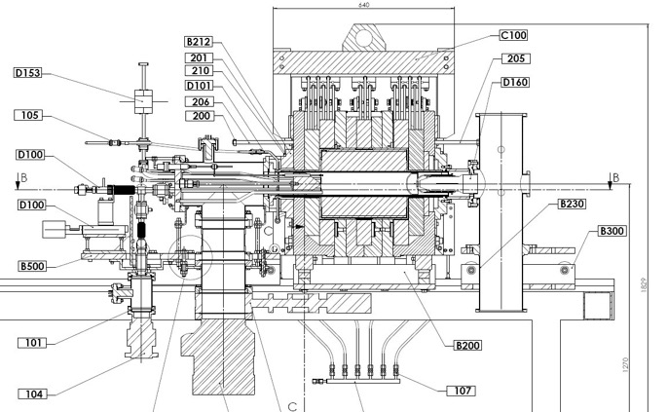
The ECRIS II
Developed 1965 by Richard Geller (France)
The plasma is confined in a “magnetic bottle”,
the longitudinal field is created with solenoids,
the radial field is created with a permanent magnet hexapole

Slide 60
The ECRIS III
magnetic field structure
radial field ~ r²
extraction field lower to balance ion creation and ion extraction
scaling laws for optimal source operation
3rd generation sources with superconducting coils
longitudinal field radial field
arbitrary values

Slide 61
The ECRIS IV
the plasma is heated due to the resonance of the injected microwave with the electron cyclotron frequency
(actual used frequencies 6.4 GHz, 14.5 GHz, 18 GHz or 28 GHz)
delivers high currents for medium charge states
no antennas or filaments in the ion production region
➔ high reliability

Slide 62
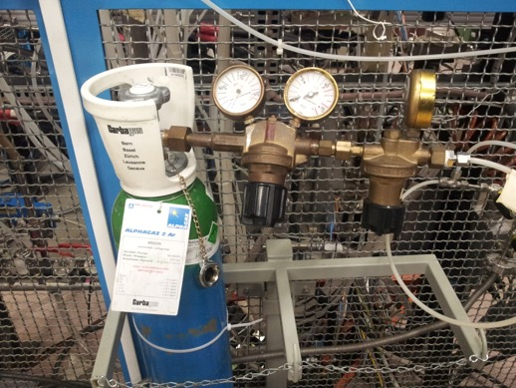
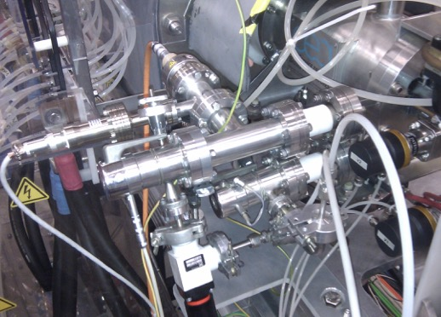
Material input
the source can be operated with gas, liquids, solids or ions
gas: direct connection with flow control
liquids: direct connection with flow control, depending on the vapor pressure some heating may be necessary
ions: single charged ions into charge breeders

Slide 63
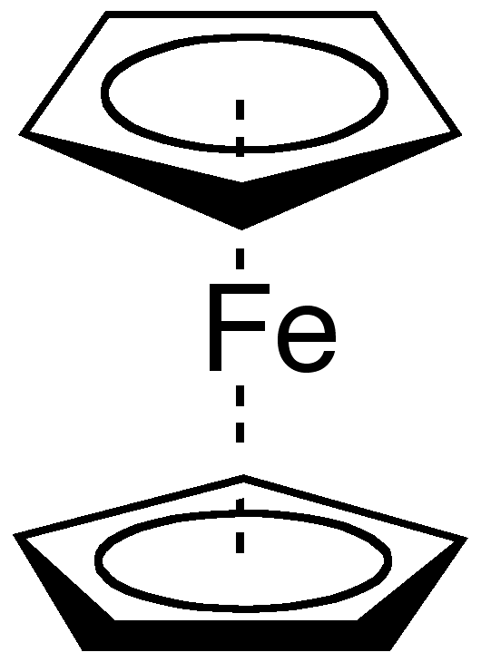
Material input - solids
high vapor pressure materials
volatile chemical compounds (MIVOC method – Metal Ions from VOlatile Compounds)
for both methods the feeding could be similar to gas input or oven operation
laser evaporation
Ferrocene

Slide 64
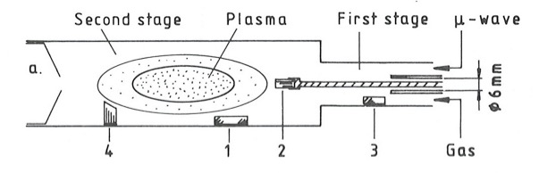
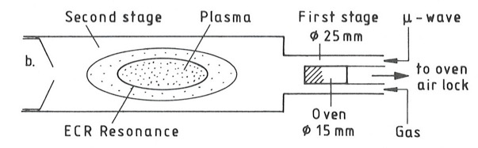
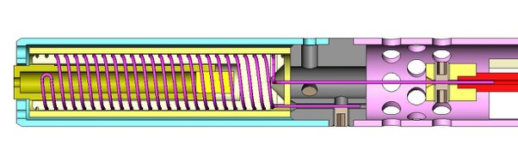
Material input – solids II
sputtering
  simple
  sample can be biased
  good for refractive materials
  difficult to control beam stability
oven
  different oven designs exist
  (up to 2000ºC)
  good control of beam stability
  problems with “hot chemistry”

Slide 65
Operation modes
not every user needs continuous beam
  synchrotrons are filled with pulsed beam
  cyclotrons take continuous beam
the microwave can be injected continuous
or pulsed into the source
  different timing -> different source behavior
  special source tuning for every mode
  different confinement -> different charge state distribution

Slide 66
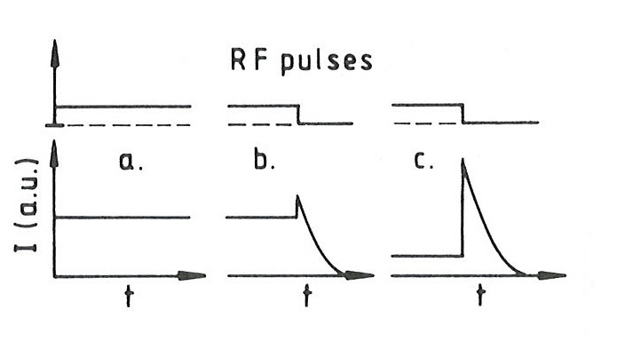
Operation modes II
  continuous wave (cw)
  pulsed
  afterglow

Slide 67
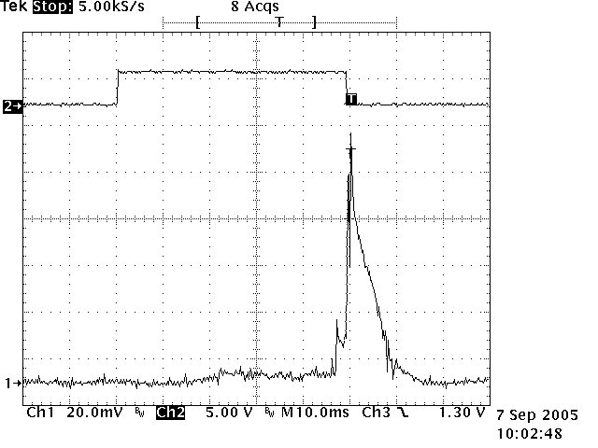
Afterglow
special mode of operation
short pulses (some ms)
of high charge states after the end of the RF pulse
RF
ion
current

Slide 68
Afterglow II
different tunings result in different time behaviors, intensities and pulse-to-pulse stabilities

Slide 69
Extraction
only particles lost from the plasma can be extracted
  high confinement -> high charge states but low current
  low confinement -> low charge states but high current
one cannot “pull” the particles out of the source
the plasma screens any external field (plasma sheath)
plasma is locally reshaped and redistributed due to the external field

Slide 70
Extraction II
the extraction can be
  space charge limited (space charge cloud in front of the extraction system)
  emission limited (plasma cannot deliver enough particles)
the emissive surface of the plasma is often referred to as plasma meniscus
the dynamic equilibrium between the plasma and the extracted particles creates the meniscus

Slide 71
Child-Langmuir law
defines the maximal extractable emission current density j
conditions
  planar and indefinite emission area
  particles have zero initial longitudinal energy
q – ion charge state, m – ion mass,
U – extraction voltage, d – extraction gap

Slide 72
Child-Langmuir law II
space charge limited
emission limited

Slide 73
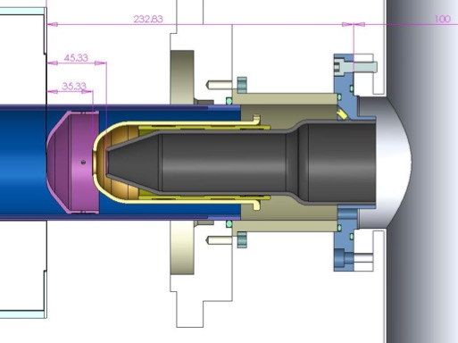
Extraction system
the extraction system consists of several electrodes
in general the source body is on high voltage and the beam line on ground potential
additional electrodes can serve for electron suppression or beam shaping

Slide 74
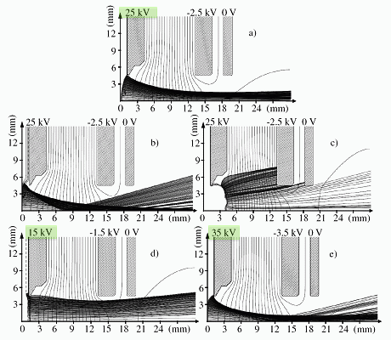
Extraction system II
Based on the extraction geometry, the extraction voltage and the plasma density the extracted beam can be overfocussed, parallel or divergent

Slide 75
Emittance
in the extraction system the initial emittance of the beam is created
emittance for the “hot” ion limit
conditions
  isotropic emission in the solid angle 2π
  homogeneous electric field
ε – temperature dependent normalized rms emittance ,
r – radius of the extraction aperture (in mm), kT_{i} – ion temperature (in eV),
M_{i} – ion mass (in amu)

Slide 76
Emittance II
emittance for the transport of a beam to a field free region (“cold” ion limit)
for the real source emittance one has to take into account field inhomogeneities and the plasma distribution
ε – magnetic field dependent normalized rms emittance,
r – radius of the extraction aperture (in mm), q – ion charge state,
B – magnetic field at the extraction where the ions originate from,
M_{i} – ion mass (in amu)

Slide 77
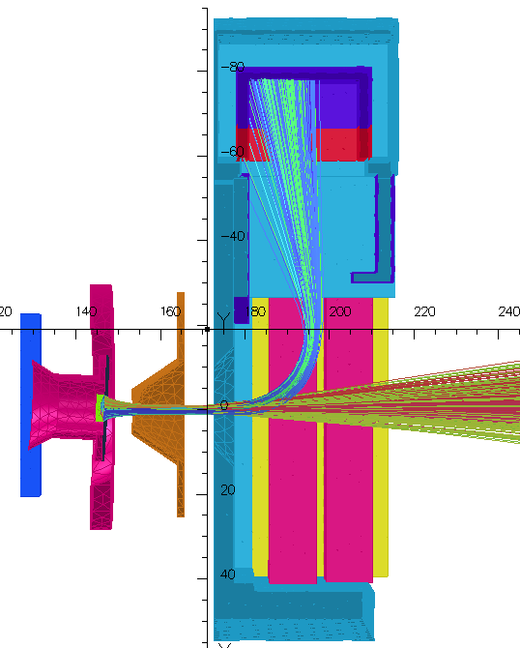
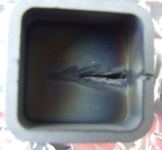
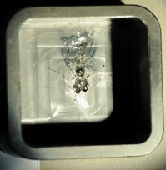
H⁻ extraction
in the case of H⁻ (or other negative ions) electrons are co-extracted
ratio e⁻/H⁻ depends on the source type and the production mechanism
the electrons are influencing the ion beam due to the space charge (emittance)
have to be removed from the beam as early as possible
at full extraction voltage the electron beam can be quite destructive

Slide 78
Plasma diagnostics
direct and indirect measurement of plasma properties
➜ density, temperature, charge state distribution
radiation
  light
  x-rays
    characteristic x-rays
    bremsstrahlung
  microwave radiation
Langmuir probe

Slide 79
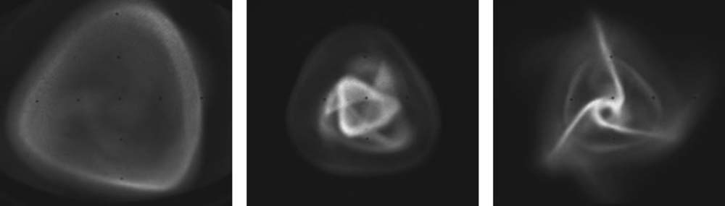
Beam diagnostics
measurement of beam properties
➜ intensity, emittance, charge state distribution
Faraday cup
beam current transformer
beam profile measurement (screens, grids)
emittance meter (slit-grid emittance meter, Allison scanner, pepper pot scanner)

Slide 80
Other source types

Slide 81
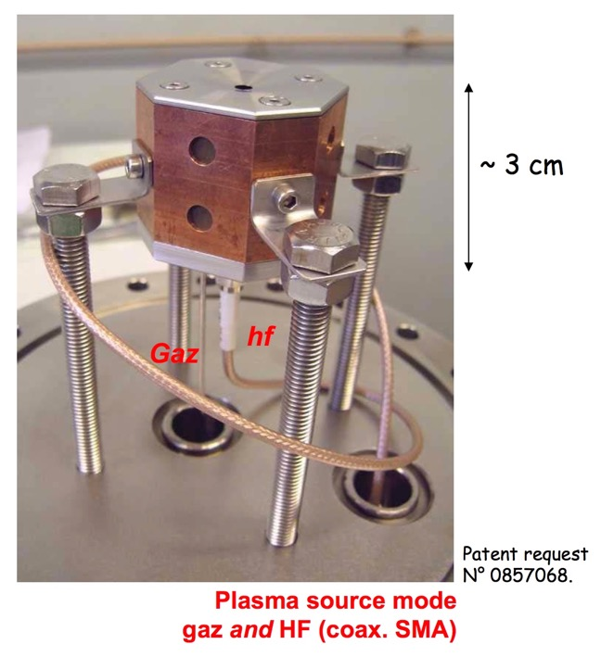
There are small sources
COMIC source
(COmpact MIcrowave and Coaxial)

Slide 82
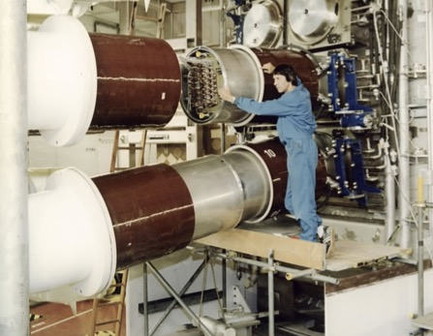
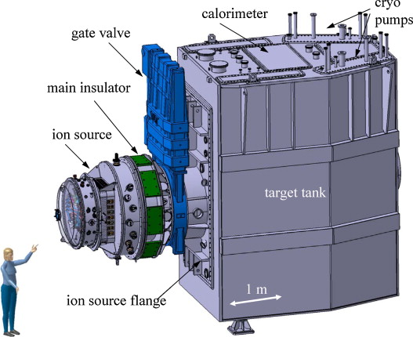
There are big sources
negative ion sources for the neutral beam injector

Slide 83






There are sources for any purpose

Slide 84

The Electron Beam Ion Source (EBIS)
Location: CERN REX ISOLDE

Slide 85

The EBIS II
Developed 1965 by
Evgeni D. Donets (Russia)
The longitudinal confinement is given by electrostatic fields
The radial confinement is given by the electron beam, which is compressed by a solenoidal field
The extraction process is controlled by the voltage level of the trap electrodes
The ion injection is also controlled by the trap electrodes (singly charged ion injection)

Slide 86
The EBIS III
The ionization takes place inside a highly energetic, high density electron beam
The total ion current depends on the trap charge capacity
Low transverse emittance
Delivers short pulses of high charge states (charge breeding)
The life time and the reliability is mainly defined by the electron gun

Slide 87

The Duoplasmatron
Location: CERN Linac2

Slide 88

The Duoplasmatron II
Developed 1956 by Manfred von Ardenne (Germany)
Driven by an arc discharge sustained by a heated filament
A strong magnetic field in the discharge region increases the plasma density (compared to the cathode region)
In the expansion cup the plasma density is reduced to decrease the beam divergence

Slide 89
The Duoplasmatron III
Duoplasmatron: there are two plasma regions
  low density plasma between cathode and intermediate electrode
  high density plasma between intermediate electrode and anode
Delivers short pulses with a very high intensity of mostly singly charged ions (mA)
Hydrogen gas is used as input medium at Linac2 (80-85% H⁺, the rest are H₂⁺, H₃⁺)

Slide 90

The Penning ion source
Location: ISIS/Rutherford Appleton Laboratory near Oxford

Slide 91

Penning source II
Penning discharge investigated by L.R. Maxwell in 1931
Penning source first used as internal sources in cyclotrons in the 1940’s
hollow anode cylinder with a cathode on each end
strong axial field confines the electrons
cathode could be cold, hot or a filament with cold anticathode
radial extraction through a slit in the anode
used for singly charged, multiply charged or negative ions
short life time due to erosion
limited beam quality (beam noise and distorted emittance due to extraction from a slit)

Slide 92
Penning source III
Extraction Electrode
Slit Aperture Plate
Penning Pole Pieces
Discharge Region
Hollow Anode
Cathode
Courtesy of D. Faircloth
10mm

Slide 93


Penning source IV
source open
extraction installed
Courtesy of D. Faircloth

Slide 94

The RF driven H⁻ source
Location: CERN Linac4

Slide 95

The H⁻ source II
RF driven ion sources were developed in the late 1940s, negative ion sources were developed according to requirements
H⁻ is created in the volume process
The RF power is coupled inductively into the plasma
The plasma region separated by a magnetic filter into two regions of different electron temperature
The plasma is confined by a magnetic cusp structure

Slide 96
The H⁻ source III
The ignition of the plasma is supported by an electron gun
The co-extracted electrons are removed in an spectrometer
Delivers pulsed high currents of H⁻
Cesium free and no antenna or filament in the plasma
➔ high reliability
The use of cesium does reduce the number of co-extracted electrons and increase the ion current

Slide 97

Secondary beams
Target ion sources
Part of isotope online separators (e.g. CERN ISOLDE)
Ionizing the material coming from the target (creating a singly charged ion beam)
Ionization done by different methods, adapted to the isotope (surface ionization, plasma ionization, laser ionization…)
Special design needed due to high radiation environment

Slide 98

Secondary beams
Charge breeder
Breed singly charged (radioactive) ions to higher charge states
(1+ -> n+)
Post-accelerator can be more compact and efficient for n+ ions
Source has to accumulate a (continuous) current of singly charged ions, breed it to higher charge states and and release them in a pulse
For radioactive beams the breeding efficiency is very important (ionization time, ionization efficiency)
Source types used: ECRIS, EBIS
Source needs to be adapted for the injection of singly charged ions

Slide 99
Engineering

Slide 100



Vacuum I
the source is pumped by several pumping groups each consisting of a roughing pump and a turbo molecular pump
(+ some valves and vacuum controls)
the pumps should be oil free
(risk of vacuum contamination with carbon hydrides)

Slide 101


Vacuum II
the vacuum levels are measured at several different positions
one of these values can be used for the gas feedback loop

Slide 102

Vacuum III
wherever possible the connections are metal sealed (CF flanges), otherwise o-rings are used (Viton, e.g. at the main insulator)
after any manipulation on the vacuum system one should make a leak detection
low base pressure => less impurities and higher possible charge states

Slide 103
Vacuum IV
the ionization processes in a plasma reduce the neutral particle density n₀ in the plasma chamber and in the plasma itself
=> the plasma acts as a vacuum pump

Slide 104

High voltage I
high voltage can be found at different locations: source extraction, vacuum gauges, ion getter pumps, microwave generator, …
insulation: ceramics, plastic, air, vacuum, …
  rule of thumb: 3-5 kV/cm in air, 1 kV/mm in vacuum (but in the presence of electric and magnetic fields the situation is different)
  keep insulators clean, avoid dust
good electric connections important
centralized earth connection on ground and on the high voltage platform (star like topology, avoid earth loops)

Slide 105


High voltage II
if there are power consumers on the high voltage platform one needs a separation transformer
communication with devices on the high voltage platform (e.g. via glass fiber)

Slide 106

High voltage III
cooling on the HT platform (local system or with demineralized water and long tubes)
active or passive beam load compensation => stored energy in the capacitors, issue during break downs

Slide 107

High voltage IV
high voltage systems need to be conditioned to minimized the drain current

Slide 108

High voltage V
high voltage breakdown at low pressures (discharge, arc)
-> Paschen’s curve
crossed electric and magnetic fields
-> Penning discharges (desired in Penning gauges, undesired in extraction systems)

Slide 109


Microwaves I
the source is driven by a klystron-based generator
( 2nd generator is available as backup )

Slide 110



Microwaves II
the waveguides are water cooled (to reduce the change of the length due to heating)
the high voltage break separates the ground from the high voltage part of the waveguide
the microwave window separates the source vacuum from the outside (quartz window inside the waveguide)

Slide 111

Microwaves III
there are different ways to inject the microwave into the plasma chamber (open waveguide, coaxial waveguide, …)
waveguide tuning may reduce losses in the waveguide and improve the microwave injection into the source

Slide 112

Cooling I
many systems need to be cooled or temperature stabilized
cooling with air
  convection, ventilator, …
  air conditioning (with temperature and humidity control)
cooling with water
  tap water (but not for magnets!)
  demineralized water
  chilled water

Slide 113


Cooling II
cooling power is controlled by the flow (influenced by the pressure difference and the mechanical design)
temperature and flow need to be controlled and interlocked (temperature sensitive equipment e.g. permanent magnetic hexapole)
a heat exchanger may be needed if the output temperature reaches critical values (to lower the input temperature)

Slide 114
Cooling III
water quality and the mechanical design of the cooling circuits are important
the system could be blocked or leaks could be created due to
  electrochemical corrosion
  (water conductivity and combination of insulators and metals)
  cavitation
  (diameter changes in the cooling channels)
condensation may be a problem if there is no power load; especially on high voltage platforms (corrosion, short circuits)

Slide 115


Control system I
control and measure device settings (voltages, currents, timing, …)

Slide 116

Control system II
data logging (short and long term)

Slide 117



Control system III
local and remote systems
can be distributed
(connection via Ethernet or dedicated bus systems)
hardware
  industrial computers
  PLC’s
  dedicated hardware
software
  EPICS
  LabVIEW
  WinCC
  “home made” (e.g. CERN FESA)
  databases for data storage (e.g. Oracle)

Slide 118

Interlock system
part of the control system
machine and personal protection
can be hierarchical
can have many input channels
has to prevent to start the device or stop it in case of problems
if possible use hardware interlocks, especially for the personal protection

Slide 119


Safety issues I
Working on an ion source one has to take into account different safety risks:
noise from racks, pumps, …
heavy weights (e.g. during source manipulation)
water in the presence of electricity
water at high pressures
systems operating with compressed air
explosive gases (e.g. hydrogen)
toxic and/or carcinogenic materials
(cesium, lead, many of the substances used with MIVOC, …)

Slide 120


Safety issues II
High voltage
  high voltage cage to enclose the biased elements
  usage of active and passive earthing devices
strong magnetic fields
  permanent magnets cannot be switched off
  careful handling of tools and metals pieces in the vicinity of the magnets

Slide 121



Safety issues III
x-rays
  shielding
  dosimetry
  monitoring
microwave radiation/
radiofrequency
  dosimetry
  monitoring

Slide 122





Safety issues IV
access restrictions/limitations
protective equipment
working procedures
safety rules
ALARA principle
(As Low As Reasonable
Achievable)

Slide 123
Schedule
coordination in relation with other machines and adaptation to changing schedules is important
the source is the first part to start-up
sequence for a start-up
  hardware preparation, setup
  hardware test
  commissioning without and with beam
  physics run
sometimes switch over time from one element or setting to an other is needed
periods for dedicated machine development time have to be requested (as the source delivers beam to all other machines)
always foresee time for repairs and maintenance

Slide 124
Conclusion

Slide 125
Summary
Ion sources are an essential part of an accelerator chain
Ion sources have a wide range of application in industry and research
All ion sources have certain limitations that define their field of application, there is no universal source
Ion sources can create primary or secondary beams in a wide range of charge states and current
The reliability of the source contributes to the availability of a beam from the accelerator

Slide 126

Bibliography
I.G. Brown (Ed.), The Physics and Technology of Ion Sources, Wiley, 2004.
B. Wolf (Ed.), Handbook of Ion Sources, CRC Press, 1995.
H. Zhang, Ion Sources, Springer, 1999.
R. Geller, Electron Cyclotron Resonance Ion Sources and ECR Plasmas, IOP Publishing, 1996.
CERN Accelerator School, Ion sources, CERN-2013-007, 2013.
F.F. Chen, Introduction to plasma physics and controlled fusion,
2nd ed., Plenum Press, 1984.
L.C. Woods, Physics of Plasmas, Wiley, 2004.

Slide 127


