Slide 1

DEPARTURE FORMALITIES

Slide 2
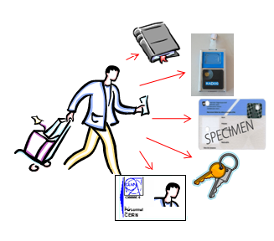
DEPARTURE FORMALITIES
Information communicated to Staff Members
Brochure from Social Services: “When you leave CERN”
2. Departure formalities
Departure letter circulated in EDH
3. Access to IT accounts
4. Documentation and Services to contact

Slide 3
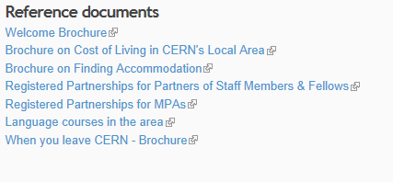
Information communicated to Staff Members
questions administratives
1. Fiche de départ
2. Derniers paiements
3. Caisse de pensions
4. Assurance maladie
5. Assurance chômage
6. Examen médical lors de l’extinction du contrat
7. Frais de voyage et de déménagement
When you leave CERN – Brochure
http://hr-dep.web.cern.ch/social/social-affairs-service
Personal Matters
Links with CERN
Pensioners
Cars (if you live in CH / FR)
Termination of leases (in CH / in FR)
Public utilities (in CH / in FR)
Insurance policies
Bank accounts (in CH / in FR)
Taxes
Social security in CH - in France – in other EU
member states
Country of residence in CH - in France – in other EU
member states
Subscriptions – using CERN’s computing facilities
Access to CERN – CERN ESO Pensioners
Association
Miscellaneous – Useful Addresses

Slide 4
Personalised Departure Formalities / EDH (1)
Applicable procedures for Staff Members for which the end of contract has been confirmed by HR
Departure formalities communicated by email
Sending date for this email =
at least 3 months before the end of the contract
earlier if the Staff Member has a lot of leave (before the last day of work)

Slide 5
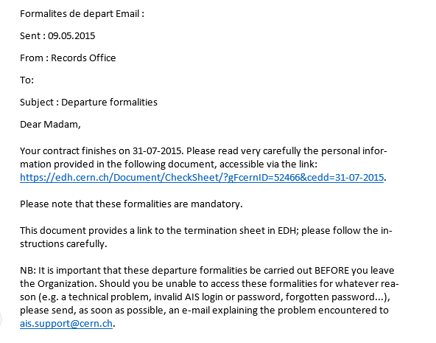
Personalised Departure Formalities / EDH (2)
Departure email
Departure letter
Departure sheet
Departure formalities email

Slide 6
Personalised Departure Formalities / EDH (3)
Departure email
Departure letter
Departure sheet
Departure letter (format pdf) generated automatically by EDH.
This letter indicates personalised information concerning the departure formalities:
brochure ‘when you leave CERN’, travel, removals, reinstallation, custom formalities, employment attestation, etc.

Slide 7
Personalized departure formalities
Mailing address: CERN, HR
Department
CH-1211 Geneva 23
Telephone: +41 22 7673700 Electronic mail: records.office@cern.ch WWW (Internet): www.cern.ch
05.08.2015
Dear Madam,
Your appointment will come to an end on 31.10.2015 and we would like to invite you to follow the instructions outlined in the termination sheet available in EDH.
Please note that this termination sheet has been produced using data from the CERN database and displays only departure instructions that are relevant to you.
Once these formalities have been completed, authorization will be given for final pay action.
Please find below useful information, displayed according to your personal situation, in order to facilitate your departure formalities.
Wishing you every success for the future.
Yours faithfully,
    Head, Human Resources Department
  Brochure from Social Service
The brochure 'When you leave CERN' http://cds.cern.ch/record/1995621/files/ WYLC.pdf will give you information on practical matters arising on termination of appointment.

Slide 8
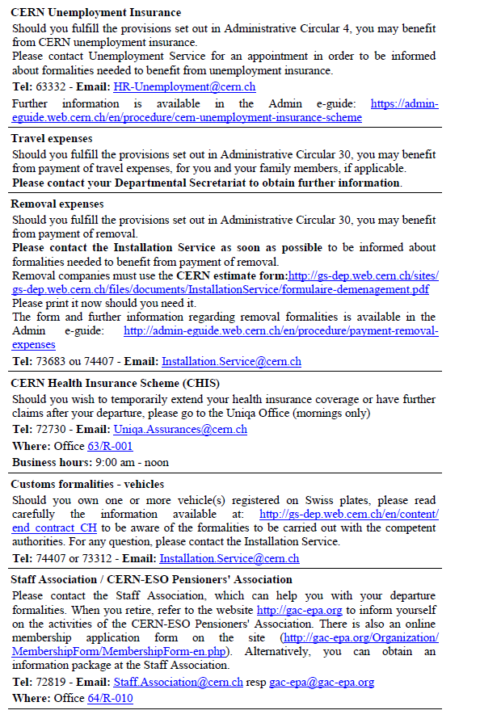
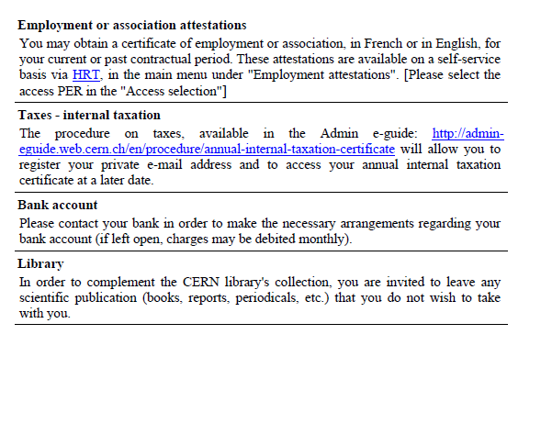

Slide 9

Informations communiquées Formalités de départ Accès aux comptes Prestations d’extinction Services à
aux titulaires informatiques de contrat contacter
Personalised Departure Formalities / EDH (4)
Departure email
Departure letter
Departure sheet
Departure check list (EDH) generated automatically by EDH.
This lists the formalities to complete according to the information contained in various CERN databases:
Library, electronics pool, dosimeter, Swiss and French cards, green plates, radioactive sources, keys, access card, car stickers, etc.

Slide 10
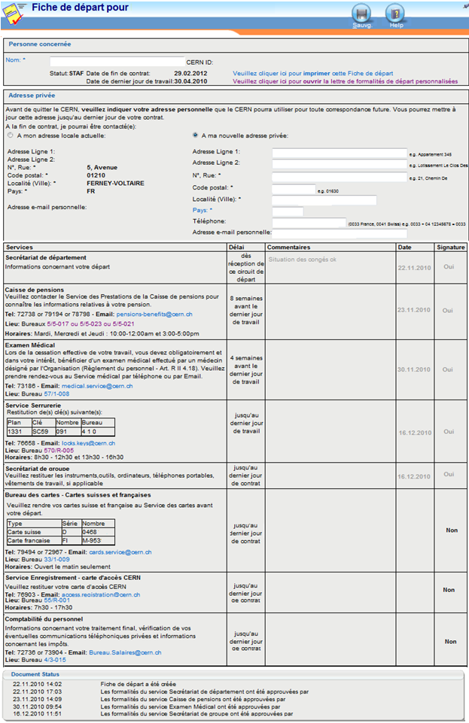

Departure formalities / EDH (5)
Enter private address in EDH, if a change is foreseen.
Follow the steps indicted (starting with: departmental secretariat (DAO), pension fund, medical service)
The services visited sign the EDH document.
In any order, respecting the comments in the column ”delay" to respect.
As the last step the Staff Member presents himself to the personnel accounts office
Before the end of the contract

Slide 11
Access to computing accounts
Date of the end of contract
time
2 month
2 months
Notification by email
Two months before the last day of contract, the Staff Member and his Supervisor receive a notification by email (list of accounts and e-groups). Transfer of responsibilities.
Computer accounts accessible until 2 months after the end of contract
In the case of vacation at the end of the contract, to access amongst others the salary sheet:
either via a monthly email
or from hrt.cern.ch, main menu, “e-documents”, Pay Info
2 months after the end of contract: account are automatically deactivated
6 months after the end of contract (grace period): the accounts are automatically deleted

Slide 12
Access to computing accounts
Enter your private email
Date of end of contract
time
Computing accounts accessible
2 months
How to obtain the annual internal taxation attestation after the closure of computing accounts ?
Annual internal taxation attestation
1. Before the date of the end of contract, enter your private email in the account management portal: https://www.cern.ch/account
page 'Manage My Accounts'.
2. Two months after the end of contract, an external account is automatically created
email sent to your private email address to validate your external account
follow the instructions to register your password
3. When the annual internal taxation attestation is generated (month of March)
email sent to your private email address to allow you to access the attestation: enter your password

Slide 13
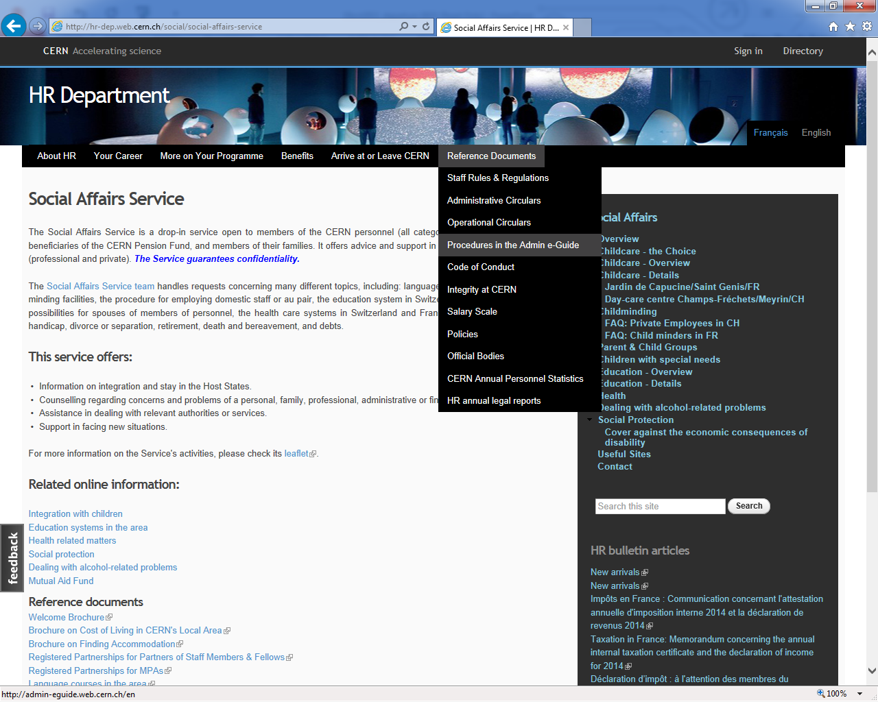

Slide 14
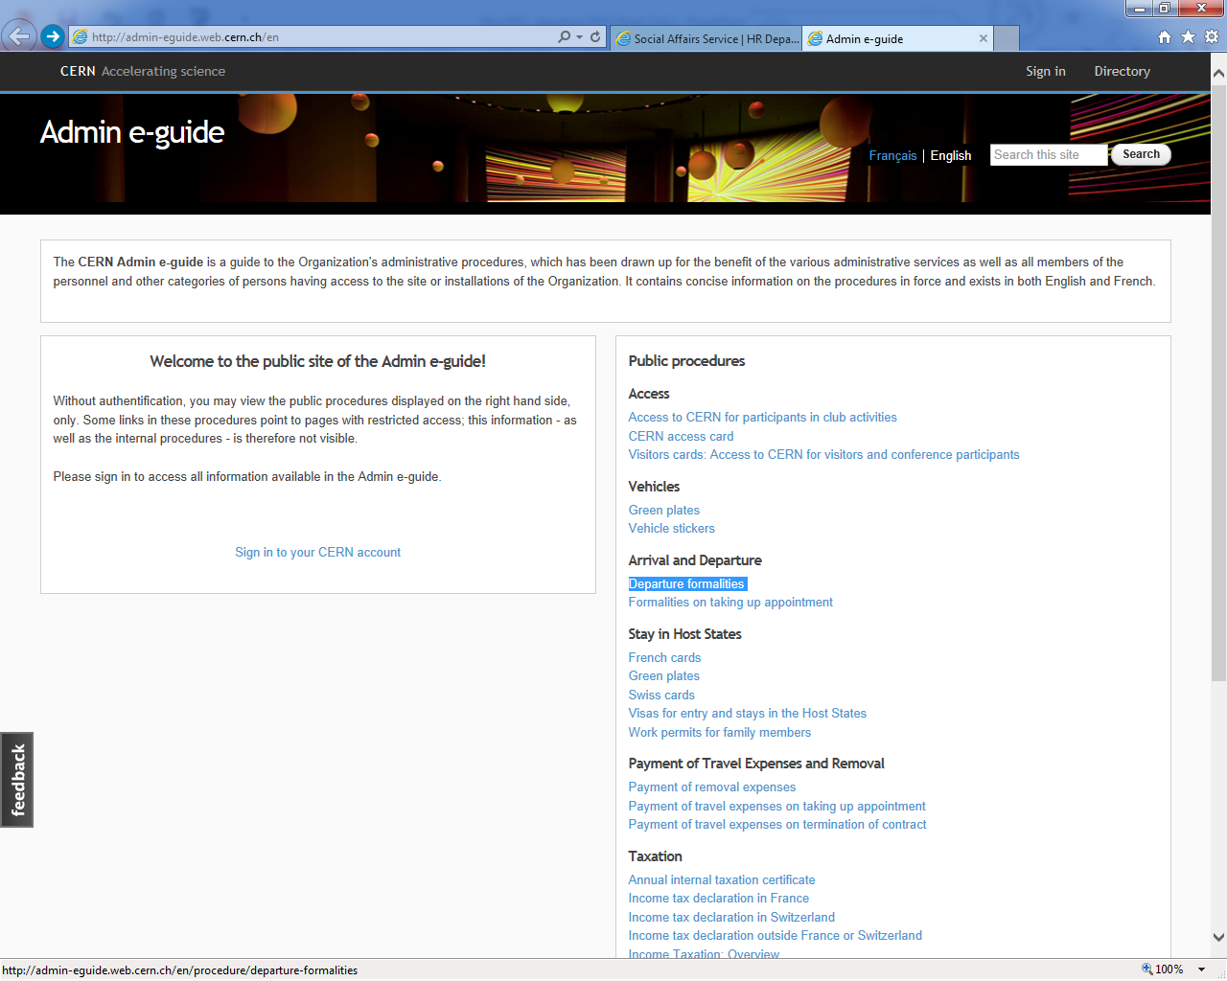

Slide 15

Services to contact: advise and assistance
General Questions | Departmental secretariat (DAO)
Brochure “When you leave CERN” | Social Services Email : social.affairs@cern.ch
Communication of departure formalities | Records Office Email : records.office@cern.ch
Computing accounts | IT Support Email : service-desk@cern.ch

