Slide 1
Application of the Voltage Holding Predictive Model- VHPM
A. De Lorenzi, N. Pilan, N. Marconato, P. Bettini
Consorzio RFX

Slide 2
Outline
The Context
Model Description
Application
  Validation against simple geometries
  NBI Accelerators
  Vacuum Circuit Breakers
Conclusions

Slide 3
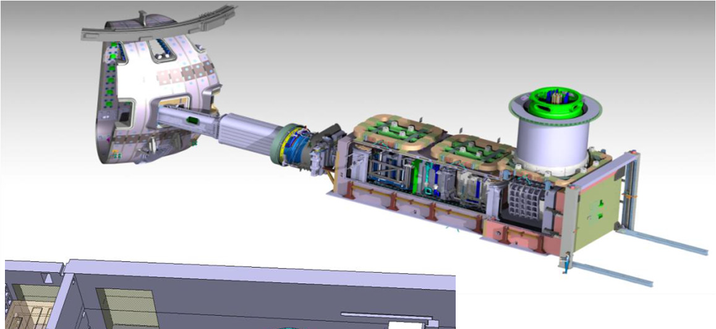
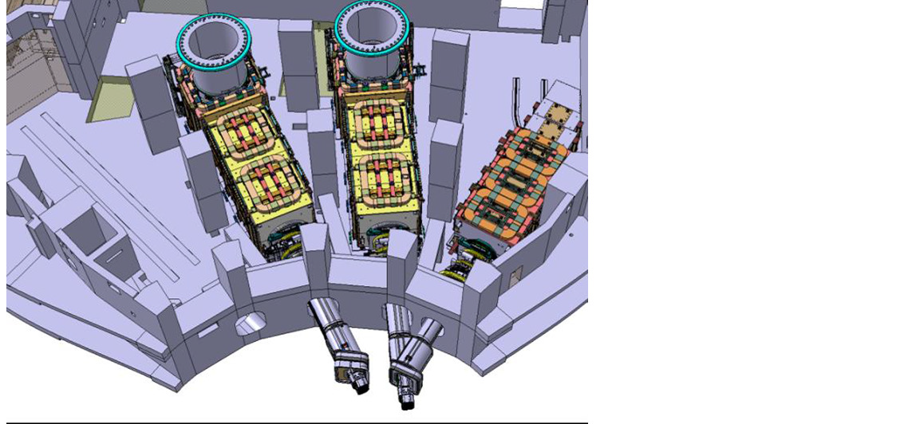
The Context
To guarantee transition from L to H modes (i.e., to ignite the plasma to thermonuclear D+T reaction ) ITER requires at least 30 MW of D injected in the plasma, through a Heating Neutral Beam System
2 HNBs (+1)
• P_{beam} = 16.5 MW
• I = 40 A
• V = 1 MV
• T_{pulse} = 3600 s
EUDA & JADA procurement
The parameters exceed by far those of existing HNB.
ITER program includes the construction of the Neutral Beam Test Facility - NBTF
  Full scale prototype of Ion Source (SPIDER)
  Full scale prototype of the HNB (MITICA)
Consorzio RFX – Padova (I) has been identified as the research structure to host the NBTF.

Slide 4
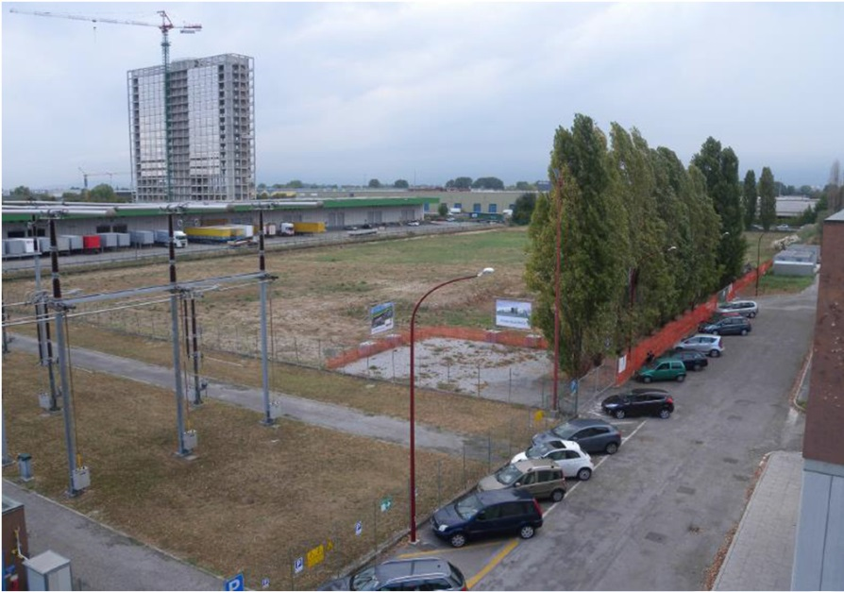
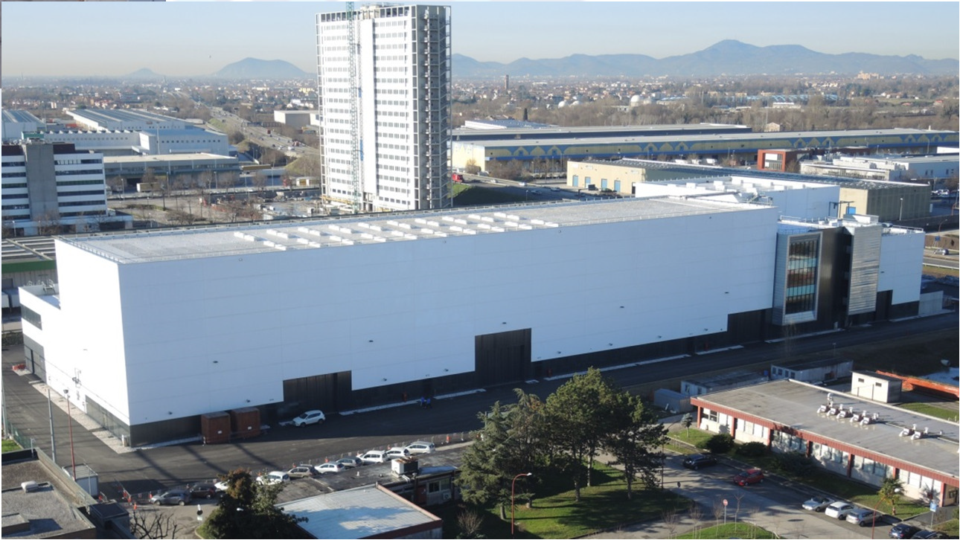
The Context
Status of the construction at RFX Buildings
Oct 2012: start of building erection
Green Field
Sept 2015: delivery of all buildings

Slide 5
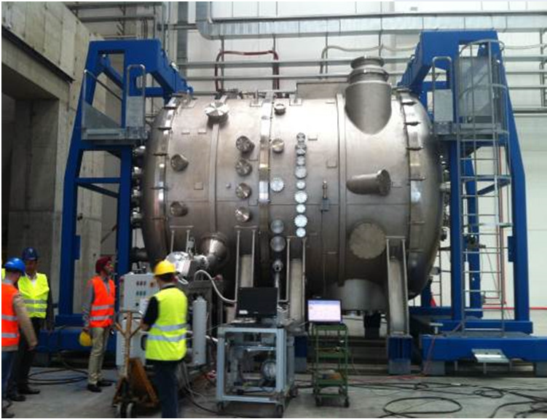
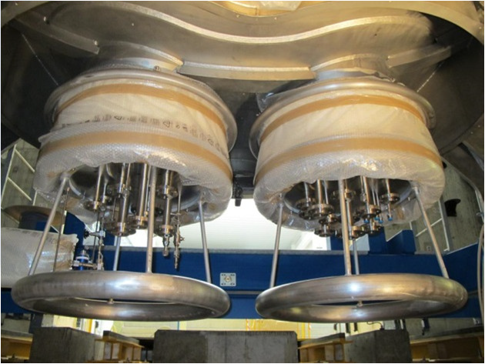
The Context
Status of the construction at RFX SPIDER
Most of components ready and commissioned
Operation: Beginning of 2018
The two hydraulic 100 kV bushings

Slide 6
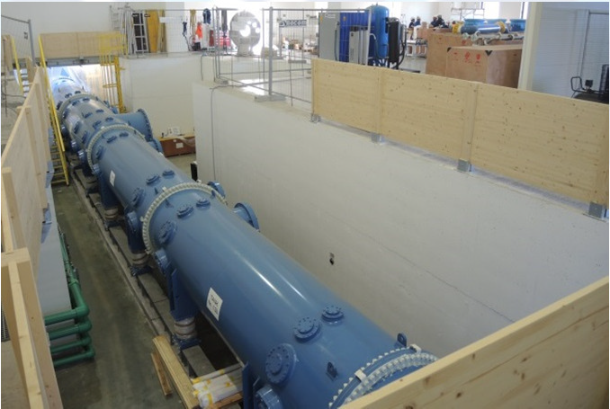
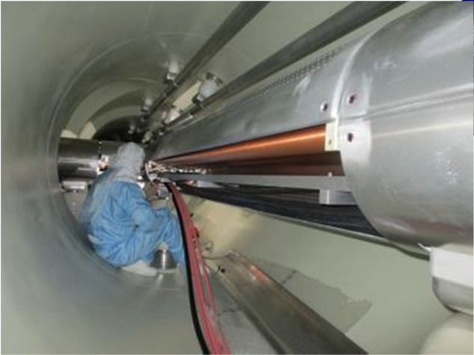
The Context
Status of the construction at RFX MITICA – The 1MV DCG & Line
5 x 200 kV – 60 A units in series
Multi conductor 1 MV TL

Slide 7
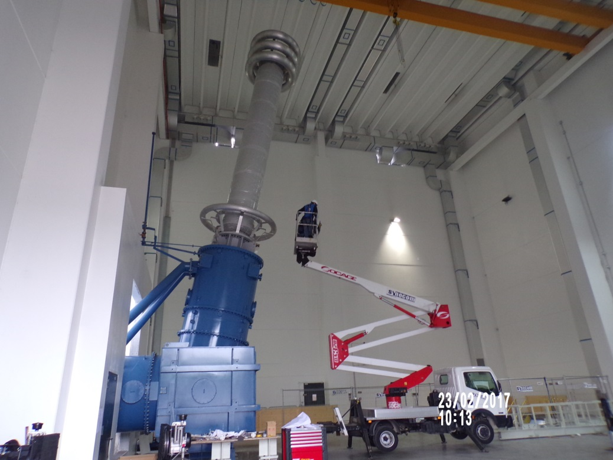
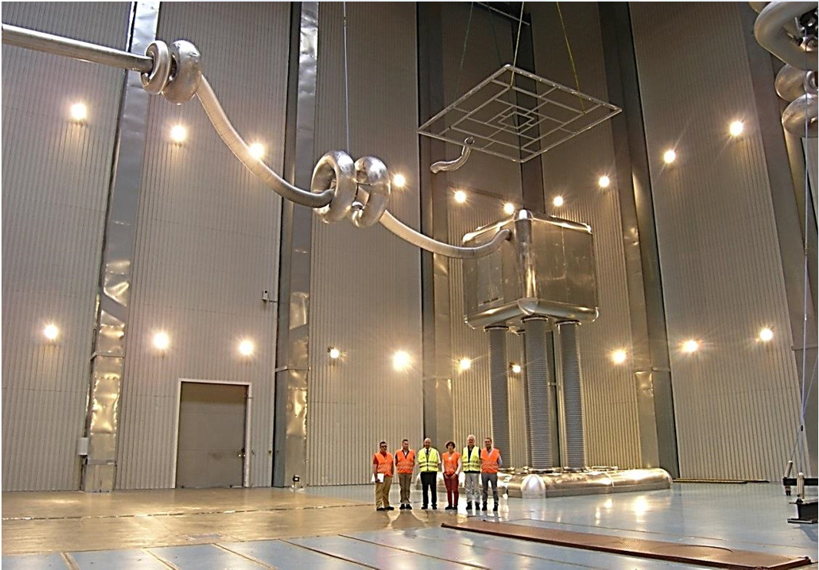
The Context
Status of the construction at RFX MITICA – The High Voltage Hall
The 1 MV insulating trasformer to feed the Ion Source Power Supplies
The 1 MV Faraday Cage hosting the Ion Source Power Supply
(Reduced Sized @ manufacturer premises)

Slide 8
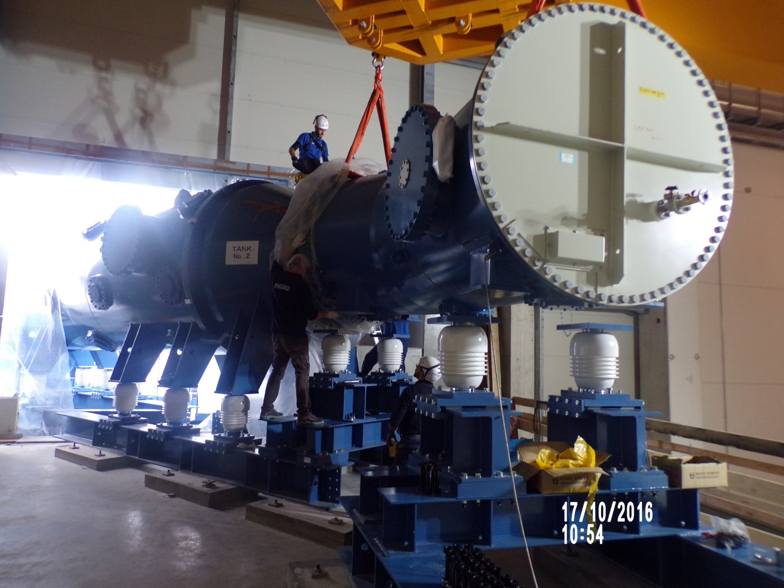
The Context
Status of the construction at RFX MITICA – Passive protection
The Magnetic Core Snubber to limit current during breakdown

Slide 9
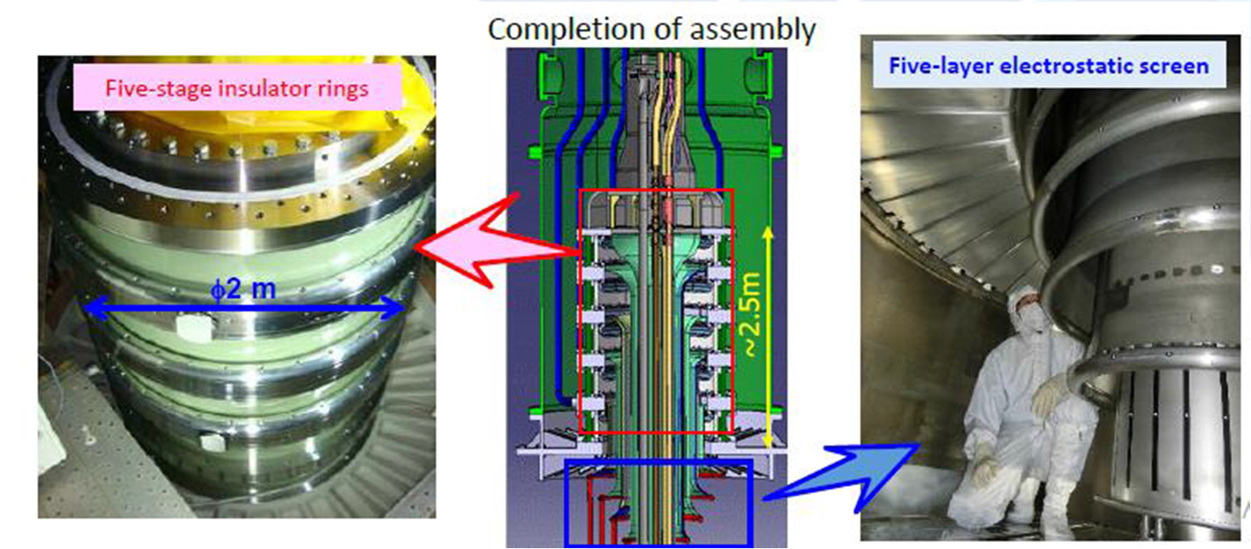
The Context
Status of the construction at RFX MITICA – The Bushing
The complex feedthrough from SF₆ insulated TL to the Vacuum insulated accelerator

Slide 10
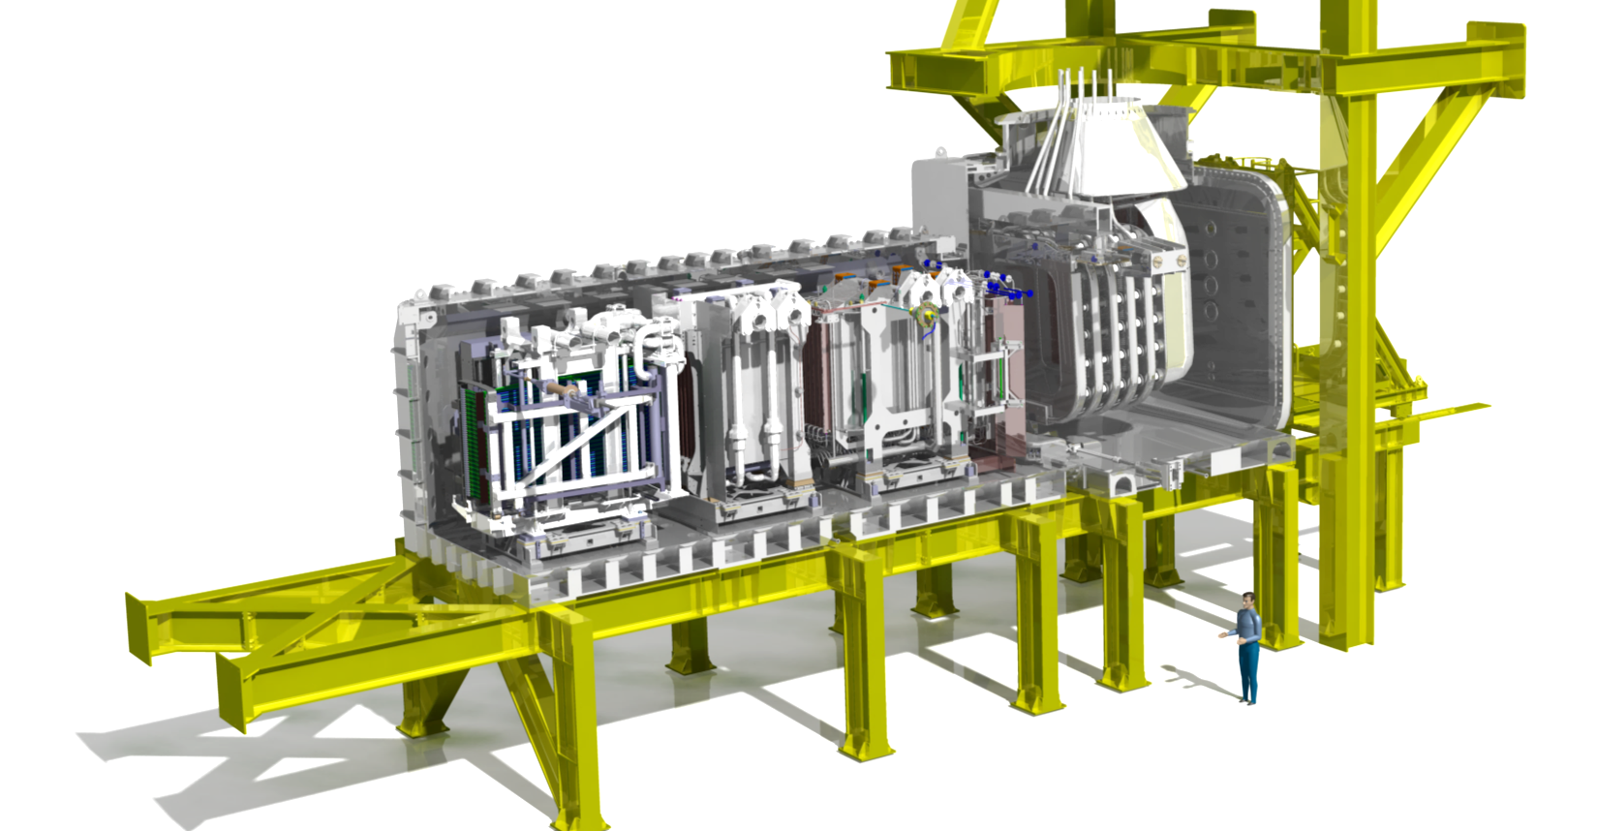
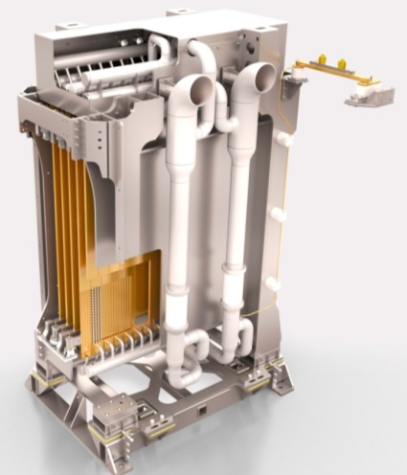
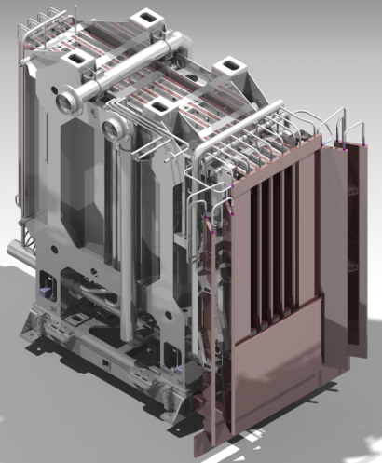
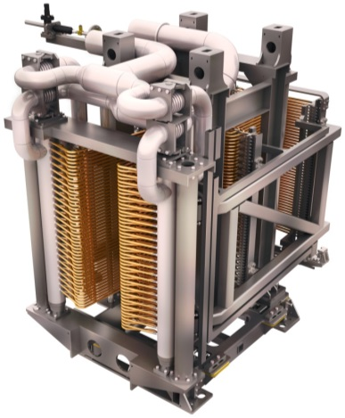
The Context
The structure of the NBI
CRYOGENIC PUMPS
BEAM SOURCE
CALORIMETER
RESIDUAL ION DUMP
NEUTRALIZER

Slide 11
The Context
The NBI accelerator, hosted inside a vacuum tank, has a very complex structure.:
  The Beam Source and the Accelerating Grids form a multi-voltage (-1.0MV; -0.8MV; -0.6MV; -0.4MV; -0.2MV) electrodes system, facing the anode (the tank); 1 MV electrode size is about 10 m²; the gap is about 1 m.
  The Bushing, connecting the 1 MV Line insulated in SF₆ to the accelerator, transfer through pipes the potential to the Grids as well as cooling water. It is built by 5 stacked alumina rings (2.0 m diameter; 0.3 m heigth)
The geometry is further complicated by the pipes, that enhance the local electric field in critical areas.

Slide 12
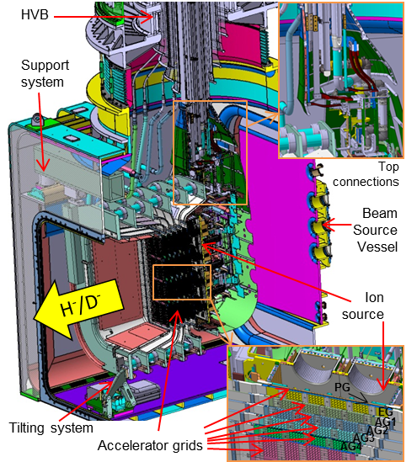
The Context
Details of the accelerator

Slide 13
The Context
Both design and operation phases will require a combination of improvements in techiques to keep voltage holding to a safe value. These techniques are:
  Voltage conditioning process
  Electrodes treatment.
  Electrodes shapings
Electric field minimization not suitable for optimization because:
  Total voltage effect not considered
  «measurable» objective function for optimization not defined.
  Area effect not considered
The VHPM fulfills these requirements

Slide 14
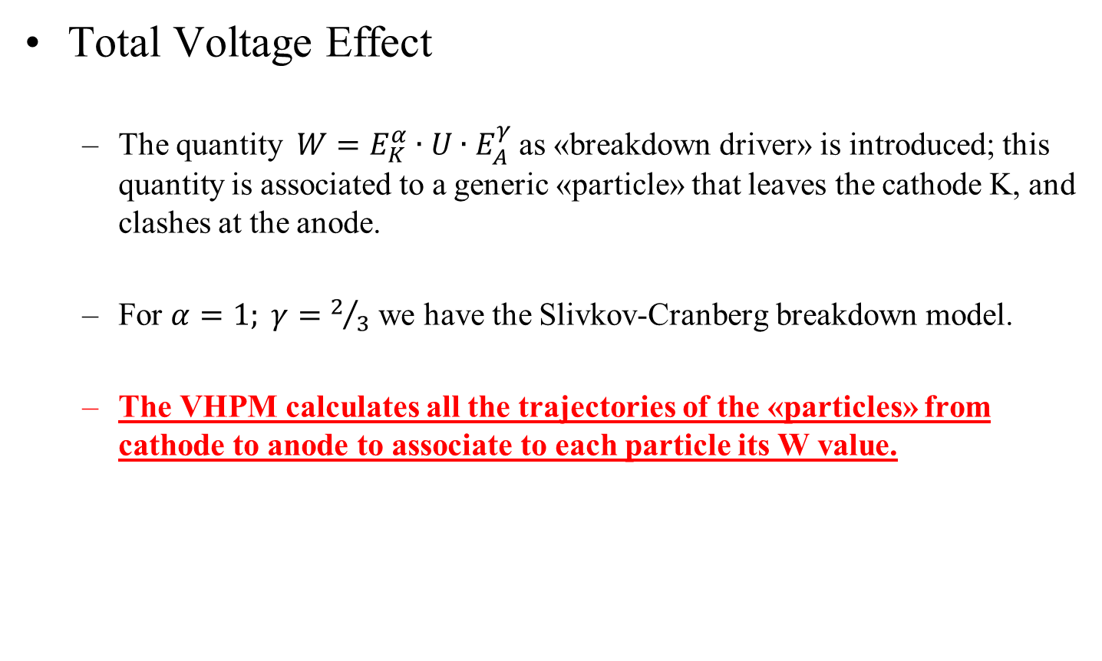
Model Description
Total Voltage Effect
  The quantity$W=E_{K}^{α}∙U∙E_{A}^{γ}$ as «breakdown driver» is introduced; this quantity is associated to a generic «particle» that leaves the cathode K, and clashes at the anode.
  For $α=1; γ=2/3$ we have the Slivkov-Cranberg breakdown model.
  The VHPM calculates all the trajectories of the «particles» from cathode to anode to associate to each particle its W value.

Slide 15
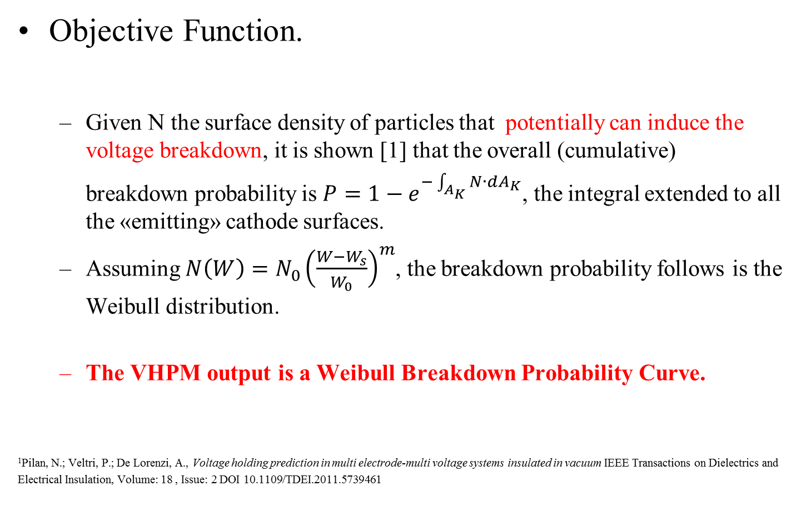
Model Description
Objective Function.
  Given N the surface density of particles that potentially can induce the voltage breakdown, it is shown [1] that the overall (cumulative) breakdown probability is $P=1−e^{−\int_{A_{K}}{N∙dA_{K}}}$, the integral extended to all the «emitting» cathode surfaces.
  Assuming $N\left(W\right)={N_{0}\left(\frac{W−W_{s}}{W_{0}}\right)}^{m}$, the breakdown probability follows is the Weibull distribution.
  The VHPM output is a Weibull Breakdown Probability Curve.
¹Pilan, N.; Veltri, P.; De Lorenzi, A., Voltage holding prediction in multi electrode-multi voltage systems insulated in vacuum IEEE Transactions on Dielectrics and
Electrical Insulation, Volume: 18 , Issue: 2 DOI 10.1109/TDEI.2011.5739461

Slide 16
Model Description
Area effect.
  The formulation of the breakdown probability is done through a surface integral along the cathodic surfaces.
  VHPM takes intrinsically into account the Area Effect.
  Input parameters
  W₀; W_{s} and m do not depend upon geometry, but only on electrode material, surface treatment, vacuum level, conditioning technique. They are derived from experiment through best fit techniques, in two ways:
    Experiment on simple geometry. The parameters are derived easily from the experiment, but VHPM prediction is reliable only if the system under analysis has the same material, surface, vacuum, conditioning..
    Experiment on a mockup of the system under analysis. In this case suitable shape function have to be calculated.
  In both cases, a «good» breakdown voltage distribution is necessary from the tests .

Slide 17
Application
Validation against simple geometries [1-2] Sphere Plane geometry – Pulsed Voltage
Parameters derived from fitting 63% voltage breakdown probability - Ordinary Steel
W₀ = 9.5.10¹⁷ [V⁸m⁻⁵]^{1/3}
m = 10
Results
Prediction 63% voltage breakdown probability
Over estimation of the
D=9.3 mm negative polarity case.
¹A. De Lorenzi, N. Pilan, E. Spada, Progress in the Validation of the Voltage Holding Prediction Model at the High-Voltage Padova Test Facility
IEEE Transaction on Plasma Science, Vol. 41, NO. 8, 2013
²Slivkov I.N. “Mechanism for electrical discharge in vacuum” Soviet Phys. Techn. 2, 1928 (1957)

Slide 18
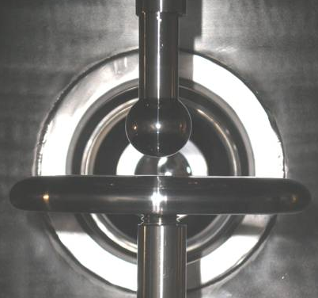
Application
Validation against simple geometries [1] HVPTF Padova - Sphere Plane geometry – dc voltage
Anode Sphere
sequences employed
Cathode Sphere
a
Parameters derived from disk-disk geometry –Stainless Steel
W₀ = 2.65.10¹⁷ [V⁸m⁻⁵]^{1/3}
m = 18.4
Results of sphere-plane geometry
Prediction in excess of 6%
Correct prediction of polarity effect
measure
model
measure
model
63.2%
63.2%
b
c
¹A. De Lorenzi, N. Pilan, E. Spada, Progress in the Validation of the Voltage Holding Prediction Model at the High-Voltage Padova Test Facility
IEEE Transaction on Plasma Science, Vol. 41, NO. 8, 2013

Slide 19
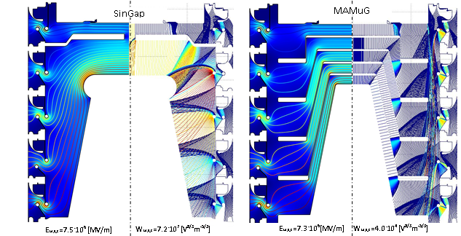
Application
  NBI Accelerators The Megavolt Test Facility in Naka (J) – dc voltage
Two different configuration tested. Single Gap and Multiple Gap
On the right: the trajectories. The warmer the color, the highest the W.

Slide 20
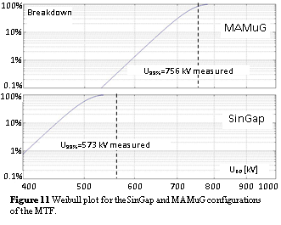
Application
  NBI Accelerators The Megavolt Test Facility in Naka (J) [1] – dc voltage
Parameters derived from MaMuG configuration fitting 99% breakdown probability 756 kV dc
W₀ = 0.115.10¹⁷ [V⁸m⁻⁵]^{1/3}
m = 8
Results
Prediction of SinGap Configuration:
99% breakdown probability 541 kV dc
¹Pilan, N.; Veltri, P.; De Lorenzi, A., Voltage holding prediction in multi electrode-multi voltage systems insulated in vacuum IEEE Transactions on Dielectrics and
Electrical Insulation, Volume: 18 , Issue: 2 DOI 10.1109/TDEI.2011.5739461

Slide 21
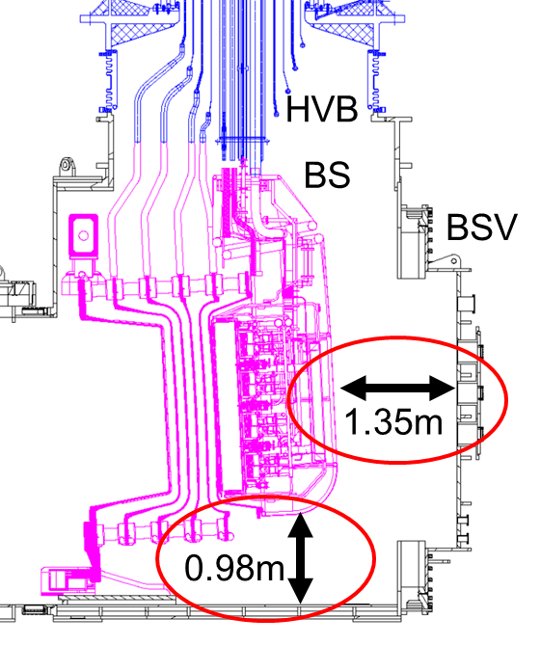
Application
  NBI Accelerators The Neutral Beam Source of ITER – NBTF – dc voltage

Slide 22
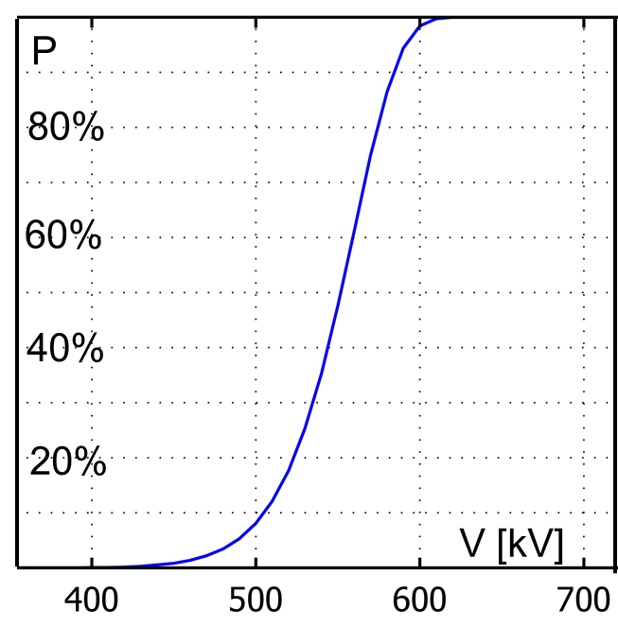
Application
  NBI Accelerators The Neutral Beam Source of ITER – NBTF – dc voltage
Test done using the same parameters used for the MTF Facility
W₀ = 0.115.10¹⁷ [V⁸m⁻⁵]^{1/3} ; m = 8
2D modelling of a pure 3D geometry
Results
Predicted breakdown voltage much less (!) than the target (1 MV)
Assessment of the W₀ value
Revision of W α and γ exponents
To implement 3D capability

Slide 23
Application
  Vacuum Circuit Breakers Research with Siemens Berlin – Pulsed Voltage (LIWV)
In 2015 has started a research funded by Siemens Akiengesellschaft (Berlin/Munich) aimed to investigate the applicability of the VHPM to the design process of the VCB tubes.
The VHPM should reduce the effort in developing new components, limiting the number of prototypes.
The voltage applied are the IEC standard Lightning Impulse Withstand Voltage 1.2/50 μs
VHPM has been applied to an AMF design and a RMF design at two different voltage ratings.

Slide 24
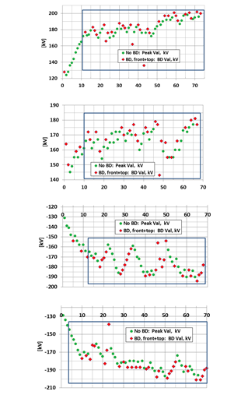
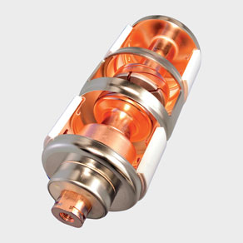
Application
  Vacuum Circuit Breakers Research with Siemens – Pulsed Voltage (LIVW)
4 tubes tested– AMF
Contact distance 10 mm
Tube | W₀ [V³m^{-5/3}].10¹⁷ | m
No. A - positive | 1.25 | 6.3
No. B - positive | 1.43 | 9.4
Merged data - positive | 1.09 | 6.2
No. C - negative | 1.29 | 7.2
No. D - negative | 1.69 | 8.6
Merged data - negative | 1.37 | 7.2

Slide 25
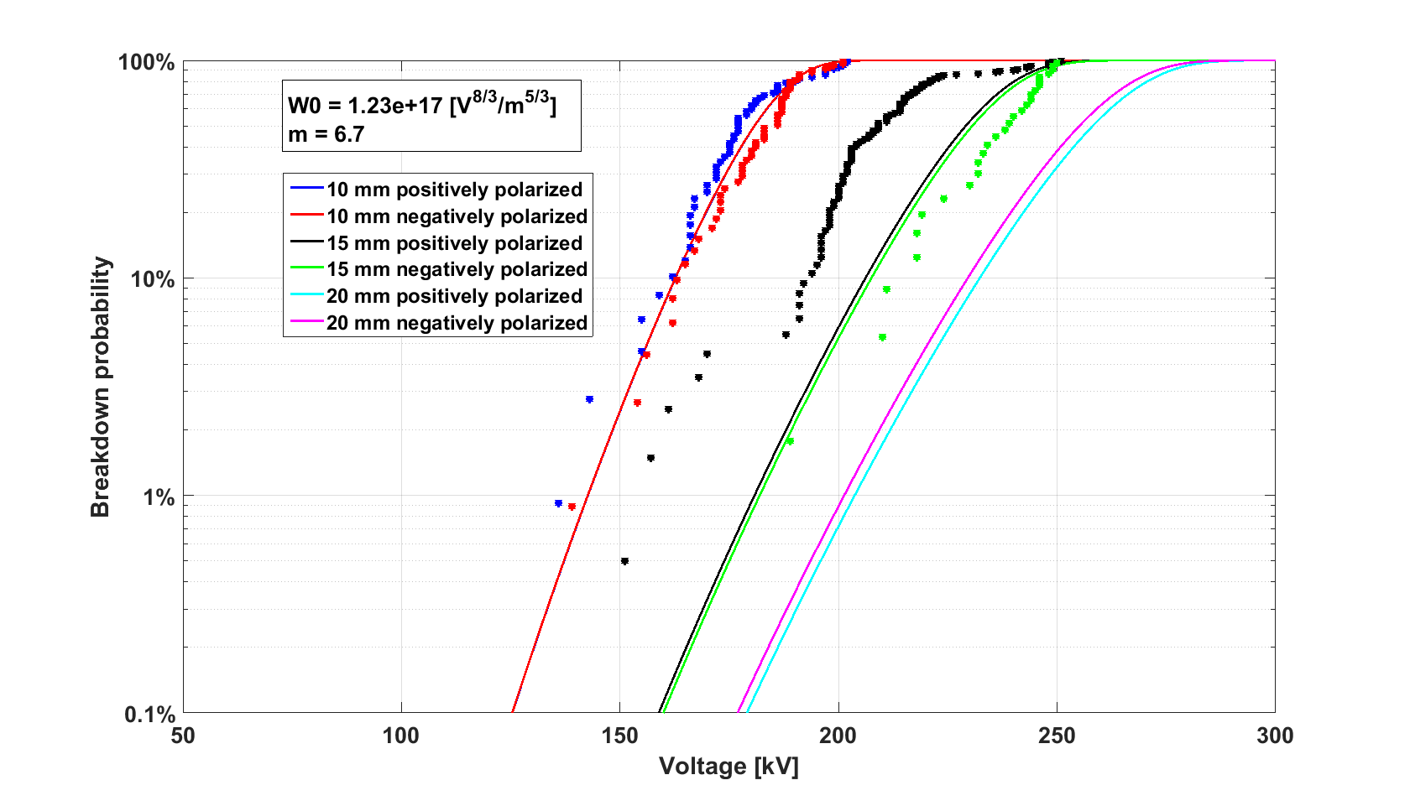
Application
  Vacuum Circuit Breakers Research with Siemens – Pulsed Voltage (LIVW)
Parameter derived from fitting 10 mm case
W₀ = 1.23.10¹⁷ [V⁸m⁻⁵]^{1/3} ; m = 6.7
Prediction for d=15 mm
Ultimate voltage correctly predicted
Weibull distribution differs from prediction
Large polarity effect unpredicted.
Mismatch reason is likely due to conditioning process not completed.
To have a “good“ sequence of breakdown voltages is fundamental to obtain reliable parameters and effective comparison

Slide 26
Application
  Vacuum Circuit Breakers Research with Siemens – Pulsed Voltage (LIVW)
The RMF tube has a remarkable 3D shaping of the contacts.
A strong effort has been deployed to upgrade the VHPM to fully 3D features.
The 3D implementation required the use of innovative techinques of mesh optimization, necessary to guarantee correcteness in the trajectory computation, with a reasonable computing time.
A prediction test has been also performed, using W₀ and m derived from AMF tubes, with d=8 mm

Slide 27
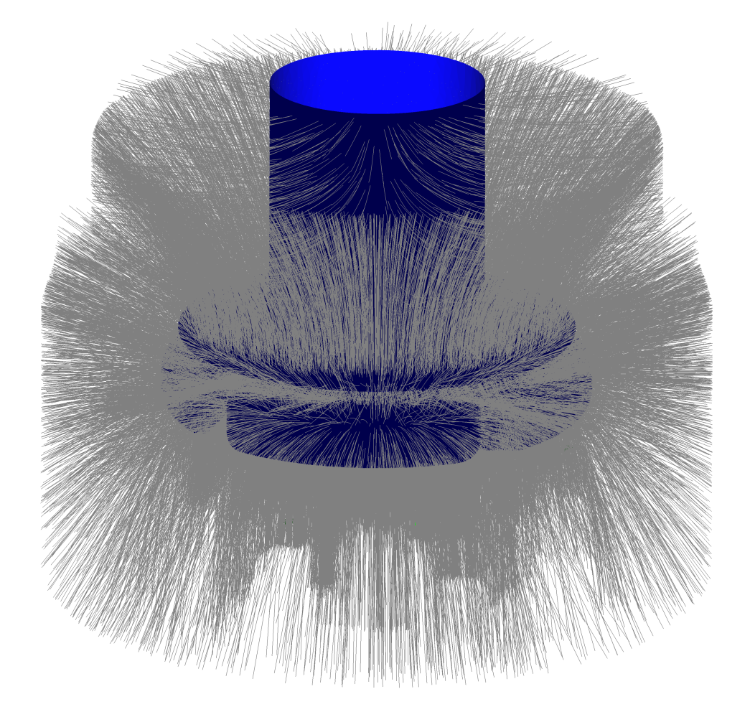
Application
  Vacuum Circuit Breakers Research with Siemens – Pulsed Voltage (LIVW)
Some million trajectories calculated (only a few shown))

Slide 28
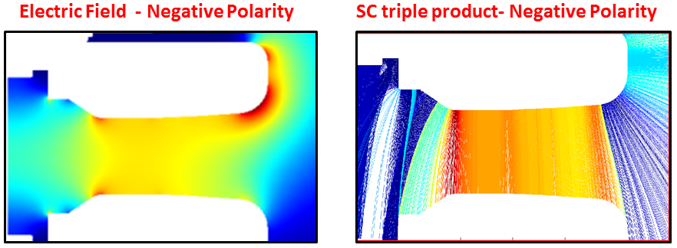
Application
  Vacuum Circuit Breakers Research with Siemens – Pulsed Voltage (LIVW)
The most critical points do not correspond necessarily to the highest electric field

Slide 29
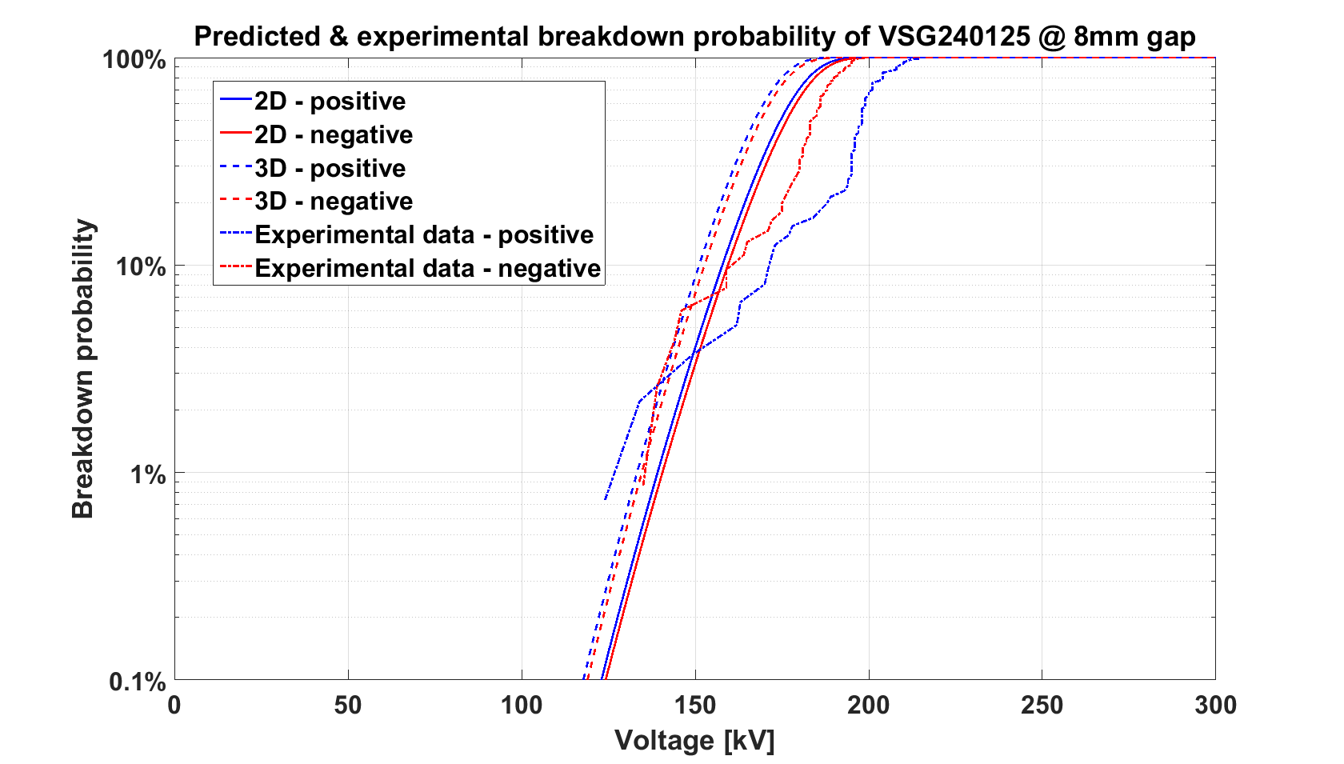
Application
  Vacuum Circuit Breakers Research with Siemens – Pulsed Voltage (LIVW)
Parameters derived from AMF tube
W₀ = 1.23.10¹⁷ [V⁸m⁻⁵]^{1/3} ; m = 6.7
Results
3D model predicts lower BD voltage than the 2D simplification of the tube
Measured distribution show (surprisingly) a higher voltage than the prediction.
Furthermore, there is a strong polarity effect, that seems not compatible with the gap length (8mm).
A new experimental campaign is planned.

Slide 30
Conclusions
The VHPM has been tested against very different conditions, each characterized by a range of W₀ and m
V_{dc} 200-300 kV Plane-Plane Sphere-Plane Stainless Steel 10-15 mm |  | V_{dc} 600-1000 kV Accelerators Stainless Steels Copper 200-1000 mm |  | V_{pulsed} 150-300 kV Sphere -Plane Stainless Steels 10-30 mm |  | V_{pulsed} 150-250 kV VCB tubes CuCr - Copper Stainless Steels 5-20 mm
W₀ . 10¹⁷ | M | W₀ .10¹⁷ | m | W₀ . 10¹⁷ | m | W₀ . 10¹⁷ | m
2.65 | 18 | 0.115 | 8 | 9.5 | 10 | 1.23 | 6.7
±22% | ±45% | - | - | - | - | ±18% | ±25%
WHPM seems to be «size dependent». Parameters derived from small setup cannot be used for larger electrostatic configurations.
Material clearly plays a great role in the W₀ determination
Error bar in the determination of parameters is still too high. It is due to a non optimal distribution of the voltage breakdown after voltage conditioning.

Slide 31
Conclusions
Future plan
To obtain «good» voltage breakdown distribution, automatic voltage conditioning procedure will be employed
  For dc voltage application it is now working
  For pulsed voltage application to be implemented (work in collaboration with Siemens)
Implementation of 3D VHPM for the ITER-NBTF accelerator. (to test the effectiveness of intermediate potential screens.
Investigation on effect of α, γ on the prediction capability.

Slide 32
Thank you for your attention !

