Slide 1
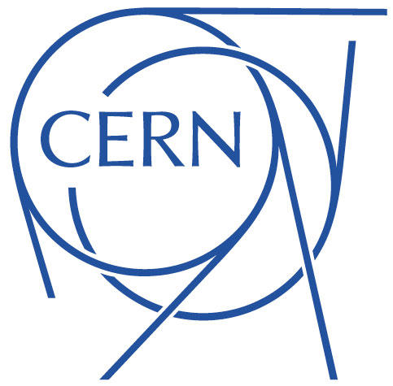


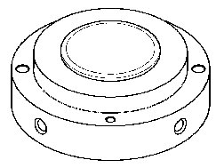
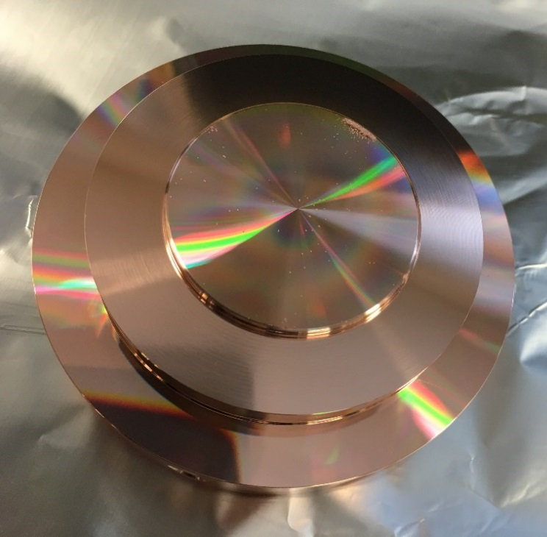
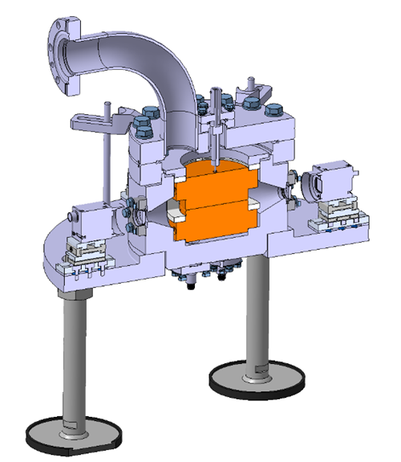
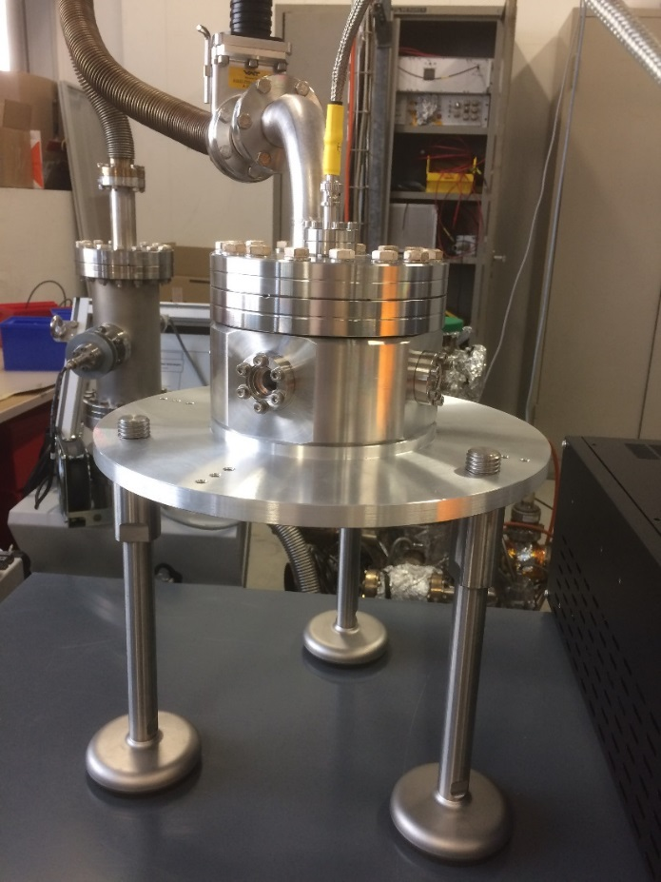
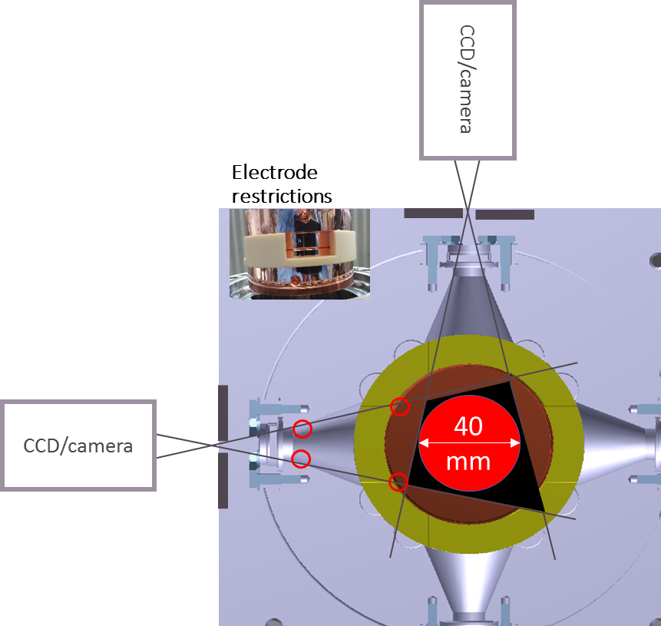
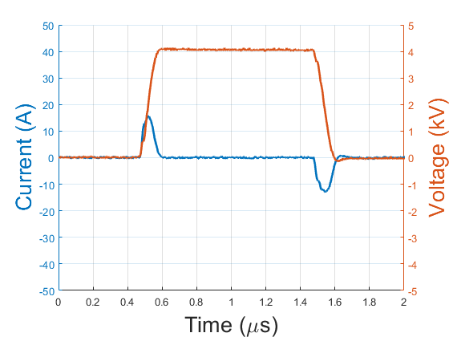
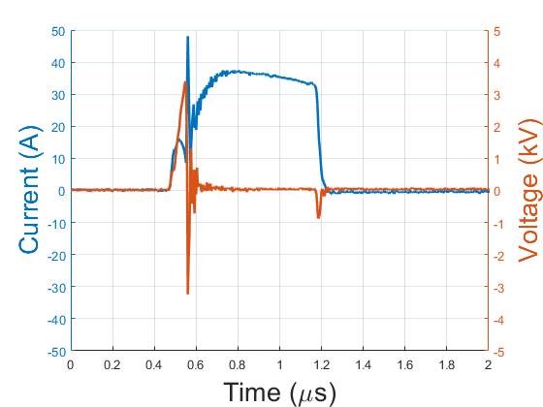
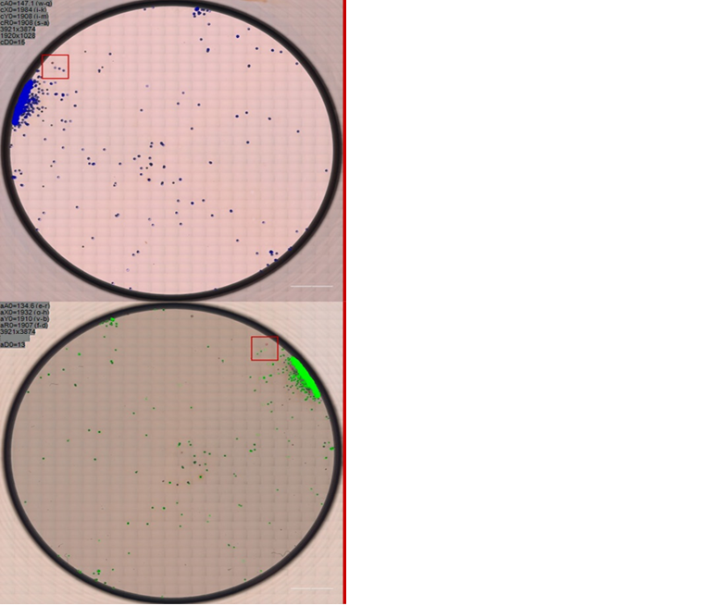
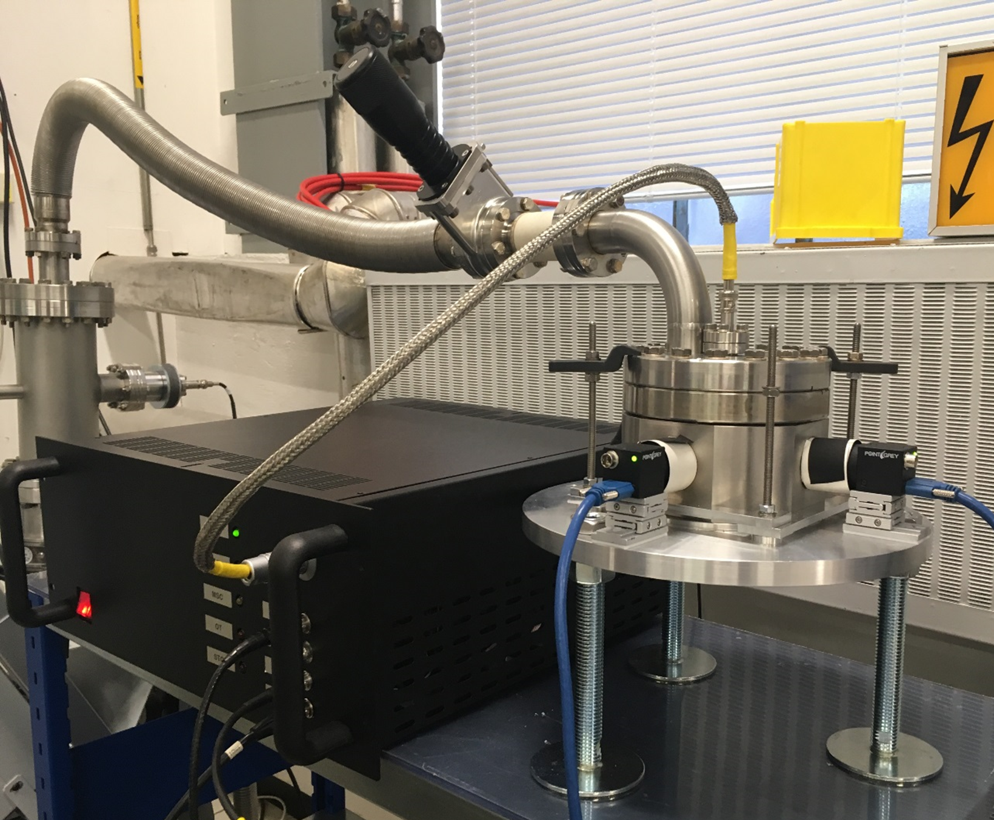
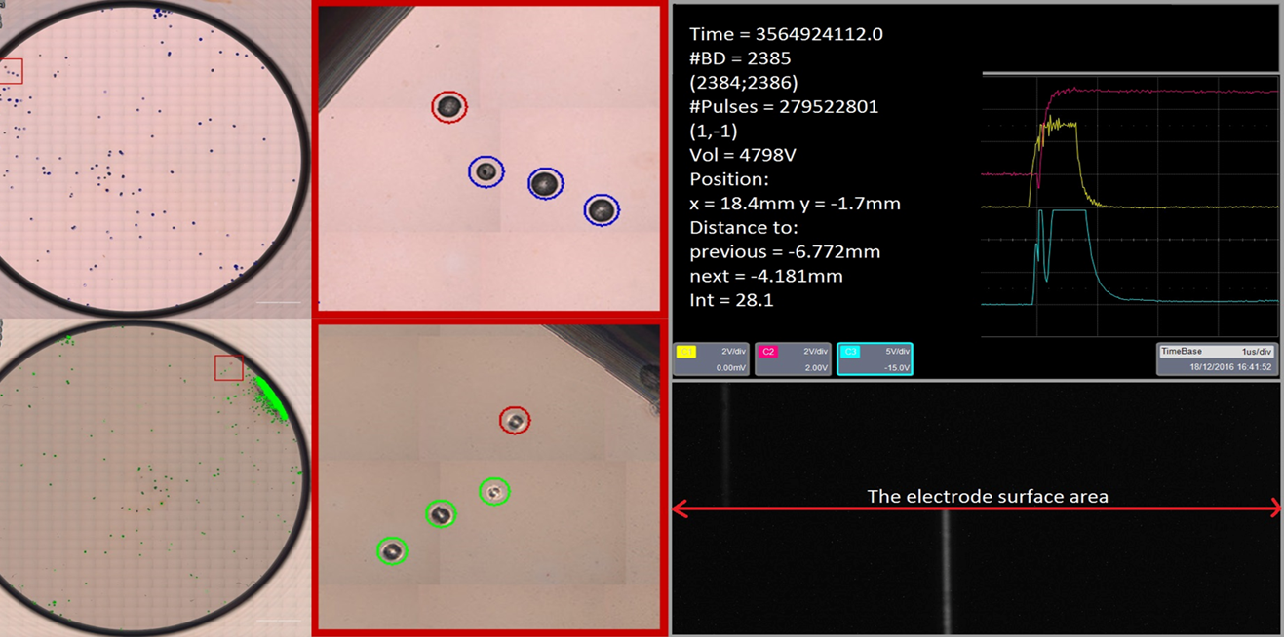
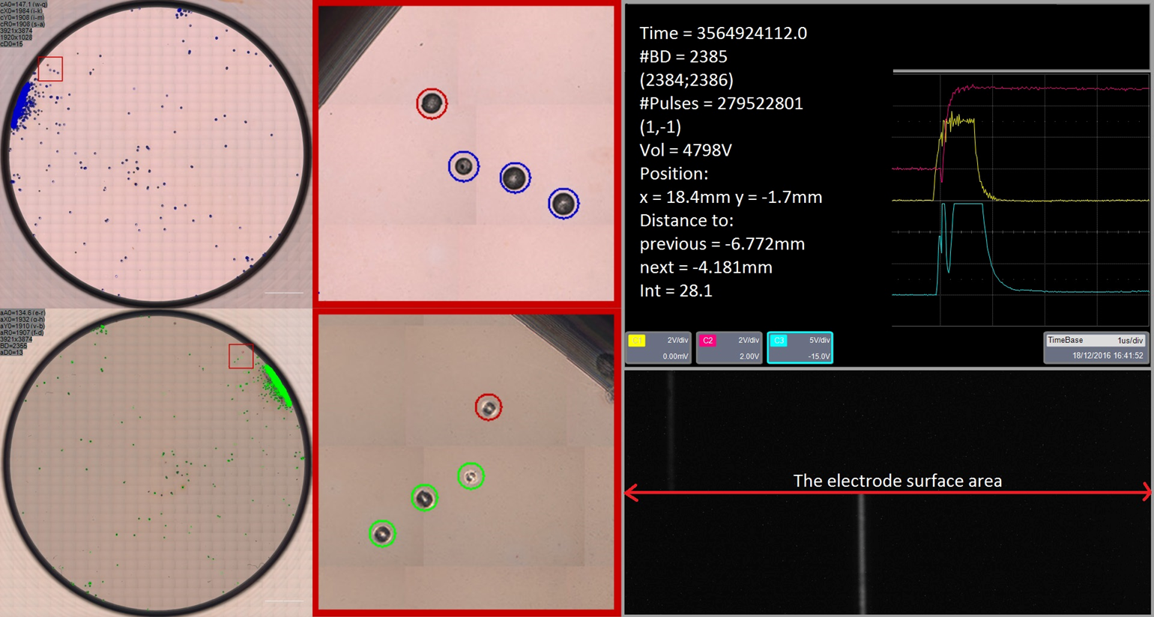
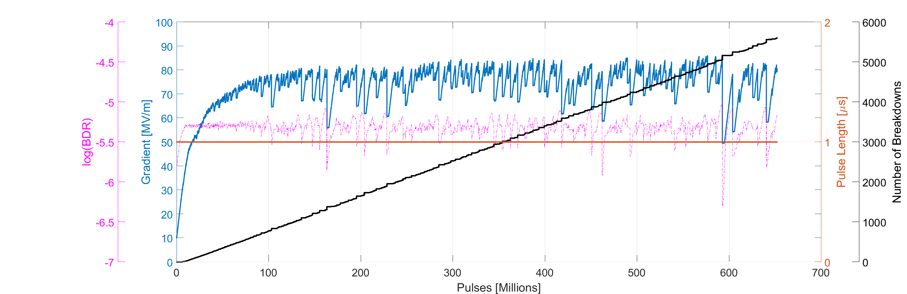


Pulsed DC System Facilities
Noora-Mari Pienimäki¹, Iaroslava Profatilova^{1,2},
Xavier Stragier¹, Enrique Rodriguez Castro¹, Thomas Lucas¹, Sergio Calatroni¹, Walter Wuensch¹
¹CERN, Geneva, Switzerland
²Institute of Applied Physics, National Academy of Sciences of Ukraine, Sumy, Ukraine
Overview
For the development of high gradient accelerating structures of CLIC and other similar machines it is vital to understand the mechanism of vacuum breakdown. Previous investigations into the phenomena were performed through lengthy and costly RF conditioning of accelerating structures and cells. In an attempt to more efficiently investigate the effects of different materials and conditioning algorithms a novel pulsed DC system has been developed at CERN. This system allows for the creation of high fields between two electrodes at a repetition rate far beyond current RF systems, conditioning the surface in weeks rather than months. Complementary to this, a newly installed camera system located breakdowns through triangulation, which along with post processing microscopy, allows great insight into breakdown trends during conditioning.
Pulsed DC system
Electrodes
Large Electrodes System (LES)
The tested electrodes are placed inside the compact vacuum chamber. The vacuum inside the chamber: ${10}^{−9}$to ${10}^{−10}$mbar. The gap between the electrodes can be varied with ceramic spacers of different size.
The electrodes are planar each with a diameter of 40 mm. The most commonly used gap distance between is 60 µm. They can be considered as parallel plate capacitors.
Power supply and Marx generator
Cameras detecting breakdowns
The electric field between the electrodes is created by the Marx generator which generates high-voltage pulses from a low-voltage DC power supply. The output voltage pulse has no overshoot and no ripple during the flattop. The Marx generator has an additional build-in current sensor for easier observation of current during breakdown.
Marx generator parameters
Max output voltage | 10 kV
Max frequency | 6 kHz
Pulse length | 400 ns - 1 ms
Stored energy | ~1.5 J
Rise time (10-90% with 4.1 kV and 285 pF) | 80 ns
Fall time (10-90% with 4.1 kV and 285 pF) | 85 ns
Delay of pulse during breakdown | 0.5 – 6 µs
Obscura-type cameras detect breakdown positions by using flash during breakdowns. The view of the cameras is limited by the spacer and the vacuum chamber dimensions.
Cameras shutters is open for 3 s followed by 5ms of blindness for readout and data transfer. Cameras allow the registration of breakdowns which are not visible for the Marx generator and oscilloscope.
a)
b)
According to the analysis the difference between the number of breakdowns detected by the Marx generator and by the cameras is about 0.5%.
The waveforms from Pulsed DC system with applied 1 µs voltage pulse: a) without breakdown (4.1 kV) and b) with breakdown (4.2 kV) and 0.6 µs delay.
Measurements and results
Running modes of the system:
The feedback mode is similar to RF conditioning algorithm. The algorithm is increasing or decreasing the applied voltage as a function of the number of pulses between breakdowns.
The flat mode is used to study the dependency of breakdown rate as a function of voltage.
The Pulsed DC System: LES, Marx generator, cameras, vacuum system and oscilloscope.
1500 um
Comparison of data from all sources: microscope, Marx generator, oscilloscope and cameras for OFE-copper, as-machined.
Marx generator | Oscilloscope | Cameras | Microscopic analysis
Number of Breakdowns Number of pulses Voltage/Gradient Pulse length | Maximum current Time to breakdown Waveforms for each breakdown | Breakdown positions Distance between breakdowns Intensity of breakdowns | Craters for breakdowns Surface defects and features Features positioning
Conditioning curve for Niobium electrodes with a 60 µm gap.
Conclusions and future plans
References
Two Pulsed DC Systems available at CERN utilizing two Marx generators.
Conditioning tests performed for different materials.
Full implementation of the breakdown localization technique.
Pulse length dependency study.
Perform dark currents measurements.
N. Shipman, Ph.D. thesis, Manchester University, 2014.
L. Mercadé Morales, M.Sc. thesis, University of Valencia, 2016.
M. Barnes http://indico.cern.ch/event/318804/, 2014.
X. Stragier http://indico.cern.ch/event/527301/, 2016.
Contact: iaroslava.profatilova@cern.ch
CERN European Organization for Nuclear Research

