Slide 1
Estimates of heat load from synchrotron radiation for HL-LHC

Slide 2
What changes from LHC to HL-LHC (LSS1 and LSS5)
Scenarios with beam current up to almost double x 2 intensity
Shorter D1 and D2, closer together ➔ shorter bending radius = x 4.3 (D1) and x 1.6(D2) factor both on photon flux and and critical energy
Larger aperture ➔ smaller Q gradients ⬆
Crab cavities
A. Rossi BE-ABP-HSS meeting 20/04/16

Slide 3

Synchrotron Radiation basics
Power emitted per unit length
Or per proton per unit length
Photon critical energy and average energy
Frank Zimmermann LHC Project Note 237 (http://cds.cern.ch/record/691934?ln=en)
A. Rossi BE-ABP-HSS meeting 20/04/16

Slide 4
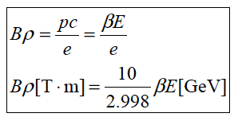
Bending radius
Dipoles (for separation dipoles geometrical factors)
Quadrupoles (assuming point-like beam distribution)
K₁ [m⁻²] quadrupole magnetic gradient
x, y [m]
For D1 and D2 one can use the bending necessary to go from 194 to 0mm separation
from twiss file provided by RdM
A. Rossi BE-ABP-HSS meeting 20/04/16

Slide 5
Calculation parameters IR1&5
 | HL-LHC |  | LHC
 | Magnetic length (m) | Magnetic grad (1/m²) | Magnetic length (m) | Magnetic grad (1/m²)
Q1 | 2 x 4.2 | +/-5.5E-03 | 6.37 | +/-8.7E-03
Q2 | 2 x 7.15 | -/+5.5E-03 | 2 x 5.5 | -/+8.7E-03
Q3 | 2 x 4.2 | +/-5.5E-03 | 6.37 | +/-8.7E-03
D1 | 6.27 | 194mm beam sep. and 66.941m distance D1-D2 | 21 | 194mm beam sep. and 85.913m distance D1-D2
D2 | 7.78 |  | 9.45
Q4 | 3.83 | (different at different location*) | 3.4 | *
Q5 | 3.4 | * | 4.8 | *
Q6 | 4.8 | * | 4.8 | *
 | HL-LHC |  | LHC
Beam current | 2.22E11 ppb x 2748 bunches |  | 1.15E11 ppb x 2808 bunches
X angle (µrad) | Nom 590 | Flat 550 | 370
A. Rossi BE-ABP-HSS meeting 20/04/16

Slide 6
Synchrotron radiation power [W] in IR1/5: HL V1.2 round, β*=15cm coll. vs LHC round, β*=40cm coll. (2016)
SR power [W] per element per beam
 | L1 & R5 B1 R1 & L5 B2 | R1 & L5 B1 L1 & R5 B2 | Photon critical energy | L1 & R5 B1 R1 & L5 B2 | R1 & L5 B1 L1 & R5 B2 | Photon critical energy
Q1 | 1.92E-01 (4.3) | 2.58E-01 (4.6) | 5-6 eV | 4.43E-02 | 5.60E-02 | 6-7 eV
Q2 | 2.69E-01 (2.7) | 8.36E-01 (2.7) | 7-8 eV | 9.91E-02 | 3.13E-01 | 8-9 eV
Q3 | 8.61E-01 (6.6) | 4.26E-01 (5.3) | 10 eV | 1.30E-01 | 8.11E-02 | 4-6 eV
D1 | 1.09E+00 (10.3) | 1.09E+00 (10.3) | 28.4 eV | 1.06E-01 | 1.06E-01 | 14.7 eV
D2 | 8.78E-01 (3.7) | 8.78E-01 (3.7) | 22.9 eV | 2.36E-01 | 2.36E-01 | 6.7 eV
Q4 | 0 | 0 |  | 0 | 0
Q5 | 0 | 0 |  | 0 | 0
Q6 | 0 | 0 |  | 0 | 0
arc | 4.14E-01 (W/m) (1.87) |  | 43.8 eV |  |  | 43.8 eV
SR estimated as irradiated by each element per beam –> PHOTON code to estimate heat load distribution
Quadrupole SR estimated assuming point like beam, dipole equivalent. Q1-Q2-Q3 in 16 slices, Q4-Q5-Q6 in 4 slices.
A. Rossi BE-ABP-HSS meeting 20/04/16
Notes:
Separation off

Slide 7
Synchrotron radiation power [W] in IR1/5: HL V1.2 round, β*=15cm collision + flat collision
SR power [W] per element per beam
 | L1 & R5 B1 R1 & L5 B2 | R1 & L5 B1 L1 & R5 B2 | L1 & R5 B1 R1 & L5 B2 | R1 & L5 B1 L1 & R5 B2
Q1 | 1.92E-01 | 2.58E-01 | 1.67E-01 | 2.24E-01
Q2 | 2.69E-01 | 8.36E-01 | 2.34E-01 | 7.76E-01
Q3 | 8.61E-01 | 4.26E-01 | 7.48E-01 | 3.70E-01
D1 | 1.09E+00 | 1.09E+00 | 1.09E+00 | 1.09E+00
D2 | 8.78E-01 | 8.78E-01 | 8.78E-01 | 8.78E-01
Q4 | 0 | 0 | 0 | 0
Q5 | 0 | 0 | 0 | 0
Q6 | 0 | 0 | 0 | 0
SR estimated as irradiated by each element per beam –> PHOTON code to estimate heat load distribution
Quadrupole SR estimated assuming point like beam, dipole equivalent.
A. Rossi BE-ABP-HSS meeting 20/04/16
Notes:
Separation off

Slide 8
Aperture and knobs effects V1.2
 | Coil aperture | Beam¹ aperture | H,V²full gaps | Sep. knob | Crossing Knob | Crab shift knob | Crab slope knob | Offset knob
 | [mm] |  | [mm] | [mm] | [mm] | [mm] | [mm] | [mm]
TAXS |  | Circle | 60, 60 | 0.8 | 6.1 | 0.0 | 0.0 | 2.0
MQXFA.[AB]1 | 150 | Octagon | 99, 99 | 0.8 | 11.2 | 0.0 | 0.0 | 2.4
MQXFB.[AB]2 | 150 | Octagon | 119, 119 | 1.2 | 16.7 | 0.2 | 0.0 | 3.6
MQXFA.[AB]3 | 150 | Octagon | 119, 119 | 0.8 | 16.6 | 0.4 | 0.0 | 2.8
MBXF | 150 | Octagon | 119, 119 | 0.5 | 15.5 | 0.5 | 0.0 | 2.4
TAXN |  | Circle | 85, 85 | 0.2 | 5.5 | 0.9 | 0.0 | 3.0
MBRD | 105 | Octagon | 84, 84 | 0.1 | 3.3 | 1.0 | 0.0 | 3.3
MCBRD | 105 | Octagon | 84, 84 | 0.1 | 1.7 | 1.0 | 0.1 | 3.4
MCBYY | 90 | Octagon | 70.8,70.8 | 0.0 | 0.1 | 1.0 | 0.5 | 4.0
MQYY | 90 | Octagon | 70.8,70.8 | 0.0 | 0.0 | 1.0 | 0.5 | 3.9
TCLMB.5 |  | RectEllipse | 57.8, 48 | 0.0 | 0.0 | 0.4 | 0.2 | 3.7
MCBY[HV].5 | 70 | RectEllipse | 57.8, 48 | 0.0 | 0.0 | 0.0 | 0.0 | 3.6
MQY.5 | 70 | RectEllipse | 57.8, 48 | 0.0 | 0.0 | 0.2 | 0.1 | 3.5
TCLMC.6 |  | RectEllipse | 45.1,35.3 | 0.0 | 0.0 | 0.0 | 0.0 | 2.3
MCBC[HV].6 | 56 | RectEllipse | 45.1,35.3 | 0.0 | 0.0 | 0.0 | 0.0 | 2.1
MQML.6 | 56 | RectEllipse | 45.1,35.3 | 0.0 | 0.0 | 0.0 | 0.0 | 2.1
¹Either Beam screen or beam pipe;
² Mechanical tolerances already removed. Rectellipse types are exchanges the H,V orientation depending on the polarity.
R. de Maria BE-ABP-HSS (ColUSM #67, 05/02/16)

Slide 9
Synchrotron radiation power [W] in IR1/5: HL V1.2 round, β*=15cm collision + same with offset knobs
SR power [W] per element per beam
 | L1 & R5 B1 R1 & L5 B2 | R1 & L5 B1 L1 & R5 B2 | L1 & R5 B1 R1 & L5 B2 |  | R1 & L5 B1 L1 & R5 B2
Q1 | 1.92E-01 | 2.58E-01 | 1.94E-01 ^{F} |  | 2.60E-01 ^{F}
Q2 | 2.69E-01 | 8.36E-01 | 2.87E-01 ^{F} |  | 8.54E-01 ^{F}
Q3 | 8.61E-01 | 4.26E-01 | 9.08E-01 ^{F} |  | 4.61E-02 ^{F}
D1 | 1.09E+00 | 1.09E+00 | 1.09E+00 ^{F} |  | 1.09E+00 ^{F}
D2 | 8.78E-01 | 8.78E-01 | 8.78E-01 ^{F} |  | 8.78E-01 ^{F}
 |  |  | L1 & L5 |  | R1 & R5
 |  |  | B1 | B2 | B1 | B2
Q4 | 0 | 0 | 6.06E-04* | 6.51E-04* | 6.69E-04* | 7.74E-04*
Q5 | 0 | 0 | 3.38E-04* | 2E-04* | 5.85E-04* | 5.85E-04*
Q6 | 0 | 0 | 1.31E-04* | 1.4E-04* | 2.24E-04* | 1.76E-04*
^{F} 30 to 60% more with operational offset
~zero w/o operational offset
A. Rossi BE-ABP-HSS meeting 20/04/16
Notes:
Separation off

Slide 10
Calculation parameters IR2&8
 | HL-LHC
 | Magnetic length (m) | Magnetic grad (1/m²)
Q1 | 6.37m | +/-8.7E-03
Q2 | 2 x 5.5m | -/+8.7E-03
Q3 | 6.37m | +/-8.7E-03
D1 | 9.45m | 194mm beam sep. and 62.7265m distance D1-D2
D2 | 9.45m
Q4 | 2 x 3.4m | *
Q5 | 2 x 3.4m (only in L2 and R8) | *
Q6 | 4.8m | *
A. Rossi BE-ABP-HSS meeting 20/04/16

Slide 11
Synchrotron radiation power [W] in HL-LHC IR2/8: Nominal optics V1.2 round, β*=15cm collision and flat collision
SR power [W] per element per beam
 | !R2/8
Q1 | 0
Q2 | 0
Q3 | 0
D1 | 4.40E-01
D2 | 8.23E-01
Q4 | 0
Q5 | 0
Q6 | 0
SR estimated as produced by each element per beam –> PHOTON code to estimate heat load distribution
Quadrupole SR estimated assuming point like beam, dipole equivalent.
A. Rossi BE-ABP-HSS meeting 20/04/16
Notes:
Separation off

Slide 12
Summary
Synchrotron radiation power produced at HL-LHC larger than LHC for
Higher beam current
Different magnets (smaller bending angles)
Optics
Preliminary values estimated for experimental insertion regions main quads and separation magnets
Up to 10 times the power irradiated by single elements (D1 IR1/5)
Up to 2 times the photon critical energy => larger gas desorption and photo-electrons.
Heat load distribution to be evaluated with MonteCarlo like code PHOTON.
A. Rossi BE-ABP-HSS meeting 20/04/16

Slide 13
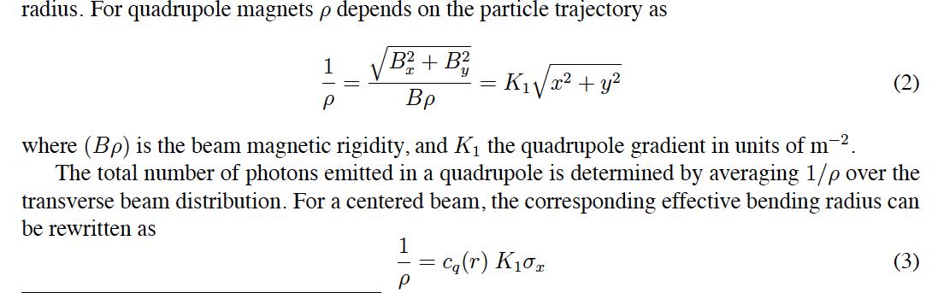
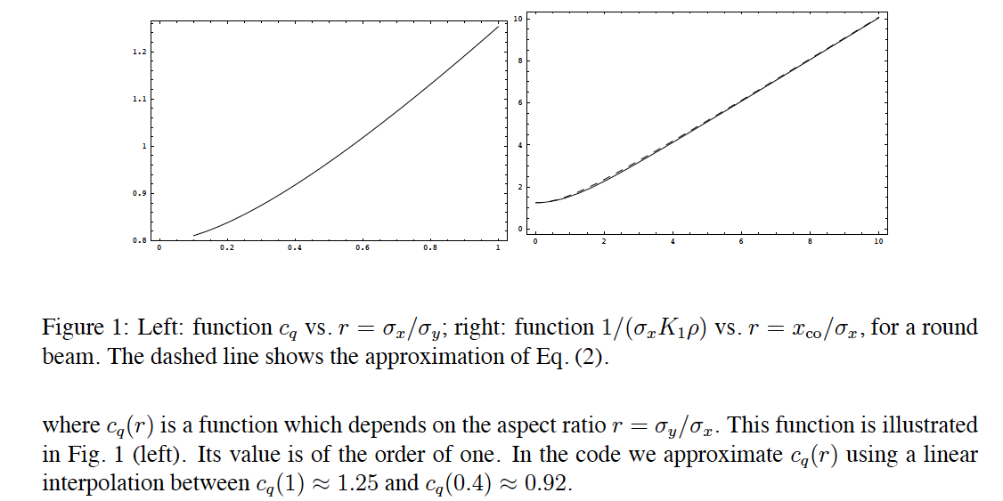
Frank Zimmermann LHC Project Note 237 (http://cds.cern.ch/record/691934?ln=en)

Slide 14
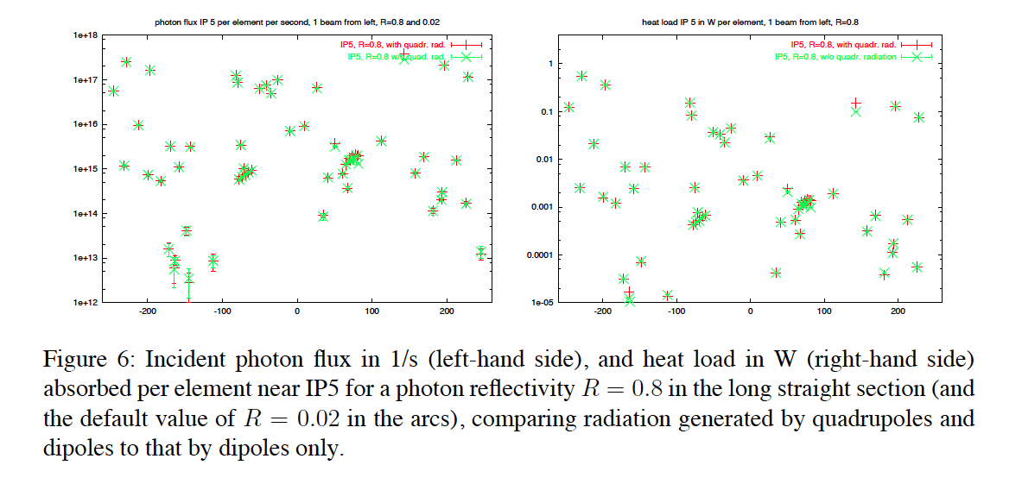
From LHC Project Report 675
Γ_{LHC}(arc) ≈ 1E17 ph/ms, <ε> ≈ 13 eV
<Γ_{LHC}(LSS)> ≈ 3.6E15 ph/ms, <ε> ≈ 5 eV, max heat load 0.5W per element
1e18 –
1e17 –
1e16 –
1e15 –
1e14 –
1e13 –
1e12 –
1 –
1E-1 –
1E-2 –
1E-3 –
1e-4 –
1e-5 –
-200 -100 0 100 200
-200 -100 0 100 200
A. Rossi BE-ABP-HSS meeting 20/04/16

