Slide 1
Automatic testing of Medipix wafers
Developing systems to measure Medipix chips
Richard Plackett - CERN – April 2nd

Slide 2
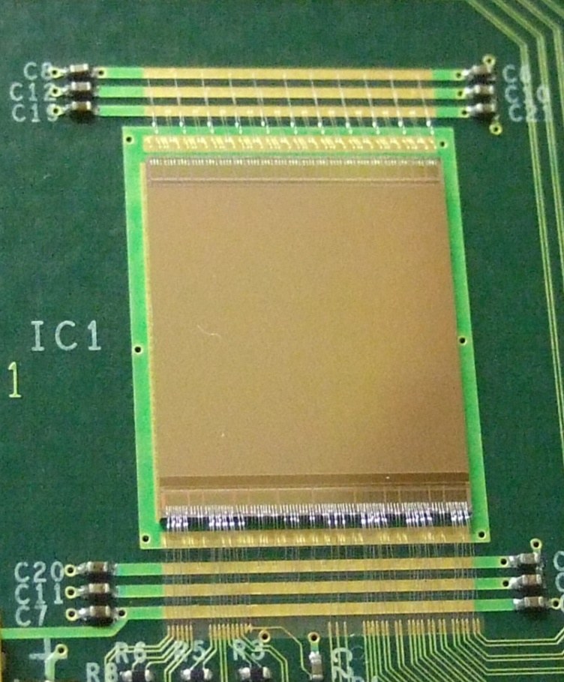
Outline
The Medipix Project
  Hybrid Pixel Detectors
  The Medipix Chips
  ‘Real World’ Applications (and HEP)
Automatic Wafer Testing
  Motivating Automatic Testing
  Tools Available
  Using Optical Feedback
  Giga-Pixel Chip Imaging
  First Results
  Next Steps
Further Work
The newly arrived Medipix3 chips

Slide 3
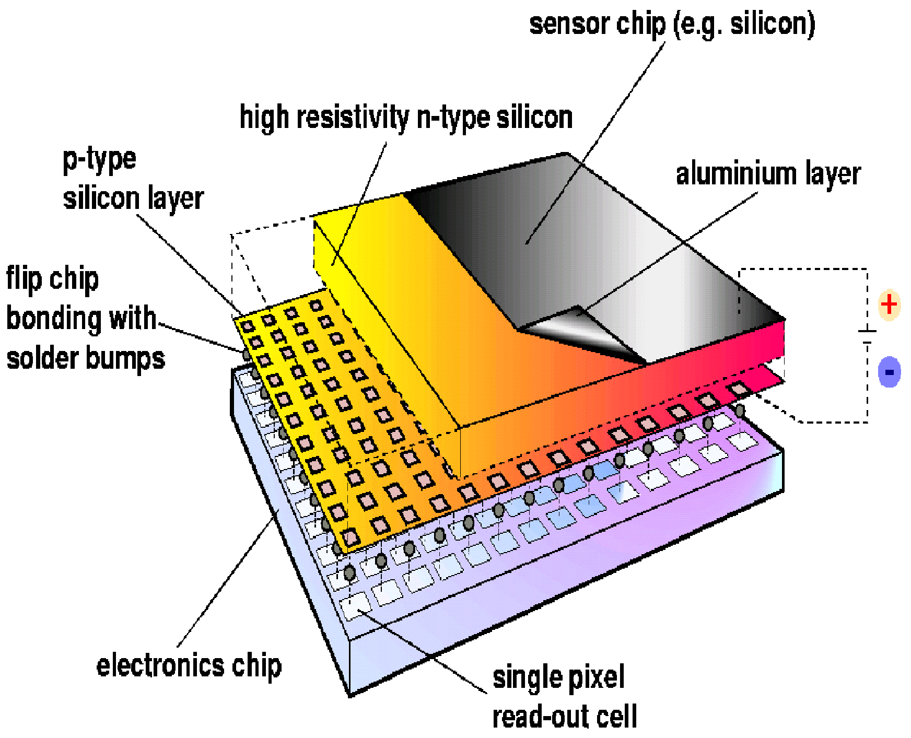
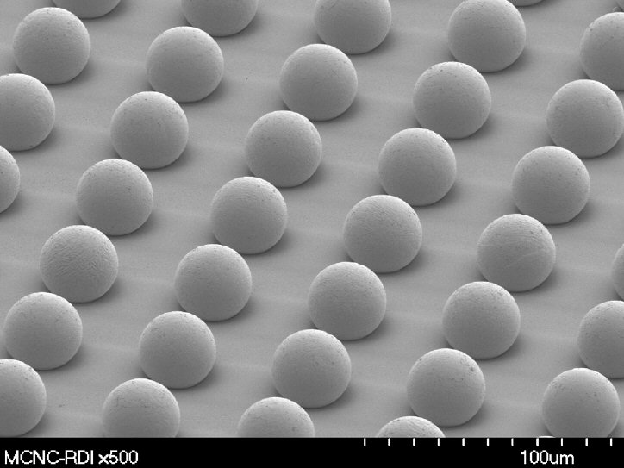
Hybrid Pixel Detectors
Hybrid Detectors are a ‘sandwich’ of a sensor and read-out chip.
Each pixel can have its own analogue and digital elements.. Amplification, shaping, discrimination, counters etc.
Very short connections to read-out reduce cross talk and noise.
Sensor
Bump-Bonding
Medipix Project
Amplification
Hybrid Detectors
Discriminator & Counter
Medipix Chips
Read-Out
Applications
Automatic Testing
Motivation
Tools
Optical Feedback
Chip Imaging
First Results
Next Steps
Further Work
High density solder bump bonding is a key technology

Slide 4
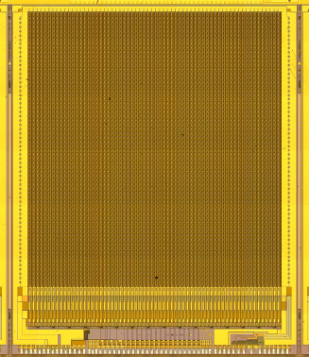
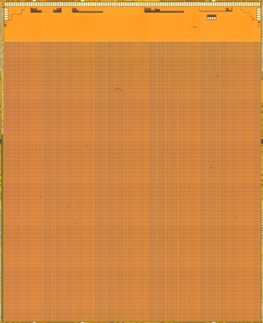
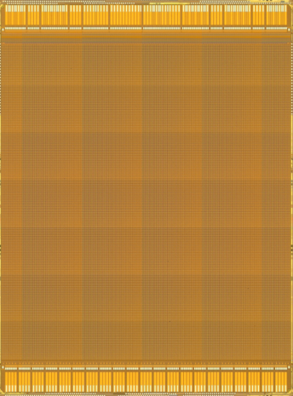
Medipix Chips
Medipix1 (1997)
Proof of concept, photon counting, 64x64 pixels, 3 bit threshold tuning
1um CMOS
Medipix Project
Hybrid Detectors
Medipix Chips
Medipix2 (2002)
Photon counting , 55um pixels, 256x256, Positive and negative sensors, Pixel level leakage compensation, 3 side tile-able
Upper and lower threshold levels
250nm CMOS
Applications
Timepix (2006)
As Medipix2, with additional..
Time over threshold energy measurement
Accurate time of arrival count
Automatic Testing
Motivation
Tools
Optical Feedback
Chip Imaging
First Results
Next Steps
Medipix3 (2009)
55um pixels, 256x256,
charge sharing summation,
2 thresholds and 2 counters per pixel,
quad pixel spectroscopic mode,
continuous readout mode,
130nm CMOS
Further Work

Slide 5
Modes of Operation
Photon Counting
Count hits over threshold rather than simply accumulating charge
Available with all Medipix chips
Time over Threshold
Threshold
Medipix Project
Time over Threshold
Measure the time a hit passes a threshold for a measurement of the energy deposited in the sensor.
Hybrid Detectors
Time of Arrival
Medipix Chips
Applications
Automatic Testing
Time of Arrival
Measure the time from a hit until the ‘shutter’ is closed
Motivation
Shutter
Tools
Optical Feedback
Spectroscopic Pixels
Using 4 pixel ‘superpixels’ the many thresholds and counters give 8 levels of energy resolution whilst losing a factor of 2 spatial resolution
Chip Imaging
Charge Summing
If a ‘cluster’ of hits is found, allocate all the charge to the hardest hit pixel. This combats charge sharing.
First Results
Next Steps
Further Work

Slide 6
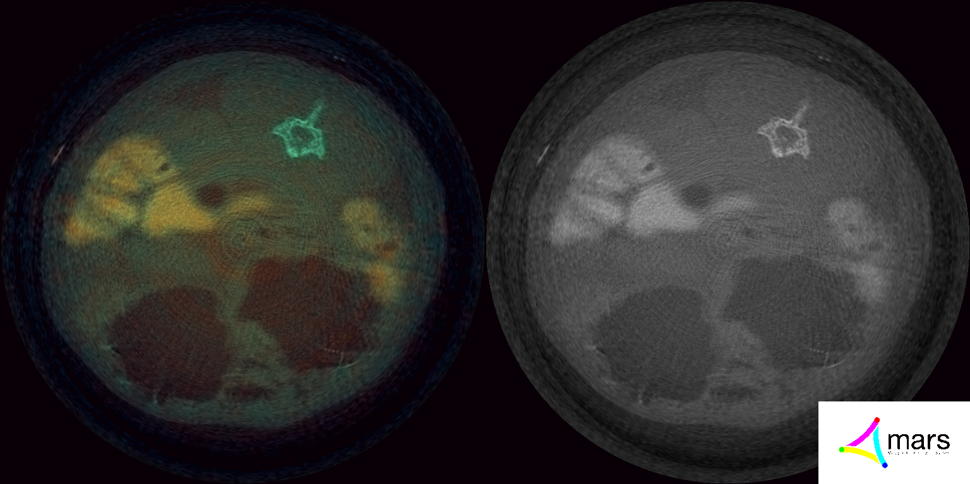
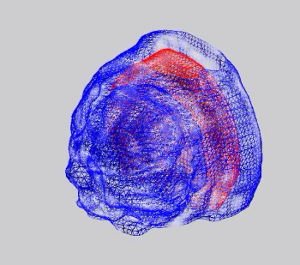
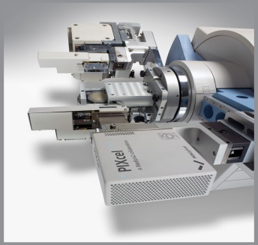
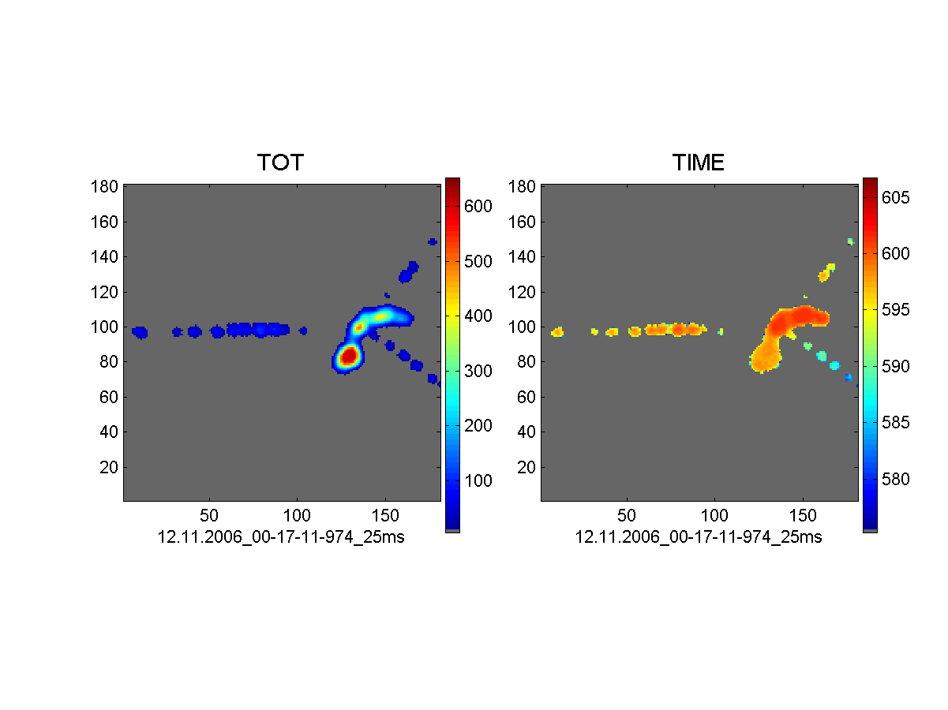
The Collaboration
People are doing lots of things with Medipix chips
Medipix CT
The MARS project in NZ is making a ‘colour’ multi spectral CT scanner.
Medipix Project
Hybrid Detectors
Medipix XRD
PANalytical (NL) is selling Medipix chips in its X-Ray Diffraction systems.
Medipix Chips
Applications
Automatic Testing
Medipix in Space
Will fly in 2010 as part of the LUCID cosmic ray flux experiment.
Motivation
Tools
Optical Feedback
Medipix to Mars
Is being used in Houston to characterise Astronaut dosage for long term interplanetary missions.
Chip Imaging
First Results
Next Steps
Medipix Tomography
Medipix is used in several high-res tomography studies with x-rays and neutrons at Erlangen, CTU an Bogotá.
Further Work
Medipix TPC
Timepix was developed for use in next generation Time Projection Chambers, demonstrated by Freiburg.

Slide 7
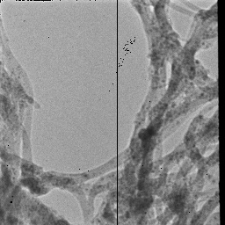
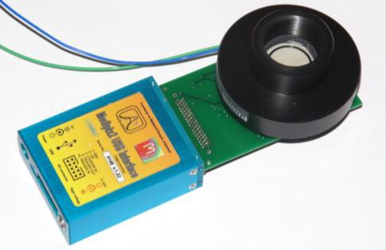
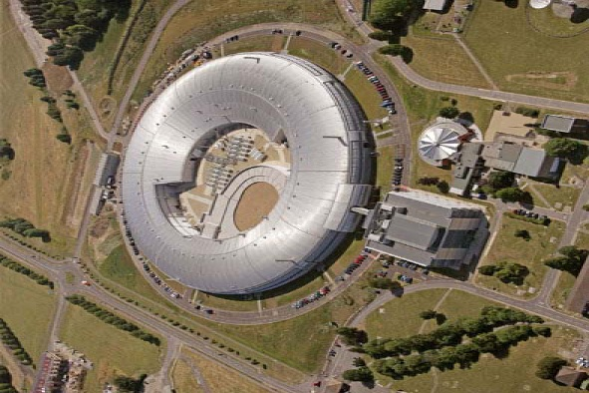
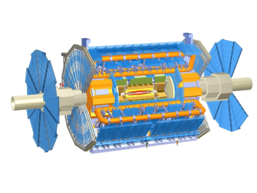
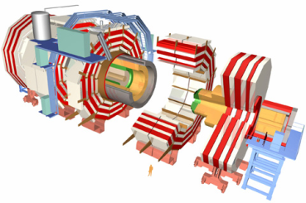
More Collaborators
Medipix Electron Microscopy
Enhancing new electron microscopy systems in collaboration with Leiden & Cambridge.
Medipix Project
Medipix Photon Detectors
New HPDs and Micro channel plate photon detectors from Glasgow and Berkley.
Hybrid Detectors
Medipix Chips
Medipix at SLSs
The Detector groups from ESRF and Diamond Synchrotron Light Sources are part of the collaboration.
Applications
Automatic Testing
Motivation
Tools
Medipix in the LHC
ATLAS and CMS are using Medipix chips as radiation monitoring devices providing real-time neutron monitoring.
Optical Feedback
Chip Imaging
First Results
Next Steps
Medipix Mass Spectroscopy
New generation imaging-spectroscopy systems at Kiev are using Medipix in fields such as proteomics.
Further Work

Slide 8
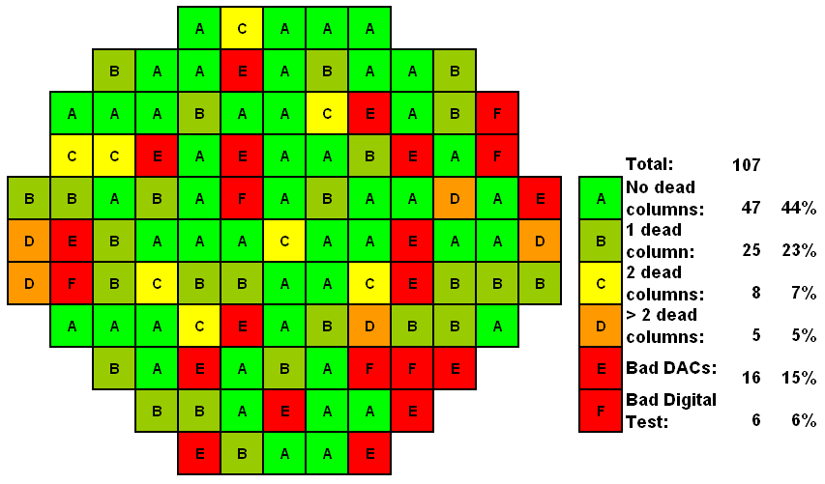

Motivating Automatic Measurements
Medipix3 chips have a 32 bit serial number that must be burnt on, so *All* new chips have to pass through a probe station once.
For Medipix2/Timepix basic probing ~3 or 4 minutes per test so operators are continuously working for several hours to complete a wafer.
Currently each chip has to be positioned and contacted by hand which is VERY time consuming… (100 chips per wafer)
CERN is a production center and our collaborators rely on us to provide them with chips and assemblies.
For PANalytical a well controlled and characterised supply is commercially necessary
Medipix Project
Hybrid Detectors
Medipix Chips
Applications
Automatic Testing
Motivation
Tools
Optical Feedback
Chip Imaging
First Results
Next Steps
Further Work

Slide 9
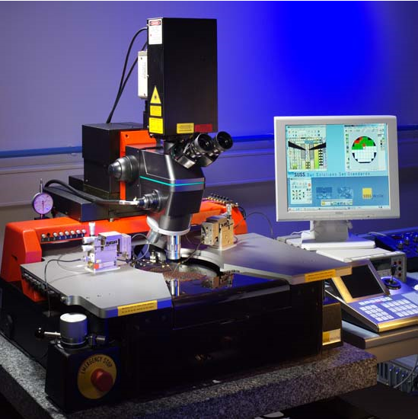
Tools Available
Suss MicroTec PA200 ‘semiautomatic’ probe station
  Already used to for previous chips
  Can be controlled via IP
  Video feedback from microscope
  Micron accuracy on chuck
Matlab
  Training provided by ACEOLE
  Easy image processing
  Good control development libraries
  Rapid development
Pixelman
  Medipix Readout Software
Medipix Project
Hybrid Detectors
Medipix Chips
Applications
Automatic Testing
Motivation
Tools
Optical Feedback
Chip Imaging
First Results
Camera integrated into microscope provides an optical feedback
Next Steps
Further Work
Probe card powers and read out chips whilst still on the wafers
4 degree of freedom vacuum chuck provides accurate wafer positioning

Slide 10
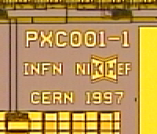


Optical Feedback
To trust the autonomous alignment and positioning we wanted some
feedback . Using the video feed from the microscope camera..
And the alignment marks on chips…
Then cross correlate … apply some cuts … peak finding … reducing multiple solutions…
We can have some confidence that the wafer is where we wanted it.
This approach allows us to be general – will work for all Medipix wafers and beyond.
Medipix Project
Hybrid Detectors
Medipix Chips
Applications
Automatic Testing
Motivation
Tools
Medipix3 alignment marks
Optical Feedback
Medipix1 ‘branding’
Medipix2 / Timepix alignment marks
Chip Imaging
First Results
Next Steps
Further Work

Slide 11
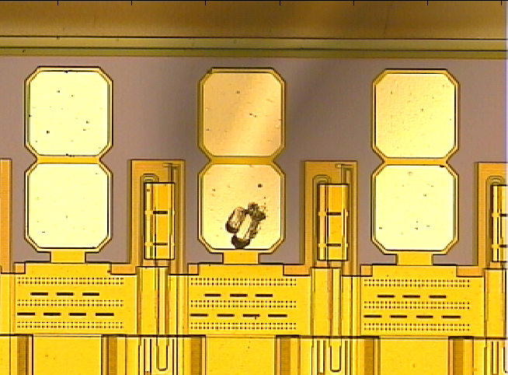
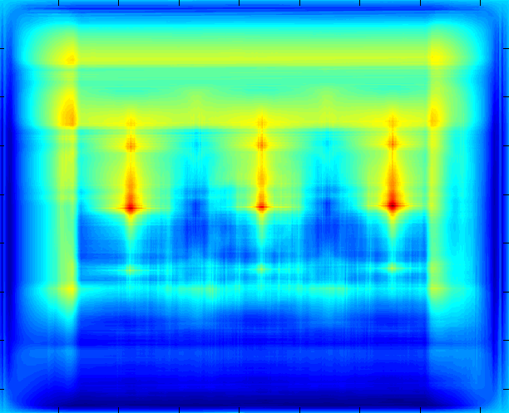
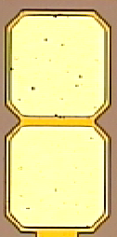

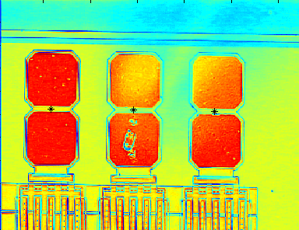
Example : Pad Finding
Medipix Project
Hybrid Detectors
Medipix Chips
Applications
Automatic Testing
Motivation
Tools
Video feed
Reference
Correlation Matrix
Optical Feedback
Chip Imaging
First Results
Next Steps
Further Work
Apply Probability Cuts
Output Matrix

Slide 12
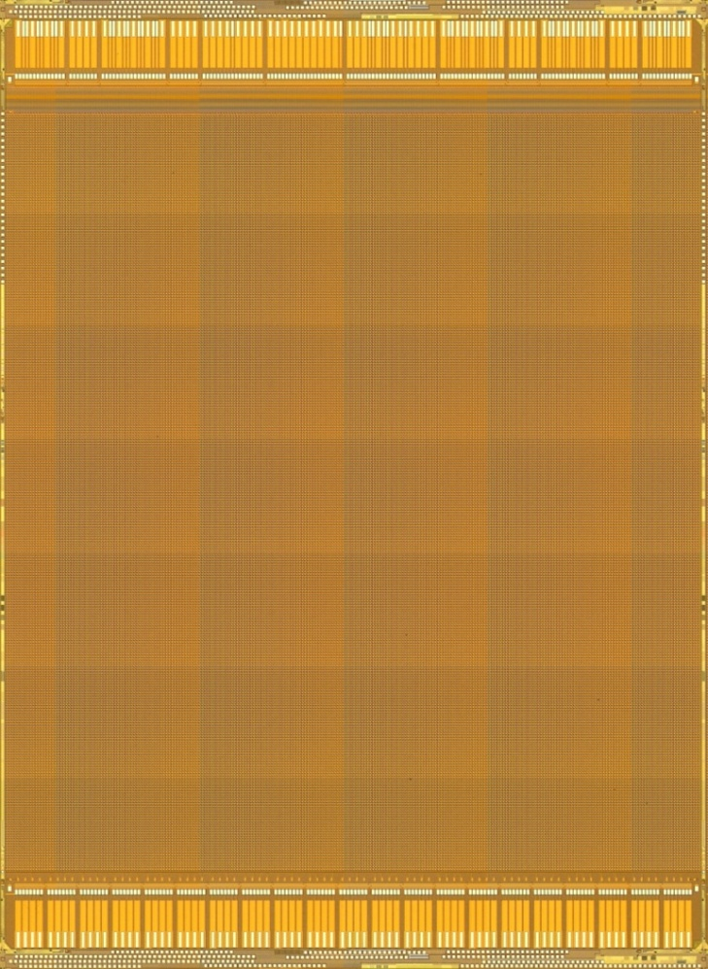
Giga-Pixel Chip Imaging
Accurate positional control of the wafer lets us use the probe station as
a giga-pixel camera to image the chip.
Medipix Project
Hybrid Detectors
Medipix Chips
Applications
Automatic Testing
Motivation
Tools
Optical Feedback
Chip Imaging
First Results
Next Steps
Further Work

Slide 13
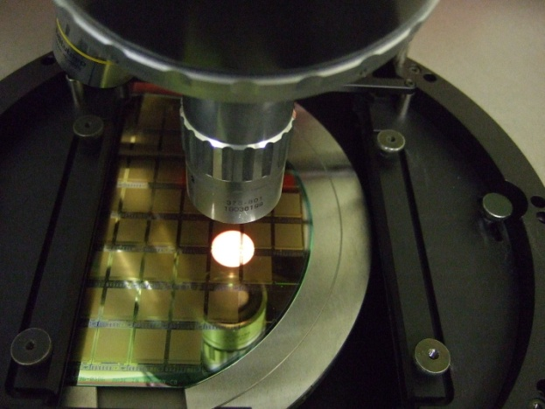
Automatic Test Results
Currently able to test Medipix2 / Timepix
Probe positioning accurate to ~1um
Wafer alignment and mapping <20mins
  Each chip is individually positioned with optical feedback and its location stored
  Angular alignment to better than 0.01 degrees
Each chip tested in less than 1 minute
  Analogue and Digital parts of the chip are tested
  Voltage levels are optimised and saved
Has re-try capability to overcome bad contacts
Medipix Project
Hybrid Detectors
Medipix Chips
Applications
Automatic Testing
Motivation
Tools
An action shot of the probe system
Optical Feedback
Chip Imaging
First Results
Next Steps
Further Work
Wafer testing time has reduced from a day to 2 hours
Operator only needed to start the system not run it continuously

Slide 14
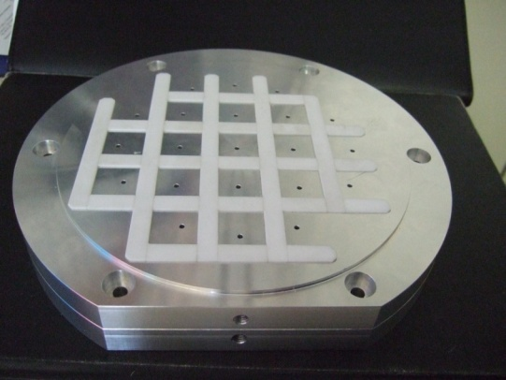
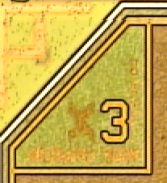
Next Steps in System Development
Increasing Robustness and Finalising system
Introducing more checks into critical functions
Feedback from analysis routines to re-check chips if necessary
Automatically produce a wafer map when tests complete
Medipix Project
Hybrid Detectors
Medipix Chips
Assembly Testing
21 assemblies in one run
Individual optical alignment of assemblies ready
Different tests for each assembly easy to script
Individual probe height adjustment is still required
Applications
Automatic Testing
Motivation
Tools
Optical Feedback
Chip Imaging
First Results
Medipix 3 – Testing and Identity Burning
System designed to work with multiple wafer types
Modular code means tests can be performed with minimal risk to wafers.
Need to be VERY careful with book-keeping.
Additional 3.3V voltage supply needs to be integrated.
Require Medipix3 readout system before we can start.
Next Steps
Further Work

Slide 15
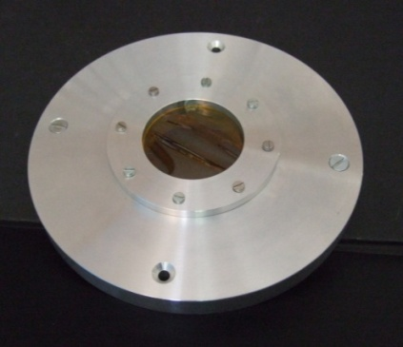
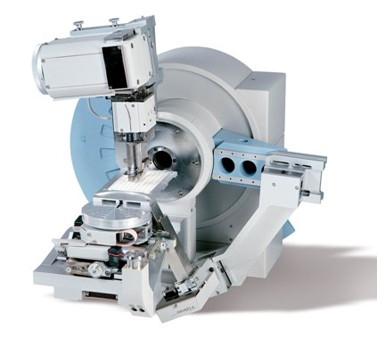

Future Work
Characterising sensors at different temperatures
  Work has begun preparing a cryostat, modified pieces have already been received from the workshop.
  We plan to measure a series of sensors GaAs, CdTe, Si etc
  We will also use it for ‘mechanical’ proving
Using XRD to analyze stresses in bonded assemblies
  XRD Training provided at PAN as part of ACEOLE scheme
  Will modify the PAN system to perform crystal stress measurements over the sensor surface.
Super-LHC Test-beams
  Tests this summer to see if Medipix technology will be suitable for some upgrade proposals.
CERN @ School
  I am working with the Langton Star Center, a secondary school project to help develop projects for a distributed cosmic ray detector based on the Timepix chip.
  Initially 10 USB detectors will be sent to begin training staff in their operation.
  GPS timing hardware has to be developed and integrated.
  Links to the LUCID cosmic ray satellite project.
Medipix Project
Hybrid Detectors
Medipix Chips
Applications
Automatic Testing
Motivation
Tools
Optical Feedback
Chip Imaging
First Results
Next Steps
Further Work

Slide 16
Summary
The Medipix Chips are VERY versatile and the collaboration is active in many areas.
Need to automatically test chips by the wafer.
Has to be very reliable and accurate.
Wafers have been successfully tested automatically.
Enhancements for Medipix3 and assemblies in development.
Several other projects now beginning to take shape.
~Thank you for your attention~

