Slide 1
Passive Optical Networks in Particle Physics
ACEOLE Six Month Meeting
02/04/2009
CERN: Ioannis Papakonstantinou, Spyros Papadopoulos
Supervisor: Dr. Jan Troska
UCL collaborators: Prof. Izzat Darwazeh, Dr. John Mitchel

Slide 2
Contents
Definition of TDMA PON systems
PON systems in TTC systems
PON Protocols: EPON vs GPON
Resource Protection in PONs
Optical Components
WDM PONs
Future PON architectures for enhancing fiber bandwidth utilization

Slide 3




Existing Access Networks
Access Network
Access Networks are the last segment connection from COs (central offices) to customers
They are also called first-last mile networks
Examples of access networks are:
ISDN
xDSL
WiMAX
and most recently PONs…
Backbone Network
Metropolitan Network
DSLAM
POTS
CO
xDSL
Ethernet, SONET etc
ISDN
WDM mesh
PON
OLT
CO
WiMAX

Slide 4
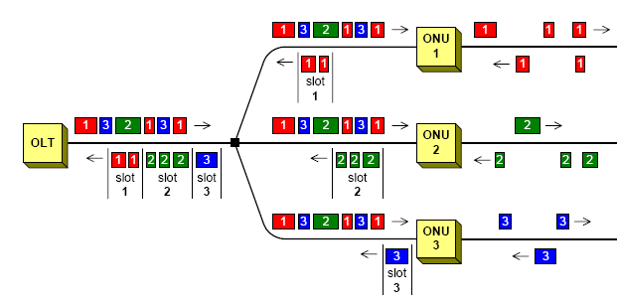

What is a PON?
PON is a Point-to-MultiPoint (PMP) optical network with no active elements in the signal’s path from the source to the destination
Data are exchanged between a central node, the Optical Line Terminal (OLT), and a number of end terminals, the Optical Network Units (ONUs)
According to where ONUs are placed we have different PON versions namely FTTH, FFTC, FFTB etc
FTTH
FTTC
FTTB

Slide 5
General PON Considerations
In the downstream direction (OLT→ONUs) PON is a broadcast network
Since there is only one transmitter collisions do not occur downstream
ONUs are filtering out data not addressed to them
In the upstream direction (ONUs→OLT) however a number of customers share the same transmission medium
Some channel arbitration mechanism should exist to avoid collisions and to distribute bandwidth fairly among ONUs
TDM is the preferred multiplexing scheme in first generation PONs as it is very cost effective. Dynamic Bandwidth Allocation Algorithms are employed for fairness
FTTH
FTTC
FTTB

Slide 6
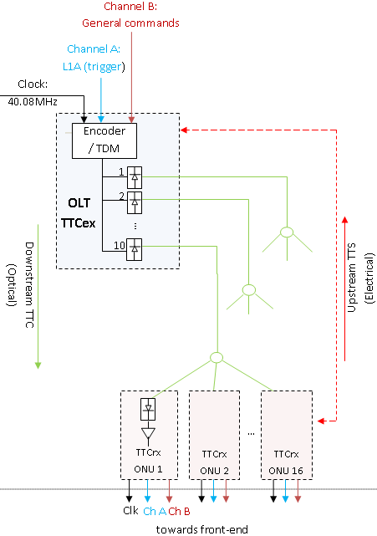
Where do PONs Fit in Particle Physics Experiments?
CMS TTCex Encoder multiplexes L1A (Ch. A) and control data (Ch. B) in time
A separate electrical link provides TTCex with a “slow control” feedback
Replacing existing optical network with PONs can bring the following advantages:
One TTC system for all experiments (CMS, ATLAS, ALICE etc)
One bi-directional link for both downstream and slow control messages
No need to come up with communication protocols as advanced PON protocols already exist
Safer prediction of components available in the future if we tight research with existing technology

Slide 7
PON Protocols: EPON vs GPON
  Standardized PON protocols
  Physical Layer Comparison
  Bandwidth allocation

Slide 8
TDMA PON Protocols
Broadband-PON (BPON) established by ITU. Work started in 1995, ITU G.983
Supports ATM frames
Ethernet PON (E-PON) established by IEEE. Work started in 2001, IEEE 802.3ah
Supports Ethernet frames
Giga-bit PON (GPON) established by ITU. Work started in 2001, ITU G.984
Supports mixed ATM and Ethernet frames through generic framing procedure (ITU G.7041)
BPON has not found wide acceptance
In the following we will focus on GPON and EPON
Standard | EPON | BPON | GPON
Framing | Ethernet | ATM | GEM
Max. BW | 1 Gb/s | 622 Mb/s | 2.48 Gb/s
Splitting ratio | 16 | 32 | 64
Avg. BW / user | 60 Mb/s | 20 Mb/s | 40 Mb/s
Max. Reach | 20 km | 20 km | 20 km

Slide 9
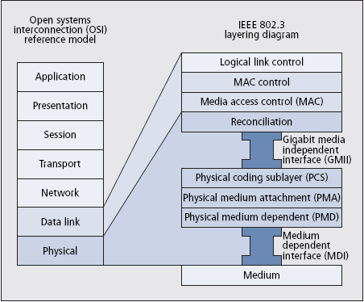
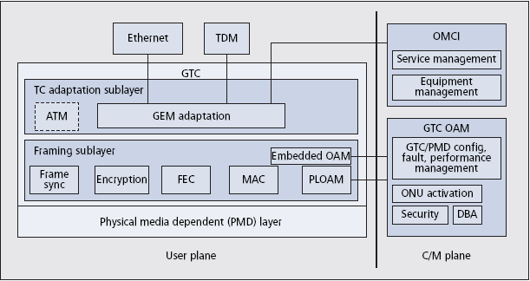
PONs in OSI Architecture
PONs reside in the last two layers in the OSI architecture namely
Data link layer which is responsible for the access to the medium and for error correction
Physical layer which is responsible for transmitting and receiving the information
In GPON terminology the two layers are called: G-Transmission Convergence (GTC) and Physical Media Dependent (PMD)
EPON modifies MAC layer to allow for bridging data back to the same port

Slide 10
EPON vs GPON Physical Layer
 | UNIT | Downstream (GPON) | Downstream (EPON) | Upstream (GPON) | Upstream (EPON)
Bit-rate | Gb/s | 1.244/2.48 | 1 | 1.244/2.48 | 1
Wavelength (SF) | nm | 1480-1500 | 1480-1500 | 1260-1360 | 1260-1360
Mean Tx Power Min | dBm | -4 A/+1 B/ +5 C | -7 | -3 A/ -2 B/ +2 C | -4
Mean Tx Power MAX | dBm | +1 A/ +6 B/ +9 C | 2 | +2 A/ +3 B/ +7 C | -1
Splitting Ratio |  | <64 | <32 | ― | ―
Max reach | Km | 20 | 20 | ― | ―
Line coding | ⁻ | NRZ | NRZ | NRZ | NRZ
Rx Sensitivity | dBm | -25 A/ -25 B/ -26 C | -27 | -24 A/ -28 B/ -29 C | -24
Tx On-Off (1 Gbps) | ns | ― | ― | 13 | 512
Clock recovery /AGC (1 Gbps) | ns | ― | ― | 36 | <400
Downstream
Upstream
ONU 1
ONU 1
OLT
OLT
ONU N
ONU N

Slide 11
GPON and EPON Frames Downstream
sequence used for the sync of the ONU Rx
MSB
MSB
PCBd
Psync (4 bytes)
Ident (4 bytes)
PLOAMd (13 bytes)
BIP (1 byte)
Plend (4 bytes)
US BW Map (N*8 bytes)
SLD + LLID
Preamble (7 octets)
SFD (4 octets)
Destination Addr. (6 octets)
Source Addr. (6 octets)
Length/Type
Counter indicating larger frames (superframes)
125 μs, 19440 bytes for 1.244 Gb/s
Indicates start of frame
Management – Control commands
Bit interleaved parity
Length or type of Ethernet frames mutually exclusive
Specifies length of BW map and ATM partition
46 – 1500 Octets
Payload / Pad
Start time – Stop time for N < 4096 different AllocIDs
Payload
GEM header
data
Error correction
FCS (4 octets)
LSB

Slide 12
Bandwidth Allocation Schemes
1 2 3
ONU 1
BW allocation schemes are not part of protocols
However, both EPONs and GPONs provide with the necessary tools for any allocation algorithm to be implemented
Two main bw allocation schemes:
Fixed/Static Bandwidth Allocation (FBA)
Dynamic Bandwidth Allocation (DBA)
FBA PON
ONU 2
4 5
OLT
1 2 3
4 5
6 7
Upstream
…
6 7
ONU N
ONU 1
1 2 3
DBA PON
7
4 5
ONU 2
OLT
1 2 3
4 5
6
7
8
Upstream
…
6 8
ONU N

Slide 13
FBA – DBA Comparison
FBA algorithm is easy to implement
However, unused bw is wasted
FBA is not frequently encountered
1 2 3
ONU 1
FBA PON
ONU 2
4 5
OLT
1 2 3
4 5
6 7
Upstream
…
6 7
ONU N
DBA can result in high bw utilization efficiency
It can also run efficiently different classes of service
However, efficiency is traded with higher complexity at the scheduler
ONU 1
1 2 3
DBA PON
7
4 5
ONU 2
OLT
1 2 3
4 5
6
7
8
Upstream
…
6 8
ONU N

Slide 14
DBA Algorithms
Requirements for DBA:
Fairness: Allocates the bw between users fairly
Low delay: Minimize latency (<1.5 ms for voice channels)
High efficiency: Can increase the efficiency of the bw (throughput) and increase peak rate
Fair Queuing Scheduling
Interleaved Polling with Adaptive Cycle Time (IPACT)
Fixed Service
Limited Service
Constant Credit Service
Linear Credit Service
Elastic Service
Deficit Round-Robin Scheduling
DBA using Multiple Queue Report Set
etc ..

Slide 15
Summary GPON vs EPON
GPON is a synchronous protocol while EPON is asynchronous (non-restrictive condition)
GPON timing mandates are stricter than EPONs
However, GPON employs power levelling and distance equalization
GPON management packets are transmitted as part of the header in GEM frames
EPON uses a separate GATE-REPORT frame approach. In that sense EPON is an offline protocol.
Both protocols favour centralized architectures where processing is accomplished at OLT
Both protocols encourage dynamic bandwidth allocation.

Slide 16
PON Resource Protection
Preplanned Protection
WDM Protection
Ring architectures

Slide 17
PON Protection
Resources that require protection:
Feeder fiber
Distribution Fiber
OLT Transceiver
ONU Transceiver
RN (Splitter / WDM Demux)
Protection Schemes
Preplanned Protection
Dynamic Restoration
ONU N
OLT
…
Tx
ONU N
ONU 1
Rx
Feeder Fiber
RN
Distribution Fibers
OLT
Tx
…
Rx
OLT
Path 2
Path 1
Tx
ONU 1
Rx
ONU

Slide 18
Protection Schemes
ITU-T G.983.1 GPON Protocol specifies four protection architectures for PONs
Simple feeder fiber architecture
Feeder+OLT transceiver
Feeder+Distribution+OLT+ONU Transceivers
Hybrid protection
ONU N
ONU N
ONU N
ONU N
OLT
OLT
…
OLT
…
OLT
…
ONU 1
…
ONU 1
ONU 1
ONU 1

Slide 19
Ring Architectures
Similar to SONET self-healing rings
Two fiber unidirectional
Two fiber bi-directional
Four fiber bi-directional
OLT
ONU 3
ONU 1
ONU 2

Slide 20
Optical Components
  Optical splitter
  Coarse WDM MUX/DEMUX
  Arrayed Waveguide Grating (AWG)

Slide 21
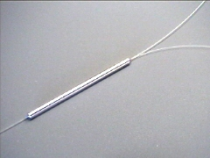
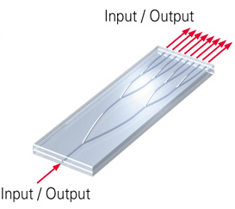
Optical Components: Splitter
Two types of splitters are found
Traditional bi-conic fused silica splitter
Photonic Lightwave Circuit (PLC) splitter
PLC has the advantage of smaller footprint
Better alignment with in/out coupled fibers
Uniform splitting ratio
Better scalability
Temperature stability
splice

Slide 22
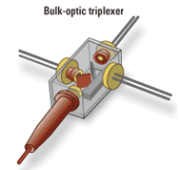
Coarse WDM Multiplexer
Bulk Optics Assembly packaging
Thin film filters
Transceivers
Fibers and lenses
Bragg Gratings on PLC
Cheaper due to less assembling steps
Dichroic mirrors
1440 nm Rx
lens
1310 nm Tx
fiber
1550 nm Rx
Bragg Grating
λ₁
λ₁
λ₂
λ₃
λ₃
λ₂

Slide 23
Arrayed Waveguide Grating
1XN
λ₁
AWGs are compact WDM DEMUX/MUX
They are the dominant candidate in WDM PONs because
They can DEMUX a large number of λ
They achieve relatively low cross-talk
Athermal versions of the device exist
Cyclic property of AWGs can be used in X-switch architectures
They can be used in efficient PON protection schemes
λ₁, λ₂, λ₃
λ₂
∆l
λ₃
NXN
∆l
Input port
1 2 3 4 5
Cyclic property of a 5X5 AWG
λ₁ λ₂ λ₃ λ₄ λ₅
1
a
λ₅
λ₄
λ₃
λ₂
λ₁
λ₂
λ₁
λ₅
λ₄
λ₃
λ₁ λ₂ λ₃ λ₄ λ₅
λ₃
λ₂
λ₁
λ₅
λ₄
λ₄
λ₃
λ₂
λ₁
λ₅
λ₁
λ₅
λ₄
λ₃
λ₂
2
b
λ₁ λ₂ λ₃ λ₄ λ₅
3
c
λ₁ λ₂ λ₃ λ₄ λ₅
4
d
λ₁ λ₂ λ₃ λ₄ λ₅
5
e

Slide 24
Future PON
WDM PONs
Colourless ONUs based on (Reflective Semiconductor Optical Amplifier) RSOAs
Colourless ONUs with injection locked lasers
Analogue modulation and OCDMA techniques

Slide 25
Wavelength Division Multiplexing PON
OLT
RN
ONUs
Band A
λ₁
Receiver
Tunable Laser
λ₁
λ₁, λ₂, … λ₁₆
λ₁₇
Coarse WDM
Laser
λ₁₇
1 x 16 router
WDM Rx
λ₁₇, λ₁₈, … λ₃₂
…
λ₁₆
Coarse WDM
Receiver
λ₁₆
…
Upstream band
Downstream band
Band B
λ₃₂
Coarse WDM
Laser
λ₃₂
Receiver Array
DEMUX
λ
In a WDM PON scenario each channel (or channel group) is assigned one wavelength upstream and one downstream for communication with OLT
Benefits are higher bandwidth per channel, loss is independent from splitting ratio, less complicated scheduling algorithm at OLT, easy expansion, better delivery of services
Main disadvantage is the need for expensive WDM components such as AWGs, filters, tunable lasers / laser arrays / laser per ONU, broadband receivers etc. Also migration from TDMA PONs to WDM PONs is not straightforward
“Colorless” WDM PONs are developed to tackle cost issues

Slide 26
Colorless ONUs based on RSOAs
Externally-Seeded RSOA (Reflective Semiconductor Optical Amplifier) based ONUs at 1.25 Gb/s
OLT
ONU 1
RN
λ_{D1}
λ_{U1} CW
RxN
Tx1
SLED
λ_{D1}
…
λ_{D1}, … λ_{DN}
λ_{U1}, … λ_{UN} CW
λ_{U1}
AWG
Coarse WDM
RSOA
TxN
3 dB
λ_{D1}, … λ_{DN}
λ_{U1}
1 x N router
λ_{UN} CW
ONU N
Rx1
Coarse WDM
…
λ_{DN}
…
λ_{D1}, … λ_{DN} Modulated
λ_{DN}
RxN
AWG
RxN
λ_{U1}, … λ_{UN}
λ_{UN}
Coarse WDM
λ_{UN}
RSOA

Slide 27
Optically Injection Locked ONUs
Externally-Seeded Injection Locked FP-LDs. 1.5 Gb/s over 30Km
OLT
CW Upstream or Downstream
ONU 1
RN
λ_{D1}
Coarse WDM
C-Band EDFA
L-Band EDFA
Modulated Upstream or Downstream
Rx
FP-LD
Rx
Coarse WDM
FP-LD
A
W
G
2
λ_{U1}
…
3 dB
ONU N
AWG1
…
λ_{DN}
FP-LD
Rx
Rx
Coarse WDM
FP-LD
λ_{UN}

Slide 28
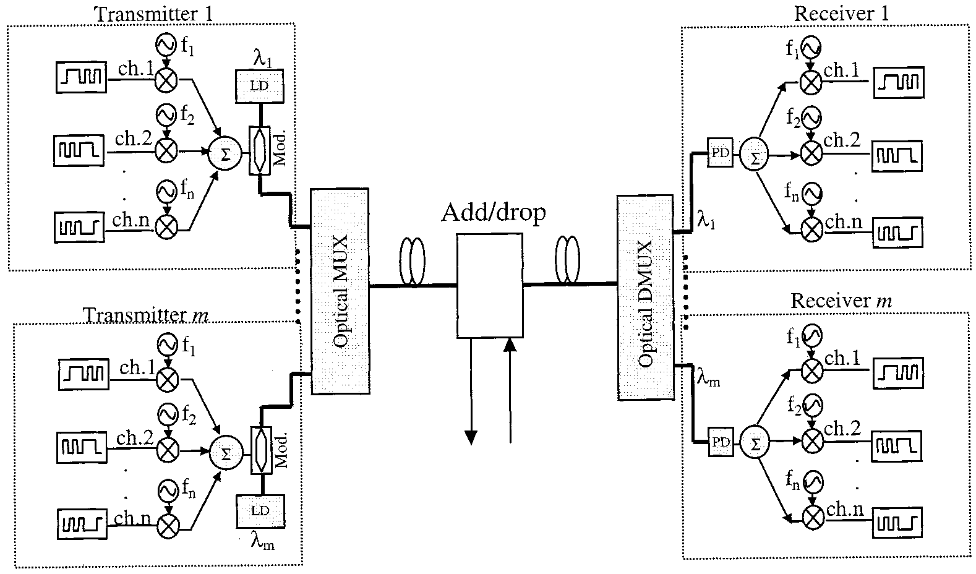
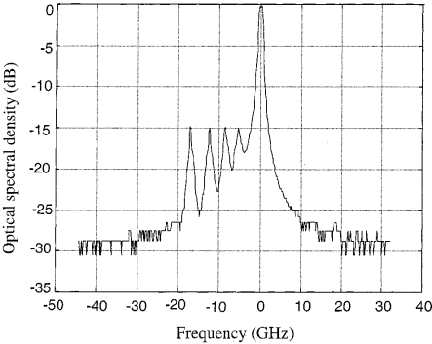
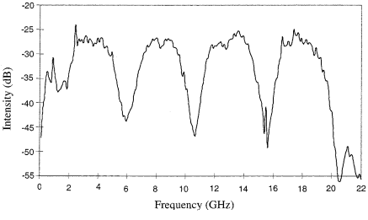
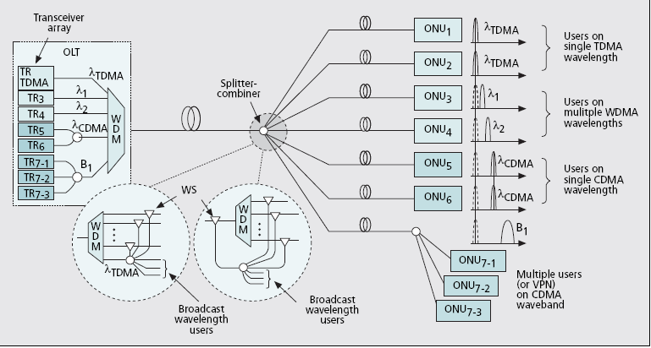
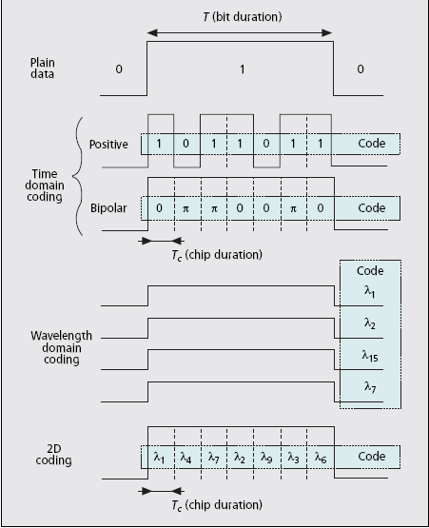
SCM and OCDMA over PONs
Hybrid WDM-SCM (sub-carrier modulation) PON
Migration scenario with OCDMA (Optical Code Division Multiplexing Access)

Slide 29
General Conclusions
Passive Optical Networks are evaluated for use in TTC systems
Both standardized EPON and GPON are capable of delivering TTC signals
However, EPON is more flexible because:
It does not require to run on a synchronous mode (although it can) as GPON does with the 8kHz clock to keep devices synchronized
The amount of control message overhead in EPON is variable and can be minimized in contrast to GPON where it is constant
More work on practical aspects of the protocols is required in order for a final decision to be made …

