Slide 1

What did we learn without beam in 2008 ?
Roberto Saban & Mirko Pojer
Training the dipoles | A.Werveij
Superconducting electrical circuits | K-H.Meß
The Sector 34 Incident | Ph.Lebrun
Calorimetric and electrical measurements and related software | N.Catalan-Lasheras
LHC Cryogenics: What did we learn from cool-down to first beams | S.Claudet
What else did we learn? | M.Pojer

Slide 2
Training the dipoles
in sector 56
A.Verweij

Slide 3
Training the dipoles
in sector 56
A.Verweij

Slide 4
Training the dipoles
in sector 56
Sector | Number of magnets |  |  |  |  | Number of quenches to 7 TeV
 | ALS | ANS | NOE | @ 6 TeV (±2) | @ 6.5 TeV (±30%) | Est. 1 | Est. 2 | Est. 3 | Est. 4
1-2 | 49 | 96 | 9 | 0 | 4 | 22 | 41 | 40 | 49
2-3 | 56 | 60 | 38 | 1 | 8 | 23 | 97 | 92 | 130
3-4 | 56 | 65 | 33 | 1 | 8 | 21 | 87 | 83 | 116
4-5 | 46 | 46 | 62 | 2 | 12 | 22 | 145 | 136 | 198
5-6 | 28 | 42 | 84 | 1 | 15 | 21 | 190 | 178 | 262
6-7 | 57 | 36 | 61 | 2 | 12 | 20 | 142 | 133 | 194
7-8 | 54 | 40 | 60 | 2 | 12 | 14 | 140 | 132 | 192
8-1 | 64 | 24 | 66 | 2 | 13 | 19 | 151 | 142 | 208
Total |  |  |  | 11 | 84 | 162 | 993 | 936 | 1349
Est. 1: Based on 115 MB’s that have been submitted to a thermal cycle in SM-18
(2008 before HWC, P. Xydi and A. Siemko)
Est. 2: Extrapolation from sector 5-6 data + estimate 1 for ALS & ANS
Est. 3: 2 quenches per NOE magnet + estimate 1 for ALS & ANS
Est. 4: 3 quenches per NOE magnet + estimate 1 for ALS & ANS
993 / 8 = 124
124 / 3 = 41
A.Verweij

Slide 5
Superconducting electrical circuits
Surprises
Harmless
  The third current lead shared by two circuits (Kirchoff’s Law)
  Short inside the dump resistor on the QF of Sector 45
  Short to ground on the dump resistor on the QD of Sector 56
  Missing resistor on one of the poles of an undulator which gave a very exotic transfer function
  Leveling of the DFB to properly wet the superconducting cable
Potential inconvenience to operation
  Distribution of the conductors on cables sharing the same DFB but on different circuits – symptom: apparent detraining
  The reference magnet puzzle – magnetization cycle
Potentially dangerous
  Symmetric quenches
  Transient spike when the dump switch opens due to the difference in Eddy currents in the two apertures
  Quench back in corrector circuits inducing coupling on other circuits … up to quenching the main magnets
  Pending: splice and voltage tap non-conformities
Unresolved
  MCBX and MCBY mystery: unexplainable transfer functions
  The hunch on the MCBYs
  Fast quench propagation observed on only the dipole circuits
K-H.Meß

Slide 6
The Sector 34 Incident
Measured versus simulated incident with 220 nΩ joint and bad contact with U-profile and wedge
Mandate of the Task Force
Establish the sequence of facts, based on experimental measurements before incident, observations after incident and timing
Analyse and explain the development of events, in relation with design assumptions, manufacturing & test data and risk analyses performed
Recommend preventive and corrective actions for Sector 3-4 and others
Temperature drift during the 7 kA current flat top (15 Sep 2008)
No electrical contact between wedge and U-profile with the bus on at least one side of the joint
No bonding at joint with the U-profile and the wedge
Ph.Lebrun

Slide 7
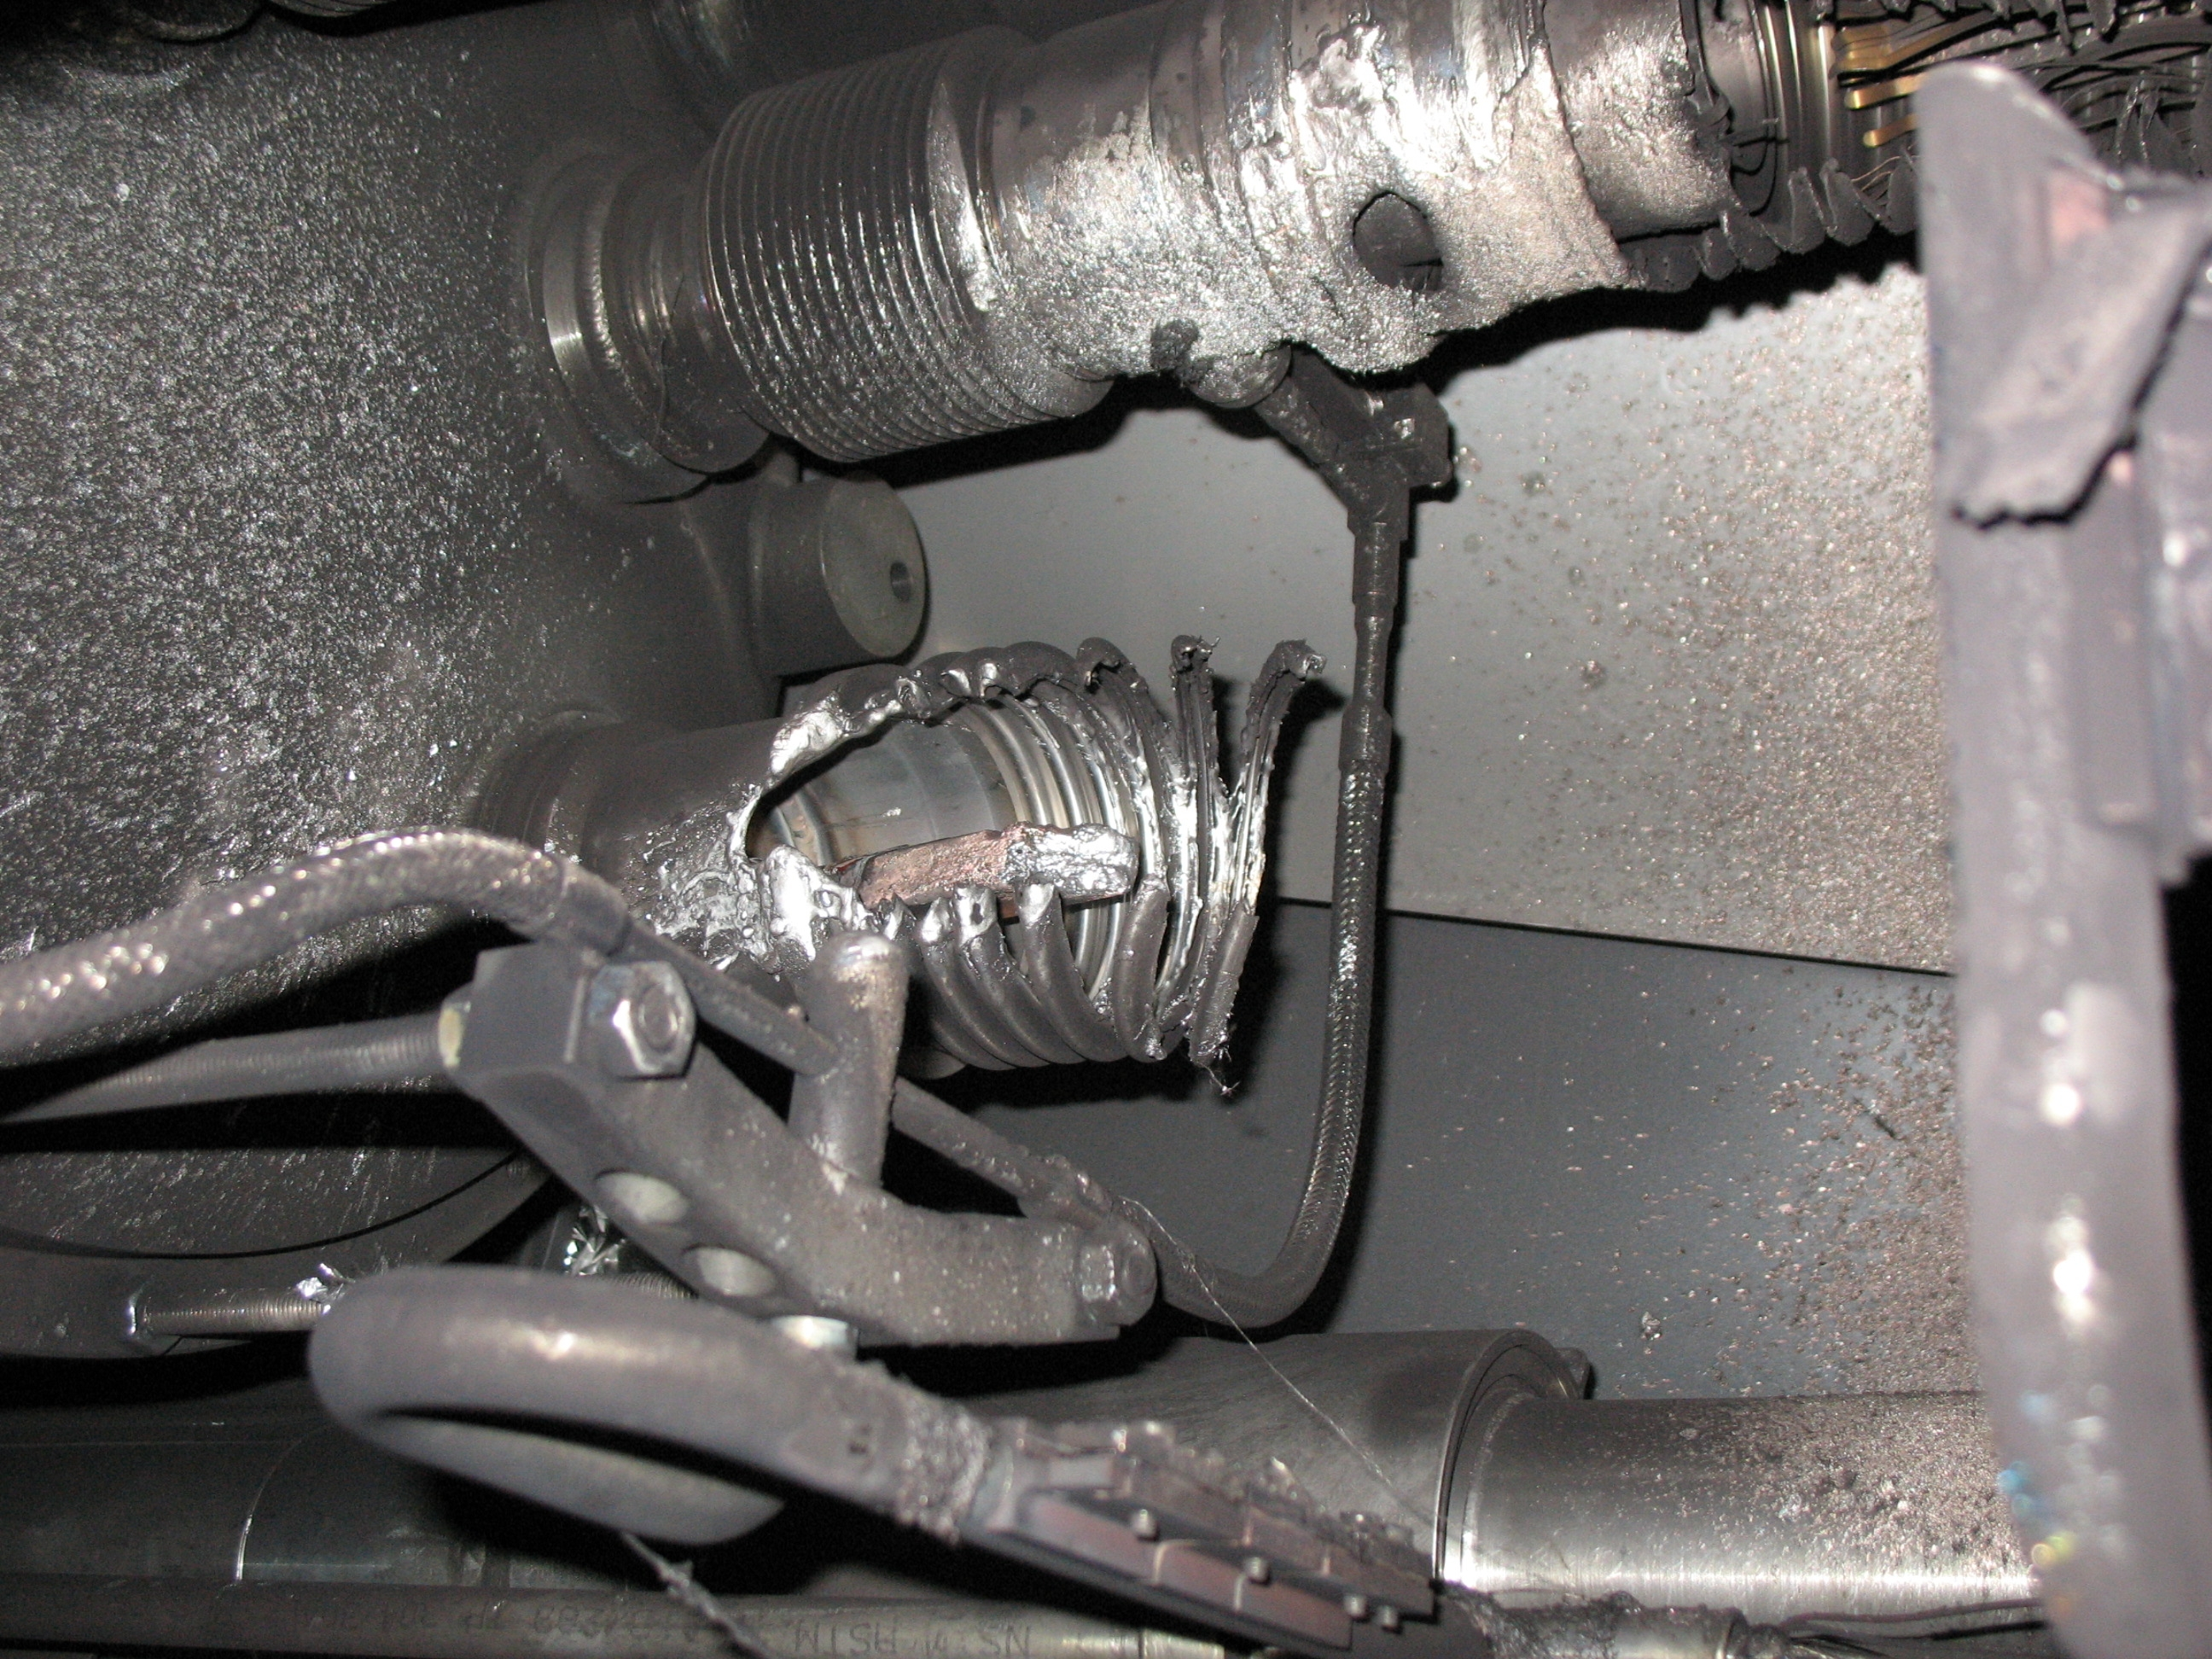
The Sector 34 Incident
The current decay from 8700 A
Energy | MJ | %
Stored in the magnets | 595.0 | 100
Dissipated in UJ33 | 71.0 | 12
Dissipated in UA43 | 104.8 | 18
Dissipated in cold mass | 144.4 | 24
Dissipated in electrical arcs | 274.8 | 46
Ph.Lebrun

Slide 8
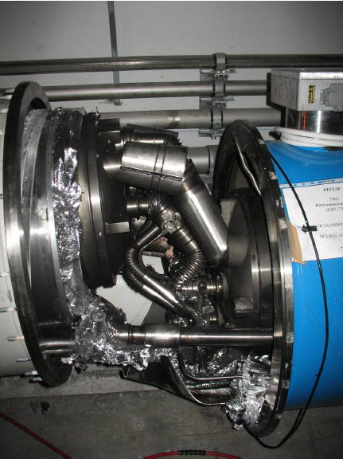
The Sector 34 Incident
Ph.Lebrun

Slide 9
The Sector 34 Incident
Recommendations
Prevention of initial fault
Mitigation of consequences
Calorimetric measurements
Electrical measurements on «suspect» cells/subsectors powered at limited current
During further power tests, track temperature evolution in normalized conditions
Modify quench detection system to include interconnects and bus bar splices
Consider option to measure currents in 13 kA circuits at both ends of sector and detect differentials
Review possible improvement of mechanical clamping of interconnects and gradually implement whenever possible
Increase number/size of relief devices on cryostat vacuum vessels
Review number, size & position of pressure relief devices on beam vacuum system
Review closure logic of beam vacuum sector valves
Consider possibility of triggered opening of quench relief valves below set pressure
Consider general firing of quench heaters
Reinforce external anchoring at locations of vacuum barriers
Reexamine personnel underground access rules
Review location of AUG in tunnel and protection from blast
Review recorded signals, recording frequency and time stamping coherence among different systems
Ph.Lebrun

Slide 10
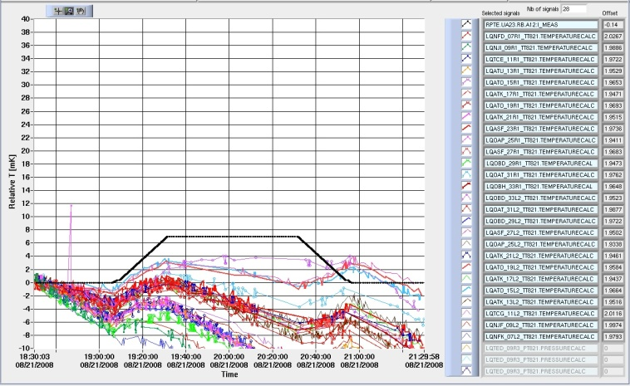
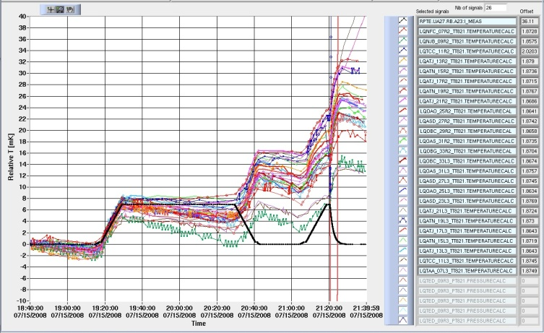
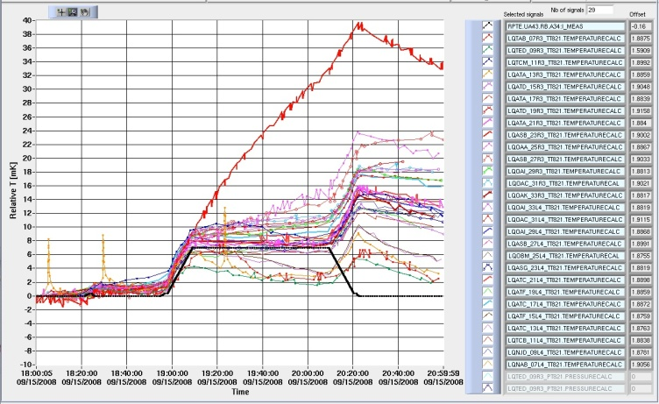
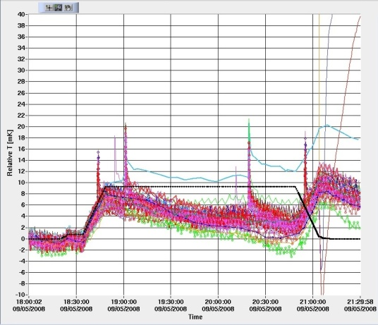
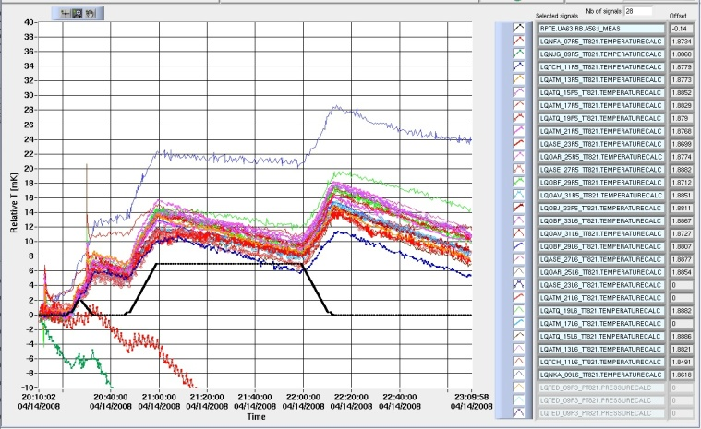
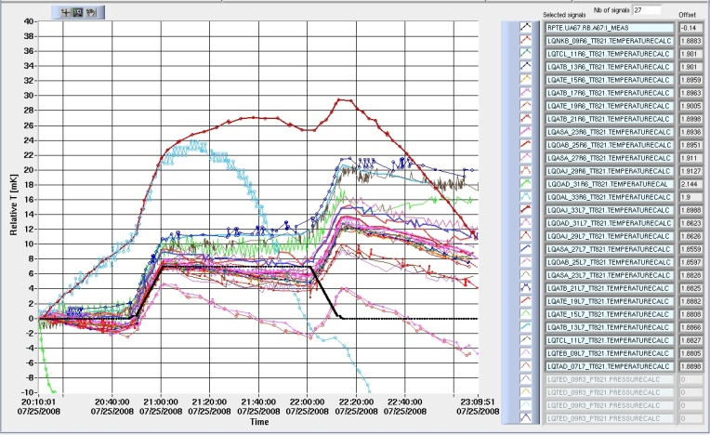
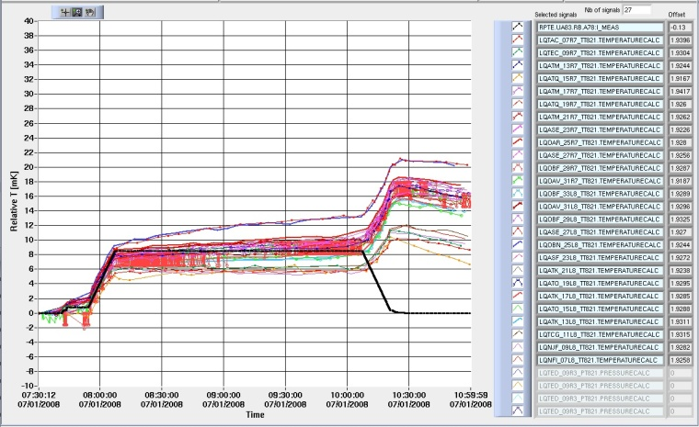
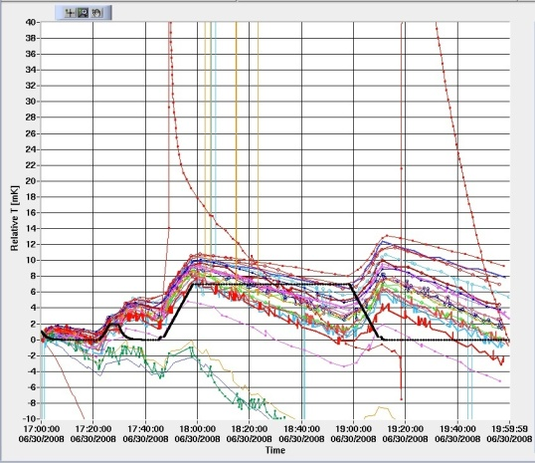
Calorimetric and electrical measurements
Sector 12
Sector 23
Sector 34
Sector 45
+40 mK
7 kA
7 kA
7 kA
9.3 kA
Relative temp
-10 mK
Sector 56
Sector 67
Sector 78
Sector 81
+40 mK
7 kA
7 kA
8.5 kA
7 kA
Relative temp
Relative temp
-10 mK
N.Catalan-Lasheras
All the current plateaux were scrutinized for suspect temperature increase
Unstable conditions and dynamic temperature control prevent accurate calculations.
1 or 2 hour flat tops

Slide 11
Calorimetric and electrical measurements
Assessment of
  the baseline slope (valve opening mismatch)
  the temperature increase during powering plateau
  the internal energy variation (J/kg)
  the deposited energy assuming a mass of 26 l/m of He
ΔU(ΔT)
 | Before heating | With heating
ΔU [J/kg] | -1.1 | 78
M [kg] | 823
ΔU [kJ] | -0.92 | 64.2
t [s] | 2880 | 6600
W [W] | -0.3 | 9.7
ΔW [W] | 10
~ 2 W @ 7 kA
N.Catalan-Lasheras
The new powering procedures will demand mandatory calorimetric and electrical tests in ALL sectors at the beginning of the next LHC powering campaign

Slide 12
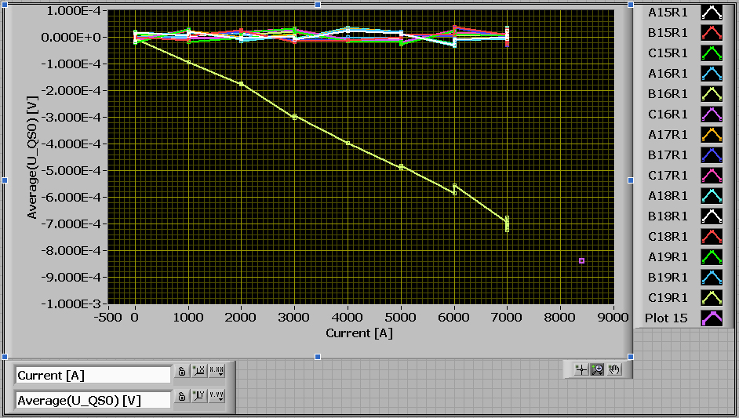
Calorimetric and electrical measurements
Calorimetric measurements spotted a suspect region in Sector 12
0.7mV/7kA=100nOhm
0.7mV*7kA=4.9W
Snapshot on 03.09.08 : 0.85mV*8.4kA=7.1W
N.Catalan-Lasheras
an inter-pole splice resistance of 105 nOhm in magnet 2334 (B16R1)

Slide 13
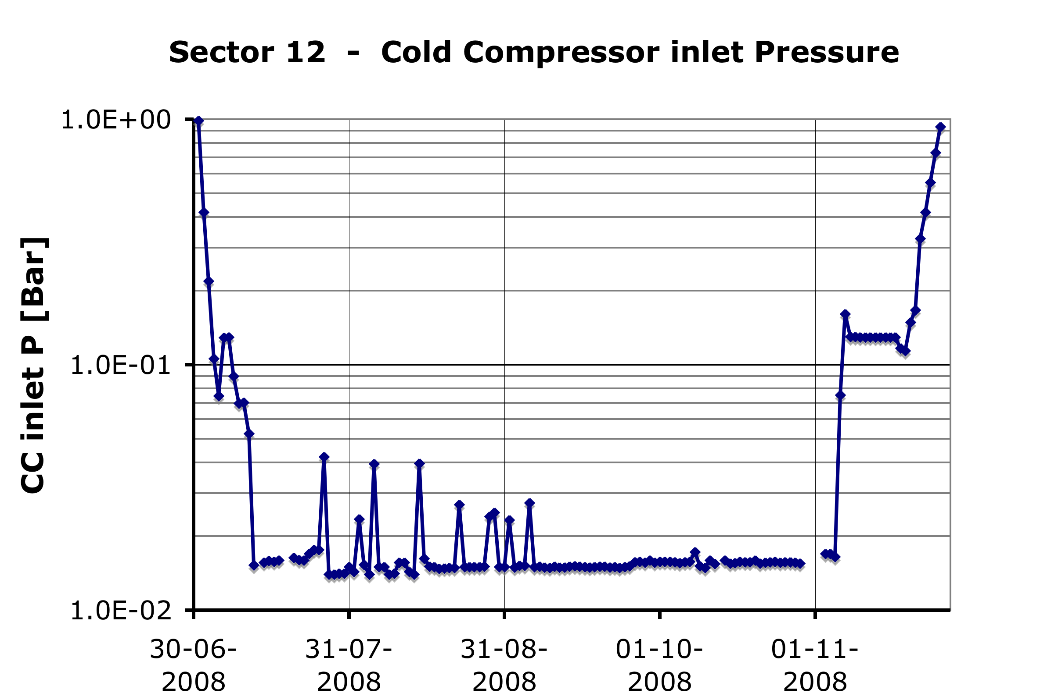
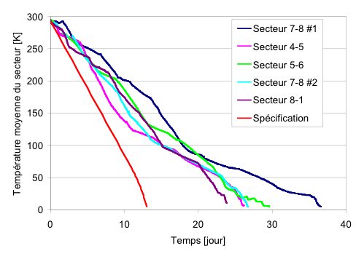
Cryogenics: from cool-down to first beams
≈15K/d x 13 d
“25 days for 20K”
+ 3 days for Filling
+ 2 days for 1.9K
30 days
(4 to 5 wks)
≈8 K/d x 8 d
≈12 K/d x 4 d
S.Claudet

Slide 14

Cryogenics: from cool-down to first beams
1.8 K Refrigeration Unit
Ex-LEP 4.5 K Refrigerator
New 4.5 K refrigerator
1.8 K Refrigeration Unit
Warm Compressor
Warm Compressor
Warm Compressor
Warm Compressor
Station
Station
Station
Station
Surface
Upper Cold Box
Cold Box
Shaft
Lower Cold Box
Cavern
Cold Compressor
Interconnection Box
Cold Compressor
box
box
Distribution Line
Distribution Line
Tunnel
Magnet Cryostats
Magnet Cryostats
LHC Sector (3.3 km)
LHC Sector (3.3 km)
Running two sectors with one cryoplant was tested during powering
Not valid for large transients, but an interesting alternative for low beam loads. It is a validated fall-back scenario if serious problems with a refrigerator
S.Claudet

Slide 15
Cryogenics: from cool-down to first beams
Non conformities were detected, workarounds found during the run and consolidations actions ongoing level gauges on stand alone magnets, DFBLC heat load, valves on current leads, heat loads on the triplet, etc.
Stability was achieved stable services, global refrigeration mastered, 15mbar established, DFB, current lead and beam screen cooling loops stabilised
Recovery from quenches or failures a lot of experience gained and results obtained
Towards more stable services electricity, cooling water controls, insulation vacuum
Getting ready for round the clock operation
S.Claudet

Slide 16
What else did we learn?
The Procedures
The Tools which implemented the procedures and assisted the operators during the execution and the analysis
  Sequencer
  Post-Mortem browser
  PIC supervision
  QPS supervision
  Powering to Nominal (P2N)
  Databases
  … others were developed during the hc
efficiency, automation and no compromise
Some teething problems were identified and were corrected or are being corrected remote resets, communications problems, timing, coherence between time stamps, etc.
M.Pojer

Slide 17
What else did we learn?
Hardware problems
600A-10V LHC type power converters QPS requires a smooth change in current, otherwise it trips
LHC 600A-10V: 0V-crossing distortion
The power converters generate some distortion when crossing through zero voltage with current in the load ➔ QPS trips
600 A-10 V Crowbar Issue
Some PCs don’t have the crowbar and are not safe under certain conditions
Reduced dI/dt and d²I/dt² which could limit operation and physics
ECR to add crowbar on those circuits
Frequent clogging of water filters installed on cables and converters lines
➔ flow reduction and stop of the converter
A decision was taken to change all filters around the machine from the present 50 μ to 100 μ mesh
M.Pojer

Slide 18
Conclusions
Many surprises: training & sector 34
During the commissioning the equipment owners and the operation crews gathered the experience which they expected to re-commission, run and debug the equipment
The incident in sector 34 requires modifications of the hardware, upgrade of protection systems and the development of additional test procedures
While during most of the commissioning campaign the observations matched what was expected; in a few cases however, they revealed non-conformities some of which remain to be understood, followed and corrected or coped with

