Slide 1
Session 8: What we will do for beam preparation in 2009
G. Arduini, R. Giachino

Slide 2
What we will do for beam preparation in 2009
Magnet circuits (A.Vergara)
Powering interlocks (M. Zerlauth)
Beam interlocks (J. Wenninger)
Injection and Beam Dump (J. Uythoven)
RF (E. Ciapala)
SC magnet (re)training (E. Todesco)
Many thanks to
all the speakers!!

Slide 3
What we will do for beam preparation in 2009
Main questions for the speakers:
  What could not be completed in 2008 and needs to be done in 2009?
  Planned modifications and impact on the re-commissioning of the systems.
  New procedures for the commissioning as a function of Sector 34 incident.
  Tools to speed-up the re-commissioning.
  Impact of new access rules on “sectorized” cold check-out in parallel to HW Commissioning.
  Needs and possible strategy for training of the SC circuits for 5 TeV operation or higher.

Slide 4
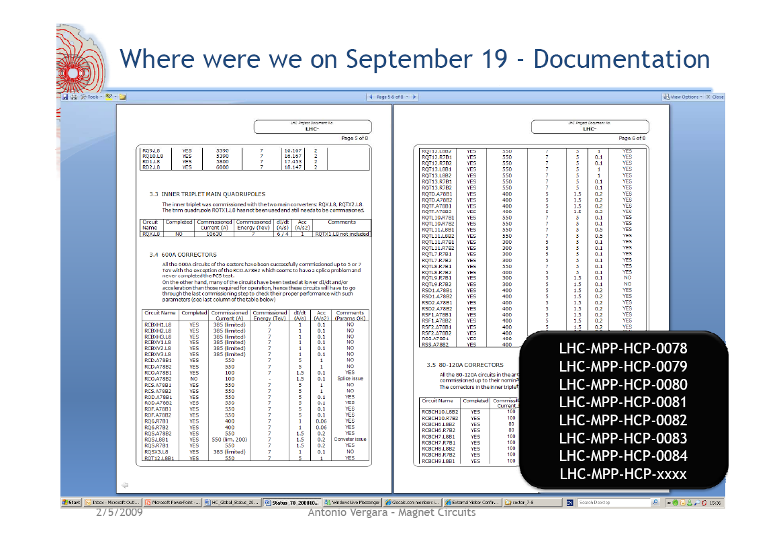
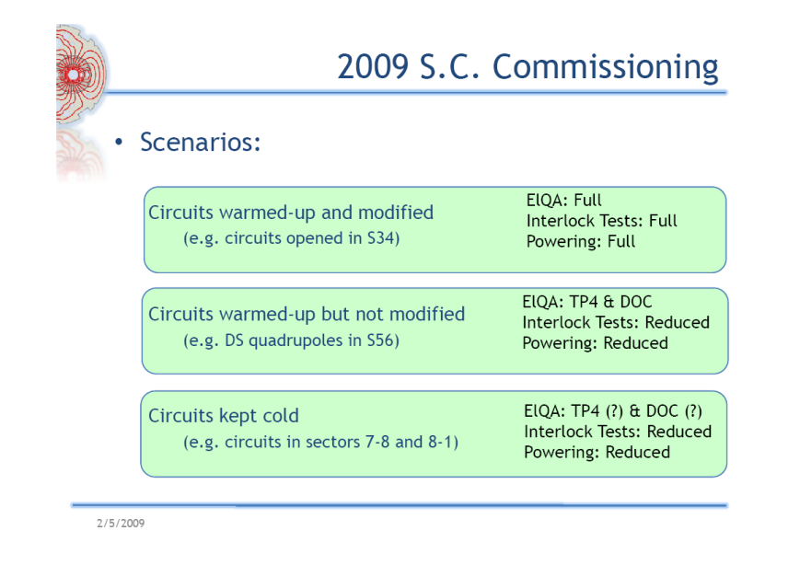
Magnet circuits
Status of the commissioning of the circuits and existing non-conformities known and (being) summarized in EDMS documents
The main lines of the strategy for the re-commissioning are sketched:
  3 different scenarios have been identified
  Possible subsets of tests have been identified
Commissioning up to ≤ 5 TeV does not save powering time but will reduce risks (for main circuits)
Need a review of the parameters required for operation (e.g. current ramp rate and acceleration) before starting the tests
Need re-definition of the detailed procedures for each of the commissioning scenarios above identified ➔ started
A. Vergara

Slide 5
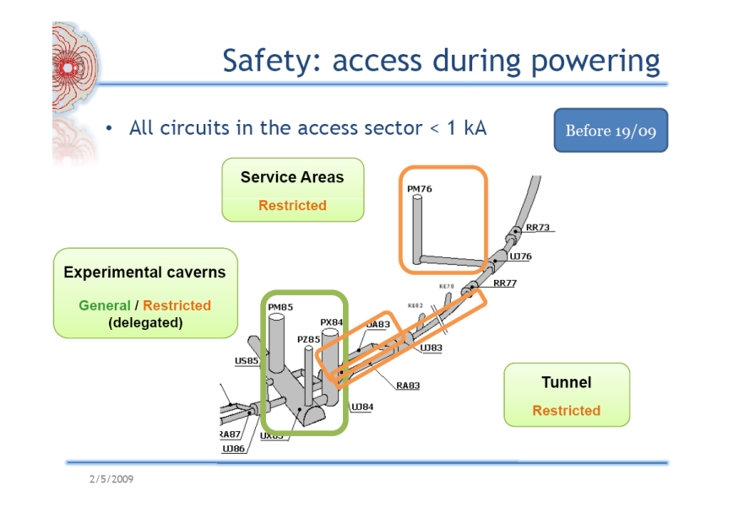
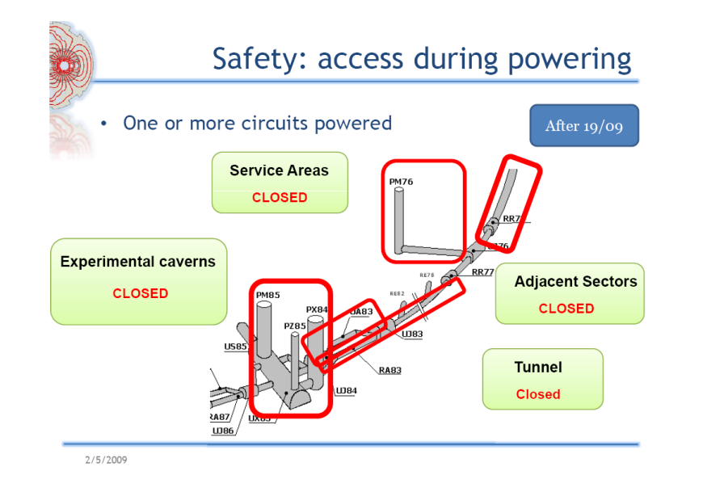
Magnet circuits
Parallelism is possible but will be strongly conditioned by access procedures during powering.
Most of the powering tests at low current
2 access modes/powering phases:
  Sector in Low Current Mode ➔ Restricted access with current limitation (HW)
  Sector in High Current Mode ➔ Machine closed and no current limitation
  Need to define the access conditions during powering ➔ ongoing
  Tools for showing on-line powering conditions and compatibility with access are needed
Possibility of running nights/WE: feasible? Enough expert coverage? Many people involved in HW Commissioning have left!
A. Vergara

Slide 6
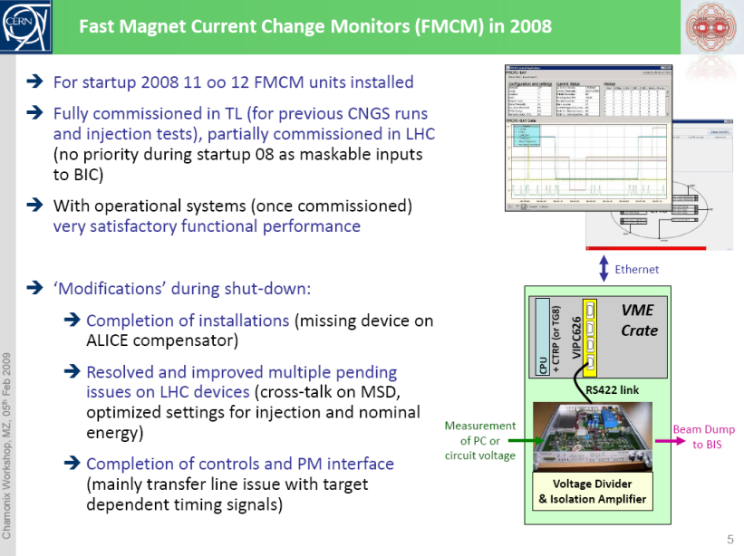
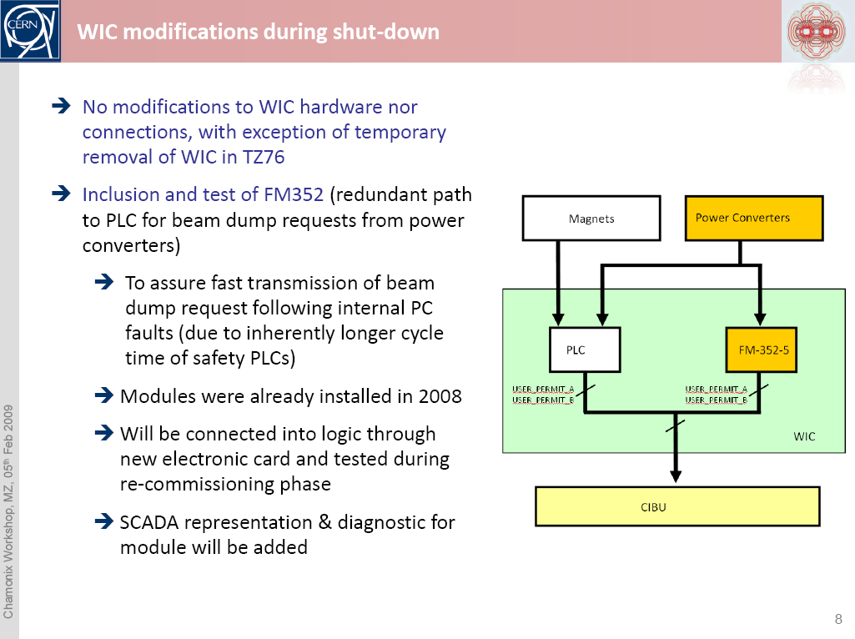
Powering interlocks
Modifications ongoing in the protection of the warm magnet circuits:
  FMCM (12 circuits):
    To complete the installation (1 –unused- circuit missing on 10/9)
    To improve settings for full operational range (injection to nominal) and complete controls interface
  Warm Magnet Interlock Controller (45 circuits):
    To add redundancy and even faster reaction time (required for operation with “unsafe beams”)
Need full re-commissioning
Given the limited number of circuits and the limited time required for the commissioning of a circuit no automatic procedure will be available for 2009 (but later)
M. Zerlauth

Slide 7
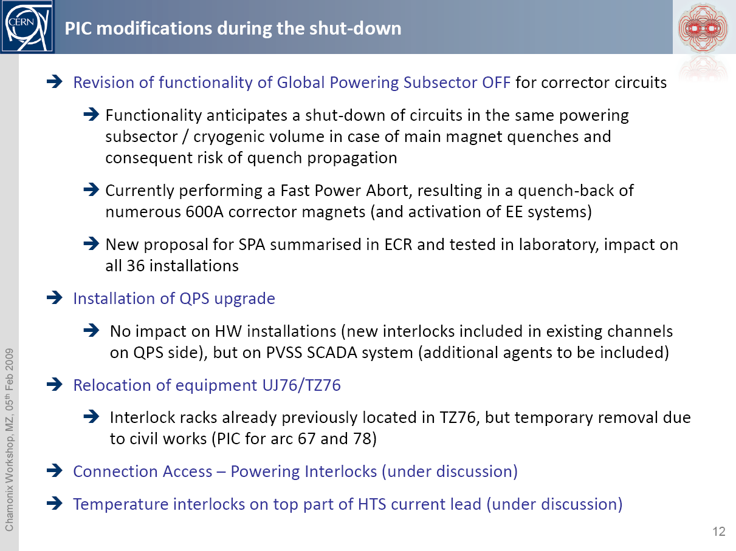
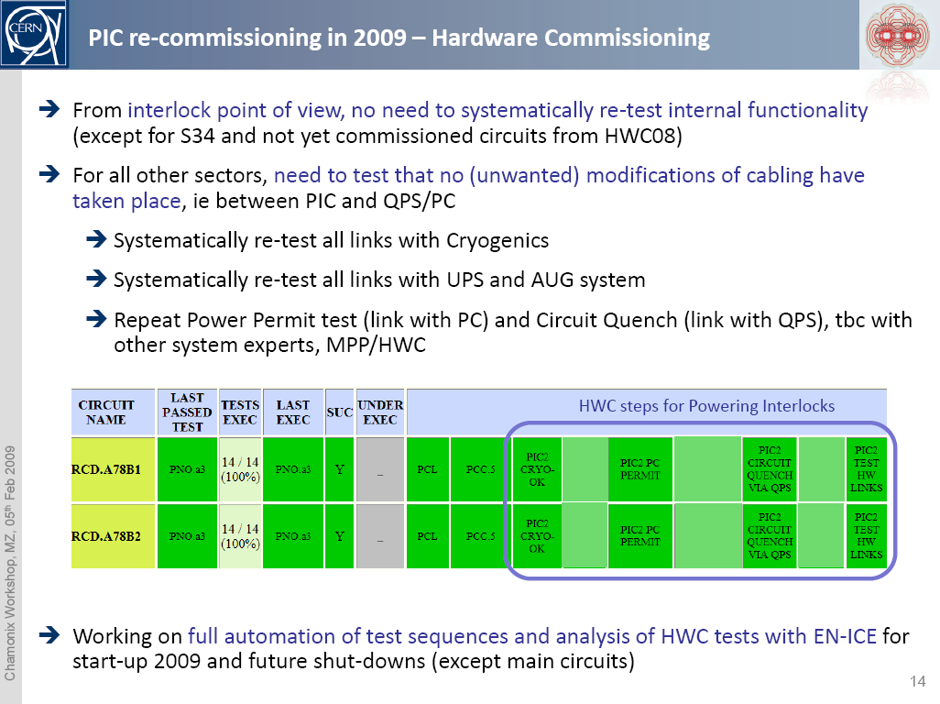
Powering interlocks
Powering Interlock Controller (820 circuits + 752 - 60 A orbit correctors). No modification of the HW but:
  Different logic for the “Global Powering Sub-Sector”
  Relocation of equipment due to civil engineering in TZ76
  A New QPS System connected to PIC.....
Except for Sector 34 (to be considered a new sector) HWC steps for powering interlocks need to be repeated ➔ automatic procedure being put in place (except for main circuits)
Automatic tests procedures for the PIC to BIC connection verification are available as well (1 hour/sector)
Potential issue: Robustness of CPLD XC95144 used in PIC against Single Event Upsets after recent radiation tests (not conclusive yet).
M. Zerlauth
Notes:
complex programmable logic device

Slide 8
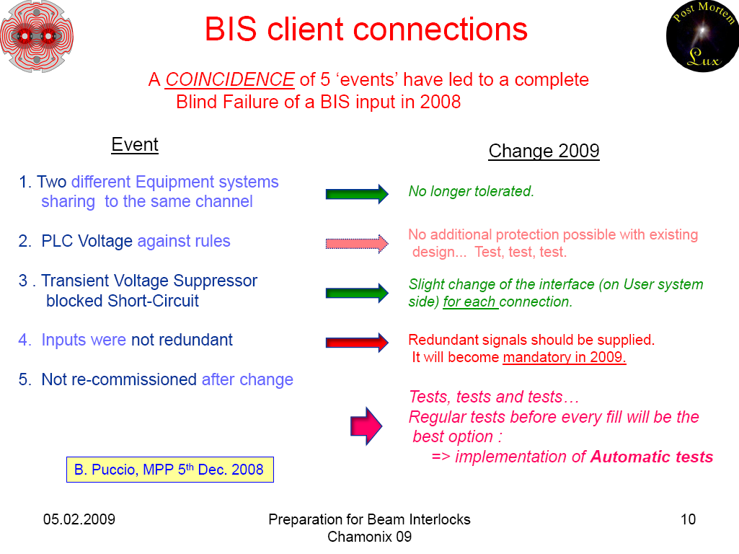
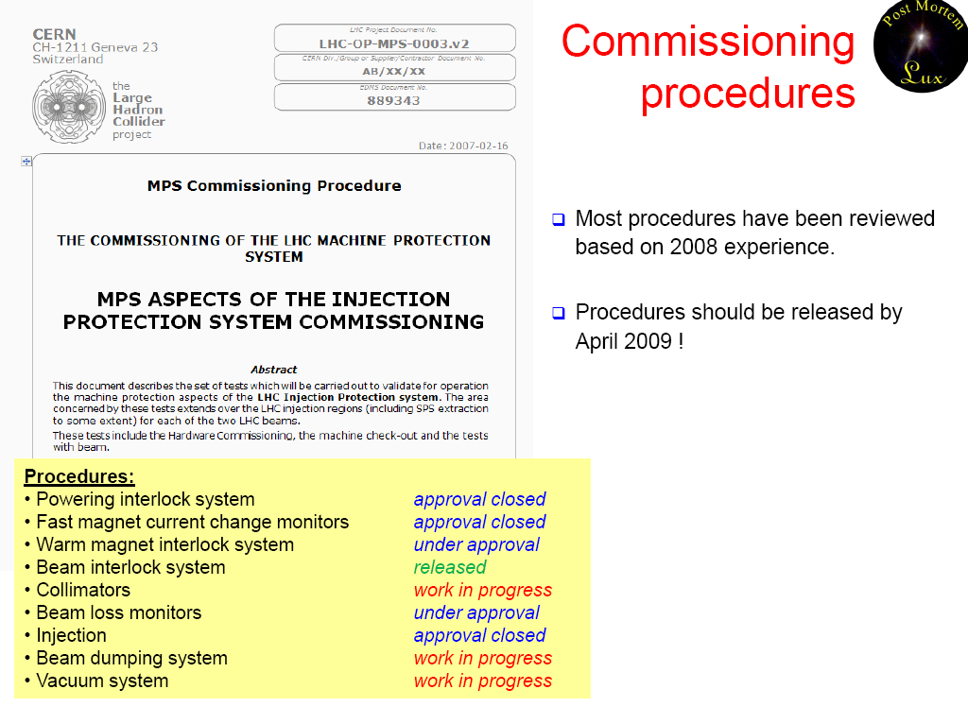
Beam Interlocks
Very large Beam Interlock System (BIS):
  ~10000 devices/interlocks connected to Beam Interlock Controllers (BIC)
  ~3800 Software Interlocks
2008 experience & status:
  Blind failure detected during LHC cold check-out ➔ solution in place for 10/9
  Definitive changes and measures being implemented during the SD ➔ 2 new channels (+ additional one)
  Safe beam flag not commissioned (we ran only with probe beam)
Full test needed of all the system
Automation is a must ➔ started in 2008 (e.g. PIC-BIC connection) ➔ being extended
Documentation/issue tracking effort ongoing (procedures, MTF)
J. Wenninger

Slide 9
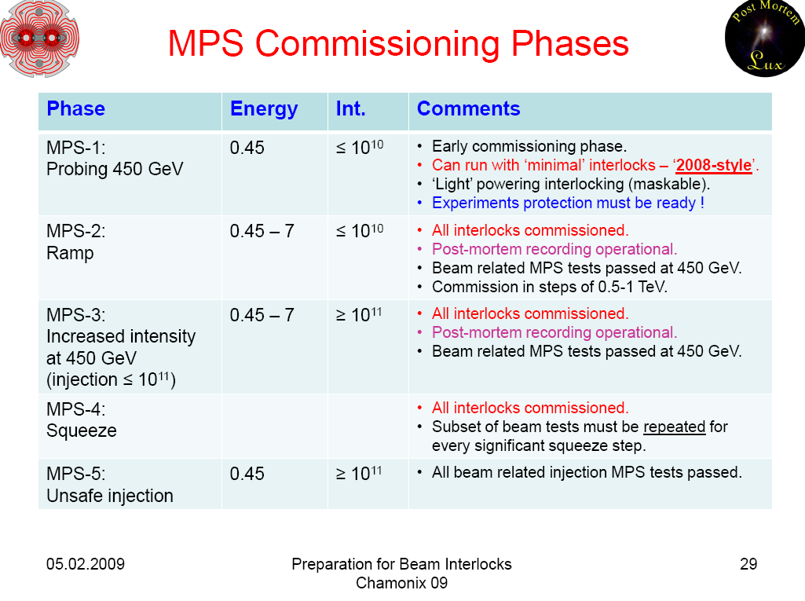
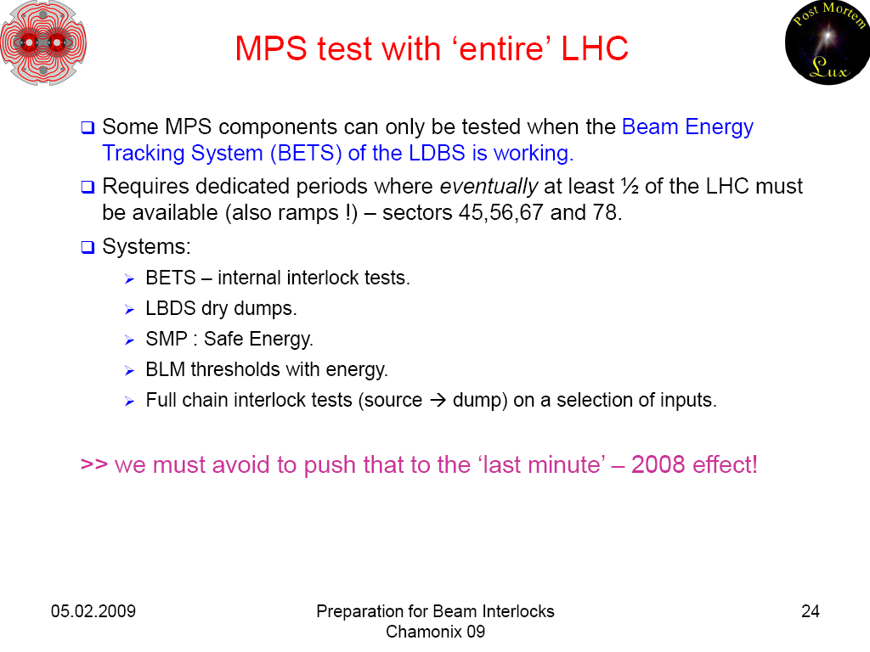
Beam Interlocks
Reliability run is needed for the BLM system (~4000 channels) on top of radioactive source verification.
Post-mortem (including BIS, powering and BI) is needed.
Phases for the commissioning identified to provide some flexibility for safe beam and MPS parallel commissioning:
  few days with machine closed and operational are needed to commission the Beam Dump System + BIS for low intensity and energy operation
  Rule of the Probe: go back to probe beam any time new territory is explored (energy, optics, ...)
Need MPS Experts to trigger and follow-up MPS staged/safe commissioning and to support Machine Coordinators/EiCs in the definition of the possible envelope of operation in case of abnormal operation of any BIS element.
J. Wenninger

Slide 10
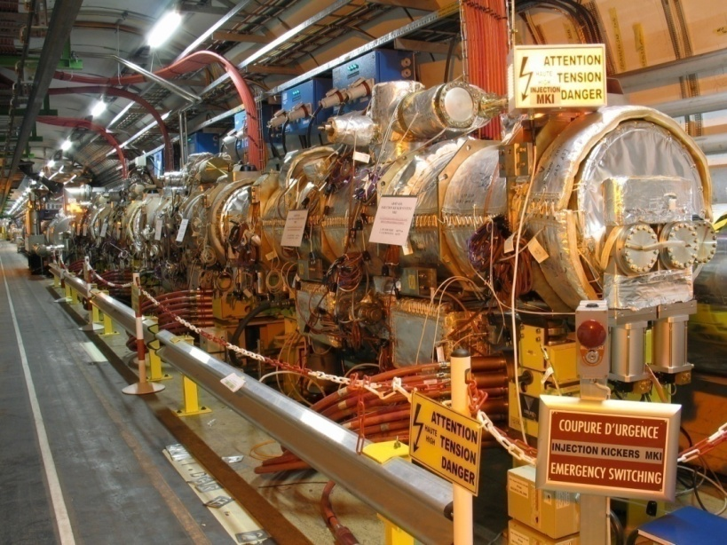
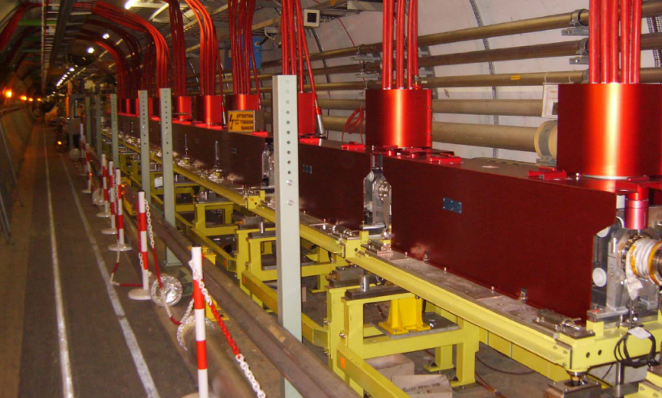
Injection and Beam Dump
2008 experience thanks to dry runs:
  MKI magnet D in LSS2L showed a breakdown (over-voltage during lab conditioning?) ➔ replaced by spare
  MKI flashovers due to beam loss (aperture studies)?: ➔ BLM installation (interlocks?) and improved conditioning sequence (SoftStart)
  Injection absorbers (TDI) and TI8 transfer line collimators (TCDI) being “consolidated” ➔ need re-commissioning
  Effect of the injection magnetic septum (MSI) stray field on the circulating beam orbit ➔ need to test possibility to run magnetic septum in DC
  Dependence of the strength of beam dump extraction kickers MKD on tunnel temperature (~ -0.2%/⁰C) ➔ Regulation of the MKD generator temperature & interlock on it at ±1 ⁰C ➔ need operational experience ➔ availability !!
J. Uythoven

Slide 11
Injection and Beam Dump
Beam 2
Beam dump dilution kicker (MKB) flashovers:
  Weak elements identified and replaced
  “Common mode” failure due to vacuum deterioration ➔ reduction of conductance and additional pumping speed
  MKBH installation will become nominal
  MKBV: 4 out of 6 magnets
J. Uythoven
Jan Uythoven, TE/ABT
➔ Beam Dump Reliability run is needed: > 4 weeks effective running for failure statistics
Energy tracking to be tested before beam (main bends in 45/56/67/78) ➔ coordination required
Additional redundancy will be added for the verification of the position of TCDQ collimator (protecting Q4 and the arc in case of asynchronous dump): ‘independent’ check vs. beam energy (now only triggered via timing)

Slide 12
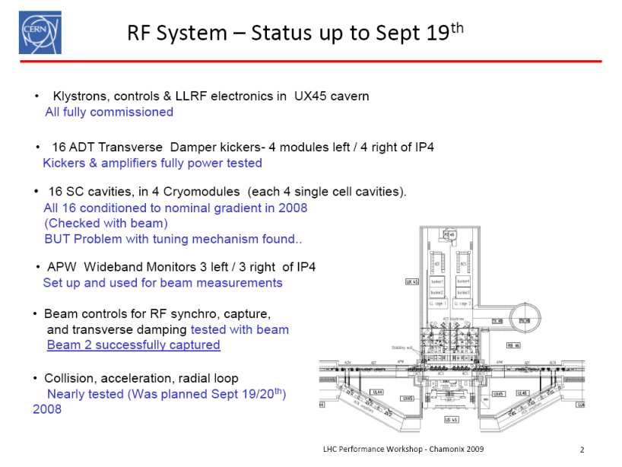
RF
Some of the Beam Controls systems could not be tested with beam due to the abrupt stop on 19/9 ➔ still a lot of work to be done!
No damage to the RF systems on 19/9
Similar event close to IP4, with sector valves open would result in dust contamination or even mechanical damage ➔ Need to keep valves closed during powering tests without beam
E. Ciapala
Use of fast sector valves evoked but perhaps only limited protection for cavities from vacuum incidents occurring in the LSS and additional risk that the beam might not be dumped before the valves close with more severe risk of damage for the cavities.

Slide 13
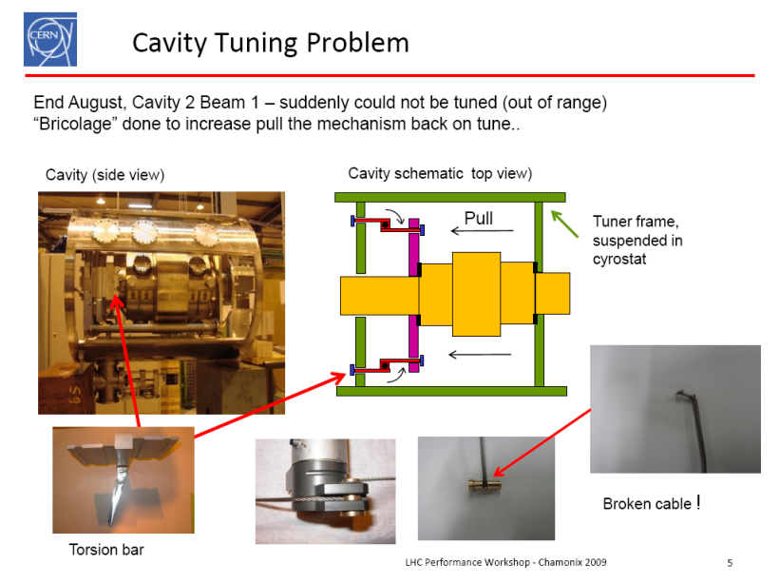
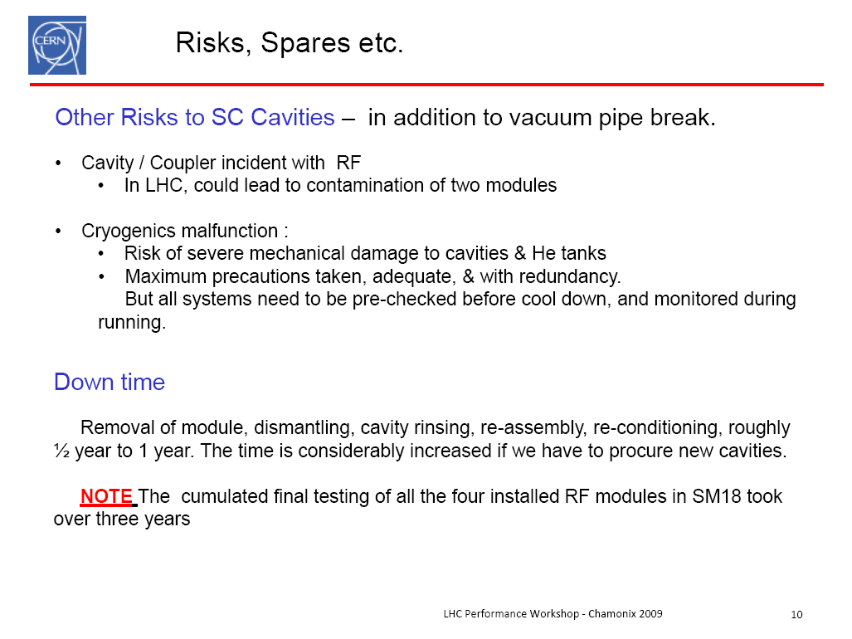
RF
Weakness in the tuning system detected and being repaired
Powering tests of the acceleration and transverse damping system are required. In particular Cavity Conditioning.
Access restrictions in UX45 can slow down this process ➔ definition of access procedures
Situation of the spares is worrying
  Proposal to purchase 3 more spare cavities + He tanks (~300 kCHF) whilst companies have still the know-how.
  Possible to run cavities to ~half gradient should be possible (limited voltage at capture)
E. Ciapala

Slide 14
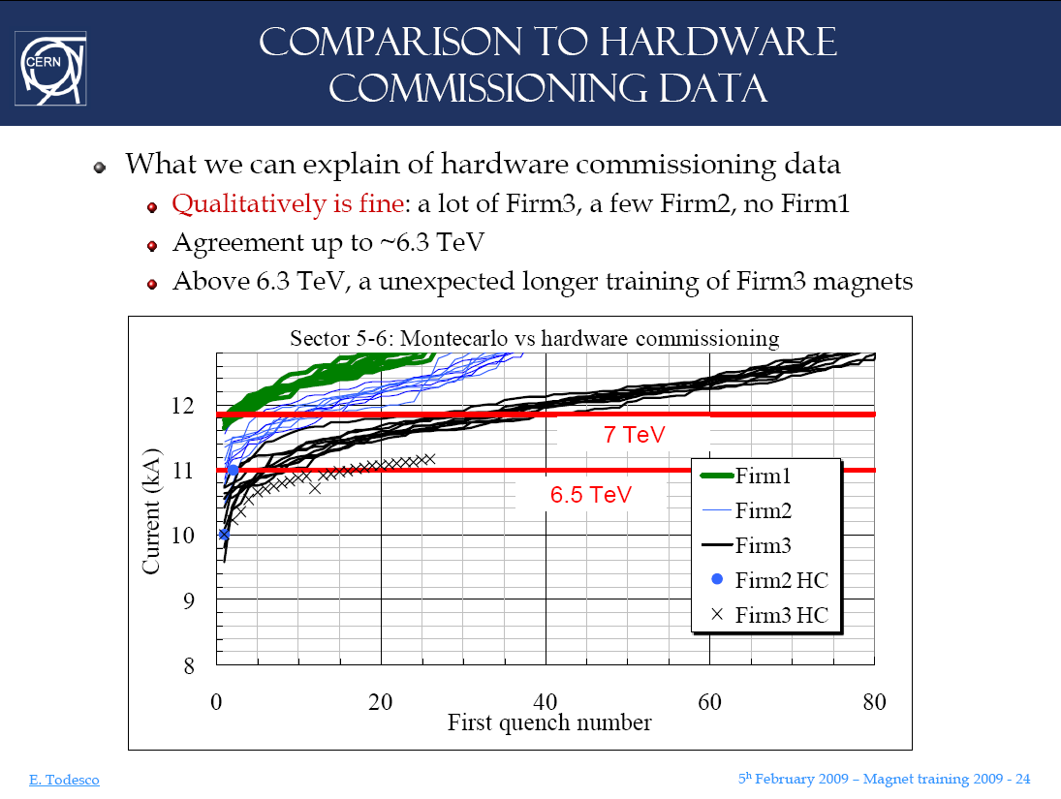
Magnet (re)training
Analysis of the data collected in SM18 and during HW Commissioning for all the magnet types
For the dipoles Monte-Carlo simulation of the training based on SM18 and HW Commissioning data
Comparison of the model with the experience in Sector 56 is good up to 6.3 TeV equivalent current
E. Todesco
Retraining estimates (mainly dominated by dipoles):
  5.5 TeV: a few (<5) quenches over all the machine
  6.0 TeV: ~15 quenches from MB, 5 from MQM and 5 from MBR
  6.5 TeV: ~80 quenches from MB, 5 from MQ, 15 from MQM-Y, 10 from MBR
Difficult to give an estimate of how to get to 7 TeV before having the experience of at least one octant

Slide 15
Conclusions
Quite some modifications are taking place on top of those resulting from the Sector 34 incident or as a result of the experience collected during HWC/Dry Runs/Machine Check-Out/Beam Commissioning in 2008
We know what needs to be re-commissioned
For the superconducting circuits the following issues need to be addressed and are being addressed:
  New procedures for powering safely taking into account the modifications of the magnet protection systems
  Definition of access conditions during powering
  As a result of the 2008 experience the steps for a staged commissioning of the Machine Protection System have been sketched ➔ This requires in particular a period of a few days with machine closed and operational before establishing circulating beam.
  In general we know how to do the Commissioning (2008 experience) but some of the people have left ➔ procedures, automation are essential
  Number of spare RF cavities to be increased before the know-how in industry is lost
15

