Slide 1
LHC Phase 1 upgrade: low β quadrupoles
Paolo Fessia
Insulation development: D. Tommasini, P Paolo Granieri, D. Richter
Magnetic Design: E. Todesco, F. Borgnolutti
Protection: N. Schwerg
Mechanic Design: F. Regis

Slide 2
Summary
Approach to the problem and original planning
The starting blocks
The development of a new porous insulation and other efforts to be able to cope with thermal load
The conceptual magnetic design
The conceptual mechanical design
The resulting coccept

Slide 3
The Approach to the problem
Guide-lines
Maximum use of material and components that have been purchased for the LHC construction, but not used
(this taking into account that we need to keep safety margins for the LHC exploitation).
Use of existing tooling that can be modified, but in such a way to be fully operational for the original use (if needed for LHC).
Exploitation of LHC magnets used and proved techniques, possibly limiting R&D efforts and reducing technological risks

Slide 4
Magnet program planning as set in February 2008
Phase | Task | Start | Completion
Model | Tooling installation | 01/02/2008 | 01/02/2009
 | Models construction | 01/09/2008 | 01/07/2009
Prototype | Prototype and series tooling installation | 01/02/2008 | 01/01/2010
 | Prototypes construction | 01/10/2009 | 01/09/2010
Series | Series production | 01/10/2010 | 01/06/2012 Date of completion or delivery of last quadrupole. Production sequence optimized for installation and construction
Procurement | Specifications and invitation to tender for prototype and series components | 01/02/2009 | 01/09/2009
 | Delivery of components | 01/10/2009 | 31/12/2011
After ¾ incident delayed
of 6 months at least

Slide 5
The starting blocks
Material | Availability | Constraints on | Need of extra purchase
SC cables: LHC-MD inner and outer cable | 205 inner U.L. (448 m) 172 outer U.L. (760 m) | Conductor distribution design | no
Steel for collars | 136 ton YUS 130 | Mechanical design | Ap. 120 mm-> need 106 ton
Iron for yoke laminations | 262 ton Magnetil | Max outer diameter of cold mass. Probably mix of different iron lamination thicknesses | Need 700 ton-> decided to purchase all the needed material
MD tooling | Curing press Welding press | Max cold mass outer diameter, max coil length | Modification for flexible use

Slide 6
Selection of type 1 cable

Slide 7
Selection of type 2 cable

Slide 8
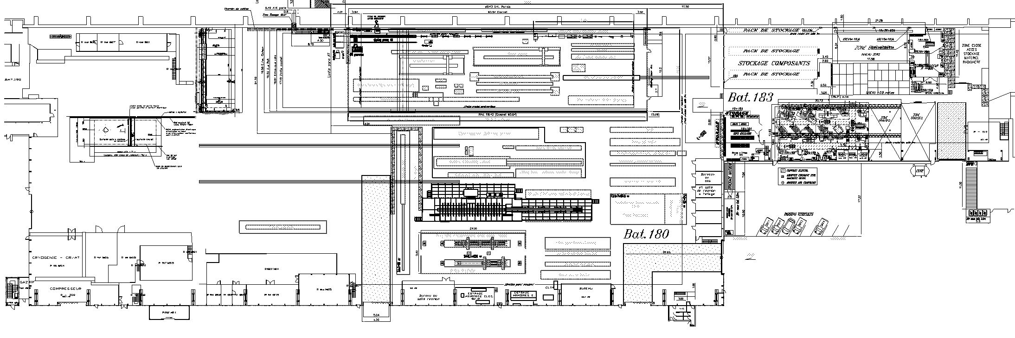
AT
PH
Notes:
8

Slide 10
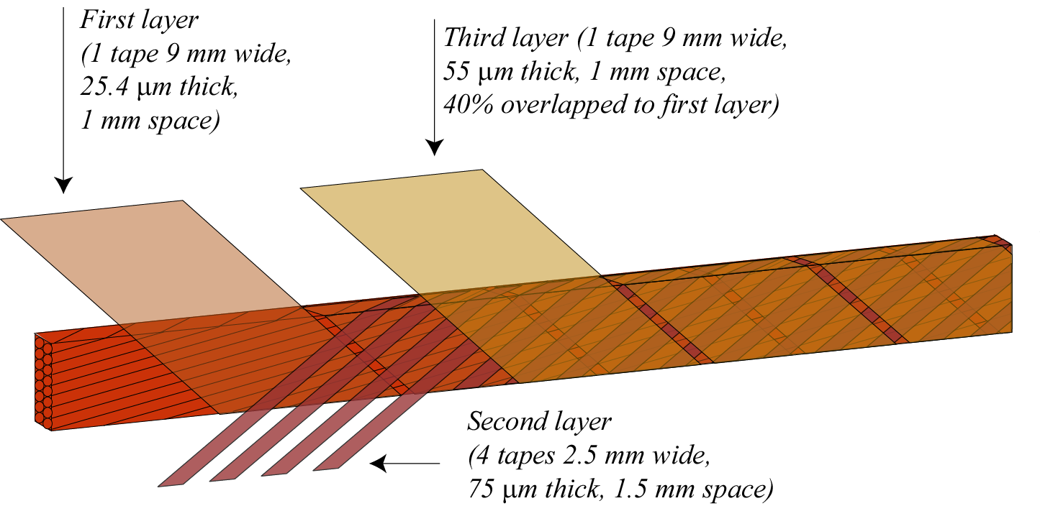
Development of new porous insulation topology: aim
Provide adequate electrical insulation
Increase the heat removal in order to better cope with the energy deposited by the I.P. debris
E-modulus should be not be too much reduced and the coil should be creep stable
Suitable to be industrialized:
  Commercially available material
  Use of Dipole recovered insulating machine
Third layer 1 tape 9 mm wide 69 µm thick and 1 mm space
50 µm
Second layer 1 tape 3 mm wide 50 or 75 µm thick and 1.5 mm space

Slide 11
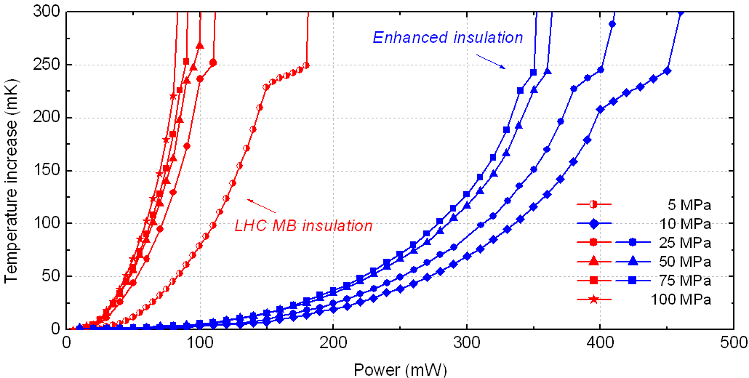
New results up to T λ

Slide 12
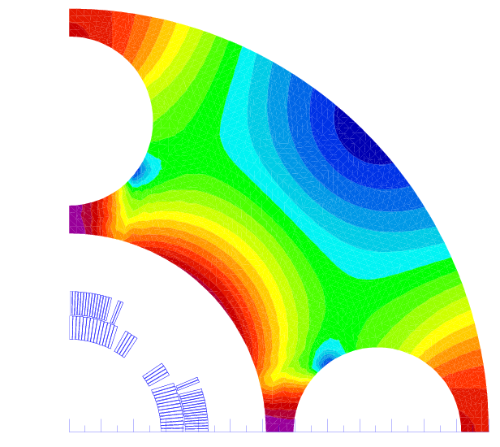
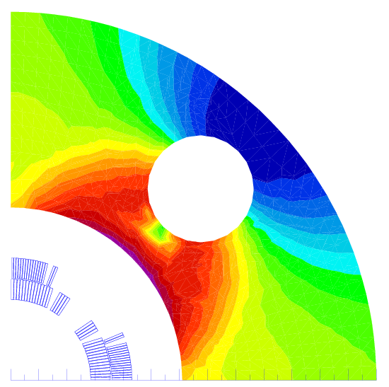
MQXC cross sections and iron yoke with heat exchanger(s)
Two possible solutions for heat exchanger proposed by the cryogenic team:
2 heat exchanger in parallel inner diameter 71 mm (1st eval. wall thickness 2.5 mm). Hole diameter 80 mm
1 heat exchanger inner diameter 100 mm (1st eval. wall thickness 3.5 mm). Hole diameter 110 mm
Both are large holes in the iron that affect transfer function and field quality
We can consider 2 possible configurations
Holes along the 2 mid-planes (larger effect on the transfer function)
Holes at 45 ⁰
We prefer solution with 1 heat exchanger on the vertical mid plane because of
Simpler interconnect
Standardization of cold masses respect 1 heat exchanger at 45 ⁰

Slide 13
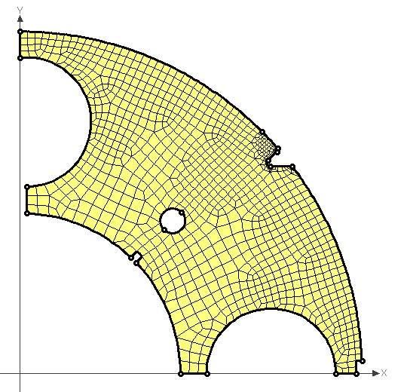
Effect of a slot in the iron on the magnetic field quality
Odd multipoles are not affected
Only even multipoles b₄, b₆, b₈ and b₁₀ are affected (multipole variation higher than 0.0001 unit)
gap
 | gap 1mm | gap 2mm | gap 3mm
Δ b4 | 0.0340 | 0.0656 | 0.0978
Δ b6 | -0.0174 | -0.0362 | -0.0536
Δ b8 | 0.0010 | 0.0020 | 0.0029
Δ b10 | -0.0002 | -0.0004 | -0.0006

Slide 14
Gradient respect cable used in the cross section

Slide 15
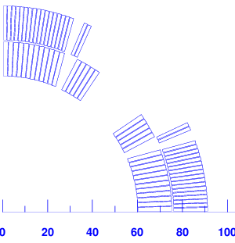
Proposed Coil Cross-Section
Coil blocks features
Angular position of the point 1 & 2
  (mechanical requirement: angles < 41º)
  Point 1: ~35º
  Point 2: ~26º
Block Nº | Nb Cond | r (mm) | φ (º) | γ (º) | cable type
1 | 12 | 60.00 | 0.2101 | 0.000 | Cable 01
2 | 5 | 60.00 | 25.728 | 27.757 | Cable 01
3 | 17 | 75.92 | 0.1849 | 0.000 | Cable 02
4 | 2 | 75.92 | 23.501 | 22.762 | Cable 02
1
2
MQXC V24

Slide 16
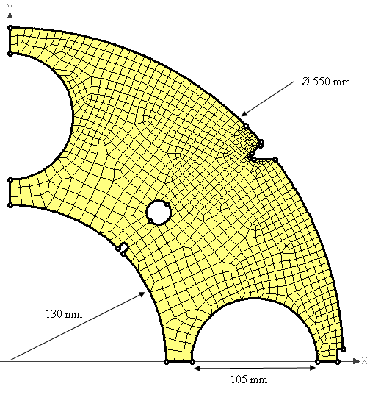
Iron Yoke Dimensions
Distance between coil outer radius and iron inner radius is of ~ 38.6 mm.
He holes are radialy centered. this lefts about 20 mm of matter on each side.
The small hole (Ø 20.5 mm) is used for the rods. It can be moved somewhere else because its impact on the multipoles is low.
20 mm

Slide 17
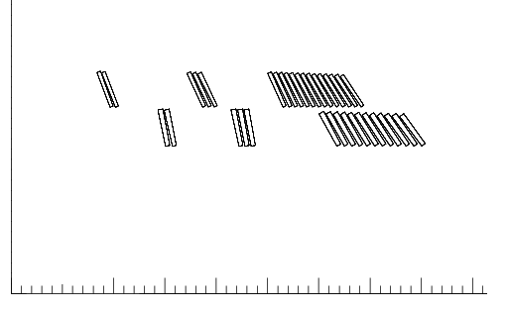
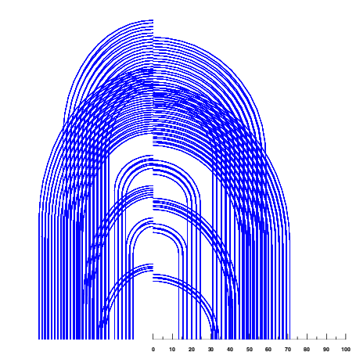
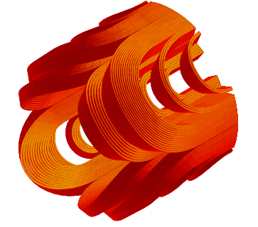
NCS head design

Slide 18
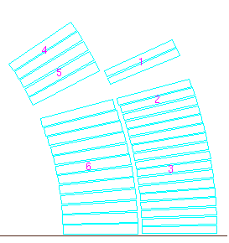
Peak field in the head,
30 mm of coil more and a lot more of margin in the head
 |  | straight part |  | head | B peak | ss field | % ss cur
no Iron Yoke | cable 01 | BS1 | 6.5 | 6.6 | cb01
 |  | BS2 | 7.3 | 7.4 | 7.4 | 9.6 | 77
 | cable 02 | BS3 | 5.7 | 6.1 | cb02
 |  | BS4 | 6.1 | 6.4 | 6.4 | 8.4 | 75
unsat Yoke | cable 01 | BS1 | 7.3 | 7.3 | cb01
 |  | BS2 | 8.1 | 8.1 | 8.1 | 9.9 | 82
 | cable 02 | BS3 | 6.4 | 6.7 | cb02
 |  | BS4 | 6.8 | 7.2 | 7.2 | 8.8 | 82
real Yoke | cable 01 | BS1 | 7.1 | 7.2 | cb01
 |  | BS2 | 7.9 | 8.0 | 8.00 | 9.8 | 81
 | cable 02 | BS3 | 6.6 | 6.6 | cb02
 |  | BS4 | 6.6 | 7.0 | 7.03 | 8.7 | 81
2
4
1

Slide 19
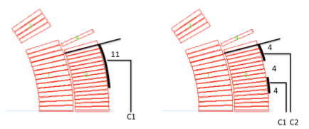
Protection Study
 |  | Nominal Current |  | Half Current
Setup |  | T peak | MIITs | T peak | MIITs
Dump resistor 40 mOhm, 10 ms delay |  | 117 | 33.6 | -- | --
 |  | 157 | 33.3 | 78 | 23.0
 | 20ms extra delay | 157 | 36.4 | 78 | 23.7 | Hot spot in outer layer
 | only half of the heaters | 220 | 38.1 | 103 | 27.5
 |  | 180 | 35.2 | 86 | 24.5
 | 20ms extra delay | 217 | 38.0 | 104 | 27.6
 | only half of the heaters | 221 | 43.4 | 102 | 30.8
 | + Dump Resistor | 118 | 29.4 | 50 | 15.2 | Hot spot close to heater
 | + Dump Resistor, half of heaters | 136 | 29.8 | -- | -- | Heater failure uncritical

Slide 20
Forces in few quads per octant

Slide 21
Key layout analysis
Forces repartition on keys according to
1key or 2key layout per quadrant structure
24 degrees
15 degrees

Slide 22
Key layout analysis
    Coil radial displacement in function of the angular distance between keys

Slide 23
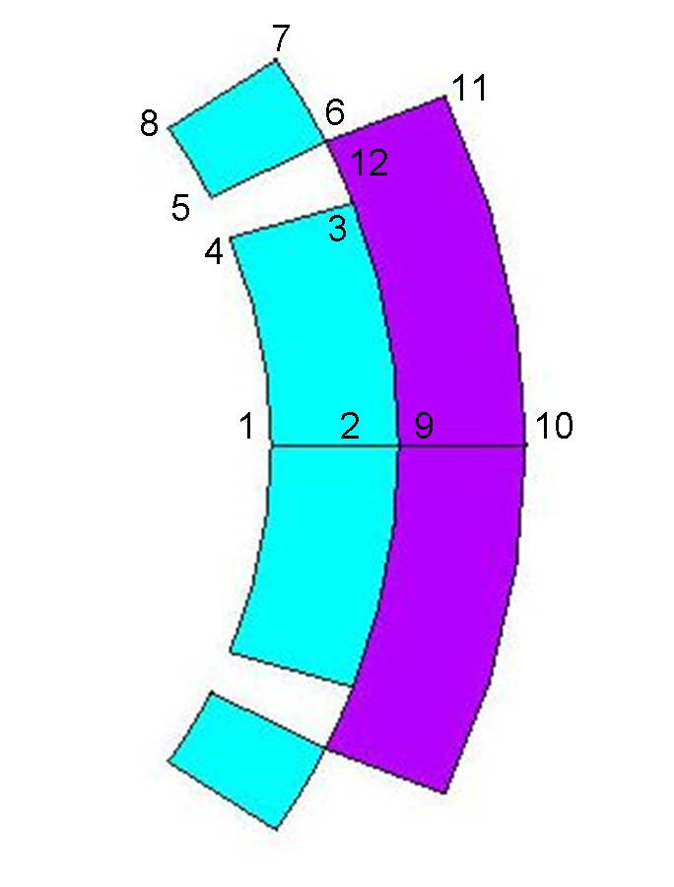
FE analysis – radial displacement

Slide 24
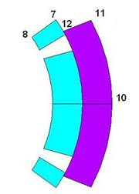
FE analysis – bending effect
∅=120mm I.L.
Notes:
24

Slide 25
Magnet and cold mass concept
 | Solution | Remarks
Coil | 2 layers independently cured with a splice and layer jump | Best use of available SC material. Re-use of LHC MB experience for layer jump
Collar | Thick self standing collars | Reduce cost of fine- blanking for collars and yoke due to mechanical de-coupling. Reduced influence of cold mass assembly on field quality a part from iron saturation and alignment
Yoke | 1 Lamination to make the yoke | Reduce cost of fine blanking for yoke
Cylinder | 10 mm thick shells not contributing to mechanical efforts. No pre-stress | Possibility to use other steels then 316 LN
Cylinder weld | No stress in the cylinder and therefore reduced stress in the weld | It is leak tight weld for which whatever weld process can be chosen and for which we can release acceptance criteria

Slide 26
Magnet and cold mass concept
 | Solution | Remarks
Ground insulation | Same scheme as MQ or MB ground insulation with 4 layers of 0.125 polyimide. Double G.I. on mid plane to provide handle for field quality and increase insulation between 1st and 2nd layer (as MB)
Q. H. | Use of intermediate G.I. foil between coil and Q.H. Use of connection without omegas | Increase reliability
Heat exchanger position | 1 large internal heat exchanger 100 mm i.d. 110 mm hole in yoke. Position vertical mid plane. Available He volume for control from 95 cm^2 to 285 cm^2 | Allows interchangeability of magnets
Cold mass support | Possibly 2 feet. With 10 m long cold masses with cylinder 10 mm thick a 1st estimation gives a max deflection of -0.35 mm with an average of -0.16 mm. This is the preferred choice for the moment for the cryostat design

Slide 27
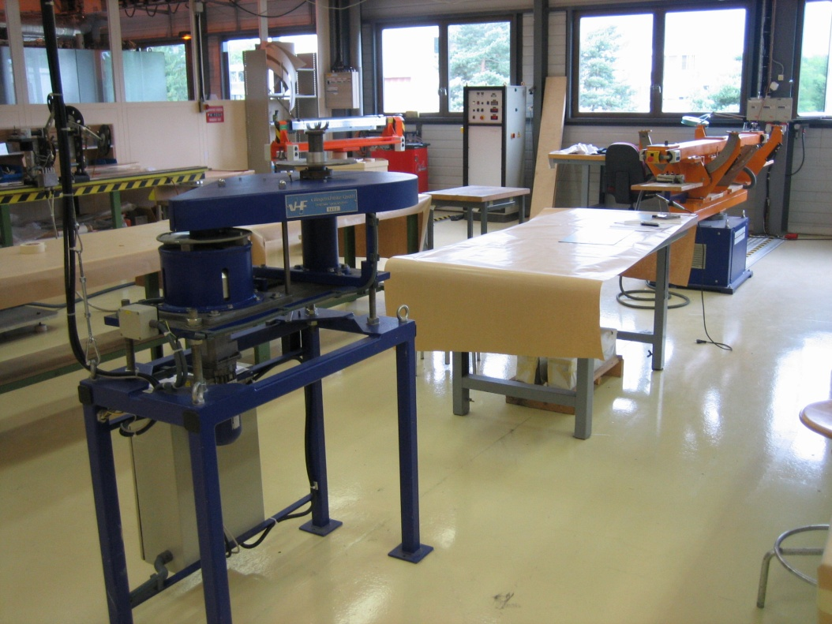
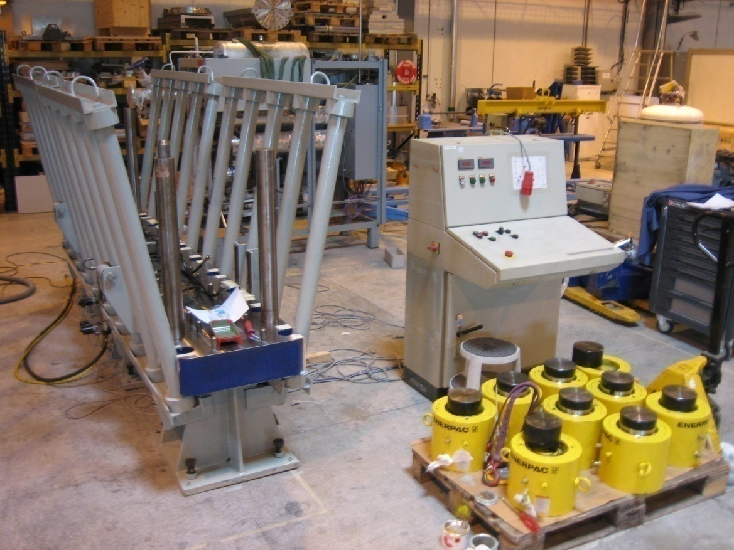
927 installation for model

Slide 28
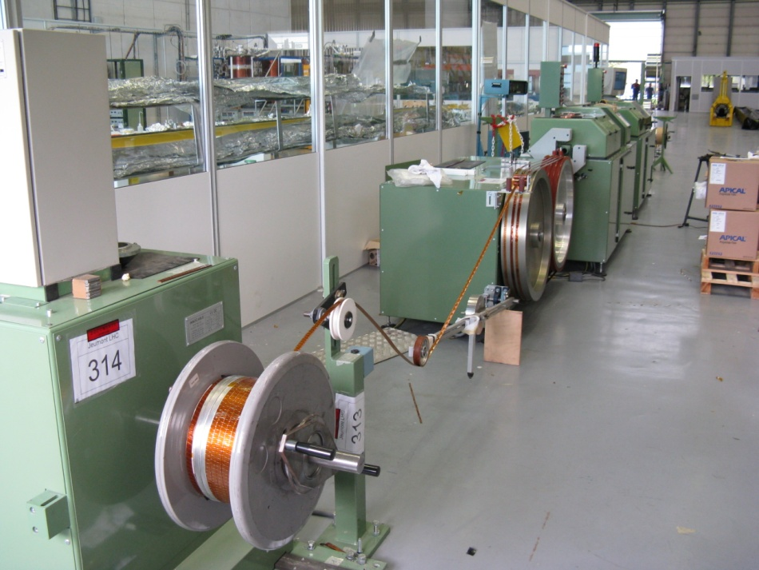
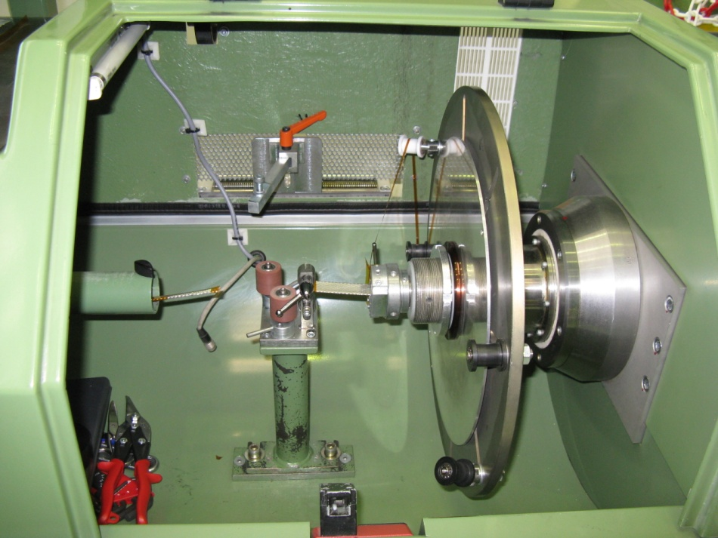
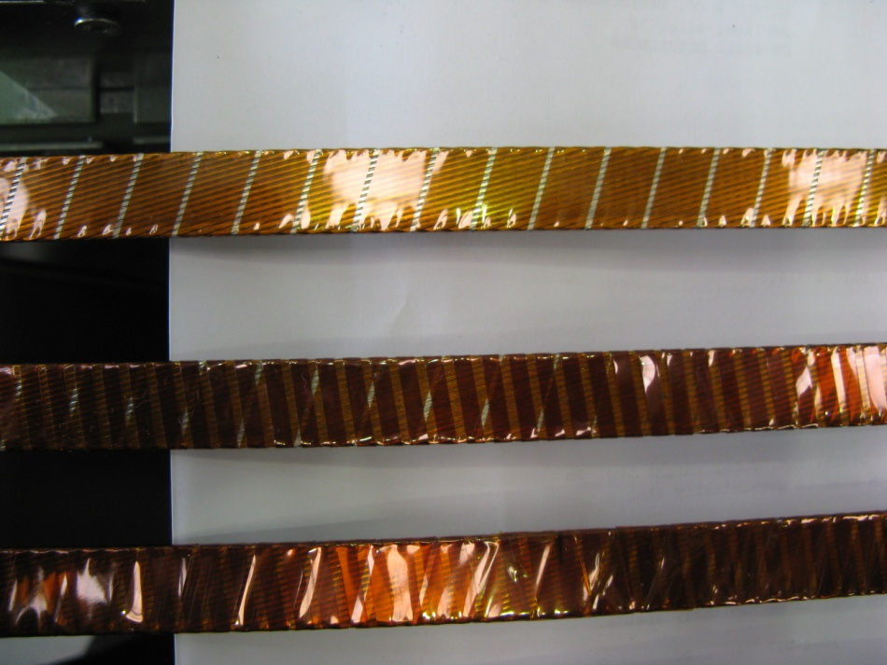
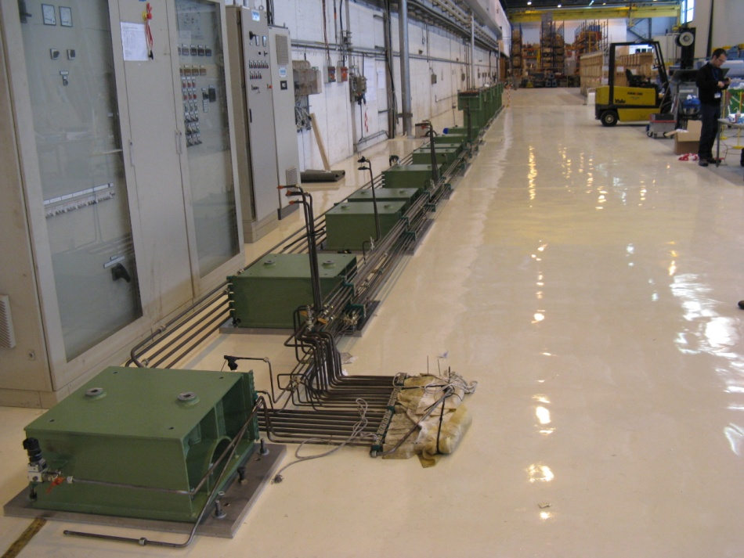
180 installation for model and prototype

