Slide 1
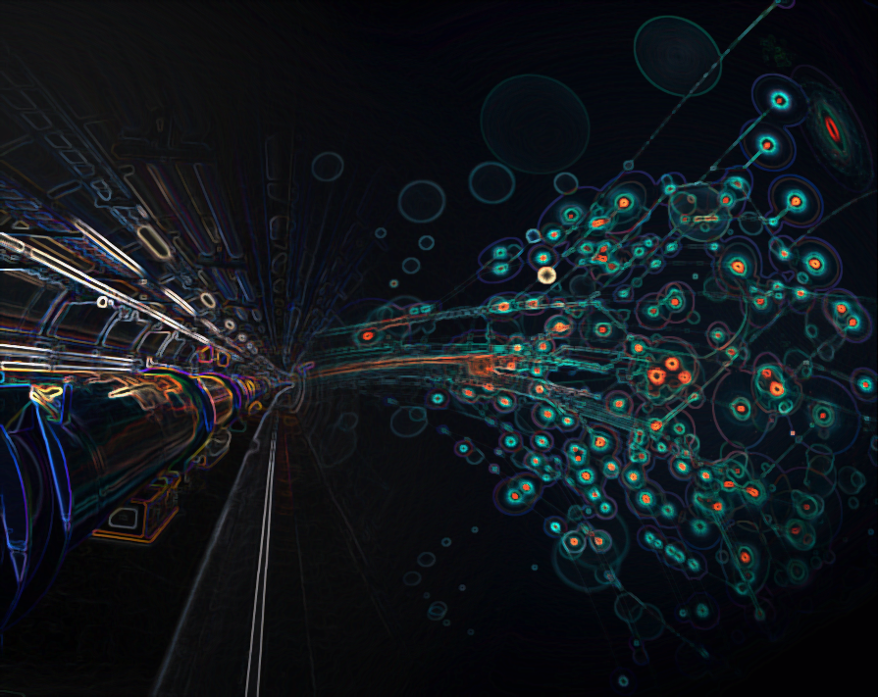

FCC-Saclay Meeting
R. Aleksan
Saclay
May 11, 2015
General News

Slide 2
Informations générales
Réunion Générale FCC 2016 à Rome
11-15 avril
> 450 personnes (des demandes d’inscription ont dû être refusées)
Collaboration FCC inclue 74 labos (ayant signé un MoU)
Les études avancent vraiment bien
  Voir l’agenda et les présentations
  https://indico.cern.ch/event/438866/overview
  Ceci est particulièrement vrai pour les machines FCC-hh et ee où on rentre dans certains détails techniques
Prochaine Réunion Générale FCC à Rome
Fin mai- debut juin 2017 en Allemagne (Berlin probablement)

Slide 3

FCC Collaboration Status
74 collaboration members & CERN as host institute, March 2016
UT Enschede, Netherlands
U Geneva, Switzerland
Goethe U Frankfurt, Germany
GSI, Germany
GWNU, Korea
U. Guanajuato, Mexico
Hellenic Open U, Greece
HEPHY, Austria
U Houston, USA
IIT Kanpur, India
IFJ PAN Krakow, Poland
INFN, Italy
INP Minsk, Belarus
U Iowa, USA
IPM, Iran
UC Irvine, USA
Istanbul Aydin U., Turkey
JAI, UK
JINR Dubna, Russia
FZ Jülich, Germany
KAIST, Korea
KEK, Japan
KIAS, Korea
King’s College London, UK
KIT Karlsruhe, Germany
KU, Seoul, Korea
Korea U Sejong, Korea
U. Liverpool, UK
U. Lund, Sweden
MAX IV, Lund, Sweden
MEPhI, Russia
UNIMI, Milan, Italy
MIT, USA
Northern Illinois U, USA
NC PHEP Minsk, Belarus
U Oxford, UK
PSI, Switzerland
U. Rostock, Germany
RTU, Riga, Latvia
UC Santa Barbara, USA
Sapienza/Roma, Italy
U Siegen, Germany
U Silesia, Poland
TU Tampere, Finland
TOBB, Turkey
U Twente, Netherlands
TU Vienna, Austria
Wigner RCP, Budapest, Hungary
Wroclaw UT, Poland
ALBA/CELLS, Spain
Ankara U., Turkey
U Belgrade, Serbia
U Bern, Switzerland
BINP, Russia
CASE (SUNY/BNL), USA
CBPF, Brazil
CEA Grenoble, France
CEA Saclay, France
CIEMAT, Spain
Cinvestav, Mexico
CNRS, France
CNR-SPIN, Italy
Cockcroft Institute, UK
U Colima, Mexico
UCPH Copenhagen, Denmark
CSIC/IFIC, Spain
TU Darmstadt, Germany
TU Delft, Netherlands
DESY, Germany
DOE, Washington, USA
ESS, Lund, Sweden
TU Dresden, Germany
Duke U, USA
EPFL, Switzerland

Slide 4
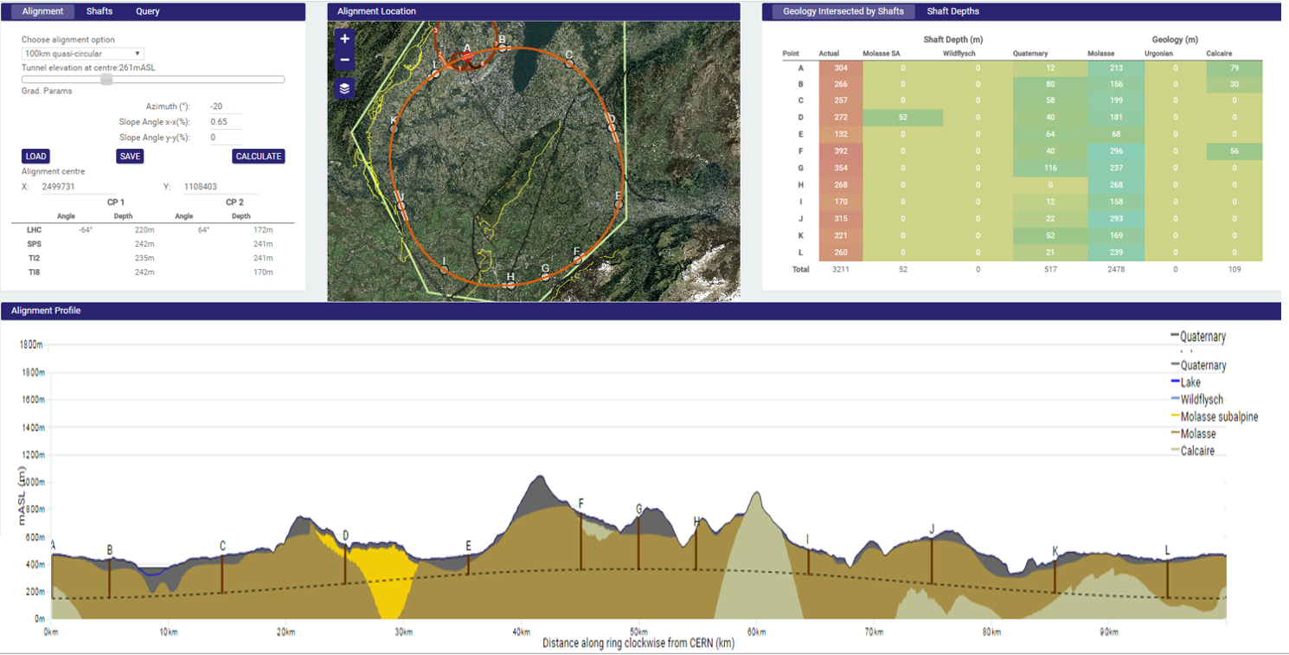
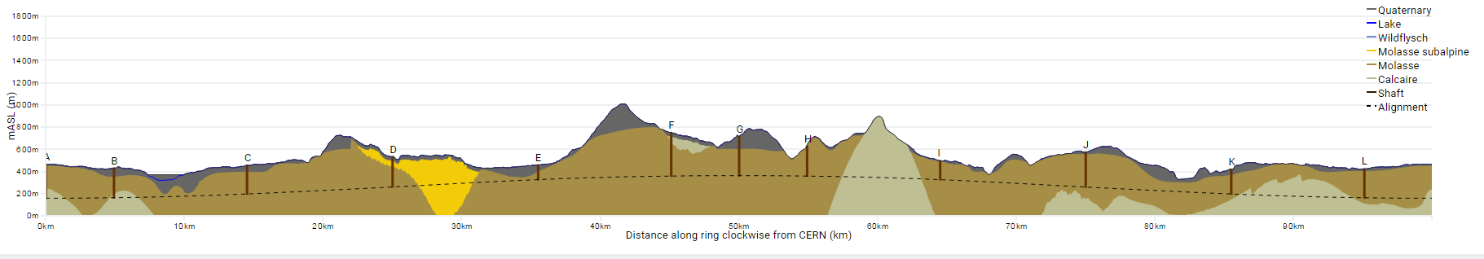
Progress on site investigations
90 – 100 km fits geological situation well
Review confirmed focus on 100 km, planar version
LHC suitable as potential injector
The 100 km version, intersecting LHC, is being studied now in more detail
Notes:
Use the latest slides from John/Charlie.
100 km machines, possibly with both versions intersecting and non-intersecting?

Slide 5
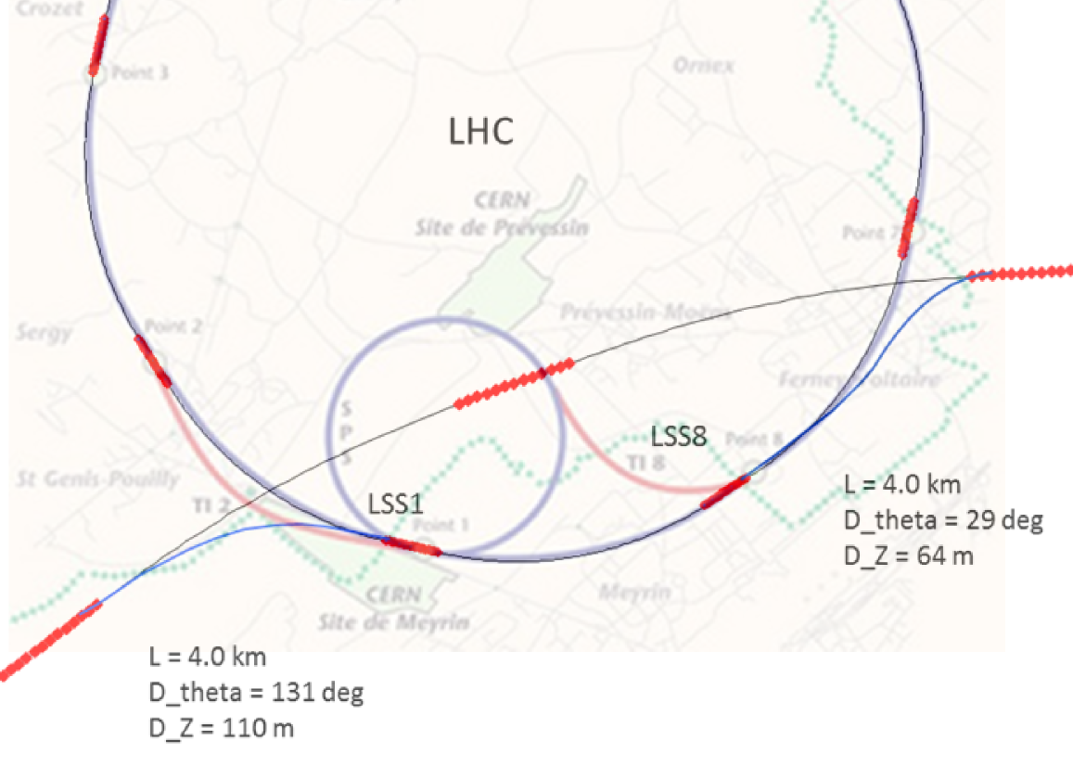
FCC-hh injector studies
Injector options:
SPS → LHC → FCC
SPS/SPS_{upgrade} → FCC
SPS -> FCC booster → FCC
100 km intersecting version
Current baseline:
injection energy 3.3 TeV LHC
confirmed by review
Alternative options:
Injection around 1.5 TeV
compatible with: SPS_{upgrade}, LHC, FCC booster
Notes:
See talk of Oliver on injection energy
Several options, present baseline is 3.3 GeV
Ínjection at 1.5 TeV studied as alternative, potentially compatible with SPS upgrade

Slide 6
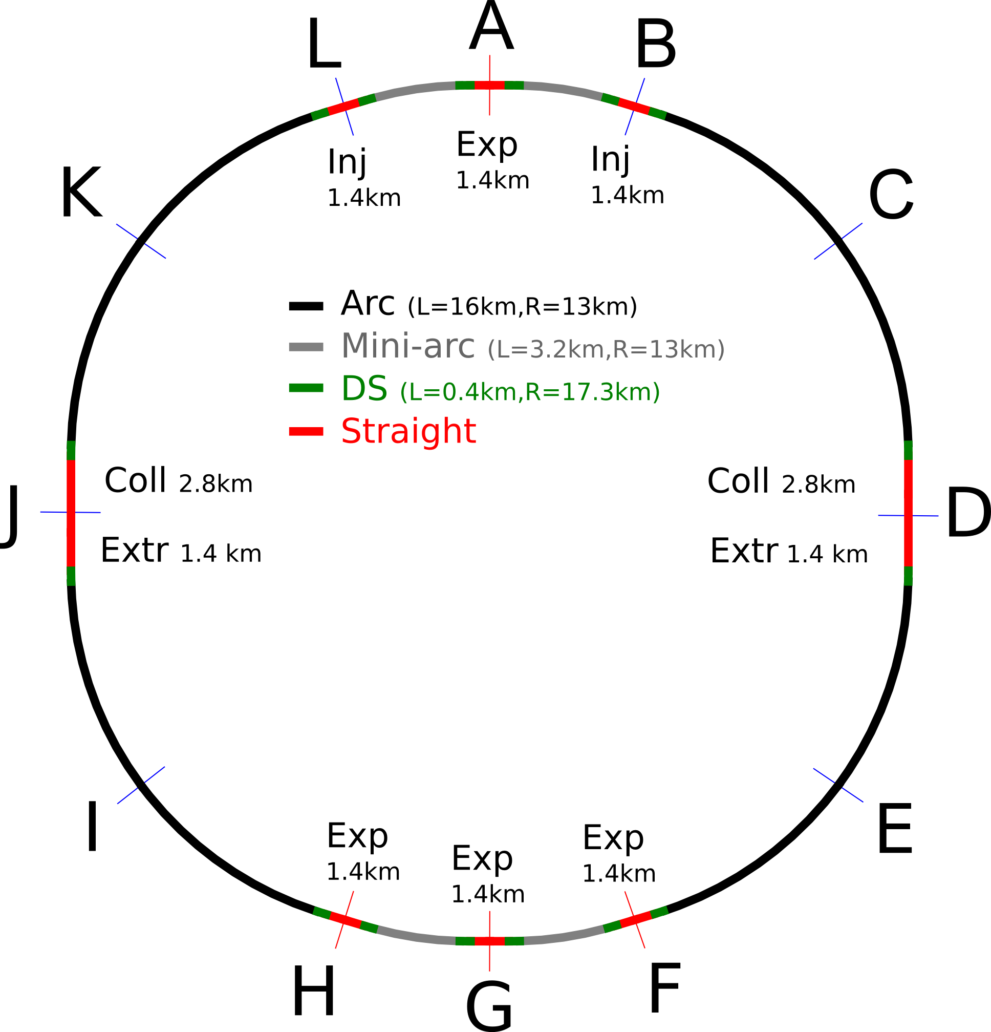
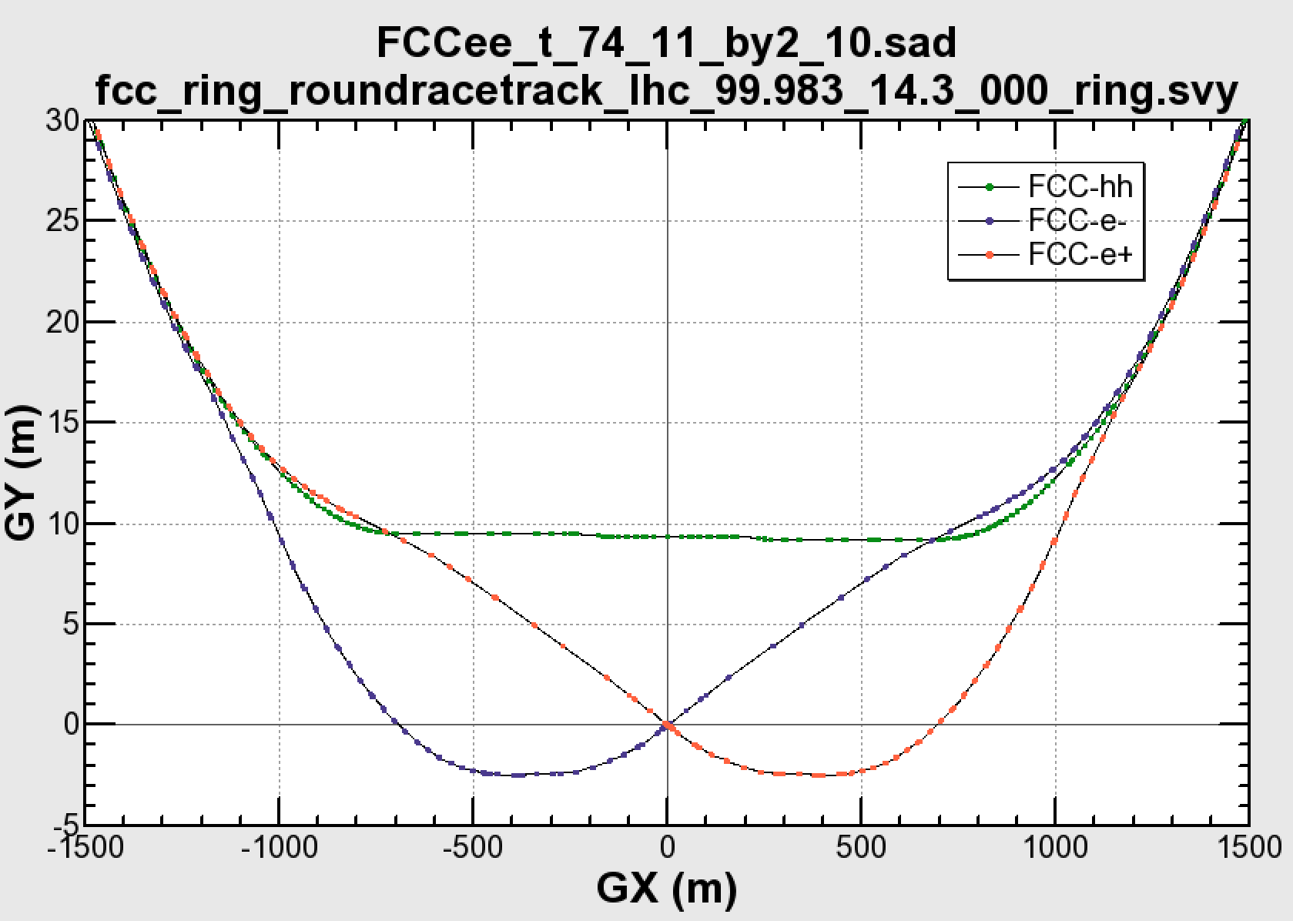

Common layouts for hh & ee
FCC-ee 1, FCC-ee 2,
FCC-ee booster (FCC-hh footprint)
11.9 m
IP
30 mrad
FCC-hh/
ee Booster
9.4 m
0.6 m
Lepton beams must cross over through the common RF to enter the IP from inside.
Only a half of each ring is filled with bunches.
FCC-hh
layout
Common
RF (tt)
Common
RF (tt)
Max. separation of 3(4) rings is about 12 m:
wider tunnel or two tunnels are necessary around the IPs, for ±1.2 km.
2 main IPs in A, G for both machines
asymmetric IR optic/geometry for ee to limit synchrotron radiation to detector
IP
Notes:
Check with Katsunobu to have latest layout.
Check with detector people if 9 m offset is acceptable for ee detector

Slide 7
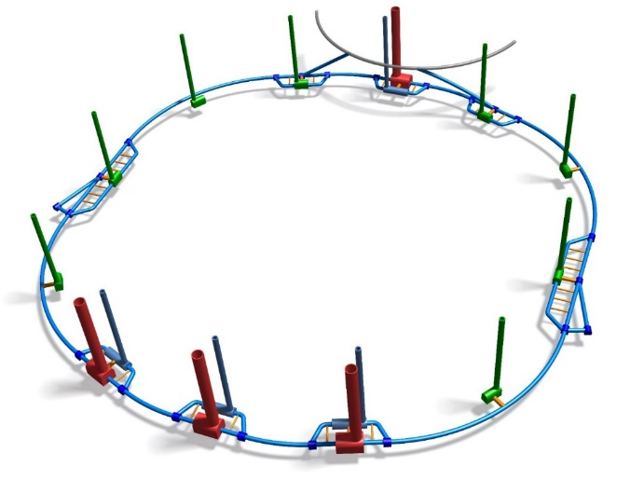
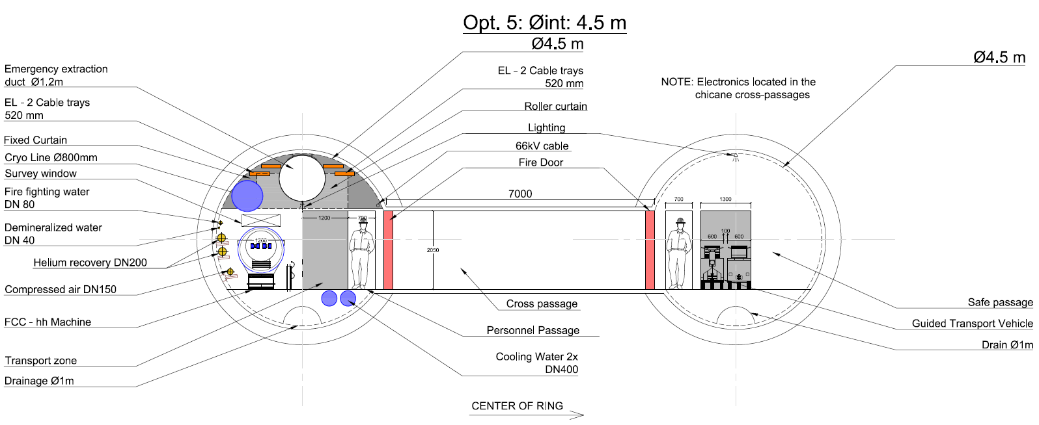
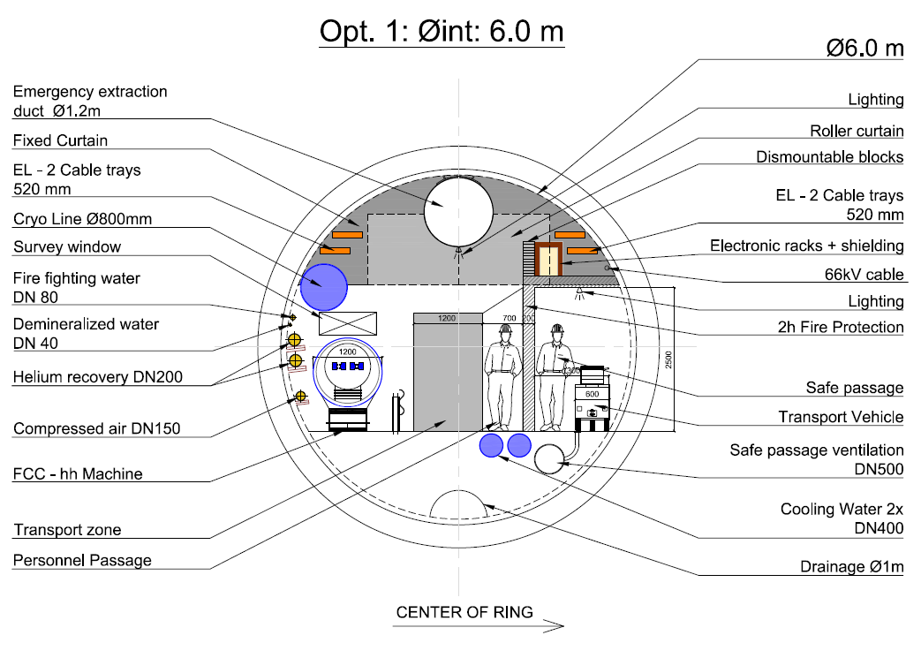
Further CE and TI optimisation
More detailed studies launched on
CE: single vs. double tunnels
CE: caverns, shafts, underground layout
technical infrastructures
safety, access
transport, integration, installation
operation aspects
Notes:
Studies are now shifting more on integration aspects, safety, access, installation.
Single vs. double tunnels, optimisation of cross sesctions, etc.

Slide 8
hadron collider parameters
parameter | FCC-hh |  | SPPC | HE-LHC* | (HL) LHC
collision energy cms [TeV] | 100 |  | 71.2 | >25 | 14
dipole field [T] | 16 |  | 20 | 16 | 8.3
circumference [km] | 100 |  | 54 | 27 | 27
# IP | 2 main & 2 |  | 2 | 2 & 2 | 2 & 2
beam current [A] | 0.5 |  | 1.0 | 1.12 | (1.12) 0.58
bunch intensity [10¹¹] | 1 | 1 (0.2) | 2 | 2.2 | (2.2) 1.15
bunch spacing [ns] | 25 | 25 (5) | 25 | 25 | 25
beta* [m] | 1.1 | 0.3 | 0.75 | 0.25 | (0.15) 0.55
luminosity/IP [10³⁴ cm⁻²s⁻¹] | 5 | 20 - 30 | 12 | >25 | (5) 1
events/bunch crossing | 170 | <1020 (204) | 400 | 850 | (135) 27
stored energy/beam [GJ] | 8.4 |  | 6.6 | 1.2 | (0.7) 0.36
synchrotr. rad. [W/m/beam] | 30 |  | 58 | 3.6 | (0.35) 0.18
*tentative

Slide 9
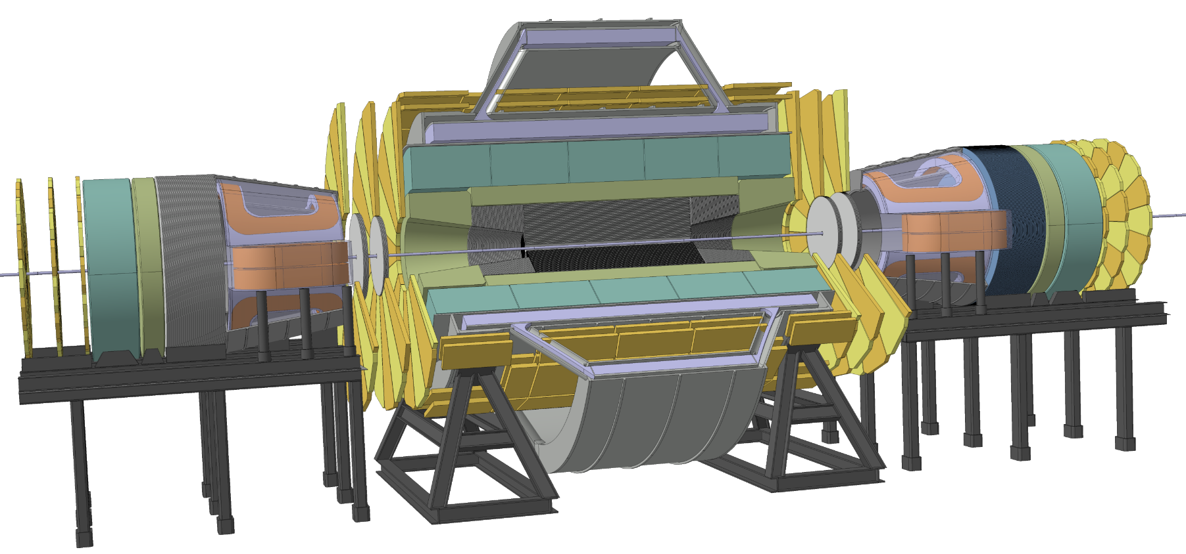
3. Today’s Default: Twin Solenoid & Dipoles
 | Twin Solenoid | Dipole
Stored energy | 53 GJ | 2 x 1.5 GJ
Total mass | 7 kt | 0.5 kt
Peak field | 6.5 T | 6.0 T
Current | 80 kA | 20 kA
Conductor | 102 km | 2 x 37 km
Bore x Length | 12 m x 20 m | 6 m x 6 m
FCC Air core Twin Solenoid and Dipoles
State of the art high stress / low mass design.

Slide 10
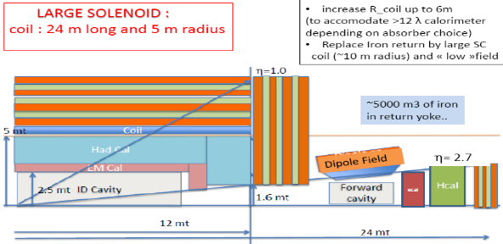
6. How to reduce size and cost…..
Reminder bending power requirements:
FCC 100 TeV, when same tracking resolution, so BL²/σ has to be increased by factor 7
Present ≈20 µm tracker granularity leads to 6T/12m system and 10Tm in forward dipole
Pushing hard for, investing in, higher tracker resolution, say 10 or even 5 µm, then a 1.5 m ID tracker is sufficient, as well as some 4 Tm in forward direction!
Then 4 T in a bore of 10 m, and half the field in the forward dipole would be sufficient
Even further, a second option is to reduce the depth of the calorimeter, accept 10 or 11λ in steel or 10λ in tungsten, leading to a 4T and 9m bore system.
This has a huge impact on size and construction cost!
Investing in large scale feasible and affordable tracker point resolution pays off, thereby reducing technical risks on the magnets as well as makes the detector affordable.
And it reduces cost of detector infrastructure, cavern, shafts, cranes…
Size / Cost (rough estimate) | Magnet Cost [B€] (25±5%) | Detector Cost [B€] (75±5%)
6T/12m + 10Tm | 0.70 – 0.90 | 2.8 – 3.6
4T/10m + 4Tm | 0.35 – 0.45 | 1.4 – 1.8
A factor ≈ 2 !

Slide 11
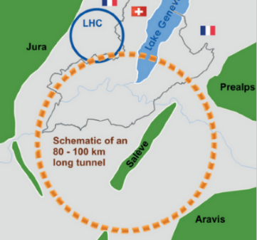
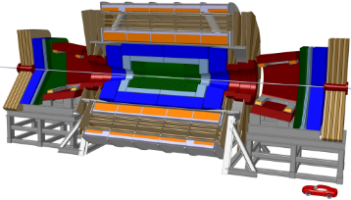
7. Conclusion
1st look at magnet systems probing 100 TeV p-p collisions completed.
Magnet size and field grow with the collision energy.
Based on present tracker resolution of 20µm, 6T/12m bore magnet systems are “huge”: 20-30 m diameter, 30-50 m long, 50-60 GJ.
Toroid based systems abandoned since stand-alone muon tracker not needed anymore.
Evolved to three 6T/12m straw-man designs (worst case, most challenging, and costly)
  Twin Solenoid, nice features: light, elegant, allowing high-quality muon tracking
  Solenoid + Minimum Yoke, heavy, even with minimized yoke, partly shielded.
  Bare Solenoid (no shielding): lightest, cost effective, solve local shielding.
And developed innovative 10 Tm dipoles and solenoids for covering forward physics
Cost reduction possible (some factor 2) by pushing up tracker resolution.
Trend is towards an ‘affordable’ 4T/10m-20 GJ design, also reduced forward direction.
Stay open minded: continue to include and test new ideas and configurations.
More presentations on detector magnets:
Matthias Mentink e.a. – oral Wednesday 11:10-11:40 in FCC-hh detector session
Matthias Mentink e.a. – poster Wednesday 17:30-19:30 on Solenoid forward magnet options

Slide 12
lepton collider parameters
parameter | FCC-ee (400 MHz) |  |  |  |  | CEPC | LEP2
Physics working point | Z |  | WW | ZH | tt_{bar} | H
energy/beam [GeV] | 45.6 |  | 80 | 120 | 175 | 120 | 105
bunches/beam | 30180 | 91500 | 5260 | 780 | 81 | 50 | 4
bunch spacing [ns] | 7.5 | 2.5 | 50 | 400 | 4000 | 3600 | 22000
bunch population [10¹¹] | 1.0 | 0.33 | 0.6 | 0.8 | 1.7 | 3.8 | 4.2
beam current [mA] | 1450 | 1450 | 152 | 30 | 6.6 | 16.6 | 3
luminosity/IP x 10³⁴cm⁻²s⁻¹ | 210 | 90 | 19 | 5.1 | 1.3 | 2.0 | 0.0012
energy loss/turn [GeV] | 0.03 | 0.03 | 0.33 | 1.67 | 7.55 | 3.1 | 3.34
synchrotron power [MW] | 100 |  |  |  |  | 103 | 22
RF voltage [GV] | 0.4 | 0.2 | 0.8 | 3.0 | 10 | 6.9 | 3.5
identical FCC-ee baseline optics for all energies
FCC-ee: 2 separate rings CEPC, LEP: single beam pipe

Slide 13
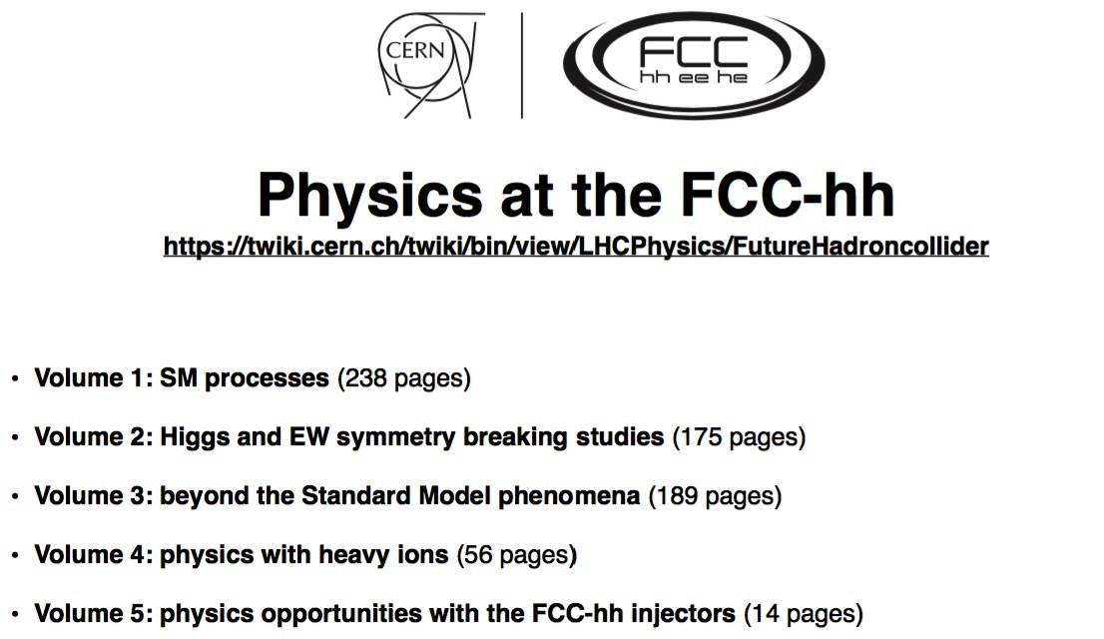
Physics prospects
will be published as CERN yellow report
paper copies available at registration desk

Slide 14
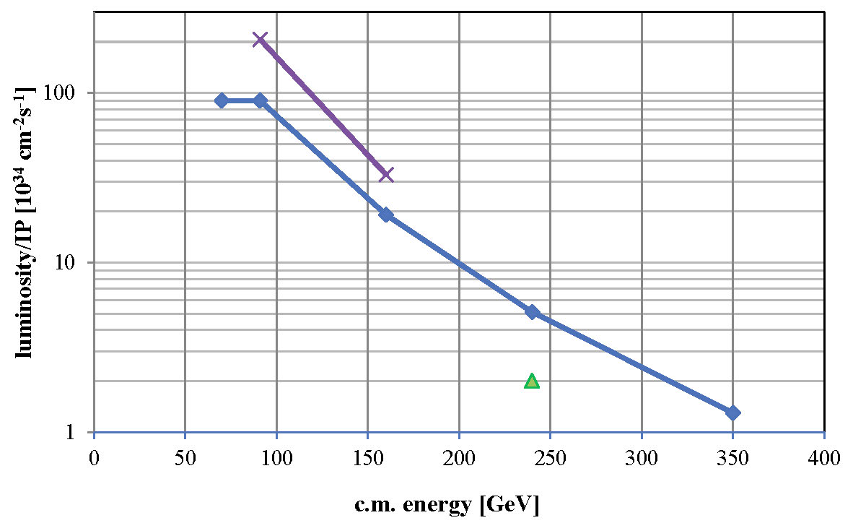

FCC-ee luminosity per IP
Further increase with squeeze to β_{y}*=1 mm, β_{x}*=0.5 m
new baseline crab waist with 2 IPs
β_{y}*=2 mm, β_{x}*=1 m
solid baseline with functioning optics, space for improvement, esp. at Z and W
α_{QED}
Z
WW
HZ
$$t\overline{t}$$
?
CEPC

Slide 15
Summary study status
Consolidated parameter sets for FCC-hh and FCC-ee machines
Complete optics baselines for FCC-hh and FCC-ee, beam dynamics compatible with parameter requirements
Common footprint for both accelerator options
First round of geology and implementation CE and TI studies completed
  6 reviews to confirm implementation, layout, optics, hh-injection & rf work
Convergence on main MDI parameters
Detector studies ongoing
Framework available for physics and detector simulations
FCC-hh physics report being published
Technologies:
  SC magnets, cryogenic beam vacuum and cryogenics programs well under way
  RF, feedback, materials, protection, beam transfer, beam diagnostics moving into focus

Slide 16
Outlook 2016/17
  Further baseline improvement (insertions optimization, MDI optimization, power optimization, …)
  Launch HE-LHC conceptual design effort
  Functional specifications of elements for technical WPs and TI to enable conceptual design work
  Enforce technical infrastructure concepts, integration, installation, safety for machines & detectors
  Continue detector simulations, detector design work and definition of infrastructure requirements
  Development of TDR and construction schedules as basis for cost estimates and governance models
  Study review at FCCW 2017, to freeze baselines

