Slide 1
  Control systems
  Detector Safety System (DSS) (no action available for an operator)
  Display of CERN Level 3 alarms and protection of NA62 hardware
Detector Control System (DCS)
  Detector monitoring and operation
  External Control Systems(no action available for an operator)
    Vacuum
    Gas (CEDAR/KTAG, Straw Tracker, RICH)
    GTK cooling plant
You should start your shift from inspection of detector state with use of all control systems

Slide 2
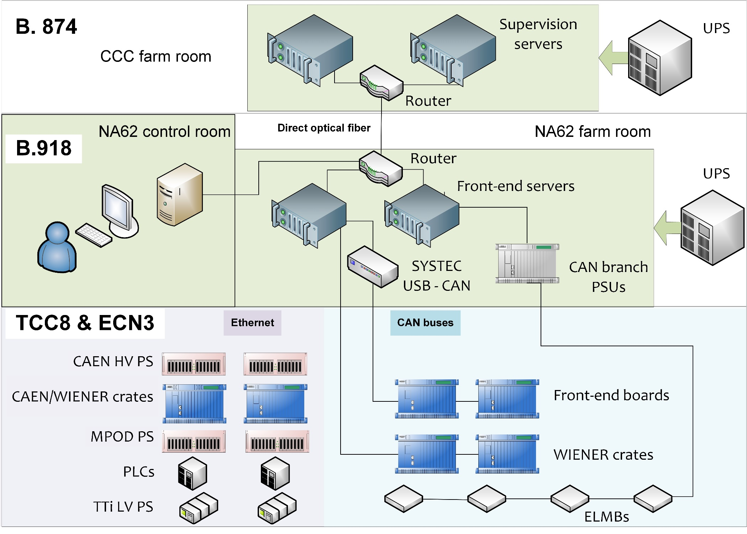
General DCS hardware structure

Slide 3
DCS (and Run Control) can be operated without FSM
(direct information and command propagation)
SCADA data server
FSM model
WinCC OA
Front end computer
OPC server
CAEN channel
FW

Slide 4
FSM facilitate hierarchical state propagation and group commanding
FSM model of subsystem
Commands
States
SCADA data server
FSM model
SCADA data server
FSM model
SCADA data server
FSM model
WinCC OA
WinCC OA
WinCC OA
Front end computer
Front end computer
Front end computer
OPC server
OPC server
OPC server
CAEN channel
CAEN channel
CAEN channel
FW
FW
FW

Slide 5
  DCS color scheme
Color | Meaning
Green | No error and ON
Blue | No error and OFF
Red | By default the red color of a state, or an alarm, means harmful to data quality
Yellow | warning or transition
Purple | State is unknown (usually because of absence of communication with hardware)
Grey | FSM is nor running

