Slide 1

Axel Lindner (DESY)
Benno Willke (AEI Hanover)
Herman Ten Kate (CERN)
Future options for searching axion-like particles through
light-shining-through-a-wall experiments

Slide 2
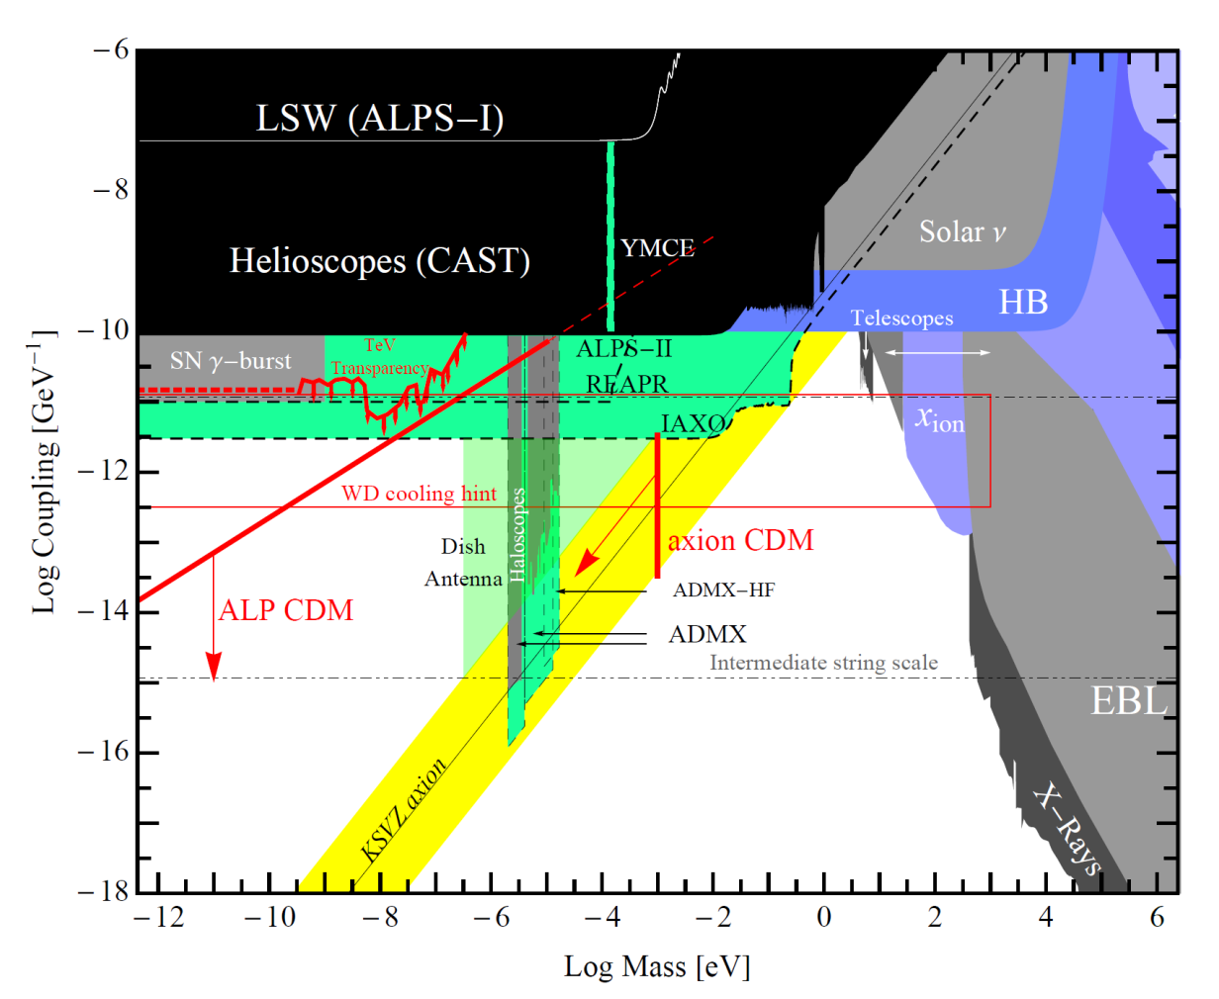
A LSW roadmap
Two-photon-coupling
axion-like particle mass

Slide 3
A LSW roadmap
2010, CROWS @ CERN 2013
OSQAR @ CERN 2015
ALPS II @ DESY 2019
ALPS III 202X ?
Two-photon-coupling
This presentation.
axion-like particle mass

Slide 4
Outline
Basics
  Motivation
  Challenges
  Fundamentals of Light-Shining-through-a-Wall
A future LSW experiment (“ALPS III”)
  Pros and cons
  Design criteria
  Magnets, optics, detectors
  Expected performance
Summary

Slide 5
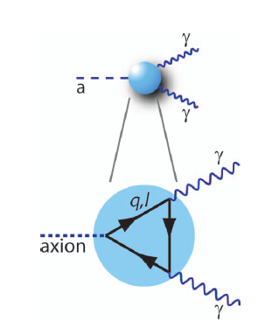
Introduction to WeaklyInteractingSlimParticles
WISPs are hypothetical bosons with masses below 1eV (< 0,000002 m_{e}).
Axion: a neutral pseudoscalar predicted to explain the CP conservation in QCD. Its physics is determined just by a symmetry breaking scale f_{a}:
  Mass: m_{a} = 0.6eV · (10⁷GeV / f_{a})
  Coupling to two photons: g_{aγγ} = α·g_{γ} / (2π·f_{a})
  Abundancy in the universe: Ω_{a} / Ω_{c} ∼ (f_{a} / 10¹²GeV)^{7/6}
Axion-like particles (ALPs):
Coupling strength and mass are not related by one f_{a}.
Hidden photons: neutral vector bosons.
Mini-charged particles, Chameleons, massive gravity scalars, …
(some of these might be related to dark energy).

Slide 6
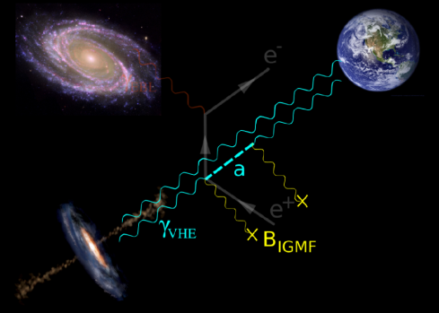
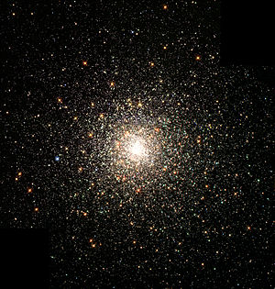
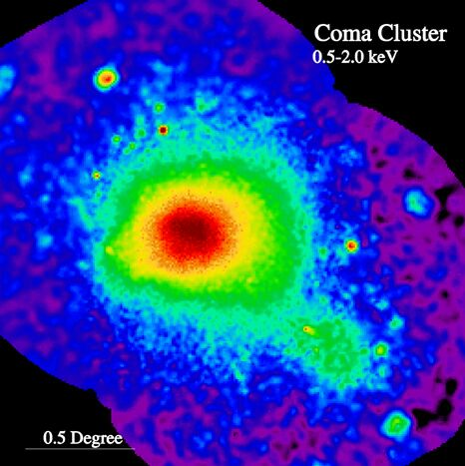
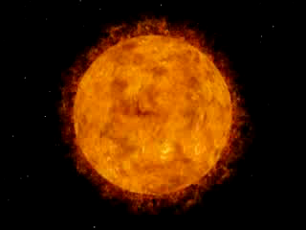
(Vague) hints for WISPs in the sky?
There are allowed regions in parameter space where an ALP can simultaneously explain the gamma ray transparency, the extra energy loss of stars, and the soft X-ray excess from Coma
and be a subdominant contribution to CDM.
Phenomenon | ALP mass [eV] | ALP-γ coupl. [GeV⁻¹] | Reference
TeV transparency | < 10⁻⁷ | > 10⁻¹² | arXiv:1302.1208 [astro-ph.HE]
Star developments | < 10³ | ≈ 3·10⁻¹¹ | arXiv:1512.08108 [astro-ph.HE] arXiv:1605:06458 [astro-ph.SR]
CAB (Coma Cluster) | < 10⁻¹³ | 10⁻¹² to 10⁻¹³ | arXiv:1406.5188 [hep-ph]

Slide 7
The big picture: ALPs
10 TeV
LHC
10⁵ TeV
10⁴·LHC
Energy scale of “new physics”
This presentation.
10⁹ TeV
Three main regions of interest:
Axion-like particles: “new physics” around 10⁵ TeV.
QCD axions: “new physics” around 10⁵ TeV.
QCD axions as dark matter: “new physics” around 10⁹ TeV.

Slide 8
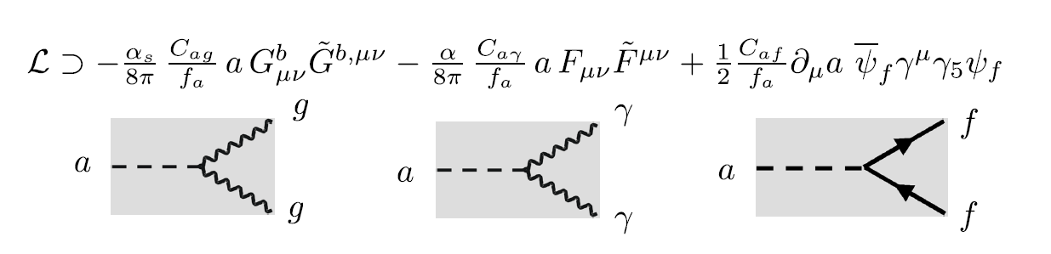
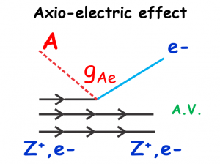
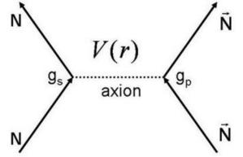
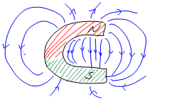
Axion and axion-like-particle (ALP) couplings
Axion and other Nambu-Goldstone bosons arising from spontaneous breakdown of global symmetries are theoretically well-motivated very weakly interacting slim (ultra-light) particles.
The coefficients are determined by specific ultraviolet extension of SM.
Courtesy A. Ringwald
γ
a

Slide 9
Axion and axion-like-particle (ALP) couplings
Axion and other Nambu-Goldstone bosons arising from spontaneous breakdown of global symmetries are theoretically well-motivated very weakly interacting slim (ultra-light) particles.
The coefficients are determined by specific ultraviolet extension of SM.
Courtesy A. Ringwald
γ
a

Slide 10
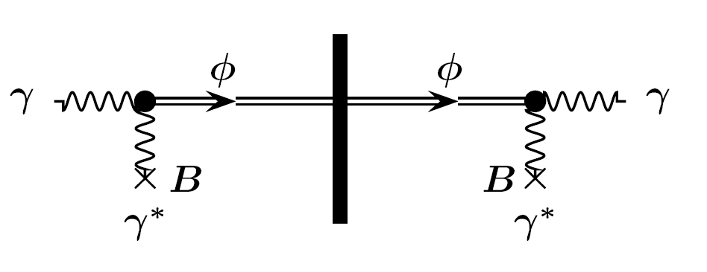
How to look for ALPs …
… by exploiting their coupling to photons:
WISPs pass any barrier and could make
light-shining-through-a-wall.
Axions, axion-like particles
Okun 1982, Skivie 1983, Ansel‘m 1985, Van Bibber et al. 1987
q = p_{γ} – p_{Φ}
l: length of B field

Slide 11
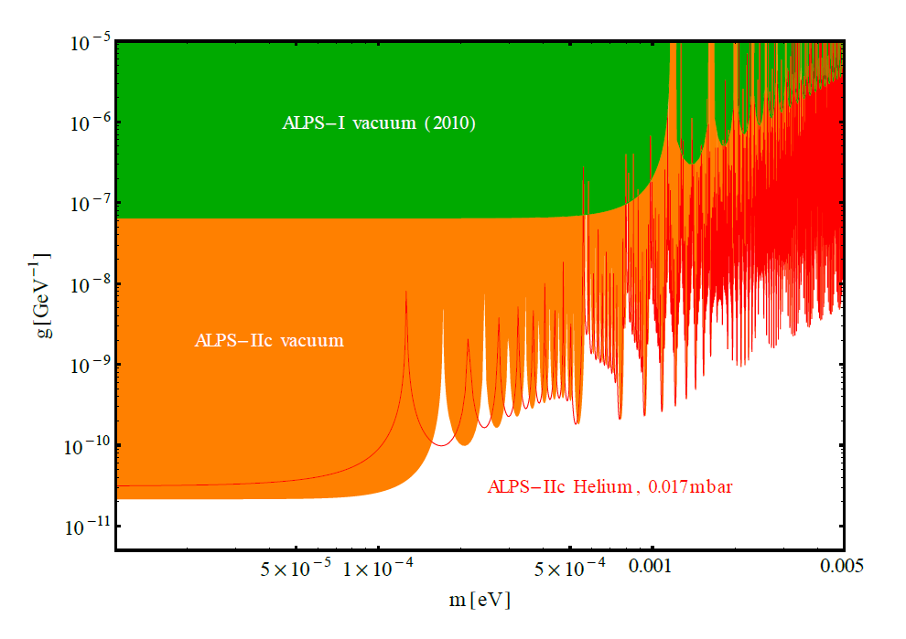
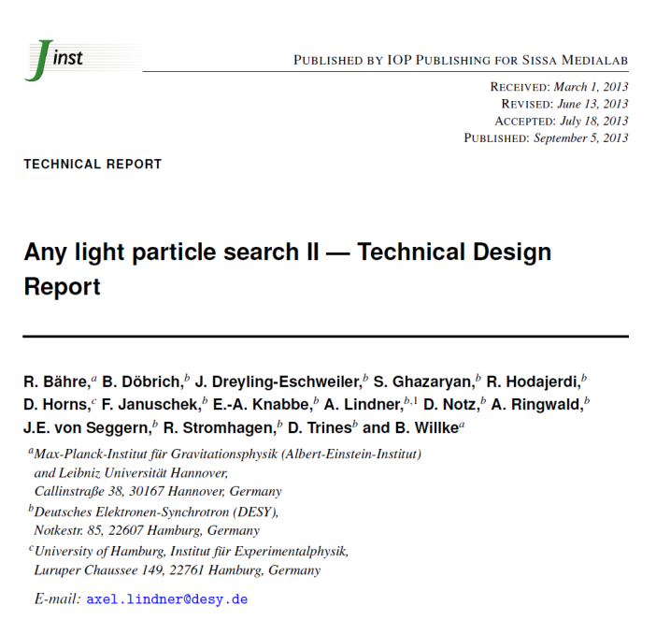
Exemplary plot on sensitivity (ALPS II)
Two-photon coupling
http://iopscience.iop.org/article/10.1088/1748-0221/8/09/T09001/meta;jsessionid=1674E7ACB2293DB65394D34574F3AFED.c3.iopscience.cld.iop.org
ALP mass
LSW experiments working with optical photons (around 1 eV)
provide high sensitivities for very low mass ALPs (below 0.1 meV).
The mass reach follows from a phase shift developing
between the light and ALP fields due to the non-zero ALP mass.

Slide 12
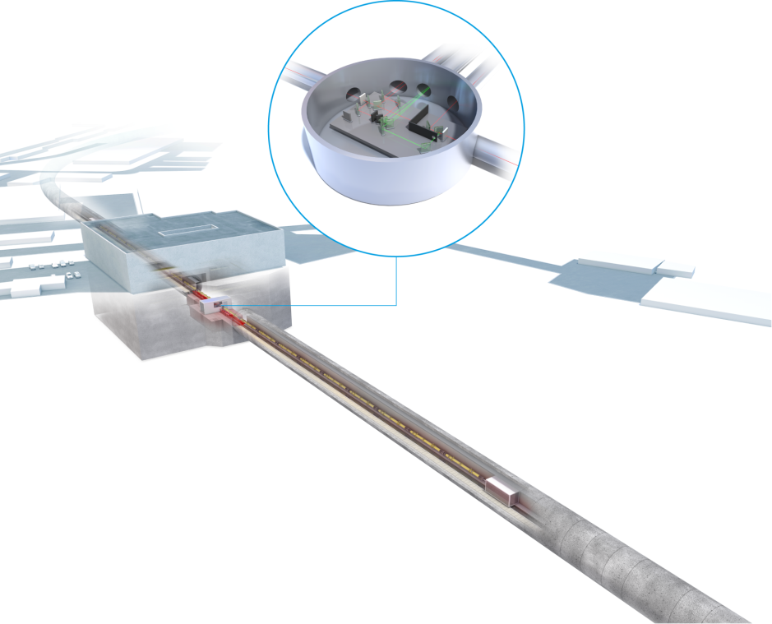
ALPS II at DESY in 2019
ALPS II will be installed in a straight section of the HERA tunnel.

Slide 13
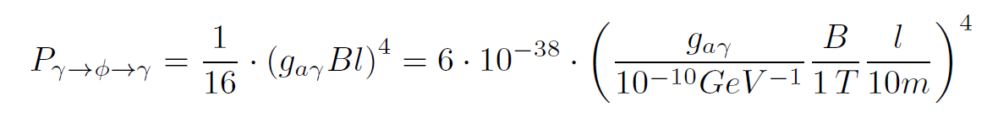
How to look for ALPs …
… by exploiting their coupling to photons:
WISPs pass any barrier and could make
light-shining-through-a-wall.
Axions, axion-like particles
Okun 1982, Skivie 1983, Ansel‘m 1985, Van Bibber et al. 1987
ql << 1; conversion and re-conversion:

Slide 14
Outline
Basics
  Motivation
  Challenges
  Fundamentals of Light-Shining-through-a-Wall
A future LSW experiment (“ALPS III”)
  Pros and cons
  Design criteria
  Magnets, optics, detectors
  Expected performance
Summary

Slide 15
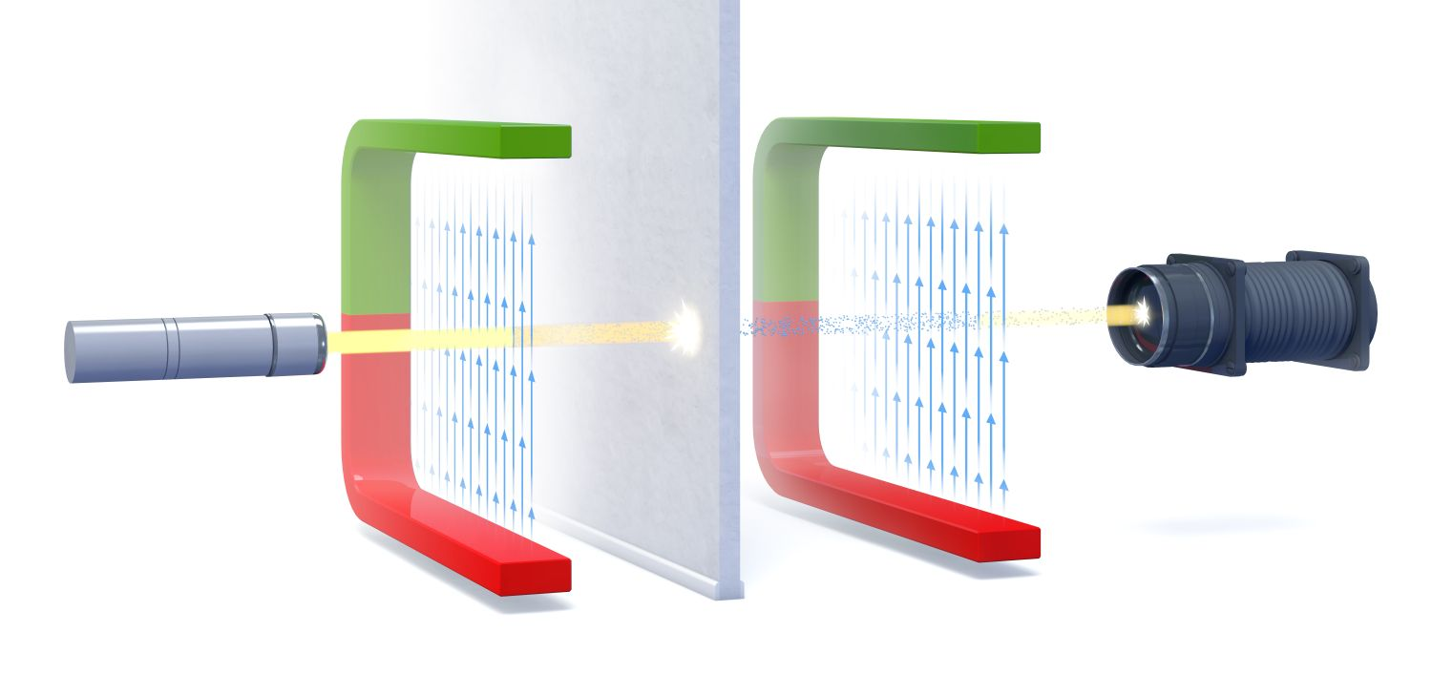
Light-shining-through-a-wall in the laboratory

Slide 16
Pros and cons for LSW in the laboratory
ALP parameter | LSW (laboratory) | Helioscopes | Dark matter searches

Slide 17
Pros and cons for LSW in the laboratory
ALP parameter | LSW (laboratory) | Helioscopes | Dark matter searches
Parity and spin | yes | perhaps | yes
Coupling g_{aγ} | yes | no | no
Coupling · flux | (does not apply) | yes | yes

Slide 18
Pros and cons for LSW in the laboratory
ALP parameter | LSW (laboratory) | Helioscopes | Dark matter searches
Parity and spin | yes | perhaps | yes
Coupling g_{aγ} | yes | no | no
Coupling · flux | (does not apply) | yes | yes
Mass | perhaps | perhaps | yes

Slide 19
Pros and cons for LSW in the laboratory
ALP parameter | LSW (laboratory) | Helioscopes | Dark matter searches
Parity and spin | yes | perhaps | yes
Coupling g_{aγ} | yes | no | no
Coupling · flux | (does not apply) | yes | yes
Mass | perhaps | perhaps | yes
Rely on astrophysical assumptions | no | yes | yes

Slide 20
Pros and cons for LSW in the laboratory
ALP parameter | LSW (laboratory) | Helioscopes | Dark matter searches
Parity and spin | yes | perhaps | yes
Coupling g_{aγ} | yes | no | no
Coupling · flux | (does not apply) | yes | yes
Mass | perhaps | perhaps | yes
Rely on astrophysical assumptions | no | yes | yes
QCD axion | no | yes | yes
LSW in the laboratory is very well suited to look for axion-like particles.

Slide 21
Design criteria for LSW experiments

Slide 22
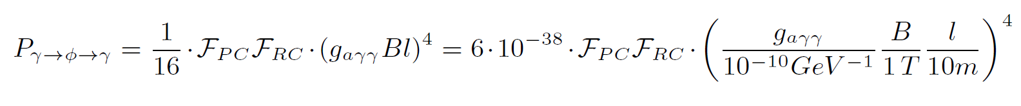
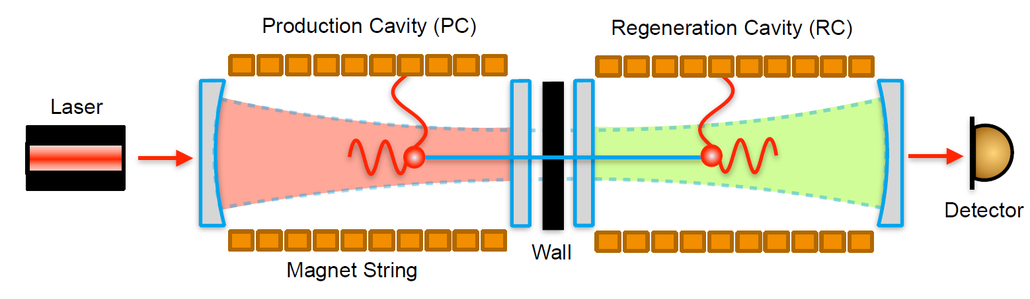
Design criteria for LSW experiments with optical resonators
Courtesy A. Spector (ALPS)
Use long strings of strong dipole magnets.
Implement optical resonators to recycle the light before the wall and
to boost the re-conversion of ALPs to photons behind the wall.
The maximal length is given by the aperture of the magnets and the beam shape of the resonating mode in the optical resonators.
The maximal circulating light power before the wall is given by the damage threshold of the mirrors and the beam spot size.

Slide 23
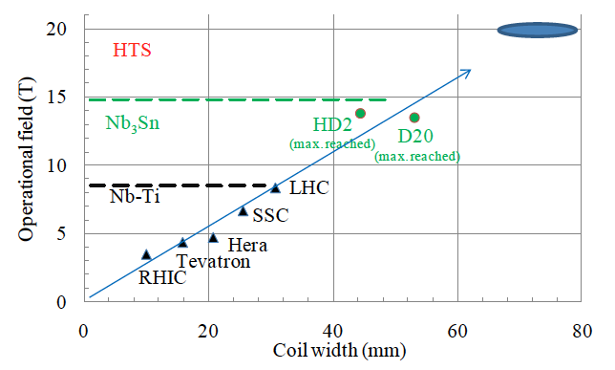
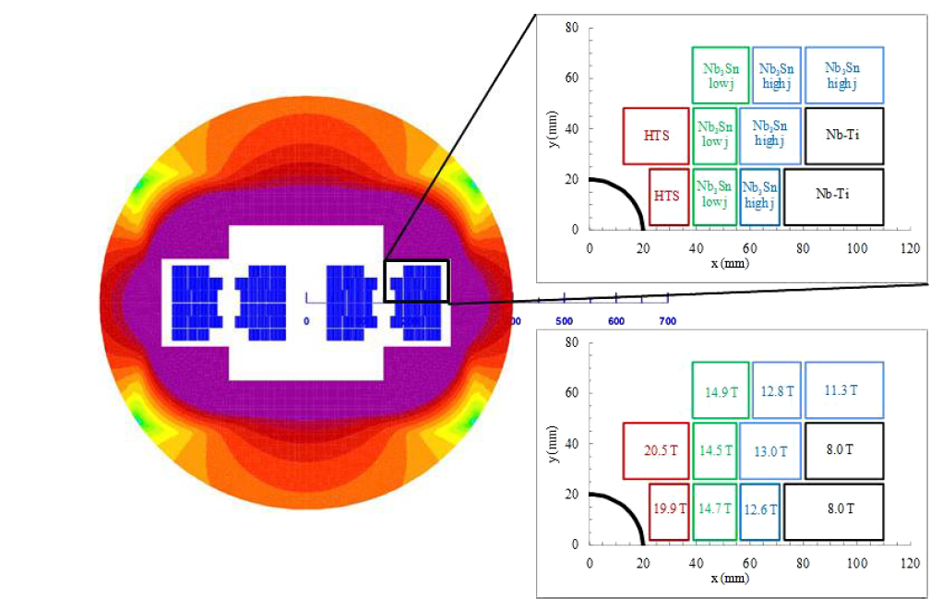
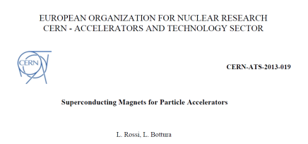
Present and future dipole magnets for LSW experiments
LSW experiments use dipoles developed for particle accelerators
(and might use in future dipole magnets presently under development).
New demonstration dipole magnets under study for
HE-LHC or FCC might provide
a magnetic field of 13 T (or later even up to 15 or 16 T)
in an aperture of 100 mm.
https://fcc.web.cern.ch/Pages/Magnets.aspx
https://fcc.web.cern.ch/Documents/Publications/Magnets/CERN-ATS-2013-019.pdf

Slide 24
Present and future dipole magnets for LSW experiments
LSW experiments use dipoles developed for particle accelerators
(and might use in future dipole magnets presently under development).
Thereafter one (or more) of these magnet designs
may be produced in small series and
become available for LSW experiments.
Depending of unit length, some 30-40 units
may be needed for a 500 m long magnet string.
https://fcc.web.cern.ch/Pages/Magnets.aspx
https://fcc.web.cern.ch/Documents/Publications/Magnets/CERN-ATS-2013-019.pdf

Slide 25
Present and future dipole magnets for LSW experiments
LSW experiments use dipoles developed for particle accelerators
(and might use in future dipole magnets presently under development).
For the “FCC” dipole parameters see for example:
  Bottura L, de Rijk G, Rossi L, Todesco E., IEEE Trans. Appl. Supercond. 22:4002008 (2012), http://ieeexplore.ieee.org/xpl/articleDetails.jsp?arnumber=6656892
  Todesco E, Bottura L, de Rijk G, Rossi L., IEEE Trans. Appl. Supercond. 24:4004306 (2014), http://ieeexplore.ieee.org/xpl/articleDetails.jsp?arnumber=6172724
Dipole | Aperture [mm] | Field strength [T] | LSW experiment | Number of used dipoles
HERA (straightened) | 50 | 5.3 | ALPS II (DESY) | 20
LHC | 40 | 9.0 | OSQAR (CERN) | 2
“FCC” | 100 | 13 | “ALPS III”

Slide 26
Optical resonators in LSW experiments
Courtesy A. Spector (ALPS)
The resonators before and after the wall have to resonate to the same mode.
Flat mirrors are placed in the center of the experiment around the wall.
The light power density is highest on the flat mirror before the wall
(mirror damage threshold)!

Slide 27
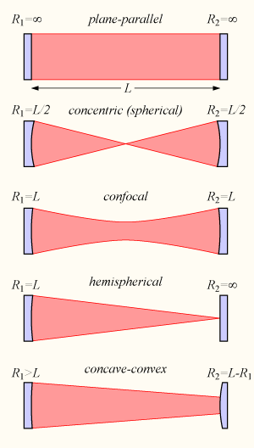
Optics for LSW experiments I: resonator configuration
https://en.wikipedia.org/wiki/Optical_cavity

Slide 28

Optics for LSW experiments I: resonator configuration
A confocal cavity:
longest resonator for a given aperture,
largest beamspot in the center and hence lowest power density on central mirror,
therefore highest circulating power in the resonator before the wall.
https://en.wikipedia.org/wiki/Optical_cavity

Slide 29
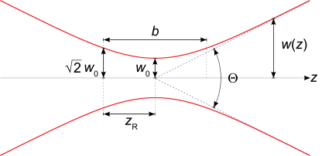
Gaussian beam in a confocal resonator
Using:
  L: length of the optical system, length of each resonator L/2.
  λ: wavelength of light
Beam waist: (ω₀)² = (L·λ) / 2π
Beam profile development:
ω²(z) = (ω₀)² · (1+(z/z_{R})²),
z_{R} = π(ω₀)² /λ
ω(L/2) = sqrt(2)·ω₀
Clear aperture required for a cavity
with a power built-up ≈ 100,000:
r₅ = 2.5·ω(z)
b = L
https://en.wikipedia.org/wiki/Gaussian_beam

Slide 30
Optics for LSW experiments II: resonator examples
Aperture [mm] | Safety margin [mm] | Eff. aperture [mm] | ω (L/2) [mm] | ω₀ [mm]
40 (LHC) | 10 | 30 | 6.0 | 4.2
50 (HERA) | 10 | 40 | 8.0 | 5.7
100 (FCC) | 10 | 90 | 18.0 | 12.7

Slide 31
Optics for LSW experiments II: resonator examples
Aperture [mm] | Safety margin [mm] | Eff. aperture [mm] | ω (L/2) [mm] | ω₀ [mm] | λ [nm] | L [m]
40 (LHC) | 10 | 30 | 6.0 | 4.2 | 1064 | 106
50 (HERA) | 10 | 40 | 8.0 | 5.7 | 1064 | 189
100 (FCC) | 10 | 90 | 18.0 | 12.7 | 1064 | 957
λ = 1064 nm is assumed following LIGO experience:
mirror coatings for this wavelength can stand high power densities for long times.

Slide 32
Optics for LSW experiments II: resonator examples
Aperture [mm] | Safety margin [mm] | Eff. aperture [mm] | ω (L/2) [mm] | ω₀ [mm] | λ [nm] | L [m] | Maximal power [kW] | Magnetic length, one string [m]
40 (LHC) | 10 | 30 | 6.0 | 4.2 | 1064 | 106 | 280 | 43
50 (HERA) | 10 | 40 | 8.0 | 5.7 | 1064 | 189 | 500 | 81
100 (FCC) | 10 | 90 | 18.0 | 12.7 | 1064 | 957 | 2500 | 426
λ = 1064 nm is assumed following LIGO experiences:
mirror coatings for this wavelength can stand high power densities for long times.
For the maximal power assume a damage threshold of 500 kW/cm².
For the magnetic length
  subtract 10 m for the optical system outside the magnets and
  assume a “filling factor” for the magnetic field of 90%.

Slide 33
Optics for LSW experiments IV: 532 nm options
Aperture [mm] | Safety margin [mm] | Eff. aperture [mm] | ω (L/2) [mm] | ω₀ [mm] | λ [nm] | L [m] | Maximal power [kW] | Magnetic length, one string [m]
50 (HERA) | 10 | 40 | 8.0 | 5.7 | 1064 | 189 | 500 | 81
100 (FCC) | 10 | 90 | 18.0 | 12.7 | 1064 | 957 | 2500 | 426
50 (HERA) | 10 | 40 | 8.0 | 5.7 | 532 | 378 | ? | 166
100 (FCC) | 10 | 90 | 18.0 | 12.7 | 532 | 1913 | ? · 5 | 856
If high power, high quality mirror coatings for λ = 532 nm were available,
LSW experiments could be doubled in length compared to λ = 1064 nm.
R&D is required to improve the power density damage threshold of coatings for 532 nm light.

Slide 34
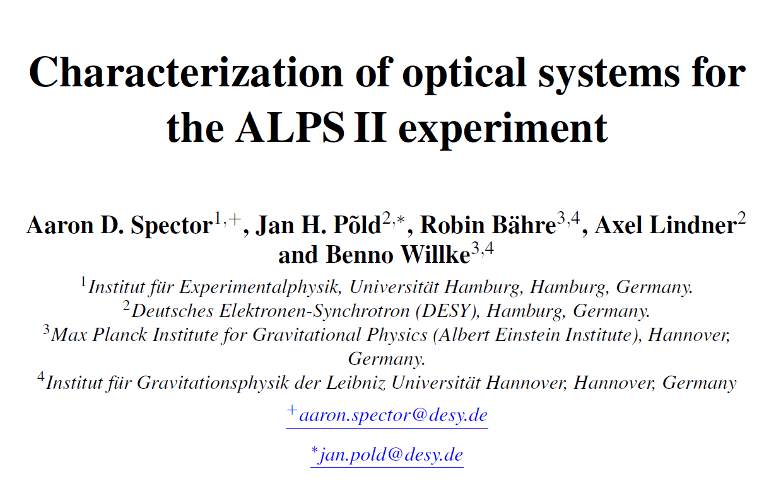
Long optical resonators in real life
The stable operation of an optical resonator becomes difficult,
if both mirrors cannot be placed on one optical bench anymore.
The influence of seismic noise increases strongly.
LIGO has impressively proven that one can deal with such challenges.
By exploiting the LIGO expertise
(AEI Hanover & Uni. of Gainesville, Florida)
ALPS II has succeeded to install
and operate a 20 m long resonator.
Publication in preparation

Slide 35
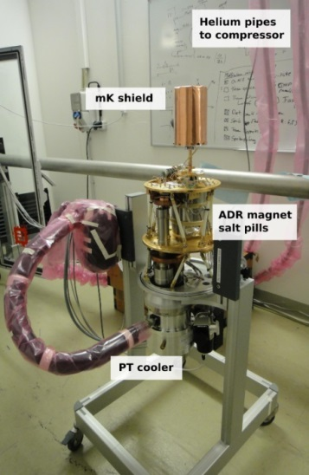
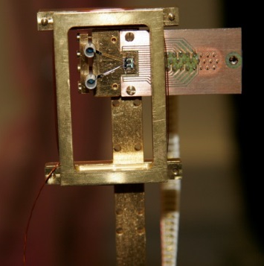
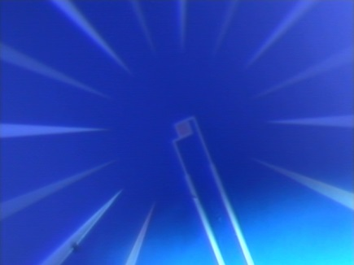
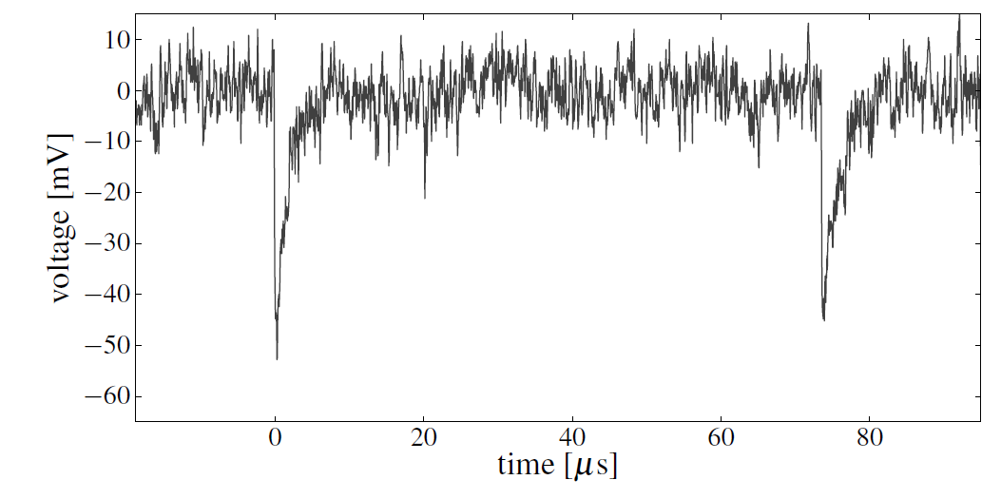
A detector for LSW experiments
ALPS II uses a Transition Edge Sensor
  20 nm thin Tungsten film.
  Operated at 80 mK.
  Single 1064 nm photon detection.
  Single photon energy resolution < 8%.
  Intrinsic background around 10⁻⁴ 1/s.
A heterodyne detection scheme
is being developed as an alternative
for the ALPS II experiment.
Conservative assumption:
LSW experiments could detect a photon flux of 10⁻⁴ 1/s.
20 nm x 25 x 25 µm²

Slide 36
Ingredients for an “ALPS III” experiment
“ALPS III” sketch based on the following assumptions:
Magnetic field strength: 13 T
Magnetic length: 426 m
Light wavelength: 1064 nm
Circulating light power: 2.5 MW
Photons against the wall: 1.4·10²⁵ s⁻¹
Power built-up behind the wall: 10⁵
Detector sensitivity: 10⁻⁴ s⁻¹
Resulting sensitivity for g_{aγ}:
1·10⁻¹² GeV⁻¹ for m < 0.06 meV

Slide 37
“ALPS III” in context
“ALPS III”
would dramatically increase
the sensitivity for purely
laboratory based
experiments searching
for axion-like particles.
would surpass even IAXO
for very low mass ALPs.
would definitely probe
astrophysics hints for ALPs.
would probe
“dark matter” ALPs.
would perfectly complement IAXO!
“ALPS III”

Slide 38
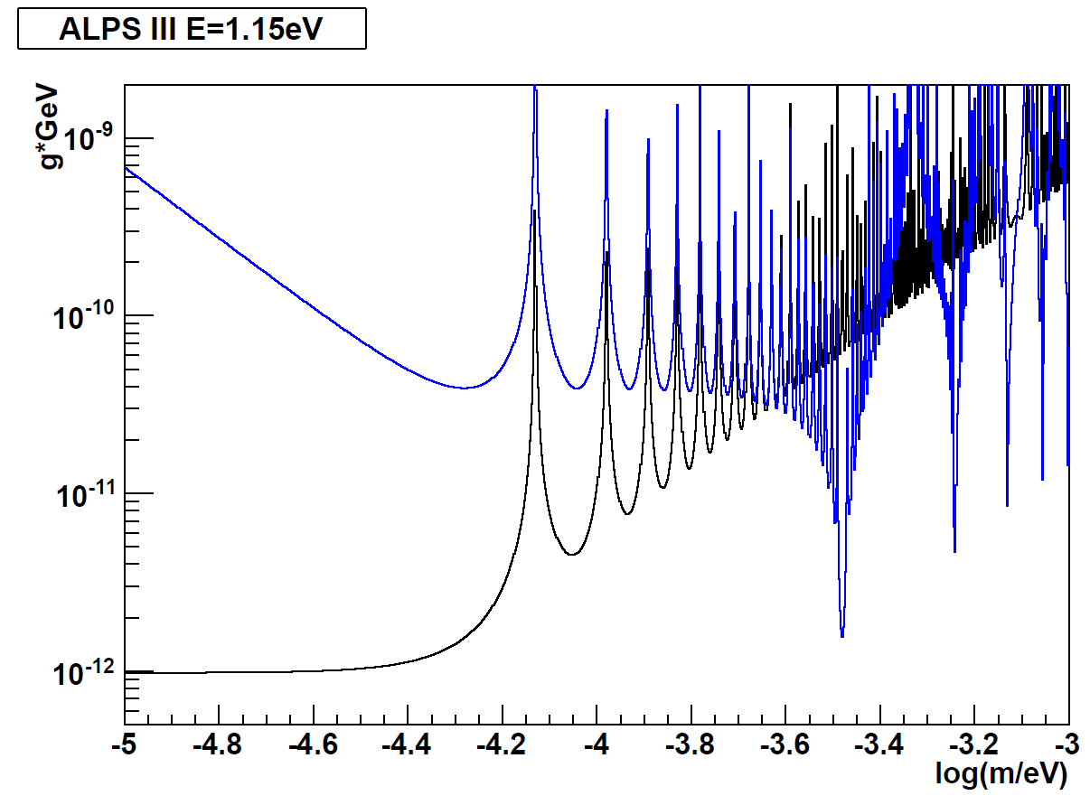
A little bonus
Assume to realize both magnet strings out of 40 dipoles each and
switch polarity between each dipole (“wiggler configuration”):
N
S
N
S
S
N
S
N
“Wiggler”
The full sensitivity is restored at a specific mass!
N
N
N
N
S
S
S
S
ALPS III

Slide 39
Just for the fun of it: a little QCD axion bonus …
“ALPS III”
would dramatically increase
the sensitivity for purely
laboratory based
experiments searching
for axion-like particles.
would surpass even IAXO
for very low mass ALPs.
would definitely probe
astrophysics hints for ALPs.
would probe
“dark matter” ALPs.
would perfectly complement IAXO!
“ALPS III”
“Wiggler”

Slide 40
Summing up
By combining
present day expertise in optics (ALPS II lessons learned from LIGO)
and
present day expertise in detectors for very low photon fluxes (ALPS II)
with
new dipole magnets under development for future accelerators
purely laboratory based searches for axion-like particles will be possible well beyond the sensitivities of experiments under preparation.
The sensitivity might be increased even more by pushing for
R&D on mirror coatings for 532 nm light.

Slide 41
To-take-home
Accelerator dipole magnets under development at CERN could be the basis of an “ultimate” light-shining-through-a-wall experiment
mainly searching for axion-like particles.
The costs of such an experiment would be dominated by
the costs of the magnet strings.
  The costs probably strongly correlate with decisions on future accelerator projects.
Considering the development of the physics case for axion-like particles in the recent years, experiments have to move from the niche
“make best use of existing equipment built for something else”
to more dedicated installations:
  IAXO and “ALPS III”.

