Slide 1

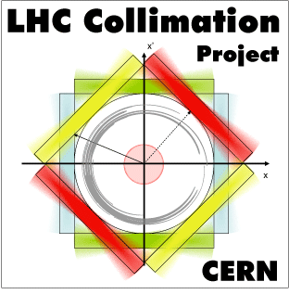



Optical layout for the measurement of Short Living Baryon Magnetic Moment
using Bent Crystals at LHC.
D.Mirarchi¹, S. Redaelli¹, W. Scandale^{1,2}, A. Stocchi².
¹CERN, ²LAL.
CERN-SPSC-2016-030/SPSC-EOI-012 (27-06-2016)
“Physics Beyond Colliders Kickoff Workshop”, Geneva, September 6th and 7th 2016

Slide 2
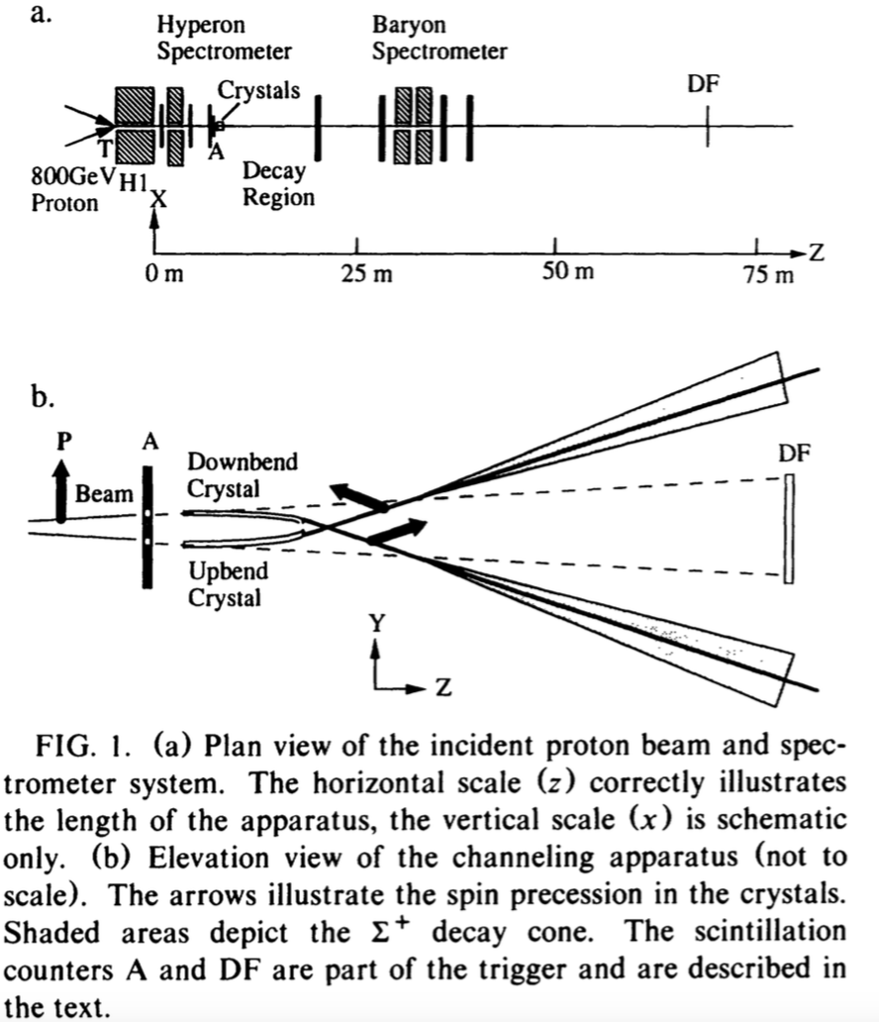
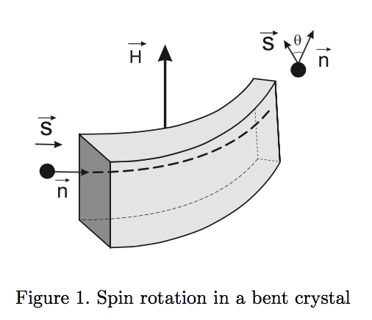
Concept & past experience
Magnetic moment of channeled particles should precess in a bent crystal
See V.G. Baryshevskii, Pis’ma Zh. Tekh. Fiz.5, 182 (1979) and PLB 757 (2016) 426-9.
Experiment E 751 at FNAL
PhysRevLett 69.3286 (1992)

Slide 3
Configuration
The proposal for LHC
We propose to measure the magnetic moment of the Λ_{c} and other charmed charged baryons at LHC top energies (see the talk of A. Stocchi).
The preferred scenario requires four new elements in LHC:
  A first bent crystal deflects the halo particles upstream of an interaction region of LHC, in our case the LHCb one, in order to separate them from the circulating beam.
  A target inserted in the pipe intercepting the deflected halo, producing short-living baryons.
  A second bent crystal to channel part of the baryons and deflect them into the LHCb detector, where the spin orientation is measured from the analysis of the decaying fragments.
  An additional absorber to intercept the halo particles non-interacting with the target, thereby allowing the possibility of fixed-target operation in parasitic mode.
An alternative scenario may consists in extracting protons in the LHC dump area and in measuring the short-living baryons polarization WITH A NEW DETECTOR.
The experiment should be based on the UA9 technology to steer with bent silicon crystals the diffusive halo surrounding the circulating beam in LHC, up to 6.5 TeV energy.
Such a technology can be applied also to produce non-resonant or resonant extraction of beams in SPS and in LHC (for our alternative scenario).

Slide 4
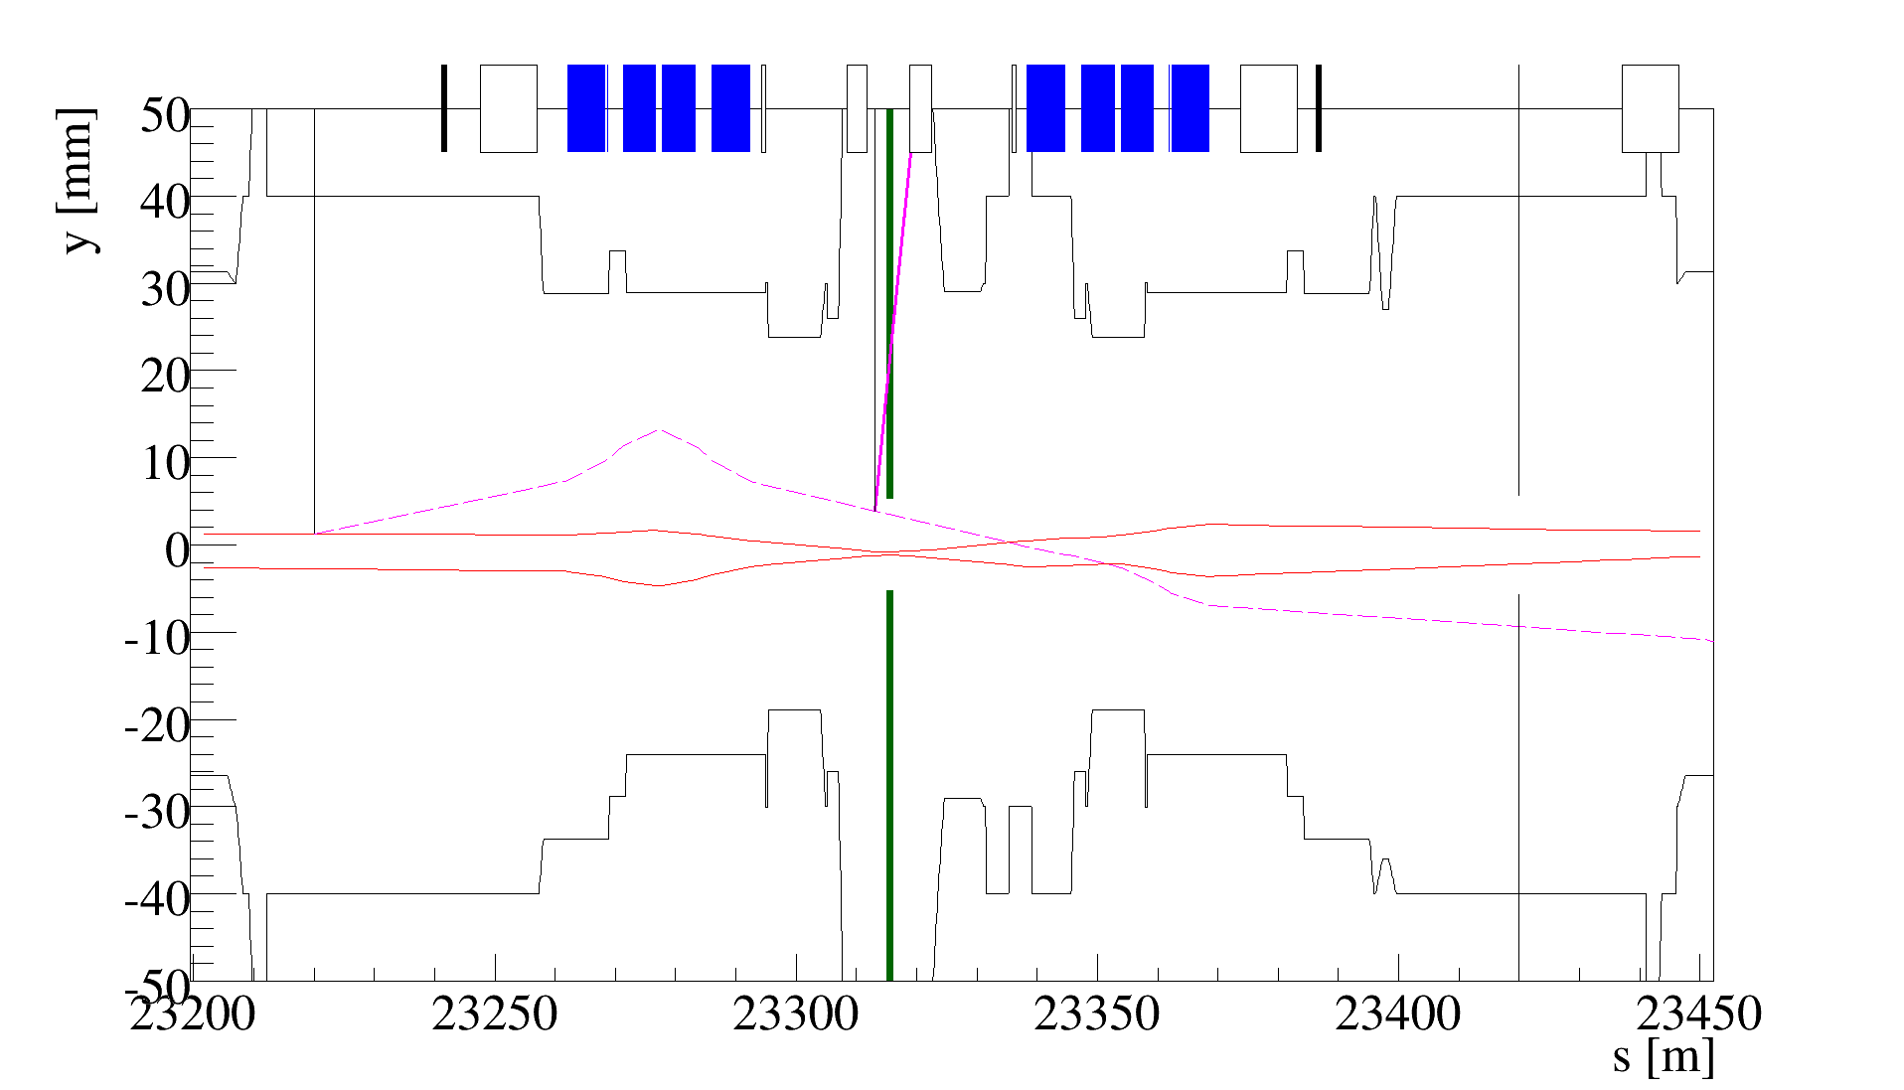
Layout upstream of LHCb
All devices placed in available slots in IR8
The crystal 1 is at 5.0 σ from the center-line, whilst the collimation system has the 2016 nominal settings, with the primary TCP at 5.5 σ.
Crystal 1
7mrad
Target & Crystal 2
1m CFC absorber
150μrad
VELO

Slide 5
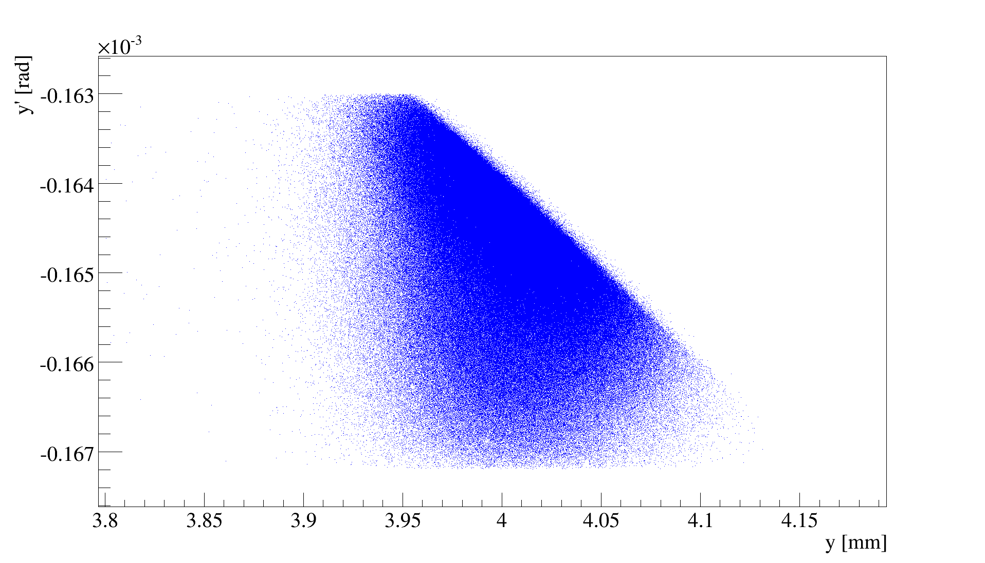
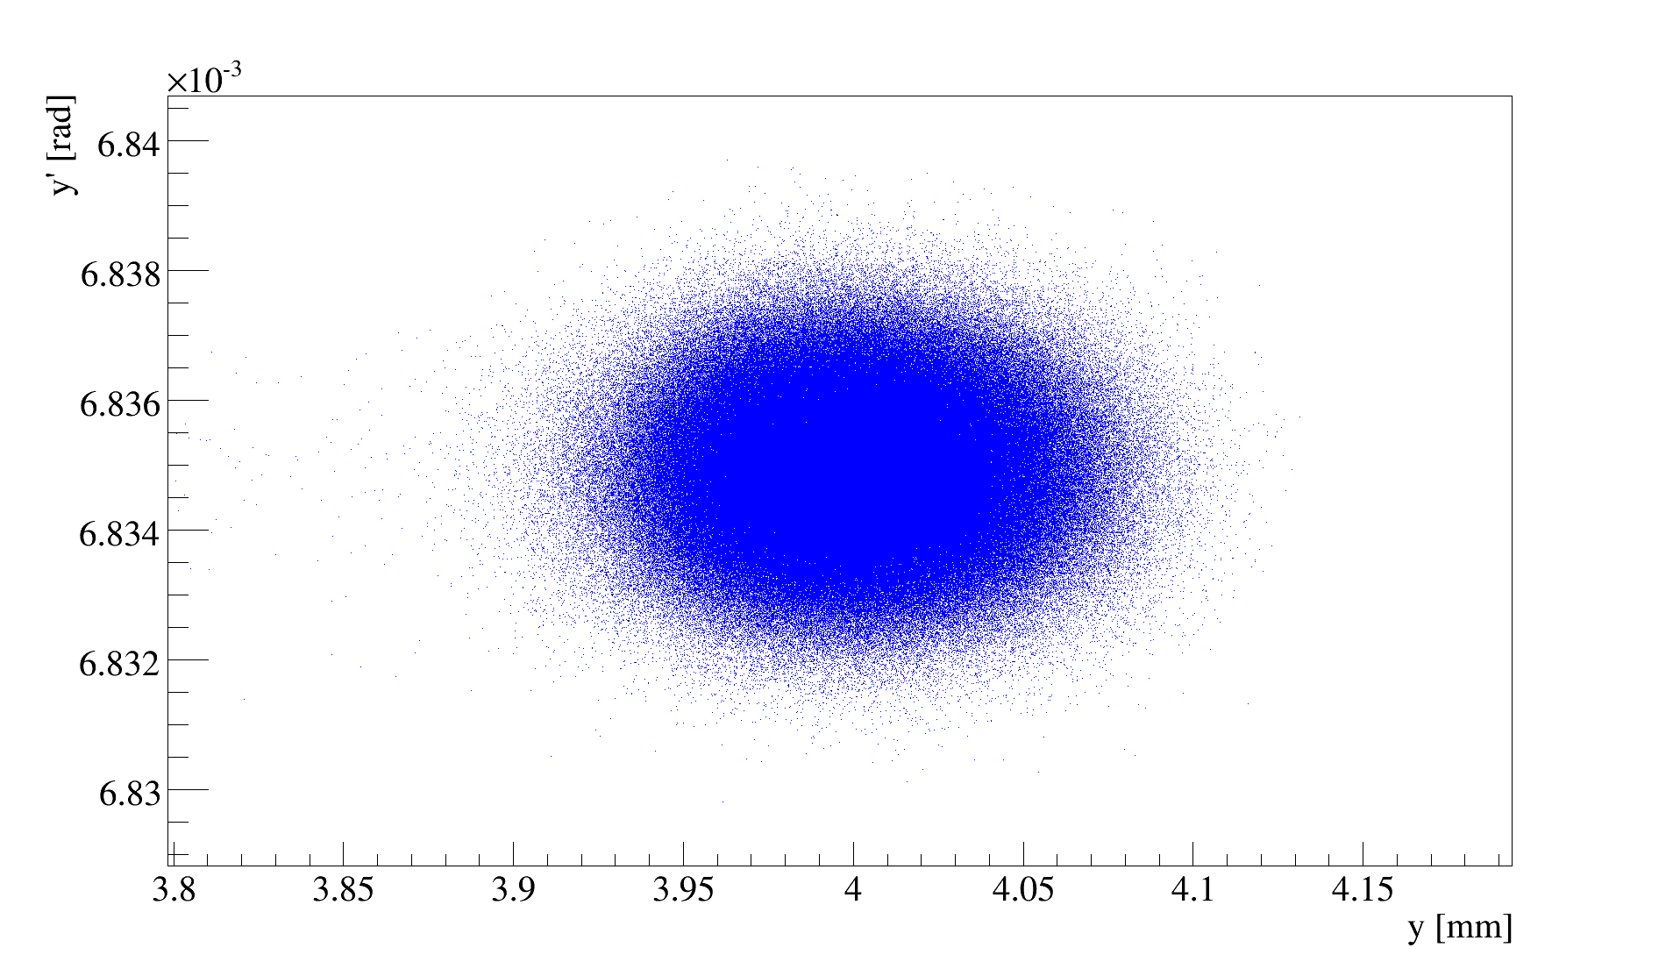
phase space at second cry.
Coordinates in the machine reference frame
Short-living baryons are produced with an energy smaller than that of the incident protons. Their angular acceptance and the phase space portrait are increased as 1/√E
Cut performed by crystal 1
Entry of crystal 2
Exit of crystal 2
Angular acceptance
for 6.5 TeV protons channeled
in crystal 2

Slide 6
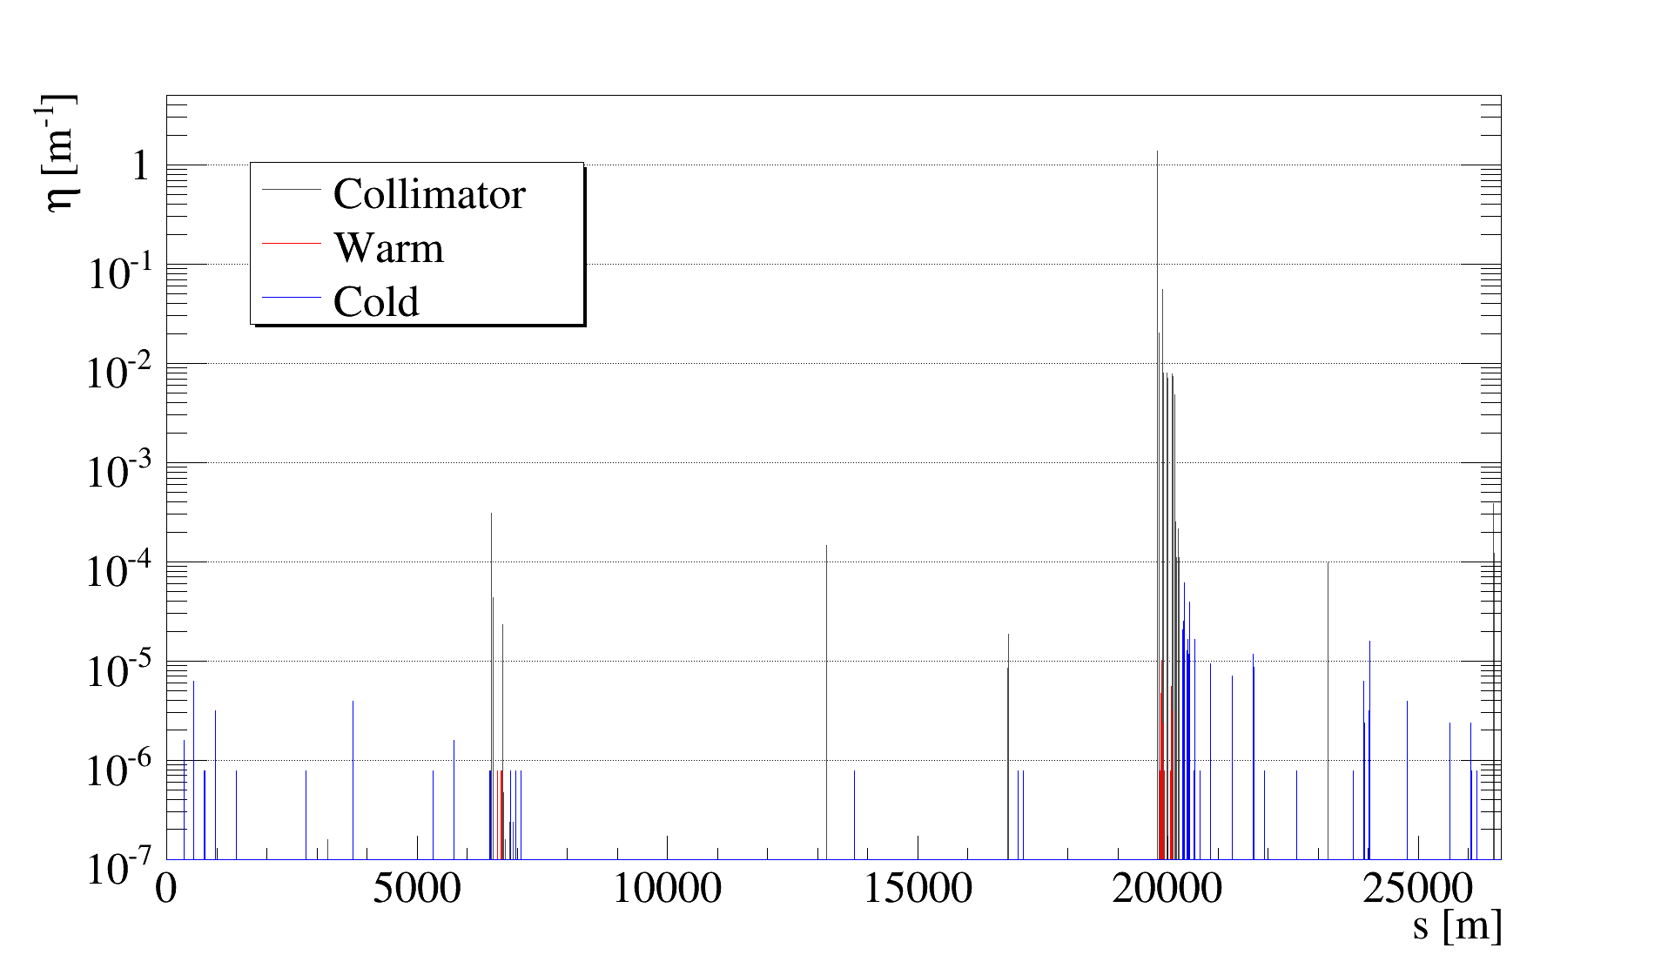
LHC reference loss map
2016 machine (squeezed beams) with 2016 collimator settings

Slide 7
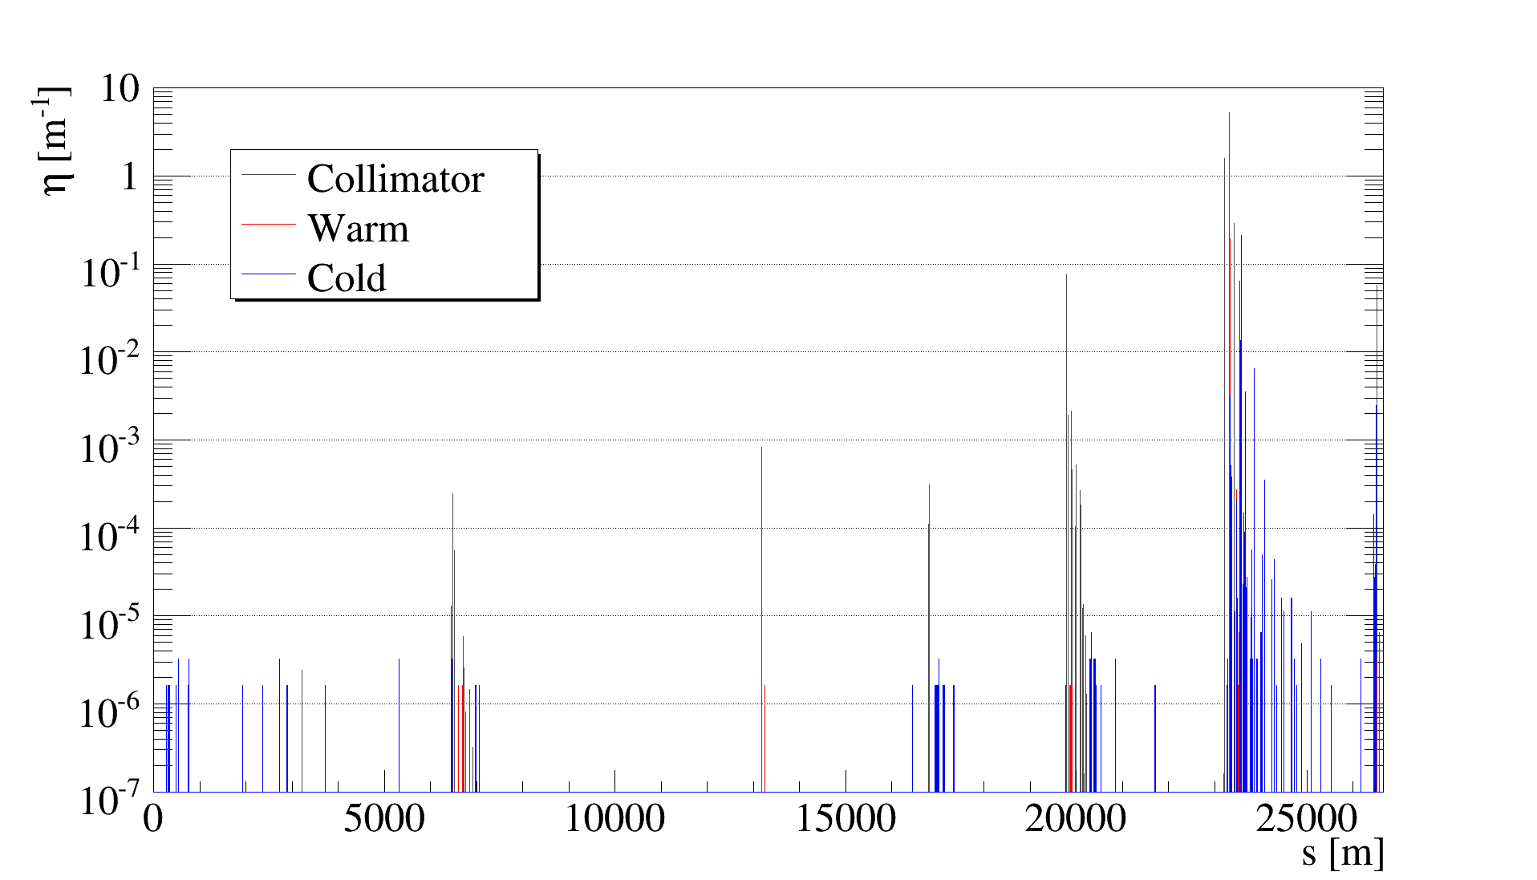
Loss map during “double channeling”
First crystal as primary restriction at 5σ
p to LHCb

Slide 8
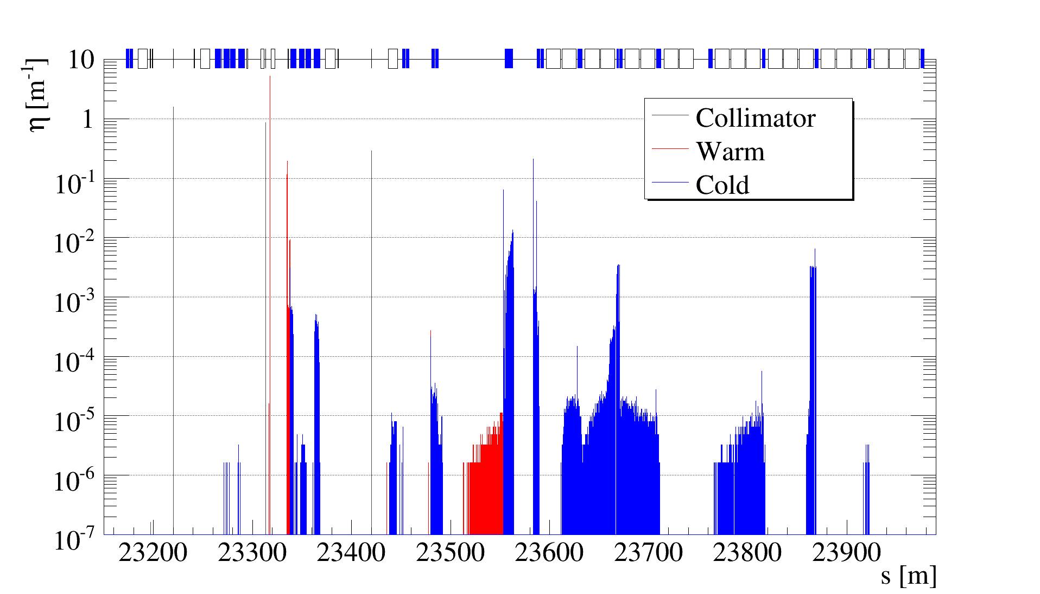
Loss map (ZOOM IP8) “double channeling”
Crystal 2
Crystal 1
p to LHCb
Absorber

Slide 9
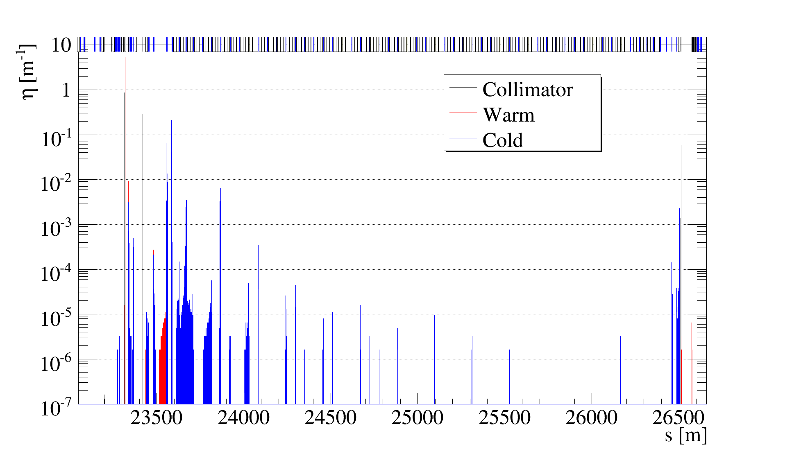
Loss map (ZOOM IP8-IP1) “double channeling”
Crystal 2
very high losses on collimators that protects IP1 triplet
Crystal 1
p to LHCb
Absorber

Slide 10
Conclusions
Possible to design and integrate such system in the present LHC layout
  “double channeling” (i.e. channeled halo by the first crystal intercepted and channeled again by the second crystal)is compatible with the LHCb geometry and acceptance (with short-living baryons traversing well the LHCb VELO).
  Still a long way for a fully effective scenario
Loss maps simulations show that a substantial reduction of the induced halo should be obtained to allow parasitic operation.
  Simulations with 5mm long W target in place and at the same aperture of the second crystal show a negligible impact expected on losses generated in the ring.
  Simulations performed using absorber made of 1 m of W (present TCLA/TCT) instead of 1m of CFC show a small improvements of losses between IP8 and IP1
  Comparisons between Flat top and Squeeze optics do not show relevant differences in terms of loss maps
Simulations will be improved soon to take into account the energy spectrum of the short-leaving baryons produced into the target.

Slide 11
Next steps
Ask the necessary support to CERN, LAL,… and LHCB in order to formulate a proposal to the LHCC
A CDR should investigate:
  Full layout
  Compatibility with the LHC collimation system and with the LHCb detector
  Optimize
    The beam energy
    The target and the crystal length to maximize the production of Λ_{c} and their channeling efficiency
    The crystal bending angle for an optimal acceptance of the Λ_{c} fragments into LHCb
  Investigate the alternative option of an experiment with an extracted beam (SPS or LHC)
Propose tests in the SPS and H8 in the North Area to investigate
  The optimal assembly Target&Crystal2
  The efficiency of the double crystal scenario
  The compatibility with the crystal collimation scenario
Propose scenarios in LHC to evaluate
  the compatibility with LHCb and with the collimation system
  The parasitic mode operation
  The background and the data taking rates.

