Slide 1
Kickoff close-out
Joerg Jaeckel, Mike Lamont, Claude Vallée

Slide 2
It’s been an intense couple of days!
Huge thanks to all the speakers and contributors for a quite remarkable survey of what’s out there and some of the possibilities.

Slide 3
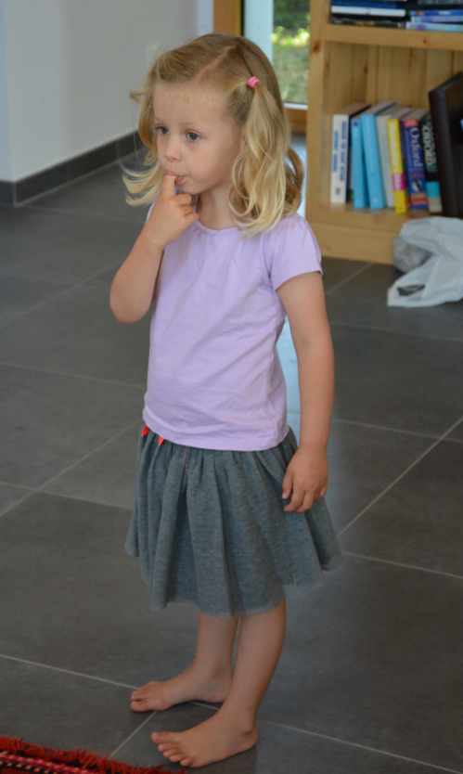


Slide 4
PBC - Scientific goal
The main goal of the Study Group is to explore the opportunities offered by the CERN accelerator complex to address some of today’s outstanding questions in particle physics through experiments complementary to high-energy colliders and other initiatives in the world.
These experiments would typically:
  …exploit the unique opportunities offered by CERN’s accelerator complex and scientific infrastructure…
Provide input for the future of CERN’s scientific diversity programme, which today consists of several facilities and experiments at the Booster, PS and SPS,
over the period until ~2040.

Slide 5
Kickoff - general points
Four sessions
  Theorists’ motivations, ideas and wishes
  Accelerator and infrastructure opportunities
  Potential future of existing programs
  New experiment ideas
Avoided a top-down approach
With the aim of getting ideas on the table
No commitment at this stage! Goal is to provide input to European Strategy Update (ESU)

Slide 6
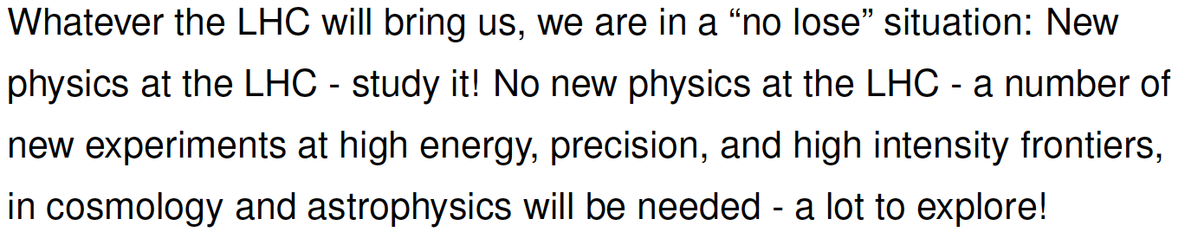

Motivation
Why CERN should have initiated the PBC study was beautiful motivated in a series of theory talks.
Mikhail Shaposhnikov
Mikhail Shaposhnikov quoting Carlo Rubbia

Slide 7
Physics reach
For the proposals on the table we should evaluate:
What is the strength of the physics motivation?
Physics reach compared to projects in established worldwide landscape:
  FNAL/JLAB/BNL/JPARC/PSI/COSI/FAIR/RAL/ESS/TRIUMF/KEK/Frascati/Orsay/DESY et al

Slide 8
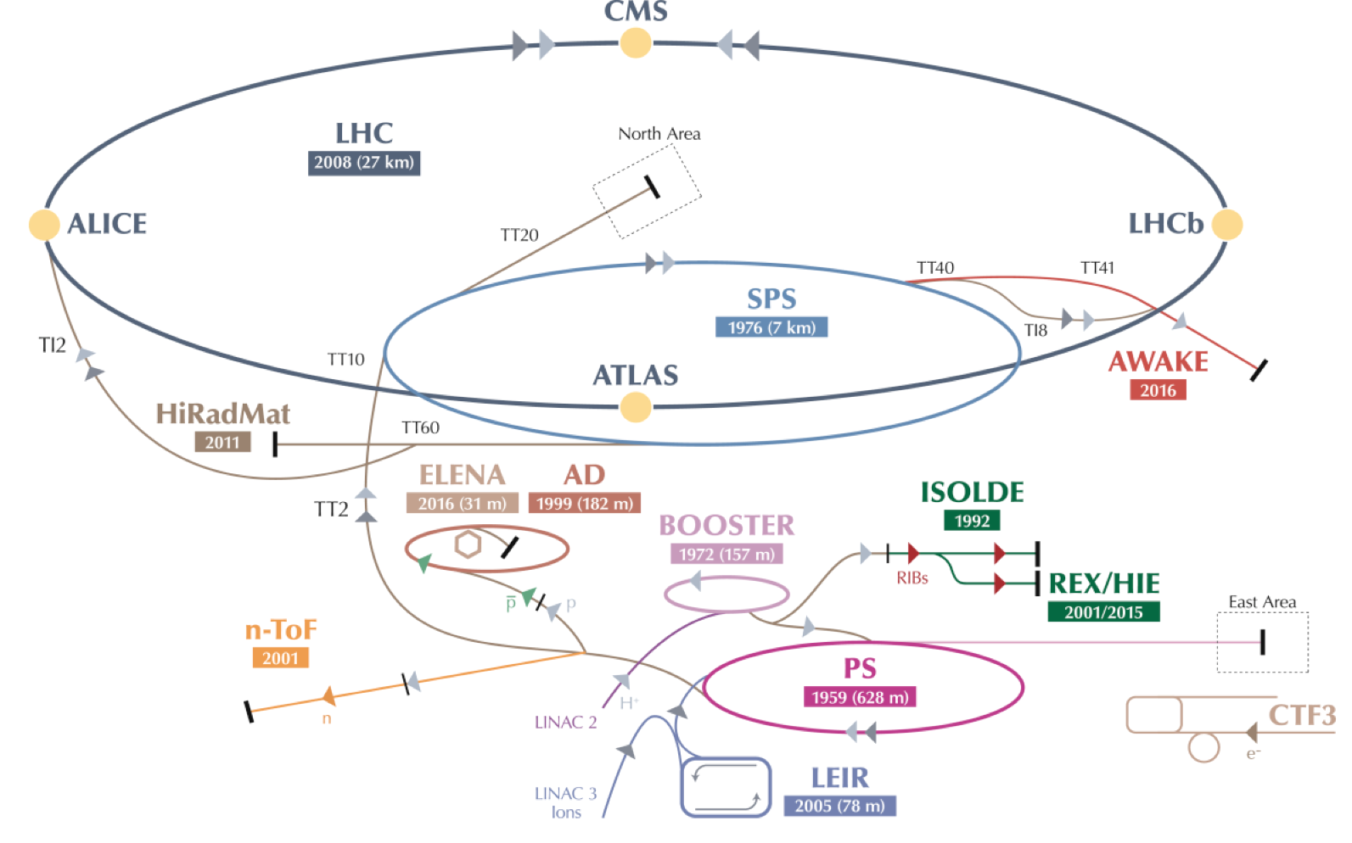
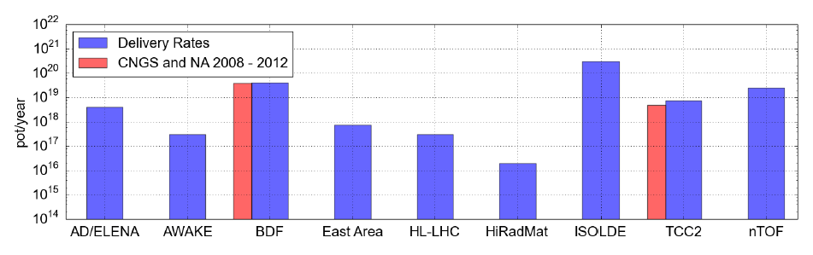
LHC will continue to dominate
Diverse forward looking program already in place!
North Area

Slide 9
Novel exploitation of existing facilities
North Area
East Area
AD/ELENA
nTOF
ISOLDE, HIE-ISOLDE, TSR (?)
Developments/studies are required to enable the proposed physics programs.
ESU will need to find right balance between upgrade/extension of ongoing projects and new projects

Slide 10
North Area – in particular
6/15 “New ideas”
Feasibility studies/resources required for proposed conventional beam upgrades
  RF separated beams for COMPASS;
  Kaon beam for NA62;
  DIRAC at SPS;
  NA60+
  etc. etc.
Evaluation of the physics case of the detector projects and investigation of possible combinations and synergy

Slide 11
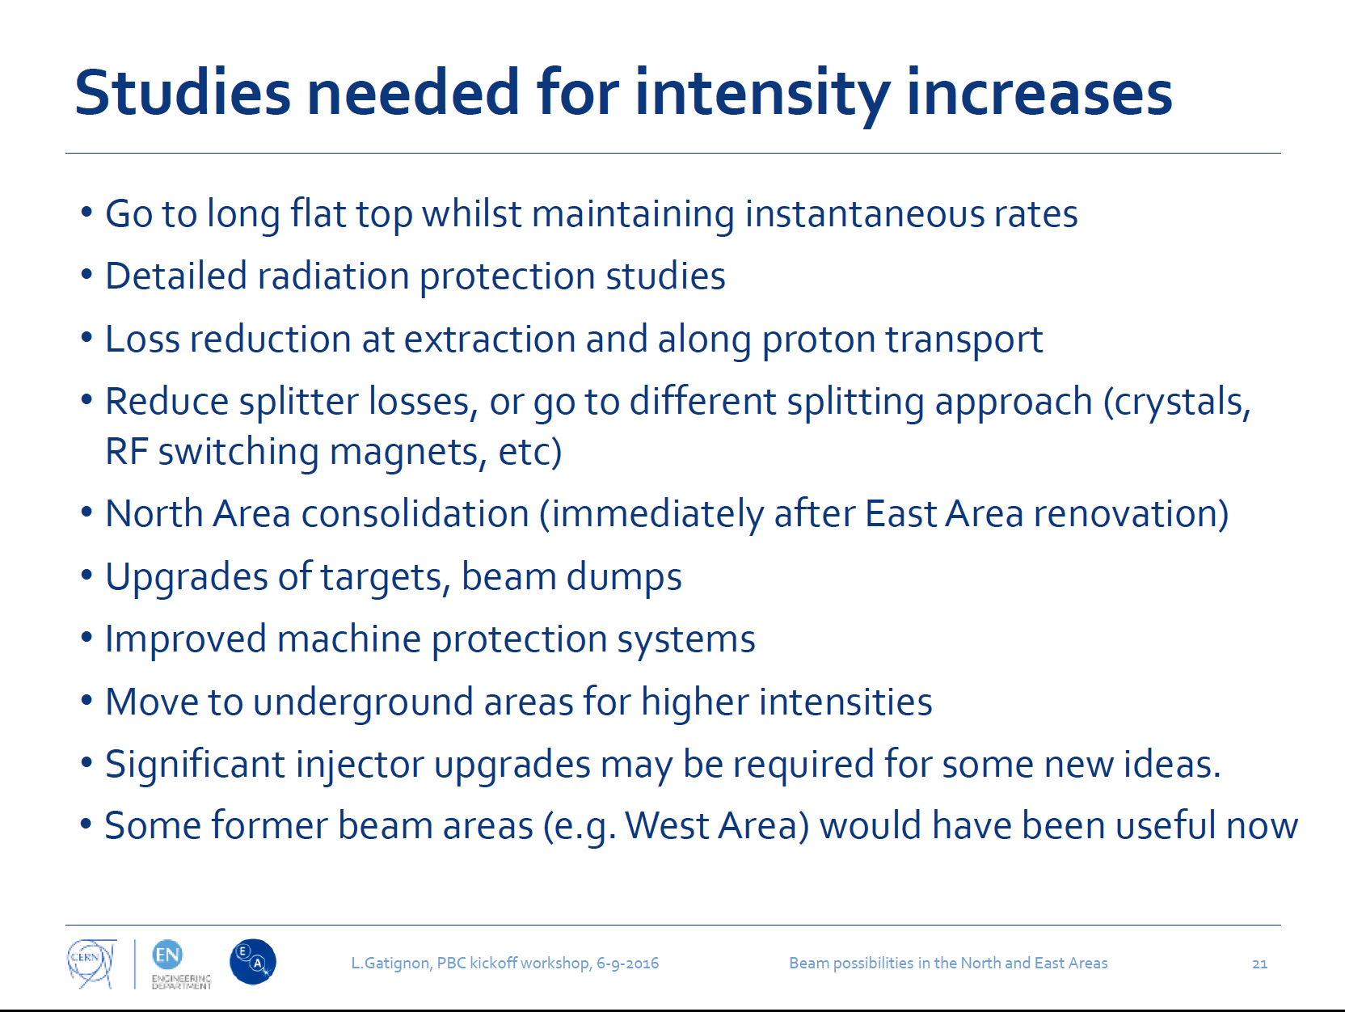
North Area
Not for the ESU but work to do

Slide 12
New ideas
SPS Beam Dump Facility
  complete technical feasibility studies of a beam dump facility in the CERN North Area (extraction, target, radiation protection)
Electric Dipole Moment
  Polarized protons, 0.7 GeV storage ring
Electron beam dump
LHC fixed target via crystal extraction
LHC fixed target via internal gas jet
Partially stripped ions – LHC - gamma source
NuSTORM – explore possible synergies (e.g. target…)
Study reports at a appropriate level depending on the maturity of project proposal with possibly a rough resource/timescale estimate

Slide 13
Non-accelerator
Searches for axion dark matter, axion-like particles, hidden photons etc.
CAST >> IAXO
OSQAR+
LSW
aKWISP
Darkside
These do not need to be realized at CERN
  Study physics case and technical requirements as input to ESU
  Explore possible technological contributions by CERN to externally hosted facilities

Slide 14
Deliverables
For update of the European Strategy for Particle Physics in ~2019-2020
Evaluation of the physics case in a world wide context
Will range from:
  Results of BDF feasibility studies
  Exploratory study reports for selected new ideas
  Required R&D going forward –initiate feasibility studies depending on resources
  Preliminary evaluations of more long term options
Ranking left to ESU
Working groups to be set-up
  Will inform the community once the structure has been decided

Slide 15
Constraints
Maximal exploitation post-LIU/proton budget
Mutual compatibility/exclusion between the various projects
Infrastructure support needed for non-accelerator projects
Bear in mind the original criteria
  exploit the unique opportunities offered by CERN’s accelerator complex and scientific infrastructure,
  experiments complementary to high-energy colliders and other initiatives in the world

Slide 16
Conclusions
Considerable potential for novel exploitation of existing complex
  Cleary need to evaluate, prioritize, and commit resources where appropriate
Some compelling new ideas at varying degrees of maturity
  Evaluate, select, develop, report
  Continue exploration of new ideas
Possible collaboration with other labs to be explored
Foresee PBC follow-up meeting next year

Slide 17
Thanks!!!
All the speakers and contributors again
Attendees!
Sylvia and the support team
Fabiola for kicking it off and her support
Connie for organizing everything.
Connie rocks.

