Slide 1
ALICE & LHCb LS2: PLANNING
Arturo Tauro
Eric Thomas
On behalf of ALICE and LHCb Collaborations

Slide 2
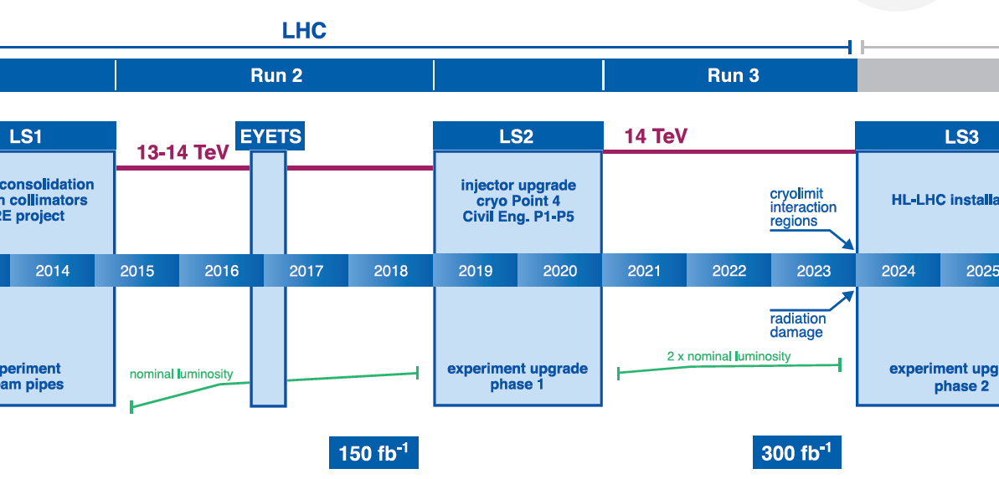
2 Years
2 ¼ years left
LHCb & ALICE
major upgrade
ATLAS & CMS
major upgrade
Phase II
LHCb detector
consolidation & improvement
ATLAS & CMS
Phase I upgrade

Slide 3
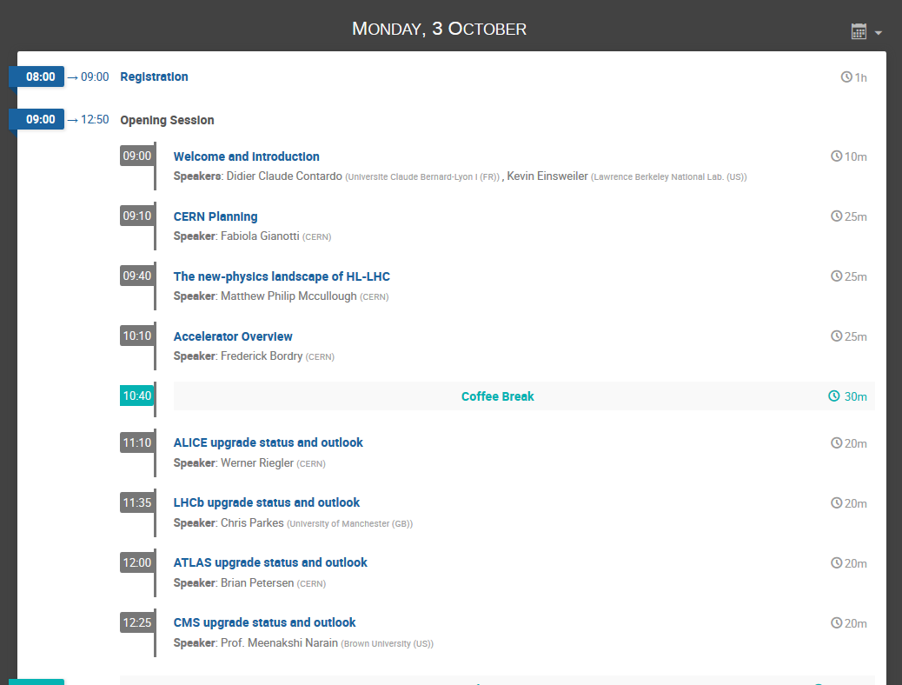
ALICE & LHCb upgrades
Notes:
We have two years for preparations and two years for installation of the ALICE upgrade.
Most subsystems go into production phase early 2017.

Slide 4

ALICE, LS2 upgrade scope
Motivation: Focus on high-precision measurements of rare probes at low p_{T}
  Cannot be selected by hardware trigger
  Need to record large sample of events
Goal: Pb-Pb recorded luminosity ≥ 10 nb⁻¹, (plus pp and p-Pb data)
  8 x 10¹⁰ events to gain a factor 100 in statistics over the Run1+Run2 programme
Strategy:
Read out all Pb-Pb interactions at a maximum rate of 50kHz (i.e. L = 6x10²⁷ cm⁻¹s⁻¹) upon a minimum bias trigger
Perform online data reduction based on reconstruction of clusters and tracks
Improve vertexing and tracking at low p_{T}
➔ New Inner Tracking System (ITS)
Notes:
We have two years for preparations and two years for installation of the ALICE upgrade.
Most subsystems go into production phase early 2017.

Slide 5

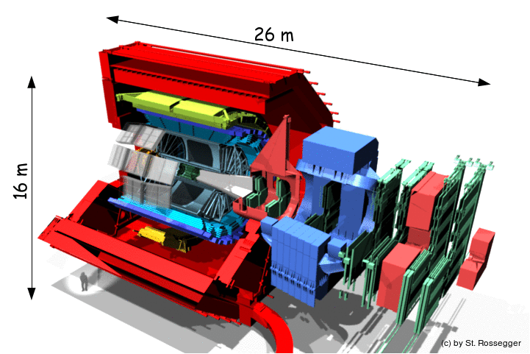
ALICE, LS2 upgrade scope
New Inner Tracking System (ITS)
improved pointing precision
less material → thinnest tracker at the LHC
Muon Forward Tracker (MFT)
new Si tracker
Improved MUON pointing precision
MUON Arm
continuous readout electronics
Time Projection Chamber (TPC)
new GEM technology for readout chambers
continuous readout
faster readout electronics
New Online/Offline computing farm (O2)
new architecture
on line tracking & data compression
50kHz PbPb event rate
TOF, TRD
Faster readout
New Trigger Detectors (FIT)

Slide 6
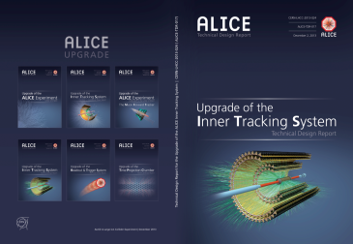




The ALICE Upgrade, 5 TDRs
  Silicon Inner Tracking System (ITS) upgrade
  Time Projection Chamber (TPC) readout chamber upgrade
  Muon Forward Tracker (MFT)
  Upgraded readout for all detectors to cope with the higher rate (SAMPA, CRU) Upgraded Central Trigger Processor Upgraded Fast Interaction Trigger (FIT) based on Quartz+MCP & Scintillator New Radiation requirements
  Upgraded Online-Offline (O2) system to handle the continuous readout at 50kHz PbPb collisions and reconstruction
Notes:
We have two years for preparations and two years for installation of the ALICE upgrade.
Most subsystems go into production phase early 2017.

Slide 7
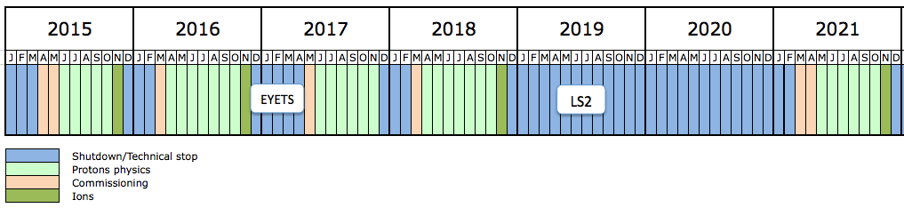
The way to LS2
Preparation
LS2
LS2 preparations since end LS1
LS2 duration: 102 working weeks (2 weeks in Dec 2018 and 2x50 weeks in 2019-20)

Slide 8
LS2 preparation

Slide 9
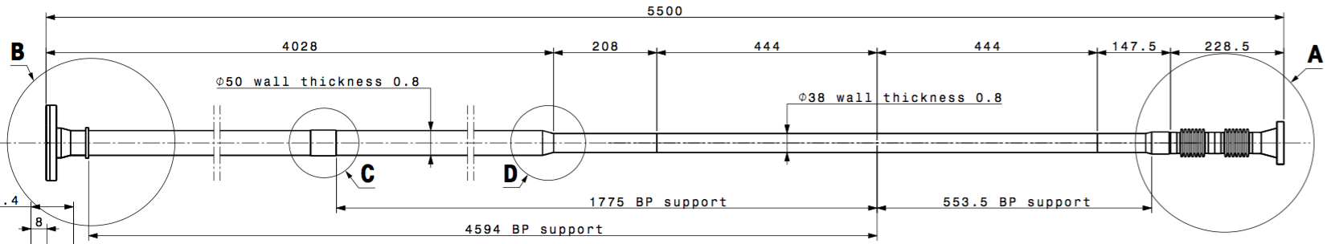
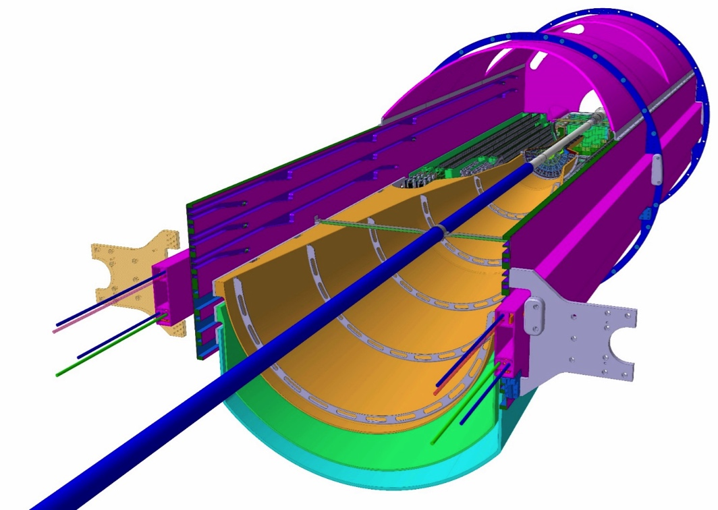
New central beampipe 1/2
 | Present beampipe | LS2 beampipe
Outer diameter | 60mm | 38mm (only central part)
Wall thickness | 800um | 800um
Length | 482cm | 550cm
Beryllium length | 395cm | 88.8cm
Bellows/flanges | SS | Al
Nb. of supports | 3 | 3
OD 38 mm
ID 36.4 mm
New ALICE beampipe geometry officially approved in September 2014 LMC

Slide 10
New central beampipe 2/2
18 months
> one year contingency
Order
Delivery to VSC
Delivery to ALICE
Installation in ALICE
Engineering design completed (now under approval)

Slide 11
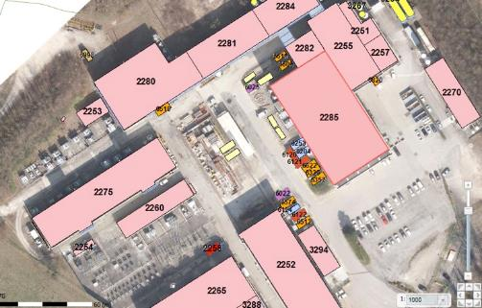
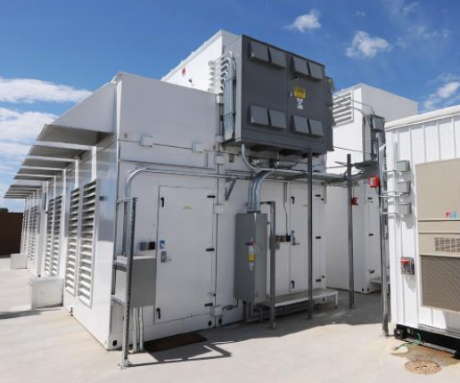
New O2 data centre at P2 (CR0)
If no data centre in Prevessin
Noise simulation done and put as requirement in ITT
EL and CV infrastructure
MDC delivery
CR0 ready
CR0 location at P2
EL infrastructure
Example of MDC

Slide 12
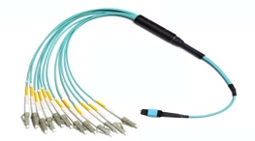

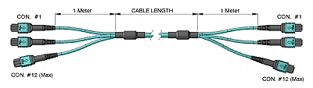
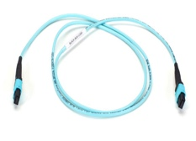
Optical fibers 1/2
19’920 links, 145 trunk cables
Architecture and technology selected: trunk cables 144F & MPO
CERN offer received in May (EN-EL), other suppliers contacted
Synergy with LHCb
Cavern CR1
DET.
MPO-LC
Patch-cord
4U Patch Panel
MPO-MPO
Trunk cable 100-150mt
MPO-MPO
4U Patch Panel
MPO-MPO
MPO-MPO
Patch-cord
CRU

Slide 13
Optical fibers 2/2
Purchase
fibers
Installation and test of fibers CR1-UX
TPC re-installation
Cable-trays CR1-UX + validate prototype
Installation of fibers CR1 to SXL2 cleanroom and CR0-CR1

Slide 14
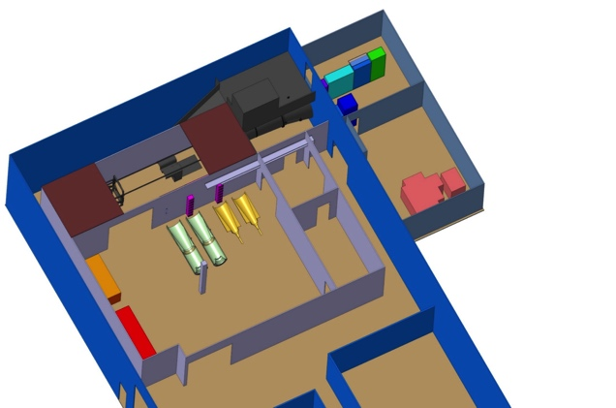
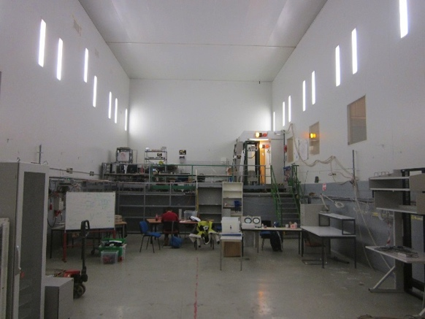
Cleanrooms
ITS cleanroom (B.167)
June 17’: TPC cleanroom (ISO7)
Zone A (Assembly hall)
Zone B (Insertion Test)
Zone C (Counting Room& Cooling Plant)
Zone D (Control Room)
C
B
D
A

Slide 15
LS2 schedule

Slide 16
LS2 schedule
1
2
3
Sep-Dec (15 weeks)
Recommissioning
  Dec-Feb (10 weeks)
  Open Experiment + TPC/ITS/beampipe de-installation
  Mar-Dec (40 weeks)
  TPC upgrade
  Dec-Aug (37 weeks)
  Reinstall TPC/ITS/MFT/FIT/beampipe + close Experiment
One shift/day
‘Long’ days foreseen for transport tasks
24h/24 for few specific tasks (e.g. TPC RO tests)

Slide 17
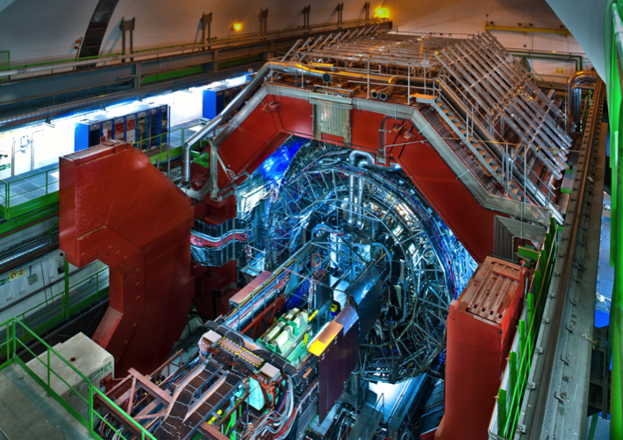
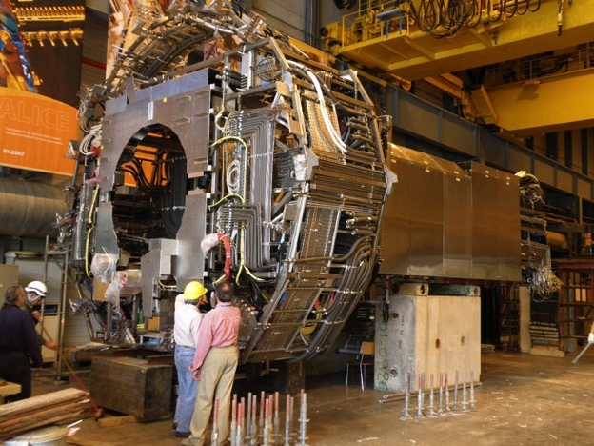
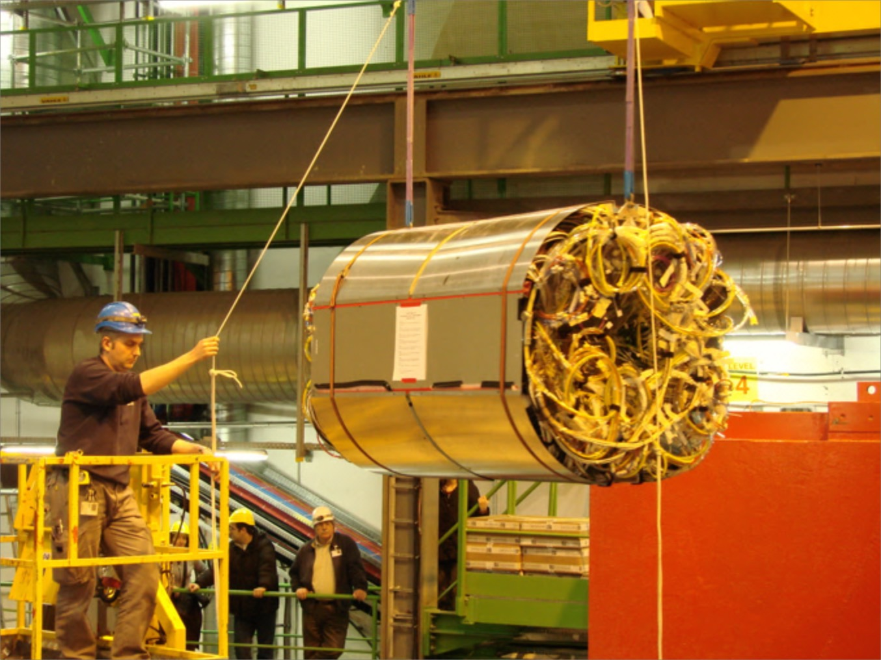
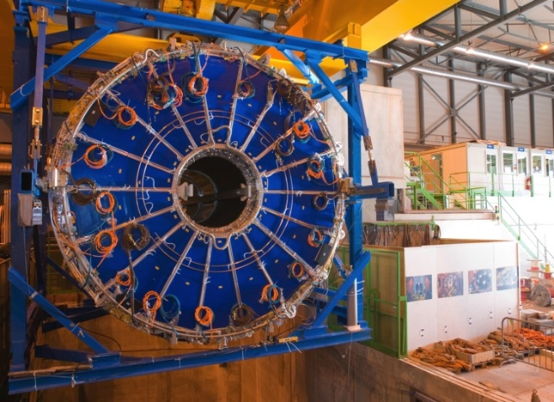
Open Experiment
+ TPC/ITS/beampipe de-installation
 | Duration
Open cavern, L3 doors, comp.magnet/miniframe | 3.5
Remove ITS & beampipe | 5.5
Bring TPC to cleanroom | 1
 | Total: 10 weeks
Miniframe
ITS
TPC
Key resources: transport, P2 technicians, ITS and TPC groups

Slide 18
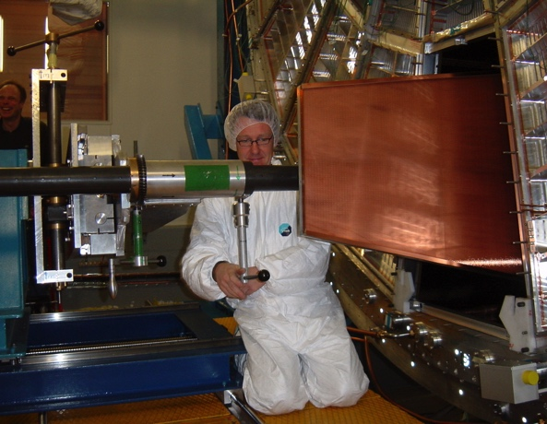
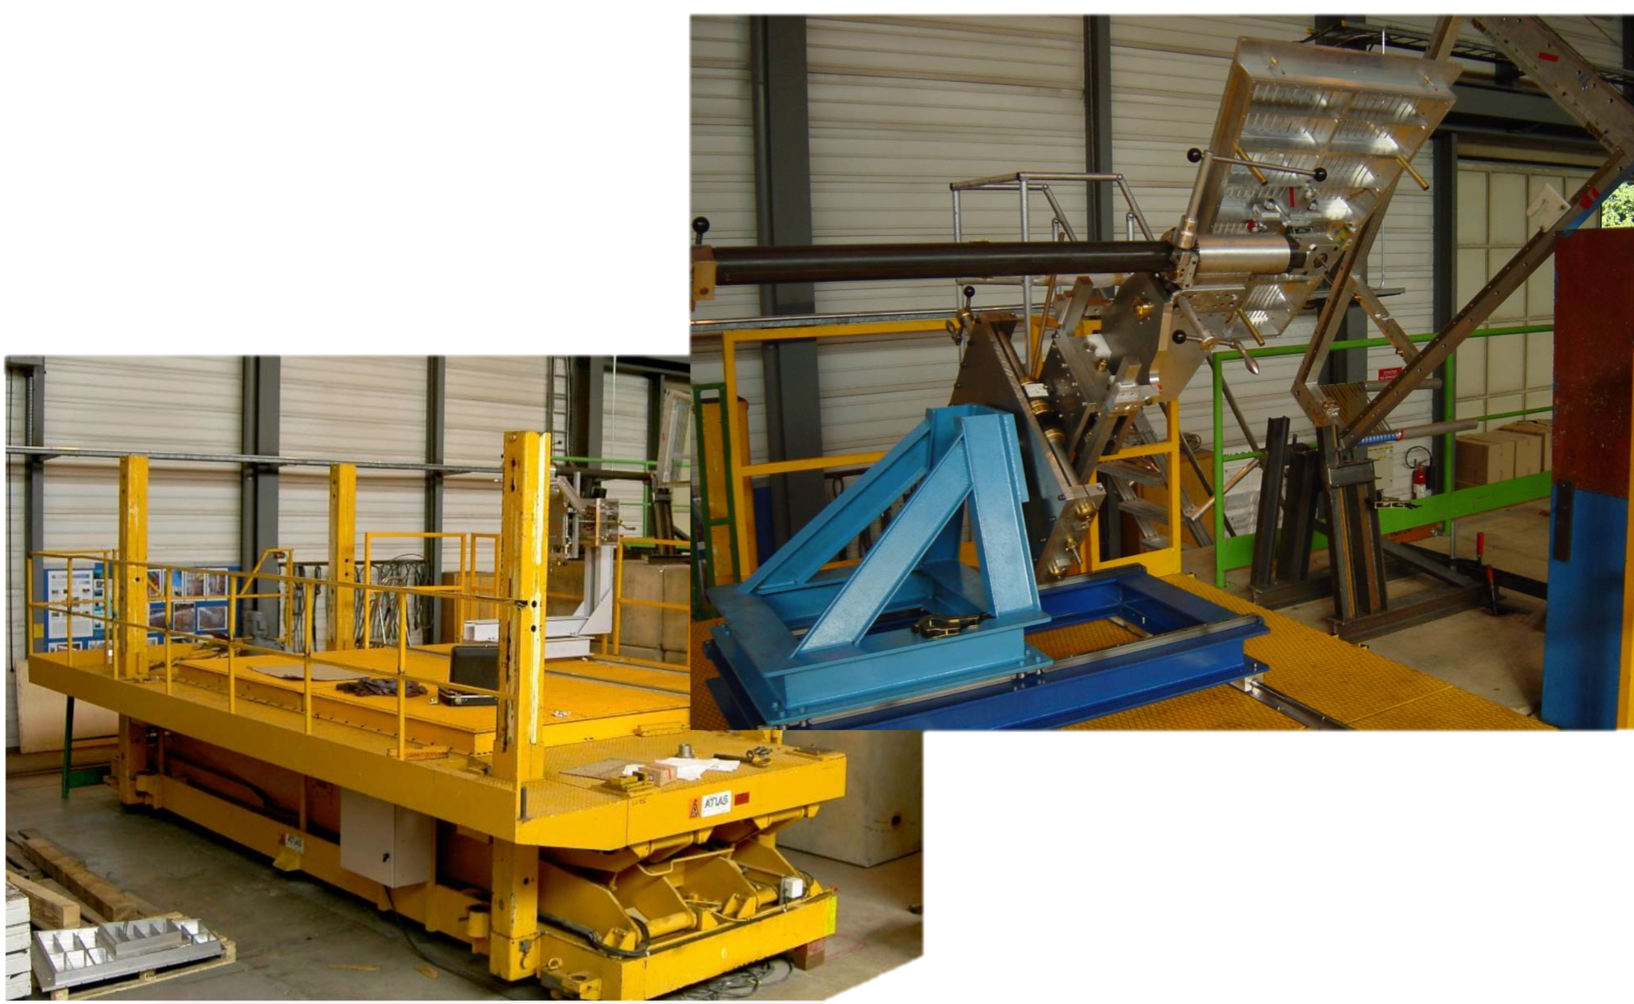
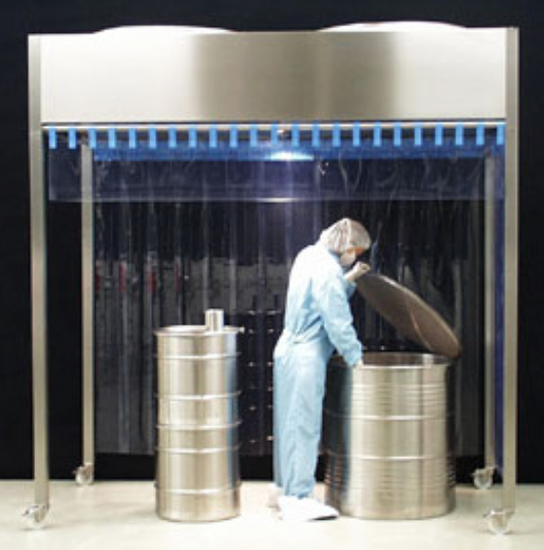
TPC upgrade
 | Duration
Remove electronics and services | 5
Swap chambers | 8
Survey and align chambers and end plates | 3
Sealing, T sensor installation and leak test | 4
Reinstall electronics | 8
Readout test | 7
Close sectors | 1
Contingency | 4
 | Total: 40 weeks
MWPC installation (photo 2006)
Yellow platform and installation jig
ISO5 tent

Slide 19
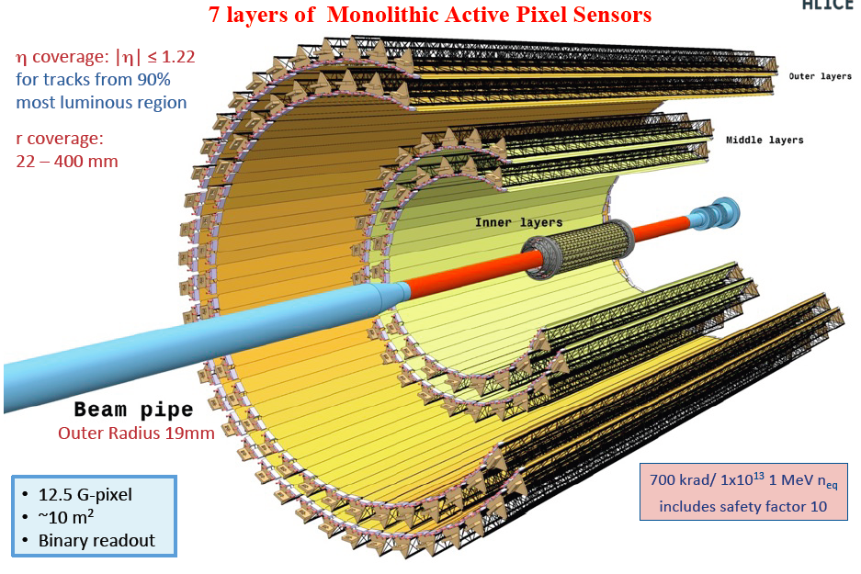
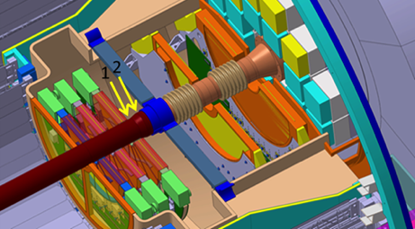
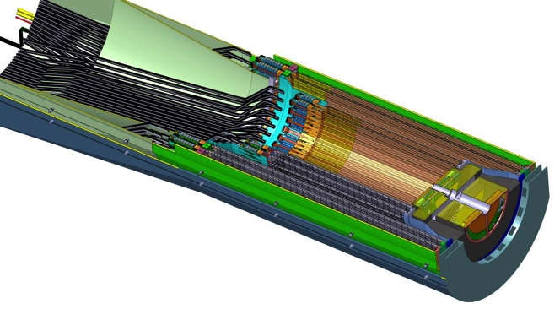
Reinstall TPC/ITS/MFT/FIT/beampipe + close Experiment
 | Duration
Reinstall TPC | 3
Install ITS cage and new beampipe (incl.bakeout) | 6
Reinstall miniframe | 2
Install & commissioning MFT/FIT/ITS | 18
MFT/FIT/ITS commissioning, close L3 doors and cavern | 8
 | Total: 37 weeks
ITS
MFT
Resources:
Survey and transport
P2 technicians
TE-VSC (beampipe)

Slide 20
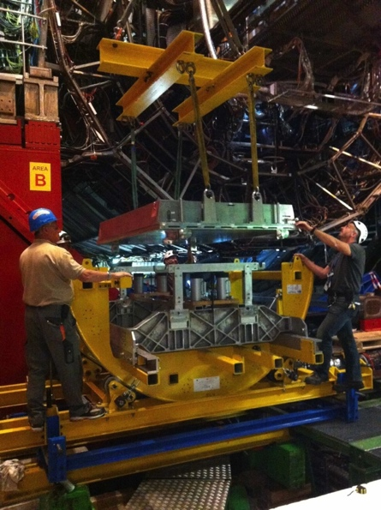
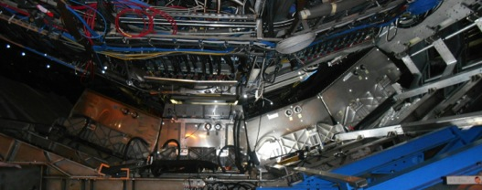

Other activities: detectors
In parallel to TPC upgrade
Uninstall all 4 PHOS modules (fix FEE/TRU cards)
Install 2 CPV modules
These interventions imply to de-install also the 3 A-side DCal modules
CPV installation (LS1)
DCal
CPV
PHOS

Slide 21
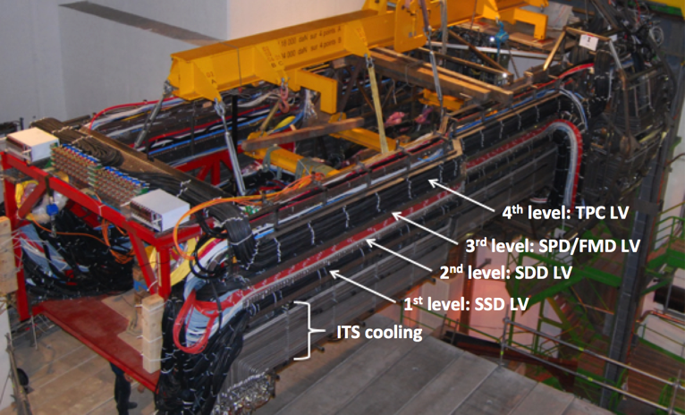
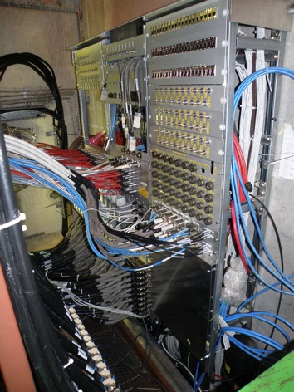
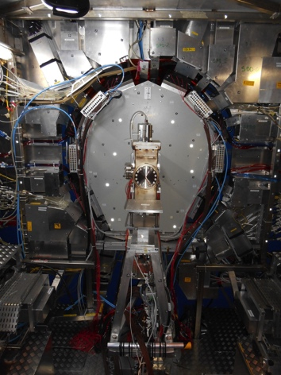
Other activities: services
In parallel to TPC upgrade
Miniframe modification (PP0 and PP1)
TPC/ITS/MFT/FIT cables
Remove all cables from C-side (absorber area)
New ITS/MFT water cooling plants (incl. new lines)
New ITS ventilation duct
Optical fibers
Miniframe
Key resources:
Dedicated FSU team coordinated by ALICE TC
Outside companies (e.g. new inox pipes)
CERN cabling and scaffolding contracts (EL, EA)
CERN EN-CV and EN-EL
PP0
PP1

Slide 22
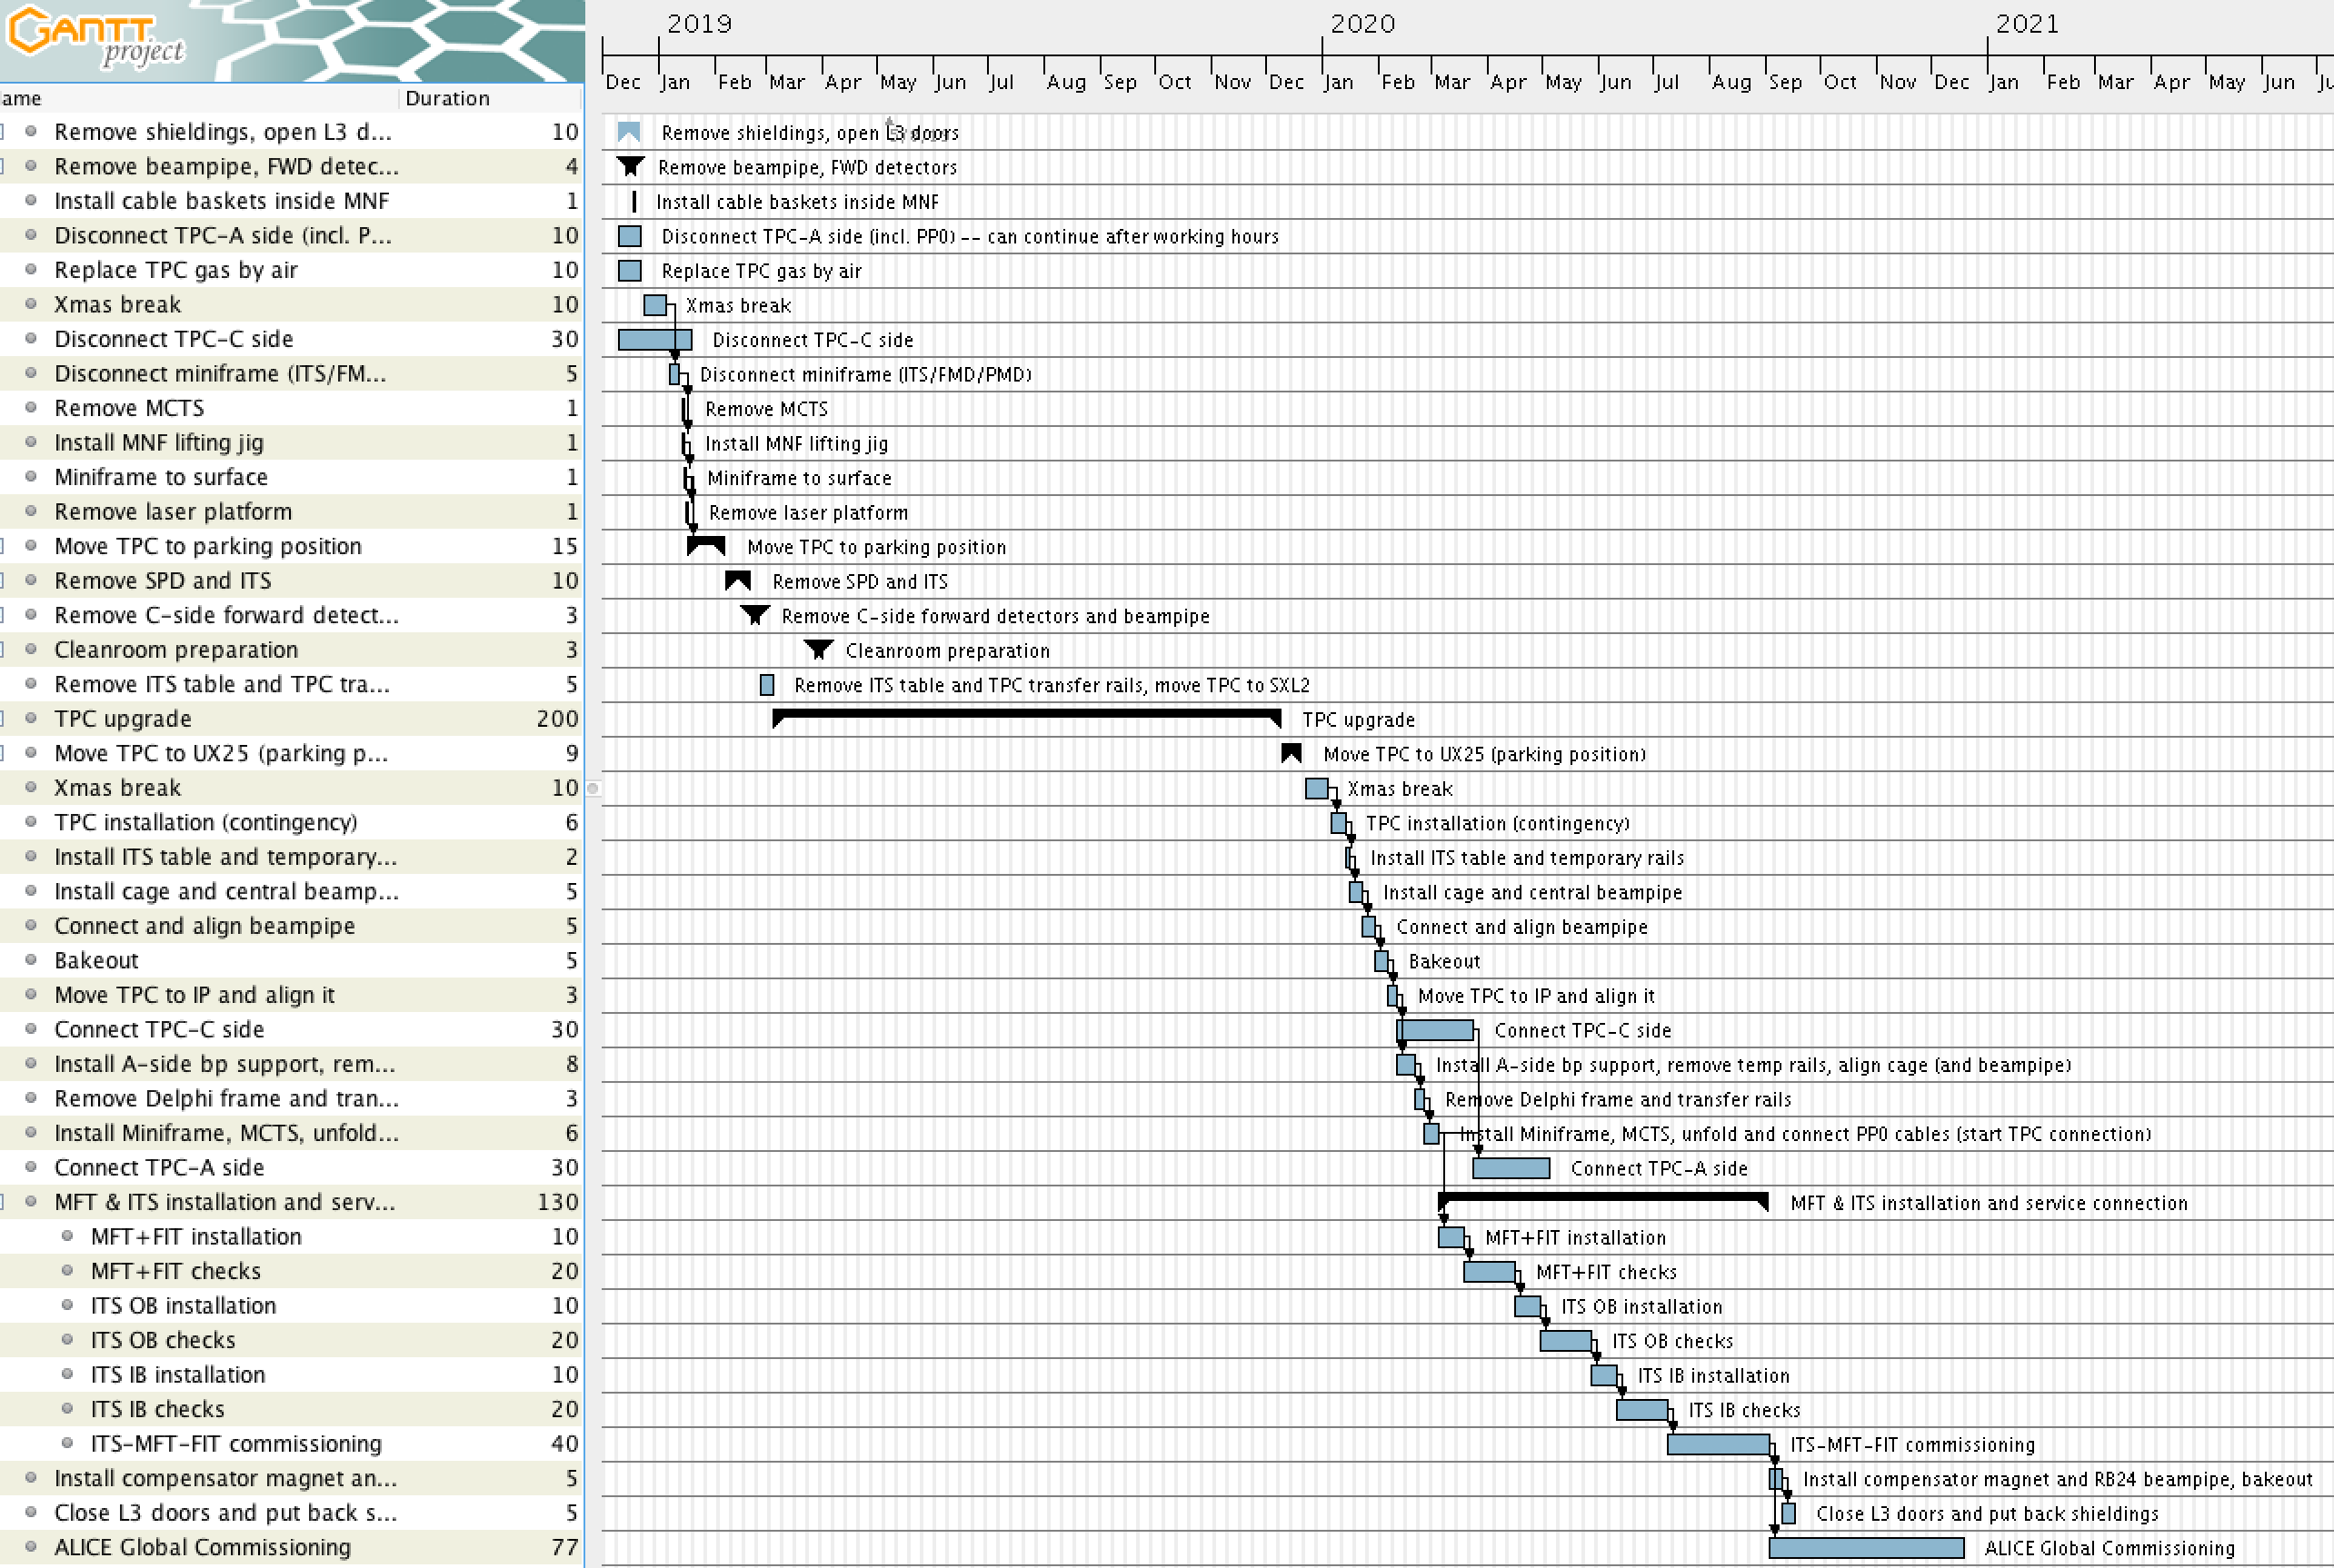
Detailed LS2 schedule

Slide 23
Conclusions
Well on track with LS2 preparations, as we started since end of LS1
New beampipe will be ordered before end of the year. More than one year contingency before installation in ALICE
Fibers will be installed in 2019, cable-trays in place already during upcoming EYETS
LS2 schedule: TPC upgrade and ITS installation must be done in sequence for obvious reasons
Dedicated FSU team for services modifications. Lot of support needed from CERN service groups (transport, survey and safety coordination) and cabling (and scaffolding) contracts!
Four months foreseen for global ALICE re-commissioning at the end of LS2

Slide 24

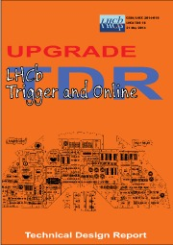


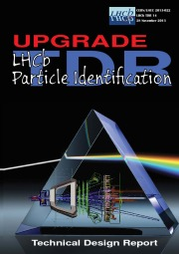
LHCb Upgrade parameters
LHCb is a high precision experiment devoted to the search for new physics beyond the Standard Model by studying CP violation and rare decays
Luminosity
Run2 4 x 10³² cm⁻² s⁻¹ (2 x nominal)
->Upgrade: 2 x 10³³ cm⁻² s⁻¹ (10 x nominal)
(Triggerless) Read-out
Run 2 1 MHz
→ Upgrade 40 MHz
Increasing the read out to 40 MHz and the higher luminosity necessitates replacing all front-end electronics and the majority of detector systems.
To cope with the enormous increase of events to be evaluated, a larger CPU farm will be unavoidable. As space and cooling/power capacities are limited in the UX, a new ‘Data Center’ at the surface is in planning.

Slide 25
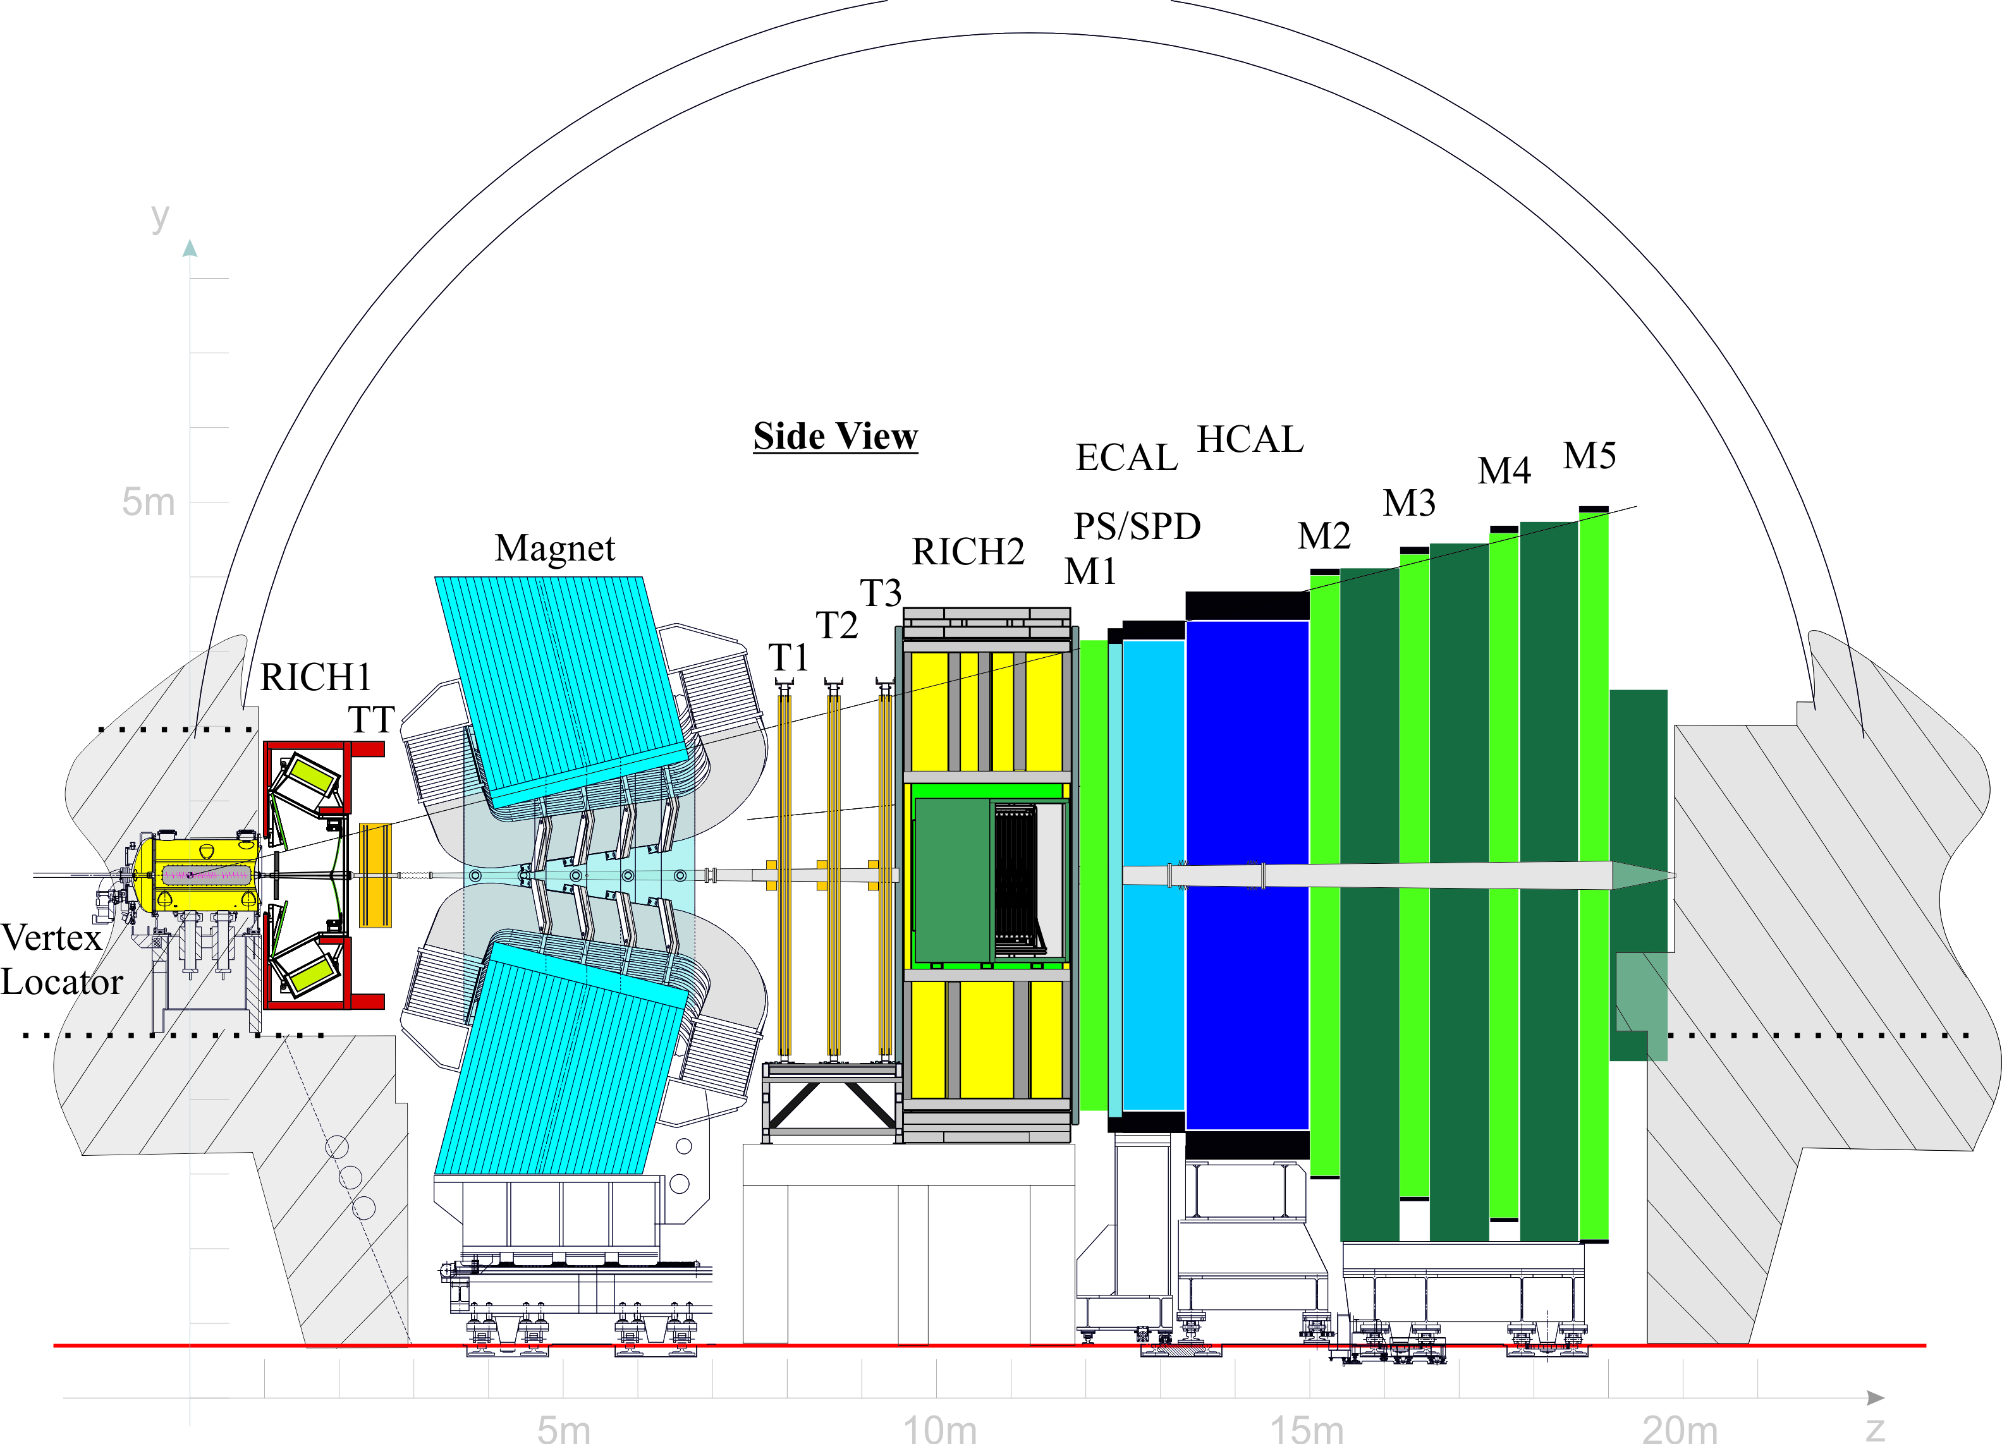
New detectors and r/o electronics
New r/o electronics
What stays in place?
RICH1 Shielding
RICH2 box, mirrors
ECAL HCAL MUON
(but NOT r/o electronics)

Slide 26
LS2 preparation

Slide 27
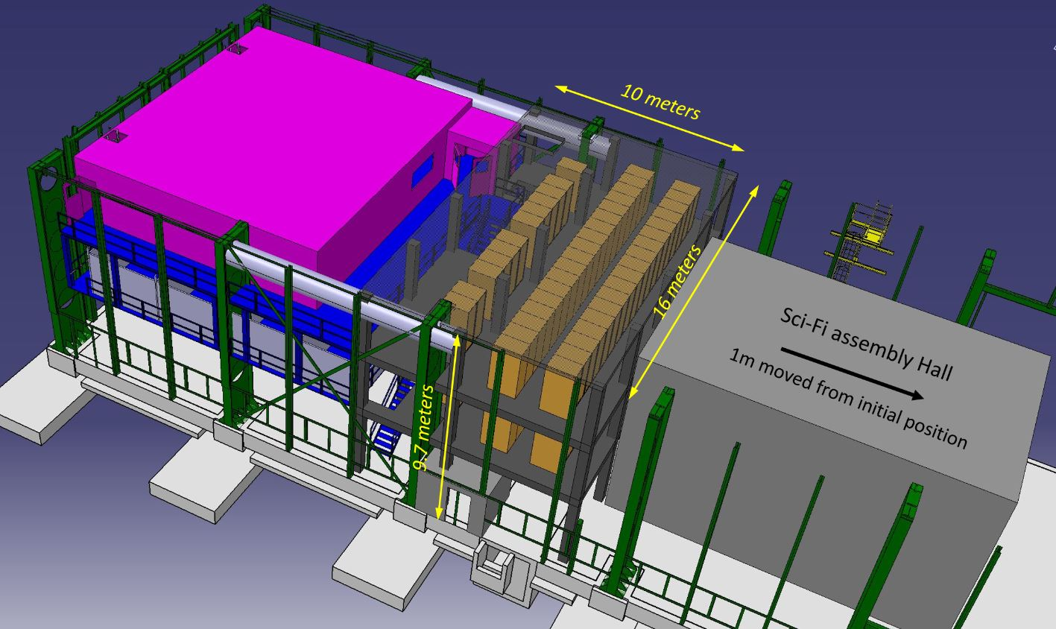
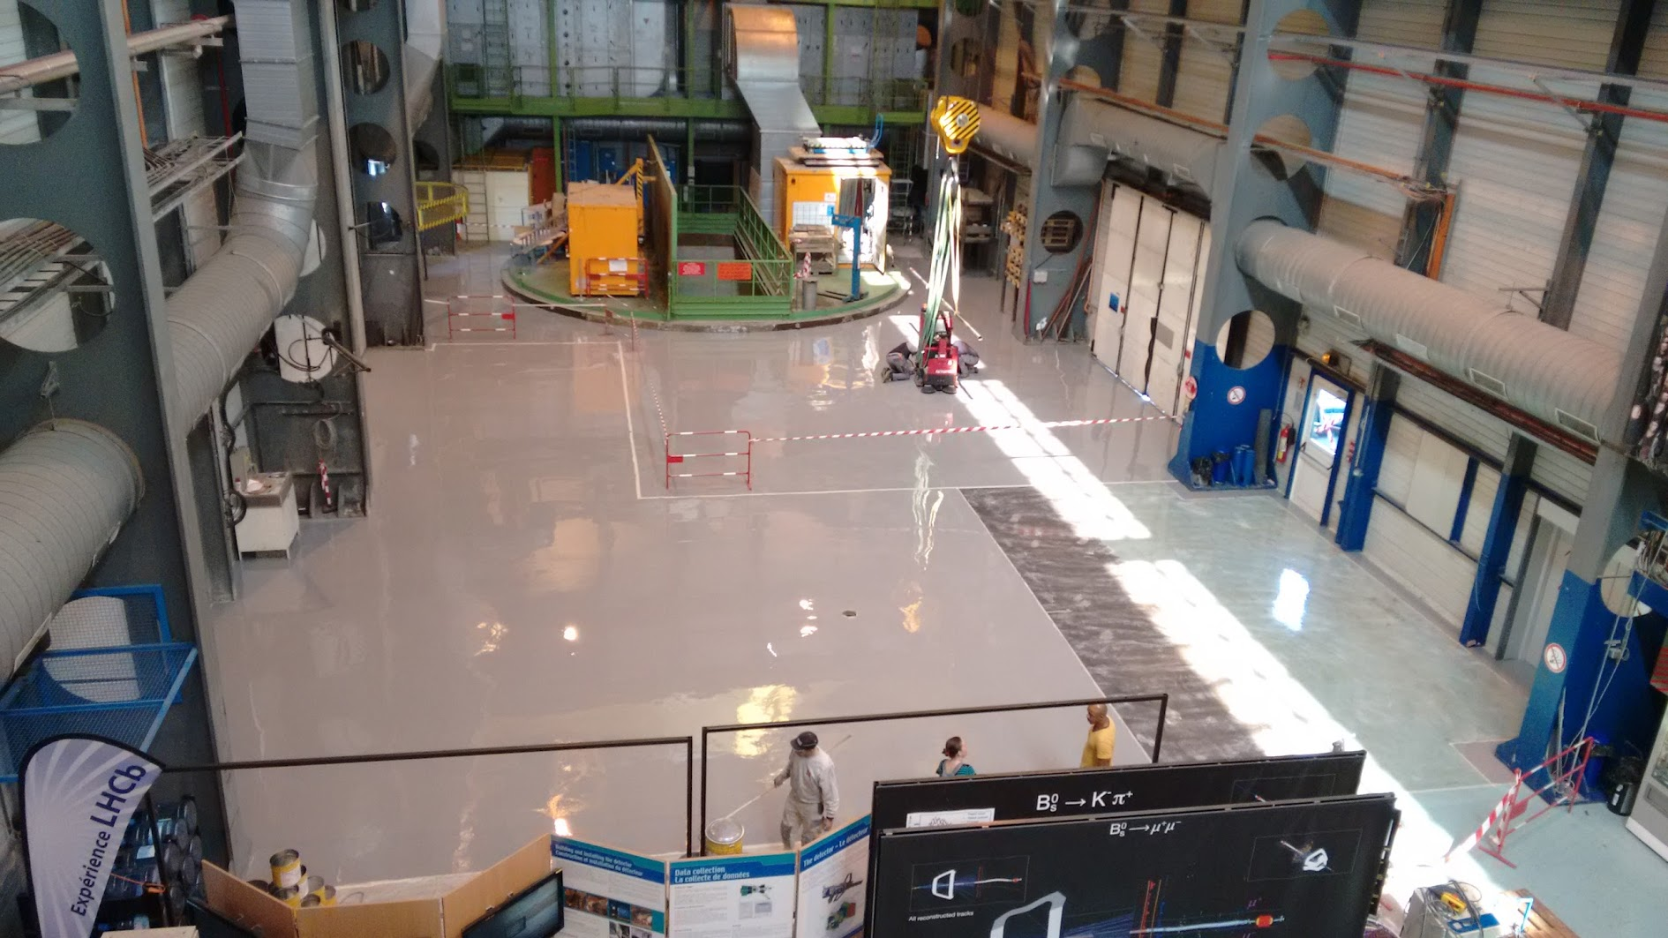
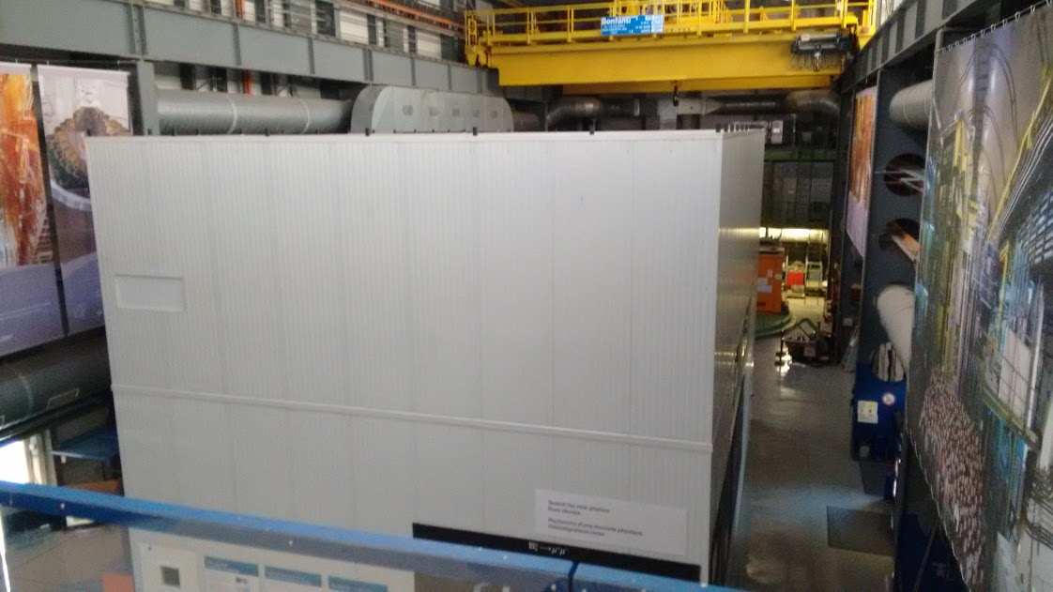
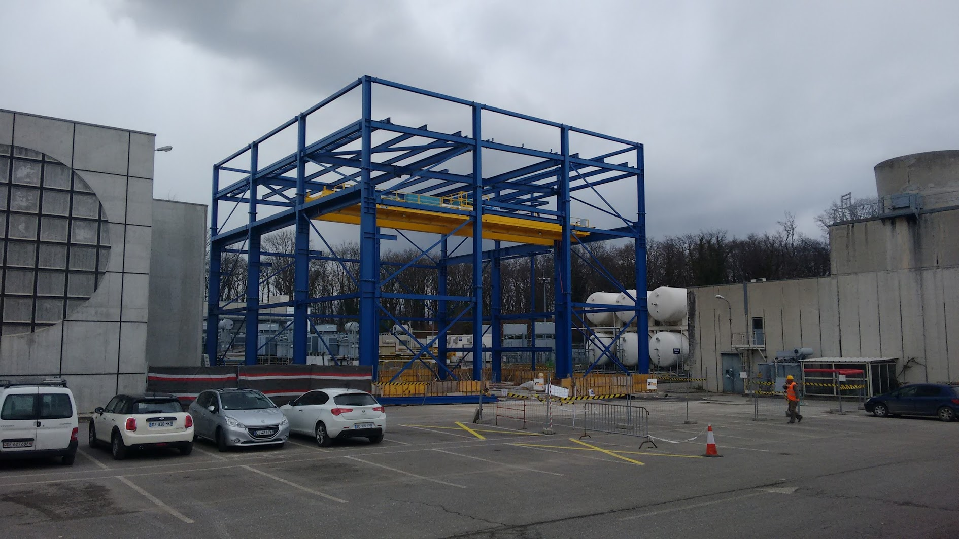
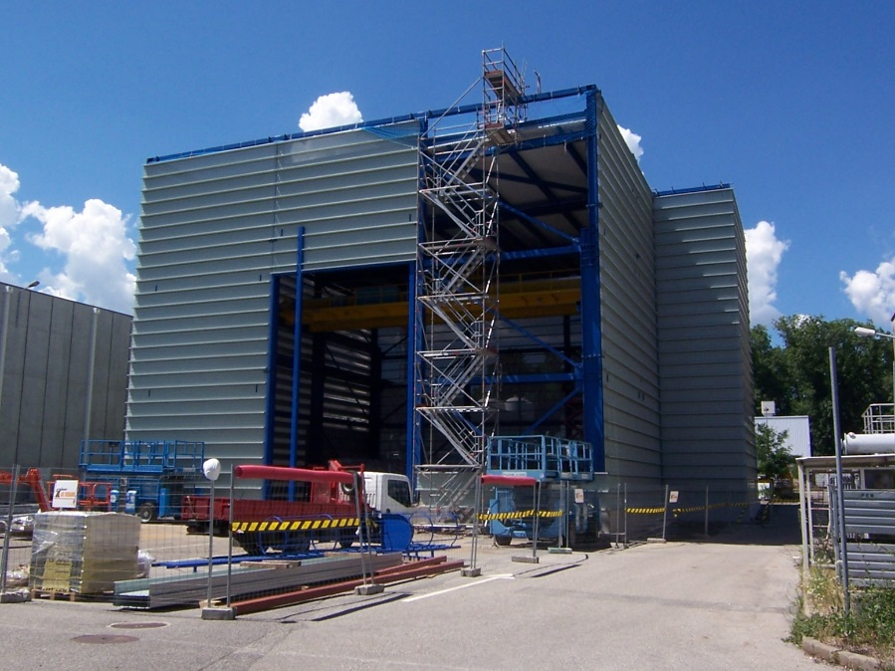
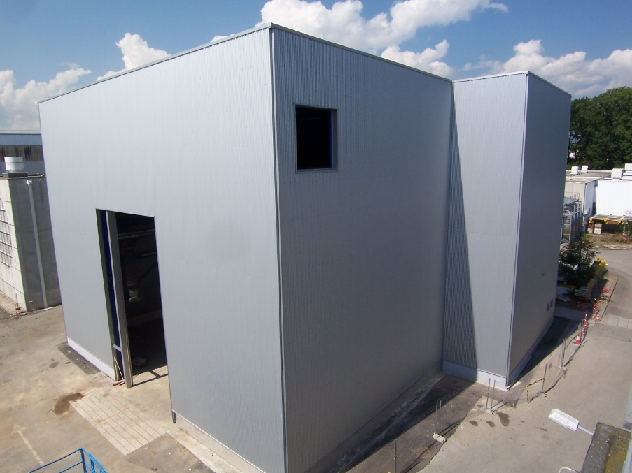
Detector assembling facilities at P8
SX8
b. 3852
SX8
SX8
SX8
b. 3852
b. 3852
b. 3852

Slide 28
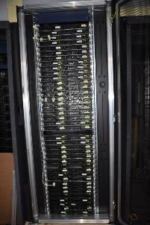
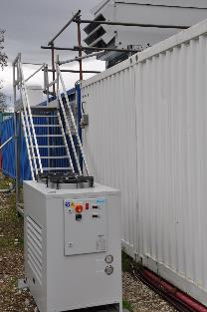
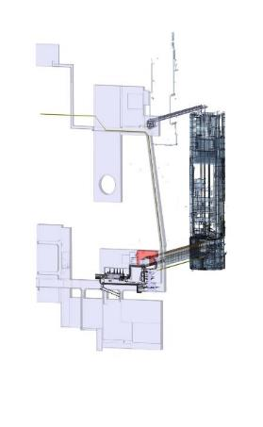
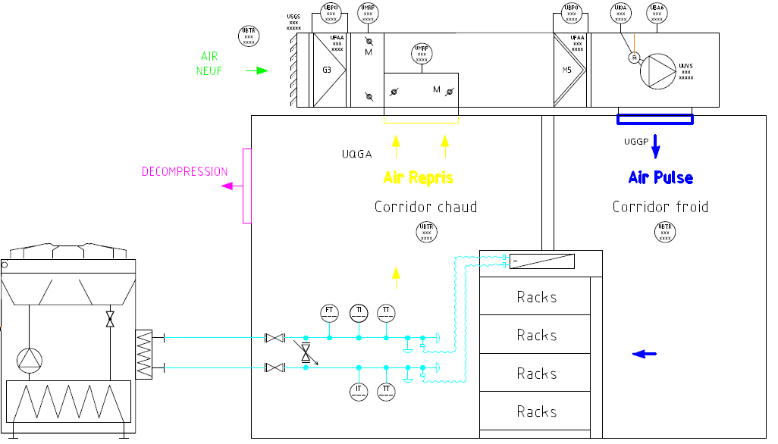
Data Centre (2MW) – Optical links (15k)
LS1:
Trays installed
Install 2x144 TEST fibres trunk cables FROM UX to SX
Validation of installation technique
Mini test data centre at surface
Test & validate DAQ chain
Option: Data Centre at P8 or Prevessin

Slide 29
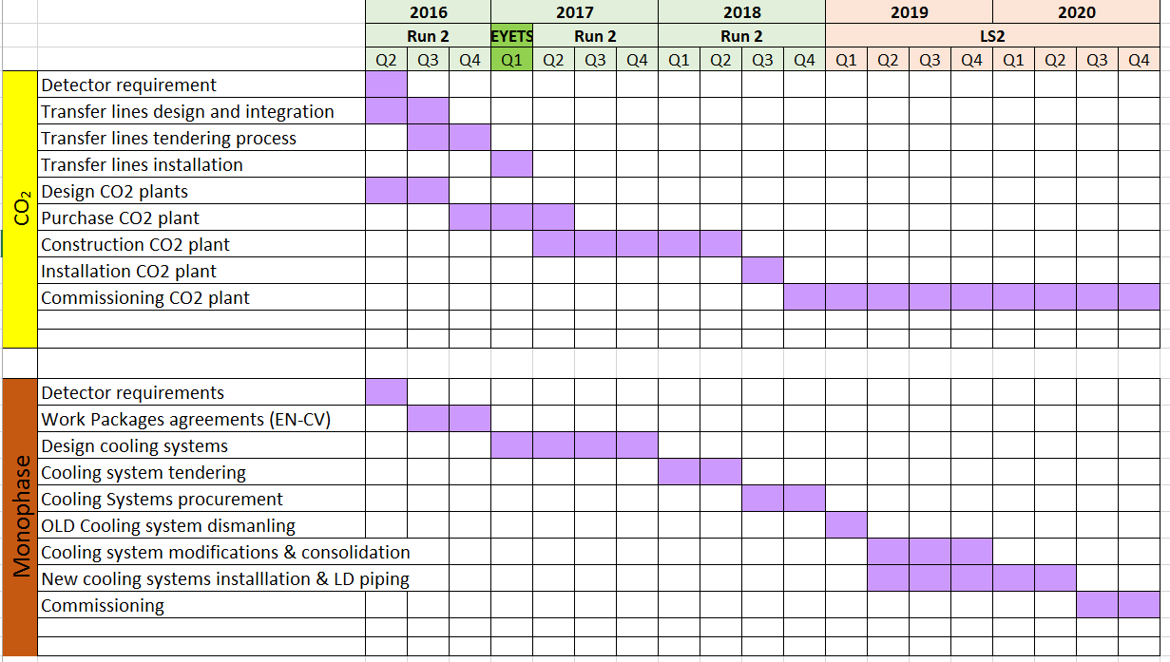
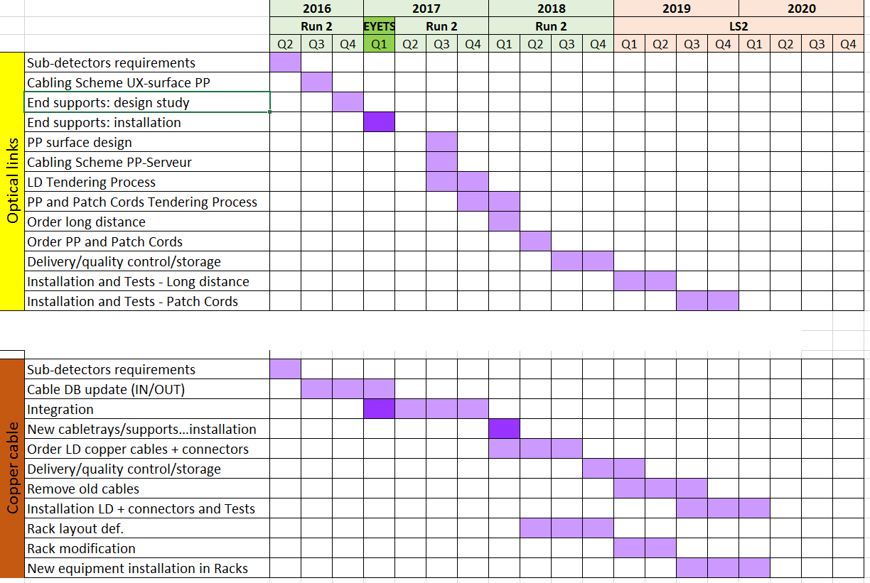
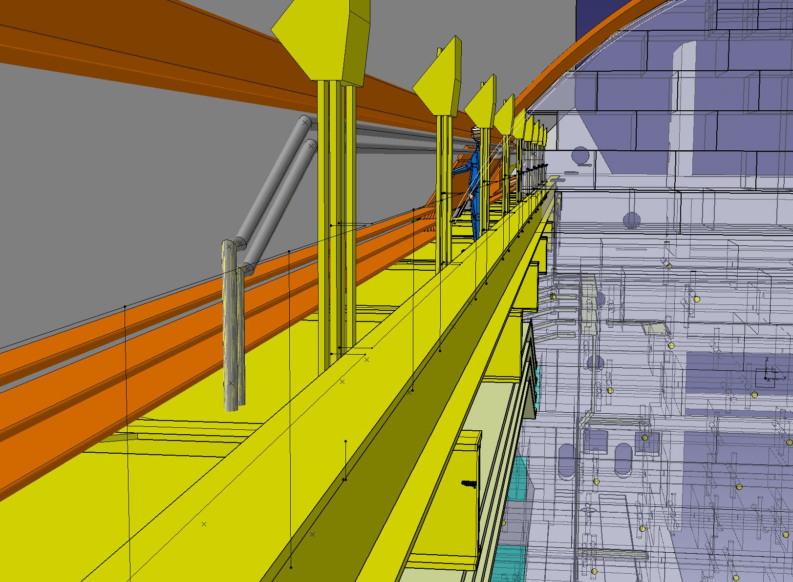
Services
CO2 transfer lines (VELO-UT cooling)
Cooling plants, pipes, optical links, copper cables: specs, design, integration, procurement and installation

Slide 30
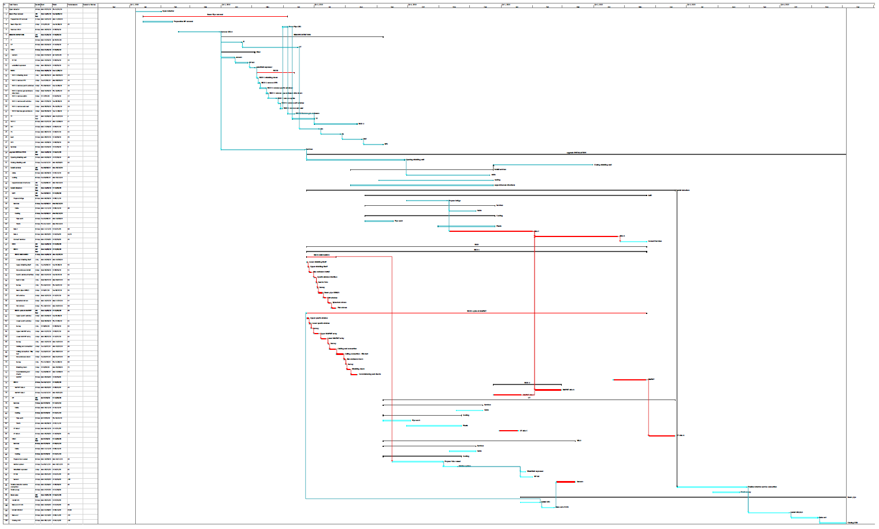
LS2 schedule: 3 phase
1
2
3
  Dec19-Aug19
  Open Experiment +
  Dismantling
  Sept19-Jul20
  Install detectors services
  Jul20 Nov20
  close Experiment
  Survey
  Recommissioning
1
2
3

Slide 31
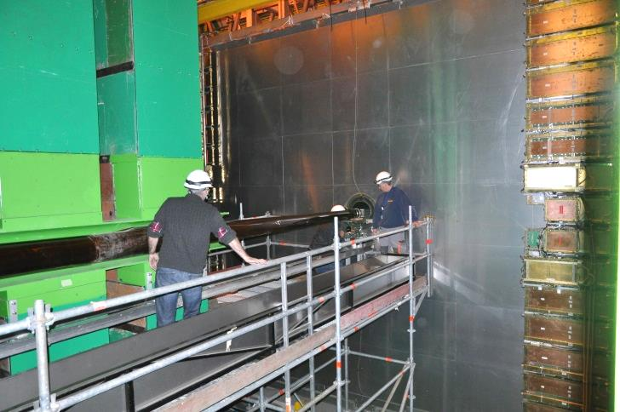
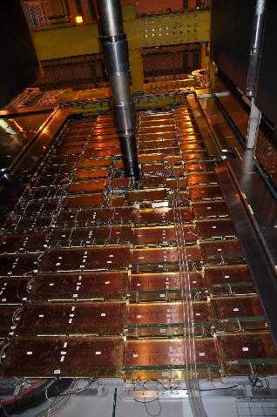
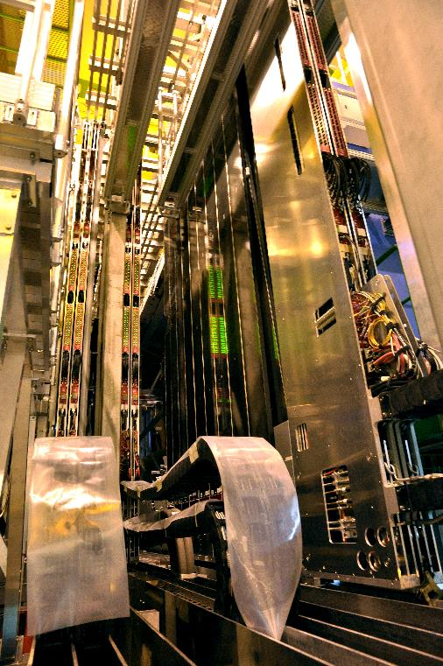

LS2 phase 1: Dismantling / Detectors
Open detectors
Dismantle beam pipe
Dismantle detectors and services
Extra constraints
Working detector environment
Radio Protection overhead
  Protection of personnel – risk assessment prior to any destructive work
  Logistic – waste sorting – waste disposal

Slide 32





LS2 phase 1: Dismantling / services

Slide 33



LS2 phase 2: Detectors Installation
R. Wallet
Detector assembling in surface facilities
(SciFi, UT, VELO)
Tests & Survey
Descent and installation in the pit
R. Wallet

Slide 34


LS2 phase 2: Detectors Installation
Most critical path: strong correlations between
UT
RICH1
VELO
BEAM PIPE
Stringent constraints on installation sequence

Slide 35
Phase 3 Closure & commissioning
Final connection between detectors and services
Beam Pipe installation and Bake-out (section 2-4)
Closing LHCb detectors
Final survey and alignment of detectors
Commissioning
Expected end date for Installation work: Nov 2020

Slide 36

Planning: simplified schedule

Slide 37
Conclusion
Tight schedule
The current planning does not foresee any contingency
Delays will be absorbed by shift work or week-ends
The success relies on strong involvement of participating Institutes and CERN:
EN – Engineering dpt.
    Survey (detector assembly and positioning)
    EL (power, copper cables, optical links)
    CV (Detector and Data Center Cooling)
    Handling,
    Safety Coordination,
    EA support
    …
TE – Technology dpt.
    Vacuum Chamber operation
    …
HSE – Radioprotection
    Radioprotection
    …

