Slide 1

Off-detector electronics: what could be a generic module?
M. Hansen, CERN

Slide 2

Phase 1 Off Detector Modules
Legacy CMS level 1 trigger system made use of ~50 different hardware modules
CMS Phase 1 upgrade make use of 6 different hardware modules and a number of different firmware sets
Common CMS microTCA Integration module
  AMC13
  TCDS (TTC, TTS), CDAQ
PCB
RAM
Multi Gbit TX
Multi Gbit TX
Multi Gbit TX
RAM
Large FPGA(s)
DAQ and Control interface
Powering,
etc.
Multi
Gbit RX
Multi
Gbit RX
Multi
Gbit RX

Slide 3
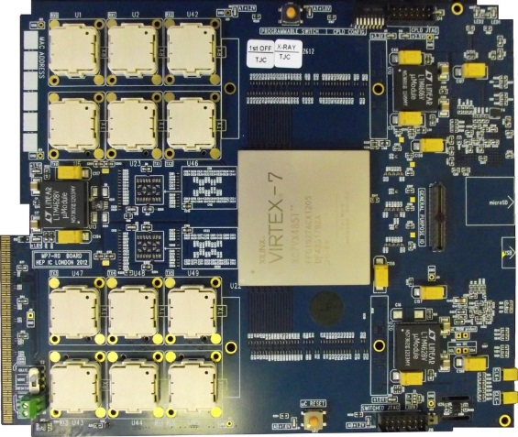
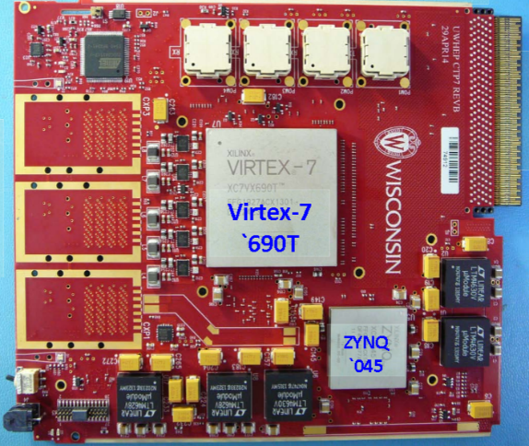
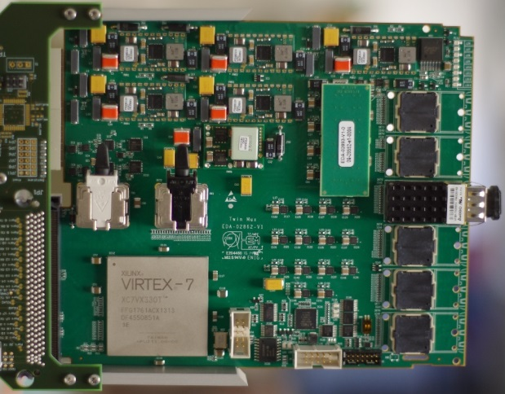

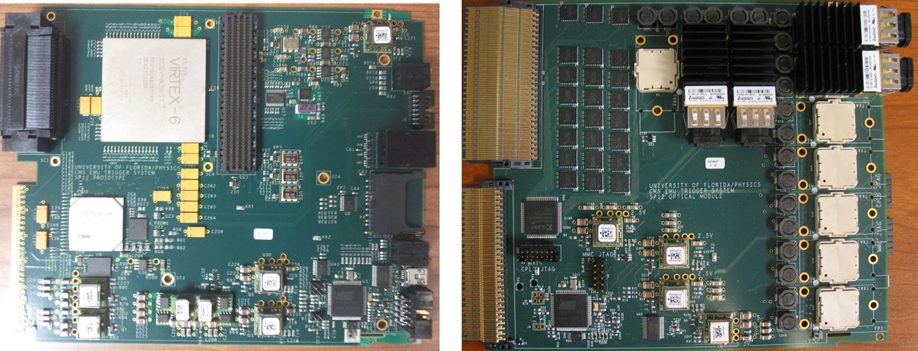
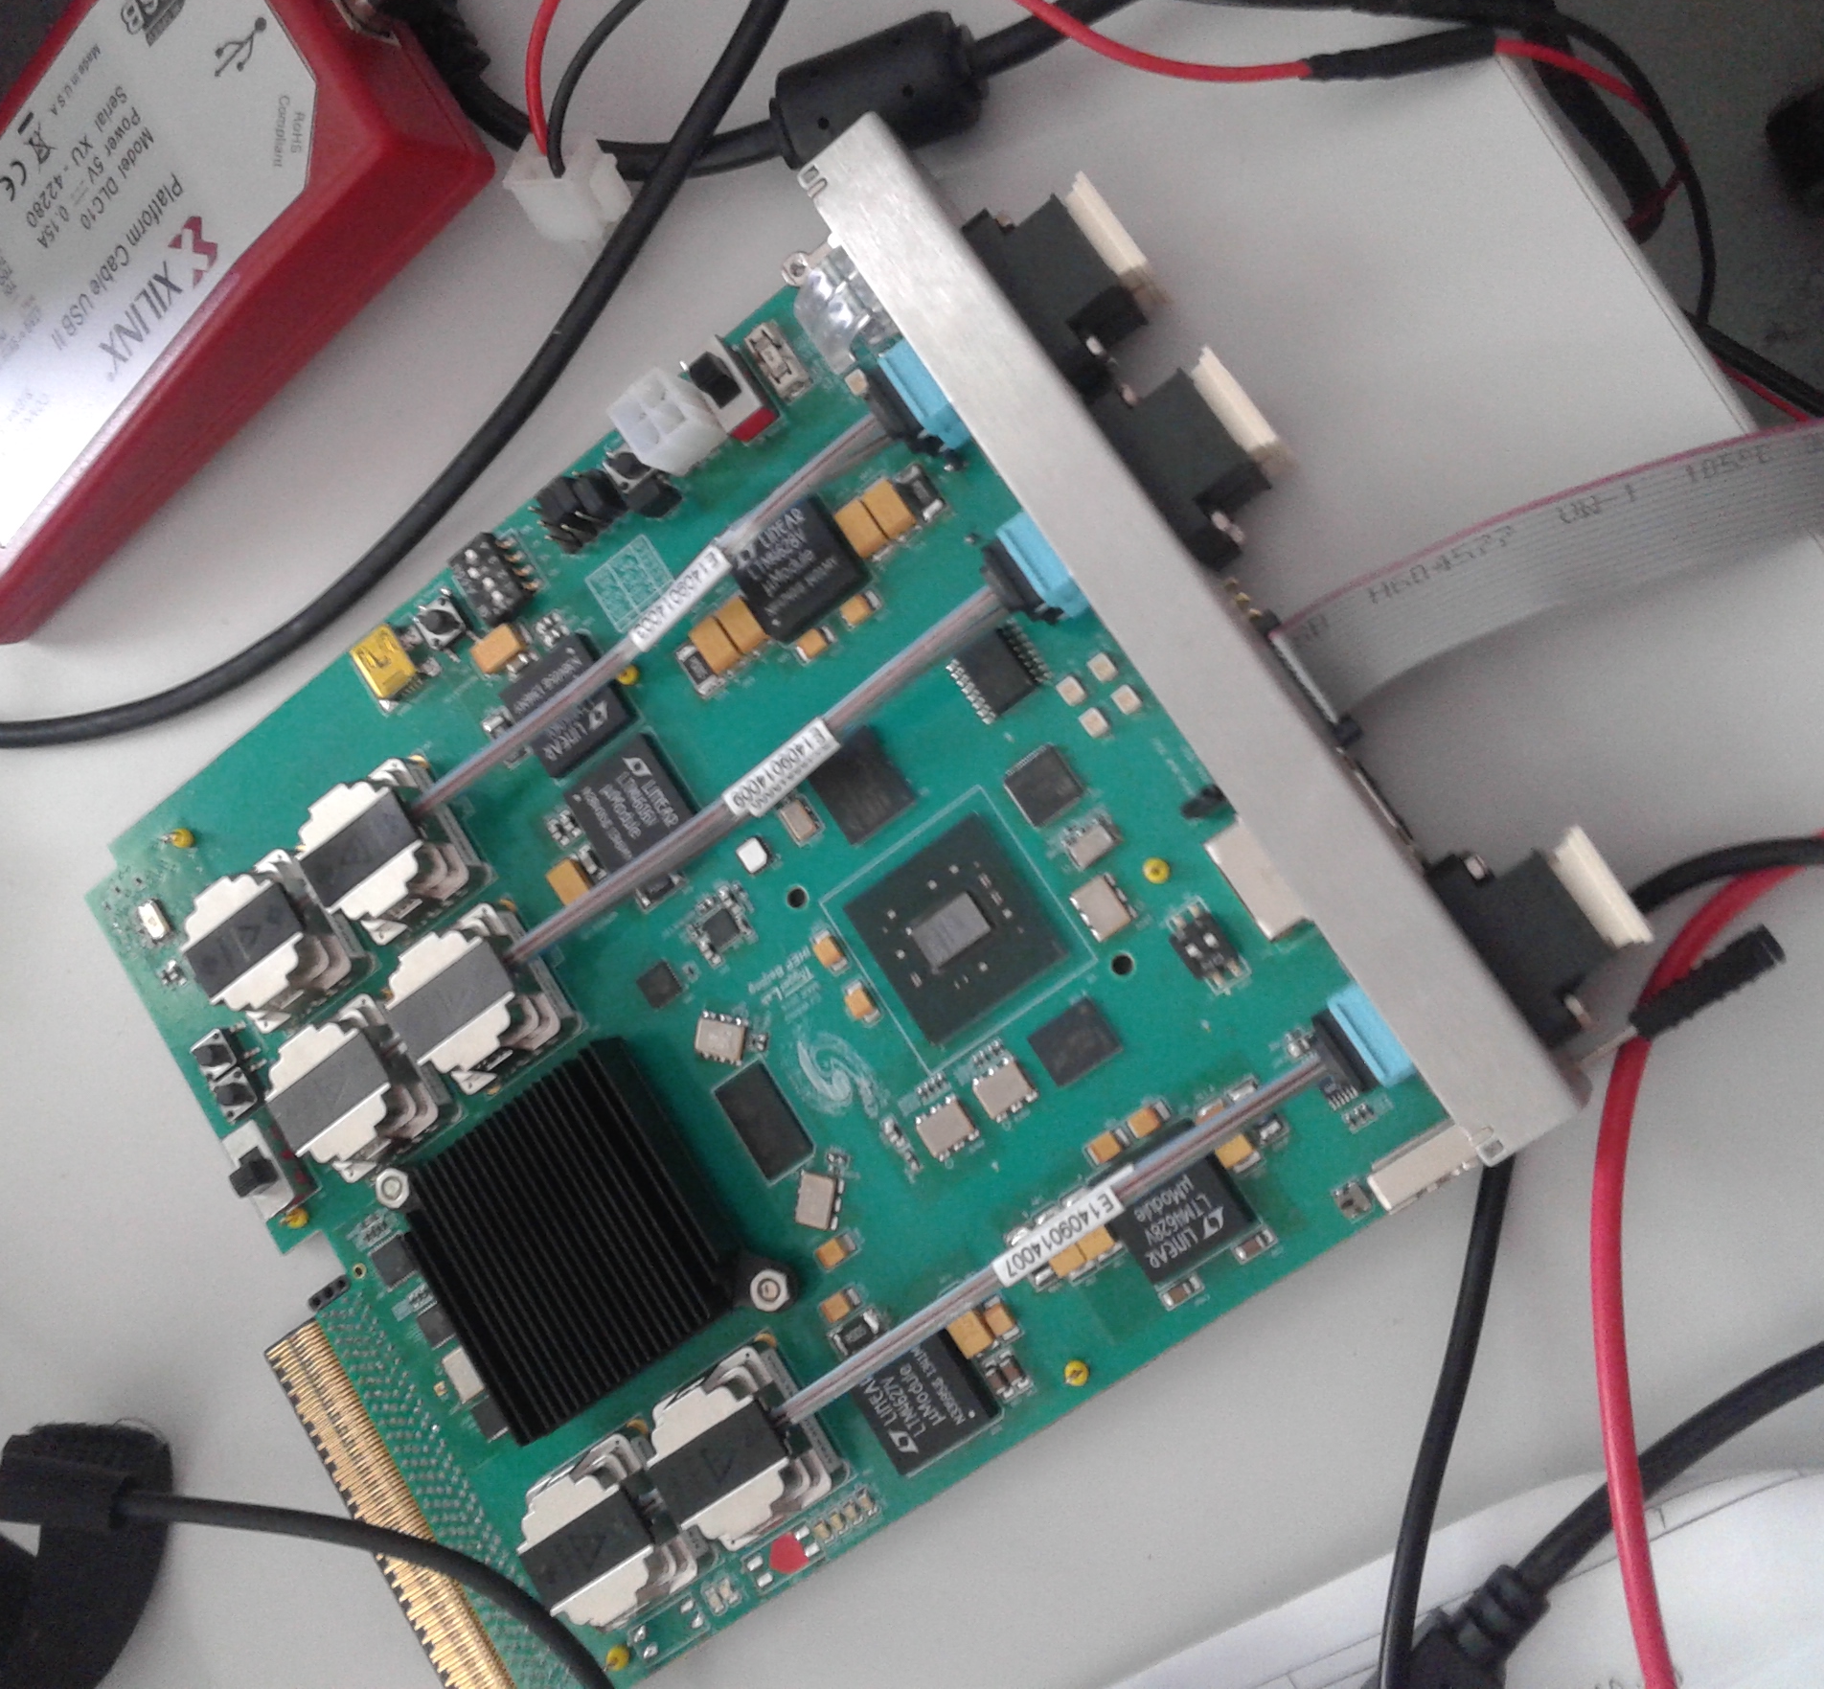
A few current
CMS microTCA FPGA modules
CTP7
TwinMux
MTF7
CPPF
(MTF6 shown)

Slide 4
The simple question
Can we use a single common system (e.g. ATCA blade) to support all users across detectors and experiments?
  Desired by Managers
  Less desired by engineers and institute leaders

Slide 5
The simple answer
Possibly.

Slide 6
Continued
What would the constraints be?
Either:
  The common system has to be designed to meet all requirements. It is not unlikely that it will take more time than available to collect these requirements
Or:
  Each subsystem has to be designed to suit that single back end blade
Or a combination of the two

Slide 7
Continued
What are the benefits?
  Reduced purchasing effort thanks to a single tendering process
  Reduced effort for long term maintenance thanks to well understood hardware
  Reduced effort for maintenance due to decreased diversity
    a single on call maintenance team can replace a failed hardware module for any system
  Reduced load on system administrators thanks to less diversity

Slide 8
Continued
What are the potential issues?
  Higher total system cost due to non-optimal hardware utilization
  Global loss of engineering expertise
  Dependency on a single group

Slide 9
Can we get benefits without drawbacks?
Reduced purchasing effort thanks to a single tendering process
  Obviously difficult; rules differ between agencies
Reduced effort for long term maintenance thanks to well understood hardware
  Can be partly achieved by specifying common functions like board controls and management
Reduced effort for maintenance thanks to limited diversity
  Can be partly achieved by making modules physically similar, e.g. the same type of optical connectors, same form factor

Slide 10
Limiting core cost
For the off detector electronics system the FPGAs are expected to be the cost driver
Xilinx Step pricing
  The Xilinx pricing model is based on a Step principle
    Min 3 steps, Max 5 steps
    Pricing per step can be renegotiated, but only for unused steps
    The current step must be completed before the next step can be used
    Pricing for a particular part is institution (e.g. CERN) wide, but it has to be exactly the same part down to package and speed grade

Slide 11
Limiting core cost
(CERN or other) purchasing office should be aware of costing rules as otherwise one single procurement can lock all other users into a non-optimal pricing structure for one specific device
The steps should be defined carefully in order to optimize total system cost
To limit construction cost we will need to limit the number of different FPGAs and purchase through the same channel
Coordinate FPGA purchases across experiments and systems

Slide 12
Possible procedure
Coordinate FPGA purchases across experiments and systems
  Can as a start be as simple as a Twiki page where one would enter FPGA type, projected quantities, and procurement schedule

Slide 13
Conclusion
No Golden Bullet

Slide 14
Session closing
Thank you!

