Slide 1

International Review of the Inner Triplet Quadruples (MQXF) for HL-LHC
(3rd review)
G. Apollinari, LARP Director
L. Rossi, HL-LHC Project Leader
CERN, 7 June 2016

Slide 2
MQXF magnet: is the HL-LHC backbone!
The review committee is invited to assess the progress from the last reviews (MQXF Superconducting cables and MQXF magnet design of end 2014), the soundness of the design and technical choices, the readiness of the various components and of the procurement plan (including QA/QC) and test plan, the status of the integration. A detailed resources analysis is beyond the scope of the review, however comments on the credibility of the plan, also with respect to the available resources, are welcome.
The MQXF project is a joint venture between CERN and the US DOE laboratories BNL, FNAL, LBNL, federated under the US-LARP program (now transforming into a construction project, HL-LHC AUP). The share of contribution between CERN and US-HiLumi at present is approximately equally shared. The committee is invited to comment on the level of integration of the teams, on the collaboration interface and on measures that could be pursued to take advantage of the work distribution.

Slide 3
Questions regrouped (JP Tock!)
Technical aspects : requirements and design
Are the magnet requirements in-line with the HL-LHC requests ? Are they realistic/achievable with sufficient margin ?
Have design alternatives been considered ? Are they correctly managed ?

Slide 4
Technical aspects : models and prototypes
Is the present and future models programme providing sufficient information ? If not what else could be necessary/useful ? Have all necessary analyses been done ? What further tests/analysis would you recommend ?
Does the overall plan allow to acquire the necessary experience with the models and prototypes before engaging in the production phase ?

Slide 5

Technical aspects : conductor and cable
Is the conductor strand and cable production advancing adequately ?
Does the production meet the specification (Ic, RRR, degradation, geometry, stability, unit length,…) ?
Is the conductor and cable production QA/QC plan sufficiently developed and answering the needs ?

Slide 6
Technical aspects : other
Is the protection scheme presented sufficiently robust and compatible with operation constraints ? If not, what should be developed or modified ?
Is the powering scheme adequate for operation ? (For memory only, covered during the conceptual design review of the magnet circuits for the HL-LHC, 21-23 March 2016)
Considering that work is on-going, is the cryostat and equipment integration development status in line with the overall progress of the project ? Are there critical missing information ?

Slide 7
Production and test scenario
Are the production facilities adequate? Is the tooling development appropriate wrt the overall project ?
Are all procurement aspects (conductor, collared coils, cold mass, cryostat,…), including QC adequately covered ? If not, what is missing or should be reinforced ?
Is the production scenario in a maturity stage compatible with the overall project ? Are the mitigations measures of technical, cost and schedule risks adequate ?
Are test facilities (including the IT String) adequate and timely ?

Slide 8
Various
Is safety level acceptable ? Are there critical areas ?
Are the recommendations from the previous reviews adequately followed(-up) ?
Are CERN and US HL-LHC AUP activities well integrated ? Are the interfaces well managed ? Is the work sharing efficient in terms of cost, schedule and risks mitigation ?

Slide 9
In summary
Is the project on good tracks to fully prove the necessary technologies for the MQXF for beginning of 2017 ? What are the critical areas ?
Is the overall plan allowing to meet the challenges of the HL-LHC project ? Is it clear, realistic and coherent ?
Is the inherent level of risk acceptable ? Are mitigations measures adequate ?

Slide 10
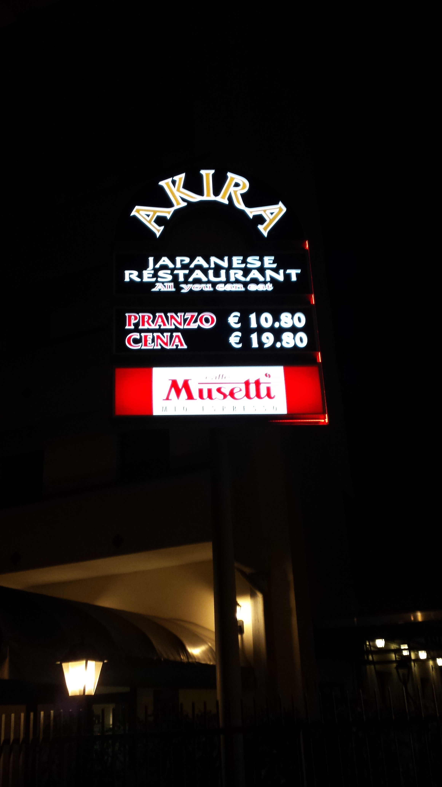
Review committee
(our deep thanks!)
Akira Yamamoto (KEK/CERN) Chair
Joe Minervini, MIT (Co-Chair)
Arnaud Devred, ITER
Pasquale Fabbricatore, INFN
Mauricio de Lima Lopes, FNAL
Pierre Vedrine, CEA
Renowned Japanese Restaurant, in Piacenza
Review dinner (by invitation) : TODAY!
Close out: Friday at 11.30 in the
TE auditorium (B.30 7th floor)

