Slide 1

HL-LHC INTERACTION REGION MAGNETS: RECENT CHANGES AND ALTERNATIVES
CERN, 7th June 2016
QXF review
E. Todesco
CERN, Geneva Switzerland
On behalf of the WP3 team

Slide 2
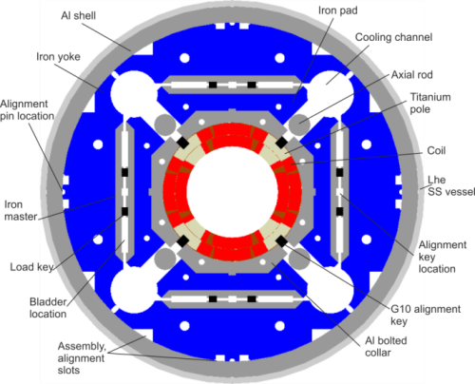
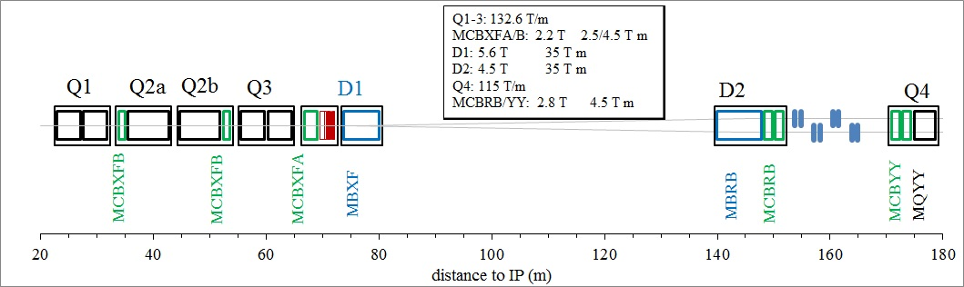
LAY OUT
WP3 includes IR magnets around IP1 and IP5
  Among them, the four Nb₃Sn triplets (plus two spares) are made of four magnets each
    Q1/3: two 8.4 m long magnets, split in two 4.2 m long magnets (US)
      Decision of splitting in two taken at an early stage, implying lower risks, longer production, larger costs, a negligible loss of performance
    Q2a/b: Two 7.15 m long magnets , integrated in the same cold mass with orbit corrector
  Same cross-section
  Bladder and key mechanical structure

Slide 3
CHANGES AND VARIANTS
Changes since last review
  Conductor specification I_{c} released by 8.5%
  Margin increased by 5%
  No energy extraction
  One circuit per triplet
New elements since last review
  Test of the first short model
  Tooling for the construction of the prototype being commissioned in US (4.2 m) and at CERN (7.15 m)
    Test station will be commissioned at CERN in summer [M. Bajko talk]
Variants
  Laminated structure
  Outer layer heaters are enough or we need other?
  US deliverable: cold mass or magnet in cryostat, with kit from CERN?

Slide 4
CONTENTS
Conductor and margin
Mechanical structure
Quench performance and field quality
Quench protection and circuits

Slide 5

CONDUCTOR AND MARGIN
  Started with ambitious target for margin: 20% on the loadline
  Conservative requirements for j_{c}: 1400 A/mm² at 15 T and 4.2 K
This was providing 140 T/m as initial guess
  Final engineering design gave this gradient with 18% margin
  Critical current of the strand (RRP) up to ~10% lower
    3% lower strand current density implies 1% less margin
Four decisions taken
  One - Reduce the specification on the j_{c} of 8.5%: down to 1280 A/mm² to avoid extra cost (from 361 A to 331 A per strand)
  Two - Reduce the gradient from 140 T/m to 132.6 T/m to recover margin
    This reduction is compensated by 5% longer coils
    Loadline margin is now 22%
Three - select the 108/127 layout
  Mainly for cost reasons

Slide 6
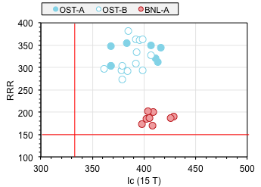
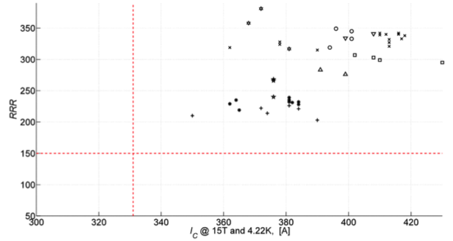
CONDUCTOR AND MARGIN
  Recent measurements of RRP show that the specification is kept in some measurements with considerable margin
RRP coils manufactured and tested in mirror and full quadrupole (see next slides)
  Incident in the production (non conform raw materials) will delay the prototype strand production (0-3 months)
RRP critical current at 15 T (US) [L. Cooley]
RRP Critical current at 15 T (CERN) [B. Bordini]

Slide 7
CONDUCTOR AND MARGIN
Four – change the cable size to reduce degradation
  Making it a bit more rectangular
    Keystone angle reduced from 0.55° to 0.40°
  Painful decision since we have now two generations of cable, so two different coil design
    But this was to minimize risk due to critical current and RRR degradation

Slide 8
CONTENTS
Conductor and margin
Mechanical structure
Quench performance and field quality
Quench protection and circuits

Slide 9
MECHANICAL STRUCTURE
  The bladder and key structure has shown a remarkable power of controlling the level of stress in the magnet
  Conservative loading done on the first model
    It is now the time to dare more
    Reloading is a fast operation, without components to replace (as in the classical collar structure)
      It will be two months for the iteration on MQXFS1 (to be done in LBNL)
      It will be even less for the US prototype (reloading can be done in loco)
  Alternative mechanical structure are not considered
    We have all evidence that bladder and key is extremely effective
    Shimming is simple and can be controlled
    This was proved on TQ and HQ, and is currently used at CERN for racetrack models
    MQXF mirror and first short model confirmed the validity of the structure [see talk from G. L. Sabbi]

Slide 10
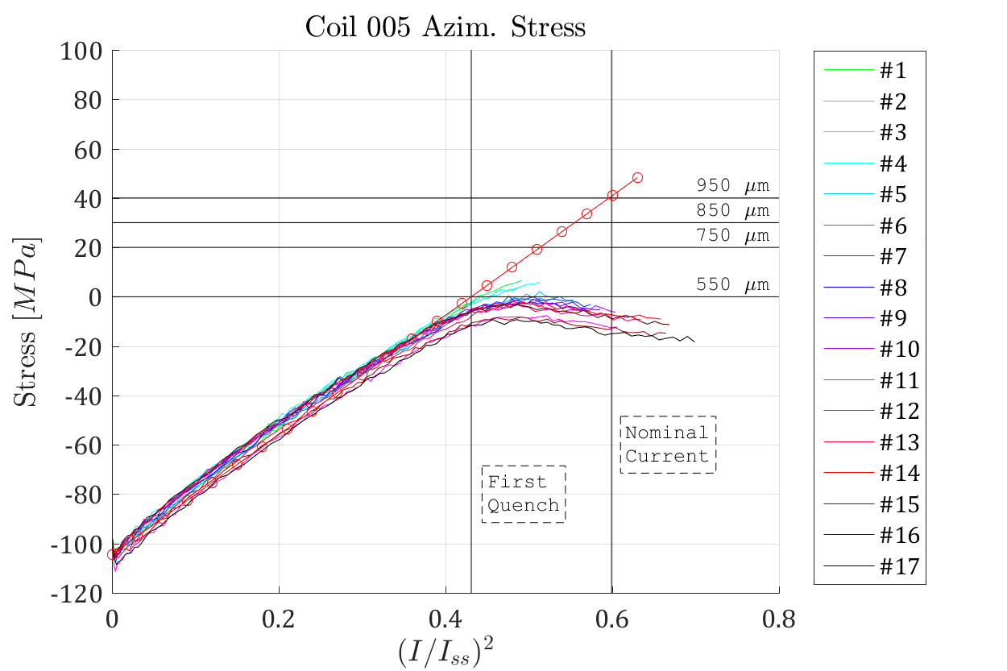
MECHANICAL STRUCTURE
  The bladder and key structure has shown a remarkable power of controlling the level of stress in the magnet
Coil unloading during MQXFS1a test [G. Vallone et al.]

Slide 11
MECHANICAL STRUCTURE
Use of laminations
  The first three structures, developed for fast prototyping, do not rely on laminations but on 50 mm thick pieces
    For a production of the series, the use of laminations can bring savings of the order of 7 M for the whole project (and possibly provide a higher precision components)
    Major efforts are going on to adapt this structure to use laminations in the iron pad
      Two short structures are being tested [J. C. Perez talk]
  All efforts to have this solution working will be done

Slide 12
CONTENTS
Conductor and margin
Mechanical structure
Quench performance and field quality
Quench protection and circuits

Slide 13
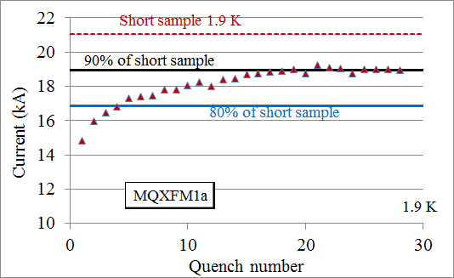
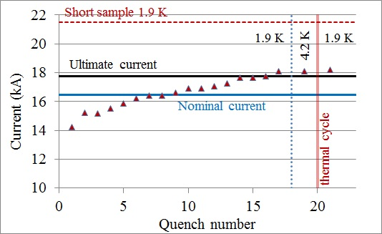
QUENCH PERFORMANCE
Mirror test in 2015, QXFS1 test in 2016
  Conform to HL LHC requirements
  Ultimate reached and kept
    Performance at 4.5 K shows large margin
  Excellent performance after thermal cycle
    Some training, possibly due to low prestress
Training of mirror magnet [G. Chlachidze]
Training of first quadrupole [G. Chlachidze]

Slide 14
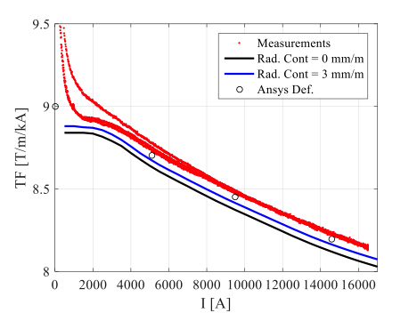
FIELD QUALITY
  First short model show excellent values of b₆
    Non allowed are the main challenge (as we know from LARP)
  b₄ (zero) and a₄ (many units) given by the coils belonging to different production lines [S. Izquiredo talk]
    a₃ and b₃ (many units) can be corrected through magnetic shimming
    Large b₅ unexplained
    Excellent warm-cold correlation – so we will have early detection of field quality problems
MQXFS1 b6 [S. Izquiredo, J. di Marco et al.]
MQXFS1 transfer fucntion [S. Izquiredo, J. di Marco et al.]

Slide 15
CONTENTS
Conductor and margin
Mechanical structure
Quench performance and field quality
Quench protection and circuits

Slide 16
QUENCH PROTECTION AND CIRCUITS
The baseline
  No energy extraction
    Expensive system and only 5% (individual powering) to 1% (all triplet on the same converter) can be extracted
  All magnets on the same power converter
    Strong pressure from beam dynamics to reduce the ripple effect by 50%
  Diodes are a must to reduce the inductive voltages
Protection relies on quench heaters between outer layers and collars (OL heaters)
  50 micron insulation to give delays of ~15 ms [G. Ambrosio talk]
  Heaters impregnated with the coil, using the LARP technology
  With these heaters we are still at the limit of the 350 K in case of failures
    This depends on several features of the model, and of the failures

Slide 17
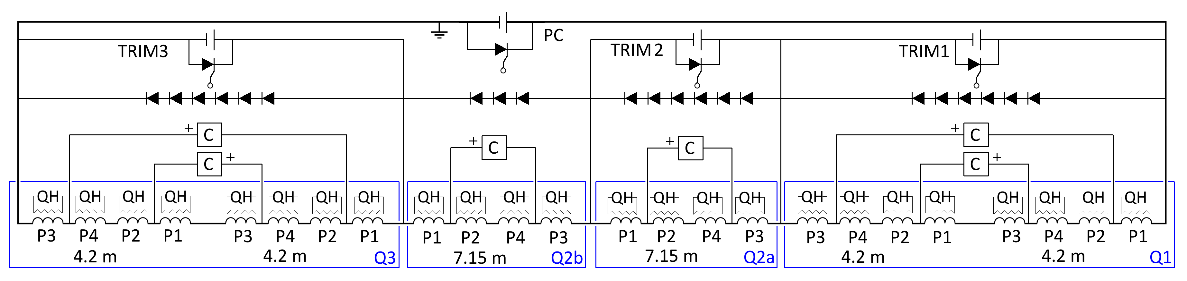
QUENCH PROTECTION AND CIRCUITS
Complexity of the circuit is non negligible, further work will prove if the Trim2 really necessary
Baseline for the QXF circuit [E. Ravaioli]

Slide 18
QUENCH PROTECTION AND CIRCUITS
  A crucial information is to have several quenches in the short model without energy extraction
    To check quench back, propagation from outer to inner layer, etc.
    This will be carried out in July
  Another crucial information is the definition of the failure scenarios
A clarification if the outer layer heaters are enough will come with these test (both short model and prototype)
  In parallel, we are developing two additional systems: inner layer heaters and CLIQ
    They can reduce the hotspot and the voltages in the failure cases
    Both are non trivial, need study and validation on models and prototypes
  A third technology, very powerful, is being developed for 11 T (interlayer heater)
In this phase there is no need of taking a decision

Slide 19
QUENCH PROTECTION AND CIRCUITS
We should profit of the 11 T project experience
  The QXF, after the reduction of the gradient, is slightly less challenging than 11 T, and shares with it many features
  As QXF, 11 T has no energy extraction
    But it is in series with the other 153 dipoles, more complex integration in the quench protection system
  11 T baseline for LS2 relies only on outer layer quench heaters
    So outer layer heaters should be enough for QXF
Comparison QXF versus 11 T quench protection [S. Izquierdo Bermudez]

Slide 20
SCHEDULE AND PRODUCTION SCENARIO
Q1/3 will be US contribution
  US deliverable is the cold mass
    This would imply a temporary cryostating to test the magnets horizontally
    We are studying the possibility of having cryostating done in the US, based on CERN design and components
  This would also remove a horizontal test at CERN
Production scenario: dedicated session on this topic

Slide 21
SCHEDULE AND PRODUCTION SCENARIO
  5 short models (common program)
    Good to have a common program, and to exchange coils, but now we should avoid having too many Frankenstein magnets
  3 prototypes in the US (1.5 cold mass)
  2 prototypes at CERN (2 cold mass)
    Main question: is this enough ?
The main challenge is now the prototype
  US is building a 4.2 m long mirror, to be tested in July
  CERN is considering the possibility of having a mirror with the first 7.15 m long coil
    It would be tested in mid 2017, i.e. about 9 months before the first 7.15 m long prototype
    Takes resources, mechanical aspects are totally different, but would allow to anticipate problems in the 7.15 m long coil manufacturing
    Without it we will have first test after manufacturing of all prototype coils
      Should we do it ?

Slide 22
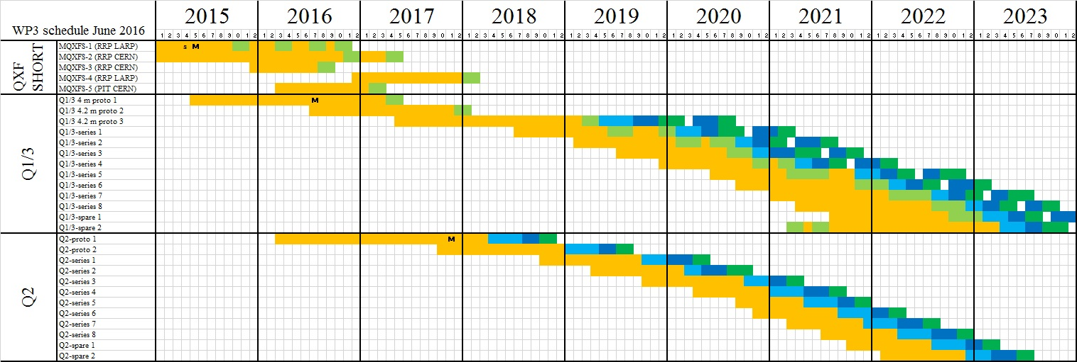
SCHEDULE (TRIPLET ONLY)

Slide 23
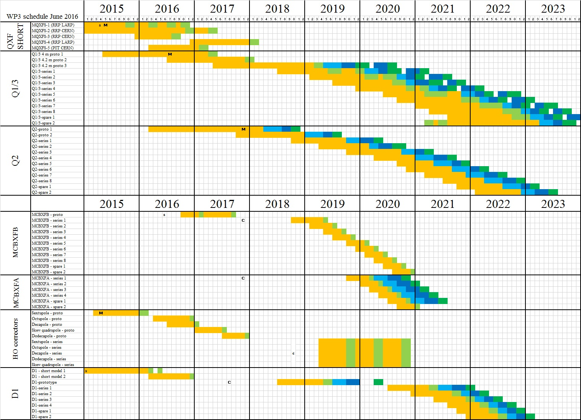
SCHEDULE

Slide 24
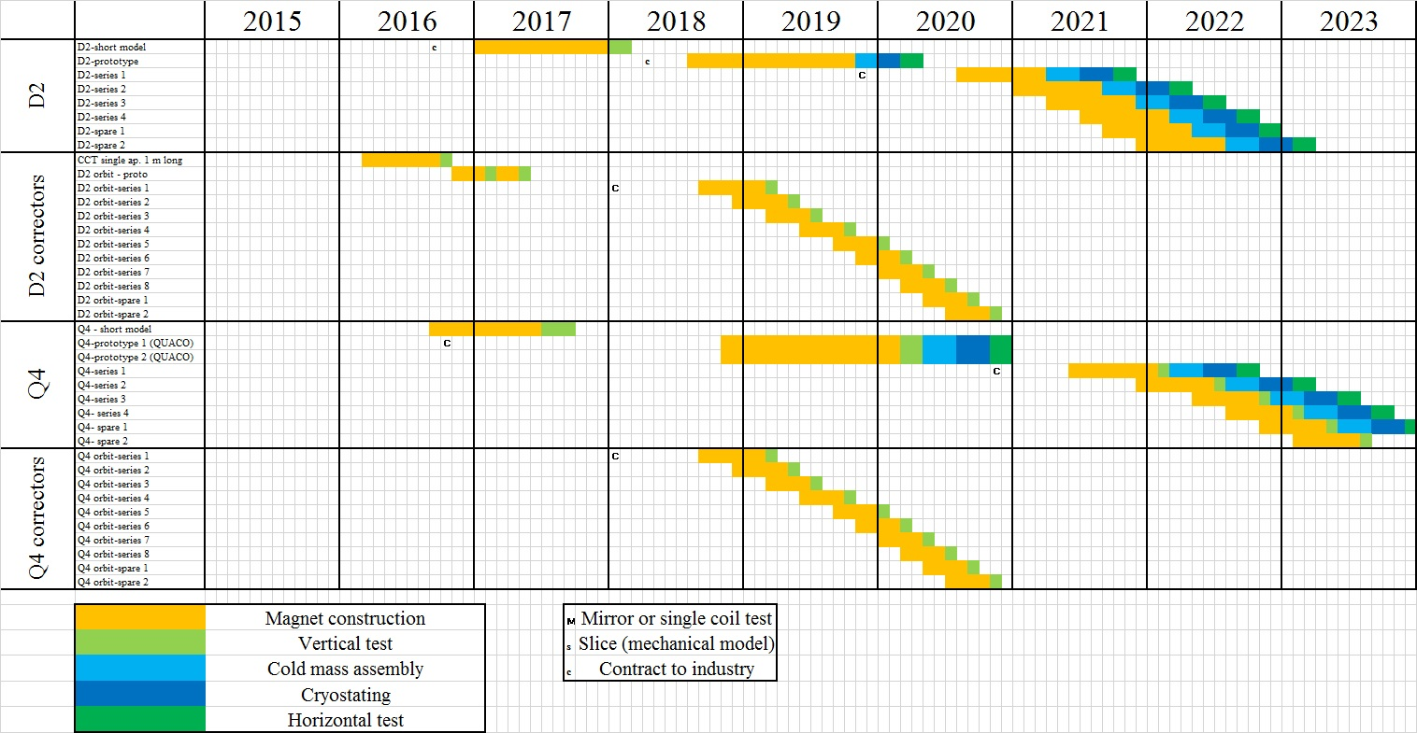
SCHEDULE

Slide 25
CONCLUSIONS
We outlined the main changes since last review
  Conductor specification I_{c} released by 8.5%
  Margin increased by 5%
  No energy extraction, one circuit per triplet
The new elements since last review
  Successful test of the first short model
  Long tooling being commissioned
    4 m long coil mirror in US coming in July
Variants
  Laminated structure: a must for production ($)
  Outer layer heaters are enough or we need more?
    We will decide next year
  US deliverable: cold mass or magnet in cryostat, with kit from CERN?
    Second option would be preferable

