Slide 1
Group picture
Today 07.06.2016
At 14h
Close to restaurant No2

Slide 2
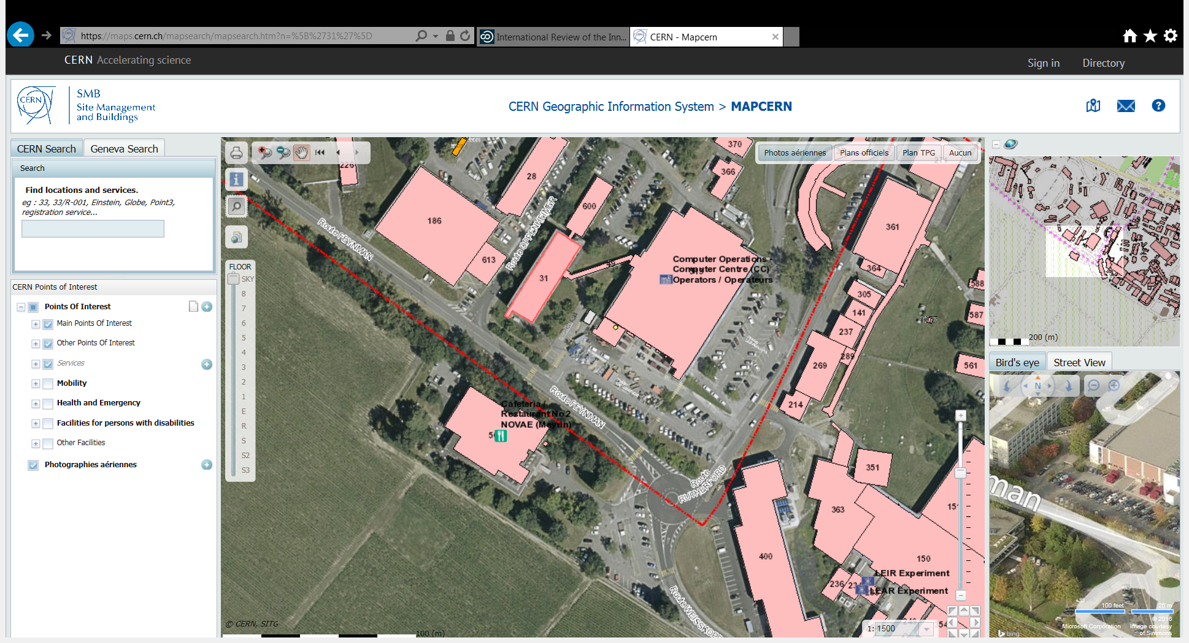
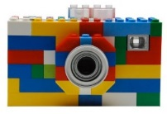

Slide 3
