Slide 1

Overall MQXF
Development & Plans
G. Ambrosio
MQXF International Review – CERN, June 7th – 10th, 2016

Slide 2
Outline
The Background
MQXF Development Goals
MQXF Development Plan
Status
  Fabrication status
  Main test results
  Schedule
Next steps
Conclusions

Slide 3
LARP Development
In 2003 the US LARP (LHC Accelerator Research Program, collaboration among BNL, FNAL, LBNL and SLAC) started developing Nb₃Sn quads for LHC luminosity upgrade:
  Magnet design development & selection
    Shell-type vs Racetrack-type coils
  Nb₃Sn coil development
  Structure development & selection
    Bladder&Keys vs Collars
  Scale-up
  Accelerator Quality features
    Cable with SS core, Coils alignment, …

Slide 4


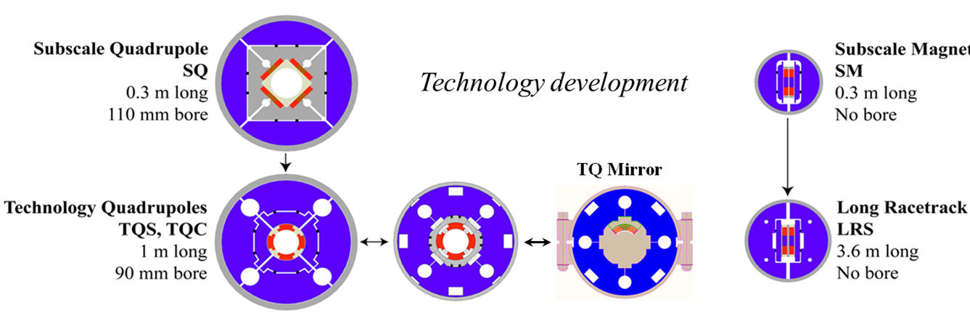
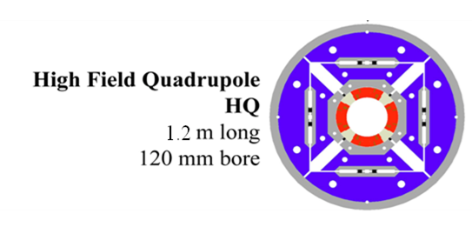
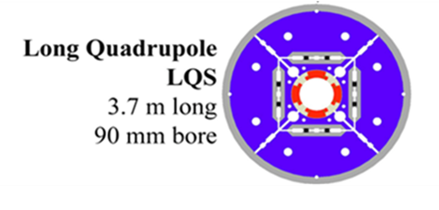
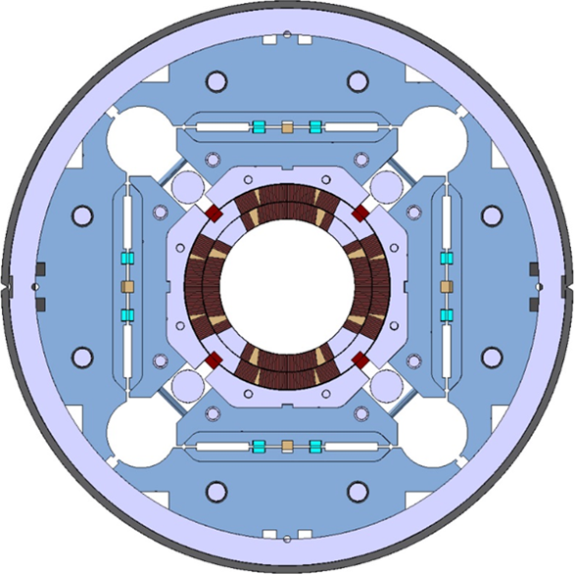
IR Quadrupole R&D Program
2003
Technology Development
Coil design selection
Structure selection
Lessons learned
2015
Long quadrupoles
Large aperture quadrupoles

Slide 5
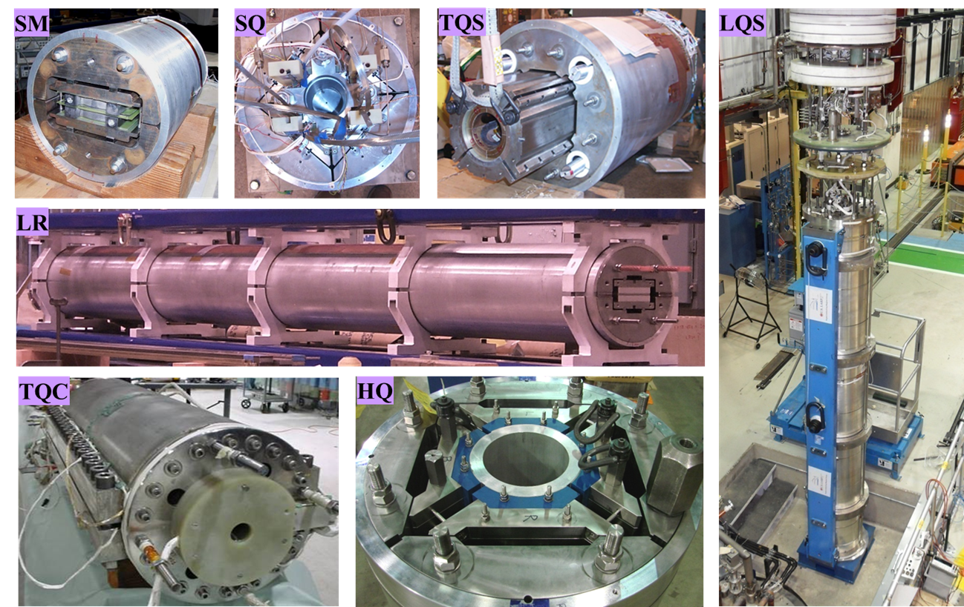
LARP Magnets Zoo

Slide 6
Requirements
MQXF (magnet) requirements almost complete
  Only High Voltage Withstand levels TBD
LMQXF (cold mass) requirements in progress
  Cold mass & cryostat designs in progress

Slide 7
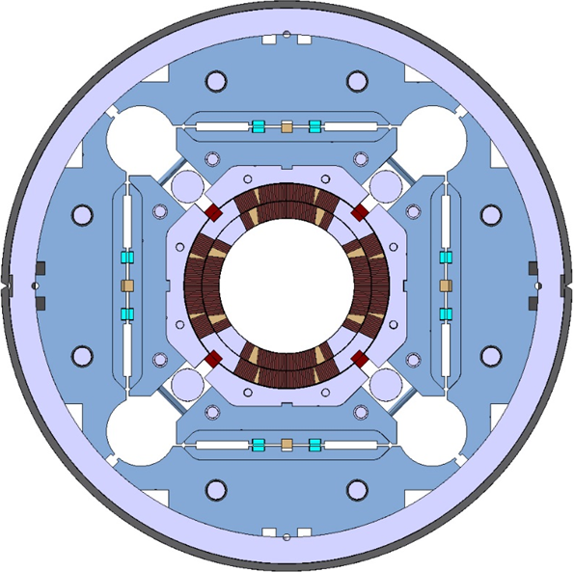
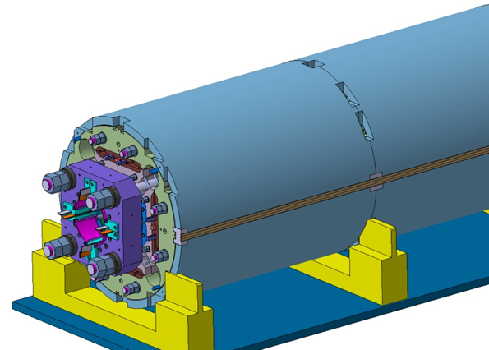
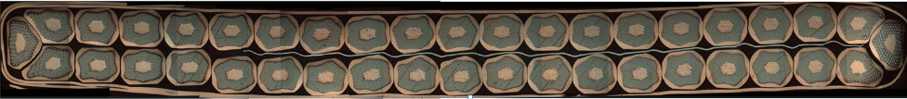
MQXFA/B Main Parameters
Design will be presented in next talk
Parameter | Unit | MQXFA/B
Coil aperture | mm | 150
Magnetic length | m | 4.2/7.15
N. of layers |  | 2
N. of turns Inner-Outer layer |  | 22-28
Operation temperature | K | 1.9
Nominal gradient | T/m | 132.6
Nominal current | kA | 16.5
Peak field at nom. current | T | 11.4
Stored energy at nom. curr. | MJ/m | 1.2
Diff. inductance | mH/m | 8.2
Strand diameter | mm | 0.85
Strand number |  | 40
Cable width | mm | 18.15
Cable mid thickness | mm | 1.525
Keystone angle |  | 0.4

Slide 8
GOALS of MQXF Development
Understand requirements and provide feedback
Demonstrate that MQXF magnets can meet requirements
  Short Models and Prototypes
Prepare for construction project/phase
Reduce risks
Value engineering

Slide 9
MQXF Development Plan
One design for both Q1/Q3 and Q2
  Not as present triplet…
Very integrated design and development plan
  Avoid duplication and leverage expertize, tools, …
Exchange parts when procurement is more difficult on one side, and to accelerate schedule
  Rapid-prototyping end parts, pole parts, traces, short structures, …
Sharing procedures, improvements and lessons learned
Sharing short-model coils

Slide 10
Status & Plans

Slide 11
Conductor
Strand:
  Common specs finalized, procurement in progress
    Status will be presented tomorrow morning
  Lessons learned: several months needed btw conductor delivery and cabling
Cables:
  Need: automatic imaging system for cable QC
Cable insulation: good
UL | Short pc | Short | Long pc | Long
LARP RRP | 0.3 | 9 + 3 |  | 6
CERN Cu | 1 |  | 3
CERN RRP |  | 7
CERN PIT |  | 7

Slide 12
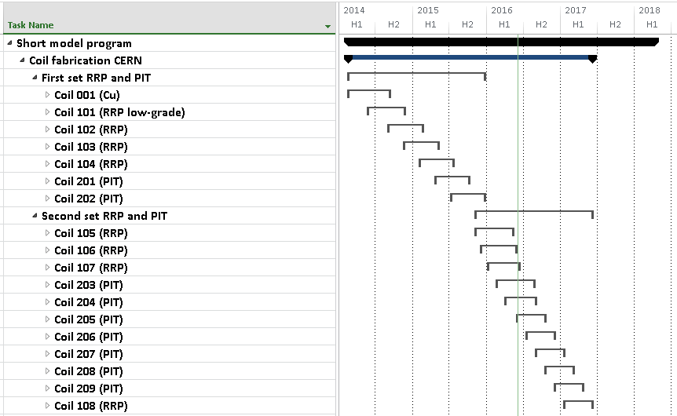
CERN short model coil fabrication
First generation: 1 Cu, 1 low-grade, 3 RRP, 2 PIT
Second generation: 3 RRP, (2 PIT in progress)

Slide 13
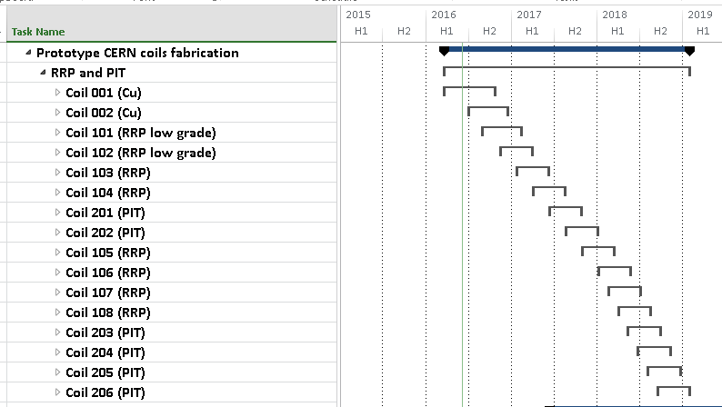
CERN prototype coil fabrication
First Cu coil started (first layer wound/cured)
Then, 2nd Cu coil and 2 low-grade coils
Then, 2 RRP and 2 PIT coils for 1st prototype
In total, 2 prototypes, 12 coils

Slide 14
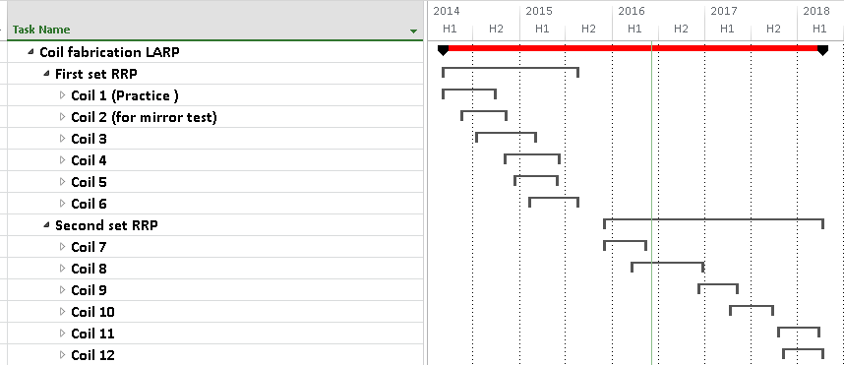
LARP short model coil fabrication
First generation: 6 RRP
Second generation: 1 RRP, (1 RRP in progress)
LARP started making prototype coils in 2015, and the main effort moved to the fabrication of the prototype coils.

Slide 15
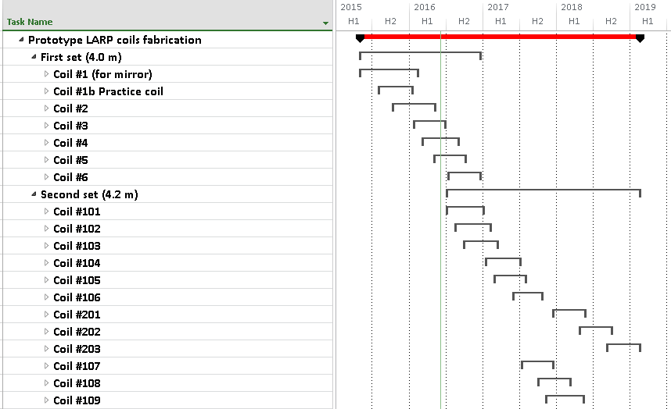
LARP prototype coil fabrication
4 m long RRP coils: 1 practice + 2 coils completed, 3 in progress,
  1 optional (depending on mirror test)
4.2 m long RRP coils: 12 coils
  Set-up & commissioning of BNL line (Wind&Cure)

Slide 16
Coils
 | Short pc | Short | Long pc | Long
LARP RRP | 1 | 6 + (1) | 1 | 2 + (3)
CERN Cu | 1 |  | 1
CERN RRP | 1 | 7
CERN PIT |  | 2 + (2)
Completed + (in progress)
15 short coils & 2 long coils successfully fabricated
Short coils are OK (3 LARP + 2 CERN success. tested)
1st 4 m long coil to be tested in July @ BNL
Need to:
  Reduce delays due to parts procurements
  Finalize requirements (electrical, dimensional)
  Reduce non-conformities

Slide 17
Structures
 | Short thick l. | Short thin l. | Long thick l. | Long thin l.
LARP | 1 | Laminations available | Procurement almost done
CERN | 1 | 1
Need to:
  Demonstrate assembly of long structures
    Short + short: successful step
  Demonstrate structure with thin laminations
    Cool down of short structure with dummy coils coming soon
  Demonstrate we can meet alignment requirements

Slide 18
Magnet Assembly
 | Short w dummy coils | Short w real coils | Short + Short w dummy coils | Long
LARP | 1 | MQXFS1
CERN | 2 |  | 1
Issue during assembly of MQXFS1
  Addressed by tooling & procedures
MQXFS1 tests ➔ short model assembly is ~fine
Need to:
  Improve warm-cold stress correlation
    Elastic module measurements coming soon
  Optimize assembly for Field Quality
    Demonstration of larger correction capability

Slide 19
Magnet Vertical Test
 | Short | Long
LARP | FNAL | (BNL July 2016)
CERN | (SM18 July 2016) | -
Issue during MQXFS1 test
  addressed by procedures and sign-offs
By end of July testing capability increases by 3

Slide 20
Cold Mass, Cryostat & Horizontal Test
This effort is starting
Planning to test welding of SS skin around MQXFS1c (this fall)
Need to:
  Finalize CM functional requirements
  Develop cryostat design ➔ CM interfaces
  Assembly plans
  Test plans
    LARP review explored several options

Slide 21
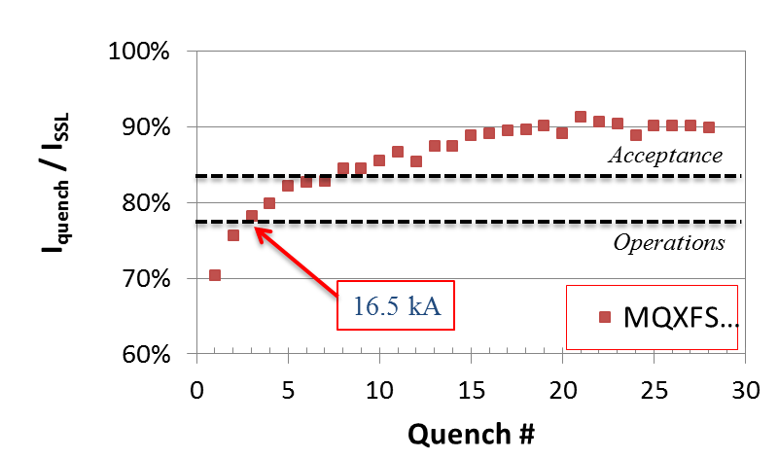
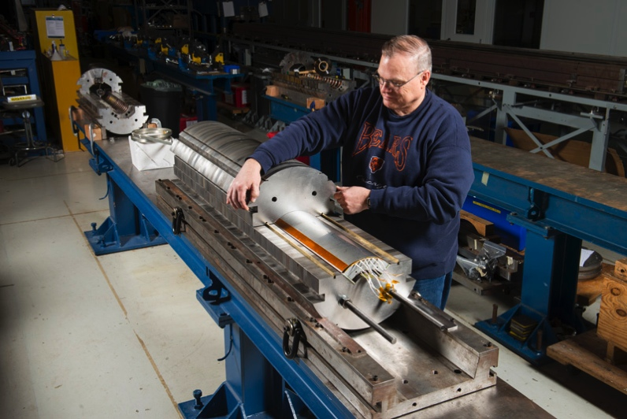
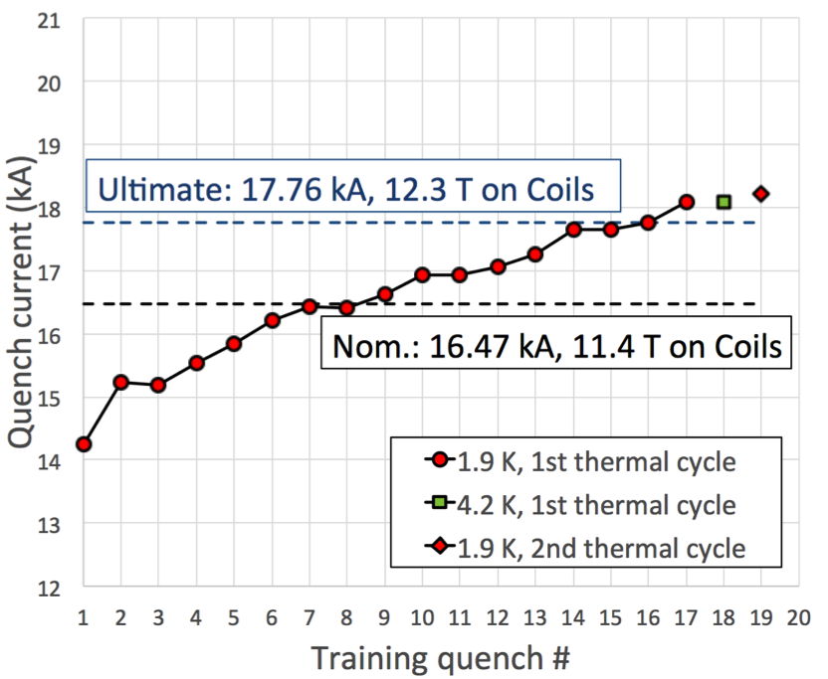
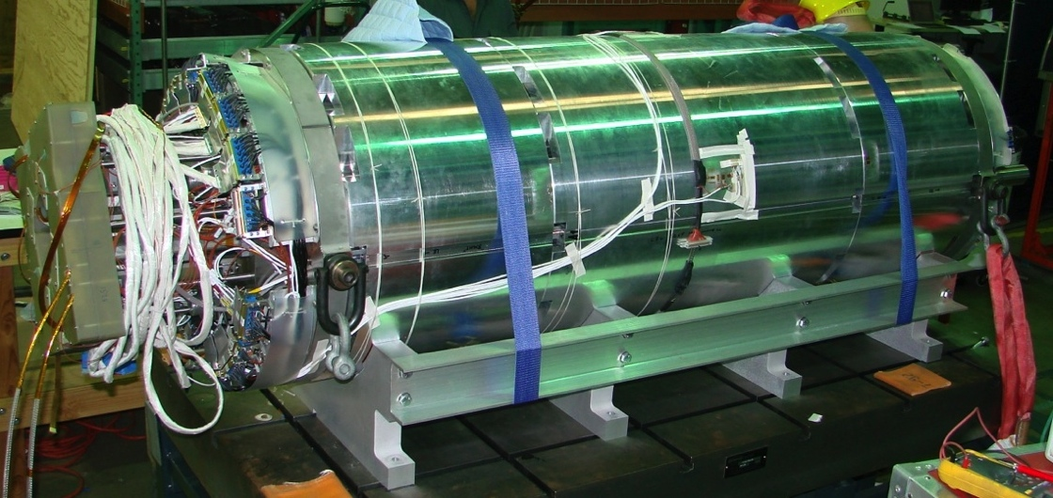
Test Results
First QXF Short Coil (MQXFSM1)
First MQXF Short Model (MQXFS1)

Slide 22
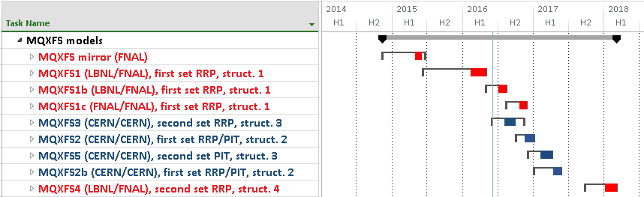
Short Models Test Program
MQXFS mirror
MQFS1
  Structure 1 (thick iron laminations)
  First model: RRP coils 1st generation
MQXFS1b: re-test with higher pre-stress
MQXFS1c: re-test with welded stainless steel shell

Slide 23
Short models Test Program
MQXFS3
  Structure 3 (thin laminations)
  Test 2nd generation RRP coils; Assembly focused on FQ;
MQXFS2
  Structure 2 (thick laminations)
  Test with RRP and PIT coils (non-conformity test)
  Larger FQ correction

Slide 24
Short models Test Program
MQXFS5
  Structure 3 (thin laminations)
  Test with PIT coils 2nd generation
MQXFS2b
  Re-test with welded stainless steel shell
MQXFS4
  Structure 4 (thin laminations)
  Test with RRP coils 2nd generation → reproducibility

Slide 25
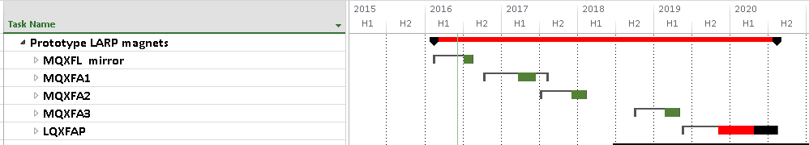
LARP prototypes
Mirror magnet to be tested in July-August
First prototype magnet in spring 2017
  4 m coils: one 1st gen + three 2nd gen coils
Second prototype magnet 2017-2018
  4.2 m coils: all 2nd gen coils (first tunnel ready MQXF)
Third prototype magnet in early 2019
  Reusing 1st structure with VE: thin laminations, …
First prototype cold mass in early 2020

Slide 26
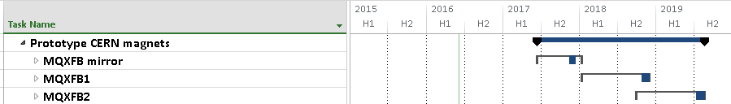
CERN prototypes
Possibility of performing a “single coil test” in 2017 under consideration
  1 real, 3 practice coils
First prototype cold mass by end of 2018
  2 RRP and 2 PIT coils
Second prototype cold mass in mid-2019

Slide 27
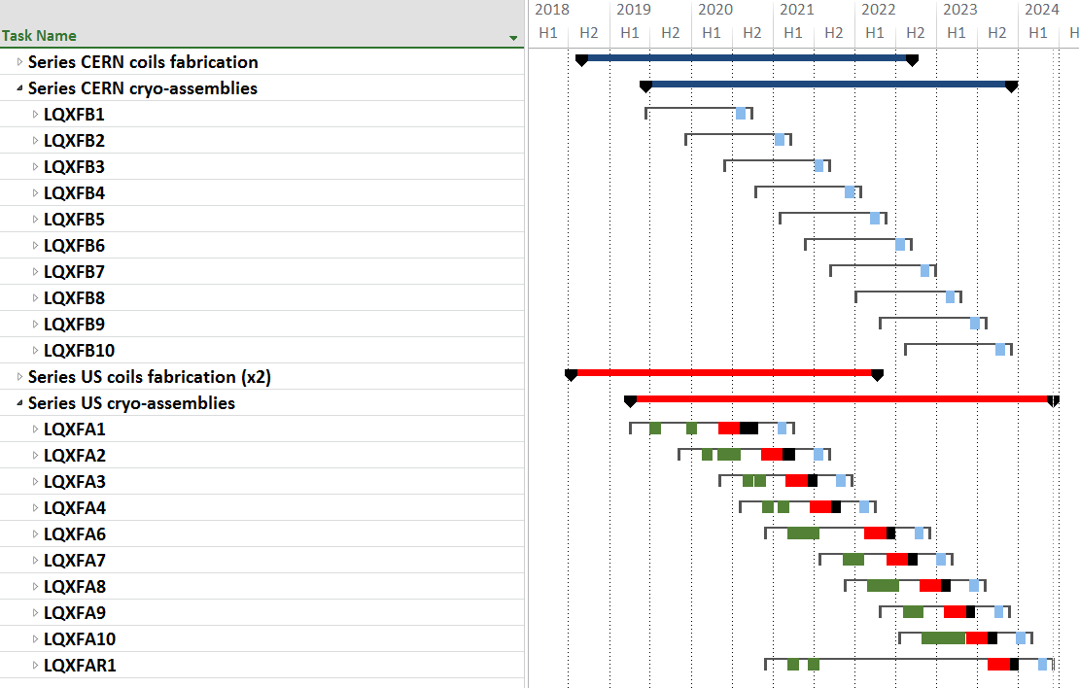

MQXF Series Production

Slide 28
Challenges to Schedule
The biggest challenge to the schedule for the demonstration of the US prototypes (MQXFA1&2) is coming from the tight budget:
  Just in time procurement
  Late start of Wind&Cure line at BNL
  No schedule contingency
  No vendor redundancy
Pushing schedule w/o adequate budget increases the risk of reduced quality

Slide 29
Conclusions
We are on track for demonstrating readiness for MQXF magnets production
  First short coil and first short model tests have validated RRP conductor, coil, and structure designs, and part of quench protection strategy.
Next steps are planned to demonstrate scale-up, reproducibility, and meeting all requirements

