Slide 1
Magnet Design
Paolo Ferracin
International Review of the Inner Triplet Quadrupoles (MQXF) for HL-LHC
7-10 June, 2016
CERN

Slide 2
Outline
Overview of MQXF design
Strand and insulated cable
Coil design, magnetic analysis, magnet parameters
Support structure and mechanical analysis
Quench protection

Slide 3
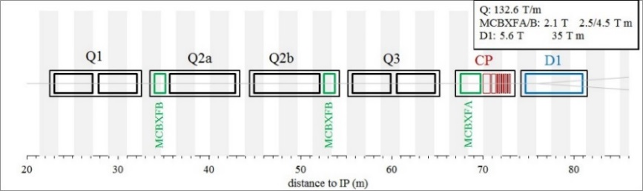
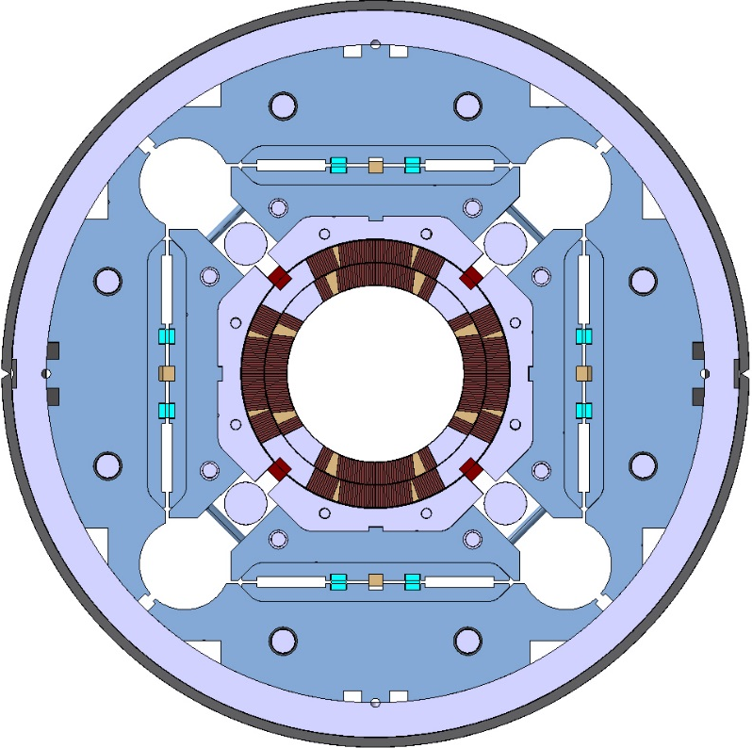
Overview of MQXF design
Target: 132.6 T/m
  150 mm coil aperture, 11.4 T B_{peak}
Q1/Q3 (by US-AUP Project)
  2 magnets MQXFA with 4.2 m
Q2a/Q2b (by CERN)
  1 magnet MQXFB with 7.15 m
Different lengths, same design
Al shell pre-loaded with bladders
  First time for an accelerator magnet

Slide 4
Overview of MQXF design
OD: 630 m
Stainless steel shell
  8 mm for LHe containment
Aluminum shell
  29 mm thick
Iron yoke
  Gaps open
  4-fold symmetry
Iron master plates
  Bladder and keys
Iron pad
SS axial rods
Aluminum collars
G10 pole key
Ti alloy poles

Slide 5
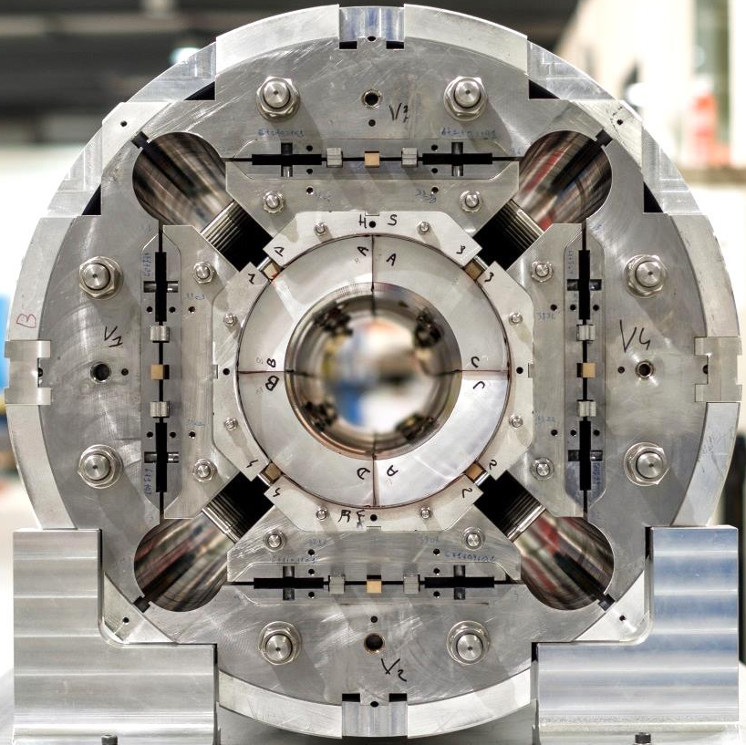
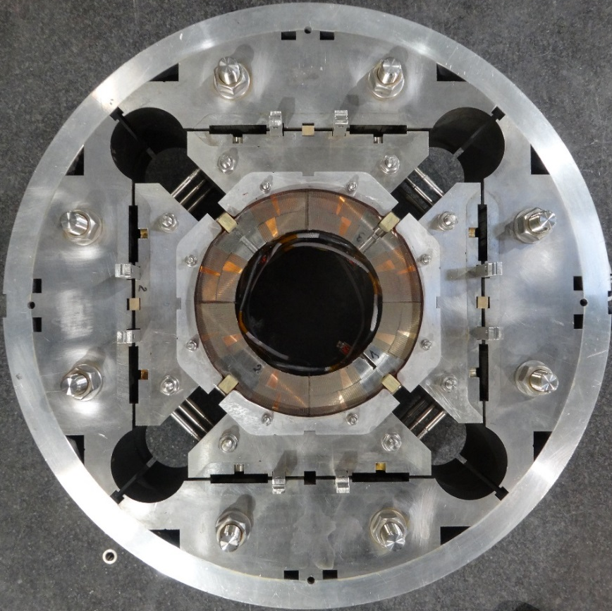
Overview of MQXF design

Slide 6
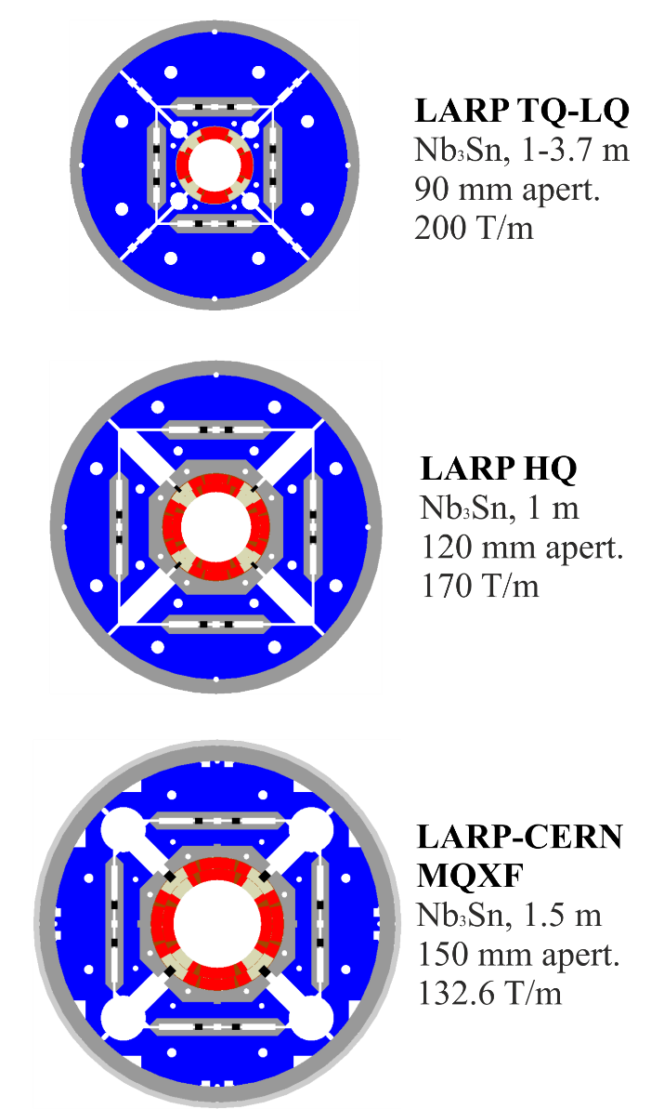
Overview of MQXF design
LARP
LHC Accelerator Research Program (since 2003)
  R&D on Nb₃Sn quadrupoles for LHC luminosity upgrade
From TQ/LQ series to MQXF
  From 90 to 150 mm
MQXF scale-up of HQ
  Similar coil lay-out
  Same structure concept
  Successfully tested

Slide 7
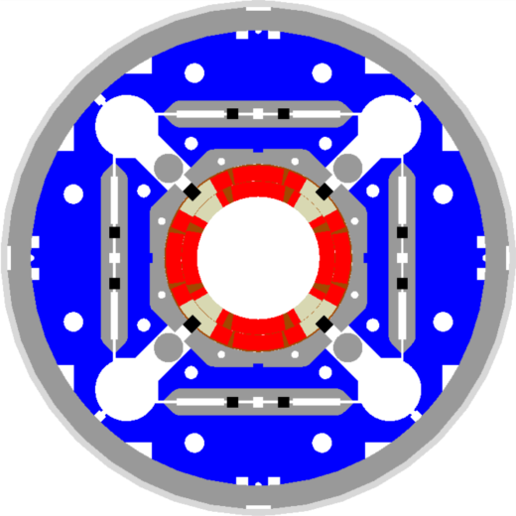
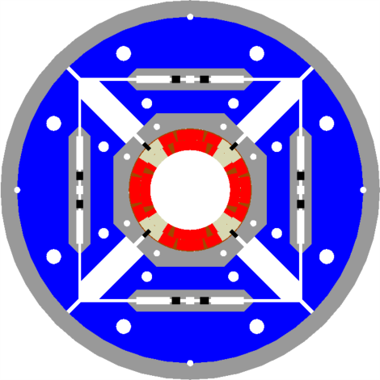
Overview of MQXF design
From HQ to MQXF
Aperture from 120 mm to 150 mm
  Strand increased from 0.778 mm to 0.85 mm
  Cable from 15 to 18 mm width (similar stress with +30% forces)
Same coil lay-out
Same structure concept
  Pre-load capabilities of HQ design qualified and successfully tested
Larger OD: from 570 to 630 mm
Additional accelerator features
HQ
MQXF

Slide 8
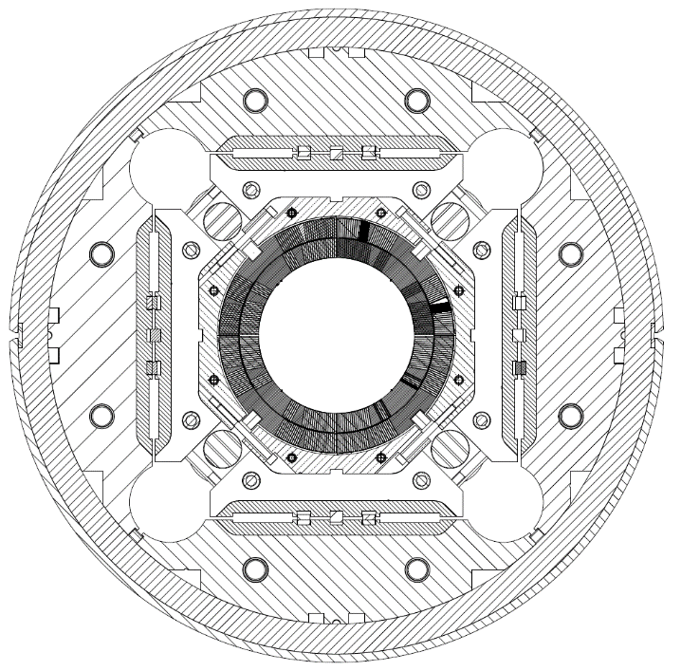
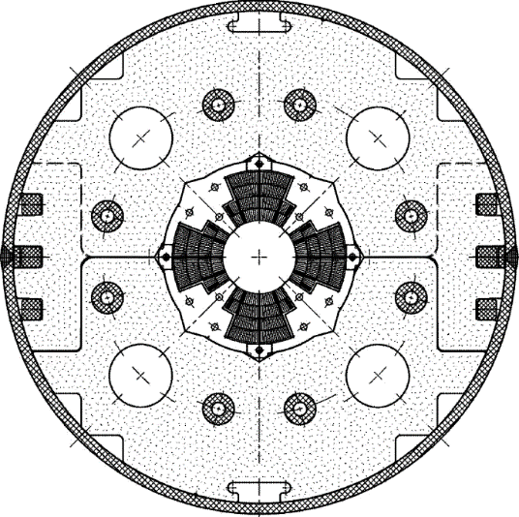
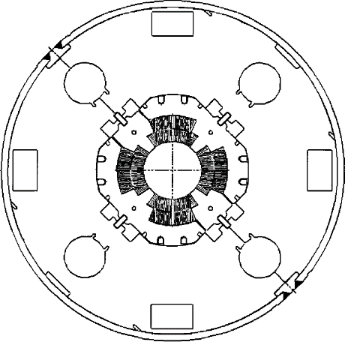
Overview of MQXF design
LHC low-β quadrupole support structures
Cold mass OD from 490/420 to 630 mm
More than double the aperture: from 70 to 150 mm
~4 times the e.m. forces in straight section
~6 times the e.m. forces in the ends
MQXA
MQXB
MQXF
In scale

Slide 9
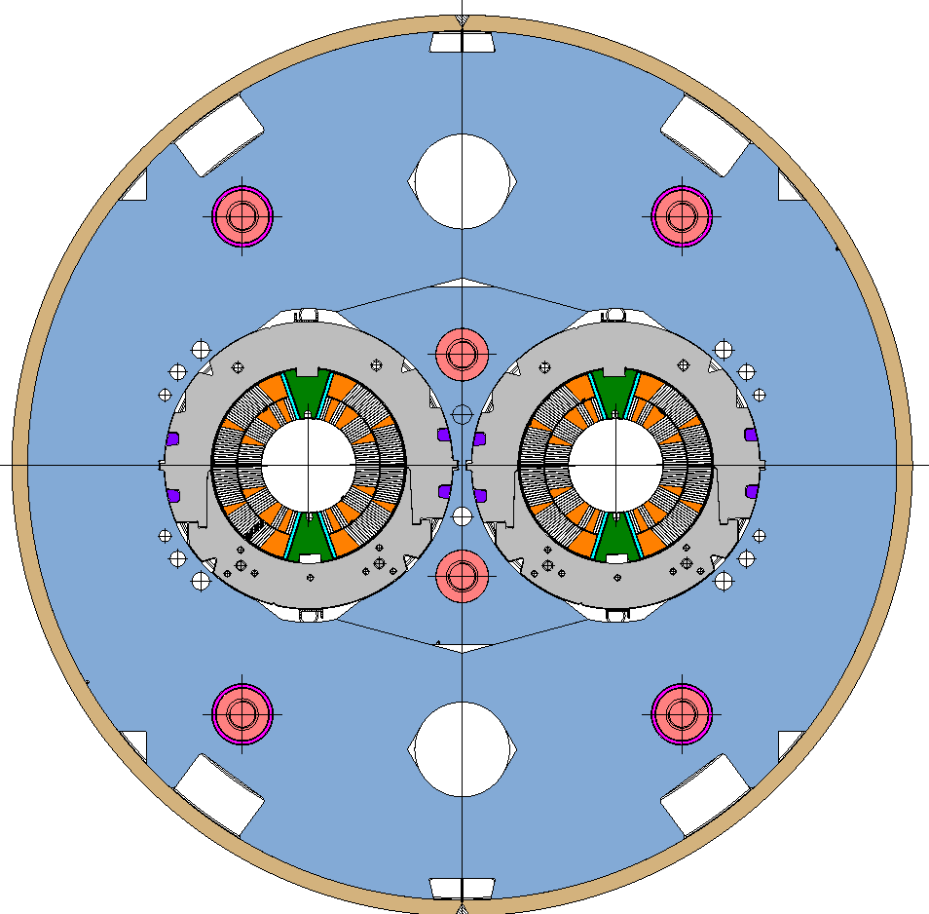
Overview of MQXF design
Comparison with LHC MB and 11T
  F_{x} = 340 t/m
  σ_{θ_e.m.}= 50-60 MPa
  F_{z_aperture} = 24 t
  F_{x} = 620 t/m
  σ_{θ_e.m.}= 90-110 MPa
  F_{z_aperture} = 48 t
  F_{x} = 680 t/m
  σ_{θ_e.m.}= 100-110 MPa
  F_{z_aperture} = 120 t

Slide 10
Outline
Overview of MQXF design
Strand and insulated cable
Coil design, magnetic analysis, magnet parameters
Support structure and mechanical analysis
Quench protection

Slide 11
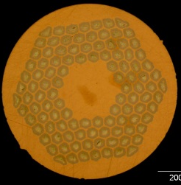
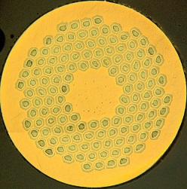
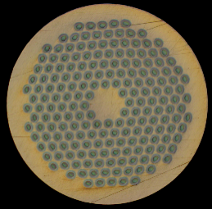
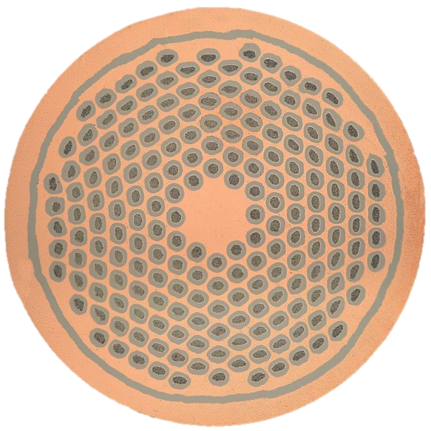
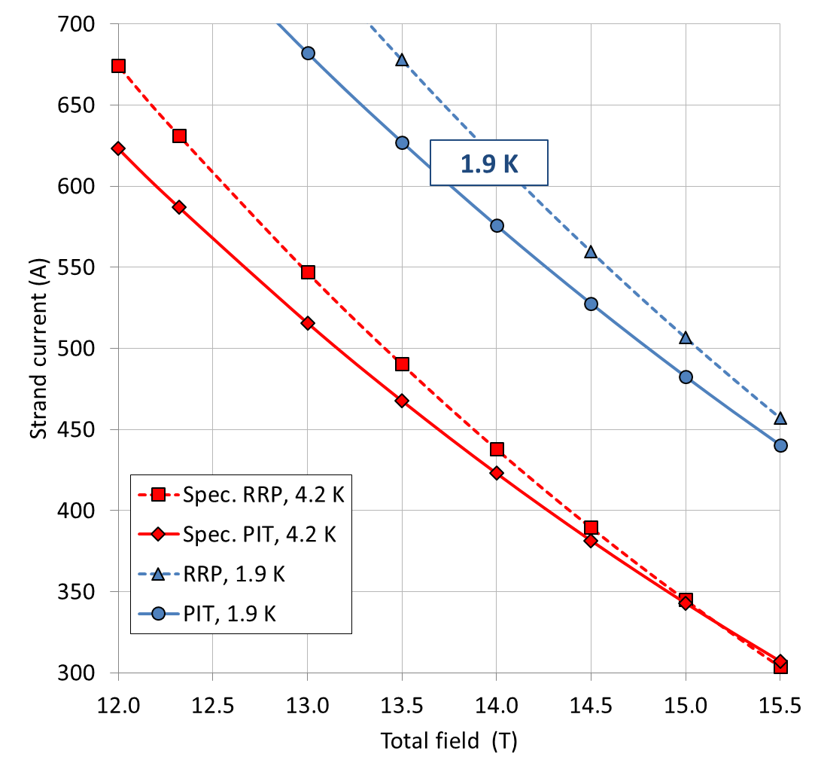
Superconducting Strand
See B. Bordini, L. Cooley
0.85 mm strand, 1.2 Cu/SC
Short model program
  OST RRP 108/127, 132/169
  EAS Bruker PIT 192
Prototype program
  RRP 108/127
  PIT 192 (with barrier)
Specifications
  RRP
    632 A (2450 A/mm²)at 12 T
    331 A (1280 A/mm²) at 15 T
  PIT
    590 A (2290 A/mm²) at 12 T
    331 A (1280 A/mm²) at 15 T
Filament ∅ ≤ 55 µm

Slide 12
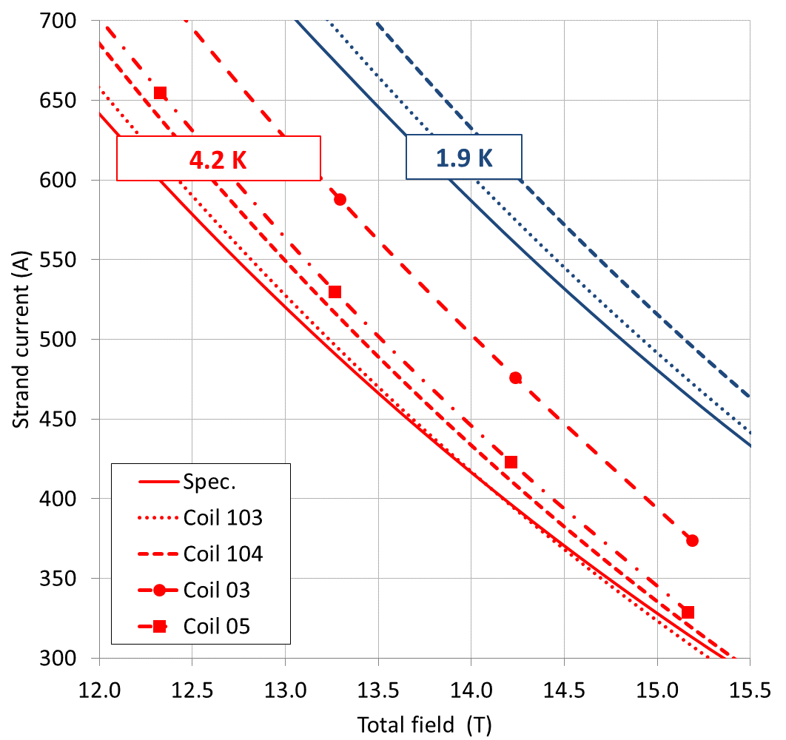
Superconducting Strand
The MQXF1 case: all coils within specs.

Slide 13
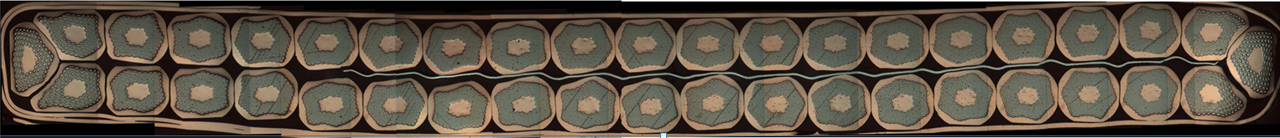
Superconducting cable (2nd generation)
See B. Bordini, L. Cooley
40-strand cable
Mid – thickness after cabling
  1.525 +/- 0.010 mm
Width after cabling
  18.150 +/- 0.050 mm
Keystone angle
  0.40 +/- 0.10 deg.
Pitch length
  109 mm
SS core 12 mm x 25 μm thick
Assumed expansion during reaction
  4.5% in thickness: ~70 μm
    same keystone angle
  1.2 % in width: ~210 μm
Mid–thickness after reaction
  1.594 mm
Width after reaction
  18.363 mm
70 μm
210 μm

Slide 14
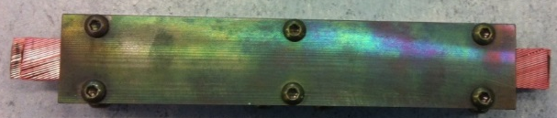
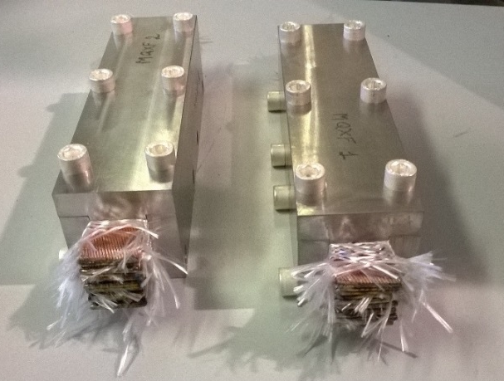
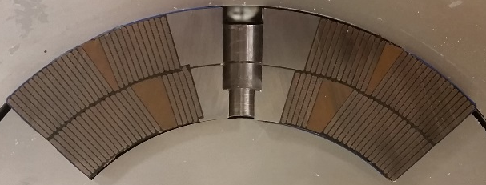
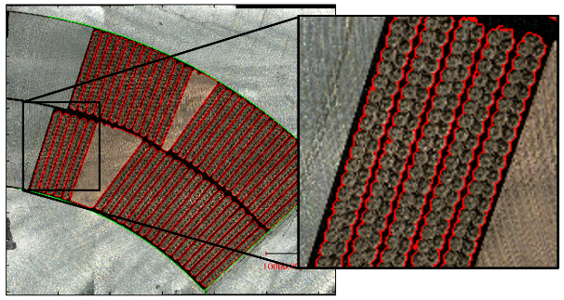
Superconducting strand and cable
Dimensional variation during reaction
See J. C. Perez
Cable/coil size after reaction is critical
  Issue in HQ01
Single cable, stacks, coil cross-section
  Image analysis of cable contours
Consistent data from different set-ups, labs, and coils

Slide 15
Superconducting strand and cable
Dimensional variation during reaction
See J. C. Perez
Overall volume expansion: +3.0 to 3.5%
Single strand
  +3.5% in volume
    +3.4% in area
    +0.1 in length
Bare cable (or loose insulation)
  +3.5% in volume
    +3.0% in thickness
    +1.0% in width
    -0.5% in length
Braided cable
  +3.0 to +3.5% in volume
    +3.0% in thickness
    +0.0 to +0.5% in width
    -0.2 to 0.0% in length
Dependence on tooling and braiding

Slide 16
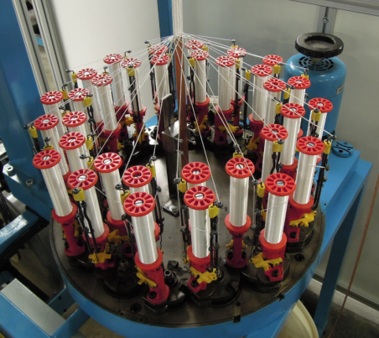
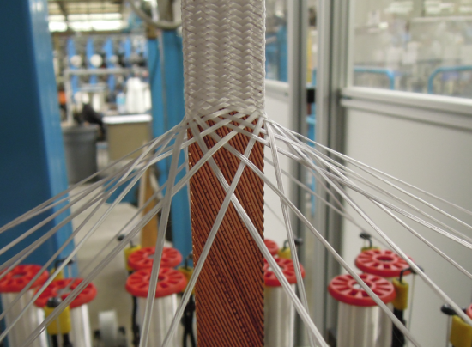
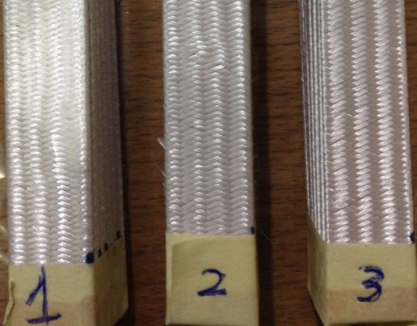
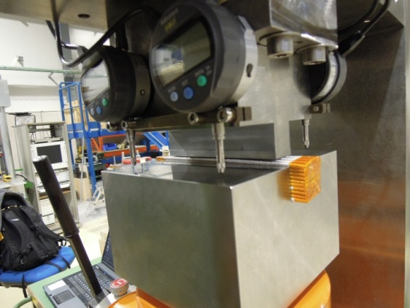
Cable insulation
AGY S2-glass fibers 66 tex with 933 silane sizing
32 (CERN, CGP) or 48 (LARP, NEW) coils (bobbins)
  Variables: # of yarn per coil and of picks/inch
Target: 145 ±5 μm at 5 MPa, average 3 cycles

Slide 17
From 1st to 2nd generation
Insulated cable design
Keystone angle reduced from 0.55° to 0.40°
  Critical current degradation due to cabling reduced to <5% both for RRP and PIT
Assumed width expansion
  From 2% to 1.2 % → increased coil compaction
Thickness of insulation
  From 0.150 to 145 µm → increased coil compaction

Slide 18
Outline
Overview of MQXF design
Strand and insulated cable
Coil design, magnetic analysis, magnet parameters
Support structure and mechanical analysis
Quench protection

Slide 19
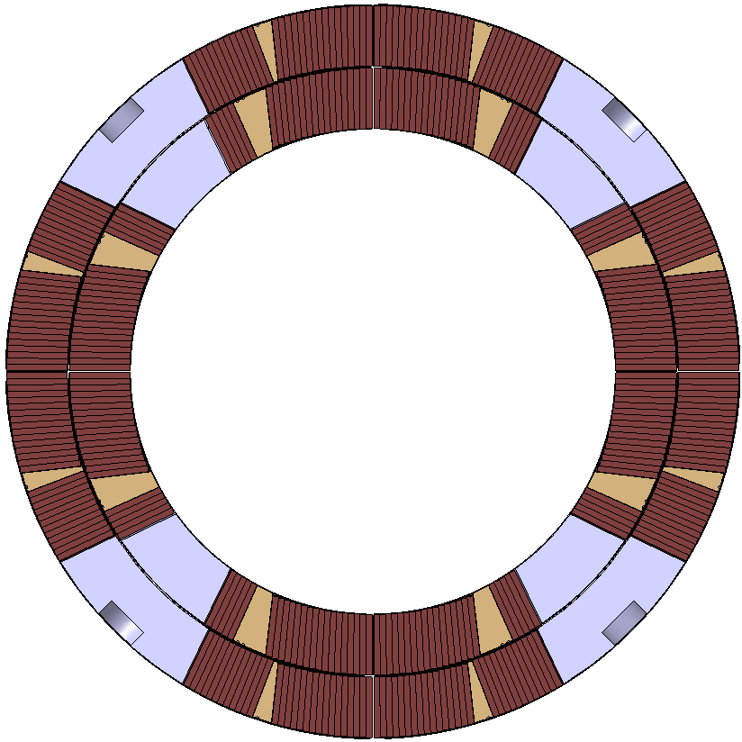
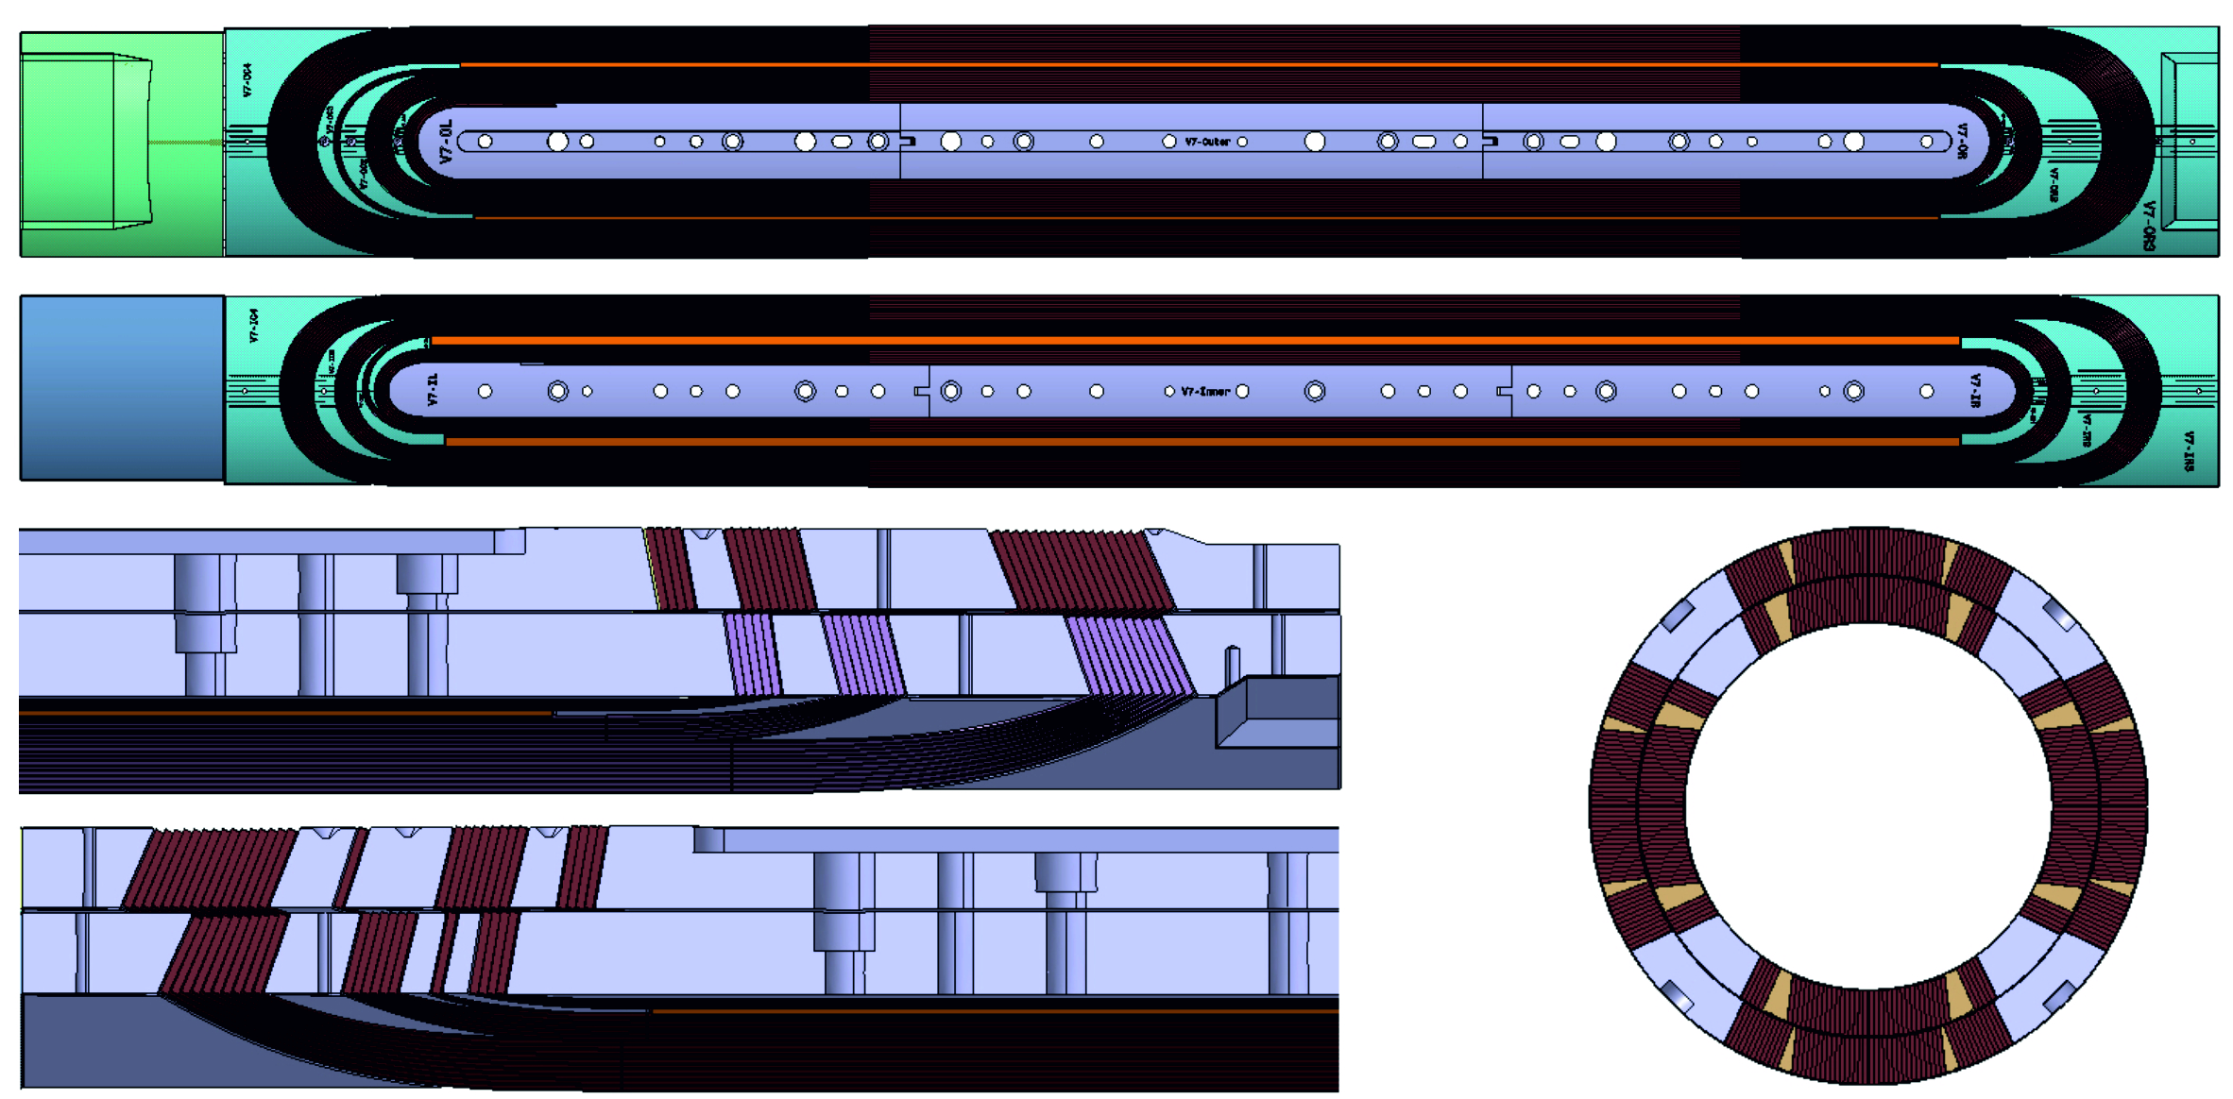
Coil design
Two-layer, four-blocks design
22+28 = 50 turns
Pole impregnated with the coil
Splice extension 140 mm long
2 end spacers for peak field reduction (1%) and field quality

Slide 20
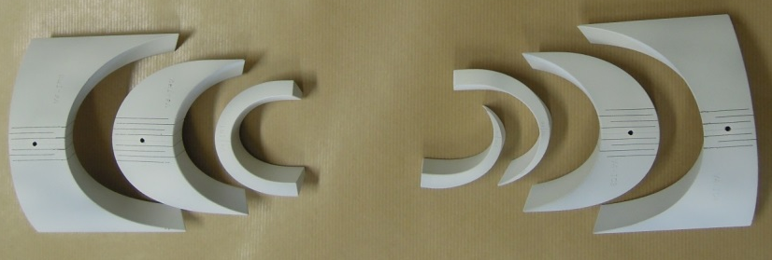
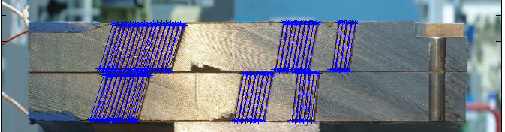

Coil design
Coated parts with cuts
Image analysis of cable contours
  Good fit of end-spacers
  But, up to 0.5 mm azimuthal and radial shift in straight section
Space for expansion reduced for 2nd generation coils
  From 2 to 1% on width
  Assumed ins. thickness in Roxie from 150 to 145 μm

Slide 21
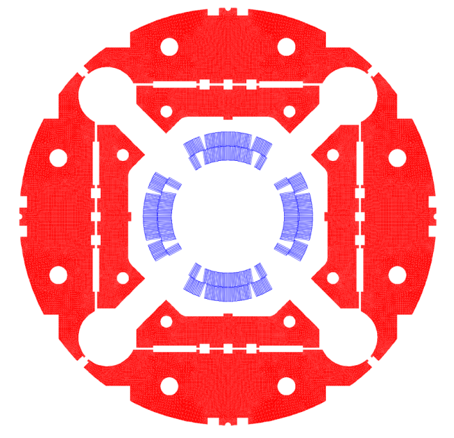
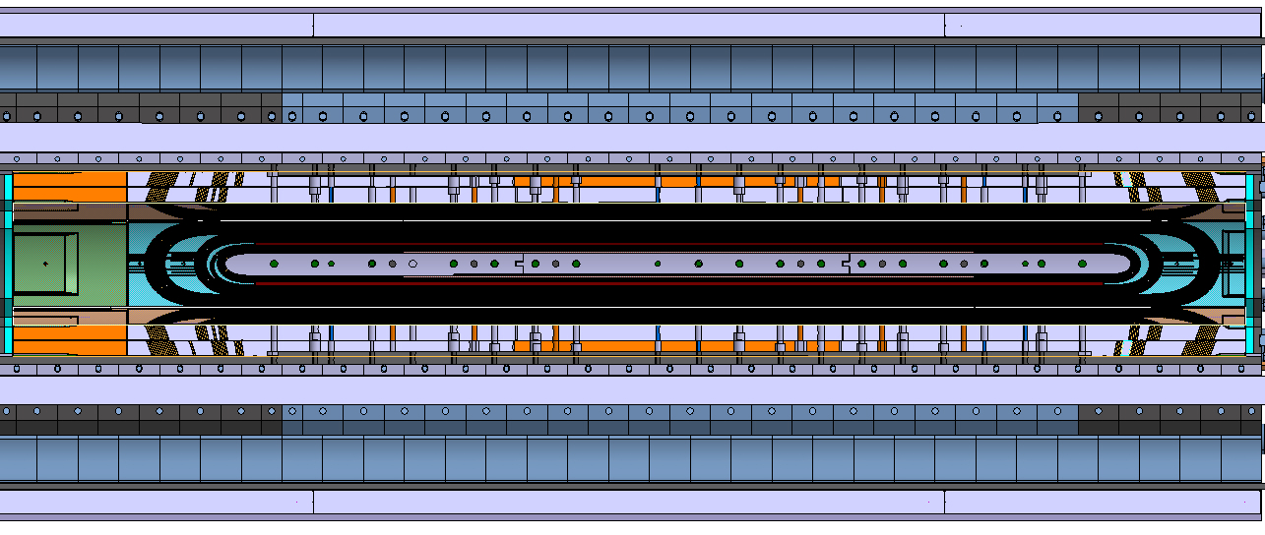
Magnetic analysis
See S. Izquierdo Bermudez
Allowed harmonics below 1 units
  Confirmed by measurements
6 blocks in the ends
  Minimized integrated harmonics
  1% lower peak field in the ends wrt straight section
    Iron pad removed from the ends

Slide 22
Magnetic analysis

Slide 23
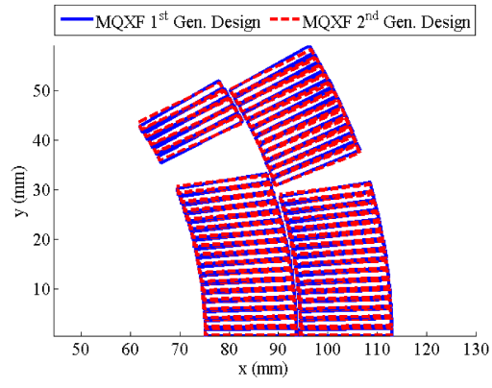
Magnetic analysis
Corrective strategies
See S. Izquierdo Bermudez
Allowed harmonics
  Pole/mid-plane shims
Un-allowed harmonics
  Magnetic shims

Slide 24
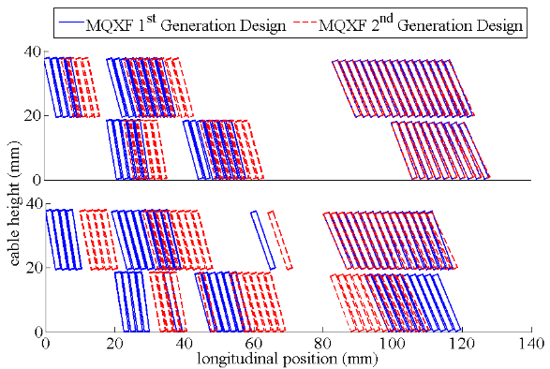
From 1st to 2nd generation
Coil design
Account for the new cable geometry
  New keystone angle and dimensions after reactions
Corrected the impact of coil mechanical deformation
Optimized harmonics at 123 T/m
  Operational current will be between 90% and 100% of nominal, depending on the LHC final energy
Added S2-glass shims on mid-plane and pole
Compensated end effects on the integrated harmonics

Slide 25
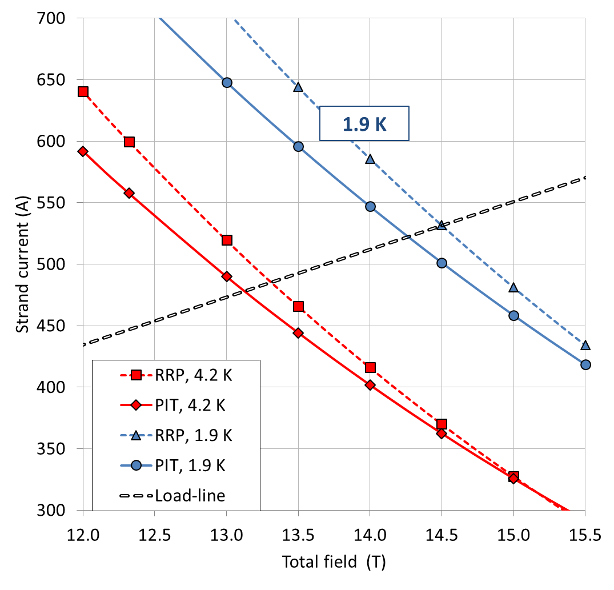
Magnet parameters
Self field corr. (ITER barrel)
5% cabling degradation
G_{op}= 132.6 T/m
  I_{op}: 16.47 kA
  B_{peak_op}: 11.4 T
RRP: 78%of I_{ss} at 1.9 K
PIT: 79% of I_{ss} at 1.9 K
Stored energy: 1.2 MJ/m
Inductance: 8.2 mH/m

Slide 26
From 1st to 2nd generation
Operational margin
From 1st to 2nd generation design
  We started with magnet I_{op} at 81% of I_{ss}
  Length: 4.0 to 4.2 m for Q1/Q3, 6.8 to 7.15 m for Q2
    Reduction of gradient from 140 to 132.6 T/m
    Magnet I_{op} from 81% to 76% of I_{ss}
  RRP spec. reduced from 361 to 331 A (1400 to 1280 A/mm²) at 15 T
    Magnet I_{op} from 76% to 78% of I_{ss}
  PIT spec. reduced from 631 to 590 A (2450 to 2290 A/mm²) at 12 T, but same at 15 T
    Magnet I_{op} at 79%

Slide 27
Outline
Overview of MQXF project and design
Strand and insulated cable
Coil design, magnetic analysis, magnet parameters
Support structure and mechanical analysis
Quench protection

Slide 28
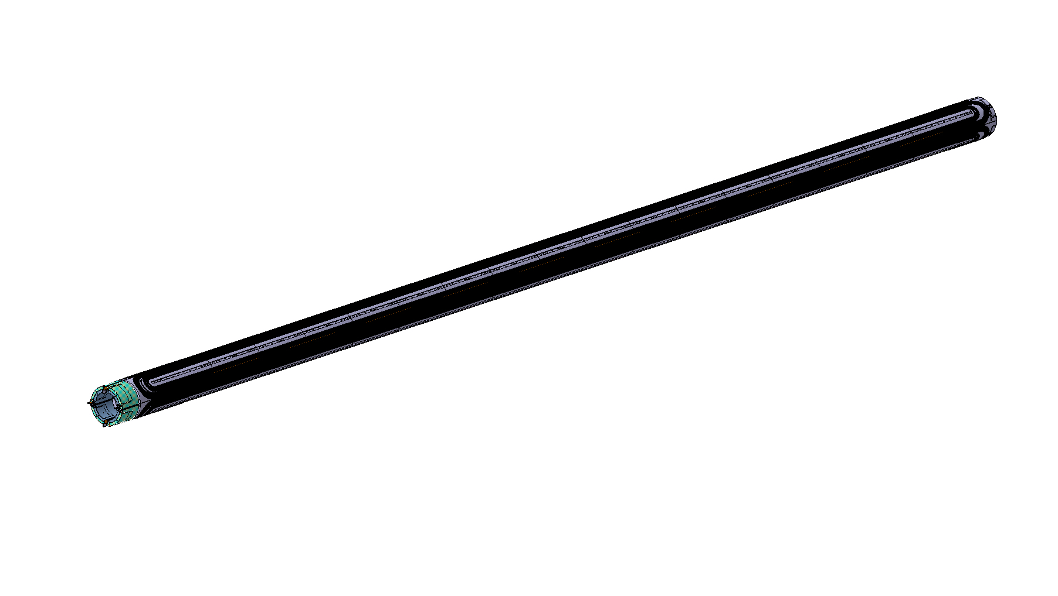
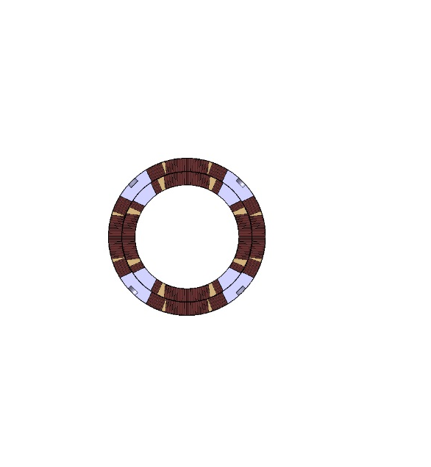
Magnet design
MQXFB
See J. C. Perez
Superconducting coil

Slide 29
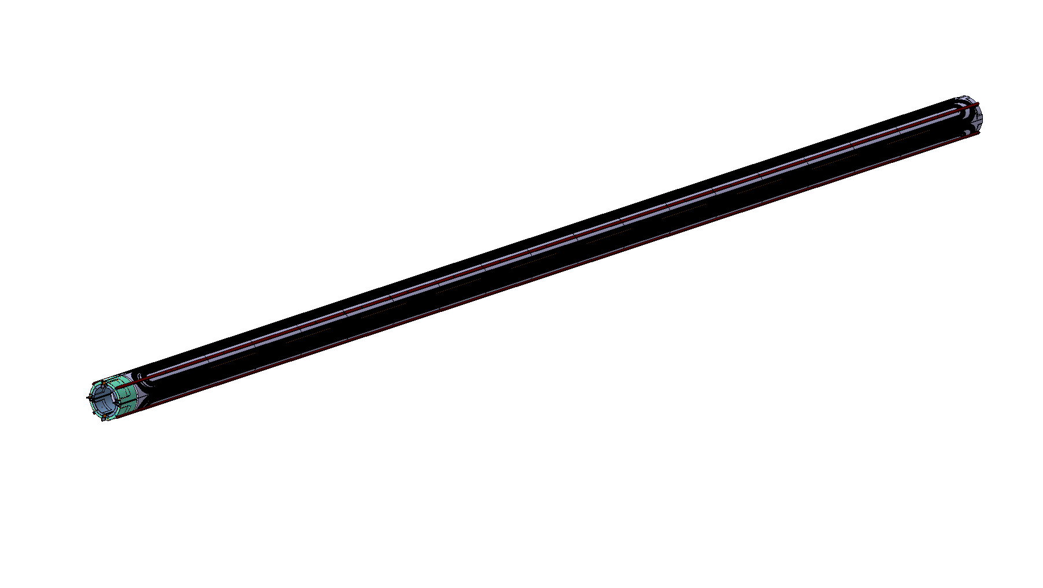
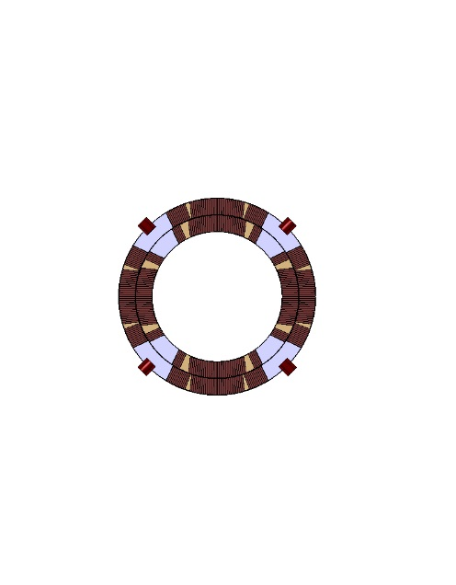
Magnet design
MQXFB
See J. C. Perez
Pole key for alignment

Slide 30
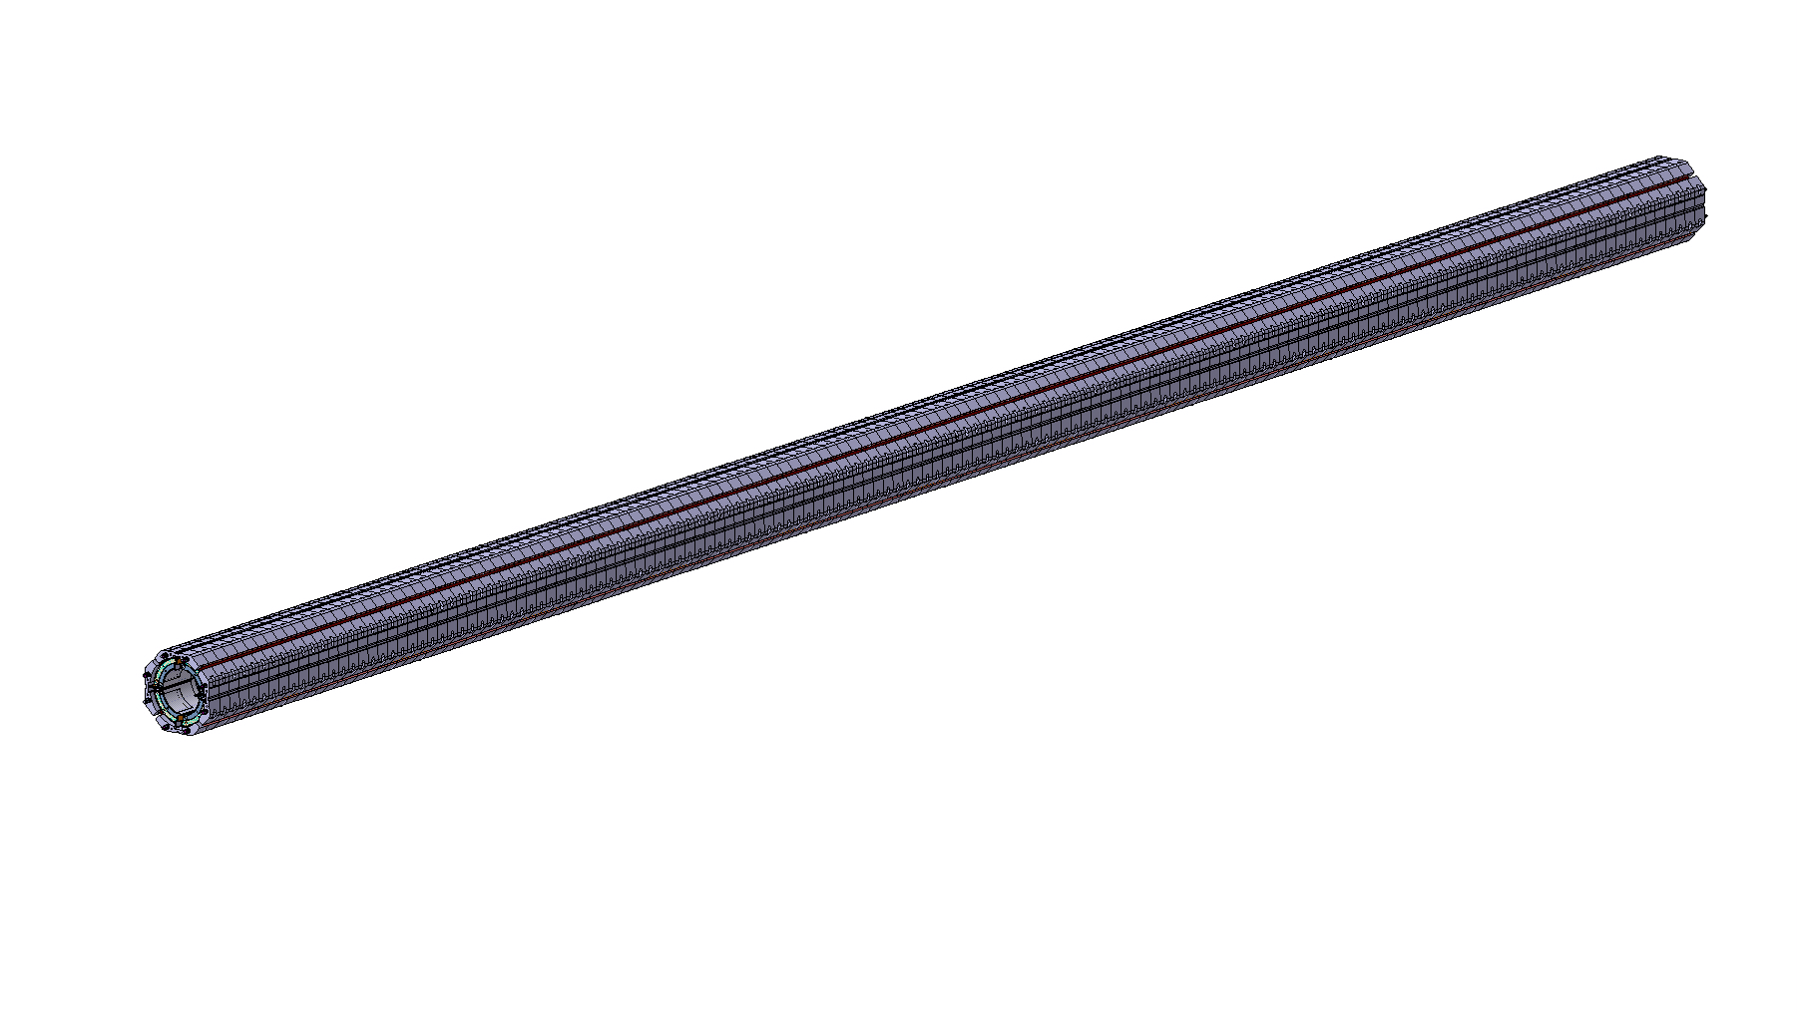
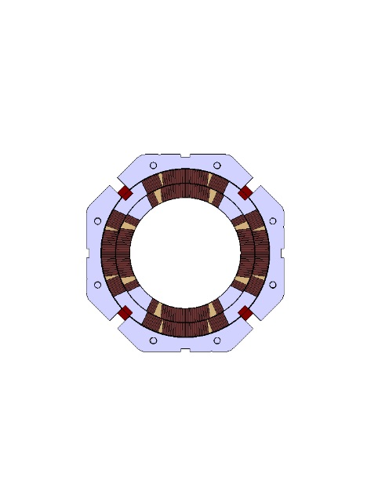
Magnet design
MQXFB
See J. C. Perez
Aluminium collar
  No coil pre-load

Slide 31
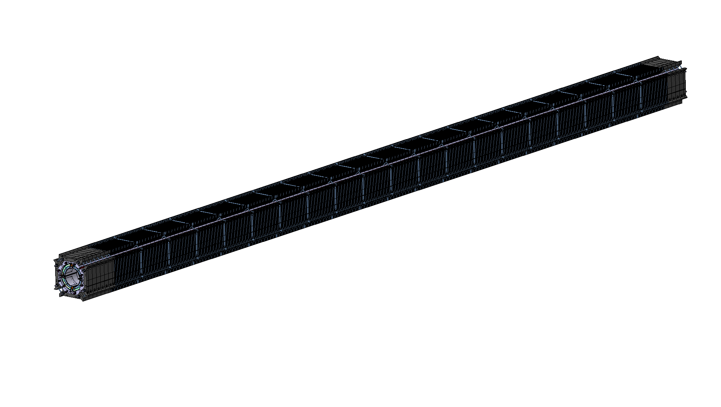
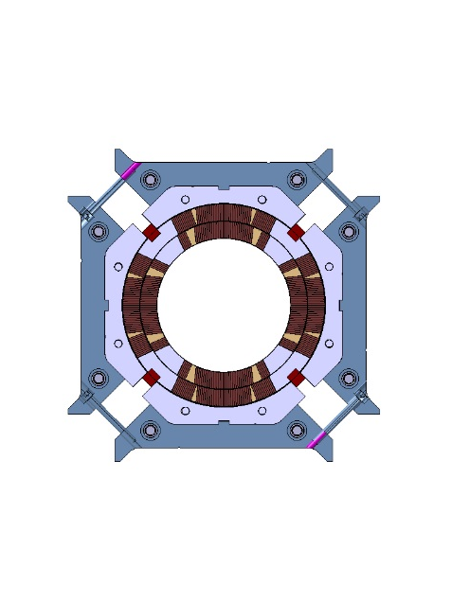
Magnet design
MQXFB
See J. C. Perez
Bolted iron pad
  No coil pre-load

Slide 32
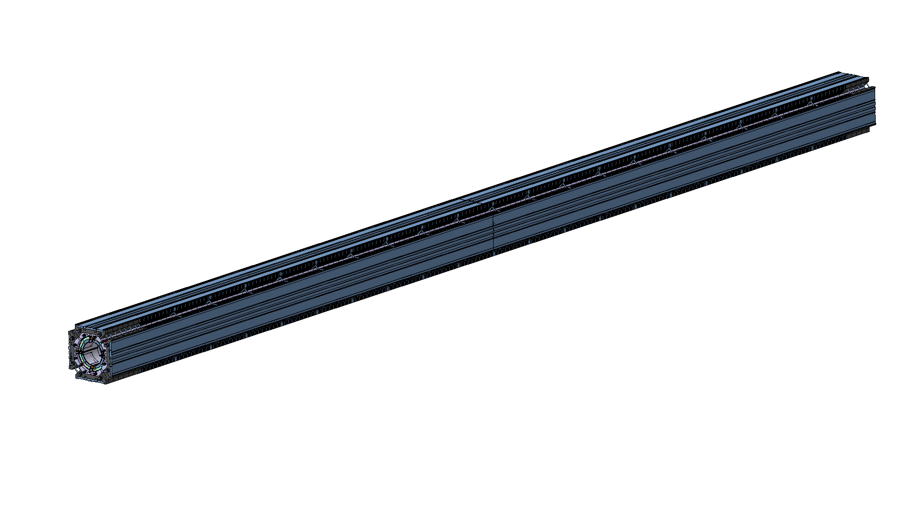
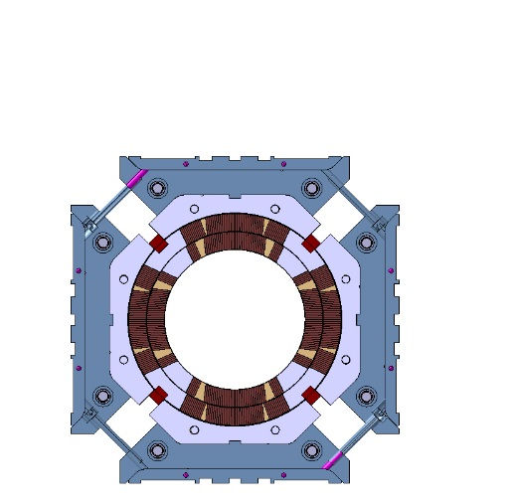
Magnet design
MQXFB
See J. C. Perez
Iron master
  Half-length plates for bladders and keys

Slide 33
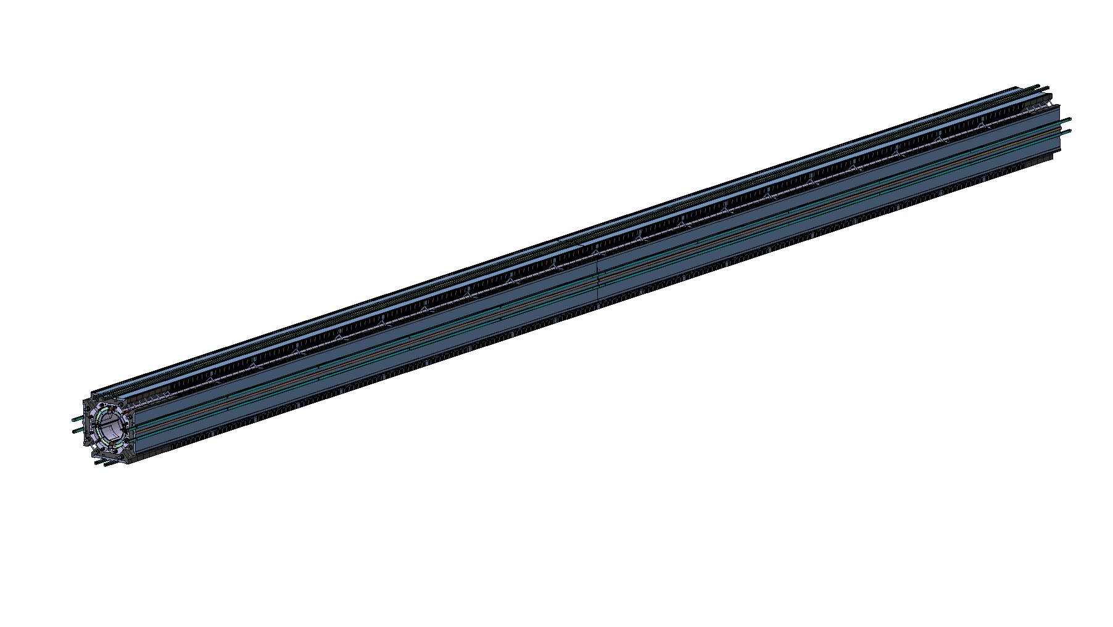
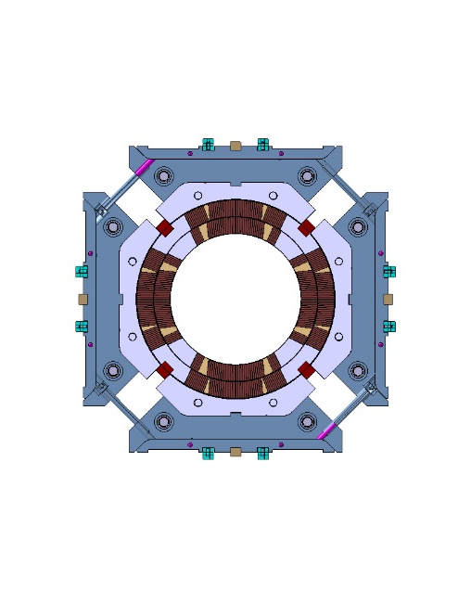
Magnet design
MQXFB
See J. C. Perez
Loading and alignment keys

Slide 34

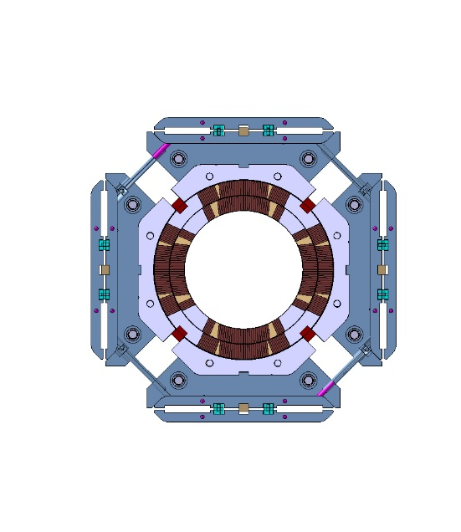
Magnet design
MQXFB
See J. C. Perez
Second iron master
  Coil-pack sub-assembly

Slide 35
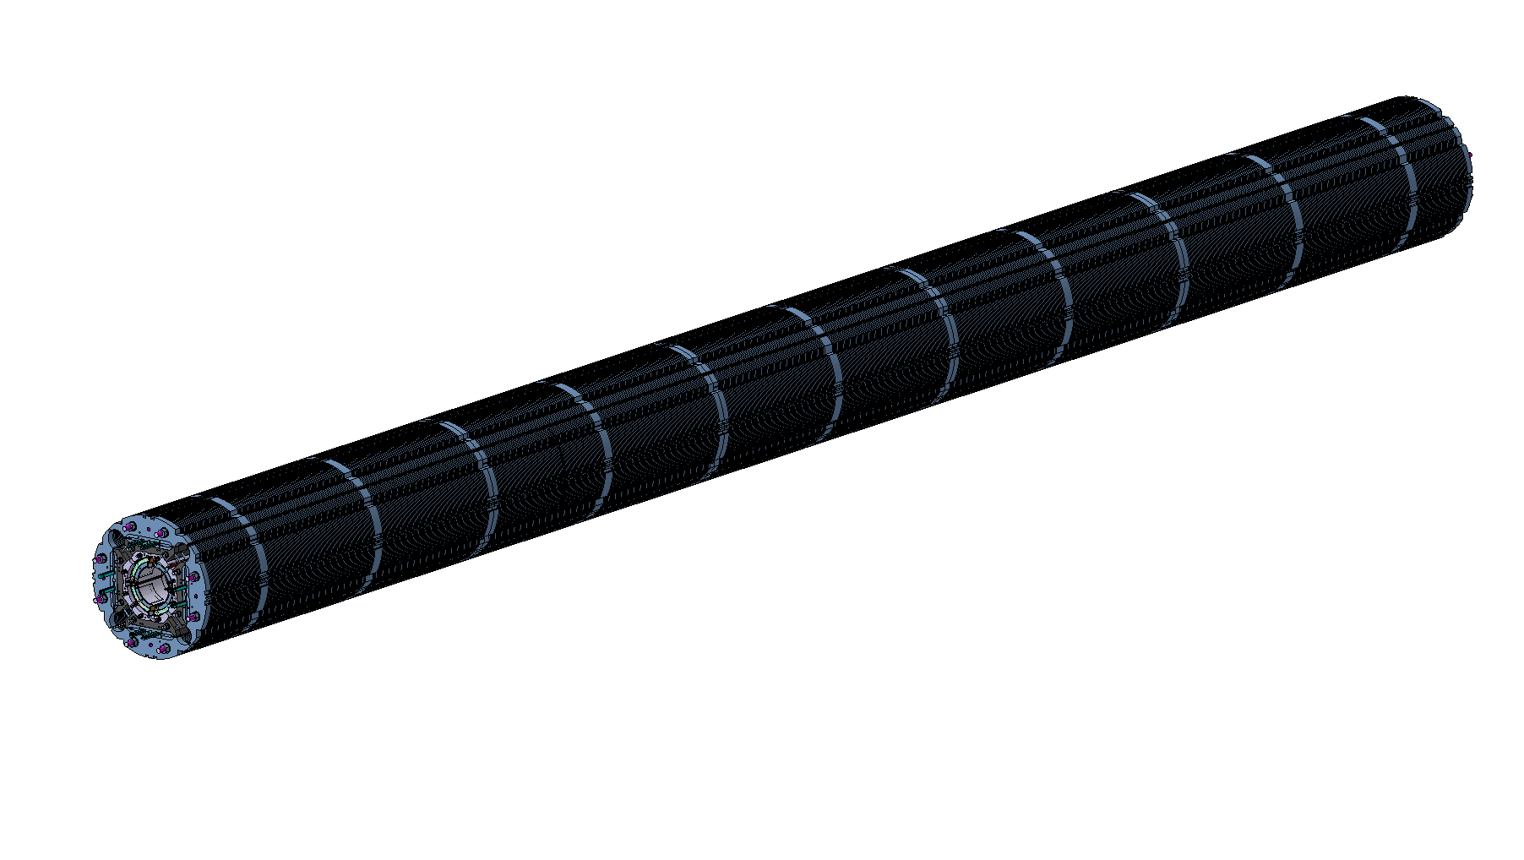
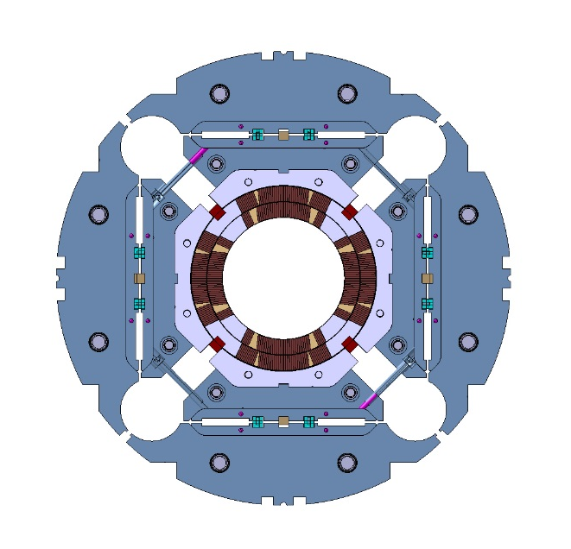
Magnet design
MQXFB
See J. C. Perez
Iron yoke laminations

Slide 36


Magnet design
MQXFB
See J. C. Perez
Segmented aluminium shell

Slide 37


Magnet design
MQXFB
See J. C. Perez
Tack-welding blocks
  Aligned to the yoke

Slide 38


Magnet design
MQXFB
See J. C. Perez
Backing strip
  For Lhe vessel welding

Slide 39


Magnet design
MQXFB
See J. C. Perez
Welded LHe vessel
  Minimum welding tension

Slide 40


Magnet design
MQXFB
See J. C. Perez
Axial support system
  SS rods and end-plates

Slide 41




Magnet assembly and pre-loading
See G. Vallone
Shell-yoke modules combined
Insertion of coil-pack sub-assembly
Then bladder operation
Deformed shape and coil peak azimuth. stress from ANSYS
-110 MPa
-100 MPa
-140 MPa
-140 MPa

Slide 42

Mechanical analysis
See G. Vallone
Shell force shared by collars and key at room T
25% intercepted at 1.9 K
Coil compressed at G_{op}
  Alignment maintained
Coil peak azimuth. stress
-110 MPa
-100 MPa
-140 MPa
-140 MPa

Slide 43



Axial loading
See G. Vallone
SS rods free to contract
Possible to
  apply coil pre-load equal to e.m. force
  maintain coil – end-parts contact pressure

Slide 44


LHe vessel
See J.C. Perez
See H. Prin
Shell cut-outs to align magnet during module assembly and tack welding process
Stainless steel shell welded with 50-100 MPa tension
  Still in contact after cool-down

Slide 45


Rigidity of the structure
See G. Vallone
Radial
  Δε_{ϑ} strain: ~70 με
  Shell radius r: 307 mm
  Δr ~20 μm
Axial
  Δε_{z} strain: ~70 με
  Rod/coil length l: 1500 mm
  Δl ~100 μm
Very small changes under e.m. forces

Slide 46
Alignment
See J. C. Perez
Pole key
Collar-pad
Pad-master
Master-master key
Master-yoke
Tack-welding blocks
Modules aligned via
  Yoke slots
  Pins
  Tack-welding blocks

Slide 47


Laminations
See J. C. Perez
With respect to previous review
  2 short model structures with thin laminations fabricated and under test
Structure 1 and 2
Structure 3 and 4

Slide 48



Cooling
Requirements
  1.5 mm clearance tube - coil
  Perforated inner layer trace (40%)
  Pole: 8 mm holes every 50 mm
    Same in the pole key
  Clear path around axial rods
  77 mm heat exchanger holes
    Top for bus-bars, bottom for cooling
  Cross-talk channels in the yoke
    8 mm diameter, every ~700 mm
  Free helium section of 150 cm²

Slide 49
Outline
Overview of MQXF project and design
Strand and insulated cable
Coil design, magnetic analysis, magnet parameters
Support structure and mechanical analysis
Quench protection

Slide 50


Quench protection
See G. Ambrosio
Challenge: 50% more stored E in the coil than LHC MB
No dump (only 5% of energy, due to high inductance)
Outer layer QH: 350-360 K reached (failure scenarios)
For additional redundancy and peak T reduction
  Inner layer QH: Cooling and detachment issues
  CLIQ (Coupling-Loss-Induce-Quench) system
    Tested on HQ and MB, aspects related to the circuit being analyzed

Slide 51
Appendix

Slide 52

Superconducting strand
RRP
J_{c}(4.22 K, 12 T)≈2450 A/mm²
J_{c}(4.22 K, 15 T)≈1280 A/mm²
Spec at 15 T reduced from 360 to 330 from last review

Slide 53

Superconducting strand
PIT
J_{c}(4.22 K, 12 T)≈2290 A/mm²
J_{c}(4.22 K, 15 T)≈1280 A/mm²

Slide 54
Strands, cables and coils
Conductor | Insulation | Thickness [%] |  | Width [%] |  | Length [%] |  | Area | Volume
 |  | Range | Avg. | Range | Avg. | Range | Avg. | Avg. [%] | Avg. [%]
Strand | Bare | 1.6:1.9 | 1.7 | 1.6-1.9 | 1.7 | 0.08 | 0.08 | 3.4 | 3.5
MQXF Cables | Bare | 2.9:3.1 | 3.0 | - | - | - | - | - | -
 | Sleeve | 2.6:3.0 | 2.8 | 1.1:1.3 | 1.1 | -0.55:-0.30 | -0.4 | 3.9 | 3.5
 | Braid | 2.9:3.6 | 3.2 | -0.20:0.15 | 0.0 | -0.05:-0.20 | -0.1 | 3.2 | 3.1
LARP coil 1 | Braid | 1.7:4.5 | 3.1 | 0.3:0.6 | 0.5 | -0.23:-0.14 | -0.18 | 3.6 | 3.4
CERN coil 101 | Braid | 1.7:4.3 | 3.0 | -0.0:0.3 | 0.1 | -0.08:-0.00 | -0.03 | 3.1 | 3.0
During the heat treatment, assuming braided insulation:
Cables expand by +3% in thickness and <+0.5% in width
Cables contract by -0.1 % in length
Overall volume expansion is around +3%
References:
Strands: | [1] | D. Bocian et al., Measurements of Nb3Sn Conductor Dimension Changes During Heat Treatment, Proc. AIP Conf., 2012.
 | [2] | N. Andreev et al., Volume Expansion of Nb-Sn Strands and Cables During Heat Treatment, Adv. in Cryogenic Eng., 2007.
Cables: | [3] | I. Pong et al., Dimensional Changes of Nb3Sn Cables during Heat Treatment, Int. Cryogenic Materials Conf., 2015.
 | [4] | M. Durante et al., Geometrical behavior of Nb3Sn Rutherford cables during heat treatment, IEEE Trans. Appl. Supercond., 2016.
Coils: | [5] | T. Holik et al., Cross-section analysis of MQXF coils, IEEE Trans. Appl. Supercond., 2016.
 | [6] | E. Rochepault et al., Dimensional Changes of Nb3Sn Rutherford Cables During Heat Treatment, IEEE Trans. Appl. Supercond., 2016.

Slide 55
Impact of insulation
Cables: area and length
Coils: length during fabrication steps
-0.17
-0.20
-0.37
-0.34
Braid is less tight for LARP coils than for CERN coils
Behavior similar to HQ02 sleeves
→ more contraction in length
Cables confined in a tight braid expand less in area and contract less in length

Slide 56

Radial tolerance sensitivity of each part
Tolerance closer to the coil has relatively bigger impact on the stress of the coil in the tolerance quadrant.
The master attach to the pad is slightly more sensitive to the tolerance; the yoke and shell are all less sensitive.

Slide 57
Impact of azimuthal tolerance
Assume each azimuthal tolerance is 25 μm, the resultant coil twist angle is (Sensitivity check):
Coil twist angle (mrad) | Collar/Pole key | Pad | Master | Yoke
0.21 | 25 | 0 | 0 | 0
0.19 | 0 | 25 | 0 | 0
0.12 | 0 | 0 | 25 | 0
0.09 | 0 | 0 | 0 | 25
0.61 | 25 | 25 | 25 | 25
If the twist angle of coil is 1 mrad, the each corresponsing azimuthal tolerance is: (Sensitivity check):
 | Collar/Pole key | Pad | Master | Yoke
Max allowable azimuthal tolerance (μm) | 119 | 132 | 212 | 278

Slide 58
Conclusion
The yoke and shell have the least sensitivity on radial tolerance. Tolerance on the other parts have similar influence to the coil stress.
The typical tolerance build-up in manufacturing only impact coil stress within about +/- 10 MPa.
The typical azimuthal tolerances in manufacturing meet the physical envelop requirement of MAXF.

Slide 59


Shell segmentation and LHe vessel (I)
See talk from M. Juchno
In case of full length aluminum shell
  High ε_{z} and σ_{z} due to friction and high thermal contraction
    Risk of ratcheting
  Variation of shell axial ε_{z} due to friction
    Large coil stress σ_{ϑ} variation
Aluminum shell in 0.755 m segments
  LQ/HQ shell axial stress levels
  Coil azimuthal stress variation ±10 MPa
Optimization of shell segments for long model in progress

