Slide 1
MQXFS short model coils and structures fabrication
Juan Carlos Perez, TE-MSC-MDT
on behalf of MQXF collaboration team
Thanks to all contributors
Review on the Inner Triplet Quadrupoles (MQXF) for HL-LHC – 7th to 10th June 2016
http://indico.cern.ch/event/524804/

Slide 2

Outline
MQXFS magnet
Coil production summary
Cable insulation and ten-stacks measurements
Coil winding and Curing
Heat treatment
Instrumentation and splices
Impregnation & post-impregnation process
Coil geometrical measurements and cross-section inspection
Mechanical structures and magnets assembly
Summary

Slide 3
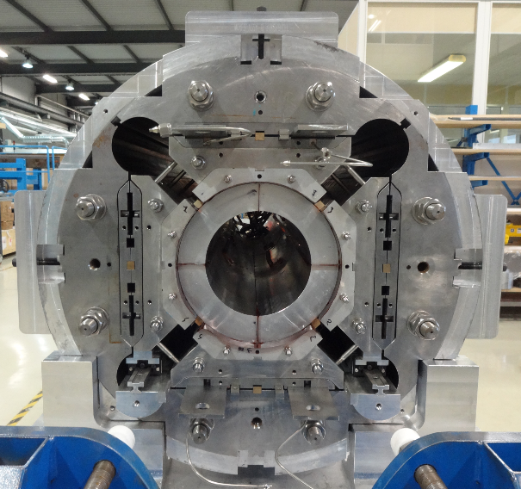
MQXFS magnet

Slide 4
Coil production at LARP
Coil # | Conductor
Pract. 1 | RRP 108/127 | R&I @ BNL. Leak during impregnation. Was cut
2 | RRP 108/127 | R&I @ FNAL. Mirror, 91% SSL @ 4.2 K (Spare coil for MQXFS2)
3 | RRP 108/127 | R&I @ BNL, mounted in MQXFS1
4 | RRP 108/127 | R @ LBNL, Reversed end-parts, not impregnated
5 | RRP 108/127 | R&I @ BNL, mounted in MQXFS1
6 | RRP 108/127 | R&I @ FNAL, coil pour MQXFS2
07 | RRP 108/127 | 2nd generation cable, R&I @ FNAL, coil pour MQXFS3
08 | RRP 144/169 | 2nd generation cable, R&I @ BNL (in progress)
All coils wound @ FNAL
1 Practise coil
5 coils with 1st generation cable
2 coils with 2nd generation cable

Slide 5
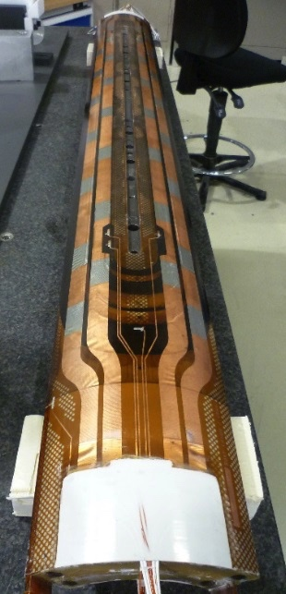
Coil production at CERN
Coil # | Conductor
Pract. 1 | Copper cable | Frabrication process validation
101 | RRP 132/169 | Low grade conductor. Was cut
102 | RRP 132/169 | Fractured filaments during Nb₃Sn/NbTi splice
103 | RRP 132/169 | Used in MQXFS1 assembly
104 | RRP 132/169 | Used in MQXFS1 assembly
201 | PIT 192 | High Ic & RRR degradation during cabling. For MQXFS2 assembly
202 | PIT 192 | High Ic & RRR degradation during cabling. For MQXFS2 assembly
105 | RRP 108/127 | 2nd generation cable. Foreseen for MQXFS3 assembly
106 | RRP 108/127 | 2nd generation cable. Coil completed. Foreseen for MQXFS3 assembly
107 | RRP 108/127 | 2nd generation cable. Waiting for post-impregnation. Short to pole. For MQXFS3
203 | PIT 192 | 2nd generation cable. Wound and cured
204 | PIT 192 | 2nd generation cable. Winding in progress
2 Practise coils, 3+2 with 1st generation & 3+2 with 2nd generation cable

Slide 6
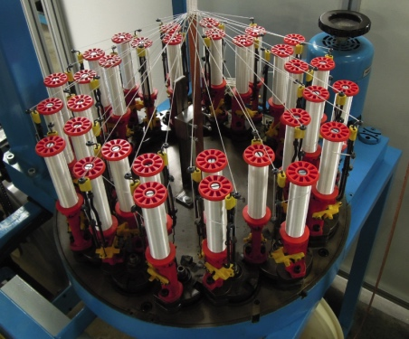
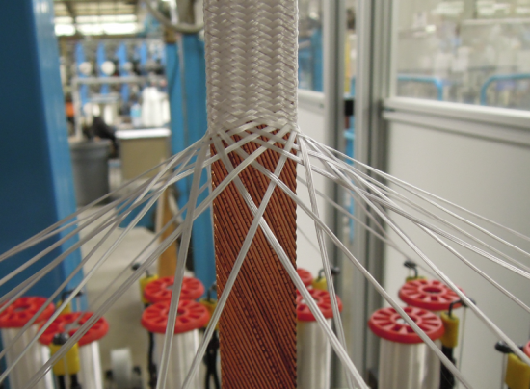
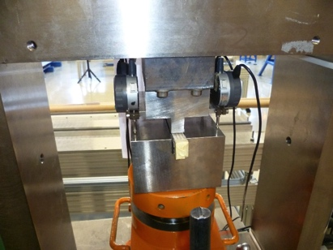
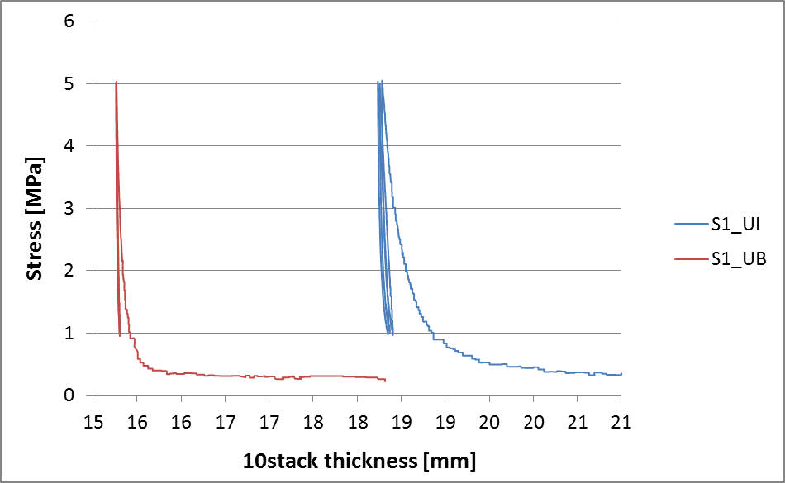
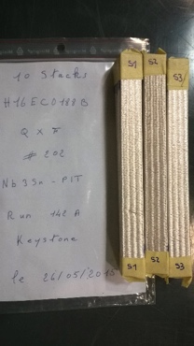
Cable insulation
Braided cable insulation using AGY S2-Glass, 66 Tex, 933 silane sizing
Target insulation thickness 145 μm @ 5 Mpa
Yarns directly braided on the bare cable
32 spindles with 2 yarns each used for CERN insulation & 48 for LARP
  Cable insulation outsourced to CGP (FR)
  Cable insulation outsourced to New England Wire Technologies (LARP)
Cable insulation thickness checked after delivery on 10 stacks
  3 samples made by 10 pieces of cable are prepared
  3 cycles of pressure until 5 MPa on each insulated sample
  The insulation is removed
  3 cycles of pressure until 5 MPa on each bare sample
  The insulation thickness is calculated on the average on the three cycles

Slide 7
Cable insulation thickness measurements
Specified insulation thickness: 145 μm @ 5 Mpa +/- 5 μm
Average value: 147 µm
Std. Deviation: 2.6 µm
The insulation thickness is within the specified values

Slide 8
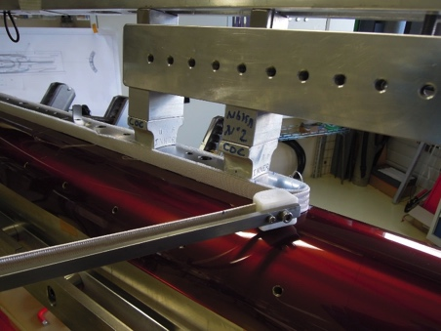
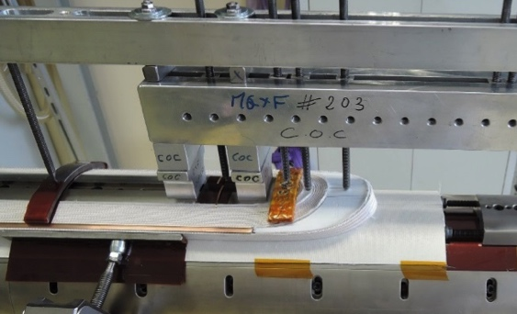
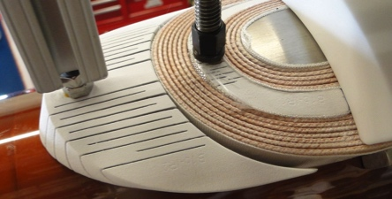
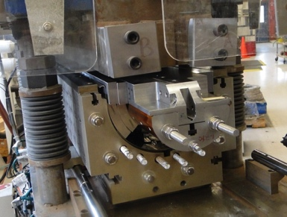
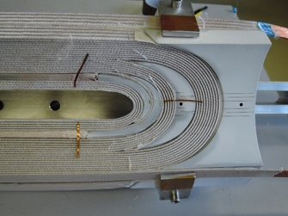
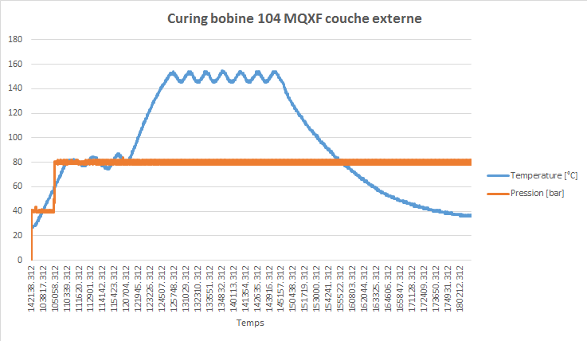
Coil winding & curing
Winding parameters
  22 turns inner layer and 28 turns outer layer
  At FNAL: First 2 turns 9 kg tension then 25 kg
  At CERN 25 kg during all sequence
  Accordion style end-parts coated with 250 μm Al₂O₃
  CTD 1202 Binder applied (Ceramic matrix)
Tool to prevent popped strands
Binder used during curing
 | LARP | CERN
End of each turn | Minimal amount | Not used. Manual tool to prevent popped strands
Interlayer insulation | 31 gr / m | 49 gr/m
Inner Layer | 90 gr | 59 gr (33 g on middle + 1 gr each end)
Outer Layer | 120 gr | 59 gr (33 g on middle + 1 gr each end)

Slide 9
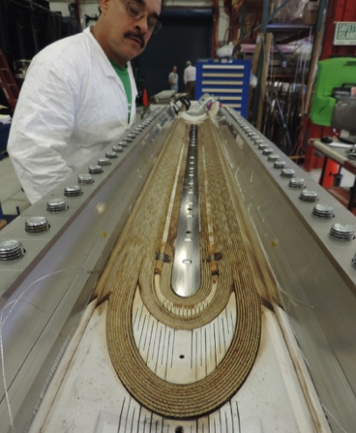
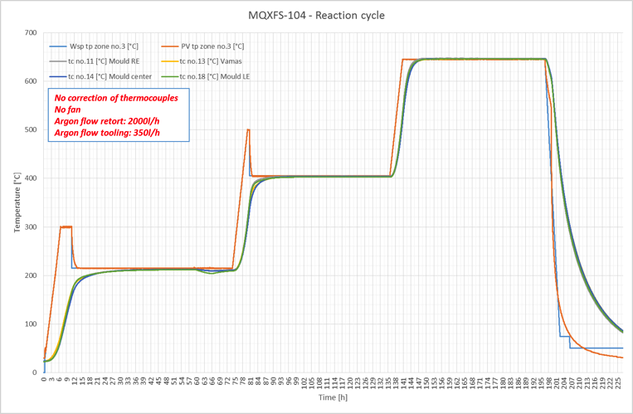
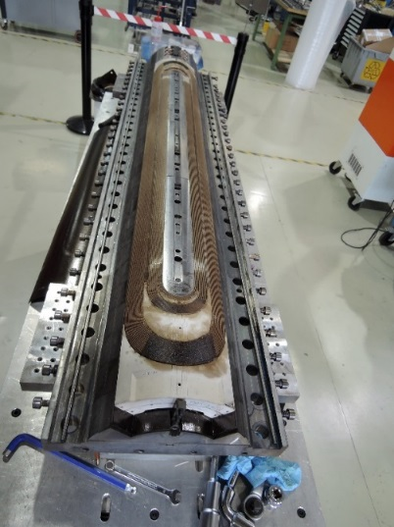
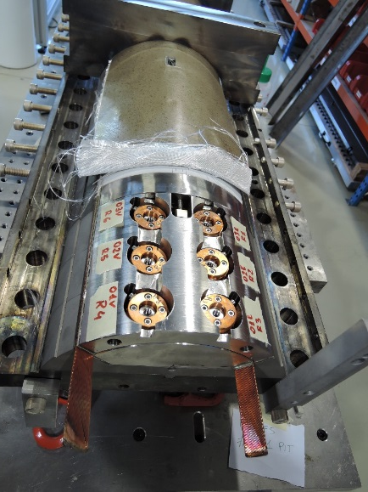
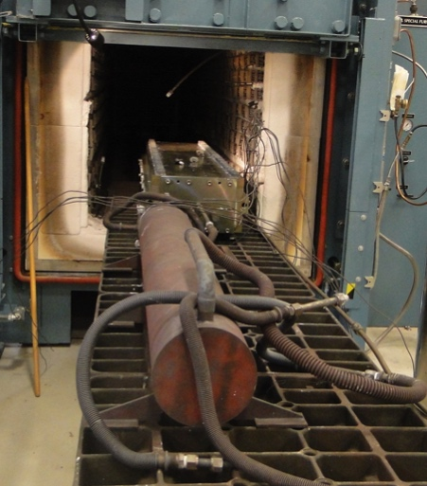
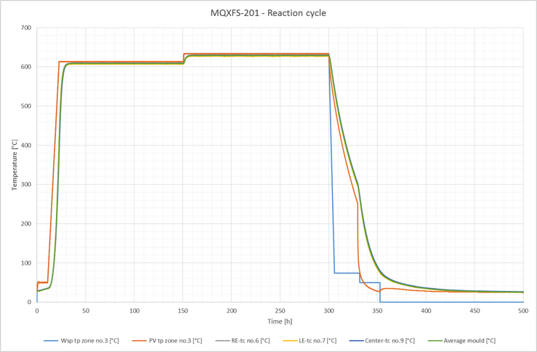
Heat treatment
Heat treatment using Ar flow
Duration is determined by time within ±5°C
All Zones measured to ±3°C
Cycle for RRP cables:
Ramp 25°C/h, hold 48h/210°C
Ramp 50°C/h, hold 48h/400°C
Ramp 50°C/h, hold 50h/640°C
Reaction cycle for PIT cables:
Ramp 50°C/h, hold 120h/610°C
Ramp 50°C/h, hold 140h/630°C
From coil 201, a new vamas box has been used, to have the vamas inside the reaction mould during the heat treatment.
Furnace, Tooling, and Witness sample retort at FNAL

Slide 10
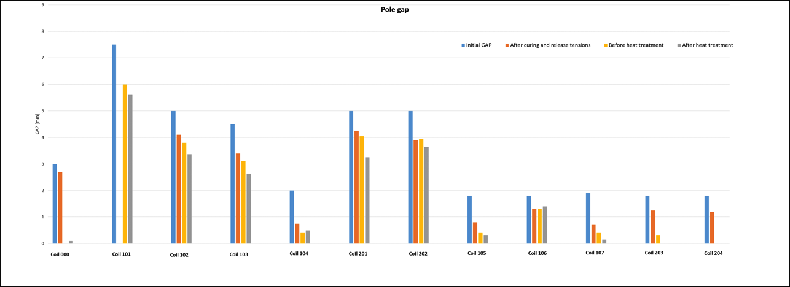
Pole gap measurements
1st generation coils
Release of the winding tension: 1 – 1.6 mm
Heat treatment
  0-0.5 mm for CERN coils
  1-2 mm for LARP coils

Slide 11
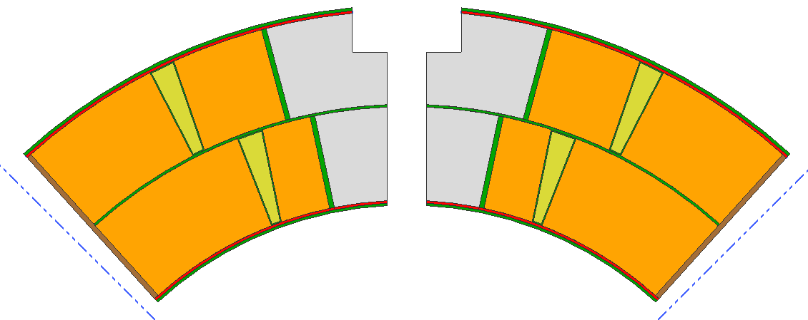
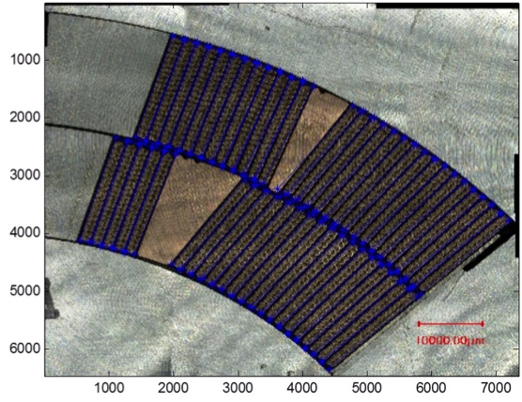
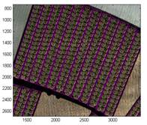
Accommodating expansion
Nb₃Sn Cable expands laterally when heat treated.
Nb₃Sn Cable contracts axially when heat treated.
Room is left in coil cavity for cable to expand.
Gaps are left in the pole to allow coil to contract.
Azimuthal:
4.5% expansion allowed
Measured: 3.0 ± 0.3%
Coil Contraction During Heat Treatment
Radial:
2% → 1.2% allowed expansion
Free Cable 1.4%
LARP Cable 0.3%
CERN Cable 0.1%
0.03%
CERN
0.17%
LARP
Measurements on a cross section slice by image analysis
Courtesy of S. Izqierdo Bermudez

Slide 12
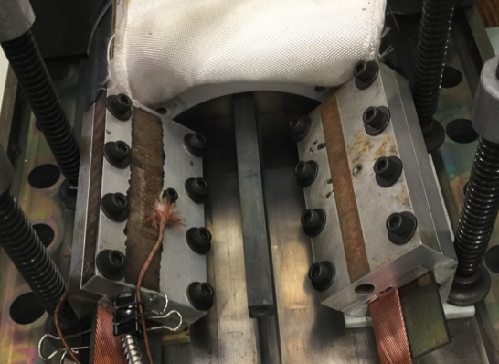
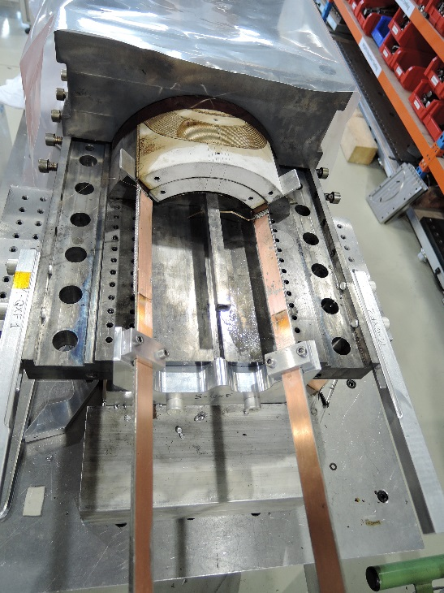
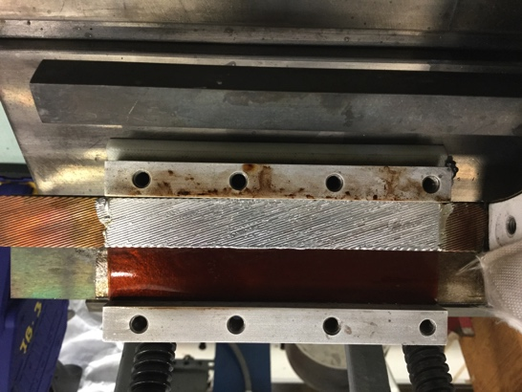
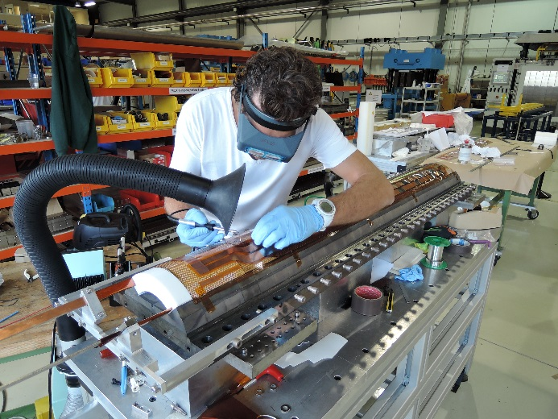
Splicing
Non-Activated MOB 39 Flux
96/4, Tin/Silver Solder
Pre-Tinned at 260°C
2 NbTi leads on LARP coils
1 NbTi lead and 2 mm copper stabilizer on CERN coils
<1 nOhm resistance in MQXFS1a
(Preliminary measurement)
Coil # | Splice R (nOhm)
3 | 0.29
5 | 0.29 / 0.35
103 | 0.15
105 | 0.10

Slide 13
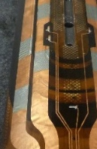
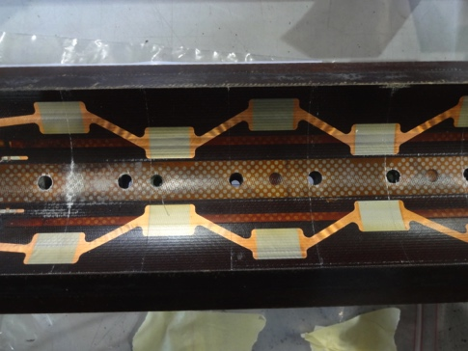
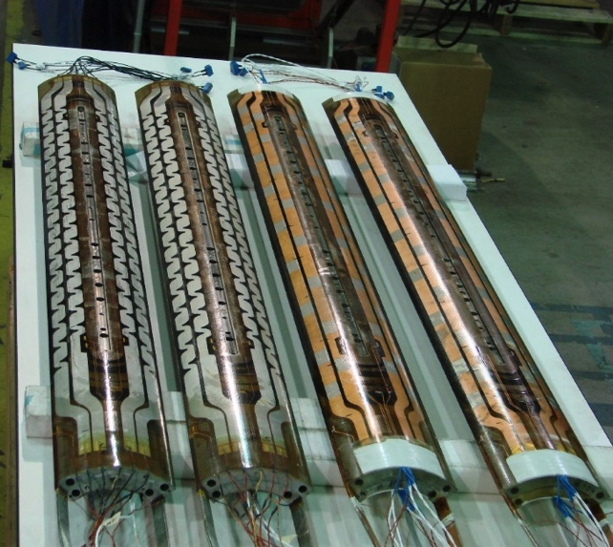
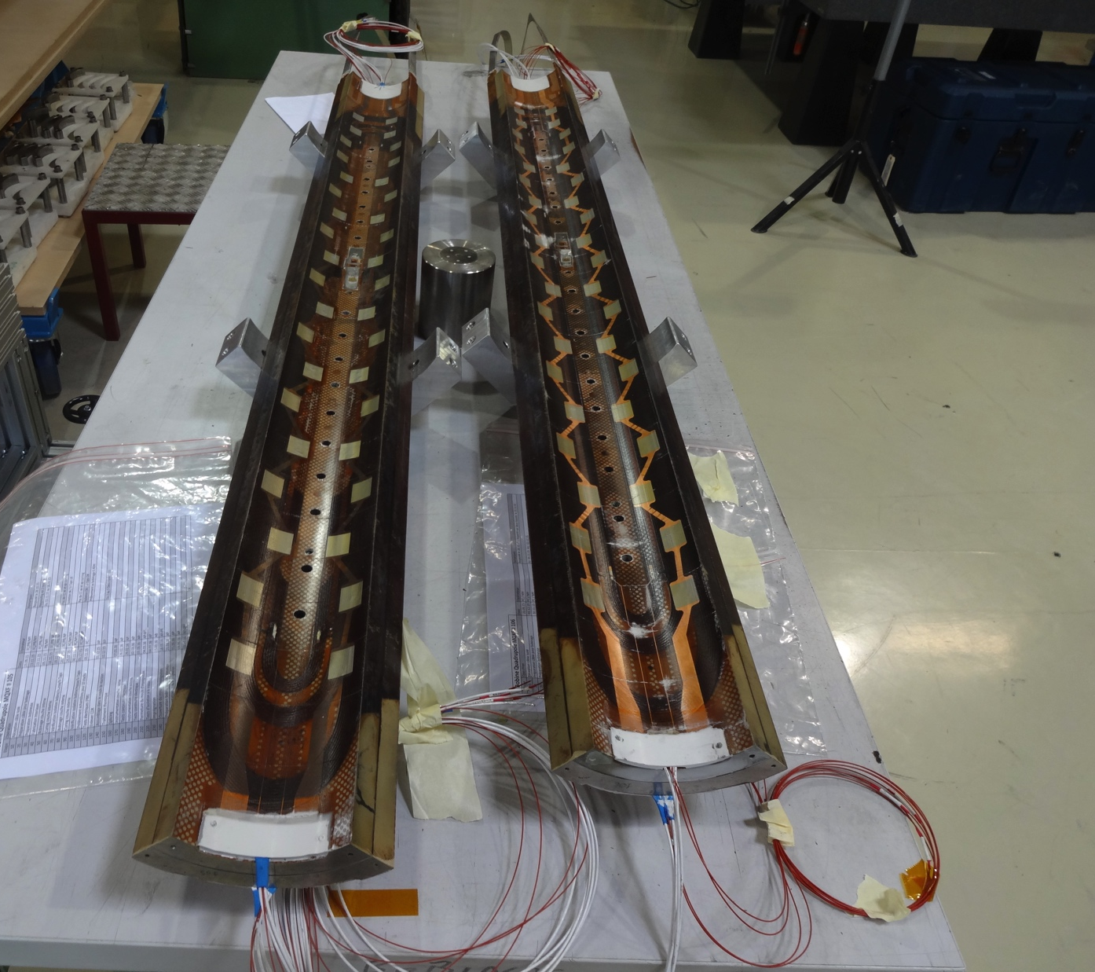
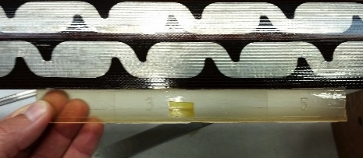
Quench heaters
Quench heaters produced at CERN
Inner and outer layer are equipped with QH circuits
2 different geometries for external QH (detailed comparative QH efficiency study to be performed during next MQXFS1b cold powering test)
Outer layer CERN design
Inner layer design
Outer layer LARP design
MQXFS1 coils ready for assembly

Slide 14
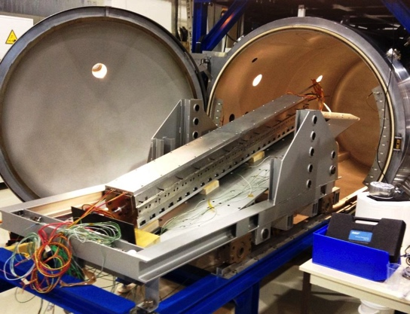
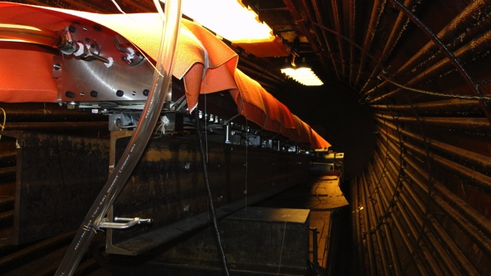
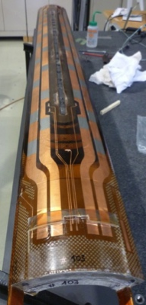
Impregnation
 | FNAL | BNL | CERN
CTD-101k density = 1.03 g/cc | CTD-101k | CTD-101k | CTD-101k
SETUP
Dryout Gas flow | none | none | N₂ (before bakeout)
Bakeout temperature | 110°C | 110°C | 60°C
Bakeout pressure | 25 mTorr | 200 - 500 mTorr | ~ 1 mTorr
Bakeout time | 10 hrs | 8 hrs | ≥ 48 hrs
Cool down temperature | 55°C | 55°C | ~55°C
Coil Orientation | ~13° wrt horiz. | Vertical | 16° wrt horiz.
EPOXY DEGAS
Parts preparation | PREHEAT parts A & B to 50°C overnight (separate)
Epoxy Volume mixed (1.7 l needed) | 22 liters (6 gal.) |  |  | 6 liters
Epoxy degas time | 45 min | 2 h |  | 1 - 1.5 hrs
Epoxy Vacuum while agitating | 800 mTorr | 500 mTorr |  | ~400 mTorr
Epoxy container depth | ~45 cm | ~8 cm |  | ~10 cm
IMPREGNATION
VPI vacuum vessel pressure | 20 mTorr | 500 mTorr |  | 0.75 mTorr
Feed method | Peristaltic pump | Peristaltic pump/ΔP |  | press diff. plus 2.5m hydrostatic
Flow measure method | pump output | pump output |  | Mass flow meter (6 mm ID tube)
Epoxy flow rate | 20 cc/min | 25 cc/min |  | 30-45 cc/min (2-3 kg/h)
Fill time (short coil) | 1.5 h - 2 h | 2 h |  | 25 min (1.5 h total to fill reservoir)
Gel / Soak
Additional Epoxy Through Flow | 30 min | none |  | 1-1.2 hour
Press/Vac cycles | none | none |  | 1 cycle to 10 mTorr over 4h
Soak/Gel time @ 50°C - 60°C | 18 h | 16 h |  | 4 hours
CURE
VPI Vessel Pressure | 760 Torr | 500 mTorr |  | 760 Torr
Coil Back pressure | 760 Torr | 760 Torr |  | 760 Torr
Initial Ramp | 60°C - 110°C (1.5 h) | 55°C - 110°C (6 h) |  | 55°C - 110°C (4 h)
Soak | 110°C (5 h) | 110°C (5 h) |  | 110°C (6 h)
Ramp | 110°C - 125°C (1 h) | 110°C - 125°C (1.5 h) |  | 110°C - 125°C (1 h)
Soak | 125°C (16 h) | 125°C (16 h) |  | 125°C (16 h)
Impregnation main parameters
CTD 101 K epoxy resin
Bakeout temperature 60⁰ C (CERN) / 110⁰ C (LARP)
Resin injection at 60⁰ C
Gel time 60⁰ C - 110⁰ C for 4 h (CERN) and 6 h (LARP)
Curing 110⁰ C 6 h (CERN) and 5 h (LARP)
Post-curing 125⁰ C for 16 h

Slide 15
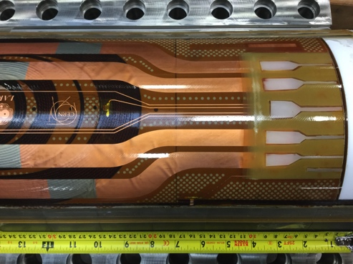
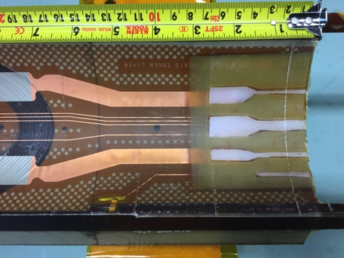
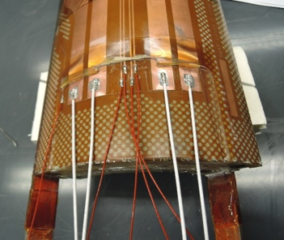
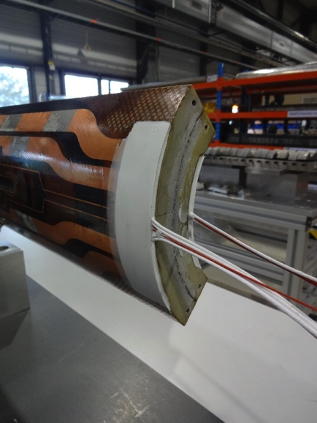
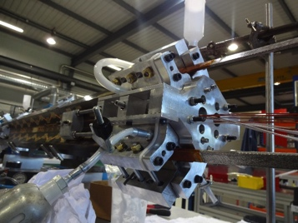
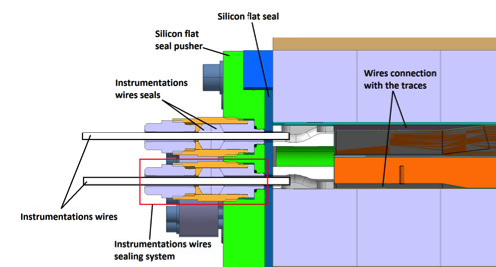
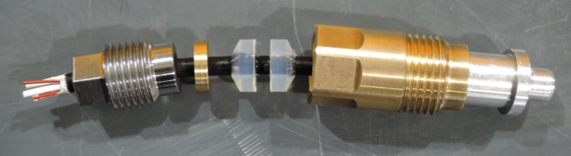
Post-instrumentation
At CERN Quench Heaters and Vtaps wires are soldered to the pads on the trace
  Soldering alloy Sn96Ag4, flux material MOB 39
  Impregnation of end parts with Eccobond
At LARP G-10 sheets and Nylon Fillers are used at coil ends during impregnation process
Quench heaters and Vtaps wires are then soldered to the pads on the trace
Remaining channels are filled with green-putty
New mold end-plate configuration under development at CERN to avoid post-impregnation operation

Slide 16
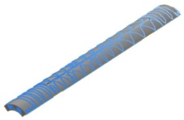
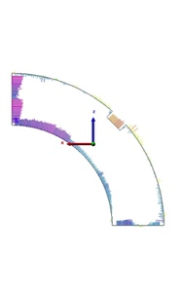
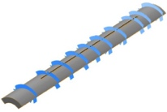

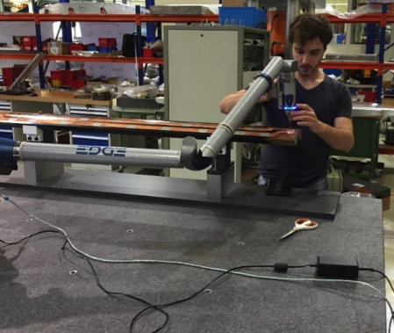
Coil metrology
Measurements performed with CMM Portable Arm (Faro Arm Edge 2.7)
Faro arm measurements results have been compared w.r.t CERN metrology laboratory with good agreement
Data produced by fitting individual cross sections to the nominal OD and Keyway and used to define coil shimming for magnet assembly
MQXFS coils tend to have little asymmetry (keyway shift) but significant size variation (L+R mid-plane deviation)
Coils Reacted and Impregnated with same tooling produce similar coil size and shape
The mid-plane deviation differences between MQXFS1a coils (103, 104, 3, 5) required additional outer diameter shimming for coils 103 and 104.
Coils 2, 6 at FNAL
Coils 3, 5 at BNL
Coils 103, 104 at CERN

Slide 17
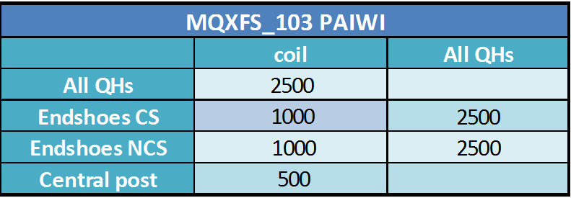
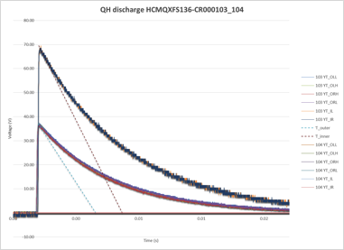
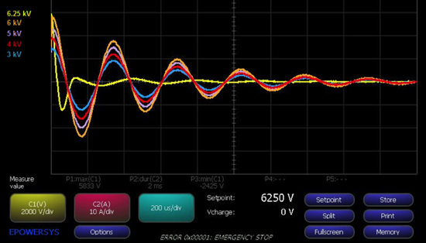
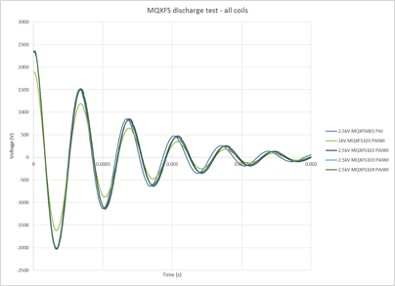
Electrical tests
Electrical tests are performed at different steps during coil fabrication process:
  Resistance & Inductance(100 Hz & 1 kHz)
  Dielectric measurements
  Coil discharge
  Quench Heaters discharge (80 A)
Main reference values for electrical tests
applied during model fabrication
Future tests level requirement from HVWL
(under discussion)
Coils 001 and 101 have been used to check electrical integrity limits.
Circuit element | V HiPot (kV) /_{30s} | I HiPot (μA)
Coil/Ground at RT | 3 | 10
Coil/QH RT | 4.6 | 10
Coil/Ground @ cold | 1.5 | 10
Coil/QH @ cold | 2.3 | 10
Breakdown voltage coil # 001~ 3.5 kV
Breakdown voltage coil #101~ 6.25 kV

Slide 18
Electrical tests results
Coil # | Impulse test kV | HiPot Coil/Pole kV | HiPot Coil/Sad. kV | HiPot Coil/QH kV | HiPot QH/Sad. kV
1a | 2.5 | ≈ 1.5 short | 1 | 2.5 | 2.5 | LARP practice coil. No heaters
1b | 5 | 3 - 3.3 | 5 | - | - | For mirror magnet
1 | 4.6 – 4.7 | 0.5 | 1.2 | 3 - 4 | 1 | Practice coil
2 | 2 | ≈ 0.39 short | 1 | 2.5 | 2.5 | For mirror
3 | 2 | 0.5 | 1 | 2.5 | 2.5
5 | 2 | 0.5 | 1 | 2.5 | 2.5
6 | 2 | 0.5 | 1 | 2.5 | 2.5
001 | 3.5 | 0.5 | Not applicable | 4 | 2 | CERN Cu coil. Not final saddles
101 | 6.5 | 0.5 | Not applicable | 5 | 2 | Not final saddles
102 | 2.5 | 0.5 | Short NCS | 2.5 | Short NCS | Nb₃Sn/NbTi splice issue
103 | 2.5 | 0.5 | 1 | 2.5 | 2.5
104 | 2.5 | 0.5 | 1 | 2.5 | 2.5
201 | 2.5 | 0.5 | 1 | 2.5 | 2.5
202 | 2.5 | 0.5 | 1 | 2.5 | 2.5

Slide 19




MQXFS mechanical structures
Initial structures design with thick laminations
Laminated structure design for series production

Slide 20


MQXFS Structures: Brief reminder
MQXFD0 and D1:
2 full mechanical structures with a 2 shells configuration have been produced and characterized using aluminum dummy coils
MQXFD0 assembled and tested at CERN @ 77 K with instrumented aluminum dummy coils
MQXFD1 tested at LBNL with a 3 shells configuration and then used for MQXFS1 assembly
MQXFD2:
Built from initial MQXFD0 structure components but equipped with 3 aluminum shells instead of 2 for coil pre-stress optimization. Tested at CERN at 77 K using dummy Al coils.
Second series of 77 K tests for coil pack assembly simulation for laminated structure design to be used on long magnets

Slide 21




MQXFD3 & D4 Structures
MQXFSD3 and D4:
2 structures produced to validate the laminated structure concept, for parts fabrication cost reduction in view of series magnets production
MQXFD3 equipped with aluminum dummy coils of MQXFD2 will be tested at CERN @ 77K Q2-2016
MQXFD4 has been shipped to LBNL and will be used for MQXFS4 assembly (Al shells and collars missing)
2 full mechanical structures are available at CERN

Slide 22










Mechanical structure characterisation
Structures MQXFD0,1, 2 and 3 equipped with aluminium dummy coils have been used to characterize structures mechanical properties at 300 K and at 77 K
  6 loadings performed
  11 thermal cycles
A 150 mm mock-up has been build to complete mechanical characterisation
  Short turn-over
  Equipped with real coil segments
  6 loadings
  10 thermal cycles
Test in SM18
See detailed presentation by G. Vallone

Slide 23



MQXFS1
Test at FNAL completed
Ultimate reached both at 1.9 K and 4.5 K
Reached 85% of current limits at 1.9 K and 93% at 4.5 K
  Significant margin confirmed by ramp-rate
Full memory
8 hours at ultimate without quenches
By G. Ghlachidzel
MQXFS1b to be tested Q3-2016 with increased pre-load (+ ≈ 30 MPa)
See detailed presentation by L. Sabbi

Slide 24
MQXFS2 & MQXFS3 assembly plan
MQXFS2 will be used to test “non-conformity coils” of first generation cable
MQXFS2 will be assembled using:
  Coil #102: RRP. Issue in the Nb₃Sn/NbTi splice area
  Coil #201: CERN PIT. High Ic and RRR degradation during cabling operation
  Coil #202: due to problems during setting the cabling machine
  Coil #6 RRP. Virgin coil
  Coil #2 RRP. Already tested in a mirror configuration. Will be kept ready as spare coil
Cold powering tests are foreseen in SM18 before Xmas break 2016
LARP
MQXFS3 will be used to test coils produced with second generation cable
MQXFS3 will be assembled using:
  Coil #105
  Coil #106 CERN Coils
  Coil #107
  Coil #7 from LARP
Magnet assembly to be completed by end of July 2016.
Cold powering tests foreseen in SM18 during summer 2016

Slide 25
Short model magnet test program
Magnet | Coils | Cold test | Remarks
Mirror | 2 | Q2-2015 | Single coil test in mirror configuration
MQXFS1 | 3 / 5 / 103 / 104 | Q1-2016 | Cold test at FNAL
MQXFS1b | 3 / 5 / 103 / 104 | Q3-2016 | Increased pre-load. Test @ FNAL
MQXFS1c | 3 / 5 / 103 / 104 | Q4-2016 | SS welding validation. Test @ FNAL
MQXFS2 | 101 / 201 / 202 / 6 | Q4-2016 | Test of non conformity coils
MQXFS2b | 101 / 201 / 202 / 6 | Q2-2017 | SS welding validation @ CERN
MQXFS3 | 2nd gen. 105 / 106 /107 / 7 | Q3-2016 | Second generation cable design
MQXF4 | 2nd gen. LARP coils TBD | Q1-2018 | Second generation cable RRP LARP
MQXF5 | PIT 2nd gen. CERN TBD | Q1-2017 | Second generation cable PIT CERN

Slide 26
Summary
17 MQXFS coils completed and 3 coils in progress (including practise coils)
Braiding insulation process well mastered by 2 external companies
No need of changes on reaction/impregnation cavity for second generation coils
Good repetitive impregnation results
New mold end-plate configuration being validated to skip post-impregnation operation
Splices contact resistance < 1 nΩ measured at cold during MQXFS1 powering tests
Coil size and shape variation being investigated (acceptance criteria to be set)
After coil fabrication learning process, satisfactory electrical test results. Test level still to be set in view of series magnet production according to HVWL-WG requirements
MQXFS1b will be tested early summer 2016 at FNAL
MQXFS3 to be tested in September 2016 at CERN
MQXFS2 with non-conforming coils to be tested before Xmas 2016 at CERN

Slide 27
Acknowledgments
CERN
  P. Bestmann, H. Bajas, N. Bourcey, A. Carlon, M. Chamiot-Clerc, D. Cote, E. Cavanna, H. Dupond, N. Eyraud, C. Fernandes, J. Ferradas, B. Favrat, S. Izquierdo Bermudez, L. Lambert, P. Ferracin, P. Grosclaude, M. Guinchard, M. Juchno, F. Lackner, J. Mazet,
  G. Maury, N. Peray, F.O. Pincot, H. Prin, E. Rochepault, T. Sahner, E. Todesco, G. Vallone, R. Van Weelderen, and many others …
BNL
  M. Anerella, A. Ghosh, J. Schmalzle, P. Wanderer
FNAL
  G. Ambrosio, R. Bossert, G. Chlachidze, L. Cooley, E. Holik, S. Krave, F. Nobrega, M. Yu, C. Santini
LBNL
  D. Cheng, D.R. Dietderich, H. Felice, R. Hafalia, M. Marchevsky, H. Pan, I. Pong, G.L. Sabbi, X. Wang

Slide 28

Thank you for your attention !

Slide 29
Back-up slides

Slide 30


Why does braided-on insulation affect cable growth?
Substantial pressure applied during HT!!!
Braided-on insulation is in intimate contact with cable
Thermal expansion of S2-Glass<< Cu,Nb + Vol. expansion
Modulus/Tensile strength of S2-Glass >>Cu, Nb
CERN has fewer carriers
  Steep Pitch Angle
  Preferentially constrict width growth
  Reduces length contraction
LARP has more carriers
  Less Constriction
  More growth
  More length contraction
Tight Braid
Free space in the reaction cavity adapted for 2nd generation coils by increasing S2-Glass insulation thickness
Courtesy of Trey Holik

Slide 31


Slide 32


Coil #107
After the impregnation, there is a short-circuit between the pole and the cable.
Some issues arose during fabrication, which might have lead to this inconvenient:
The poles of 2nd generation coils have a hole (for cooling) in the location reserved to the strain gauge (inner central pole).
Two pins are usually placed in the holes near this location, to restore the missing material around the strain gauge.
One of the pole pieces has been misaligned (some tenth of mm) while doing this operation.
It was then re-aligned.

Slide 33




Coil #107
While closing the impregnation mould, there was a short-circuit between mould and cable.
The mould was re-opened and a metal chip was found between two turns (probably a residual of soldering alloy).
After its removal and the further closure of the mould, the short-circuit disappeared.
After impregnation, there is again a short-circuit between the pole and the conductor.
Another object was found between pole and first turn on the inner layer.
After its removal, there is still the short circuit.

