Slide 1

Mirror and Short model tests and quench performance
GianLuca Sabbi
MQXF International Review – CERN, June 7th – 10th, 2016

Slide 2
Presentation Goals and Outline
Purpose of this presentation is to provide an overview of the tested configurations, their objectives, and their quench performance
  Following talks will present in more detail the mechanical, quench protection and field quality measurements and analysis
Outline:
Short Model Assembly and Test Timeline
MQXFSM1 Mirror Design and Fabrication
  Mirror structure, conductor and assembly parameters
MQXFSM1 Test Results
  Training and temperature dependence
MQXFS1 Quadrupole Design Features and Parameters
  Conductor, coil, assembly, protection and instrumentation
MQXFS1 Test
  Training, ramp rate and temperature dependence
Summary and next steps

Slide 3
Short Model Assembly and Test Timeline
MQXFSM1 (mirror magnet)
  Using LARP coil #2 to get feedback as early as possible
  Magnet assembly completed in March 2015
  New high current, 1.9K header commissioned at Fermilab VMTF in April 2015
  Mirror magnet test carried out in May 2015
MQXFS1 (quadrupole short model)
  Using two CERN coils and two US coils, again for earliest possible feedback
  Assembly completed in October 2015 with a conservative choice of the pre-load
    After assessing potential risk due to incident in early stages of assembly
  A first attempt to test the magnet in November 2015 was interrupted during initial check-outs, due to undetected lead quench causing damage to the NbTi leads
  Performed first test in February-March 2016, after completing the facility repairs
  Full thermal cycle and test in April 2016
Next step: re-test as MQXFS1b with increased pre-load

Slide 4
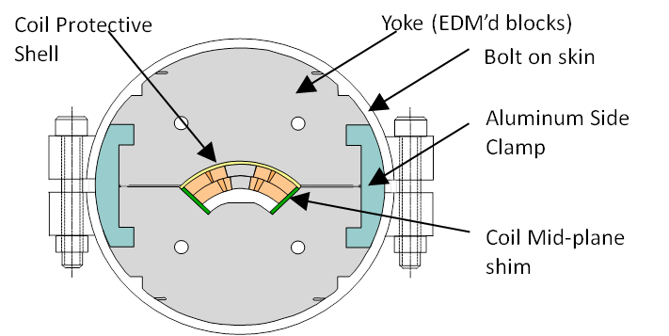
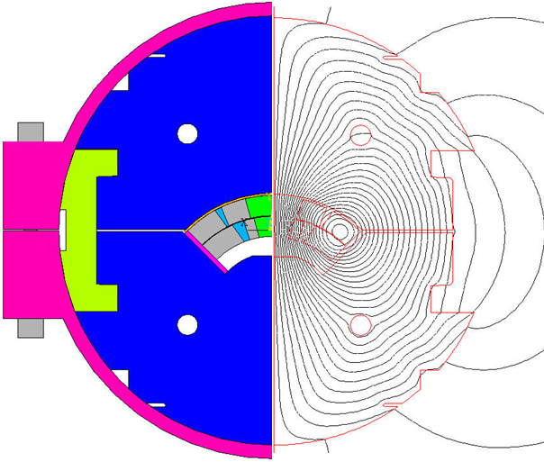
Mirror Test Objectives and Features
Magnetic mirror structure allows standalone testing of coils
  Developed by FNAL GARD and used extensively by LARP
Provides early feedback on cable and coil design/fabrication
  Main driver is single coil requirement, not faster assembly/test
Useful at the start of a new series, or to check design/processing variants
  Strength: demonstrated capability to achieve conductor limit
  Weakness: generally slow training (but: faster quench recovery due to lower stored energy)
  Note: some results not representative of quadrupole layout (e.g. ramp rate dependence)
A key step in the development of both short and long coils
R. Bossert

Slide 5
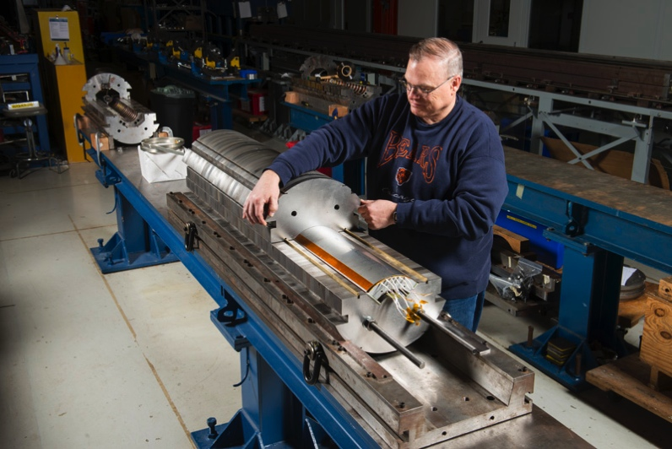
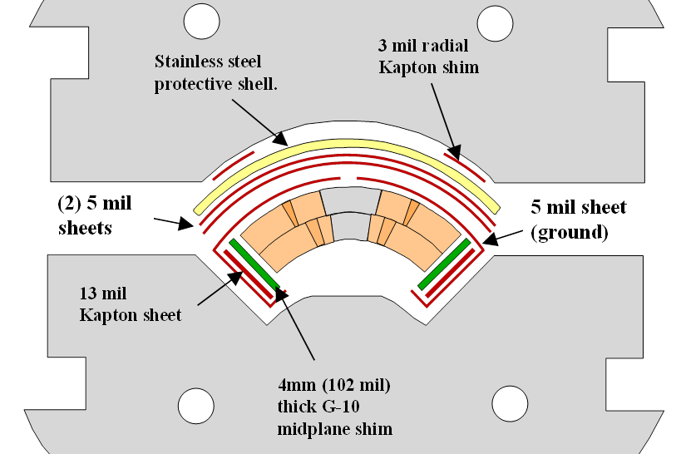
MQXFSM1 Coil and Assembly Parameters
Conductor and short sample parameters
LARP Coil #2 assembled in mirror structure
Parameter | Unit | Value
Alloy |  | (Nb-7.5w%Ta)₃Sn
Sub-element layout |  | 108/127
Non-Cu fraction | % | 43.6
Number of strands |  | 40
Cable Width | mm | 18.094
Cable Mid-Thickness | mm | 1.529
Keystone angle | Deg. | 0.52
Cable Twist pitch | mm | 109
Core material |  | 316 SS
Cable insulation |  | AGY-S2-Glass Braid
I_{ss} at 1.9K (4.5K) | kA | 21.1 (18.7)
B_{ss} at 1.9K (4.5K) | T | 14.5 (13.2)
Shim configuration for pre-load tuning
D. Dietderich, A. Ghosh, A. Godeke, I. Pong
Pre-load target: 70 MPa (average)
Maximum coil stress (calculated):
  During assembly: 110 MPa
  After cool-down: 125 MPa
  At 18 kA: 150 MPa
R. Bossert
I. Novitski

Slide 6
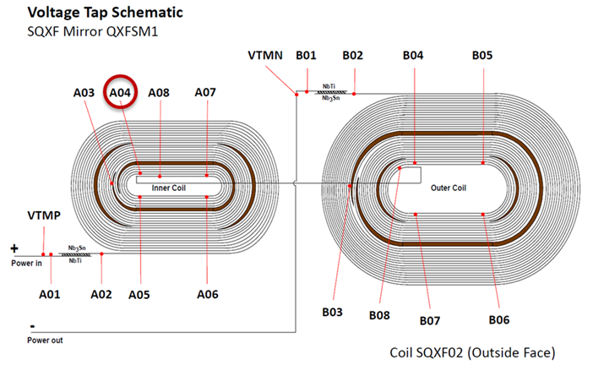
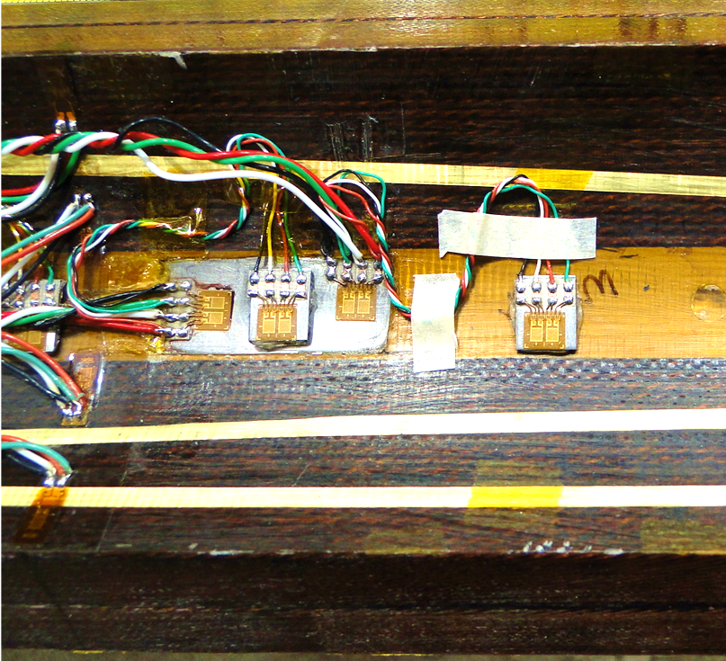
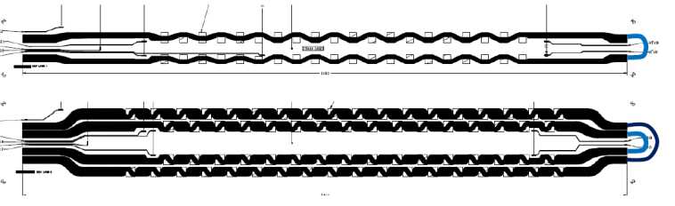
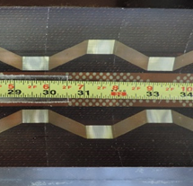
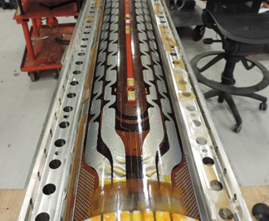
MQXFSM1 Instrumentation and Protection
Voltage taps:
7 taps/layer: pole turn, spacer, splice
Strain gauges:
1 pole (azimuthal & axial), 4 coil (assembly only)
IL heaters: copper cladded, 1 strip/half coil, in series; OL heaters: all stainless, 2 strips/half coil (HF/LF), in series
LARP Coil #2
R. Bossert, D. Cheng, G. Chlachidze, M. Marchevsky, T. Salmi, T. Strauss

Slide 7
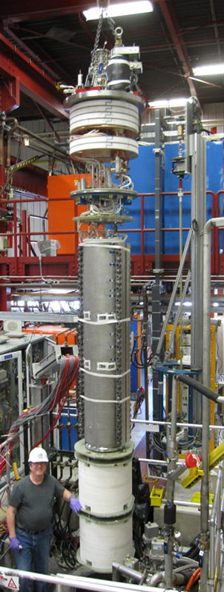
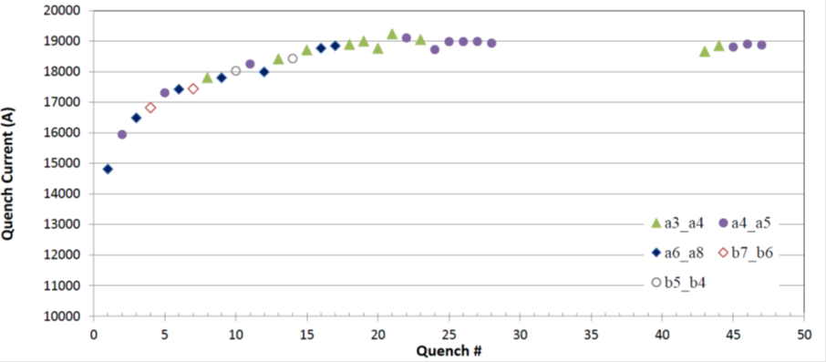
MQXFSM1 Quench Performance
Tested at FNAL VMTF using new header designed for MQXF
First quench 70% of SSL; reached plateau at about 90% of SSL after ~20 quenches (I_{max}=19.2 kA, 91.3% SSL)
  Fast quench recovery (30 min, 18 quenches in one day)
Plateau quenches appear to originate at same location near V_{tap} A04 (A03-A04 and A04-A05 segments start together)
Same current reached after ramp rate and protection studies
Protection studies
G. Chlachidze, S. Stoynev
Reference: LARP MQXFSM1 (Mirror) Magnet Test Summary, http://larpdocs.fnal.gov//LARP-public/DocDB/ShowDocument?docid=1087

Slide 8
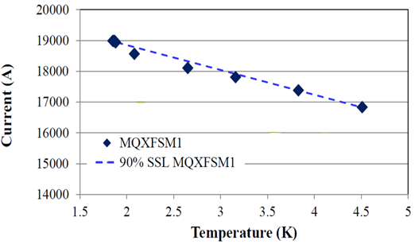
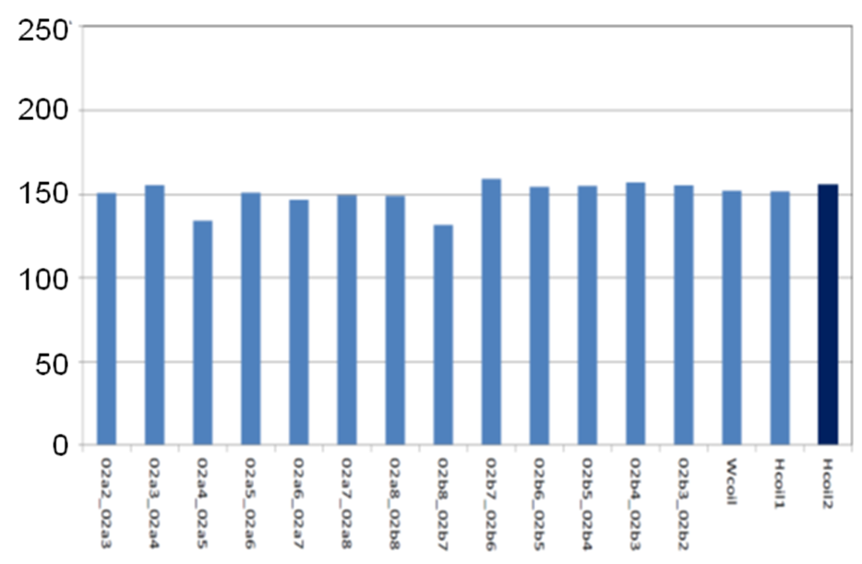
Temperature dependence and RRR
Temperature dependence is consistent with a conductor-limited quench origin
  Higher strain sensitivity of Ta-doped RRP conductor used in mirror coil may have been a contributing factor to local degradation
  Improved strain sensitivity using Ti-ternary RRP and higher heat treatment temperature
Quench current does not decrease significantly with ramp rate, however this result cannot be directly extended to the quadrupole
Coil RRR ~150 is consistent with average of short sample measurements (which have relatively large spread 82-282), and shows good uniformity among segments
Splice resistance: 1.71 nΩ (inner), 1.14 nΩ (outer)
G. Chlachidze, S. Stoynev
Quench Current vs. Temperature
Coil segment RRR
Reference: LARP MQXFSM1 (Mirror) Magnet Test Summary, http://larpdocs.fnal.gov//LARP-public/DocDB/ShowDocument?docid=1087

Slide 9
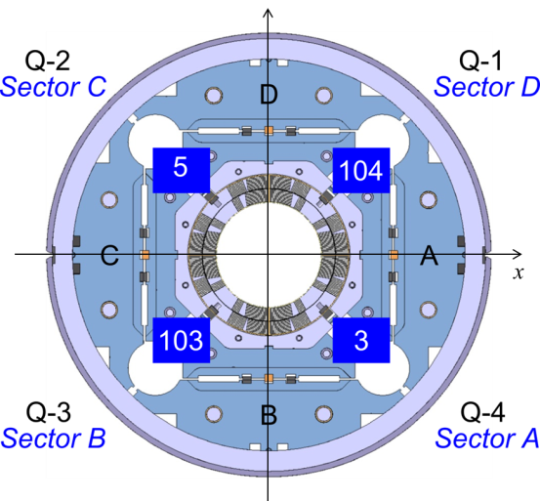
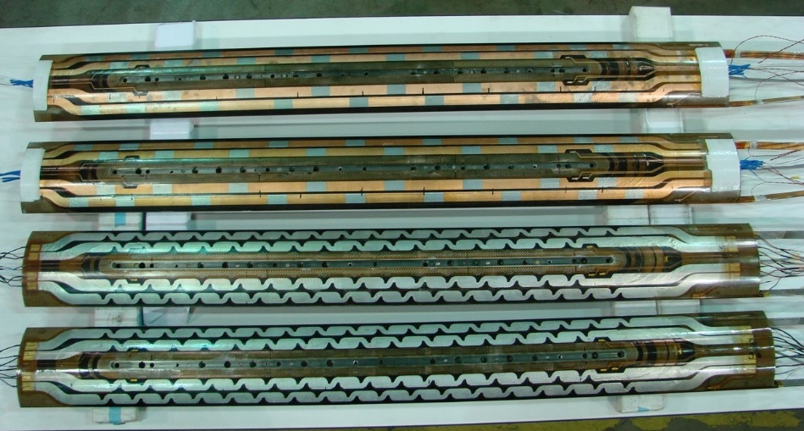
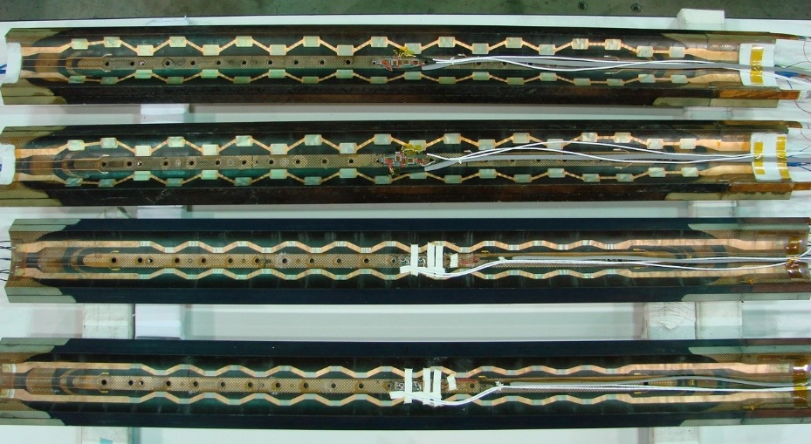
MQXFS1 Quadrupole
First-generation cable and coil design (larger keystone angle)
Two coils from CERN and two from LARP
  CERN (#103 and #104) – RRP 132/169
  LARP (#3 and #5) – RRP 108/127
Magnetic length 1.2 m, Coil length 1.5m
Reference: MQXFS1 Design Report,
http://larpdocs.fnal.gov//LARP-public/DocDB/ShowDocument?docid=1074
MQXFS1 Coils: Outer Layer
MQXFS1 Coils: Inner Layer
CERN 103 & 104
CERN 103 & 104
LARP 3 & 5
LARP 3 & 5
D. Cheng, J. Schmalzle, J.C. Perez, M. Yu et al.

Slide 10
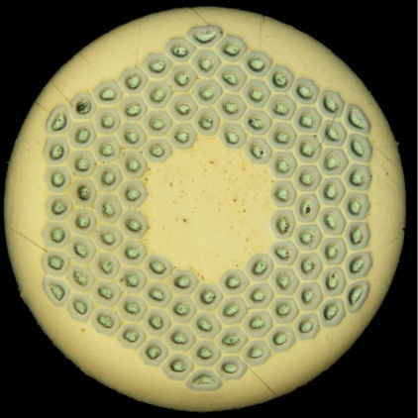
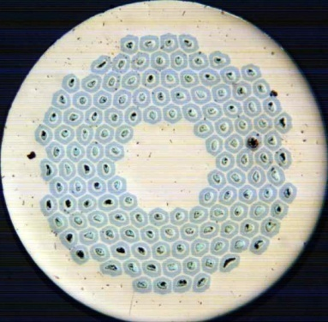
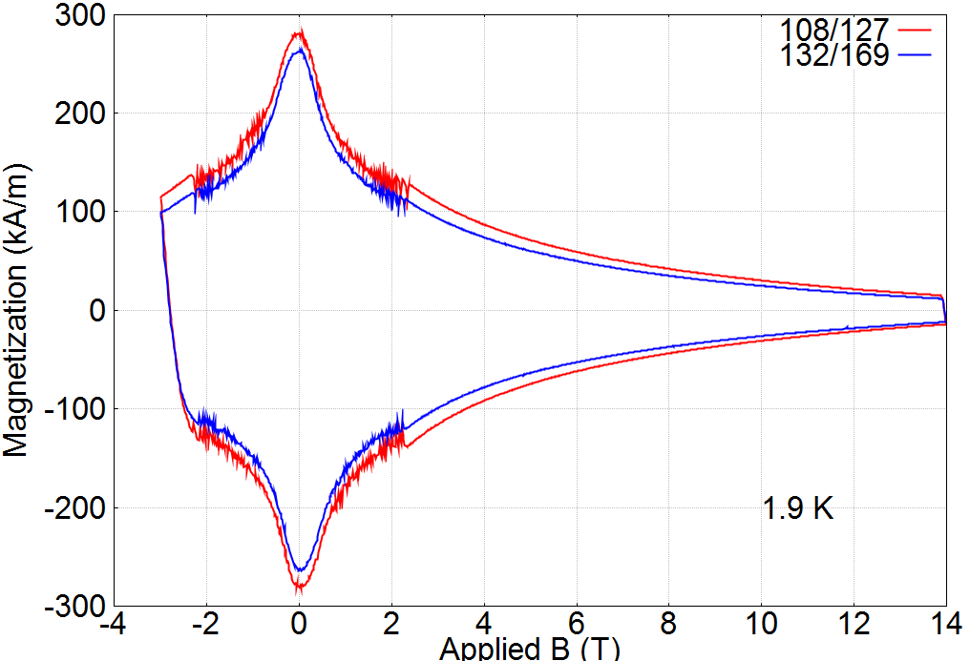

MQXFS1 Conductor and Cable
RRP 108/127
RRP 132/169
Magnetization loops
Note: measurements are from generic wires (not MQXFS1)
1.9K
M. Sumption, X. Xu, X. Wang
D_{s}=55 μm in 0.85 mm wire
D_{s}=50 μm in 0.85 mm wire
Coil Reaction schedules
Cable Parameters
Coil # | Temp 1 [°C] | Soak 1 [h] | Temp 2 [°C] | Soak 2 [h] | Temp 3 [°C] | Soak 3 [h]
3 | 210 | 72 | 400 | 48 | 637 | 48
5 | 211 | 72 | 401 | 48 | 641 | 48
103 | 210 | 47 | 400 | 51 | 639 | 52
104 | 209 | 53 | 400 | 49 | 640 | 50
Width | mm | 18.094
Mid-Thickness | mm | 1.529
Keystone angle | Deg. | 0.52
Twist pitch | mm | 109
Number of strands |  | 40
Core material |  | 316 SS
B. Bordini, L. Cooley, D. Dietderich, A. Ghosh

Slide 11
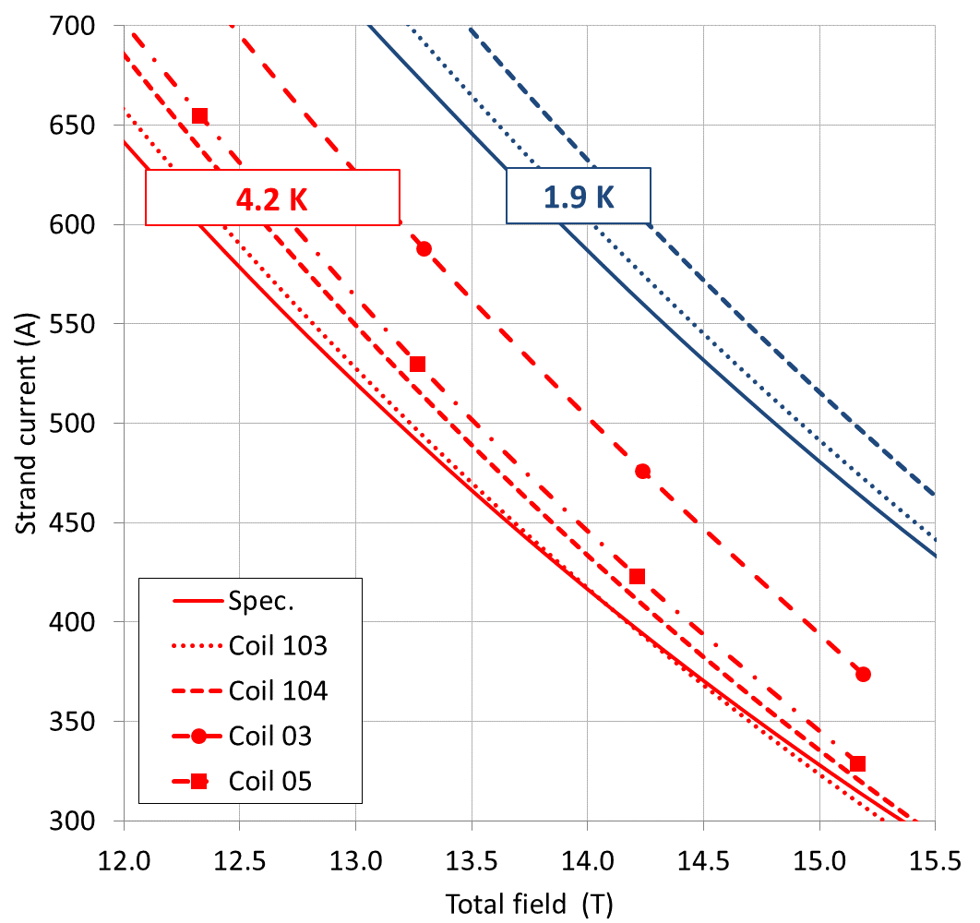
Short Sample and Reference Current Levels
Parameter | Current | Field | Gradient | I_{nom}/I_{ss}
Temperature | 1.9 K | 1.9 K | 1.9 K | 1.9 K
Unit | kA | T | T/m | %
Coil 103 | 21.50 | 14.6 | 169.08 | 77
Coil 104 | 21.78 | 14.77 | 171.03 | 76
Coil 3 | 22.28 | 15.08 | 174.57 | 74
Coil 5 | 21.85 | 14.81 | 171.52 | 75
Current [kA] | Symbol | Gradient [T/m] | Remarks
0.01 | I.warm | 0.09 | Warm measurements
0.1 | I.res | 0.9 | Reset level for pre-cycle
0.96 | I.inj | 8.5 | Injection level
6.0 | I.lim | 48.8 | Current limit (pre-training)
16.48 | I.nom | 132.6 | Nominal level
17.76 | I.ult | 143.2 | Ultimate level
21.50 | I.ssl | 171.0 | 1.9K Short Sample Limit
4.3K SSL:
Parameter | Current | Field | Gradient
Unit | kA | T | T/m
Coil 103 | 19.55 | 13.38 | 155.16
B. Bordini, A. Ghosh, P. Ferracin

Slide 12
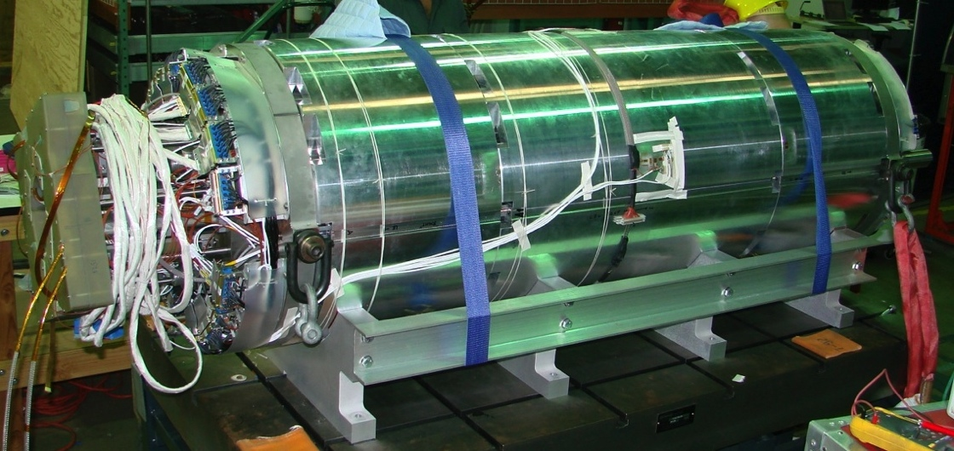
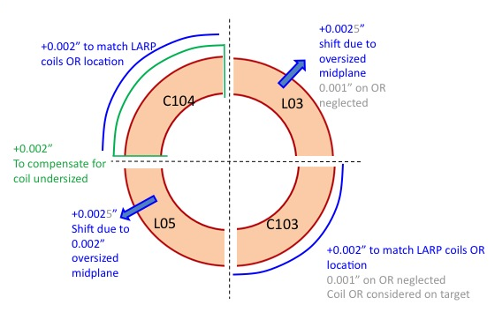
MQXFS1 Mechanical Support
Individual shimming of coils was introduced for the first time in LARP to account for size differences between coils
Mechanical structure: built as 2-shells, modified to 3-shell configuration
Coil size deviation from nominal | Azimuthal (Mid-plane) [mm] | Radial (average) [mm]
LARP Coil 3 | +50 | +25
LARP Coil 5 | +50 | ~0
CERN Coil 103 | ~0 | -25
CERN Coil 104 | [-75, -100] | - 0.050
Preload goal:
Pole turn support (light compression) up to nominal gradient
Design calculations:
Target load key interference 550 μm
Expected peak coil stress ~150 MPa both cold (pole) and I.nom (mid-plane)
D. Cheng, H. Felice, P. Ferracin, S. Izquierdo Bermudez, H. Pan, J.C. Perez, G. Vallone

Slide 13
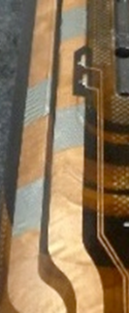
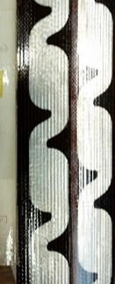
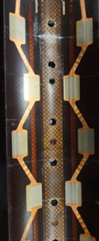
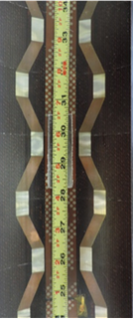
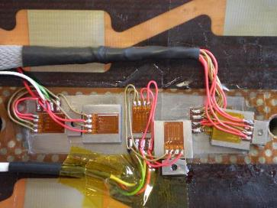
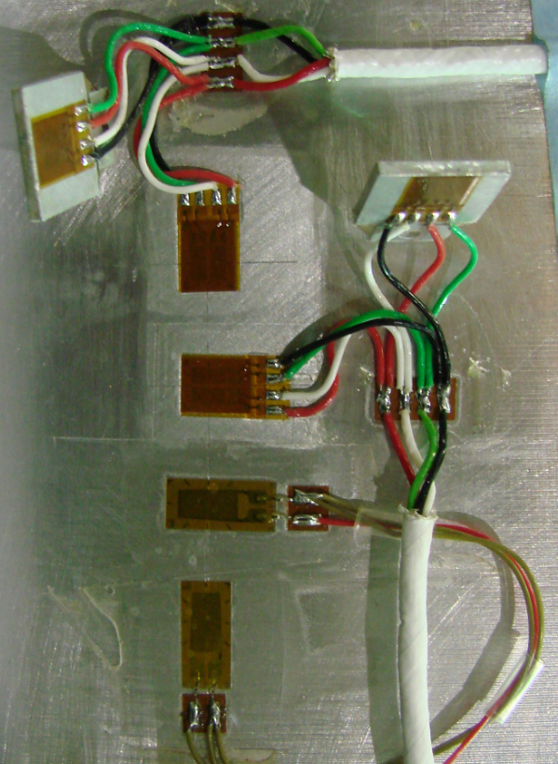
MQXFS1 Instrumentation and Protection
LARP and CERN exploring alternatives in some of the critical areas:
  Quench heaters: geometry optimization, copper cladding
  Strain gauges: full vs half bridge, DC/AC, different vendors
Voltage tap configuration is the same as the one showed for the mirror coil
New quench antenna design aimed at long quadrupoles with sparser V_{tap} coverage
Extensive dimensional and electrical QC performed at all critical stages (covered in detail by J.C. Perez and other review presentations)
CLIQ leads attached to coil-to-coil splices, allowing testing of different configurations (starting in MQXFS1b)
OL Heaters
IL Heaters
Coil Gauges
Shell Gauges
CERN
LARP
CERN
LARP
LARP
LARP
CERN
CERN
D. Cheng, S. Izquierdo Bermudez, M. Marchevsky, J.C. Perez, E. Ravaioli, T. Salmi
M. Guinchard, P. Grosclaude, D. Cheng, H. Pan, T. Strauss

Slide 14
MQXFS1 Test Goals and Strategy
Main objectives:
Measure pre-load variation during cool-down and compare with targets
Confirm the magnet electrical integrity and performance of test system
Assess any internal coil damage due to coil pack assembly incident
Confirm design calculations up to the level allowed with the available coils
Provide feedback to select the pre-load and coil configuration for next test
Strategy:
Conservative approach in view of additional tests using same coils
  Training limited to I.ult (with some margin for stable operation at I.ult)
  Quench studies and parameters organized and selected considering MIITs budget; high MIITs studies delayed until future tests
    Minimize delays (no propagation studies); maximize energy extraction; no CLIQ, etc.
Strong prioritization effort to allow faster progress toward next assembly (e.g. heater tests focused on baseline CERN design, postponed reproducibility tests)
Reference: MQXFS1 Test Plan, http://larpdocs.fnal.gov//LARP-public/DocDB/ShowDocument?docid=1079

Slide 15
MQXFS1 Quench Training
G. Chlachidze, S. Stoynev
Surpassed I.nom after 8 quenches and I.ult after 16 quenches
Highest quench: 18.1 kA, 145 T/m, B_{max} 12.5 T, 84.2% of SSL
At 4.5K the highest quench level was fully retained: 92.6% SSL

Slide 16
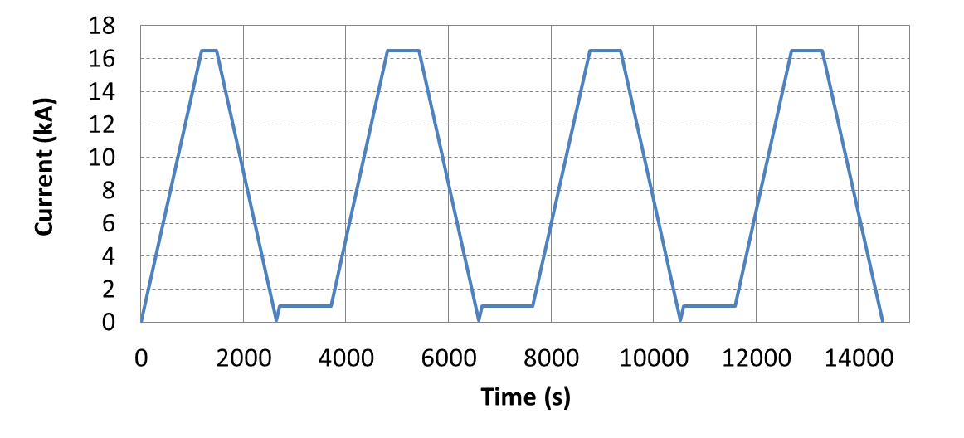
Thermal Cycle, Ramp Rate, Accelerator Profiles
Training memory:
First quench after thermal cycle was at maximum level achieved during first TC
Ramp rate:
Above I.ult up to 300 A/s
No quench on 300 A/s down-ramp from I.ult
Confirms effectiveness of cored cable
Accelerator profiles:
Several accelerator cycles including pre-cycle and 2-3 ramps to I.nom or I.ult were performed during both TC1 and TC2
High current operation:
Capability of maintain the operating level over an extended period of time was demonstrated in both thermal cycles
  TC1: 8 hours at I.nom
  TC2: 8 hours at I.ult
Ramp Rate Dependence
G. Chlachidze, S. Stoynev
Accelerator Cycle to I.nom

Slide 17
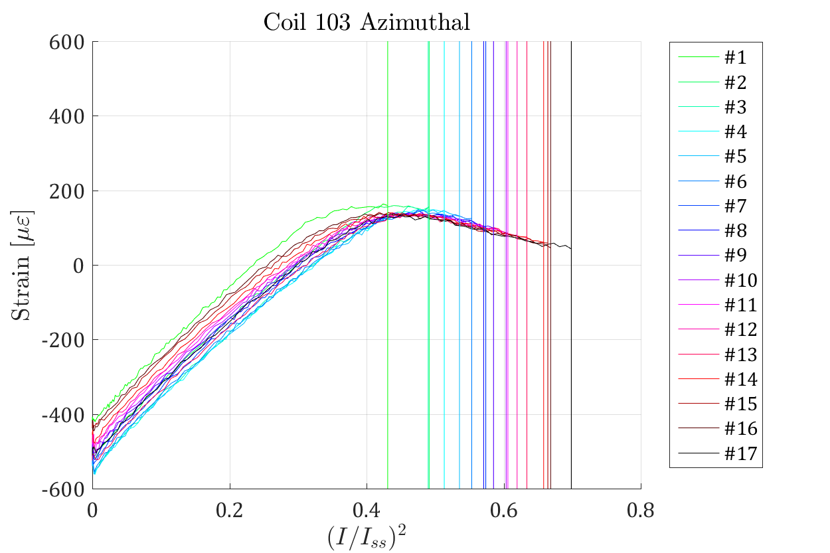
Quench Analysis
Quench locations:
Quenches observed in all coils and distributed over many locations in the high field areas
  About 50% in coil 103 (both lower margin and earlier unloading)
Some quenches in end regions and layer ramp
Strain gauges: [G. Vallone presentation]
Preload increase during cool-down lower than expected
During excitation, deviation from linear behavior starts at about 65% of SSL
H. Pan, T. Strauss,
G. Vallone
G. Chlachidze, S. Stoynev
Strain gauges, distribution of quench locations, and quench level independent of temperature consistently indicate low pre-load as the main limiting factor
No indication of coil performance degradation up to the quench level achieved

Slide 18
RRR and Splice Resistance
RRR measured in different segments shows good uniformity along each coil
Significant difference between 108/127 and 132/169 conductors
  Also observed in extracted strands, but coil segments are at / below low end of samples
Coil 3
Coil #103
Coil #104
Coil #5
RRR measured in the MQXFS1 coil segments during magnet warm-up
250
200
150
100
RRR measured in strand samples extracted from cables
Coil | 103 | 104 | L03 | L05
# samples (XS) | 3 | 3 | 6 | 6
RRR - minimum | 164 | 146 | 232 | 347
RRR - maximum | 186 | 172 | 432 | 604
Nb₃Sn-NbTi splice resistance: 0.3 nΩ in LARP coils and 0.12 nΩ in CERN coils

Slide 19
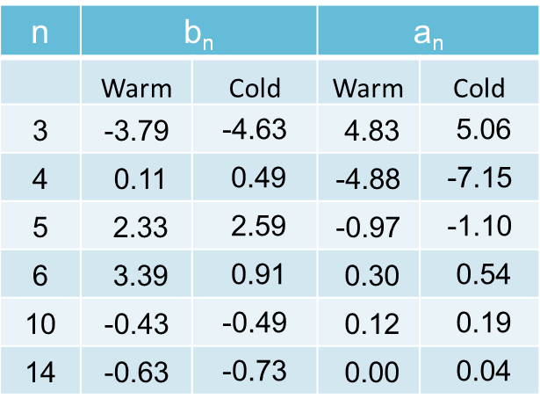
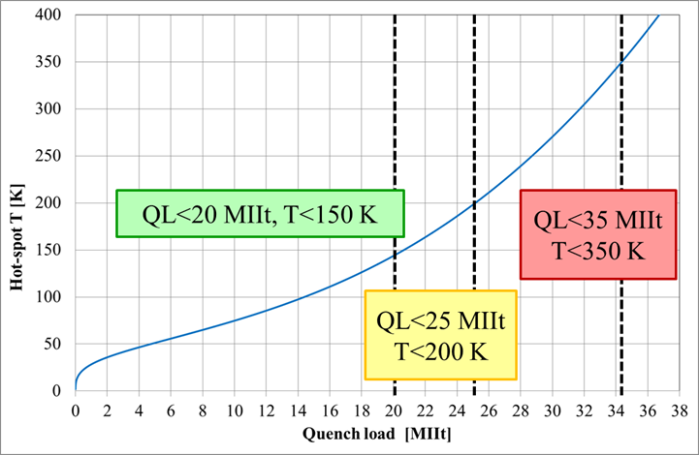
Magnetic Measurements and Protection Studies
Magnetic Measurements: [S. Izquierdo Bermudez presentation]
Axial scans at I.warm, I.inj, I.lim, I.nom, I.ult
Accelerator cycles to I.nom, I.ult
Effect of reset current: [100], 300, 500 A
Long injection plateau: 6000 s
Stair-step loop (21 current steps)
Ramp rate dependence: [14], 20, 40, 80 A/s
Central Harmonics (110 mm probe)
J. DiMarco, X. Wang
Protection studies: [G. Ambrosio presentation]
Minimum (peak) power density and (total) energy density to quench
Heater delays at different fractions of SSL, with powering parameters aimed at reproducing the long magnets in the accelerator configuration
Current decay during fast extractions with different R_{dump} (dynamic effects)
MIITs Budget for Quench Studies
E. Ravaioli , S. Izquierdo Bermudez

Slide 20
Summary
MQXFSM1 Mirror:
  Achieved 90% of the short sample limit using LARP coil #2
  Provided critical, timely, and generally positive feedback in many design areas
MQXFS1 Quadrupole:
  Surpassed I.nom after 8 training quenches, and I.ult after 8 more quenches
    Strain gauges, distribution of quench locations, and quench level independent of temperature consistently indicate low pre-load as the main limiting factor
  Fully retained the maximum quench level above I.ult after a thermal cycle
  Stable operation during accelerator cycles and 8-hour hold at I.nom and I.ult
  Fully retained maximum quench level at 4.5K, reaching 92.6% of SSL
Performance of MQXF mirror and first quadrupole short model confirms the validity of the main design and fabrication choices in the areas of conductor, cable, coil fabrication, mechanical support
The choice of a conservative preload for first test follows the successful approach of previous LARP magnets
  Starting from MQXFS1b, the program will explore the higher pre-load range to minimize training in long models and production magnets

