Slide 1

Magnetic Measurements and Analysis
S. Izquierdo Bermudez, J. DiMarco, X. Wang
G. Ambrosio, G. Chlachidze, P. Ferracin, T. Holik,
G. Sabbi, S. Stoynev, T. Strauss, E. Todesco, G. Valone, G. Velev et al.
MQXF International Review, CERN, June 2016

Slide 2
Outline
MQXFS1 parameters and features
Magnetic measurements system
Magnetic measurement overview
Geometric field errors
Machine cycle analysis
Summary and next steps

Slide 3
Outline
MQXFS1 parameters and features
Magnetic measurements system
Magnetic measurement overview
Geometric Field Errors
Machine Cycle Analysis
Summary and next steps

Slide 4
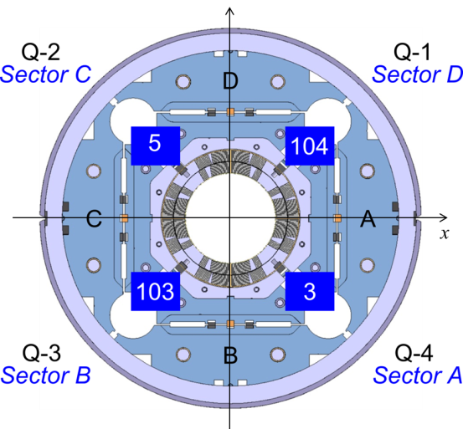
MQXFS1 parameters and features
Magnet and coil positioning
MQXFS1 was assembled using 2 coils from CERN (coil 103 and 104) and 2 coils from LARP (coil 3 and 5).
CERN coils:
  Use RRP 132/169 layout
  Are systematically smaller than nominal
LARP coils:
  Use RRP 108/127 layout
  Are systematically bigger than nominal
Magnetic length is ≈ 1.2 m and the uniform straight section ≈ 0.5 m
 | Units | MQXFS
Magnetic length | mm | 1192
Overall coil length (including splice extension) | mm | 1510
Magnetic yoke extension | mm | 1550
Magnetic pad extension | mm | 975
References
G. Ambrosio et al., MQXFS1 Design Report, http://larpdocs.fnal.gov//LARP-public/DocDB/ShowDocument?docid=1074
X. Wang et al., Coordinate system for magnetic measurements of MQXF magnet, http://larpdocs.fnal.gov//LARP/DocDB/0010/001079/003/MQXF-MagMeasCoordinateSystem-v1.docx

Slide 5
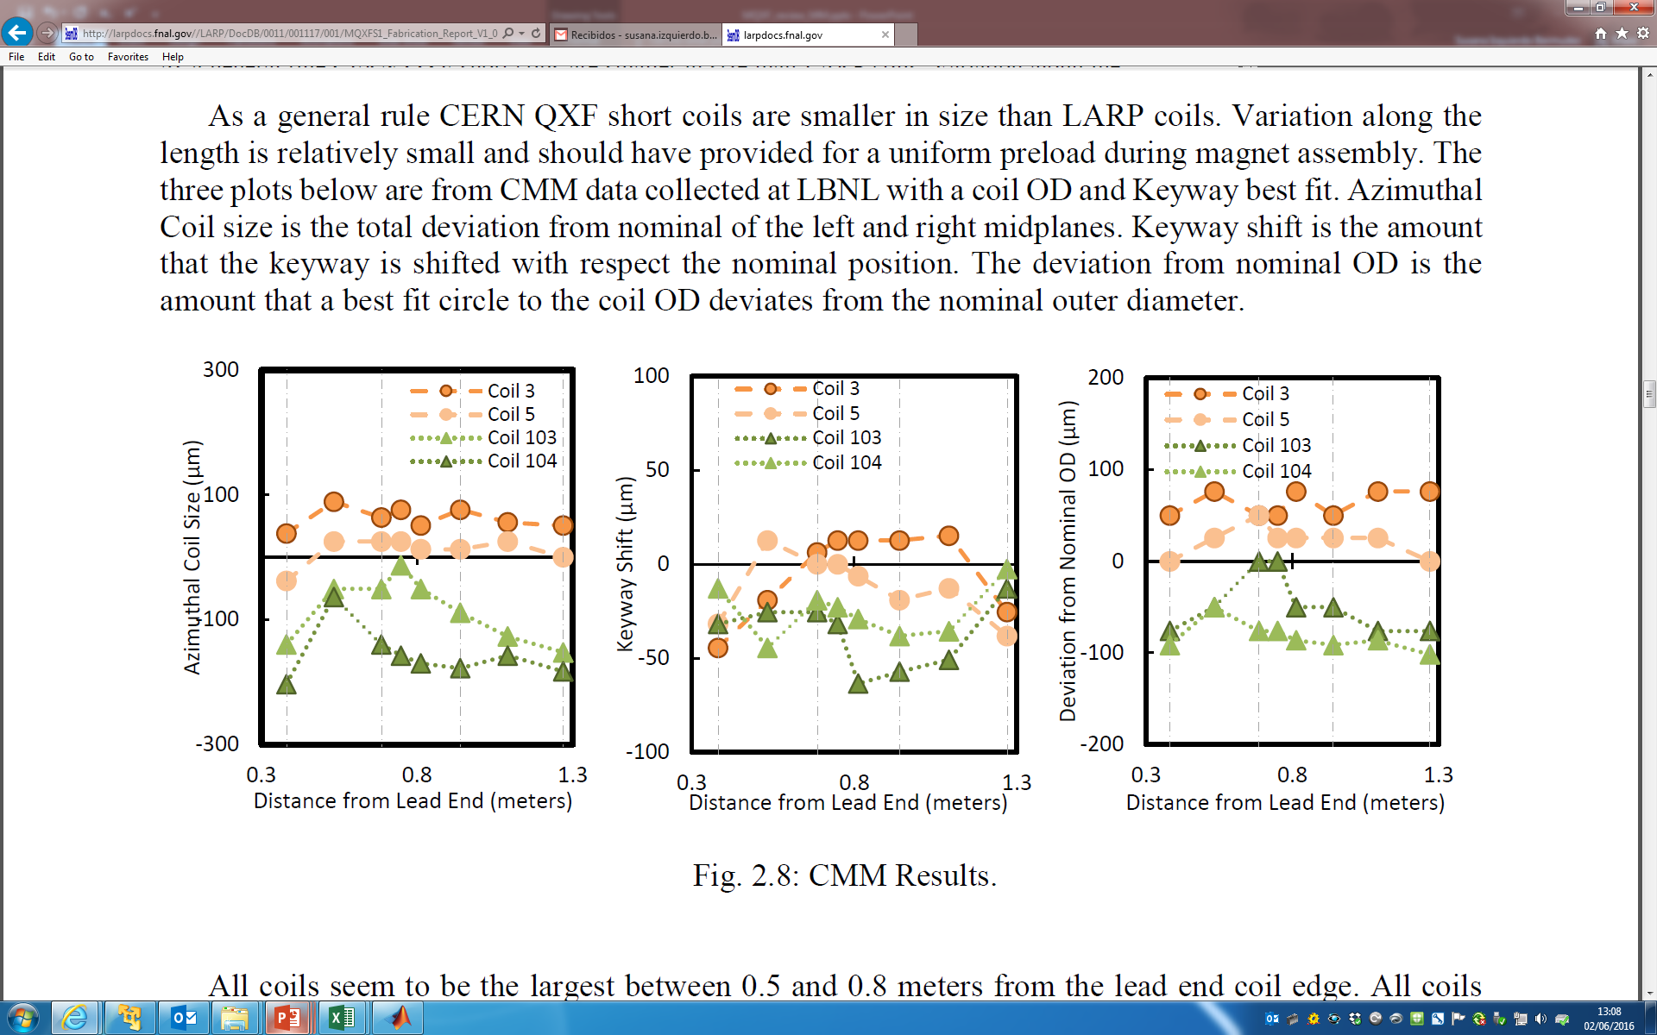
MQXFS1 parameters and features
As a general rule CERN MQXF short coils are smaller in size than LARP coils:
  LARP coils: Azimuthally oversized by 50 – 100 µm
  CERN coils: Azimuthally undersized by 50 – 200 µm
total deviation from nominal of the left and right midplanes
amount that a best fit circle to the coil OD deviates from the nominal outer diameter
Reference
G. Ambrosio et al., MQXFS1 Fabrication Report, http://larpdocs.fnal.gov//LARP/DocDB/0011/001117/001/MQXFS1_Fabrication_Report_V1_050916.pdf

Slide 6
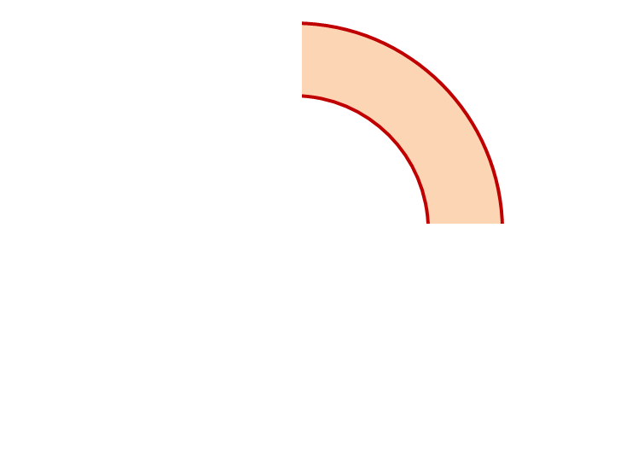
MQXFS1 parameters and features
Goal: bring all the coils on the same collar arc length
Remark: Assembly rotated by 90 degrees to be consistent with the magnetic axis definition
Coil 5
Mid-plane oversized by 0.05 mm
OR in target
Coil 104
Mid-plane undersized by 0.05 – 0.1 mm
Undersized OR by 0.050 mm or in target
5
104
0.050 mm to match LARP coils OR location
+0.050 mm to compensate for coil undersized
0.050 mm to match LARP coils OR location
103
3
Coil 103
Mid-plane on target
Undersized OR by 0.025 mm or in target
Coil 3
Mid-plane oversized by 0.05 mm
Oversized OR by 0.025 mm
Reference
G. Ambrosio et al., MQXFS1 Fabrication Report, http://larpdocs.fnal.gov//LARP/DocDB/0011/001117/001/MQXFS1_Fabrication_Report_V1_050916.pdf

Slide 7
Outline
MQXFS1 parameters and features
Magnetic measurements system
Magnetic measurement overview
Geometric Field Errors
Machine Cycle Analysis
Summary and next steps

Slide 8
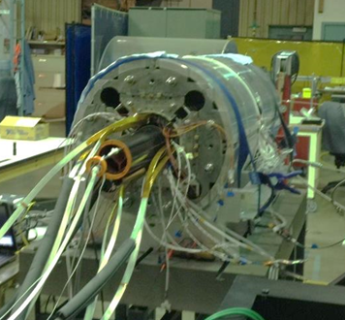
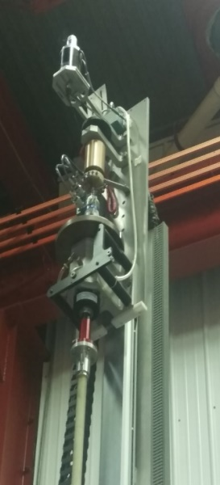
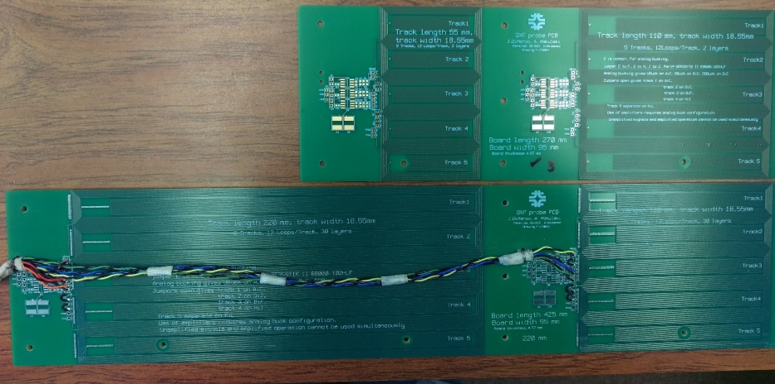
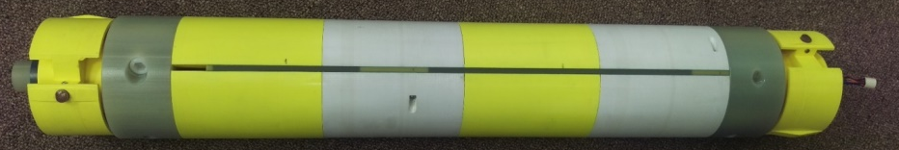
Magnetic Measurements System
General approach:
Short rotating probes scanning the magnet bore
FNAL-developed PCB probe technology (already validated in HQ models)
All measurements reported at 50 mm ref. radius
Warm measurements during assembly at LBNL:
Probe supported by temporary bore tube
MQXF probe (provided by FNAL) has a radius of 59.5 mm, and length of 110 mm (& 220 mm)
No automatic system for longitudinal positioning
Cold/warm measurements at Fermilab VMTF:
Probe shaft centered in (new) anti-cryostat
MQXF probes have a 50.5 mm radius (taking into account clear bore and anti-cryostat requirements)
Vertical test sled positions and rotates probe
Different PCB probes in the two Thermal Cycles
  TC1: 30 layer, 110 & 220 mm, with attenuator
  TC2: 2 layer, 55 and 110 mm, no attenuator
Warm measurements during assembly (LBNL)
Vertical test sled
(FNAL VMTF)
TC2:
2-layer PCB
55 & 110 mm
TC1:
30-layer PCB
110 & 220 mm
Probe shaft & spring-loaded bearing blocks

Slide 9
Outline
MQXFS1 parameters and features
Magnetic measurements system
Magnetic measurement overview
Geometric Field Errors
  Warm magnetic measurements
  Cold magnetic measurements
  Cold-warm correlation
  Possible source of field errors and correcting actions
Machine Cycle Analysis
  Iron saturation effect
  Persistent currents effects
Summary and next steps

Slide 10
Magnetic Measurements Overview (I)
Warm measurements during assembly (July-August 2015):
  Performed after insertion of the collared coil (before and after pre-loading)
  The plan is in the future to perform also measurements on the collared coil (before insertion on the yoke-shell structure)
First thermal cycle (TC1, March 2016)
    Warm measurements before cool-down in VMTF in good agreement with those performed during assembly
    Signal from 30-layer PCB probe saturates amplifiers, requiring the use of an attenuator → difficult to correct (data not usable)
Reference: MQXFS1 Test Plan,
http://larpdocs.fnal.gov//LARP-public/DocDB/ShowDocument?docid=1079

Slide 11
Magnetic Measurements Overview (II)
Second thermal cycle (TC2, April 2016)
  Replaced 30-layer probe with 2-layer probe and no attenuator
  Field quality characterization up to nominal current
    Longitudinal scans at selected currents
    Accelerator cycle to nominal current
    Ramp rate dependence
    Stair step measurement
    Effect of reset current
  Additional studies up to ultimate current
    Accelerator cycle to ultimate current (including a cycle with longer injection plateau)
    Z-scan at ultimate current
  Measurements during and after warm-up
    Magnetic measurements at intermediate temperatures
    Final z scan after warm up
Focus for this presentation
Reference: MQXFS1 Test Plan,
http://larpdocs.fnal.gov//LARP-public/DocDB/ShowDocument?docid=1079

Slide 12
Outline
MQXFS1 parameters and features
Magnetic measurements system
Magnetic measurement overview
Geometric Field Errors
  Warm magnetic measurements
  Warm-Cold-Warm correlation
  Possible source of field errors and correcting actions
Machine Cycle Analysis
Summary and next steps

Slide 13
Warm magnetic measurements –
Main Field
20-30 units discrepancy on the transfer function with respect to ROXIE model using the nominal coil geometry.
In the straight part (z=[-300,200] mm), the longitudinal variation of the main field is within 8 units.
Reference: S. Izquierdo Bermudez, Analysis of MQXFS1 warm magnetic measurements, https://indico.fnal.gov/getFile.py/access?contribId=2&resId=0&materialId=slides&confId=11130

Slide 14
Warm measurements –
Field Harmonics After Assembly
Field harmonics are evaluated at 2/3 of the aperture radius (R_{ref}=50 mm).
The standard deviation of the harmonics on the straight section (z=[-300,200] mm) corresponds to a random displacement of the coil blocks of 50 µm.
 | Normal Components (b_{n}) |  |  |  | Skew Components (a_{n})
n | Average | Max | Min | Std. Dev. | Average | Max | Min | Std. Dev.
3 | -3.24 | -1.17 | -4.56 | 1.20 | 3.46 | 4.84 | 2.38 | 0.91
4 | 0.30 | 1.59 | -0.70 | 0.79 | -4.18 | -2.91 | -5.58 | 0.83
5 | 2.47 | 2.84 | 2.27 | 0.18 | -0.55 | 0.36 | -1.05 | 0.47
6 | 3.57 | 6.78 | 2.60 | 1.21 | 0.65 | 2.27 | -0.30 | 0.73
7 | 0.13 | 0.40 | -0.18 | 0.20 | 0.27 | 0.70 | 0.02 | 0.20
8 | 0.23 | 0.31 | 0.05 | 0.08 | -0.25 | -0.03 | -0.45 | 0.13
9 | 0.15 | 0.29 | 0.00 | 0.10 | 0.31 | 0.43 | 0.18 | 0.07
10 | -0.49 | -0.33 | -1.25 | 0.26 | 0.12 | 0.25 | 0.00 | 0.07

Slide 15
Warm measurements -
Before vs. After Pre-Loading
A measurable effect is observed, however, the overall strength and longitudinal structure of the harmonics is not fundamentally altered
Pre-load effect is relatively small compared to coil fabrication or initial assembly (collared coil)
b₆
a₃
b₅
a₆
b₄
a₅
b₃
a₄

Slide 16
Cold Magnetic Measurements -
Cold vs. Warm
Good cold warm correlation, except:
  b₃, which increases by 1 unit
  a₄, which increases by 2 units
Allowed harmonics in very good agreement with the model.
b₅
a₃
a₆
b₆
a₅
b₄
 | MEASURED (average at I_{nom}) | ROXIE
b₆ | 0.95 | 0.68
b₁₀ | -0.51 | -0.39
b₁₄ | -0.70 | -0.66
b₃
a₄

Slide 17
Warm Magnetic Measurements
Before vs. After Cold Test
  Very good correlation on the field harmonics before and after cold powering test → there is not a permanent deformation on the coil visible in terms of field quality.
  The overall strength and longitudinal structure of the harmonics is not fundamentally altered
b₆
b₅
a₃
a₆
a₅
b₄
b₃
a₄

Slide 18
Contribution of the Coil Ends
The contribution of the coil ends is very well captured by the 3D ROXIE model
Measurements at 10 A after cold test, using 50 mm probe

Slide 19
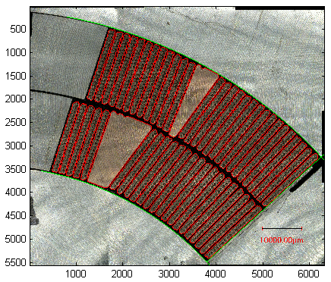
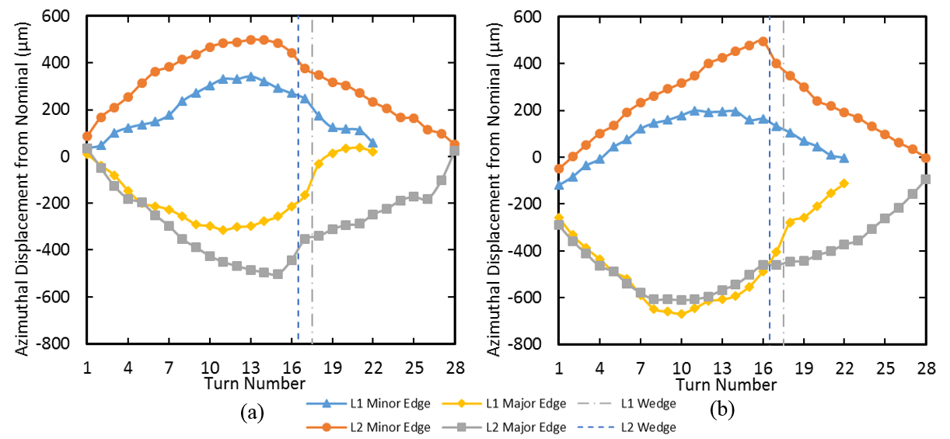
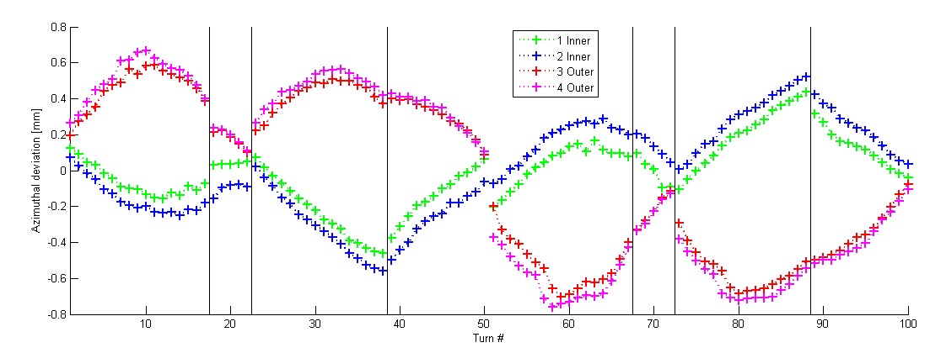
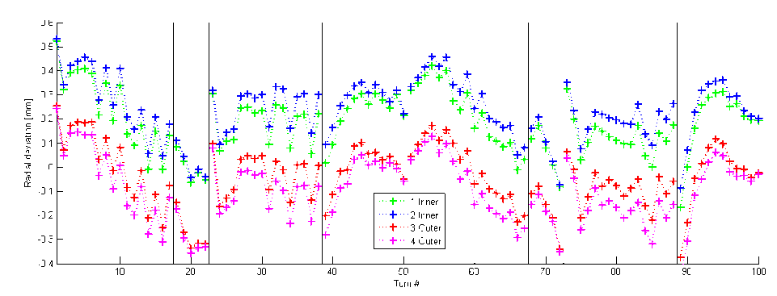
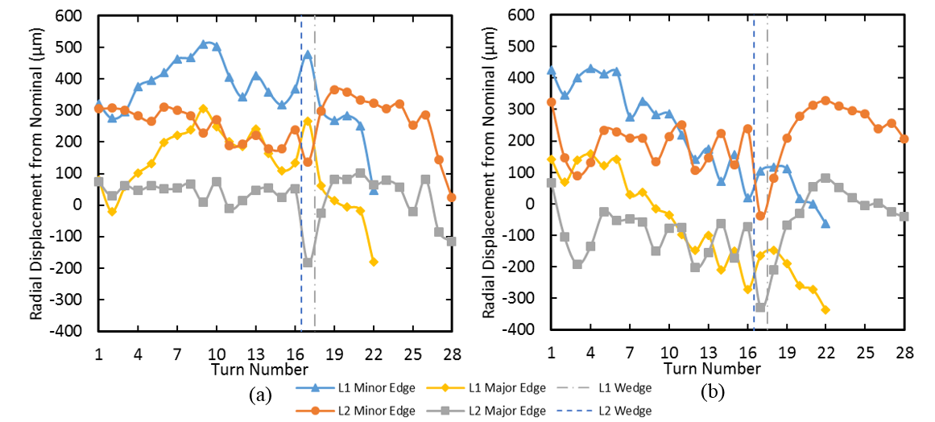
Un-Allowed Harmonics
Coil Cross Sections Characterization
Efforts on going to link the measured un-allowed harmonics to the possible errors on the coil turns positioning based on cross section analysis.
What we observe:
  Mid plane and pole turns are well in place.
  Large azimuthal/radial deviation on the intermediate coil turns (∽ 0.5 mm)
[E. Holik]
[E. Rochepault]

Slide 20
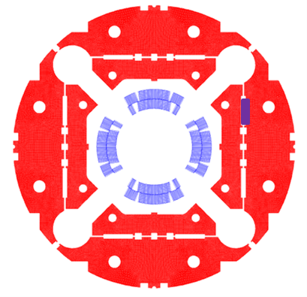
b₃ and a₃
Measured normal and skew sextupole can be corrected inserting magnetic shims in the bladders slot
  Magnetic shims installed in MQXFS1b to prove the correction capabilities
Correction capabilities using 9x58 mm shim in the bladder slots
Order | bn | an
3 | 4.24 | -4.24
4 | 0.00 | 0.00
5 | 0.40 | 0.40
6 | 0.00 | 0.00
MQXFS1 Meas. | b₃ |  | a₃
 | Warm | Cold | Warm | Cold
Average | -3.24 | -4.21 | 3.46 | 3.29
Max. | -1.17 | -1.83 | 4.84 | 5.06
Min. | -4.56 | -5.34 | 2.38 | 1.14
Std. Dev. | 1.20 | 1.14 | 0.91 | 1.37

Slide 21
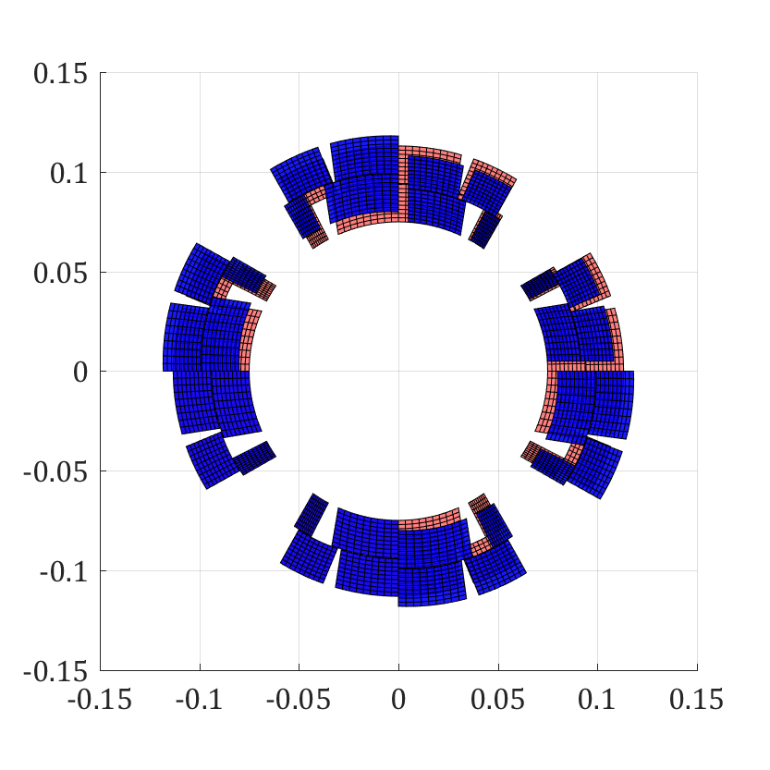
b₄ and a₄
Large a₄ is expected due to the differences in between CERN and LARP coils
  Should improve when assembling coils produced in the same manufacturing line.
5
104
 |  | b₄ |  | a₄
 |  | Warm | Cold | Warm | Cold
Computed |  | 0.00 |  | -4.82
Measured | Average | 0.30 | 0.32 | -4.18 | -6.49
 | Max. | 1.59 | 2.06 | -2.91 | -5.11
 | Min. | -0.70 | -0.96 | -5.58 | -8.14
 | Std. Dev. | 0.79 | 1.10 | 0.83 | 0.96
103
3

Slide 22
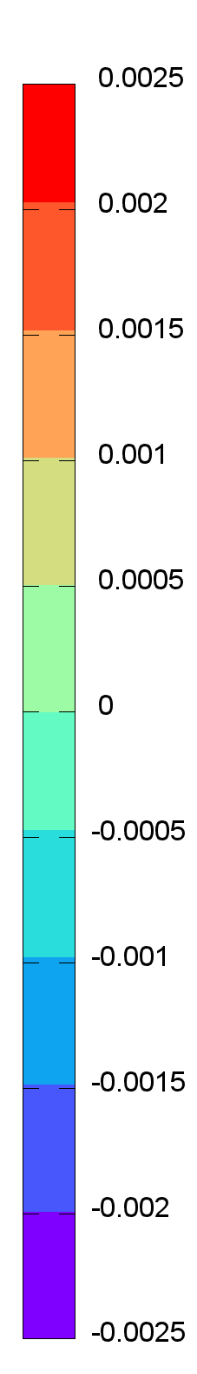
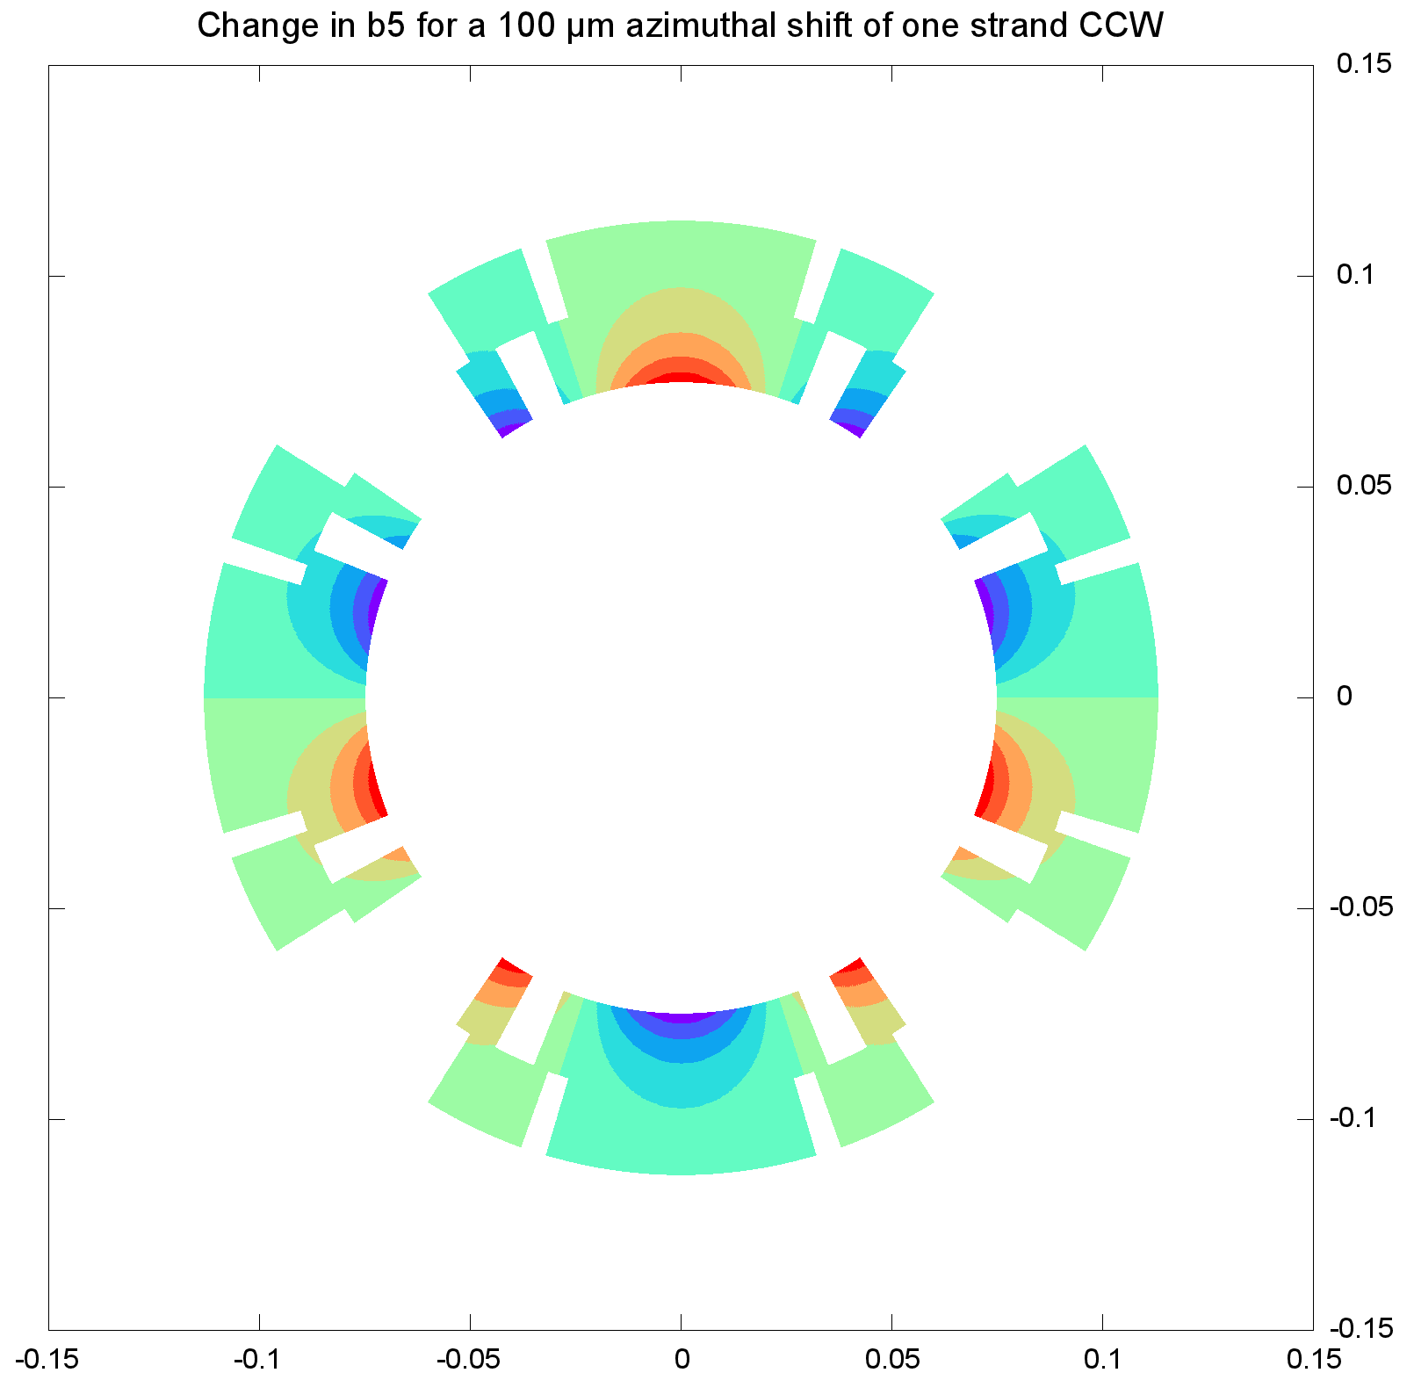
b₅
[E. Holik]
With the level of displacements measured in coil cross sections, large high order harmonics can be generated.
If all other coils were nominal:
      10 turns within box are shifted 700 µm
      Max effect region has ~ 0.002 units per strand
-> 40/2 strands * 10 turns * 0.002 * 700/100
= 2.8 Units from one coil
(measured b₅ = 2.5)
Actions taken: Reduction of the room left for conductor expansion during heat treatment for the second generation design:
  From 2% to 1.2% in width
  (0.150 mm less per turn)
  From 4.5 % to 3.8% in thickness
  (0.010 mm less per turn)
~No change
Max effect

Slide 23
Outline
MQXFS1 parameters and features
Magnetic measurements system
Magnetic measurement overview
Geometric Field Errors
Machine Cycle Analysis
  Iron saturation effect
  Persistent currents effects
Summary and next steps

Slide 24
Transfer function
Saturation well captured by ROXIE model
Good agreement calculation/measurements on geometric transfer function:
  Measured field is 30 units stronger assuming a coil radial contraction during cool down of 3 mm/m
  Measured field is 10 units stronger introducing the coil deformation as computed in ANSYS.

Slide 25
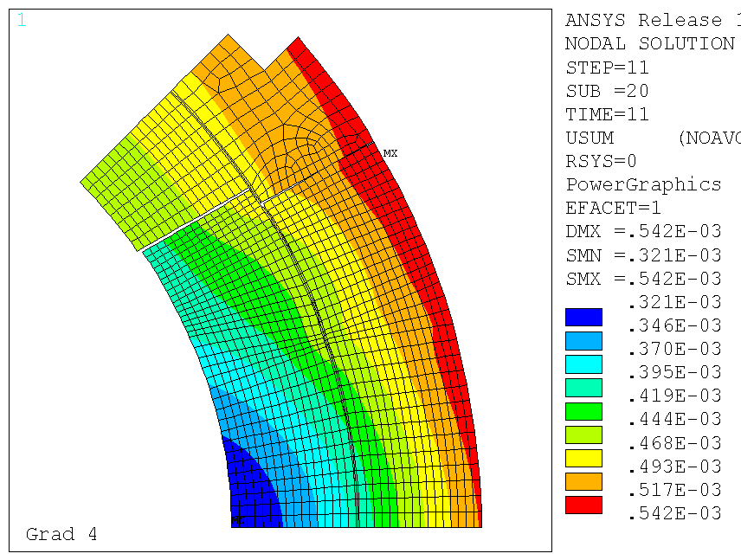
Allowed harmonics
The effect of the iron saturation effect on b₆ is close to ROXIE prediction.
The impact of saturation on the rest of the harmonics is negligible (as expected).
The impact of the coil deformation during powering due to the electromagnetic forces is small (as expected).

Slide 26
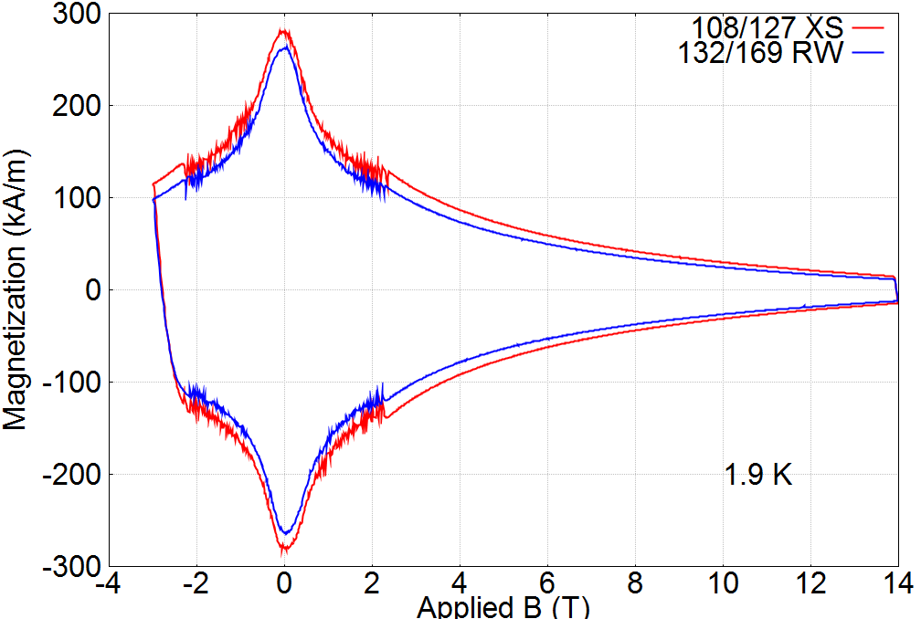
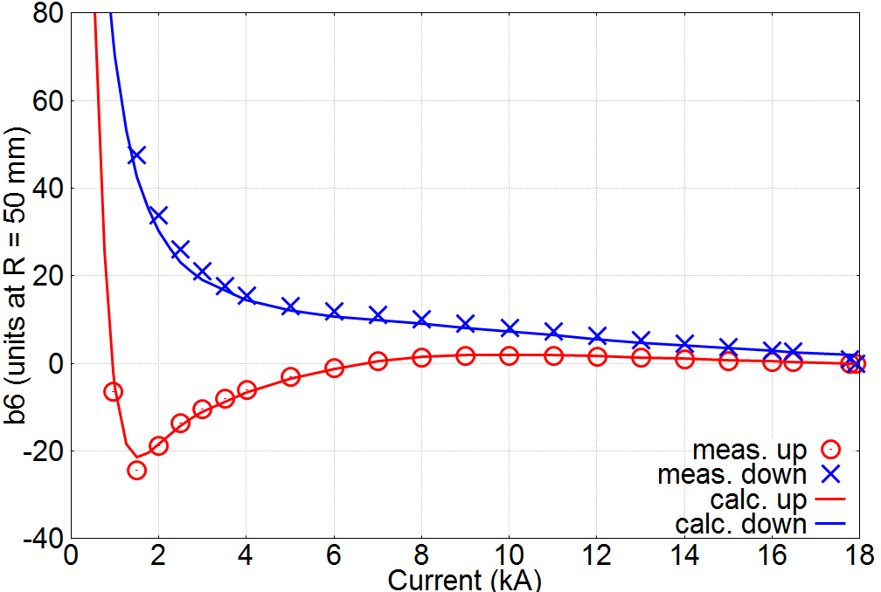
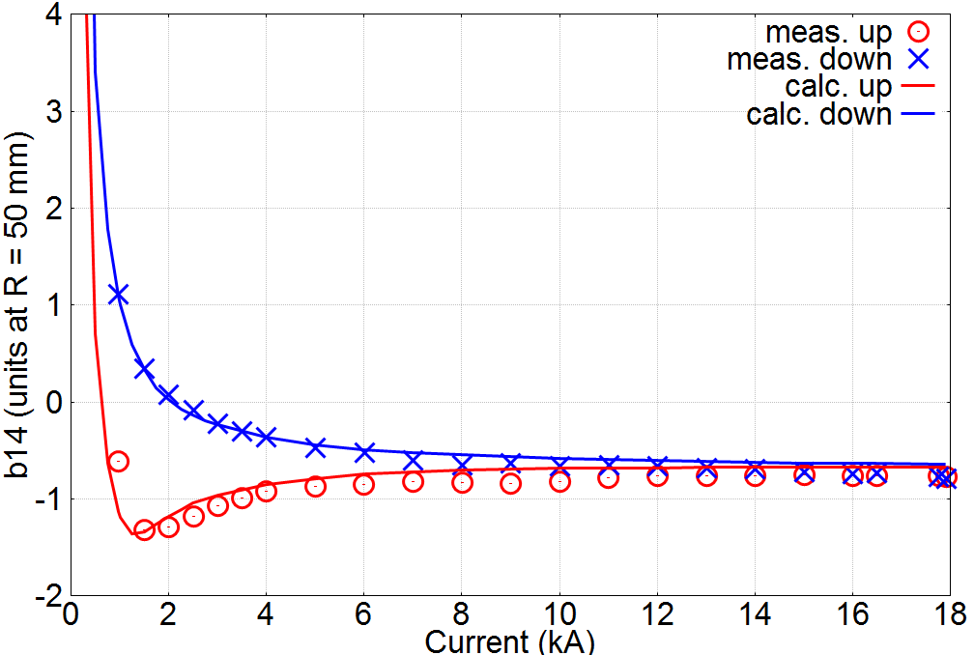
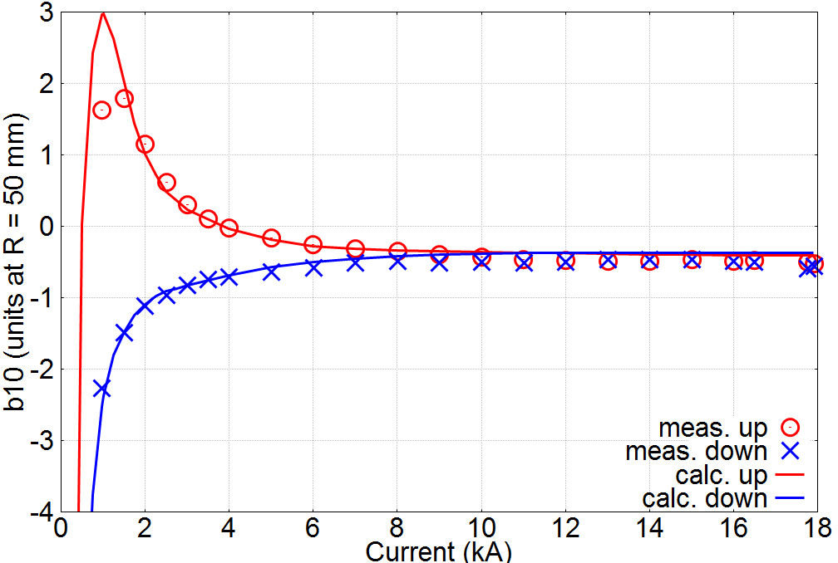
Persistent current effects (I)
Estimates using magnetization measurements and the model developed based on HQ experience. [X. Wang]
Magnetization measured by M. Sumption and X. Xu at OSU
Strands provided by A. Ghosh and B. Bordini
(measurements performed in reference strands, not on extracted strands from MQXFS1)
Excellent agreement between measurements and model for the allowed harmonics

Slide 27
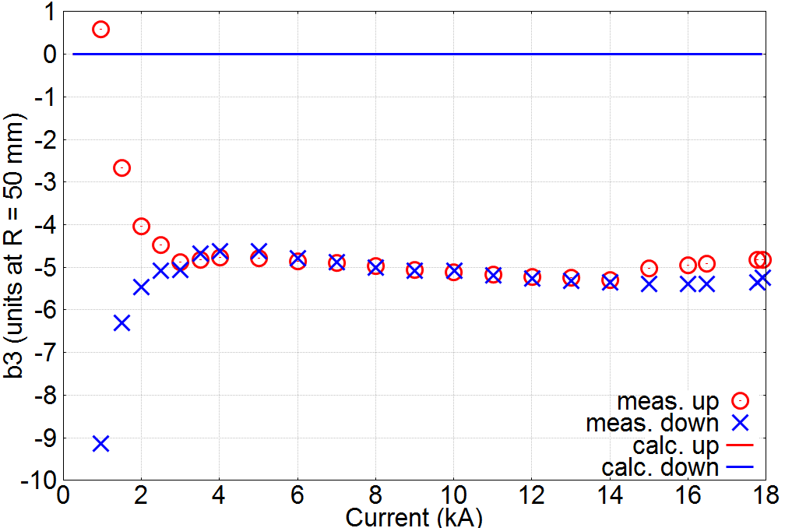
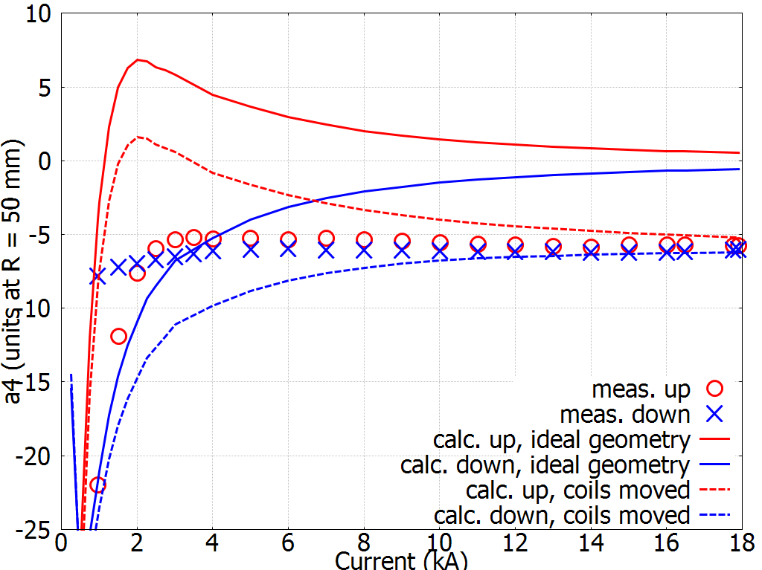
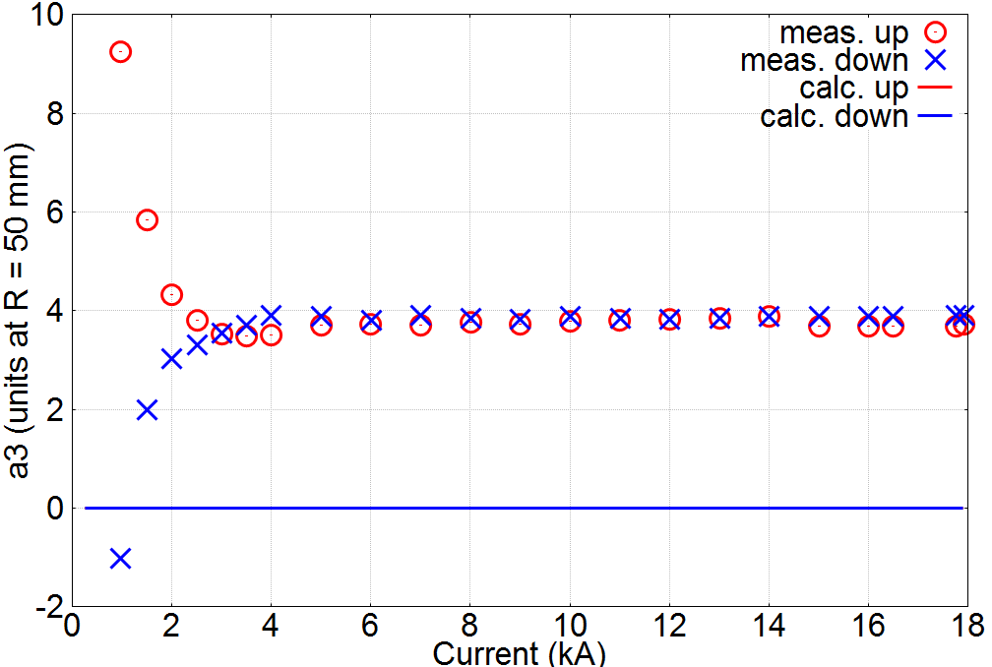
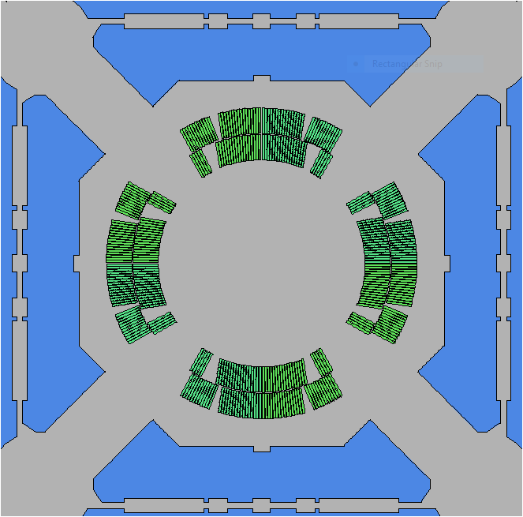
Persistent currents effects (II)
[X. Wang]
MQXFS1 used different strands layout:
  132/169 strands: CERN coils 103 and 104
  108/127 strands: LARP coils 3 and 5
b3
As a result, additional non-allowed that are over-estimated in the model
a3

Slide 28
Outline
MQXFS1 parameters and features
Magnetic measurements system
Magnetic measurement overview
Geometric Field Errors
Machine Cycle Analysis
Summary and next steps

Slide 29
Summary
Good agreement in terms of saturation, coil end effects and persistent currents.
Geometric field errors:
  b₃ and a₃ can be corrected through magnetic shims
  a₄ can be explained due to the differences in between CERN/LARP coils.
  Higher order harmonics (as the measured b₅) can be generated considering the measured azimuthal displacements on coil cross sections.
  The overall strength and longitudinal structure of the harmonics is not fundamentally altered from the initial assembly (collared coil) to powering → The dominant source of field errors is the coil geometry and its initial assembly in the collared coil.

Slide 30
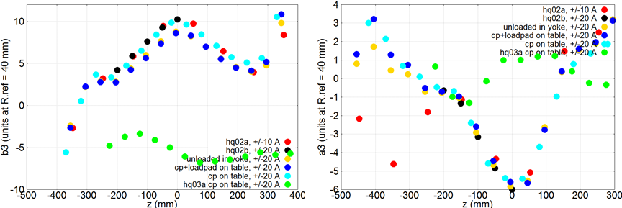
Plans
Based on MQXFS1a experience: field errors are very similar before and after magnet loading.
Based on HQ experience: coil pack assembly is enough to identify the non-allowed harmonic content→ simplify the process as there is no need to introduce the coil pack in the yoke-shell assembly.
Plans for MQXFS3: Perform two coil pack assemblies at CERN with different shimming configuration.
HQ02
HQ02
HQ03
HQ03

Slide 31
Thank you

Slide 32
Magnetic Measurements Plan
Studies performed:
Axial scans at I.warm, I.inj, I.lim, I.nom, I.ult
Accelerator cycles to I.nom, I.ult
Effect of reset current: [100], 300, 500 A
Long injection plateau: 6000 s
Stair-step loop (21 current steps)
Ramp rate dependence: [14], 20, 40, 80 A/s
Pre-cycle (applied to all measurements):
From 0 to I.nom at 14 A/s,
Hold for 300 s at I.nom,
Ramp down to I.res at 14 A/s
Hold for 0s at I.res
Ramp to I.inj at 14 A/s
[Hold at I.inj included in meas. cycle]
Main Current Levels
Current [kA] | Symbol | Gradient [T/m] | Remarks
0.01 | I.warm | 0.09 | Warm measurements
0.1 | I.res | 0.9 | Reset level for pre-cycle
0.96 | I.inj | 8.5 | Injection level
6.0 | I.lim | 48.8 | Current limit (pre-training)
16.48 | I.nom | 132.6 | Nominal level
17.76 | I.ult | 143.2 | Ultimate level
21.5 | I.ssl | 171.0 | 1.9K Short Sample Limit
Reference: MQXFS1 Test Plan, http://larpdocs.fnal.gov//LARP-public/DocDB/ShowDocument?docid=1079

Slide 33
Harmonics at nominal current
 | Normal Components |  |  |  | Skew Components
n | Ave | Max | Min | Std. Dev. | Ave | Max | Min | Std. Dev.
3 | -4.21 | -1.83 | -5.34 | 1.14 | 3.29 | 5.06 | 1.14 | 1.37
4 | 0.32 | 2.06 | -0.96 | 1.10 | -6.49 | -5.11 | -8.14 | 0.96
5 | 2.76 | 3.16 | 2.58 | 0.19 | -0.87 | 0.09 | -1.42 | 0.50
6 | 0.95 | 3.53 | 0.27 | 0.95 | 0.52 | 1.76 | -0.45 | 0.68
7 | 0.18 | 0.43 | -0.19 | 0.19 | 0.32 | 0.77 | 0.07 | 0.20
8 | 0.25 | 0.34 | 0.12 | 0.07 | -0.65 | -0.44 | -0.88 | 0.15
9 | 0.22 | 0.40 | 0.07 | 0.12 | 0.33 | 0.48 | 0.15 | 0.09
10 | -0.51 | -0.36 | -1.07 | 0.19 | 0.16 | 0.26 | 0.04 | 0.07

Slide 34
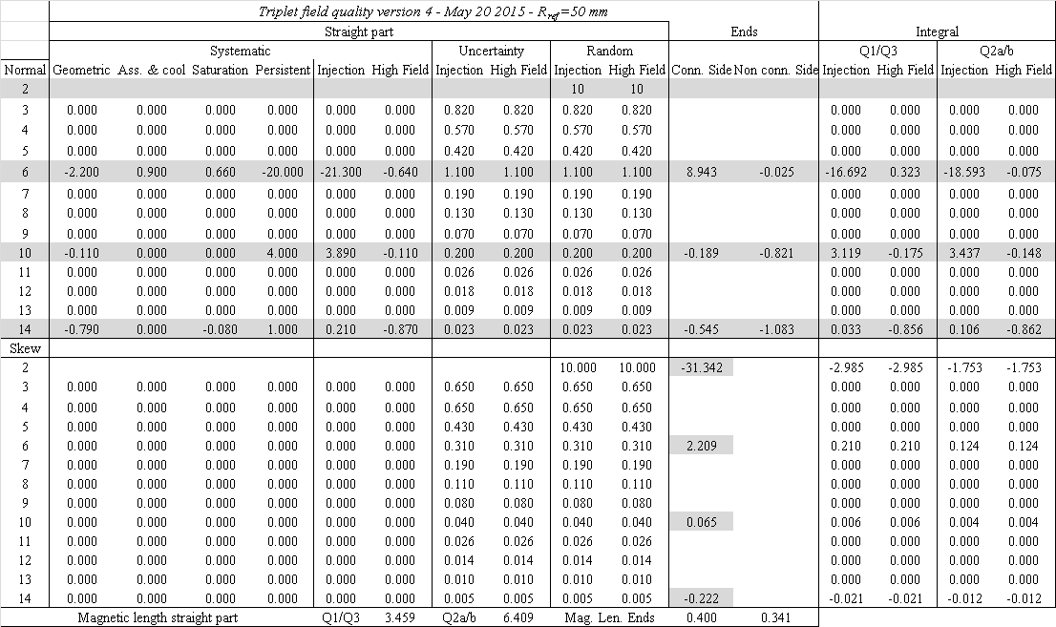

Slide 35
Roxie non-insulated conductors

Slide 36
Transfer Function

Slide 37


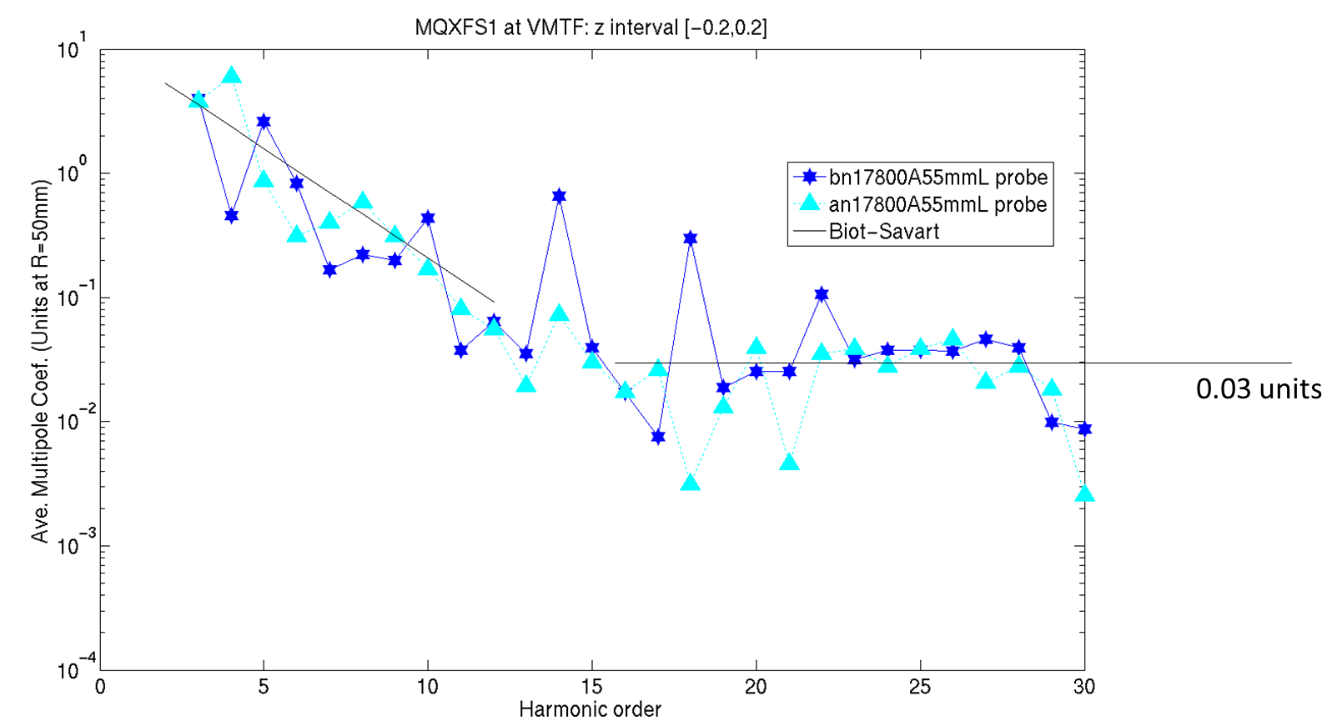
Probe Resolution (TC2)
Text

Slide 38
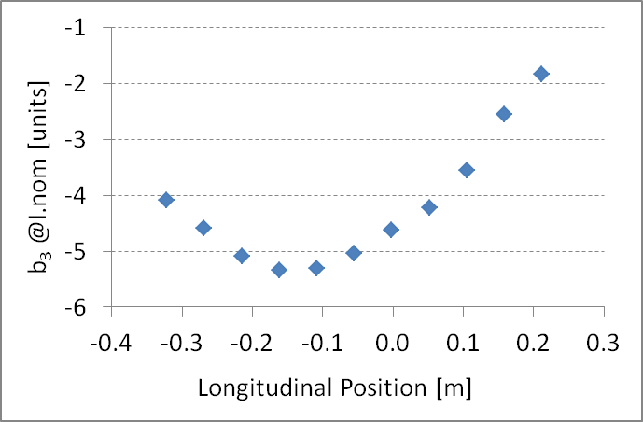
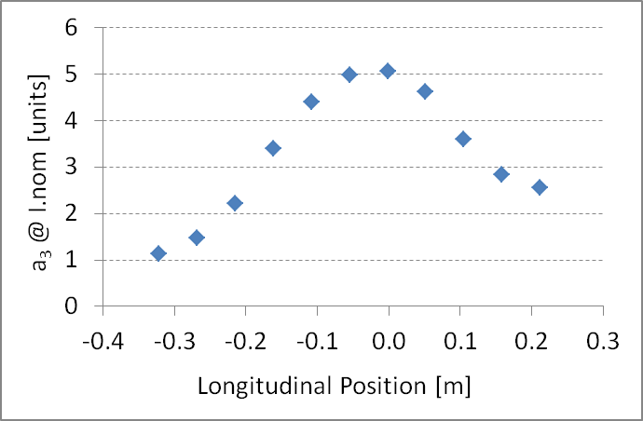
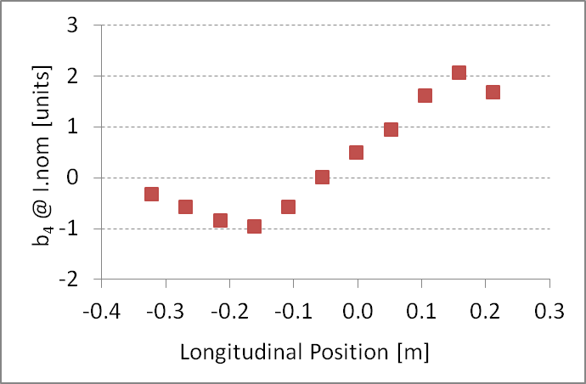
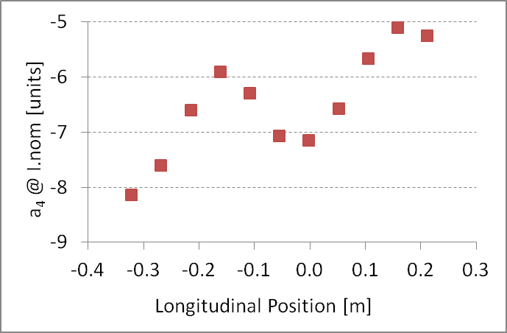
Straight section b₃, a₃, b₄, a₄
Axial variations (measured with short probe) need to be considered when analyzing/evaluating results

Slide 39
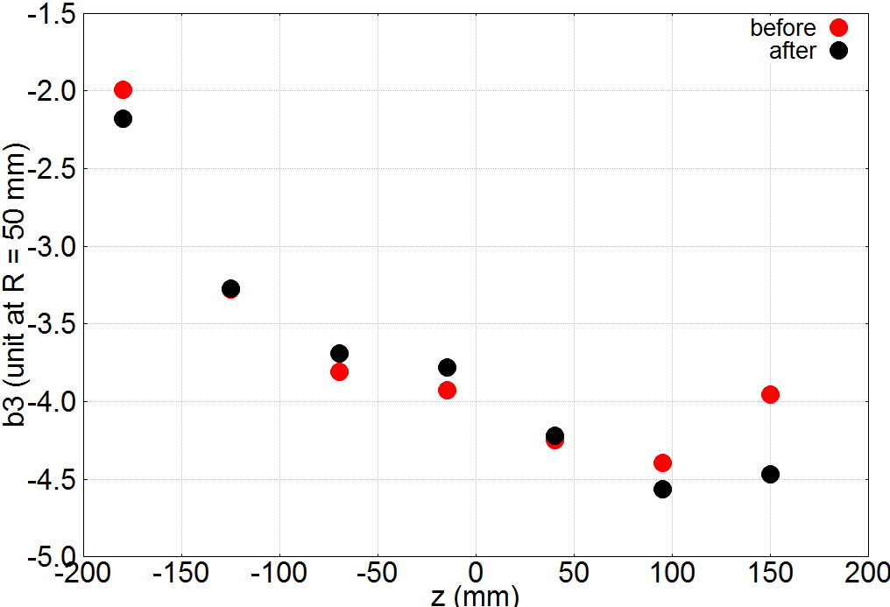
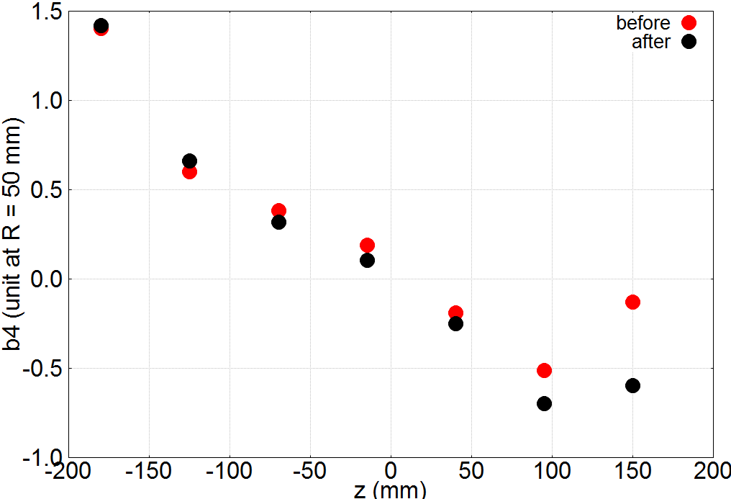
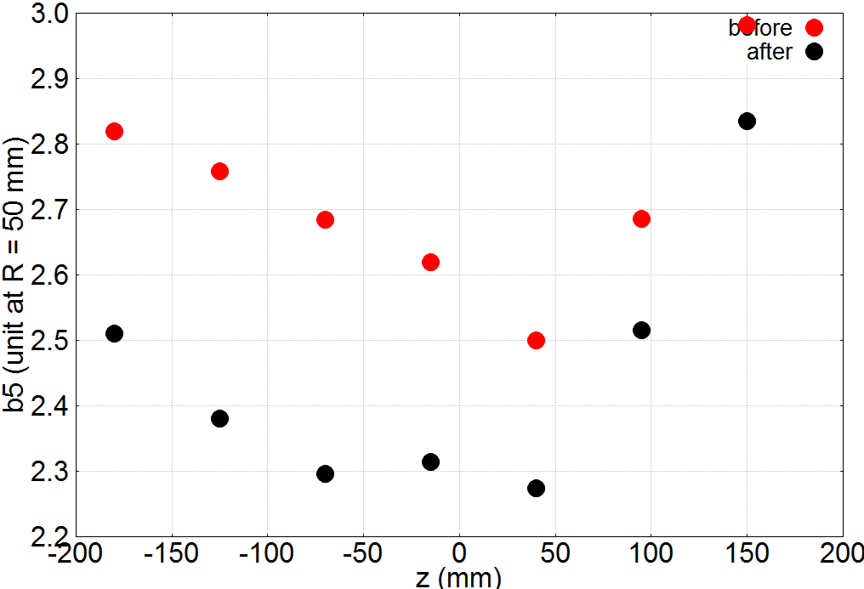
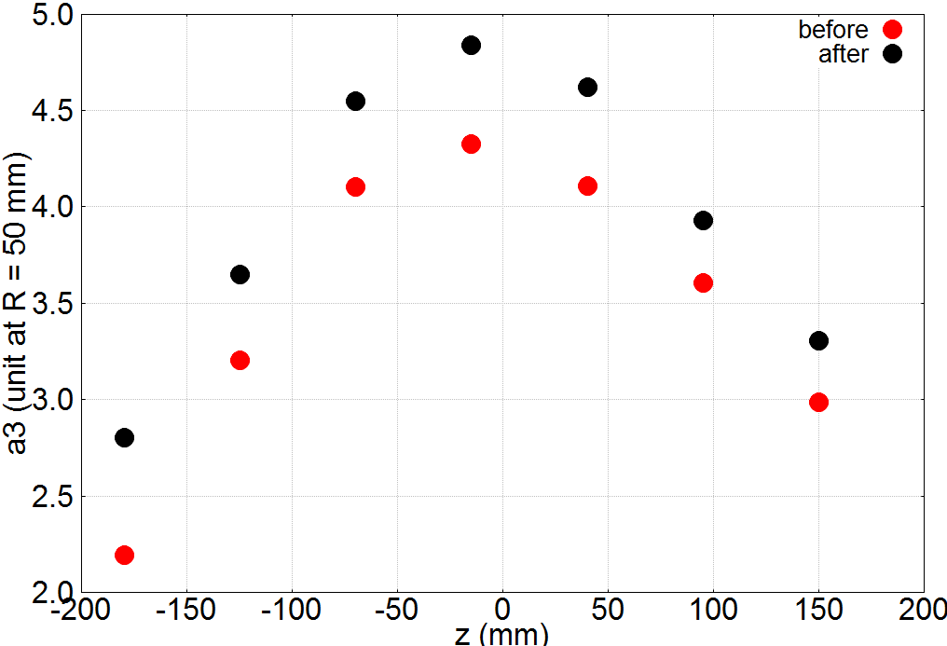
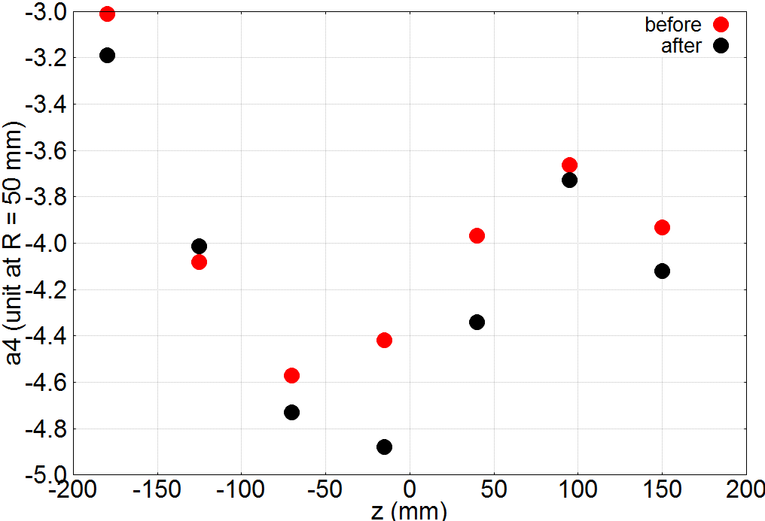
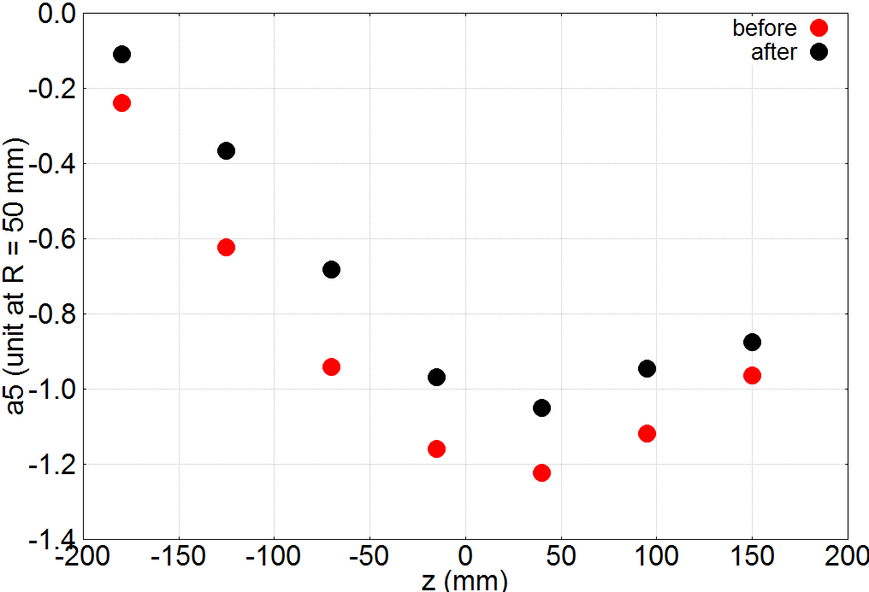
Before vs. After Pre-Loading
A measurable effect is observed, however, the overall strength and longitudinal structure of the harmonics is not fundamentally altered
Pre-load effect is relatively small compared to coil fabrication or initial assembly (collared coil)

