Slide 1

Quench Protection Measurements & Analysis
G. Ambrosio
MQXF International Review – CERN, June 7th – 10th, 2016

Slide 2
Outline
Quench Protection Strategy
  Main elements
  Open questions
    Inner layer heaters
    CLIQ
MQXFS1 Test Results
  Heater delays
  Dynamic effects
Updated Simulations
Conclusions

Slide 3
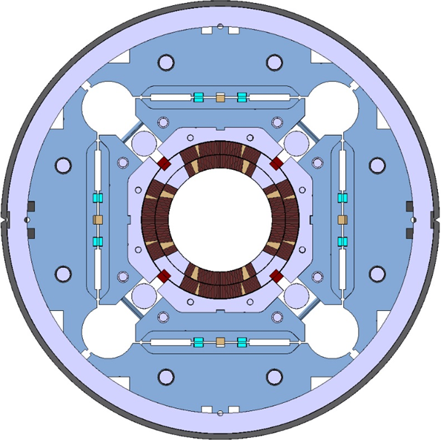
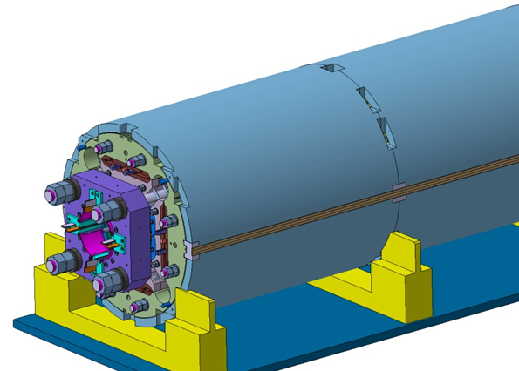
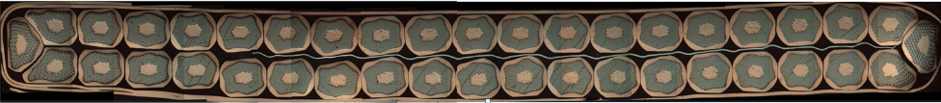
MQXFA/B Main Parameters
Parameter | Unit | MQXFA/B
Coil aperture | mm | 150
Magnetic length | m | 4.2/7.15
N. of layers |  | 2
N. of turns Inner-Outer layer |  | 22-28
Operation temperature | K | 1.9
Nominal gradient | T/m | 132.6
Nominal current | kA | 16.5
Peak field at nom. current | T | 11.4
Stored energy at nom. curr. | MJ/m | 1.2
Diff. inductance | mH/m | 8.2
Strand diameter | mm | 0.85
Strand number |  | 40
Cable width | mm | 18.15
Cable mid thickness | mm | 1.525
Keystone angle |  | 0.4

Slide 4
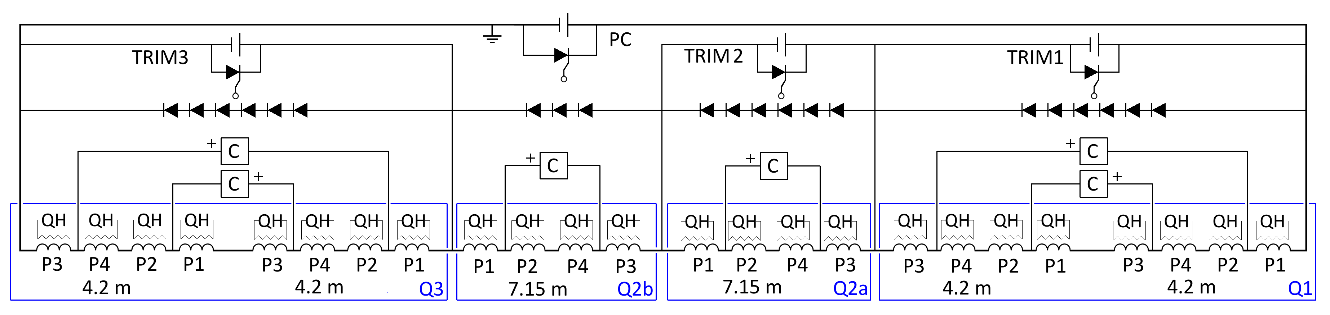
Quench Protection Plan
Elements:
No Energy Extract.
Heaters
CLIQ units
VT for detection
Strategy:
Outer Layer heaters ➔ protection & some redundancy
IL heaters & CLIQ ➔ reduced hot spot Temp. & additional redundancy
Heaters can be optimized for low current (because there is no dump)

Slide 5
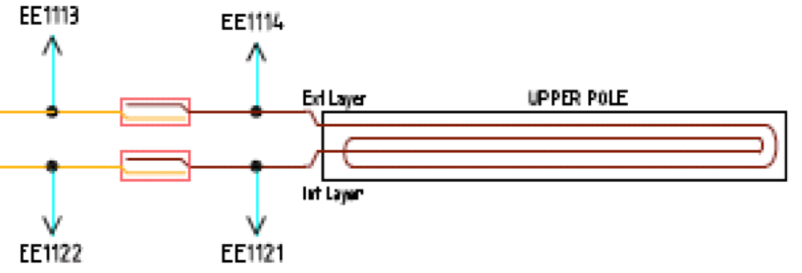
Quench Detection
Instrumentation for Quench Detection:
4 voltage taps per coil
  2 VT per lead around Nb₃Sn-NbTi splice
Detection:
Threshold: 100 mV
  at high current
Verification: 10 ms
Power supply switch:
delay: 5 ms

Slide 6
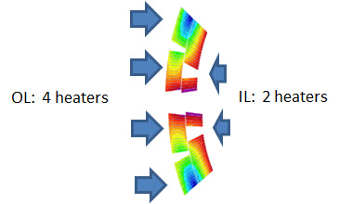
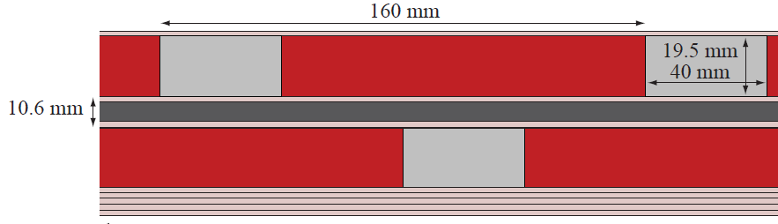
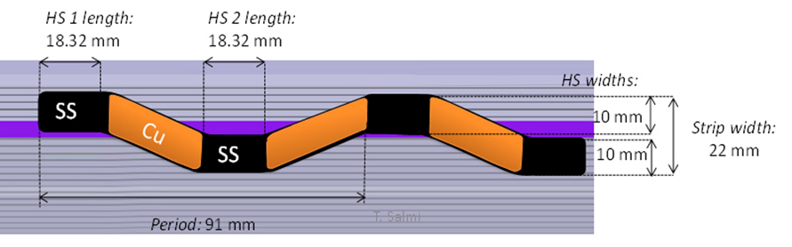
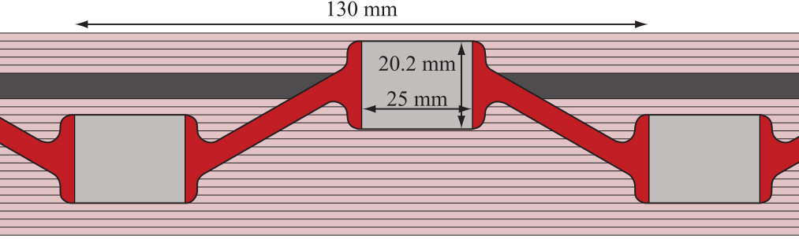
Protection Heaters
Quench heaters have been designed using copper plating for inner and outer layer:
  Two strips on each side of the outer layer
    “High Field” and “Low Field”
  One strip on each side on the inner layer
  Inner layer 40% polyimide free
Outer Layer
Inner Layer

Slide 7
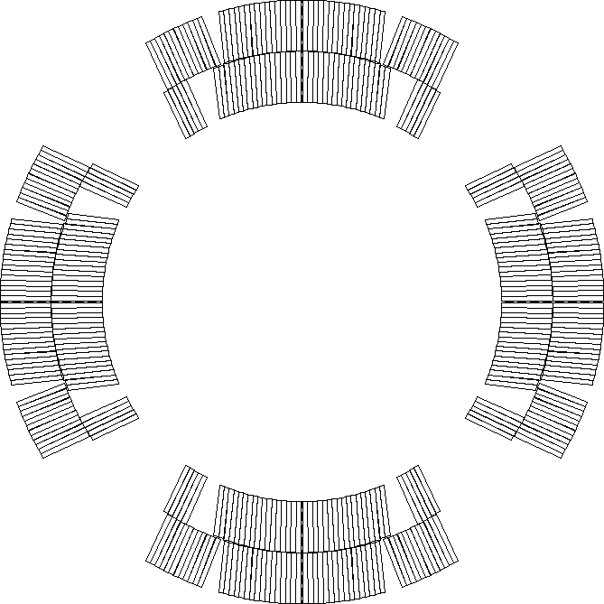
Proposed QH Connection Scheme
Each QH supply is connected to 2 strips in series
  Connection scheme that compensates the voltages induced by CLIQ and QH
  Connecting in series 2 strips attached to different poles reduces the effects of failures (hot-spot temperature, voltage distribution)
LF3
LF2
HF3
HF2
HF4
HF1
IN3
IN2
LF4
IN4
IN1
LF1
Standard LHC quench heater power supply
Charging voltage: 900 V
Voltage to ground: ±450 V
Capacitance: 7.05 mF
Note: 2x 450 V, 14.1 mF modules in series
LF1
IN1
IN4
LF4
IN2
IN3
HF1
HF4
  Only a quarter of the circuits shown
HF2
LF2
LF3
HF3
E. Ravaioli, and G. Sabbi

Slide 8
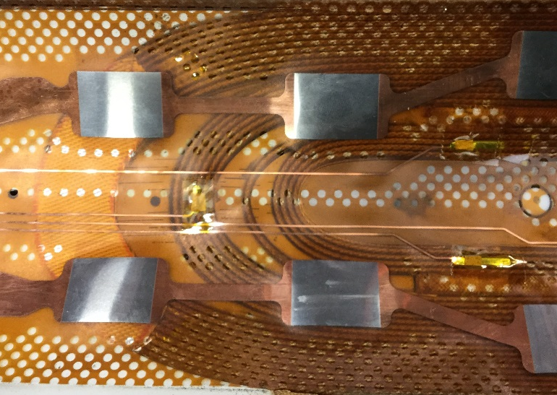
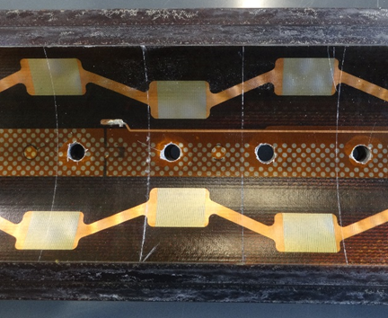
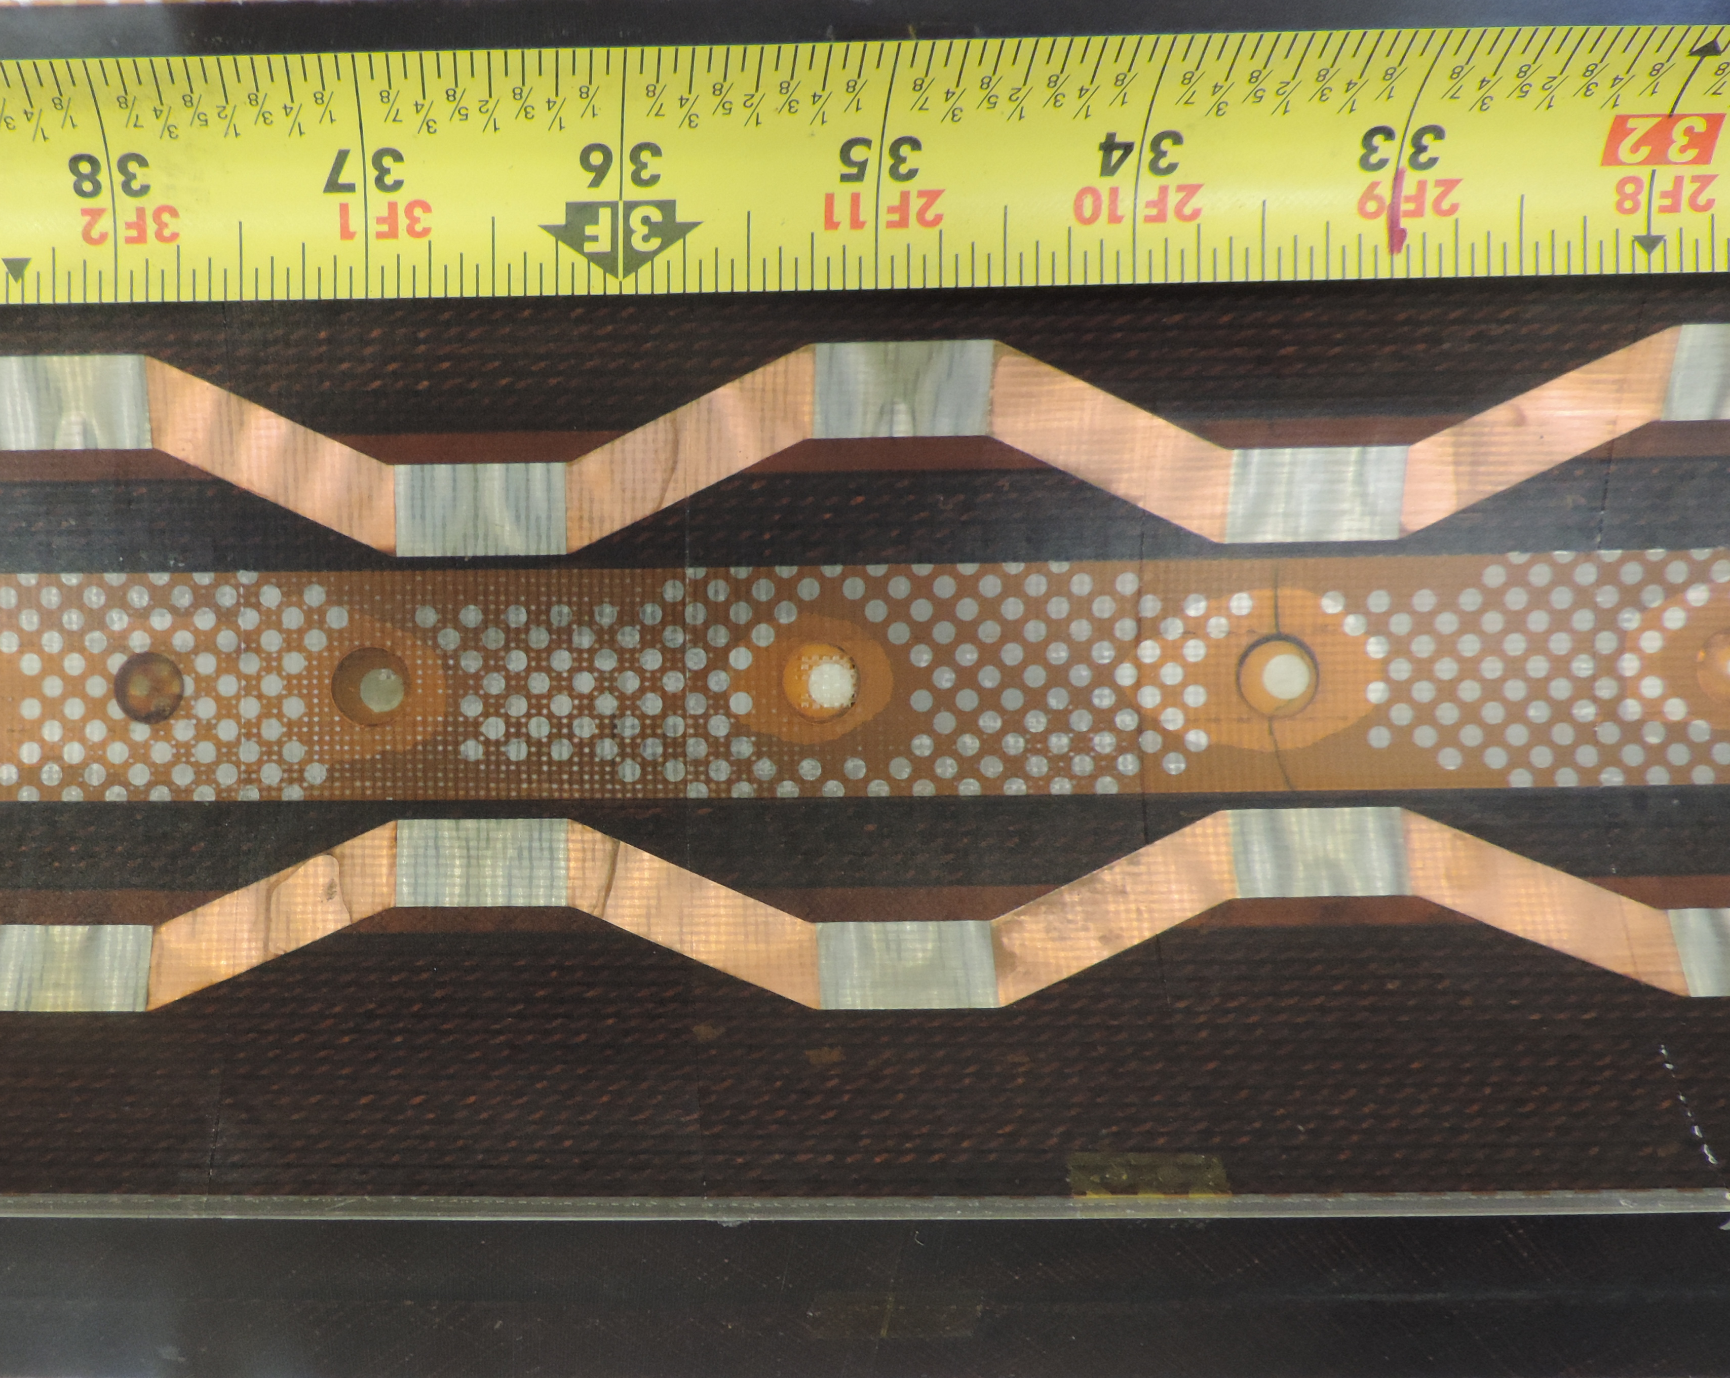
OL & IL Protection Heaters
Outer Layer heaters: very reliable
  Survived large number of quenches and heater studies on many LARP magnets
Inner Layer heaters are not pushed toward the coils as Outer Layer heaters ➔ risk of “bubbles”
  Polyimide perforation (40%) should help
  Different designs
CERN design (E. Todesco)
LARP design (T. Salmi)

Slide 9
MQXFS1 Bore View (after test)
Several bubbles on two coils
Very few bubbles on two coils
Different heater design
Different fabrication site
Heater tests Y/N

Slide 10
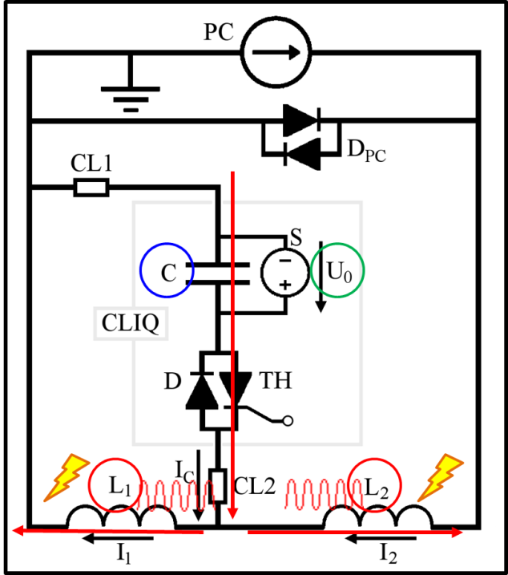
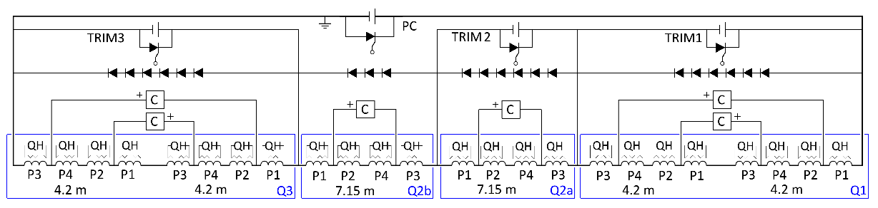
CLIQ
Coupling-Loss Induced Quench system
  Successfully tested on Nb₃Sn short models and NbTi long magnets
  Presentation showing concept and validation (by E. Ravaioli) available upon request
Note: the failure of a CLIQ unit can be simulated by single magnet analysis because of the diodes

Slide 11
Simulated Currents in the Circuit
Q2a/Q2b
Q1/Q3
CLIQ units for Q2a/Q2b
Charging voltage: 1000 V
Capacitance: 40 mF
CLIQ units for Q1/Q3
Charging voltage: 600 V
Capacitance: 40 mF
Diodes
Hot-spot temperature T_{hot}~230 K
Currents through the SC Link (no fault case)
Main leads: Magnet current ± AC oscillations, 1.5 kA, 12 Hz
Trim leads: Their initial current + AC pulse, 500 A, 12 Hz
CLIQ
Simulations performed with TALES

Slide 12
CLIQ
Work in progress to address open questions:
  “Investigate further the CLIQ technology, in particular, assess the long-time reliability and availability when applied for Nb₃Sn coils, …”
Recommendation from Circuit Review
  Impact on other elements of the circuit, for instance the superconducting link.
Large number of failure cases have been studied and addressed
  Diodes are used to mitigate some failure scenarios

Slide 13
Test Results

Slide 14
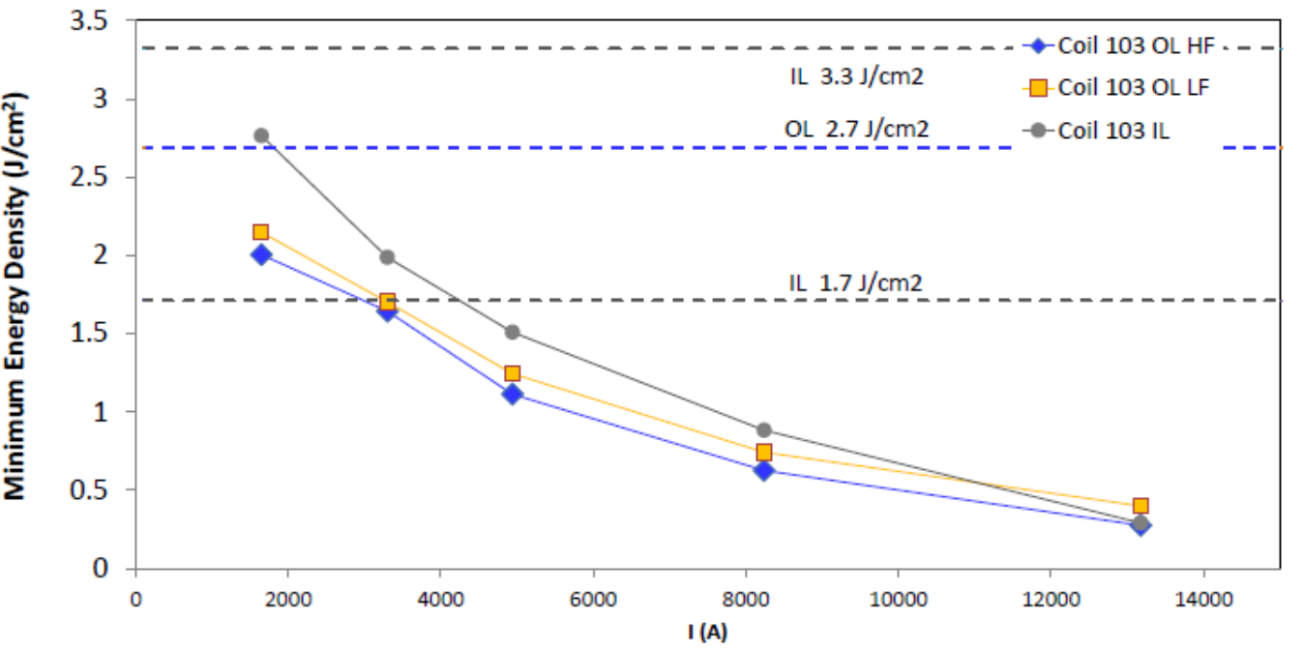
MQXFS1 Heater Effectiveness
Heaters tested in “MQXFC-like” conditions
➔ MQXF heaters can quench magnet at I < 2 kA
Starting configuration “2 strips in series” is OK
  IL strips can be powered singularly if needed
G. Chlachidze, S. Izquierdo-Bermudez & E. Ravaioli
1 IL strip per HFU
2 OL strips in series
2 IL strips in series

Slide 15
MQXFS1 Heater Delay Tests - I
OL heaters: very good agreement with simulations
12 ms
18 ms
Simulations performed with CoHDA by T. Salmi (TUT)

Slide 16
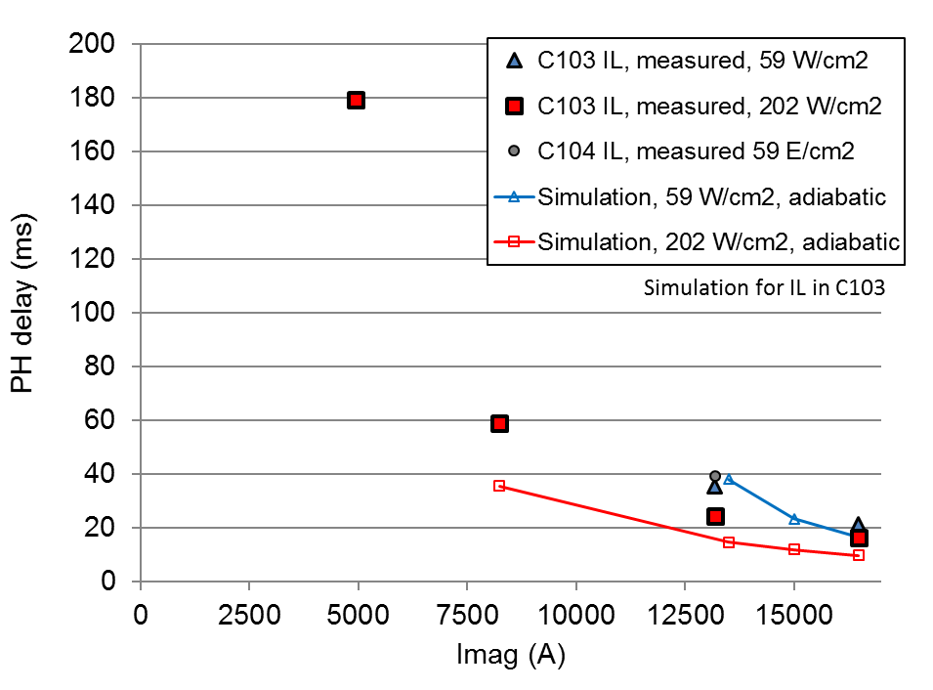
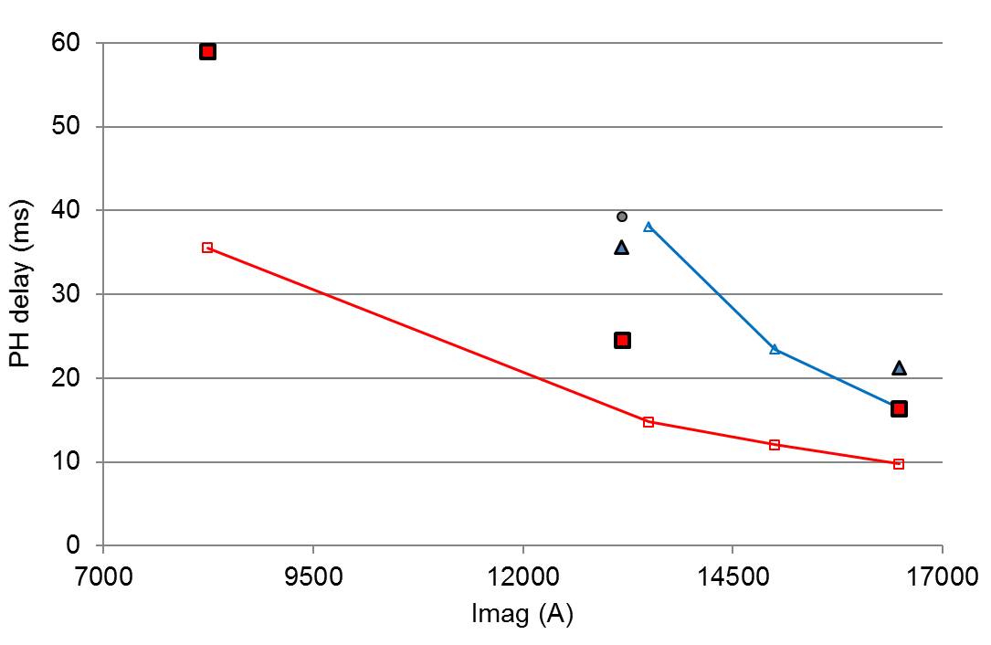
MQXFS1 Heater Delay Tests - II
IL heaters: longer delays than in simulations
18 cpr 10 ms
Simulations performed with CoHDA by T. Salmi (TUT)

Slide 17
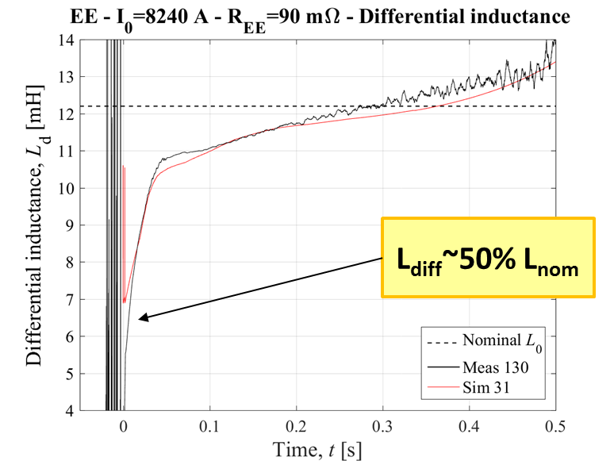
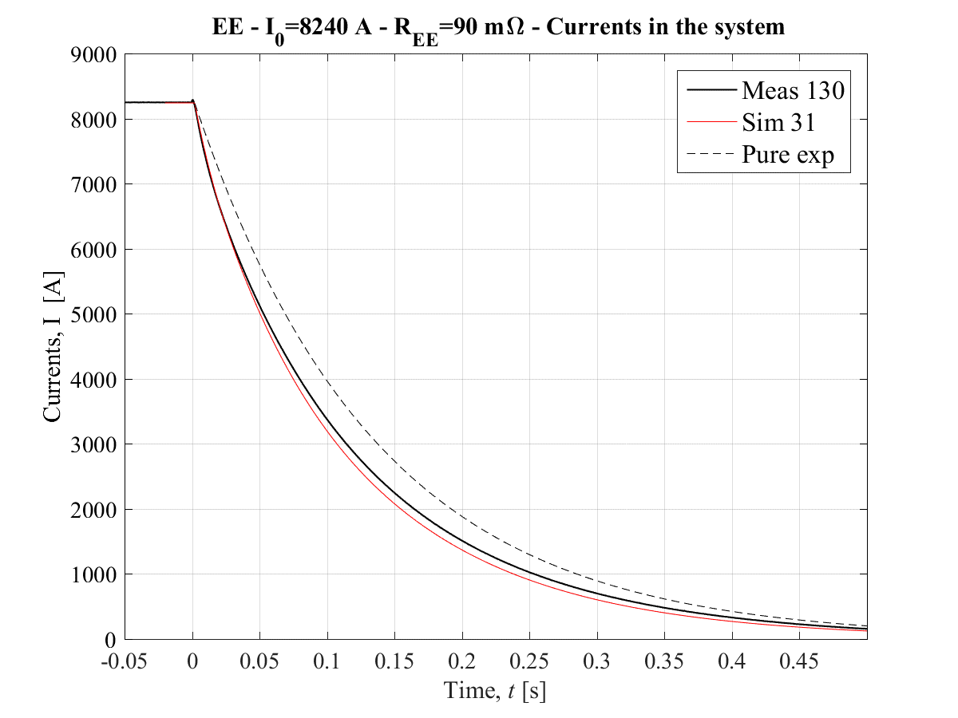
Dynamic effects
Very good match btw computed and measured dynamic effects
  L_{diff} ~ 50% L_{nom}

Slide 18
Updated Simulations

Slide 19
Peak Temperatures and Voltages
Scenarios: |  | 1 | 2 | 3 | 4 | 5 | 6
OL heaters |  | Y | Y | Y | Y | F1 | F2
IL heaters |  | Y | Y | N | N | N | N
CLIQ |  | Y | N | Y | N | N | N
Hot-spot Temp. | K | 219 | 229 | 228 | 324 | 349 | 363
Coil-Ground | V | 507 | 314 | 507 | 287 | 467 | 579
Turn-Turn | V | 31 | 32 | 35 | 54 | 65 | 71
Layer-Layer | V | 497 | 259 | 497 | 426 | 572 | 670
Mid-plane | V | 509 | 34 | 509 | 33 | 237 | 376
Assumptions:
Detection | mV | 100
Verification | ms | 10
Heater switch delay | ms | 5
Circuit |  | Single Power Converter for Inner Triplet
Energy extraction |  | NO
Dynamic effect on inductance |  | YES
Quench back |  | YES
Quench propagation OL-IL |  | YES, simulated
Simulations performed with Tales by E. Ravaioli
Failure scenarios:
F1 | one OL-HF circuit ( = 2 strips)
F2 | one OL-HF circuit and one OL-LF circuit, on the same coil and same side (= 4 strips)
Note: Energy extraction reduces hot-spot temperature by ~10 K, and increases coil-ground voltages by ~400 V in some cases

Slide 20
Code Benchmarking & Comparisons
Several codes are being used
  For quench simulations: Tales, QLASA, ROXIE, ...
  For Quench Heater delays: CoHDA
All codes have been tested using Nb₃Sn magnet data
Direct comparisons:
 | Code: | A | B
OL heaters |  | Y | Y
IL heaters |  | N | N
CLIQ |  | N | N
Hot-spot Temp. | K | 324 | 320
Coil-Ground | V | 287 | 357
Turn-Turn | V | 54 | 56
Layer-Layer | V | 426 | 560
Mid-plane | V | 33
Code A | Tales |  | Analysis by E. Ravaioli
Code B | QLASA & ROXIE |  | Analysis by V. Marinozzi

Slide 21
Conclusions
Tests and simulations are demonstrating that MQXF magnets can be protected using Outer Layer heaters
  Very reliable solution based on years of LARP tests
IL and/or CLIQ reduces Hot Spot by 100 K
  Additional redundancy can be provided by Inner Layer heaters and/or CLIQ
Plan will be finalized after Prototype tests
  Technical review

Slide 22
BACKUP SLIDES

Slide 23
6. Experience on MB heaters failure
According to MB_quench_heater_failures.ppt (M. Bajko) and EDMS 889445:
  12 magnets were refused after delivery to CERN due to quench heater failure
  11 magnets were reworked before delivery to CERN due to quench heater failure
  Around 2/3 of the failures are on the magnet extremities
According to https://twiki.cern.ch/twiki/bin/view/MP3/QuenchHeaterIssues:
  In total, 10 magnets showed quench heater issues:
    5/10 magnets were replaced during LS1 (all produced by the same company).
    In 2 magnets, the wire connection was repaired during LS1.
    In 3 magnets, the HF heater was replaced by the LF.
  In total, 32 heater power supplies failures were identified (mainly due to a switch related issue):
    All replaced
    It never happened in a quenching magnet (heater power supply voltage is always monitored in the LHC)
    It never happened to have two heater power supplies failing in the same magnet.

Slide 24
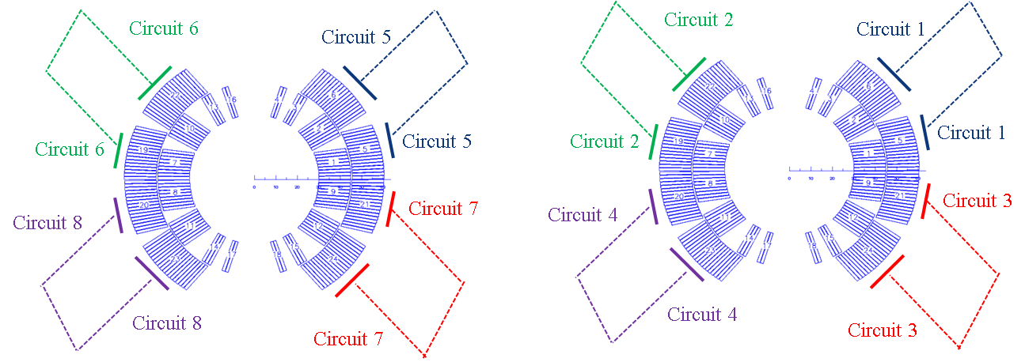
6. DS-11T vs MB
Circuit 4
Circuit 3
Circuit 2
Circuit 1
MB
11 T
https://twiki.cern.ch/twiki/pub/MP3/General_Info_13kA/main_dipole.pdf
If 1 QH power supply fails:
  Heater power supply will be replaced during the next access.
If 2 QH power supply fail:
  Beam dump and heater supply replacement.
If one heater circuit fail (1/4):
    Next access heater re-wired to the low field heater.
    During next long shut down the magnet might be replaced.
If more than two circuits fail: individual case needs to be studied.
If 1 QH power supply fails:
  Heater power supply will be replaced during the next access.
If 2 QH power supply fail:
  Beam dump and heater supply replacement.
If one heater circuit fail (1/16):
    During next long shut down the magnet will be replaced.
If more than two circuits fail: individual case needs to be studied.

Slide 25
Case 4 Coil-Ground

Slide 26
Case 4: Coil-Ground

Slide 27
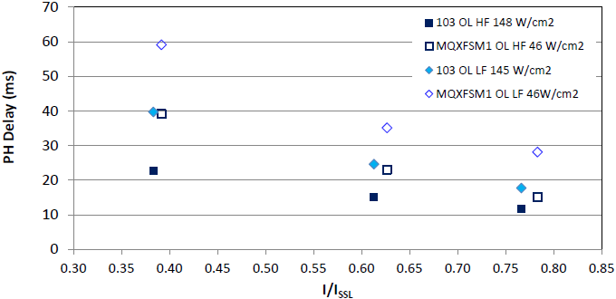
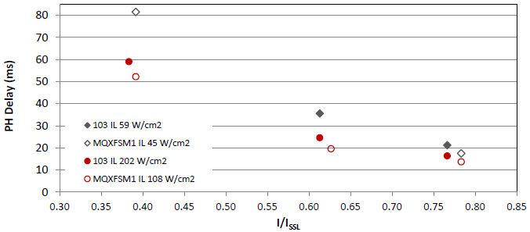
MQXFS1 Heater Tests - II
Outer Layer heater delays =< computed
Inner Layer heater delays > computed
  Worse at mid & low I
103:
CERN-style heaters tested in MQXF-like configuration
MQXFSM1:
LARP-style heaters tested with lower power density than nominal

Slide 28
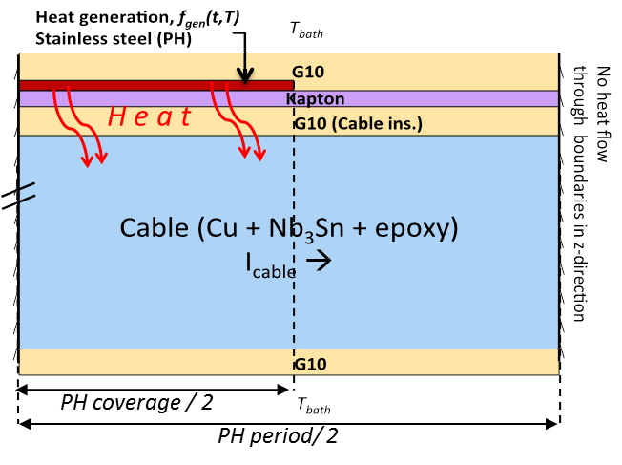
Heaters Optimization
Heaters have been designed & optimized by
  M. Marchevsky (LBNL) design w/o copper plating
  E. Todesco (CERN) design with copper plating
  T. Salmi (Tampere Univ.) delay computation & optimizat.
    2D thermal simulation using CoHDA
    Verification & calibration using LARP HQ magnets
      Criteria adjusted from T_{max} = T_{cs} ➔ T_{ave} = T_{cs}
HQ02a-b outer layer

Slide 29
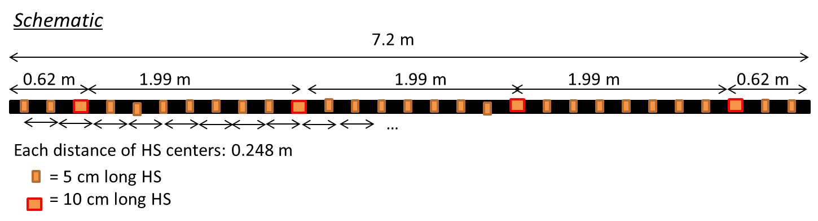
Protection at Low Current
Without energy extraction MQXF magnets may need active protection also at low current (1 kA)
  Quench initiation in a few points per coil is enough
  Heater design can be adjusted to do it in case present heaters cannot (tests in progress)
    ➔ Super-Heating stations

