Slide 1

SC procurement and QC at CERN
B. Bordini, A. Ballarino, M. Macchini, D. Richter
International Review of the Inner Triplet Quadruples (MQXF) for HL-LHC CERN, 7–10 June 2016

Slide 2
Outline
Wire Technical Specs
  Main Parameters
  Magnet Margin
Received 108/127 RRP Wire
The bundle-barrier PIT Wire
Status of the wire Procurement and Planning
Wire Production QC
  Suppliers’ documentation and measurements
  CERN verification measurements
Conclusions

Slide 3
RRP Wire Technical Specs
Main Parameters
 | MQXF Quadrupole
Wire diameter Φ | 0.850 ± 0.003 mm
Nominal sub-element diameter | < 55 µm
Copper to non-copper ratio | 1.2 ± 0.1
Wire twist pitch | 19 ± 3 mm
Wire twist direction | Right-handed screw
Minimum critical current @ 4.22K, 12T | 632 A
Minimum critical current @ 4.22K, 15T | 331 A
RRR (after full heat treatment) | > 150
n-value @ 4.22K, 12T | > 30
J_{c}(4.22 K, 12 T)≈2450 A/mm²
J_{c}(4.22 K, 15 T)≈1280 A/mm²

Slide 4
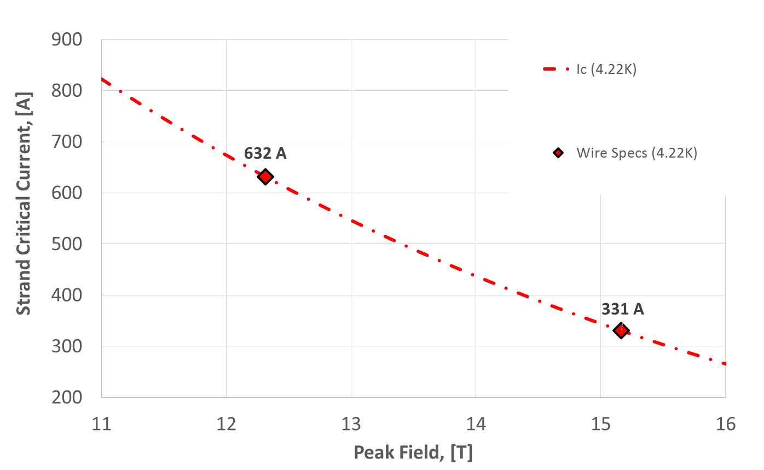
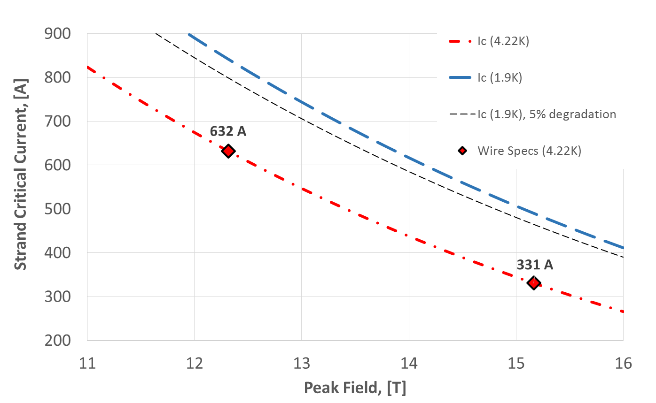
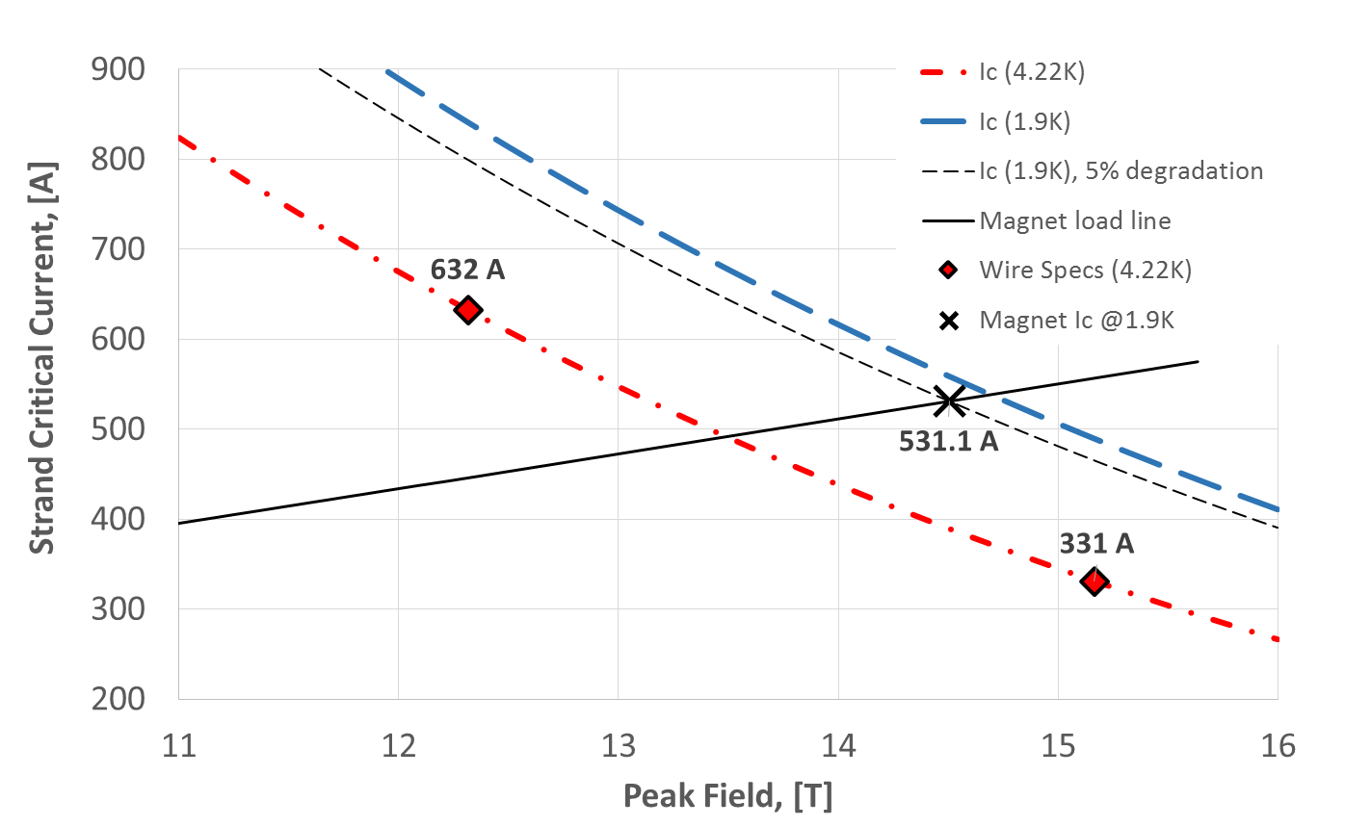
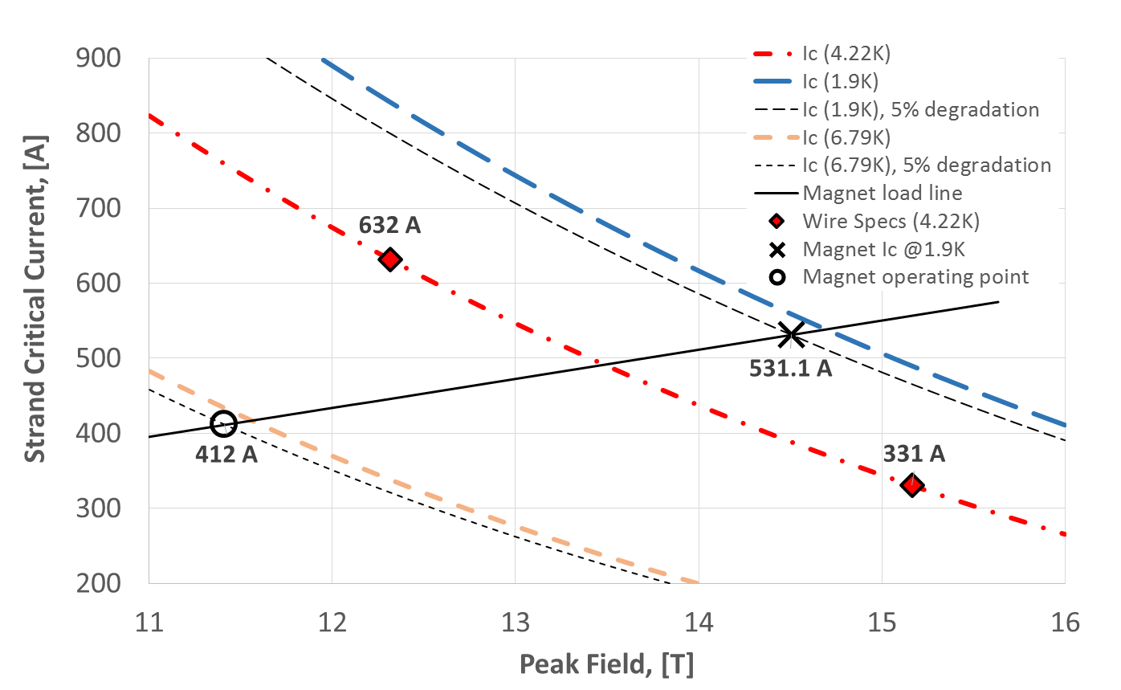
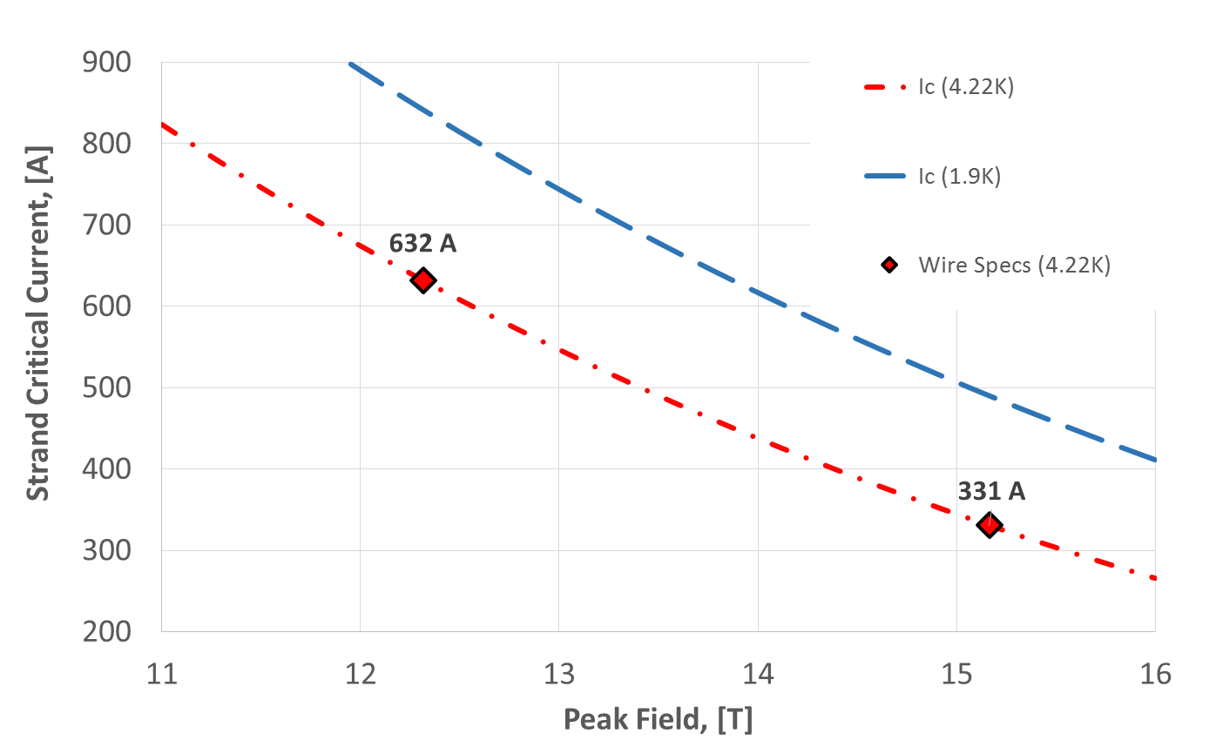
RRP Wire Technical Specs
Magnet Margin
4.9 K Temperature Margin, Current Margin 127%
22.4% Margin on the Load-Line

Slide 5
PIT Wire Technical Specs
Main Parameters
 | MQXF Quadrupole
Wire diameter Φ | 0.850 ± 0.005 mm
Nominal sub-element diameter | < 55 µm
Copper to non-copper ratio | 1.2 ± 0.1
Wire twist pitch | 19 ± 3 mm
Wire twist direction | Right-handed screw
Minimum critical current @ 4.22K, 12T | 590 A
Minimum critical current @ 4.22K, 15T | 331 A
RRR (after full heat treatment) | > 150
n-value @ 4.22K, 12T | > 30
J_{c}(4.22 K, 12 T)≈2290 A/mm²
J_{c}(4.22 K, 15 T)≈1280 A/mm²

Slide 6
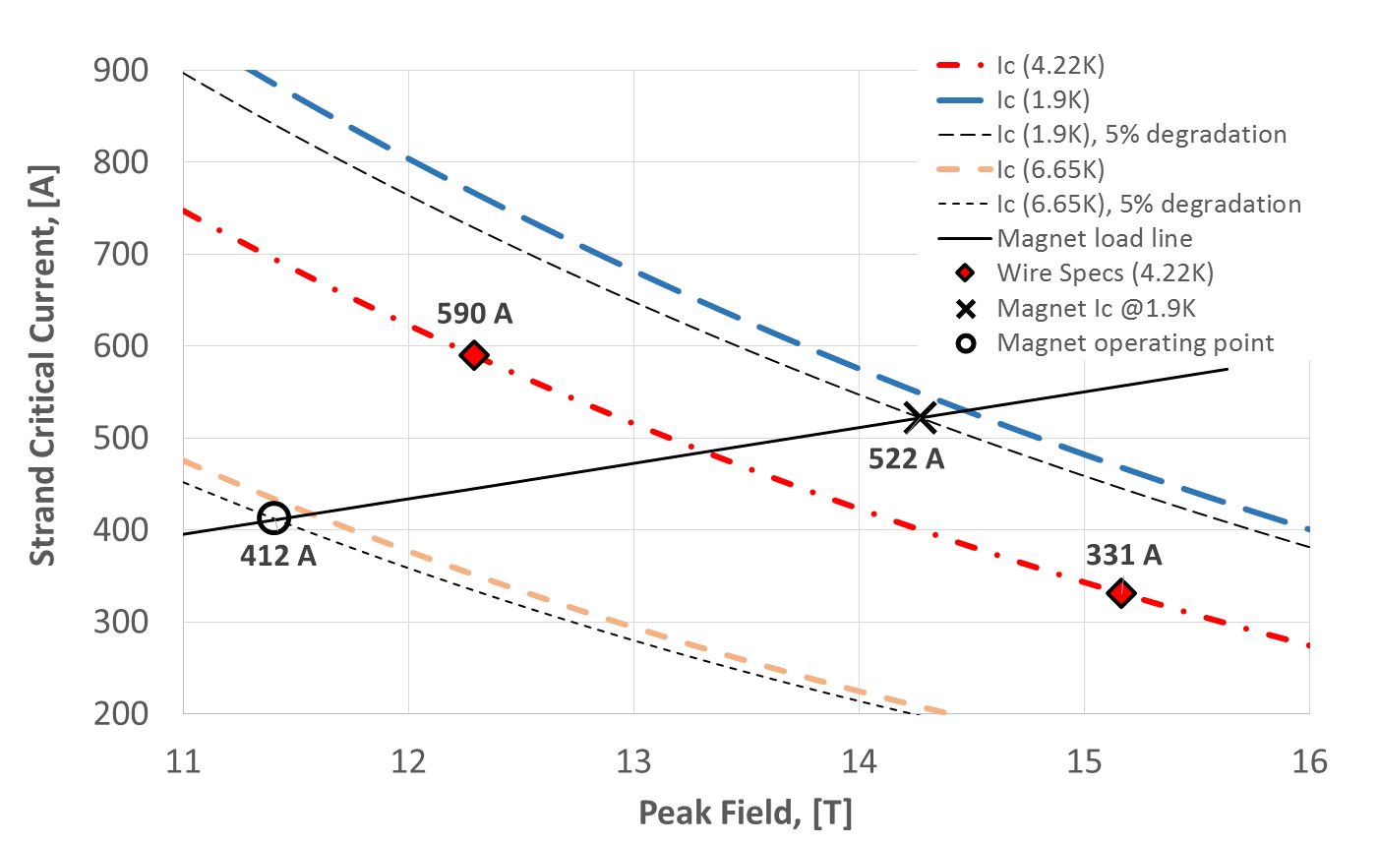
PIT Wire Technical Specs
Magnet Margin
4.75 K Temperature Margin, Current Margin 104 %
21.1% Margin on the Load-Line

Slide 7
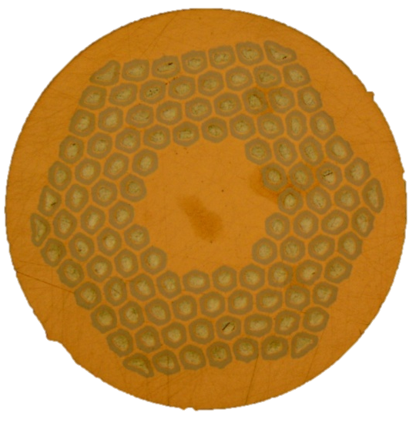
Received 108/127 RRP Wire
I_{C} @ 12 T, 4.22 K & RRR – OST Data 1/2
0.85 mm RRP | Value
Quantity [km] | 73.83
n° billets | 9
Layout | 108
Average I_{c} , RMS [A] | 720.1, 22.4
I_{c} spec [A] | 632
Average RRR, RMS | 290, 51.4
RRR spec | 150
Average J_{c}, RMS [A/mm²] | 2760, 85.0
Average B_{c2}, RMS [T] | 25.6, 0.45
For the RRP Prototypes and the series magnets the 108/127 layout will be used
The average I_{c} value is about 14% larger than specification; the RMS value is 3% of the average value
The average RRR value is almost two times the spec value; the RMS value is 18% of the average value

Slide 8
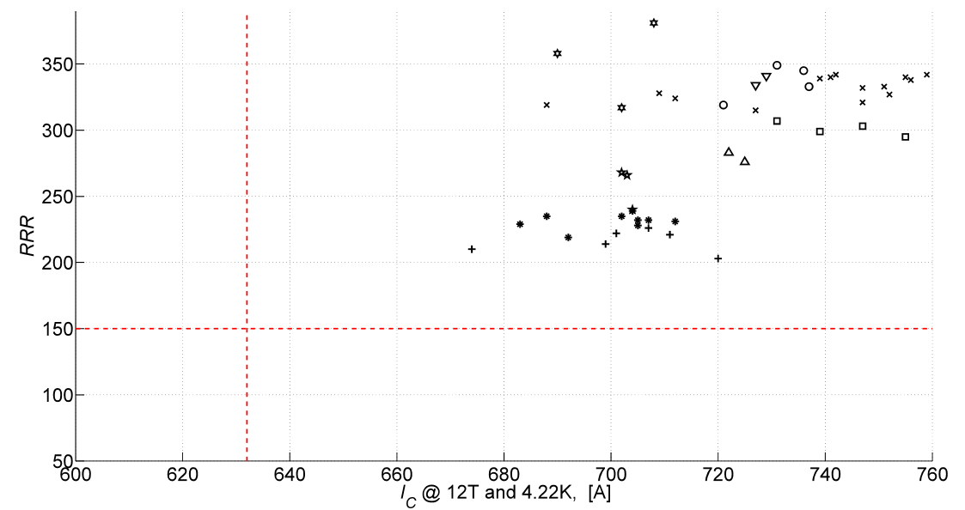
Received 108/127 RRP Wire
I_{C} @ 12 T, 4.22 K & RRR – OST Data 2/2
Different Markers
Different Billets
632 A
The lowest measured I_{c} value is more than 6% larger than spec
The lowest measured RRR is larger than 200

Slide 9
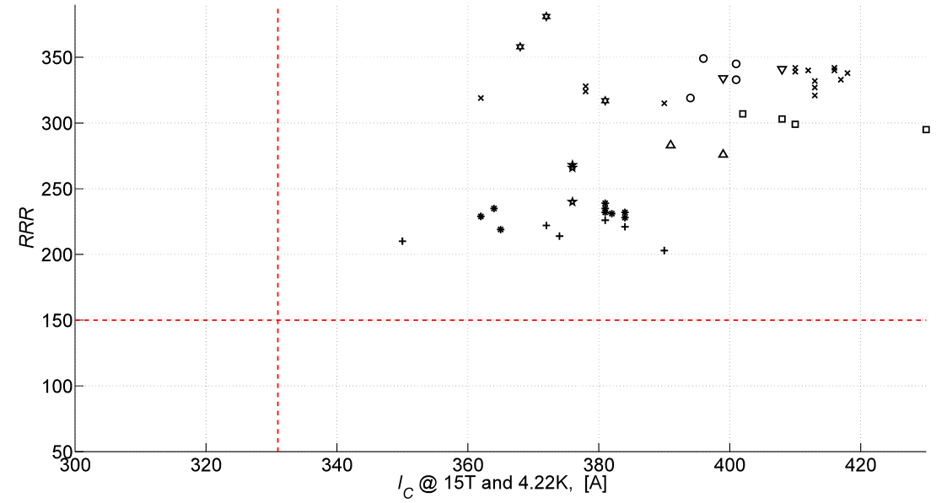
Received 108/127 RRP Wire
I_{C} @ 15 T, 4.22 K & RRR – OST Data
Different Markers
Different Billets
331 A
At 15 T the average I_{c} value is about 391 A, 18% larger than specification; the RMS value is 5% of the average value
The lowest measured I_{c} value is more than 5% larger than spec

Slide 10
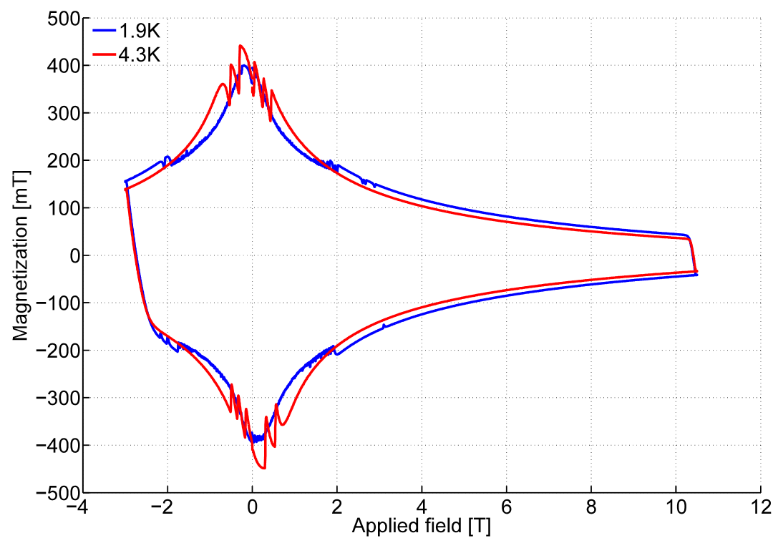
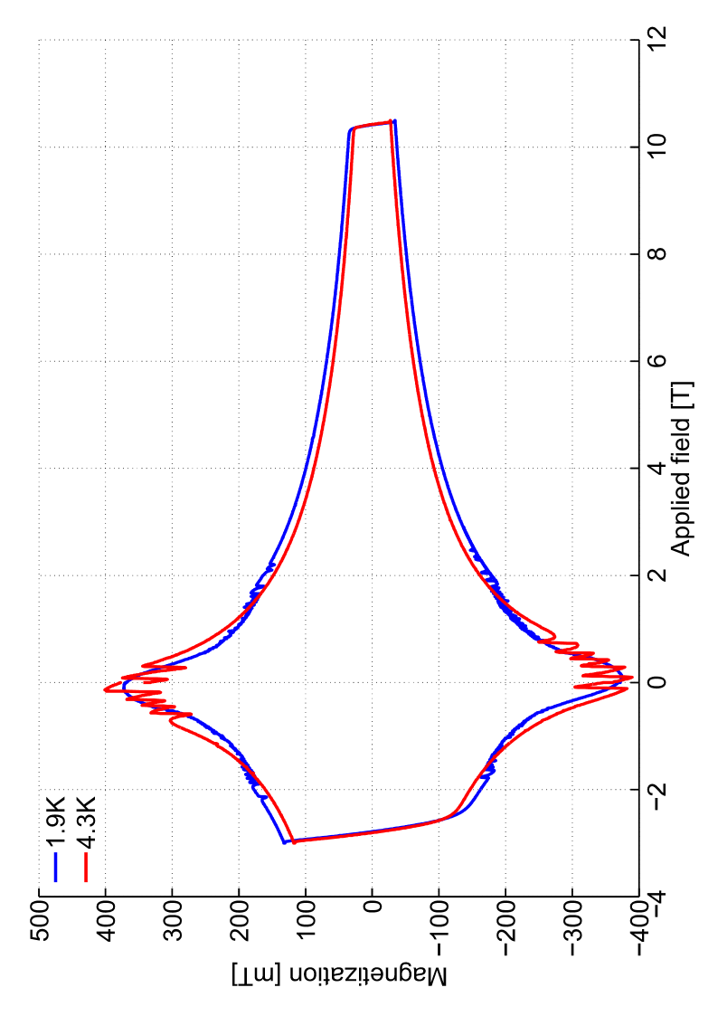
Received 108/127 RRP Wire
Magnetization
Billet | DM (3 T, 1.9 K)
11 | 303
12 | 300
13 | 297
15 | 303
16 | 304
23 | 298
24 | 296
26 | 297
27 | 299
Billet 12
Magnetization Measurements are carried out only at CERN
The 9 billets shipped to CERN were measured and, as expected, they showed a good reproducibility of the measured values

Slide 11
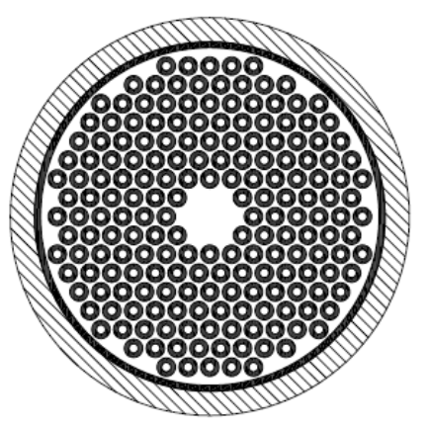
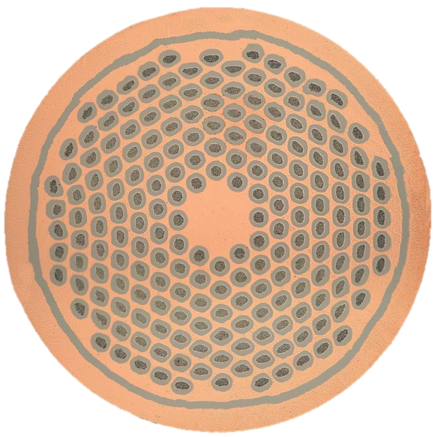
The Bundle-Barrier PIT wire
Layout and Improvements
Additional Nb barrier around the filaments’ bundle
Drastically reduced the effect on the Residual Resistivity Ratio (RRR) of:
  mechanical deformations
  The Heat Treatment (HT) cycle
Already a slightly larger critical current with respect to the previous generation of PIT wire; potential to further improve.
CERN/Bruker-EAS Collaboration for HL-LHC

Slide 12
The Bundle-Barrier PIT wire
Magnetization
The Nb bundle-barrier has a limited effect only for fields below 0.5 T
1.9 K
For fields above 0.5 T, the magnetization of the Nb bundle-barrier PIT is a factor of two lower than the one of 108/127 RRP

Slide 13
The Bundle-Barrier PIT wire
Material Produced
Produced 65 km of bundle-barrier PIT wire for models
  Long piece lengths: 96 % above 840 m (CERN unit length) and 86 % above 1680 m (two times CERN unit length)
  Characterized by Bruker-EAS 43 km of wire (reacted with one HT):
    average I_{c}(12 T, 4.22 K)=603 A; RMS 1.7 % of the average value
    average I_{c}(15 T, 4.22 K)=341 A; RMS 2.1 % of the average value
  Additional Heat Treatments are under investigation to further improve the current performance

Slide 14
Status of the RRP wire Procurement
Running Contract: Prototype Material
Received 73.660 km out of the 360 km ordered
In 2016 limited procurement: problems on the Nb raw material procured by OST for the sub-element diffusion barrier
  NbB particles that produce small tears in the barrier (low RRR)
  Never occurred in the past, most likely a new Nb ore source
  Established a polishing procedure that allows identifying particles in samples taken during processing of the ingot (and at final stage)
Received 100.8 km of wire for 3 dummy coils
Recovery Plan : delivery of the remaining material within the first quarter of 2017
No delay in CERN magnet program, we will compensate with the PIT

Slide 15
Status of the PIT wire Procurement
Running Contract: Prototype Material
Ordered 220 km of bundle-barrier PIT for prototypes
Bruker-EAS has started the production
  More than 50% of the filaments were already produced
  First Billet Assembly foreseen by middle of July
  All material expected by April 2017

Slide 16
Wire Procurement for Series
CERN will adopt a double sourcing procurement
2000 km over 5 years (2nd semester 2017- first semester 2022)
RRP wire procurement for Prototype
RRP Prototype Cable Needs
PIT wire procurement for Prototype
PIT Prototype Cable Needs
PIT Prototype Cable Needs
Wire procurement for Series
Cable needs for Series
F.C. → Financial Committee
S. → Signed (contract)
S.R. → Strand Received (first shipment)

Slide 17
Wire Production QC
Documentations: List of Documents per Shipment
Certificate of Conformance for Delivery
  List of spools, Shipped Length, Order Length, Order Weight
Pedigree Report
  Sub-Elements and ID of the raw material used in each billet
Raw Material Certificates
Production History
  Pieces after intermediate draw (1.6 mm), pieces after final inspection, gross yield (km and %), phase when breakages or cuts occurred
QA Datasheets – Results of the measurements on the wire

Slide 18
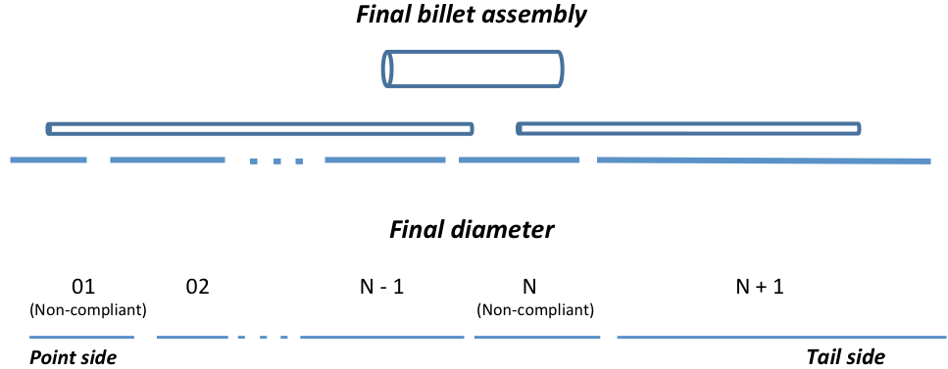
Wire Production QC
Supplier Measurements per Piece Length
Continuous measurements of the diameter, ovality and eddy current
At least*: 1 Copper to not-Copper, 1 Twist Pitch length and direction, I_{c} and 1 RRR - (tail of the piece length)
*Additional measurements: 1 Cu to not-Cu, 1 Twist Pitch, 1 I_{c} and 1 RRR on the point of the piece length in the case of
the first delivered piece length of a billet
a piece length following a not delivered piece length
Each extremity of the delivered piece lengths are characterized**
** The X indicate the locations of the measured samples
X
X
X
X
X

Slide 19
Wire Production QC
Supplier Measurements per Billet
2 micrographs (point and tail) with measurements of the minimum and maximum dimensions of the sub-elements
1 micrograph (tail) of the rolled wire
6 sharp bend tests (3 billet point, 3 billet tail)
6 spring back test (3 billet point, 3 billet tail)
1 I_{c} of 15 % rolled sample (billet tail)
1 RRR of 15 % rolled sample (billet tail)

Slide 20
Wire Production QC
Verification measurements by CERN or other Ref Lab
1 micrographs x billet (tail)
6 sharp bend tests x billet (3 point, 3 tail)
6 spring back test x billet (3 point, 3 tail)
1 I_{c} of 15 % rolled sample x billet (tail)
1 RRR of 15 % rolled sample x billet (tail)
1 magnetization sample x billet
1 diameter, 1 Copper to not-Copper, 1 Twist Pitch length and direction, I_{c} and 1 RRR x piece length - (tail)

Slide 21
Wire Production QC
Measurements of the received OST wire
I_{C} @ 12 T, 4.22 K – OST vs CERN data
CERN measurements about 5% lower
Investigation on going
In any case full in spec with large margin

Slide 22
Wire Production QC
Measurements of the received OST wire
B_{C2} @ 4.22 K – OST vs CERN data
Lower B_{c2} measured by CERN (0.5-1 T)
Investigation on-going
Most likely due to different strain on the sample

Slide 23
Wire Production QC
Measurements of the received OST wire
RRR – OST vs CERN data
The RRR value measured by CERN is about 10% lower
In any case full in spec with large margin

Slide 24
Wire Production QC
Measurements of the received OST wire
Cu to non-Cu – OST vs CERN data
Good agreement between CERN and OST data

Slide 25
Approval Procedure
Database: 3 phases approval procedure
The data from the manufacturer (QA datasheets) are in Excel format and are uploaded automatically in the CERN superconductor database
The results of the CERN verification measurements are also stored in the superconductor database
The approval procedure is managed via the superconductor database and it is divided in three phases:
  Analysis of the manufacturer data: completeness and conformity. The manufacturer will obtain the green light for shipping the material only when this phase will be by approved
  Analysis of the CERN Verification measurements: conformity with respect to the technical specification
  Comparison between manufacturer and CERN data: the difference shall be limited

Slide 26
Conclusions: Performance, Procurement
For the prototypes and series magnets the following wires will be used
  RRP 108/127
    CERN has received about 74 km of this wire; it satisfies the technical specs with a significant margin
  PIT 192 Bundle-barrier
    Solved the problem of RRR degradation due to: 1) mechanical deformation; 2) overreacting the superconductor
    Produced 65 km, which will be used for models, with good performance
    Lowered the specs at 12 T (from 632 A to 590 A); 1% impact on the load line margin
    Started production of 220 km for the prototype magnet
For the series CERN will adopt a double sourcing wire procurement

Slide 27
Conclusions: Wire QC
To guarantee the quality of the received wire, CERN requires for each billet
  A comprehensive documentation that describes the production process and the used raw material
  A detailed measurement campaign from the manufacturer
  Extensive verification measurements that cross-check the manufacturer data
All the data are stored (electronically) in the superconductor database and an extract of these results is sent to the QA team
The material approval procedure is managed via the superconductor database
Matlab routines, which extract the data from the superconductor database, trace the evolution of the wire production

Slide 28
Thank You For Your Attention !

