Slide 1

Long coil manufacturing plan & QC at CERN
F. Lackner, P. Ferracin, F. Savary, J-C. Perez, H. Prin, M. Duret,
L. Grand-Clement, D. Smekens, C. Loeffler, L. Favier, S. Triquet, S. Luzieux,
R. Principe, C. Scheuerlein, P. Revilak, T. Genestier, E. Cavanna,
& all other colleagues involved in the LMF MQXFB activities.
International Review of the Inner Triplet Quadruples (MQXF) for HL-LHC, June 8, 2016

Slide 2
Content
Coil production plan schedule/status/team
Infrastructure and tooling
  Infrastructure (Layout, Winding, Furnace, Impregnation)
  Tooling (Winding/Curing/RHT/IMP)
    QA: Procedures and follow up with 11T; Procedures in built up for first coils.
      Risk mitigation, Expected process times (reference for schedule)
Conclusion

Slide 3
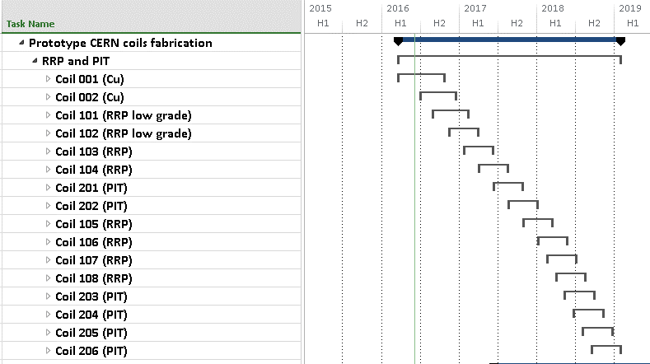
Production schedule MQXFB prototypes
Practice coils
  First Cu coil started
(first layer wound/cured)
Then, 2nd Cu coil &
2 low-grade coils
Then, 2 RRP and 2 PIT coils
for 1st prototype
In total, 2 prototypes, 12 coils

Slide 4
Production outlook MQXFB prototypes
Pole supply for 2 Prototype magnets from 2016 to 2018
Project coil demand: 16 coils (4 practice; 12 poles)
Start of production
 | Cu | RRP | PIT | ∑
2016 | 2 | 2* |  | 4
2017 |  | 6 | 2 | 8
2018 |  |  | 4 | 4
Assumed initial production time 100 days/coil
* low grade

Slide 5
Production goals for 2016
Validation of tooling and infrastructure with practice coils
Coil status
Coil ID | type | Steps by end of 2016
001 | Cu | Finished
002 | Cu | Finished
101 | RRP* | Reaction heat treatment
102 | RRP* | Winding and curing
Assumed production time 120 days/coil
* low grade

Slide 6
Current status
Projected coil status
Coil ID | type | Current step
001 | Cu | Curing IL, start winding OL
002 | Cu | Cable available for winding
101* | Nb₃Sn
102* | Nb₃Sn
Assumed production time 120 days/coil
* low grade

Slide 7
How… ?
Safety first: ES&H, Talk by T. Otto, 9 Jun 2016, 09:00 - 31-3-004 - IT Amphitheatre (CERN)
Processes transferred from CERN MSC-MDT section and US LARP program:
  Minor adjustments to tooling and infrastructure, except from length
  Counting on experience & feedback from 11T dipole prototype
  Subsequently becoming responsible for procurement of components
Continuous exchange of information:
  Weekly meeting (coordination & technical) was held with MDT
  Participation to video meetings with US-LARP
  From mid of June :
  New combined coordination meeting for 11T and MQXF (Weekly)
  Separate engineering meeting on technical challenges (2 weeks interval)
QA processes are currently being drafted and written with LMF QA team
QA: Talk by R. Principe, 9 Jun 2016, 12:00 - 31-3-004 - IT Amphitheatre (CERN)

Slide 8
Who… ?
LMF
US LARP
MDT
The team consists of:
Engineers | CERN & (Industrial contracts) | 5 (2)
Technicians | CERN & (industrial contracts) | 5 (2)
Technicians | FSU contracts | 3
QA - team | LMF
…Industrial contracts are shared between 11T & MQXF

Slide 9
LMF Infrastructure for MQXF
A brief introduction to your visit in LMF

Slide 10
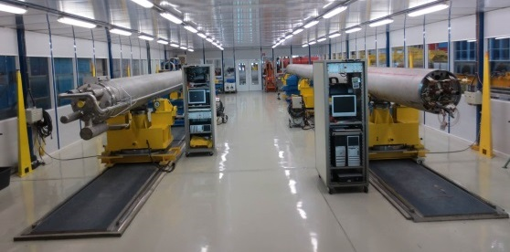
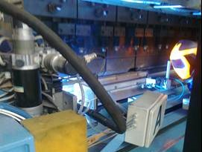
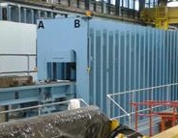
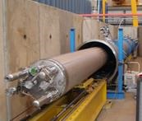
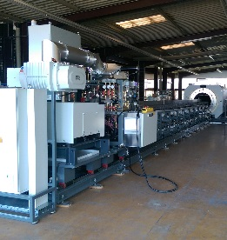
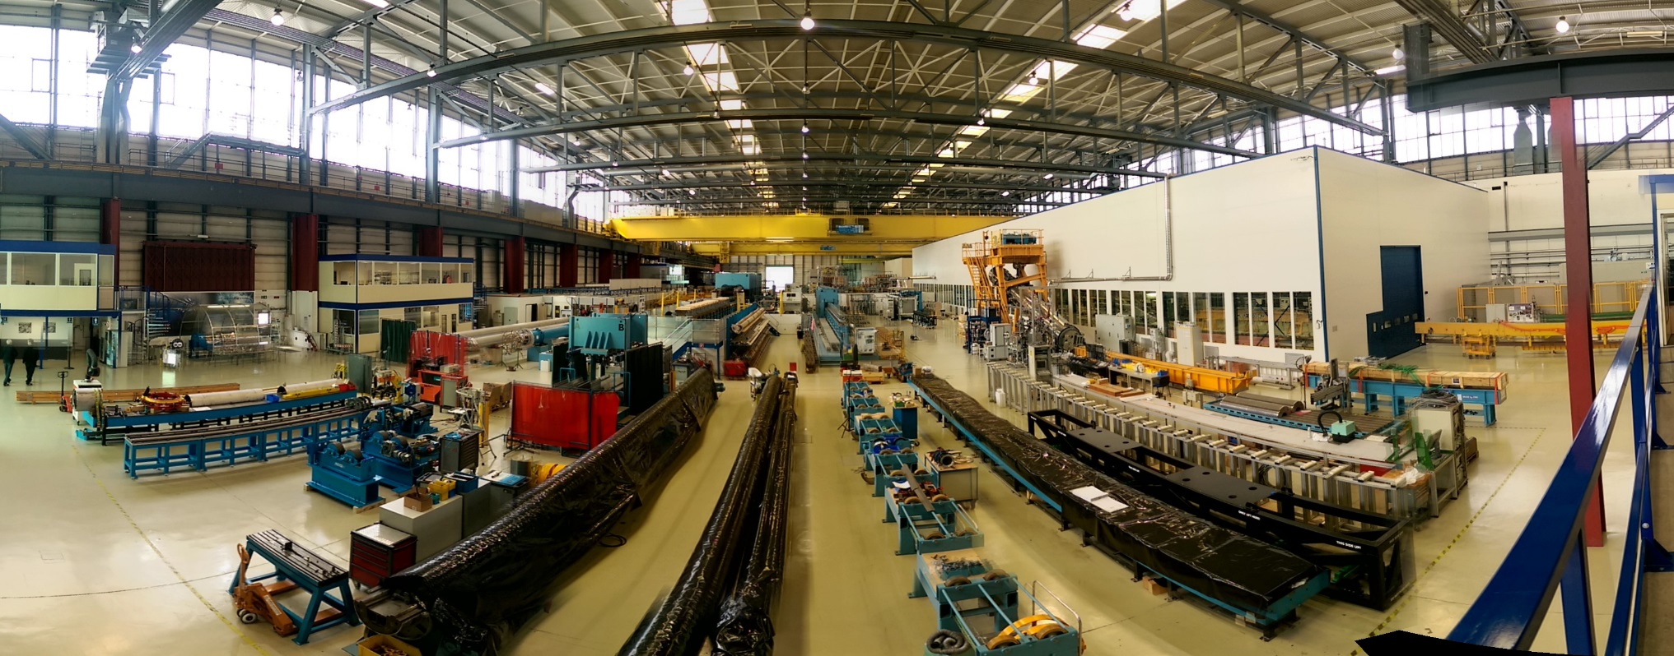
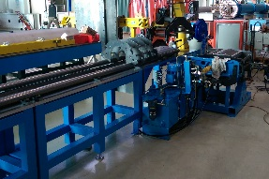
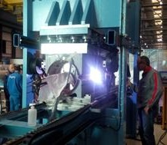
Finishing benches
Geometrical measurements
15m Welding press
15m Collaring press
Pressure/leak bench
Nb₃Sn Reaction furnace
“Winding house”
Impregnation chamber
Yoke assembly bench
Cold mass magnetic measurement bench
Welding press for 2m models
Half Yoke returning bench
Cold mass assembly bench
Collared coil returning bench
Collared coil magnetic measurement bench

Slide 11
Preparation, 2014 - 2016
Refurbishment of LHC winding machine (2015)
MQXF conform reaction furnace (2014-2016)
Impregnation machine in combination with 11T dipole (2014-2016)
Hydraulic sectoring of curing press in combination with 11T dipole (2015)
Re-arrangement of LHC main dipole production area (2015 - 2016)
Development of adequate rotation bench and lifting tools (2016)
Purchase of handling tool (2016)
Assembly benches (2016)
Metrology, benches and devices (2015 - 2016)
Coil storage, buffer zone

Slide 12
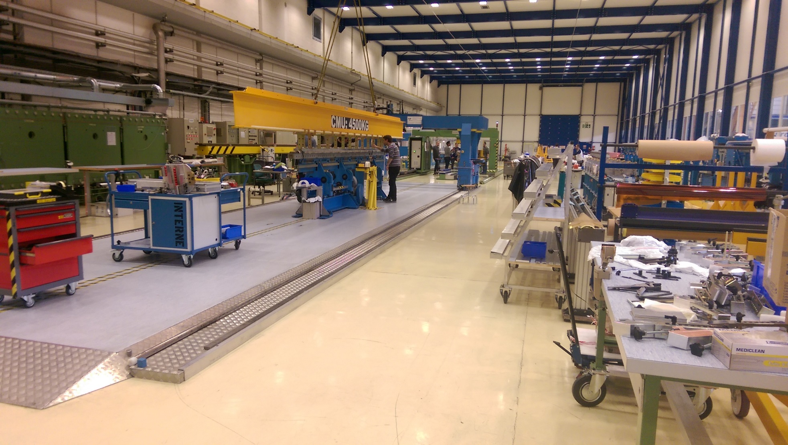
LMF - Winding house (bldg. 180)

Slide 13
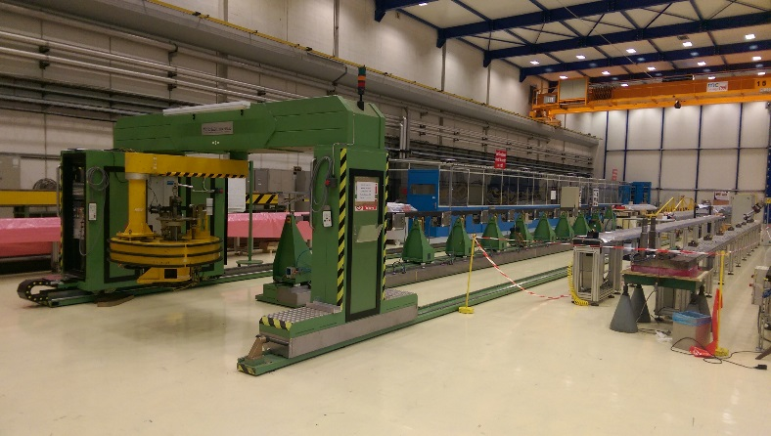
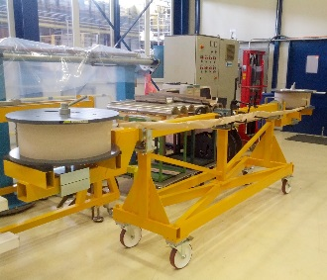
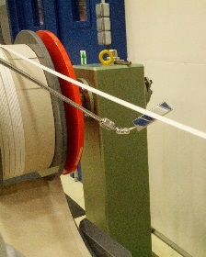
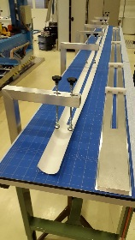
MQXFB – refurbishment of machine
Refurbishment of previous dipole winding machine for LHC:
Insulated cable is separated on two reels for inner and outer layers
New support for mandrel
New improved cinematics
New transfer gantry OL
Integrated strain tension force measurement system
New control system
Automatic driving

Slide 14
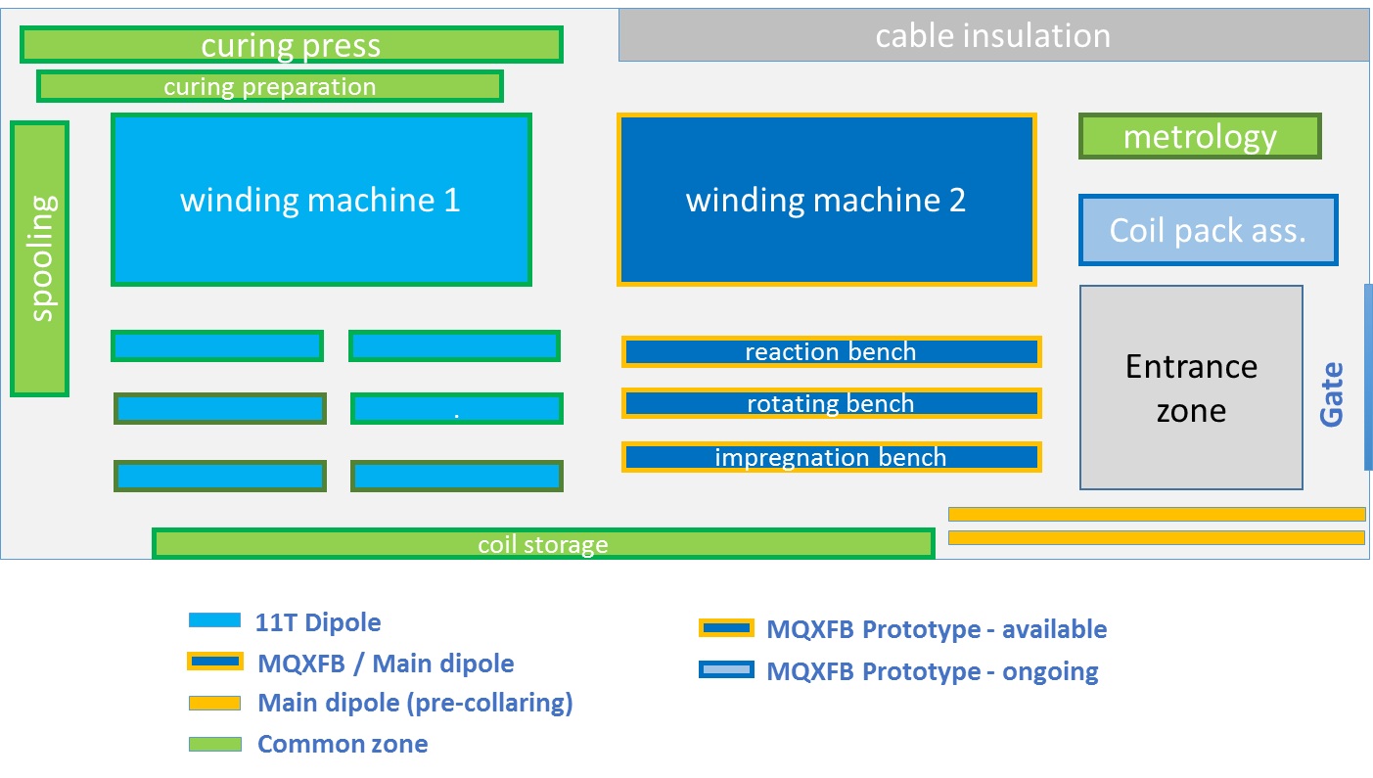
Layout of the LMF - Winding House
Re-arrangement of existing winding house layout and infrastructure for simultaneous winding operations for 11T and MQXF. MQXF benches designed for double use with LHC main dipoles.

Slide 15
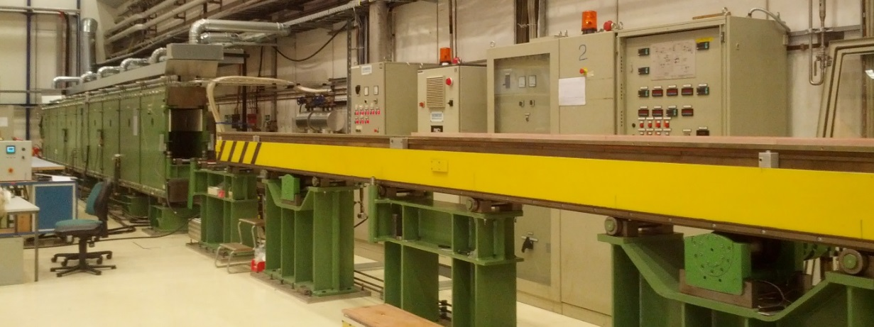
Curing press
Curing Press :
  Re-use of the 15m long press used for NbTi LHC dipole magnets
  Hydraulic sectoring was required for compatibility with the change in coil length.
Hydraulic sectoring was finalized for full compatibility with the 11T and MQXFB coil design.

Slide 16
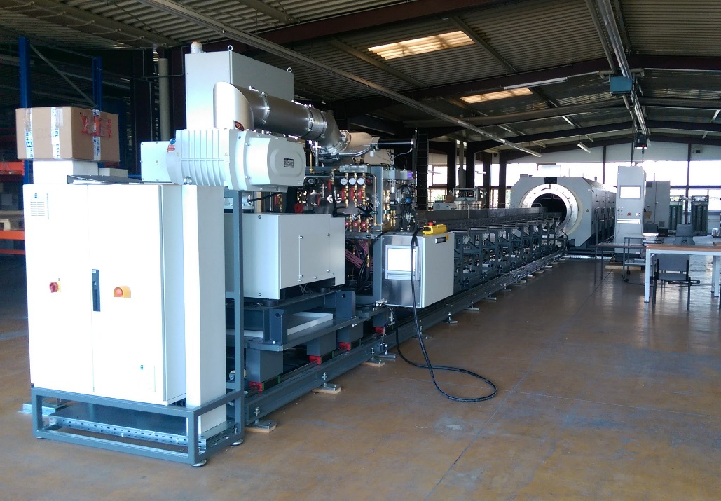
LMF - Reaction furnace
Contract launched in April 2015 – reception April 13th, 2016
In-house acceptance: June 2016
Plateaus 210°C; 400°C; 665°C; ±3°C, max. 900°C
Heated length Ø1 m; l 10,5 m; 700 kg/m
Width < 4 m; l < 35 m; h< 4 m
40 probe TCs
Evacuation at RT to 2x10⁻² mbar; 700 l/s
Argon purging prior RHT
Loading and unloading automatic 20mm/s², 0,5 mm/m
Oxygen reduction in < 10 h
Heat treatment start oxygen level < 10 ppm
52 weeks delivery
Allows simultaneous reaction of two coils
Final in-house acceptance June 2016

Slide 17
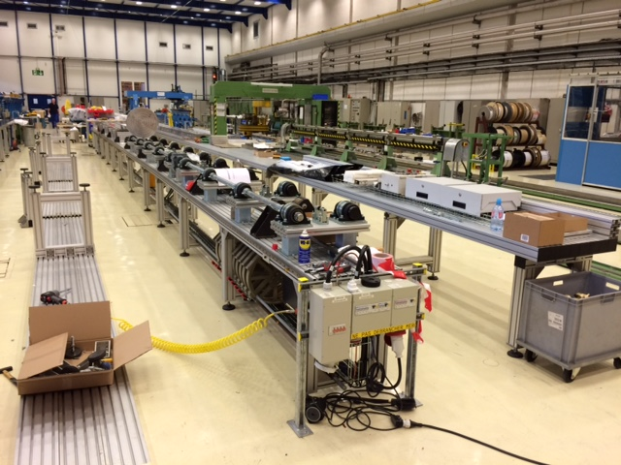
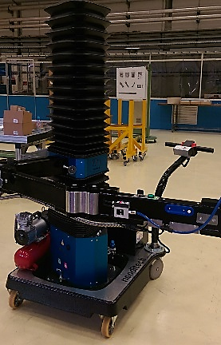
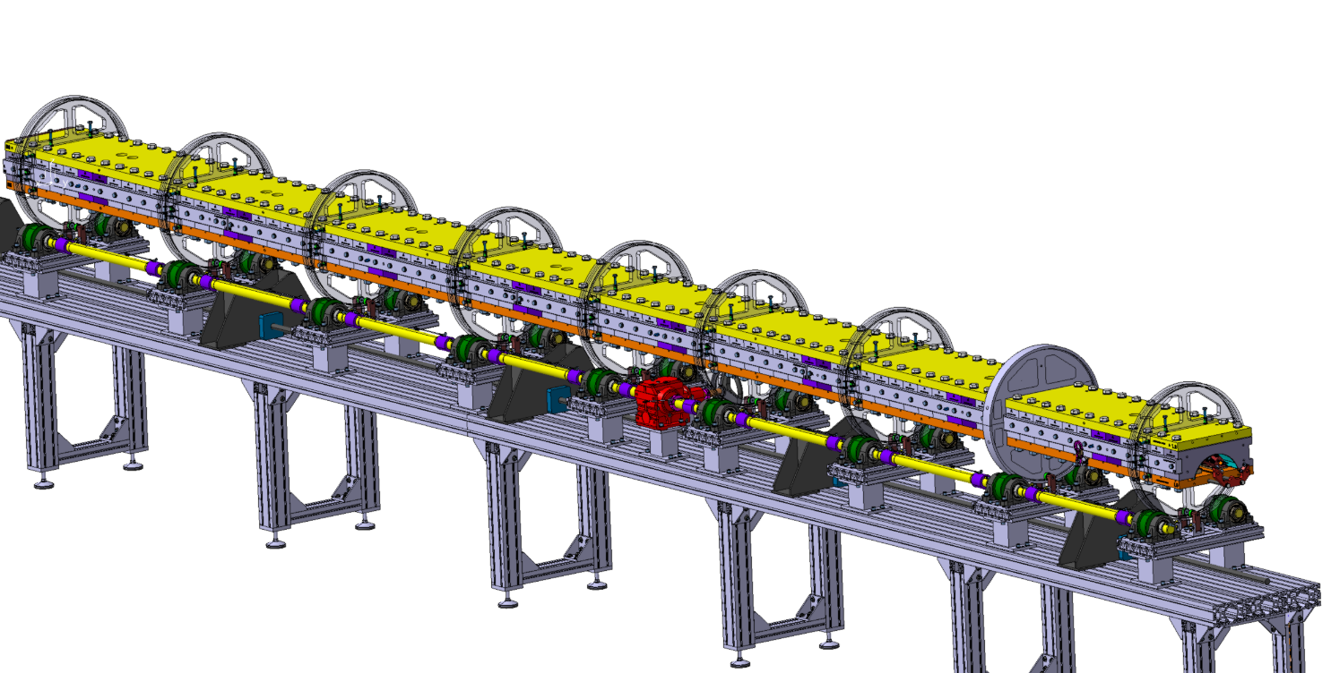
Specific benches & handling tool
Autonomous and mobile lifting assistance needed:
  22kg formblocks
  5 kg mandrelblocks
Guarantee an easy and safe positionning of blocks on the reacted coil
9 supports
Accuracy of the rotating axis of (0.2mm/m)

Slide 18
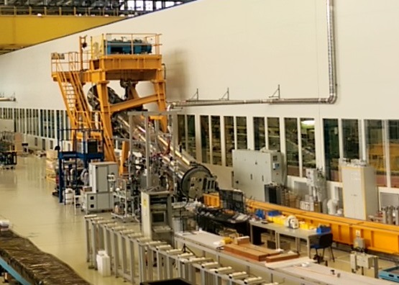
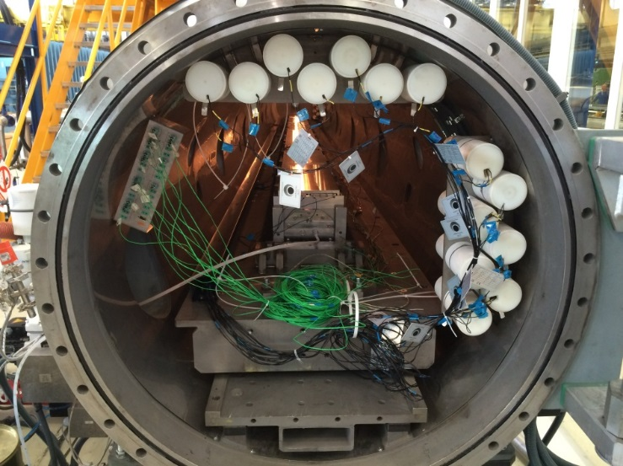
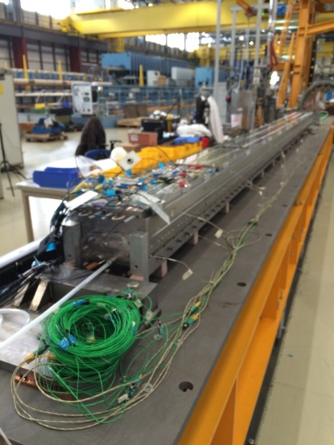
Impregnation system
VPI machine, currently under commissioning
Continuous learning
Three short model coils (sm201, sm114, sm115) already impregnated.
A first 11T 5.5 m copper coil impregnation was performed.

Slide 19
Specific tooling for MQXFB

Slide 20
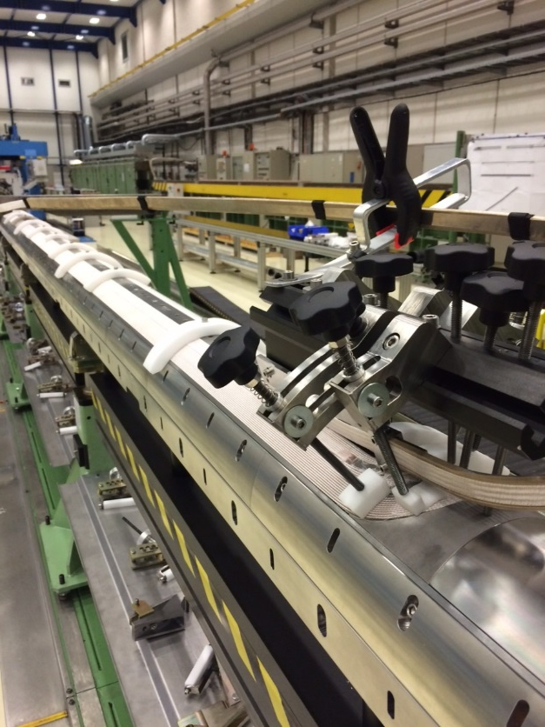
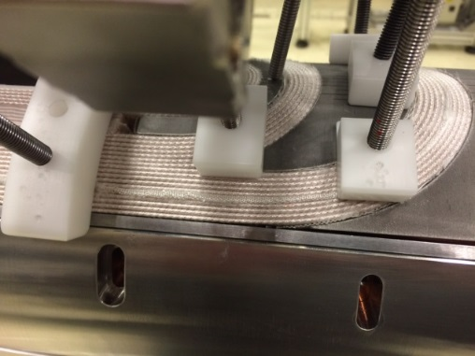
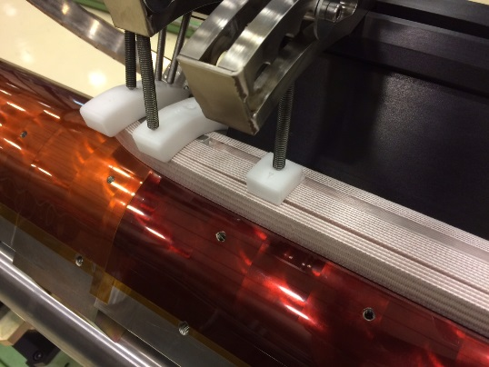
Specific tools required for coil winding
Dedicated tools coming from short models experiences, specially in the heads zones:
Heads upper pushers
Lateral pushers
Upper guides
Cable « strain gauge » to monitor the winding tension
Interlayer template

Slide 21
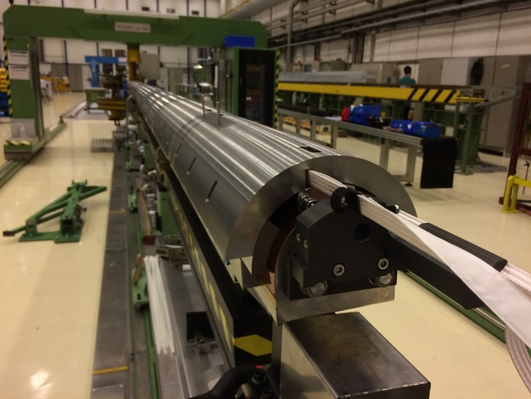
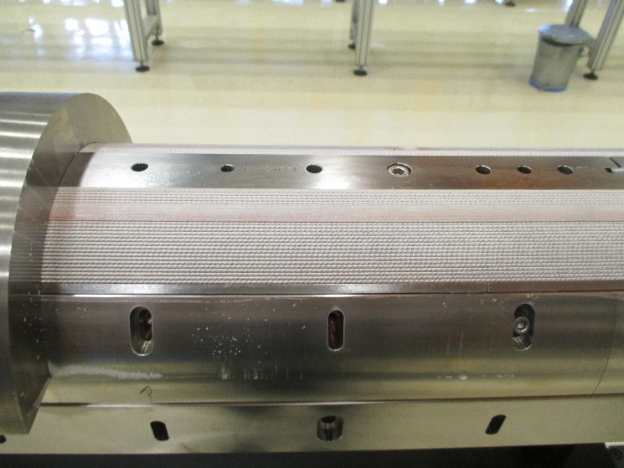
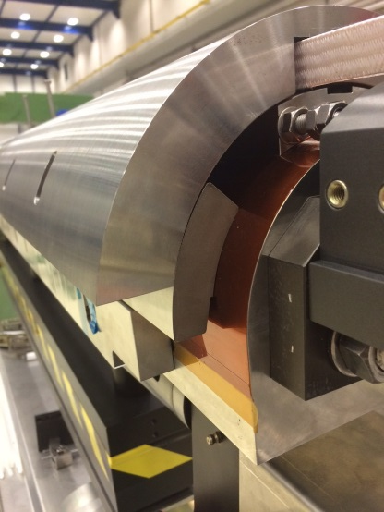
Curing tool
Curing mould and heaters are available
Lifting tool available
First curing process on inner layer finished

Slide 22
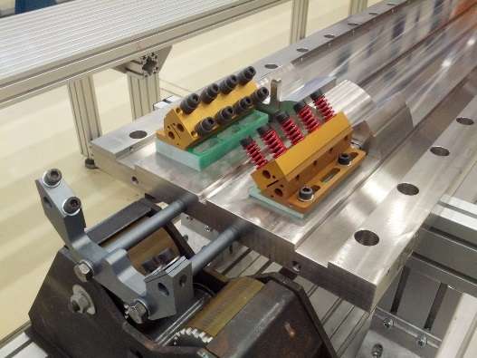
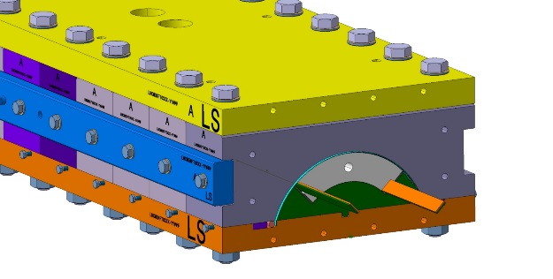
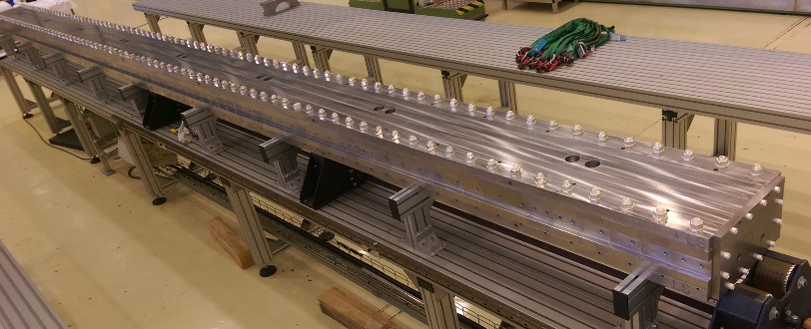
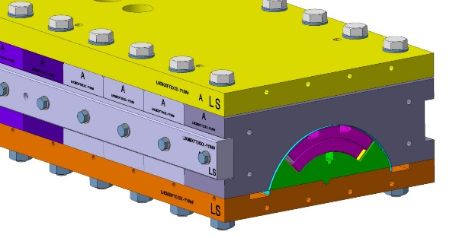
Reaction and impregnation fixtures
Blank assembly completed
Will be used for the inhouse acceptance test of reaction furnace
Splicing block available
Geometric monitoring plan of plates and blocks implemented after each reaction cycles

Slide 23
Coil metrology

Slide 24
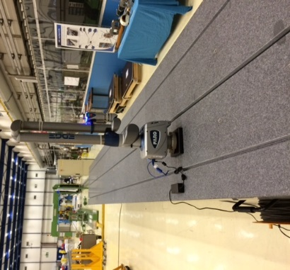
Metrology instruments
Metrology of coil
Tooling:
Measurement table – delivered, length 12 m
FARO-Arm (Coil metrology)
Lasertracker (Cold mass metrology)
Finishing benches and metrology
The laser tracker Leïca LTD500 will be replaced by AT-402 or AT-930.
Axyz software is being substituted by Spatial Analyser.
The Magnet Geometrical Measurement automated process (MGM-SA) is being programmed with EN-STI-ECE leaning on past developments (MGM).
Faro edge 2.7 will be used inside the winding house, delivery: already received
Granite table for winding house metrology, delivery: May 2016

Slide 25
Production processes

Slide 26
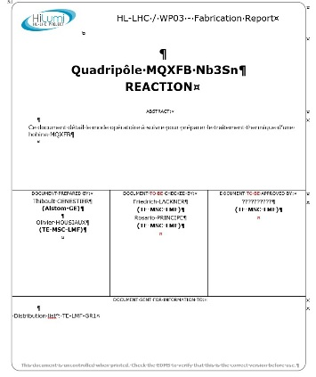
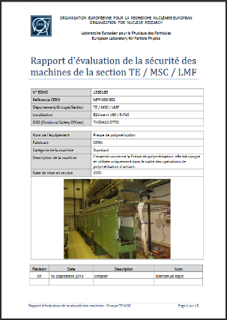
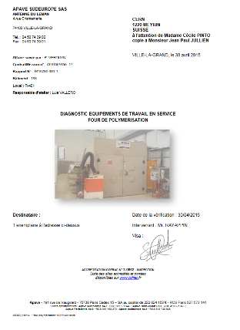
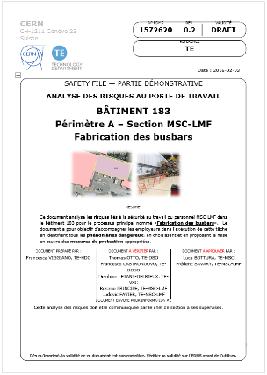
Safety and quality aspects
A CERN number is given for each machine.
All technical documentation relevant are archived inside EDMS:
    Certificate of conformity, User manual, Drawings…
A preliminary safety report is prepared by QA,
A safety diagnose is made by a certified company,
The working procedure written by QA includes the safety instructions,
Finally the workspace safety is analyzed by TE department.
Covered in detail by R. Principe & T. Otto

Slide 27
Risk mitigation and redundancy
Production step | Duration | Risk | Mitigation
Winding | 4 – 5 weeks | Only 1 winding machine
Curing | 3 days | 1 curing press | Curing based on mechanical clamping
 |  | 1 curing tool
 |  | 1 set of resistive heaters
RHT | 2 weeks | 1 furnace | Potential for heat treatment of 2 coils
 |  | 1 reaction fixture | Purchase 2nd reaction fixture*
Impregnation | 3 – 4 weeks | 1 system – bottle neck in the production flow | Currently no alternative available
 |  | 1 impregnation system | Purchase of 2nd impregnation fixture*
*Additional fixtures would lead to bottle neck on assembly and rotation benches
*Increase of storage for tooling
*Additional manipulation tool
…

Slide 28
Conclusion

Slide 29

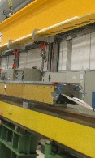
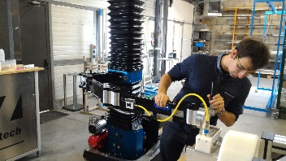

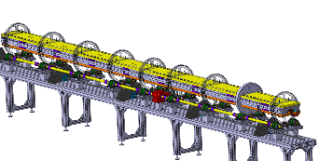

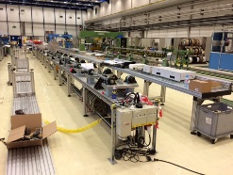


Tooling, status overview
Winding machine Spooling machine Transfer gantry OL
Curing press mould Curing mould
Reaction furnace Reaction fixture In-house acceptance test
Impregnation machine Impregnation fixture Commissioning with 11T
Lifting tools Manipulatoin tool
Rotation bench
Preparation benches Splicing block
Coil pack assembly
Design study ongoing
Baseline from MDT
Installation inside WH

Slide 30
Conclusions
Production line preparation is close to finalization
Winding house – Transition to Nb₃Sn coil production is well advanced, finalization in the end of 2016
Heat treatment – Reaction furnace commissioned, in-house acceptance ongoing, 2nd pair of reaction and impregnation fixtures will be ordered once the production process has saddled and no modifications are needed
Impregnation – Commissioning of impregnation system is ongoing, continuous improvement is necessary for reducing onsite preparation time
Assembly tooling – Design was launched
Next talk: J. Perez, Long magnet manufacturing plan and QC at CERN
Talk: H. Prin, Cold mass design, assembly plans and QC at CERN
Validate all remaining assembly process and tooling during first prototype assembly

Slide 31

Thank you

