Slide 1

MQXFB manufacturing plan and QC
Juan Carlos Perez, TE-MSC-MDT
on behalf of MQXF collaboration team
Thanks to all contributors
Review on the Inner Triplet Quadrupoles (MQXF) for HL-LHC – 7th to 10th June 2016
http://indico.cern.ch/event/524804/

Slide 2
Outline
MQXFB magnet cross-section
MQXFB design and main assembly steps
Prototypes schedule and status on components
Tooling design schedule and status
QC & plans for long prototype
Summary

Slide 3
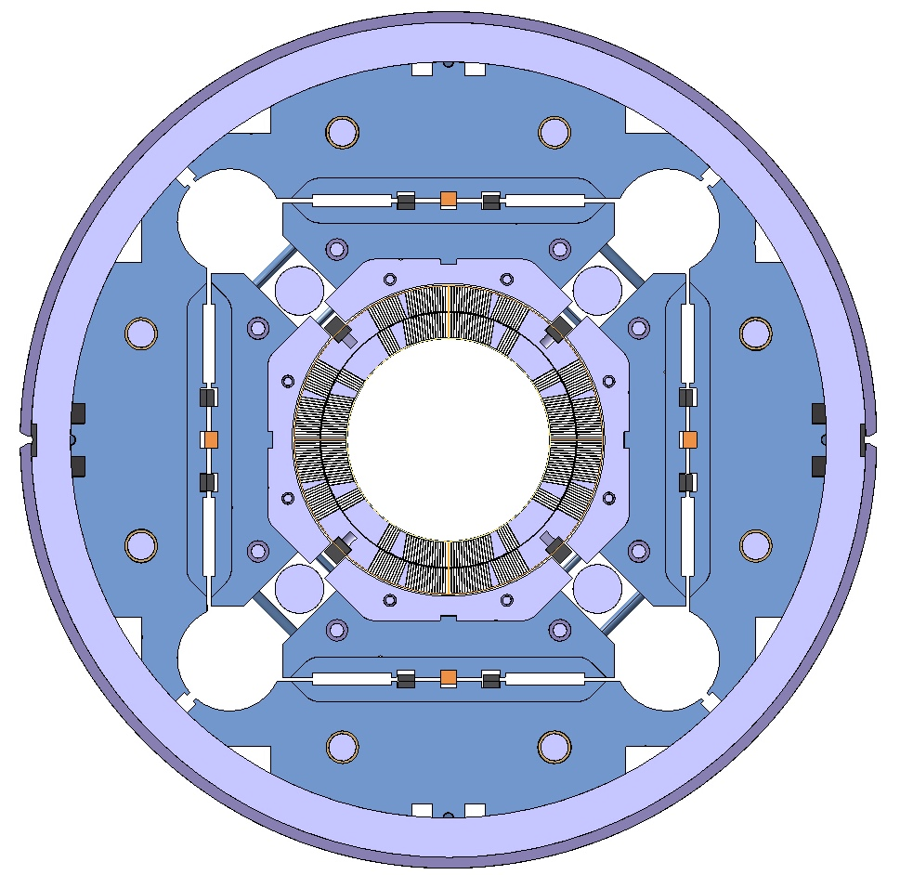
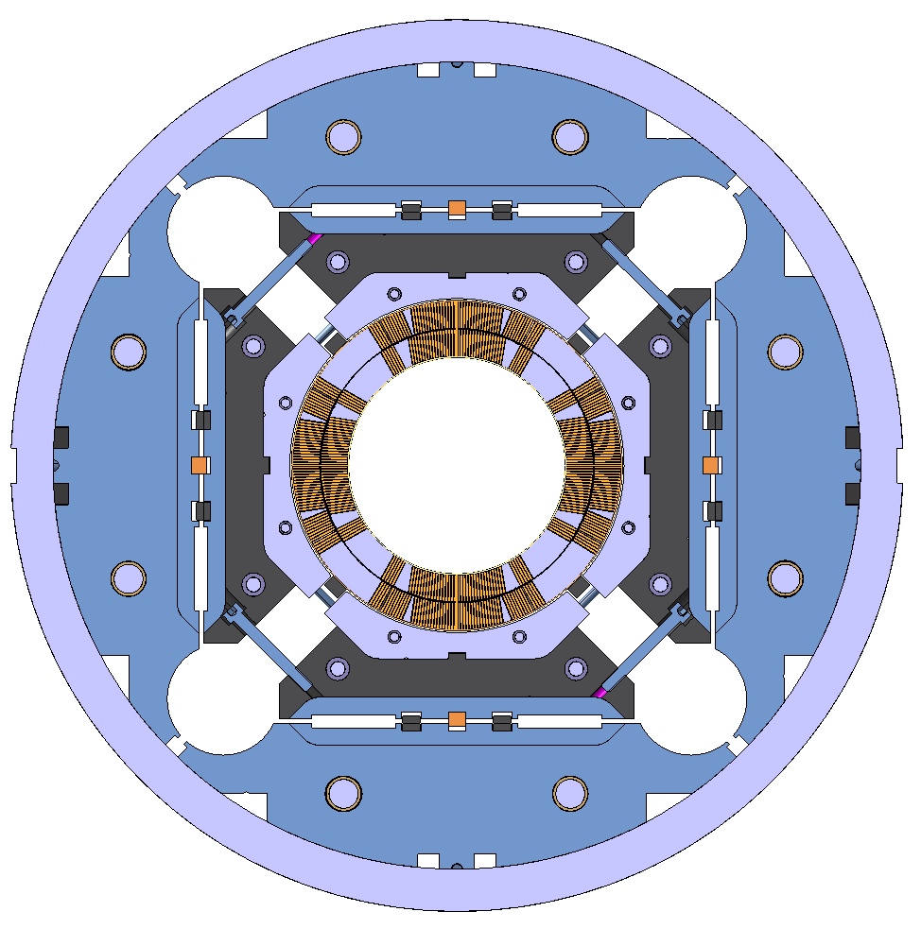
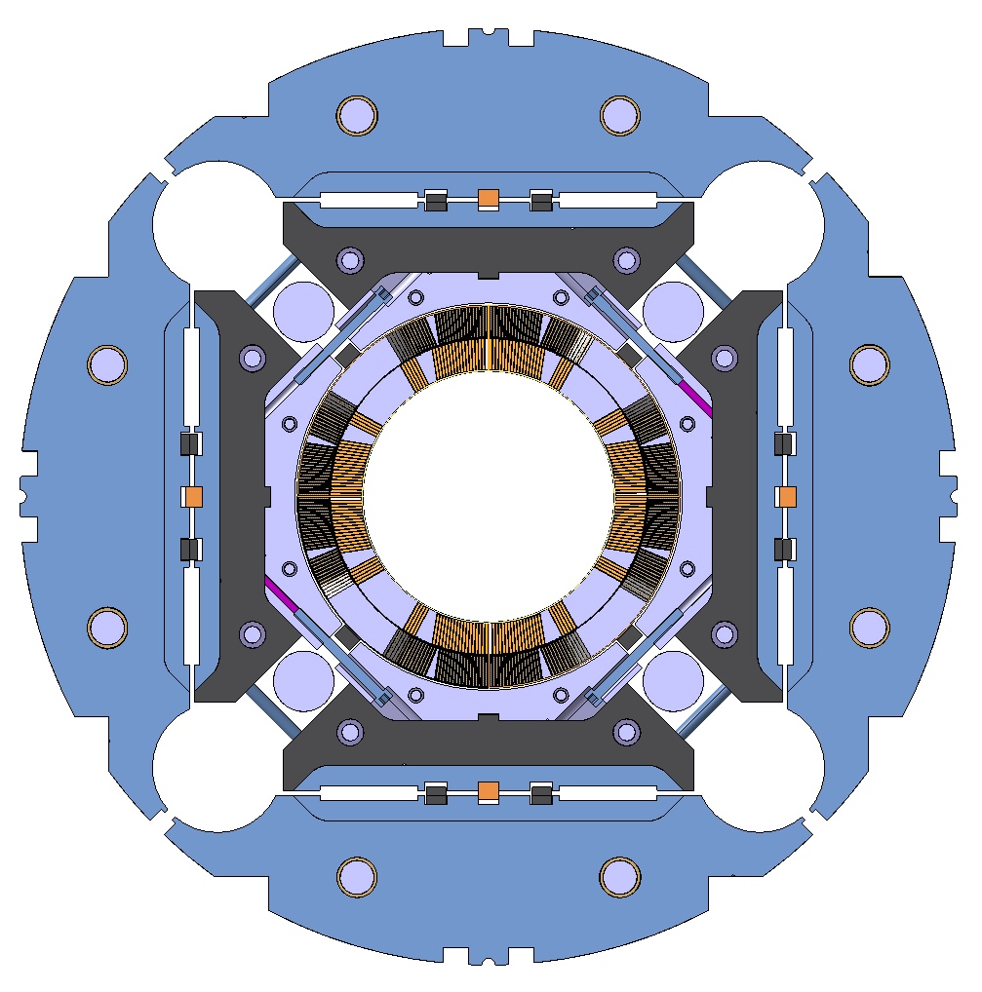
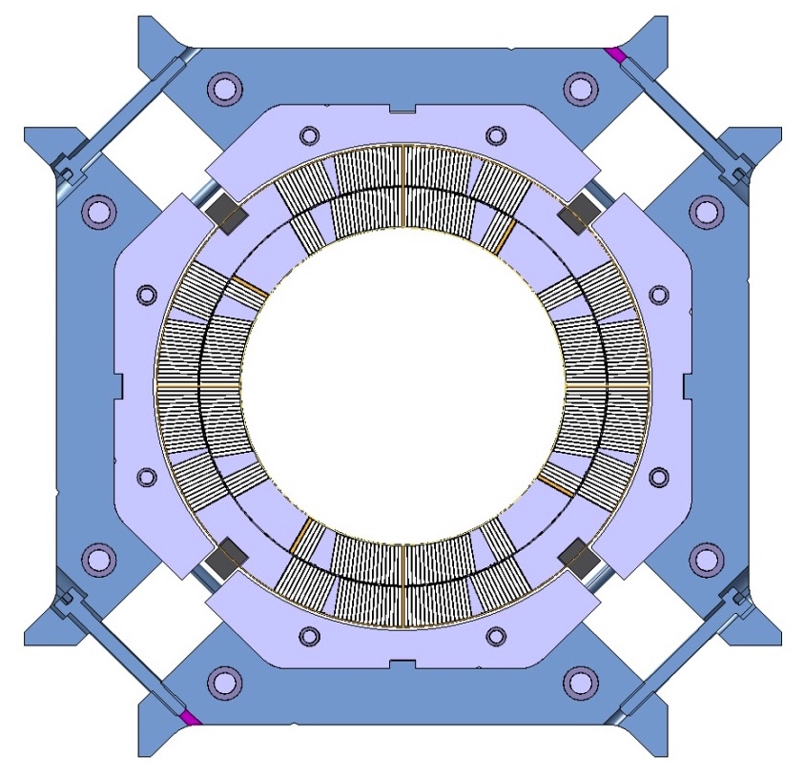
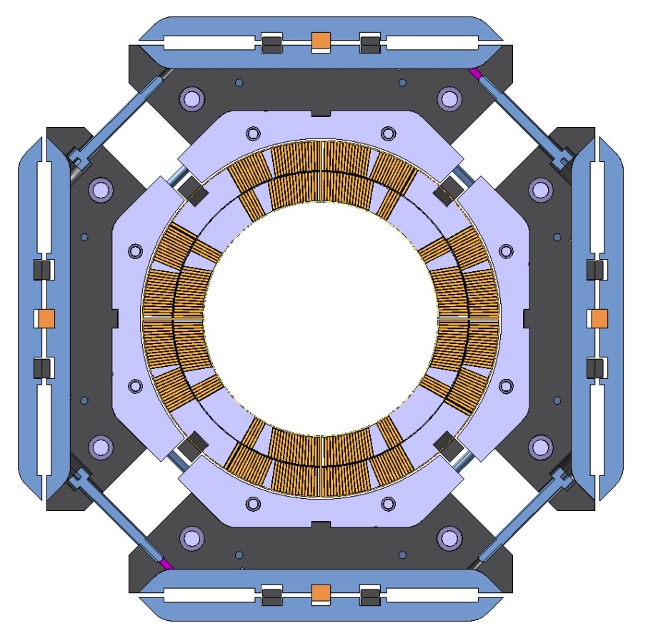
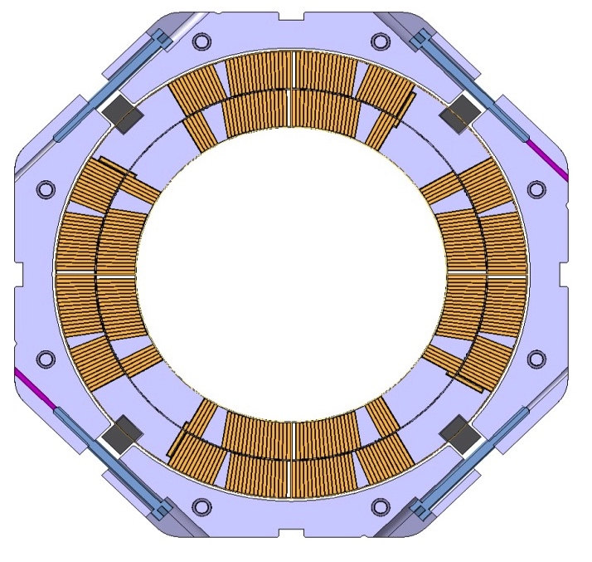
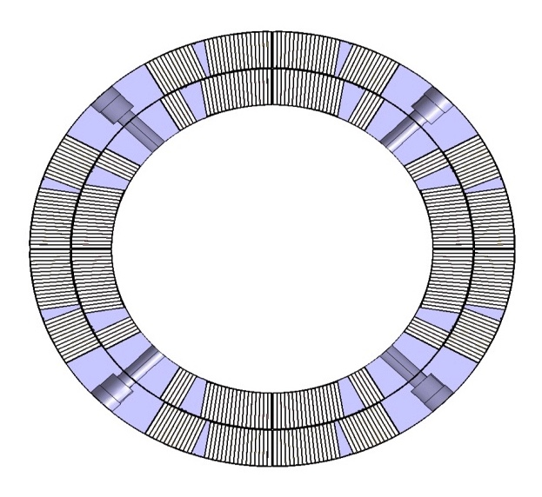
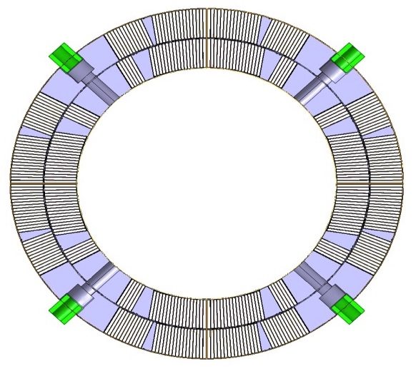
MQXFS cross section
Target: 132.6 T/m
  150 mm coil aperture, 11.4 T B_{peak}
  MQXFB magnet 7.15 m
Al shell pre-loaded with bladders
Coils
Coils pole keys
Aluminum collars
Iron & stainless steel pads
Iron masters, alignment and loading keys
Iron yoke
Aluminum shell
Stainless steel shell and welding strip

Slide 4
Outline
MQXFB magnet cross-section
MQXFB design and main assembly steps
Prototypes schedule and status on components
Tooling design schedule and status
QC & plans for long prototype
Summary

Slide 5
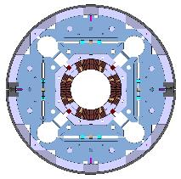
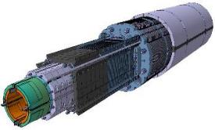
MQXFB magnet design
≈7.5 meters long coils
50 mm thick aluminum collars
Coil angular positioning w.r.t collars using radiation resistant G10 alignment keys
Pads assembly : combining 5.8 mm and 28 mm pieces
≈ 3.8 m long masters & bladders
Yokes assembly : using 5.8 mm and 46 mm thick pieces
10 long and 2 short aluminum shells
≈ 8.5 long rods for longitudinal loading
≈ 10 meters long ½ SS shells to be welded

Slide 6
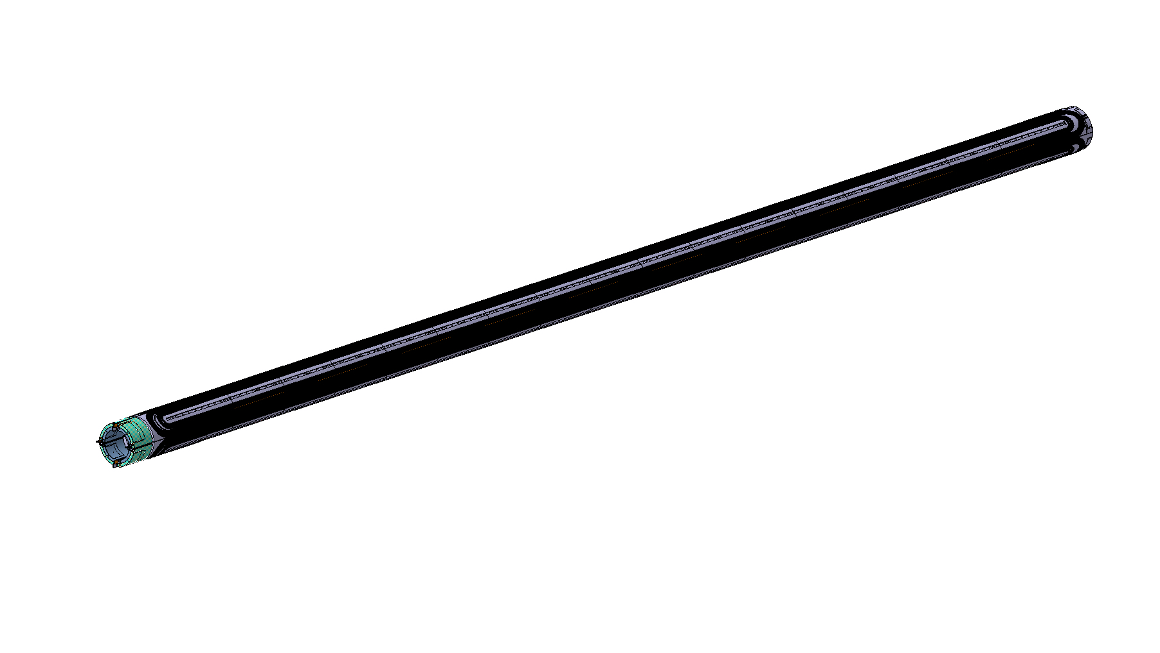
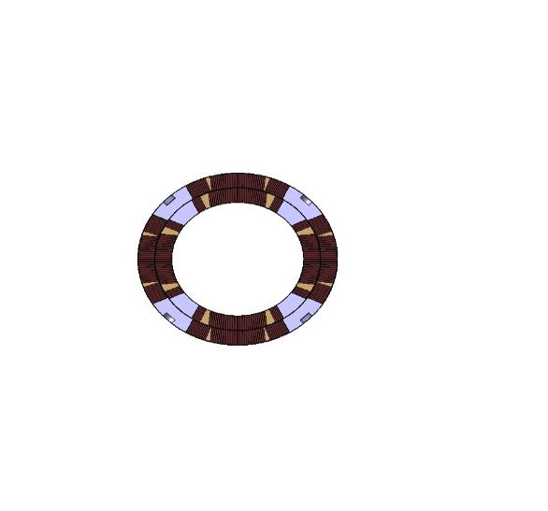
MQXFB magnet components
Superconducting coil

Slide 7
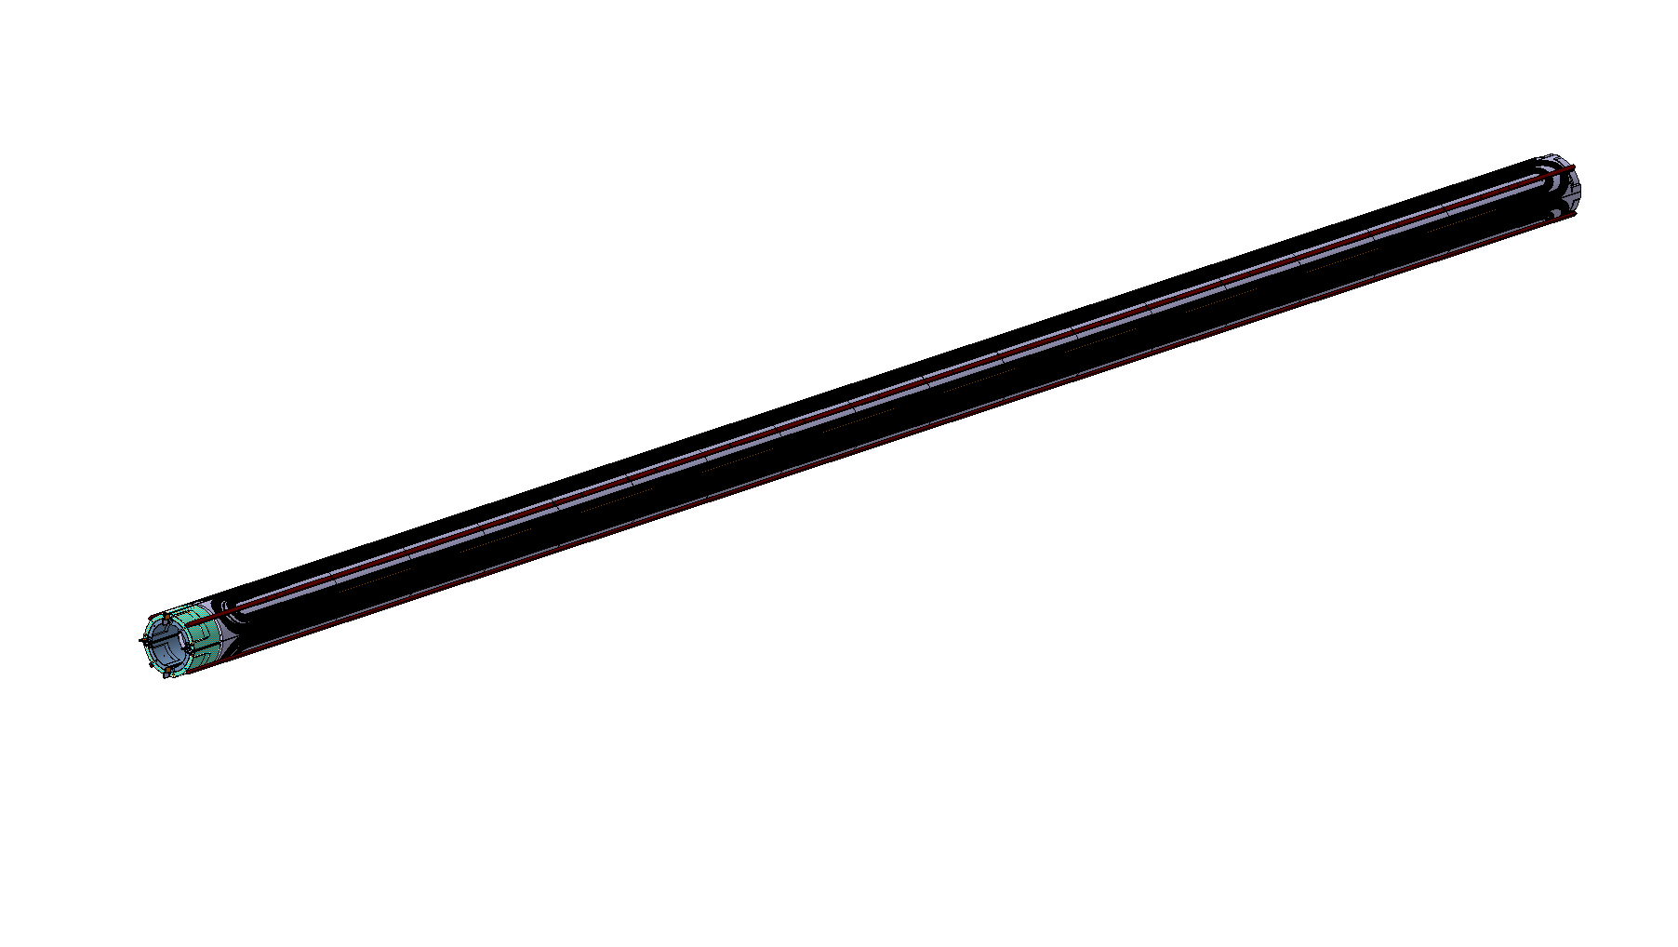
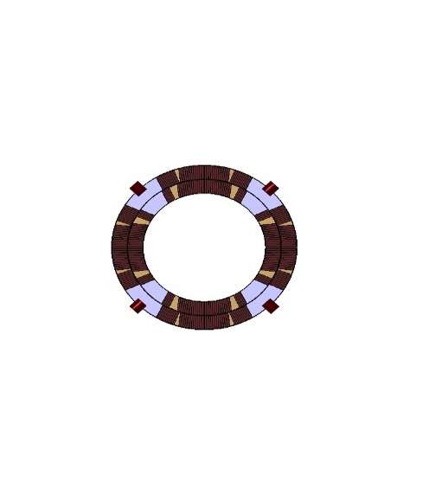
MQXFB magnet components
Pole key for alignment

Slide 8
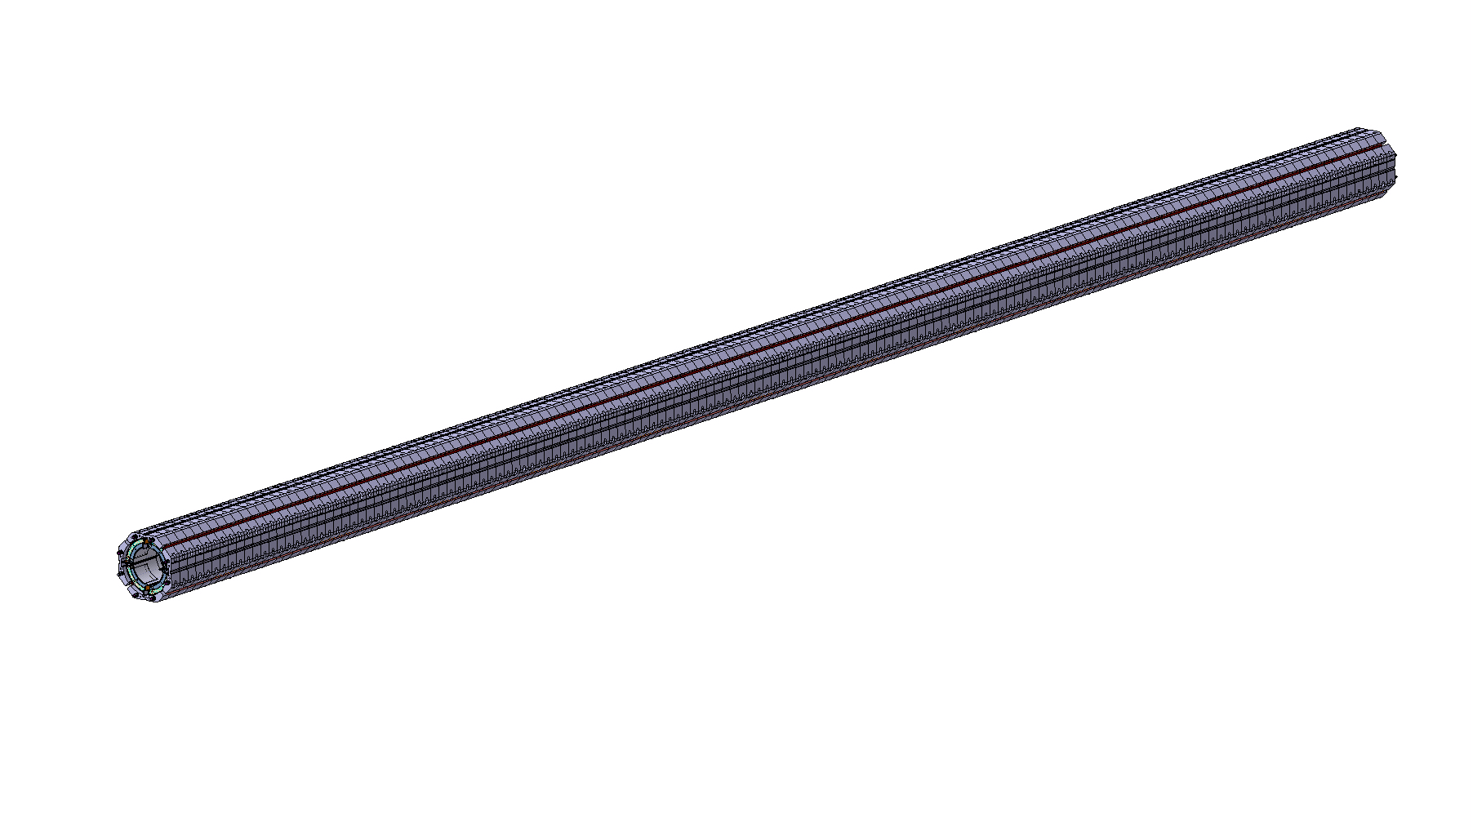
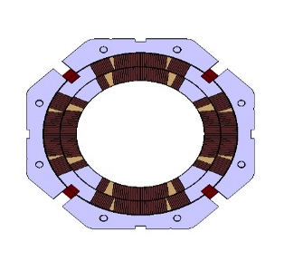
MQXFB magnet components
Aluminium collars
  No coil pre-load

Slide 9
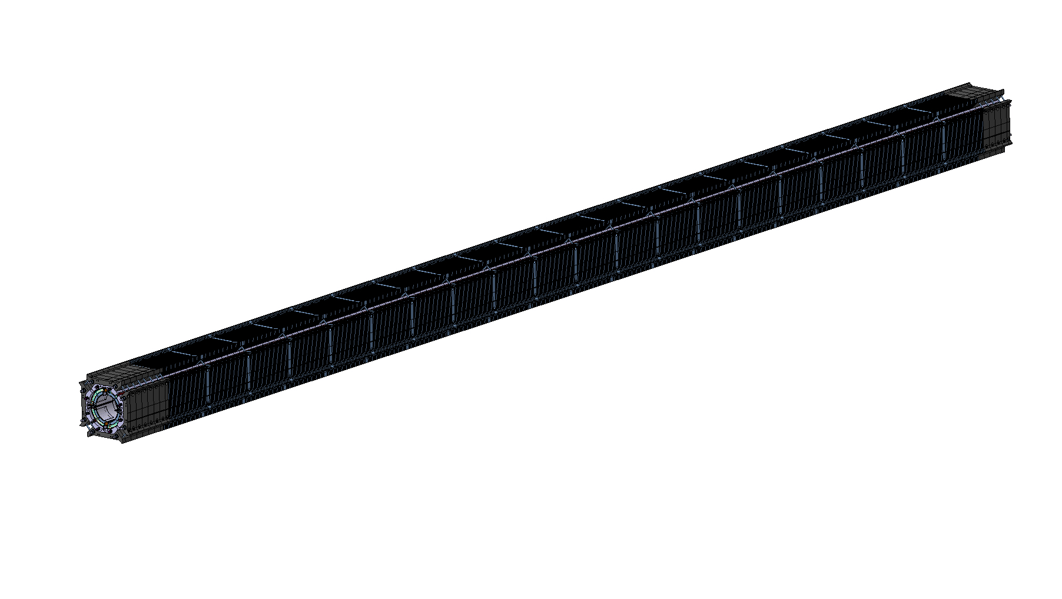
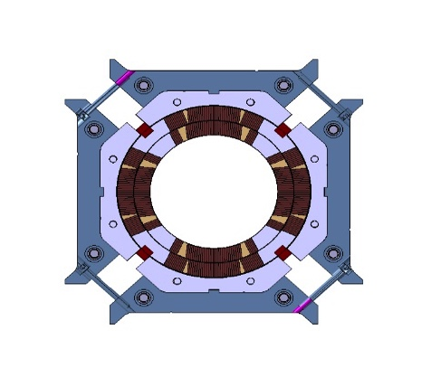
MQXFB magnet components
Bolted iron pad
  No coil pre-load

Slide 10
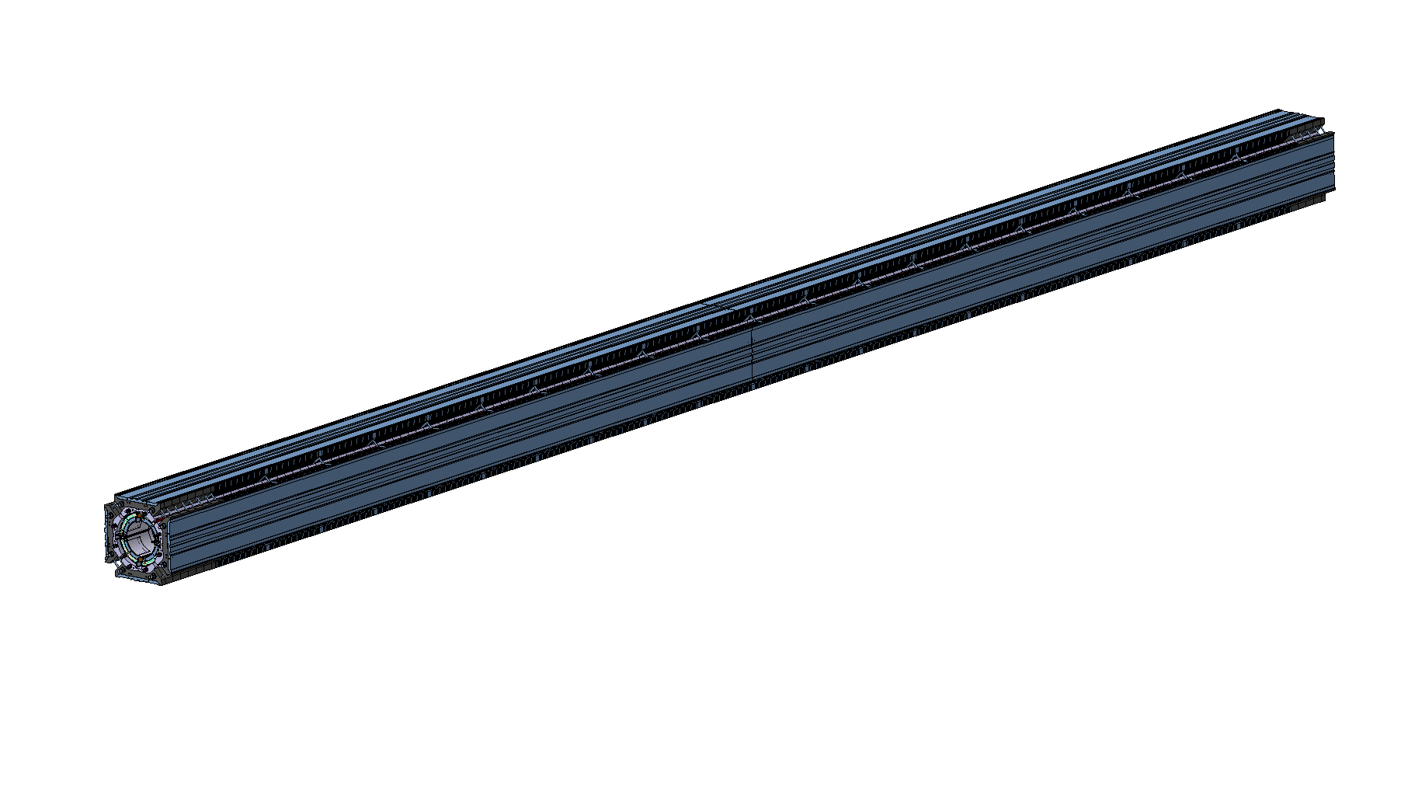
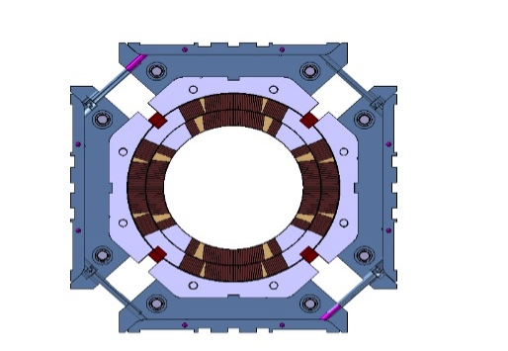
MQXFB magnet components
Iron master
  Half-length plates for bladders and keys

Slide 11
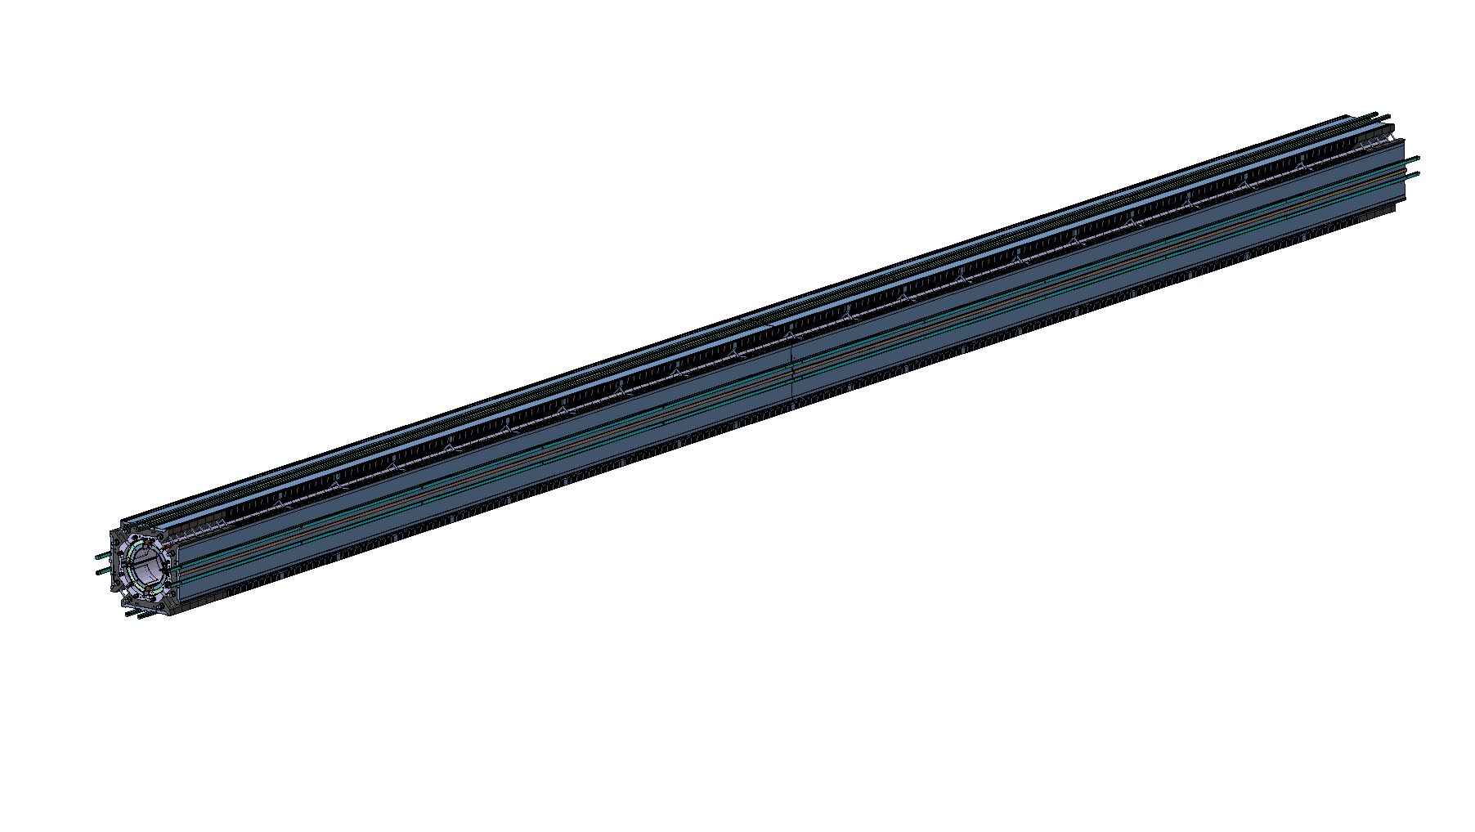
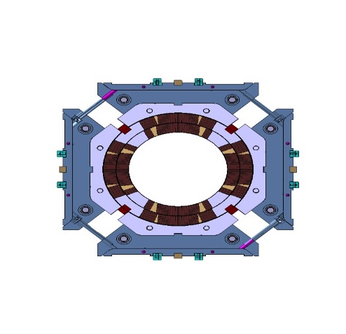
MQXFB magnet components
Loading and alignment keys

Slide 12

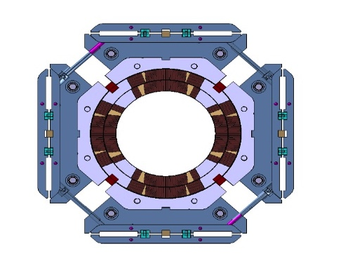
MQXFB magnet components
Second iron master
  Coil-pack sub-assembly

Slide 13
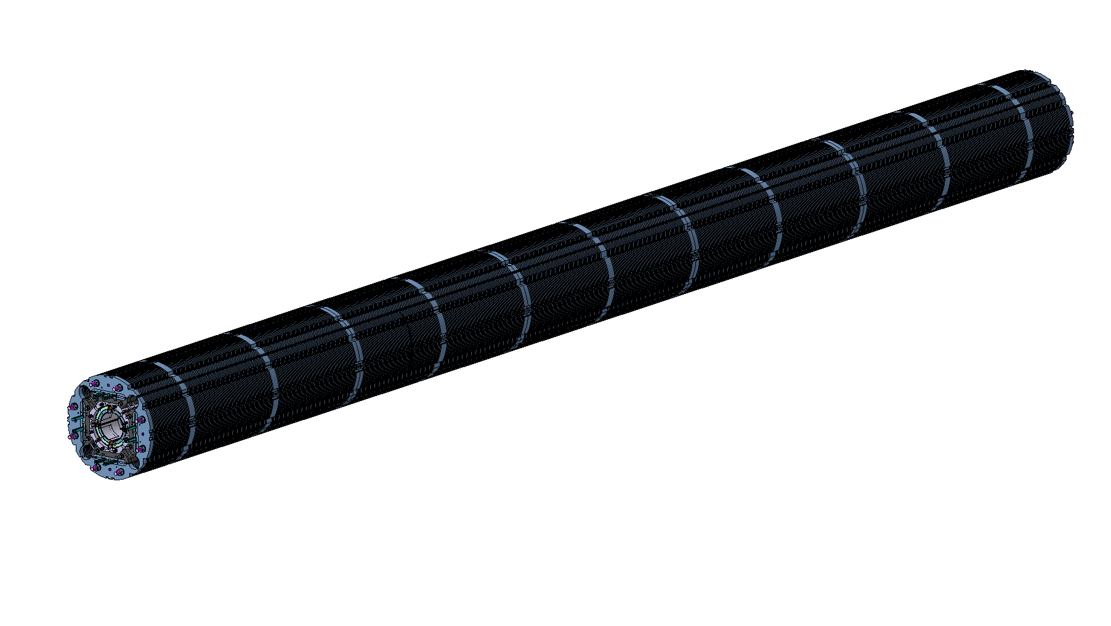
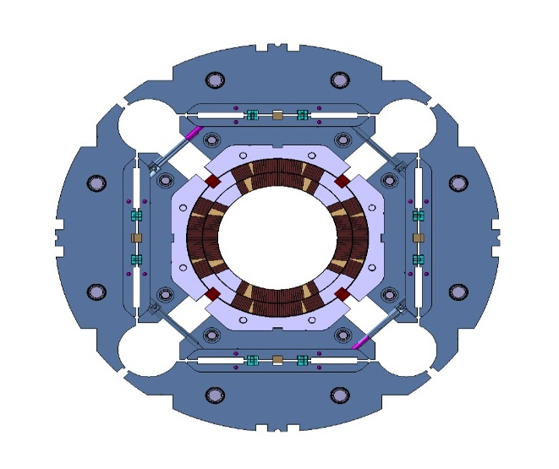
MQXFB magnet components
Iron yoke laminations

Slide 14
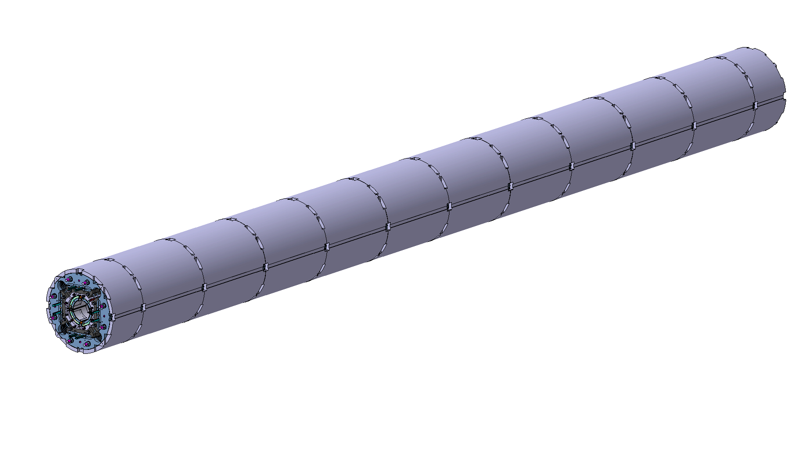
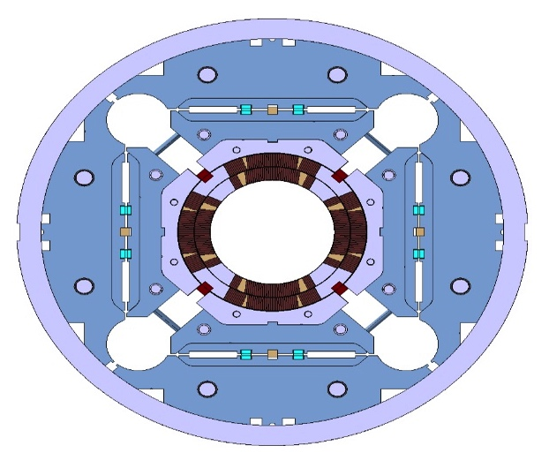
MQXFB magnet components
Segmented aluminium shell

Slide 15

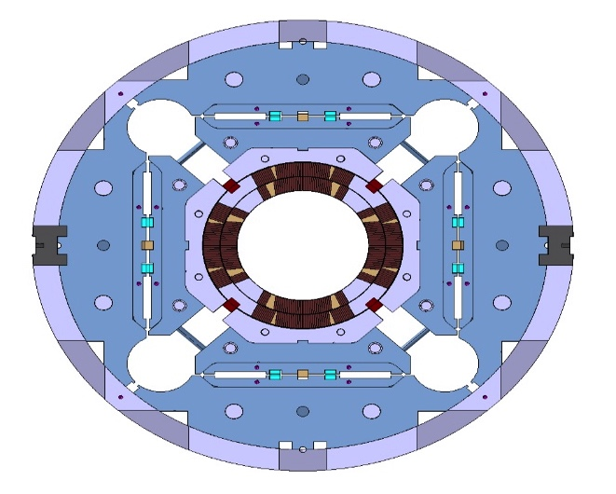
MQXFB magnet components
Tack-welding blocks
  Aligned to the yoke

Slide 16

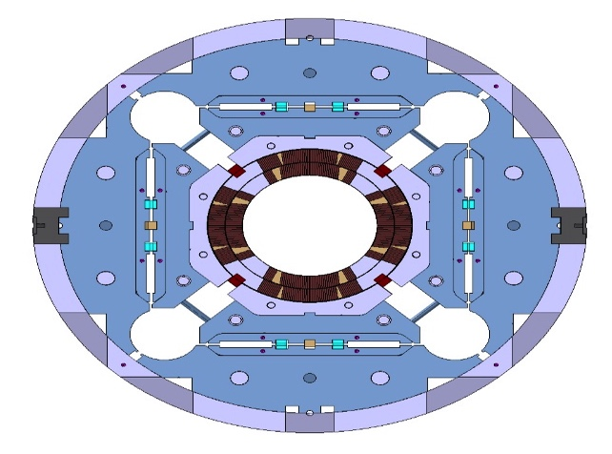
MQXFB magnet components
Backing strip
  For Lhe vessel welding

Slide 17
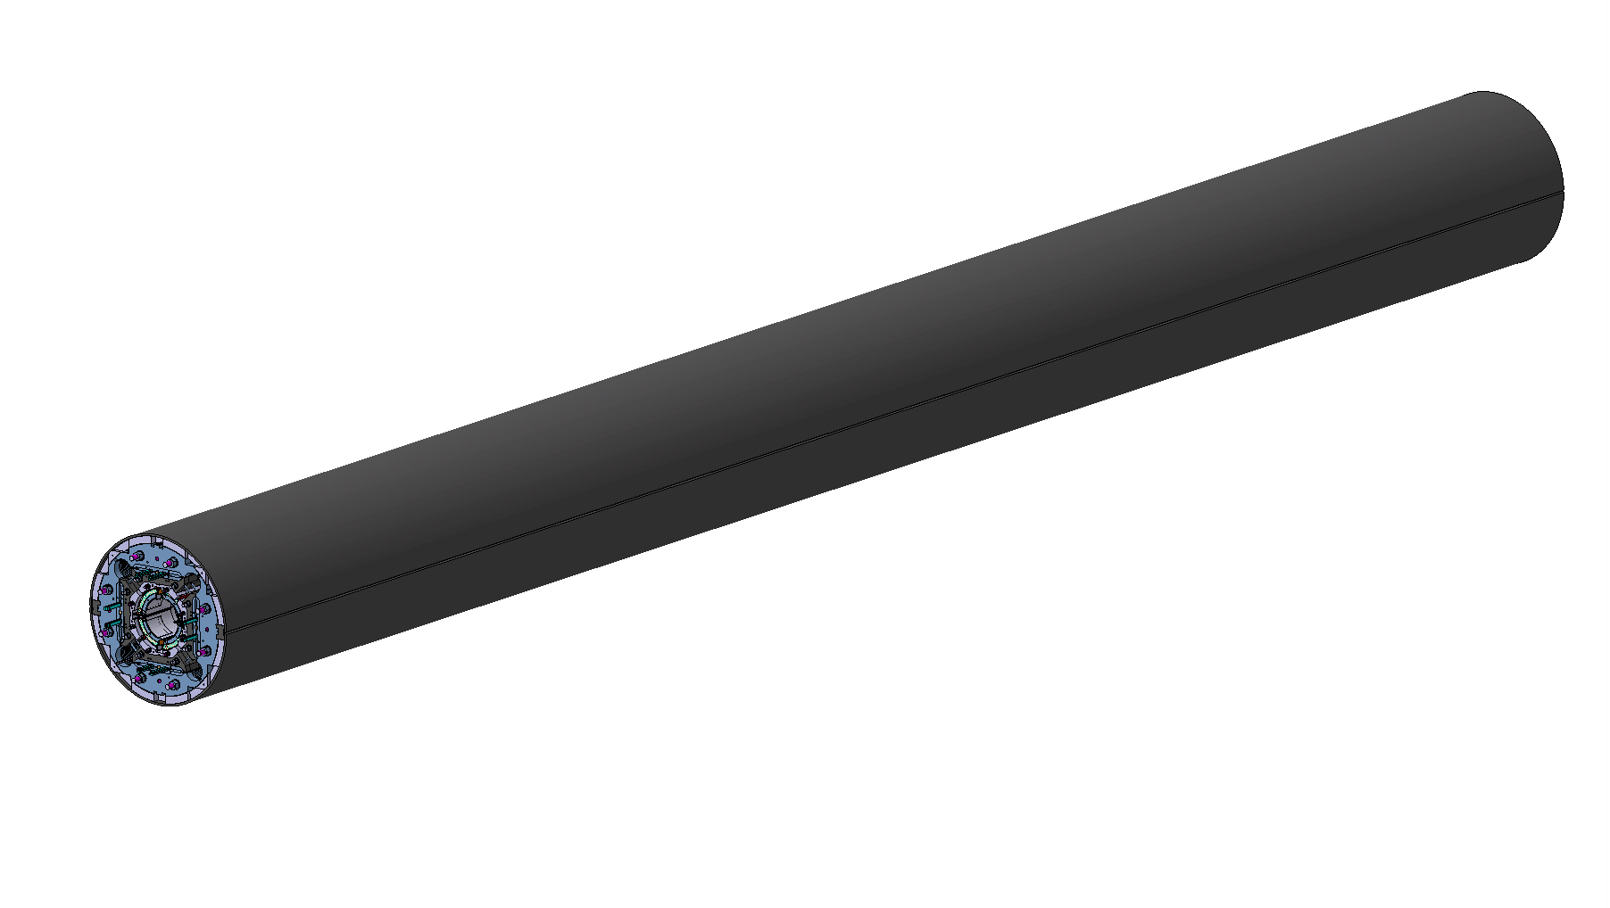
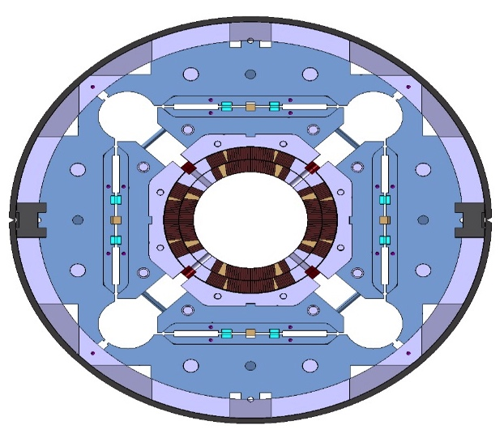
MQXFB magnet components
Welded LHe vessel
  Minimum welding tension

Slide 18

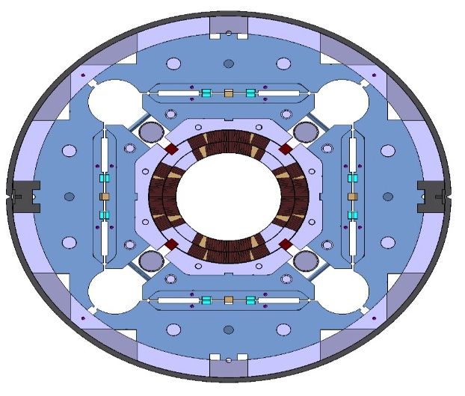
MQXFB magnet components
Axial support system
  SS rods and end-plates

Slide 19
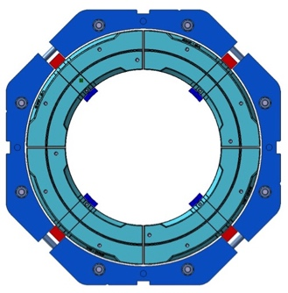
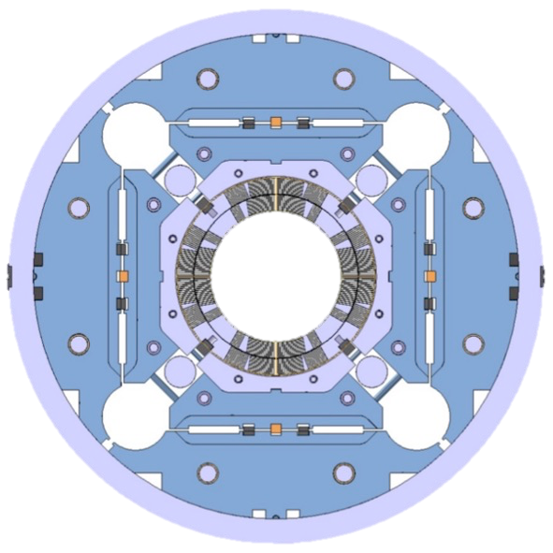
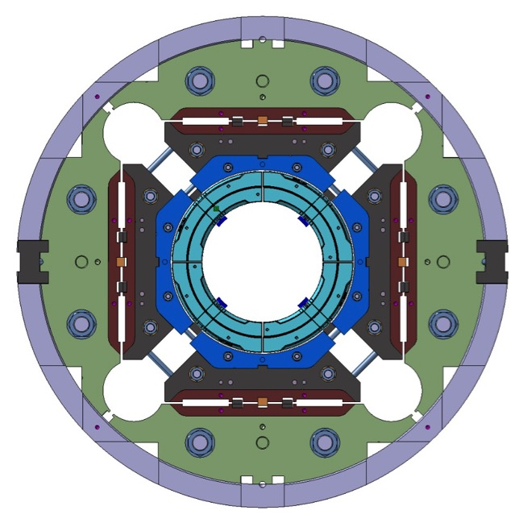
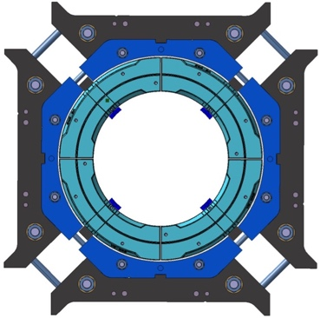
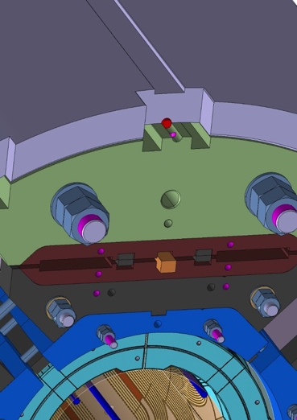
MQXF components alignment: general concept
Alignment of the assembly is defined by the following fixtures/interactions
  Coils to Collars
  Collars to Pads
  Pads to Yoke
  Yoke to Shell
3
1
2
4

Slide 20
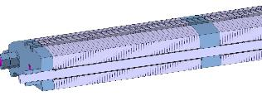
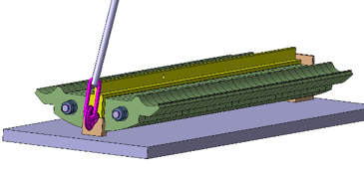
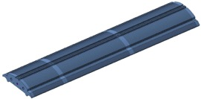
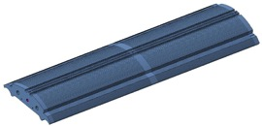

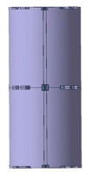
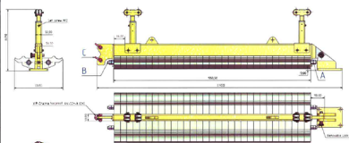

¼ yoke packs preparation for MQXFB
5 modules of yoke + shells per magnet pre-assembled using bladders and yoke keys
¼ yokes assembly operation will be performed on horizontal position using temporary tie-rods
2 & 3 shells configuration to be assembled
50 mm thick plates are required at shells junctions to bolt the supporting blocks for backing strip welding (strips tack-welded to the blocks)
3 Shells configuration
1 short & 2 long
1708 mm
2 Shells configuration
1368 mm

Slide 21
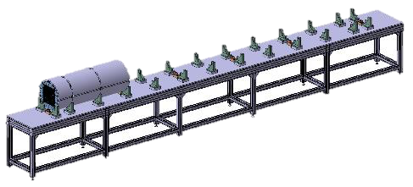
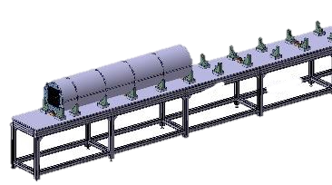
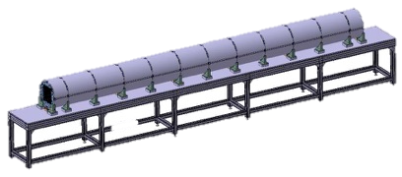
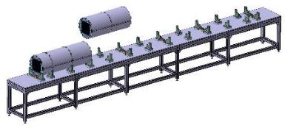
Yoke & Shells modules assembly
Each individual yoke pack will be measured during models and prototypes assembly phase
Overall magnet length can adapted by machining the 2 SS end-plates
First 3 shells module will be placed on its support feet and blocked in longitudinal direction
Next module will be placed on top of its corresponding feet and pushed against the first one to guarantee the contact of the 2 thick extremity plates.
The same sequence will be repeated to assemble the 4 remaining modules

Slide 22
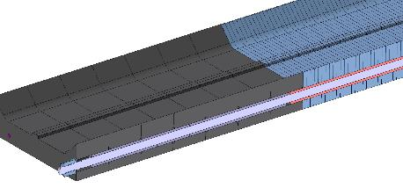
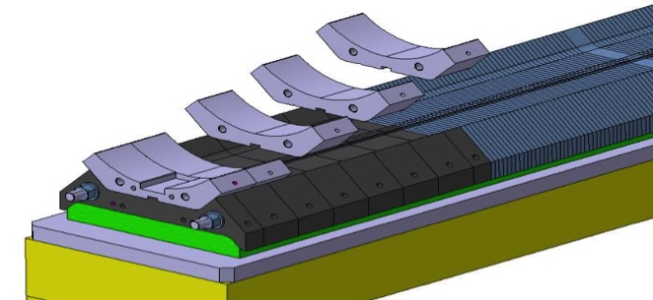
Load pads and aluminum collars assembly
The central part of load-pad packs will be assembled on top of a reference table using a SS alignment tube (tack welded at the extremities)
50 mm SS pieces will be assembled using 50 mm bushes
Stainless steel rods will be inserted for longitudinal compression
Stainless steel tube tack welded for thin laminations assembly
The aluminum collars will be assembled on top of the full length ¼ pad assembly using bushes
Top pad plane and pad indentation will be used as assembly reference surfaces for ¼ collar packs
Stainless steel rods will compress the collar assembly

Slide 23
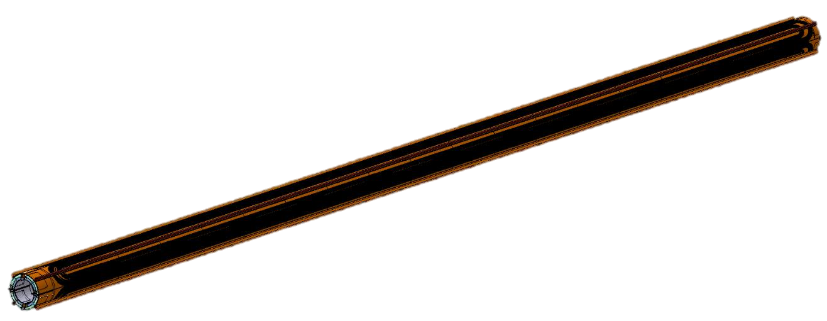



Coil-pack assembly
≈7.5 meters coil
4 coils of ≈7.5 meters long to be assembled
How to support them over the full length?
Upper ¼ pad & collars preparation
Assembly method as for MQXFS

Slide 24






Coil-pack insertion
The same insertion table concept used for MQXFS assembly will be scaled-up for MQXFB coil-pack insertion

Slide 25




Longitudinal compression and connection box
End-plate assembly and axial loading using the system validated on MQXFS
The connection box will be mounted after shell welding operation

Slide 26
Outline
MQXFB magnet cross-section
MQXFB design and main assembly steps
Prototypes schedule and status on components
Tooling design schedule and status
QC & plans for long prototype
Summary

Slide 27

CERN prototypes schedule
Possibility of performing a “single coil test” in 2017 under consideration
  1 real, 3 practice coils
First prototype cold mass by end of 2018
  2 RRP and 2 PIT coils
Second prototype cold mass in mid-2019

Slide 28



Yokes
Contracts follow-up for magnet components and tooling by
P. Moyret: EN-MME
Machined with EDM technic for prototypes
Fine blanking foreseen for series magnet production
Order placed to HV Wooding (UK) for first prototype
MAGNETIL steel from LHC shipped to the company
Waiting for final drawings (alignment features to be implemented according to MQXFS3 assembly experience)

Slide 29




Aluminium shells
Drawings approved
Prince inquiry launched for first prototype
Waiting for DR approval to place the final order
Order will be launched by end-June 2016
Raw material for 2 magnets will be available Oct-2016
Shells should be delivered before Xmas with material certificate and dimensional report

Slide 30




Aluminium collars and load-pads
Order placed to METRALEC (Spain) for first prototype
MAGNETIL steel (CERN LHC stock) and ARMCO plates shipped to the company
Delivery expected Q4-2016

Slide 31




Masters & end-plates
Prince enquiry launched
Offers expected within 2 weeks
Orders will be placed by end-June 2016

Slide 32
Outline
MQXFB magnet cross-section
MQXFB design and main assembly steps
Prototypes schedule and status on components
Tooling design schedule and status
QC & plans for long prototype
Summary

Slide 33








MQXFD3 coil-pack assembly validation
MQXFD3 has been used to validate the assembly procedure with a laminated structure
Collars assembly
Coil-pack assembly table
Pad assembly
Coil-pack assembly table
Bolting the coil-pack
Coil-pack assembled

Slide 34



Lamination assembly tooling
First design not satisfactory
Modifications in progress:
  Better alignment (on-going test to define alignment tube adjustment)
  Mechanical stoppers to have repetitive pack-length
  Clamping while rotating and handling

Slide 35



MQXFB coil-pack assembly and insertion table
MQXFS coil-pack assembly and insertion tooling will be scaled-up for MQXFB
Design in progress

Slide 36





Rotating & lifting tooling
Existing CERN rotating device used during MQXFS program will be used during yoke & shell assembly
Design in progress for dedicated lifting & pivoting tooling

Slide 37







New Bladders concept
Version 1
New bladders produced from Ø 50 mm, 0.5mm thick SS tube
The tube is crushed in a press to obtain the required shape (i.e. 3mm total bladder thickness)
1st version: SS sheets laser welded and connector TIG welded
2nd version: SS tube, new connector geometry, only TIG welding
Procurement of extruded tubes to be launched (extrusion tooling development required)
Fabrication cost reduction (≈ 30%) and shorter fabrication time
New version
Courtesy of N. Bourcey

Slide 38

Bladder station
Identified provider
Delivery time around 10 weeks (2 stations to be ordered)

Slide 39




Quench Heaters development
A dedicated copper deposition machine has been developed, built and successfully tested to copper plate at CERN traces up to 7 meters (not adapted for series production)
All production steps are mastered at CERN (validated on MQFFS and first MQXFP circuit delivered to FNAL)
An Italian company is being qualified for long circuits production (Long process. Several orders already placed and some technical issues still to be solved)
On going alternative development program with others companies (Electron-beam evaporation)
Quench heaters production for series magnets will be outsourced
Internal fabrication at CERN will be kept as backup solution

Slide 40
Magnet geometrical alignment specification
One needs to specify the length of the measuring mole (integral) to specify the waviness of the
  centre of the quadrupole
  direction of field
In the LHC production we had measuring moles of 750 mm
  We should use the length of the probes we are going to use (500?)
Waviness (not specified for LHC)
  I (E. Todesco May 2016 at SLAC) would set a target on the peak to peak (magnetic)
  ±0.5 mm for the centre
  ±2 mrad for the axis direction
  This corresponds on a position of the midplane within ±0.11 mm
±2mrad
ZMQXFB
 | MQXFB
Δxmaxi (mm) | ±0.5mm
Δzmaxi (mm) | ±0.5mm
αmaxi (mrad) | ±2mrad
Combined magnetic and mechanical axis measurements will be required to define real coil shape when assembled in the magnet structure. Dedicated mole to be designed and built .
ZMQXFBi
Roll φ
Pitch θ
Yaw ψ
XMQXFBi
0.5mm
XMQXFB
0.5 mm
See detailed presentation by H. Prin

Slide 41










Checking mechanical alignment accuracy MQXFSD2&D3 for 3 m magnet assembly simulation
This assembly has also been performed to validate long magnet assembly procedure using a laminated structure

Slide 42


MQXFD2-D3 measurements after loading
Shell geometry
Twist and misalignment analysis
Aperture considered reference
Twist analysis using shell reference: Reference points are moving as well during operations. No information is valid.
- 0.04 mm
LATERALVIEW
- 0.04 mm
Z
TOP VIEW
Y
-0.09 mm
Bore
Bore axis
0.01 mm
Outer Shell
Outer Shell axis
Y
X
Asymmetric shell deformation due to key & bladder operations
0.24 mm towards cylinder axis (Maximum)
0.25 mm towards external part (Maximum)
Twist analysis using “Spatial Analyser” in progress
Measurements using shells windows foreseen on MQXFD3 assembly (end of May 2016)
Courtesy of Patrick Bestmann & J. Ferradas

Slide 43

Mechanic vs Magnetic Axis
Courtesy of Juan Garcia Perez
Born in 2000. Old system with most of its components (hardware & Software) obsolete but still working well with the old infrastructure-equipment.
Characteristics: 100 mm length coil. Centred reflector.
Optical system (CDD camera embarked) for cold bore geometry measurements.
Magnetic axes scan, so pitch and yaw angles available for alignment. No big current needed (AC power, from few mA to 1 A, 25 Hz). Magnetic angle measurement for any type of magnet.
It was able to measure the axis of LHC dipoles at cold in SM18. It measured all Short Straight section LHC magnet assemblies automatically.
Difficult to adapt to different bore diameters. Not optimised for field quality.

Slide 44
Outline
MQXFB magnet cross-section
MQXFB design and main assembly steps
Prototypes schedule and status on components
Tooling design schedule and status
QC & plans for long prototype
Summary

Slide 45

MQXFB magnets measurements
What, when and how?
Information:
Single component metrology report
Tooling geometry
Assembly geometry
Analysis:
Operations influence over structure geometry
Assembly alignment

Slide 46

Plans for long prototypes
MQXFB CAD model has been completed
Possible modification of yoke tolerances depending on MQXFD3 assembly results (tests @ 77 K in progress)
SS shells have been ordered to qualify the welding process using MQXFS2b model magnet (delivery is foreseen during autumn 2016)
Order for long shells still to be launched
Procurement of material for 1+1 prototype structure has been launched
Goals
First prototype structure components delivery foreseen by early 2017.
Assembly in a “mirror” configuration mid-2017 using one Nb₃Sn coil and 3 copper/low-grade coils
First real MQXFB prototype by end 2018
Second prototype by mid-2019

Slide 47
Still to do for MQXFB magnets
Mechanical alignment accuracy addressed during magnet design still to be confirmed on a long structure even if promising results have been obtained when coupling MQXFS2 & MQXFS3
Prototype magnet will be used to quantify mechanical structure alignment accuracy
MQXFB handling tooling has to be carefully studied in order to maintain alignment between the different segments and sections in order to minimise shear and bending in the coils
Magnet geometry to be mapped before and during cold-mass assembly (in particular when the magnet has been stored for a long time or transported)

Slide 48
Outline
MQXFB magnet cross-section
MQXFB design and main assembly steps
Prototypes schedule and status on components
Tooling design schedule and status
QC & plans for long prototype
Summary

Slide 49
Summary
MQXFB assembly procedure has been defined and is being tested during MQXFS model program
The assembly procedure will be extrapolated for MQXFB construction and validated on the first prototype to be built at CERN from February 2016 on
  Most of the existing tooling can be scaled-up from models to 8 m long magnet
Plan to check alignment at each assembly step. Dedicated mechanic vs magnetic measuring mole to be designed and built
Most of structure components detailed design completed
Components procurement for the first prototype started. Delivery scheduled for early 2017
First MQXFB prototype (mirror configuration) assembly scheduled for end 2017 (being discussed)
First real MQXFB prototype to be completed by end 2018
Second prototype by mid-2019
Handling and assembly tooling to be designed and manufactured
No show-stopper identified so far!

Slide 50
Acknowledgments
CERN
  P. Bestmann, N. Bourcey, A. Carlon, D. Cote, E. Cavanna, H. Dupond, N. Eyraud, C. Fernandes, J. Ferradas, B. Favrat, S. Izquierdo Bermudez, L. Lambert, P. Ferracin, P. Grosclaude, M. Guinchard, M. Juchno, F. Lackner, J. Mazet,
  G. Maury, P. Moyret, N. Peray, F.O. Pincot, H. Prin, E. Rochepault, T. Sahner, E. Todesco, G. Vallone, R. Van Weelderen, and many others …
BNL
  M. Anerella, A. Ghosh, J. Schmalzle, P. Wanderer
FNAL
  G. Ambrosio, R. Bossert, G. Chlachidze, L. Cooley, E. Holik, S. Krave, F. Nobrega, M. Yu, C. Santini
LBNL
  D. Cheng, D.R. Dietderich, H. Felice, R. Hafalia, M. Marchevsky, H. Pan, I. Pong, G.L. Sabbi, X. Wang

Slide 51
Thank you for your attention !

Slide 52
Backup slides

Slide 53

CERN prototype coil fabrication
First Cu coil started (first layer wound/cured)
Then, 2nd Cu coil and 2 low-grade coils
Then, 2 RRP and 2 PIT coils for 1st prototype
In total, 2 prototypes, 12 coils

Slide 54
Risk and Mitigations
Components & tooling | Risk | Mitigation | Critical?
Aluminium shells | Low. Well known technic and company from models
Yoke & Pads | Low for prototypes (EDM). Will required tooling develop. for series magnet (fine-blanking)
Masters, collars, End-plates & rods | Well on track. Masters geometry over ≈ 3.6 m?
Assembly tooling | Low risk. Simple tooling
Mechanic/Magnetic mole | Long development process | Make use of existing mole. High risk of problems if failure (old components & Soft)
Bladders | Need qualification for extruded tubes (cost reduction) | Laser welded plates as plan B
Bladders station | Low risk. Standard components to be assembled. Experience from models | Bladder station from model program available. (Need 2 for series)
Quench heaters production | Long qualification process for new companies | Urgent need to find at least a second qualified provider

Slide 55

CERN cryo-assembly production
Starts on mid 2019, finish on mid/late 2023
About a year for cryo-assembly
  3 months for magnet assembly
  3 months for cold mass assembly
  3 months for cryostating
  1.5 month for testing
  1 month for preparation for installation

Slide 56







MQXFSD3 yoke-shell assembly
MQXFD2 coil-pack has been used to try to align the yoke laminations using the masters shape
The assembly has been measured during bladder operation to see how the yoke was pressing on the shell
Asymmetric behavior and longitudinal non-uniformity (keys can get stuck in those peaks)
We inserted three 12.1 mm and one 12.0 mm key
This required 550 bar pressure and 1900 με strain on the shell
The residual strain on the shell was of about 100 με
The last key could enter the opened gap but got stuck in the middle of the assembly
We could not establish if this was due to a lamination tolerance or/and to the misalignment
New bladders support to be inserted in the heat-exchanger holes being developed to help yoke-shell assembly operation
Asymmetric behavior & longitudinal non-uniformity
All measurements and data analysis from P. Bestmann (EN-ACE-SU) & J . Ferradas (TE-MSC-MDT)

Slide 57









MQXFB assembly table concept
(presented in February 2016)
  Bench alignment axis
Horizontal reference plane
Transversal alignment
Supports measured and levelled
All supports within 0.1mm deviation w.r.t average plane
  All points within 0.05 mm deviation w.r.t fitted line

Slide 58








Finishing benches
Geometrical measurements
15m Welding press
15m Collaring press
Pressure/leak bench
Nb₃Sn Reaction furnace
“Winding house”
Impregnation chamber
Yoke assembly bench
Cold mass magnetic measurement bench
Welding press for 2m models
Half Yoke returning bench
Cold mass assembly bench
Collared coil returning bench
Collared coil magnetic measurement bench
Courtesy of F. Lackner

