Slide 1

Long magnet manufacturing plan and QC by US HL-LHC-AUP
Dan Cheng
For the MQXFA team
MQXF International Review – CERN, June 7th – 10th, 2016

Slide 2
Outline
LARP magnet structures development at LBNL
Requirements and Reviews
Assembly tooling and infrastructure
Assembly Breakdown Structure and documentation
Manufacturing plan
Status
Summary

Slide 3
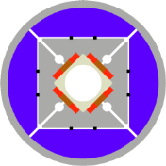
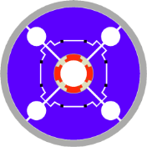
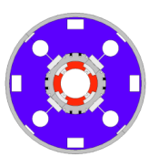
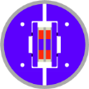
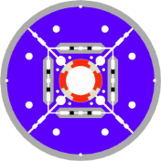
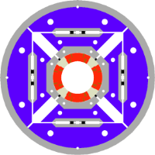
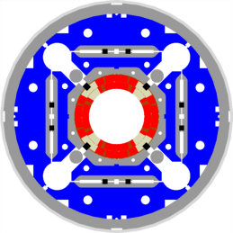
LARP History
Length
2004
1 m
0.3 m
1.5 m
3.6-3.7 m
2005
4.5 m
SQ
Subscale quad
Concept
2006
2007
LR
Long Racetrack
LRS01-02
Length demonstration
TQ
Technology Quadrupole
TQS01/02a-b-c/03a-b-c-d
Concept on cos2θ
Technology selection
Ultimate stress exploration
2008
2009
Scale-up & design optimization
LQ
Long
Quadrupole
LQS01a-b/02/03
Some accelerator quality features
Length with cos2θ
Accommodating variability in coil dimension
2010
HQ
High-field
Quadrupole
HQ01a-b-c-d-e
HQ02a-b / HQ03a
Accelerator quality features
Mechanical alignment
High stress regime
2011
2012
2013
2014
2015
MQXFS
MQXFS1/D1
2016
MQXFA
Length scale up
Time

Slide 4
MQXFA Structure Assembly
Shell-Yoke Structure
  Half-length subassemblies
  Joined shell-yoke subassembly, full-length
Coil pack subassembly
  Load pad stacks
  Collar stacks
  Instrumented and dressed coils
Master Key packages
  Load keys, alignment keys, shims
Axial load
  Axial rods, [end plates, wire guides]
Splice Connection box (Not shown)
Magnet support ring (Not shown)
Instrumentation connector skirt (not shown)

Slide 5
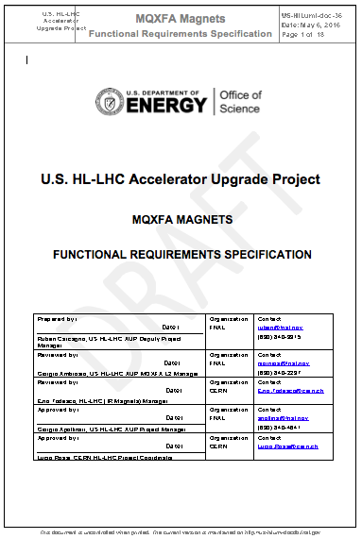
MQXFA Requirements
Draft requirements already agreed upon:
  Aperture (T) = 150 mm
  Gradient (T) = 143 T/m
  Magnetic Length (T) = 4.2 m
  O.D. (T) = 614 mm
  Fringe Field (O) < 50 mT at 0.5 m
  Operating Temp. (T) = 1.9 K
  Yoke Channel Diameter (T) = 77 mm (for HX tubes)
  Cooling Provisions (T):
    Polyimide-free area: 40% inner coil surface
    Free passage through the coil pole and G-10 alignment key, equivalent of 8 mm diameter holes repeated every 50 mm
    Free Helium paths interconnecting the yoke cooling channel holes
    Free cross sectional area of at least 150 cm²
  Maximum ΔT at cool down: 100 K
  Ramp rate (T): 14 A/s
  Instrumentation (T): Voltage taps
R. Carcagno, et al.:https://us-hilumi-docdb.fnal.gov:440/cgi-bin/ShowDocument?docid=36
Threshold Requirements (T): Project must meet
Objective Requirements (O): Project should meet and will strive to achieve

Slide 6
MQXFA Requirements
Draft requirements already agreed upon (cont.):
  Quench memory (O): reach operating current after thermal cycle with no more than 1 quench
  Ramp Down (T): Not quench while ramping down at 300 A/s
  Radiation dose (O) < 30 MGy
  Powering cycles (O) < 3,000
  Quenches (O) < 50
  Interfaces (T):
    Cold Mass, CERN cryo system, CERN power system, CERN quench protection system, CERN instrumentation system
      Details defined in interface document (to be written)
  Safety (T): complies with CERN’s “Launch Safety Agreement” (LSA) for IR Magnets (WP3)

Slide 7
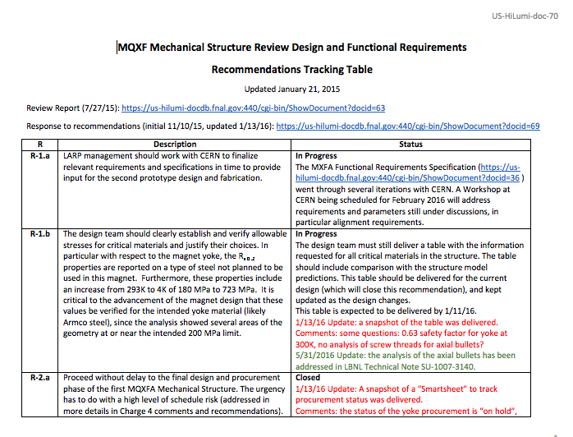
MQXFA Internal Review, July 2015
Review Committee:
  Ruben Carcagno* (FNAL), Michael Anerella (BNL), Shlomo Caspi (LBNL), Thomas Nicol (FNAL), Alfred Nobrega(FNAL)
  Observer: Juan Carlos Perez (CERN)
5 Key Recommendations
  12 specific items to be addressed on tooling effort, design questions etc.
16 additional Action Items
8 issues closed;
4 issues in progress, some pending 1st prototype structure
12 issues closed;
4 issues in progress, some pending 1st prototype structure
* chair

Slide 8
MQXFA Action Items from Feb 2016 Workshop
 | Done | Notes
Verify axial preload conditions with SST rods | ☑
Fabricate Nitronic 50 endplates for CERN | ☑ | Not shipped yet
Check coil stress with SST LHe containment | ☑
Check SG versus model during bladder operations | ☐ | In Progress
Perform tolerance analysis on dummy coil case (and full tolerance analysis) Will also investigate impact of azimuthal tolerances | ☐ | Eng. Note in Progress
Update analysis with adjusted modulus | ☑
Evaluate possible use of extruded bladders | ☑ | CERN
Check rigidity of integration table | ☑

Slide 9
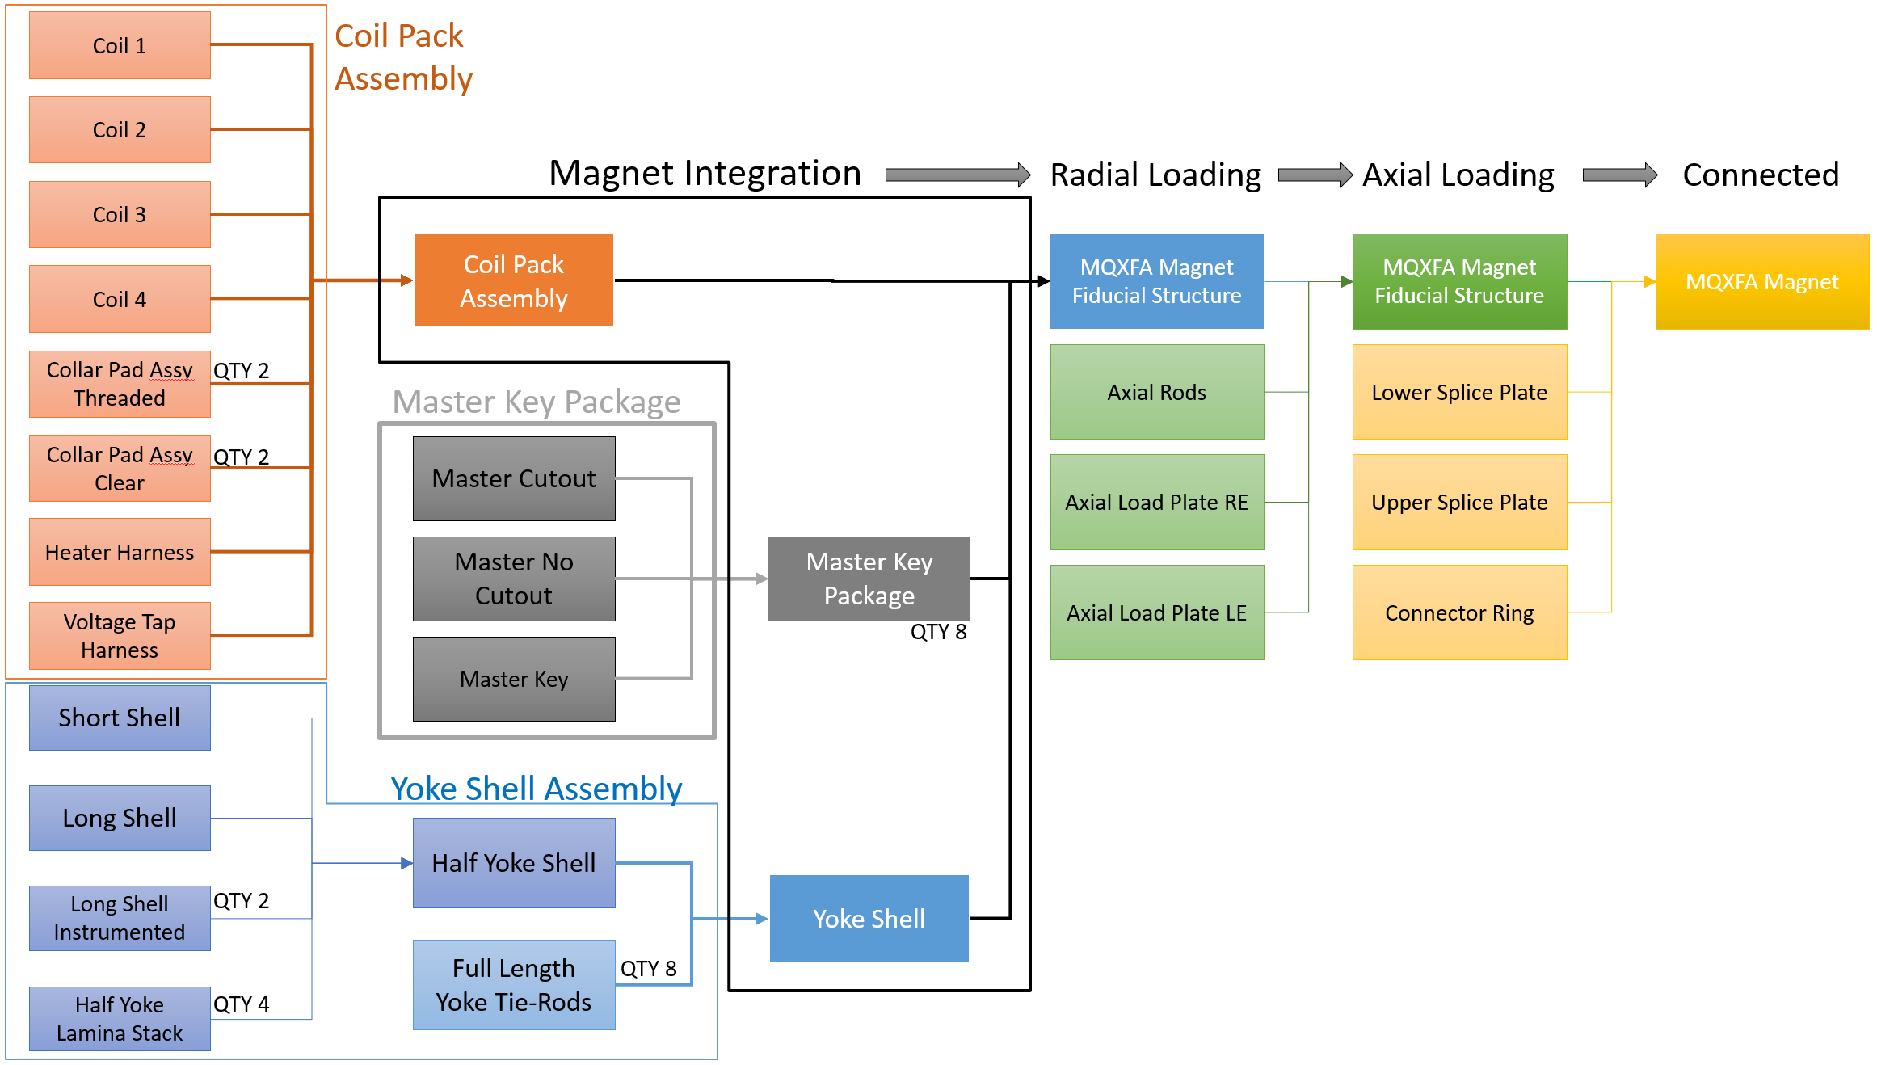
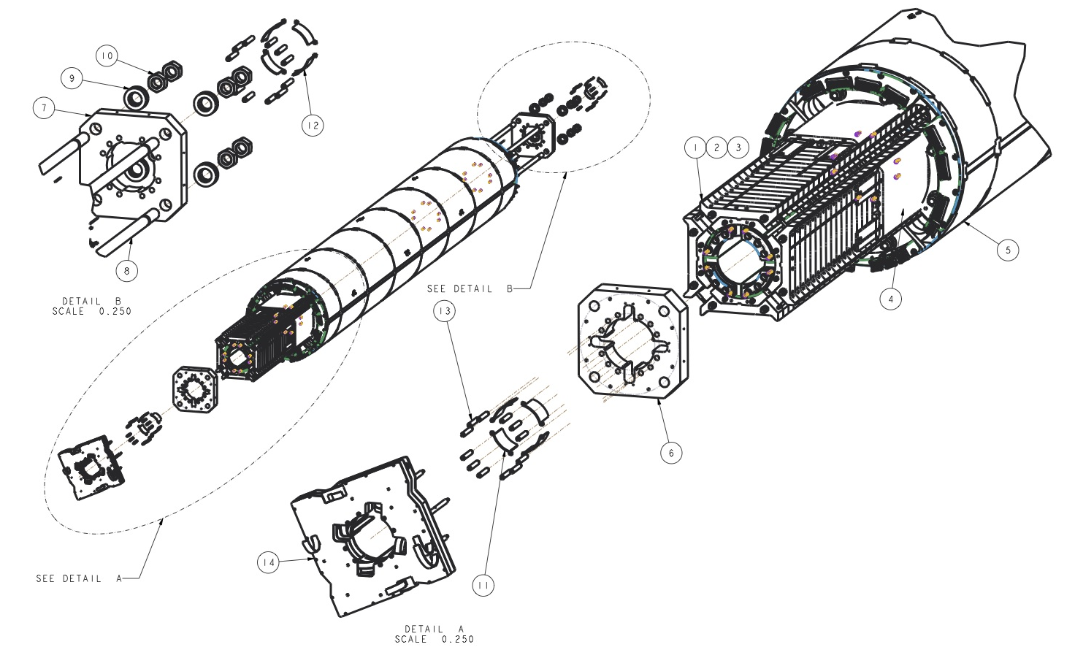
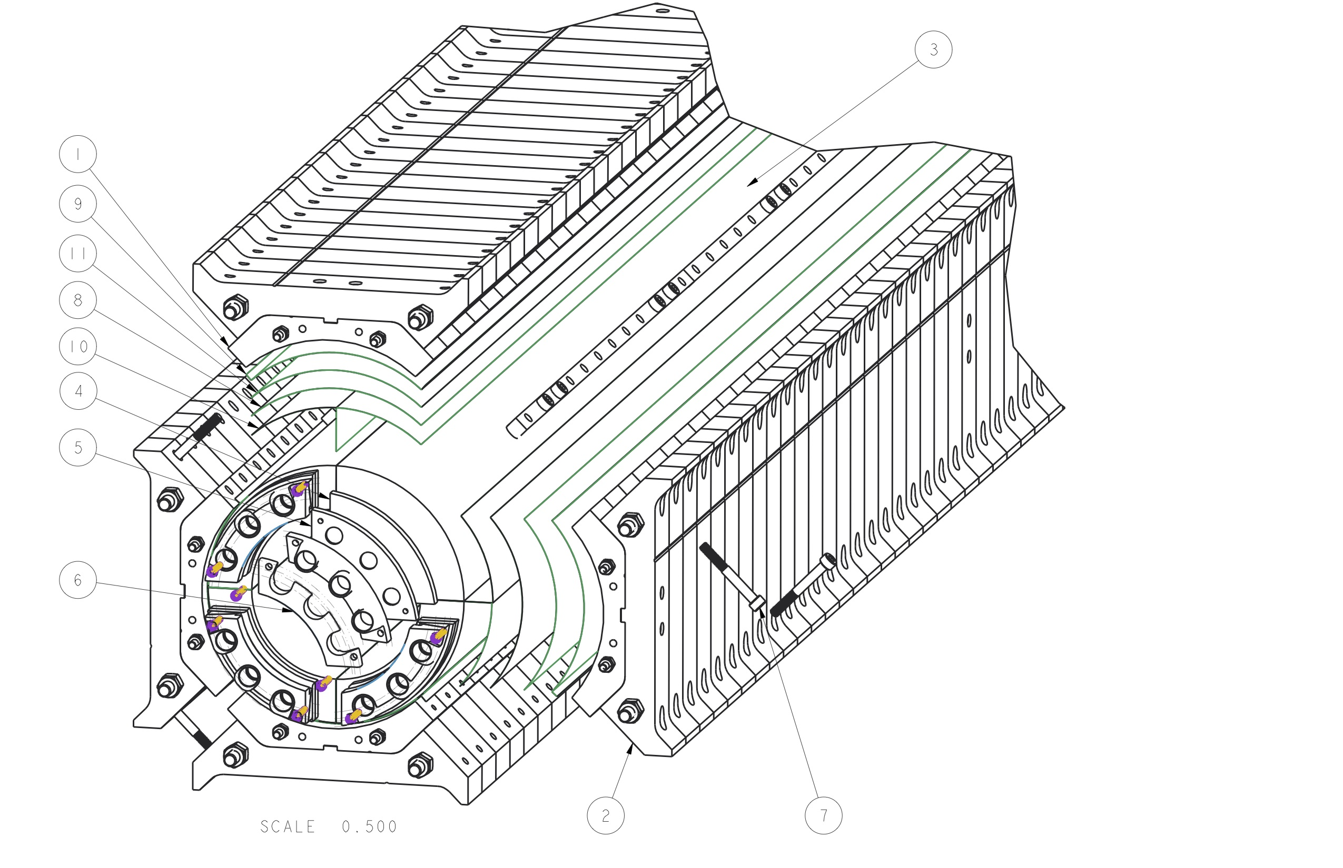
Magnet Assembly Process Flow

Slide 10
Applying Lessons Learned
Key takeaways from our magnet development
LQ
  We learned manufacturing and assembly techniques for long magnets and their related structures
  Tooling related to the length scale up from short models was functional, but for would require design additions for efficiency
HQ
  The addition of the alignment key feature also required better manipulation of coil CMM data and overall shim package control
  We refined the process of calculating radial shim packaging due to large variances of coil sizes that were observed
MQXFS(D/1)
  Beginning to apply efficiency and throughput improvements (with the use of custom-sized radial shims, for example, etc.)
  Our tooling for manipulating the coils during preparation and assembly are designed to be scaled up for production
  Adjusting dimensions of parts (collar radius, adding tooling process keys) will simplify the assembly process by reducing number of parts that have to be handled during operations
Parallel short magnet development with CERN provides feedback for similar tools & tooling designs

Slide 11
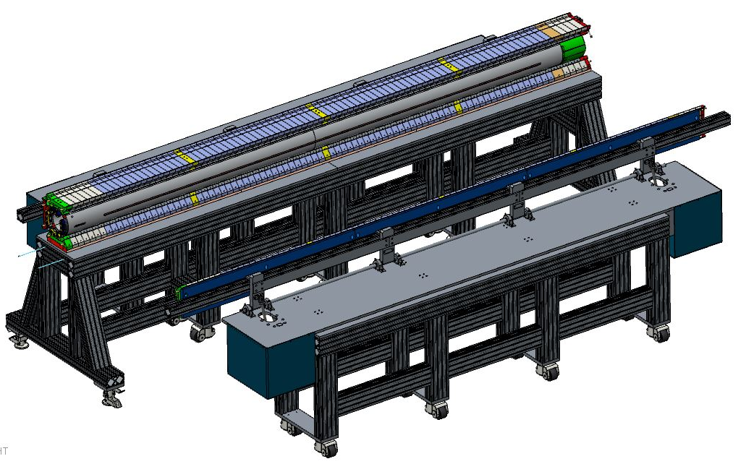
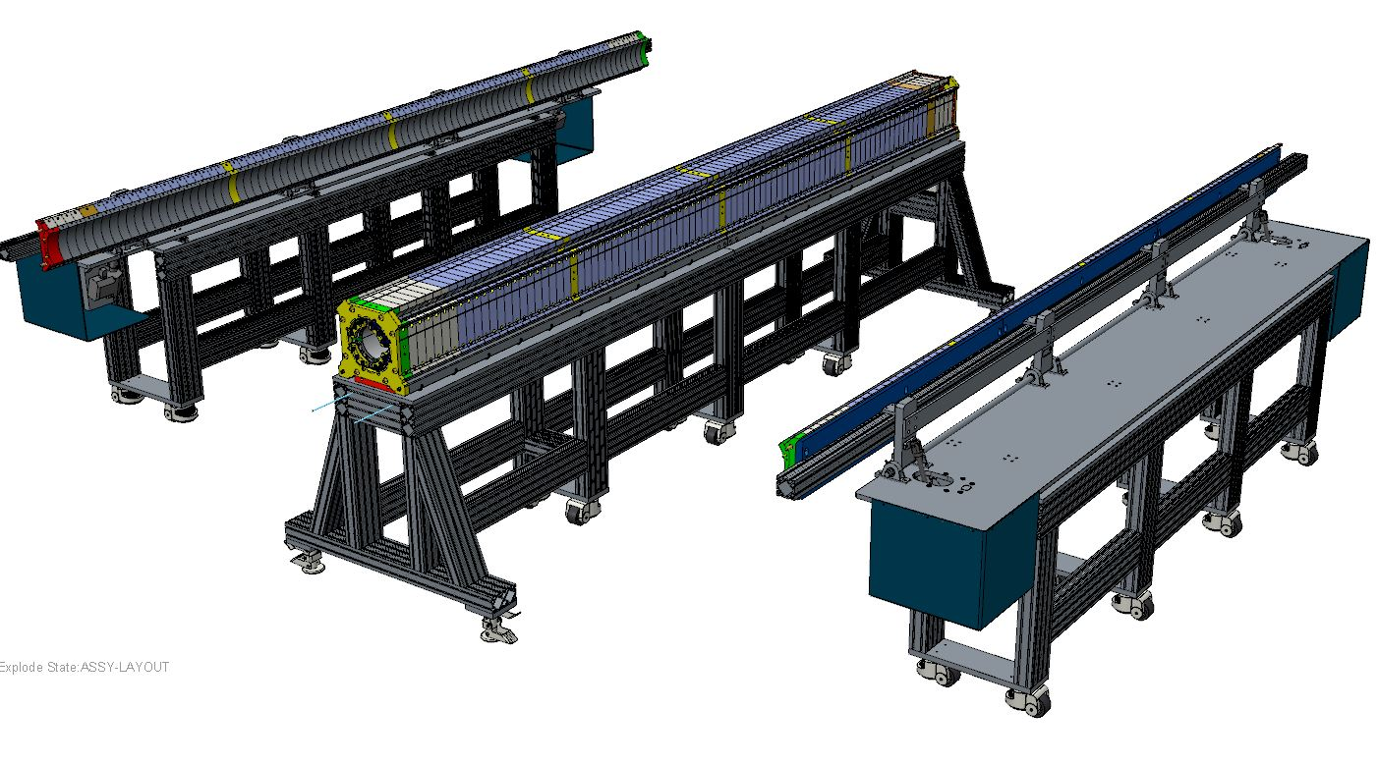
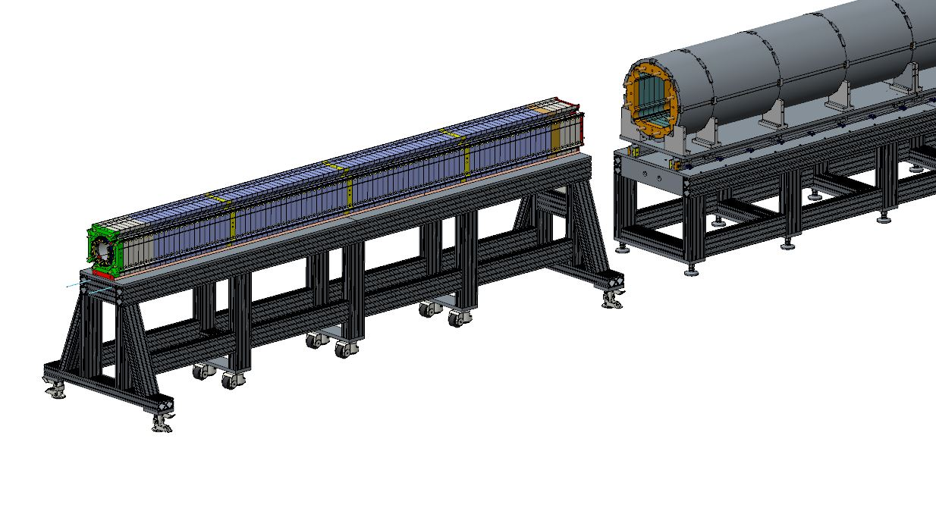
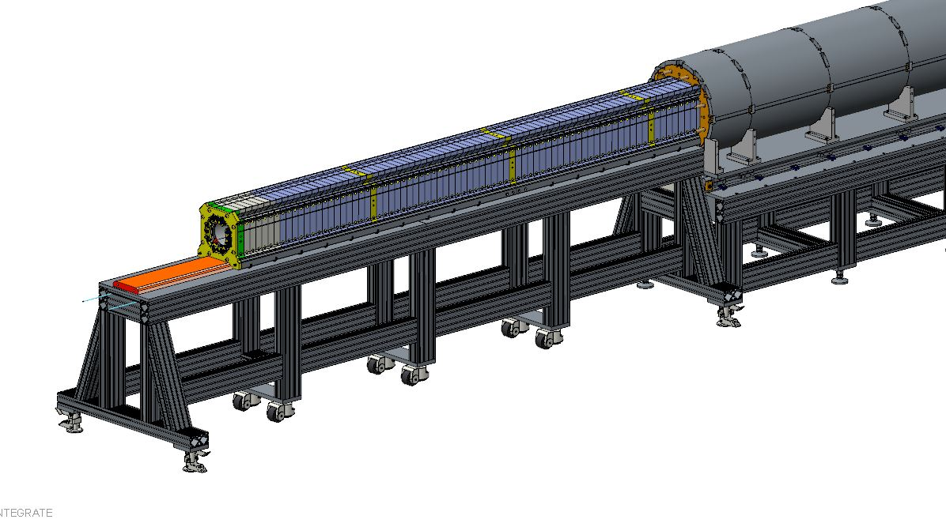
Assembly Tables and Lifting Fixtures
Coil pack assembly
table
Coil pack integration
Into shell-yoke subassembly

Slide 12
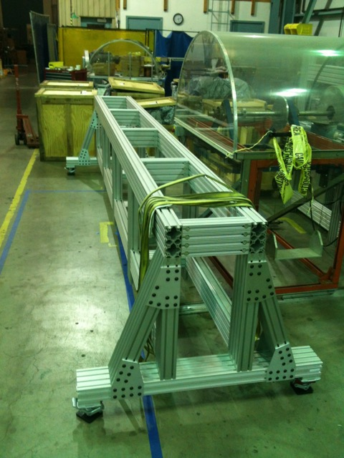
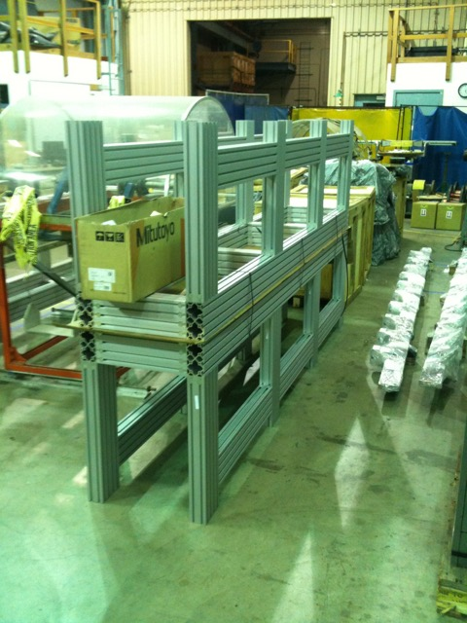
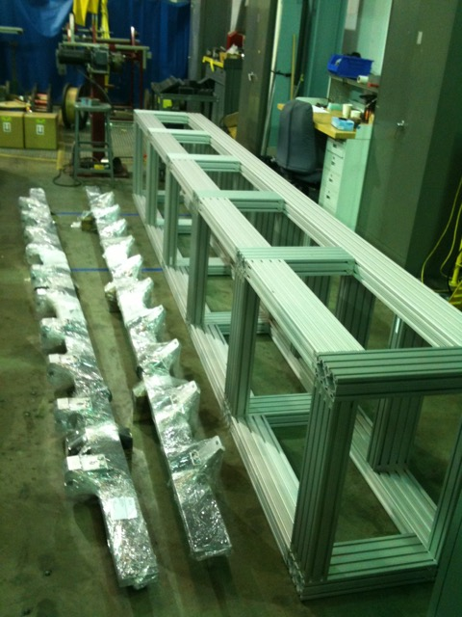
Assembly Tables and Lifting Fixtures

Slide 13
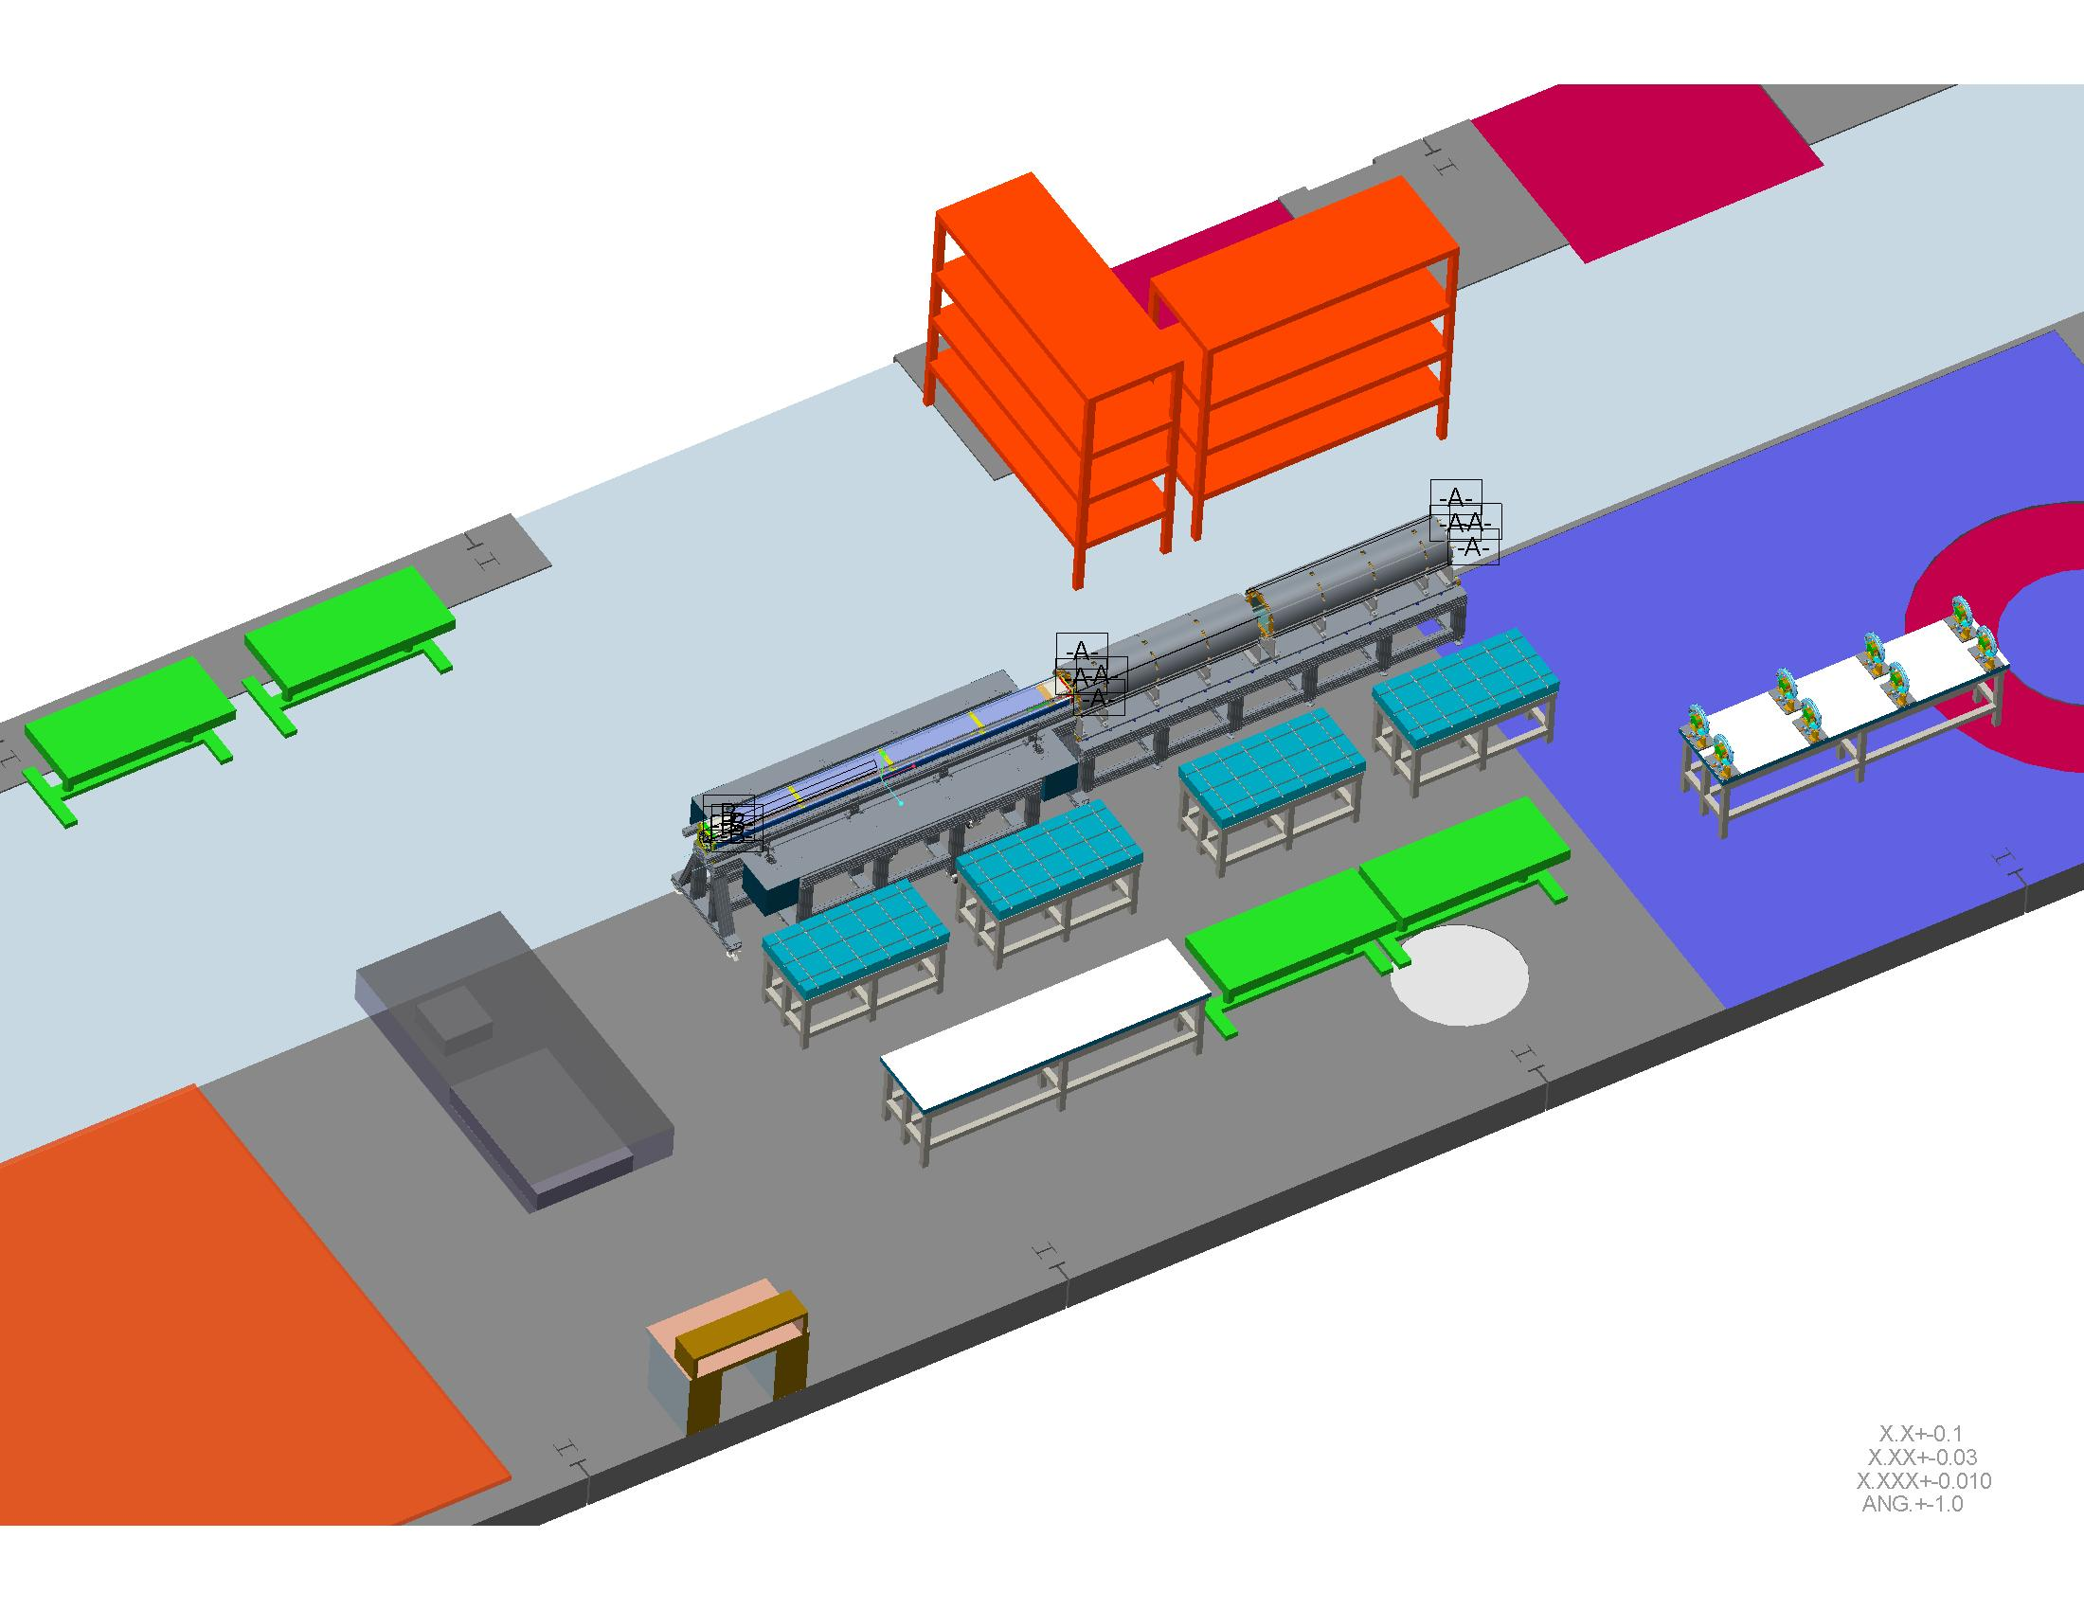
Magnet Assembly Tooling Layout
Magnet integration table will be surveyed and fixed into place
Network of semi-permanent survey monuments for aligning the tables and defining coordinate system when surveying magnet mechanical structure

Slide 14
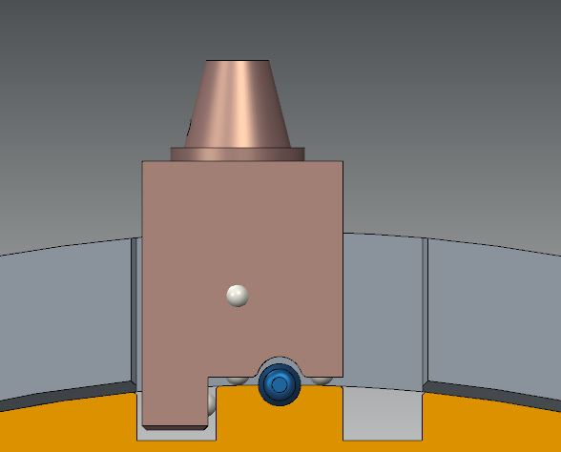
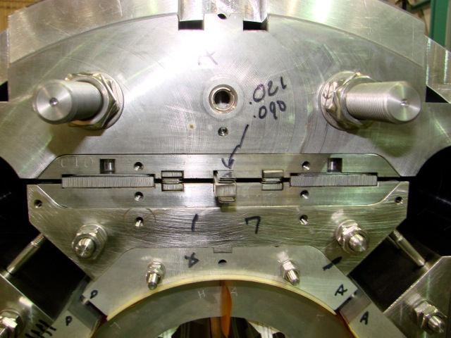
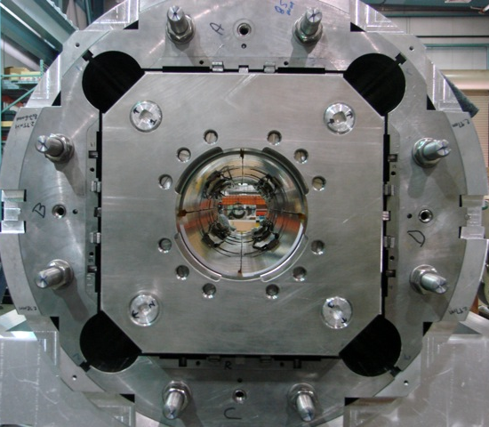
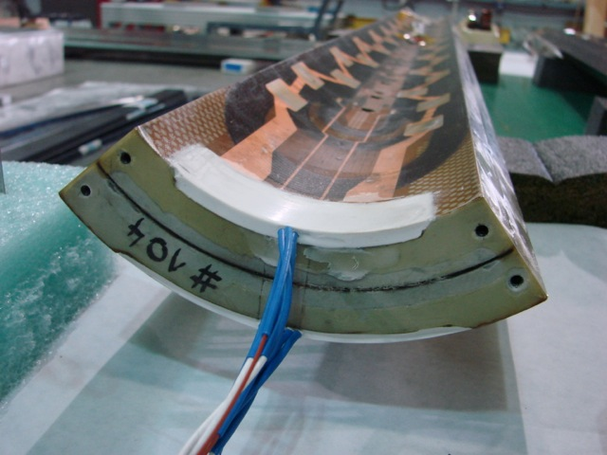
Fiducializing the Magnet Structure
Yoke/magnet fiducial features must be accessible after magnet has been assembled, as depicted here
1-2-3 survey
block
Alignment requirements proposed by CERN at the collaboration mtg. last month are under discussion
Coil targets defined to their mechanical center
Yoke features
remain accessible after axial
endplates are installed
Yoke survey block will be
defined to coil targets

Slide 15
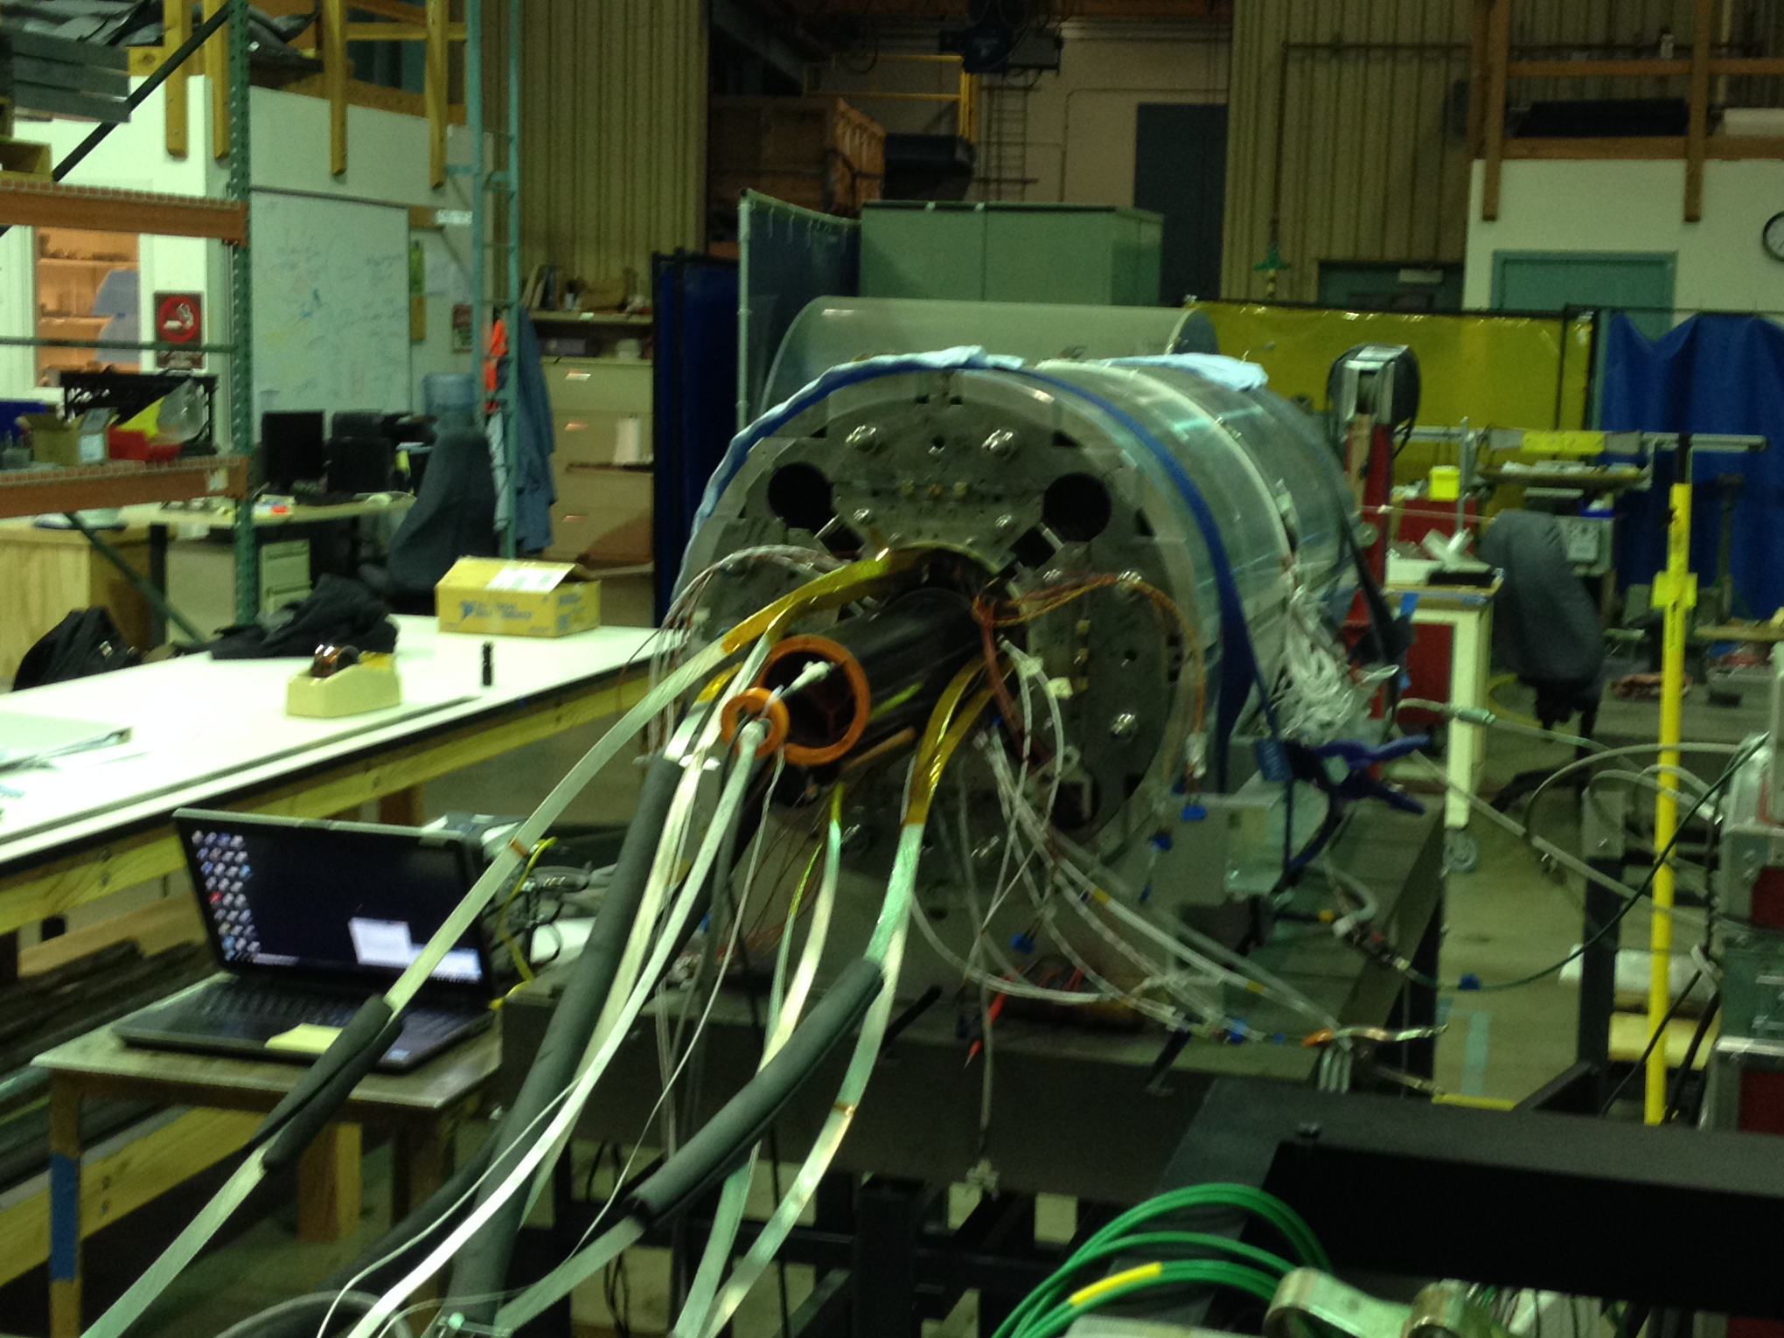
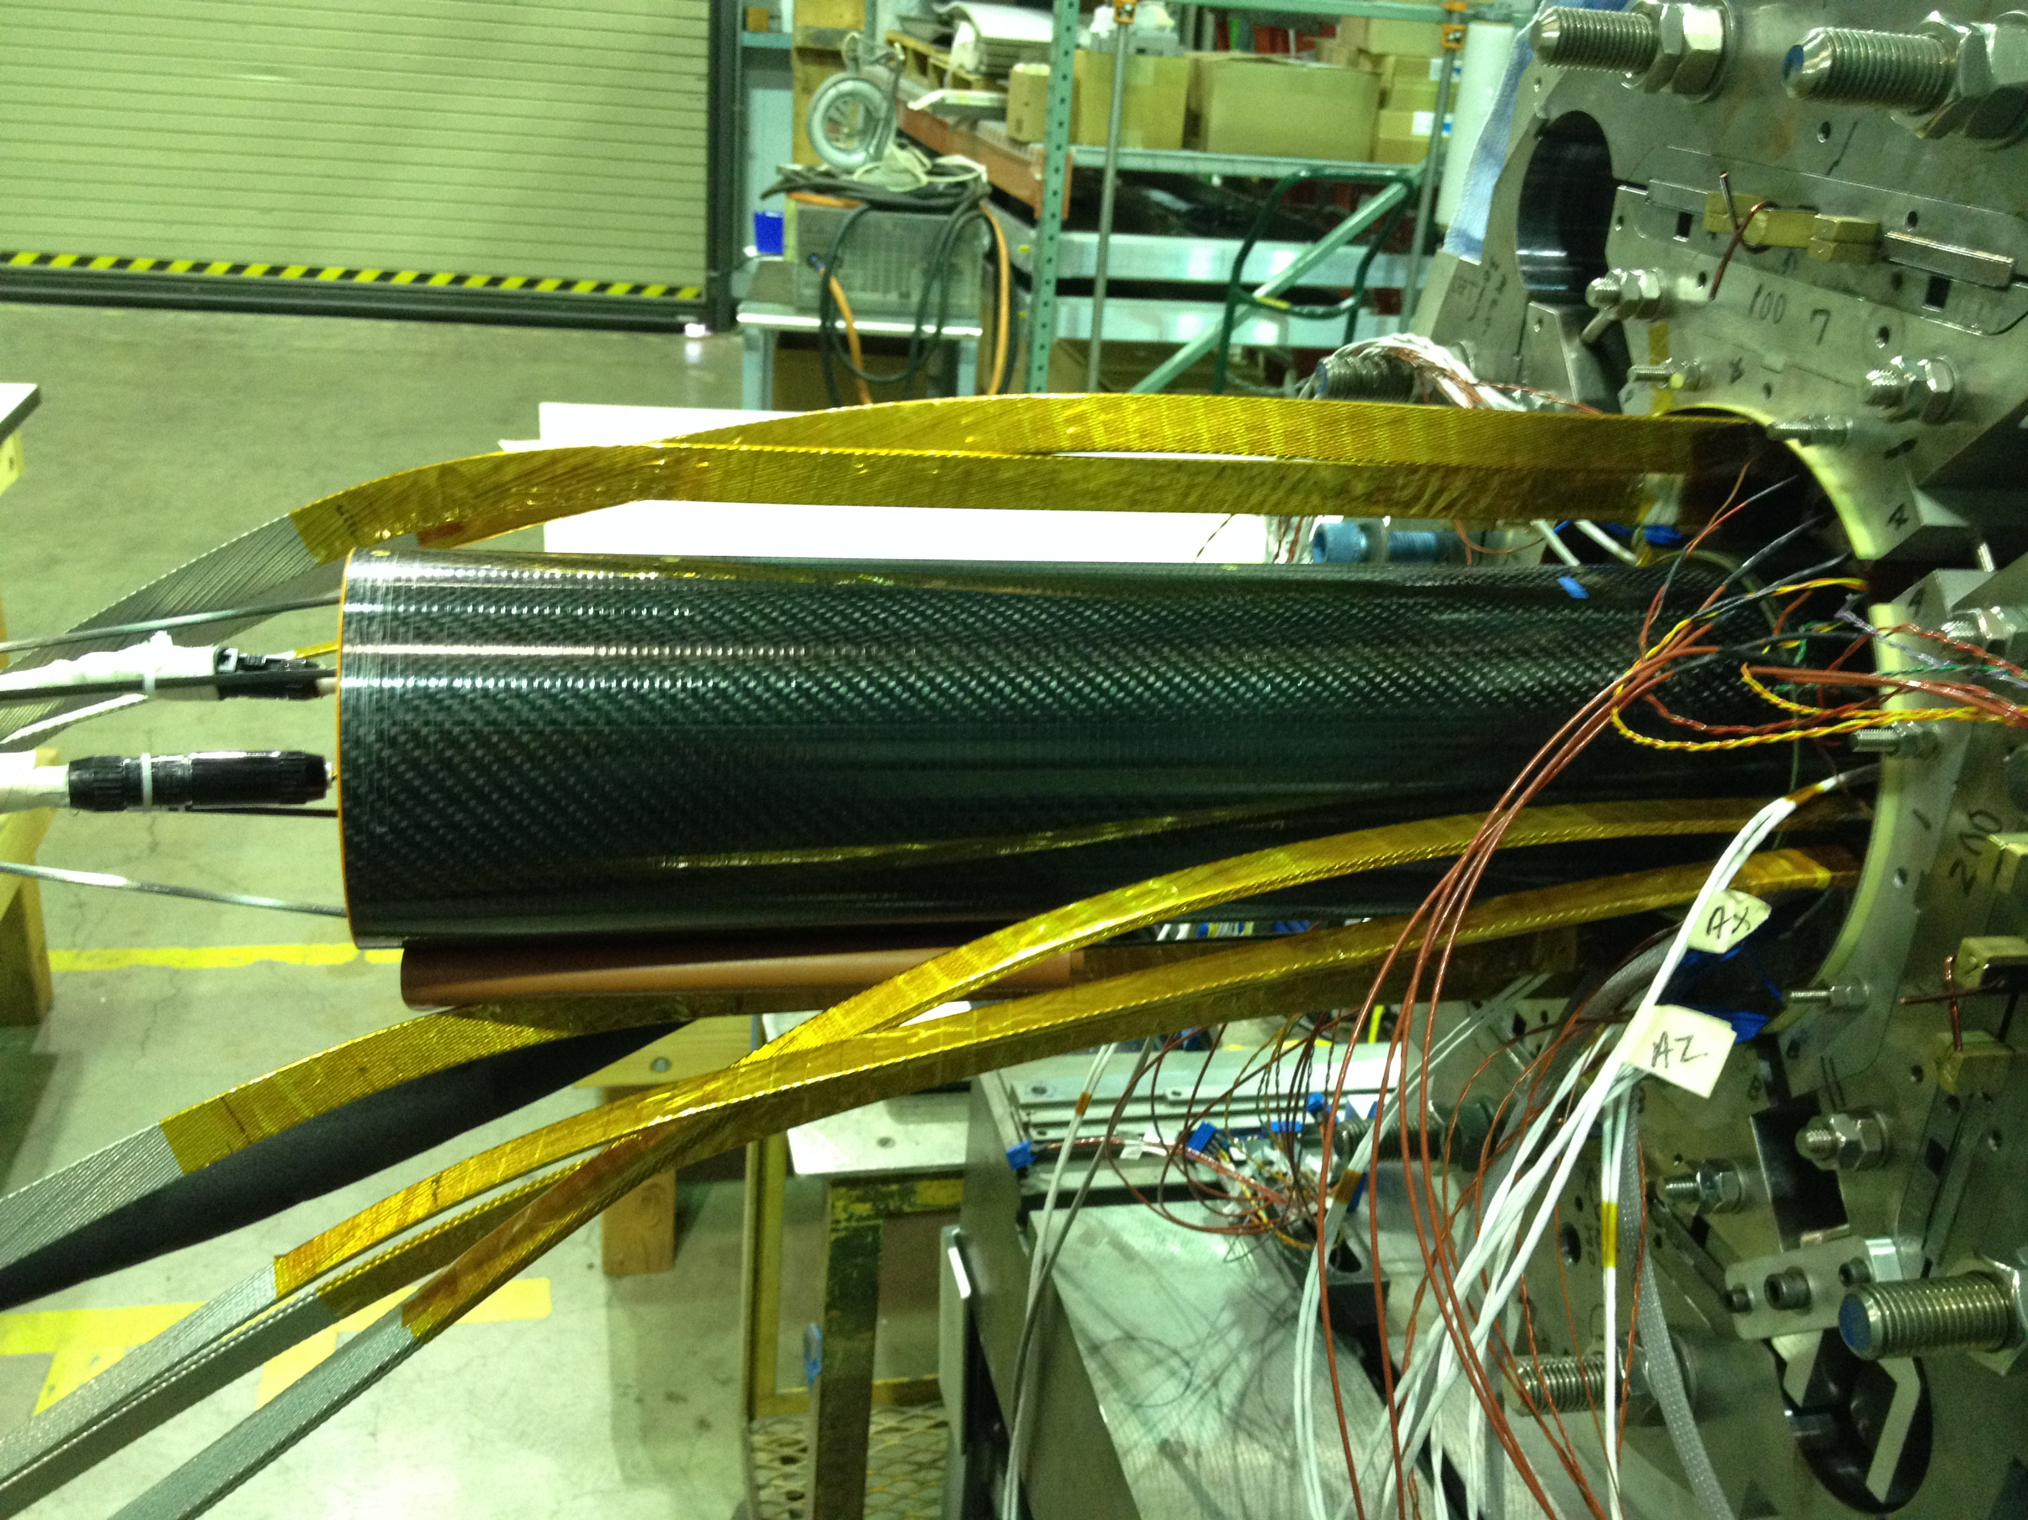
Warm Magnetic Measurements
May use the existing warm measurement probe with a different arrangement of two pickup coils
  We can measure the field angle from the first coil relative to that from the second coil as we scan along the magnet (We will check the possible resolution of this method)
Tilt angle sensors in mole
  The typical accelerometer with 12-bitADC has a resolution of 1 mrad (0.057 degrees). With inclinometers the resolution can reach 0.1 mrad
Survey targets can be attached to the measurement probe to track position and location of probe during measurements
Stretched wire measurements may also be performed
This information will be combined with the mechanical fiducialization data

Slide 16
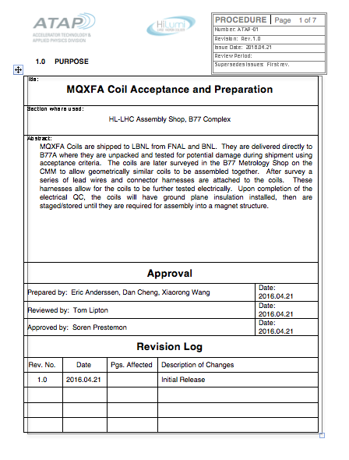
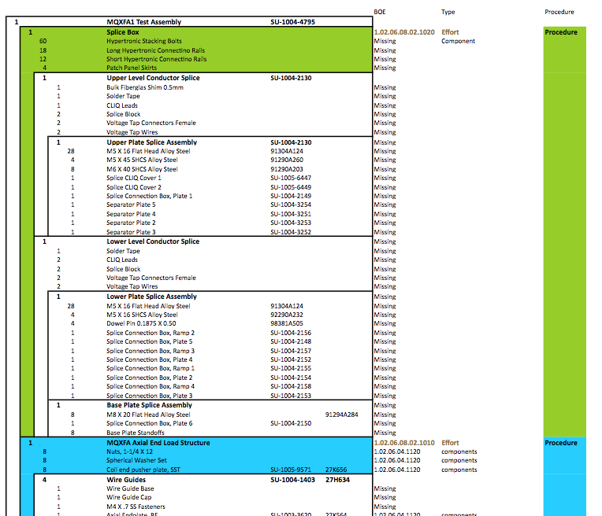
ABS and Documentation
Assembly Breakdown Structure document
  Identifies “Independent” tasks/subassemblies
    Dedicated procedures
    Dedicated QA elements
    CAD drawings, BOM
  Captures what information will be required for travelers / documentation that will be entered directly to CERN MTF system

Slide 17
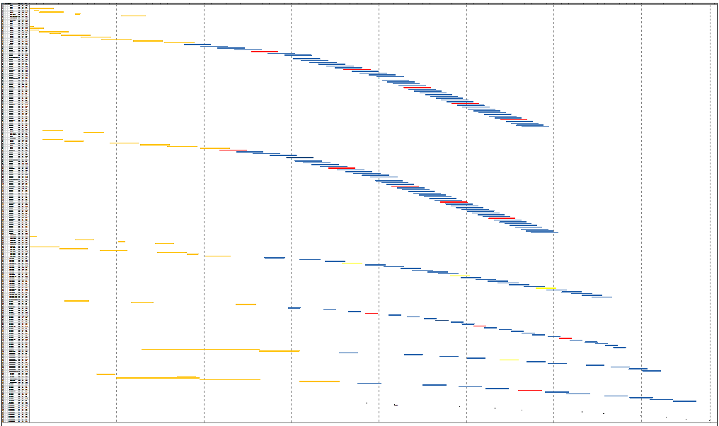
Manufacturing Plan
OCT 2016
Today
FY17
FY18
FY19
FY20
FY21
FY22
FY23
FY24
LARP
FNAL Coils
Project
Project assumes that 3 magnets of 20 will require rework after cold test
BNL Coils
LBNL Structure Assembly
BNL Vertical Test
FNAL Cold Mass Assembly
FNAL Cold Mass Test
Delivery to CERN

Slide 18
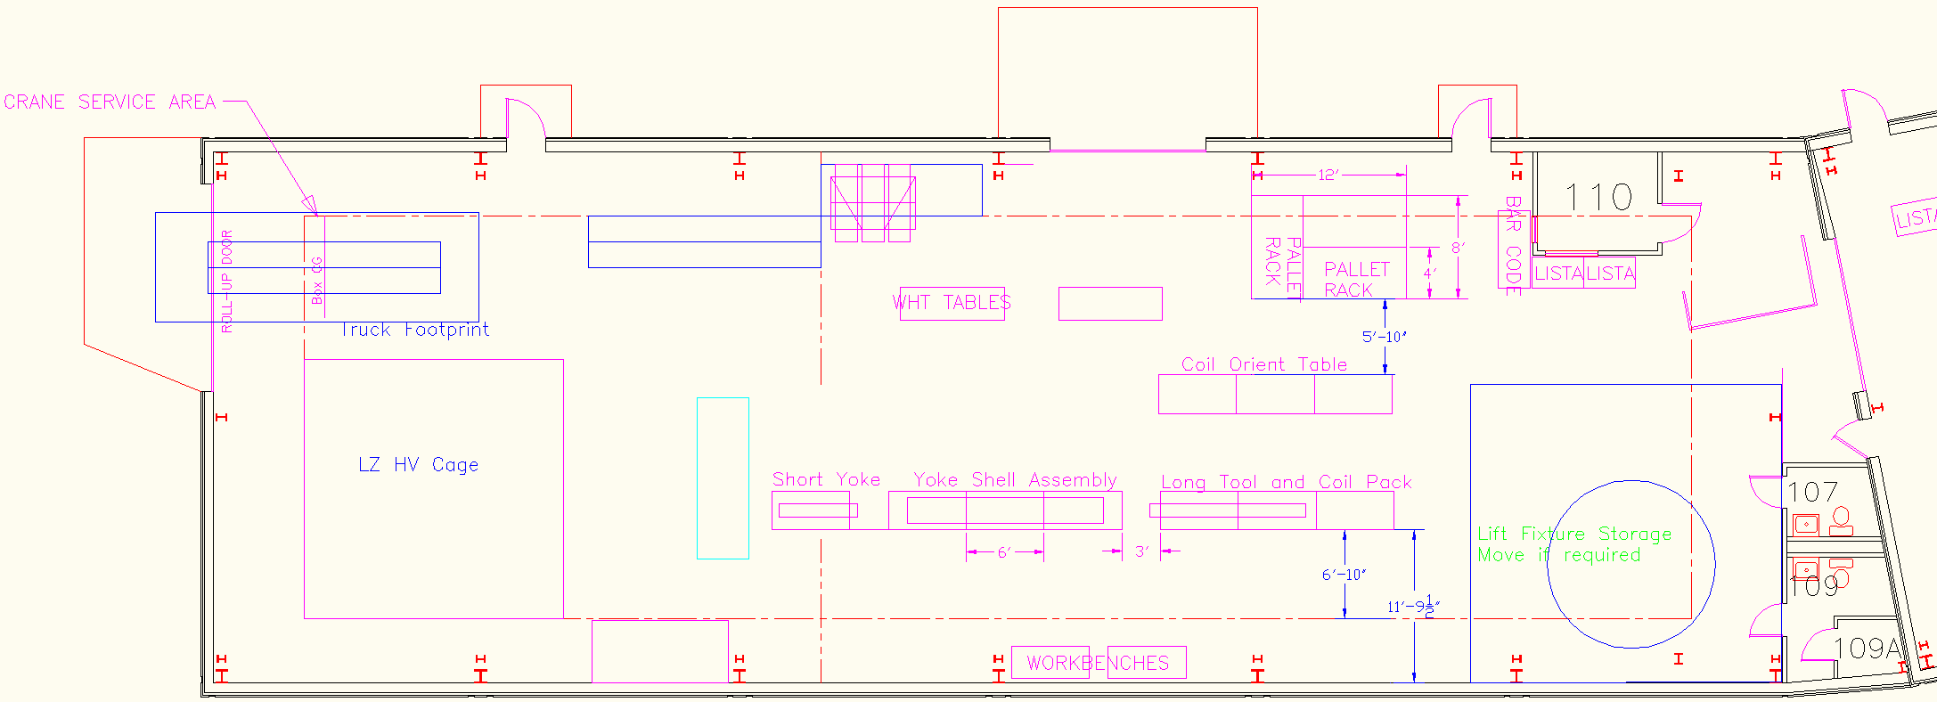
Present Tooling Infrastructure Footprint
Layout for MQXFA (early 2016)
Accommodates the short magnet program that is continuing in parallel with the prototype development
Long prototype layout presently being built up
Entire long operation serial, no parallelization

Slide 19
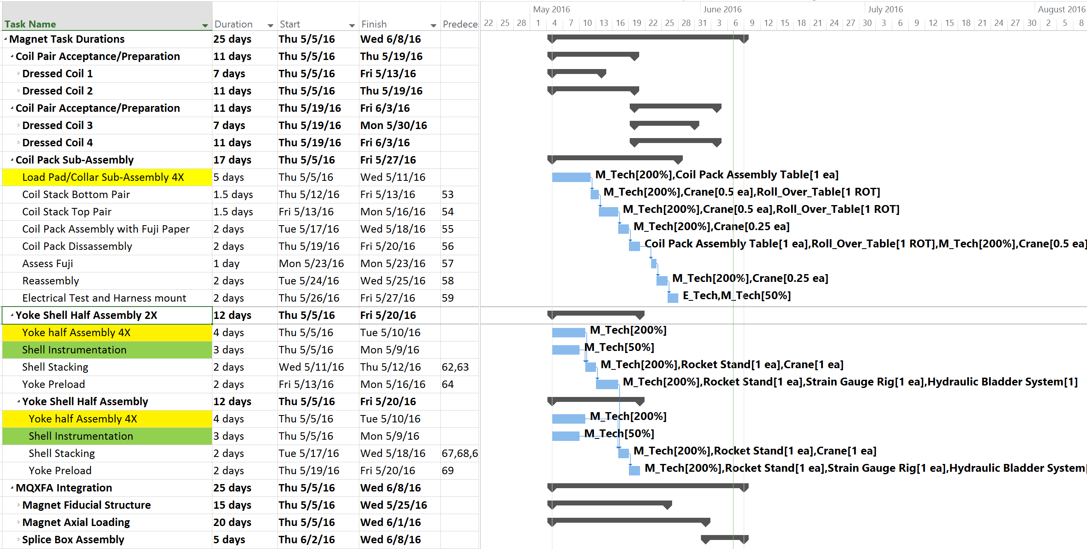
Production Task Durations—Max Duration 25d
Coil prep for a magnet (4 coils) would take 22 days
Coil pack subassembly takes 17 days
Full-length shell-yoke subassembly takes 24 days
Magnet Integration takes 25 days (longest task)
See next slide
Tasks shown in parallel to determine durations only
Actual parallel activities require adequate manpower resources and leveling—ongoing
Stageable schedule
  Items in yellow: possibility of vendors supplying stacked elements
  Items in green can be done off critical path (shells and rods (not shown) instrumentation)

Slide 20
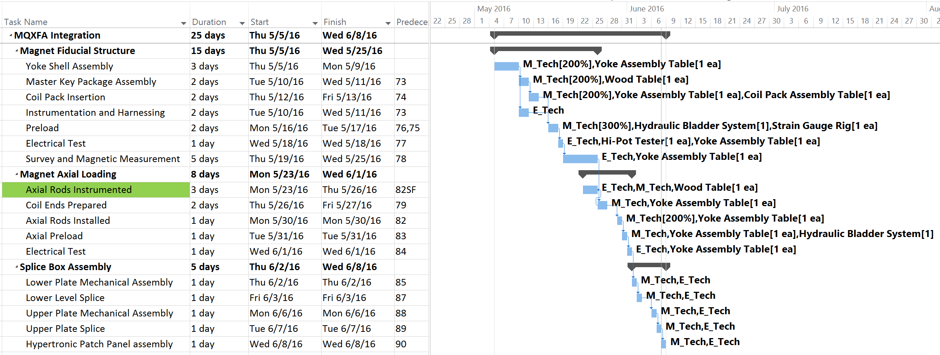
Magnet Integration—Max Duration 25d
Even if manpower/resources were available for full parallel activities, magnet production cannot be any faster than this
Stageable schedule
  Item in green can be done off critical path

Slide 21
Structures Status
Shells received
  Currently being instrumented
Nitronic 50 endplates received
  Will be sending one set to CERN (material delivery is more difficult in Europe with this alloy)
We experienced significant delays on key laminated structural parts
  Did not expect tight tolerances and inspection of these features would prove so difficult with these particular vendors; initiated order with backup vendor for yokes
First sets of laminations (load pads, collars) are moving forward with production
We expect the first mechanical model to be assembled this summer, but may have a slight delay in the start the assembly of the 1st prototype
For second prototype
  1st Structure bid process revealed wide range in both cost and delivery for many parts
  Cost and lead times were drivers of our decision making
  In hindsight, we can leverage our experience (with the lamination vendors, for instance) to ensure on-time delivery of parts at a reasonable cost
  Some structural parts will also be redesigned to address stress concentrations observed in FEA results

Slide 22
Assembly Tooling Status
Tooling is starting to arrive
  Lifting fixtures are in the process of being qualified
  Integration table frame & coil pack assembly tables
  Seismic restraints have been analyzed
Procurements have been initiated with almost all tooling
Assembly procedures and QC parameters are being developed from the scaled-up short model procedures, incorporating lessons learned
Survey & Alignment techniques will be evaluated with the 1st mechanical model and 1st structure
Hipot levels are still to be specified

Slide 23
Summary
Structure has been well developed through many years of LARP model magnet development
Assembly tooling and procedures are based on the experiences and lessons learned from both short and long models
Manufacturing plan was presented; based on the prototypes and tooling currently being fabricated
  Lessons learned from our first prototype are being applied to the production of the 2nd prototype
  Survey, Alignment, and fiducialization measurements will be tested and evaluated in both the mechanical model and first model
  Some requirements (hipot, alignment) remain in discussion, hopefully to be defined soon
First long magnet test expected in 2017
Second prototype structure assembled late 2017

Slide 24
Acknowledgements
LBNL
  H. Felice, H. Pan, E.C. Anderssen, D.R. Dietderich, R. Hafalia, M. Marchevsky, S. Myers, S. O. Prestemon, G.L. Sabbi, X. Wang, J. Wirdzek
CERN
  N. Bourcey, P. Ferracin, M. Juchno, J. C. Perez, H. Prin,
BNL
  M. Anerella, A. Ghosh, J. Schmalzle, P. Wanderer
FNAL
  G. Ambrosio, R. Bossert, E. Holik, S. Krave, F. Nobrega, M. Yu

Slide 25
Backup Slides

Slide 26
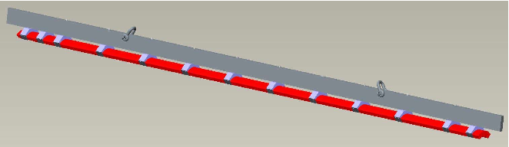
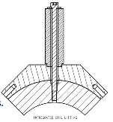
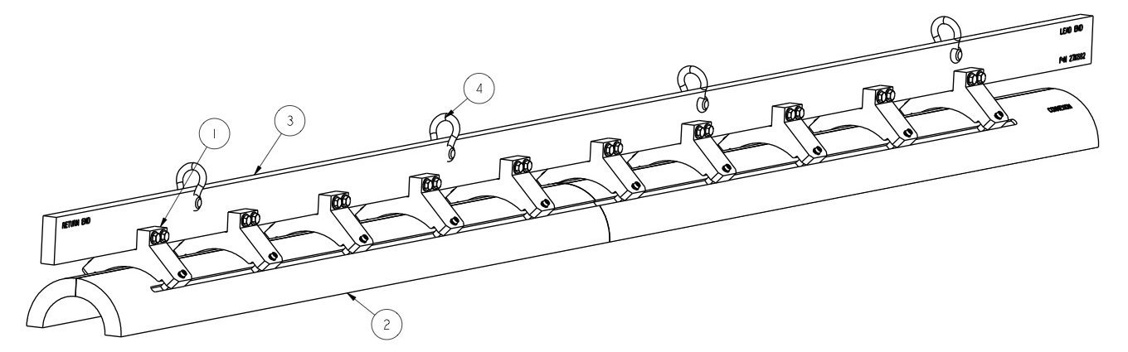
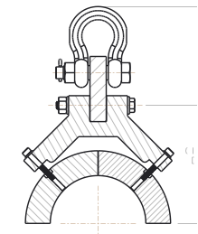
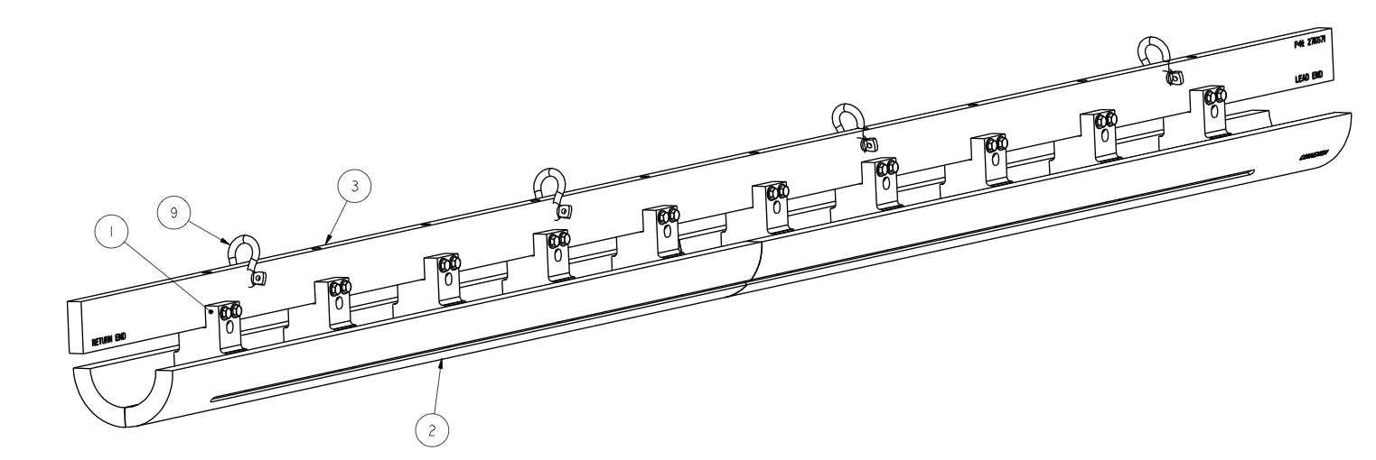
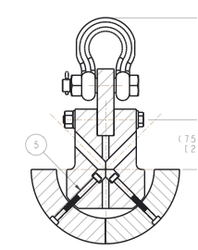
Coil Pack Assembly Prep--Coil Preparations
Coil lifting tooling has been scaled up from the MQXFS coil lifting
  Rollover tooling is an extension of the table being used for the MQXFS
  Lifting tooling will be scaled up from MQXFS fixtures
    Single coil, OD-pick (BNL design)
    Coil pair, OD-pick
    Coil pair, ID-pick

Slide 27
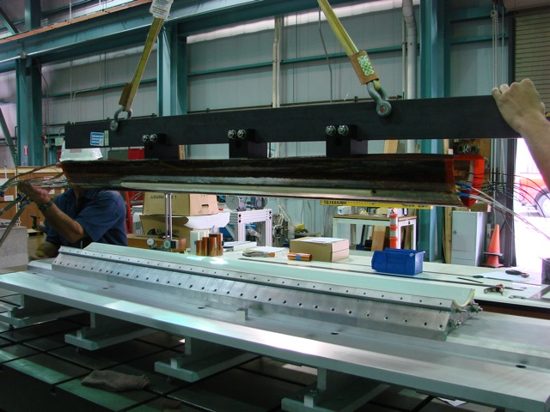
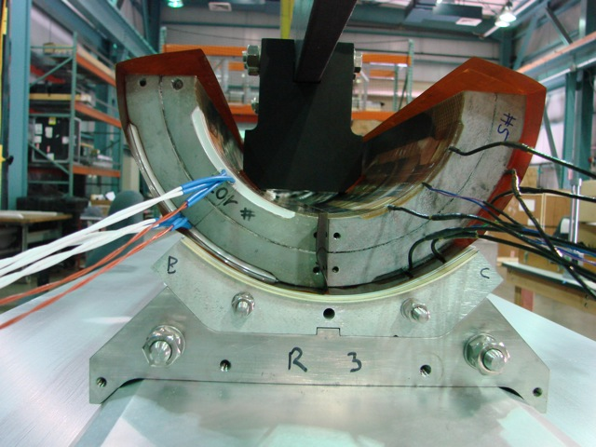
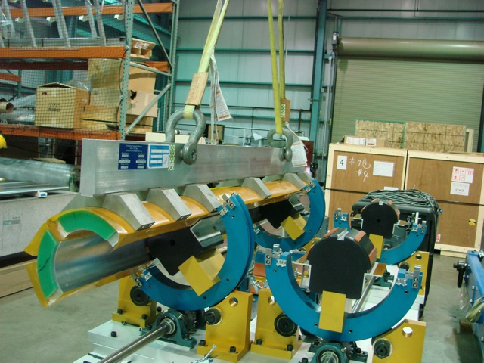
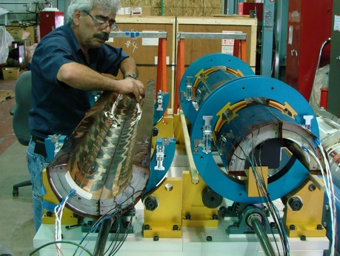
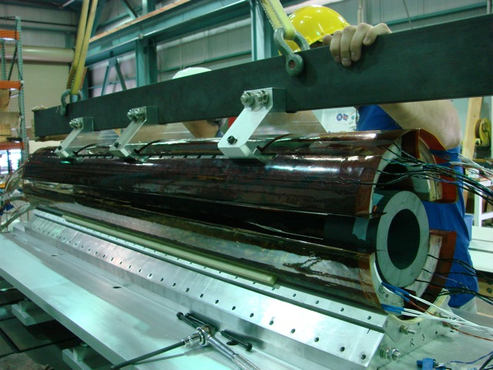
Coil Pack Assembly Prep--Coil Preparations
Coils will be received, CMM’d, instrumented
  CMM measurements will also capture fiducial information (see later talk on MQXFA Alignment proposal)
Rollover tooling is used
  To apply the coil GPI layers
  To pair coils
  To orient coils for handling

Slide 28
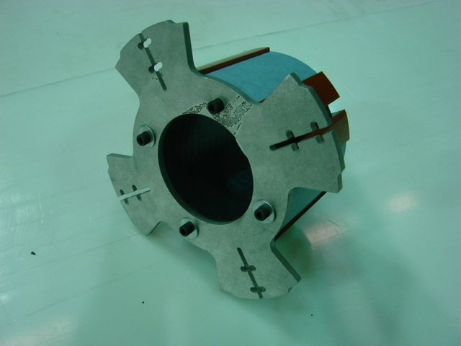
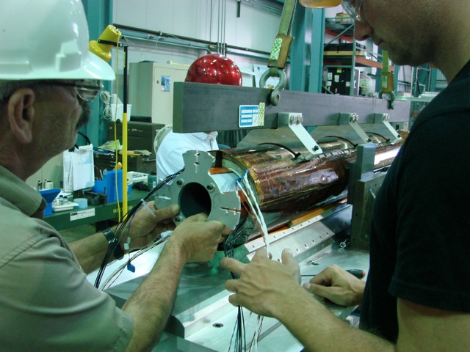
Coil Pack Assembly Prep--Coil Preparations
Install coil assembly support spuds
  Spud engages with the holes in the RE end shoe
    Tooling also clears the Kapton GPI layers, instrumentation wires, and leads (LE only)

Slide 29
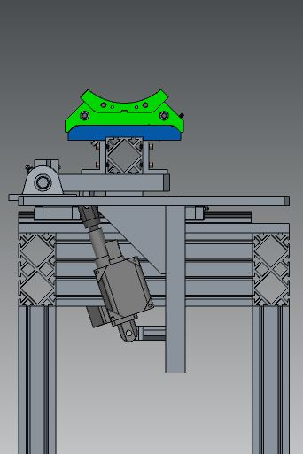
Coil Pack Assembly Prep—Load Pads & Collars
The assembled loadpad-collar subassemblies are moved to auxiliary tables for positioning and assembly of the coilpack
Only load pads will be bolted in the assembly
Assembled coil pack is ready for insertion

Slide 30
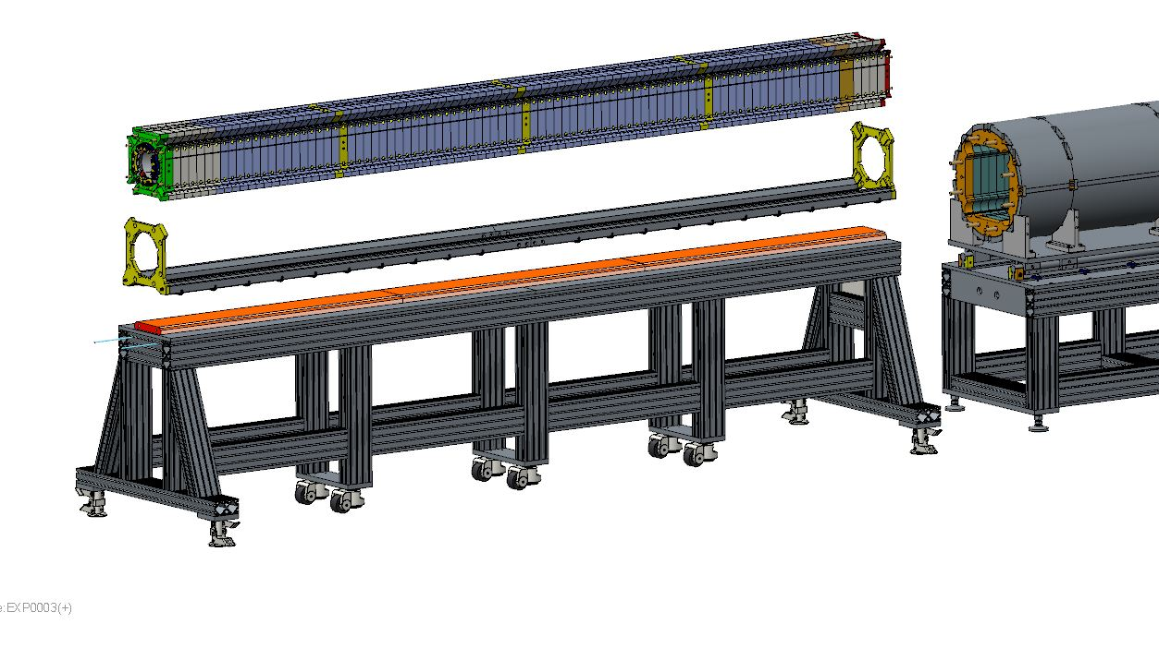
Magnet Integration
Insertion rails are attached to the coil pack (exploded view shown; not actual process)
Rails will be split and pinned in the middle so that they can be pulled out from each end easily.

Slide 31
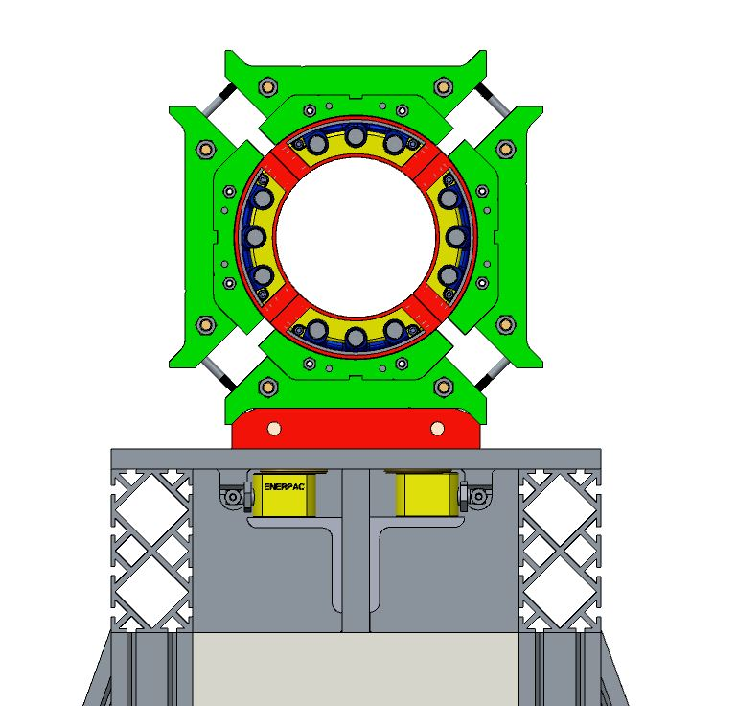
Magnet Integration
Coil pack assembled on assembly master

Slide 32
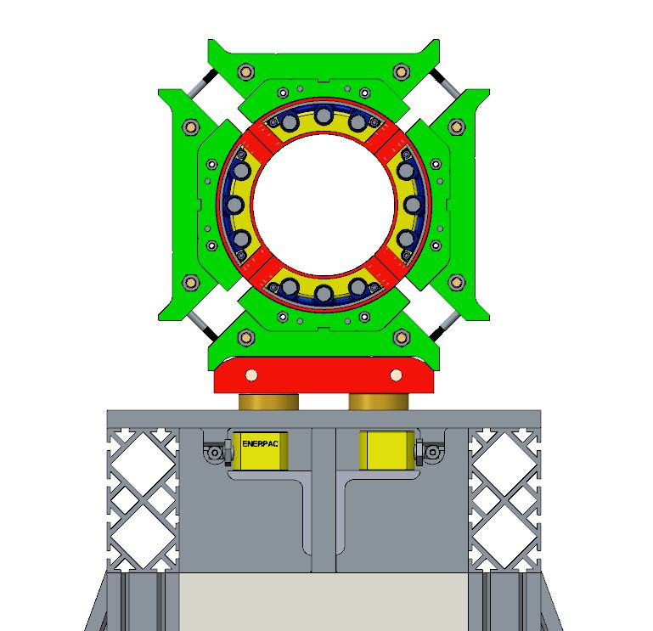
Magnet Integration
Coil pack assembled on assembly master
Activation of the cylinders

Slide 33
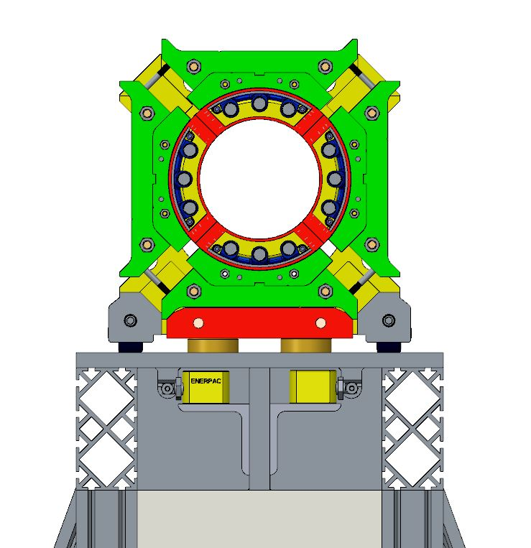
Magnet Integration
Coil pack assembled on assembly master
Activation of the cylinders
Installation of the wheel racks underneath the coil pack

Slide 34

Magnet Integration
Coil pack assembled on assembly master
Activation of the cylinders
Installation of the wheel racks underneath the coil pack
Actuator pressure released
~1 mm gap between assembly master and coil pack

Slide 35

Magnet Integration
Coil pack assembled on assembly master
Activation of the cylinders
Installation of the wheel racks underneath the coil pack
Actuator pressure released
Coil pack ready to be
inserted

Slide 36

Magnet Integration
Assembled coil pack is ready for insertion
Coil pack assembly table is shifted over to magnet integration table
Tables are aligned into place
Coil pack is inserted into yoke-shell structure

Slide 37
Magnet Integration
Assembled coil pack is ready for insertion
Coil pack assembly table is shifted over to magnet integration table
Tables are aligned into place
Coil pack is inserted into yoke-shell structure

Slide 38

Magnet Integration
Assembled coil pack is ready for insertion
Coil pack assembly table is shifted over to magnet integration table
Tables are aligned into place
Coil pack is inserted into yoke-shell structure

Slide 39
Magnet Integration
Assembled coil pack is ready for insertion
Coil pack assembly table is shifted over to magnet integration table
Tables are aligned into place
Coil pack is inserted into yoke-shell structure

Slide 40

Magnet Integration
Assembled coil pack is ready for insertion
Coil pack assembly table is shifted over to magnet integration table
Tables are aligned into place
Coil pack is inserted into yoke-shell structure

Slide 41


Magnet Integration
Assembled coil pack is ready for insertion
Coil pack assembly table is shifted over to magnet integration table
Tables are aligned into place
Coil pack is inserted into yoke-shell structure
Half-length (~2.3 m long) master keys and bladders are inserted.

Slide 42

Proposed Coil Ends
Either a coil fiducial plate, impregnated
(Both ends),
Or, 2-3 pin holes to be drilled into the end shoes and reamed after reaction
This method will be a direct measurement to the coils, removing the uncertainty of measuring the collar ends

Slide 43

Fiducializing the Coil Mechanical Center
When coils are measured, CMM data will also measure the fiducials on both ends to locate them with respect to the theoretical center
Perhaps pin holes in poles can also be used in the ID if necessary; requiring spot faces

Slide 44


Yoke Survey Tooling Block
“1-2-3” Style block
  Magnetic hold down

Slide 45


Proposed Fiducial Plan
Yoke Fiducials, 3x-4x per axial location
(bottom may not be readily accessible)
1-2-3 survey
block
Coil Fiducials,
Impregnated (4x),
Both ends
Measured centers
(mechanical/magnetic)

Slide 46


Fixed, and aligned Magnet Integration Table
Magnet shell/yoke assemblies will be located onto pillars that have been surveyed in

Slide 47

What is Achievable?
This is more of a fiducialization process
Magnet alignment: No real “knobs to turn”
  Assembly tooling will be aligned, though
  Will likely use a laser tracker (FARO Vantage system)
  Our survey crew will need to perform some tests
http://www.faro.com/products/metrology/faro-laser-tracker/overview

Slide 48
Summary of LQ Experience
What we learned:
  Master keys were integral to the design and assembly of the long structure assembly process
  Joining shell-yoke subassemblies is a viable option to making long magnets
  Half-length master key assemblies were effective in the preload operations
  Collar shimming and coil radial contact was important for the preload of the magnet coils
What we wanted to do better:
  Long shell machining started with one piece, but limited fabrication options, and added time and cost
  Long coil handling tooling was functional, but not efficient
  Load pad handling was also functional, but not necessarily scalable
  Coil pack insertion method is not necessarily scalable
  Instrumentation wire routing at magnet level needed improvement

Slide 49
Summary of HQ Experience
What we learned
  We refined the process of calculating what shims were required to ensure the contact between collars, coils, and alignment keys
  Collars required ground plane protection in addition to better control of radial shimming
  Full length (G10) alignment keys only needed to be shimmed to size at pole island region
  Strain gauge installation process was refined, which improved reliability

Slide 50
Summary of MQXFS/D Experience
What we learned
  We were able to preload several shells in one shell-yoke preload assembly step
  Yoke/Shell alignment may only require 1 quadrant pin for clocking, which will not over-constrain system
  Custom width GPI coil layers facilitated ease of preparation
  Strain gauge measurement systems are showing comparable results
What we’d like to do better
  Seismic support of the shell-yoke subassembly needs improvement
  Bladder support cross requires double slots for lower pressure operation => more reliability
  GPI creasing technique/tooling to be improved
  Collar radius will be adjusted to reduce amount of radial shims required
    Collar shims will be custom width sheets of Kapton rolls, also for ease of prep
  Pressure paper sensitivity was not high enough
  Coil pack installation support needs to positively engage coils during assembly
  Alignment and load keys will be adjusted in thickness to reduce the amount of shim stock required, and also be made out of bronze instead of steel

