Slide 1

2.7 Test facility and test plan at CERN
M. Bajko
On behalf of the TF section and the SM18 UPG project
QXF Review June 2016 https://indico.cern.ch/event/355818/

Slide 2
MY CONCLUSIONS @ the review in 2014
R&D
TQ, SMC,HQ,RMC
Modelling
SQXF, MQXFA , MQXFB
Prototyping
Q1,Q2a,Q2b,Q3
Production
Q1,Q2a,Q2b,Q3
STRING
Post installation
Subject of this talk
NOT Subject of this talk
HORIZONTAL position
VERTICAL position
Short or no time for feed back from model to the prototype with CERN installations
2014 : 20 kA @ 1.9K, 570 mm for 4 m
For HQ, SMC, RMC
Summer 2016 : 30 kA @ 1.9 K, 800 mm for 5 m
(alternative HFM cryostat: but only @ 20 kA in April 2016)
For MQXS, MQXFA
March 2017 : 30 kA + 4 kA @ 1.9 K
(alternative Cluster A: but only 17 kA + 600 A @ 1.9 K in 2015)
Very tight ! CRITICAL
Outer D 630 mm
Iss MQXFS,MQXFA ∼ 22 kA
Lss ∼ 4 m
Seems to be feasible
For Q1,Q2a,Q2b,Q3
Iss MQXFA, MQXFB ∼ 22 kA
I MCBXF = 4 kA
Lss ∼ 15 m
NO vertical test facility is available @ CERN ,nor planned for the individual test of MQXFB…. 6.8 m !!

Slide 3
Content
Magnet test stand layout @ CERN
Vertical cryostat for model magnets
  HFM
  Cluster D
Horizontal test benches for cold masses
  Cluster A
  Cluster E
Services
Test plan
Planning
Risk and mitigation of risk
Summary and conclusions

Slide 4
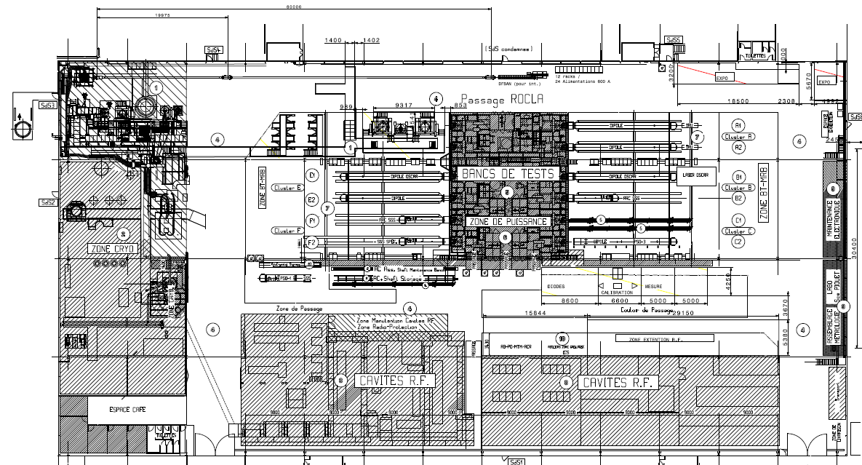
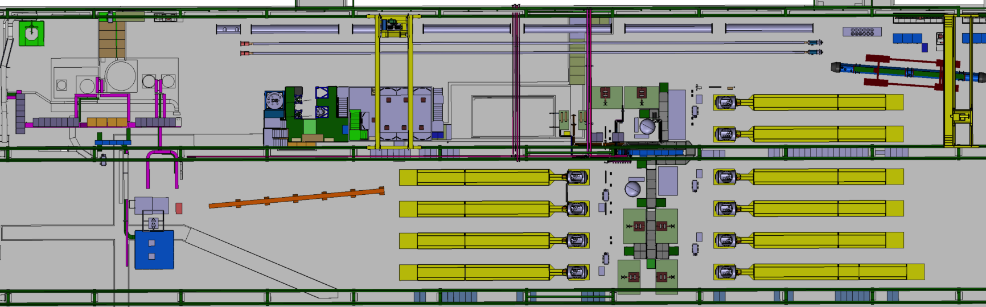
Magnet test stands layout @ CERN
THE SUPERCONDUCTING MAGNET TEST STAND AT CERN in SM18
STRING and SC LINK
CLUSTERS
F E D
HORIZONTAL BENCHES
CLUSTERS
C B A
Is in a building of 7200 m² over which the test stands for magnets occupies about 50%.
INSTALLATIONS
3 vertical cryostats ,
1 feed box for supercritical He,
1 cryostat for LN₂,
10 horizontal benches
OPERATION
I= 0.12 kA-20 kA
T = 1.9 K to 70 K He
withstanding U = 1V to 3 kV
CRYOGENIC ZONE
Superconducting RF CAVITY TEST ZONE
LN₂ TEST ZONE

Slide 5
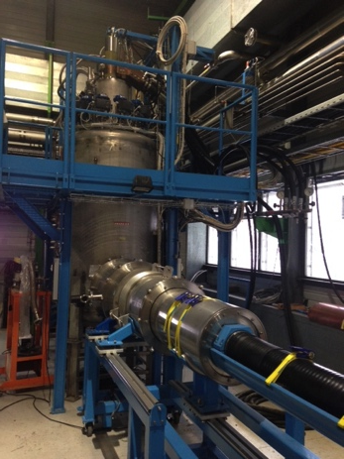
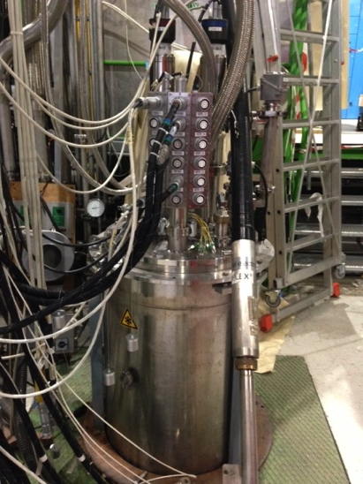
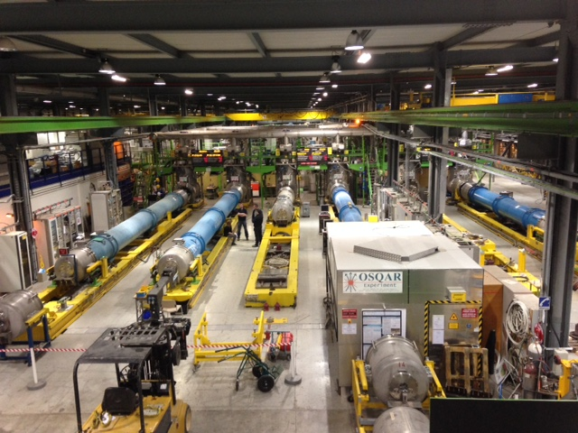
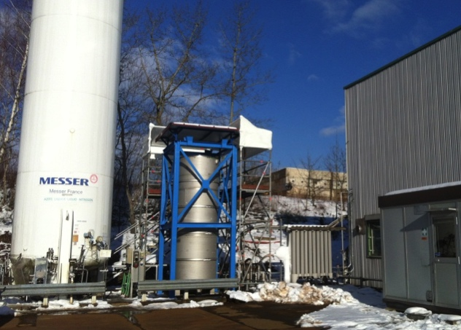
Magnet test stands layout @ CERN
INSTALLATIONS
3 vertical cryostats ,
1 feed box for supercritical He,
1 cryostat for LN₂,
10 horizontal benches
OPERATION
I= 0.12 kA-20 kA
T = 1.9 K to 70 K He
withstanding U = 1V to 3 kV

Slide 6
MY CONCLUSIONS @ the review in 2014
R&D
TQ, SMC,HQ,RMC
Modelling
SQXF, MQXFA , MQXFB
Prototyping
Q1,Q2a,Q2b,Q3
Production
Q1,Q2a,Q2b,Q3
STRING
Post installation
Subject of this talk
NOT Subject of this talk
VERTICAL position
Summer 2016 : 30 kA @ 1.9 K, 800 mm for 5 m
(alternative HFM cryostat: but only @ 20 kA in April 2016)
For MQXS, MQXFA
Very tight ! CRITICAL
Outer D 630 mm
Iss MQXFS,MQXFA ∼ 22 kA
Lss ∼ 4 m
NO vertical test facility is available @ CERN ,nor planned for the individual test of MQXFB…. 6.8 m !!

Slide 7
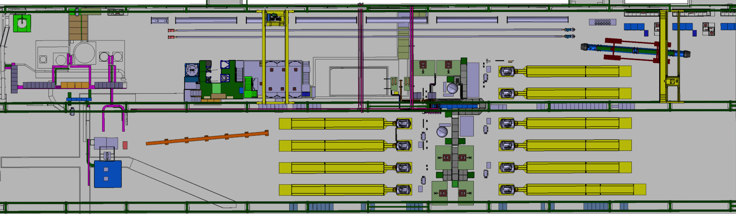
Vertical test stand upgrade
Cluster G
Cluster D
The vertical cryostats zone , called Cluster G of about 400 m² is under upgrade with an extra space called Cluster D of 150 m² to accommodate the test of larger diameter magnets @ higher operating current for HL LHC.

Slide 8
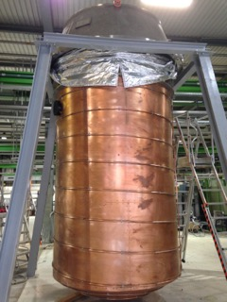
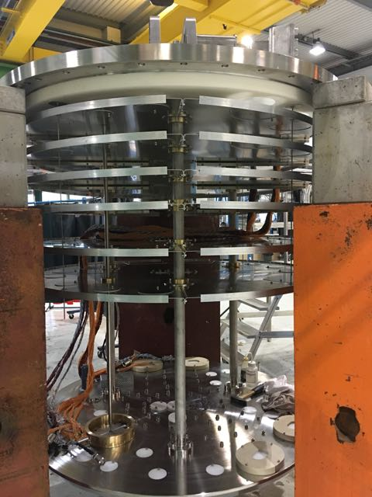
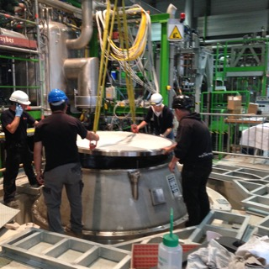
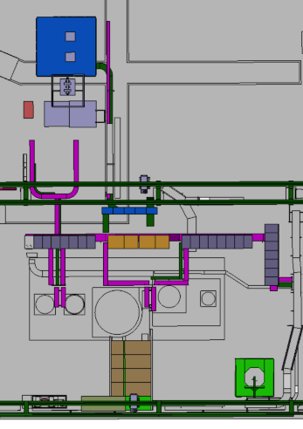
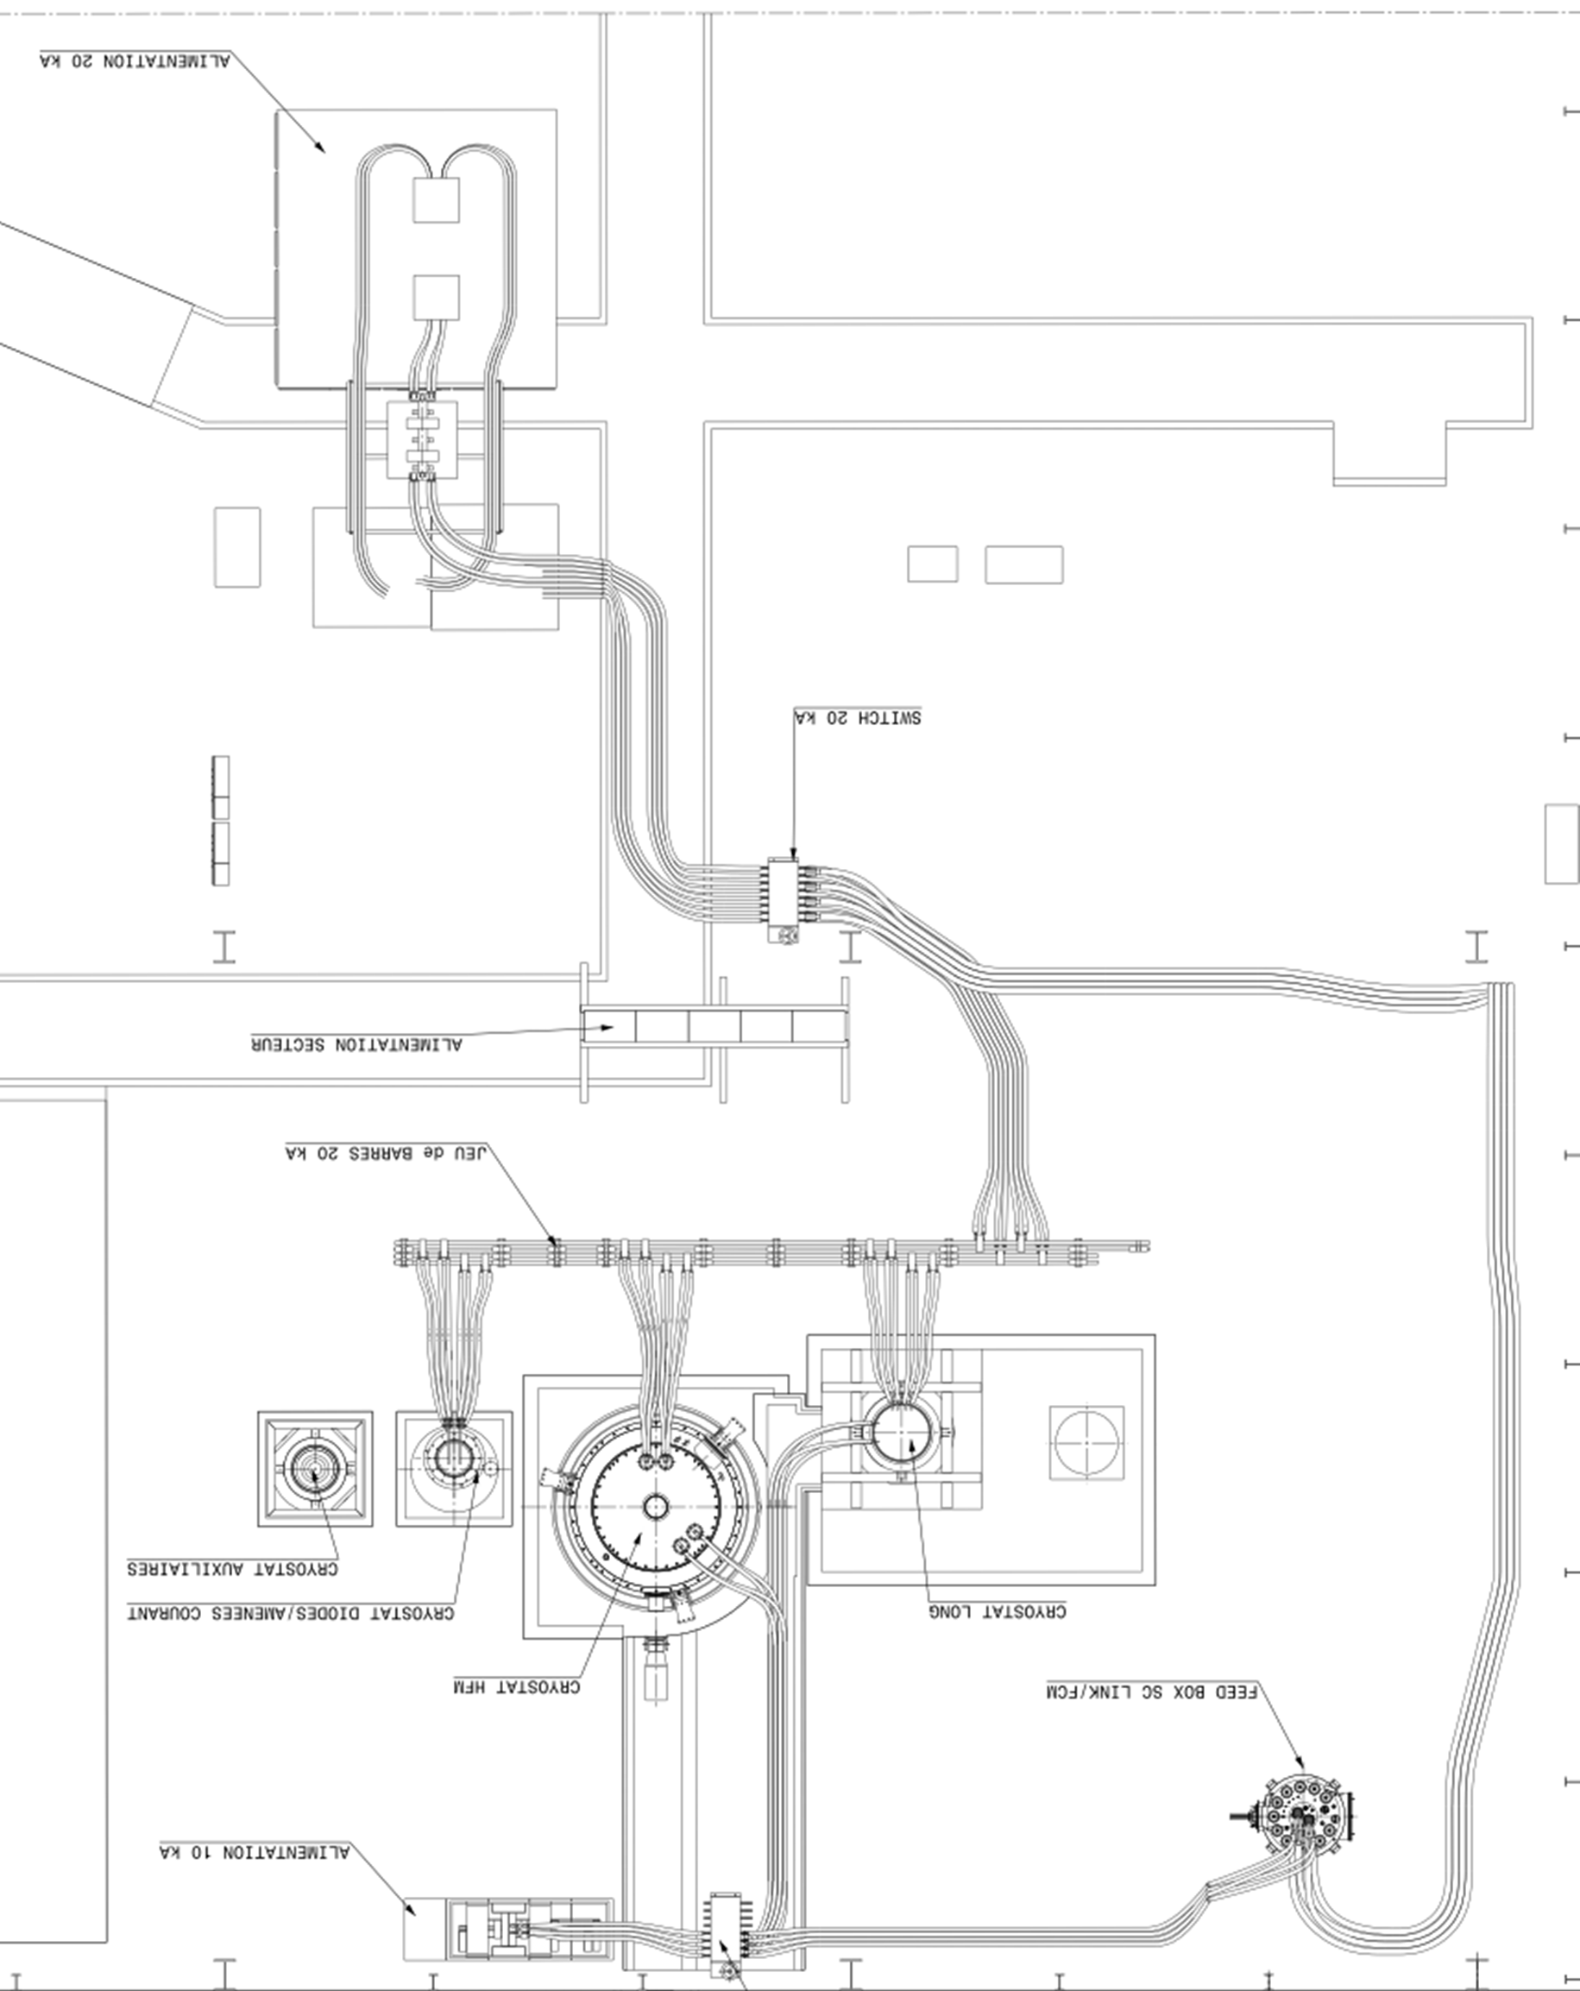
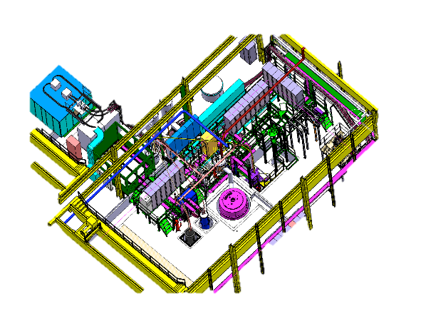
Cluster G upgrade
PRE COOLING WITH He GAS AND QUENCH BUFFER FOR COLD He RECOVERY
20 KA POWER CONVERTER
with EE and DUMP RESISTOR
The circuit is distributing current towards vertical cryostats or the feed box via a commutator
“DIODE/LEAD” CRYOSTAT :
@ 4.2 K
“LONG” CRYOSTAT :
3.8 m long and 600 mm diameter @ 1. 9 K
“SIEGTAL” CRYOSTAT :
1.4 m long and 800 mm diameter @ 1. 9 K
The new cryostat in this zone is the:
“HFM” CRYOSTAT ALLOWING MAGNETS TO BE TESTED WITH
1500 mm diameter and 2. 5 m length
CRYOGENIC
FEED BOX FOR
He 4.2-80 K
Ref. HFM cryostats is financed by EUCARD and the WP19 task of HL LHC

Slide 9
Vertical test stand upgrade
Cluster D

Slide 10
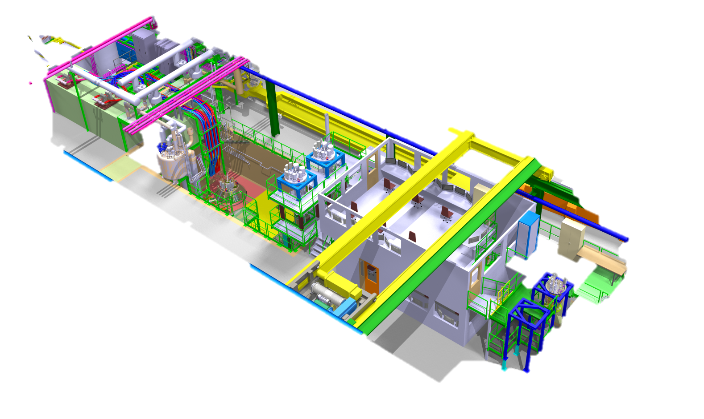
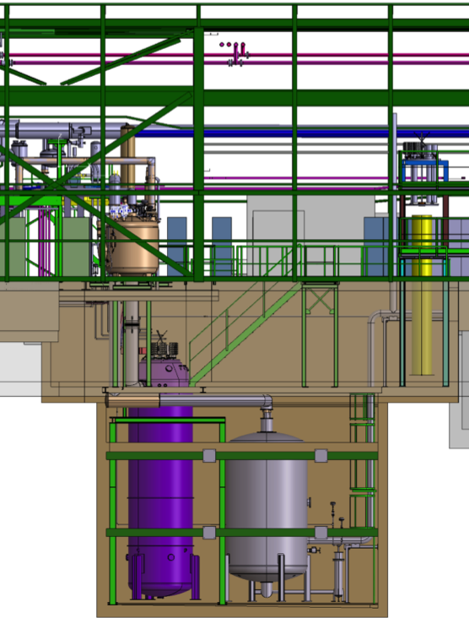
Cluster D test stand
CRYOSTAT : 4.8 m LONG AND 800 mm @ 1. 9 K
EE and DUMP on the 2 m LEVEL
POWER CONVERTERS30 kA AT GROUND LEVEL
PREPARATION ZONE AT 0 AND -3 m LEVEL
5.5 m
ELECRICAL AND CRYO RACKS NEAR THE CONTROL ROOM
2 m
0 m
TWO ODH ARE IN THE -3 m ZONE ( mostly justified by presence of N₂)
-3 m
CONTROL ROOM NEAR THE CLUSTER
-10 m
COLD He RECOVERY BUFFER - 10 m³ à 5 bar, UNDER THE WORKING AREA IN CONFINED SPACE
NEW OVERHEAD CRANE ALLOWS HADLING 25 t AND AT -3 m LEVEL
Integration by A.Kosmicki

Slide 11
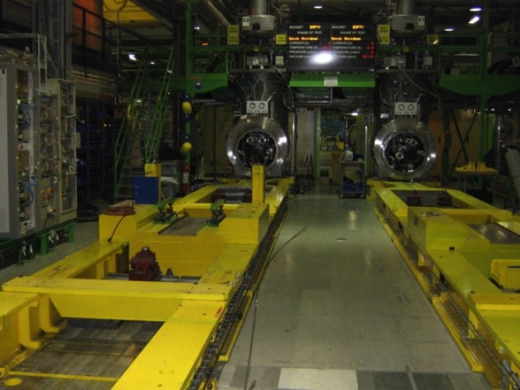
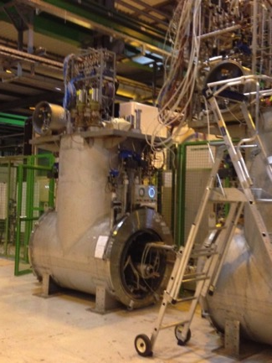
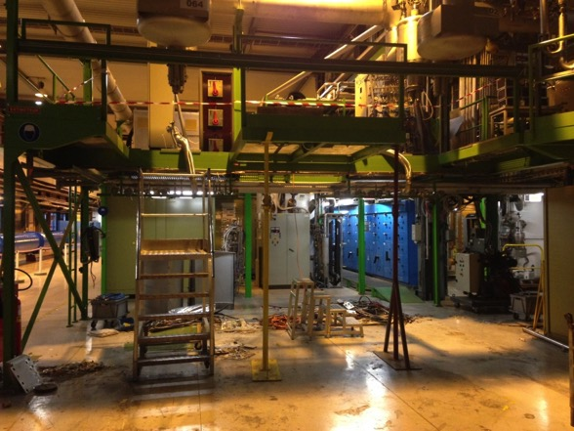
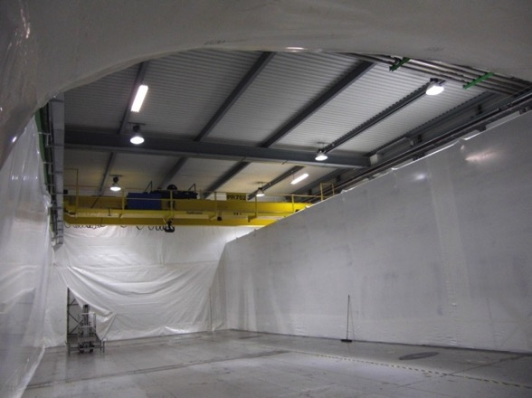
Where we are today? My side in 2014 Review
Civil engineering starts in January 2015 with planned end in August 2015
A standard Cluster
Show stopper seems to be:
Cryogenics
Energy extraction
The dismounted Cold Feeding Unit
Space ready for civil engineering with protection
Cluster D dismounting

Slide 12
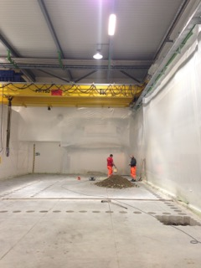
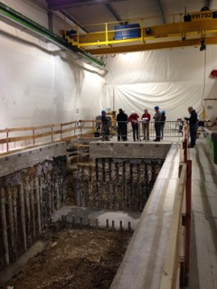
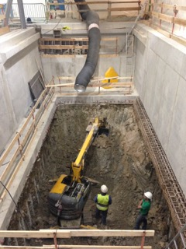
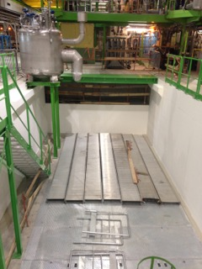
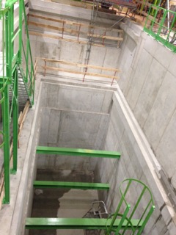

Cluster D in pictures
Ref.
Construction:
H. Botella, R. Morton, E. Perez Duenas,
Safety: E. Paulat

Slide 13
MY CONCLUSIONS @ the review in 2014
R&D
TQ, SMC,HQ,RMC
Modelling
SQXF, MQXFA , MQXFB
Prototyping
Q1,Q2a,Q2b,Q3
Production
Q1,Q2a,Q2b,Q3
STRING
Post installation
Subject of this talk
NOT Subject of this talk
HORIZONTAL position
Short or no time for feed back from model to the prototype with CERN installations
March 2017 : 30 kA + 4 kA @ 1.9 K
(alternative Cluster A: but only 17 kA + 600 A @ 1.9 K in 2015)
Seems to be feasible
For Q1,Q2a,Q2b,Q3
Iss MQXFA, MQXFB ∼ 22 kA
I MCBXF = 4 kA
Lss ∼ 15 m

Slide 14
Horizontal test bench upgrade
Cluster A
Cluster E
The horizontal test zone Cluster A to F excluding D is composed by 10 benches equipped with 5 independednt electrical curcuits allowing to test magnets up to 15 kA @ 1.9 K. Two clusters are planned to be upgraded to 20 kA capacity.

Slide 15
Horizontal test bench upgrade
Cluster A
Cluster E
The upgrade is driven by the following :
Magnet weight: 25 tonnes
Operating temperature: 4.2 K and 1. 9 K
Max. Operating current: 15 kA, 2x 0.6 kA
Max. Pressure in the magnet in case of quench: 20 bars
Max. Test voltage: 3 kV
Magnet weight: 25 tonnes
Operating temperature: 4.2 K and 1. 9 K
Max. Operating current: 20 kA, 2x 2 kA
Max. Pressure in the magnet in case of quench: 20 bars
Max. Test voltage: 3 kV
Target for prototypes: 90%I_{SS} ≤ 20 kA
Target for series : 108% I_{nom} = 17.8 kA
Cluster E will have the same characteristics. Foreseen later.

Slide 16
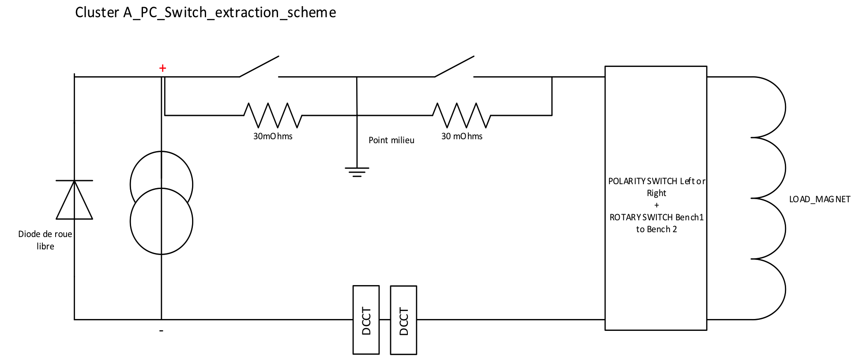
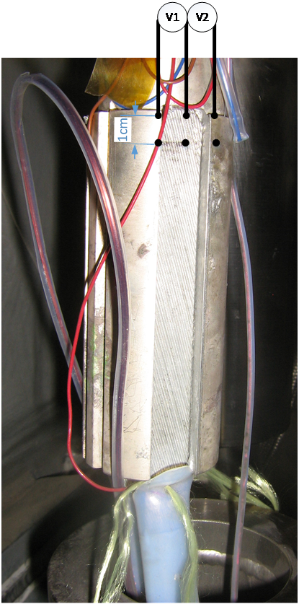
Status of the Cluster A
Test in summer 2015. Is a prove of feasibility… but we specified longer time….
[..] 16.5 kA for 8 h and 18 kA for 2 h while only quench performance test at 20 kA (max 1-2 min).
Superconducting magnet test facility sm18 upgrade for hl-lhc: cluster A. EDMS nr. 1552135
Mechanical switch not possible to cool ( anyhow not necessary and too long 55 ms reaction time)
☺ Dismounted. No need.
☺ Redone and resistance in the nOHM range
CL Sc part had high contact resistance (up to 100 mOhms)
What was limiting the performance of the circuit?
The full test at COLD is foreseen in June 2016.
PC needed more water flow
☺ Redone allowing 20 kA @ warm
WCC needed more water flow
DCCT limited to 15 kA
☺ Ordered new for 20 kA
☺ More flow. Good result.

Slide 17
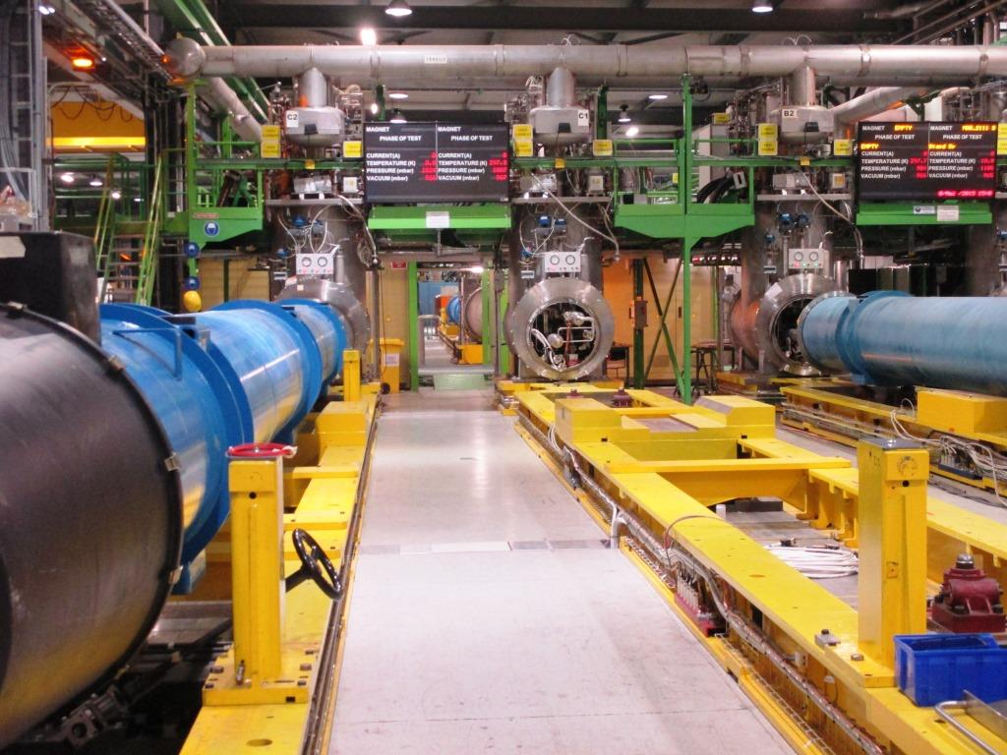
Other modifications of the horizontal benches
Connectivity
Modification of the support feet to be checked
Anticryostats for magnetic measurements need to be modified MB magnetic measurement shaft will be modified
Instrumentation
  Nr. Of vtaps wires and the connectivity to be defined( See presentation of H. Prin)
Quench heater discharge units:
  Nr. Of units and hardware to be adapted
  Need to handle 150 A during discharge from ± 450 V with 7 mF of capacitance
  Need electronics upgrade to reduce QH delay from 5 to < 1 ms
Quench detection system
  New QDS in development for the quench detection system. Prototype expected this year with variable detection thresholds (see HiLumi circuit review by J. Steckert, indico 477759)
NEEDS of QH power supplies for SM18
NEEDS of CLIQ systems for SM18

Slide 18
Status of benches for testing at CERN
Installation finished
Commissioning in May June
Operational in July 2016
CE finished. Installation started
Commissioning the earliest in Aug
Operational in October 2016
Test at Warm done with success.
Test at cold and qualification with magnet by the end of 2016.
HFM in 2016 max 20 kA
Vertical : MQXFS
Cluster D in 2017 full configuration
Vertical :MQXFS
Cluster A in 2017 max 20 kA
Horizontal : Q1, Q2a,Q2b,Q3
Cluster F in 2020 max 20 kA
Horizontal : Q1, Q2a,Q2b,Q3
Functional specification is done
Foreseen for 2020

Slide 19
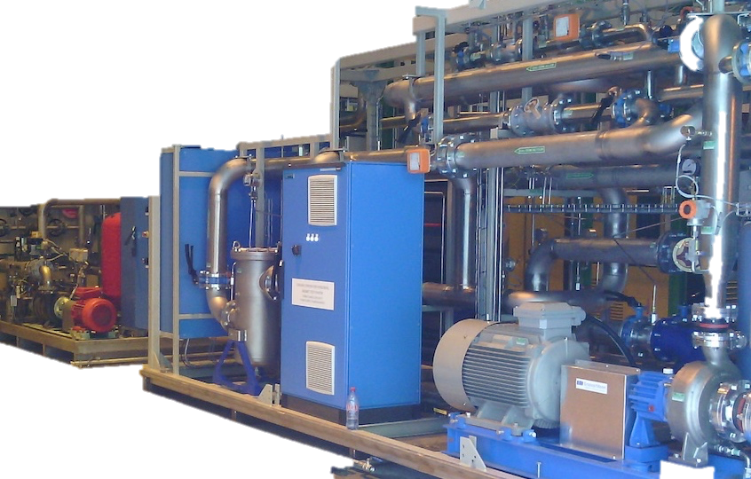
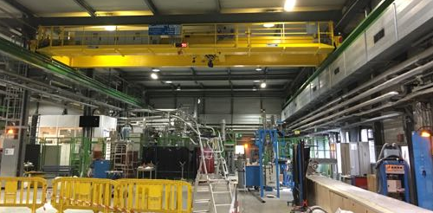
Status of Facilities Upgrade
Remarks
UPGRADE DRIVEN BY The recommendation enabling to carry out the full test programme with no contraints
For 2019
  CRYOGENIC COOLING PRODUCTION: + 35 g/s LHe
  NEEDS essentially for the running of the HL LHC IR STRING in parallel with magnet testing
  DEMINERALISED WATER PRODUCTION: + 150 m³/h
  NEEDS FOR DEMINERALISED WATER ENTIRELLY COMING FROM MAGNET operation
  HANDLING: 25 t and longer rope
  NEEDS FOR OVERHEAD CRANE CHANGE ENTIRELLY COMING FROM MAGNET OPERATION
  nCONTROL ROOM
  NEEDS TO EXTEND THE TOO SMALL CONTROL ROOM OF THE VERTICAL
  TEST FACILITY TO BE USED ALSDO FOR HORIZONTAL BENCHES AND Sc link
Operational
Operational
For mid 2016

Slide 20
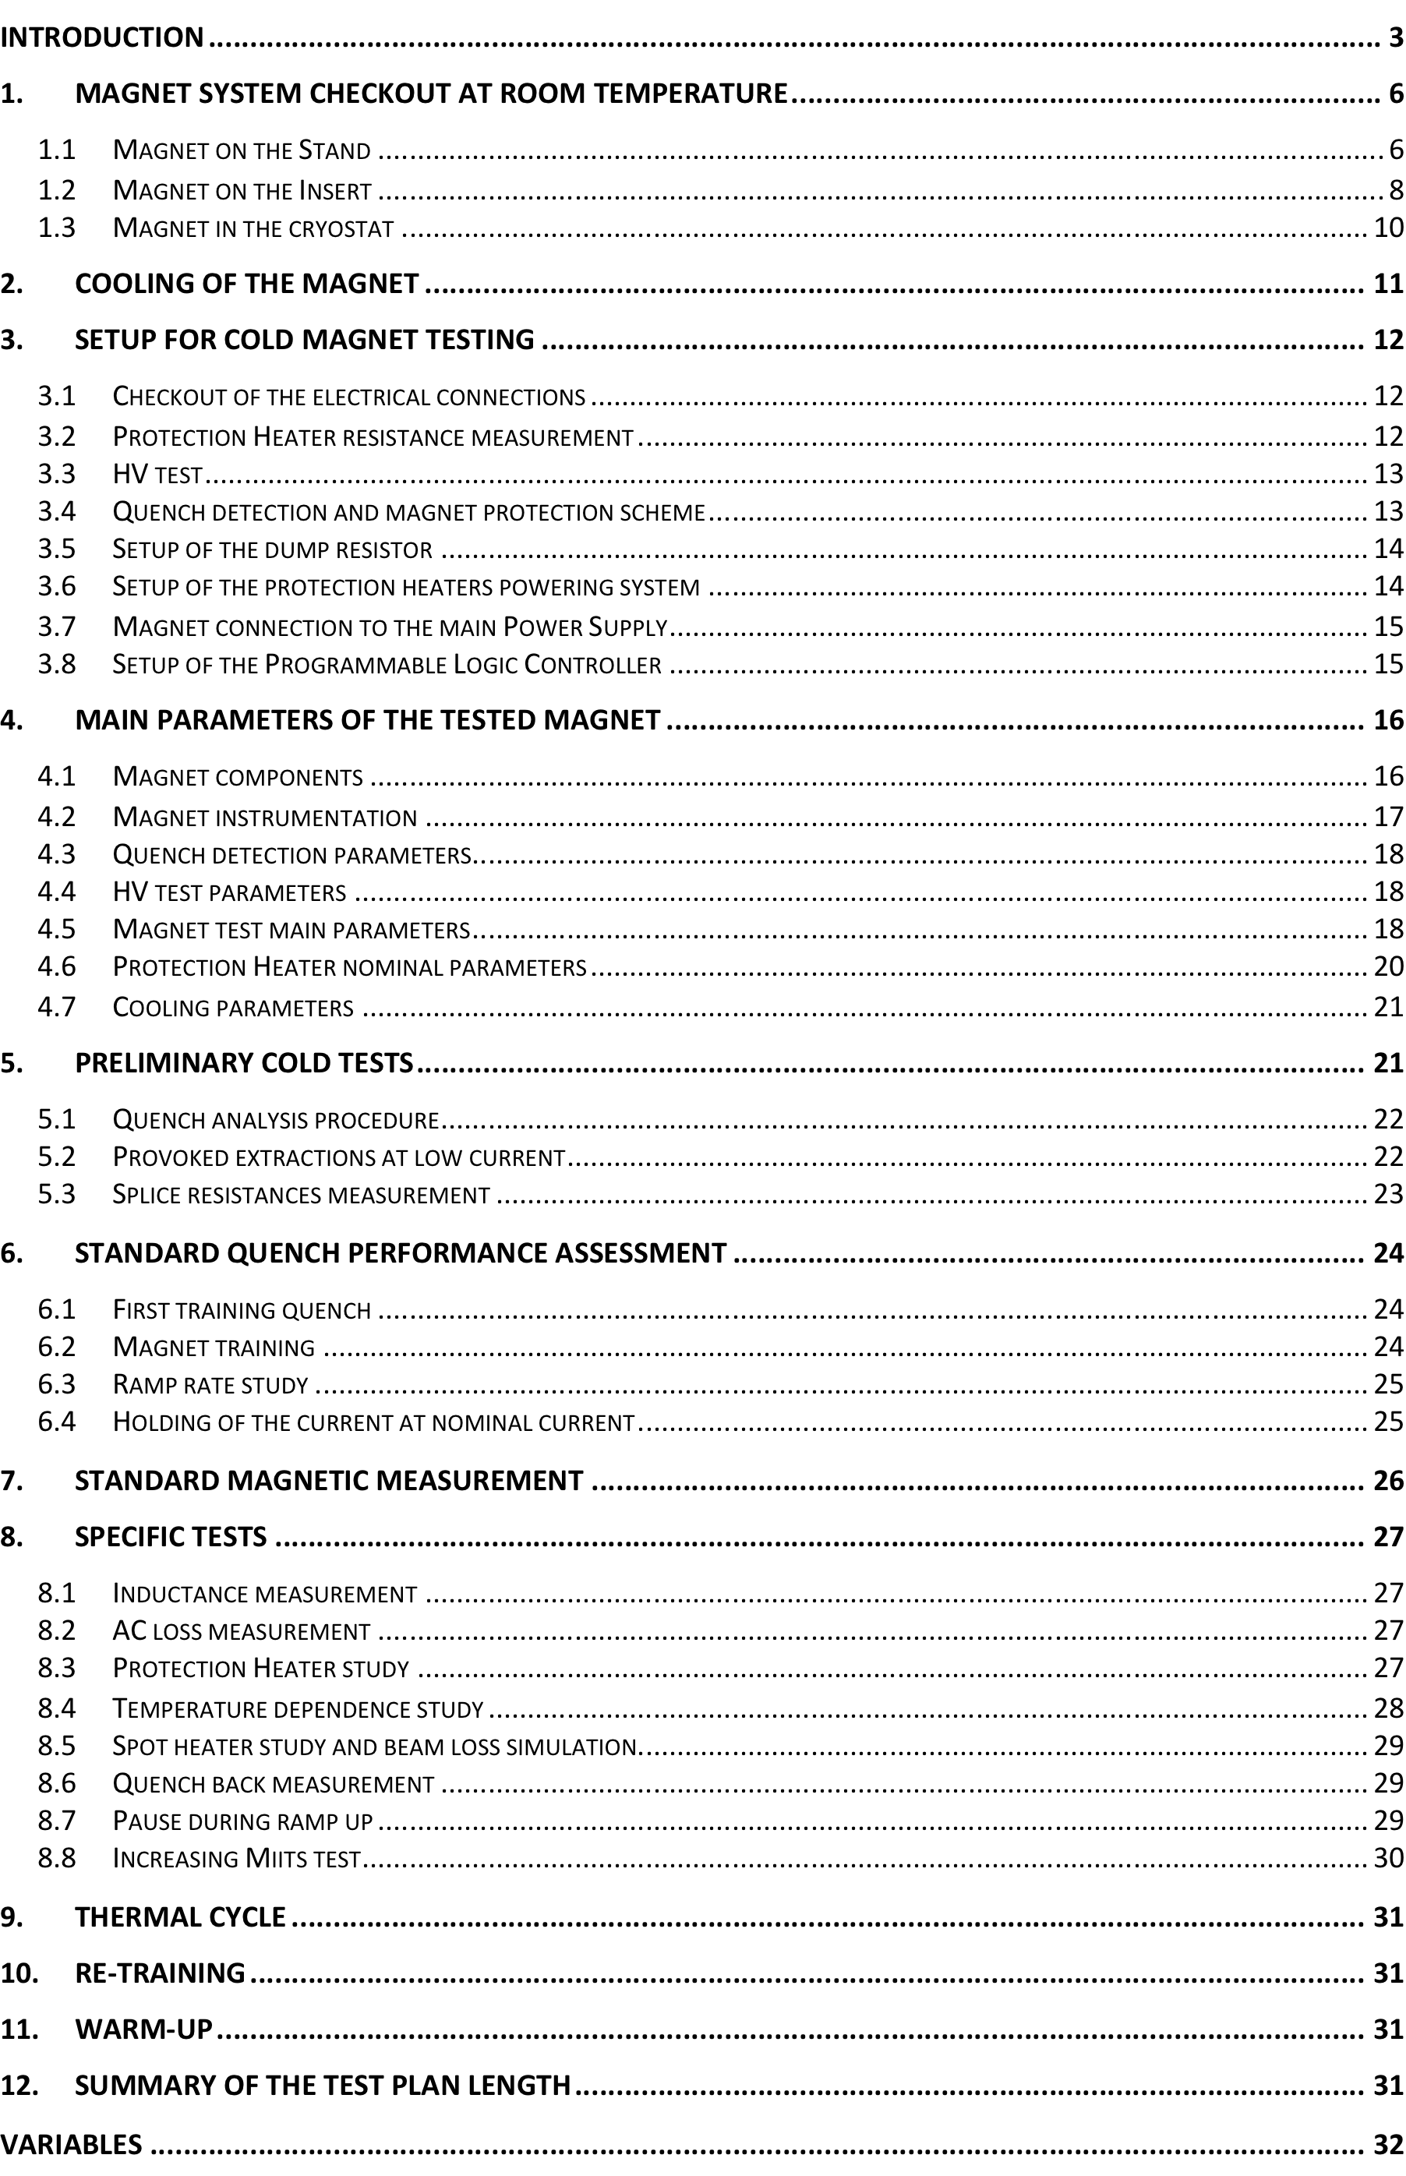
TEST plan
Warm tests in SM18 after transport
  HV test at room temperature aftre trasnport
  Preparation and test of electrical connections to test station
  QH discharge at T_{room} + resistance measurement
  Coil resistance measurements
  HV test after connection at 300 K.
  Leak tests
Cold tests
  HV test at cold max 3.1 kV
  Re-check of all instrumentation, QH and protection cards.
  Powering to 108 % I nom ( 18 kA) , flattop test of 4 to 8 hours.
  Cold magnetic measurements are not part of standard qualification tests
  Internal resistance measurements
Possible additional tests
  From full test plan
Complete test plan

Slide 21
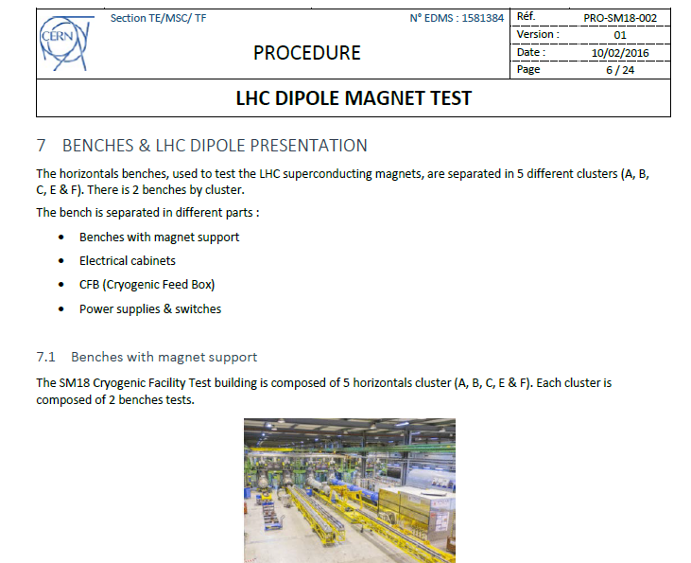
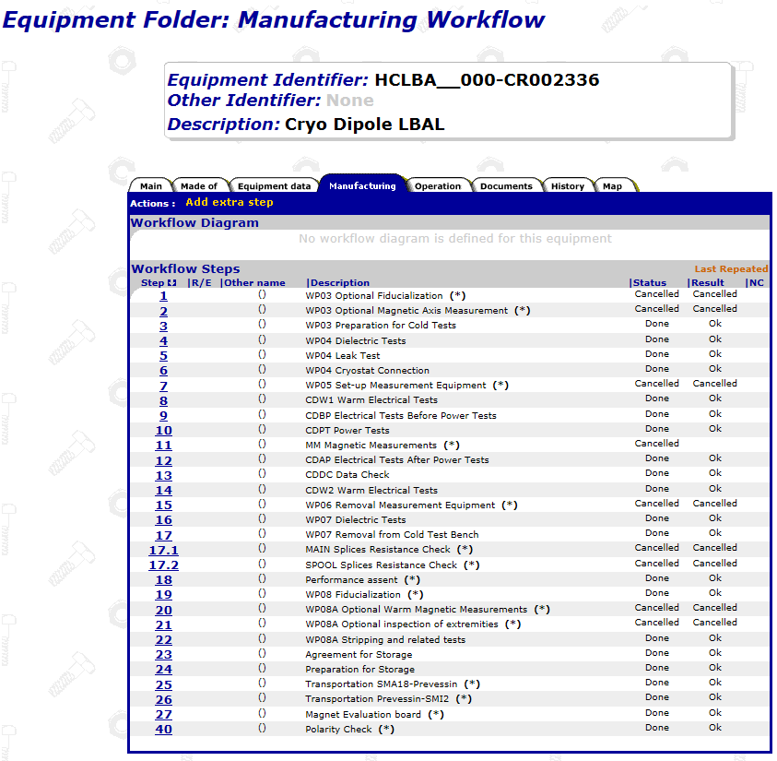
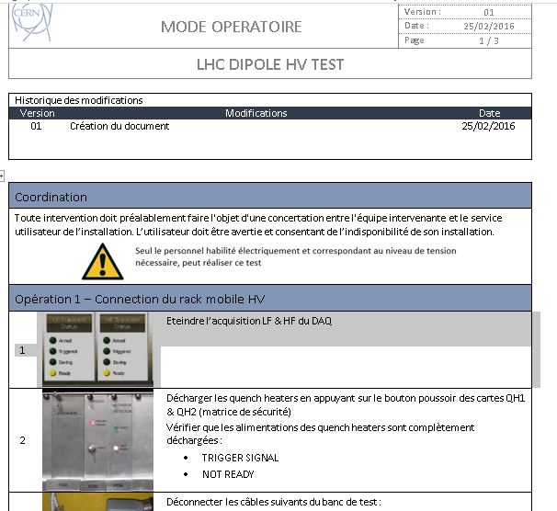
Quality assurance documentation
A. For the magnet
MTF is the official place for tracking manufacturing work flow up to cold powering tests. It is used for the Dipole not yet for HL LHC magnets
Possible specific steps may be added.
B. For the tests
Test procedures are currently being updated, major work done by O.Ditsch, soon published in EDMS.
All Modus Operandi well documented and structured, made up to date, soon to be published in EDMS.
Safety documents to comply with documentation for HL-LHC work is in progress.

Slide 22
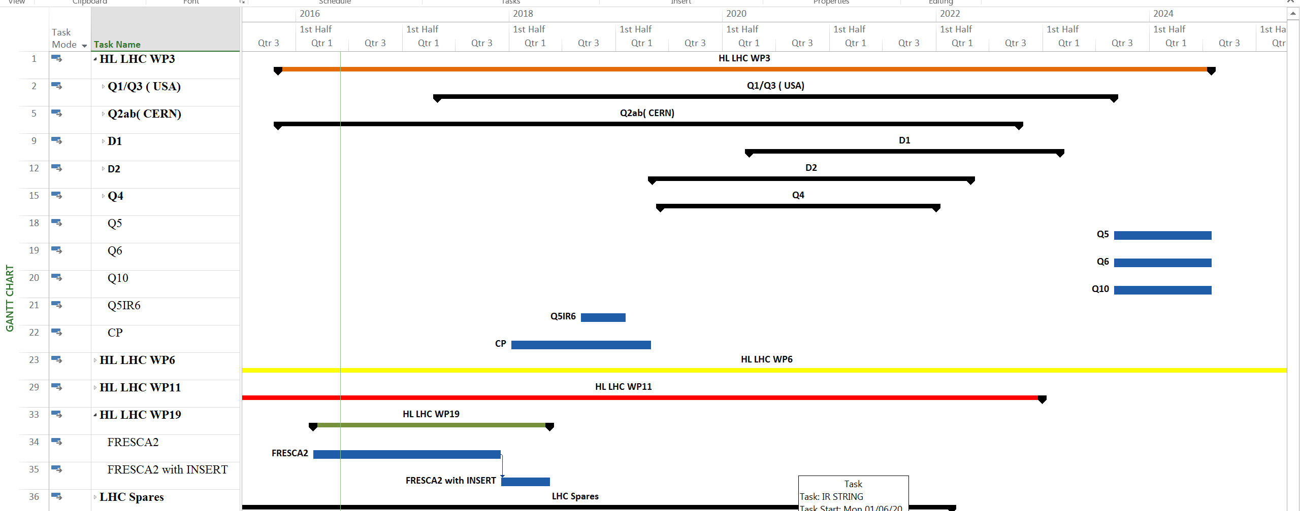
Test planning
Considerations for the planning
  planning is linked to the HL-LHC master planning presented at C&S Review March 2015
  each magnet is assigned to a test bench for 4 weeks + 2 weeks of thermal cycling
  only two magnets in horizontal bench is at the same time powered at cold
  all other projects (non HL LHC) requiring tests are in the same planning
  4 weeks annual holidays are considered
  6 weeks of cryogenic shut down is considered and centered around X mass
  Only normal working hours are planned to be used for test
Coordination is required as well as increase of manpower for test

Slide 23
Risk and Mitigations
Risks on |  | Relevance for |  |  | Cause of risk | Mitigation of risk | Critical?
 |  | Model | Proto | Series
Infrastructure readiness | Cluster G |  |  |  | new cryo and electrical equipment with new features. HWC maybe long. | preparation of HWC | yes till end 2016
 | Cluster D |  |  |  | new cryo hardware with new features. Some items as EE in delay. HWC maybe long | learn from HFM HWC; learn from BNL with similar set up; participate in their HWC; exchange info between BNL and CERN | yes till end 2016
 | Cluster A |  |  |  | cooling of CL to be proven yet with high current | study feed box modification | yes till end 2016
 | Cluster E |  |  |  | procurement and integration of a new PC, renovation as cluster A the connections and the entire warm circuit | specifiecation in time; intervention in time; cluster A is an alternative and has teo benches | no
Facilities readiness | Cryogenics |  |  |  | limitations in the Lhe production and pumping to 1.9K requires good coordination and skilled operators | new liquefiyer procuerment but only for 2019 will arrive, coordination of activities will be needed as in LHC | no
 | Demin. water |  |  |  | limitation in the quantity | operational so risk reduced | no
 | Electrical powering |  |  |  |  | no need | no
 | Control room |  |  |  | limitation in space | ordered and foreseen to be operational in 2016 | no
 | Handling equipment |  |  |  | limitation in deserving both HFM and Cluster D cryostats | procured new additional 25 t overhead craneinstalled. operational | no
Co activities with other projects |  |  |  |  | RF not in the TE department, SC link and Vertical test facilities are sharing equipment, smaller( yet) but importan projects as Eucard, Aries, FCC etc | common planning between all users and coordination of test in the TF section, coordination of cryogenics above RF and MSC | yes
Manpower |  |  |  |  | not possible yet to make a dedicated team for a single magnet test ( 1 Eng + 1 tech) risk in mixing conditions or requirements in the test | collaboration agreements…FSU contracts… FELL etc. | yes

Slide 24
Summary and Conclusions
Infrastructure is foreseen to be ready with 3-6 months delay wrt the original planning but if HFM HWC is successful in the planned time we will be ready for the next model testing
Facilities upgrade is partially done or on-going and is not anymore critical
Test equipment is ordered or ready
Horizontal test stand upgrade is on-going… we are not far from the complete feasibility demonstration
Risks are associated to the new hardware but can be reduced if good collaboration is established between test stands and specifically with BNL and FNAL.
Risk is also associated to the co-activities and lack of personnel for operating the test stans. It can be mitigated thanks to collaboration agreements and initiatives of the MSC group presently launched.
Planning of tests is not on critical path

Slide 25
Thanks for your attention
Thanks for the contribution of the TF section
and to the SM18 UPG project of :
V. Mertens, C. Giloux, F. Formenti, L. Serio, E. Vergara
V. Benda, A. Lee, A. Van De Craen, M. Struik, S. Gianelli, M. Strychalski, C. Gonzalves Perez, G.J. Cohelingh, K. Dahlerup-Petersen, A. Dinus,, H. Thiessen, S. Yammine, A. Kosmicki, P. Perret, V. Maire, R. Betemps, N. Dos Santos, A. J. Broche, R. Rinaldesi, R. F. Ortega, M. Charrondiere, P. Viret, J. Feuvrier, H. Bajas, H. Reymond, M. Charrondiere, M. I. Tapani, F. Gomez de la Cruz, E. R. Bigo, C. Arregui, T. Otto, E. Paulat, H. Botella, R. Morton, E. Perez Duenas , G. Dib, R. Principe, L. Favier, P. Chambouvet, F. Flammand, R. Bouvier,O. Claude Ditsch, B. J. Mouches, H. Prin

Slide 26
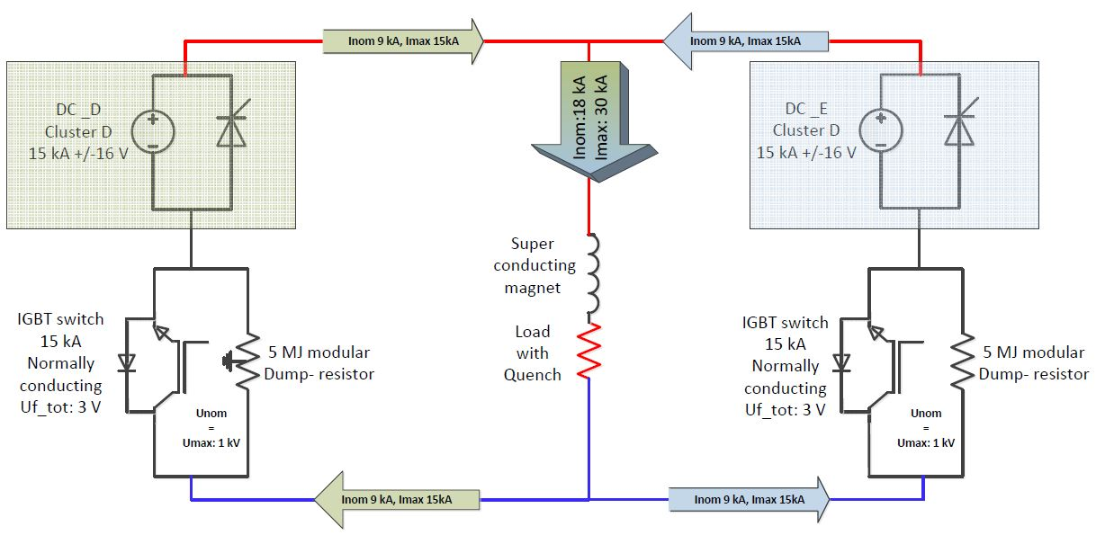
CLUSTER D: electrical circuit
EL CIRCUIT PARAMETERS
Maxi stored energy 10 MJ
Short Sample current 21.5 kA
Magnet inductance 8. 27 mH/m
Nominal Ramp Rate 11 – 20 A/s
Max Ramp Rate 200 A/s
Max current 30 kA
Max EE voltage 1 kV
Reaction time : < 10 ms
DESIGN DRIVEN BY: cost reduction and operation optimization implying to use two existing 15 kA power converters for the new circuit
Ref. H. Thiessen, C. Giloux, G.J. Coehling, P. Viret

Slide 27
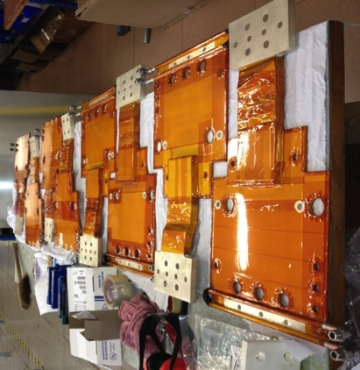
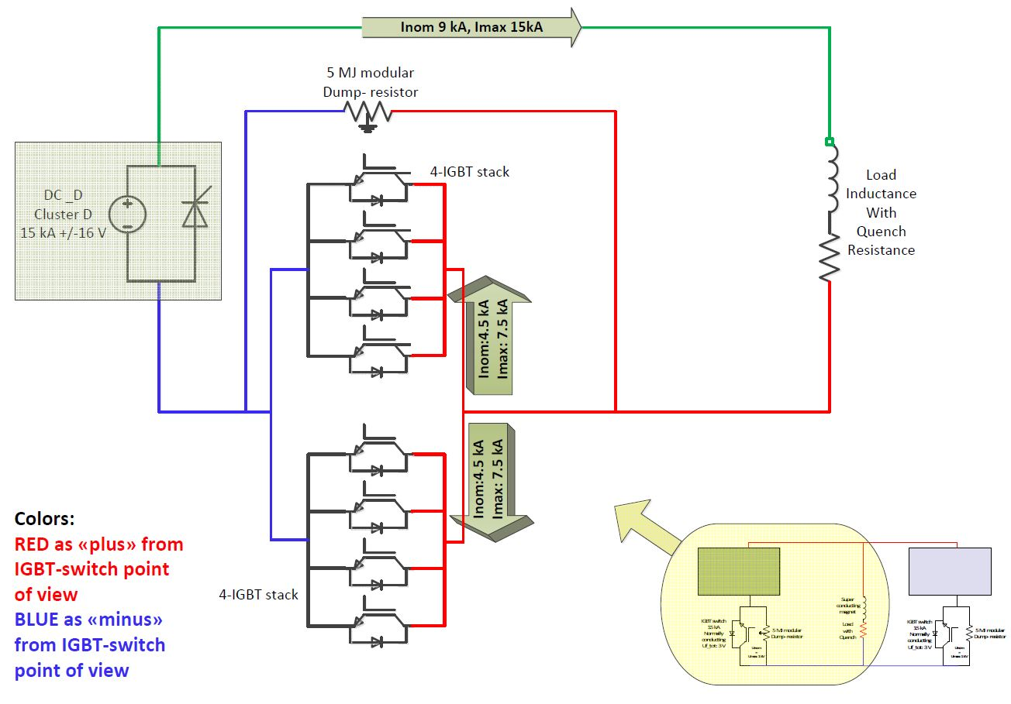
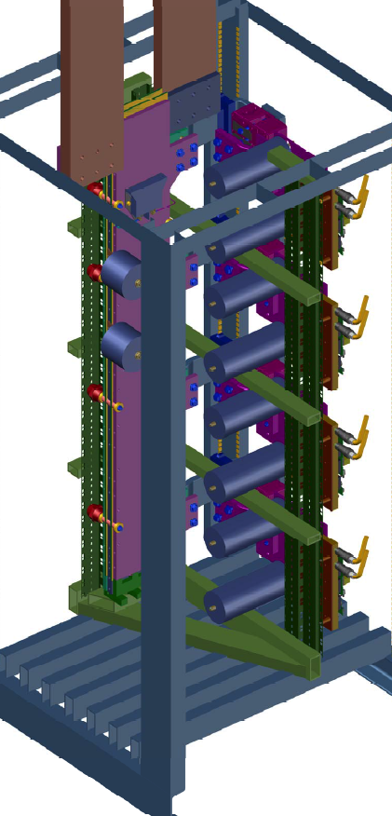
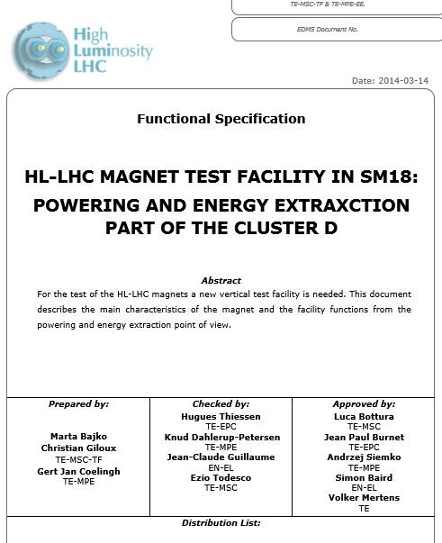
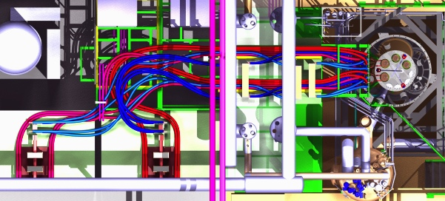
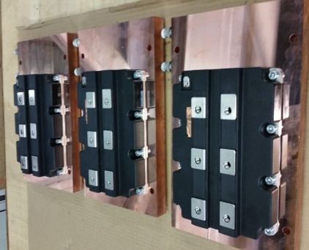
Cluster D : energy extraction
DESIGN DRIVEN BY : Reaction time < 10 ms, which implied the use of IGBTs
THE 30 kA SWITCH IS MADE OF 2 UNITS OF 15 kA EACH COMPOSED BY A MODULE OF 7.5 kA
EACH UNIT OF 15 kA IS EQUIPPED WITH A DUMP RESITOR
FOR 5 MJ
DESIGN GOLAS FOR BUS BARS
Equal paths for all currents
Equal impedances
Compact and cold:
(T max 110 °C and 80 °C on junctions)
Ref. G.J. Coehling, A. Dinus, K. Petersen

Slide 28
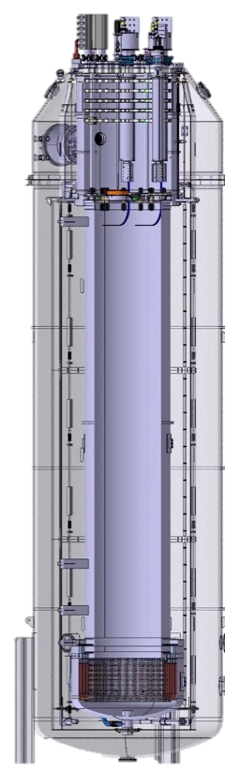
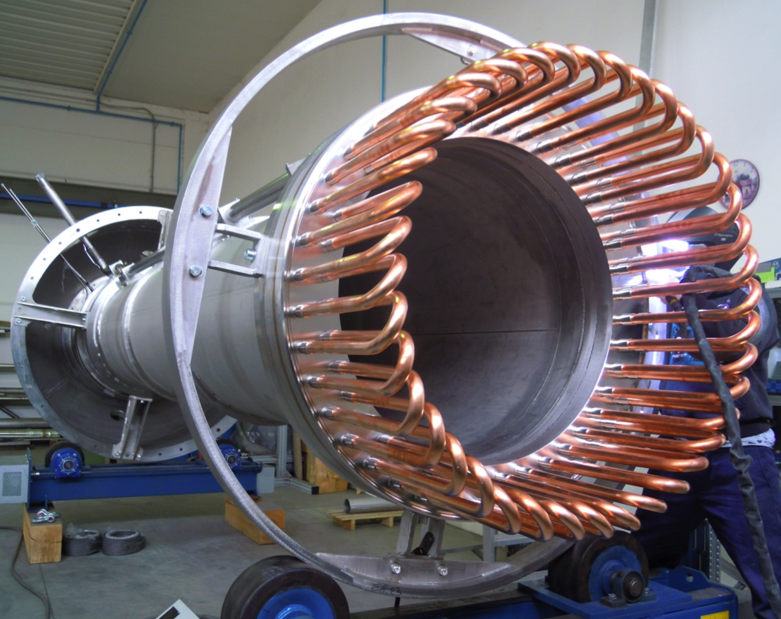
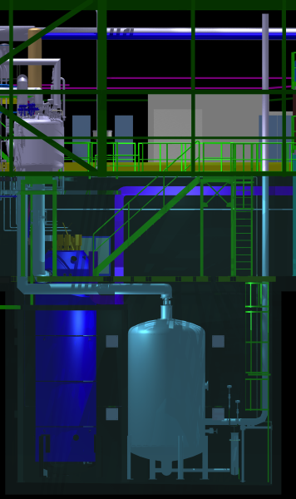
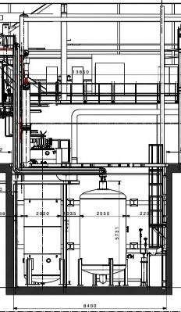
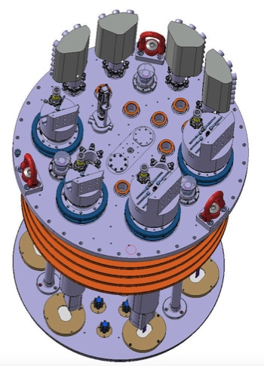
Cluster G and D: cryostat and insert
USE OF CRYOGENIC BUFFER FOR COLD He
DESIGN DRVEN by optimization in operation
Minimizing time and risk at hydraulic connection
Minimizing the loss of He after quench
INSERT DOES NOT HAVE ANY CRYO LINE CONNECTIN
CRYOSTAT PARAMETERS
(Cluster G/D)
Max internal pressure : 5 bara
Magnet temperature : 1.9 K
Useful diameter : 1500/ 800 mm
Useful length in 1.9 K bath : 2.5/5.2 m
Max. thermal gradient : 50 K
Magnetic measurements: yes
Estimated lifetime : 20 years
Number of thermal cycles : < 1000
Number of Quenches : < 10000
Ref. Cryostat: A. Van De Craen, M. Struik
Cryogenics: V. Beda, A. J. Lee
Insert: M. Strychalski, P. Viret

Slide 29
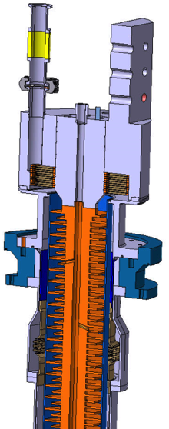
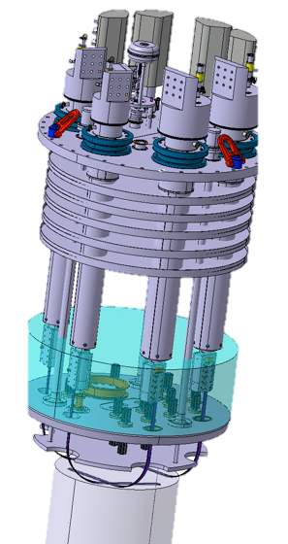
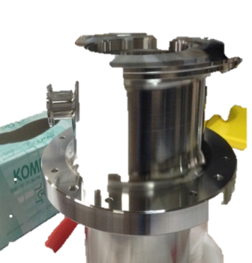
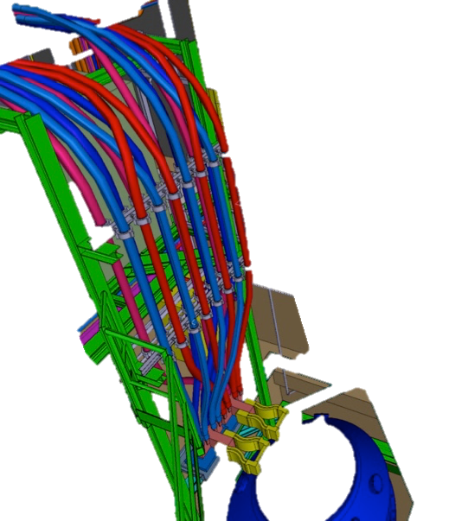


Cluster G and D : WCC and Current Leads
DESIGN DRIVEN BY Optimization in operation :
Flexible cables
Current lead operation homogenized with the rest of the test stand and minimized flow
CONVENTIONAL GAS COOLED Cu LEADS:
length: 1.7 -2.1 m
top flange d:260-280 mm
Connection : SC cable
Water Cooled Cables
SPECIFIED PARAMETERS
Current: 5 kA DC
Max in. temperature: 28°C.
Pressure in operation: 16 bar.
Maximum delta T: 10°C.
Water speed : <2.5 ms⁻¹
Max. temperature : 50°C.
Operating Voltage: 1 kV
(if fault to ground)
500 MM²
CABLES SECTION
He vapor flow @ 4.2 K:
20 kA lead: 0.87 g/s
30 kA lead: 1.82 g/s
15 kA lead: 0.88 g/s
Current Leads
SPECIFIED PARAMETERS
Main circuit: 20 kA/30 kA
Secondary circuit: 15 kA
Design pressure : 5 bara
Max. Voltage to GRD: 3.5 kV
Ref. WCC: C. Gonzalves Perez
Current Leads: S. Gianelli, P. Moyret

Slide 30



Cluster DAQ system
Example of HF system
DAQ
SPECIFIED PARAMETERS
Input channels: +/- 10 V analog
Nr of HF channels: 200 differential
HF frequency: 200 kHz
HF,MF,LF resolution: 16 bit resolution
HF,MF,LF accuracy: 1mV
MF frequency: 50 kHz
Nr of LF channels: 144
LF frequency: 1kHz
Timing: GMT synchronization
Data Analysis with DIADEM
Ref. DAQ: H. Reymond, M. Charrondiere, M. I. Tapani
Analysis: H. Bajas, F. Gomez de la Cruz

Slide 31

Test stands : cryogenics upgrade
An additional 35 g/s liquefier (thus bringing the total production capacity for LHe at 4.2 K to 60 g/s)
The existing total pumping capacity in SM18 at 1.8 K is 12 g/s, combining the capacity of WPU1 and 2.
If need for IR STRING a dedicated 3rd WPU shall be installed.
Ref. L. Serio
Foreseen for 2019

Slide 32


Test stands : demineralized water production
The demands for the magnet test stations, including the IT String, will rise to a peak of 1.7 MW (142 m³/h).
At present SW18 houses a demineralised water station with a thermal capacity of 800 kW limiting the operation to two test stands
Operational from April 2016
Ref. A. J. Broche

Slide 33



Test stand : HADLING
To enable insertion of test objects into the HFM cryostat the operating height, must be increased to 6 m (presently 5.3 m).
Cluster D, on the other hand, will be deeper than the existing vertical facilities. To handle the inserts the operation depth between the hook and the top of the cryostat must be increased to 9.3 m.
Ref. R. Rinaldesi
25 T HANDELING CAPACITY WAS KEPT
Operational from February 2016

Slide 34





New Control room
The motivation to build a new control room is driven by:
Safety and
Working conditions
CONTROL ROOM AT THE PROXIMITY OF THE CRYOSTATS
CONTROL ROOM WITH LARGER SPACE
Ref. M. Charrondier
Foreesen for Jul 2016

