Slide 1

Horizontal Test Facility and Test Plans by US HL-LHC-AUP
Guram Chlachidze
MQXF International Review – CERN, June 7th – 10th, 2016

Slide 2
Outline
Horizontal Magnet Test Facility at Fermilab
Options for cold mass tests
Expected test facility upgrades
Test plans
Open Questions
Risk and Hazard Analysis
Conclusions

Slide 3
Horizontal Test Facility
Horizontal Test Stand 4 at Fermilab’s Magnet Test Facility (MTF)
Previously used for testing the LHC IR quadrupoles in 2002-2006

Slide 4
The LHC IR quadrupole tests at FNAL
Q2 optical elements for the LHC IR final focus
Each Q2 (LQXB) consists of 2 identical quadrupoles (MQXB) with a dipole orbit corrector (MCBX)
All MQXB were tested at Fermilab’s MTF
Quench Training
Field quality measurements
Internal alignment of the MQXB elements
Translation of the cold mass magnetic axis to external fiducials

Slide 5
LQXB Magnetic measurements
Cold field harmonics measurements
0.8 m long tangential probe
8 locations throughout the MQXB length
Each MQXB measured separately
Integral field strength measurement with the Single Stretched Wire System (SSW)
LQXB alignment
To determine the average magnetic field axis of the MQXB pair and translate this to external fiducials on the LQXB cryostat
SSW measurement of the magnetic axis before cool down, at 4.5 K and at room temperature again
The beam tube axis determined using a “geo-mole” system supplied by CERN

Slide 6
LQXB Test Summary
10 LQXB tested in total
Each MQXB trained to 230 T/m gradient.
The 2nd thermal cycle only for few magnets
Most of the training with the external energy extraction
Valuable experience of test preparation & testing obtained at FNAL
key personnel still actively participating in magnet testing today

Slide 7
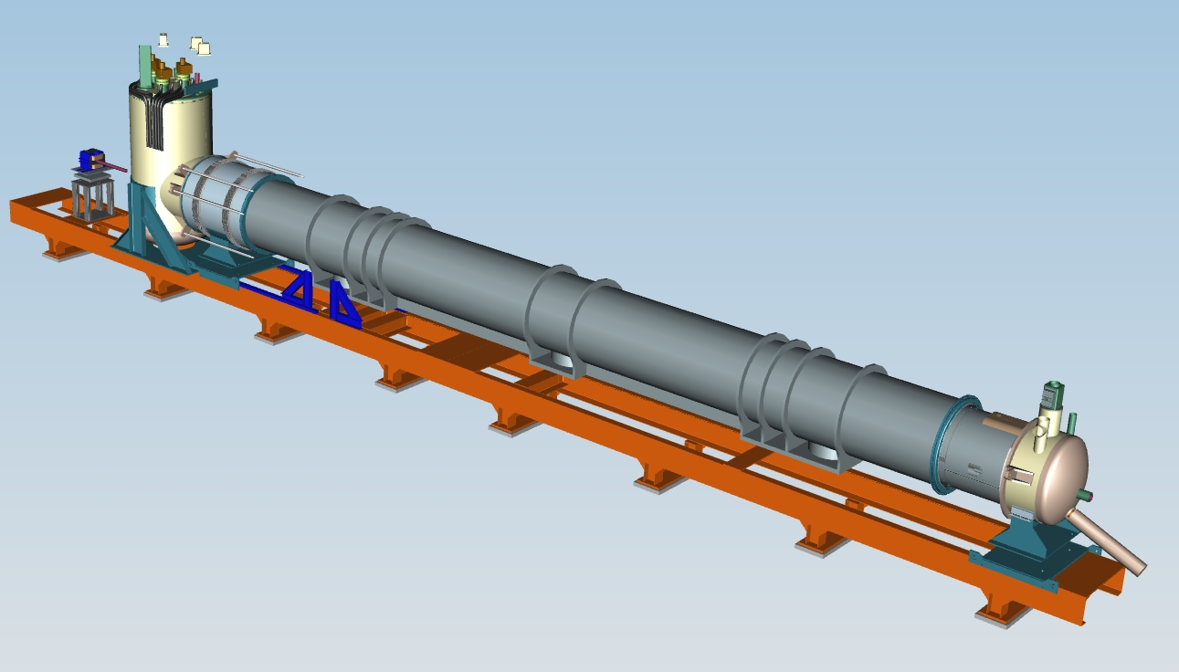
Cold Mass Tests for the HL-LHC
Q1 and Q3 optical elements will be tested at Stand 4
Each cold mass LMQXFA consists of 2 identical quadrupoles MQXFA
Reuse as much of the
existing test stand as possible
Power bus and leads
Feed-can
Racks, cables, wiring
MQXFA magnets will be tested in a vertical test facility at BNL (see presentation by Joe Muratore)
Quench training with a thermal cycle
Comprehensive magnetic measurements

Slide 8
Options for a Cold Mass Test
The baseline test option is
Option 1: Cold mass test with powering the magnet up to 15 kA only
Existing 15 kA current leads will be used
Magnetic measurements with 46-mm diameter probes
Option 2: Full power test of the cold mass in a reusable cryostat
Full qualification of the US deliverable
Power tests up to the ultimate current (17.8 kA)
Magnetic measurements with 100-mm diameter probes
Option 3: Full power test of the cold mass in a final (CERN) cryostat
Full qualification of the US deliverable
Power tests up to the ultimate current (17.8 kA)
Time and cost-effective solution (no need to build re-usable cryostat)

Slide 9
Expected Test Facility Upgrades
DAQ, Protection and Magnetic measurement system upgrades required in all test scenarios
Minimum upgrades of the cryogenic system is required also in all test options
Valves, piping, instrumentation
The turn-around-can
Specific upgrades:
For the baseline test option:
Re-usable cryostat
For the alternative test options:
Power leads rated up to 20 kA
New warm bore tube
Assembly of CERN cryostat

Slide 10
Test Plans for the Baseline Option
Cold mass test with powering the magnet up to 15 kA
MQXFA training up to the ultimate current of 17.8 kA, and comprehensive field quality measurements performed at BNL’s vertical test facility
Electrical inspection of cold mass
Warm and cold Hipoting tests. Splices, leads and bus bars will be inspected at room temperature and after cool down
Cold mass performance tests:
Check magnet retraining and confirm stable operation at a maximum current of 15 kA
Confirm magnet protection with protection heaters and CLIQ in one or two cold mass assemblies: heater induced quenches, no external energy extraction (EE)
Continue further tests and measurements with the EE in order to reduce the quench recovery time and save helium

Slide 11
Test Plans (cont’d)
Warm Magnetic measurements:
Average integral roll angle between two magnets
  SSW system, individual MQXFA powering to 10 A
Alignment of magnets’ axes
  130-mm diameter rotating probe with a laser tracker target, individual MQXFA powering to 10 A
  Suggested probe length: Two 220-mm long probes
  Will determine straightness of beam tube, and magnetic axis with respect to average magnetic axis
Integral field strength
  SSW measurements at 10 A
Multipole harmonics
  130-mm diameter rotating probe, individual MQXFA powering to 10 A
  Confirm room temperature measurements at BNL

Slide 12
Test Plans (cont’d)
Cold Magnetic measurements:
Average integral roll angle between magnets
    SSW system, individual MQXFA powering to 10 A
Alignment of individual magnets’ axes
    46-mm diameter rotating probe with a laser tracker target, individual MQXFA powering to 10 A
    Suggested probe length: Two 220-mm long probes
    Verify straightness of beam tube and magnetic axis with respect to average magnetic axis after cool down
Accurate integral strength measurement with SSW at 15 kA
Multipole harmonics at 15 kA
    46-mm diameter rotating probe
    Field strength vs Z
    Measure final positions of cold masses axially

Slide 13
Test Plans (cont’d)
Thermal cycle will be done only for a couple of cold masses
  Check magnet settling in a cold mass
Cold Magnetic measurements after thermal cycle:
Average integral roll angle between magnets
    SSW system, individual MQXFA powering to 10 A
Alignment of individual magnets’ axes
    46-mm diameter rotating probe with a laser tracker target, individual MQXFA powering to 10 A
    Verify straightness of beam tube and magnetic axis with respect to average magnetic axis after thermal cycle
Multipole harmonics
  46-mm diameter rotating probe, individual MQXFA powering to 10 A
Minimal magnetic measurements at room temperature after the test
  130-mm diameter rotating probe, individual MQXFA powering to 10 A

Slide 14
Test Plans for the alternative test options
Option 2: Full power test of the cold mass in a re-usable cryostat
Full qualification of US deliverables
Power tests up to the ultimate current of 17.8 kA
Magnetic measurements with 100-mm diameter probes
Test plan is the same as in the baseline option, only with the maximum test current increased to 17.8 kA, and probe diameters increased to 100 mm
Option 3: Full power test of the cold mass in a final (CERN) cryostat
Change in the list of US deliverables
Full qualification of US deliverables
Time and cost-effective solution (no need in re-usable cryostat)
Test plan is the same as for the option 2, only the cold mass magnetic axis will be translated to the external fiducials on the final cryostat

Slide 15
Open Questions
The baseline test option to be finalized
Cold mass test in a re-usable cryostat or in a final cryostat
Powering MQXFA to 15 kA or to the ultimate current of 17.8 kA
Reference radius of magnetic measurements
Acceptance requirements for the US deliverables
Field quality requirements
Alignment requirements
Required test stand upgrades and Test schedule
Depends on the baseline test scenario

Slide 16
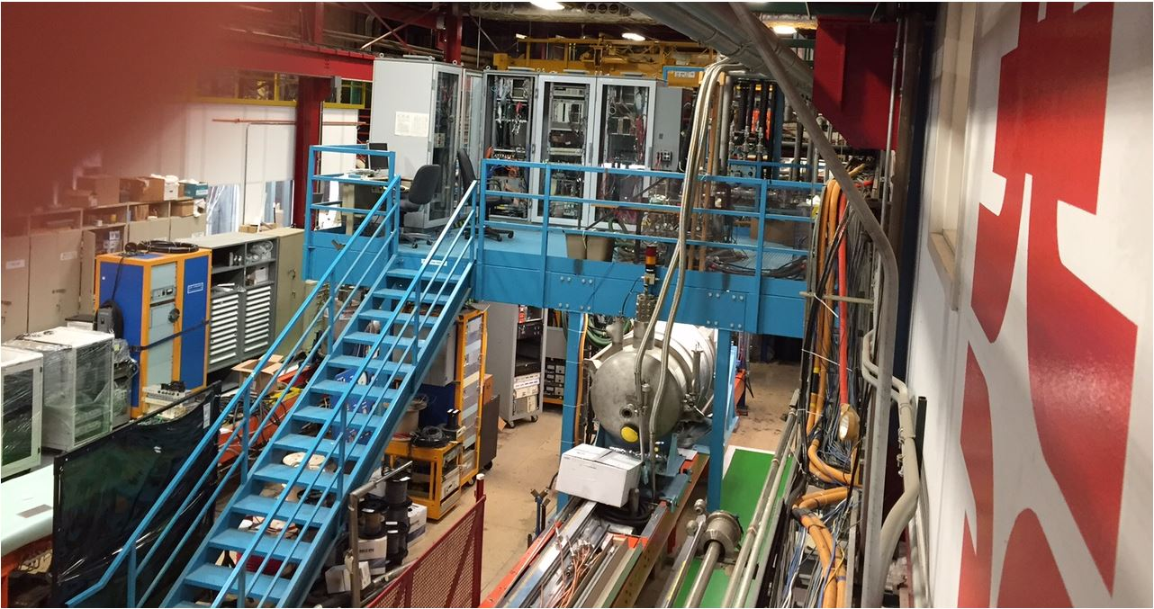
Risks in the baseline test option
Stand 4 upgrades:
No construction work is required
Power bus and leads, Feed-can in place
The turn-around-can : design development started
The re-usable cryostat: design development started
Stand 4

Slide 17
Risks analysis (cont’d)
DAQ and monitoring systems:
DAQ racks, cabling and wiring in place
PLC upgrade: Existing Siemens PLC will be upgraded to Allen-Bradley
Quench characterization systems: existing VME/VxWorks system is obsolete. New FPGA-based system (3rd generation) already developed for Mu2e experiment. New isoamplifier design already deployed in other test areas
Quench protection:
Most of the wiring in place
New digital and analog systems already developed for Mu2e experiment
CLIQ leads: First tests will be performed with the short model at Fermilab, and then with the full-length magnets at BNL
Detailed plans, cost estimate and schedule for DAQ and Quench protection upgrades were presented at LMQXF cold mass review at FNAL (April 25, 2016)

Slide 18
Risks analysis (cont’d)
Magnetic measurement system:
DAQ, motion control upgrade and new motion stages: New DAQ system deployed recently for the KEK experiment
Dual probe ferret (mole type) probe: already developed at Fermilab
Manpower:
Key personnel with experience of testing the LHC IR quadrupoles still available
New team members obtained significant experience of testing short and long models of Nb3Sn magnets
Stand 4 Cryogenics:
LHe inventory: Nominal He liquefaction rate is 300 liters/hour
Refurbishment of the vacuum (Kinney I and II skids) pumps
Risks eliminated when connected to the new Kinney pumps with 4 skids installed in parallel

Slide 19
Operational Hazards and mitigation plans
Cryogenic systems
Long history of operating cryogenic plant
Engineering notes with safety calculations for Stand 4
Pressure test of the system
Safety review
High Current Power Supply
All sub-systems commissioned and operational up to 15 kA
LOTO procedure, authorized user training procedures available
Engineering note and Safety review required for higher currents
CLIQ
Operation manual and Hazard Analysis exist
Safety review
Magnet protection
Engineering note and safety review required before operation

Slide 20
Conclusions
Valuable experience of testing the LHC IR quadrupoles obtained previously at Fermilab
Various challenges in test preparation and testing already addressed for the LHC IR quadrupoles
Key scientific, engineering and technical personnel who participated in these tests are available
Fermilab has a long and successful history of testing Nb3Sn magnets, including the short MQXF models
The baseline test option includes magnet performance test and field quality measurements at currents up to 15 kA. Cold mass will be tested in a re-usable cryostat
The alternative test options are suggested, including power tests up to the ultimate current and in a final cryostat.

Slide 21
Conclusions (cont’d)
Required test facility upgrades and related technical risks for different test options are well understood. Risk mitigation measures were introduced at LMQXF cold mass review at FNAL
Magnetic probes and related equipment already developed at Fermilab
Cold mass test plan is developed for the current baseline option. Only minor changes are expected in the test plan for the alternative test options
All open questions will be addressed as soon as the baseline test option is selected

