Slide 1
MQXF Review:
Safety
Thomas Otto
HL-LHC Project Safety Officer
International Review of the Inner Triplet Quadrupoles (MQXF) for HL-LHC

Slide 2
Contents
CERN Safety Policy
HL-LHC Safety Organisation
HL-LHC Safety Process
Launch Safety Agreement
Pressure Equipment Directive
Next Steps

Slide 3
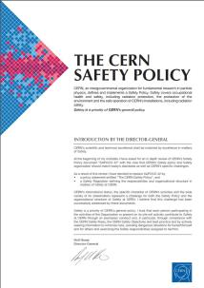
CERN Safety Policy
Excellence in matters of Safety
Objectives:
to ensure the best possible protection in health and safety matters of all persons participating in the Organization’s activities as well as of the population living in the vicinity;
to limit the impact of the Organization’s activities on the environment, and
to guarantee the use of best practice in matters of Safety.

Slide 4
CERN Safety Policy
Excellence in matters of Safety
Implementation principles
Organic units are responsible for implementing the Safety policy
HSE unit has the role of providing assistance and independent control
Specialised units have specific tasks (Medical Service, Fire Brigade …)
Establishment of a Safety Management System

Slide 5
Who is in Charge of Safety ?
Hierarchical Line
Consulting
Means
Rules / Advice/ Control

Slide 6
CERN Safety Rules
Grant a high level of Safety
(European practice in occupational Safety)
Take account of the intergovernmental status of the Organization.
CERN Safety rules are based on regulations, directives and standards of the European Union, if they exist and are deemed applicable to CERN.
For cases not covered by CERN Safety Rules, the regulation applicable in the competent Host State is used.

Slide 7
Two aspects of Safety
Conformity | Preventive Workplace Safety
Equipment | Process
Standards (ISO, EN, Eur. Dir….) | Safety Rules, best practice
Inspection | Hazard identification, risk assessment
Report on non-conformities | Safety Report, action list
Make conform | Apply rules and best practice
Conformity marking
User manual | Procedure manual
Training in use of equipment | Training the process
Safety Training
Personal Protective Equipment

Slide 8
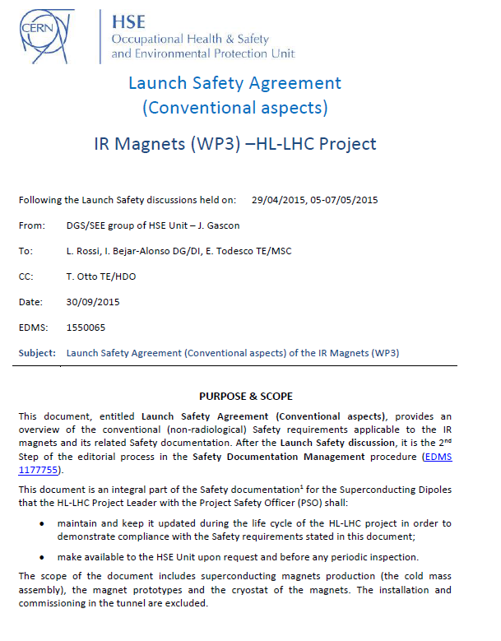
Equipment Conformity Issues
Project and HSE unit draw up Hazard Register for the equipment
HSE unit produces “Launch Safety Agreement”
Compulsory list of applicable rules, codes and standards
Deliverables required for Safety Clearance by HSE
More by Carlos Arregui
(next talk)
Notes:
More on this by Carlos

Slide 9
HL-LHC Safety Process
Equipment Conformity
Workplace Safety
Hazard Identification of operation of the finished equipment
Launch Safety Agreement, fixing Safety requirements
Design, production, testing
  Collect documents for a “Safety File”
Safety Clearance by HSE unit
Install and operate
Hazard Identification of the production process
  Laboratories, Workshops
  Production facilities
  Test facilities
Workplace Risk Assessment with Action List for Supervisors
Act on recommendations
Produce, test, repair items

Slide 10
Safety Files for TE Buildings
Identification of priority buildings (next slide)
Safety File consists of
  Descriptive Part: description of Building and major processes
  Workplace Analysis, for each process, describing hazards, risks, applicable safety rules and Safety Action Plan
Descriptive part approved by DH and GLs
Workplace analysis approved by SL and GL

Slide 11
Organisation of Safety File
Building
Process
Process
Process
subprocess
subprocess
subprocess

Slide 12
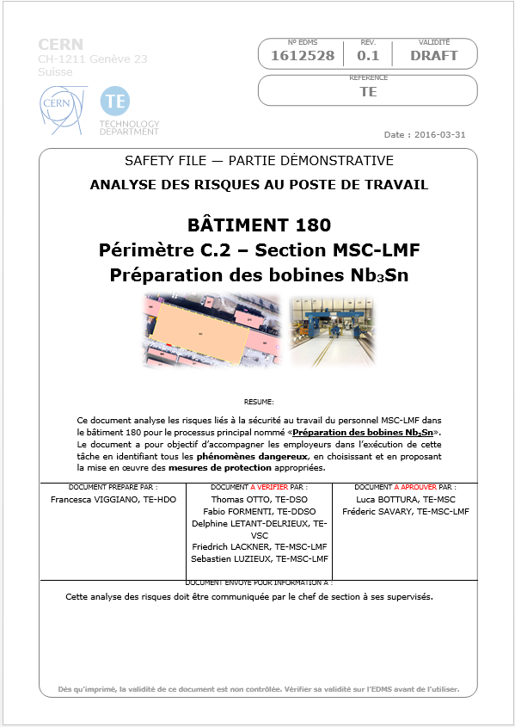
Workplace Safety Assessment
Process Identification

Slide 13
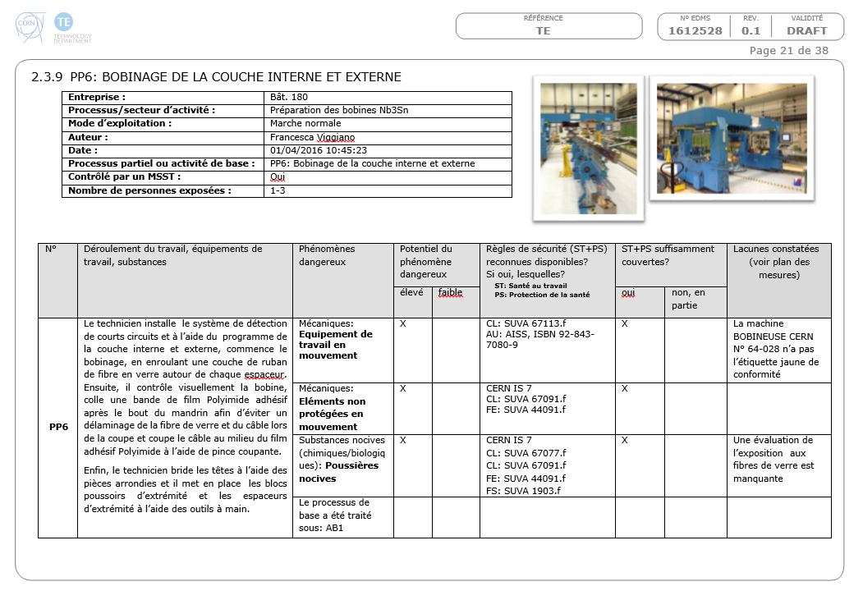
Workplace Safety Assessment
Subprocess analysis
Observations

Slide 14
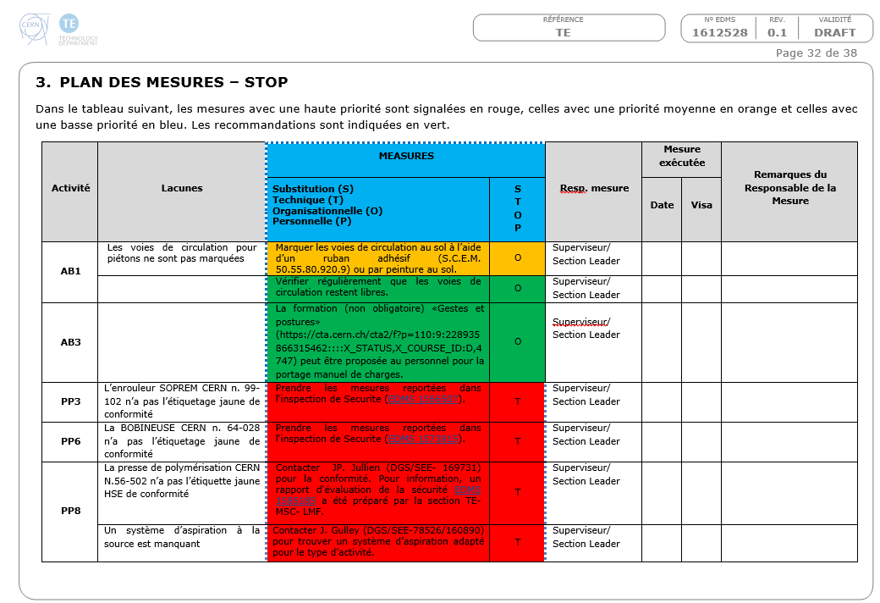
Workplace Safety Assessment
Action List

Slide 15
Workplace Safety Assessment
Status for HL-LHC Magnet WPs
Building | Purpose | Status
163 | s.c. cable testing | Under approval
103 | s.c. cable production | In work
101 / 911 | Polymer laboratory | In work
183 | Support Workshop | Under approval
927 | Model Production | In work
180 | Prototype Production | Under review
SMI-2 | Cryostating
SM-18 | Magnet testing | Released

Slide 16
Summary
The HL-LHC Project and the CERN HSE unit have established a Safety Process for
  Conformity with Safety Standards
  Safe workplaces at CERN
The process is (hopefully) made transparent by
  Requirement documents (LSA)
  Specific linkpersons (PSO, HSE correpondents and experts)
  Integration of Safety in the project structure

Slide 17
Thank you for your Attention

