Slide 1

Compliance with CERN Safety Rules – Role of CERN Health, Safety & Environment protection (HSE) Unit
C. Arregui, S. Marsh (HSE-SEE)
International Review of the Inner Triplet Quadrupoles (MQXF) for HL-LHC
9th June 2016

Slide 2
Contents
Safety at CERN
CERN Mechanical Safety Rules
Pressure Equipment Directive (PED)
Launch Safety Agreement (LSA)
Application of CERN Mechanical Safety Rules
Conformity assessment by HSE
Conclusions

Slide 3
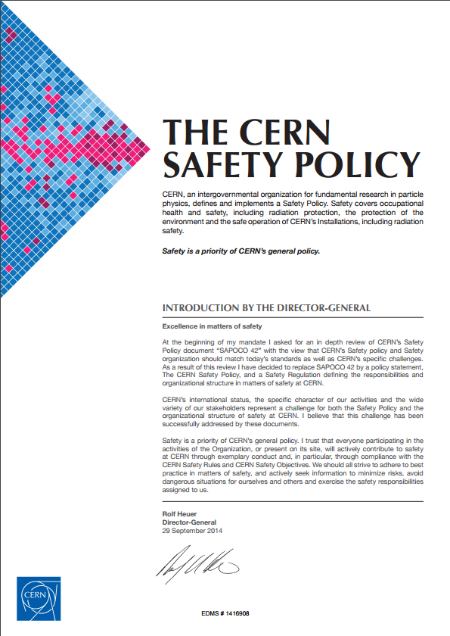
Safety at CERN
CERN Safety Policy
Objectives: “to ensure the best possible protection in health and safety matters of all persons participating in the Organization’s activities or present on its site […]”
Means: “the Organization establishes and updates Safety Rules and ensures compliance therewith”.
HSE Unit shall:
  Support and monitor the implementation of the CERN Safety Policy, the CERN Safety Rules, the CERN Safety Objectives and best practices at all levels;
  Grant Safety clearance for installations, activities, projects and CERN Experiments with major Safety implications.

Slide 4
CERN Mechanical Safety Rules
Purpose of the rules
  To define the minimum Safety requirements applying to mechanical equipment used or intended for use at CERN. Applicable to all stages of the equipment’s life cycle, from design to decommissioning.
  Takes into account:
    Laws and regulations of the Host States;
    EU regulations and directives;
    International regulations, standards and directives.
Scope
  Mechanical equipment: lifting, pressure equipment, cryogenic equipment, lifts.

Slide 5
Pressure Equipment Directive (PED)
European Directive: legislative act that sets out a goal that all EU countries must achieve.
Goal of PED: to guarantee free movement of pressure equipment products in the EU internal market while ensuring a high level of safety.
Scope: pressure equipment with a maximum allowable pressure PS* > 0.5 barg
  Vessels;
  Piping;
  Pressure accessories;
  Safety accessories;
  Assemblies.
(*PS = Maximum allowable pressure)

Slide 6
Pressure Equipment Directive (PED)
Essential Safety Requirements - pressure equipment must be:
And they qualitatively cover:
As to ensure its safety when
Put into service as per manufacturer’s instructions
Other foreseeable conditions (including potential misuse)
Designed
Manufactured
Checked
Equipped and installed (if applicable)
Design
Calculation/experimental method
Provisions for safe handling/operation
Manufacturing
WPS and welding personnel to be approved by NoBo or recognized third party
NDT
Materials
Appropriate properties
Covered by EN, EAM or PMA
Adequate strength
Appropriate Safety factors
Safety accessories against overpressure
Operating instructions
Compulsory declaration from material supplier affirming compliance with a specification.
Traceability of material from receipt of material through final testing
Final proof test (normally hydrostatic, other tests allowed with additional measures, such as NDT)

Slide 7
Pressure Equipment Directive (PED)
Essential Safety Requirements - few quantitative requirements though:
Allowable stresses:
Joint coefficients: 0.7, 0.85 or 1 depending of extent of NDT;
Momentary pressure surge allowed: 110% of PS;
Hydrostatic test pressure: 1,43 x PS.
Material |  | Permissible general membrane stress
Austenitic steel | A > 30% | 2/3 of R_{e/t}
 | A > 35% | Min [5/6 of R_{e/t} ; 1/3 of R_{m/t}]
Aluminium alloys |  | Min [2/3 R_{e/t} ; 5/12 R_{m/20}]

Slide 8
Pressure Equipment Directive (PED)
Classification of equipment: 4 categories (I-IV) + Sound Engineering Practice.
Classification related to perceived level of hazard. 3 elements to take into account:
  Type of fluid: hazardous (group 1) or other (group 2);
  State of fluid: gas or liquid;
  Features of vessel: PS, Volume or DN.
e.g.
Table 2
Vessels
Group 2 gas

Slide 9
Pressure Equipment Directive (PED)
Conformity assessment
  Conformity assessment modules: Higher the category, more demanding requirements (increase of supervision from Notified body over the whole fabrication process).
Notified bodies
  Organizations appointed by EU states to assess conformity of a product to the ESRs before being put in the market.
  Categories II-IV require having conformity assessed by external independent Notified bodies.
CE marking
  Affixed to equipment by the manufacturer.
  Statement that the equipment meets requirements of all relevant Directives – Declaration of conformity.
  Permitted only after Notified body attests full conformity to the Directive(s).

Slide 10
Launch Safety Agreement (LSA)
Launch Safety Agreement (LSA):
  Agreement between HSE and the project for the compliance with CERN Safety rules;
  Not only for pressure equipment, but other domains too, i.e. fire safety, electrical safety, environment protection, etc.).
Terms of compliance defined in LSA:
  Definition of Safety requirements as per CERN Safety Rules;
  Classification as equipment liable to have ‘major Safety implications’ (mSi).

Slide 11
Application of CERN Mechanical Safety Rules
Baseline approach for pressure equipment
  Compliance with Pressure Equipment Directive (PED) 97/23/EC.
  CE marking.
Exceptions to the baseline approach:
  Foreseen by the rules – equipment liable to have ‘major Safety implications’;
  mSi equipment requires Safety clearance from HSE;
  HSE defines the Safety requirements that need to be met for the Safety clearance;
  HSE performs conformity assessment.

Slide 12
Conformity assessment by HSE
Requirements for HSE Safety clearance:
  Compliance with applicable Essential Safety Requirements from PED compulsory.
  Use of harmonized European standards wherever applicable (presumption of conformity) for design, manufacturing and testing.
    EN 13445 – Unfired pressure vessels;
    EN 13458 – Cryogenic vessels – static vacuum-insulated vessels;
    EN 13648, ISO 4126 – Cryogenic safety devices;
    EN 10028 – Flat products made of steels for pressure purposes;
    …

Slide 13
Conformity assessment by HSE
Requirements for HSE Safety clearance:
  Where foreign standards may be used provided compliance with ESRs is fully demonstrated.
  Eventual non-compliances to be assessed individually. The project shall propose compensatory measures to ensure commensurate level of Safety.
  Assessment of conformity to the ESRs may be carried out by HSE acting as an ‘independent’ party.
Provided Safety requirements are met and Safety clearance is achieved, CE marking is not compulsory as per the Safety Rules.
HSE acts as de facto Notified body; involvement of external Notified body not required.

Slide 14
Conformity assessment by HSE
Design examination
  HSE will validate the design of the equipment prior to the commencement of fabrication;
  Manufacturer must produce technical documentation as to enable an assessment of the conformity of the equipment with the ESRs.
Production quality assurance
  HSE and project to agree on the Inspection and Test Plan, including Safety relevant Hold Points;
  Manufacturer to provide quality records for the manufacturing part of the QA system, such as inspection reports and test data, qualifications of personnel concerned, etc.;
  Documentation to ensure full traceability of components and processes.

Slide 15
Conclusions
  CERN sets out Safety objectives for the Organization, HSE supports CERN in the attainment of said objectives.
  Pressure equipment at CERN must respect the ESRs of the PED.
  European standards to be implemented wherever possible. Alternative foreign standards may be accepted provided full compliance with ESRs is demonstrated.
  Non-compliances to be dealt with on a case-by-case basis. Compensatory measures may be required.
  Safety clearance from HSE required for mSi equipment. HSE defines Safety clearance requirements and assesses conformity.
  HSE becomes the de facto Notified body.
  Provided that HSE grants Safety clearance, exemption from CE marking is permitted.

Slide 16
Thank you for your attention
CERN HSE website: hse.cern
CERN Safety Rules: https://espace.cern.ch/safety-rules-regulations/en/rules/byType/Pages/home.aspx

