Slide 1

Status of cryostat integration and conceptual design
D. Ramos, V. Parma, M. Moretti, C. Eymin, H. Prin, A. Temporal, J. Hrivnak
International Review of the Inner Triplet Quadruples (MQXF) for HL-LHC
June 2016

Slide 2
Outline
Designing the cryostat implies a complete system integration
Mechanical layout
Main integrated systems
  Cryogenics
  Magnet powering
  Beam vacuum (beamscreen and BPM)
Cryostat cross section
Support scheme
Vacuum vessel design
Cold support posts
Cryostat assembly procedure and tooling
Integration studies

Slide 3
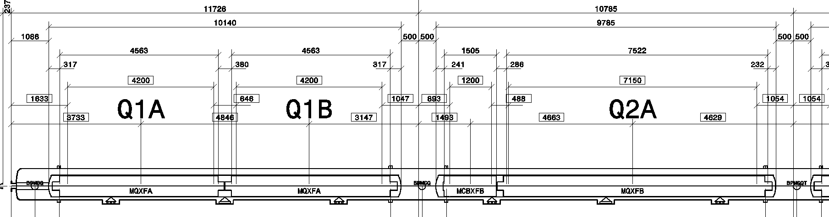
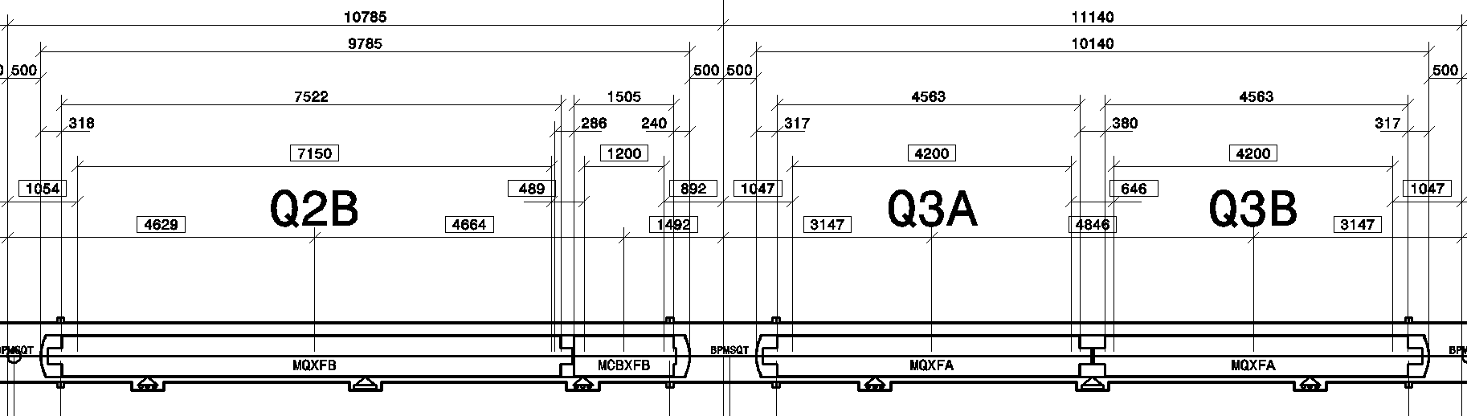
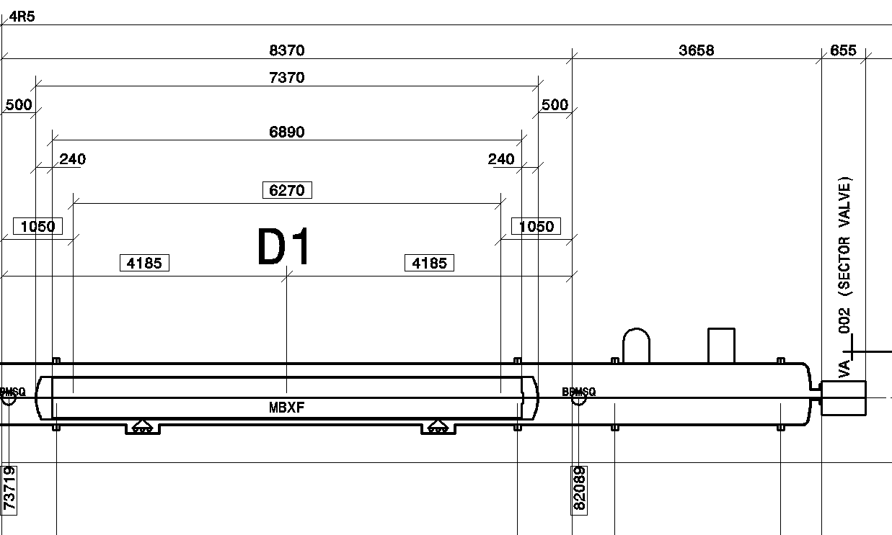
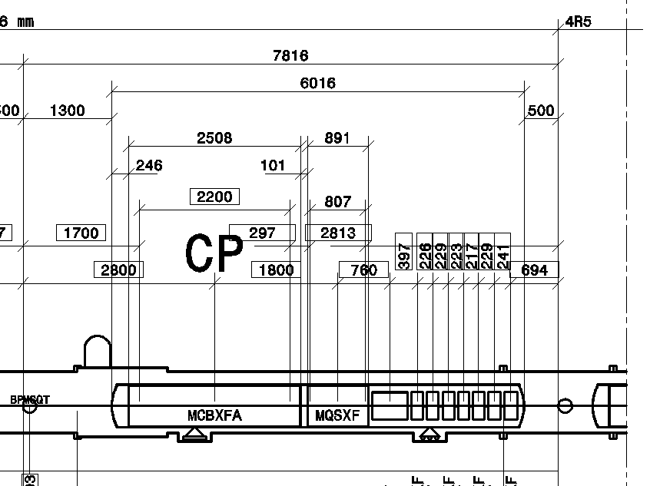
Mechanical layout
IR5 right example: LHCLSXH_0010
Jumper 2
To SC link
Jumper 1
Total length: 64.6 m

Slide 4
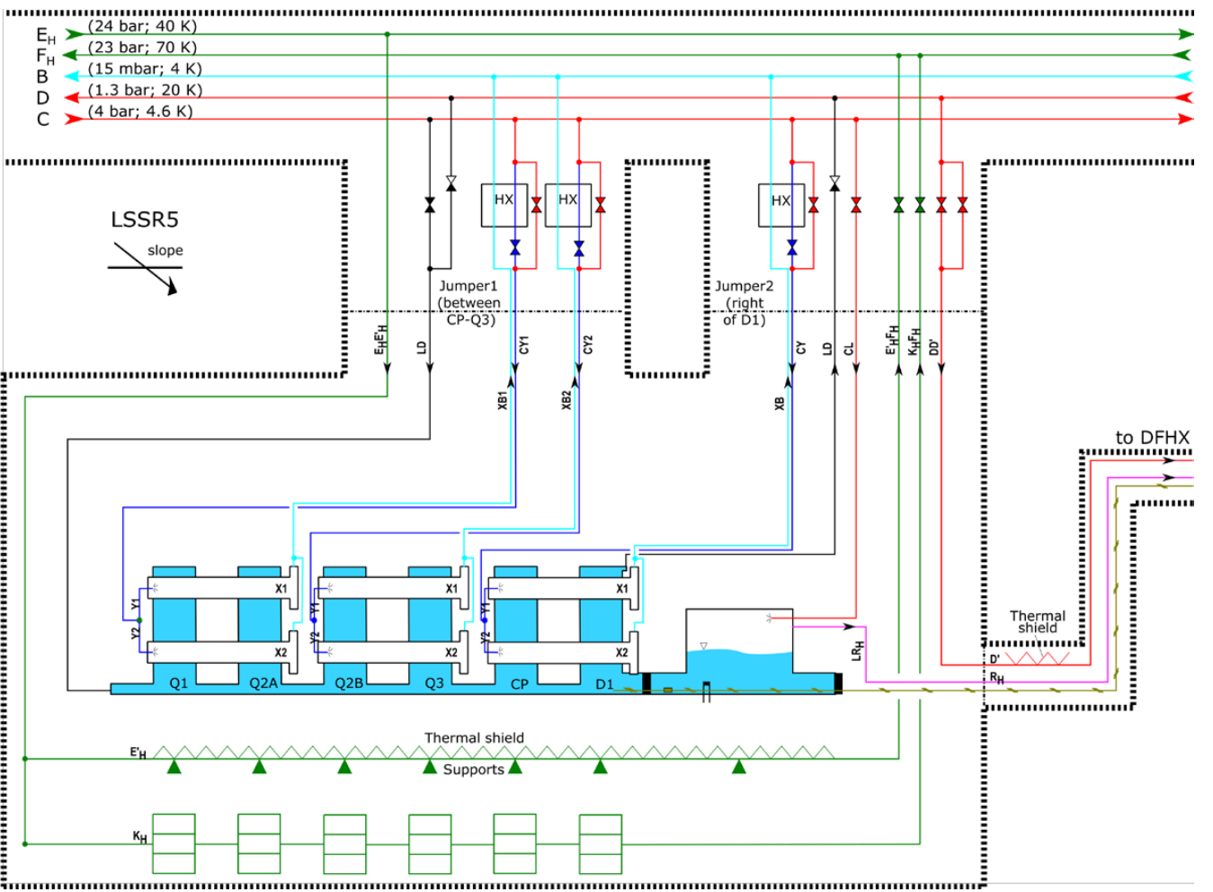
Cryogenics (ex. IR5 right)
EDMS 1573115
Slope dependent layout
!
Ø90~100 mm
!
150 cm²
100 cm²

Slide 5
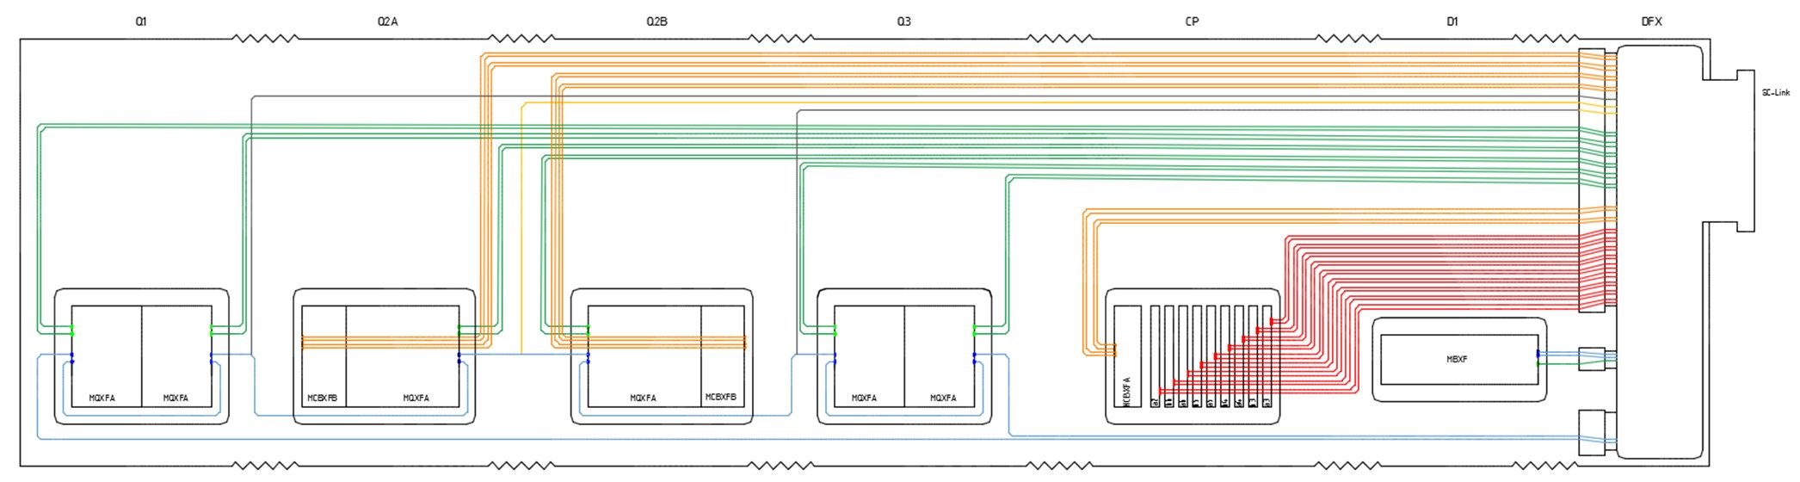
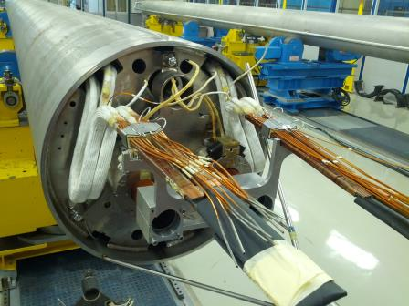
Powering and instrumentation
See Hervé’s talk on cold mass
Expansion loops required
Quads + D1
Management of thermal contractions
Accessibility for interconnection
Compatibility with other interfaces
Orbit Correctors
Trim Q1
Trim Q2b
High Order Corr.
CLIQ

Slide 6
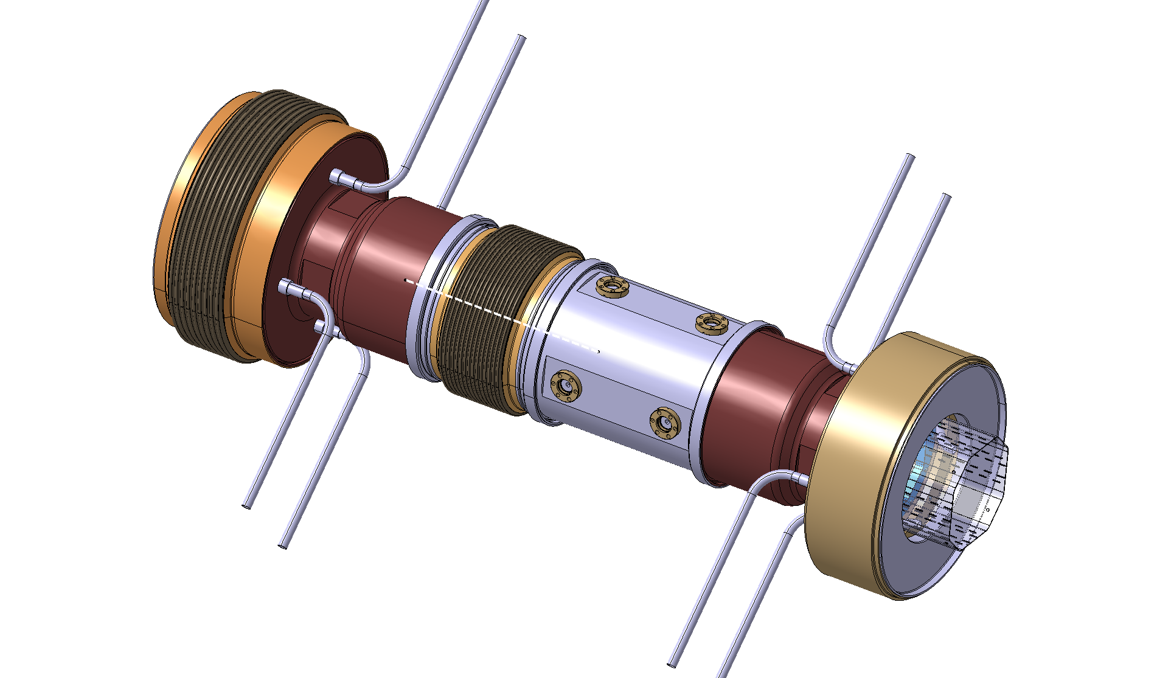
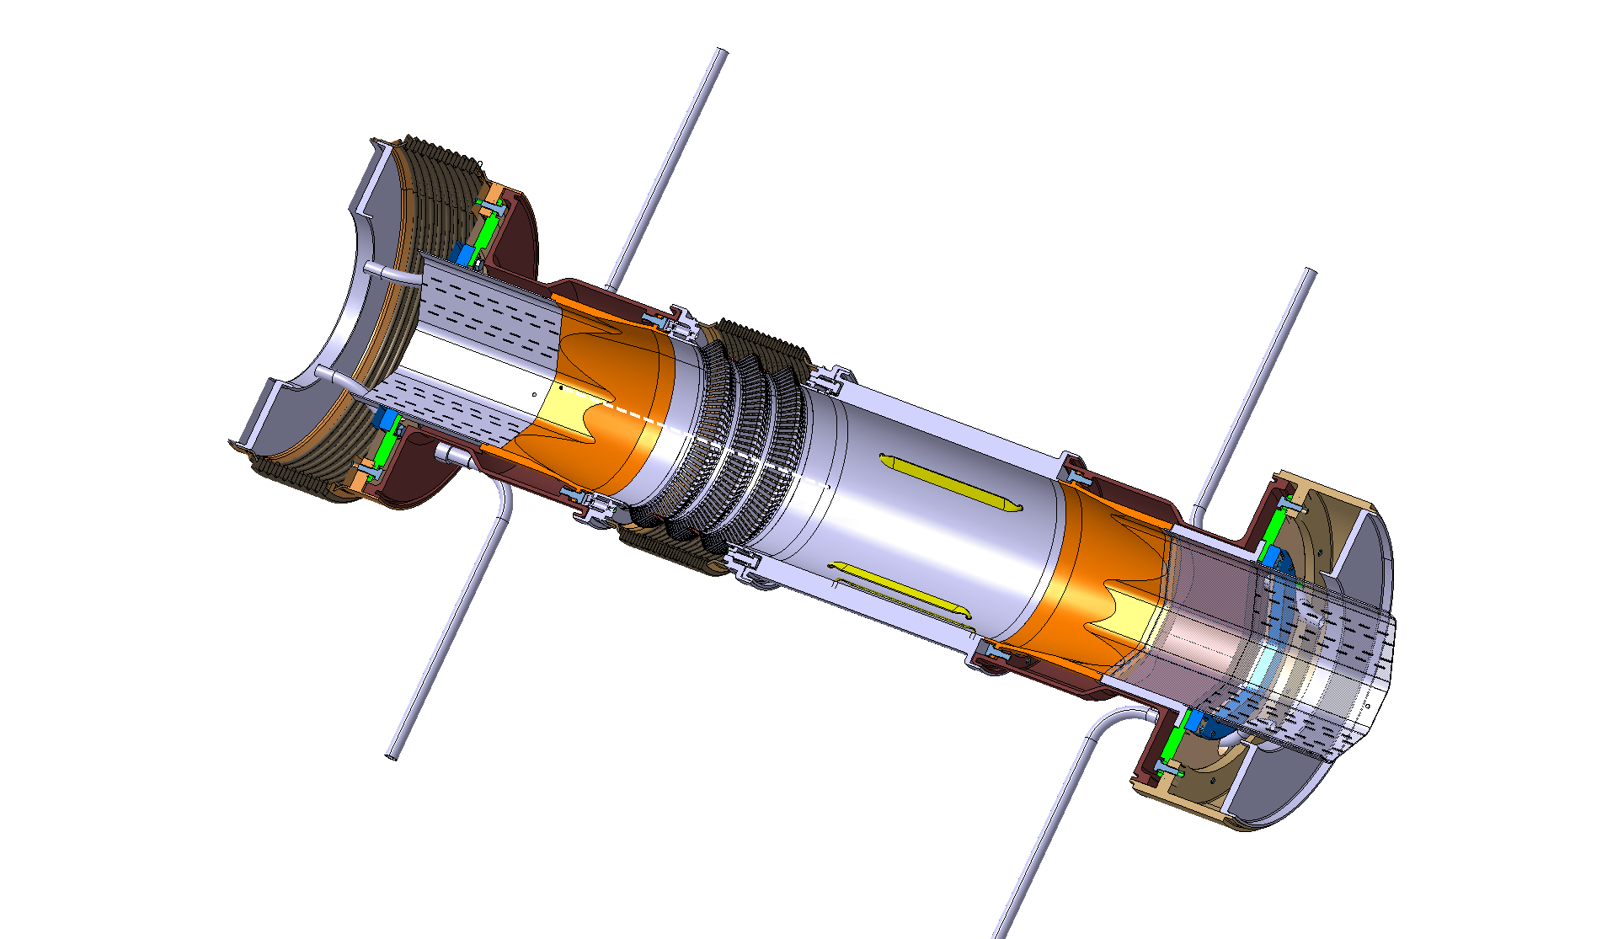
Beamscreen and BPM
Beamscreen to cold mass bellows
BPM
Cooling piping feedthroughs
RF-shielded expansion joint
Designed by TE-VSC

Slide 7
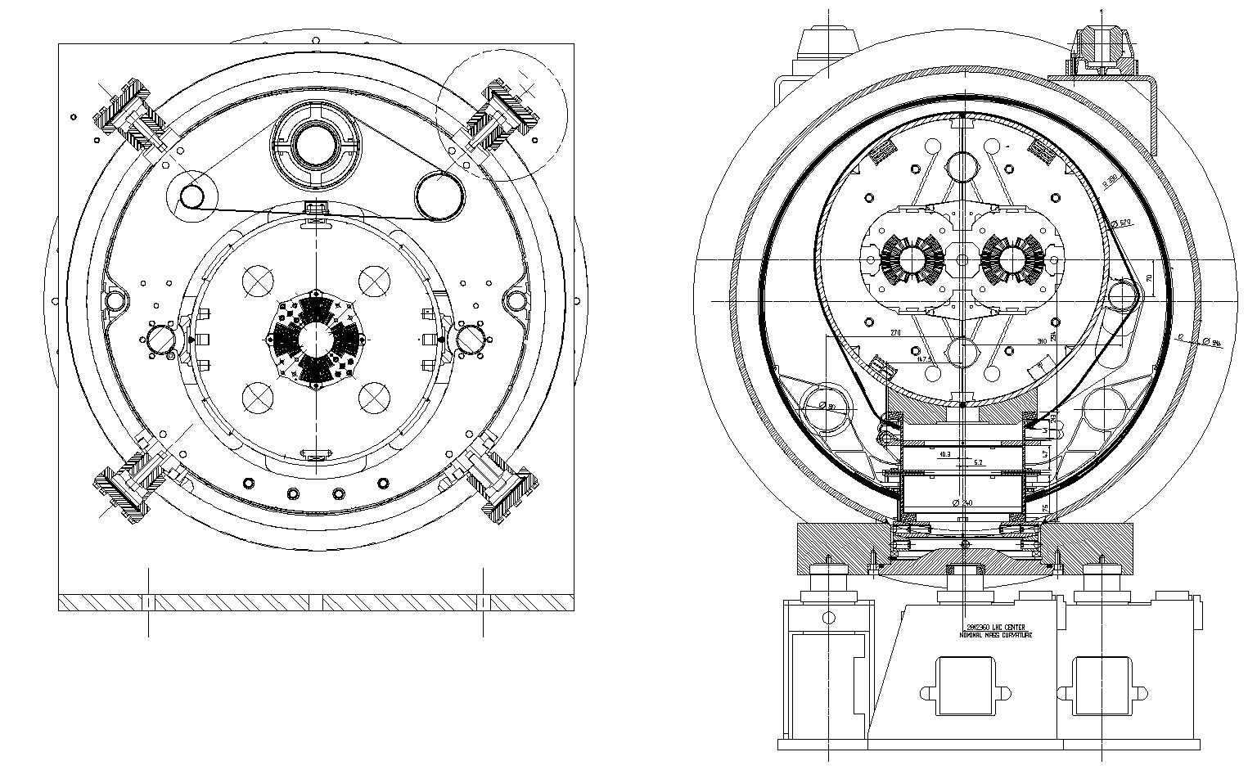
LHC triplet and dipole cross sections
Present LHC triplet
LHC dipole
Preference for column support posts but LHC arc layout cannot fit a larger cold mass plus extra cryo and busbar lines

Slide 8
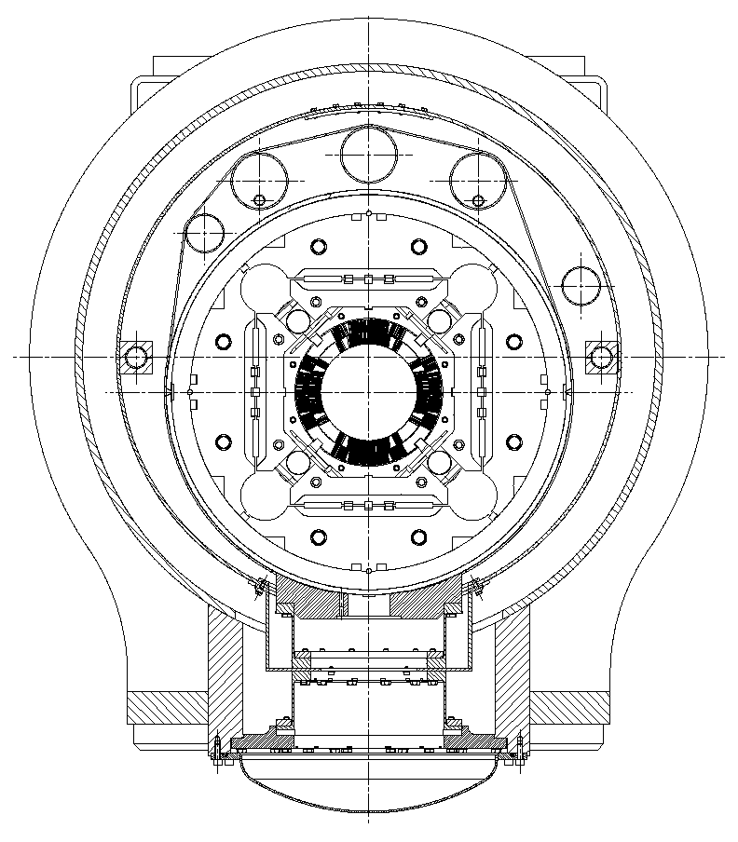
Based on first estimations of piping diameters, all to be confirmed by TE/CRG
1.8 K pumping (15 mbar)
External Busbar line
1.8 K inlet
Beamscreen and thermal shield inlet
Cold mass in/out. (quench line)
Thermal shield
(40-70 K, 24 bar)
Ø 1055 (upper limit for transport in the tunnel)
Cylindrical shell Ø 914x12
54 mm offset
Four possible locations for 2 heat exchangers (1.8 K saturated He)
Present LHC triplet
50 K heat intercept
GFRE split columns
LHC dipole
HL-LHC cross section proposal (Q1 to D1)

Slide 9
Reinforcing rings to prevent ovalisation
3 cold support posts
Fixed support post in the middle for better cold mass stability when handling
Optimum distance ~3500 mm
Isostatic vacuum vessel supports (3 points) postioned for minimum cold mass bending

Slide 10
Dealing with vacuum and pressure end loads
“Vacuum force” (~80 kN, @ Q1 and DFX)
(free,free,0)
(0,free,0)
(0,free,0)
Tie rod for longitudinal loads
(free,0,free)
Pressure end effect from cold mass interconnect
(depends on interconnect design)

Slide 11
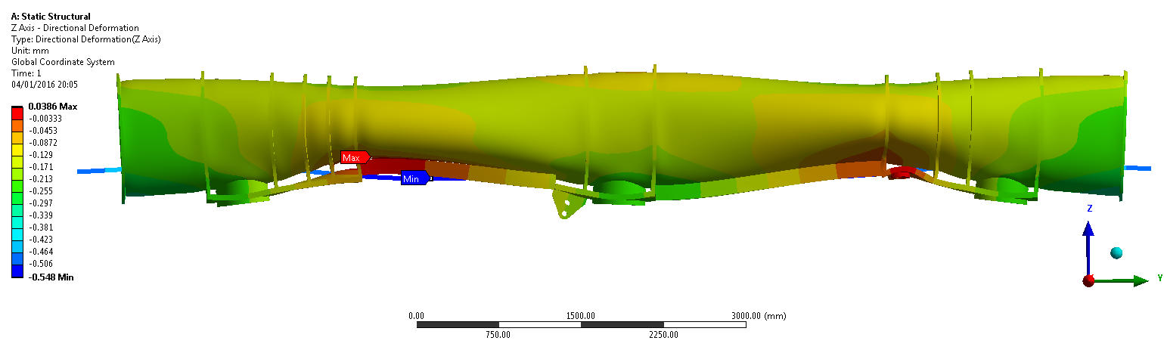
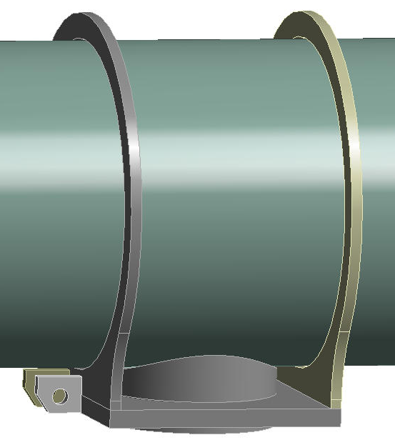
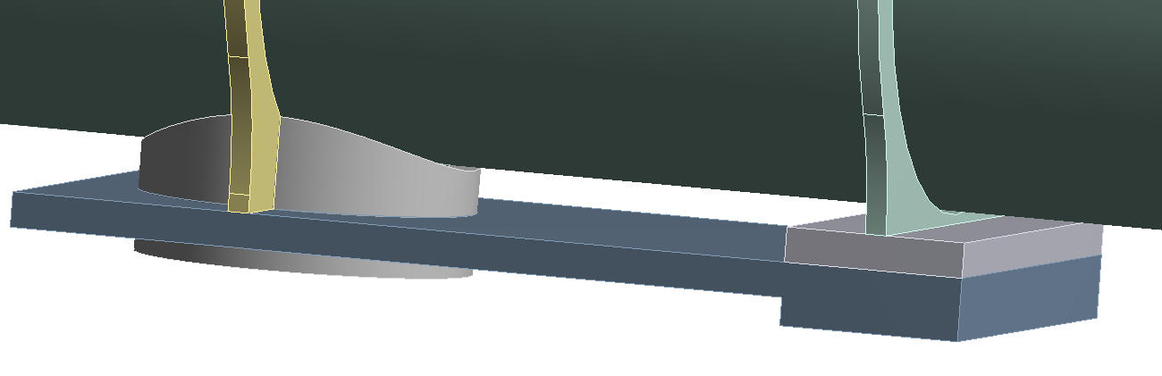
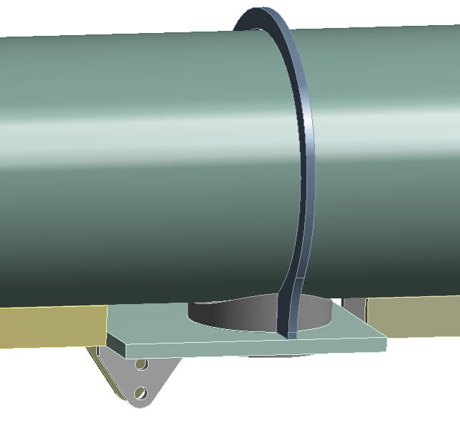
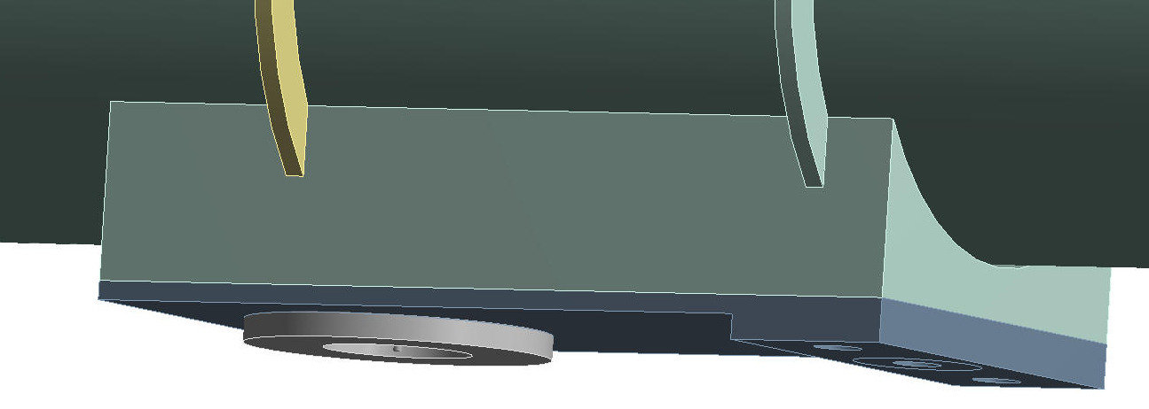
Vacuum vessel design (on-going)
Model includes cold mass stiffness
Several reinforcement configurations being tested:
Location of longidudinal restraint
Minimimum differential displacement of cold mass interfaces (~ 50 microns)
Manufacturability
Internal stresses and stability in time (less welding)

Slide 12
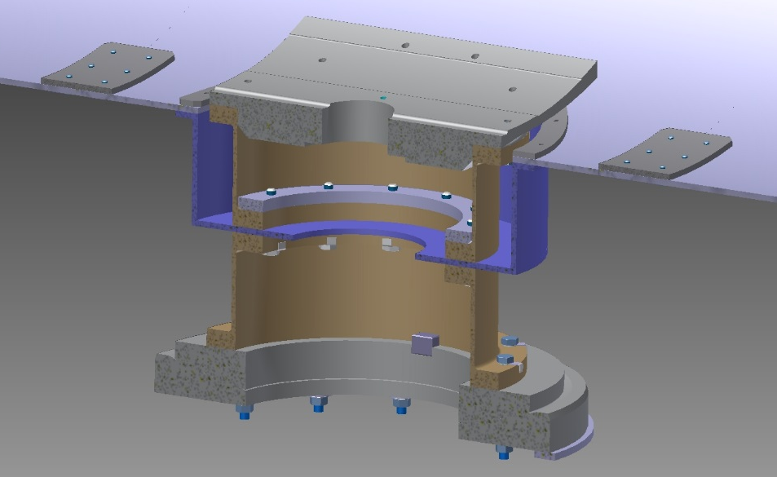
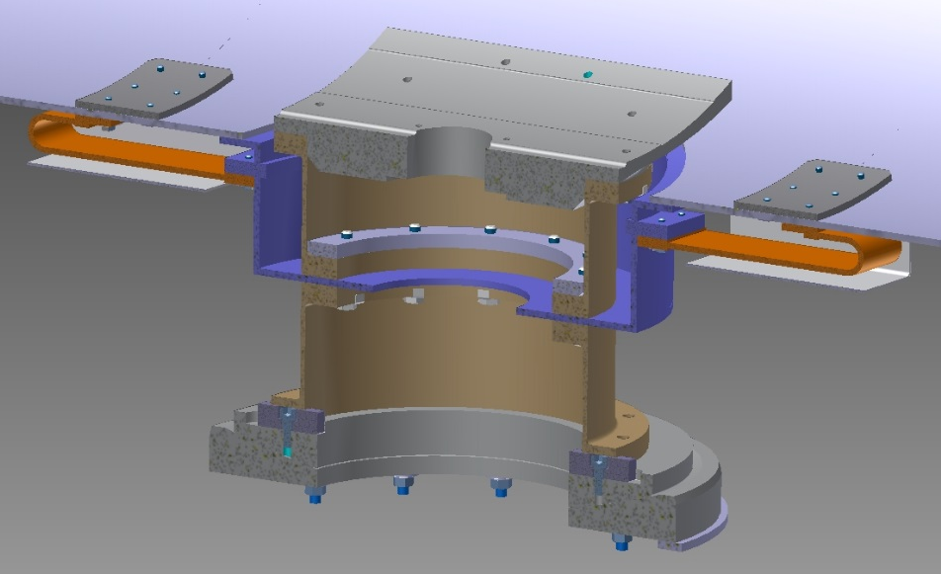
Cold mass support posts
Two-part GFRE column
Aluminium heat intercept plate (perfect heat intercept)
Fixed support in the centre of cold mass rigidly connects the cold mass to vacuum vessel
Sliding support bolted to the cold mass and sliding on vacuum vessel
Bolted assembly using invar washers and lock tab washers to ensure preload maintained at cold
Thermal shield is supported by the heat intercept plates, thus without additional heat load
Thermalization straps on sliding support for independent movement between cold mass and thermal shield
Fixed support
Sliding support (2x)

Slide 13
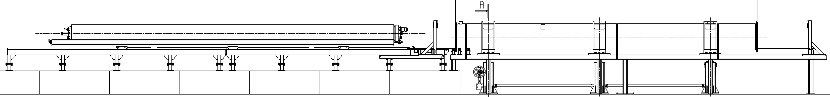
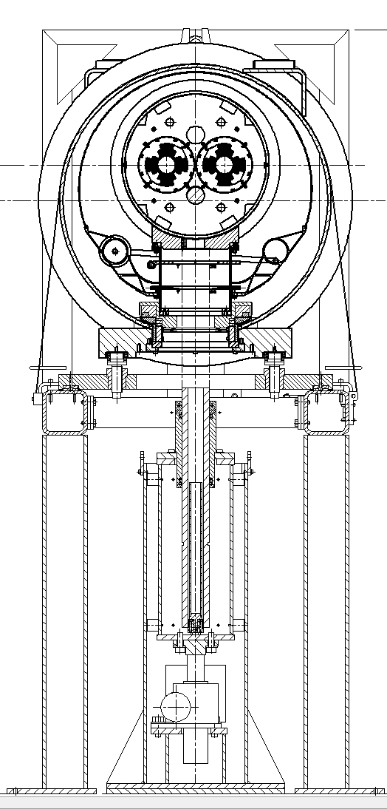
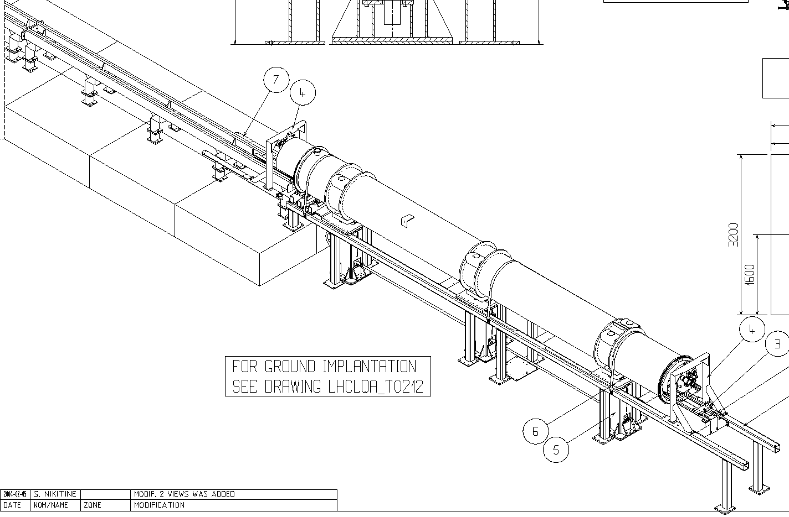
Cryostating tooling: sledge on rails
The principle currently used in dipoles and long SSS
Cold mass supported on at least 3 points at all times
Minimum gaps for cold mass insertion and removal of sledges must be accounted for

Slide 14
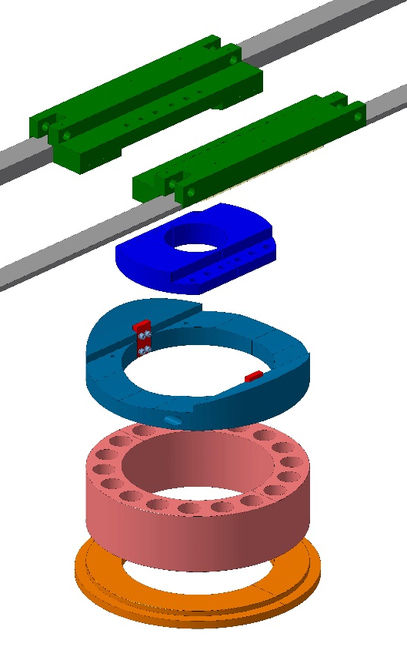
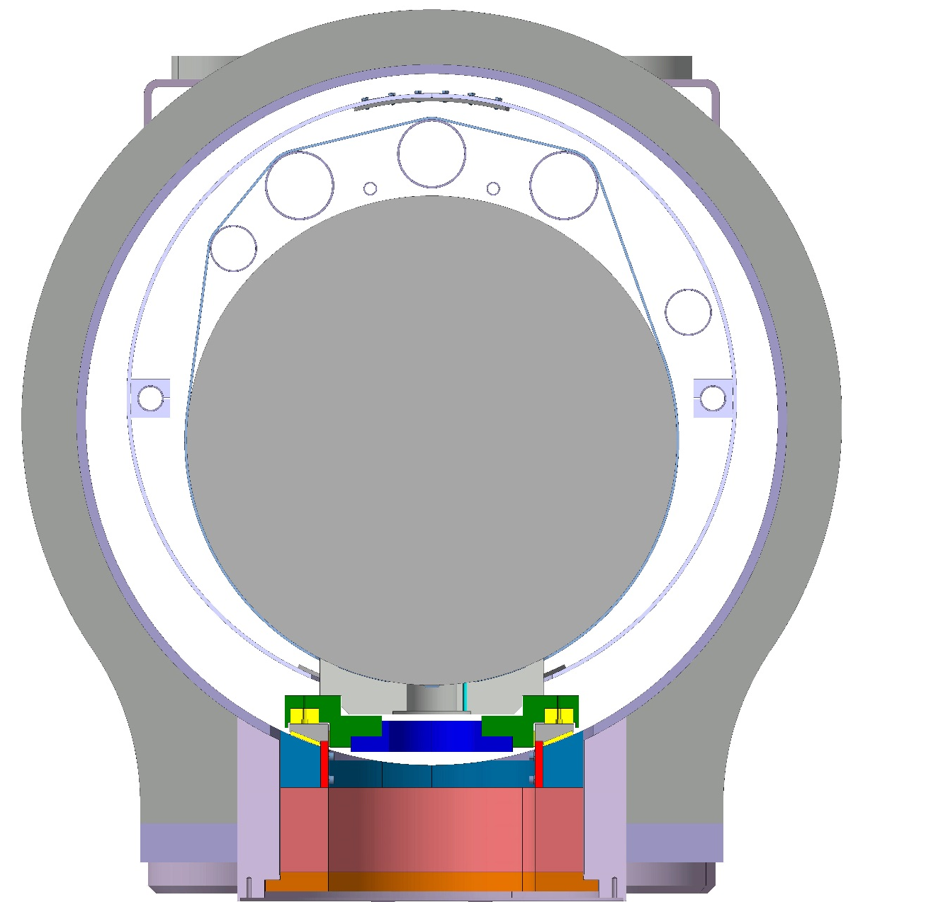
Cryostating tooling
Cold mass+shield lifted wrt nominal
Sledge on rails
Lifting jack
Lifting jack
Support assembly
Tooling removal

Slide 15
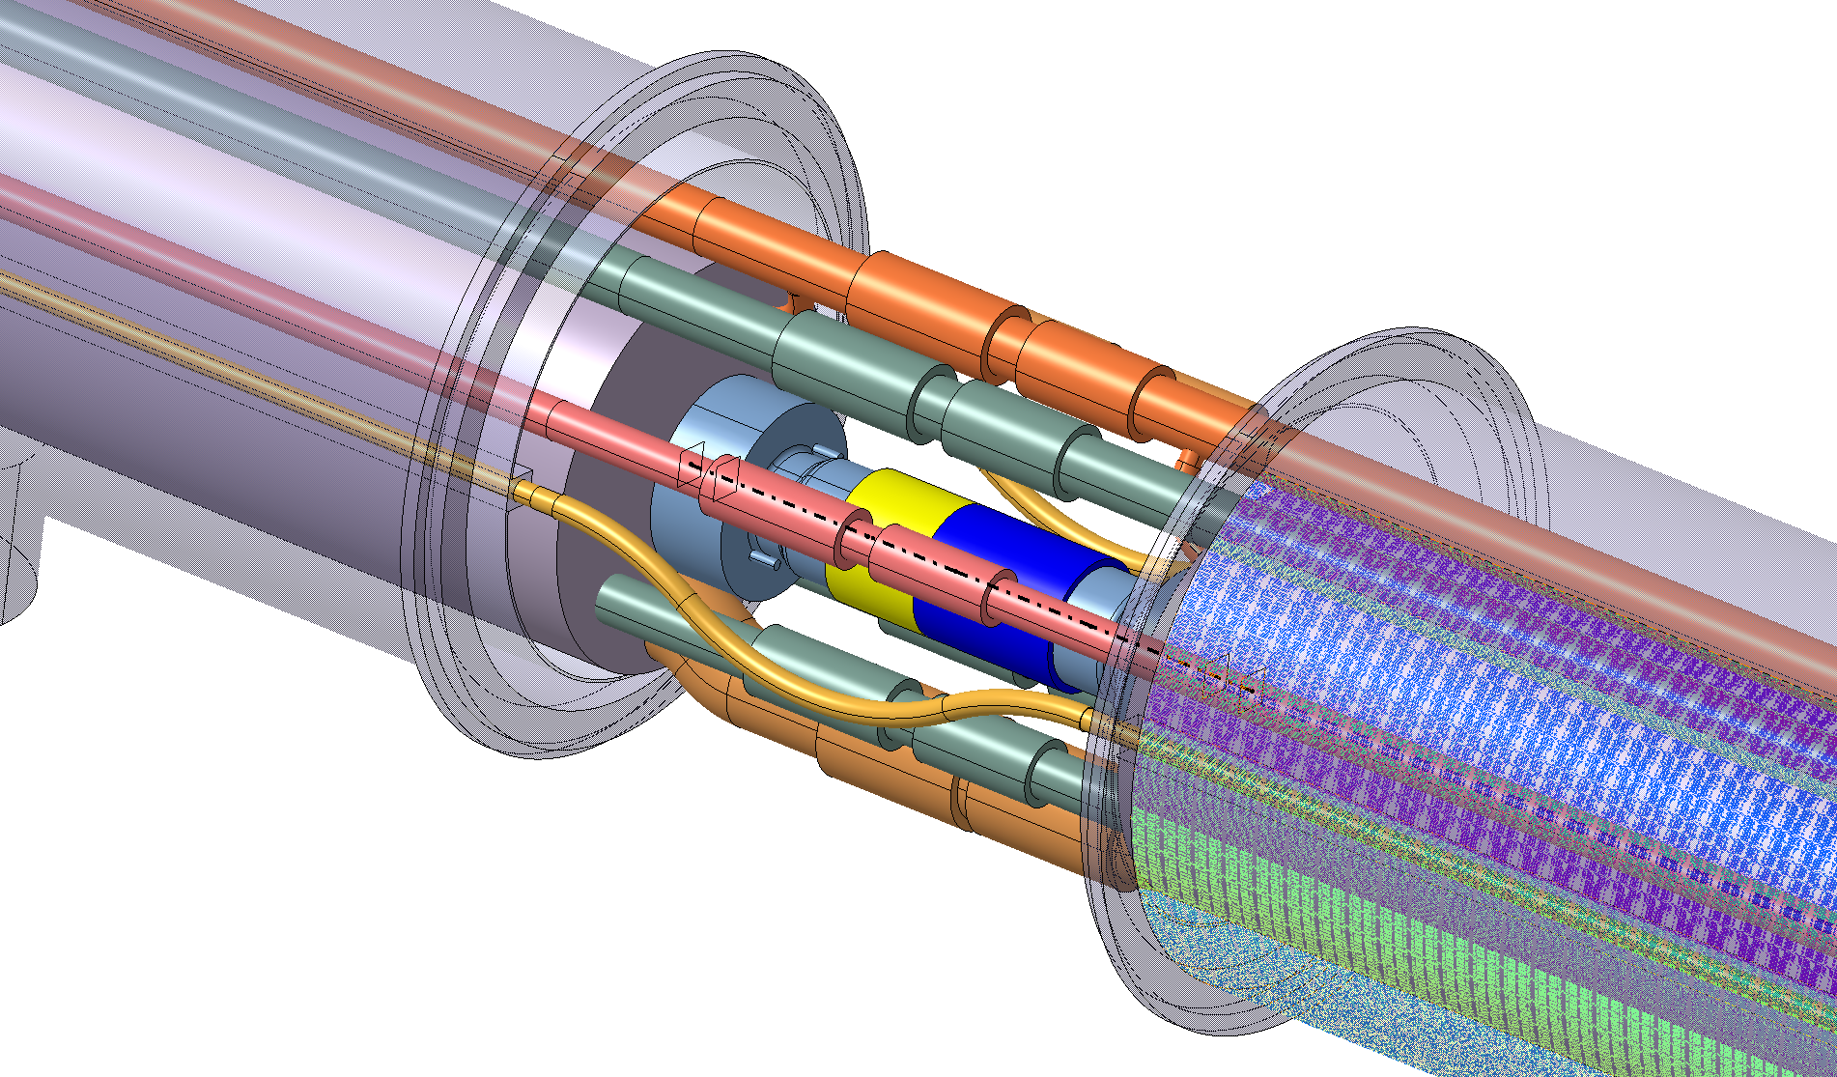
First detailed integration studies
Full 3 D modelling of all cryostats and interconnects is on-going, with various proposals being tested

Slide 16
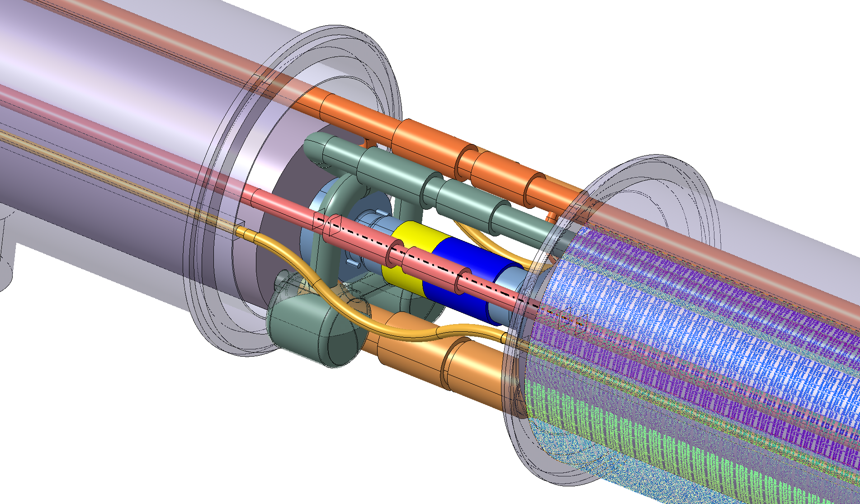
One of the integration challenges
Limited space for the connection of the phase separators to the pumping line.

Slide 17
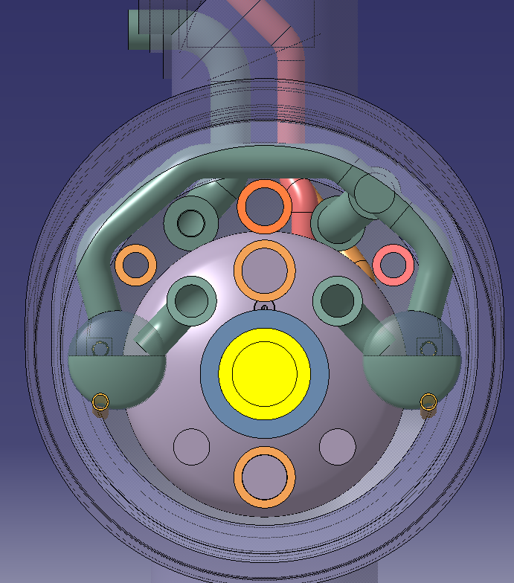
A proposal being studied
External busbar line
Pumping line
Cold mass interface and 18 kA busbar line
Beamscreen and thermal shield inlet
Heat exchanger
Phase separator
Hydraulic connection

Slide 18
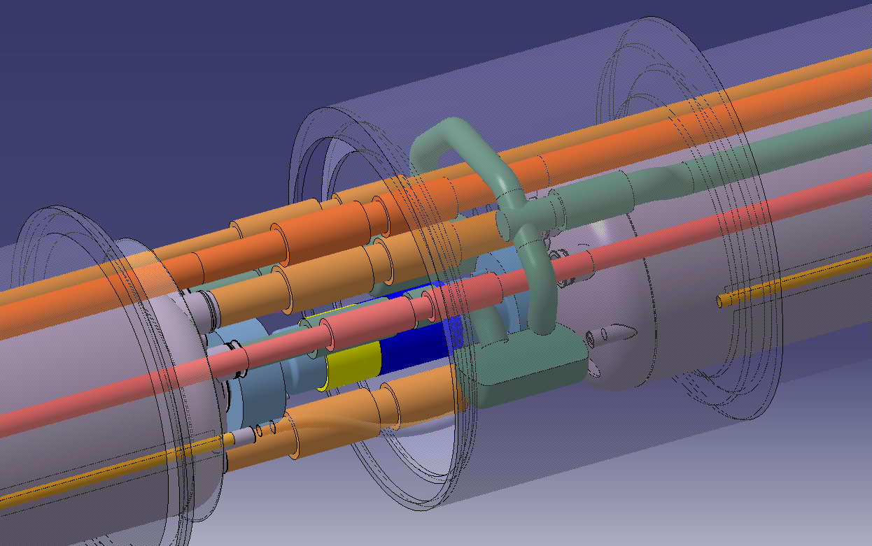
Service module
Phase separators connected either to the upstream or downstream cold mass

Slide 19
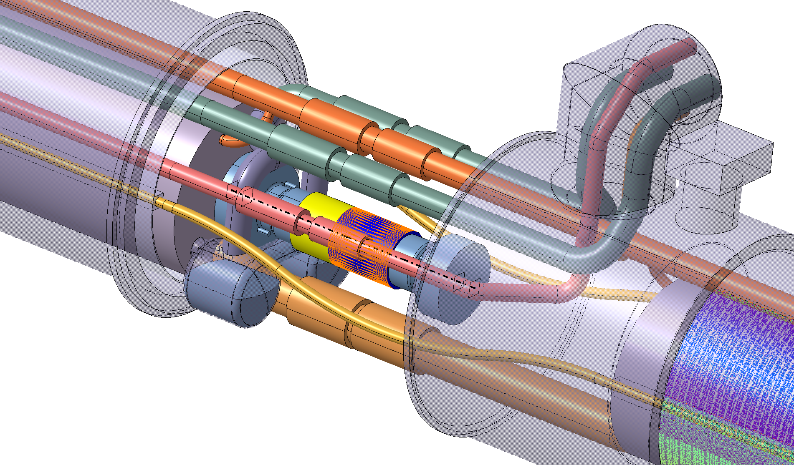
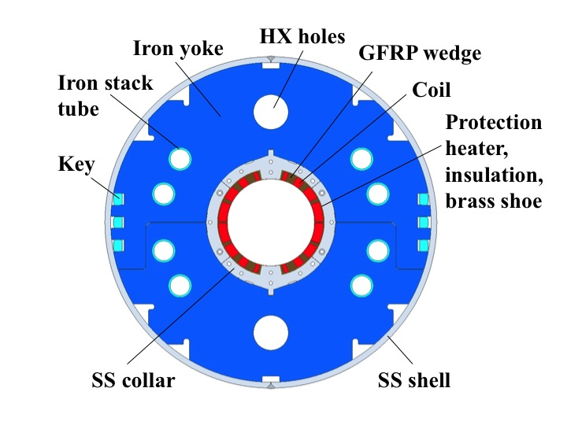
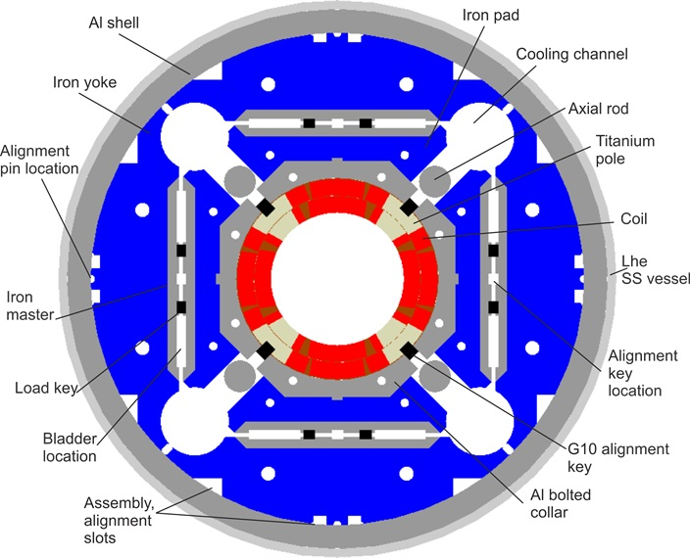
Impact of HX position in integration of busbars and cryo lines
Full integration work led to conclude that busbar and cryogenic pipe routing feasibility requires HX position to be identical from Q1 to D1

Slide 20

Cryostat design “roadmap”
EDMS 1573115
EDMS 1610730 / 1690235
Cryo scheme, temperatures and pressures
Heat loads
Pipe diameters and volumes
Cryostat cross section and pipe routing
Busbar parameters (cross section, voltages, splices, expansion loops, connection scheme)
Interconnect layout
Approval of integration
Cold mass interfaces
Component design
CLIQ and instrumentation (quantity, voltages, currents, cryo instrumentation)
Wire routing and feedthrough/ current lead integration
Stiffness of support system, adjustment degrees of freedom, response to variations in pressure and temperature
Pre-design of cryostat supports
ALARA and remote handling
Alignment and stability requirements
Dynamic response measurements and simulations

Slide 21
Summary
We have a conceptual cross section allowing the integration of a 630 mm cold mass plus cryogenic and busbar piping
The support post approach has been studied together with its assembly procedure and tooling
Integration at the level of the interconnects remains a challenge: Changing the HX position in CP and D1 to match MQXF is crucial (recently requested)
The 18 kA busbars are better routed from cold mass to cold mass including along CP and D1
The definition of the cold mass interfaces depends on a complete and validated integration study (on-going)
Input on all cryogenic piping diameters and phase separator volumes is essential in order to proceed with the design (expected end of June)

Slide 22
Spare slides

Slide 23
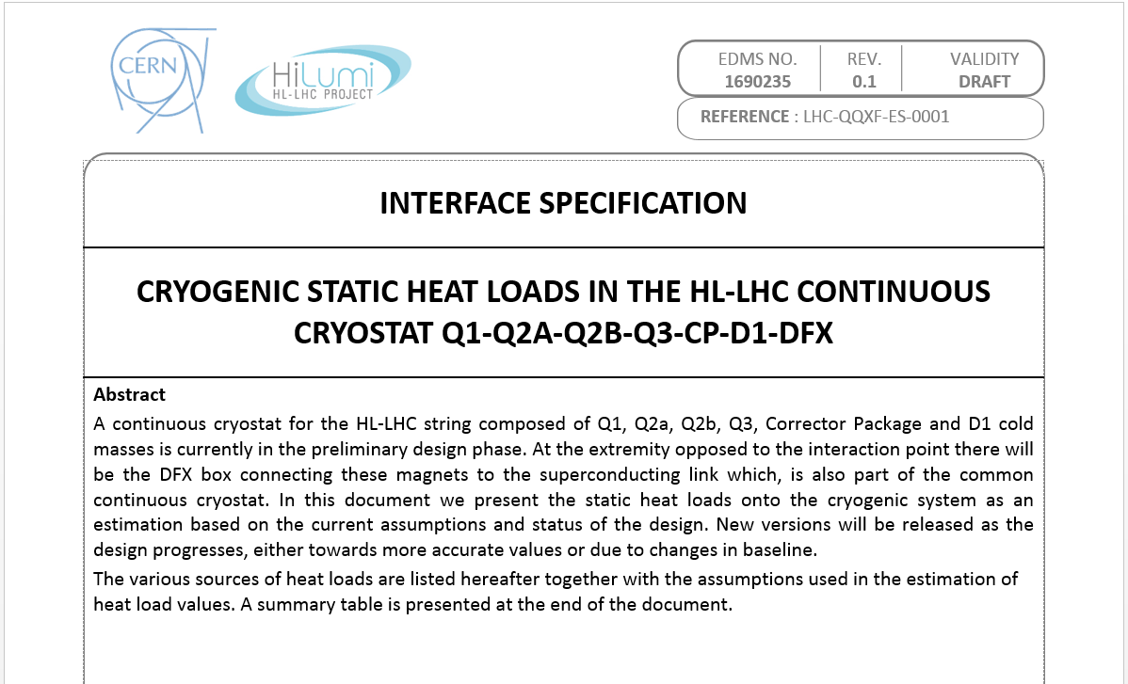
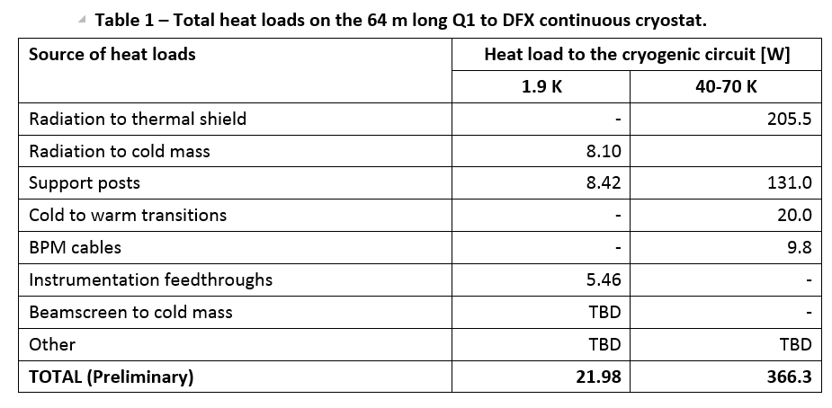
Heat load estimations
(input for cryogenic design)
Note: Total heat load at 1.9 K (design value) ~ 1300 W , i.e. static heat loads are second order!

Slide 24

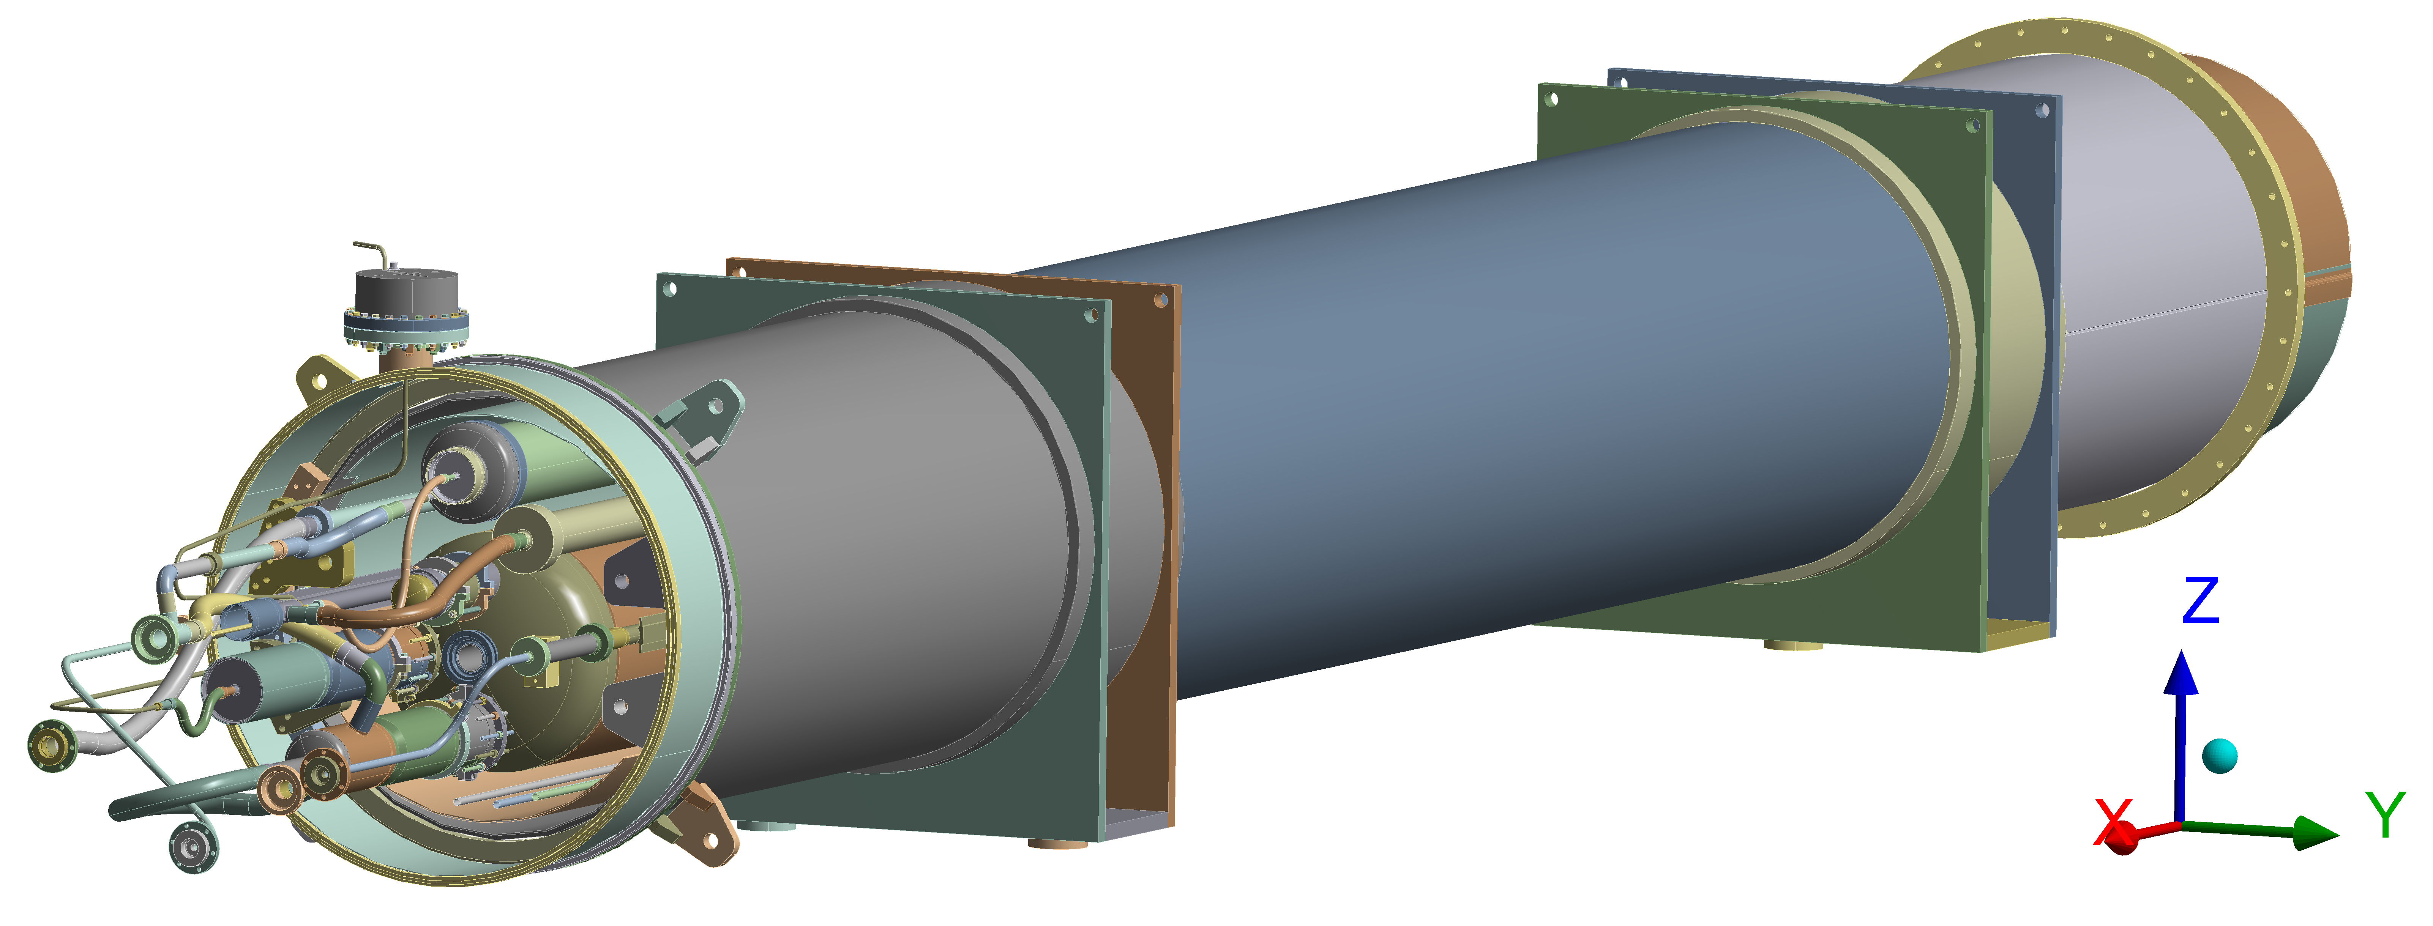
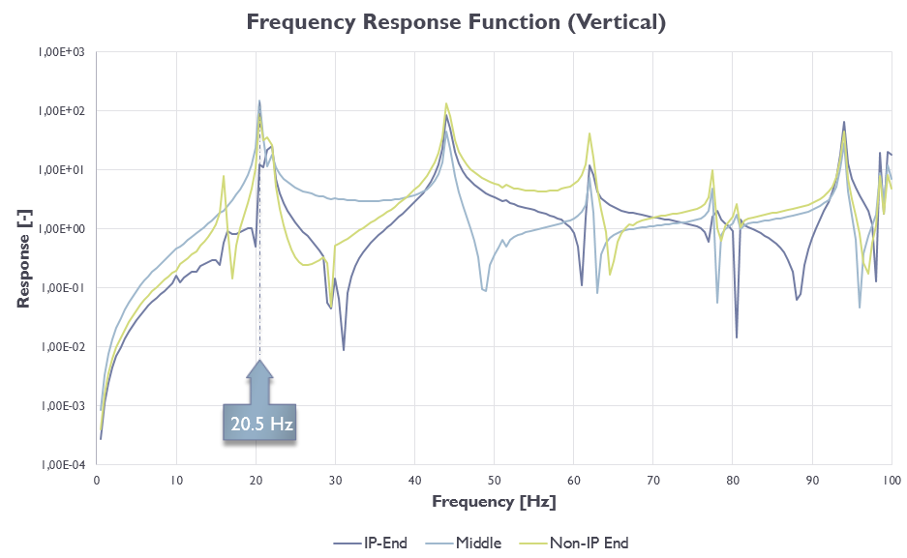
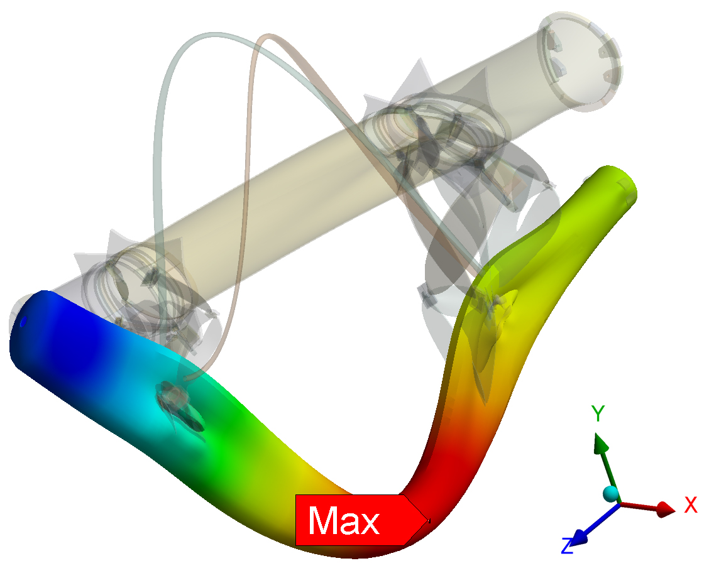
    Summary of Q1 dynamic studies
Experimental and numerical vibration analysis have been performed in order to obtain natural shapes and frequencies.
There is good agreement between frequencies obtain by both methods, especially at the 1st mode.
Experimental modal analysis (EMA) has been performed recently on MQXA and the results will help us to uderstand the dynamic behavior of the cold mass and update the numerical model.
------ Further actions ------
Results of EMA still needs to be post-procesed and compared with FEA.
Perform EMA on Q1 in way which can be reproduced by using FE analysis.

