Slide 1

Cold mass design, assembly plans and QA/QC at CERN
H. Prin
With contributions from: CAD design: A. Temporal
MQXFB: P. Ferracin, J.-C Perez
MCBXFB: F. Toral, J.-C Perez
Instrumentation: L. Grand-Clement
Cryostat interfaces & integration: D. Duarte Ramos, C. Eymin
Alignment: E. Todesco, R. Carcagno, J.-C Perez
International Review of the Inner Triplet Quadruples (MQXF) for HL-LHC
CERN, Switzerland – 7th to 10th June, 2016

Slide 2
Outline
LMQXF Cold Masses Design Parameters
LMQXF Design vs. existing LHC Cold Masses
Known Failures and Mitigations
Assembly Process
Assembly Tooling
Quadrupoles Polarity and Internal Connection Scheme
Busbars Integration
Instrumentation Integration
Summary

Slide 3
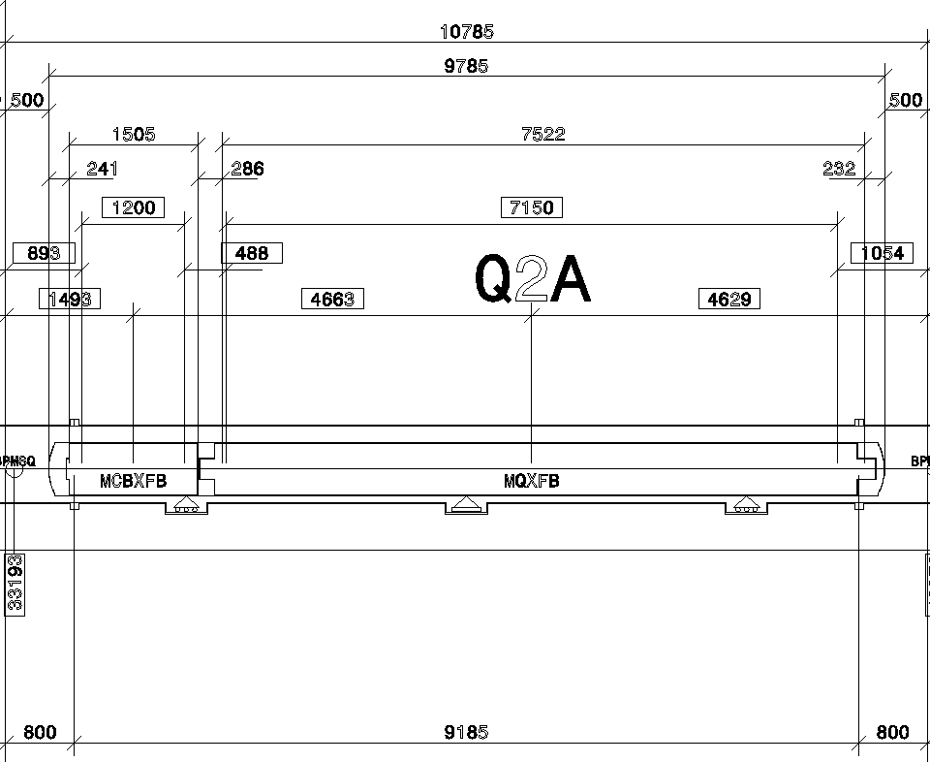
Cold Mass Definition
cold mass:
Leak tight envelope surrounding one or more superconducting magnets which acts as a helium pressure vessel and provide the mechanical rigidity to align the magnetic element(s). It can be composed of two welded half-shells (main dipoles, insertion cold masses...) or by an "inertia tube" (arc SSS) closed by two end covers in the extremities.
https://espace.cern.ch/HiLumi/TCC/SiteAssets/LHC_Glossary_high_resolution.pdf

Slide 4
LMQXF Cold Masses Design Parameters
Length | LLMQXFA/B= 10140mm LLMQXFC/D = 9785mm | ✓ | Defined by the magnets length and spacing in btw Indirectly used in optics calculations
He vessel | Øint = 614mm Øint = 630mm | ✓ | Imposed by MQXF Al shell outer diameter and such that the cold mass could be housed inside a std LHC vacuum vessel Thickness to minimise the sag and withstand internal pressure
Cold bore tube | Øint = 136.7H8 Thk = 4 0/+0.5 | ✓ | Machined 316LN seamless tubes delivered by VSC group
Supporting system | 3 pads 3.5m spacing Ø232g6 H=328.5mm | ✓ TBC TBC TBC | Identical spacing in btw the supports for the 2 types of cold masses Central support is the longitudinal fixed one
Fiducialisation references | 3x Ø12H7 | ✓ R TBD | 3 points per end cover to defined “C” and “L” planes Location on the H and V planes,
Magnets housing | 2x MQXFA or MQXFB + MCBXFB | ✓ | Lengths provided by the magnets project engineers Distances in btw magnet minimised
Busbars housing | 2x 18kA 10x 2kA 1x 120A 12x CLIQ leads | ✓ ✓ ✓ ✓ | In orange busses to be designed
Instrumentation | Capillary or connectors | TBD | To be discussed with protection and magnets project engineers
Heat exchanger | 2x Øint 68mm | TBC | 2 internal smooth copper pipes
Cooling section | ≥150cm² | TBC

Slide 5
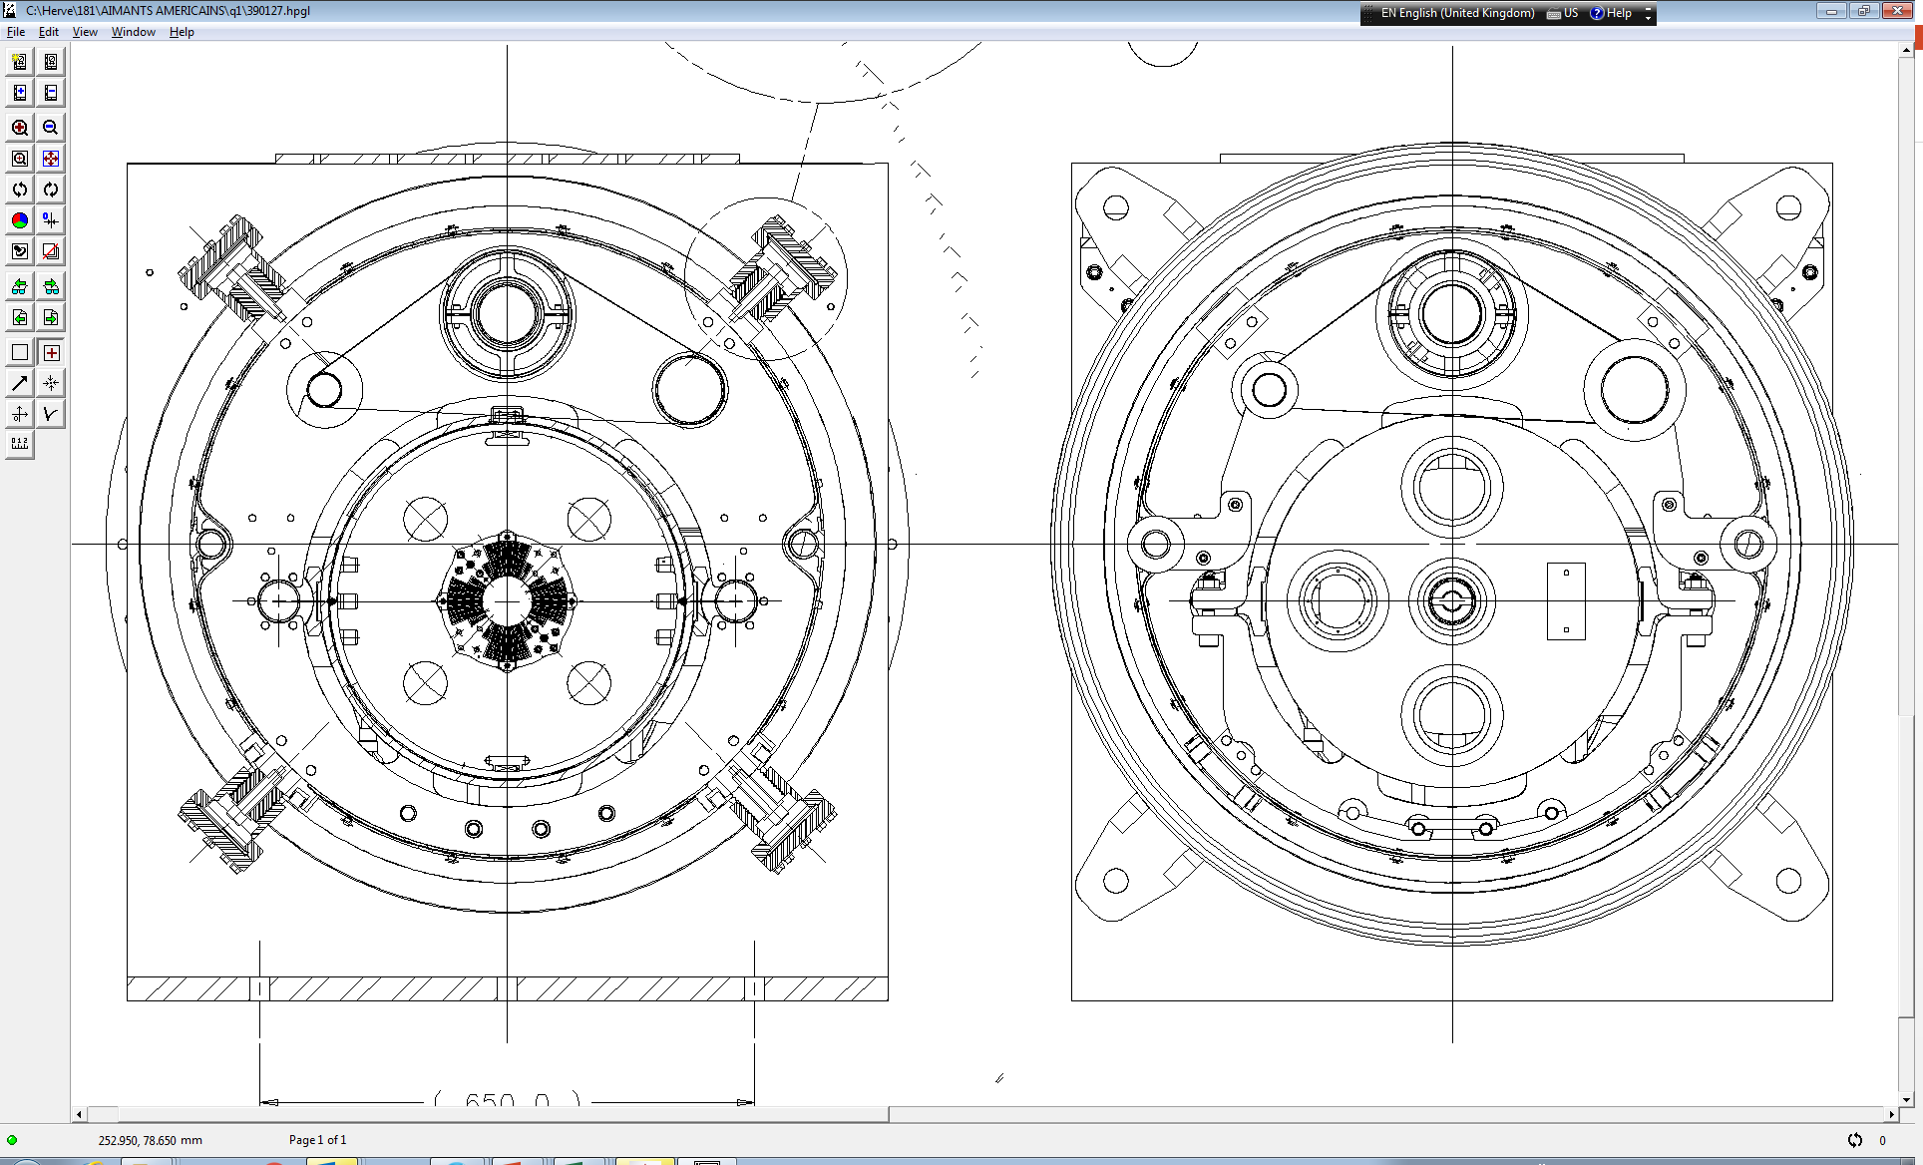
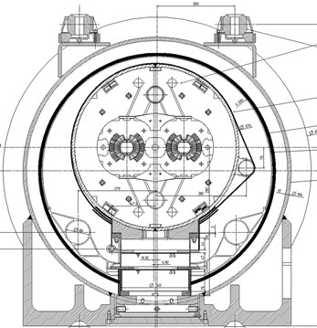
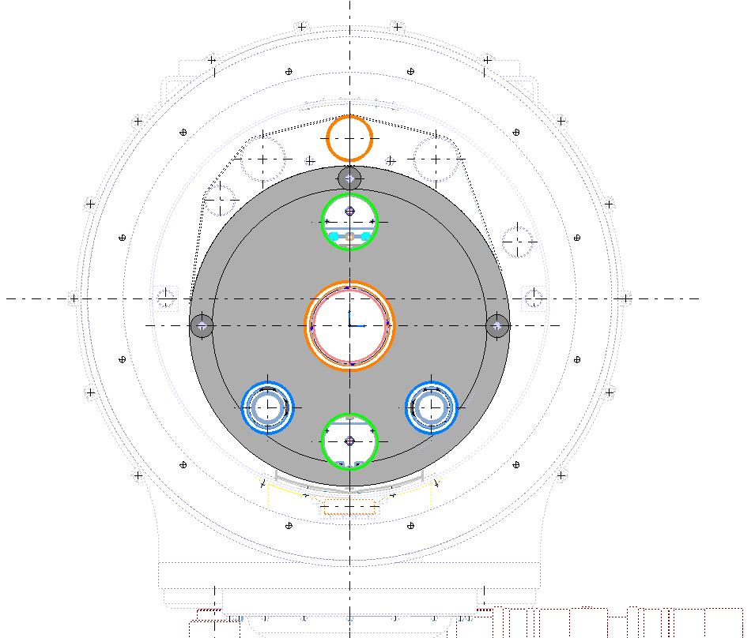
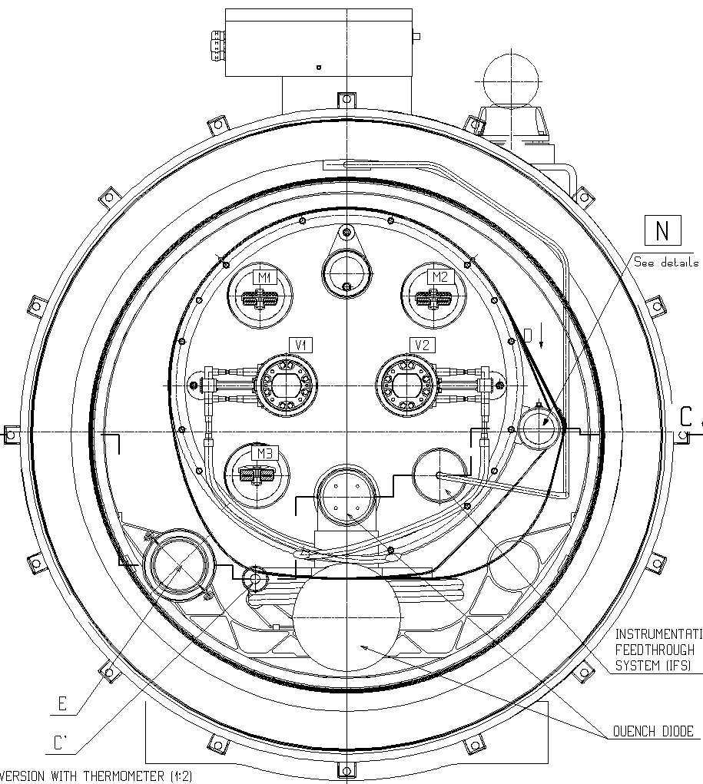
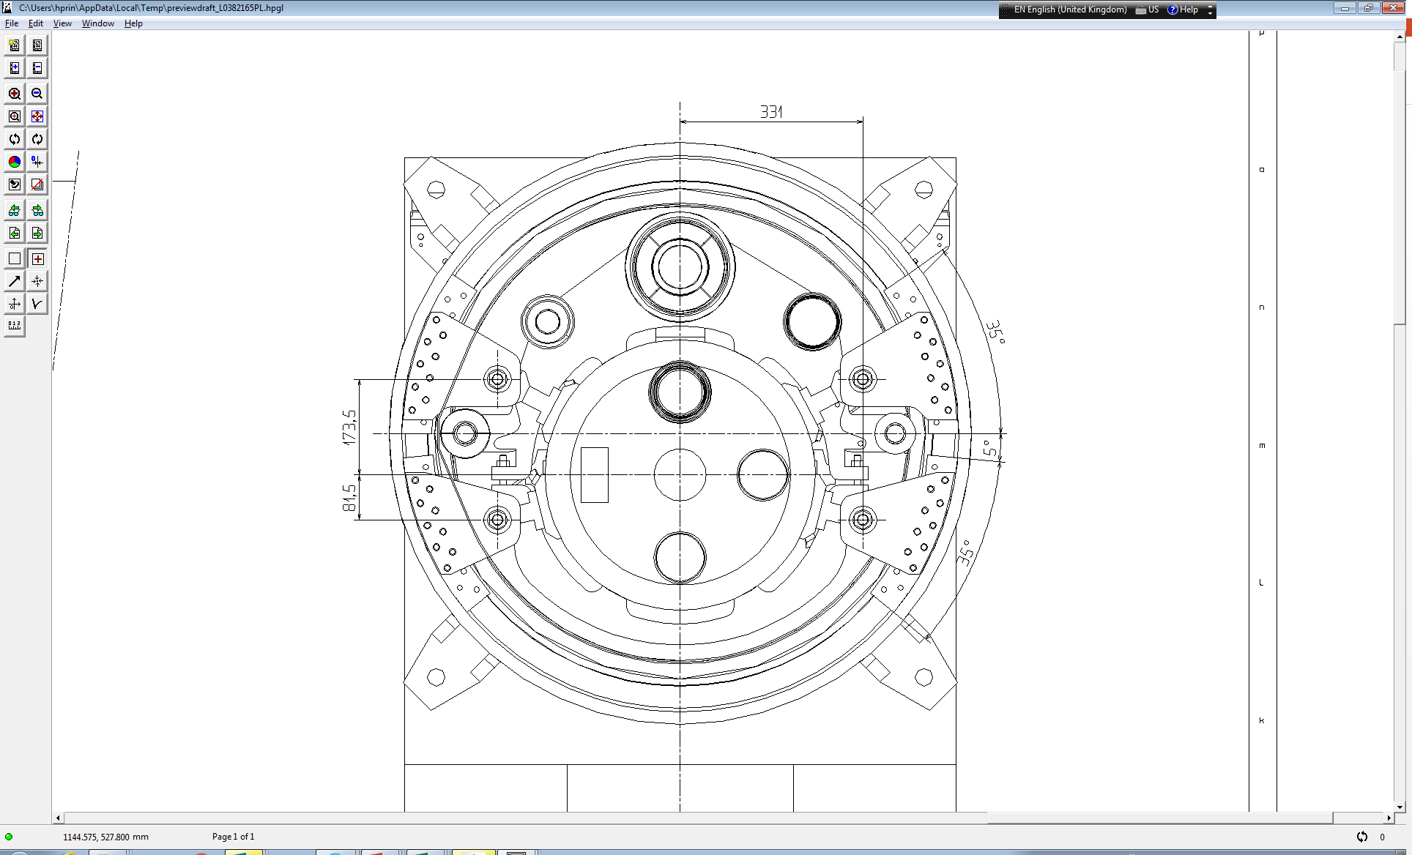
LMQXF Design vs. existing LHC Cold Masses
LQXA/B/C
Present inner triplet
LMQXF
H-Lumi cold masses
LB
Main dipole
External heat exchanger tube Ø83/95mm (corrugated)
Internal heat exchanger tube Ø 54mm
Ø630mm
Ø570mm
Ø510mm (Q1-Q3)
Ø416mm (Q2)
Single aperture Ø CBT 53 and 63
Double aperture Ø CBT 50
Single aperture Ø CBT 137.8
“Spider” radial supports
+ cartridges
2 Internal heat exchanger tube Ø 68mm
Support posts
Support posts
Instrumentation line or capillary?
Busbars lines
Busbars line
Axillary Busbars line
Instrumentation line
Busbars line
Instrumentation capillary

Slide 6
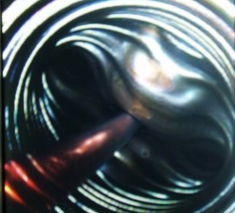
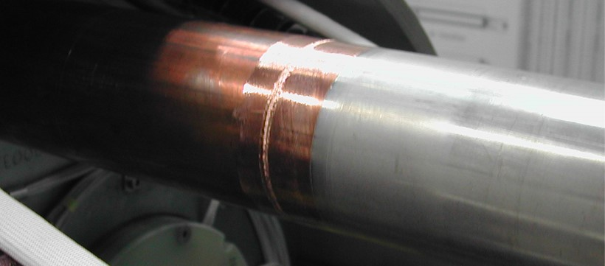
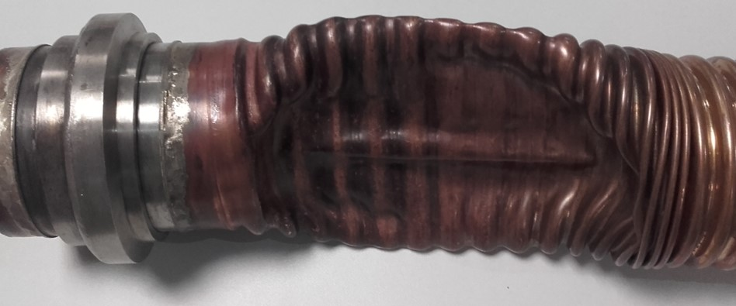
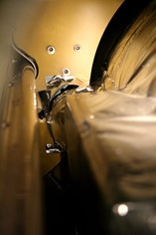


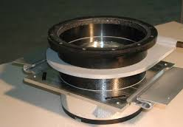
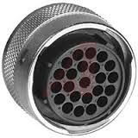
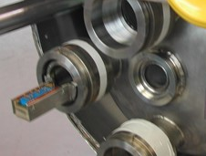
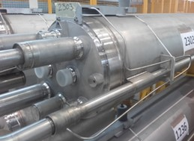
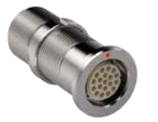
Known Failures and Mitigations 1/2
Heat exchanger Stainless Steel to Copper transitions
Supporting system
Instrumentation connectors reliability
Support posts inspired from the LHC main dipole
+
Burndy®
IFS capillary
Connectors compatible with
cryogenics environment
or
Fischer®
Developed in next slides

Slide 7
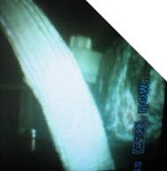
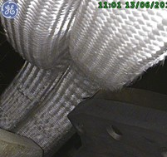

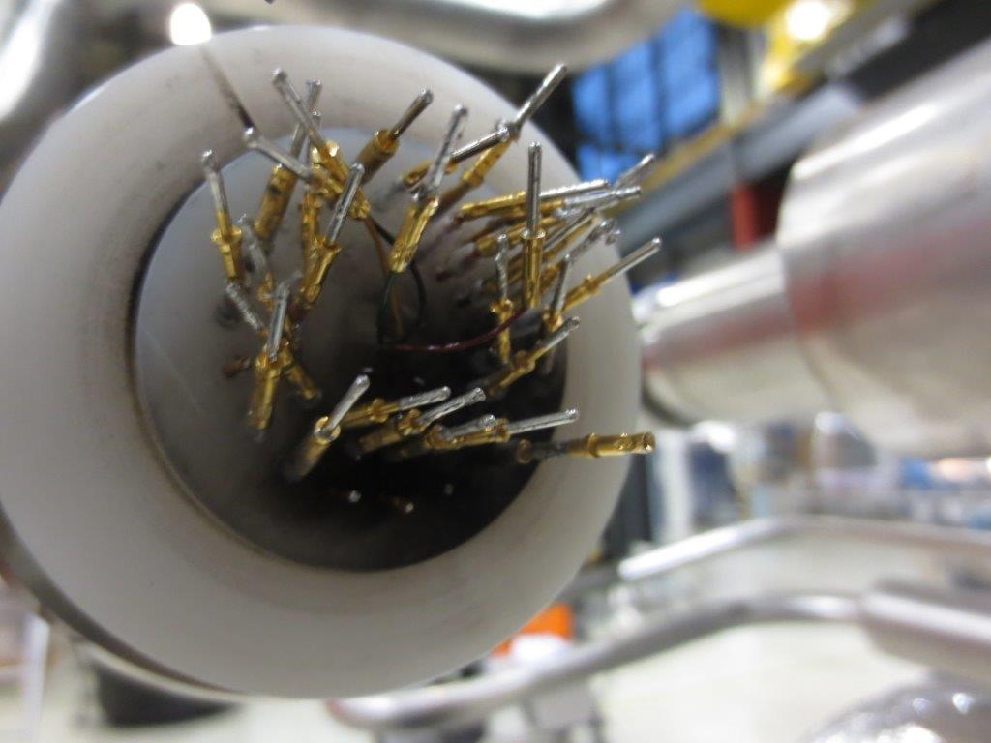
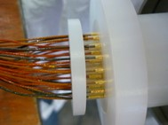
Known Failures and Mitigations 2/2
Increase dielectric strength by:
Move busses away from each others and from ground
Generate large volumes, not cluttered, for the expansion loops
Install efficient and robust insulation with redundancy
Discharge test voltage to be defined by the High Voltage Withstand Levels WG
Busbars proximities and insulation faults
Internal splices resistances
Instrumentation connection failures
Use as far as possible standard and proven procedures, straight splices that provides stabilisation continuity and if required develop QA processes
Enhanced insulation in the connections, increase distances between the pins

Slide 8

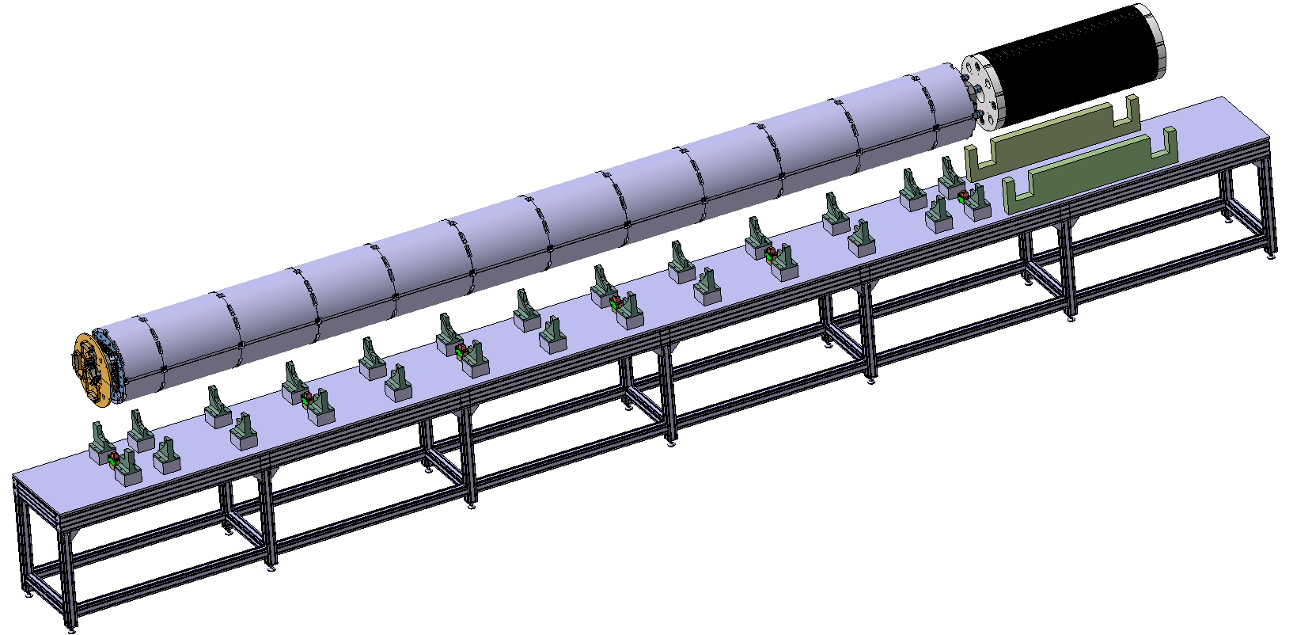
Assembly Process
Magnet reception and alignment
Magnet reception and alignment
Visual inspection
Electrical reception test:
  Dielectrical HV test
  V-Taps continuity
  Quench Heaters continuity
  Transfer function
  Discharge in the magnet
  Discharge in the QH

Slide 9
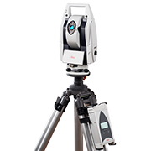
Assembly Process
WPS
Stainless Steel block insertion
Stainless Steel block insertion
Alignment Keys positioning and tack welding
  Mechanical geometrical measurements
  Geo-Magnetic measurements
Alignment Keys positioning and tack welding

Slide 10
Assembly Process
Cold Bore Tube insertion
Heat Exchanger Tubes insertion
Cold Bore Tube insertion
Heat Exchanger Tubes insertion
Busbars connections
Instrumentation wiring
Electrical reception test:
  Dielectrical HV test
  V-Taps continuity
  Quench Heaters continuity
  Discharge in the QH
Busbars connections
Instrumentation wiring

Slide 11
Assembly Process
WPS
Shell installation on top
Tack welding btw the shell beveller and the backing strip

Slide 12
Assembly Process
Rolling rings assembly

Slide 13
Assembly Process
Handling to the rotation bench
Shackles removal
Half turn rotation around the longitudinal axis

Slide 14
Assembly Process
Handling to the welding bench (welding press conveyor)
Upper shell installation and alignment
Electrical reception test:
  Dielectrical HV test
  V-Taps continuity
  Quench Heaters continuity
  Thermometer
  Cryoheater
  (Bus bars insulation)
  Mechanical geometrical measurements
  Geo-Magnetic measurements
  (Polarity test)

Slide 15
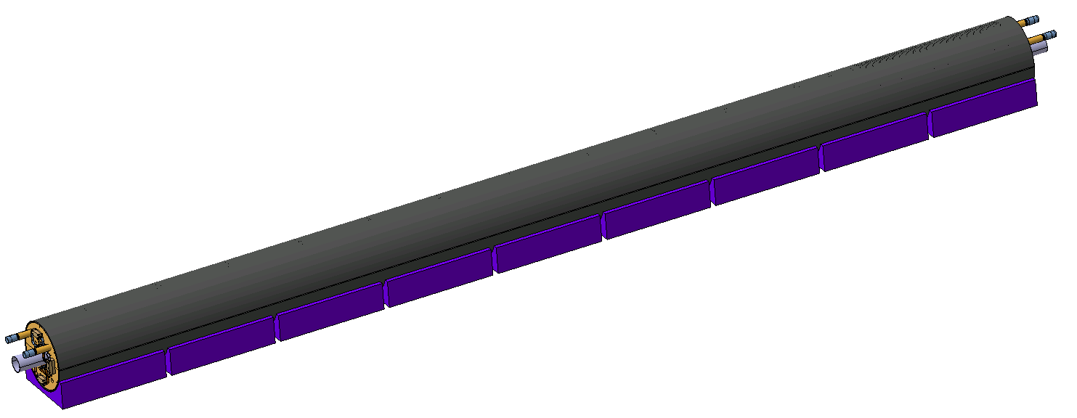
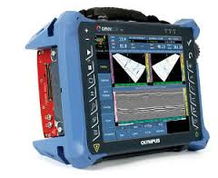
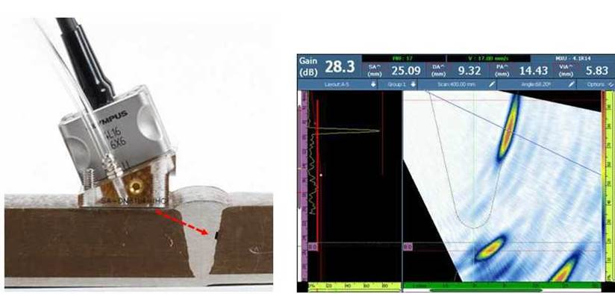
Assembly Process
WPS
To be refine
  Longitudinal welding
  Longitudinal welding
  Welding non destructive inspection
  Visual inspection
  Samples (shell extremities) X-rays
  Longitudinal ultrasonic inspection
Electrical reception test:
  Dielectrical HV test
  V-Taps continuity
  Quench Heaters continuity
  Thermometer
  Cryoheater
  (Bus bars insulation)
Non destructive inspection using Phased Array Ultra-Sonic technology ongoing development according to ISO 17640.

Slide 16
Assembly Process
  Cold mass finishing
  Cold mass finishing
  Geo-Magnetic measurements
  Shell and cold bore tube extremities machining
  Alignment and welding
  End covers,
  Supports,
  Flares,
  Flanges,
  Parallel line
  Welding non destructive inspection
WPS

Slide 17

Assembly Process
  Preparation for pressure/leak and cold tests
  Preparation for pressure/leak and cold tests
  Busbars (circuit) and instrumentation preparation
  Cold mass volume closure
  Pressure/leak test
  25bars in the cold mass volume and parallel line
  5 bars in the heat exchangers
  Pressure/leak test

Slide 18
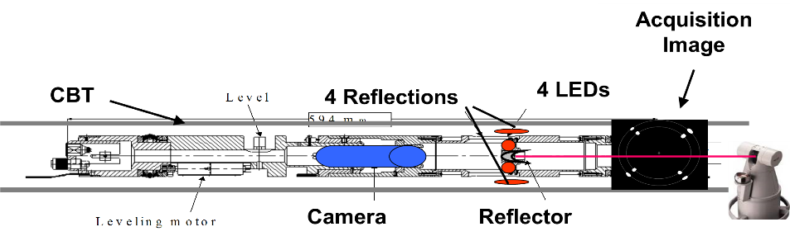
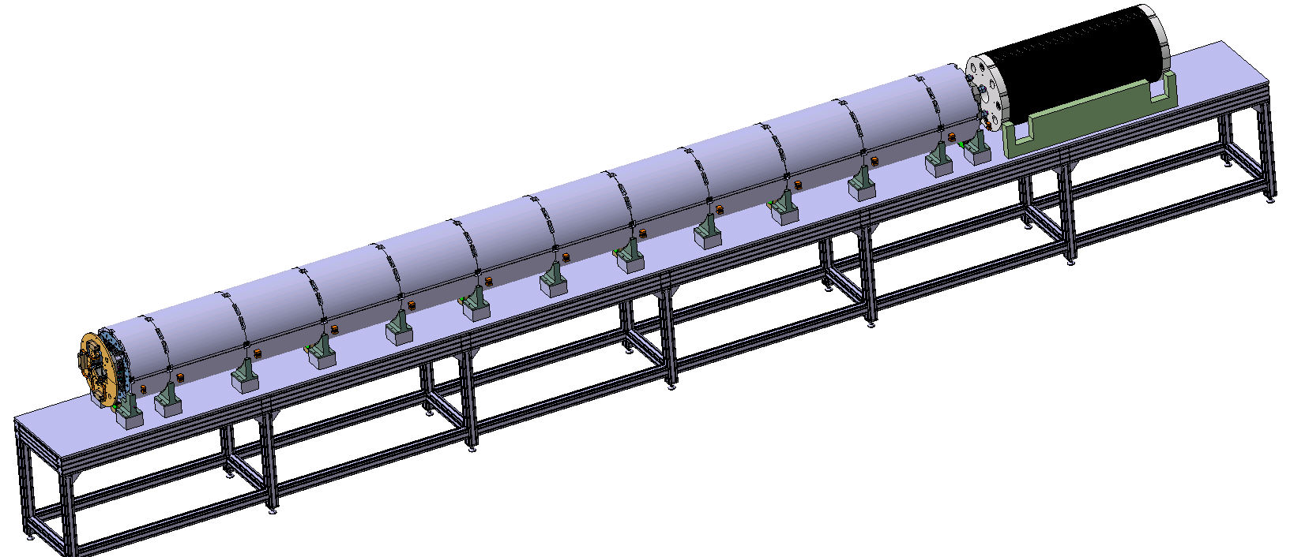
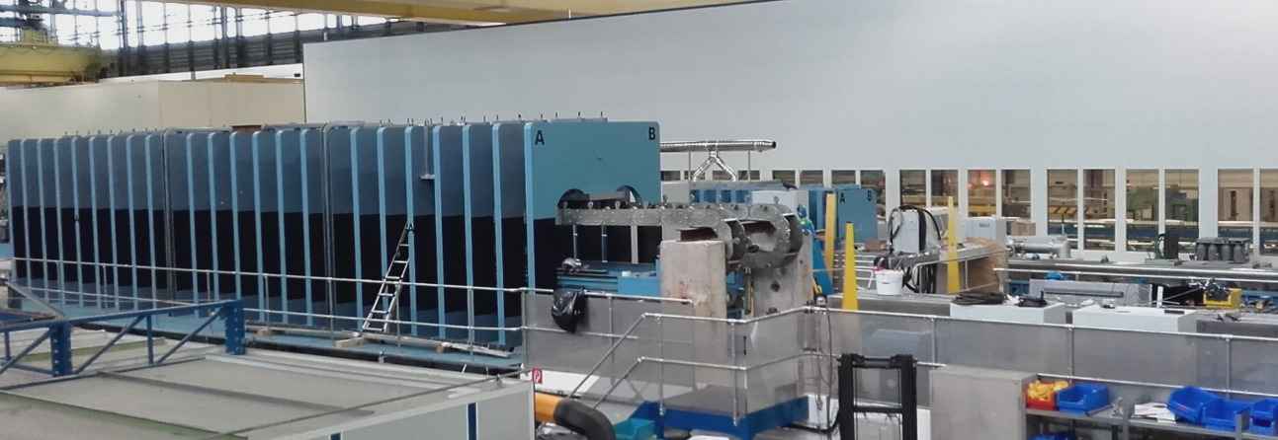
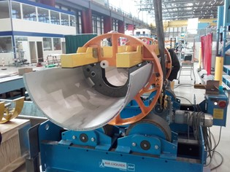
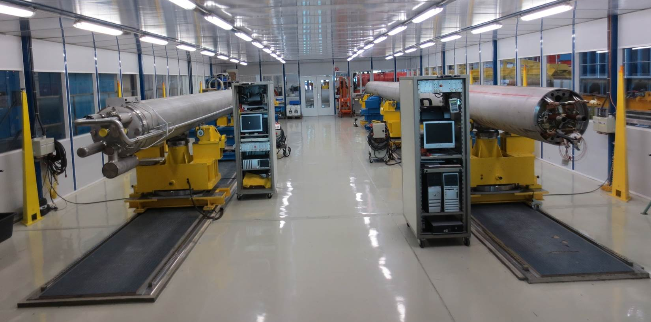
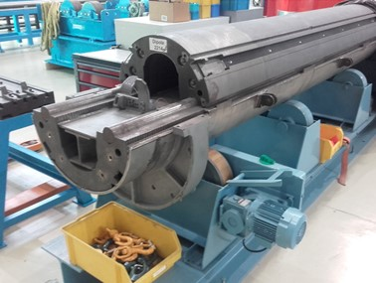
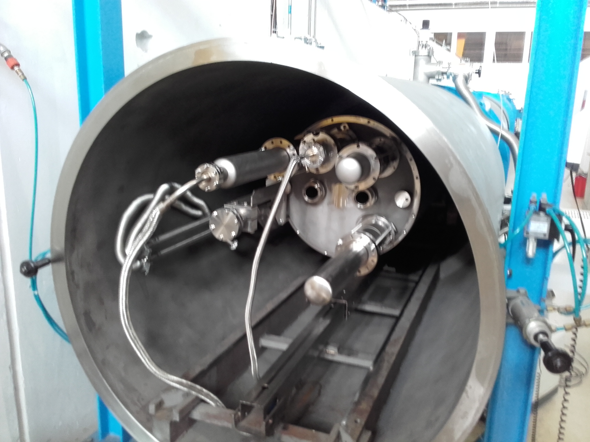
Assembly Tooling
MQXFB/MCBXFB alignment bench | In line with the quadrupole coil pack insertion bench
Lifting beam | To be designed for the magnet To be adapted for the cold masses
Shell rotation tool
Cold mass rotation bench
AC mole for magnetic measurements | Adapted from existing system : Magnetic axis scan, so pitch and yaw angles available for alignment if needed. No big current needed (AC power, from few mA to 1A, 25 Hz). Magnetic angle measurement for any type of magnet.
Welding bench | Existing welding press presently divided into sectors and adapted for Ø630mm shells
Finishing bench | Existing finishing room with 2 benches with new AT-402 (or AT-930) laser tracker and Spatial Analyser software
Pressure/leak test tank | To be adapted for Ø630mm shells

Slide 19
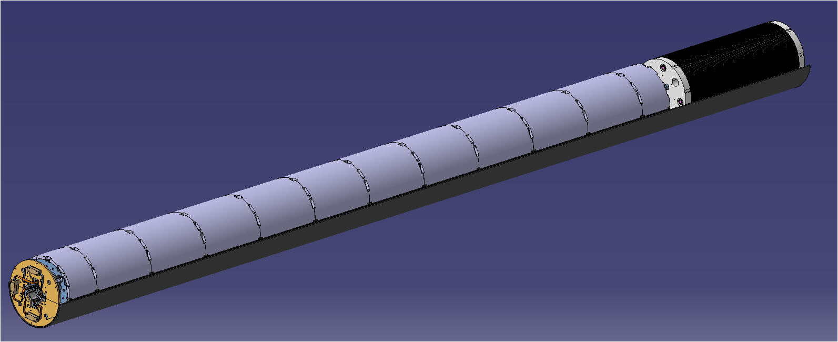
Magnetic Alignment Specifications
ZMCBXFB
±2mrad
ZMQXFB
 | MQXFB | MCBXFB
Δxmaxi (mm) | ±0.5mm | ±0.5mm
Δzmaxi (mm) | ±0.5mm | ±0.5mm
αmaxi (mrad) | ±2mrad | ±2rad
 | MQXFB MCBXFB
ΔX (mm) | Ref | ±1mm
ΔZ (mm) | Ref | ±1mm
Roll φ (mrad) | Ref | ±1mrad
Pitch θ (mrad) | -Ref | ±4mrad
Yaw ψ (mrad) | -Ref | ±1mrad
YMCBXFB
ZMQXFBi
YMQXFB
XMCBXFB
XMQXFBi
1 mm
XMQXFB
ZMQXFB
1 mm
XMQXFB
ZMQXFB
ZMCBXFB
Roll φ
Pitch θ
Yaw ψ
2 mm
±4mrad
XMQXFB
±1mm
XMCBXFB
2 mm

Slide 20
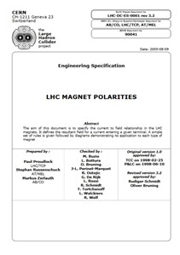
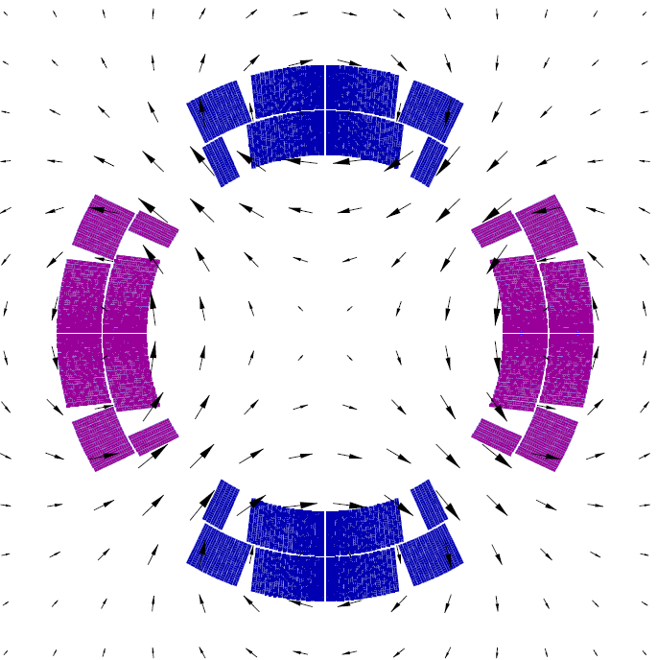
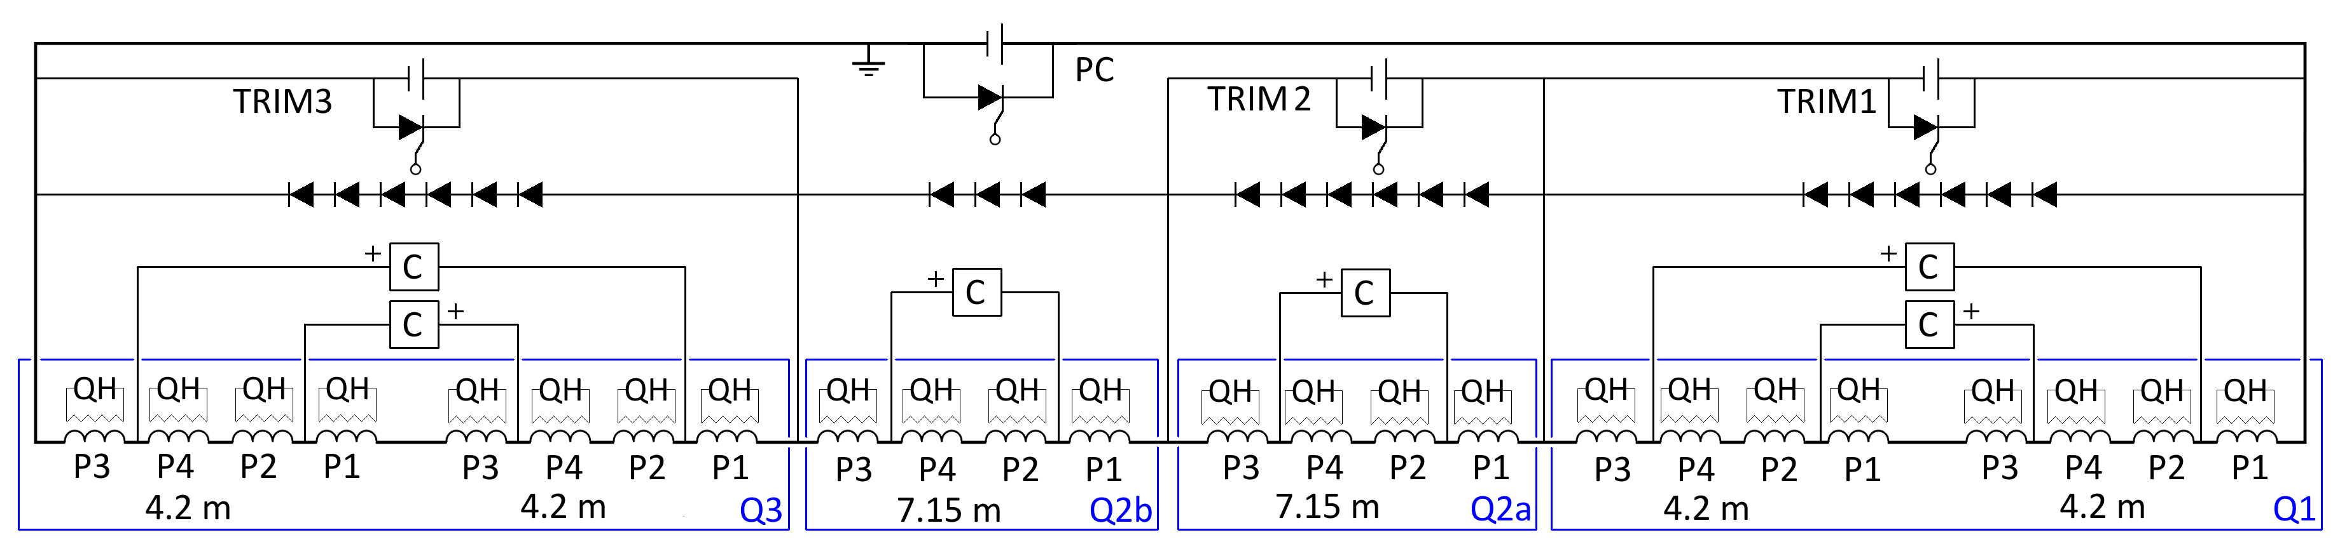
Quadrupoles Polarity and Internal Connection Scheme
View from F
I
-
P1
P2
P1
F
P2
+
P4
P3
Courtesy of Susana
P3
P4
View from G
-
P3
F
P2
P1
G
+
P4
LHC-DC-ES-0001
P2
P3
Courtesy of Susana
P1
I
P4
P1 P2 P4 P3
P1 P2 P4 P3
P1 P2 P4 P3
P1
P3
P3
P1
Q1
Q3
P2
P4
Q2A
Q2B
P4
P2
P4
P2
P2
P4
P3
P1
P1
P3

Slide 21
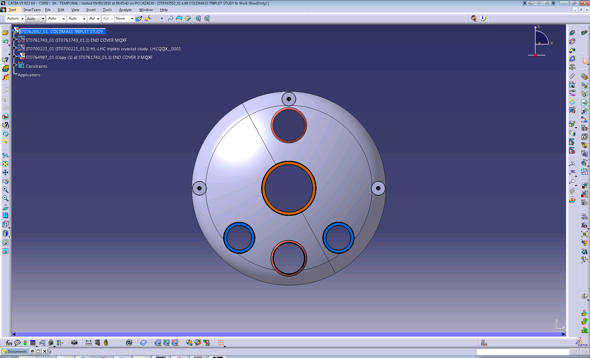
Internal Connection Scheme and Integration
Option 1
Q1
Q2A
Q2B
Q3
P1
P3
P3
P1
P1
P3
✓
✗
P2
P4
P4
P2
P2
P4
P4
P2
P2
P4
P4
P2
P3
P1
P1
P3
P3
P1
⇨ EDMS 1682592: New working baseline after Conceptual Design Review of the HL-LHC Magnet Circuits
Not yet approved
Option 2
Q1
Q2A
Q2B
Q3
P1
P3
P3
P1
P1
P3
A
P2
P4
P4
P2
P2
P4
B
P4
P2
P2
P4
P4
P2
P3
P1
P1
P3
P3
P1

Slide 22
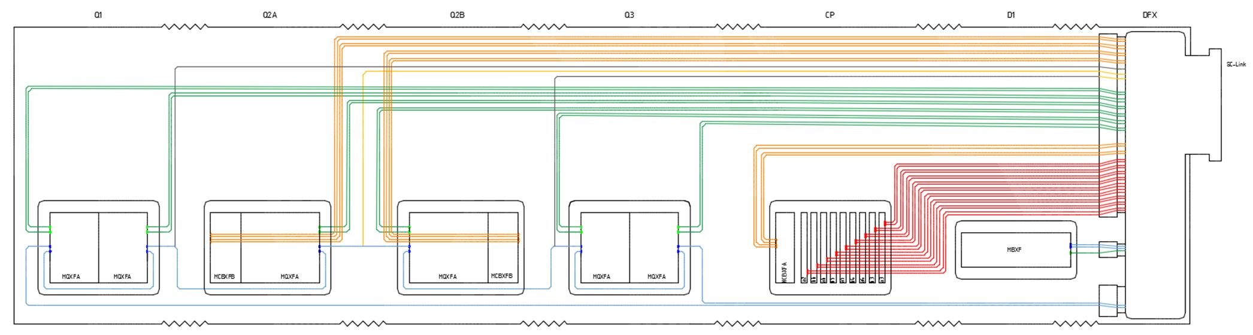



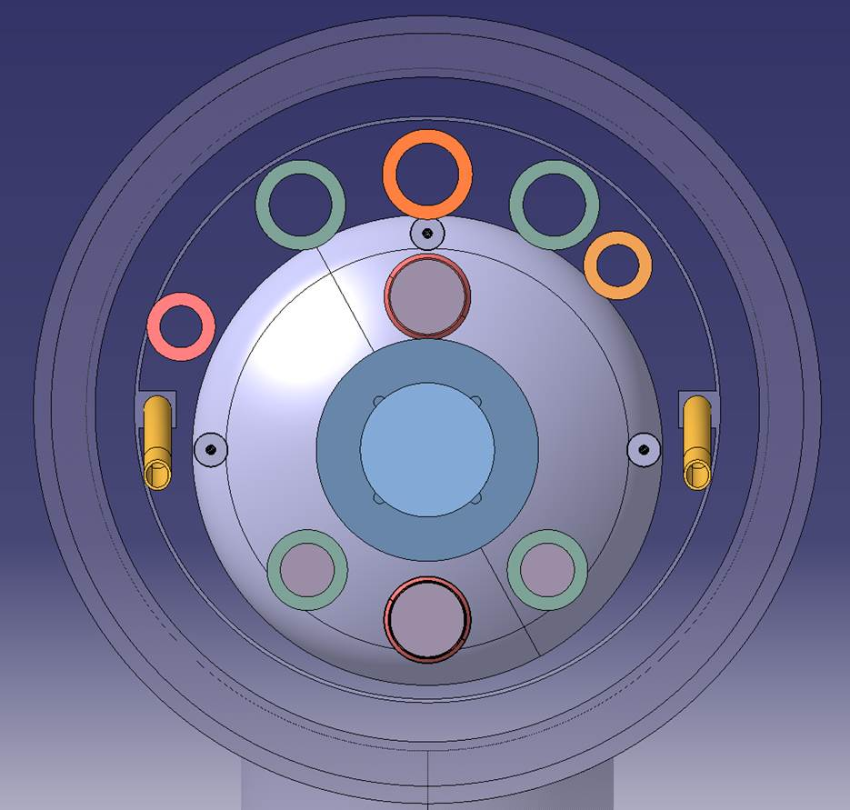


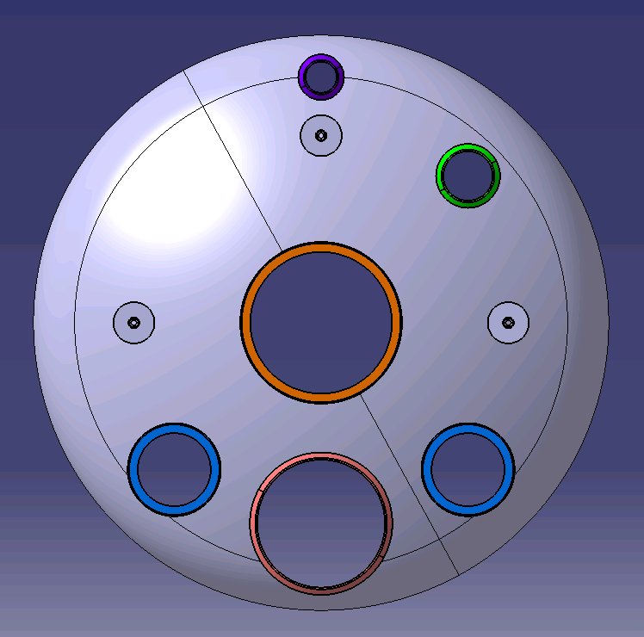
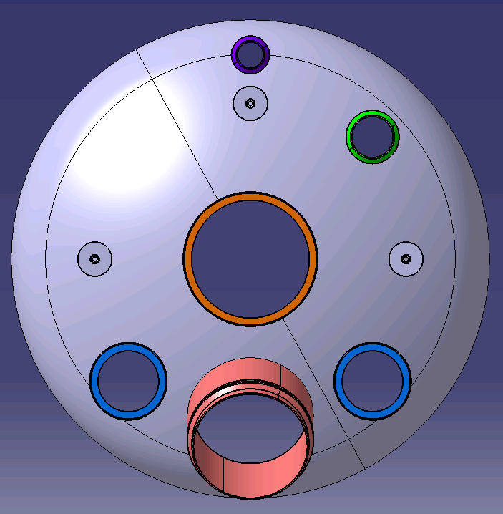
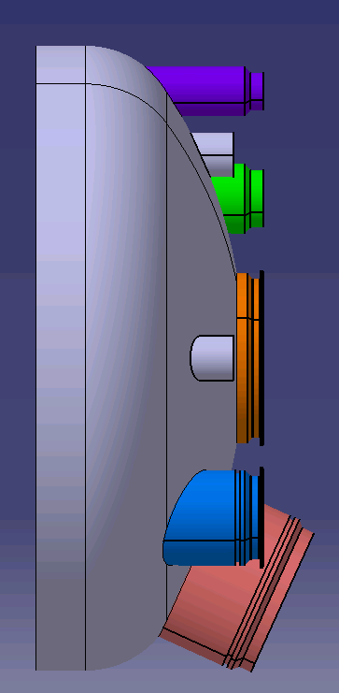

Inner Triplet Busbars Integration
(Proposal presented during the Conceptual Design Review of the HL-LHC Magnet Circuits)
External busbars
(round cable type)
2kA
17kA | 13
12kA | 2
2kA | 4
2kA | 24
200A | 2
200A | 36
CLIQ | 27
200A
2kA
200A
2.8kA,
12Hz fast decay
In Q2 cold masses
106 splices
For cold mass design, production, installation work and spare policy, ideally the end covers are:
using the vertical plane of symmetry as far as possible,
identical on both sides of the cold masses,
routing busbars through aperture(s) in the vertical plane.
Internal busbars
(stabilized Rutherford cable)
18kA
Courtesy of Cedric Eymin

Slide 23
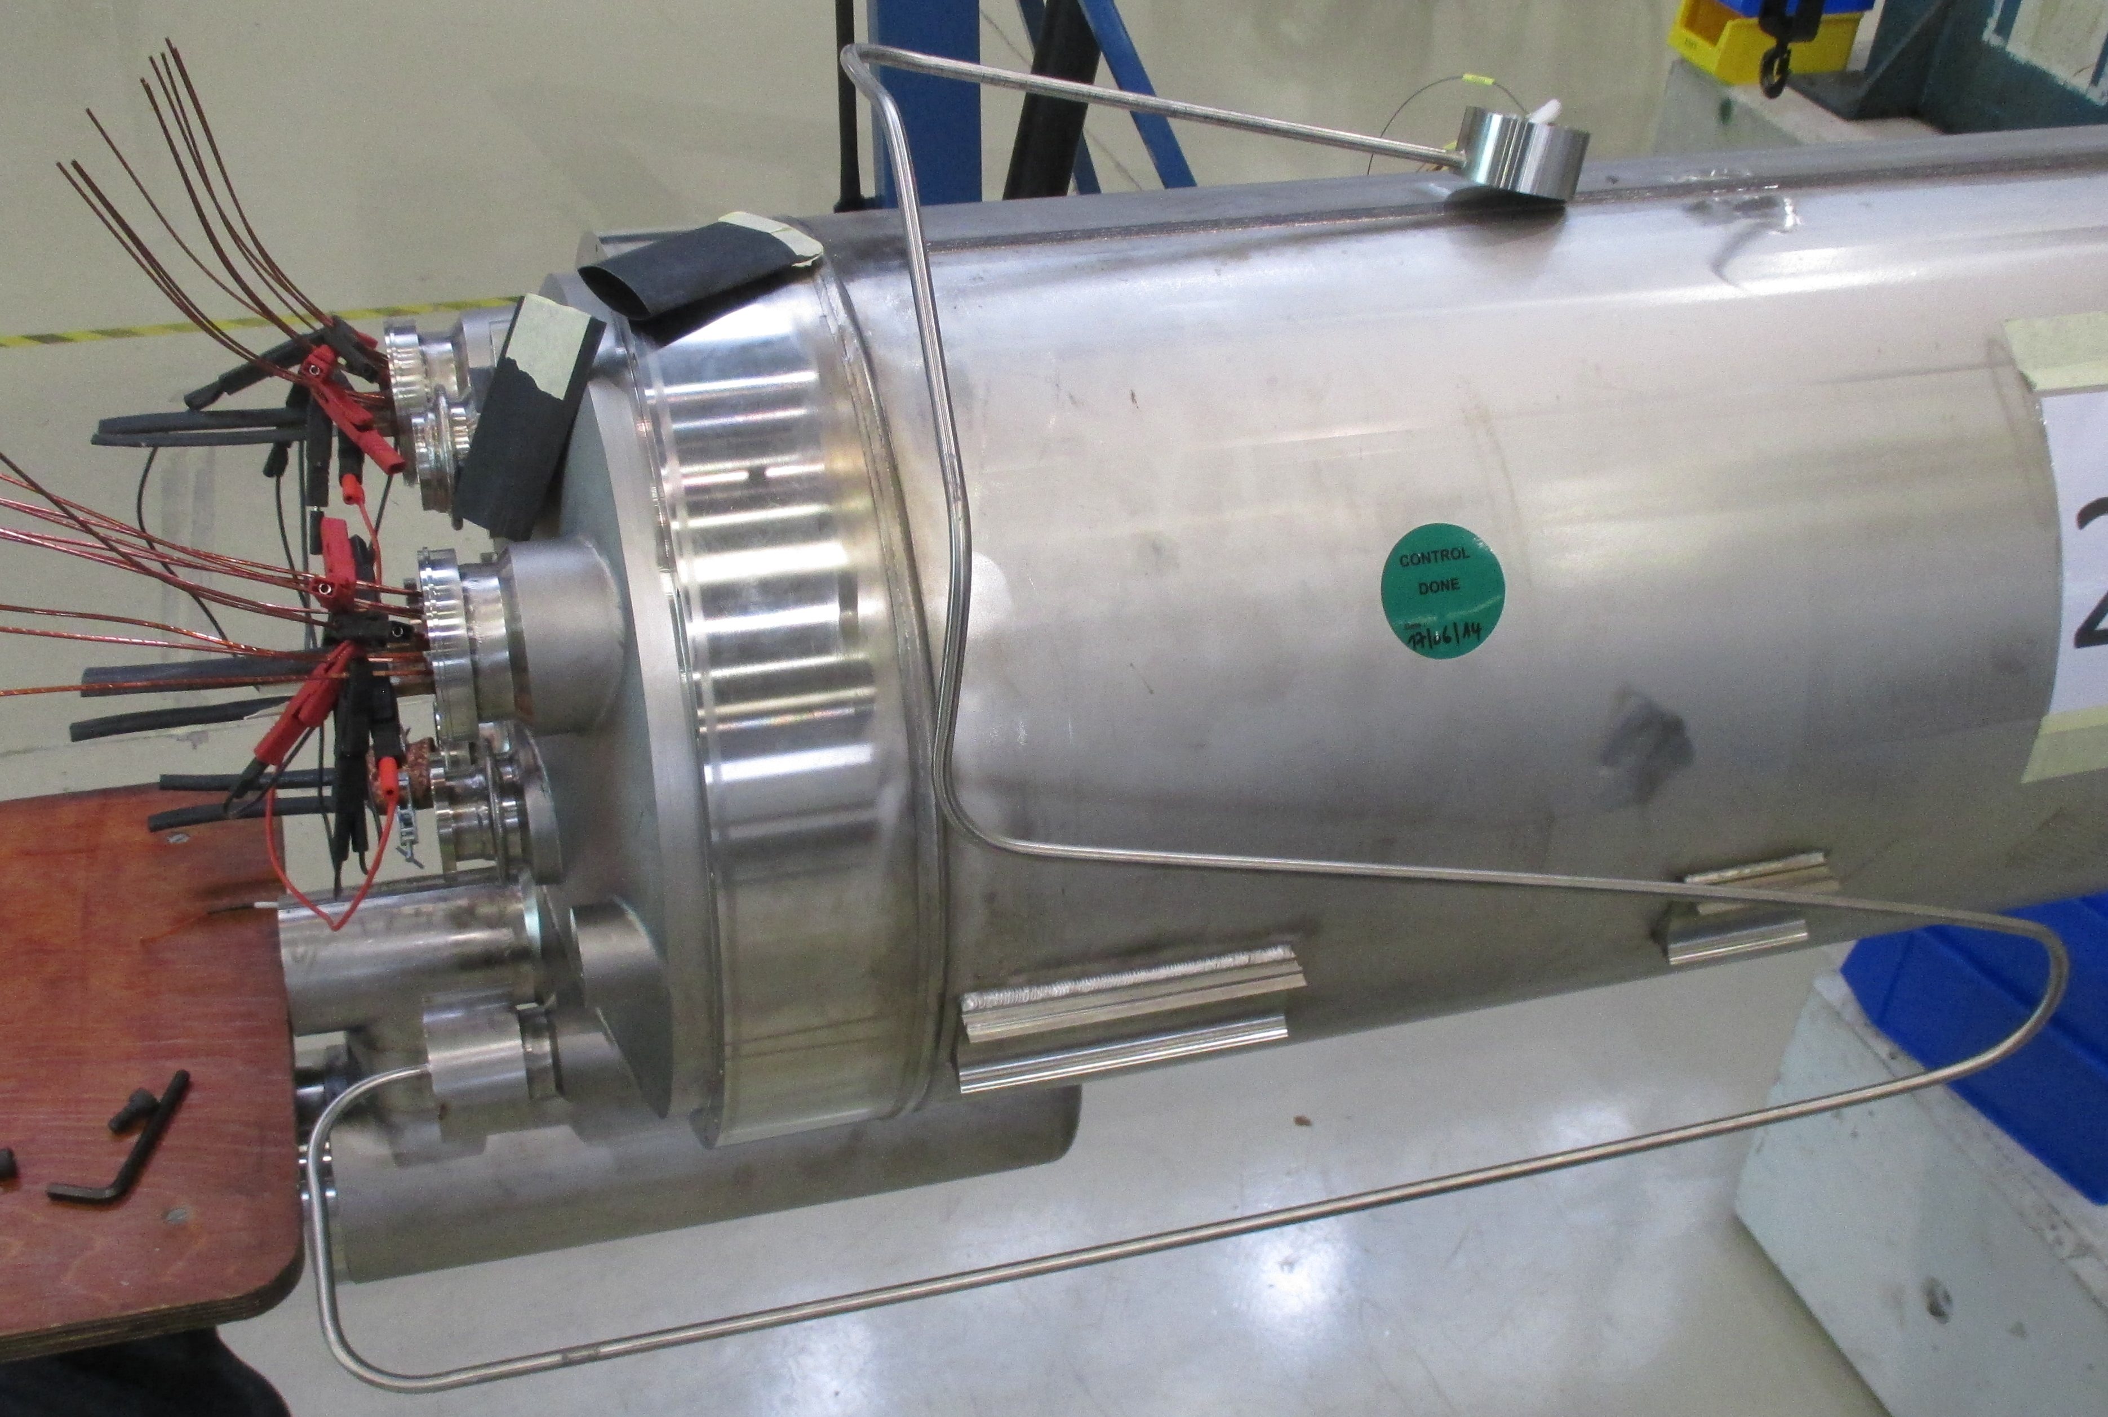
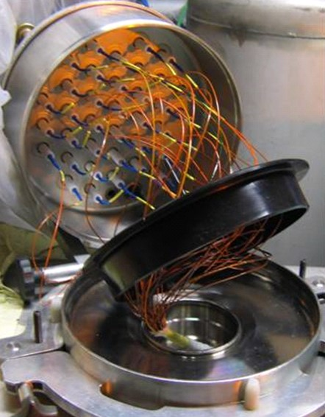
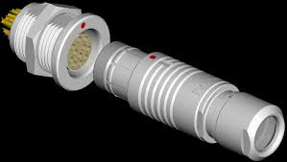
Instrumentation Integration
Option 1
MB IFS Capillary
Standard LHC Cover Flange
Option 2

Slide 24
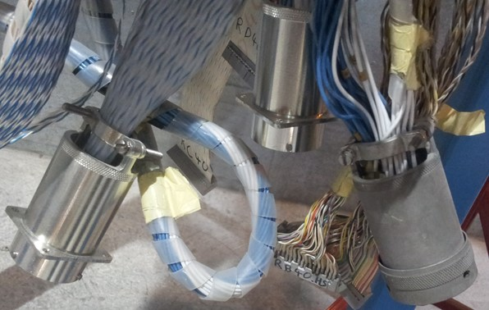
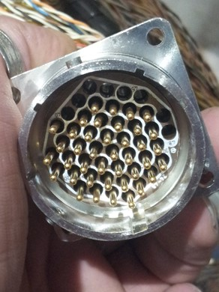
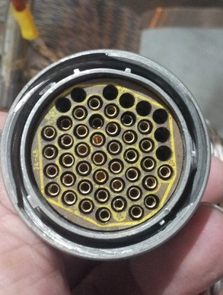
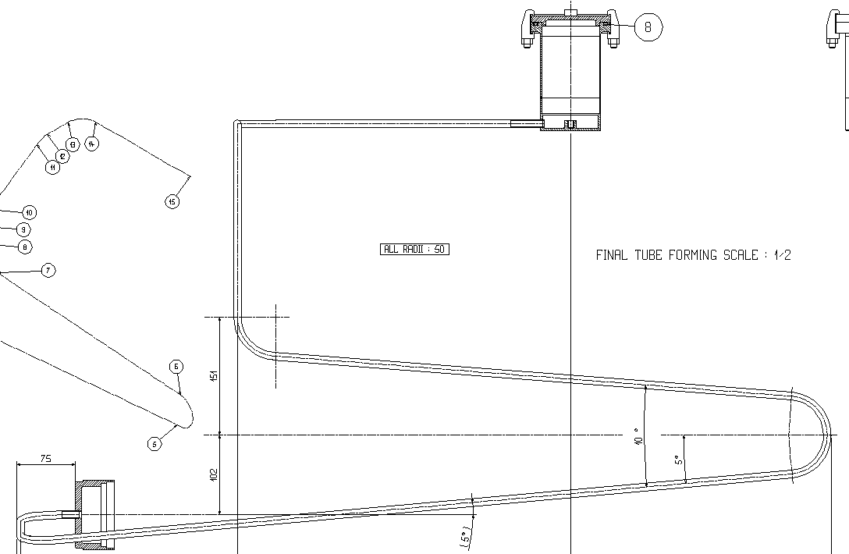
Instrumentation Options Pro and Cons
Instrumentation connectors presently used in the vertical test station in SM18
 | IFS | Connectors
ELQA Accessibility (and ALARA principle) | Q1 IFS box close to the experimental shielding | Centralised location in the end of the triplet Additional line to open in case of magnet exchange
Integration | Obstacle to slide the W bellow | Additional housing line or through the cold masses Connectors in each interconnection or only the extremities
Heat Loads | Distributed along the triplet string | Centralised on the DFX
 | Well known configuration | Easy and fast plug-in connectors Off the shelves standard components
Cold test station | Final configuration present during cold test | CFB to be adapted Repeatable configuration for all cold mass types
Reliability | - | To be demonstrated as radiation hard
New
Old
Courtesy of P. Viret
Input on relevant experience is welcome

Slide 25
General Remarks
Required inputs to go further ahead:
  Cryogenics parameters
  Electrical scheme to be approved (ECR⇨ECO) and internal connection scheme to be agreed
  Instrumentation inventory (on going) and routing scheme
  Different circuits tests and voltage levels
  CLIQ conductor cross section and possible routing through a dedicated line
No BLM foreseen in the cold masses (nor in the cryostat)
Assembly tolerances are fixed from the magnetic point of view, further analysis is needed to determine mechanical alignment tolerances.
Both Q1/3 and Q2 cold masses types would benefit from coordinated procurement procedures (at least raw material) in order generate companies interest, cost reduction, components reproducibility and compatibility, and maintenance (shells, end covers…) event at the expense of extra administrative workload. [Already foreseen for cold bore and heat exchanger tubes.]

Slide 26
Schedule

Slide 27
Summary
Cold masses design has started, stakeholders are well defined but many parameters still to be defined or confirmed. Interfaces are not fixed yet.
The design principle is to standardise one cold mass for Q2A or Q2B (Rotation).
Components design, assembly procedures and welding processes are based on existing experience and proven technologies used in the present LHC.
The Busbars routing and the cryogenics requirements are two major drivers for this study (cable housing and routing, polarity requirements, paths trough the end covers, interconnect, ergonomics for splicing, developments…). Definition needed by the end of Aug. 2016.
  Busbars routing was presented during the Conceptual Design Review of the HL-LHC Magnet Circuits in March and “appears to be on the right track” according to Appendix 3 of the report from the Review Panel. Considered as a strong input.
  Inputs and relevant experience on the cryogenics instrumentations routing are welcome.
Global integration in the interconnection is studied in close collaboration with the cryostat design team (D. Duarte Ramos, C. Eymin) who assesses the soundness and efficiency of cold masses standardisation proposals.

Slide 28
Spare Slides

Slide 29

Step2: Magnet straightening and measurement
Analysis after alignment over the global production:
Targeted values
ΔXmax= ±0.2 mm
ΔZmax = ±0.2 mm
αmax = ±2 mrad
IR magnets yoke alignment and measurement

Slide 30
Magnets positioning in the half shell statistics
Magnets yoke alignment over the cold mass length in the cold mass referential
 | mean | min | max | σ
Δxmaxi (mm) | 0.170 | 0.071 | 0.435 | 0.083
Δzmaxi (mm) | 0.153 | 0.049 | 0.690 | 0.086
αmaxi (mrad) | 0.539 | 0.164 | 1.407 | 0.261
 | Quads Mean σ |  | Correctors Mean σ
ΔX (mm) | 0.001 | 0.022 | 0.003 | 0.250
ΔZ (mm) | 0.002 | 0.027 | 0.303 | 0.231
Roll φ (mrad) | -0.009 | 0.078 | -0.143 | 0.182
Pitch θ (mrad) | -0.006 | 0.193 | -0.059 | 0.389
Yaw ψ (mrad) | -0.012 | 0.061 | -0.036 | 0.209
Targeted values
Δxmax= ±0.1 mm
Δzmax = ±0.1 mm
αmax = ±1 mrad
Magnets alignment over the cold mass length in the cold mass referential
IR magnet alignment in the cold masses
Targeted values
ΔXmax= ±0.1 mm
ΔZmax = ±0.1 mm
Roll Φ = ±0.1 mrad
Pitch θ = ±1 mrad
Yaw ψ = ±0.1 mrad
roll φ and pitch θ angles are determined by the alignment cradles
yaw ψ angle is minimized by the control of the shell straightness

Slide 31
Analysis over the production
Spread of the beam tube measurements per fabrication decade
Series Number | 1-10 | 11-20 | 21-30 | 31-40 | 41-50 | 51-60 | 61-70 | 71-80
σx | 0.202 | 0.241 | 0.209 | 0.226 | 0.181 | 0.215 | 0.167 | 0.193
σz | 0.416 | 0.333 | 0.332 | 0.247 | 0.296 | 0.232 | 0.283 | 0.247
Targeted values
ΔXmax= ±0.6 mm
ΔZmax = ±0.6mm
IR quad cold masses alignment and measurements
The difference between H and V planes comes mostly from the general tendency of the beam tube to sag inside the correctors: the cold mass was originally designed to minimise the sag along the quadrupole and the radial clearance between the beam tubes and magnet coils is larger in the correctors than in the quadrupoles
Cold bore tubes inspection introduced during the production to eliminate local deformation
The spread in the vertical plane has steadily reduced to 0.25 mm, and is fully compatible in the latest production to that in the horizontal plane.
⇨The alignment is stable and well within the tolerance
Improvements for LMQXF cold masses
⇨ Integrate the corrector magnet in the deflection optimisation
Design symmetrical cold masses with 3 supports
Develop a centring system for the cold bore tube
Machined cold bore with higher inertia (see C. Garion talk)
Try to standardize Q1 and Q3 cold bore thickness (spare policy)
Stiffness of the aluminium cylinder sections pro or con ?
[Extracted and adapted from Production of the Superconducting Matching Quadrupoles for the LHC Insertions, MT19 ]

Slide 32
AC mole example and principles
Courtesy of J. Garcia Perez
Born in 2000. Old system with most of its components (hardware & software) obsolete but still working well with the old infrastructure-equipment.
Characteristics: 100 mm length coil. Centred reflector.
Optical system (with CCD camera embarked) for cold bore geometry measurements and inspection.
Magnetic axis scan, so pitch and yaw angles available for alignment if needed. No big current needed (AC power, from few mA to 1A, 25 Hz). Magnetic angle measurement for any type of magnet.
It was able to measure the axis of LHC dipoles at cold in SM18. It measured all Short Straight Section LHC magnet assemblies automatically.
Difficult to adapt to different bore diameters. Not optimised for field quality.

