Slide 1
WP3 Quality Assurance
Rosario Principe
Richard Berthet, Olivier Housiaux, Sabine Menu, Paula Alvarez Lopez
International Review of the Inner Triplet Quadrupoles (MQXF) for HL-LHC
June 2016

Slide 2
Outline
  QA for MQXF
  Documentation management and EDMS
  Procedures
  Drawings
  Quality Control and traceability and MTF
  Non conformities management
  Procurement
  Conclusions

Slide 3
Mandate
In collaboration with the MQXF Technical Responsibles, draft and edit the procedures
Collect, classify and distribute for info/approval the technical documentation provided by the WP3 stakeholders
Write the related follow-up files needed to monitor the WP3 activities
In field quality control and audit the operation compliance (MIP)
Process, analyse and archive data collected during operations
Traceability of operations (MTF)
Manage the non-conformity reports
Monitor and archive the WP3 documentation

Slide 4
Experience and Sensitive Points
Experience
  WP11 quality management
  LS1 project, MSC-LMF magnet repair
  Literature
  Hilumi Quality Assurance Plan
  LHC Quality Assurance Plan
  Quality Management for the Accelerators & Technology Sector (Hardware baseline)
Sensitive Points
  Documentation Management
  Interface management
  Manufacturing and Inspection Plan (MIP)
  Design and drawings
  Procurement
  Communication (project complexity, collaborations)

Slide 5
Documentation Management
One way to Quality within WP3
Documentation managed and named after the procedure LHC-LBH-QA-0005
    LHC Quality Assurance Plan
    Hilumi Quality Assurance Plan
    International standards (ISO 9001)
    Regular meetings with QAC and Hilumi PLO representatives
Document redaction process:
  Redaction of the documents by the technical responsible in collaboration with the Quality service
  Document classified and circulated for approval by the Quality service

Slide 6
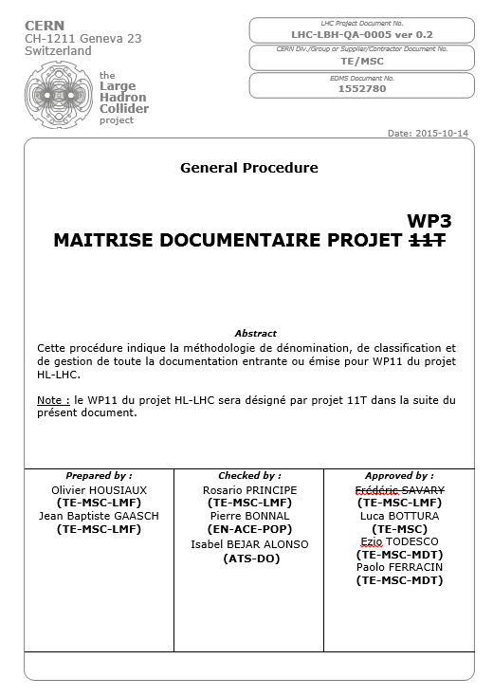
Maitrise Documentaire

Slide 7
Documentation Management
One way to Quality within WP3
Documentation managed and named after the procedure LHC-LBH-QA-0005
    LHC Quality Assurance Plan
    Hilumi Quality Assurance Plan
    International standards (ISO 9001)
    Regular meetings with QAC and Hilumi PLO representatives
Document redaction process:
  Redaction of the documents by the technical responsible in collaboration with the Quality service
  Document classified and circulated for approval by the Quality service

Slide 8



Documentation Management
  Document adressed via e-mail to QA.WP3@cern.ch
  Or call the Quality service at +41 75 411 0232 (16 0232)
  Other available numbers:
    Sabine Menu +41 75 411 3528 (163528)
    Richard Berthet +41 75 411 6884 (166884)
    Olivier Housiaux +41 75 411 5300 (165300)
  The Quality Team to ensure that :
    The document is named according the HL-LHC QAP and QAC
    Available within WP3 + HL-LHC + Hardware Baseline
    Validation process respected
  To the Quality Service to launch the approval process in accordance with the document type and/or the equipment code based on the LHC procedure «Equipment Naming Conventions» and naming portal CERN.

Slide 9
Documentation Management
WP3 documents available in EDMS (Engineering & Equipment Data Management Service)
  HiLumi: CERN-0000096384
  HL-LHC Item catalogue: HCLQXFC001
  Once validated, documentation also available in:
  LHC Hardware baseline
  Validation circuit (as discussed with Hilumi PLO):
  Engineering Check: technical responsibles + other stakeholders if needed
  Approval :
      Impact on WP3 uniquely → WP3
      Impact outside WP3 → HL-LHC PLO

Slide 10
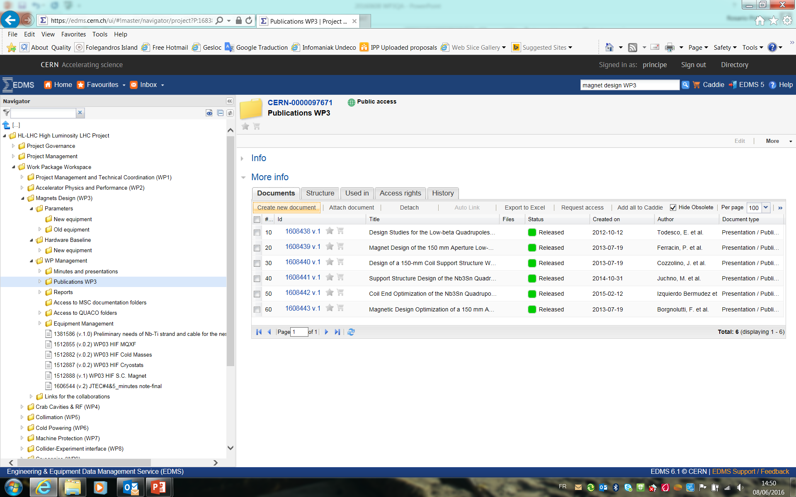
HiLumi: CERN-0000096384

Slide 11
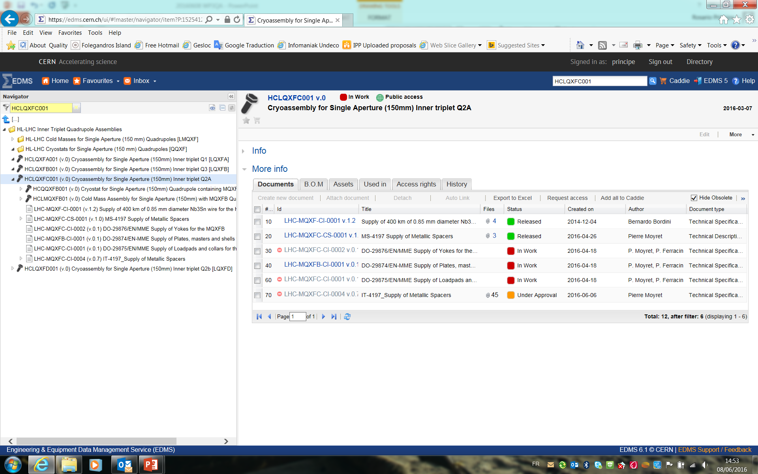
Item catalogue: HCLQXFC001

Slide 12
Procedures
Write and edit the QAP/QAM and all procedures for WP3 in collaboration with the technical responsibles
Collect and archive and distribute all procedures edited in collaboration with:
  CEA
  INFN
  KEK
  LARP
  CIEMAT

Slide 13
Collaborations
HL-LHC quality requirements: first info to collaborations
First training for the use of common tools and explore other used systems
→ Have a Quality System accessible and/or compatible with the project and CERN standards
→ Example from LARP experience

Slide 14
LBNL and Fermilab
Objectives:
  To provide an overview of the HL-LHC Quality Management System and Documentation Management Policy
  To present and train the collaborations in the use of CERN documentation tools, especially EDMS and MTF
Two 1.5 day long sessions held at Berkeley (May 23rd-24th) and Fermilab (May 25th-26th), with video attendance from BNL
Sessions attended by ~25 people (project engineers, technicians, and QA teams)
Indico events 535419, 531261

Slide 15
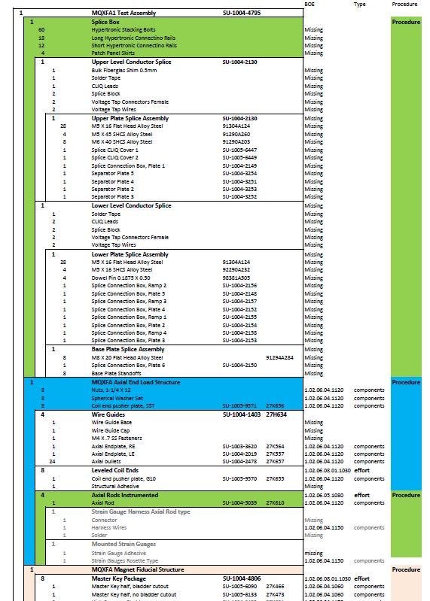
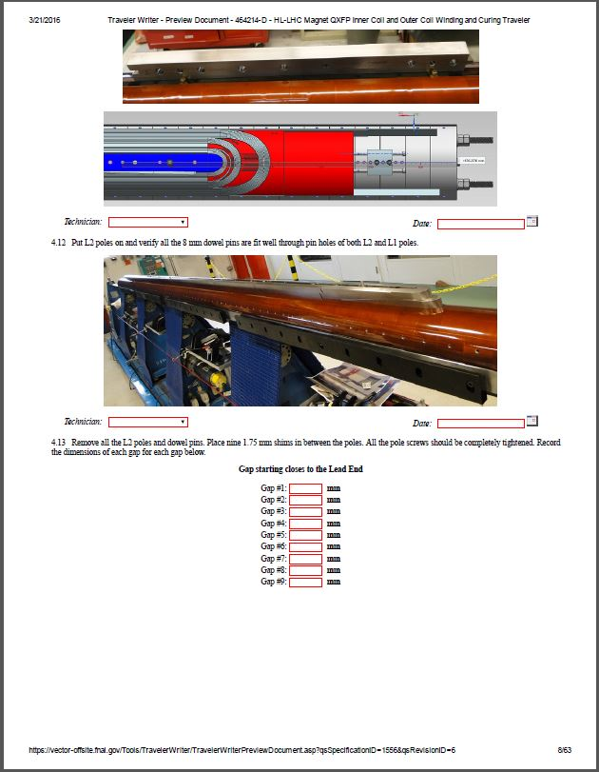
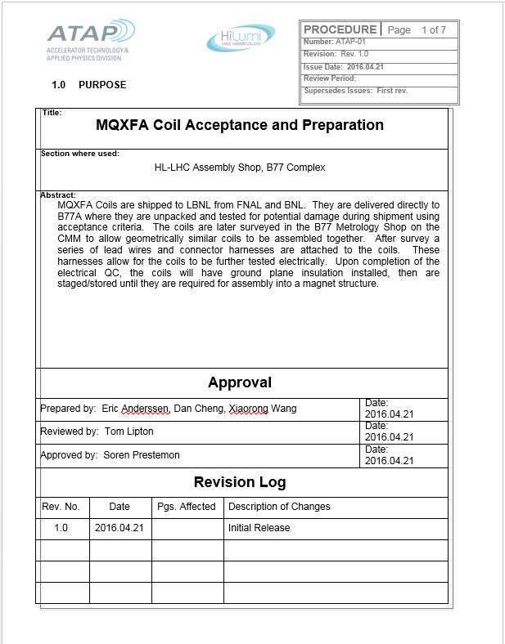
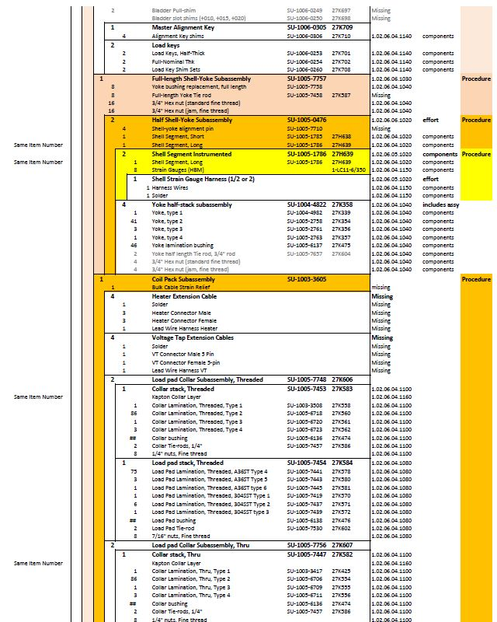
From ABS, Vector Traveler, Manufacturing Procedures…

Slide 16
Drawings
Drawings provided at CERN by Project Engineer + Design Office
Today the drawings always double-controlled :
  Control 1 by the Design Office
  Control 2 by the Project Engineer
In some cases a larger approval circuit is required:
  To be sure dwgs interface correctly with:
    Other equipment families within WP3
    Other work packages within Hilumi project
    Other LHC stakeholders (transport, vacuum, et…)

Slide 17
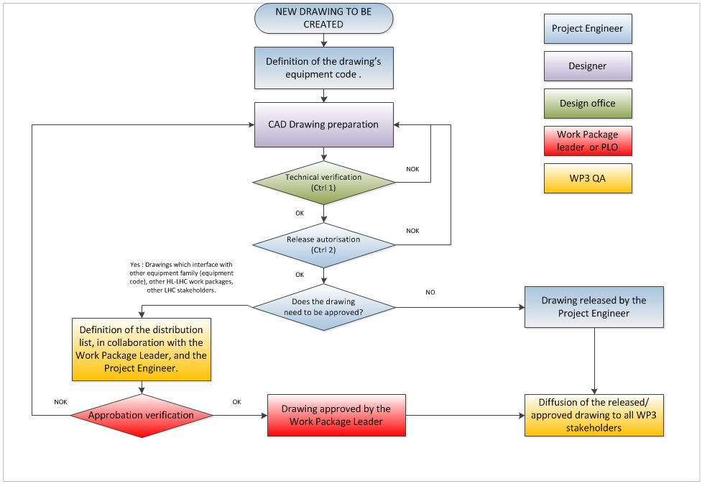
Drawings validation circuit
(Drawing and 3D Model Management and Control, LHC-PM-QA-305)

Slide 18
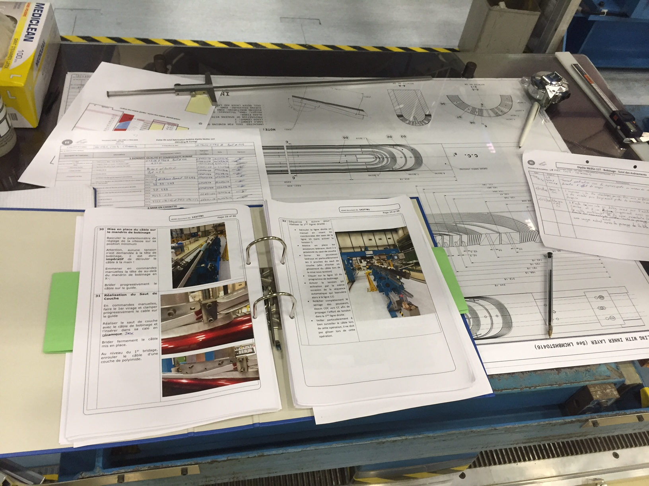
Quality control
In field quality control of any single production step
Manufacturing flowcharts
Manufacturing and inspection Plans
Fabrication Procedures
Follow-up files
Control Procedures

Slide 19
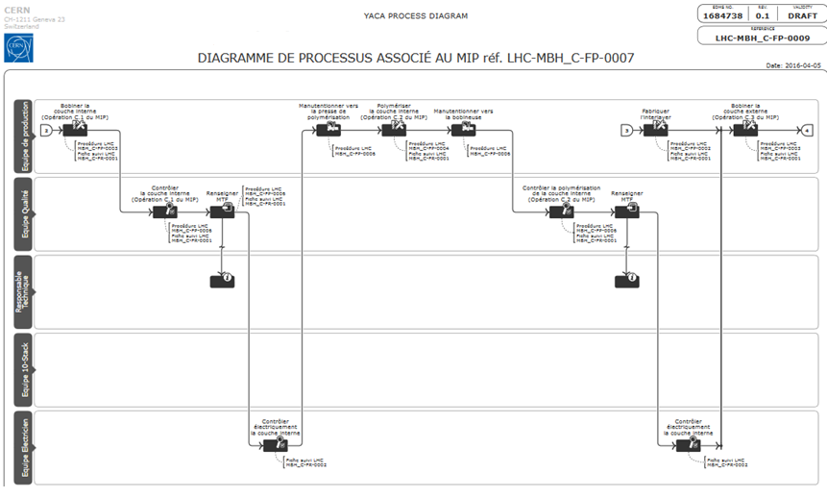
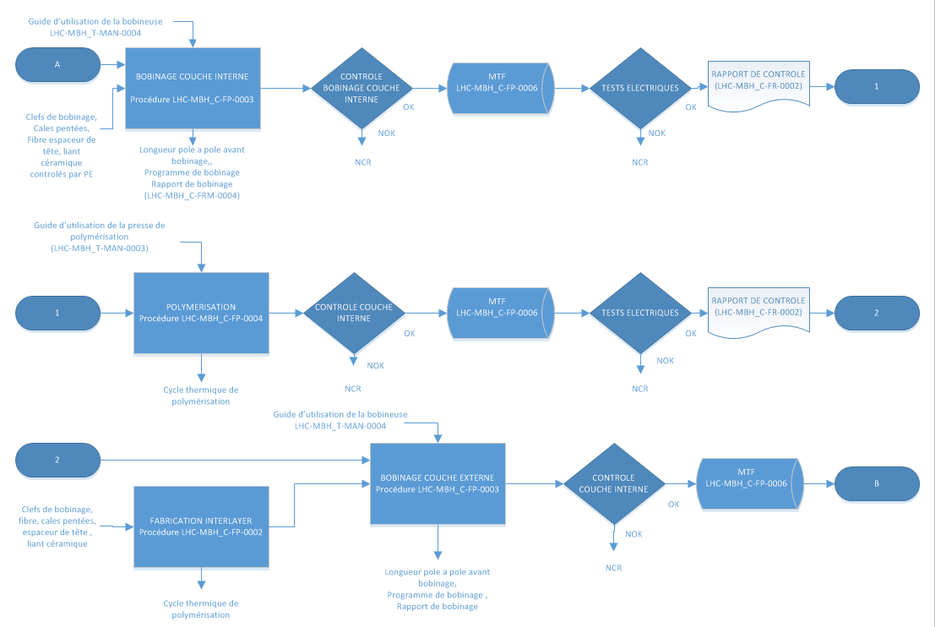
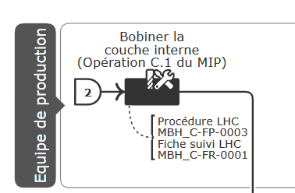
Manufacturing Flowchart
Example: Coil Manufacturing Flowchart

Slide 20
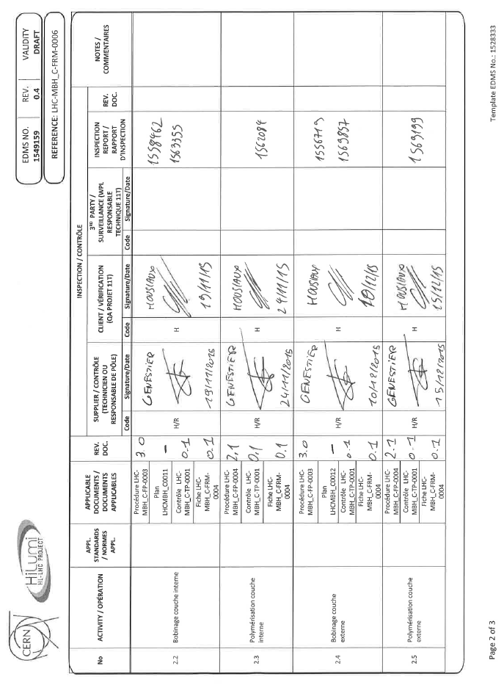
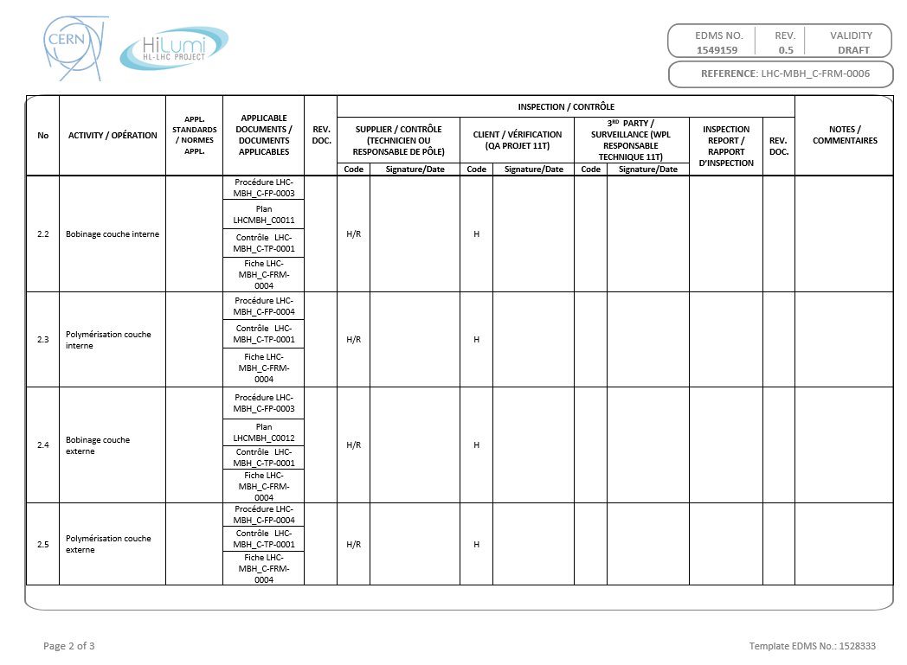
Manufacturing and Inspection Plan (MIP)

Slide 21
Manufacturing and Inspection Plan
Documentation traceability
Operation : Internal layer winding
Follow-up file
Validation
Control
Reports

Slide 22
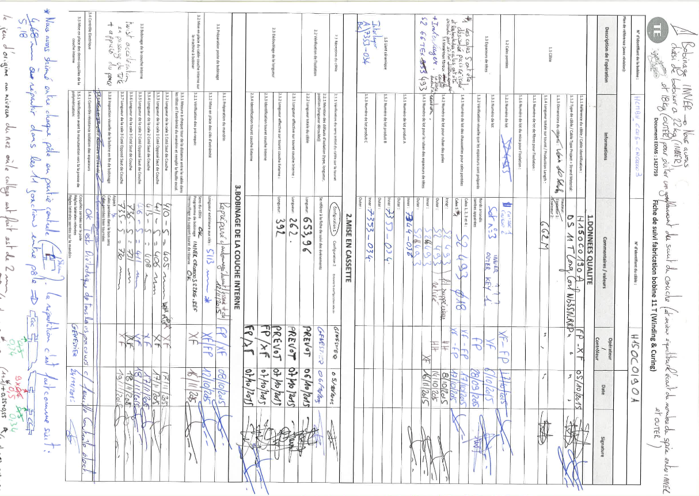
Follow-up files

Slide 23
Follow-up files

Slide 24
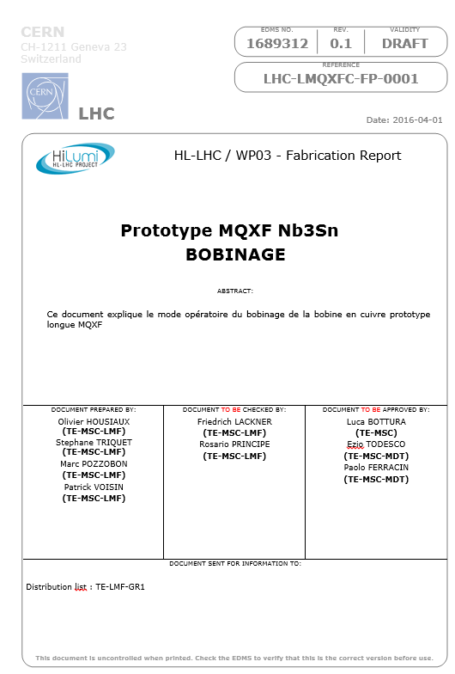
Fabrication Procedures
Naming and traceability
Validation Process

Slide 25
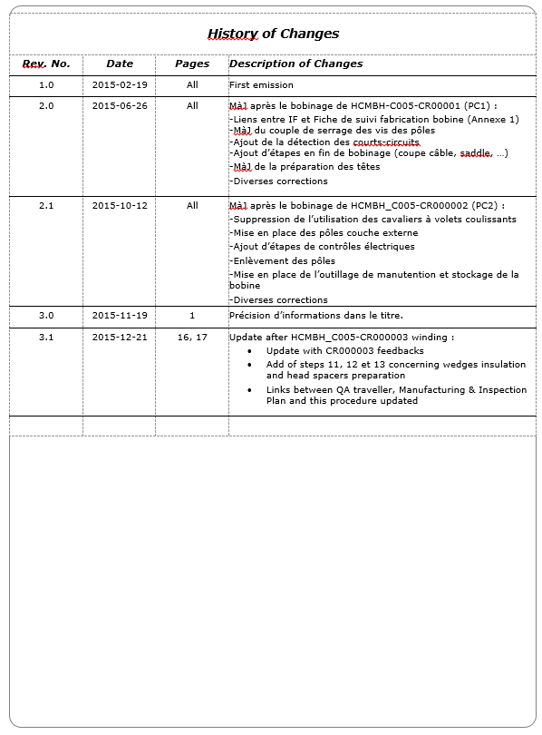
Fabrication Procedures
Traceability of modifications

Slide 26
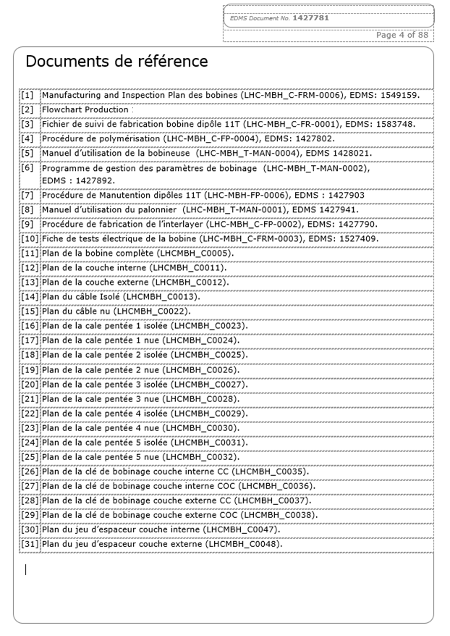

Fabrication Procedures
References (Follow up files, MIP, Flowchart…)
Drawings

Slide 27
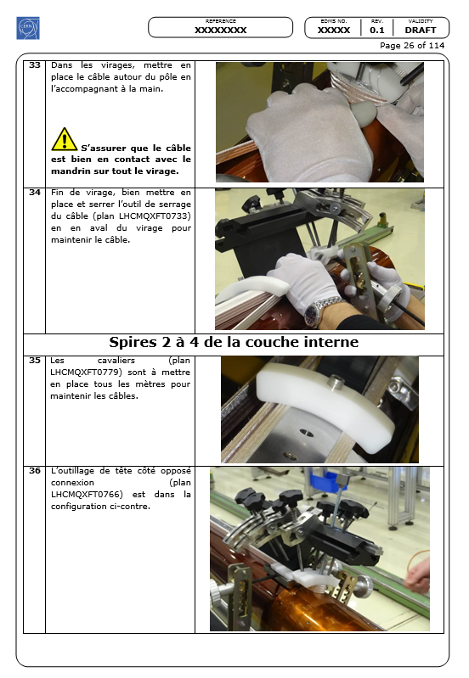
Fabrication Procedures
Quality instructions.
Manufacturing instructions

Slide 28
Control procedures
Each control step can be found in the related Control Procedure
  Inspection in field
  Documentation
  Traceability
Control procedure
Control

Slide 29
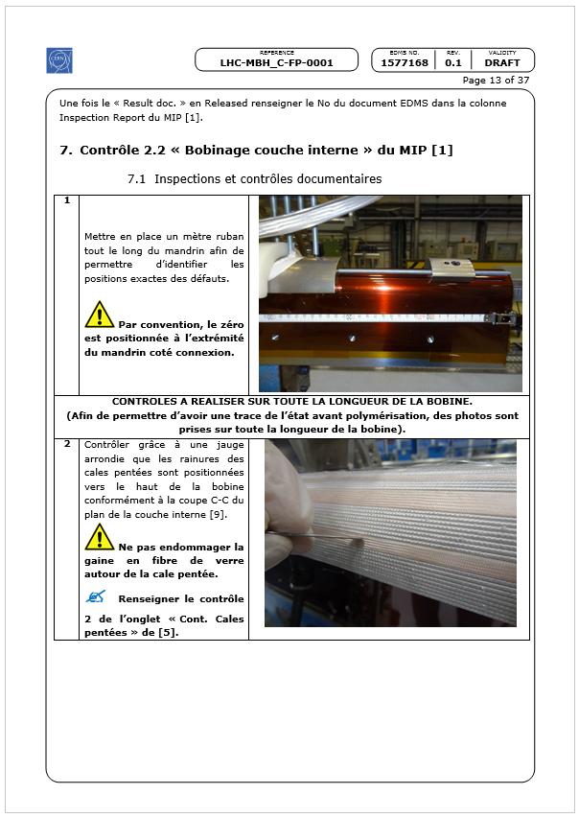
Control procedures
Quality control

Slide 30
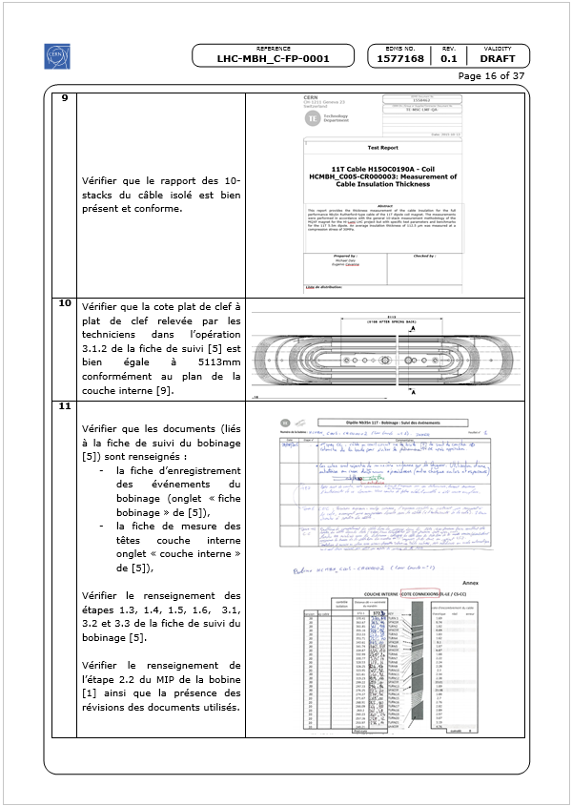
Control procedures
Documentation check

Slide 31
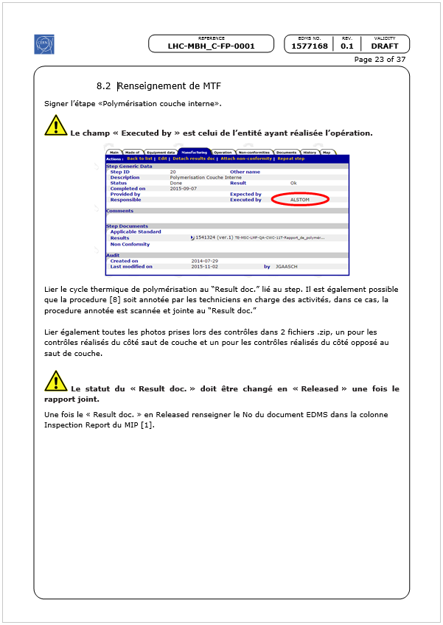
Control procedures
Traceability in MTF

Slide 32
Follow-up of the WP3 Activities
Follow-up in the Manufacturing and Test Folder (MTF)
CERN developped an interface which provides
    Traceability of the sub-equipments installed in the magnets,
    Traceability of the operations,
    Retrieval of all documentation, reports, test results…
    Easy access to critical data (possibilities of reporting),
    Non conformity report management.

Slide 33
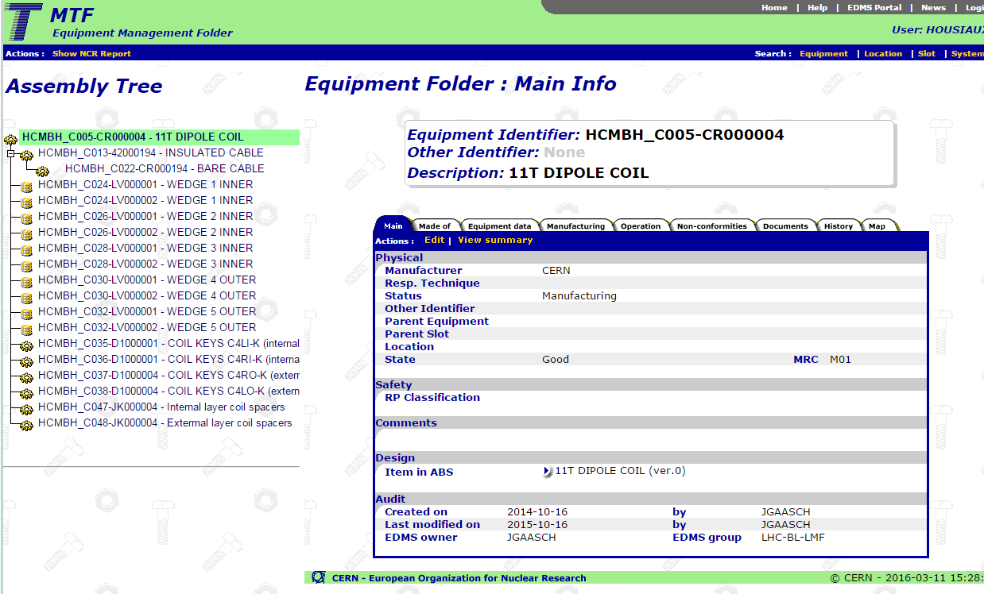
Follow-up in MTF

Slide 34
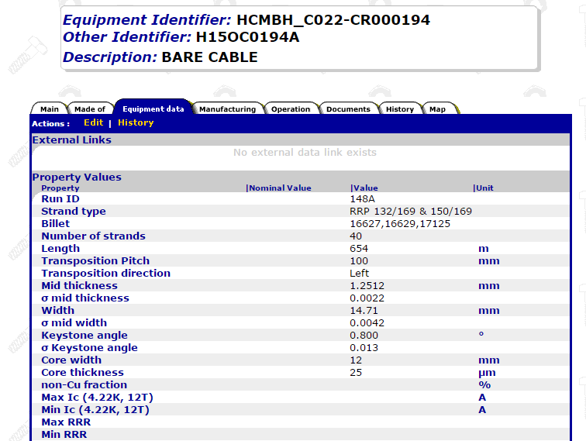
Ease the access to critical data

Slide 35
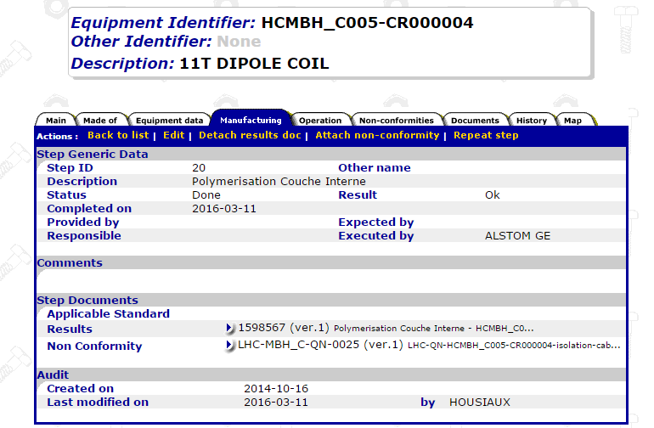
Operation traceability
Operation traceability
Reporting
Non conformity

Slide 36
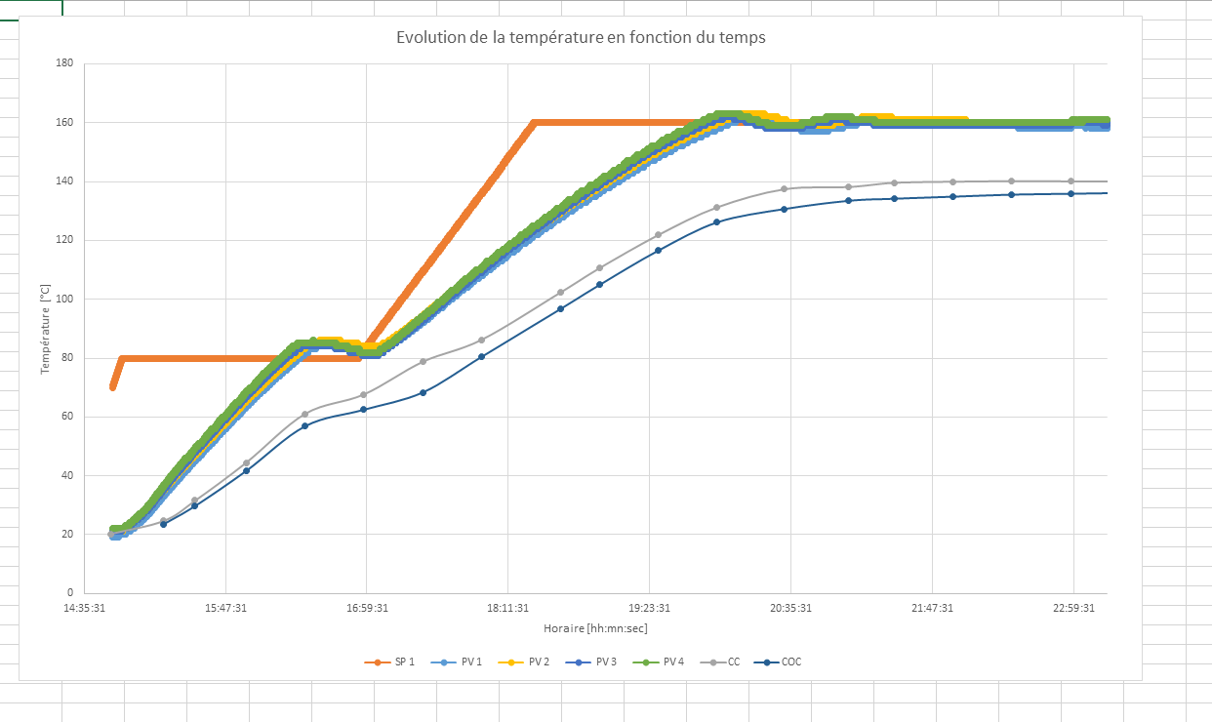
Info in MTF (polymerization cycle)

Slide 37
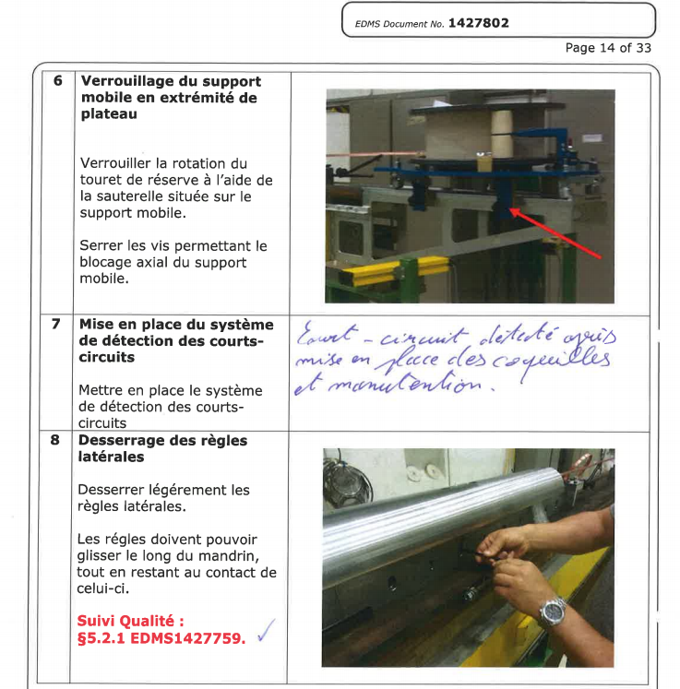
Annotated procedures

Slide 38
Non conformity management
As soon as a Non-Conformity (NC) is detected:
  By technicians during manufacturing
  During Quality Control
A NC Report is opened by
  the QA responsible and the Technical Responsible
The Technical Responsible and the QA resp. define
  The proposed action to be taken in order to fix the non conformity,
  The proposed corrective action to be implemented in order to eliminate the causes of the Non Conformity,
  The criticity of the non conformity (Critical / non critical).

Slide 39
Non conformity management
The QA resp and Technical Resp. define the Criticity level
  Critical : according to LHC procedure Handling of Nonconforming Equipment (LHC-PM-QA-310): ”All nonconformities that may have an
    impact on the equipment performance, durability, interchangeability,
    interface to other LHC systems,
    health or safety are categorised as critical nonconformities”.
    In the HL-LHC project: ”Interface to other HL-LHC Work Package”.
  Non Critical : according to LHC procedure Handling of Nonconforming Equipment (LHC-PM-QA-310): ”All nonconformities that are not evaluated to be critical as defined above are categorised as noncritical nonconformities”.

Slide 40
Non conformity management
Once all the parameters are set, the QA Responsible and the Technical Responsible define the list of persons who should be involved in the validation of the non conformity (LHC systems, HL-LHC work packages and HL-LHC Project Leader Office).
Once all the parameters are set, the non-conformity’s life cycle follows the process define in the LHC procedure «Non Conformities Reporting » (LHC-PM-QA-0611).

Slide 41
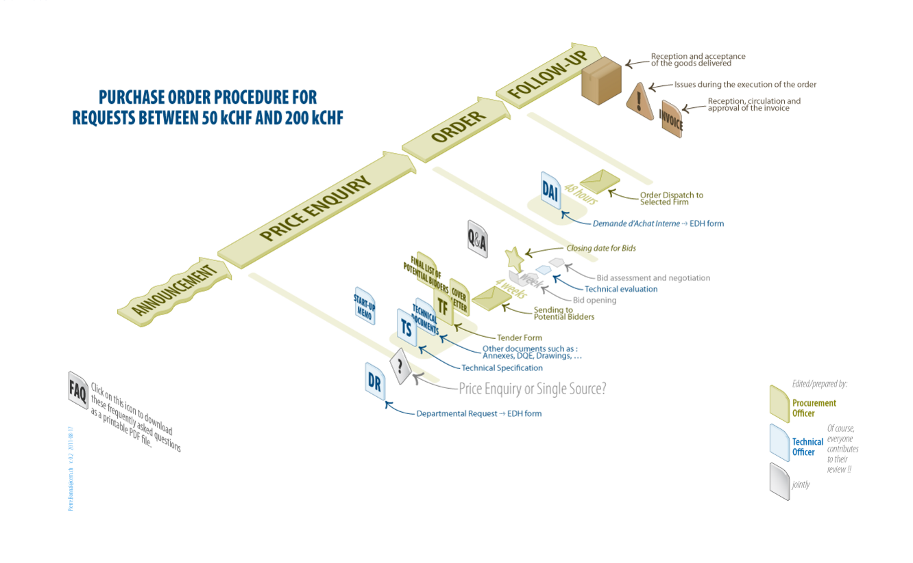
Procurement
The Procurement must comply with the rules defined by the CERN’s IPT.

Slide 42
Procurement
Reception and acceptance
Acceptance by the Technical Responsibles:
  In collaboration with the Logistic Service (storage),
  And with the Quality Service (traceability).
Controls to be performed before acceptance:
  Visual inspection (Logistic + Technical Responsible)
  Documentation control (Quality + Technical Responsible)
  Acceptance Sampling

Slide 43
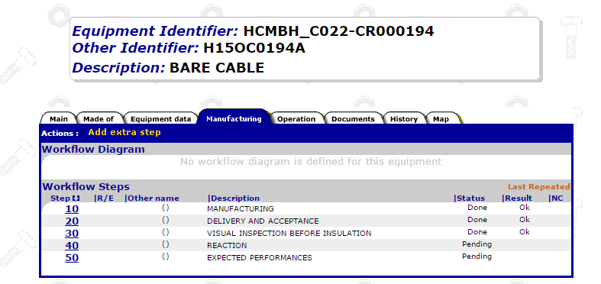
Procurement
Traceability in MTF
MTF = Manufacturing and Test Folder
Manufacturing information
Formal acceptance by the Technical Responsible

Slide 44
Conclusion
QA/QC must be rigorous and systematic
  QA team to provide 100% of the required documents
    A number of procedures to be provided for WP3 (200…300?)
    + Follow-up files, Fabrication and Test reports, MIPs, et.
    WHEN THEY ARE NEEDED
  Continuous improvement and upgrade of QA
    Feed-back for the production → presence in field
    Adapt immediately the documents to the working methods
  Implementation of the MIP and Follow-up files
  MTF (info and documents)
  Share the info and communicate
    Take over the ownership of the QA system
    Shared attitude within the project
Be sure of a QA team COMPETENT and AVAILABLE when needed
Establish CLEAR INTERFACE with the collaborations

Slide 45
Thank you

Slide 46
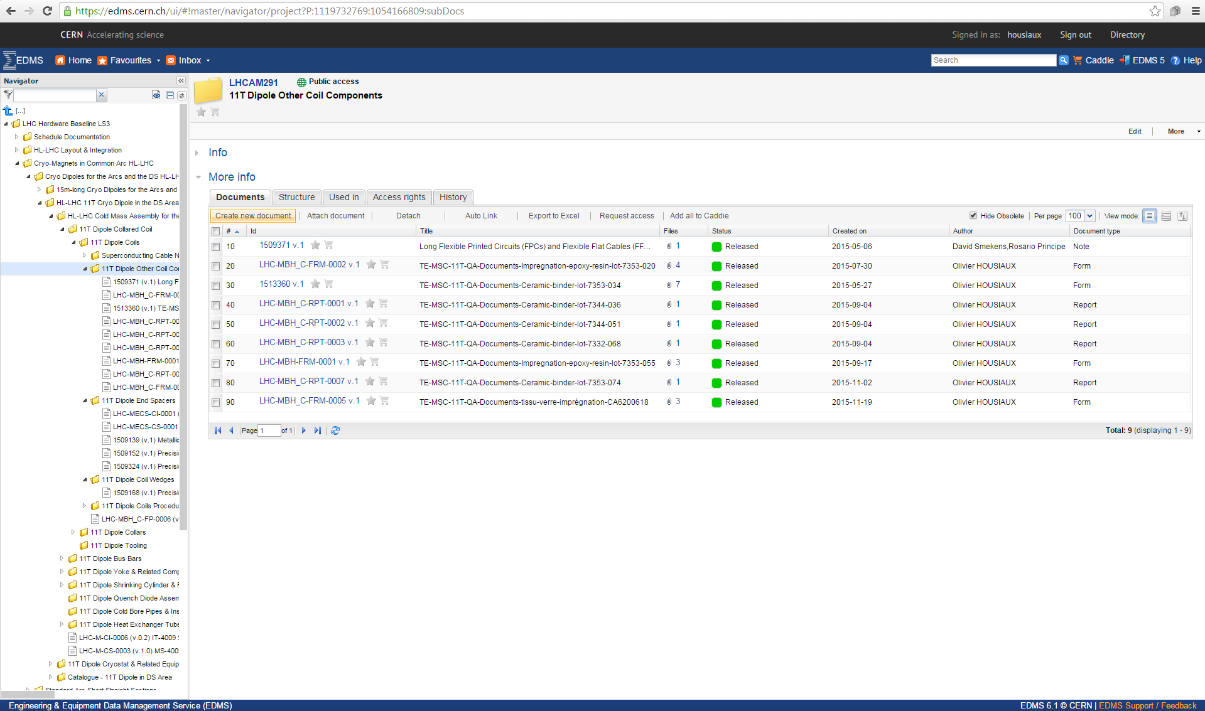
Hardware baseline

Slide 47
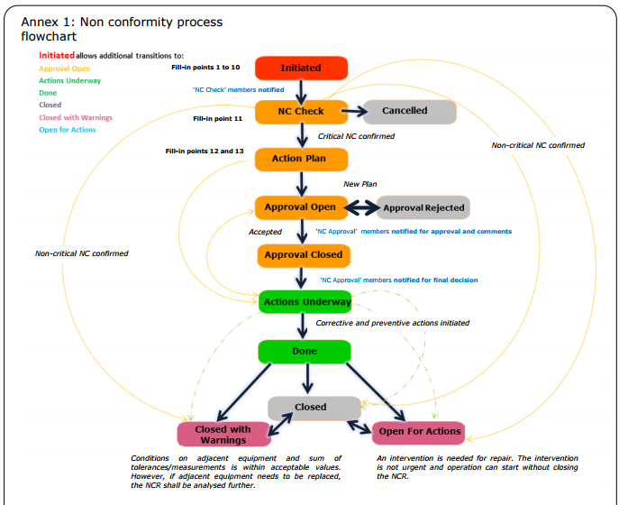
Non conformity management

