Slide 1
Coil strain
Paolo Ferracin and Giorgio Ambrosio
International Review of the Inner Triplet Quadrupoles (MQXF) for HL-LHC
7-10 June, 2016
CERN

Slide 2
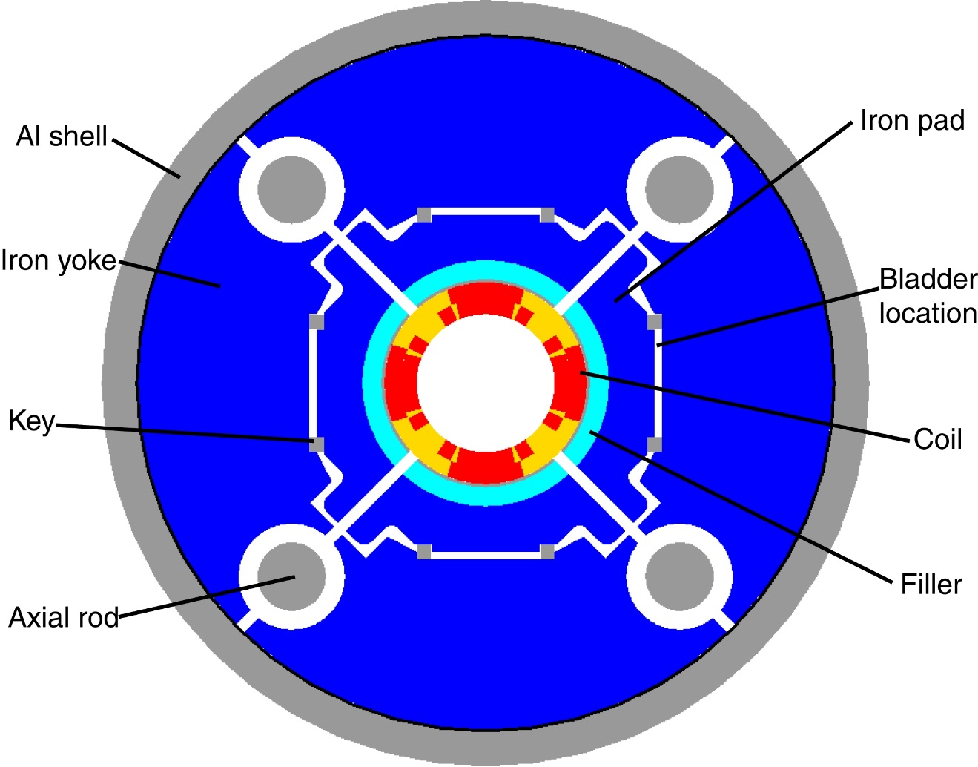
TQS01 – shell, keys, rods
No collars – islands attached to coil
Bladders for coil azimuthal pre-stress.
Piston for coil axial pre-stress.
Low RT assembly pre-stress.
High Cold assembly pre-stress.

Slide 3
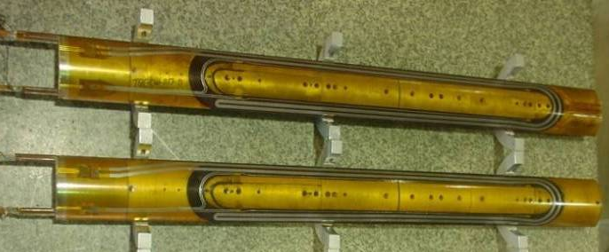
TQ coils

Slide 4
TQS01/01b: Quench-Origin Comparison
TQS01
1
Ramp
Plateau
1,4,5
TQS01b
Ramp
1
Plateau

Slide 5
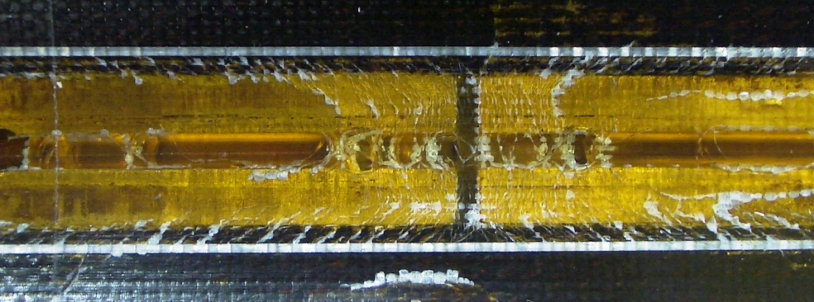
TQC01 post test Island

Slide 6
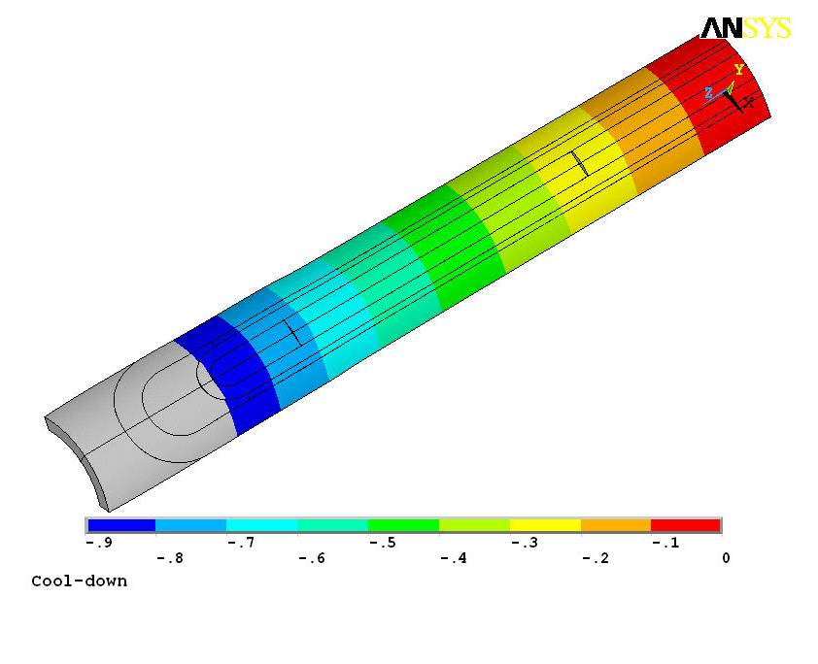
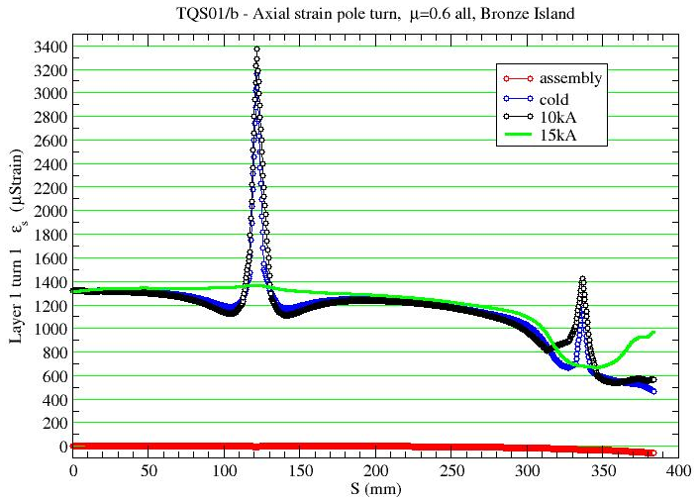
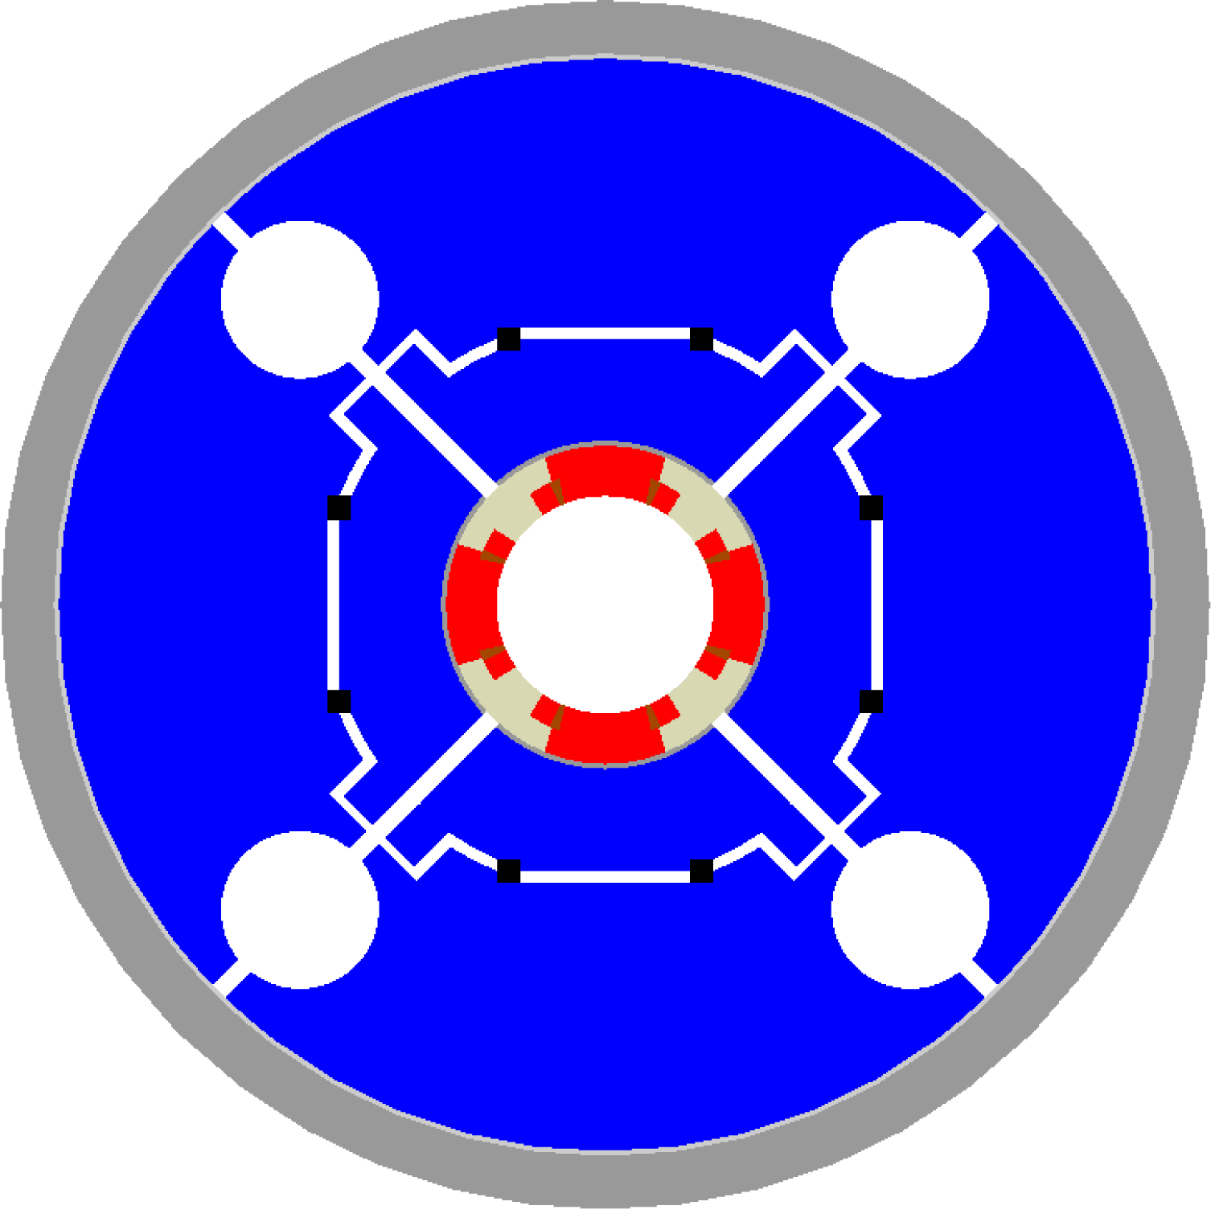
Coil fabrication process
Nb₃Sn coils are wound around segmented bronze poles (heat treat.)
Because of bronze high thermal contraction, gaps open after cool-down and increase during ramp-up
In TQ test, quenches occurred around gaps: peak tension in pole turn
Displacement scaling: 100

Slide 7

Coil fabrication process
Nb₃Sn coils are wound around segmented bronze poles (heat treat.)
Because of bronze high thermal contraction, gaps open after cool-down and increase during ramp-up
In TQ test, quenches occurred around gaps: peak tension in pole turn
Displacement scaling: 100

Slide 8

Coil fabrication process
Nb₃Sn coils are wound around segmented bronze poles (heat treat.)
Because of bronze high thermal contraction, gaps open after cool-down and increase during ramp-up
In TQ test, quenches occurred around gaps: peak tension in pole turn
Displacement scaling: 100

Slide 9
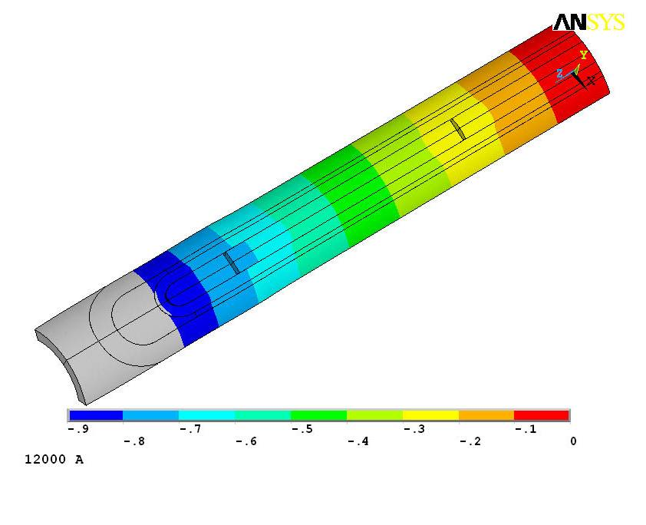
Coil fabrication process
Nb₃Sn coils are wound around segmented bronze poles (heat treat.)
Because of bronze high thermal contraction, gaps open after cool-down and increase during ramp-up
In TQ test, quenches occurred around gaps: peak tension in pole turn
Displacement scaling: 100

Slide 10
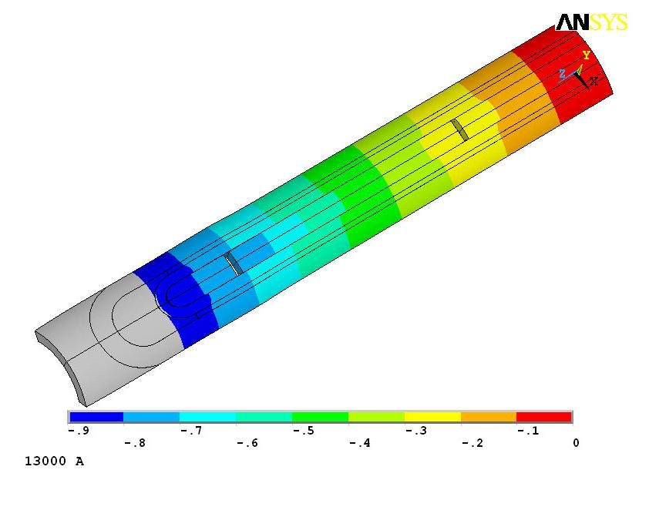
Coil fabrication process
Nb₃Sn coils are wound around segmented bronze poles (heat treat.)
Because of bronze high thermal contraction, gaps open after cool-down and increase during ramp-up
In TQ test, quenches occurred around gaps: peak tension in pole turn
Displacement scaling: 100

Slide 11
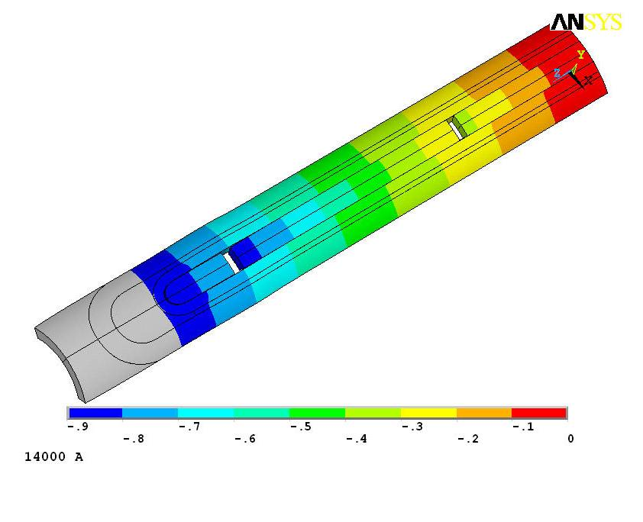
Coil fabrication process
Nb₃Sn coils are wound around segmented bronze poles (heat treat.)
Because of bronze high thermal contraction, gaps open after cool-down and increase during ramp-up
In TQ test, quenches occurred around gaps: peak tension in pole turn
Displacement scaling: 100

Slide 12

Coil fabrication process
Nb₃Sn coils are wound around segmented bronze poles (heat treat.)
Because of bronze high thermal contraction, gaps open after cool-down and increase during ramp-up
In TQ test, quenches occurred around gaps: peak tension in pole turn
Displacement scaling: 100

Slide 13
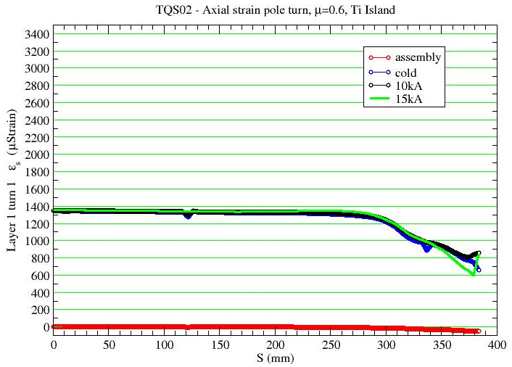
Coil fabrication process
Pole material changed to titanium alloy (low contraction)
  Pole in compression
Gap closed during operations
No peak tension in pole turn

Slide 14
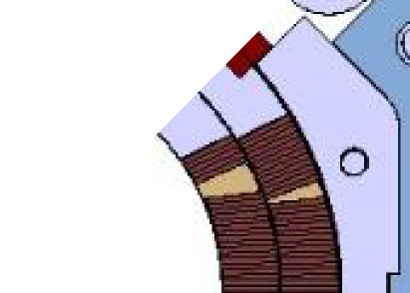



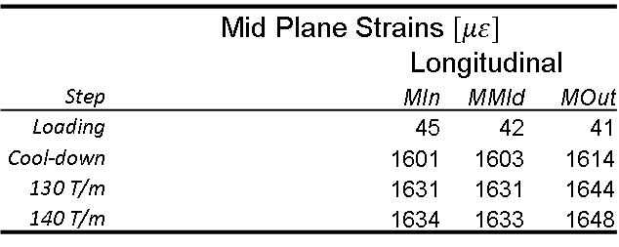
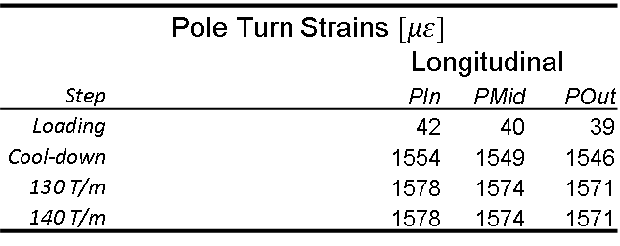
MQXFS1 – FE Strains
(From G. Vallone)
Pole Turn Strains $[με]$
 |  |  |  | Longitudinal
Step |  |  |  | PIn | PMid | POut
Loading |  |  |  | 42 | 40 | 39
Cool-down |  |  |  | 1554 | 1549 | 1546
130 T/m |  |  |  | 1578 | 1574 | 1571
140 T/m |  |  |  | 1578 | 1574 | 1571
 | Mid Plane Strains $[με]$
 |  |  |  | Longitudinal
Step |  |  |  | MIn | MMId | MOut
Loading |  |  |  | 45 | 42 | 41
Cool-down |  |  |  | 1601 | 1603 | 1614
130 T/m |  |  |  | 1631 | 1631 | 1644
140 T/m |  |  |  | 1634 | 1633 | 1648
Provided values are computed by means of the 3D FE model at the magnetic centre
Longitudinal strains:
  Negligible at room temperature
  Constant along the radial direction
  Almost equal on the pole turn and on mid-plane
  Not affected by the Lorentz Forces
POut
PMid
PIn
MIn
MMid
MOut

Slide 15
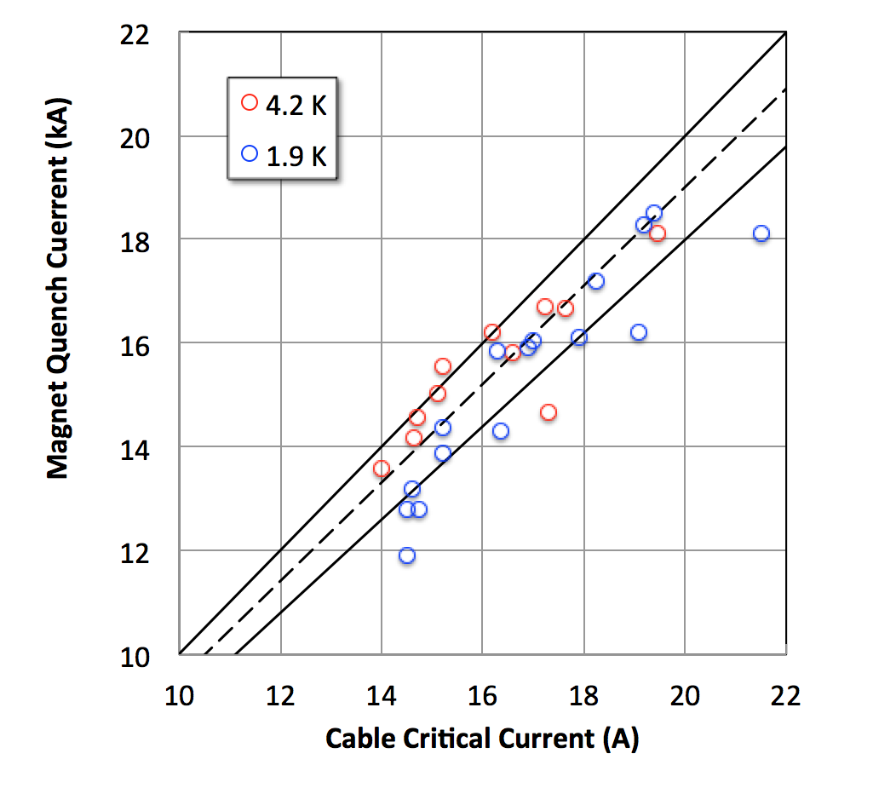
From H. Bajas
100 %
95 %
90 %

